Slide 1
The Bifrost spectrometer
Progress
STAP 2018 / 2
Rasmus Toft-Petersen
Technical University of Denmark

Slide 2
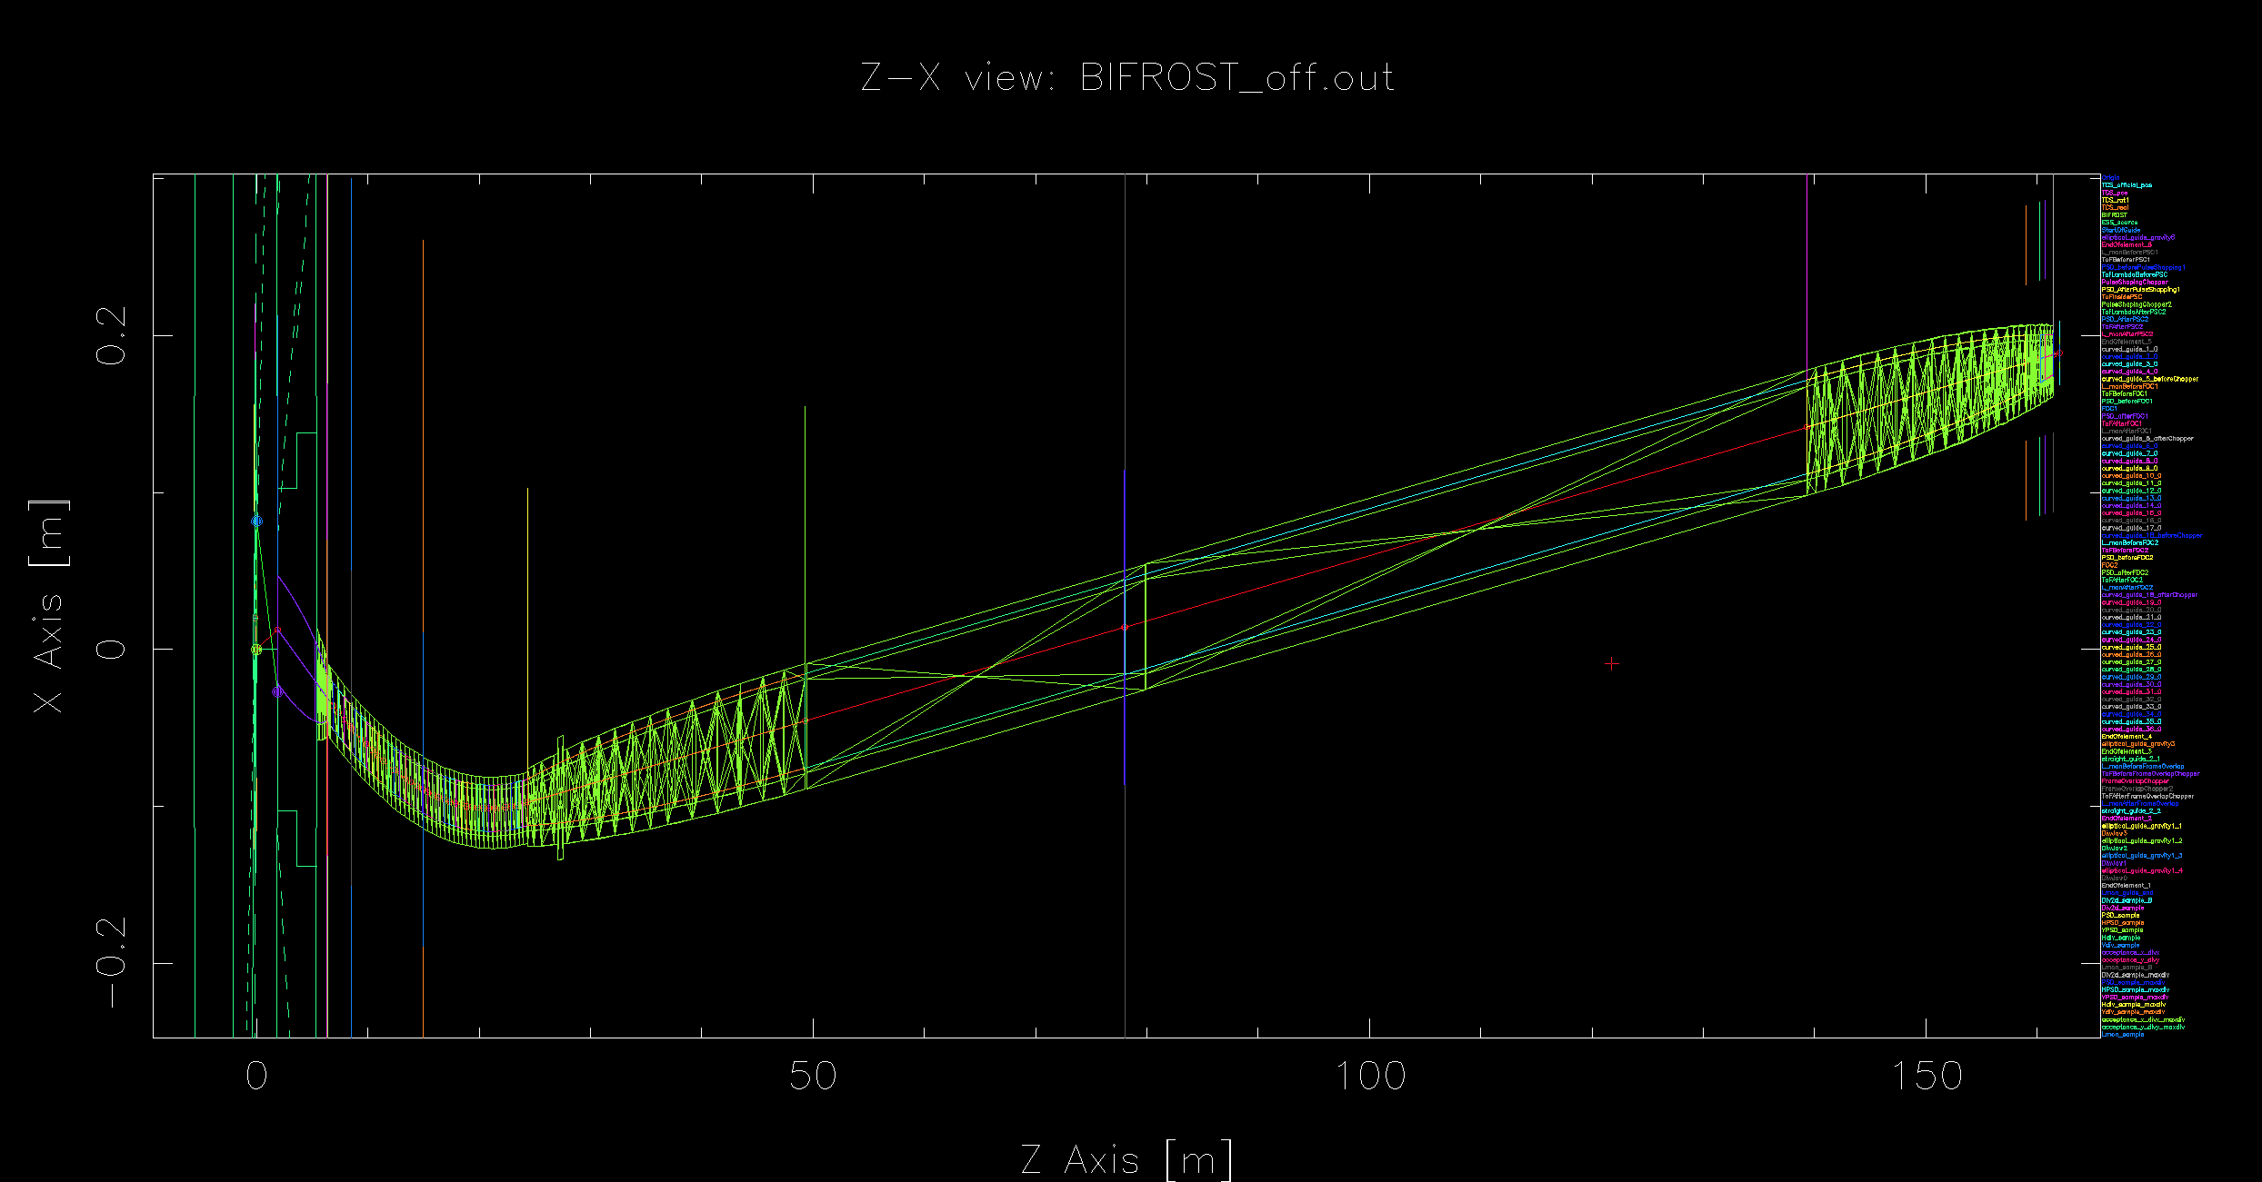
Validating the McStas file with CAD
(Martin Olsen)

Slide 3
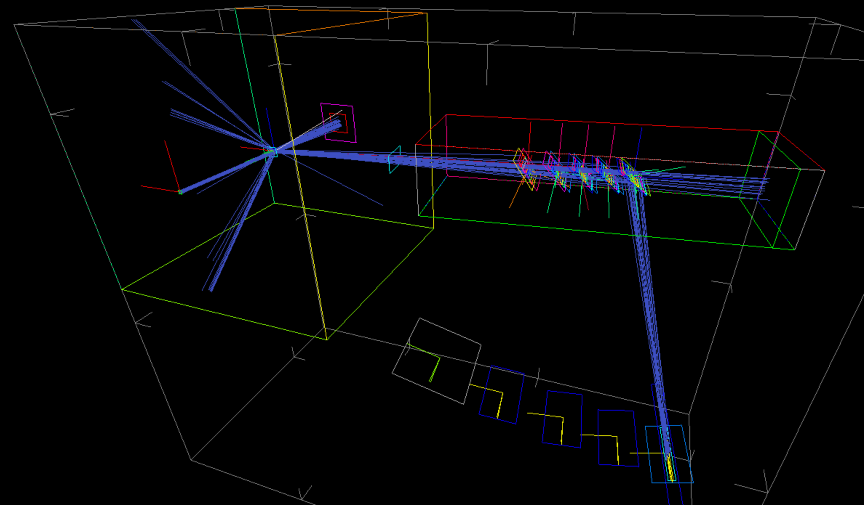
Backend from detector group!
(Milan Klausz)

Slide 4
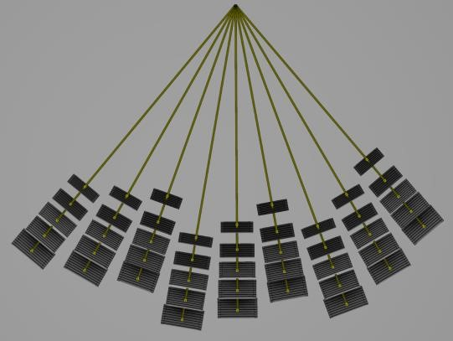
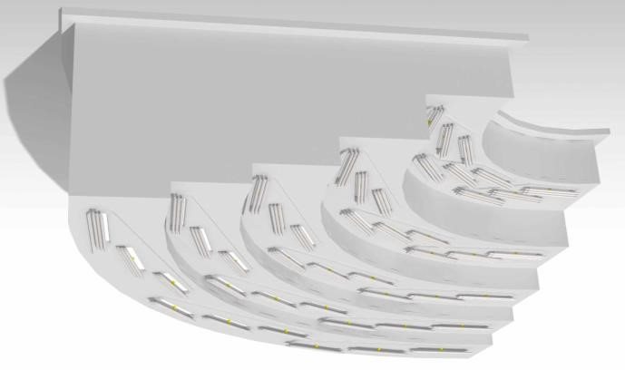
Analyzers
Final arrangement

Slide 5
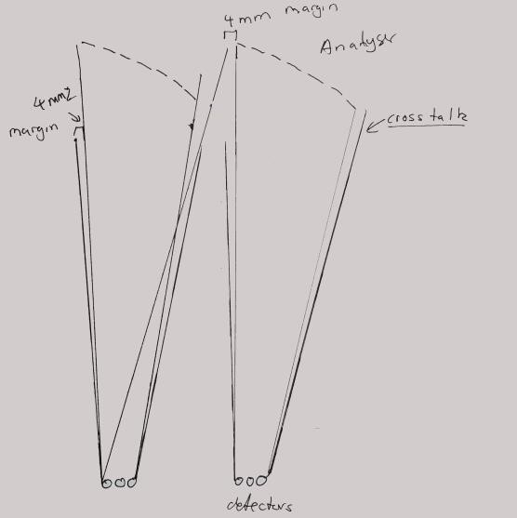
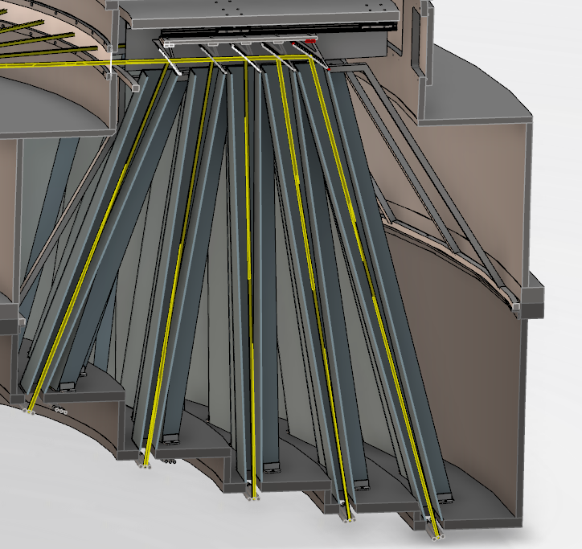
Cross talk shielding

Slide 6
Point-to-point make it simple

Slide 7
Validation of detailed geometry

Slide 8
Validation of detailed geometry

Slide 9
Performance is slightly staggered

Slide 10
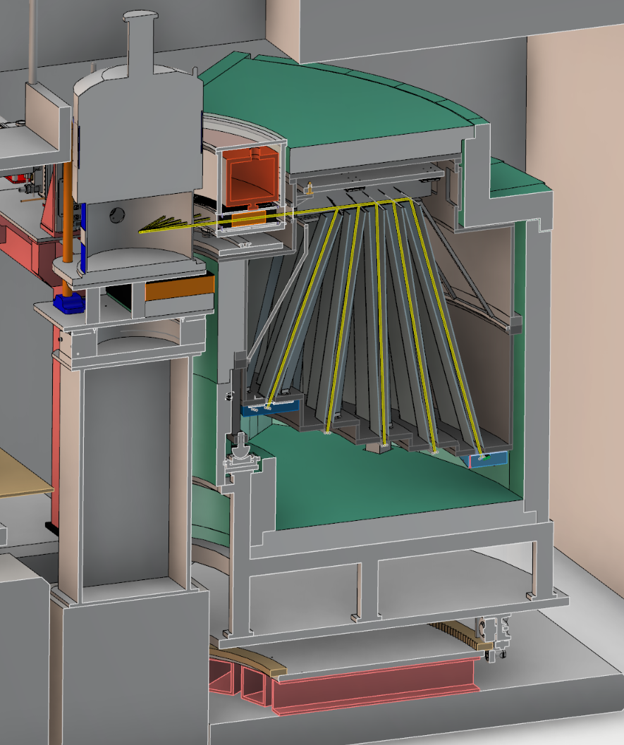
Cave and tank
Cd Lined Vac Tank
150mm Borated PE
Beryllium Collimator
Analysers
Gamma Shielding (Cu)
Cross Talk Shielding
Detectors
Rotational System

Slide 11
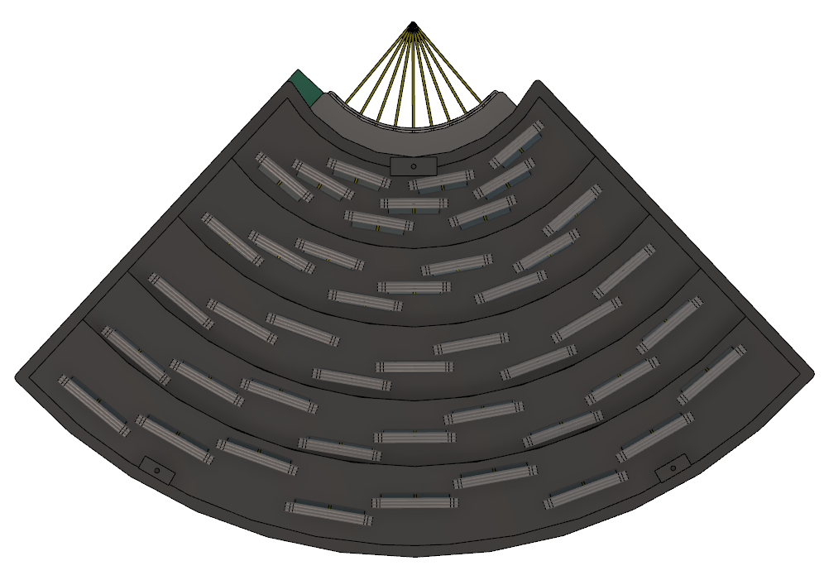
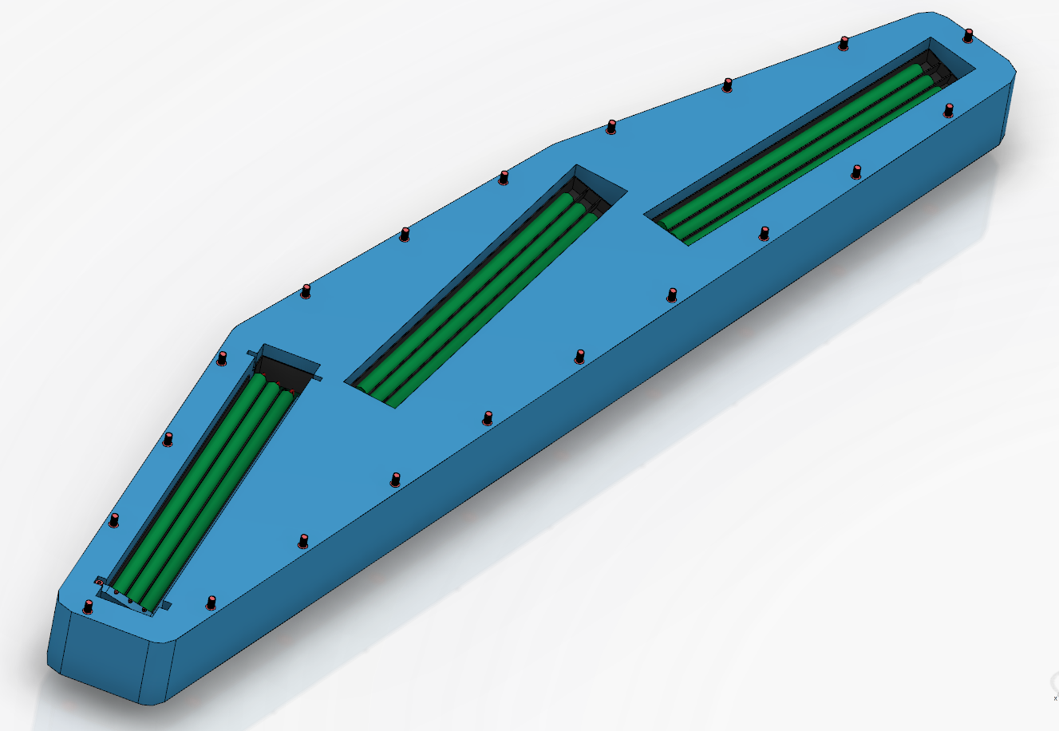
Tank bottom

Slide 12
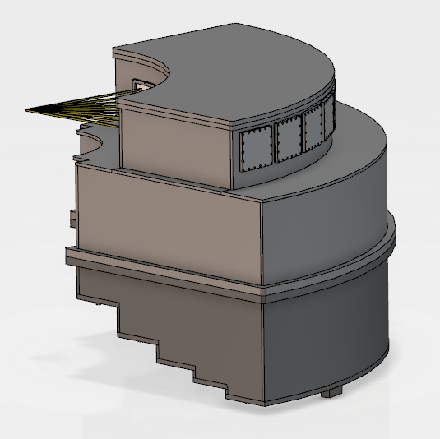
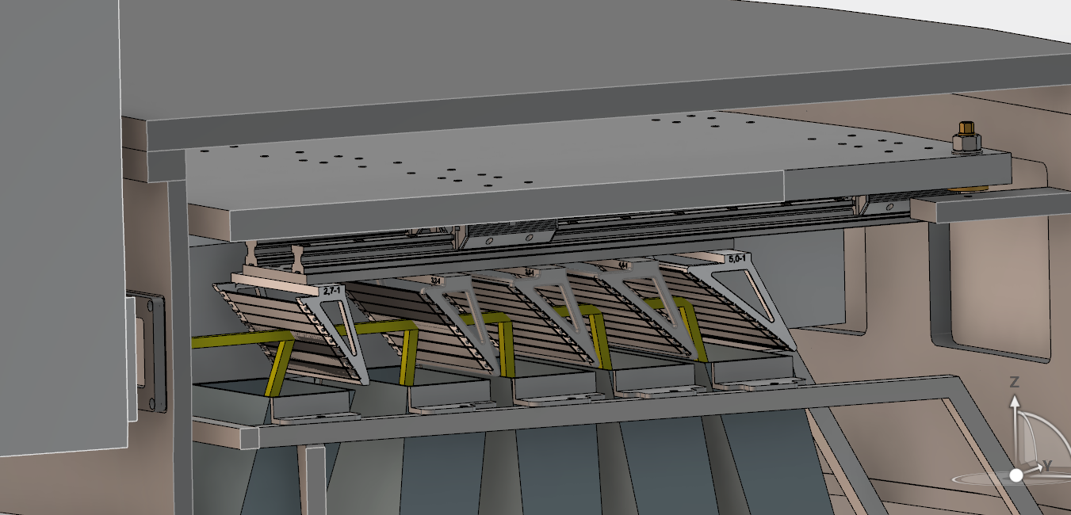
Analyzer access

Slide 13
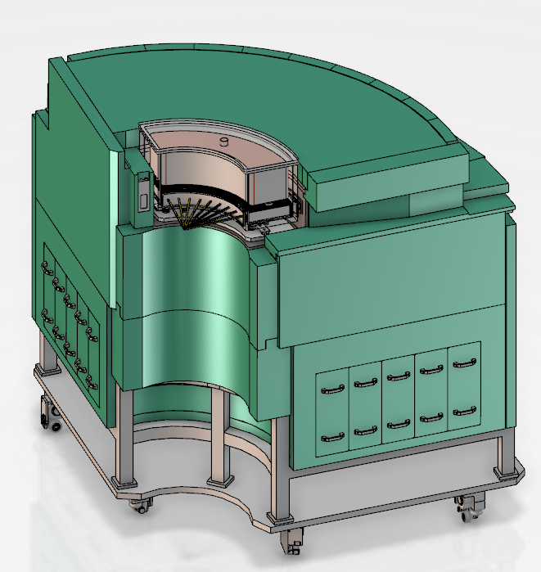
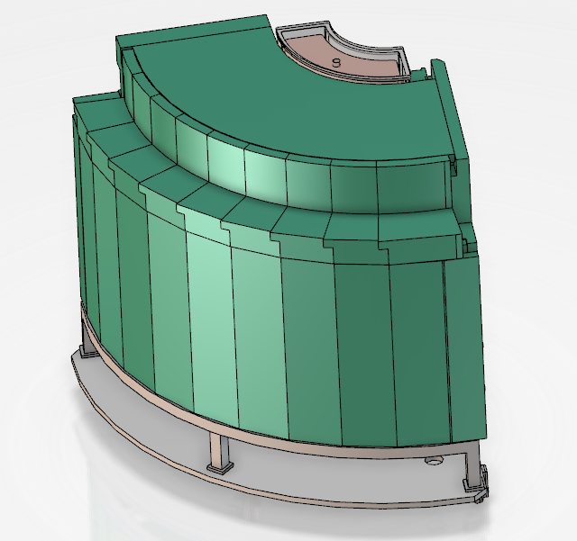
Shielding
Polyethylene weight drives motion system design

Slide 14
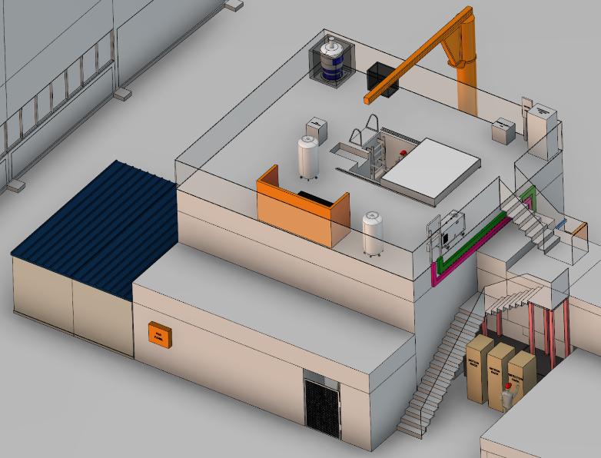
Cave (II)

Slide 15
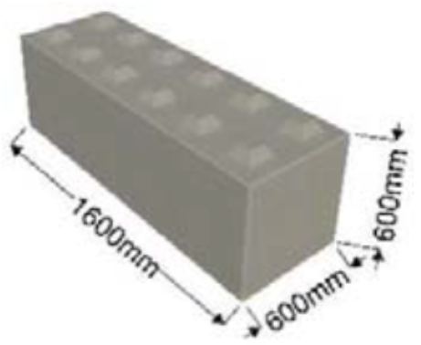
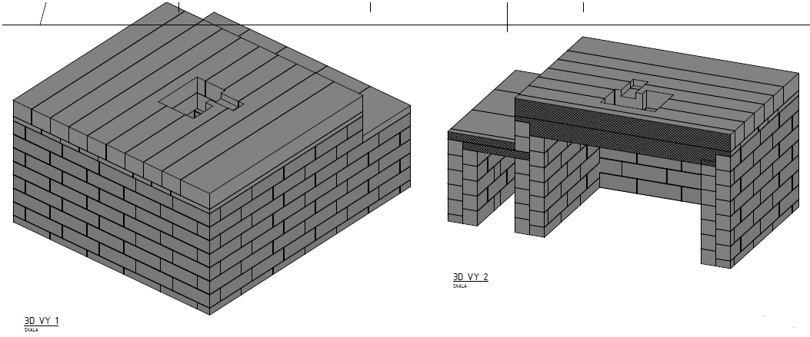
Cave (III)
Double layered, LEGO block construction
Working with Swedish company – C3C
Latest quote – 165k€ for design, manufacture and installation of cave walls (not including roof and penetrations)
Now working on the roof layout

Slide 16
The Bifrost spectrometer
Technical hot commissioning -
Procedures and schedule
Rasmus Toft-Petersen
Technical University of Denmark

Slide 17
Outline
Pre-hot commissioning
Chopper calibration
Monitor/flux validation
Normalization
Energy resolution
Q-resolution
Test-experiment (non-science)

Slide 18
Outline

Slide 19
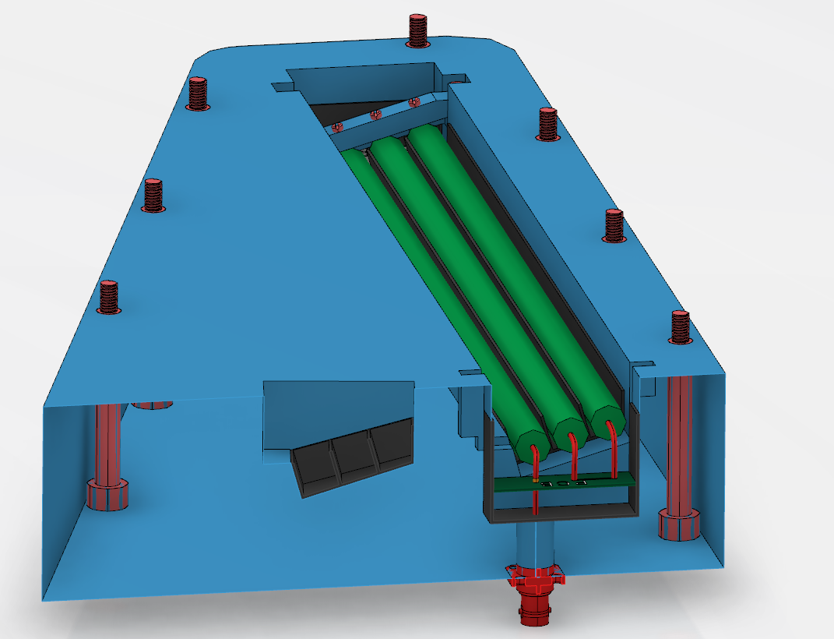
Pre-hot commissioning
Hot source detector/electronics commissioning
Check the relationship between gamma and neutron response, estimate thresholds for discrimination, check positioning resolution and triplet performance
Check software
Make sure detector geometry in Mantid is correct, make a simulated data set, reproduce simulated dispersion in Mantid. Check sample environment software, monitoring software etc.
Make sure the magnet can go on Bifrost,
and is controllable
A couple of months work to be done in parallel

Slide 20
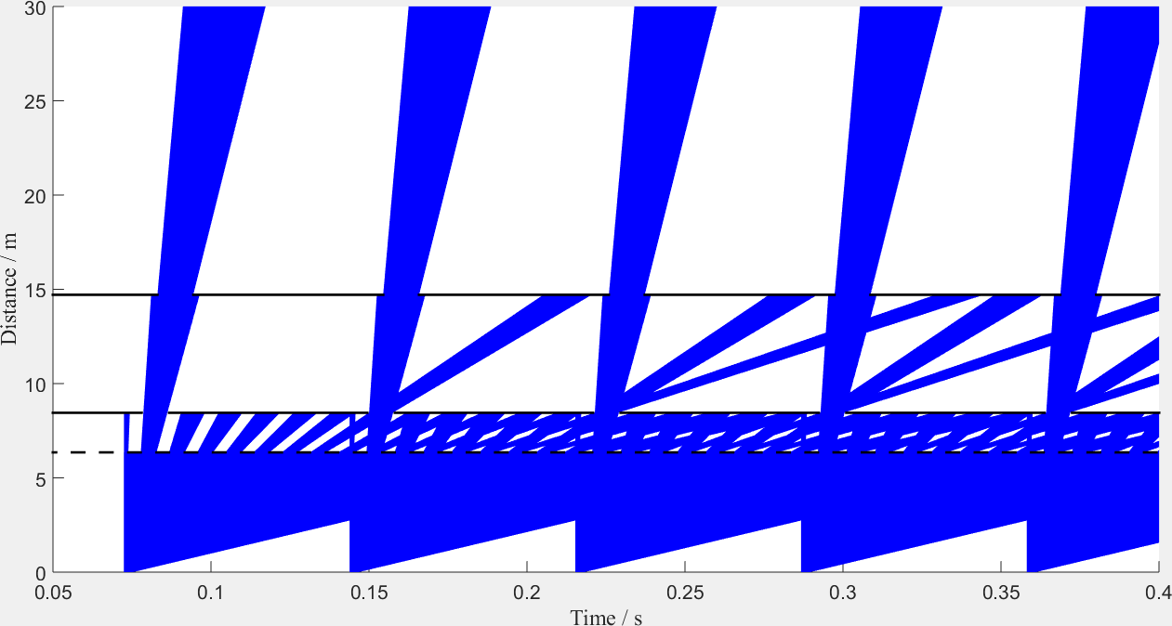
Chopper calibration
Opening profile and chopper timing
Fluence
> 10¹² n/s
Monitor

Slide 21
Chopper calibration
Flux and overlap measurement

Slide 22
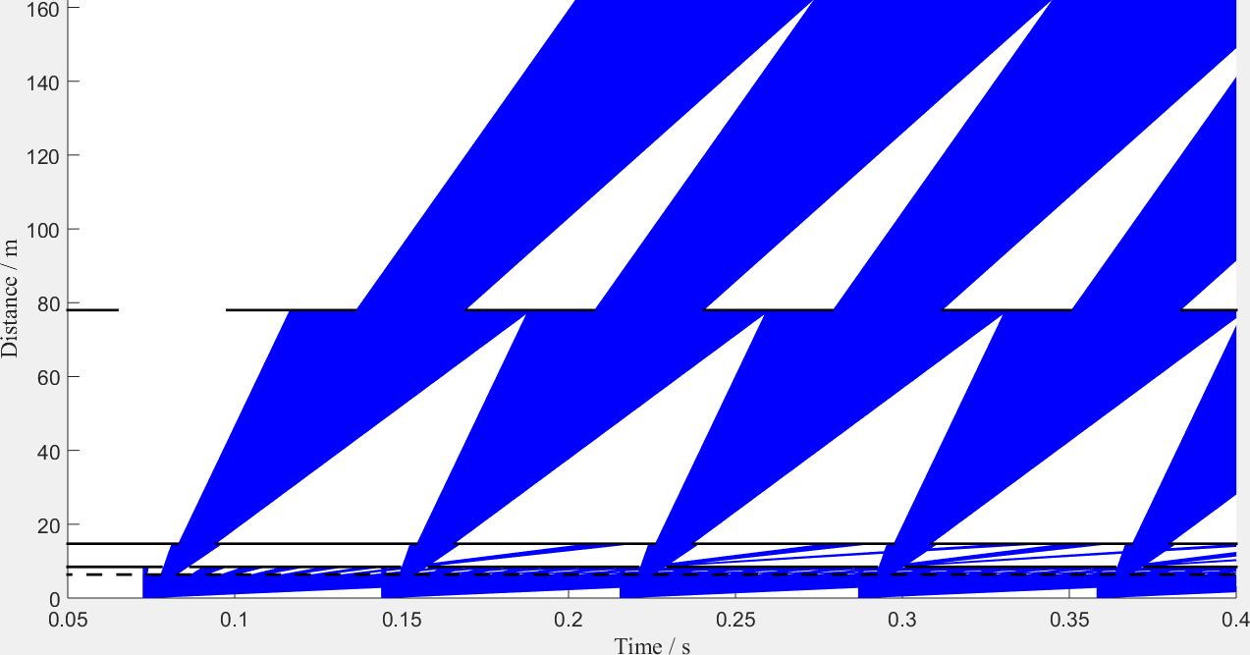
Chopper calibration
Opening time, timing, transport measurement

Slide 23
Chopper calibration
Overlap measurement, transport measurement, rise/fall times

Slide 24
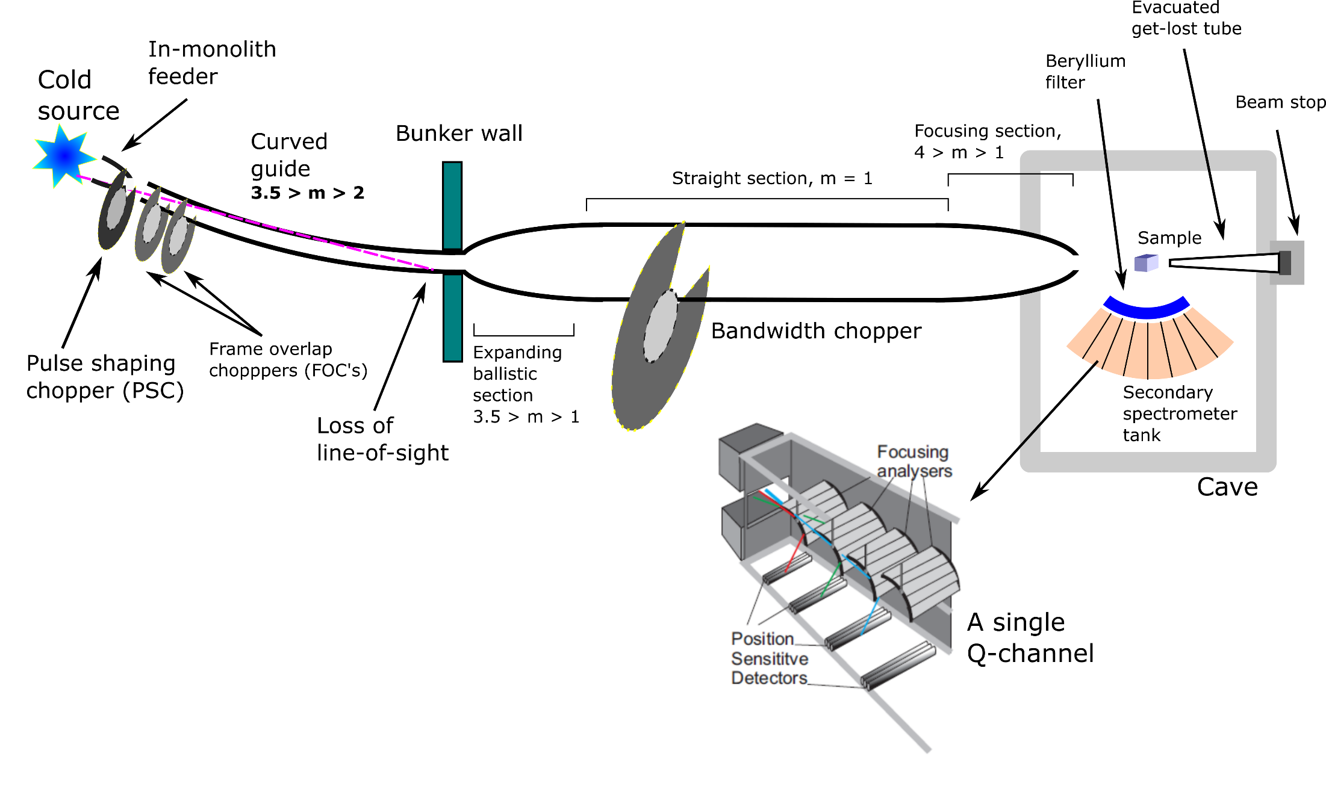
Monitors
We use 4 monitors along the beamline, for guide diagnostics,
chopper diagnostics and normalization
Fission?
N2 MWPC?
Scintillators?
MWPC?
GEM?

Slide 25
Monitor suggestions
Near monolith: Fission chamber with low efficiency – 10^-8. Fast neutron flux from fission will be insignificant at 160 m. Should be able to measure fluence of 10^12.
Post-Bunker and post BW: Ordela monitors with nitrogen gas, efficiency of 10^-6 and max count rate of 10^6. Gamma sensitivity comparable to neutron. May smere signal
At sample : Either low efficiency for Day 1, or GEM type detectors if the count rate can come down low enough. We might have a massive
stability problem, which the ESS is looking into – larger than we presumed

Slide 26
Chopper calibration
Overlap measurement, transport measurement, rise/fall times
Estimated time for chopper calibration:
5 weeks (in total)

Slide 27
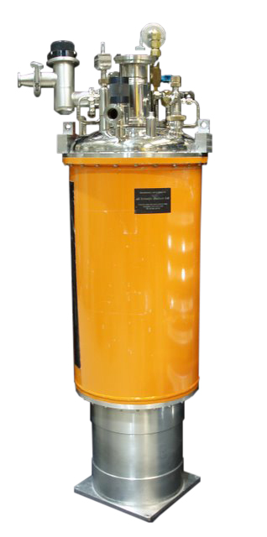
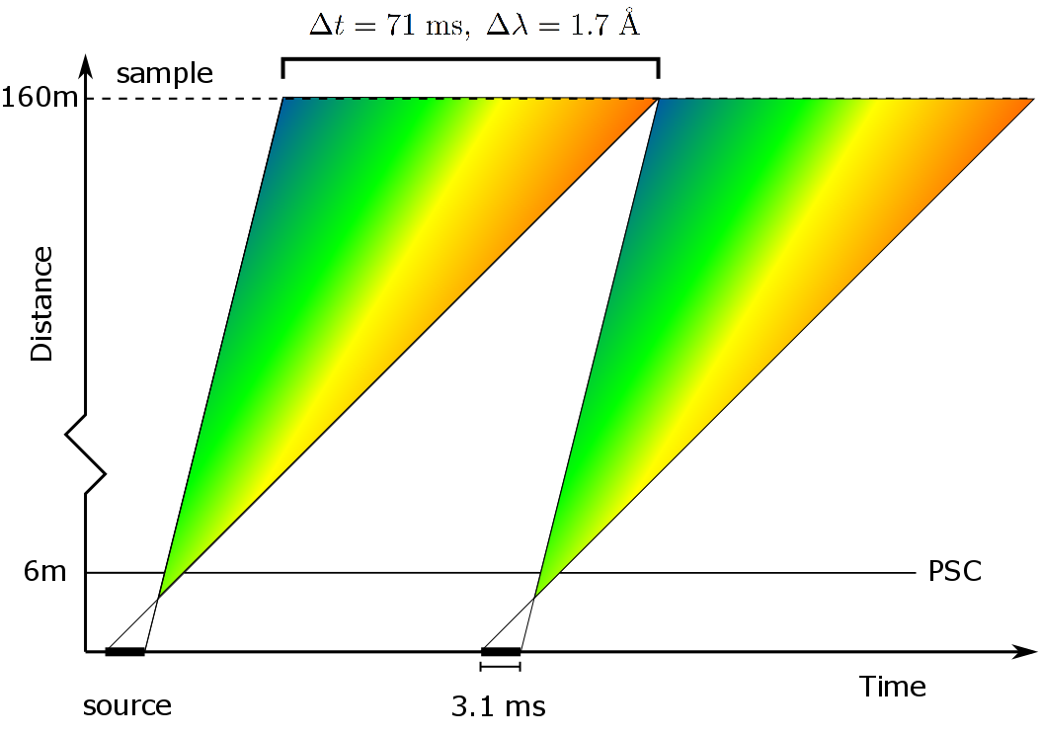
Monitor and flux calibration
Gold foil for absolute flux.
Identify aluminum bragg peaks in monitor, maybe YIG sample before monitor
Use CF levels on known crystal to verify intensity across the frame.

Slide 28
Monitor and flux calibration
Gold foil for absolute flux.
Identify aluminum bragg peaks in monitor, maybe YIG sample before monitor
Use CF levels on known crystal to verify intensity across the frame.
Estimated time for monitor
calibration:
2 weeks

Slide 29
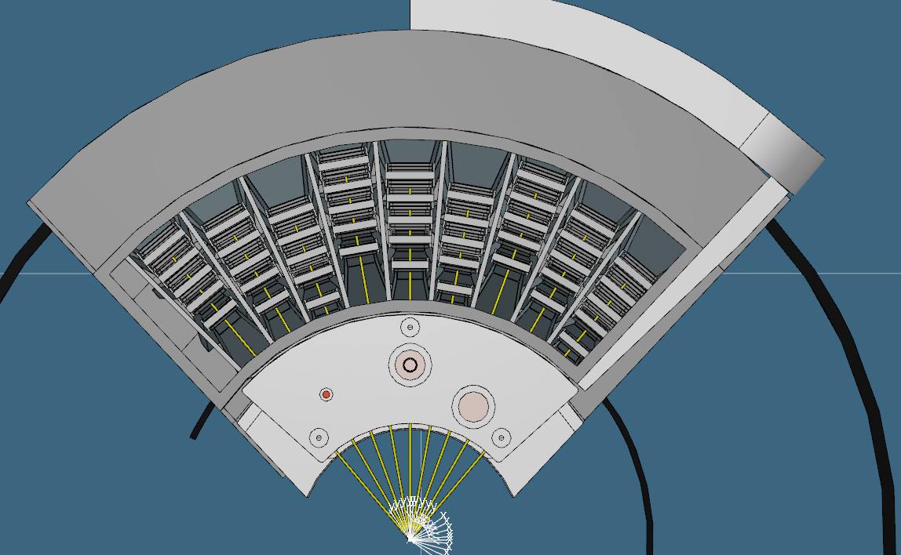
Normalization:
Vanadium and CF levels
Normalize for: Analyser reflectivity,
spatial angle and incoming flux
Scale resolution volume
and try to compare
CF levels for different
analyzers
Compare CF level
intensities normalized
by monitor and
acc current, respectively

Slide 30
Normalization:
Vanadium and CF levels
Normalize for: Analyser reflectivity,
spatial angle and incoming flux
Scale resolution volume
and try to compare
CF levels for different
analyzers
Compare CF level
intensities normalized
by monitor and
acc current, respectively
Estimated time for monitor
Normalization:
2 week

Slide 31
Energy resolution:
Vanadium and CF levels
Use vanadium to
quantify the size
and variance of elastic
line widths
Use e.g. LiHoF4 to
do the same in inelastic
mode
Use cold chopper
results to verify
Prototype measurements on MARS @ PSI

Slide 32
Energy resolution:
Vanadium and CF levels
Estimated time for monitor
Energy resolution:
1.5 weeks
Use vanadium to
quantify the size
and variance of elastic
line widths
Use e.g. LiHoF4 to
do the same in inelastic
mode
Use cold chopper
results to verify
Prototype measurements on MARS @ PSI

Slide 33
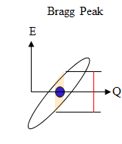
Q-resolution:
Vanadium and CF levels
Use Bragg peaks to determine center width
and to verify divergence jaws
Use steep magnon to verify overall
Q-resolution

Slide 34
Q-resolution:
Vanadium and CF levels
Estimated time for monitor
Q-resolution:
1.5 weeks
Use Bragg peaks to determine center width
and to verify divergence jaws
Use steep magnon to verify overall
Q-resolution

Slide 35
Test eksperiment:
Known dispersion – MnF2?

Slide 36
Test eksperiment:
Known dispersion – MnF2?
Two samples,
Two settings,
Low flux
4 weeks

Slide 37
Total beam time requirements
Chopper cascade: 5 weeks
Monitor/normalization: 3 weeks
Energy resolution 1.5 weeks
Q-resolution 1.5 weeks
Test-experiments 4 weeks
Background 3 weeks
___________________________________
Perfect world total: 18 weeks
Accelerator fudge (x1.2)
Scientist fudge (x1.2)
DMSC fudge (x1.1)
Grand total : 28 weeks of beam time
7-8 months

Slide 38
The Bifrost spectrometer
Early science and ressources
Rasmus Toft-Petersen
Technical University of Denmark

Slide 39
Outline
Schedule
Day 1 capabilities
Early science: 4-spin plaquettes
Early science: Electrical fiels
Minimum day 1 requirements from SAD
Minimum day 1 requirements DMSC

Slide 40
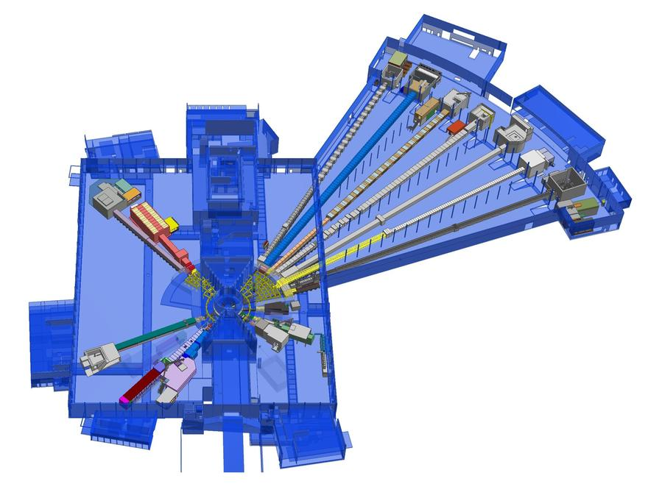
Rough access times
E01: Oct - 19
E02/1: Oct - 19
E02/2: May - 21
D03 : Feb - 21
Bunker: August 21

Slide 41
Critical dates
Cave installation and fitout: Oct-19 – Jan-21
Guide/beamline shielding installation: Jan-21-July 21 (ESS)
Inbunker: Aug-21 – Oct-21
Cold commisioning: 6 months (ongoing throughout installation)
BoT: July 22
Ready for science in early 23

Slide 42
Day 1 capabilities

Slide 43
Day 1 capabilities
500 kW flux is 1.6 * 10⁹ n/s/cm² -> factor of 5 on Thales
Assume adding multiple Ef-maps together not straightforward.
Single Ef gain on Thales: x 5
So if one really needs the mapping capability, we have a factor of 25 on Thales
at 500 kW.
We have much better resolution at similar flux. We can still do
impressive stuff, if we stay delocalized.
Motivation:
Prove that Bifrost works, and produces mapping data sets that
can be easily analyzed.
Entice the community to do ambitious sample environment
experiments.
Stay away from the high risk stuff

Slide 44
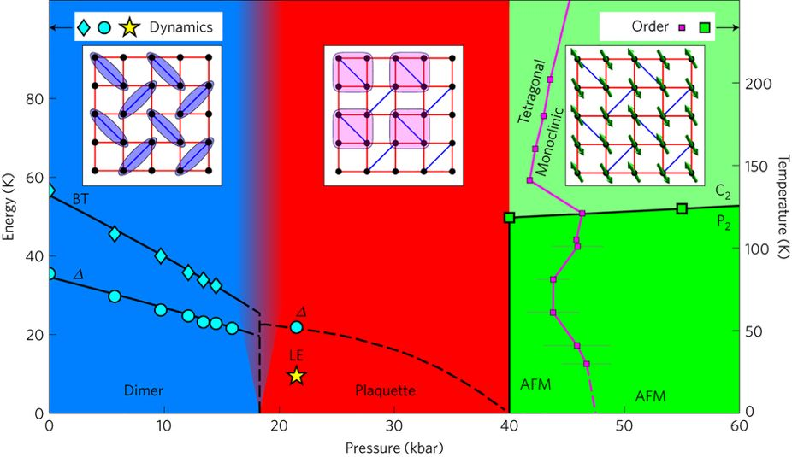
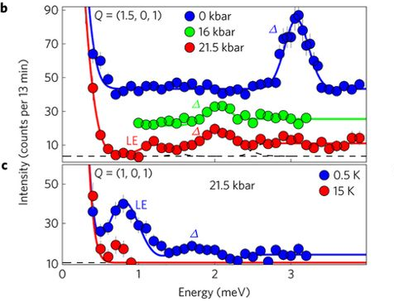
Early science:
4-spin plaquettes
New quantum states in exoctic matter: a 4 spin plaquette
M. E. Zayed, Nature Physics volume 13, pages 962–966 (2017)

Slide 45
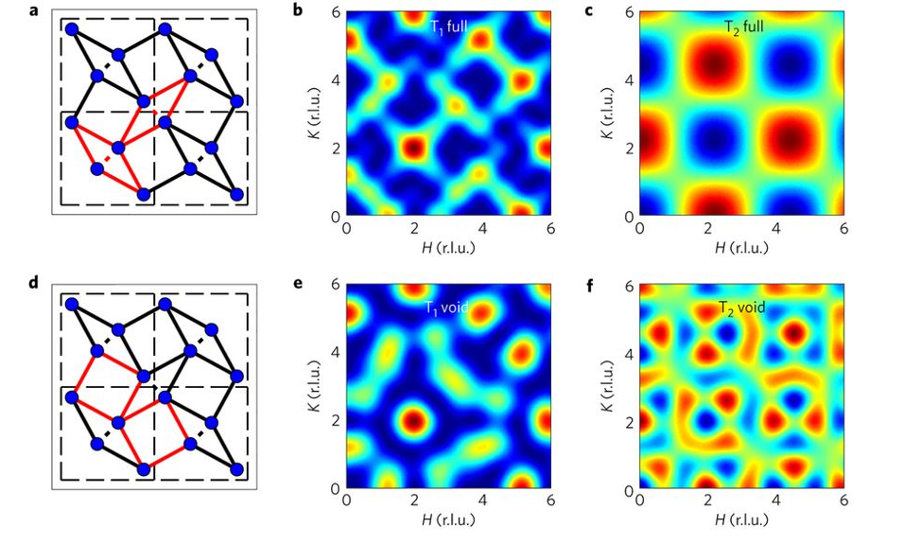
Two plaquette types

Slide 46
Two plaquette types
Mapping studies on
very small samples in pressure?
Only on Bifrost. Would take
a while at 500 kW but would
be feasible (not at 100 kW)

Slide 47
Electrical field mapping - only on Bifrost?
E. Latagne Hutubise, et al, PRB (2017) – theory paper
M. Bartkowiak, Rev Sci Instr (2014)

Slide 48

Minimum requirements
The cost book value of
the instrument is unchanged
Money is tight and we are defining the mininum requirements, stripping away
nice-to-haves
Current ESS
Future ESS

Slide 49
SAD requirements
We need the 15 T magnet and orange 6 months before
ready-for-beam-on-sample. We need to test magnetic
environment, sample handling procedure, etc, before neutrons
For early science, we need a 20 kBar pressure cell, with
a large sample space to demonstrate small sample performance.
A dilution fridge maintained by SAD would be good for wow-factor
and proof of operation. (Q4 22)
Pressure cell should be timed with 500 kW operation, dilution may
be useful before.

Slide 50
SAD summary
1) 15 T magnet and orange: Q4/21
2) Pressure cell: Q4/22
3) Access to dilution stick: Q4/22
4) Electrical fields: Q1/23
Pressure cells and electrical fields might be in external collaborations. Only
1) is essential for workhorse science
We need to test the mounting and operation of sample environment
that should be done in cold commissioning, if possible, and otherwise
during shutdowns

Slide 51
DMSC requirements
If we focus on need-to-have, the high level DMSC requirements
is a step-function, we need:
Controls, and parameter visibility in the exp hut.
Easy access to raw data (I vs ToF on detectors and triplets
– monitor data), and quick reduction options.
Data normalization
Data reduction -> S(q, w)
Binning and slicing, or possilibity to export map to existing
slicing software
Rough binning for fast analysis on the fly
We don’t need advanced analysis tools on day 1 (SpinW, automatic
fitting, etc). We’ll do hot commissioning and we cater to superusers.

Slide 52
DMSC collaboration
Stuff we can do, coordinating with the DMSC:
We have a PhD student working on the similar PSI CAMEA project, Jakob Lass. He will try to work in the direction of Bifrost data reduction. DSMC responsibility is paramount, though.
We can simulate a realistic data set in McStas, using a simple
dispersion relation. We can use this as a starting point to generate a good user interface.
The LLB will make a triplet prototype, that we will use to test the setup. If useful to the DMSC we can use real data for testing.

Slide 53
Ressources for HC
and early science
2 beamline scientists
In perfect world: 1 post doc
0.5 data scientist
1-2 good students if possible – employed close by in the user community (Lund + DK?)
Superusers are a really important ressource
Software is a single point of failure, advanced sample environment is important but less critical.

Slide 54






Thank you for your attention

