Slide 1
Temperature and Field Sample Environment for Diffraction & Spectroscopy
Name
Position
European Spallation Source ERIC
Date

Slide 2
Temperature and Field Sample Environment Systems

Slide 3
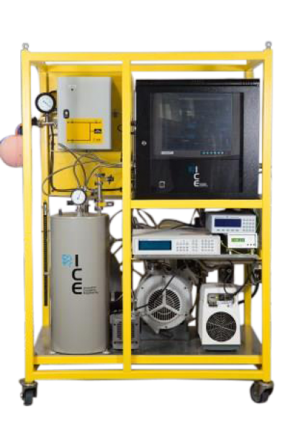
Ultra Low Temperatures
T<1K - Dilution systems
He3/4 Dilution Cryostats
  8-50mK base temperature. Lowest T depends on size, pumping ability, lack of external heat sources (vibration, RFI, thermal radiation).
  Poor T control above 1K. Can help this with weak link, at expense of base temperature 80-mK-~5K then possible. Control above 5K possible with He3/4 mixture removed, but not optimal.
  ~3-6 hour prep time from 300K during which measurement difficult (thermal contraction moves sample).
  Rotation of sample stage possible but challenging.
  Auxiliary equipment (for dilution insert only):
    Gas Handling System incl. N2 trap. ~0.5-1m²
    Long inserts - >2m (e.g. 2100mm @ PSI)
    Multiple bellows tubes, some with large (40-50mm) diameter.
2 available in pool. To be procured with ’MAGiC’ Magnet.

Slide 4
Ultra Low Temperatures
<!K He3 sorption
T: 0.3-30 K
Cool down from 300K in a few hours
One-shot – hold time ~40 hours, requires regeneration (~1hour)
Few moving parts, only T controller required.
1 pool 1 CSPEC

Slide 5
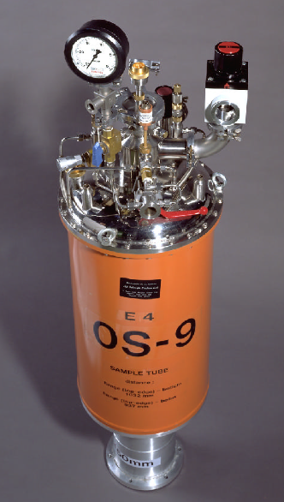
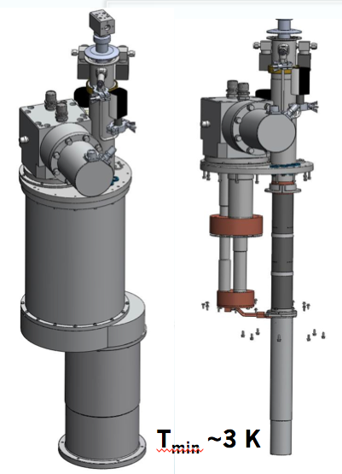
Cryostat/Cryofurnace
Wet cryofurnace (cryostat) – 1.5 - 600 (300) K
  High cooling power, 300K-base in 15 mins
  Requires regular He/N2 filling, He pumping cart
  Cheap
  Suitable for Dilution/He3 insert
  50, 70, 100mm bore sizes
Dry top loading cryostat 3 K – 600K
  ~1 hour sample change.
  Less good for Dilution/He3 insert
  V easy to use
Sample sticks/inserts interchangeable in principle.
Tails can be changed (e.g. different materials)

Slide 6
Furnaces

Slide 7
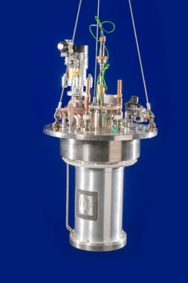
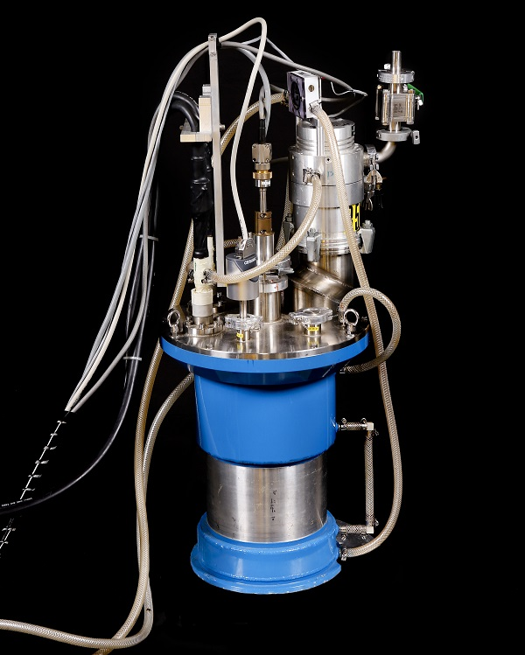
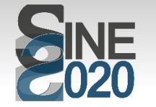
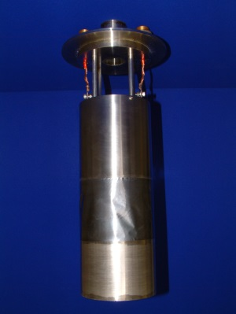
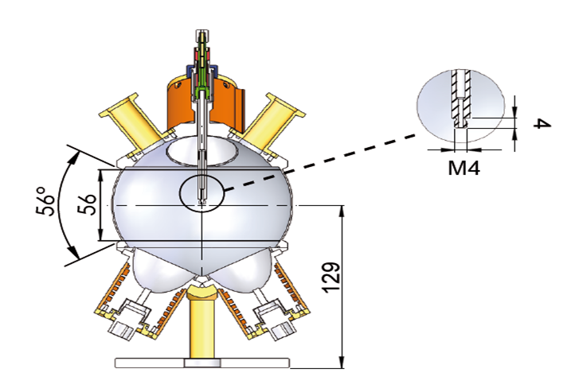
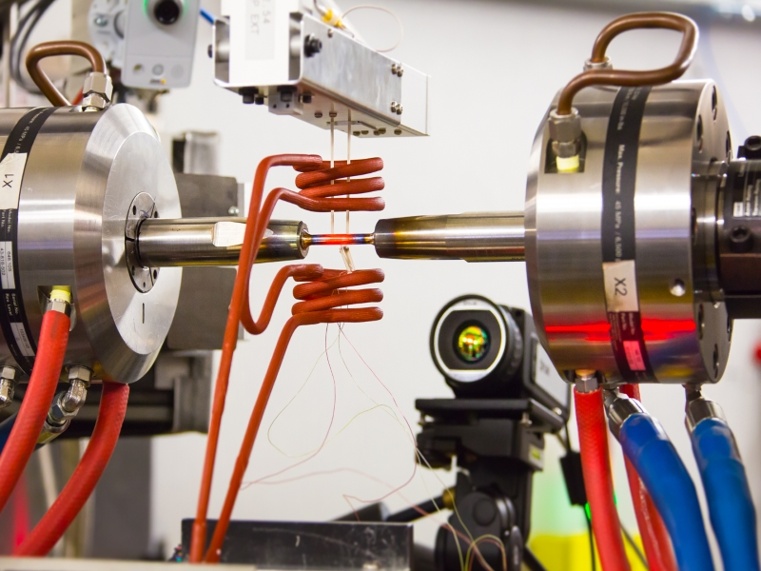
Furnace Designs Used at Neutron Facilities:
    Paul Scherrer Institute.
      ILL style furnace supplied by AS Scientific 300 to 2073K.
      Small furnace 350 to 700K.
      Tantalum furnace ILL style 375K to 1400K.
      Cryo-furnace 2K to 550K.
      Laser furnace.
    Institute Laue-Langevin.
      ILL style furnace supplied by AS Scientific 300K to 1873K.
      ILL style furnace supplied by AS Scientific 300K to 1273K.
      Reflector Furnace 300K to 1923K.
      Cryo-furnace 1.5K to 550K.
    ISIS Neutron Facility
      ILL style furnace supplied by AS Scientific 300 to 2073K.
      ILL style furnace supplied by AS Scientific 300 to 1273K.
      RAL Style furnace 300K to 1273K.
      Riso furnace 300K to 2273K.
      Mari furnace 300K to 1173K.
      Lower temperature furnace 300K to 673K.
      Reflector furnace 300K to 1400K.
      Cryo-furnace 1.5K to 600K.
    FRM II
      ILL style furnace supplied by AS Scientific 300 to 2073K.
      Laser Furnace 300K to 1500K (Herbert Weiß).
      Reflector furnace 300K to 1400K.
    Also
      Induction furnace (e.g. ORNL)
      Hot air gun (HEIMDAL team)
Thanks to C. Goodway, M. Christensen
Notes:
Main types:
ILL style resistive heating
IR optical
Induction
Hot air gun
Combined Cryo & furnace

Slide 8
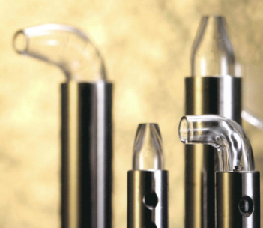


Hot airblower RT-1000 K
1000 W system 40 L/m dry air
heating to 1000 K in 100s
combined with gas flow system
active cooling by dry air => fast sample change
Test at PSI for in situ reduction experiments of
  CoFe₂O₄ –H₂–> CoFe₂ + CoFe₂O₄
Setup compatible with collaborative robot.
Hi Heater

Slide 9
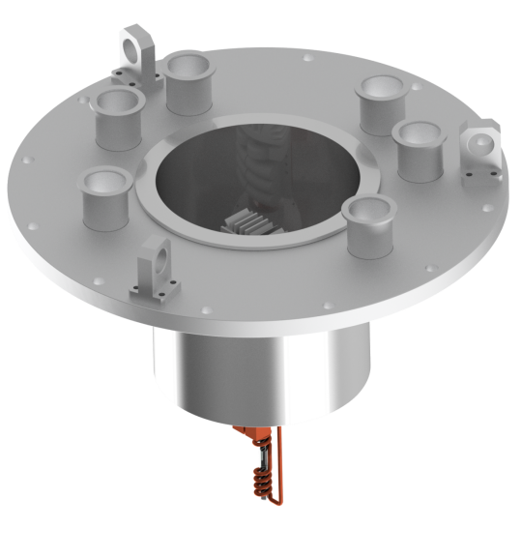
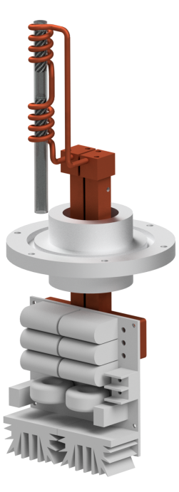
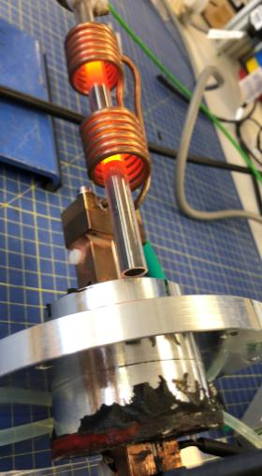




Induction heating system:
- Electromagnetic radiation tested at ISIS
Vacuum tested
No beam shadow on Polaris / HEIMDAL
Fast heating – settling in minutes
High temperature >1370 °C (only limited by thermocouple)
Test with beam scheduled for 23th of November 2018

Slide 10
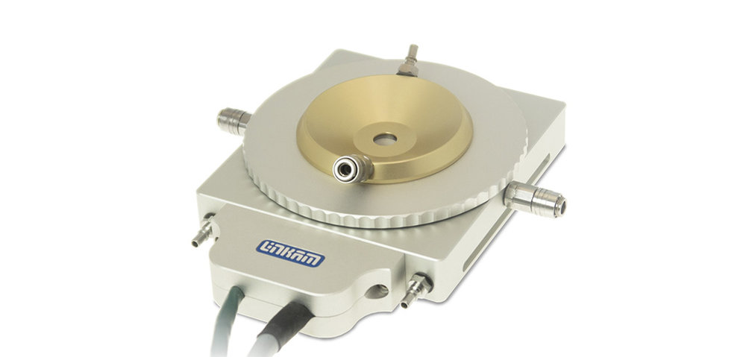
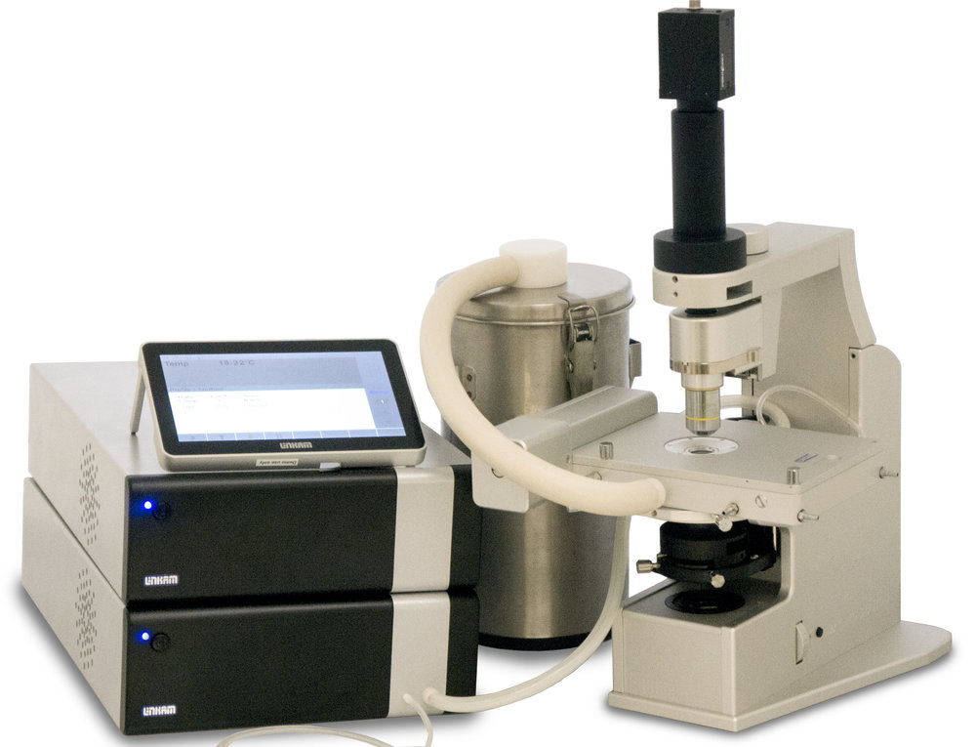
Temperature controlled stages 77K-900K or higher.
http://www.linkam.co.uk/temperature-controlled-stages

Slide 11
Questions
Temperature range – combine with cryo?
Type of sample (metallic, insulating, powder, single crystal)
Sample size/shape, reactivity, holder type/material
Gas loading
Geometry
Measurement time

Slide 12
Sample changers – non ambient
Alex Holmes
Scientific Activities Division
www.europeanspallationsource.se
21 January, 2019

Slide 13
Instruments with low-T sample changers requested
DREAM
VESPA
CSPEC
HEIMDAL
MIRACLES
ESTIA (Whole Cryostat)

Slide 14
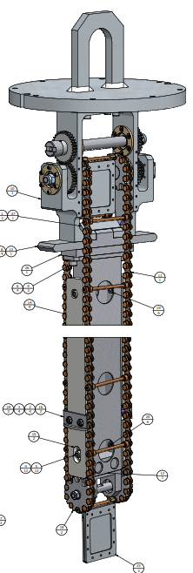
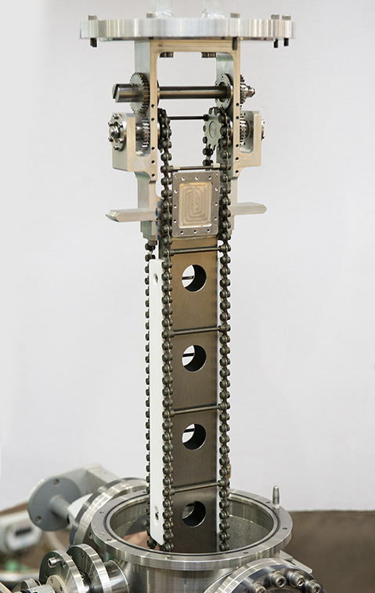
Sample changer (SC) –ideas from VESPA
TOSCA SC
Requirements:
  Needs to work with the VESPA CCR (no change-over!)
  < 1 hr for installing it
  Should contain at least 30 samples, preferably 50 (needs to have enough space to run for a weekend: 1 hr/sample including cooling time)
  Waiting samples should be pre-cooled, preferably to 70K or lower
  Camera/scanner to scan the sample that goes into beam for tracking
TOSCA SC:
  36 Samples at 10K
  Not reloadable while running

Slide 15
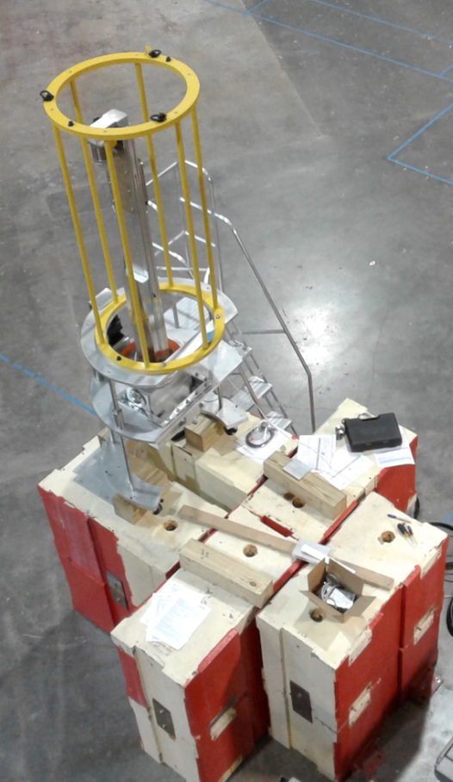
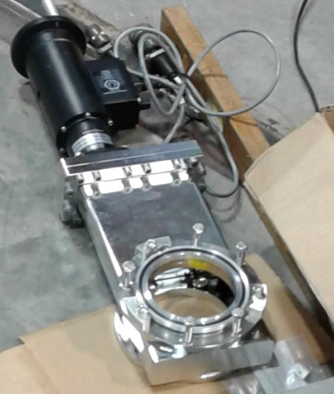
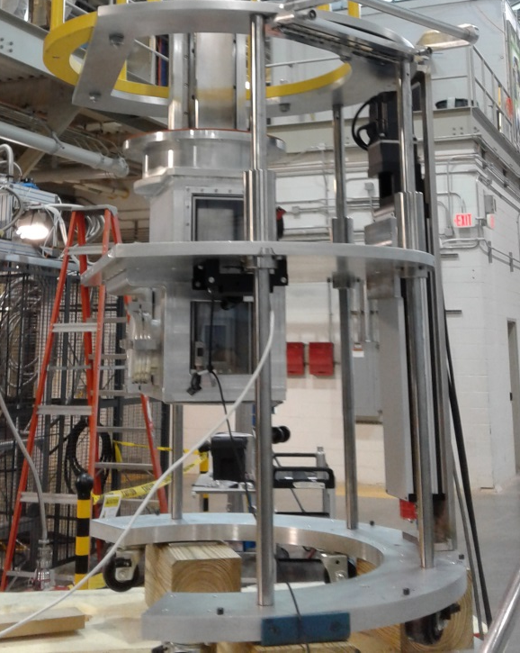
Sample environment: sample changer (SC)
Variable temperature (8-300K)
Enough samples to last the weekend (~50 samples)
Easy/fast to install. Uses the VISION CCR
Samples are cooling while “waiting”
SC
Valve to keep CCR sample area
evacuated while installing SC
Sample Magazine
CCR
VALVE
Wheels for easy
move of SC
Floor of exp. cave

Slide 19
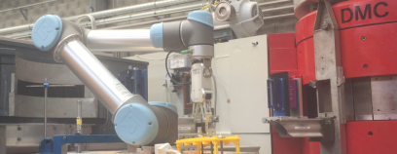
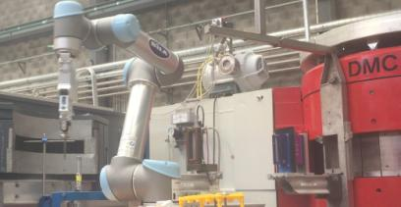
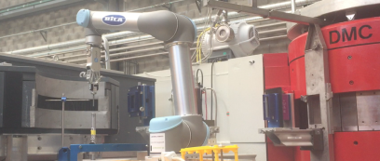


SAMPLE ENVIRONMENT FOR HEIMDAL
Collaborative robot
Universal robots UR5
Very easy programming for pick and place.
Tested at ambient condiditions
running 18 samples in 24 hours at DMC at PSI
Combined with hot air blower would allow
Pick and place + temperature RT-1000K
Next step:
Barcode reader before placing sample
Vacuum around sample
Sample rotation by robot

Slide 20
https://www.youtube.com/watch?v=Yttsp6UZYS0&list=PLhuA2DQyfTMnbccQENFdgCUox85EWiBmS&index=3

Slide 21
Questions
Temperature range (low, high, both in same apparatus?)
Type of sample (single crystal, powder)
Sample size/shape, holder type (e.g. V can)
Typical measurement time
Number of samples
Sample in vacuum, exchange gas, etc.
Instrument geometry

Slide 22
Motion Axes

Slide 23
Motion axes
Default is nothing except manual sample stick rotation and height adjustment
Kinematic mounts will help with reproducibility
What do we need within SEE? What is consequence of not having particular axis motorised?
  Height
  Stick rotation
  Xtal alignment
What is needed for SEE support – can we share stack between instruments? N.b. not in SAD scope.
Alignment tools - lasers, cameras

Slide 24
Magnets

Slide 26
Magnets
Priority | SYSTEM | DETAIL | INSTRUMENTS |  | READY BY
=1 | 2.5T Warm bore cryomagnet | Similar to MLZ design MAG-2.2T-HTS | ESTIA +EVERYONE |  | 21/Q4
=1 | Vertical 10T cryomagnet | large opening, assymetric (<100K?) | MAGIC CSPEC DREAM TREX HEIMDAL |  | 23/Q1
=1 | Vertical 15T cryomagnet (2nd hand) | split coil | BIFROST DREAM HEIMDAL |  | 21/Q4
2 | ~12-14T spectroscopy magnet | Largish opening | CSPEC TREX MAGiC DREAM BIFROST |  | 22/Q1
3 | 2.5T warm bore small footprint | No bottom access | ALL incl MIRACLES
4 | Horizontal 11T cryomagnet | SANS MA11+ | SKADI ESTIA MAGIC DREAM HEIMDAL |  | 22
5 | Medium field cryo | Assym. large opening | MAGIC CSPEC DREAM TREX HEIMDAL
6 | 1T electromagnet |  | LOKI ESTIA SKADI FREIA |  | 21/Q4
7 | Horizontal medium field large opening |  | BIFROST DREAM HEIMDAL |  | 23
 | Pulsed field, High Tc >25T | When mature |  |  | 24

Slide 27
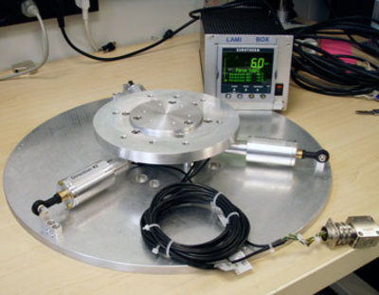
Magnets - practicalities
Aux equipment
  Power supply/control electronics
  VTI pumping cart
  Lambda stage pump
  Recondensing compressor or He/N2 filling
  Equipment for inserts
  Turbo cart for IVC pumping/exchange gas removal
Force testing
Question – realistic to share between top loading and floor mounted instruments?

