Slide 1
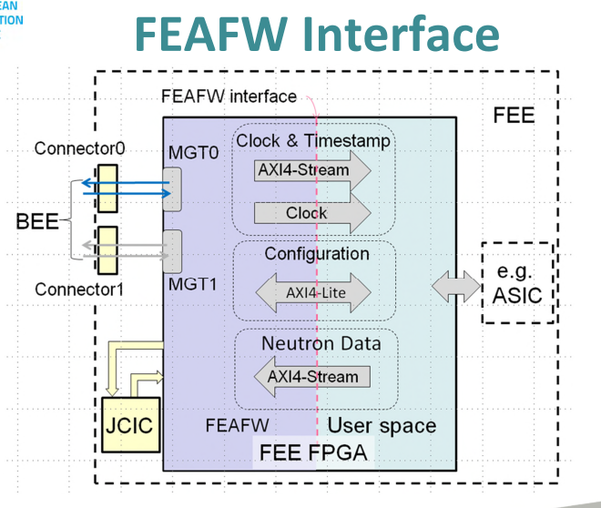
Slow Control Alerts from Detector
Add I/O Interrupt lines to FEA interface
Ir req
Ir ack
Ir req Latches Alert in Private Register of FEA
BackEnd engine continually polls Alerts from all Rings / Nodes (without intervention by ICS)
Summary Alert status stored in BE register
This can be polled by ICS
Or
If set can send Alert cmd packet to BE to ICS

