Slide 1
CDR 2019 nBLM end to end connection
Saclay CEA
Edvard Bergman
BD Laboratory manager
Cables/EMC/EMI
ESS ERIC
www.europeanspallationsource.se
7 February, 2019

Slide 2
Example from telecom industry EMI magnitude.
“Worst case” low level CW impact as EMI.
“Stray capacitance”

Slide 3
Signal from nBLM.
The signal output from the nBLM goes through an amplifier. This make its not “critical” as icBLM in terms of capacitance and it is regarded as single mode termination rather than differential mode. A coaxial (“triaxle”) cable through conduit has been chosen.

Slide 4
nBLM signal end to end connection

Slide 5
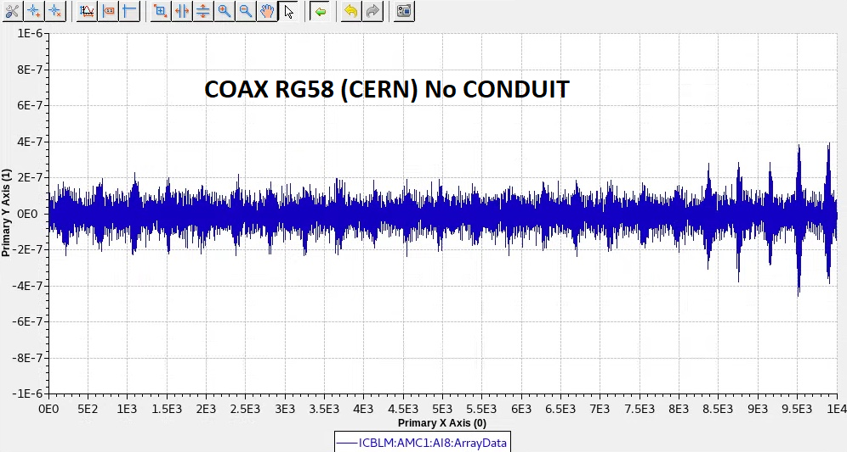
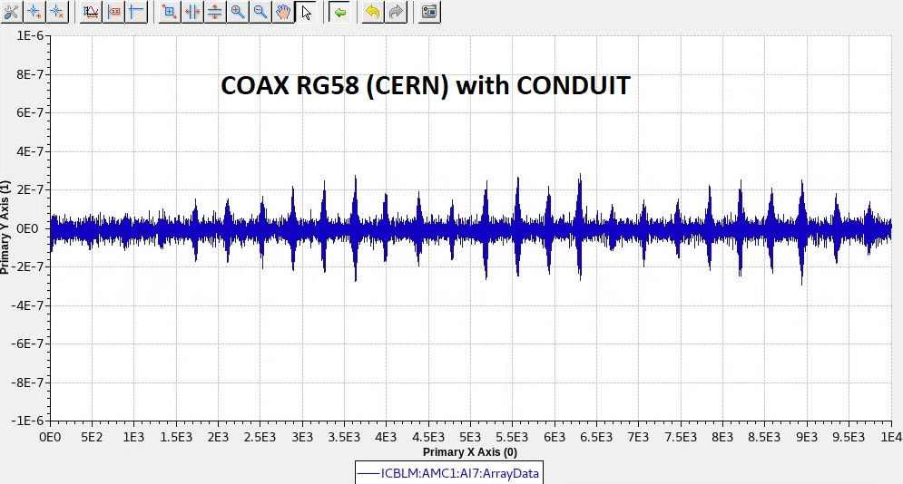
icBLM measurement at Uppsala test facility. COAXIAL RG58 (CERN). 10m with and without CONDUIT

Slide 6
nBLM Low voltage end to end connection.

Slide 7
nBLM High voltage end to end

Slide 8
Thank you!

