Slide 1
icBLM Detectors
Viatcheslav Grishin
Irena Dolenc Kittelmann, Thomas Grandsaert, Clement Derrez, Edvard Bergman
icBLM CDR 2019-02-12 CEA

Slide 2
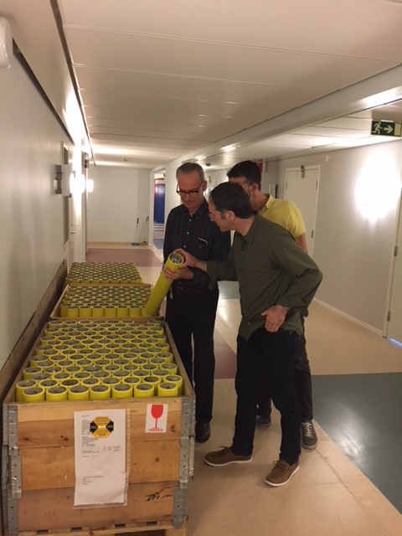
BLM Ionization Chamber at ESS

Slide 3
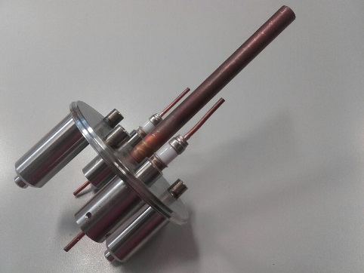
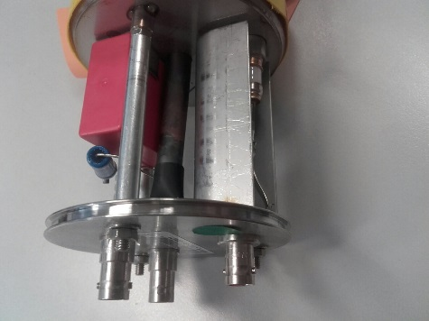
BLM Ionization Chamber

Slide 4
BLM Ionization Chamber description
61 circular parallel plate Al electrodes
HV = 1500V
1.5 l N₂ gas (1.1 bar pressure at 20 C)
Sensitivity: 5.26 x 10⁻⁵ C/Gy derived from
ρ(N₂) = 1.2 kg/m³
W = 34.8 MeV (avg energy for ionization)
Dynamic range (10⁺⁸⁾ limited by:
Leakage current (<1 pA)
Saturation effects (space charge)

Slide 5
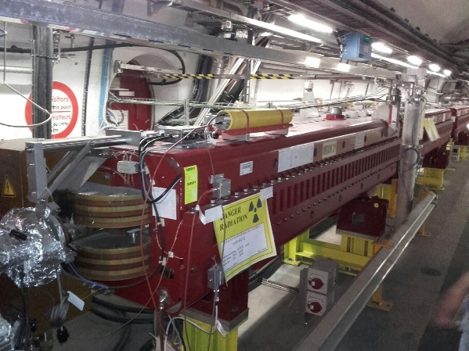
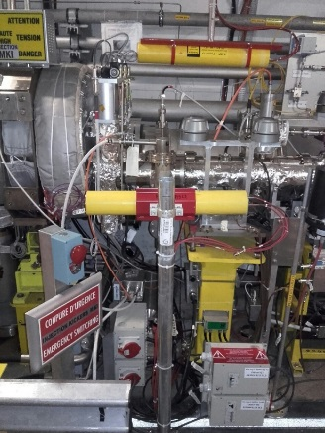
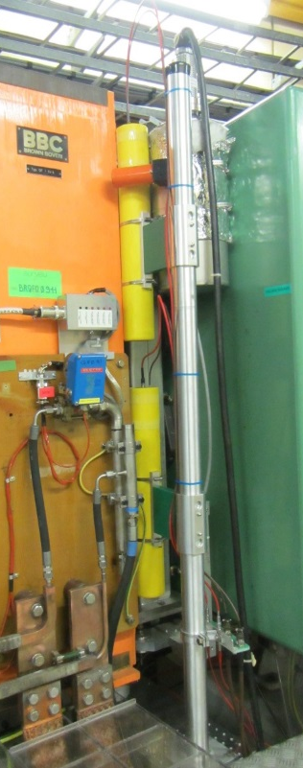
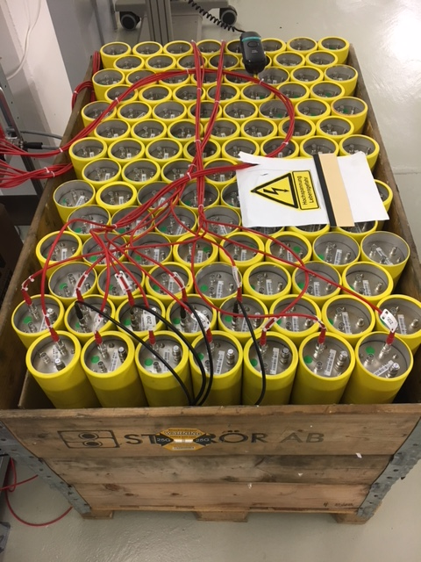
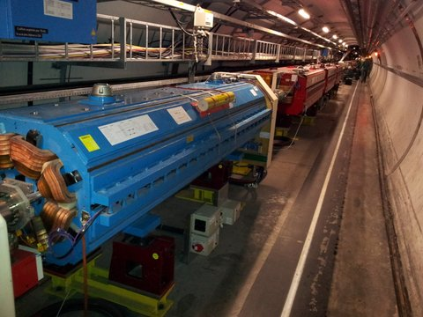
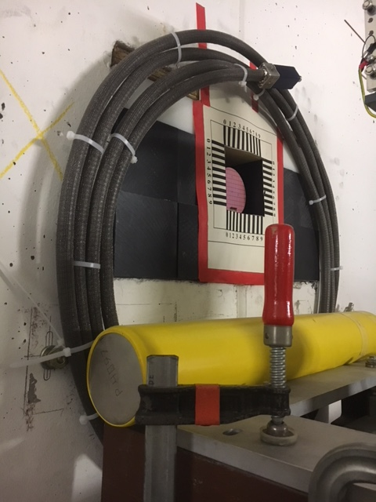
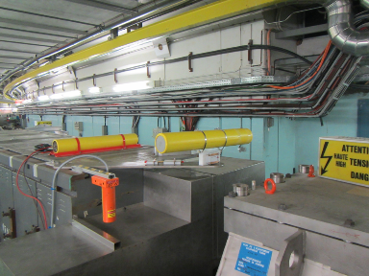
<6000 Beam Loss Monitors at CERN and GSI
At the beginning of Run 2, BLM LHC system had 3929 monitors
with 3518 Ionization Chambers (IC), 108 LIC and 191 SEM (and 1 FIC)
BLM PSB system had 32 installed IC and 32FIC.
GSI
LINAC 2 had 5 IC
LINAC 4 installed 24 IC
~100 ICs are in PS

Slide 6
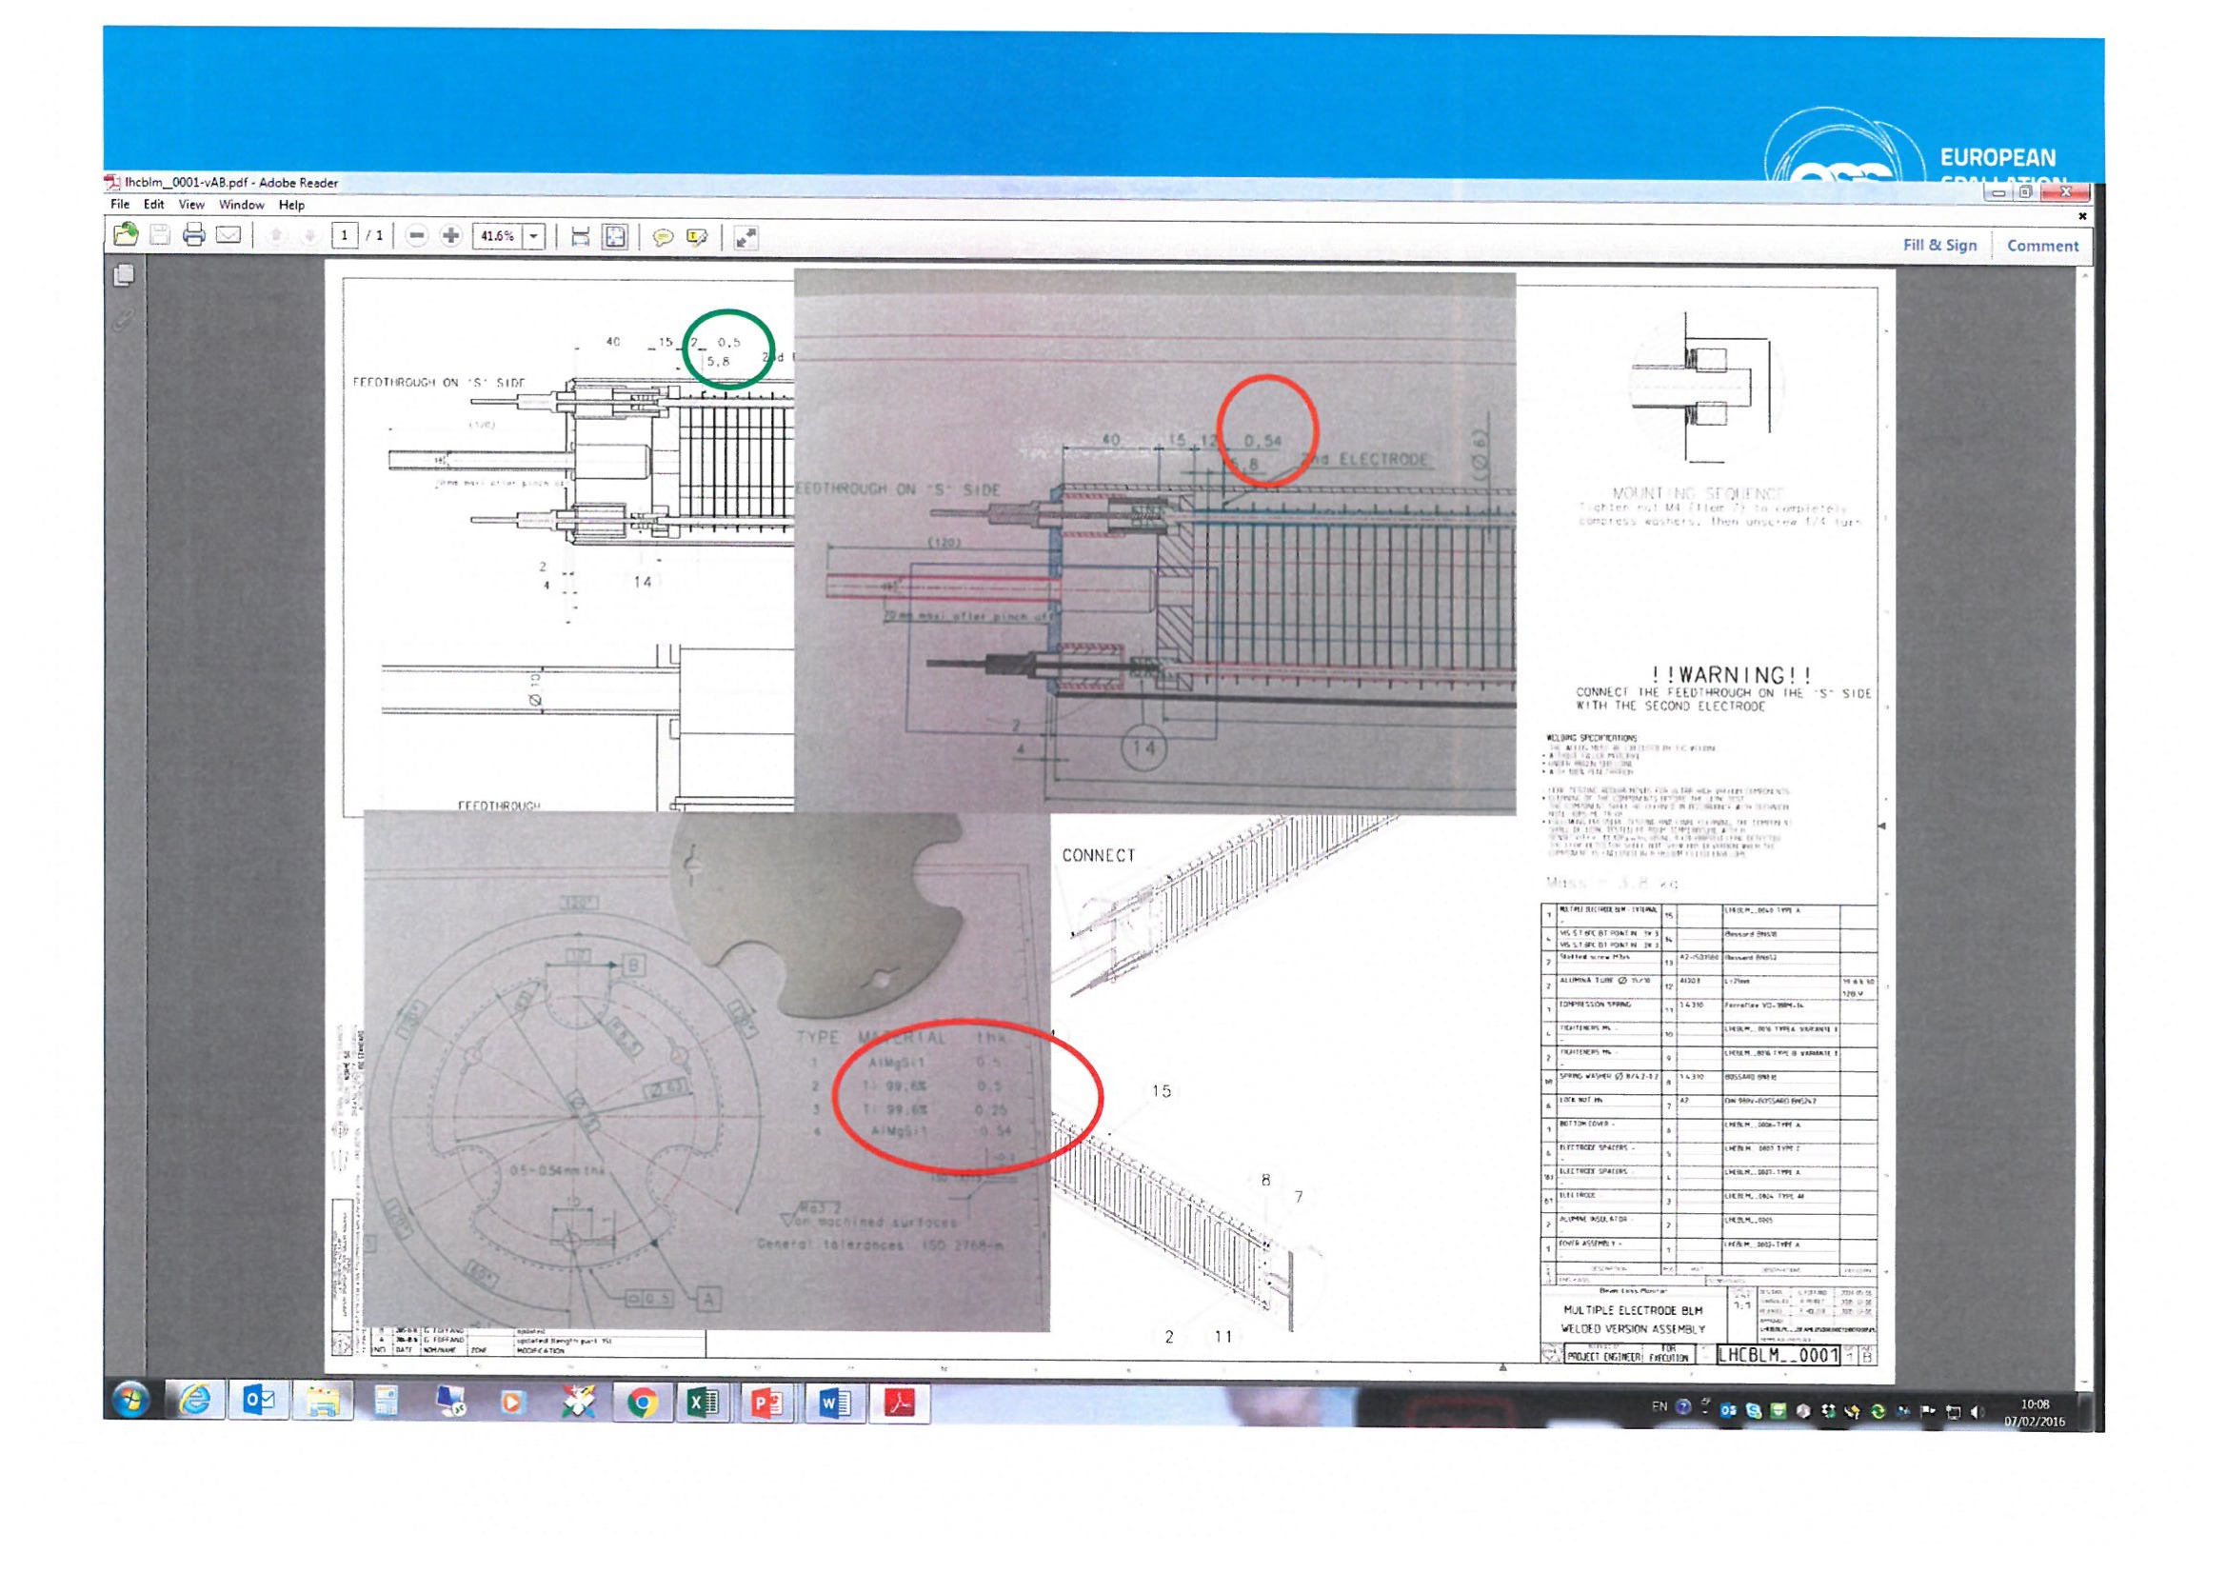
LHC type Ionization Chamber.
-LHC type (ic08) Ionization Chamber and LHC type (ic17) Ionization Chamber.
In one active zone consists of 61 parallel electrodes with 5.75 mm distance between electrodes, in the other – the gap between electrodes is reduced to 5.71 mm every 2nd electrodes.
ESS, GSI, CERN

Slide 7
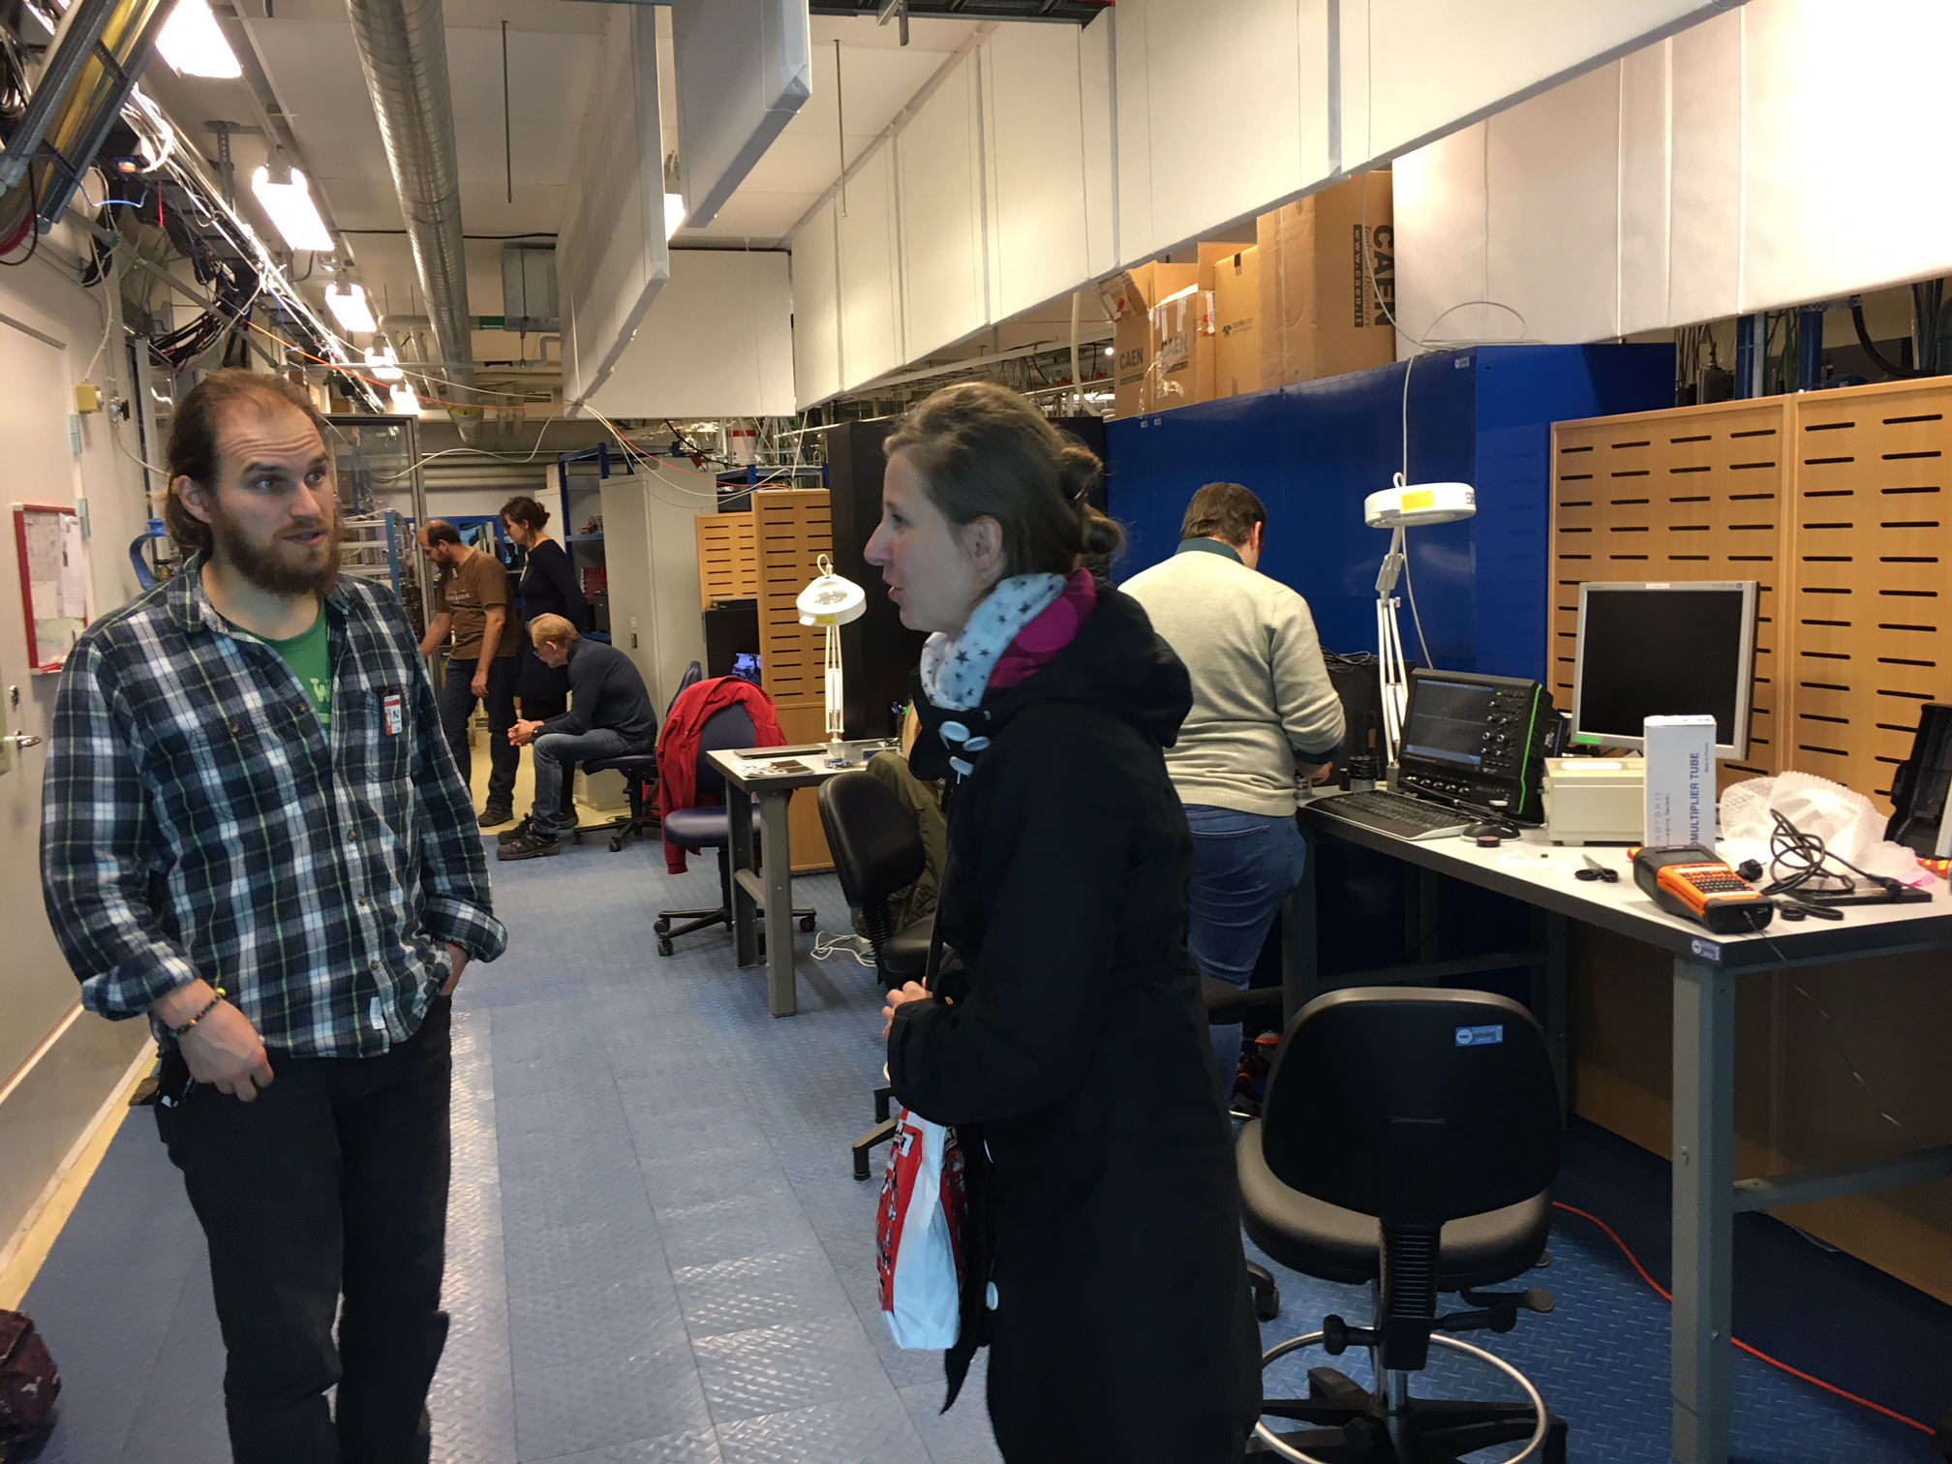
I) The Source Testing Facility at Lund University
The Source Testing Facility (STF) is a laboratory providing access to radioactive sources and infrastructure for detector tests and characterizations.
It boasts a complete range of gamma-ray and Be-based neutron sources for characterizations of detectors and equipped with a the wide range of moderators and shielding materials, tools, electronic components.

Slide 8
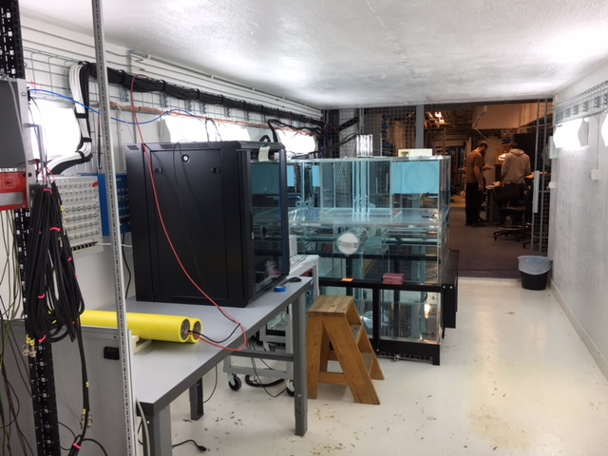
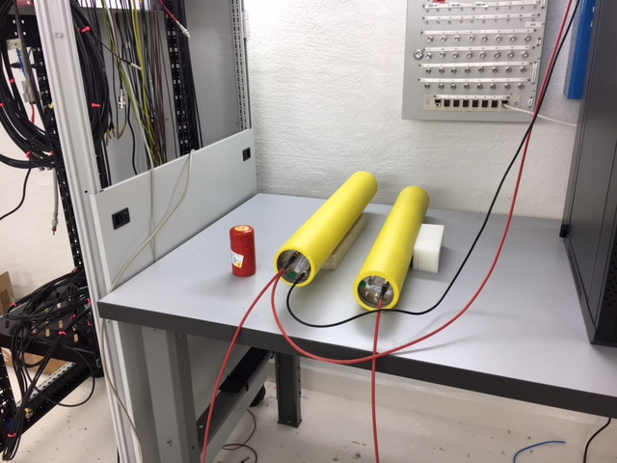
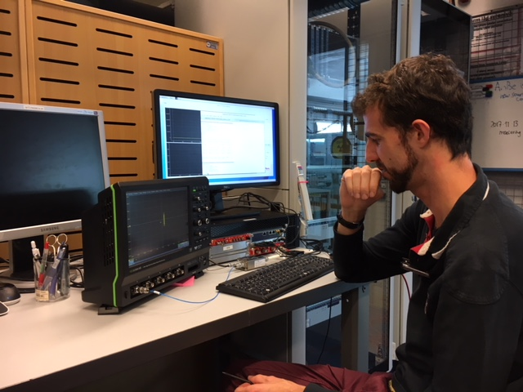
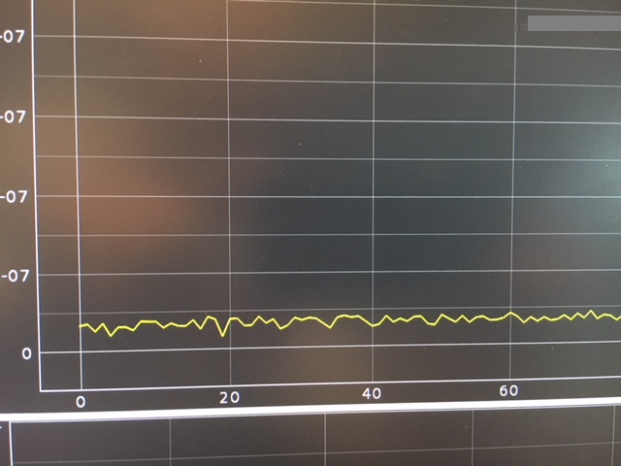
I) LU: Leakage current and the source induced signals test at STF
Test of 2 chambers:
LC - 1 pA
Signal under gamma irradiation –
10 pA for both chambers

Slide 9
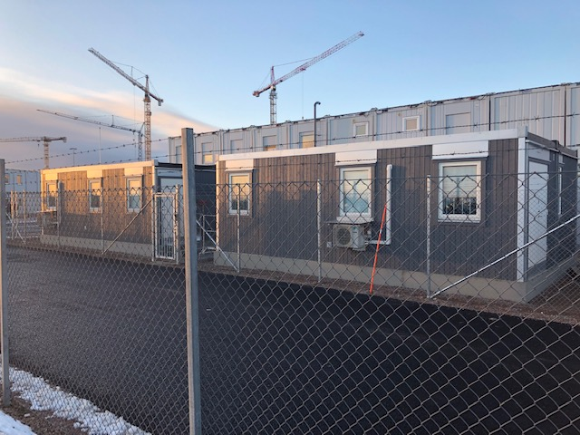
1a) March-April, 2019 test at ESS rad workshop
3.7MBq Cs-137, which once it’s in its housing will give around 50µSv/h at 1cm

Slide 10
II) Supports for icBLM (Thomas Grandsaert)
ELLIPTICAL LOCATIONS
SPOKE LOCATIONS

Slide 11
II) Supports for icBLM (Thomas Grandsaert)

Slide 12
III) Test icBLM at HiRadMat
Viatcheslav Grishin
Clement Derrez, Edvard Bergman, Irena Dolenc Kittelmann (ESS ERIC , Lund)
Tatiana Medvedeva, Ewald Effinger, Christos Zamantzas, Raymond Tissier, Ion Savu (BE-BI-BL)
ARIES-CERN-HiRadMat-2017-01 - BLM2

Slide 13
Motivation
IC: Comparison of response in high radiation conditions of LHC type (ic08) Ionization Chamber and LHC type (ic17) Ionization Chamber.
Monitors tested in 2017 and in 2018:
-LHC type (ic08) Ionization Chamber. Active vol 1.5l, filling pressure 1.1 bar.
-LHC type (ic17) Ionization Chamber. Active vol1.5l, filling pressure 1.1 bar.
Study of the signal linearity and response, calibration, saturation.

Slide 14
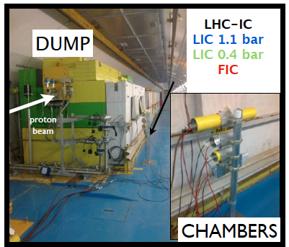
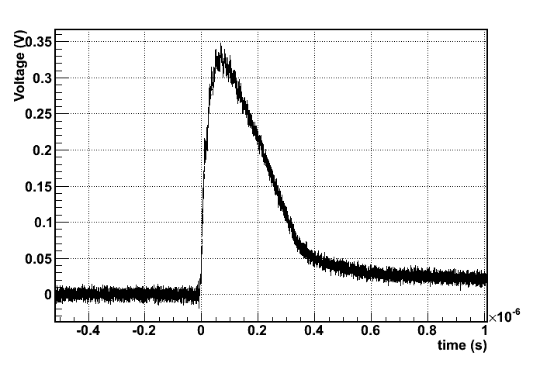
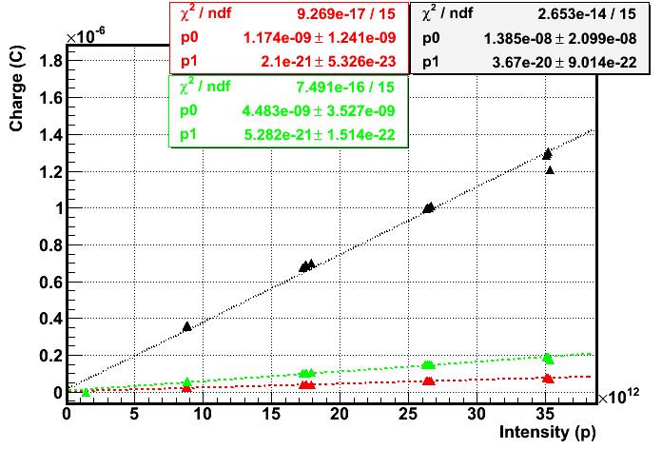
Detector performance for Set up in 2015 and in 2016
Mixed radiation field. Protons onto dump
Total (ion) charge collected in 300us
Response linear with intensity
Electron induced signal
Courtesy E.Nebot
plot of the integrated charge (over 40 us), Sep 2015 at HRM
black = IC, green = FIC, red =LIC

Slide 15
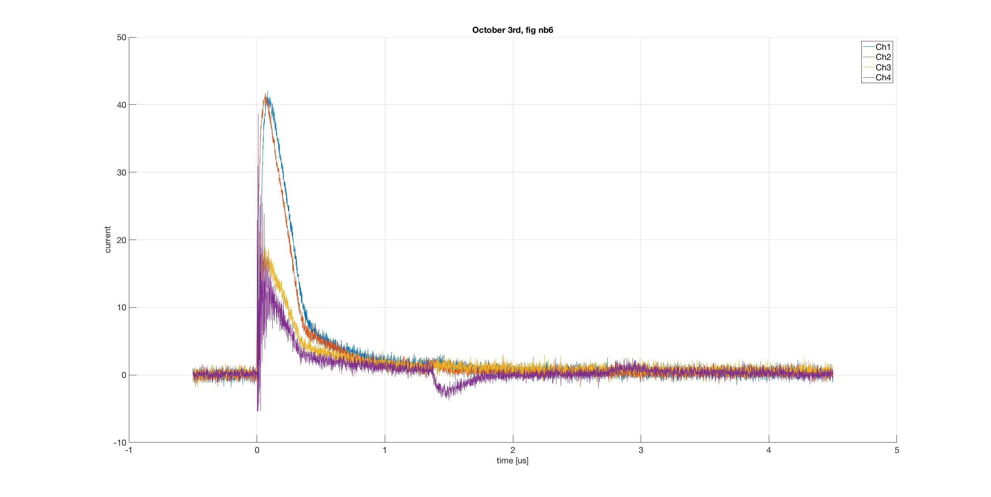
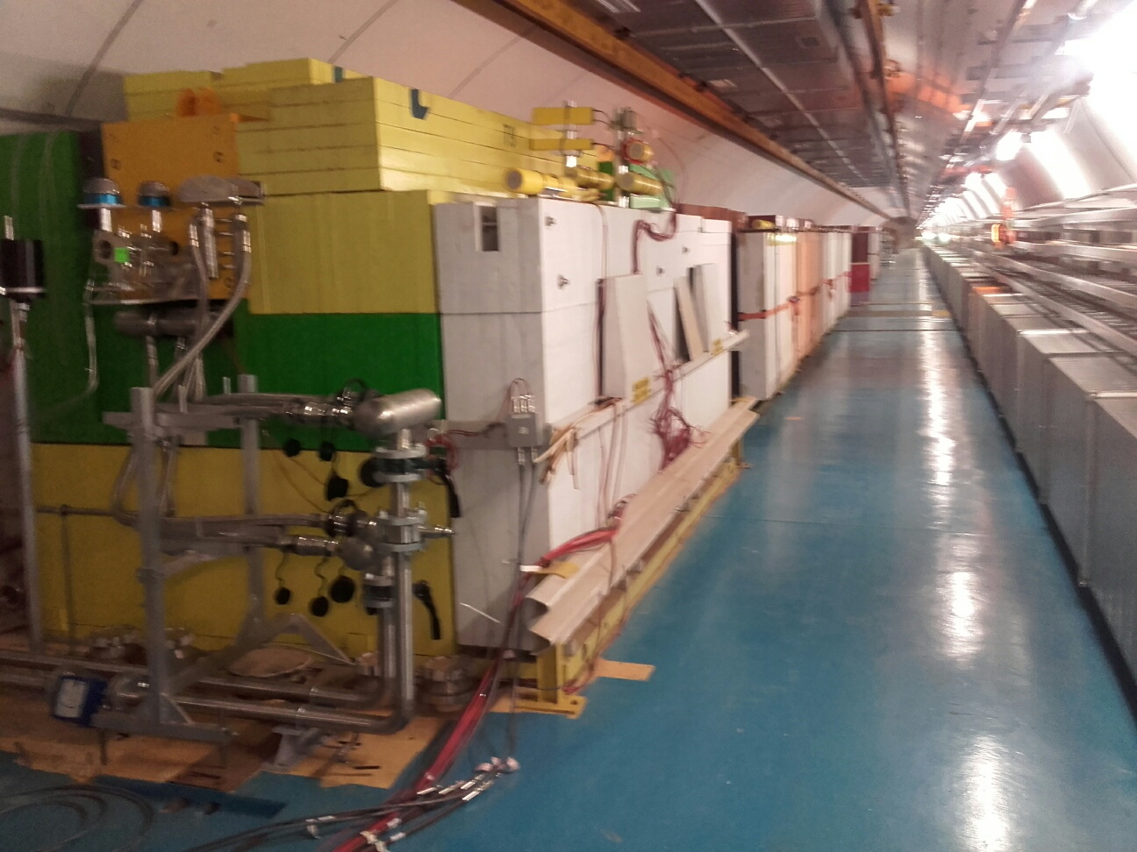
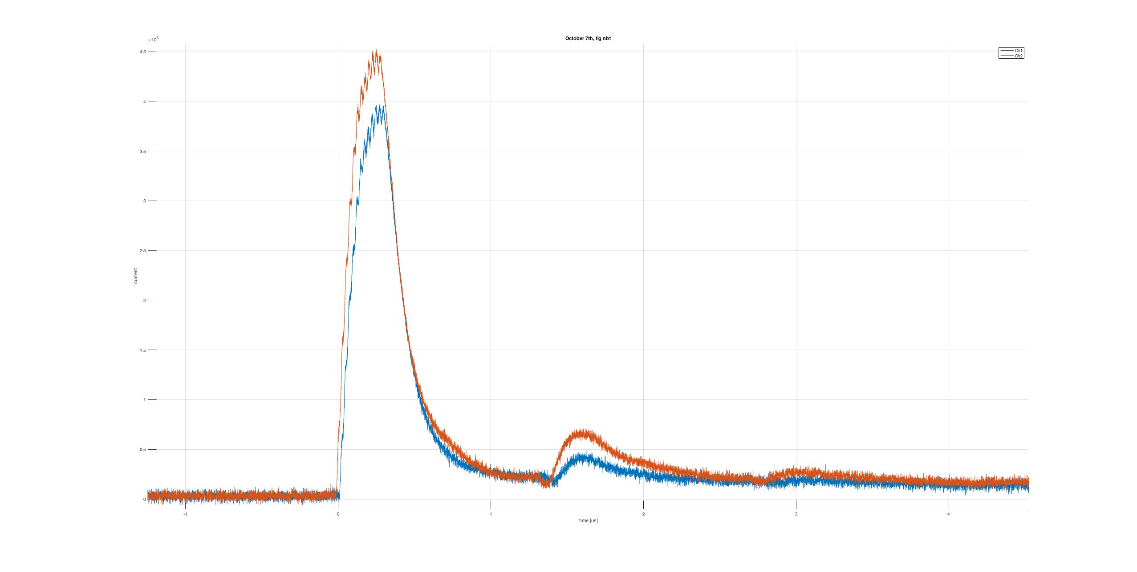
Set up and raw results in 2017

Slide 16
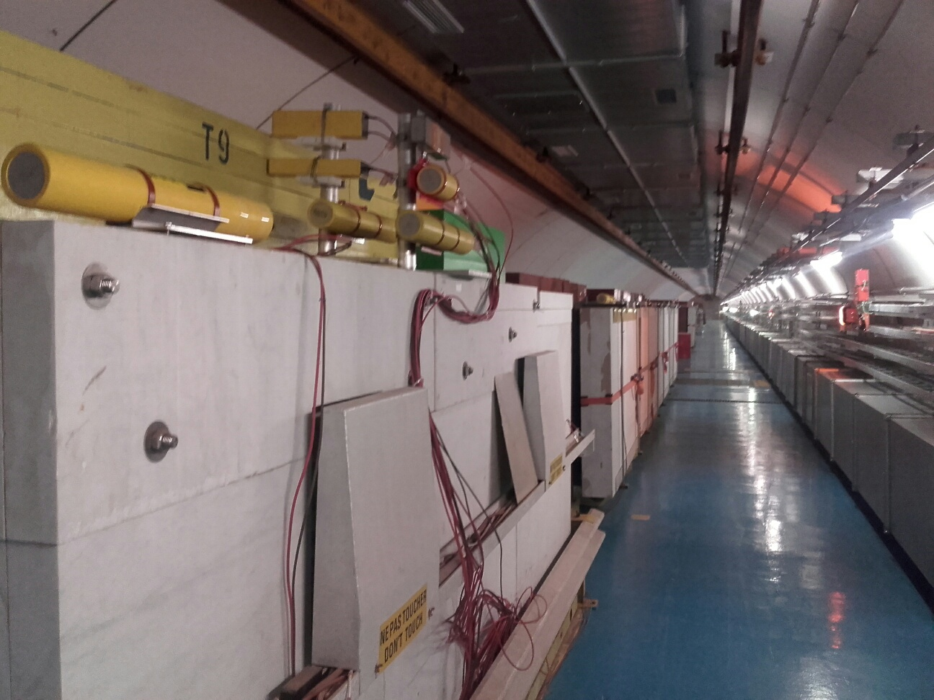
Set up in 2018
TT66.BLM.660518LOSS_EXTR1 next to the last BTV on the beamline (just before the beam exit window)
TT66.BLM.660523LOSS_EXTR1 next to table B (where your experiment is installed)
TT66.BLM.660526LOSS_EXTR1 next to table C (most downstream table)
Length of cables
2018for DAQ for BLM2@&HRM
2 USB Pico scopes connected to a PC and Ethernet, running automated acquisition on the scopes and sending data.

Slide 17
The beam pulse list
The beam pulse list:
Calibration: 1, 12 bunches x pulses 0.5e11
High intensity:
1.2e11 ppb
pulses with 12 nominal bunches
pulses with 24 nominal bunches
pulses with 48 nominal bunches
pulses with 72 nominal bunches
pulses with 144 nominal bunches

Slide 18
Full charge from flux: IC1-ic17, IC2-ic08

Slide 19
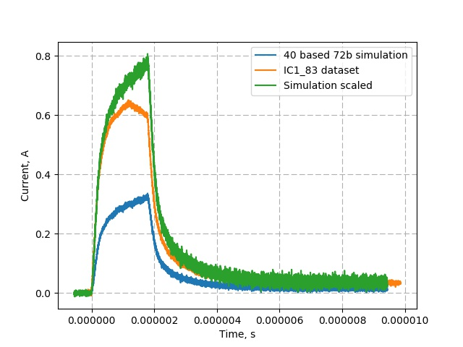
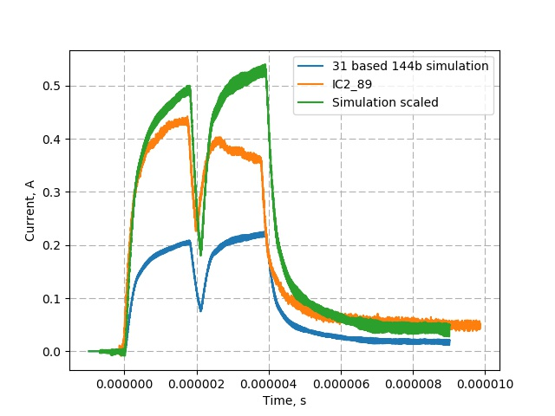
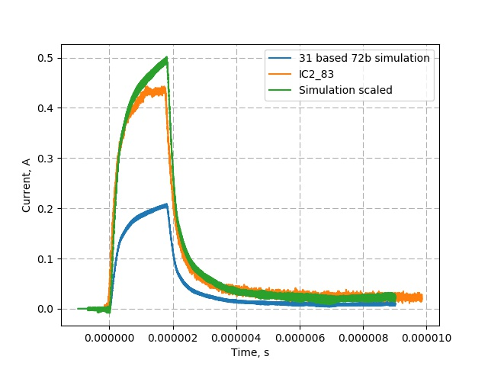
IC1-icBLM17; IC2-icBLM08 (saturation)

Slide 20
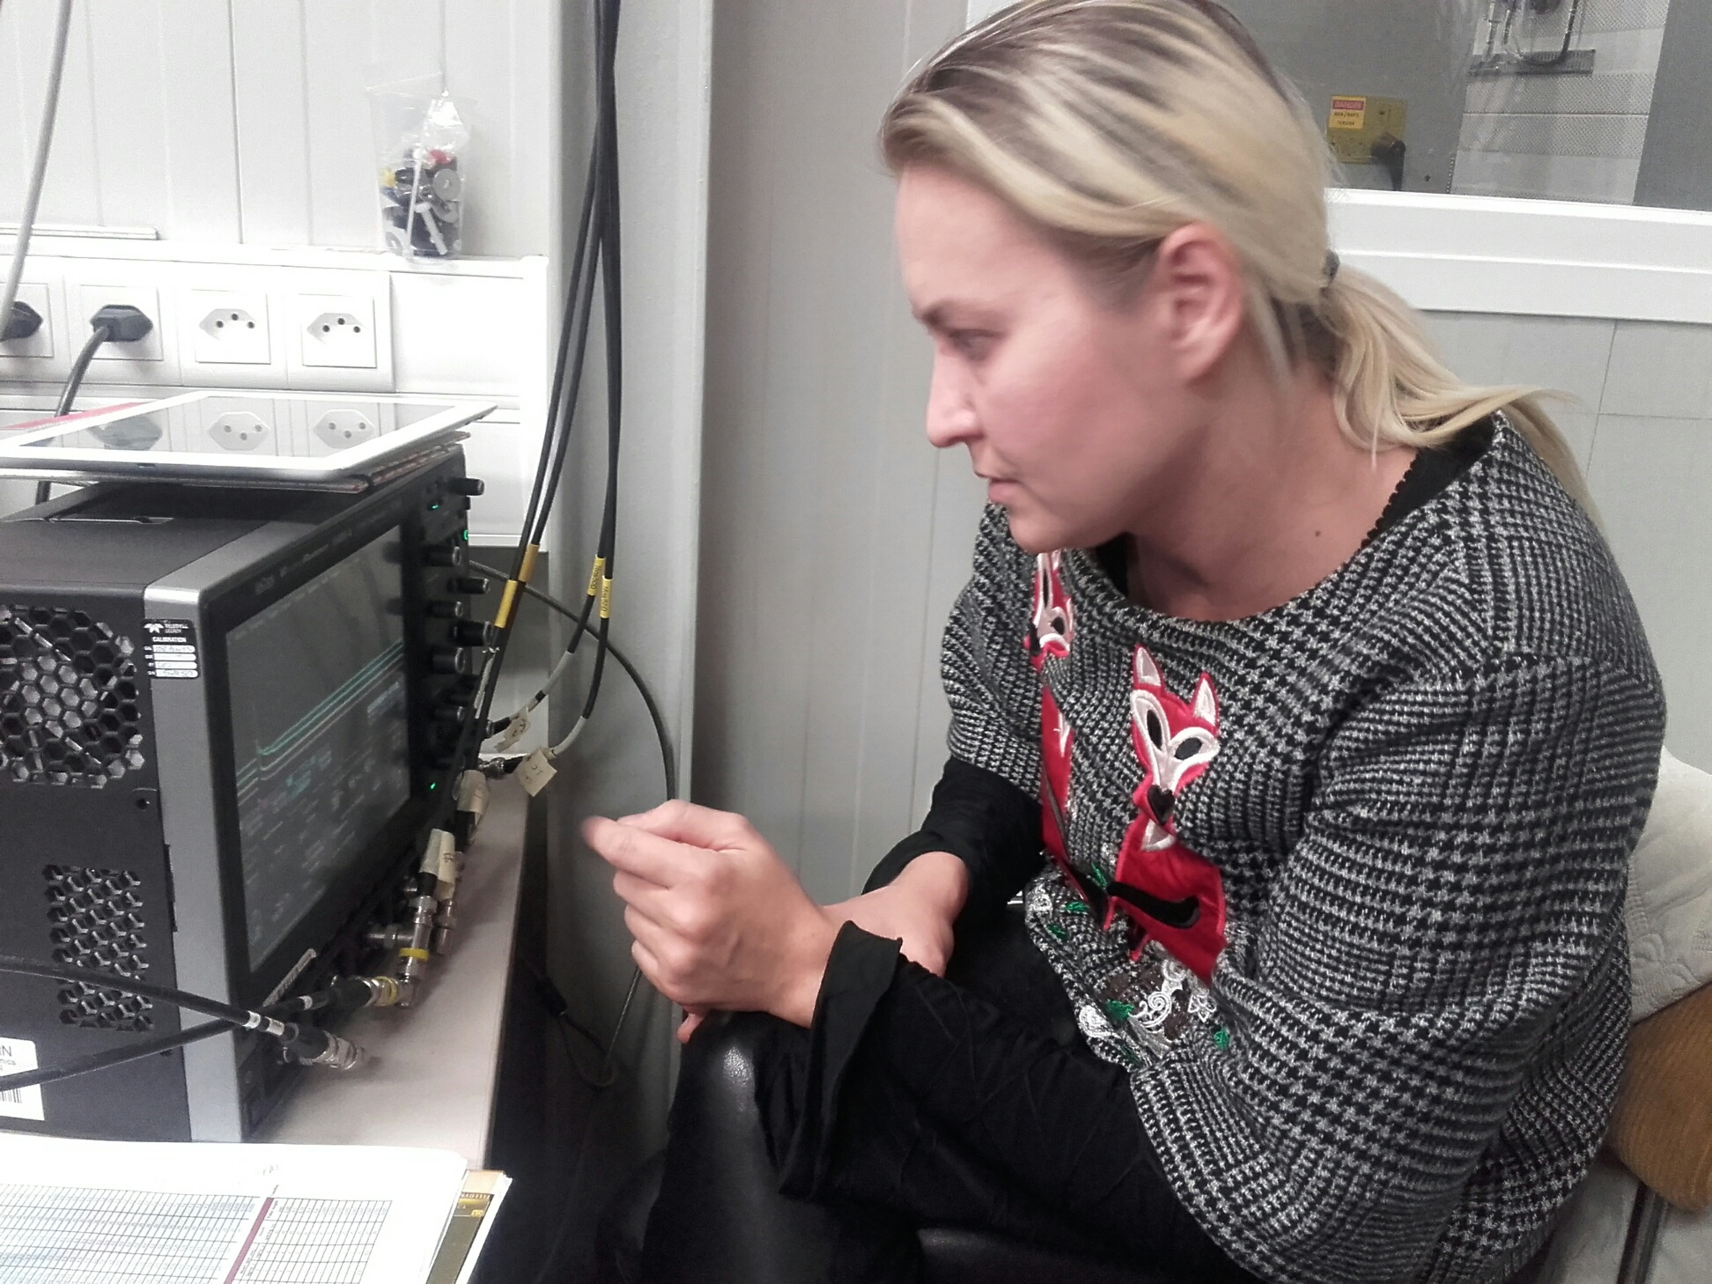
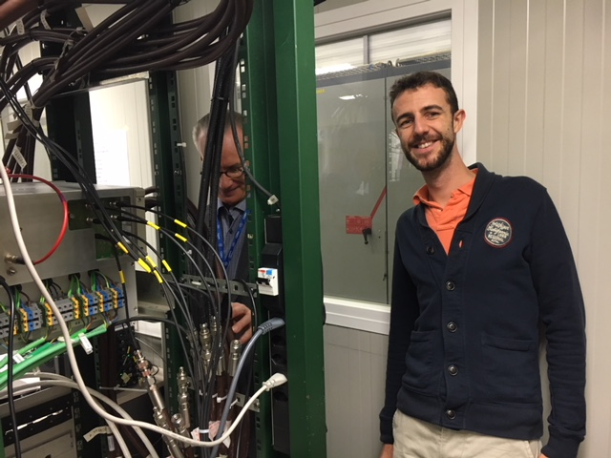
ARIES-CERN-HiRadMat-2017-01 - BLM2
Thanks to

