Slide 1
icBLM digitizer
Clement Derrez
European Spallation Source ERIC
Date

Slide 2
Reminder: system overview
MPS
Post mortem
Timing
Detectors: ICs
Control rack crates
Timing receiver
User screens,
Archiver…
HV
ECAT
FPGA processing,
interfacing
Signal acquisition
EPICS IOC
2
Tunnel
Gallery
ESS control room

Slide 3
Reminder: requirements
Signal acquisition: Dynamic range | Input current dynamic range: 10 nA to 10 mA. | Two separate ranges shall be used: the low end set by the condition that the operators must be able to tune on beam loss measurements down to 10 mW/m, while the high end shall allow recording of total beam loss during faults and machine studies | BLM is required to be able to measure at least 1% of 1W/m loss during normal operation and up to 1% of the total beam loss.
Signal acquisition: Response time | NC LINAC: Calculated melting time values of 3-4 us SC LINAC: 10 us The signal acquisition card shall therefore feature a bandwidth of at least 300 KHz and a minimum sampling rate of 1MSPS | “Particle time” - PT: time between the onset of beam loss (the primary is lost) and the moment particle (primary or secondary) hits the detector. Detection time: time needed for the detector signal to develop and to collect enough hits/current Processing time: from the output of the detector to the BIS output on the FPGA
Signal acquisition: resolution | The signal acquisition card shall have a resolution of at least 20 bits
Signal acquisition: noise figure | The signal acquisition card shall have a typical noise better than 10 nA in its lowest range, including temperature induced noise
→ 300 KHz Bandwidth
→ Trigger on a 800 nA, 5 us pulse width, with 100m max cable length

Slide 4
CAENels FMC-PICO
ESS requirements customized version: FMC-PICO-1M4-C3
20 bits 4 channels floating 1 MSPS ammeter
300 KHz bandwidth
2 ranges, “manual” switching:
500 uA (‘RNG1’)
10 mA (’RNG0’)
Resolution:
1 nA in RNG1
20 nA in RNG0
Fully VITA 57.1 compatible
A CAENels DAMC-FMC25 full size standard AMC board or IOxOS IFC 1410 hosts 2 PICO - FMC mezzanine cards in the Beam Diagnostics testbench.

Slide 5
Tests results: DAMC carrier
PICO-8 Range | Test cable | CAENels | ESS testbench
10 mA range | Open Circuit | 220 nA | 199 nA
500uA range | Open Circuit | 12 nA | 12 nA
10 mA range | Equivalent to 30 m Twinax | 220 nA (3 nF) | 230 nA
500uA range | Equivalent to 30 m Twinax | 20 nA (3 nF) | 41 nA
10 mA range | 100 m Twinax + detector |  | 318 nA
500uA range | 100 m Twinax + detector |  | 139 nA

Slide 6
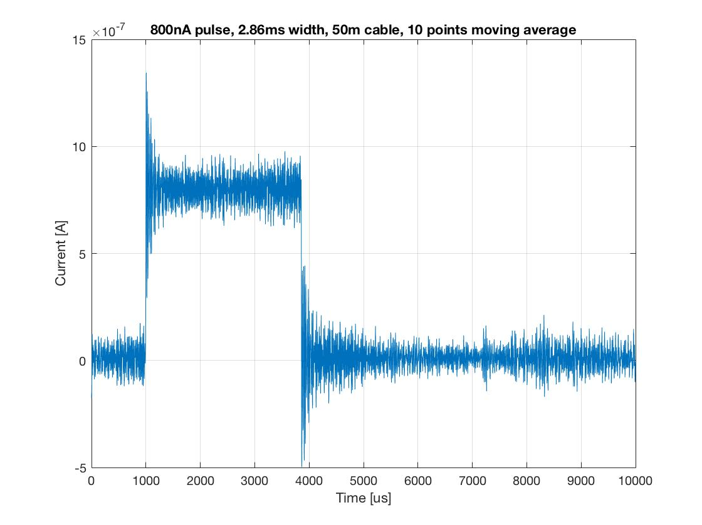
Tests results: DAMC carrier
Key parameter
Key parameter | value | comment
RMS 500uA range 100m cable | < 140 nA | Peak2rms is close to 4 on this signal. This level of performance allows the system to measure a < 600 nA pulse at 1 MSPS

Slide 7
Tests results: IOxOS carrier
PICO-8 Range | Test cable | DAMC carrier (RMS) | ESS testbench
10 mA range | Open Circuit | 199 nA | STD = 3.9 uA (RMS = 4.1 uA)
500uA range | Open Circuit | 12 nA | STD = 15 nA (RMS = 67 nA)
10 mA range | 30 m coaxial + detector | 230 nA | RMS = STD = 1.2 uA
500uA range | 30 m coaxial + detector | 41 nA | -
10 mA range | 100 m Twinax + detector | 318 nA | -
500uA range | 100 m Twinax + detector | 139 nA | -
Notes:
Test system available extremely late, data gathered last Friday
Different offset values observed on each channel
Channel nb 4 does not seems to be useable
Noise about 5 times higher on IOxOS than DAMC
→ Debug needed…

Slide 8
Coming priorities
Main priority:
Deeper evaluation of the picoammeter FMC on the IOxOS carrier. We are at a CDR with a platform that does not meet requirements right now
Continue with tests in FREIA to better assess cables’ noise performances and background levels
Further integration tests with the ISEG HV PSU in ICS integration lab
Detector tests in BD lab

Slide 9
Thank you!
Questions ?

