Slide 1
Introduction, Overview, Charge,
Project Plan, Requirements
Preliminary Design Review of the Common Shielding Project
Lund, 24th of January 2019
Ken Andersen, Zvonko Lazic

Slide 2
Agenda
09:00 – 09:30 | Introduction, Overview and Charge | K. Andersen / Z. Lazic
09:30 – 10:00 | Neutronics | P. Bentley
10:00 – 10:30 | Coffee
10:30 – 10:50 | Engineering | S. Kudumovic
10:50 – 11:00 | Installation | A. Bianchi
11:00 – 11:20 | Operations and Alignment | K Andersen
11:20 – 12:00 | Discussion
12:00 – 13:00 | Lunch
13:00 – 14:30 | Discussion
14:30 – 15:00 | Coffee Break
15:00 – 16:30 | Closed session
16:30 – 17:00 | Close-out
17:00 | Close

Slide 3
Agenda
09:00 – 09:30 | Introduction, Overview and Charge Project Plan, Requirements | K. Andersen / Z. Lazic
09:30 – 10:00 | Neutronics | P. Bentley
10:00 – 10:30 | Coffee
10:30 – 10:50 | Engineering | S. Kudumovic
10:50 – 11:00 | Installation | A. Bianchi
11:00 – 11:20 | Operations and Alignment Risk and Hazard Analysis | K Andersen
11:20 – 12:00 | Discussion
12:00 – 13:00 | Lunch
13:00 – 14:30 | Discussion
14:30 – 15:00 | Coffee Break
15:00 – 16:30 | Closed session Parallel: Information for Instruments
16:30 – 17:00 | Close-out
17:00 | Close

Slide 4
Charge for the PDR
Have system requirements been defined, and are they complete and adequate to ensure acceptable system performance?
Is the proposed design expected to meet the functional and performance requirements, and are interfaces properly identified and defined?
Have appropriate options and alternatives been considered in selecting the design approach? Are there further value engineering opportunities that should be considered?
Is the proposed design sufficiently mature to proceed to final design?
Have major project risks and safety hazards been appropriately identified, characterised, and mitigated?
Is the project plan drafted and is it compatible with the overall requirements of the NSS project? Are schedule and cost estimates reasonable?

Slide 5
Information provided for PDR
System requirements
System verification plan
Preliminary design report
Risk Analysis
Conceptual shielding designs
  Guide shielding in D01/D03
  Guide shielding E02
  Chopper pits
Neutronics reports
  Within line-of-sight: DREAM and T-REX, T. Randriamalala
  Prompt gamma shielding, R. Kolevatov
  ODIN shielding, F. Grünauer
  BIFROST up to 35m, R. Kolevatov
  HEIMDAL, R. Kolevatov
Information in these presentations
  Answers to questions
In the pipeline
  Concept of operations
  System architecture description
  System validation plan

Slide 6
Background: shielding costs from scope-setting
Instrument | cave cost | guide shield cost | total shield cost
FREIA | 720 k€ | 1,101 k€ | 1,821 k€
BEER | 658 k€ | 1,885 k€ | 2,543 k€
BIFROST | 686 k€ | 1,667 k€ | 2,353 k€
CSPEC | 867 k€ | 1,344 k€ | 2,211 k€
DREAM | 1000 k€ | 996 k€ | 1,996 k€
ODIN | 1500 k€ | 1,887 k€ | 3,387 k€
SKADI | 1000 k€ | 1,999 k€ | 2,999 k€
LOKI | 1000 k€ | 730 k€ | 1,730 k€
MAGIC | 457 k€ | 952 k€ | 1,409 k€
MIRACLES | 1080 k€ | 1,109 k€ | 2,189 k€
T-REX | 538 k€ | 1,686 k€ | 2,224 k€
VESPA | 822 k€ | 2,221 k€ | 3,043 k€
HEIMDAL | 630 k€ | 2,070 k€ | 2,700 k€
Total | 10,958 k€ | 19,647 k€ | 30,605 k€
Average | 843 k€ | 1,511 k€ | 2,354 k€

Slide 7
Scope of proposal in April 2018
Offer: guide shielding for long and medium instruments
  from bunker to cave
  include shielding around choppers
  Include all long instruments (West sector)
  No short instruments: LOKI, FREIA, ESTIA
    strongly integrated with neighbouring beamlines
  Include medium instruments: ODIN, DREAM, VESPA, SKADI
Use engineering resources from bunker team
Use whatever neutronics resources we can get our hands on
  Mainly from instruments which have signed up
8 instruments signed up:
  Long instruments: CSPEC, BIFROST, MAGIC, T-REX, HEIMDAL
  Medium instruments: ODIN, DREAM, VESPA

Slide 8
Scope of Phase 1 Project
December 2018:
  mechanical design completed
    Instrument-specific solutions
    analysis of compatibility with logistics
    3D model
    integration drawing(s)
  preliminary neutronics calculations completed
    validating and driving mechanical design
    reports issued
  cost offer for each instrument
  manufacturing and purchasing strategy agreed
January 2019: Preliminary Design Review

Slide 9
Priorities for Guide Shielding
1. Shielding performance
  Reaching 3 µSv/hr
2. Activation
  Choose standard components, so they count as spare parts, not waste
  Apply ALARA for decommissioning
  Maintenance access within 24 hours
3. Instrument background
  Primarily addressed by cave design
  Long distance (60-170m) also helps
Expected outcome: cost-effective solution which instruments will choose to sign up to
Modular design
  Shrink to minimise cost
  High degree of standardisation
  Vary steel thickness as required
  Use borated concrete on inside as required

Slide 10
Project Organisation
Ken Andersen
Project Sponsor
Zvonko Lazic
Project Manager
Gabor Laszlo
Engineering Advisor
Phillip Bentley
Physics Lead
Mark Ridgley
Systems Documentation
Senad Kudumovic
Design Engineer
Tsito Randriamalala
Ext. Neutronics
Rodion Kolevatov
Ext. Neutronics
Valentina Santoro
Neutronics
Nataliia Cherkashyna
Neutronics
Damian Martin Rodriguez
Neutronics
Florian Grünauer
Ext. Neutronics
Giuseppe Scionti
Ext. Neutronics
Uwe Filges
Ext. Neutronics

Slide 11
Project Organisation
Ken Andersen
Project Sponsor
Zvonko Lazic
Project Manager
Gabor Laszlo
Engineering Advisor
Phillip Bentley
Physics Lead
Mark Ridgley
Systems Documentation
Senad Kudumovic
Design Engineer
Tsito Randriamalala
Ext. Neutronics
Rodion Kolevatov
Ext. Neutronics
Valentina Santoro
Neutronics
Nataliia Cherkashyna
Neutronics
Damian Martin Rodriguez
Neutronics
Florian Grünauer
Ext. Neutronics
Giuseppe Scionti
Ext. Neutronics
Uwe Filges
Ext. Neutronics
Project Budget: 150k€
Instrument Contributions
10k€ each
MAGIC
DREAM & T-REX
BIFROST & HEIMDAL
ODIN & CSPEC
VESPA

Slide 12
What happened in Phase 1?
2018 | April | May | June | July | August | Sep. | Oct. | Nov. | Dec.
Proposal Development
ICB10 Meeting
Sign-up
Preparation
Project kick-off
Engineering design
Neutronics workshop
Neutronics start
Neutronics work
Design work complete
Costing & documentation
Project completion
Agreed work-flow
  Weekly minuted meetings for progress update and sharing of tasks
  Documentation written as work progresses and shared on-line
Work progressed according to schedule

Slide 13
Project Timeline
 | 2018 H1 | 2018 H2 | 2019 H1 | 2019 H2 | 2020 H1 | 2020 H2 | 2021 H1 | 2021 H2
Proposal Development
ICB10 Meeting
Concept Development
PDR
Detailed Design
IDR & TG3
Procurement
Contract Signature
Manufacturing
First Delivery
Installation
Phase 1
Phase 2: Instrument-specific
Register interest:
pay 10 k€ towards Phase 1
Decision point:
cost offer made
commit expenditure from instrument budget
Earliest possible start of installation

Slide 14
Purchasing & Manufacturing plan
Stage I (tender publication):
Following publication of the tender, the supplier is selected.
The supplier and NSS enter the contract, based on open book, collaborative set-up (OBC).
The OBC ensures cost tracking, allows the latest changes to be implemented during the contractor’ manufacturing design stage.
Stage II (manufacturing design):
ESS provides design & manufacturing QA engineer.
The manufacturing takes place at contractor’ facility; the system components are produced and delivered according to ESS integrated schedule.
Stage III (installation):
NSS provides installation manager and installation resources (hardware and workforce).
The contractor provides the installation supervisor.
Following successful installation, with sign-off from both, the NSS installation manager and the contractor installation supervisor, the contract is closed.
Cold box arrival to ESS

Slide 15
Purchasing & Manufacturing plan
The project structure could look like this:
Supplier – manages ‘production office*’ (houses common shielding production project personnel, drafting personnel; calls for any ‘open book contract’ discussions)
*This office is responsible for ordering all materials, production of detailed drawings, managing logistics and assembly of individual blocks; manages delivery of completed components to the ESS site.
NSS Common Shielding office – oversees the drafting and production effort. Enables collaboration model to work (ensures communication is maintained, key milestones are reviewed, and calls for any discussions relating to managing the open book contract).

Slide 16
Costing
We have market prices for bulk materials, and for cutting/manufacturing cost.
  We have obtained bulk material pricing from the companies involved in current ESS projects,
  The steel bulk unit prices are obtained from a Norwegian and Danish steel suppliers.
    Median numbers are taken into calculation for the final sum.
Uncertainties include:
  Raw material utilization (especially for plate materials).
  Logistics cost.
  Installation model (NSS is responsible for securing installation resources. All available data is correct today, but changes are expected as the installation time approaches).
Cold box arrival to ESS

Slide 17
The Common Shielding Project - Tender
ESS scope
Tendering requirements
Supplier’ scope:
Concept design evaluation
Detailed design
Design validation where required (internal reinforcement, lifting features,…)
Manufacture
FATs
Delivery to site
Installation oversight
SATs oversight
Design life requirements
Delivery schedule
QC requirements
Concept design
Manufacturing QC oversight
Interfaces definition
Installation
Open book, collaborative contract
Notes:
Explain better design deliverables (what is it we have defined and what is it contractor will deliver)

Slide 18
Storyboard
The Common Shielding Project
Manufacture
Transportation
On Site Activities
Installation
Decommissioning
The Common Shielding Project tender has to be placed taking into account ESS installation schedule.
Being a large project (by volume), the plan is to stage the production and delivery in the order of the NSS need, as dictated by the ESS integrated schedule. For example, the first shielding blocks for the first instrument in line for installation will be delivered by mid-2020
Notes:
NBPI is under design CDR is not done yet so this storyboard is our plan during detailed design and might be subject to change as time progress
Decommissioning is for inserts/plugs, not the facility

Slide 19
Installation Schedules
T-REX, HEIMDAL, VESPA to be determined…

Slide 20
Manufacturing & Installation
Manufacture
Transportation
On Site Activities
Installation
Decommissioning
Design for manufacturing (detailing)
Transport
Production
Installation controller
E02.1 blocks
Design approval
E02.2 blocks
Installation Manager
D01/03 blocks
Installation
Manufacturing QC & FATs
Contractor
Acceptance tests
ESS

Slide 21
The Common Shielding Project Overview
Outlook
Mechanical Design – Conceptual design finalized
Physics – The first round of simulations, providing input for the conceptual design, has been completed
Documentation – PDR required documentation completed.
Purchasing/schedule – Following this PDR, we will prioritize work and schedule delivery of the final design(s) in the order of instrument installation priorities. Timing for the (first) CDR will be determined following the PDR and sign up (to the project) of a number of instruments.
Budget - Current cost estimates are on budget.

Slide 22
Requirements
ID | Description | Type
01 | Safe restricted access for installation/removal | Functional
02 | Safe restricted access for maintenance | Functional
03 | Design to allow for 22 instruments | Constraint
04 | Support delivery of NSS programme | Constraint
05 | Design to allow for future expansion of instrument suite | Constraint
06 | Maximum lifting load: 5t | Constraint
07 | Maximum dimensions of elements: 3x1.5x1.5m3 | Constraint
08 | Element identification | Constraint
09 | Satisfy maximum radiation level in experimental: 3 uSv/hr | Rad.Safety
10 | Comply with dose budgets from General Safety Objectives | Rad.Safety
11 | Reduce radiation leakage through shielding: 10-fold rule | Rad.Safety
12 | Access restriction: PSS linked to proton beam | Rad.Safety
13 | Dust contamination: Surface coating of concrete surfaces | Rad.Safety

Slide 23
Requirements
ID | Description | Type
14 | Conventional safety barriers | Conv.Safety
15 | Comply with limit on storage of radioactive waste | Environmental
16 | Provision for safe routing of utilities | Interface
17 | Comply with load limit on D01 floor: 14 t/m² | Interface
18 | Comply with load limit on D03 floor: 14 t/m² | Interface
19 | Comply with load limit on E02 floor: 20 t/m² | Interface
20 | Do not impede D03/E02 floor dilatation joint | Interface
21 | Do not impede E01/E02 floor dilatation joint | Interface

Slide 24
Price Offers
Fixed price offers will be made
  December 2018: ODIN, DREAM, CSPEC, BIFROST, T-REX
  MAGIC (February), HEIMDAL (March), VESPA (May)
ESS will guarantee shielding performance
  Deficiencies to biological shielding will be fixed at no added cost to instruments
  ESS takes the risk on cost overruns and performance issues
ESS will act as provider to instrument consortium
  Similar to approach for delivering detector systems
  Possible instrument contributions (neutronics, installation, …) to be discussed individually
Decision from instrument teams needed as soon as possible
  Deadline to be communicated

Slide 25
What happens next
Finalise preliminary design and costing for MAGIC, HEIMDAL, VESPA
Get decisions from all instruments
  Exchange information and discuss terms and conditions
Establish prioritisation on installation timescale
  1. CSPEC, BIFROST, MAGIC
  2. DREAM, ODIN
  3. T-REX
  4. HEIMDAL, VESPA
Establish detailed operational requirements
  Start with early instruments
Agree on timescale for detailed design
  To be agreed individually with each instrument
  Establish dates for IDRs and sub-TG3s
Secure needed resources
  Engineering resources mostly secured
  Neutronics resourcing: use internal and external resourcing, following prioritisation

Slide 26
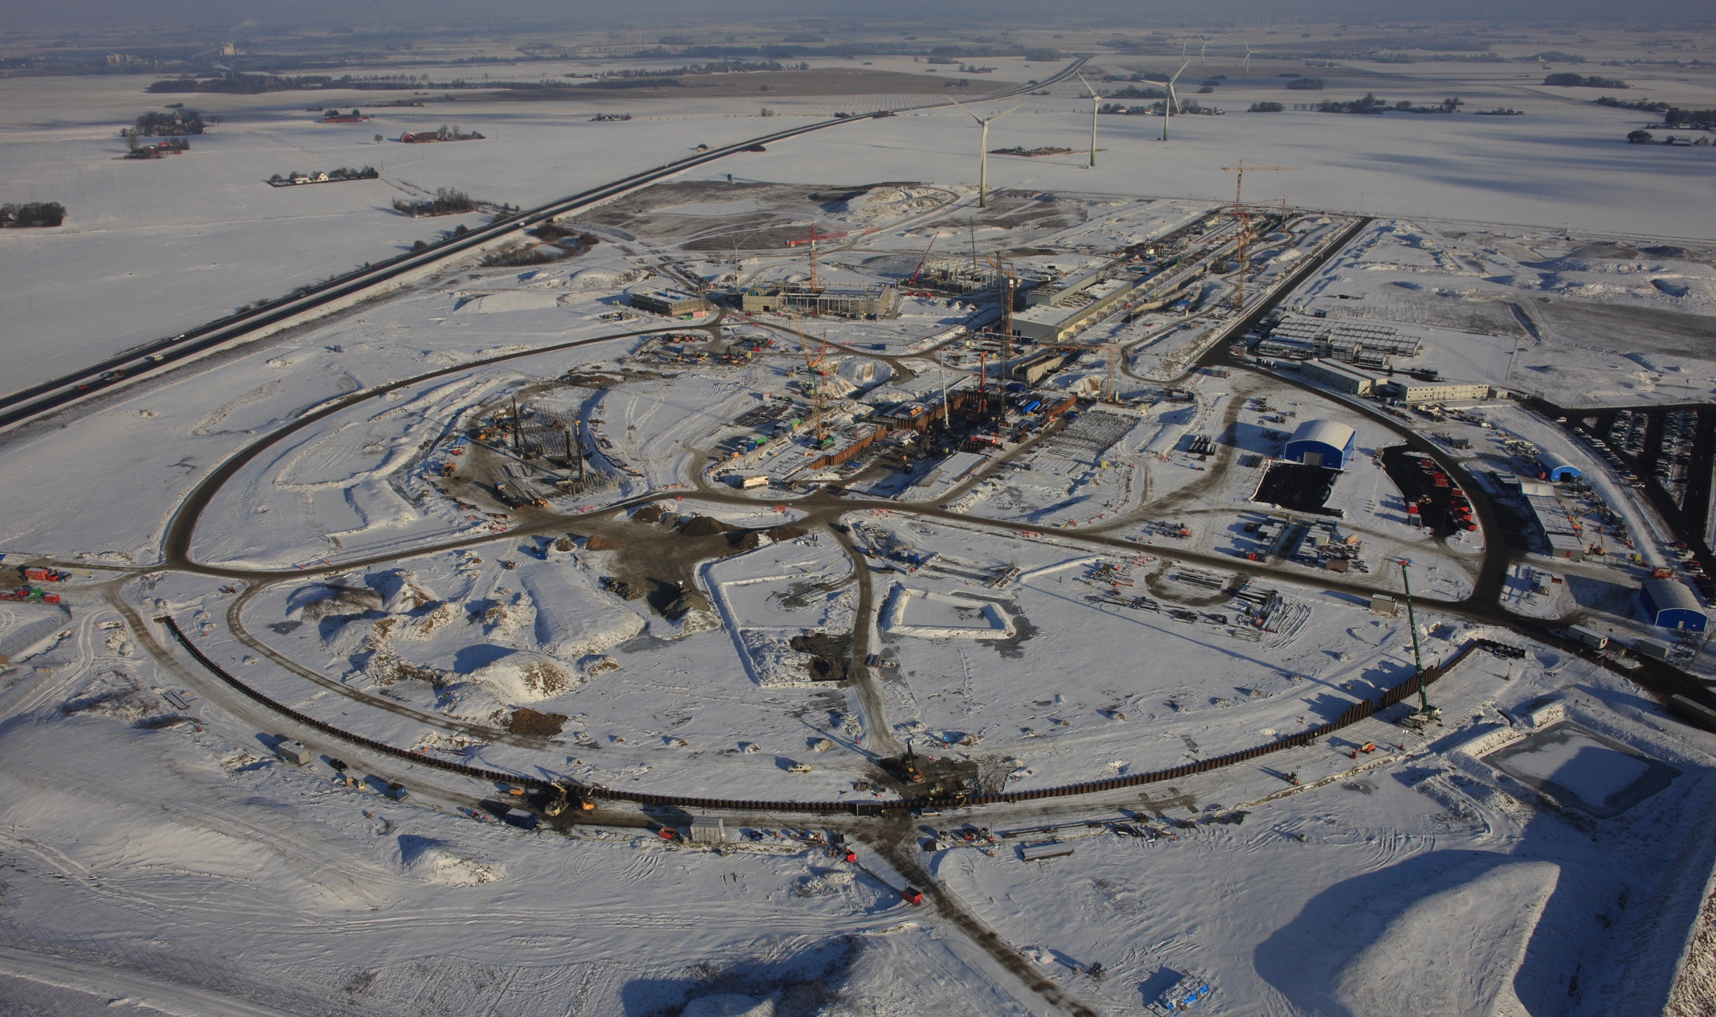
Thank you!
ESS site 2016
5th June 2015

