Slide 1
Status of Ion Source and LEBT Commissioning
Alejandro Garcia Sosa
European Spallation Source
TAC#19 - 10-12 April 2019

Slide 2
Outline
Introduction
Issues
  Grounding
  LEBT Solenoids
  LEBT Chopper
  IRIS
Status of Commissioning
Conclusions
Notes:
I’ll give a short introduction of the ESS Ion Source and then I’ll talk about the issues we faced during these months of commissioning, including grounding, LEBT solenoids, the problems commissioning the chopper, and the status of the IRIS.

Slide 3
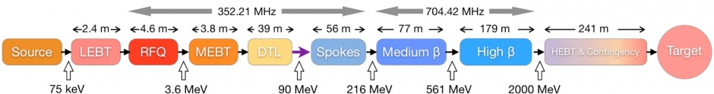
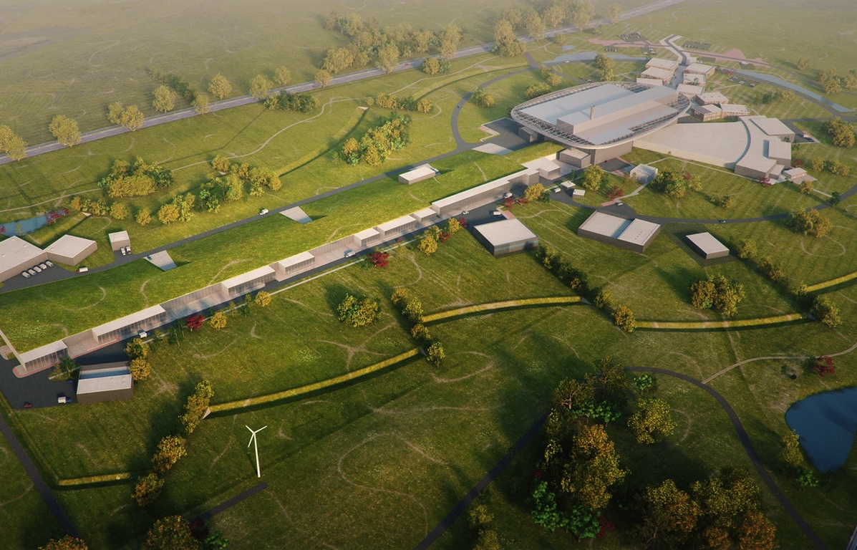
The ESS accelerator is about 600 m long and accelerates protons to 2 GeV
Target Station:
– He-gas cooled rotating
W-target
– 42 beam ports
LINAC:
– Energy: 2 GeV
– Rep. Rate: 14 Hz
– Current: 62.5 mA
Ion Source
I
Notes:
The ESS LINAC is roughly 600 metres long from Ion Source to Target. It will provide 2 GeV protons with a current of 62.5 mA at a repetition rate of 14 Hz to the tungsten target which is cooled with He gas.

Slide 4
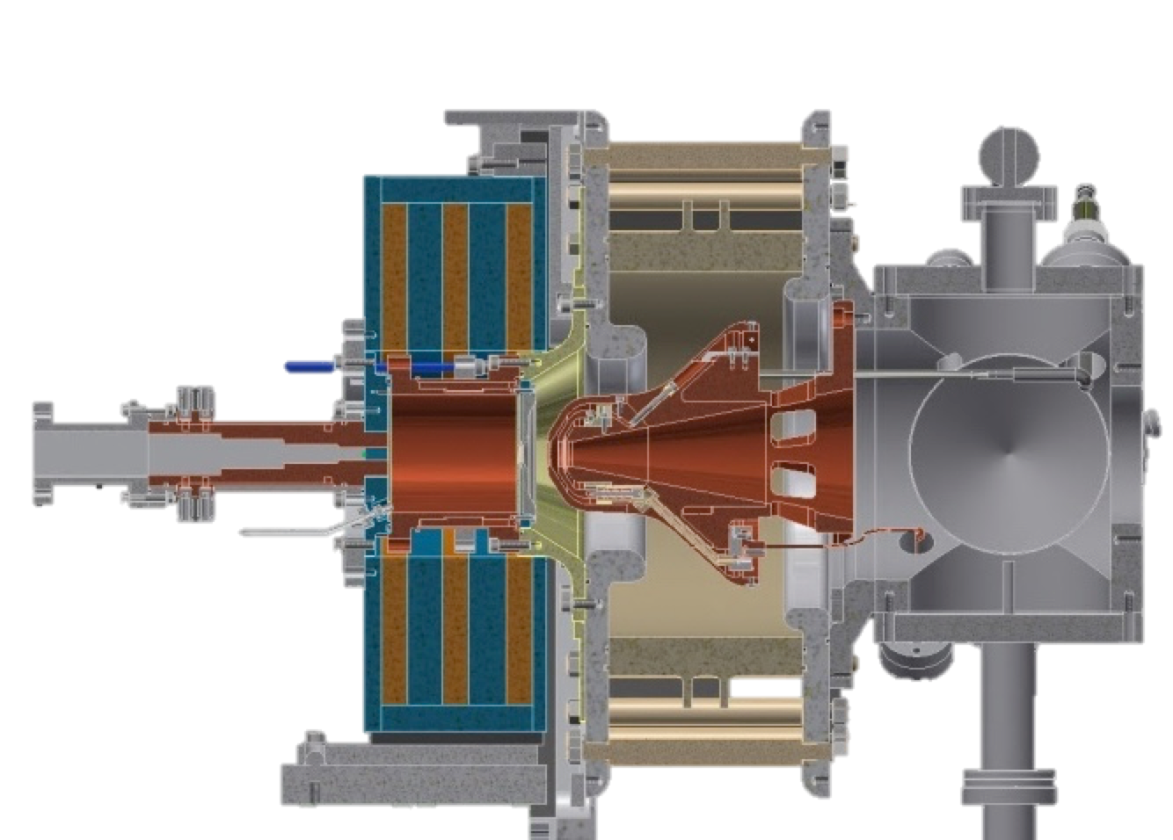
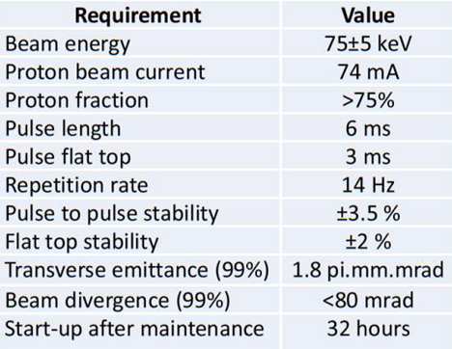
Ion Source
Microwave Discharge Ion Source (MDIS)
High voltage insulator
Extraction electrodes
Plasma chamber
Waveguide
Gas injection
Pumping ports
50 cm
3 Solenoids
4
Notes:
The Ion Source of ESS is a Microwave Discharge Ion Source. These sources produce high currents of singly charged ions with low emittance. A stepped matching transformer is used to allow smooth transition between the waveguide and plasma chamber impedances. An extraction system with a repeller electrode is employed to limit the back-streaming electrons. Microwave Discharge sources differ from ECR sources in the sense that they operate slightly off-resonance and the plasma is not completely confined by the magnetic field. Also, ECR sources have an additional hexapole field surrounding the plasma chamber to further confine the plasma and obtain ions of high charge states.

Slide 5
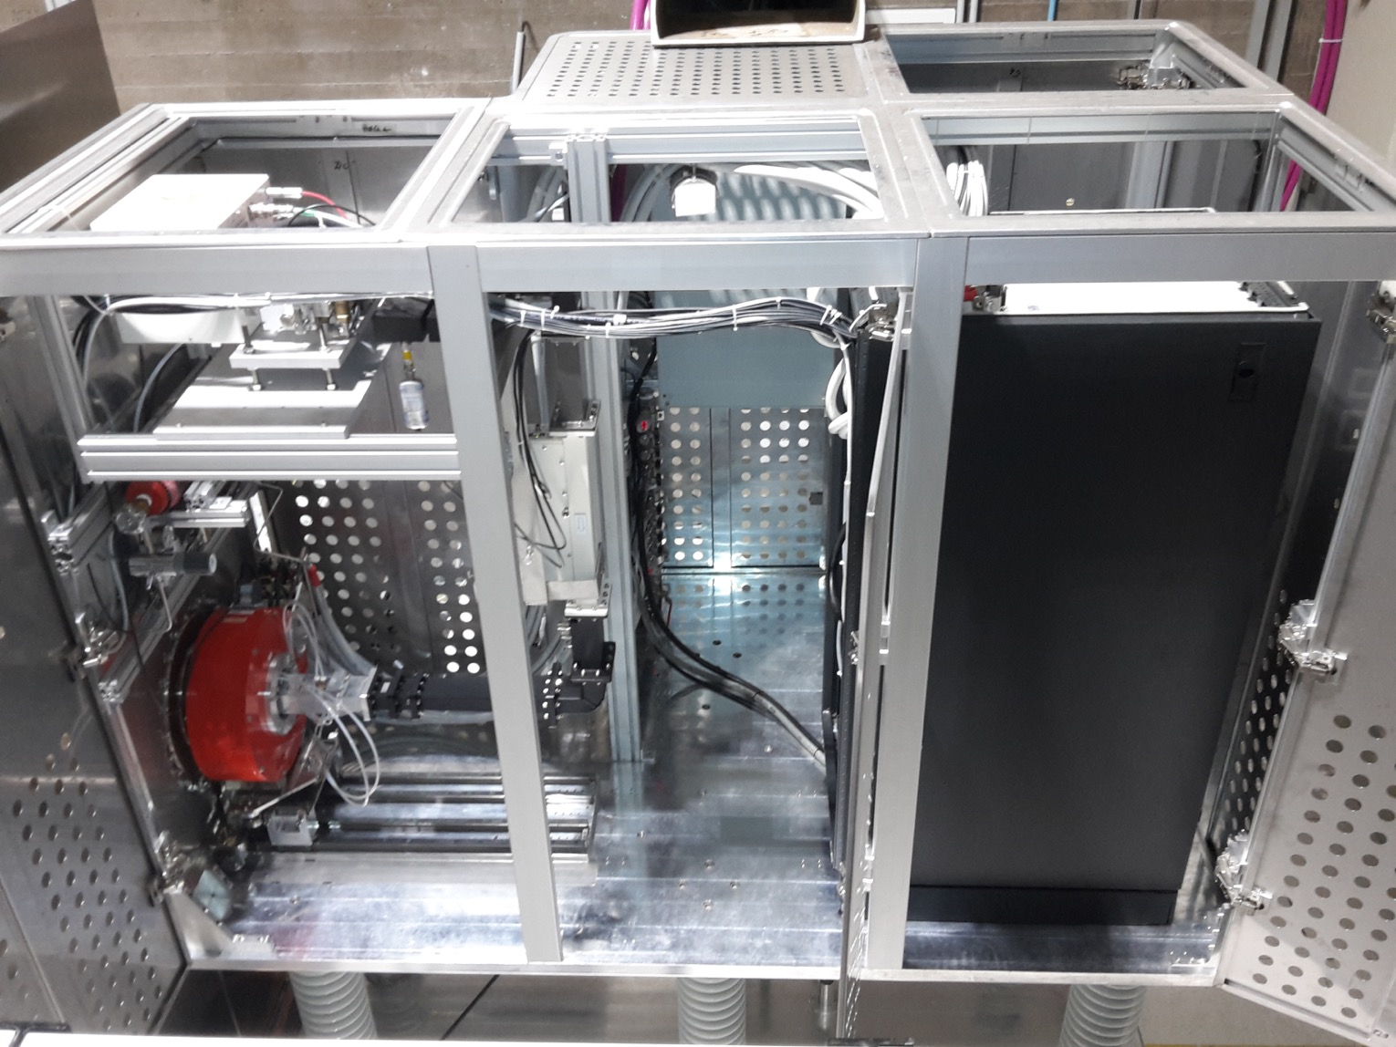
The ion source sits inside a 75 kV high voltage platform
Magnetron head
Electrical panel
Waveguide
Electronics rack
Ceramic insulators
3 Solenoids
Notes:
The ion source sits inside a high-voltage platform biased at 75 kV DC during operation. This setup provides the voltage difference to ground that allows the extraction of protons from the source plasma. In this picture you can see the HV platform with all its doors open and the ceiling panels removed. You can also see the high-voltage insulators, the electronics rack, the electrical panel, the magnetron head, the waveguide and the coils of the Ion source with the plasma chamber inside.

Slide 6
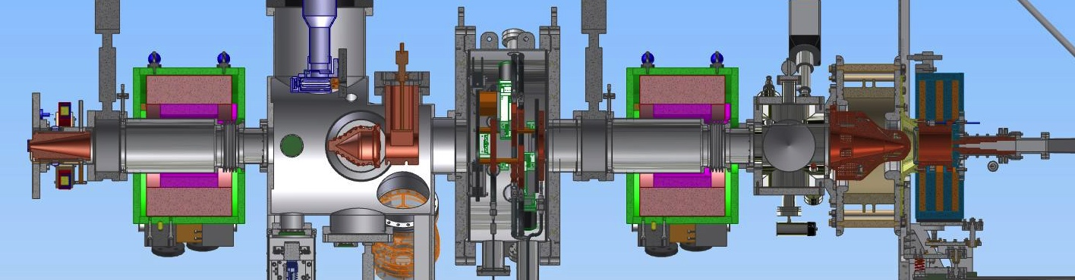
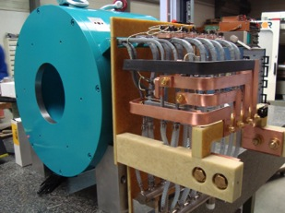
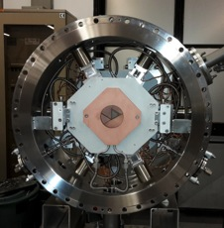
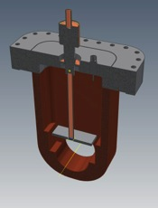
The Low Energy Beam Transport (LEBT) matches the beam to the RFQ input
Ion Source
– creates the H⁺ beam
Solenoid
– focuses the beam
Iris
– controls the current
Chopper and collimator
– controls the pulse length
Notes:
The LEBT matches the beam to the entrance of the RFQ. In the LEBT, immediately after the ion source and extraction electrodes, we have a small tank with vacuum ports for turbopumps, vacuum gauges and a Residual Gas Analyzer (RGA). We have two solenoids for beam focusing, the iris, which is a moveable aperture to control the beam current, and also a diagnostics tank where the Chopper is. The chopper discards the tails of the beam pulse into the collimator, just before the entrance of the RFQ.

Slide 7

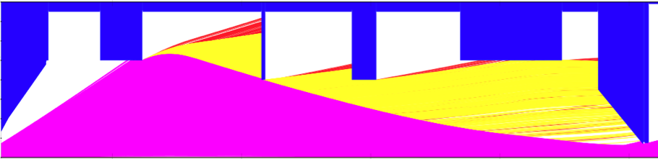
Using simulations, we can simulate the beam transport through the LEBT
H₂⁺
H₃⁺
H⁺
Notes:
Using IBSimu we can simulate the beam transport through the LEBT. Here we can see a very divergent beam scraping at the 1st solenoid, the blade of the IRIS, the chopper and then the 2nd solenoid, arriving to the collimator with a beam that has a very high proton ratio, while other species like H2+ and H3+ are left behind.

Slide 8
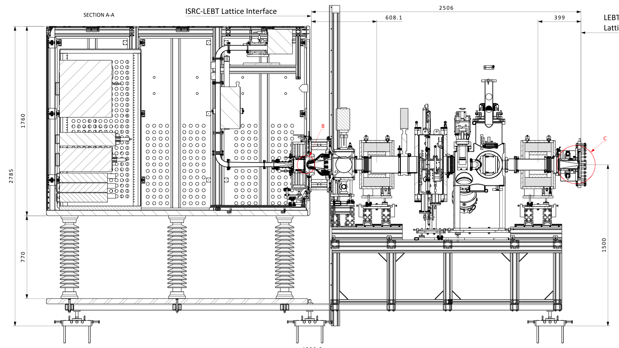
Issues: Grounding
Electronics rack
Electrical Panel
Notes:
Ever since we started beam commissioning, we had issues with electric discharges taking out fuses and damaging electronics inside the platform. This turned out to be a major showstopper for the commissioning that took 5 months to overcome. Specifically, we had breakers trip on the electric panel of the platform, which sits here. We also tripped the breakers on the back of some power supplies in the electronics rack that is over here. The Magnetron PS could be recovered resetting manually after a spark, but we had one instance where the 3 coil power supplies were damaged at once. Since we only had 1 spare, we were left waiting for 2 new power supplies to arrive.

Slide 9
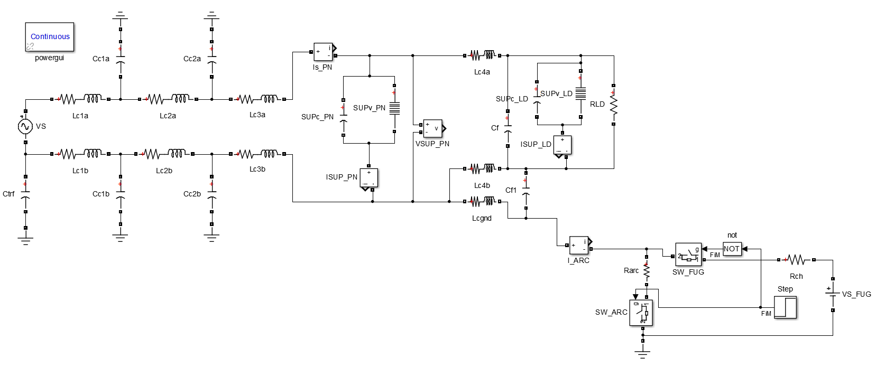
Single-phase Model of HV platform Power Distribution
Phase and Neutral LV cable to Electronics rack
Power Supply w/ internal Surge Suppressor
FUG HV Power Supply (100 kV DC)
Spark generator
Isolation transformer
Phase and Neutral HV cables
Electrical Panel Surge Suppressor
Grounding wire to platform
HV platform
Notes:
It became clear that we had a grounding issue and that additional grounding was needed. The HV platform and all its connections were modeled in a simulation where we could study the effects of 75 kV discharges. The parasitic capacitance, impedance and inductance of every element was estimated and then a spark generator was simulated to generate sparks in the platform from 75 kV to ground.

Slide 10
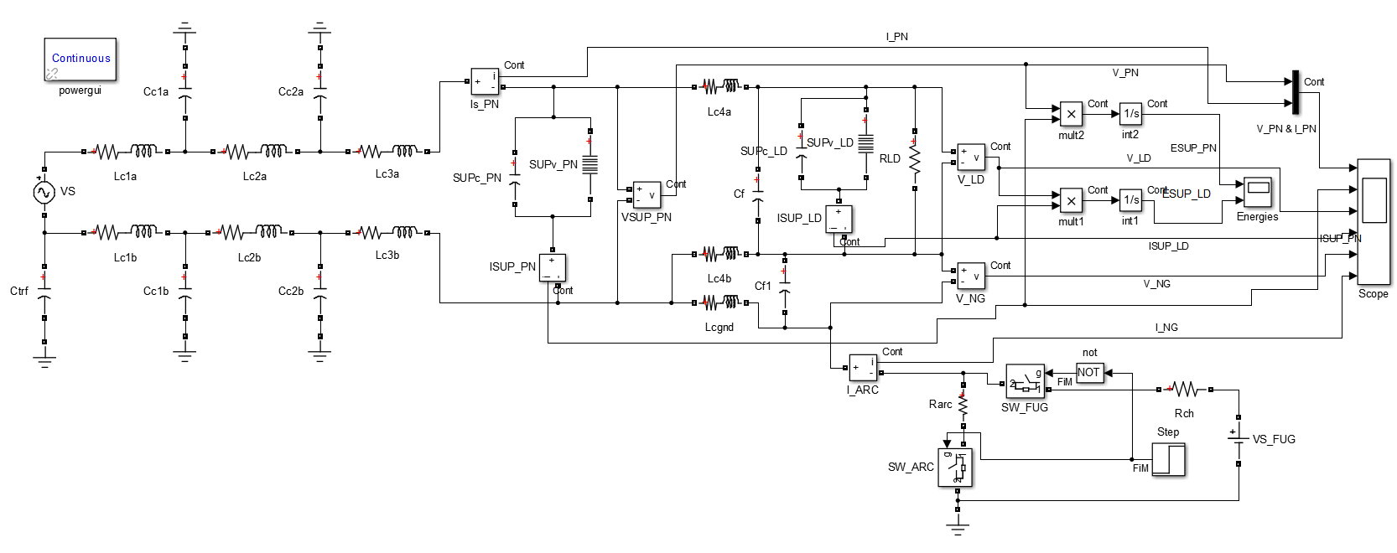
Single-phase Model of HV platform Power Distribution
(Simulation model, including sensors and energy estimators)
Notes:
In this simplistic model, only one phase and a neutral were studied, and then sensors for current and voltage were added at key points in the system. The outputs were connected to a virtual oscilloscope.

Slide 11
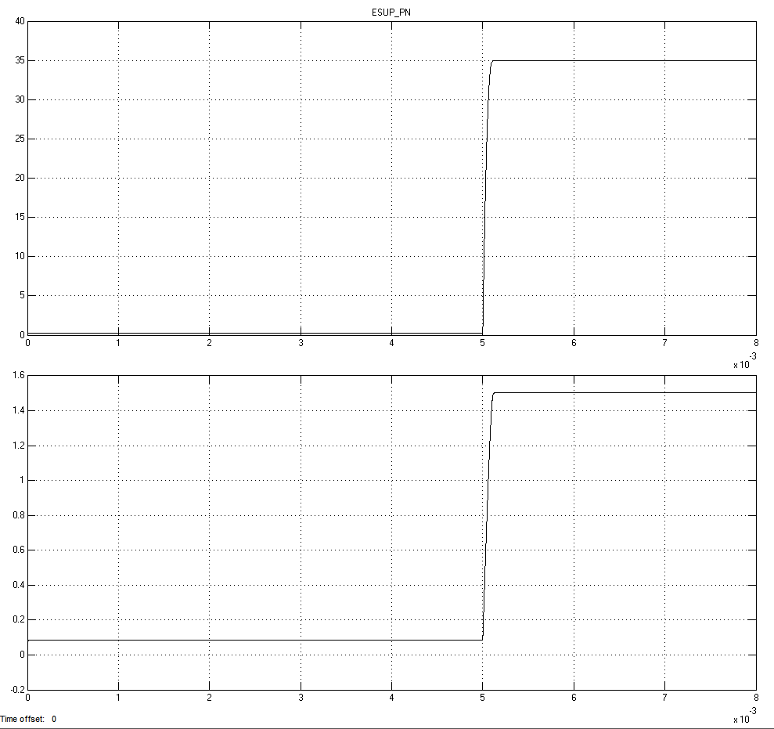
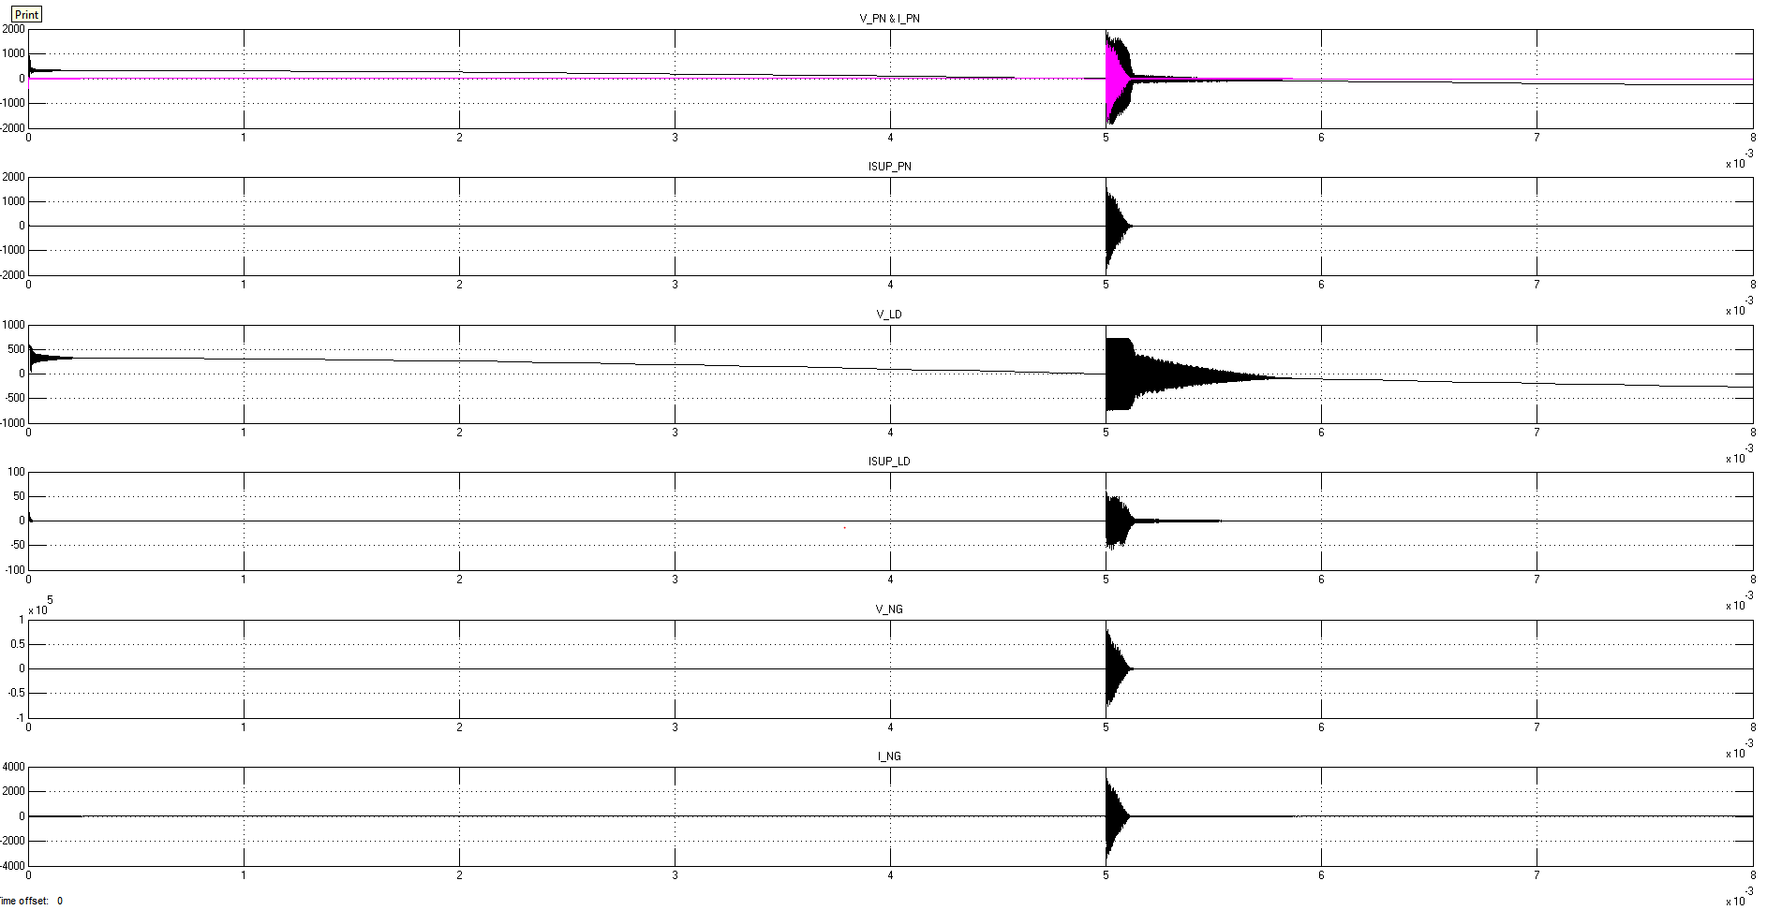
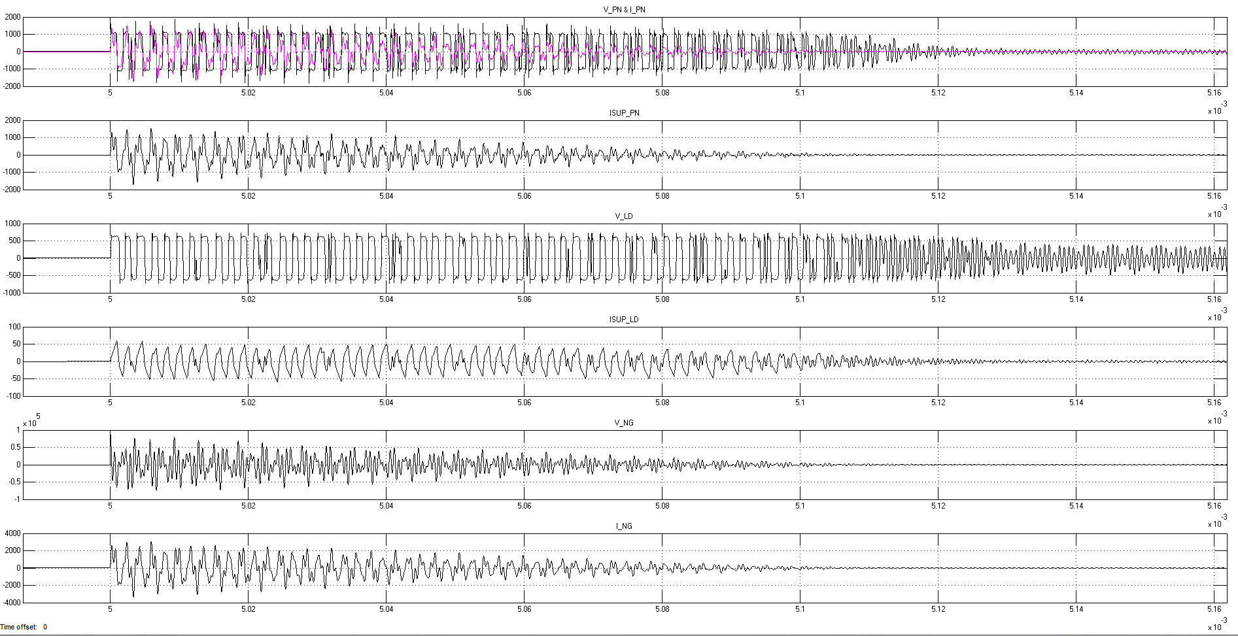
Current HV cables:- 20m long cable
Electrical Panel
Zoom at arcing instant
Electronics rack
Notes:
And these are the results for the original installation with 20 meter long cables from the isolation transformer on the rack area to the ion source. Initially we thought of relocating the isolation transformer very close to the ion source because the energy stored in the secondary winding and the 3-phase cables is significant, and whenever the platform discharges to ground you can have voltage differences of more than 1 kV between the phase of the components and the neutral.

Slide 12
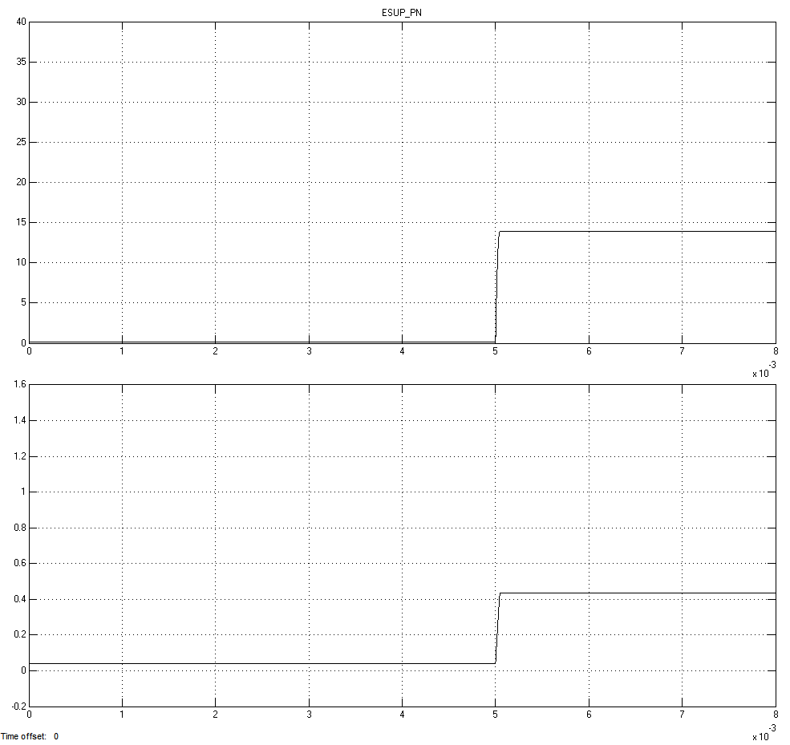
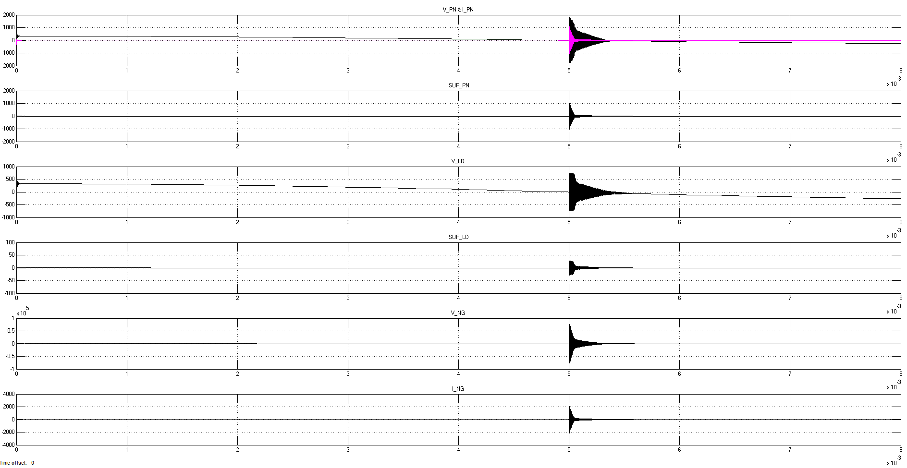
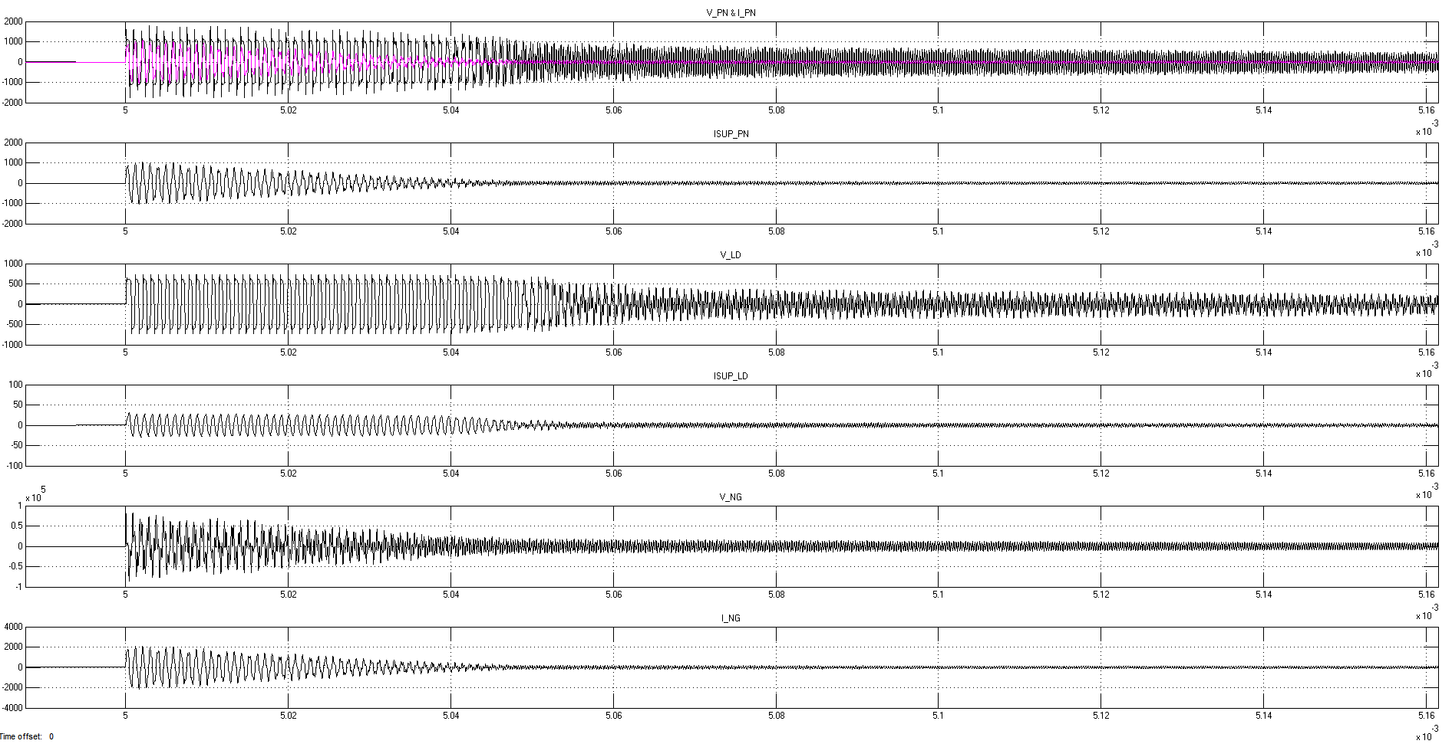
Shorten HV cables only:- 5m long cable
Electrical Panel
Zoom at arcing instant
Electronics rack
Notes:
But according to the simulation, even shortening the transformer cables to 5 meters did not improve the situation by much. The oscillations are shorter but the amplitudes are still concerning.

Slide 13
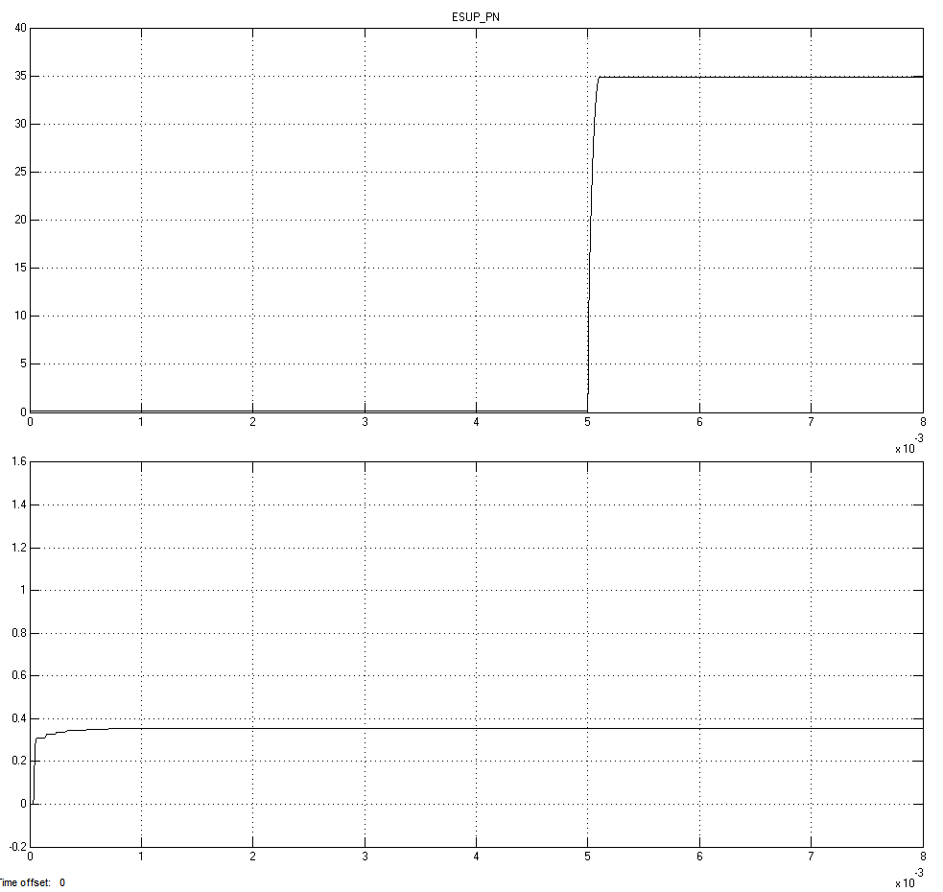
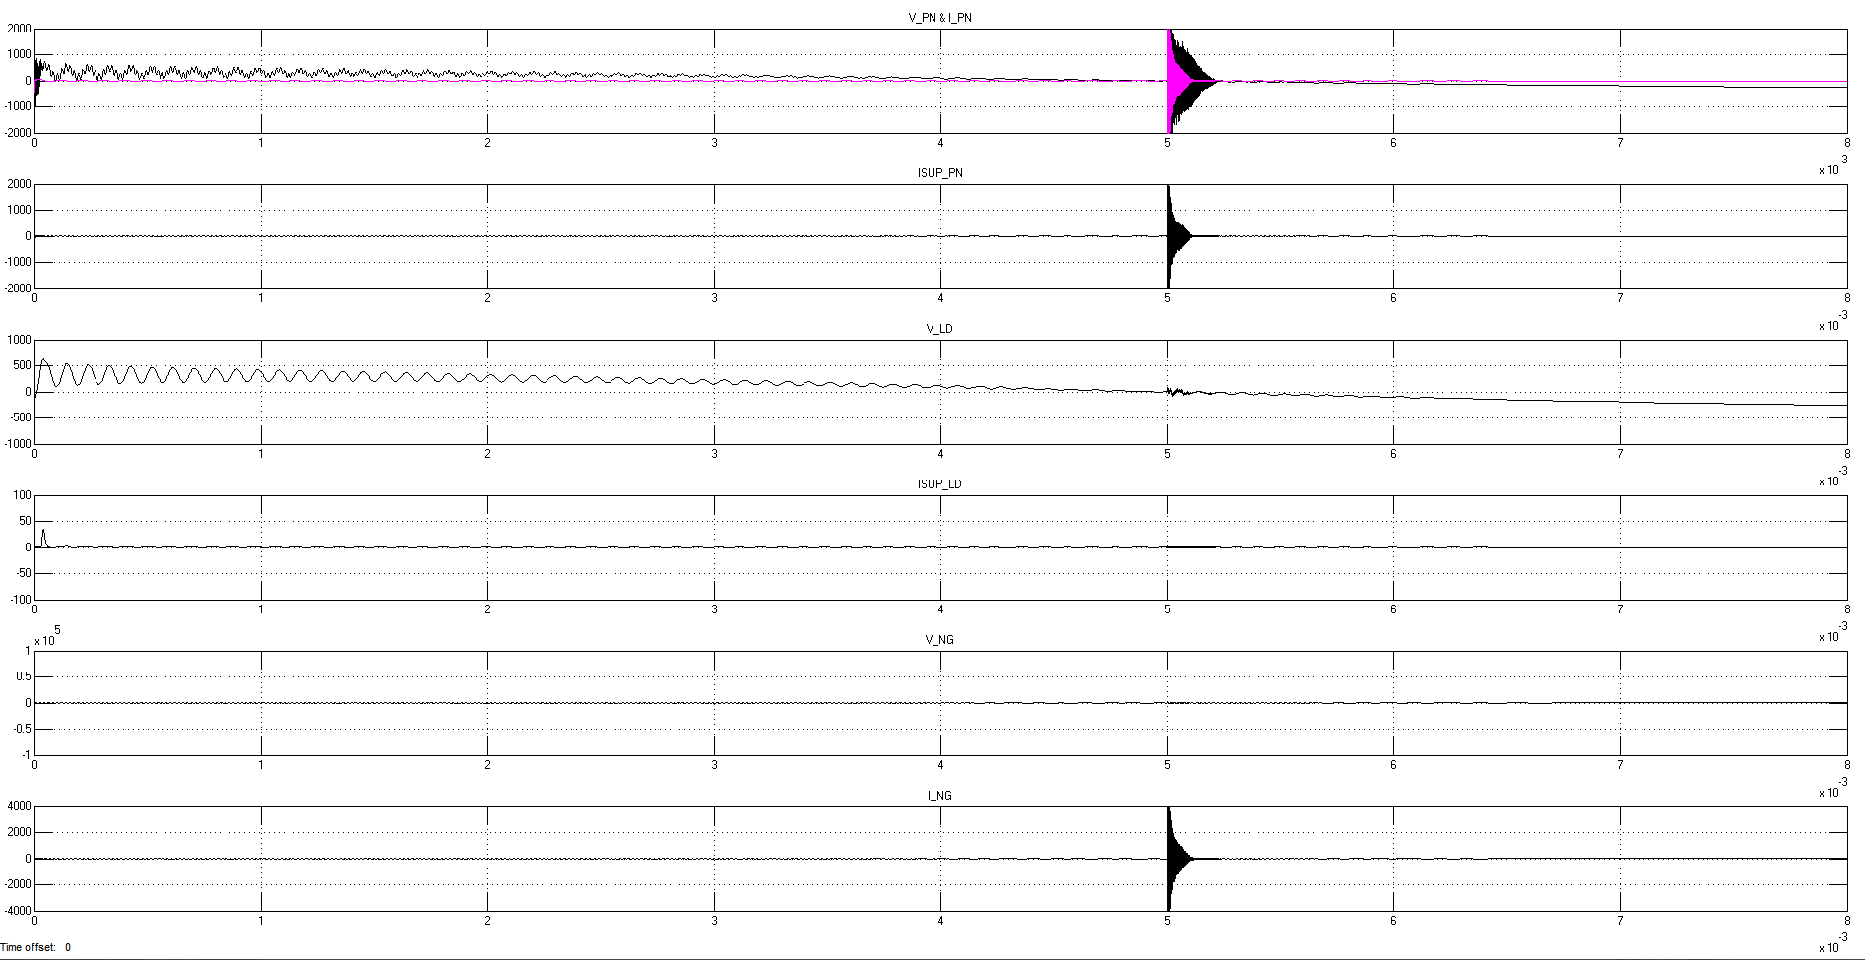
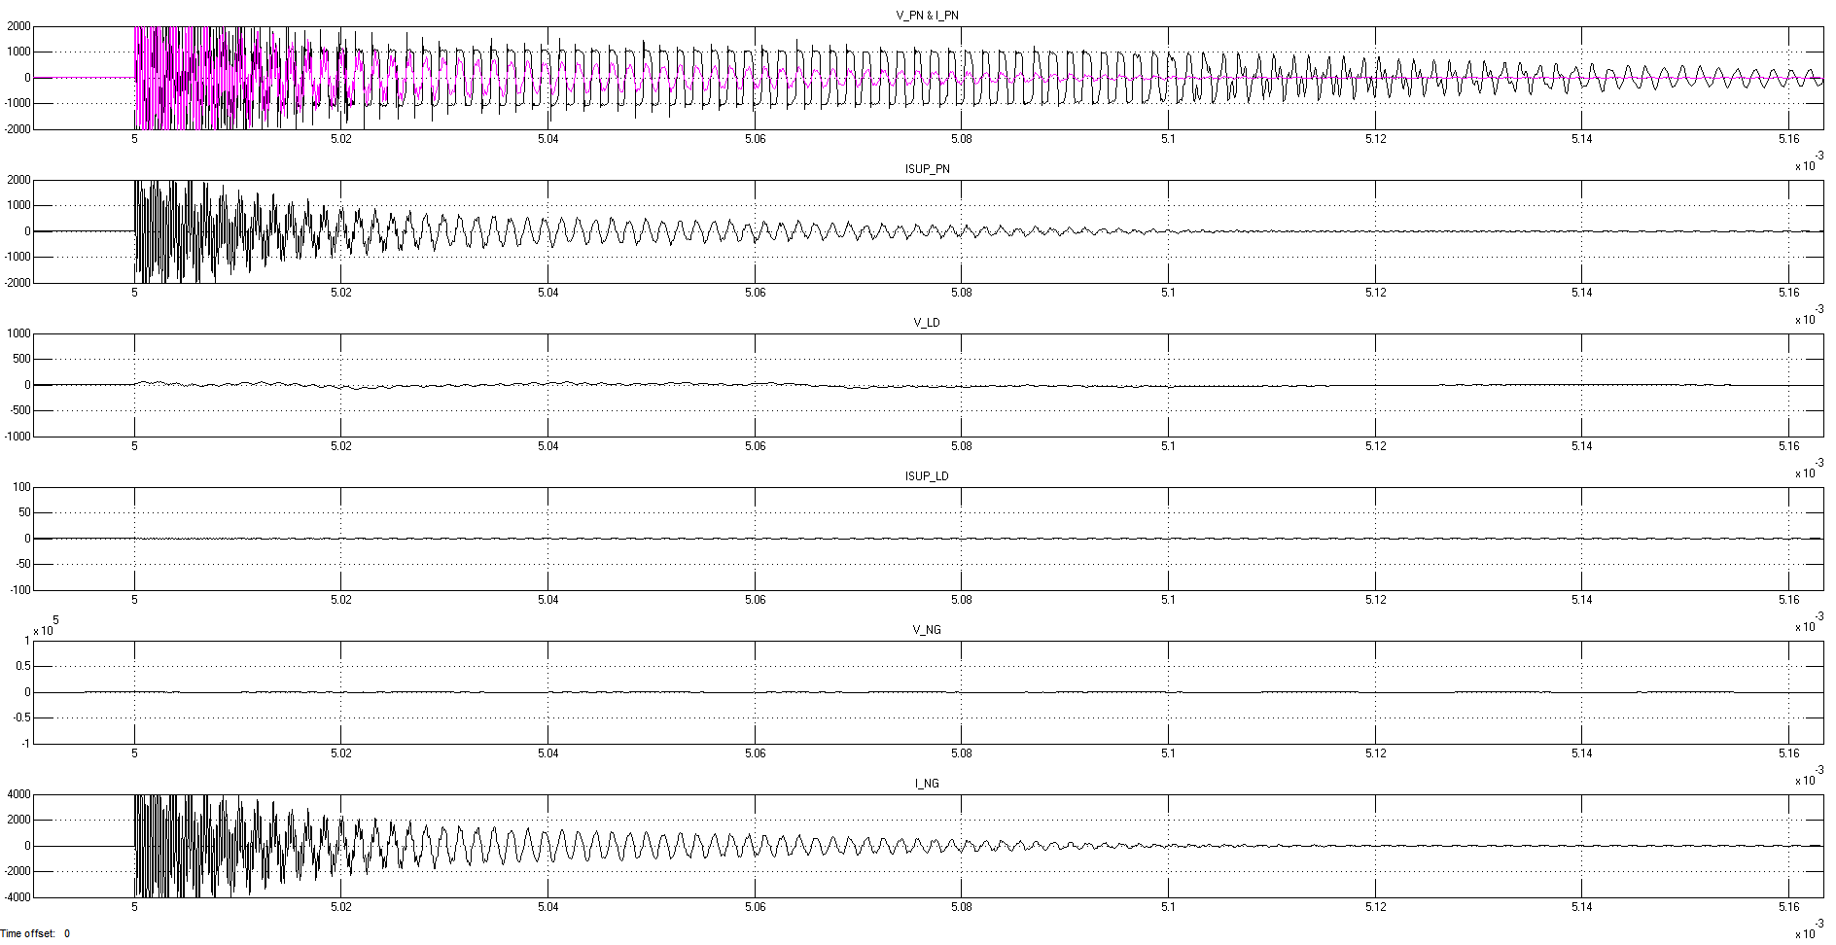
Current HV cables (20m long) + Foil on GND link + EMC filter
Electrical Panel
Zoom at arcing instant
Electronics rack
Notes:
By redesigning the connections between the elements of the platform and the electrical panel, the energy from the 75 kV discharges is mitigated significantly. This is achieved by using EMC grounding, i.e. Aluminium foil with lots of surface and low inductance and also installing an EMC filter that channels the energy to ground away from the sensitive electronics.

Slide 14
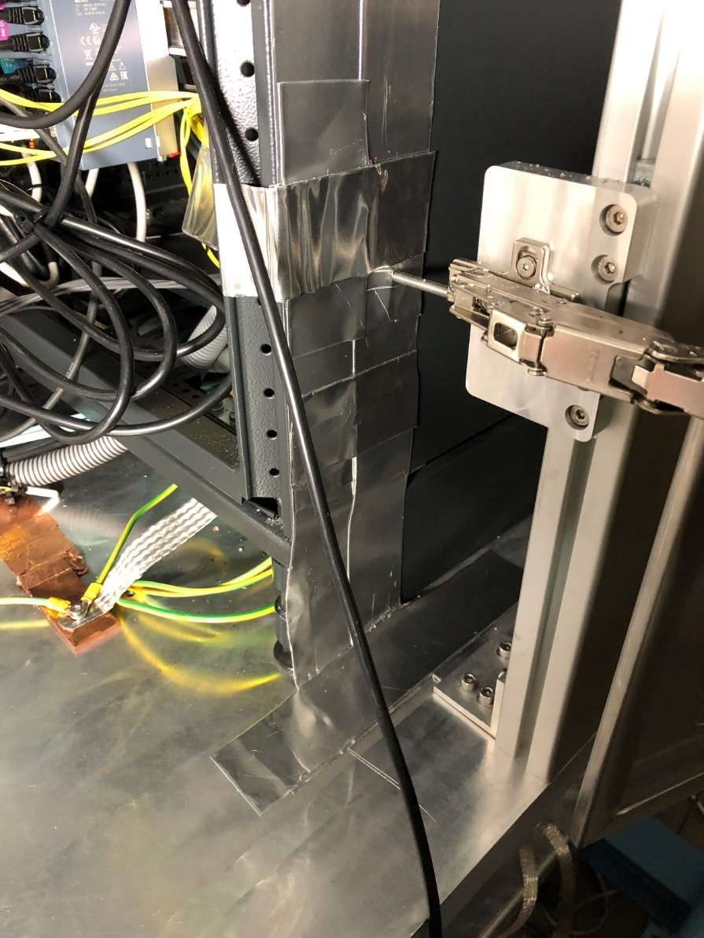
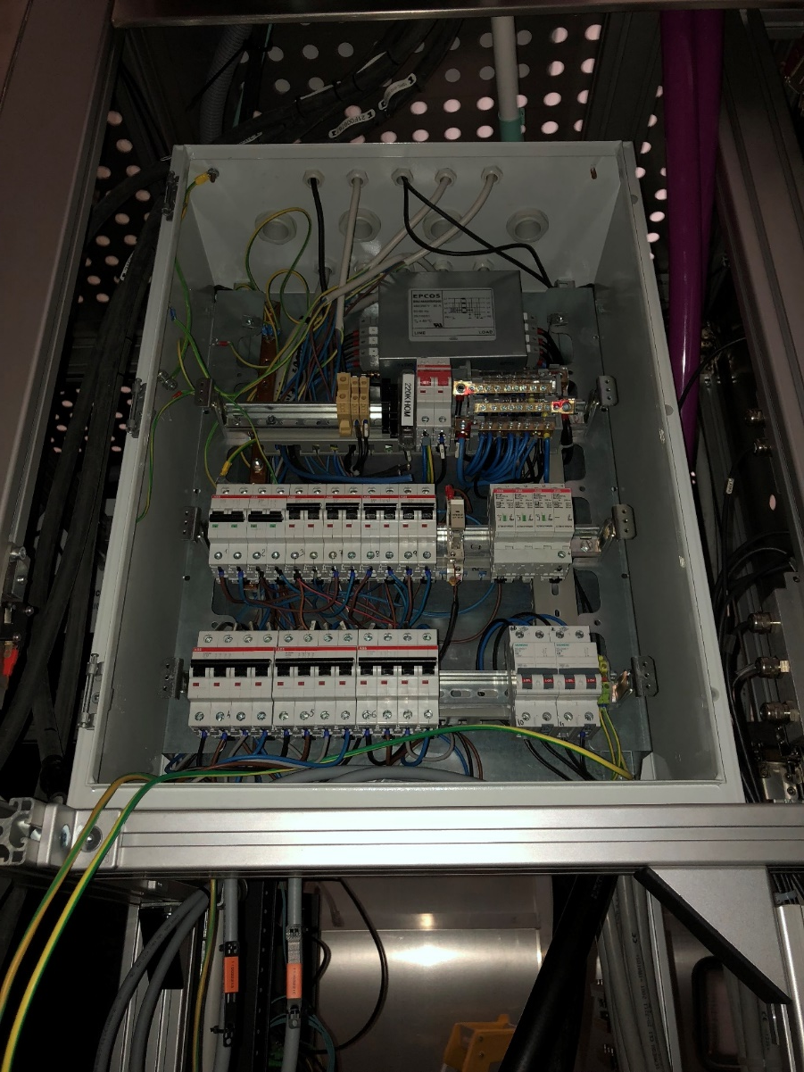
EMC grounding
Notes:
The grounding system of the Ion Source is comprised of a network of 10 cm wide flat copper bars that are interconnected and grant access to the grounding mesh beneath the concrete floor through connections to the nearest pads and to the copper bar on the wall. The electronics of the racks were grounded using aluminium foil and flat braids. The electric panel of the platform was completely rearranged, installing a new surge suppressor and an EMC filter.

Slide 15
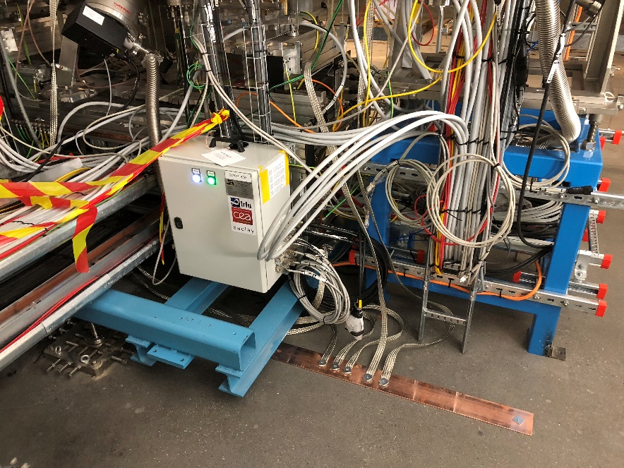
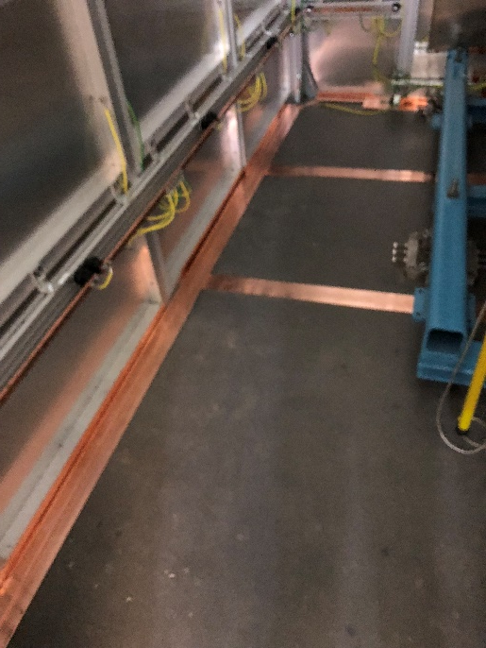
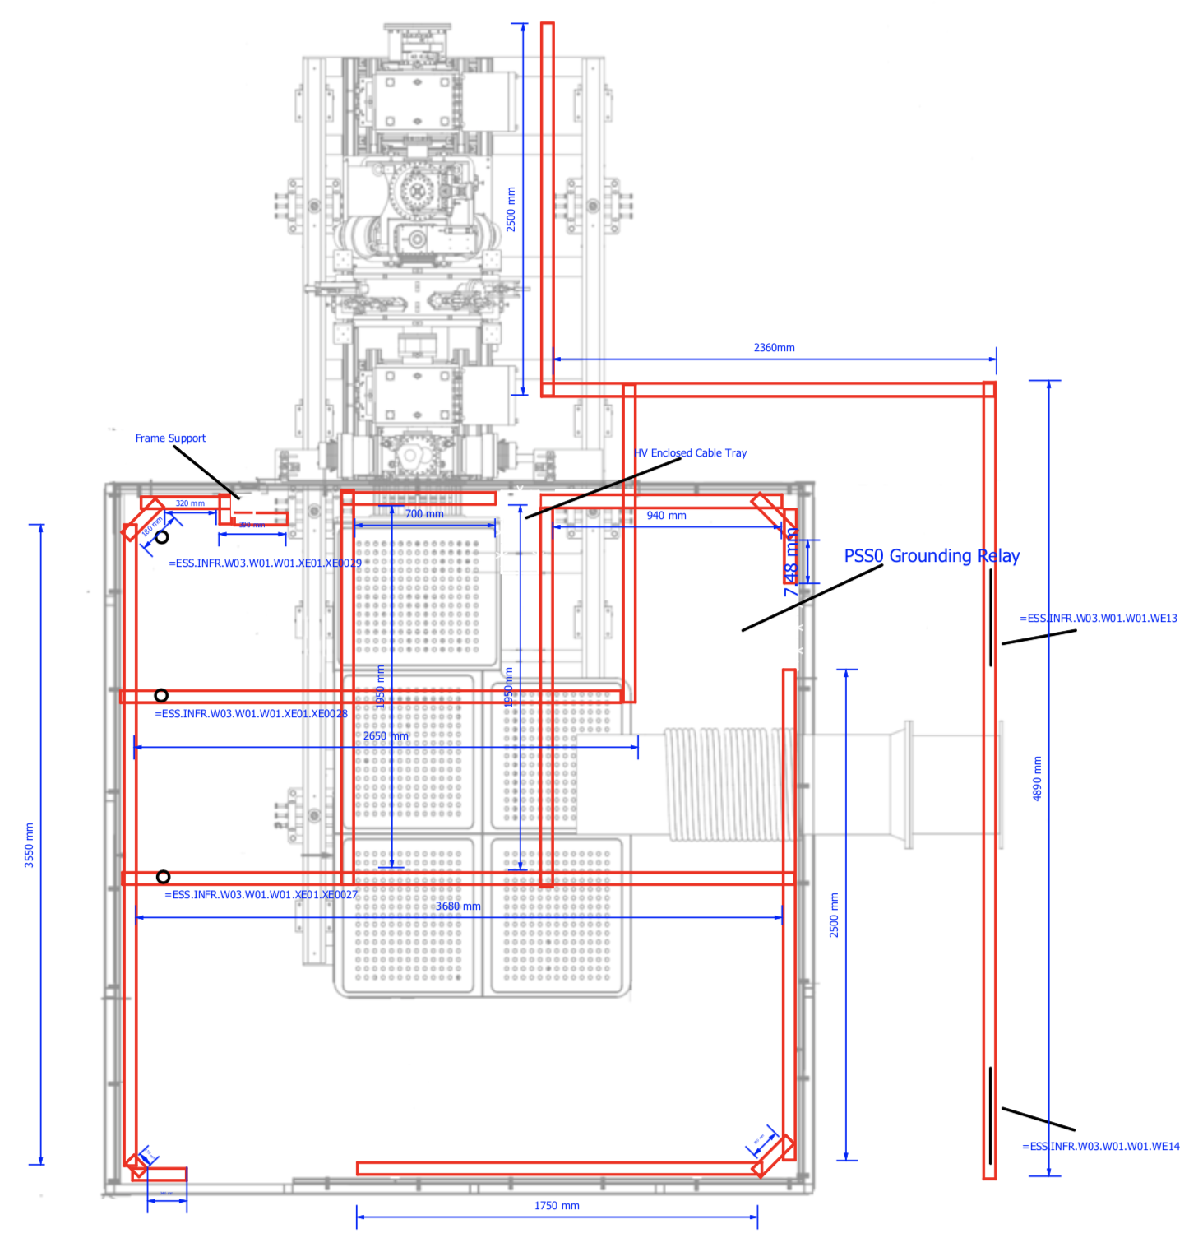
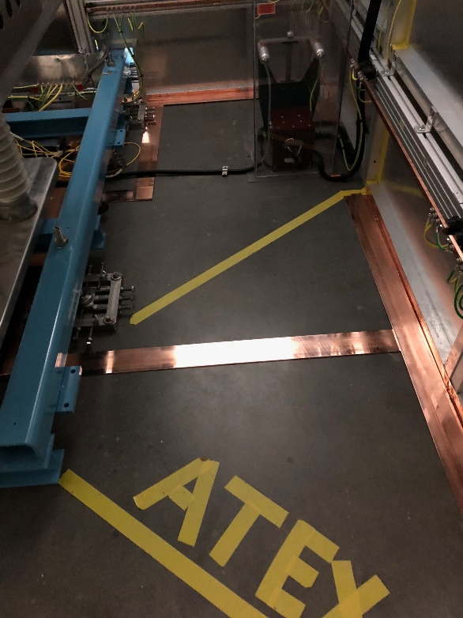
Racks
FEB090
Tunnel
Enclosed Cable tray for
Isolation transformer cables.
Pad
Enclosed Cable tray for
HV power supply cables
HV Power Supply
Isolation Transformer
Pad
Pad
Pad
Pads provide access to
the mesh beneath the concrete
Notes:
Here you can see the pads inside the safety fence and over by the rack area where the copper bars connect to the grounding mesh underneath.

Slide 16
Issues: LEBT Solenoids
LEBT Solenoids have an issue in the connectors of the cooling circuit that make them prone to leak
Corrector magnets use single polarity PS. Polarity is switched using relays that have their own set of issues
Polarities of H1 V1 were swapped. H2 V2 not tested yet.
Sol 1 and 2 had opposite polarities
Notes:
Now moving on to magnet issues. The LEBT solenoids have a problem in the connectors of the cooling circuit that make them prone to leak. We’ve had one of the cooling channels leak because of this, and it is an issue intrinsic to the way these solenoids are manufactured. In order to fix this permanently, all inserts of the cooling channels need to be replaced and brazed to the copper channels. Also, corrector magnets use single polarity power supplies, and the polarity is switched using a relay, which have their own set of issues. We have experienced broken relays already, because a relay was stuck changing polarity many times and ended up getting burned. Also, the polarities of the first set of corrector magnets was reversed. The second pair of correctors is not tested yet. Also, Solenoid 1 and 2 did not have the same polarity, which is an issue if you are trying to steer the beam in a systematic way using the correctors.

Slide 17
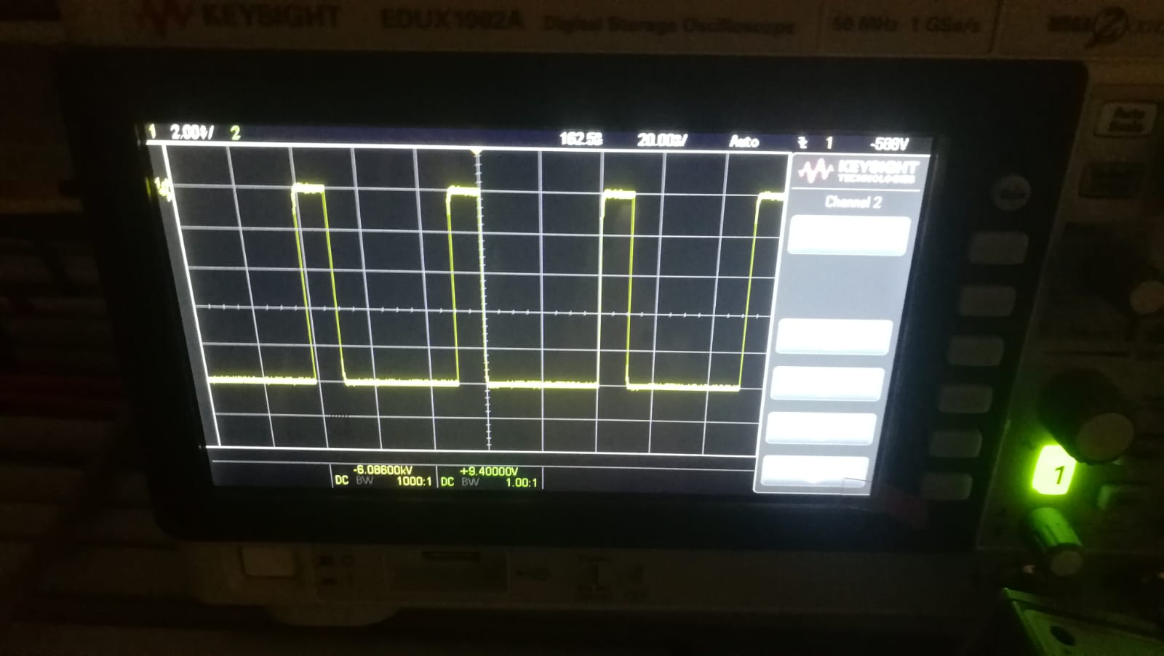
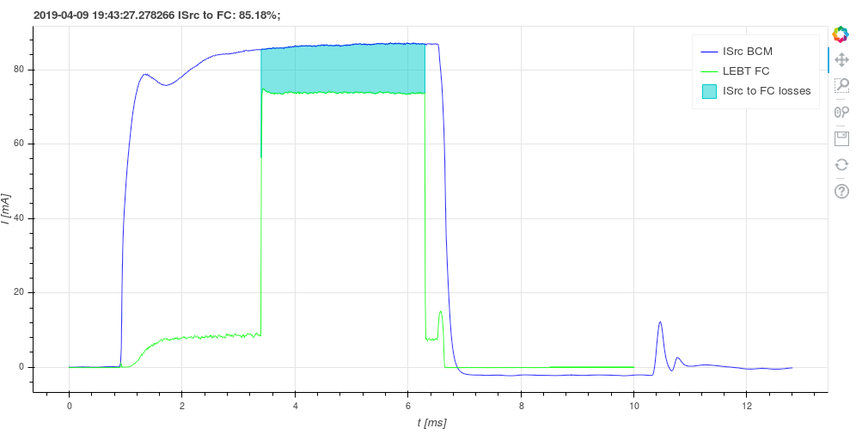
Issues: LEBT Chopper
Commissioning of the chopper started on March 5
Issues reaching the nominal voltage during testing
Debugging the system
Local test successful!
Remote control test ongoing
Notes:
The commissioning of the LEBT chopper started just last month. We installed the different electronic modules and the power supply, and during testing we observed issues reaching the nominal voltage of -10 kV. We are still debugging the system to find the cause of the problem.

Slide 18
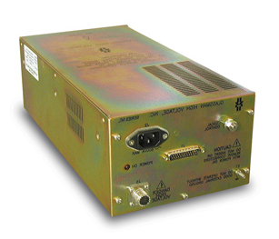

HV Switch
HTS 151-03 GSM Behlke
HVS module
20 meters
27Ω
27Ω
1nF
HV module
HV Power Supply
ML12N25 Glassman
RF 35
Caburn Feedthrough
TTL
Fast Beam Stop
Chopper Enable
Voltage Reference
Interface
V / I Monitor
Fast/Slow Alarm
Fault
Reshasped
LV module
Notes:
The power supply of the chopper is connected to a HV switch which is controlled by a low voltage module. We are using a negative polarity chopper because, when using a positive bias, the chopper electrode picks up electrons from secondary emission or from the residual gas and it drains more current from the power supply, which is an issue for holding the voltage properly.

Slide 19
Issues: IRIS
Six-blade diaphragm to control beam current
Six motors in-vacuum
24 in-vacuum water connections
Issue with blade motion and limit switches. Problem is likely related to the encoders.
Need to remove the IRIS for disassembly and debugging.
Notes:
The IRIS in the LEBT has six motors and 24 water connections all in-vacuum. Ever since we started commissioning we have not been able to operate the IRIS. We think the problem is likely related to the encoders of the motors, but we need to remove it from the beam line for disassembly and proper debugging. We will take advantage of the need to dismantle the LEBT during RFQ tuning to troubleshoot the IRIS.

Slide 20
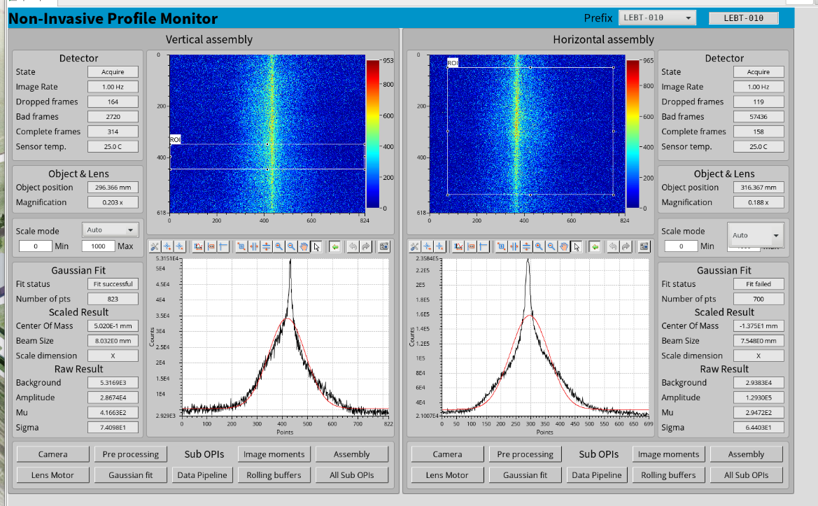
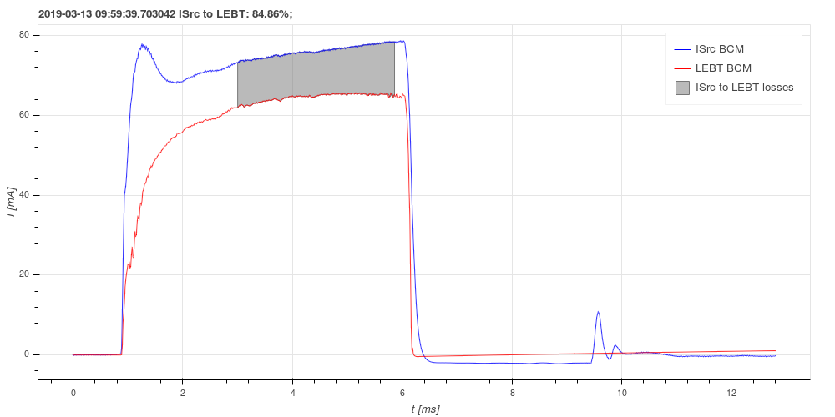
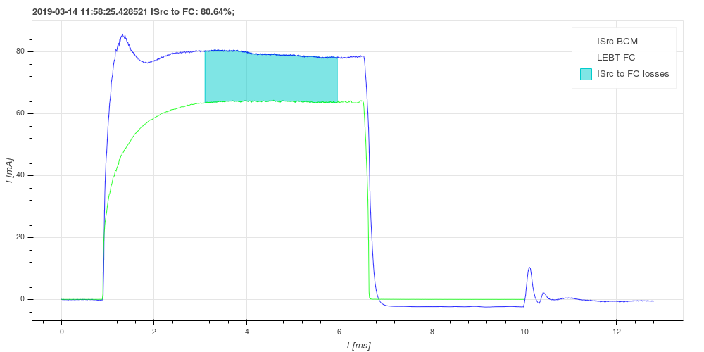
Status of Commissioning
Faraday Cup
NPM
Beam transport studies
Ion source characterization studies
Notes:
Once we solved the grounding issue, beam commissioning started properly last February. We started by commissioning and validating the Faraday cup, which is now installed in the diagnostics tank. Then we moved on to commission the non-invasive profile monitors to measure beam size, and then we started transporting the beam to the end of the LEBT where we have a BCM. We achieved transmissions of up to 85% in some configurations.

Slide 21
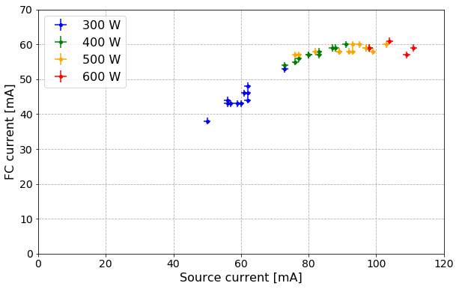
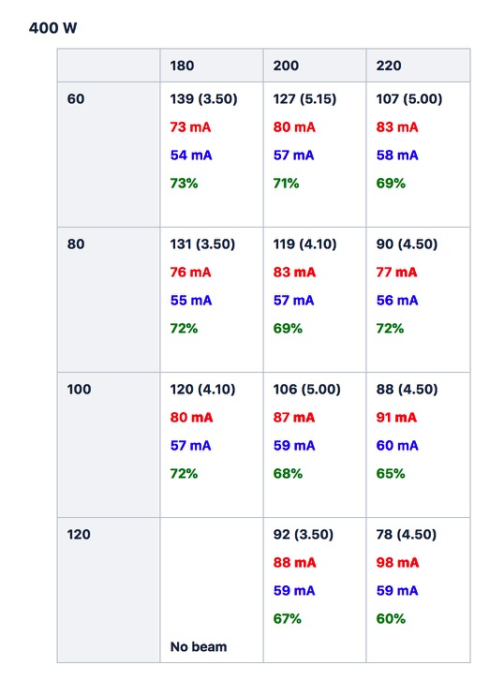
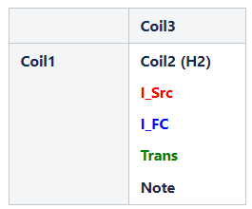
A few studies done so far
ISRC characterization
Example data:
Notes:
We have also done some characterization studies in the ion source to find good operating points with a stable beam pulse and high current and transmission.

Slide 22
Next steps
Commission Emittance Measurement Unit
  measure the beam conditions at the RFQ entrance
  solenoid scan study
Commission second pair of NPMs at the commissioning tank
  full trajectory correction
Commission the doppler
  know the fraction of beam species
  better knowledge of transmission efficiency
Notes:
So the commissioning of beam diagnostics is work in progress, with the EMU, the second pair of NPMs at the commissioning tank and the Doppler monitor next in line. I highlight here in red that measuring the emittance at the entrance of the RFQ is the single most important measurement of this commissioning, and that’s where we are focusing all our efforts.

Slide 23
Conclusions
Extensive debugging and troubleshooting of all systems
This had a significant impact on the time available for testing and commissioning of the ISRC & LEBT
Lack of spares
Commissioning is ongoing and showing promising results
Notes:
To conclude, I’d like to say that even though the beam commissioning of the ISRC & LEBT officially started on September 2018, the machine was far from ready at that point to be handed over to Operations, as none of the subsystems was fully tested. Furthermore, extensive debugging and troubleshooting of all systems is being done, which was not foreseen in the plan. The lack of spares available on site also contributed to the delay in the commissioning. All of this had a big impact on the time available for testing and commissioning of the ISRC & LEBT. Other than that, the commissioning is now going well and showing promising results.

Slide 24
Acknowledgements
Beam commissioning leader:
  Ryoichi Miyamoto
Beam Physics section:
  Mamad Eshraqi
  Natalia Milas
  Yngve Levinsen
  Ciprian Plostinar
  Emelie Nilsson
  Björn Gålander
Beam Instrumentation Section:
  Cyrille Thomas
  Elena Donegani
  Clement Derrez
  Roxana Tarkeshian
Operations section:
  Lali Tchelidze
  Marc Muñoz
Integrated Control System:
  Saeed Haghtalab
  Thomas Fay
  Emanuele Laface
  Juan F. Esteban Müller

Slide 25
Thank you!
Questions?

Slide 26
BACKUP SLIDES

Slide 27
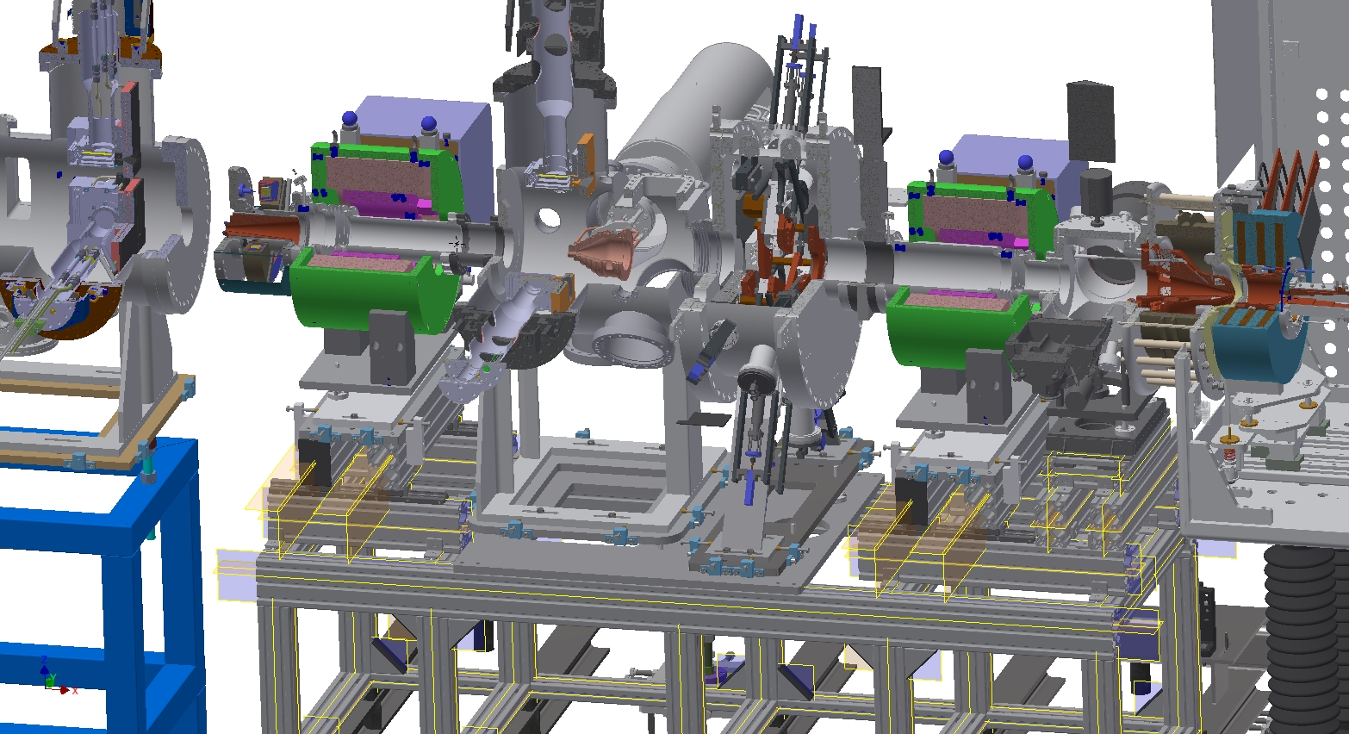
3D Model

Slide 28
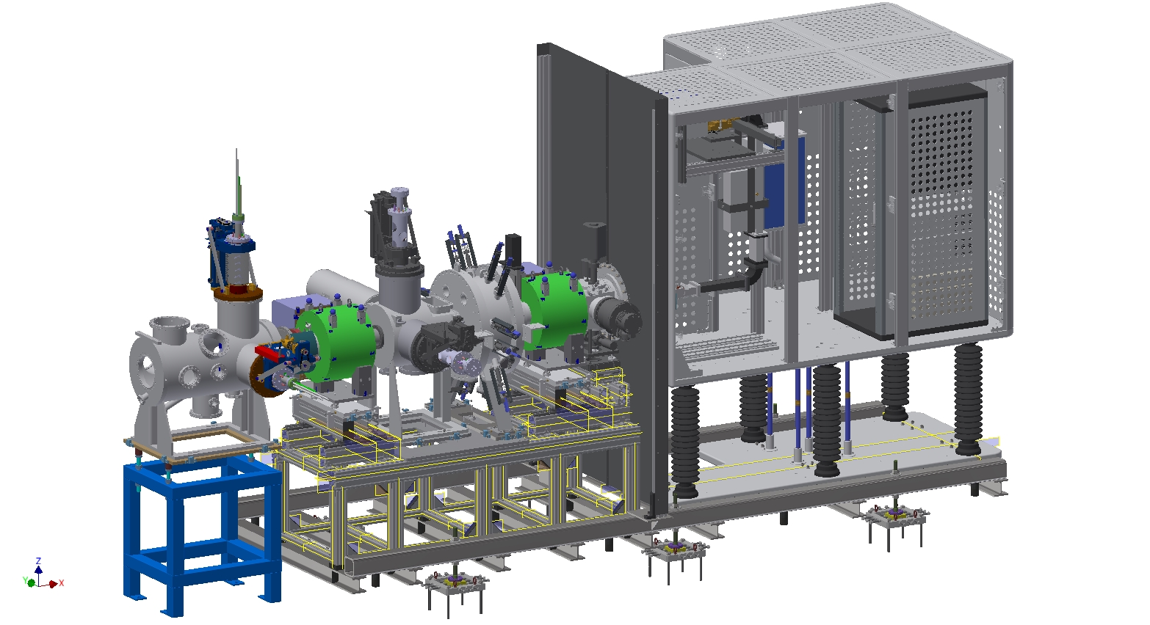
3D Model

Slide 29
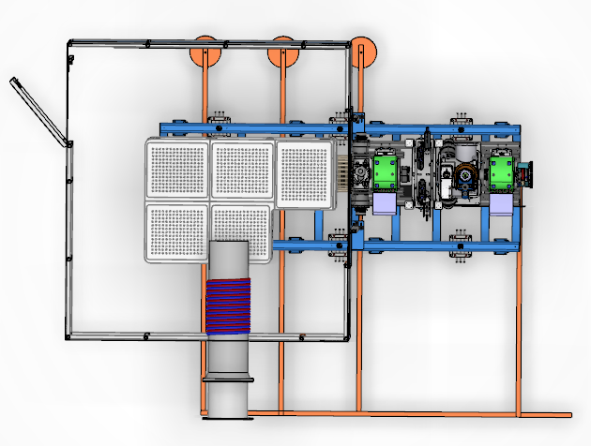
Top view of ISRC & LEBT
PSS0 Entry
Connection to grounding
mesh in the floor
Connection to
wall grounding
Ion source
water cooling

Slide 30
Ion Source + LEBT
Installation and Commissioning timeline
December 2017 – LEBT and source shipped from Catania to Lund
January 2018 to May 2018 – Installations in the tunnel
July 2018 – Safety Readiness Review
September 2018 – Start of commissioning
November 2018 to January 2019 – Sparks from the High Voltage cause damages to a few power supplies, new work with grounding required
February 2019 – Commissioning restarts
April 2019 – End of commissioning and start of RFQ installations

Slide 31
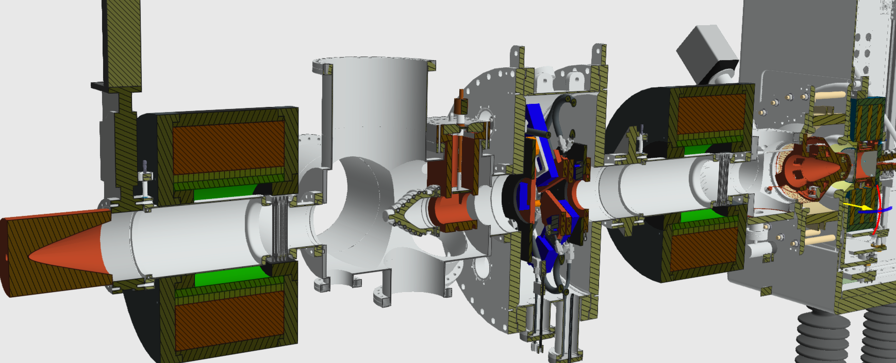
LEBT-RFQ lattice interface

