Slide 1
SRF at ESS
Paolo Pierini
Superconducting RF Section
European Spallation Source ERIC
April 11th 2019
Notes:
CDS 29/04-30/12 2019
CDS testing in January 2020
CDL in TS2 tested after Easter

Slide 2
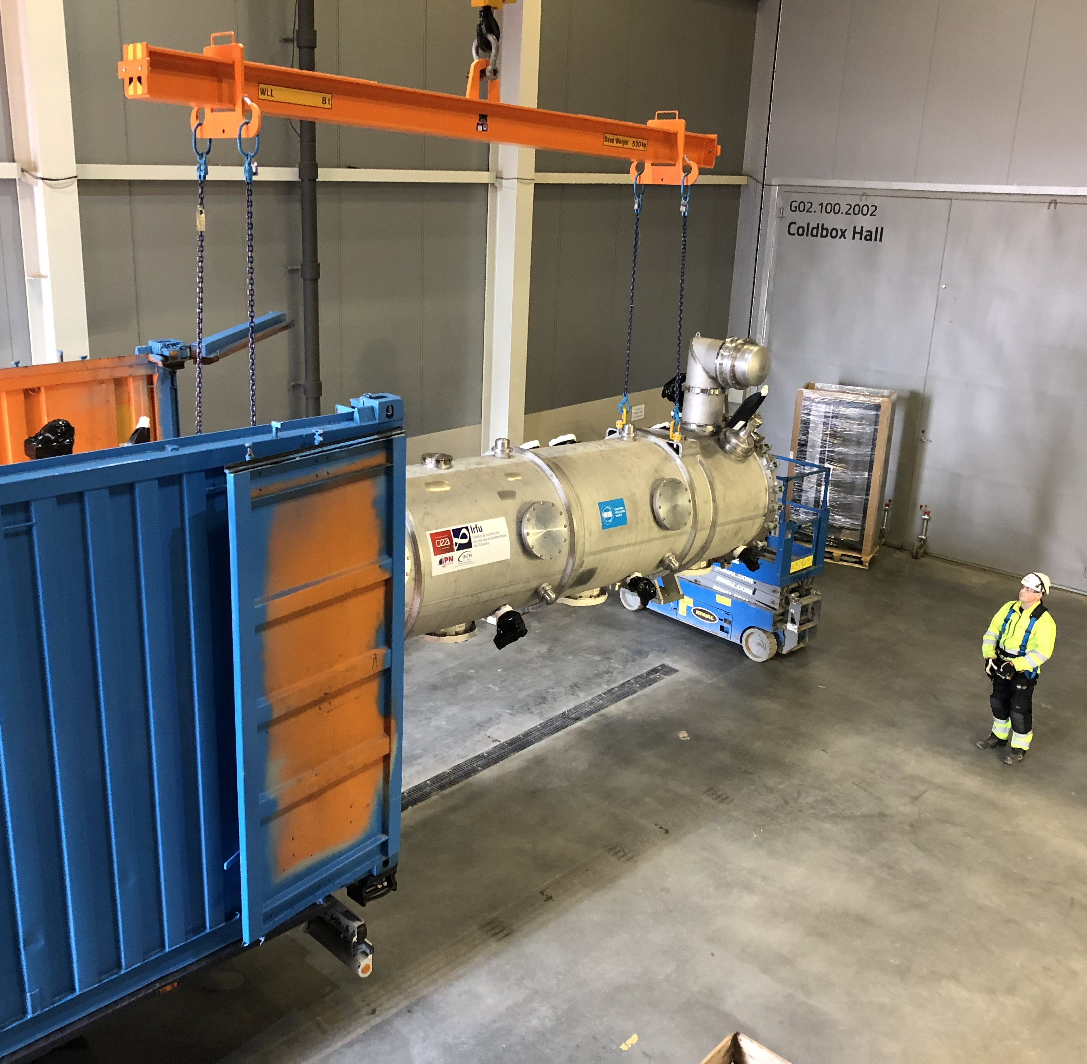
Session on SRF
Contents of the agenda
Intro
Component Readiness
Status of IK work and deliveries Christine
Status of Freia Test Stand Roger
Status of TS2 Preparation Wolfgang
CM transports to ESS Felix
Testing
Elliptical module reception/preparation Michal
SRF Test Plan Cecilia
TS2 CM Controls Emilio
Discussion/Q&A
February 15th 2019

Slide 3
The ESS Accelerator
Scope, Parameters, Technical Performances
Key parameters & Design criteria:
Pulse length: 2.86 ms pulses
Max Energy: 2 GeV
Pulse peak current: 62.5 mA
Pulse Repetition rate: 14 Hz
Particles: Protons (H+)
Low losses
Minimize energy use
Flexible design for risk mitigation and future upgrades
Design Drivers:
High Average Beam Power
5 MW
High Peak Beam Power
125 MW
High Availability (User Facility)
95%
Collaborative: 18 IK partners in 8 countries,
5 collaboration partners
Staged: 1.3 GeV capacity with 2 MW on target for 2025
remaining RF sources (40) installed after 2026

Slide 4
ESS, large in kind scope
Technical SRF work so far at IK, shift to ESS for test/install/commissioning
Almost all components of the linac are designed and provided as in kind contributions
After handover scope transferred to ESS
For the SRF linac, the partners are organized in the ESS SRF Collaboration with the workshare:
Spoke cavities and cryomodules (including prototype) by IPNO, F
Testing of spokes modules by FREIA laboratory of Uppsala University, S
Medium beta cavity production, by INFN, I
High beta cavity production, by STFC, UK
Cryomodule assembly and prototyping, CEA, F
Testing of elliptical module at TS2@ESS
Construction project:
External WP4 (IPNO) WP5 (CEA) for preparation and delivery of components
Internal WP19 for testing, installation, commissioning and initial operation
ESS Organization: Accelerator Division/Linac Group/SRF Section
➜ Christine

Slide 5
From Construction to installation and operation
(from IK to ESS)
In Construction Phase (Past)
Most of the SRF activities during the Construction Phase so far has been performed by the In-Kind partners at the home institutions (CEA, IPNO, INFN and STFC) ➜ Christine
Design, construction and prototyping of cavities and modules
ESS in charge of the CM “interface” agreements towards neighboring WPs
Testing & Installation is getting very close (Now)
Delivery of prototypes at test stand happened and first series components in Mid 2019
Start of the Test Stand 2 operation for the Elliptical CM testing ➜ Wolfgang
Start of the FREIA Test Stand operation at UU for Spoke CM testing ➜ Roger
Getting ready for testing and commissioning (Now & Future)
Transfer know-how from IK, capture design intent, get ownership of SRF components
Ramp up of local “hands-on” SRF activities at ESS ➜ Cecilia
Current ESS staff cannot fully cope the installation and testing needs!
Construction to Test and Operation

Slide 6
95% of the ESS energy gain by an SRF linac
Where are SRF-related activities at ESS?
WP 4: Spoke Cryomodules (IPNO)
Prototype activities
Design, realization, shipment of spoke CM to ESS
Organization
Currently 138
92 ESS staff
EIS, Consultants, Students, Planners
12 InKind (10 from PL institutes)
Construction
Project WPs
External
WP 5: Elliptical Cryomodules (CEA)
Prototype activities
Design, realization, shipment of elliptical CM to ESS
Cavities: inkind contribution of
INFN (Medium Beta)
STFC (High Beta)
ACCELERATOR DIVISION
time
BEAM PHYSICS
LINAC
RF
Tech Services
Est. 12/2017
Front End
Power Convert
Cryo
WP 19: SRF
SRF testing of spoke/elliptical CM (UU & TS2)
Installation, commissioning and operation
+ “Support” WPs
…
WP08: RF Systems
WP11: Cryo
WP17: Pow Conv
SRF
RF Sources
Vacuum
Internal
Test Stand & Utilities
WP 10: Test Stands
Setup/operation of the test facilities at UU/Lund

Slide 7
Resources: SRF Staffing at ESS
In SRF Section and “at large” for TS2
SRF Section, currently 4+2+(1 soon) FTEs (“steady state” staff 8 FTEs)
3 permanent staff members (Engineer)
1 PhD student (09/2019)
2 Engineering staff from other units in ORG chart (1 EIS + 1 LINAC)
1 permanent Technician starting May 2nd
Existing IK agreement with IFJ-PAN for (non-SRF) TS2 operation ➜ Wolfgang
Total of 55 FTE for Mechanical, Vacuum, Cryo ➜ Michal
Collaboration agreement in final stage with IFJ-PAN for SRF testing scope at TS2
Total of 11 FTE of SRF engineers (~3 FTEs/year) ➜ Cecilia
Contribution by collaborating institutions (IMP-CAS, IHEP), through medium/long-term visits
Support from other AD units (TS2+Install+…)
Coordination with operation group for testing (e.g. shift organization and LCR responsibility)

Slide 8
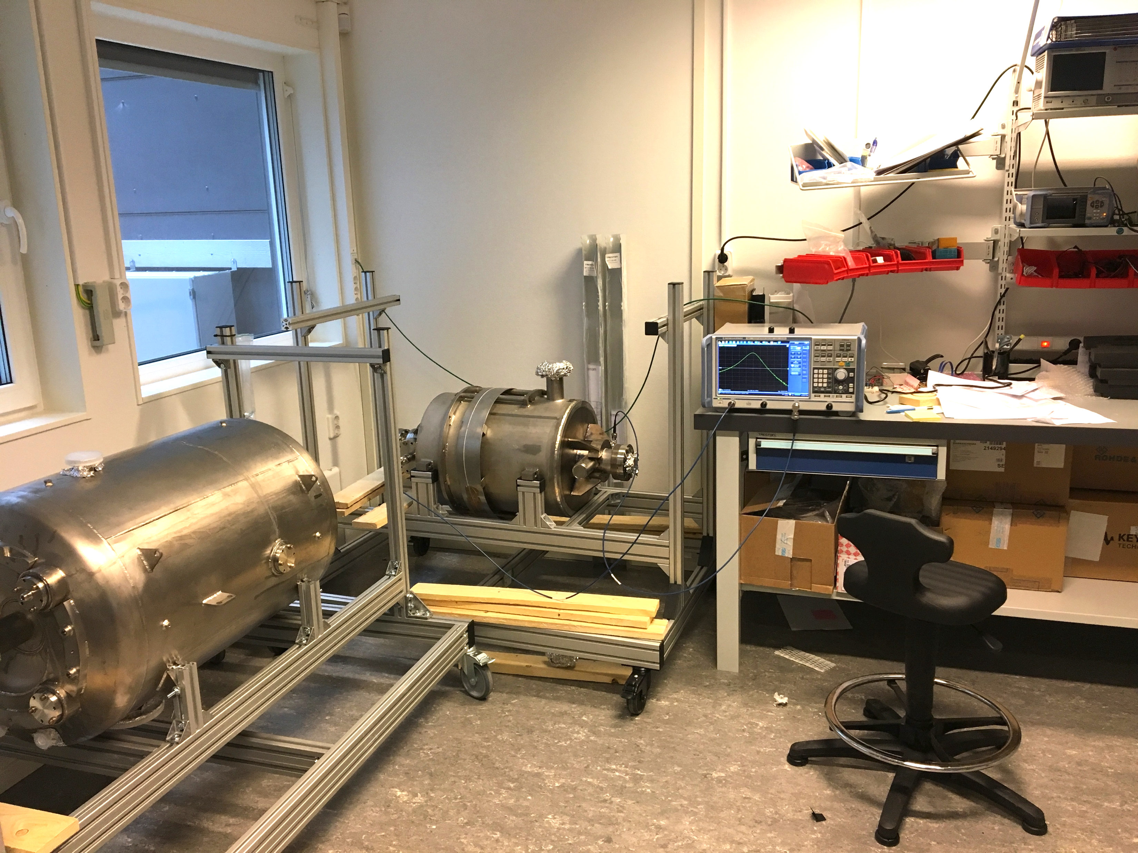
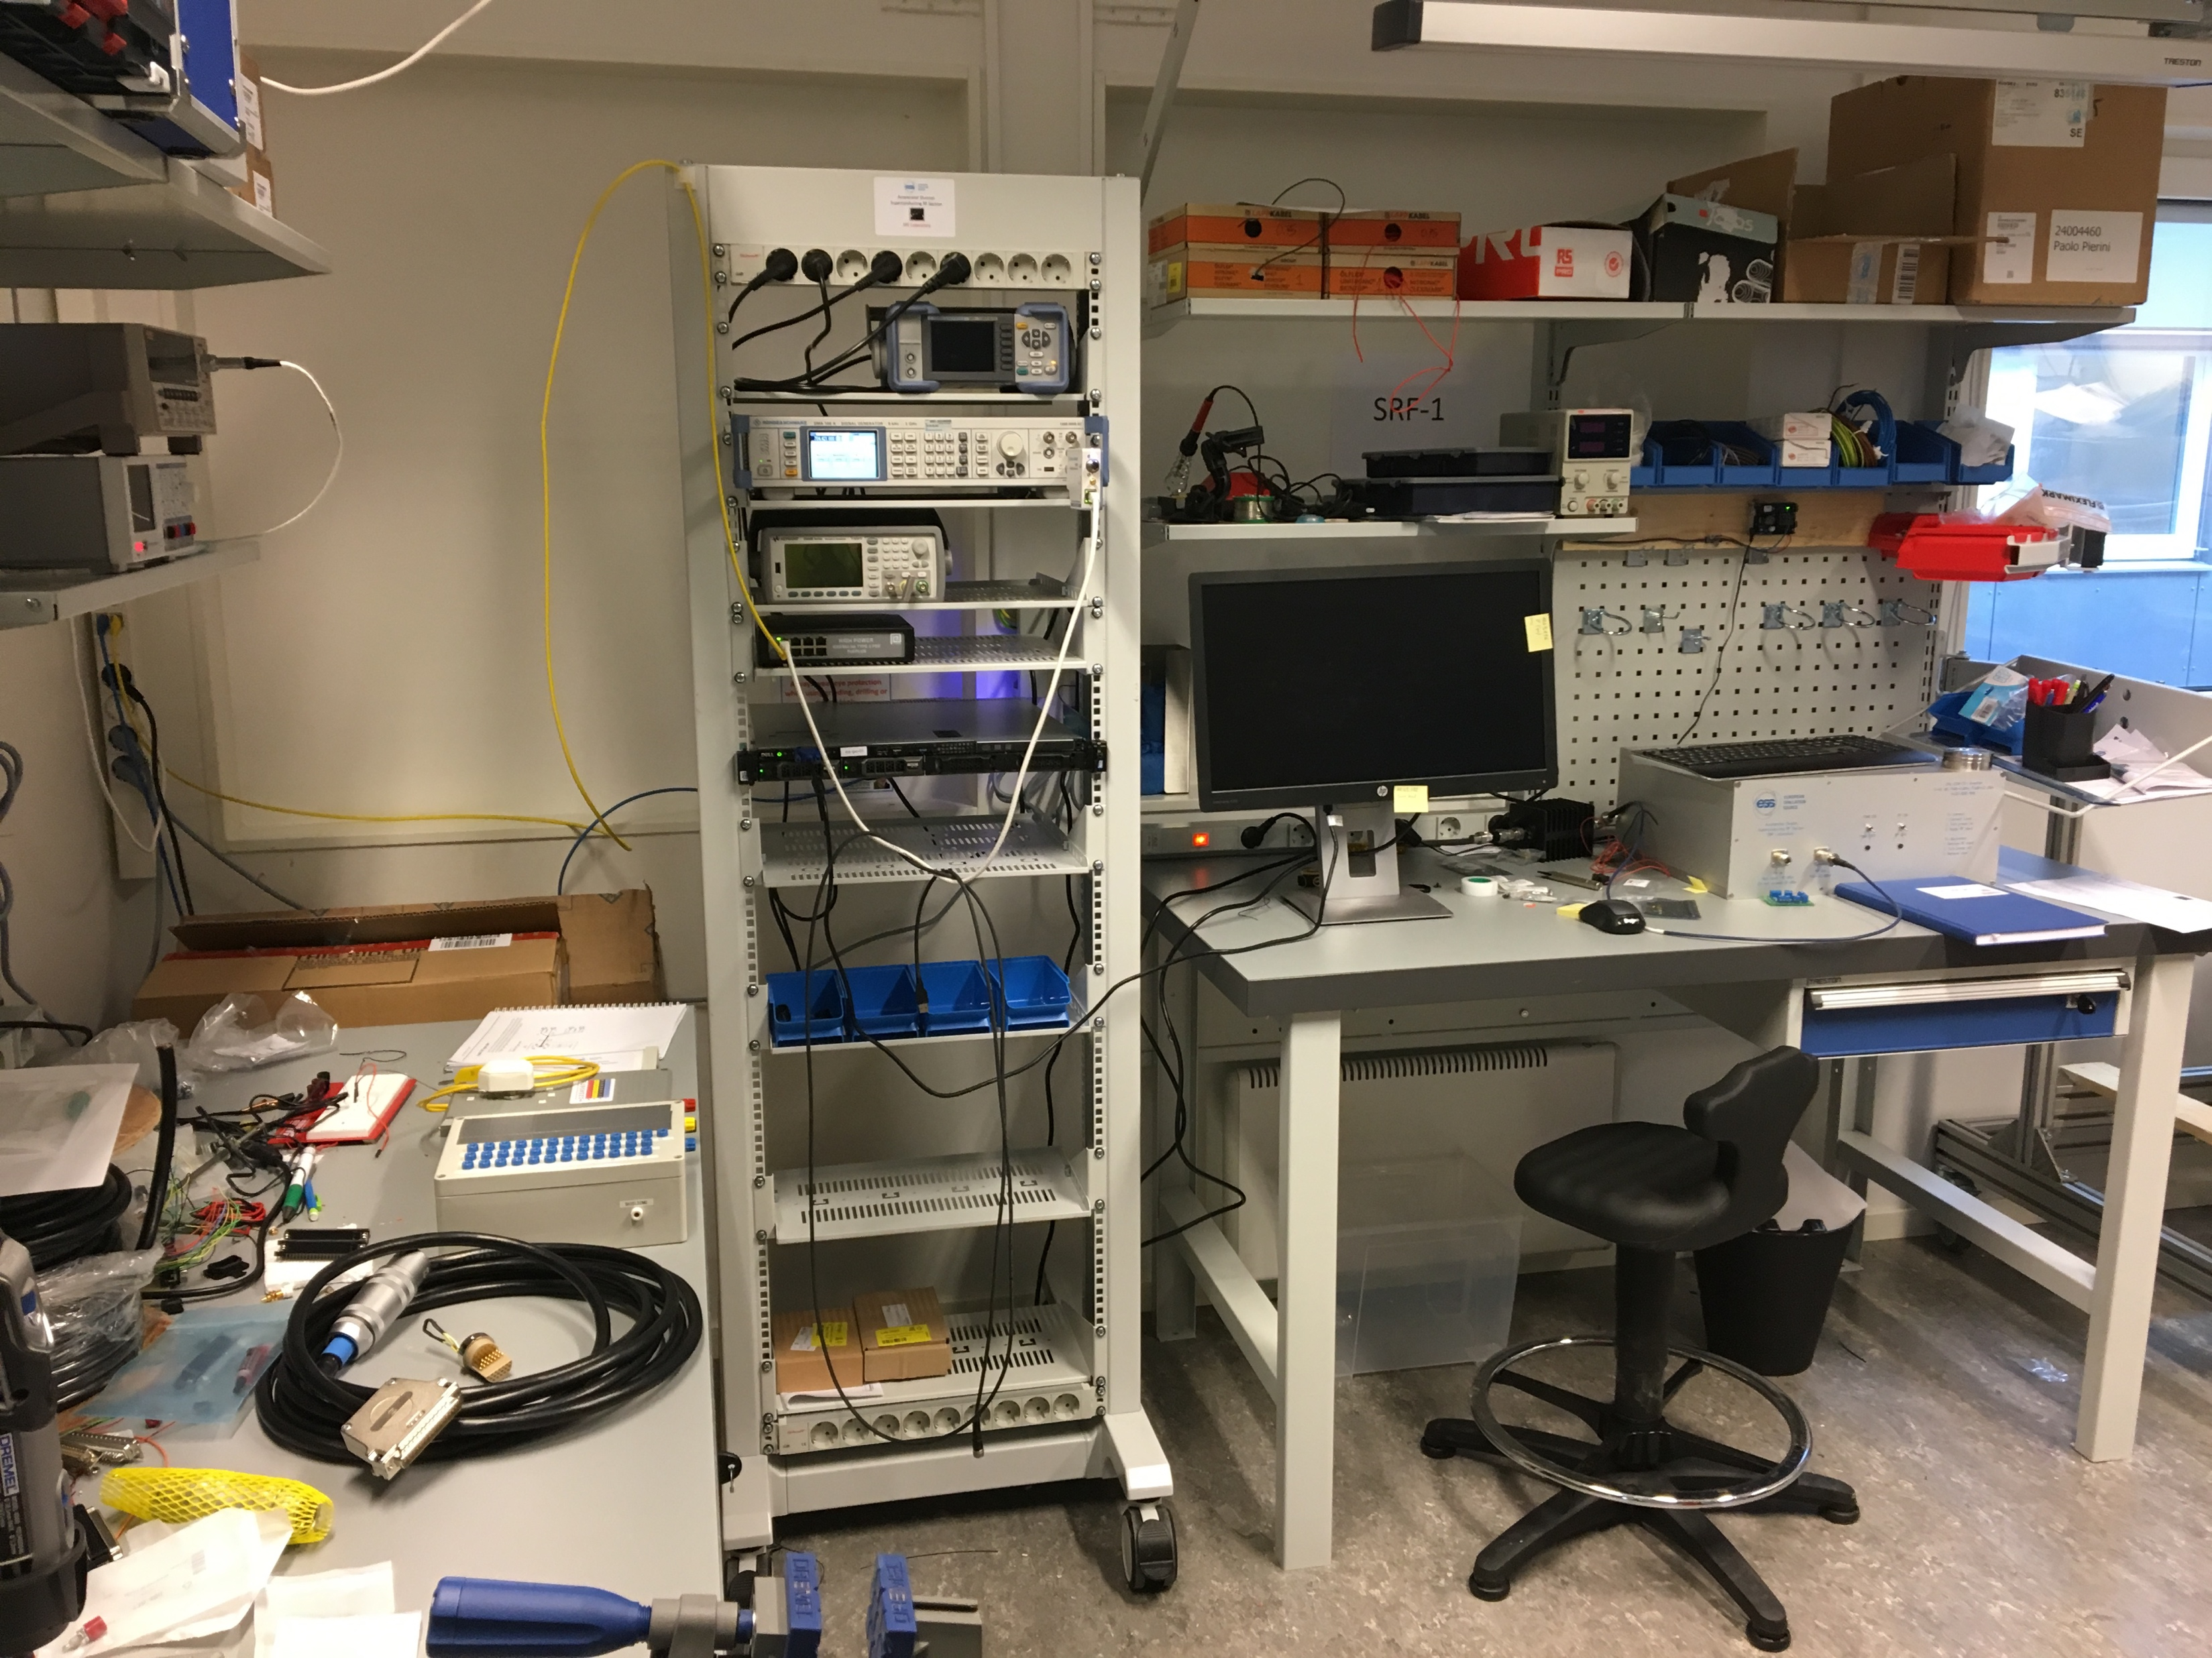
Preparation activities: SRF
Incoming RF activities: Setup of an SRF laboratory
From September 2017 to now:
Setup of SRF Laboratory for the preparation of all incoming reception measurement at warm
Lab will be moved to B02 lab building when available
SigGen
Racks
IPC (IOC)
Meters
RF Amp
…
INFN β=0.5 5-cell elliptical
20W SSA
IPNO ESS Double Spoke

Slide 9
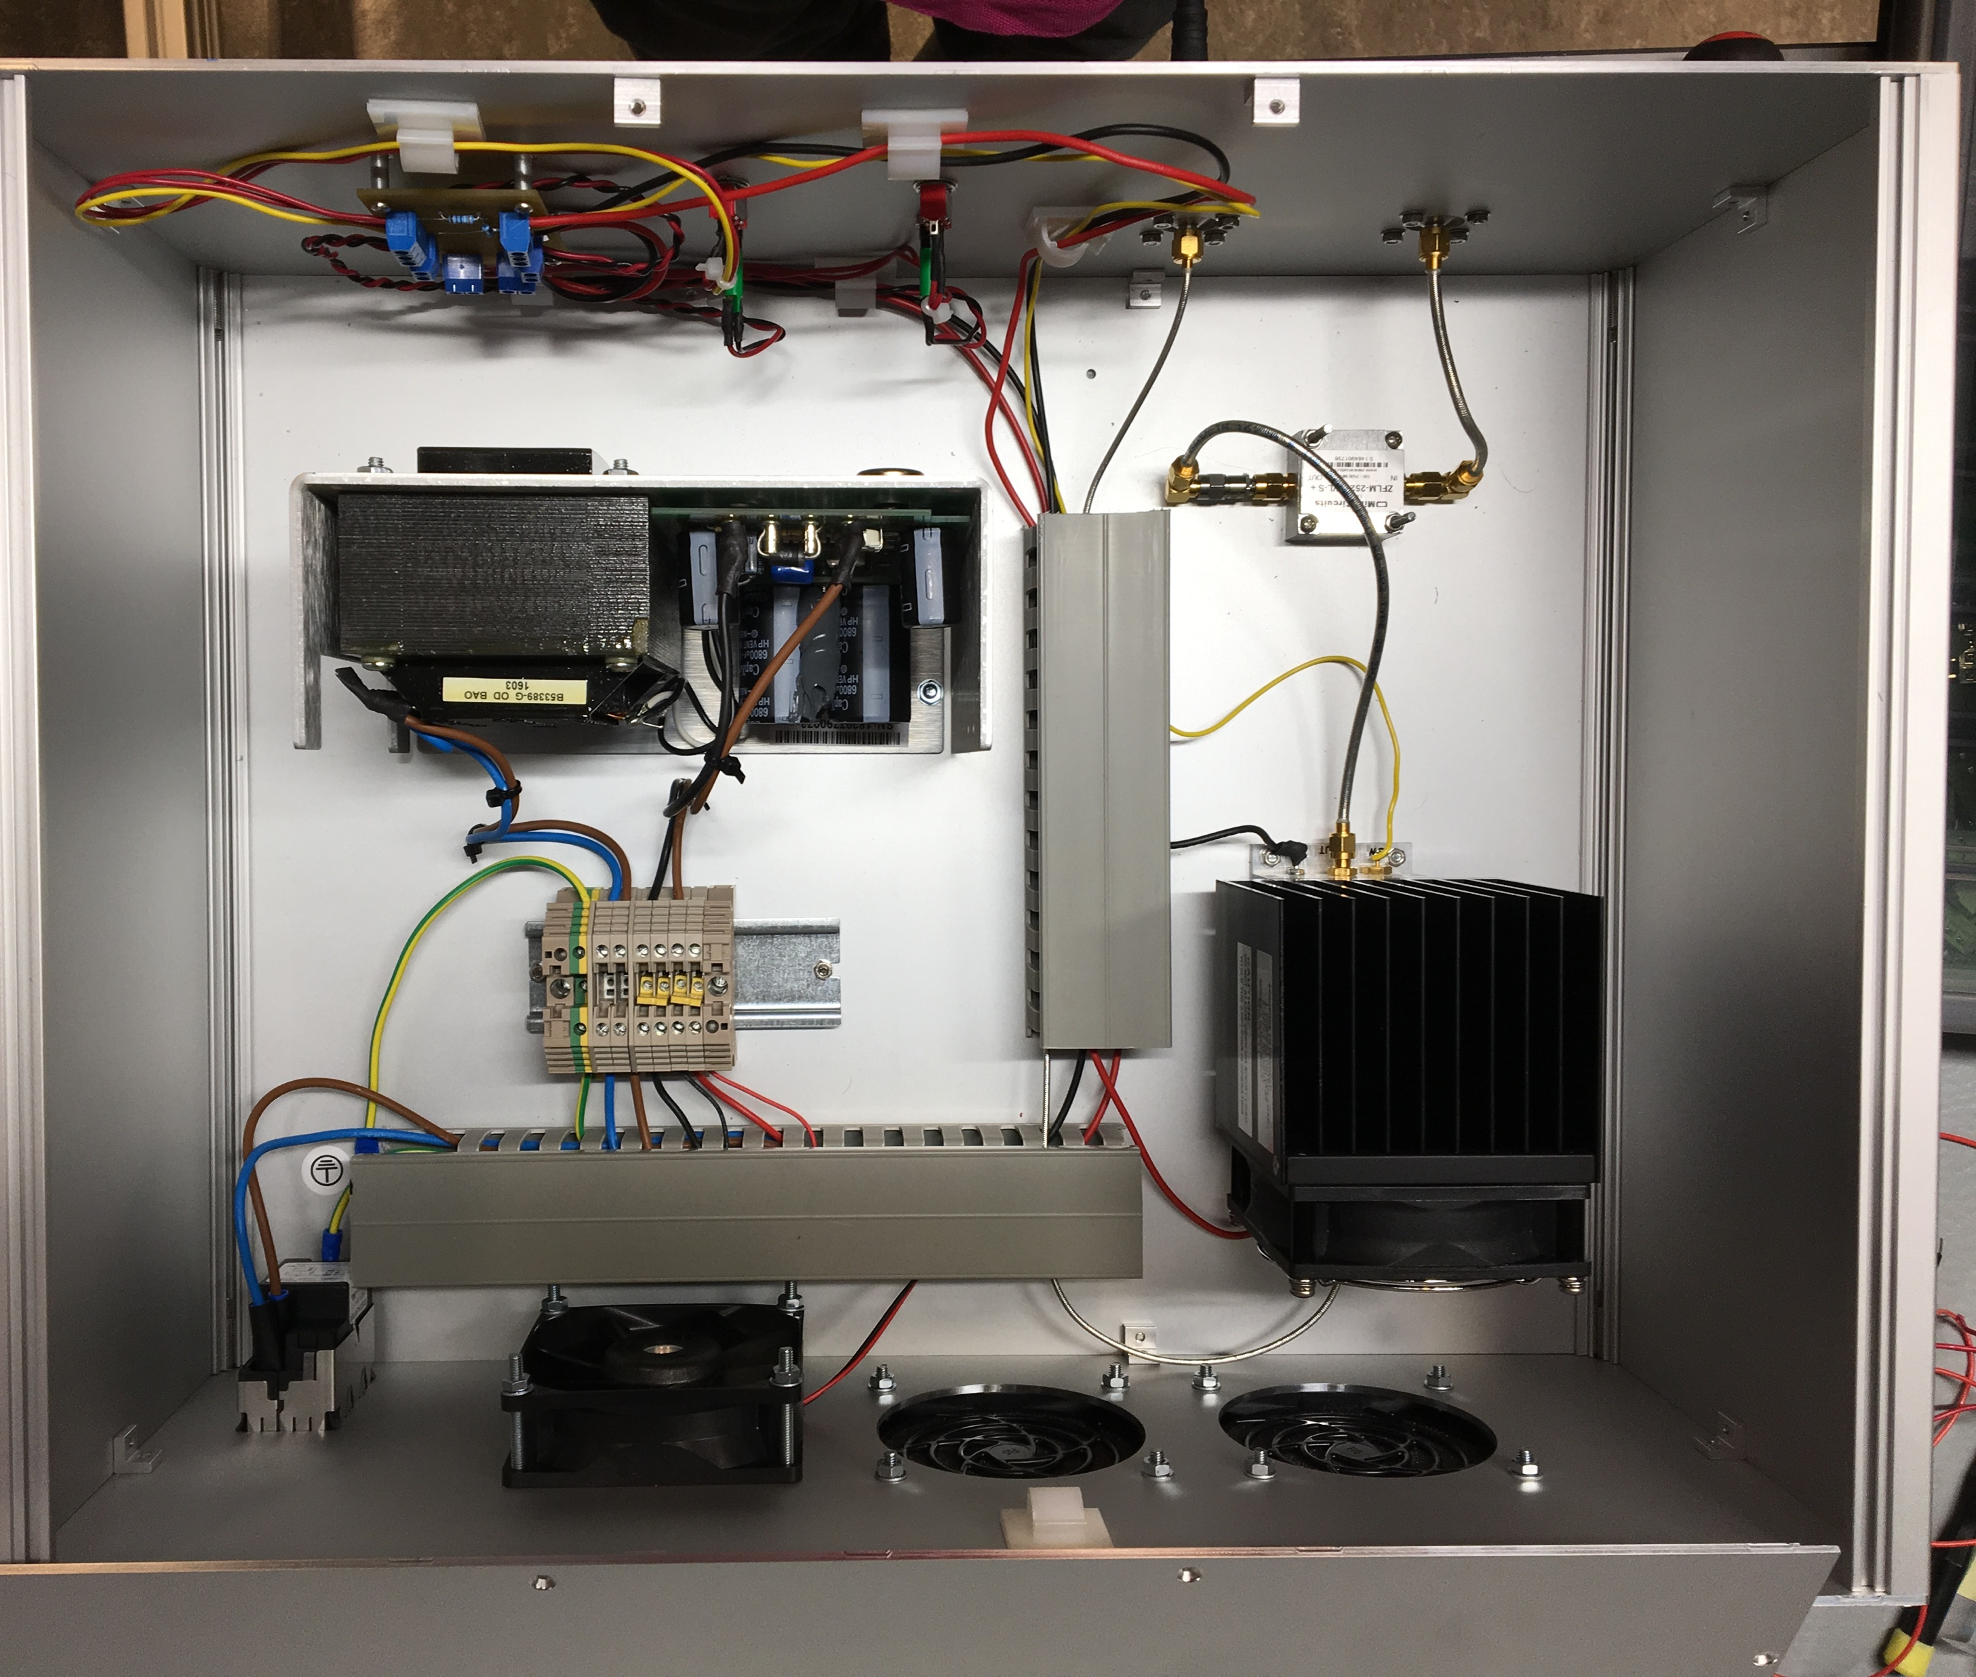
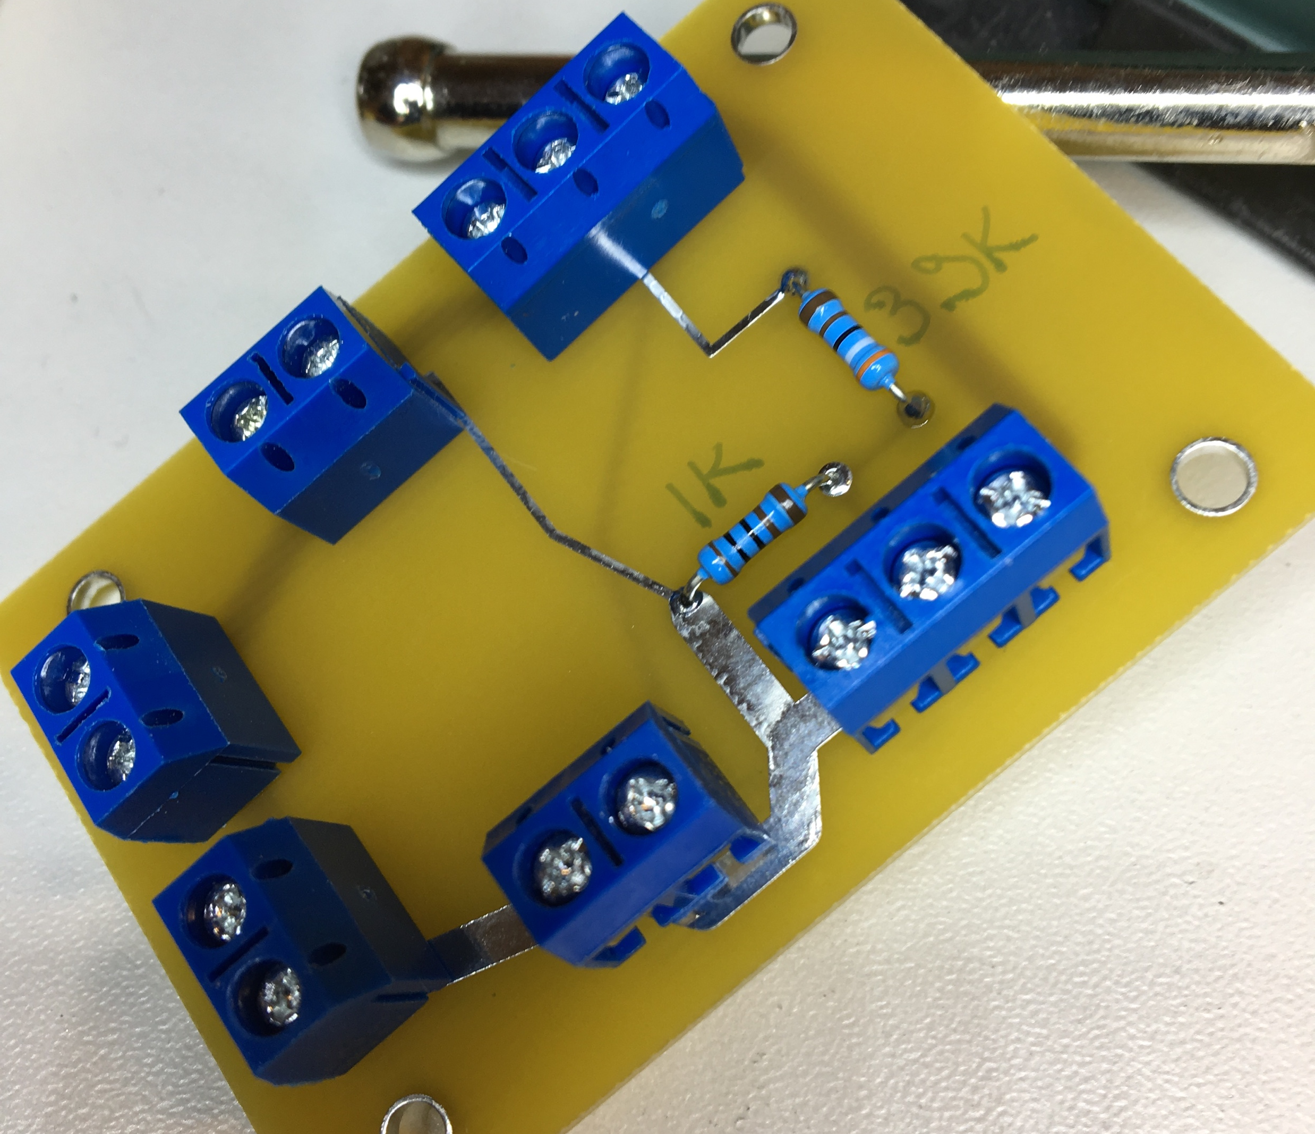
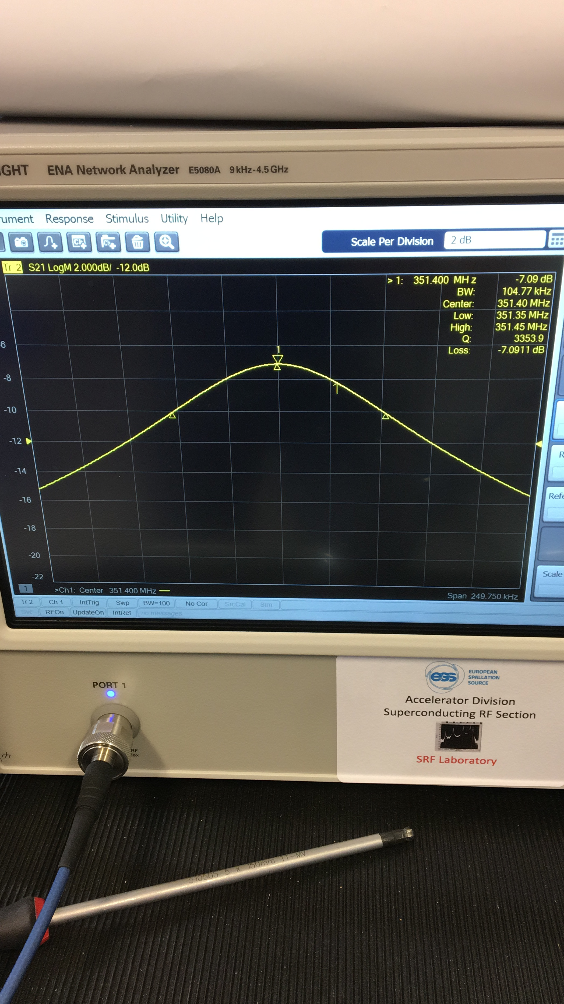
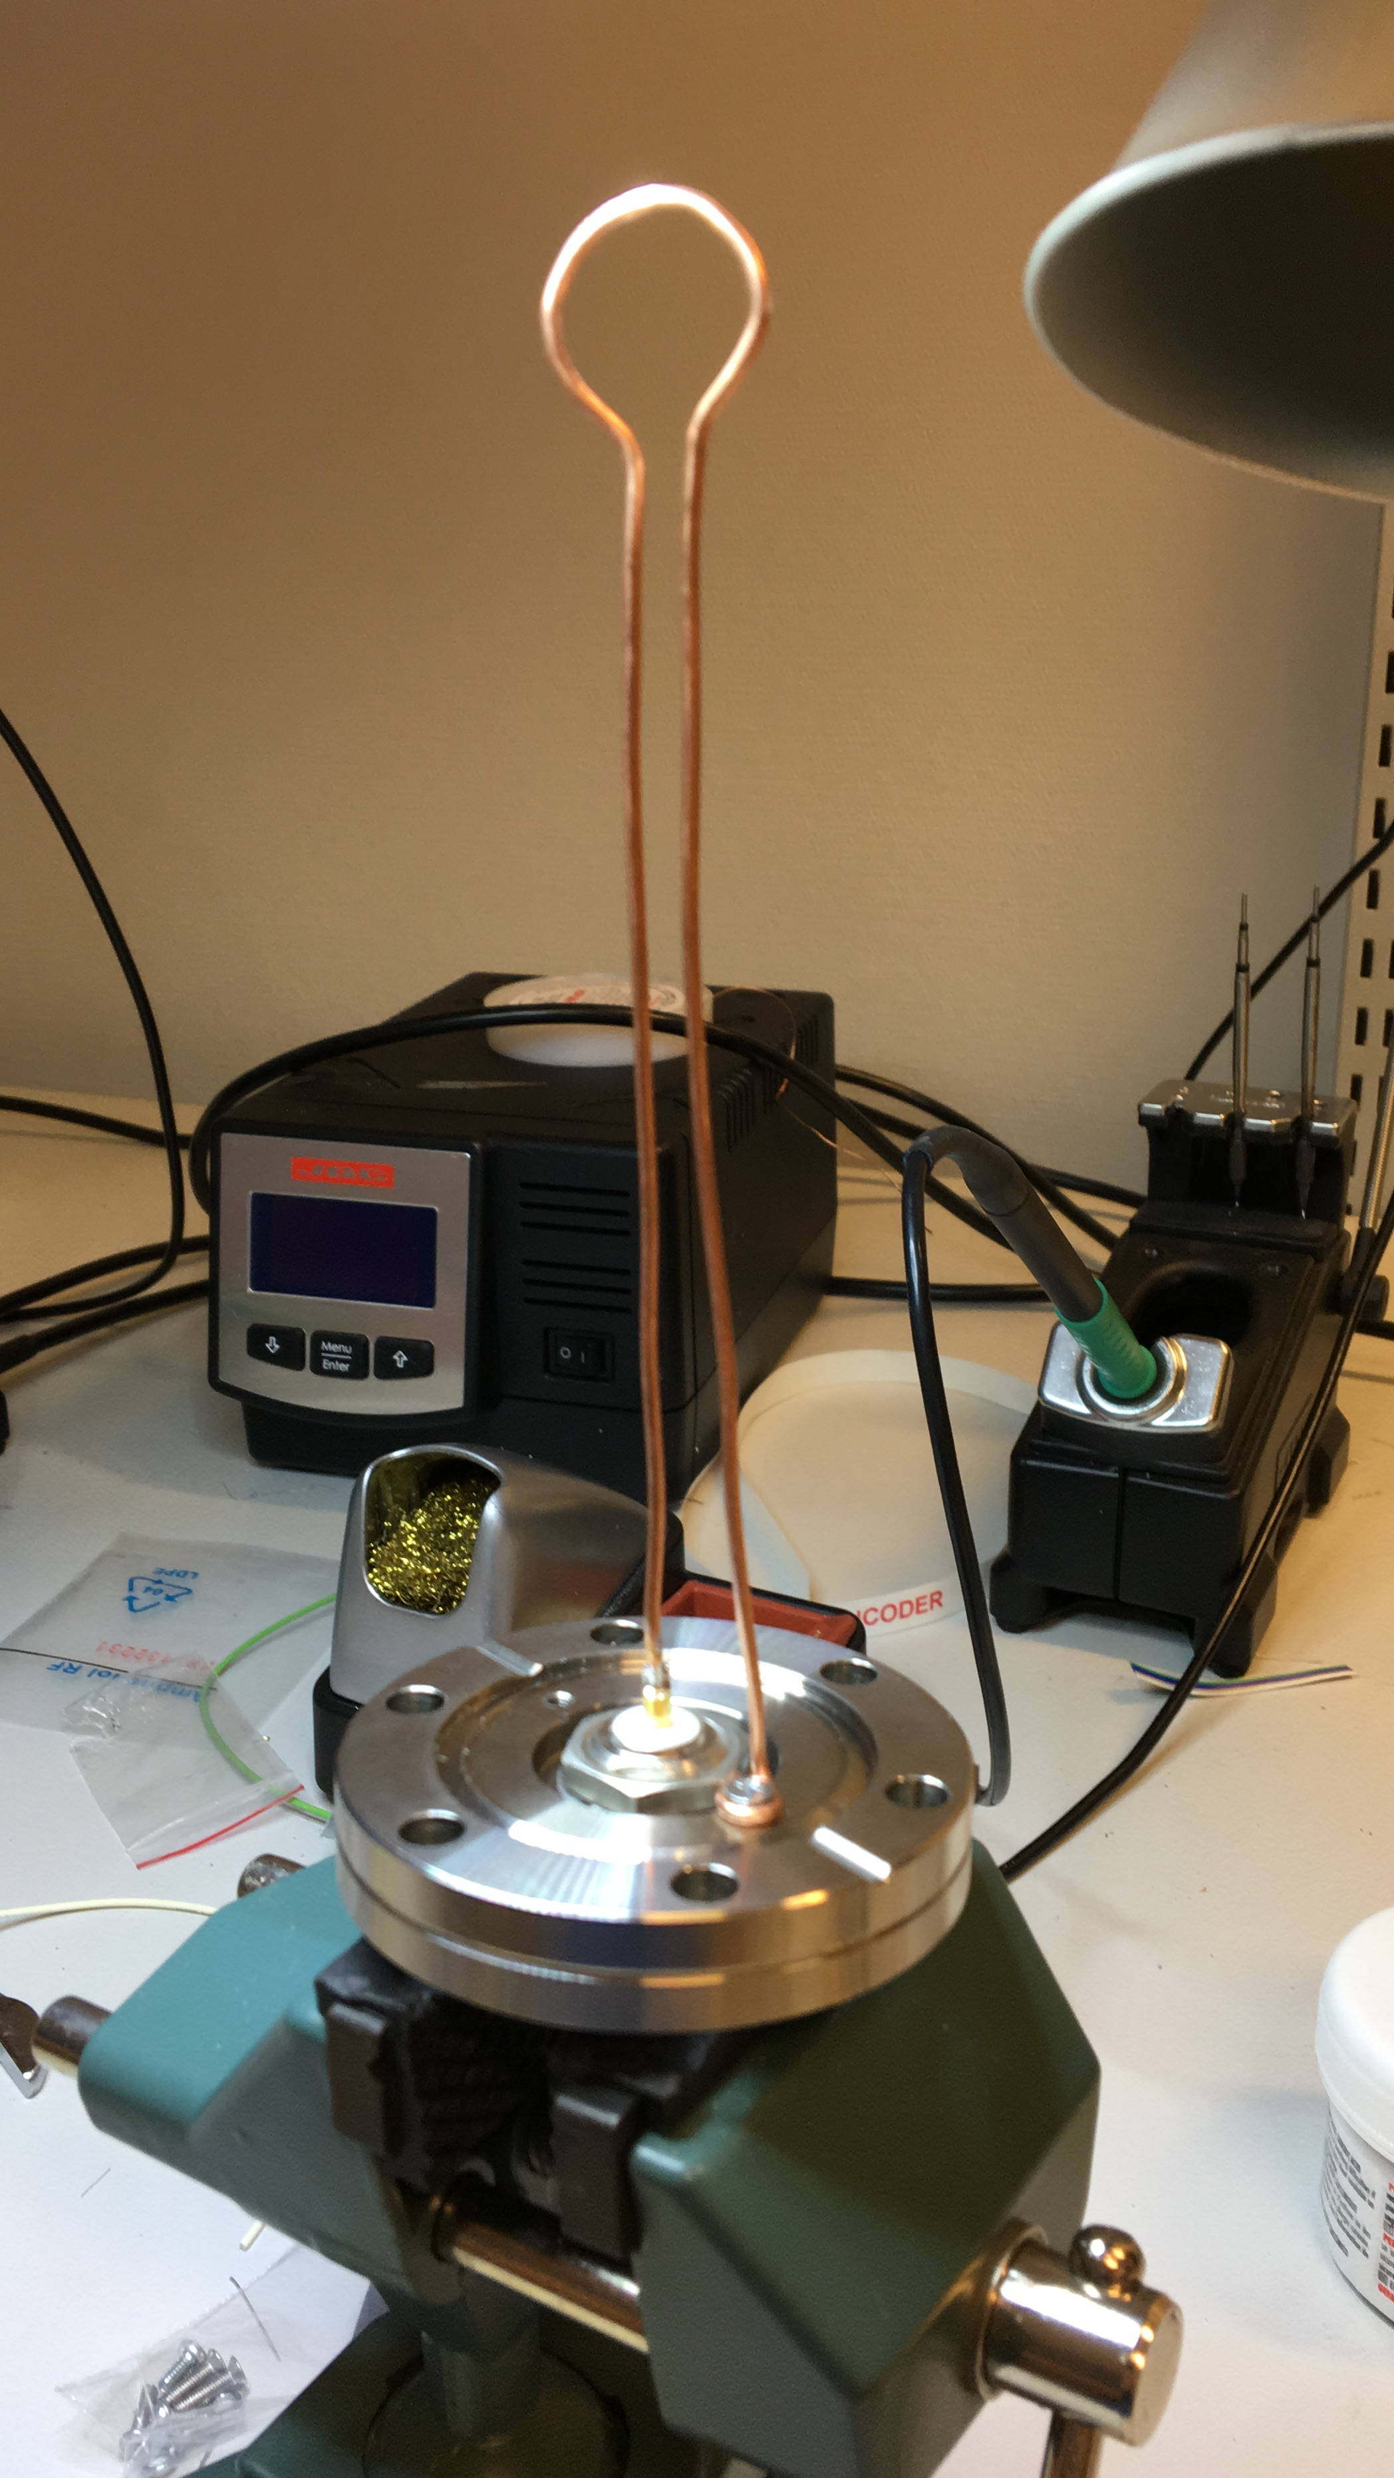
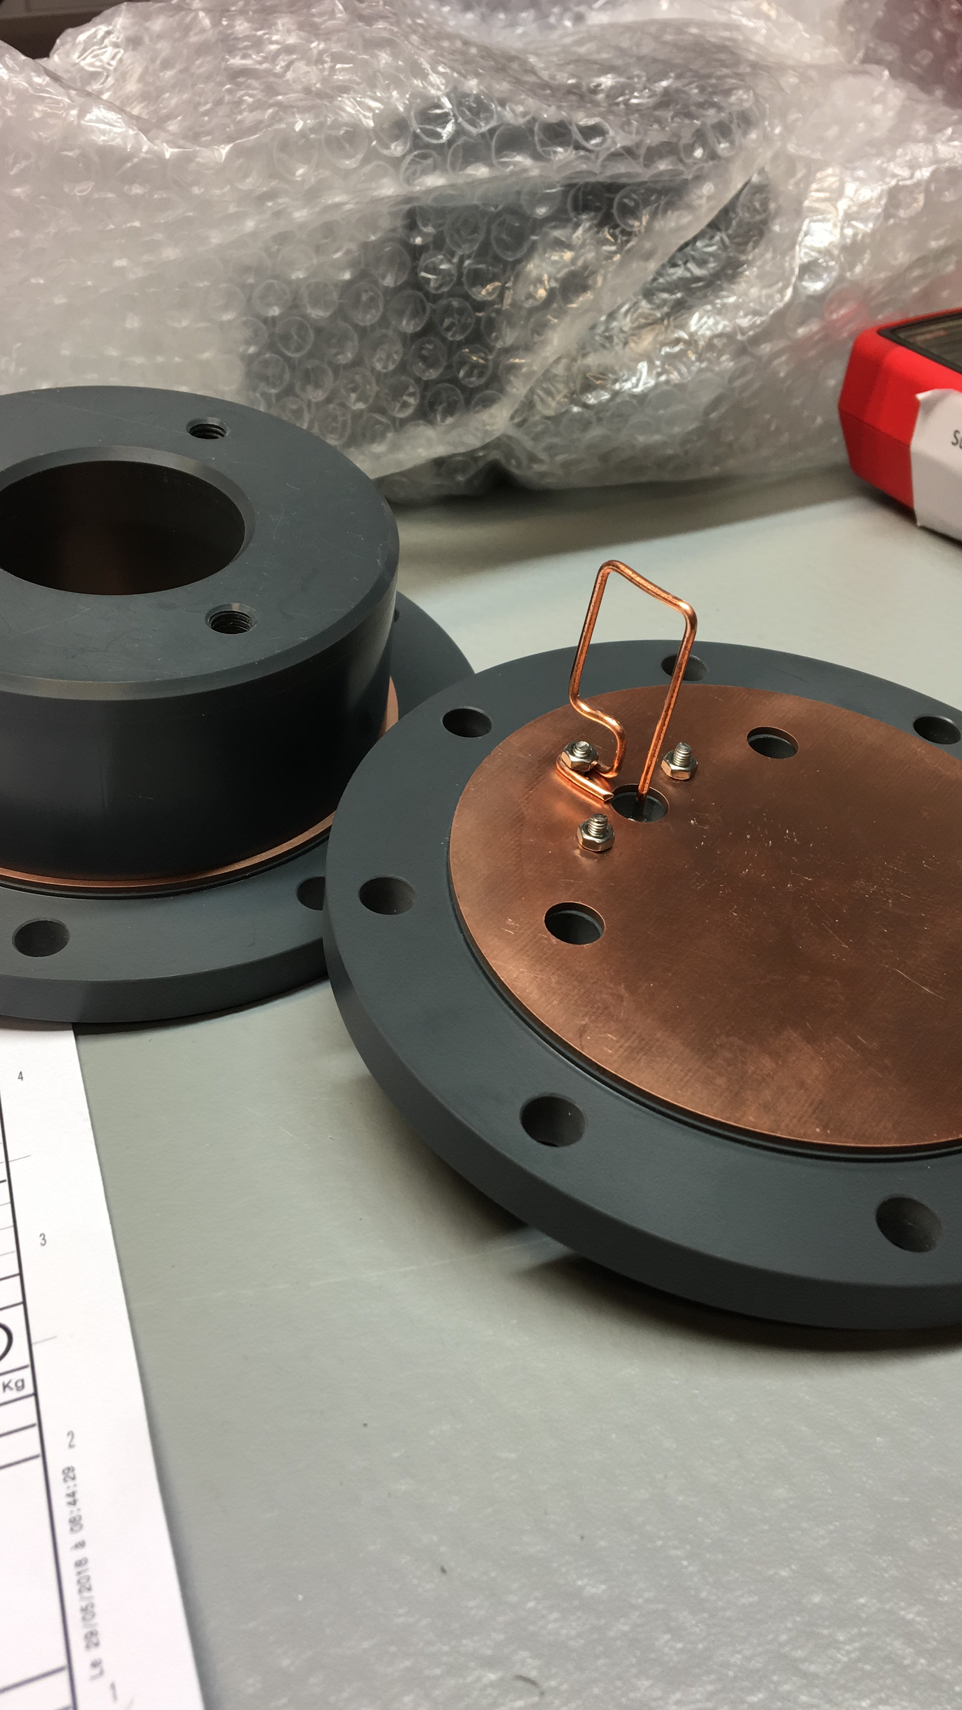
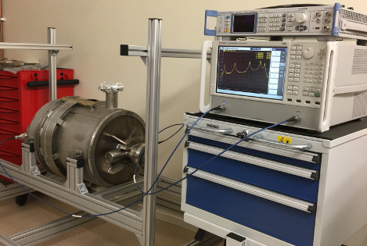
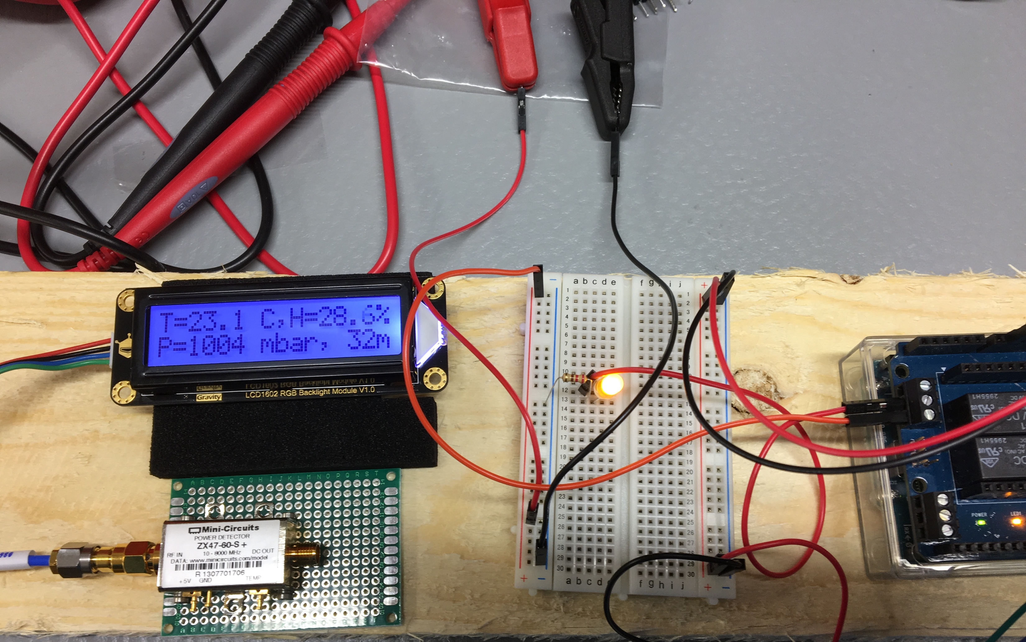
Preparation activities: “hands-on” SRF
Start of regular SRF “Lab life” and local development capabilities
Acknowledging help/support/collab from IK and more importantly all over ESS (RF, STS, EIS, ICS…)

Slide 10
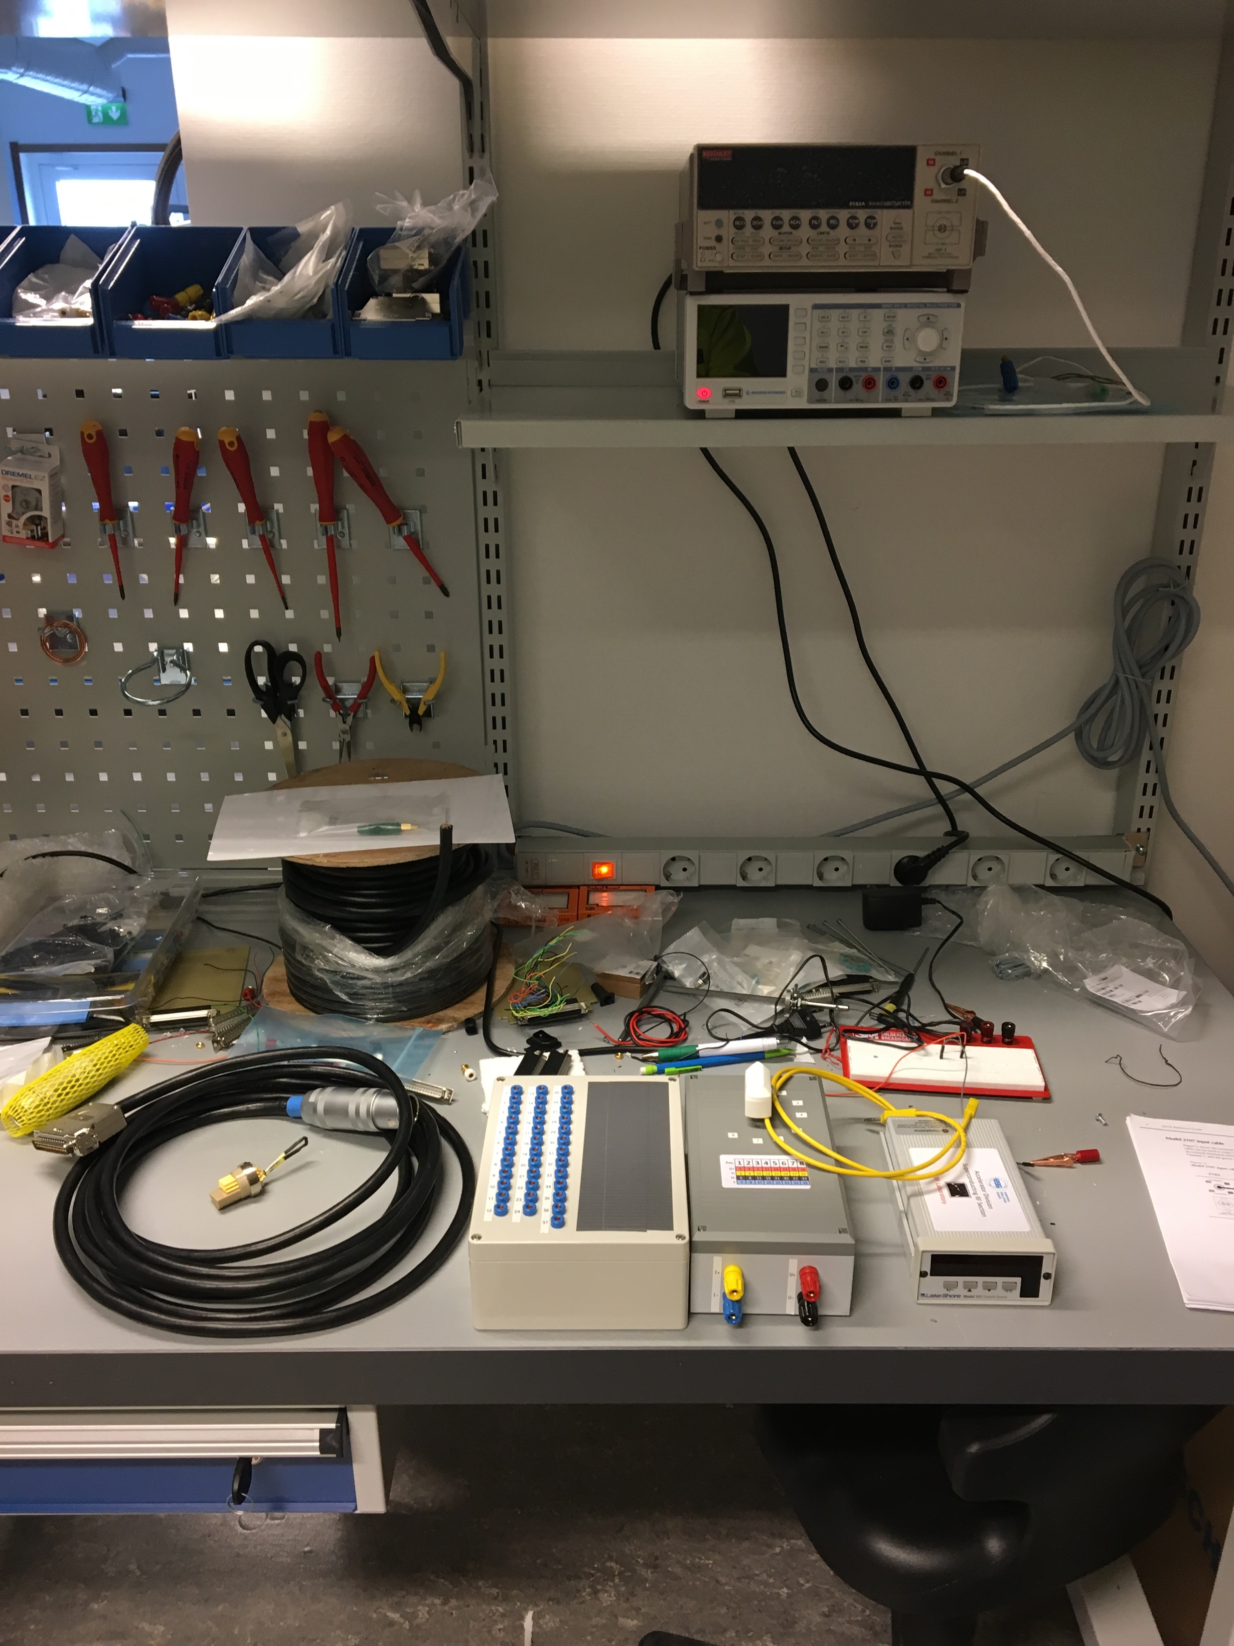
Preparation activities: Signals
Incoming reception of internal instrumentation
SRF section provides support for the development and realization of the needed instrumentation in the scope of the incoming tests
Laboratory development & testing environment
Procurement, maintenance of instruments, tools and consumables
Activity relying on strong contribution of IFJ-PAN team
Preparation of the hardware for the toolboxes to check the internal sensors of the modules (CERNOX, PT, Heater, Motors, …)
Prepare the incoming reports for the assessment with the outgoing documentation from CEA
Definition of # and contents of inspection reports ➜ Michal

Slide 11
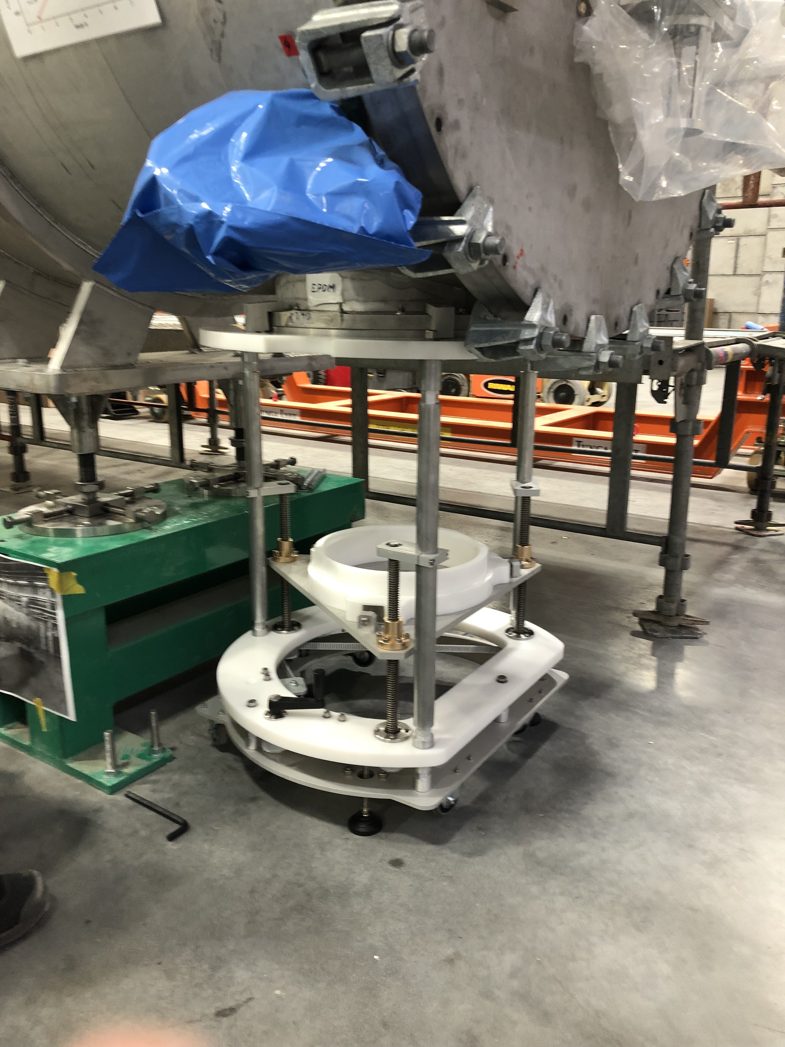
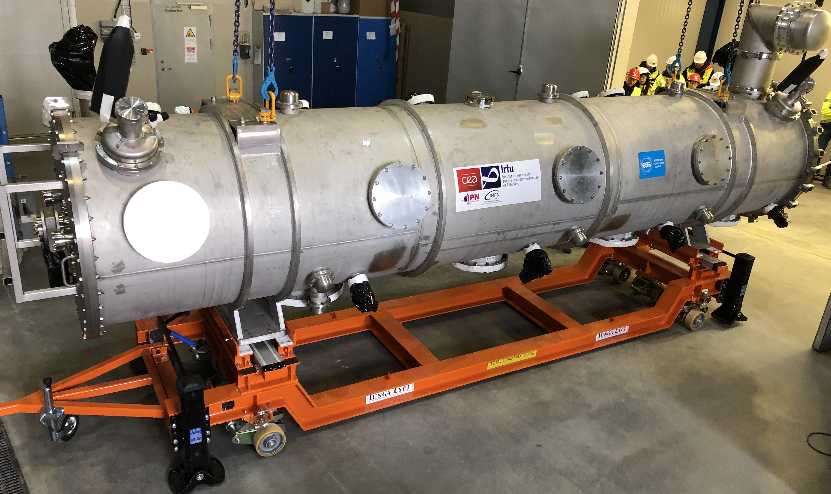
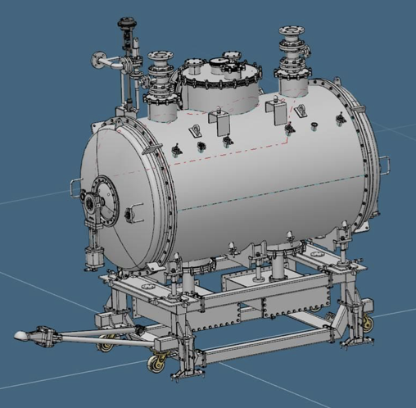
Preparation activities: Mechanical
EIS Legend
MS: Manufacturing Section
METS: Mechanical Engineering & Technology
SAM: Survey, Alignment and Metrology
Development of ESS tools
ESS responsibility for transport tools (IK, internal) and supports
In close contact with ESS Rigging/SAM/MS ➜ Felix
Customization of CEA assembly tools to adapt to the TS2/Tunnel
e.g. Doorknob Installation Tool
Support from EIS, from METS/MS for engineering and manufacturing
Design at ESS discussed with IK
Part of know-how transfer process, support from EIS
On site transport cart
Proto in May
DK installation tool (ESS)

Slide 12
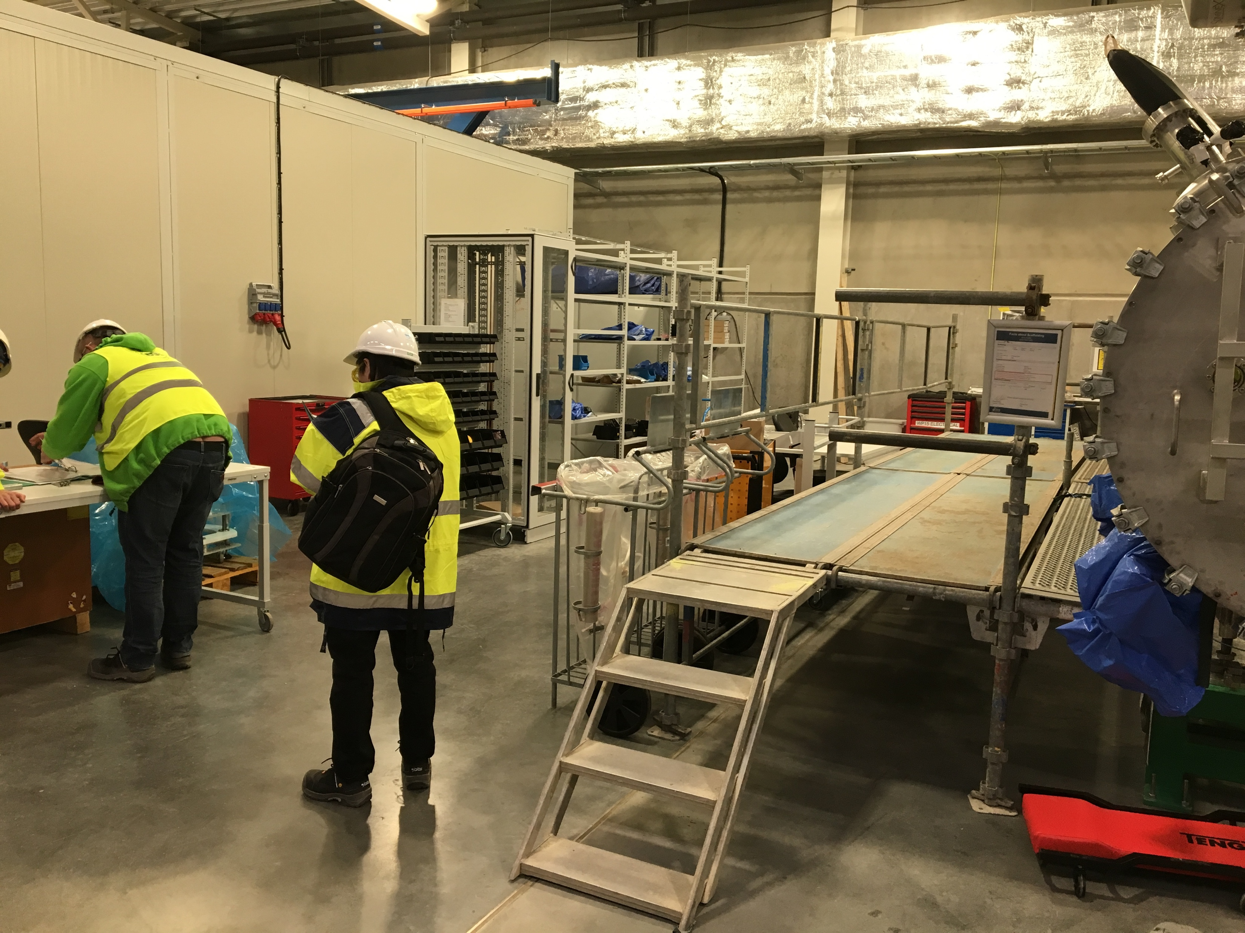
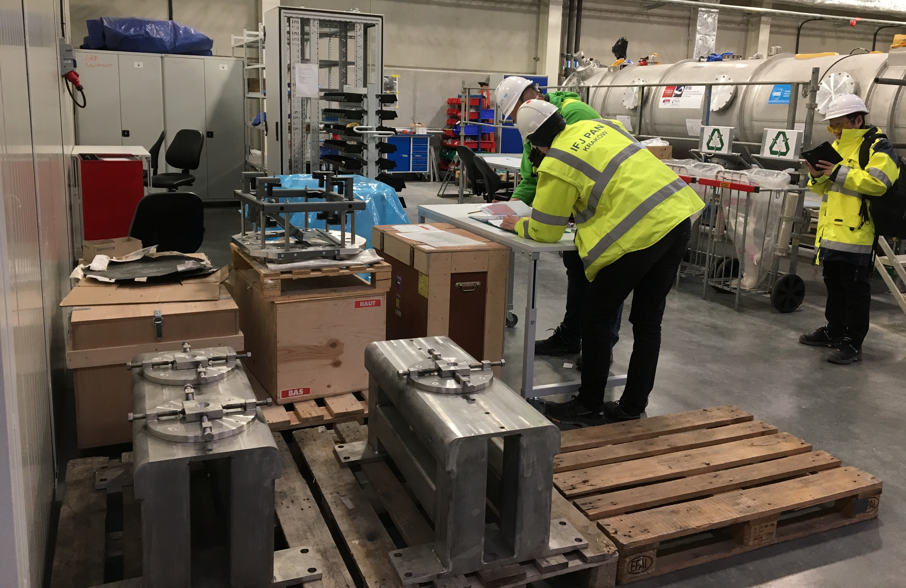
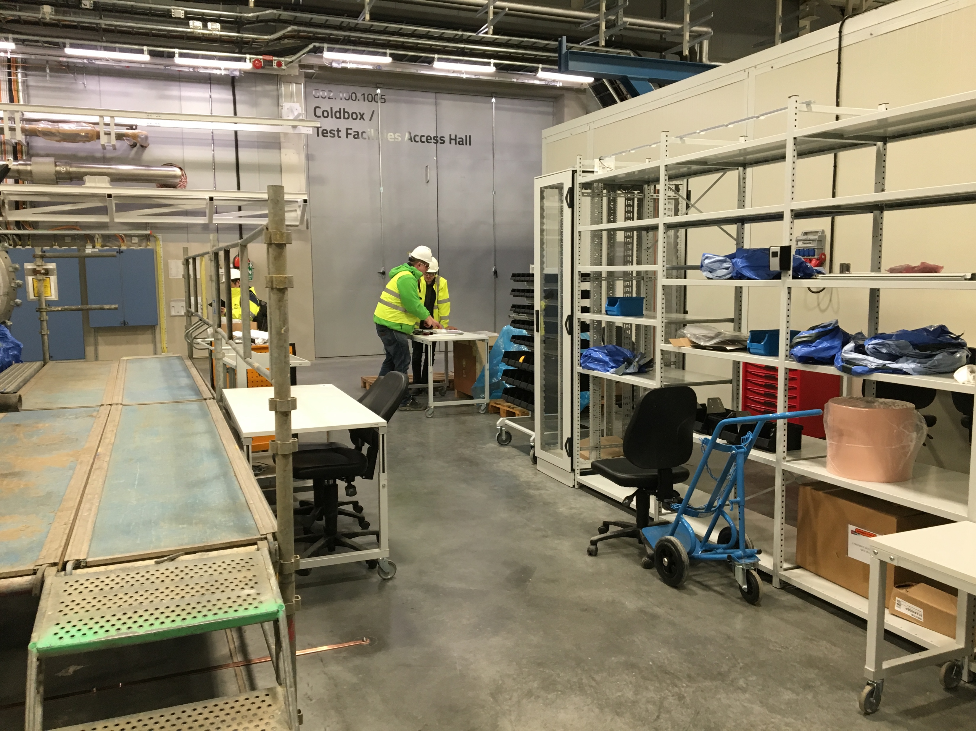
Preparation activities: Test workflow at TS2
Setup of Module reception area
➜ Michal
2019: Preparation of areas for
Storage of components/instrumentations/tools (jointly WP19/WP10)
Workstations for mechanical, electrical and RF incoming inspections
Workstations for activities needed for the TS2 test/tunnel
E.g. dismount/remount of transport fixations on thermal shields and string
Local instrumentation racks
Training teams!
Performed main mechanical reception operations on M-ECCTD
Started iso-vacuum procedures
Performed RF incoming measurements
Soon electrical
DK Fixation
Doorknobs (to be assembled)
TS2 Bunker Supports

Slide 13
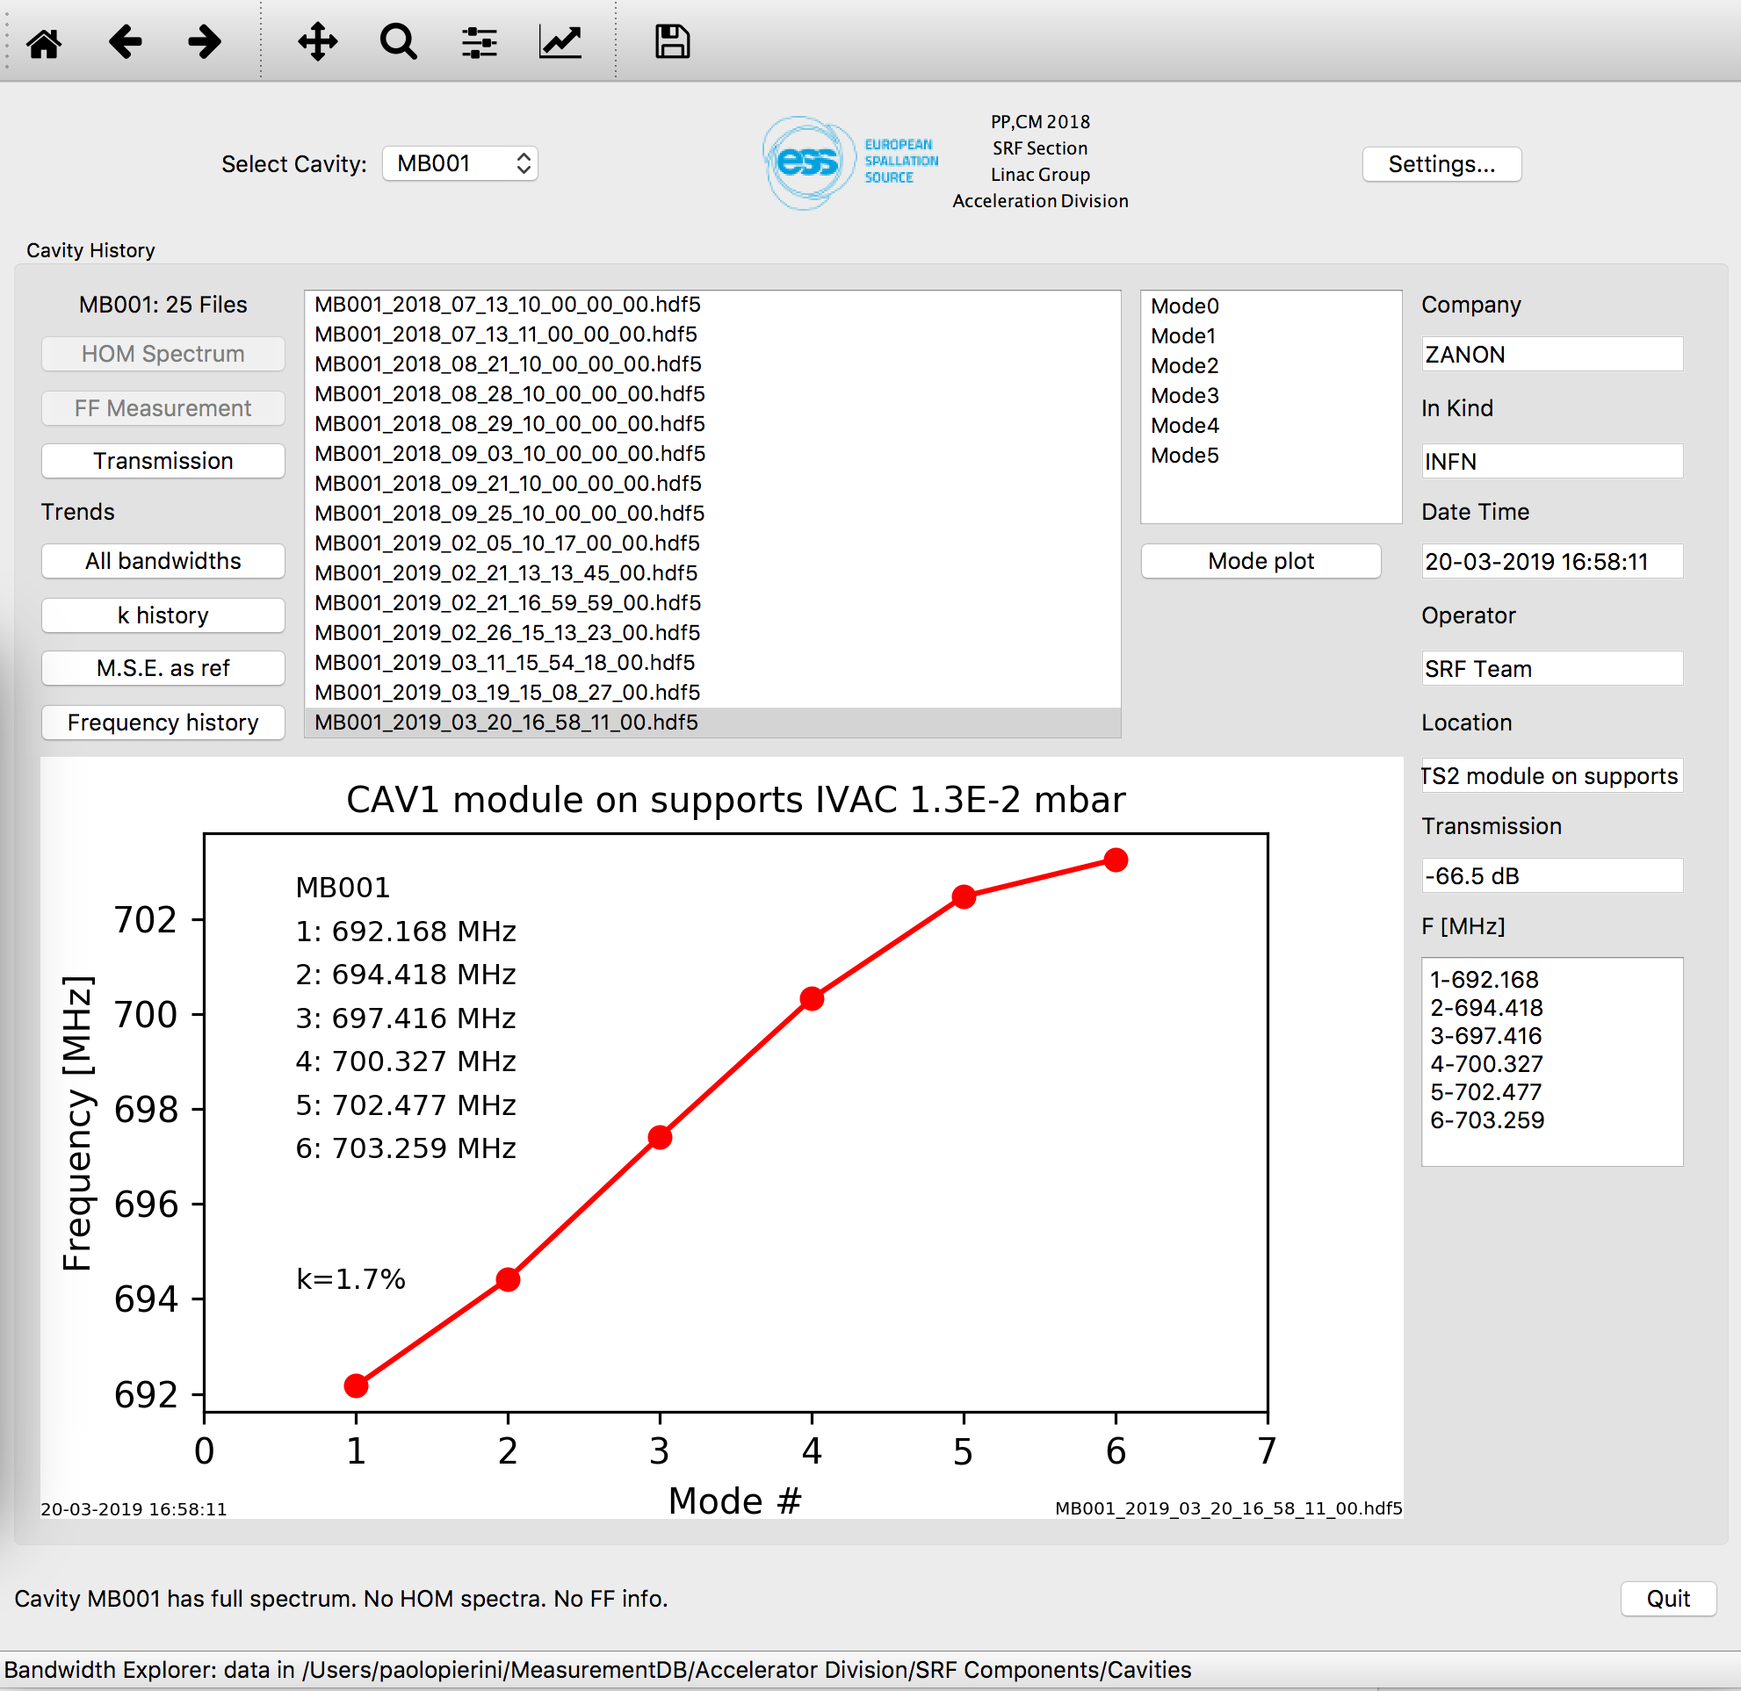
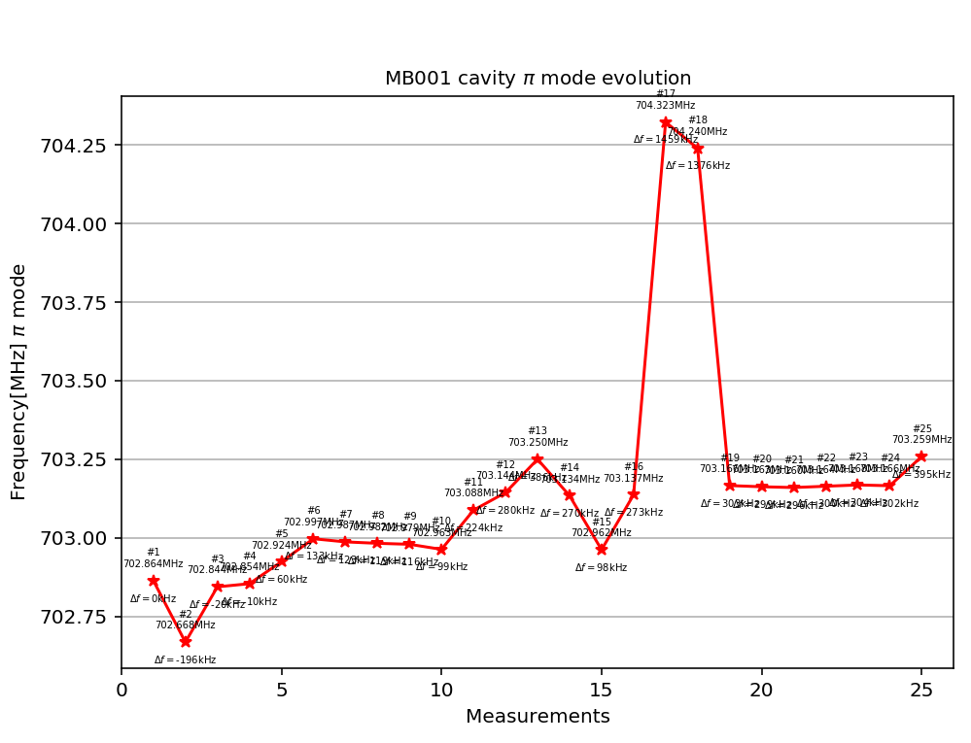
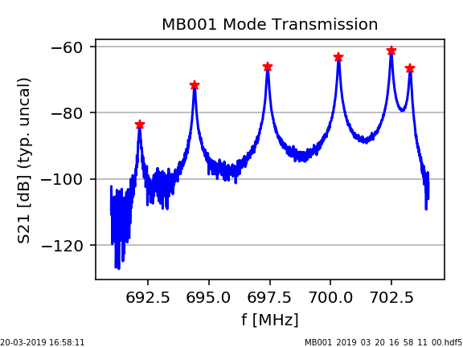
Preparation activities: We need to know our cavities!
Setup of a Measurement DB
Measurement at IK are transferred into Measurement DB, to allow reception and evaluation at TS2 ➜ Cecilia
Part of handover process IK-CEA-ESS
Data at ESS then adds on it
M-ECCTD f history
ESS Reception
String ASSY@CEA
Fabrication
Cooldown @ CEA

Slide 14
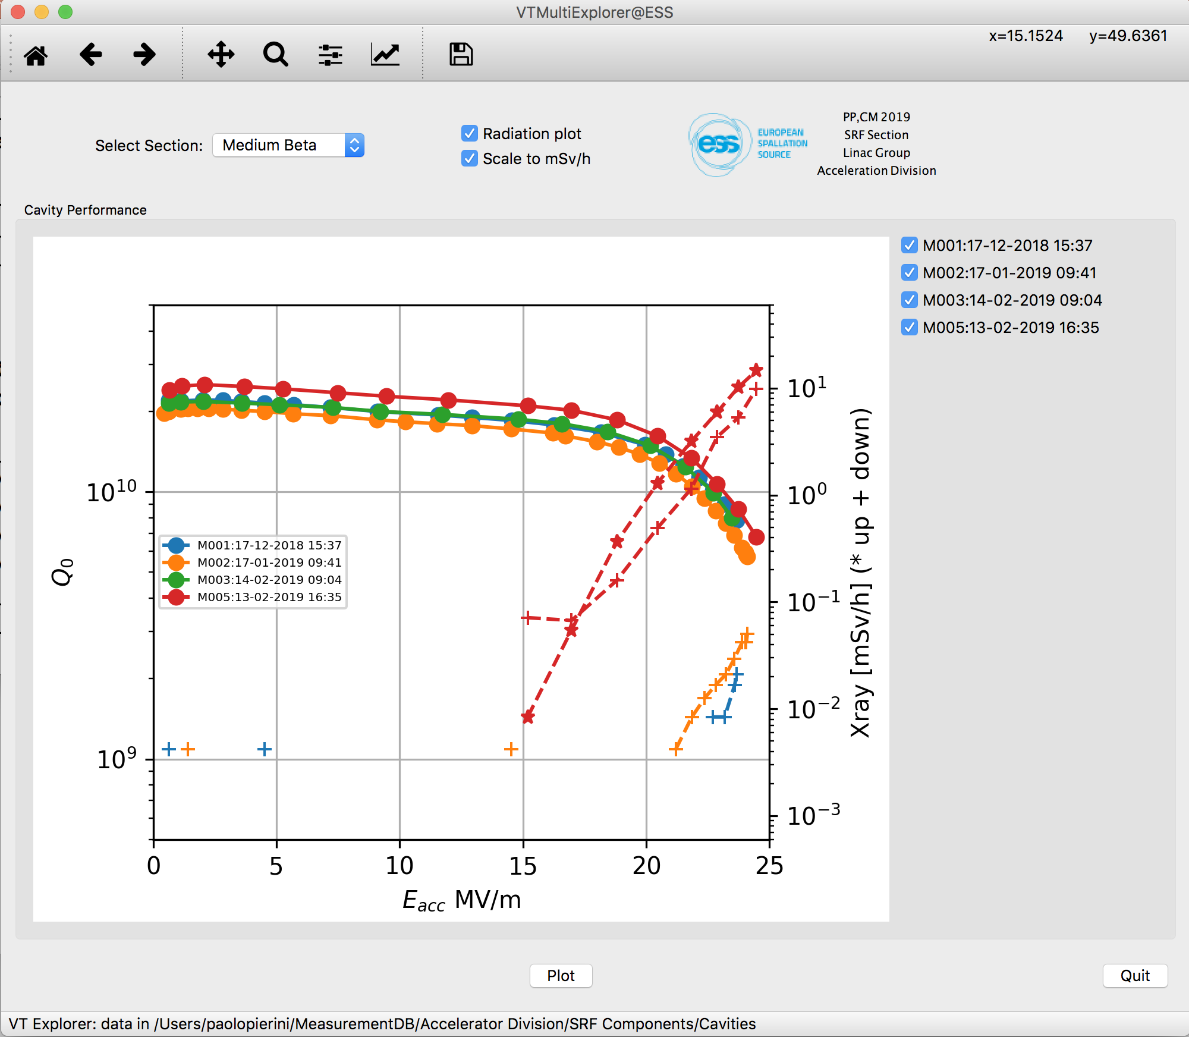
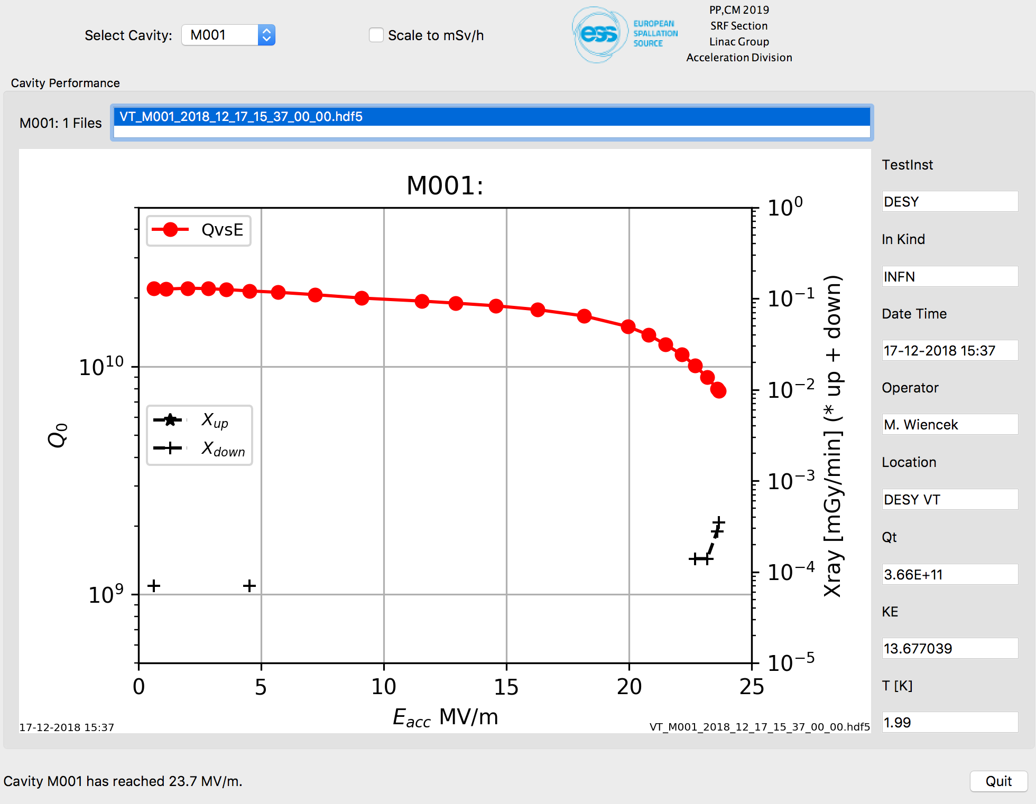
Preparation activities: Cavity performance data
First four cavities of M1 string, real time transfer
In the handover we also receive from the IK the summary data of the vertical tests
Performance data (Eacc, radiation levels)
Calibration data for TS2
e.g. PU calibration data from DESY VT

Slide 15
Elliptical CM Testing Timeline
And setup of TS2
Test stand preparation (ongoing)
Cooldown of cryoline foreseen in May, with preliminary CDL controls ➜ Emilio
Safety Readiness Review end of May
Prerequisite is the finalization of the PSS system ➜ Wolfgang
Commissioning of TS2 with M0 (M-ECCTD)
Start ASAP after SRR (and receiving the SSM TS2b licence)
Verify CM control system, HL “zeroing”
Perform nominal SRF test plan and finalize test program/tools
2 months minimum, M1 available from CEA in August, H0 (H-ECCTD) in January 2020
Series Testing
M2 at ESS mid March 2020
Approx one module per month going to TS2 until mid November

Slide 16
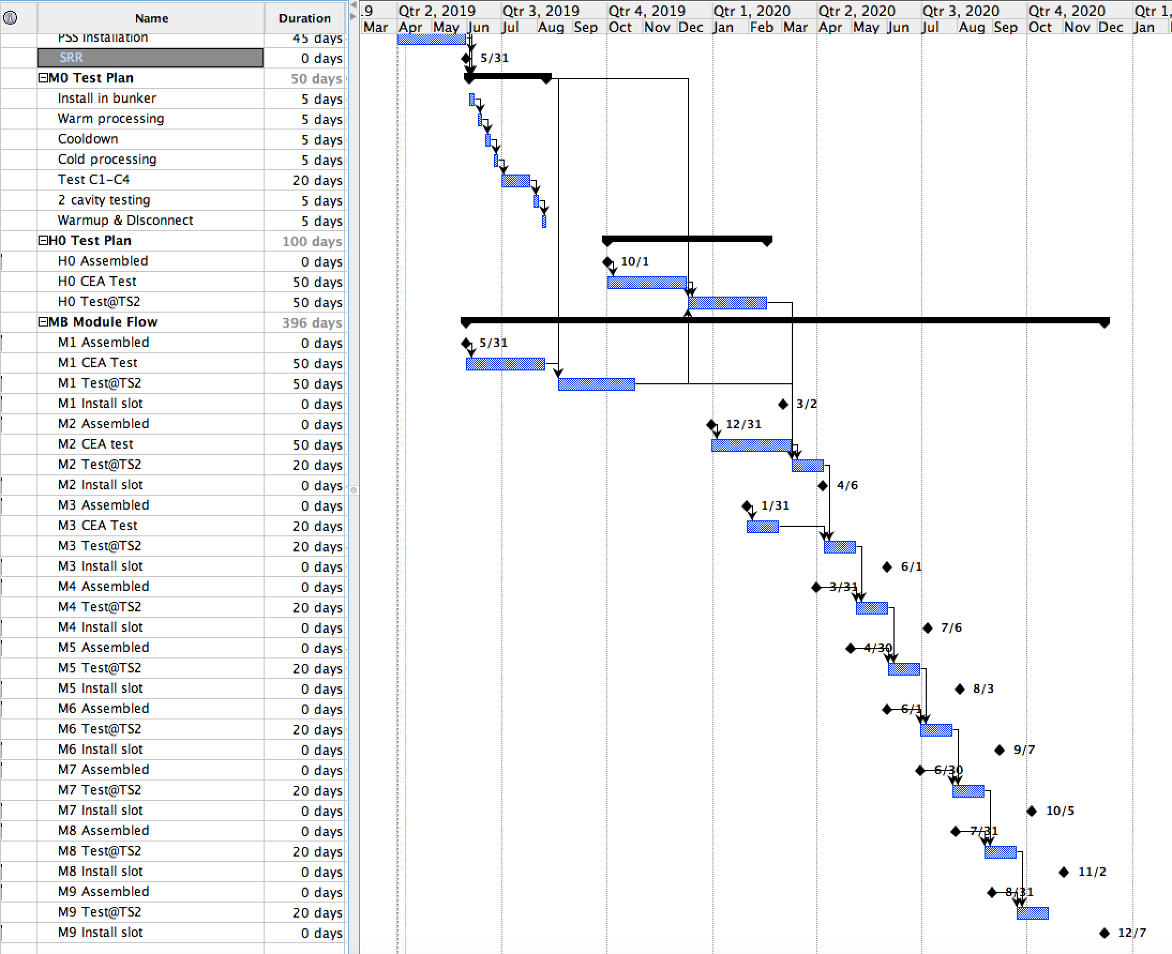
Plan
M0
H0
TS2 ”Learning curve” with M0/M1/H0
e.g. 10 weeks test time each
until March 2020
CEA/TS2
Benchmark
M1
M2
M3
M4
M5
March 2019 ITC installation dates
TS2 nominal test cycle,
4 weeks each
End of module assembly dates
M6
M7
M8
M9
P.S. M1-M3 tested first at CEA

Slide 17
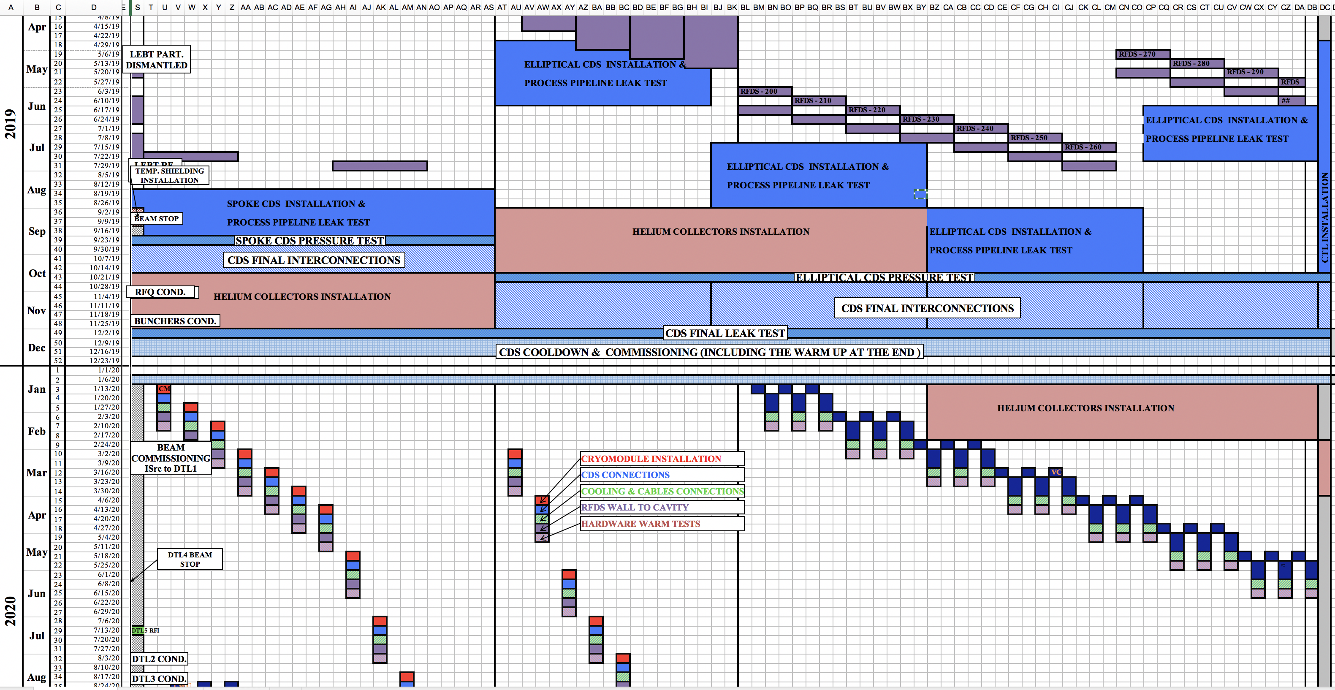
Component flow to current installation plan
Start TS2 operation

Slide 18
2020, concurrent SPK/MB ELL Component installation
13 Spokes
9 MBEll

Slide 19
Long term maintenance of the facility
Spares, SRF Module repair facility at ESS?
ESS linac mainly consists of SRF components provided by European Institutions through In Kind
State of the art infrastructures for development, testing and assembly are in partner laboratories
The ESS long term implies provisions for maintenance, repair and possible upgrades
Outside the realistic timeframe of collaboration agreements with the partners providing the components
SRF technology may loose focus at partner laboratories
Plan for long term SRF maintenance to be developed
A local SRF facility as a place to ensure maintainability and to perform activities that would enable retaining motivated and competent staff to perform it
Not in the current scope of construction phase
Goal for availability ~2025, ~4 years, est. cost ~10 ME
Benchmarked needs against EU facilities (lead by HD), update of 2016 assessment of WH
Wish list for new building on site ~ 1000 m²
Module assembly/disassembly hall, ~200 m²
Space with mechanical workshop, module assembly/disassembly area, lifting devices, tooling for sliding the string on its rail system
Large clean room for cavity and string handling, ~300 m²
Adjacent to assembly hall, ISO 7-4 (EN ISO 14644-1) areas to receive the cavity string for disassembly and reassembly,
Cavity chemical treatment facility in ISO 7
Buffered Chemistry facility for cavity etching
Cleaning and rinsing cabinets with UPW
Clean preparation area in ISO 4
High pressure rinsing station
String assembly and disassembly area
Cavity Test Stand, ~50 m²
Vertical cryostat for individual cavity performance assessments
Module Test Stand, ~450 m²
Radiation shielded bunker for High power testing of complete cryomodules
Currently TS2 is in contingency space of Linac gallery, to be relocated

Slide 20
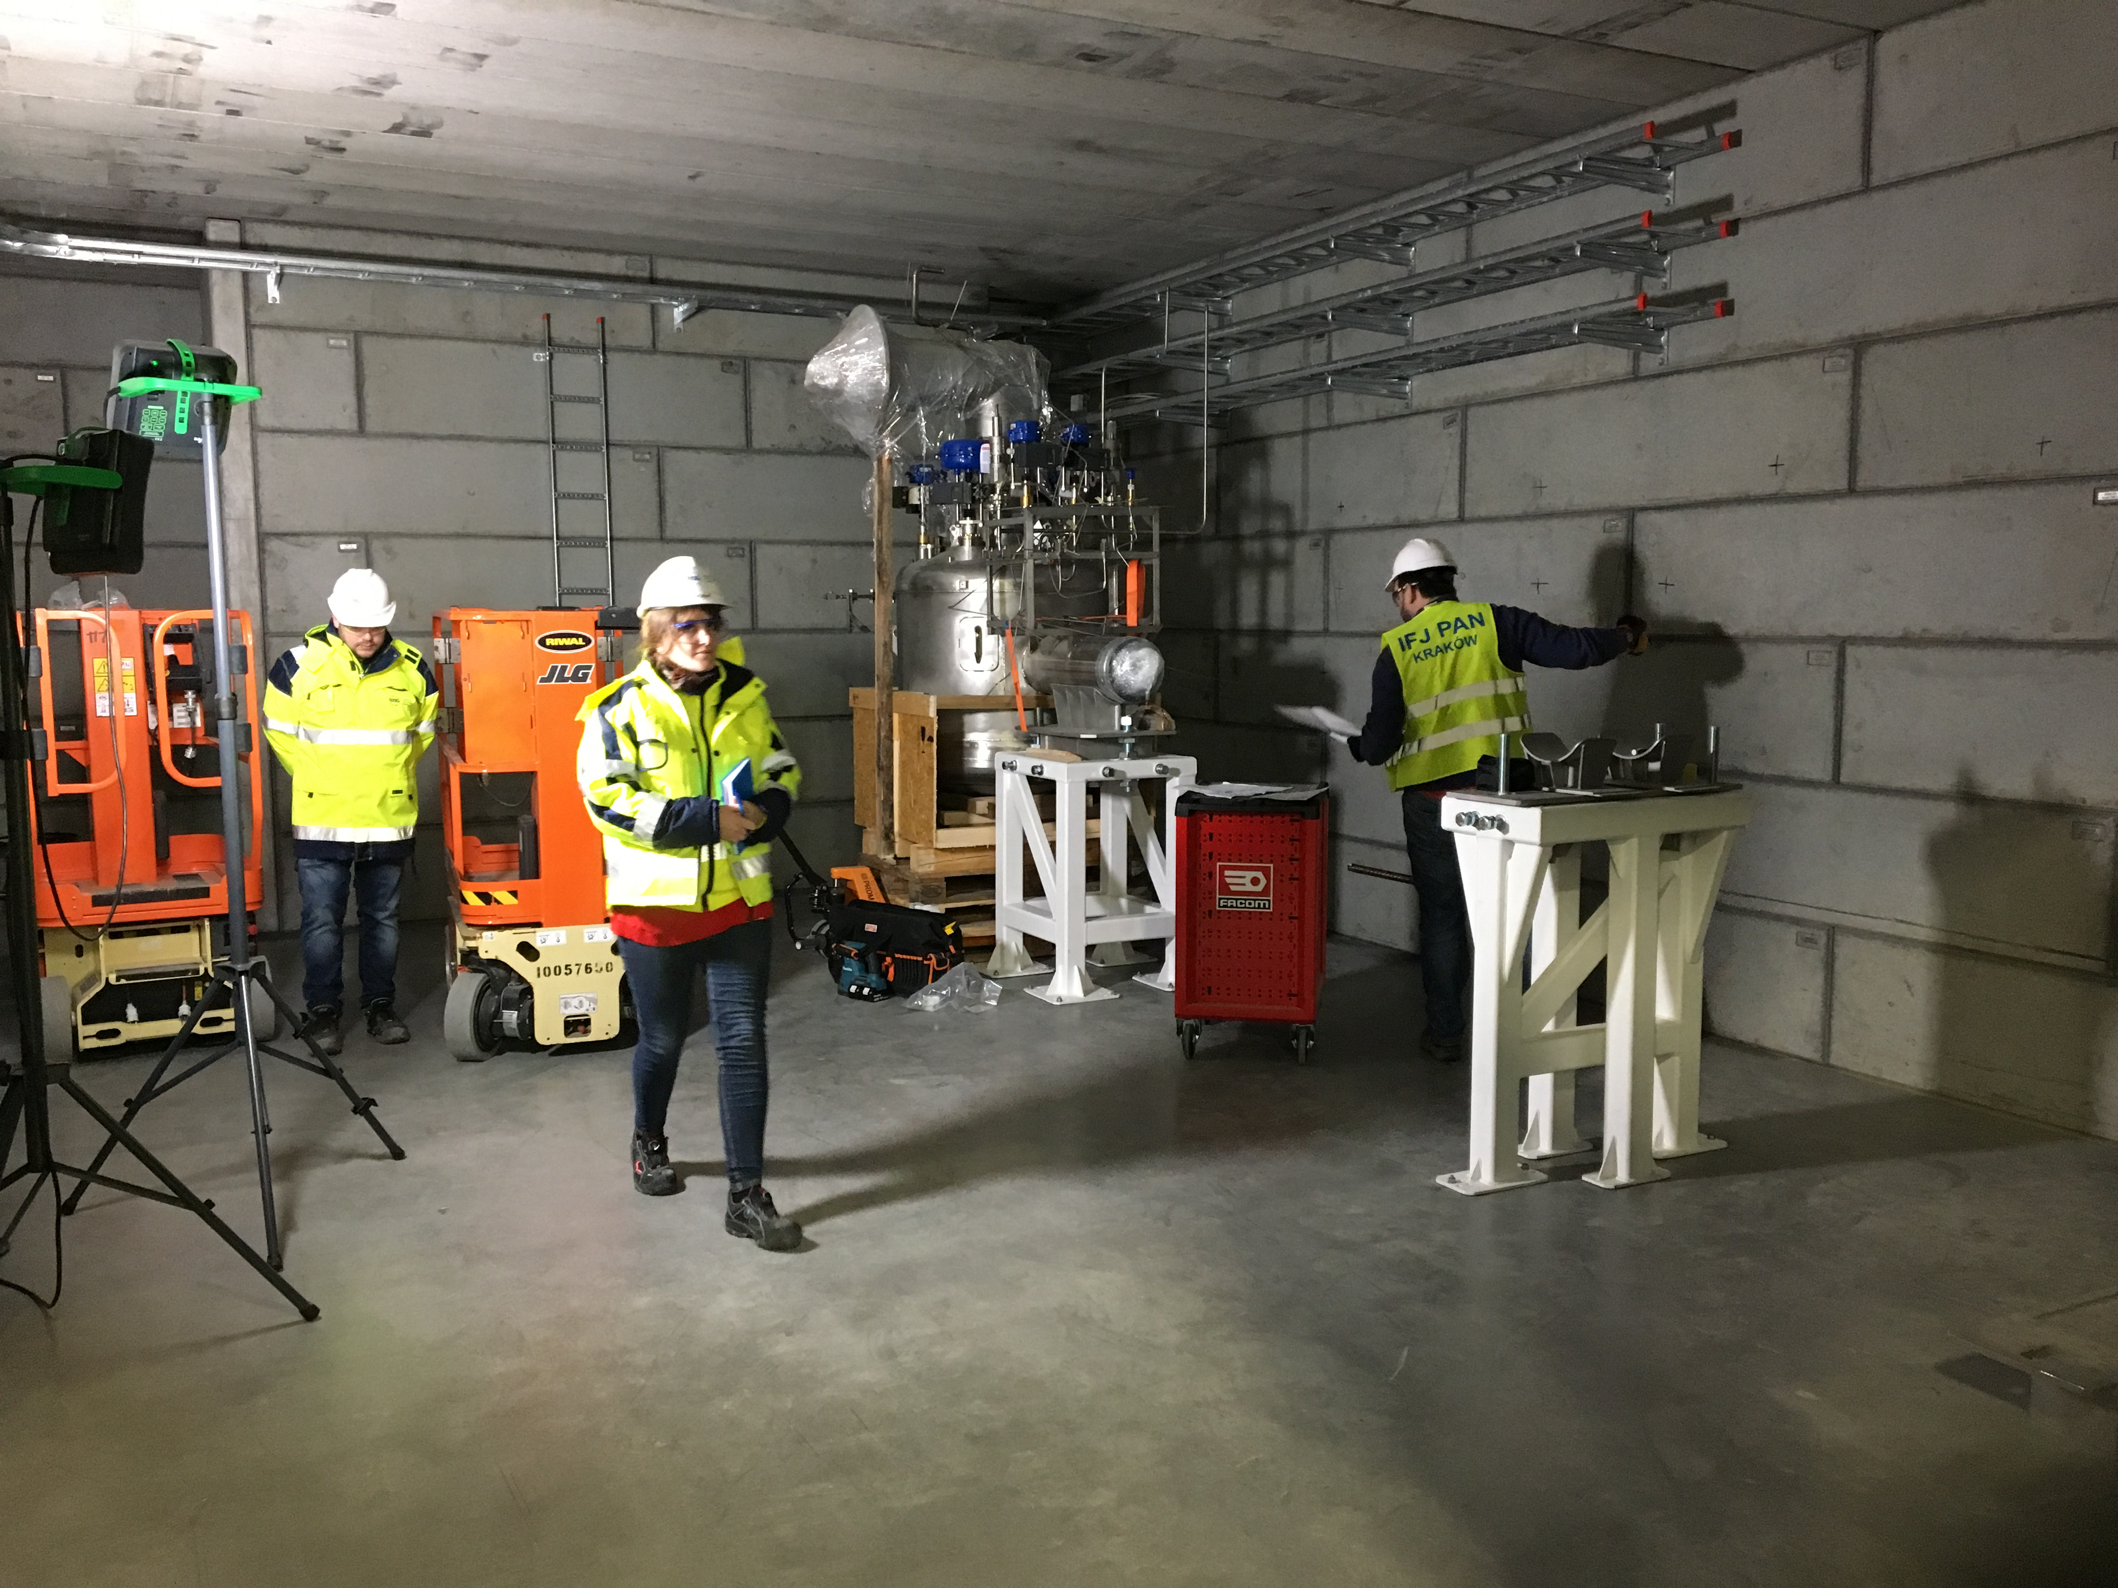
A busy 2019 awaits us all!
Quick ramping up of “hands-on” SRF activities at ESS, …
Thanks for the attention!
DISCLAIMERS:
No IK partners were harmed in the making of this presentation, as no picture displayed has been taken at our IK partner premises
Nothing, however, could have been shown here without our great IK partner work!

