Slide 1
TAC 19 Installation and commissioning 2019
Karl Vestin
Philippe Rabis
www.europeanspallationsource.se
2019-04-11

Slide 2
Glossary
BCM - Beam Current Monitor
BI - ESS Beam Instrumentation group
BLM - Beam Loss Monitor
BPM - Beam Position Monitor
CCDB - Controls Configuration DataBase
CDR - Critical Design Review
CEA - Commissariat à l’Énergie Atomique et aux Énergies Alternatives - in-kind partner
DTL - Drift Tube Linac
FAT - Factory Acceptance Test
FC - Faraday Cup
FEB - Front End Building
FIT - Final Integration Test
INFN - Istituto Nazionale di Fisica Nucleare - in-kind partner
LLRF - Low Level RF
LPS - Local Protection System
MEBT - Medium Energy Beam Transport
NCL - Normal Conducting LINAC
NPM - Non-invasive Profile Monitor
PDR - Preliminary Design Review
RFQ - RadioFrequency Quadropole
SAR - Systems Acceptance Test
SAT - Site Acceptance Test
SIT - Site Integration Test TS2 - Test Stand 2 at ESS - Klystrons and cryomodules

Slide 3
ICS work package 10: Accelerator Integration
Main role for work package 10 is to deliver control systems for the accelerator of the ESS facility
Daily work with multiple stakeholders of the accelerator division through:
control systems for a large diversity of technologies and disciplines: RF, Beam Instruments, Cryogenics plants, Cryogenics of cold linac, Water cooling systems, Vacuum, Magnets and power supplies
Located in different sections of the accelerator: MEBT, RFQ, DTL, Super Conducting Linac and Beam delivery systems
Where a key word is: integration, integration..
Numerous interfaces and stakeholders: internal and external

Slide 4
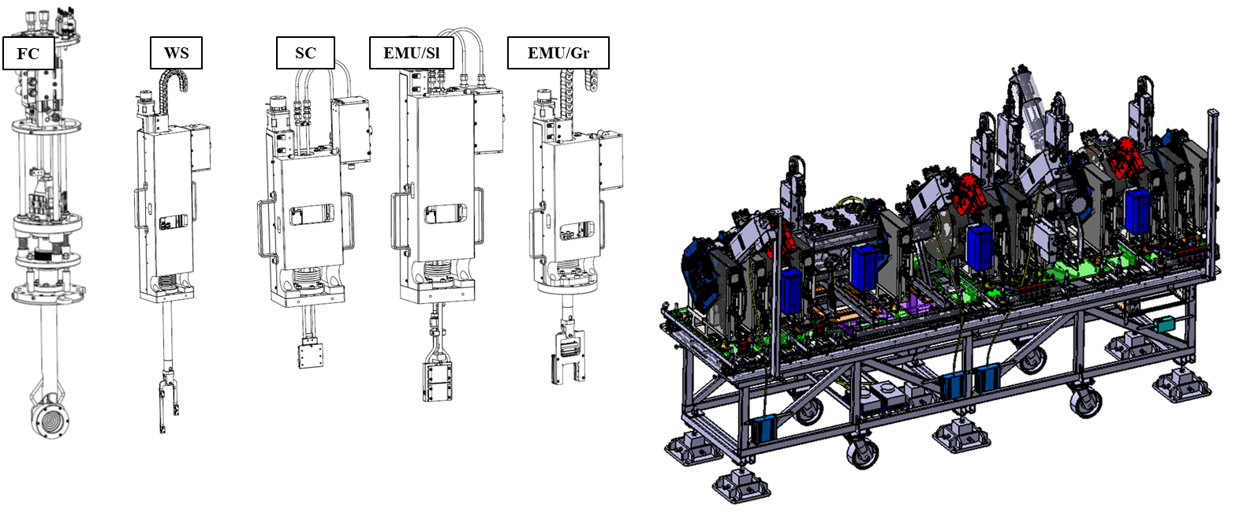
Achievements (MEBT)
Supporting ESS Bilbao and establishing a sound and reliable relationship with in-kind partner
Work beyond original scope to ensure that MEBT is ready for installation with the required control systems architecture; special focus on instruments
Wire Scanners
Emittance Measurement Units
Longitudinal Bunch Monitor
Neutron Beam Loss Monitors
Non Invasive Profile Monitors
Beam Current Monitors
Beam Position Monitors
Scrapers
Faraday Cup

Slide 5
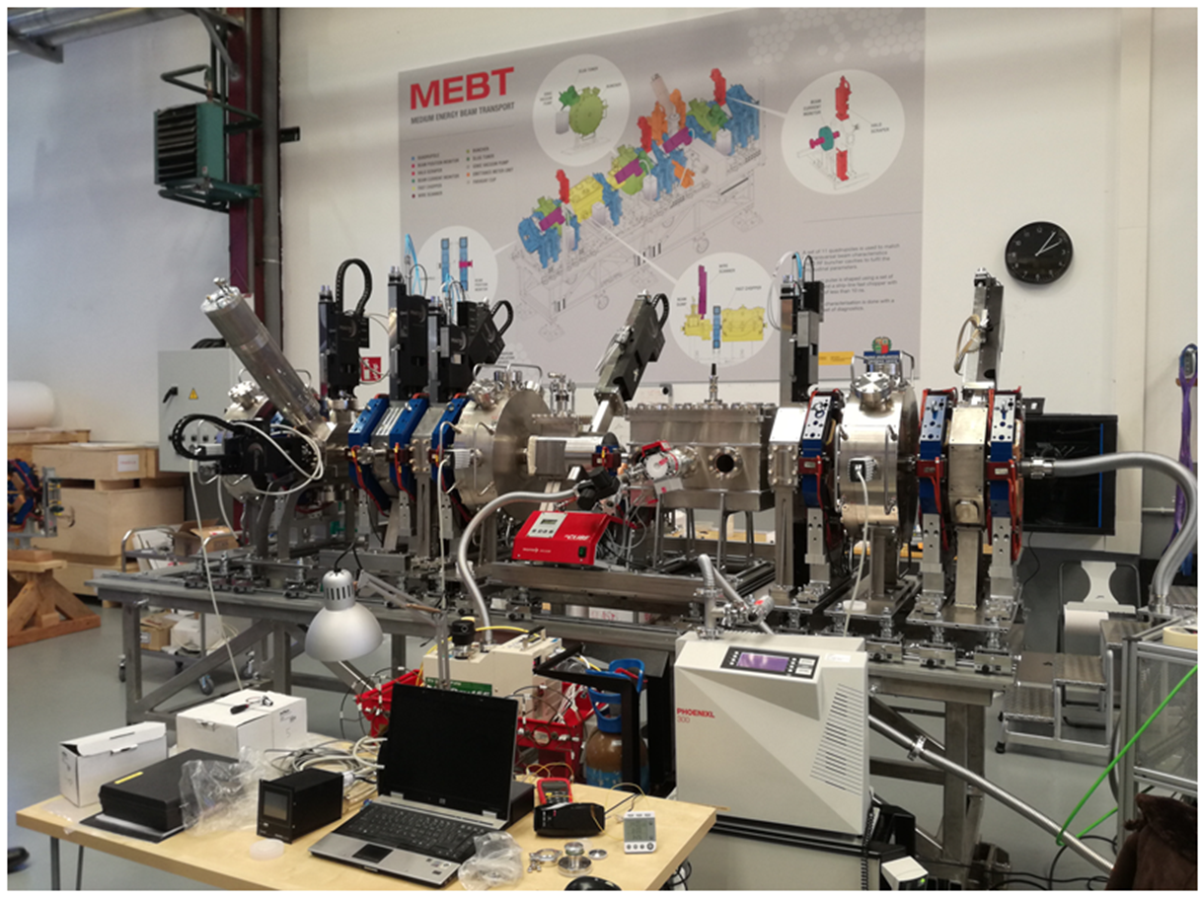
Achievements (MEBT)
Complete system vertical integration tests at ESS Bilbao in collaboration with ESS control and Diagnostics team
MEBT SAR in 2019-03 passed with recommendations, no show stopper

Slide 6
Achievements
RFQ:
Support to CEA for the supply of the control systems (including familiarisation with PLC factory, interfaces, tests, CCDB)
Water cooling skid installed (2018)
DTL:
CDR DTL control systems at INFN Legnaro passed successfully with no major issue (end 2018-10)
HW equipment now delivered to in-kind partner (INFN) as per contract with some delays
Beam instruments :
Constant development of several instruments supported by IFC cards during 2018
CDR for DTL FC (2018)
CDR NPM and BLM successfully passed (collaboration with BI department and CEA) early 2019
Successful collaboration with BI for preparation of instrument tests at J-Parc

Slide 7
Achievements
Cryogenics:
Support for PLC based control systems in order to deliver as per schedule Accelerator Cryogenics Plant and Test & Instrument Cryoplant.
Successful collaboration with Cryogenics team and equipment provider (Linde, Air Liquide) (EPICS integration)
TS2:
Support to TS2 for PLC control sytems as per schedule
RF group:
CDR LLRF ESS Bilbao (support to RF team) early 2019
Ongoing development of LLRF systems and RF LPS (SIM and FIM) including development of FPGA firmware (completed)

Slide 8
Installation plan for 2019 - 2020
RFQ RF System Operational
MEBT RF System Operational
9 Aug, 2019
11 Nov, 2019
Start of Beam Commissioning (Isrc to DTL4)
DTL1 RF System Operational
Start of Beam Commissioning (Isrc to DTL1)
Today
11 Oct, 2019
17 Feb, 2020
28 Sep, 2020
2019
Q1
Q2
Q3
Q4
Q1 2020
Q2
Q3
Q4
21 Mar, 2019
15 Jul, 2019
14 Oct, 2019
25 Nov, 2019
9 Mar, 2020
8 Jun, 2020
RFQ IRR
MEBT IRR
MEBT TRR
DTL1 TRR
DTLs 2, 3, 4 IRR
DTLs 2, 3, 4 RF Conditioning TRR
29 Jul, 2019
16 Sep, 2019
16 Dec, 2019
RFQ TRR
DTL1 IRR
RFQ/MEBT/DTL1 RF Conditioning TRR
RFQ
17 wks
May 20 - Sep 13
RFQ Assembly
6 wks
May 20 - Jun 28
RFQ Local Hardware Tests
4 wks
Jul 1 - Jul 26
RFQ Infrastructure Work Completion
Jul 29 - Aug 9
RFQ Integrated Hardware Tests
5 wks
Aug 12 - Sep 13
MEBT
20 wks
Aug 12 - Dec 27
MEBT Assembly
6 wks
Aug 12 - Sep 20
MEBT Infrastructure Work Completion
Sep 23 - Oct 4
MEBT Local Hardware Tests
3 wks
Oct 7 - Oct 25
MEBT Integrated Hardware Tests
9 wks
Oct 28 - Dec 27
DTL1
12 wks
Oct 7 - Dec 27
DTL1 Installation
4 wks
Oct 7 - Nov 1
DTL1 Infrastructure Work Completion
Nov 4 - Nov 15
DTL1 Local Hardware Tests
Nov 18 - Nov 29
DTL1 Integrated Hardware Tests
4 wks
Dec 2 - Dec 27
PSS Validation (ICS)
4 wks
Sep 30 - Oct 25
MPS Final Integration Tests (ICS)
4 wks
Dec 30 - Jan 24
RFQ/MEBT/DTL1 RF Conditioning Window
7 wks
Dec 30 - Feb 14
SRR2
Feb 3 - Feb 14
Beam Commissioning (ISrc to DTL1)
DTLs 2, 3, 4 Installation Window
Feb 17 - May 15
DTLs 2, 3, 4 RF Conditioning Window
May 18 - Jul 31
Aug 3 - Sep 25
SRR3
Sep 14 - Sep 25
Beam Commissioning (ISrc to DTL4)
Sep 28 - Dec 25

Slide 9
Key challenges
High number of parallel activities
Resource constraints
High technical risk
Many different stakeholders
Difficult to get unambiguous prioritization

Slide 10
Methodology for 2019
Methodology and strategy for 2019:
Establish agreed scope and priorities with all stakeholders
Regular sessions with stakeholders to review activities, deliverables and plan, cross functional:
AD Project support meeting
Accelerator sections (warm linac) installation meeting
Overall installation plan and milestones (high level)
Specific discipline reviews:
Beam instruments
RF group
Assign system owners and focal points: work package 10 and stakeholder sides
Hardware and integration monthly resources allocation boards to ensure adequate resource allocation

Slide 11
Methodology for 2019
Dedicated super conducting linac project focused meeting
Align and continously re-align work package 10 activities plan with AD installation and development (beam instruments) plan
Use of the same supporting work tools, i.e.
Jointly accessible and updated Primaver P6 acivity plans
Common activity table in Jira
Regular stakeholder coordination meetings (see following slides for proposal under preparation/discussion)

Slide 12
Normal conducting linac stakeholder meeting
Coordination of common activities towards the beam commissioning steps
from the RFQ up to DTL5
Machine directorate based approach to get things installed, tested and ready for beam
Strong involvement of in-kind partners for direct exchange
Definition of dependencies and feedback into and from the P6 planning
Align strategies and priorities for one machine section
Communication of progress, issues and blockers

Slide 13
Normal conducting linac stakeholder meeting (ICS proposal)
Program increment. Time boxed 2-3 months.
The stakeholder forum creates a set of tasks, procurements and issues that taken as a whole generates a meaningful result.
The forum occurs at the beginning of each program increment and contains representatives for all members (see below).
Procurements
--------------
--------------
--------------
Tasks
--------------
--------------
--------------
Issues
--------------
--------------
--------------
Beam diagnostics
Cryo group
Protection system group
Vacuum group
Test stand 2
SCL group
Radio frequency
NCL group
Hardware and integration group
Notes:
KRISTINA

Slide 14
Resource situation
The hardware and integration group had an unfortunately high attrition rate in 2018
The situation seems to have stabilized
Recruitment and procurement of consultancy services has now brought the number of integrators back in line with staffing plan
Ongoing recruitments and procurements will add:
Additional 2 FTE employees
Additional 2-4 FTE consultants to meet the resource peek expecetd in 2019 - 2020
A complete offsite team of 5 FTE to support the control system development for the cryomodules and cryo distributions system for the SCL

Slide 15
Thank you!
Thank you for your attention

