Slide 1
TAC 19 Ion Source And LEBT commissioning Lessons Learned
Saeed Haghtalab
Karl Vestin
www.europeanspallationsource.se
2019-04-12

Slide 2
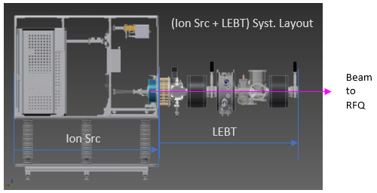
Ion source and LEBT control system
FC
NPM
IRIS
Chopper
EMU
BCM
NPM
Doppler
Power supplies
Water flow sensors
Vacuum system
Source
PLC
Cooling
Skid
Vacuum
PLC
Motion crate
MTCA
Crate
VME
Crate
Timing
Source IPC
Virtual machine
Notes:
KRISTINA

Slide 3
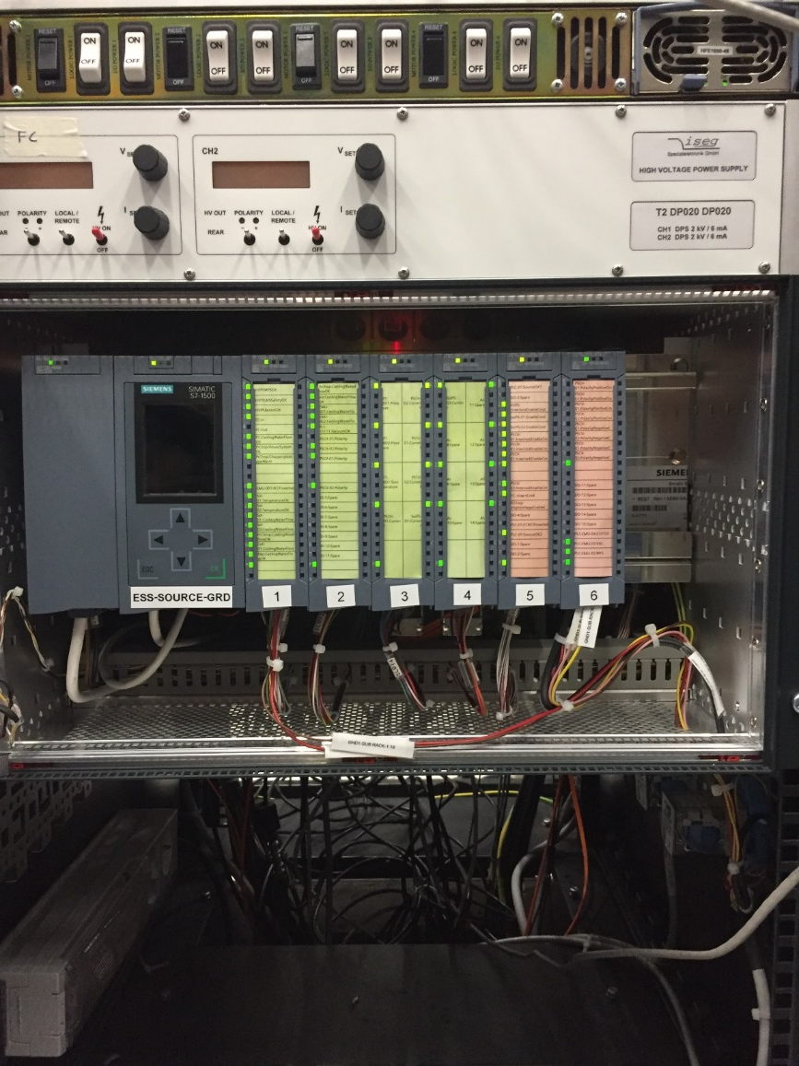
Source/Interlock PLC
Interfaces many different systems, including:
PSS
Vacuum
EMU
…
In case of errors or exceeded trip limits generates interlock
In case of interlock it shuts off magnetron, high-voltage power supplies etc thereby stopping beam
Notes:
KRISTINA

Slide 4
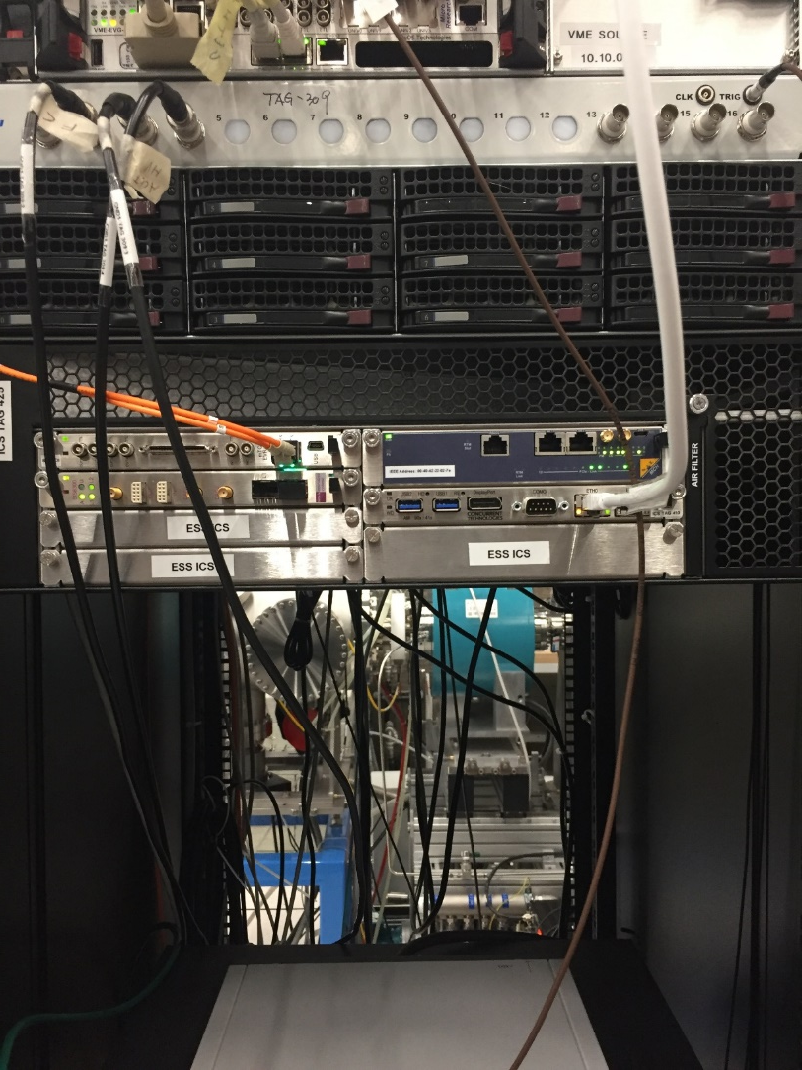
MicroTCA Crate
Data acquisition and timing receiver for instrumentation:
BCM
FC
EMU
Hosts IOCs for BCM, FC and EMU on a MicroTCA/Concurrent CPU
MRF Timing/event receivers (EVR)
DAQ AMC cards are Struck 8300
Notes:
KRISTINA

Slide 5
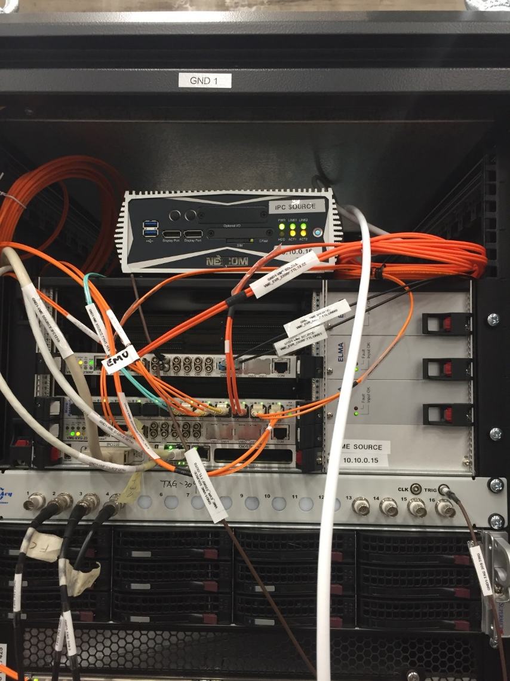
VME crate and IPC
VME crate contains the MRF timing event generator
VME crate also hosts the EVG and EVR for magnetron and chopper
IPC hosts IOCs for:
Ion source control
LEBT control
Interlock system
Notes:
KRISTINA

Slide 6
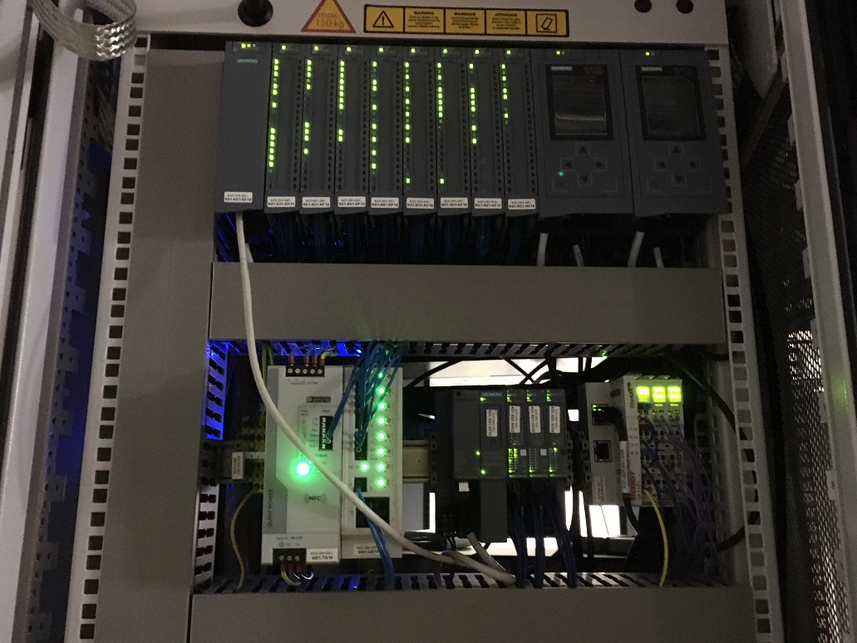
Vacuum PLCs
Two separate PLCs
For vacuum process control
For vacuum interlocks
Two IOC’s
One running on dedicated IPC for data acquisition
One running in virtualized environment for status readout and manual control
Notes:
KRISTINA

Slide 7
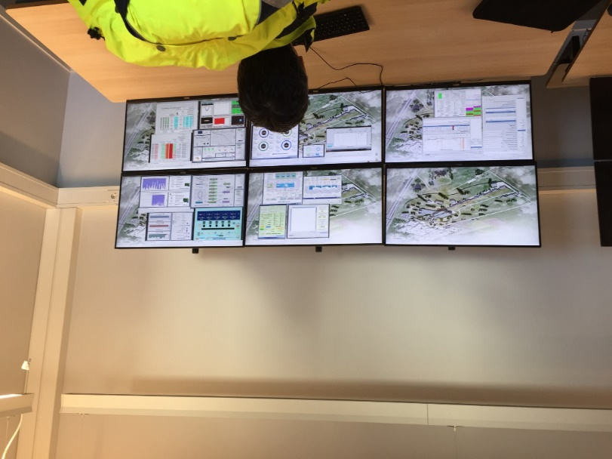
EPICS and OPI’s
In total ~15 IOCs to monitor and control the ion source, LEBT and all associated systems
Each system has a dedicated OPI for operators and an engineering OPI
All systems are connected to archiver appliance. Selection of PVs for archiving made in collaboration with system owners.
Alarms are configured and generated by the IOC’s.
Alarm server (BEAST) configuration and workflow to be defined
Notes:
KRISTINA

Slide 8
Delivery from in-kind
Reinforce
Ion source, LEBT and associated control systems delivered as a consistent and tested unit
Constant work to clarify tasks with in-kind partner in a constructive and friendly manner
Improve
The configuration used for testing during the Factory Acceptance Test (FAT) was not fully documented
Site Acceptance Test (SAT) should be conducted using a configuration matching the FAT configuration
The testing conducted during the FAT could have been more comprehensive.
Ensure close interaction with in-kind partner prior to delivery to ensure fully documented configuration and comprehensive well-documented factory acceptance tests
Notes:
KRISTINA

Slide 9
Organization and planning
Reinforce
Regular follow-up meetings in the cross-division commissioning team
Clear leadership for the commissioning planning
Agile and flexible approach to enable rapidly changing priorities
Improve
Clarity in role and responsibility distribution
Planning of commissioning activities
Clarify role and responsibility for the “Declaration of Conformity” sub-project
Address commissioning as one cross-division “core team” with clearly defined roles and responsibilities. Engage proactively with the rest of the commissioning team to ensure better coordination of activities.
Notes:
KRISTINA

Slide 10
Installation
Reinforce
Onsite presence of in-kind personnel during installation
Visibility and active participation to AD weekly meetings, specific NCL, SCL, AD project support meeting, commissioning coordination: we are often the last contributor to the final installation
Improve
Avoid overlap of installation and commissioning activities
If critical installation activities (water/power) are significantly delayed the commissioning project needs to be re-planned, not just nudged a few days
Follow installation progress and adjust commissioning plans to ensure realistic and relevant planning when the hectic commissioning period starts.
Notes:
KRISTINA

Slide 11
Commissioning
Reinforce
We did get beam in the end. This was an accomplishment of ESS working as a team, all differences and arguments set aside. This should be commended and reinforced.
Improve
Verification of control systems before commissioning. We had too many unexpected problems.
Establish a prioritized list for control systems early in order to allow for correct planning of work.
Avoid underestimating time and effort required for commissioning
Work with in-kind contributors the reinforce verification and documentation of deliverables. Work with “core team” to have a clear prioritization of tasks. Do verification in controlled environments before commissioning.
Notes:
KRISTINA

