Slide 1
European Spallation Source
TAC 19 – Integration with in-Kind Partners
João Paulo Martins
Control Systems Engineer
European Spallation Source ERIC
2019-04-11

Slide 2
TAC 19 – Integration with in-Kind Partners
Agenda
The MEBT Project
Hardware integration
Software integration
Support and collaboration
Lessons learned
Acknowledgements

Slide 3
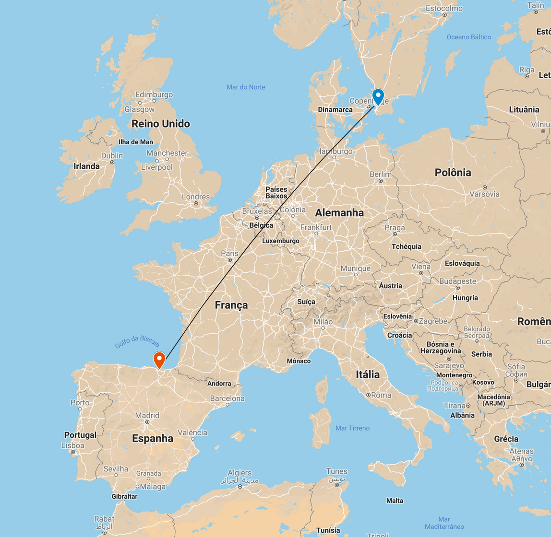


TAC 19 – Integration with in-Kind Partners
Agenda
The MEBT Project
Hardware integration
Software integration
Support and collaboration
Lessons learned
Acknowledgements

Slide 4
TAC 19 – Integration with in-Kind Partners
The MEBT Project
The MEBT is just one of the many ESS Bilbao contribution to ESS;
In-Kind Agreement with ICS since 2016-12;
The deliverables include the integration of:
  RF systems;
  Magnets and power supplies;
  Local protection systems;
  Specific beam instrumentation systems;
Controls hardware is provided by ICS according to our hardware strategy;

Slide 5
TAC 19 – Integration with in-Kind Partners
The MEBT Project
The project is in the delivery stage at the moment;
System Acceptance Review realized last week 2019-03;
MEBT delivery to Lund expected to 2019-06;
Rack equipment will be installed before;
MEBT integrated tests expected to 2019-11;

Slide 6
TAC 19 – Integration with in-Kind Partners
The MEBT Project
Some numbers:
  10 different diagnostics instruments;
  3 RF buncher cavities;
  Fast chopper with tight requirements;
  All types of hardware platforms from ICS catalogue are present: PLCs, Beckhoff EtherCAT and 10 MicroTCA crates;
  Number of IOCs and things to control much higher than ISrc + LEBT;

Slide 7
TAC 19 – Integration with in-Kind Partners
Agenda
The MEBT Project
Hardware integration
Software integration
Support and collaboration
Lessons learned
Acknowledgements

Slide 8
TAC 19 – Integration with in-Kind Partners
Agenda
The MEBT Project
Hardware integration
Software integration
Support and collaboration
Lessons learned
Acknowledgements

Slide 9
TAC 19 – Integration with in-Kind Partners
Hardware integration
The MEBT will employ all different types of hardware from ICS catalogue: MTCA, PLC and Beckhoff EtherCAT;
As defined in the agreement, ICS should provide this hardware to ESS Bilbao;
Summary of Controls Hardware for MEBT
System | MicroTCA | PLC | Beckhoff ECAT | Serial Device
RF Systems (LLRF, SSA, RFLPS)
Buncher Tuner
Fast Chopper
Magnets Power Supply
Faraday Cup
Emittance Meter Unit
Scrappers

Slide 10
TAC 19 – Integration with in-Kind Partners
Hardware integration
How does it work?
  ESS Bilbao elaborates the hardware list based on their design;
  The list is reviewed together with ICS;
  ICS proceeds with purchase and shipment to ESS Bilbao;
  This procedure is iterative;
Delays during the procurement phase obviously affects ESS Bilbao;
MTCA hardware is mostly driven by ICS;
PLC hardware is mostly driven by ESS Bilbao;

Slide 11
TAC 19 – Integration with in-Kind Partners
Hardware integration
First developments were done on VME hardware as a temporary solution;
ESS Bilbao was affected by the delays from other in-kind partners of ESS – MicroTCA digital platform;
Fast Chopper controls was entirely developed using VME; The system was successfully tested using MTCA hardware in 2018-12;
We should consider FPGA firmware as part of the hardware package;
ICS will absorb any remaining integration work related to MTCA to mitigate the impact of delays;

Slide 12
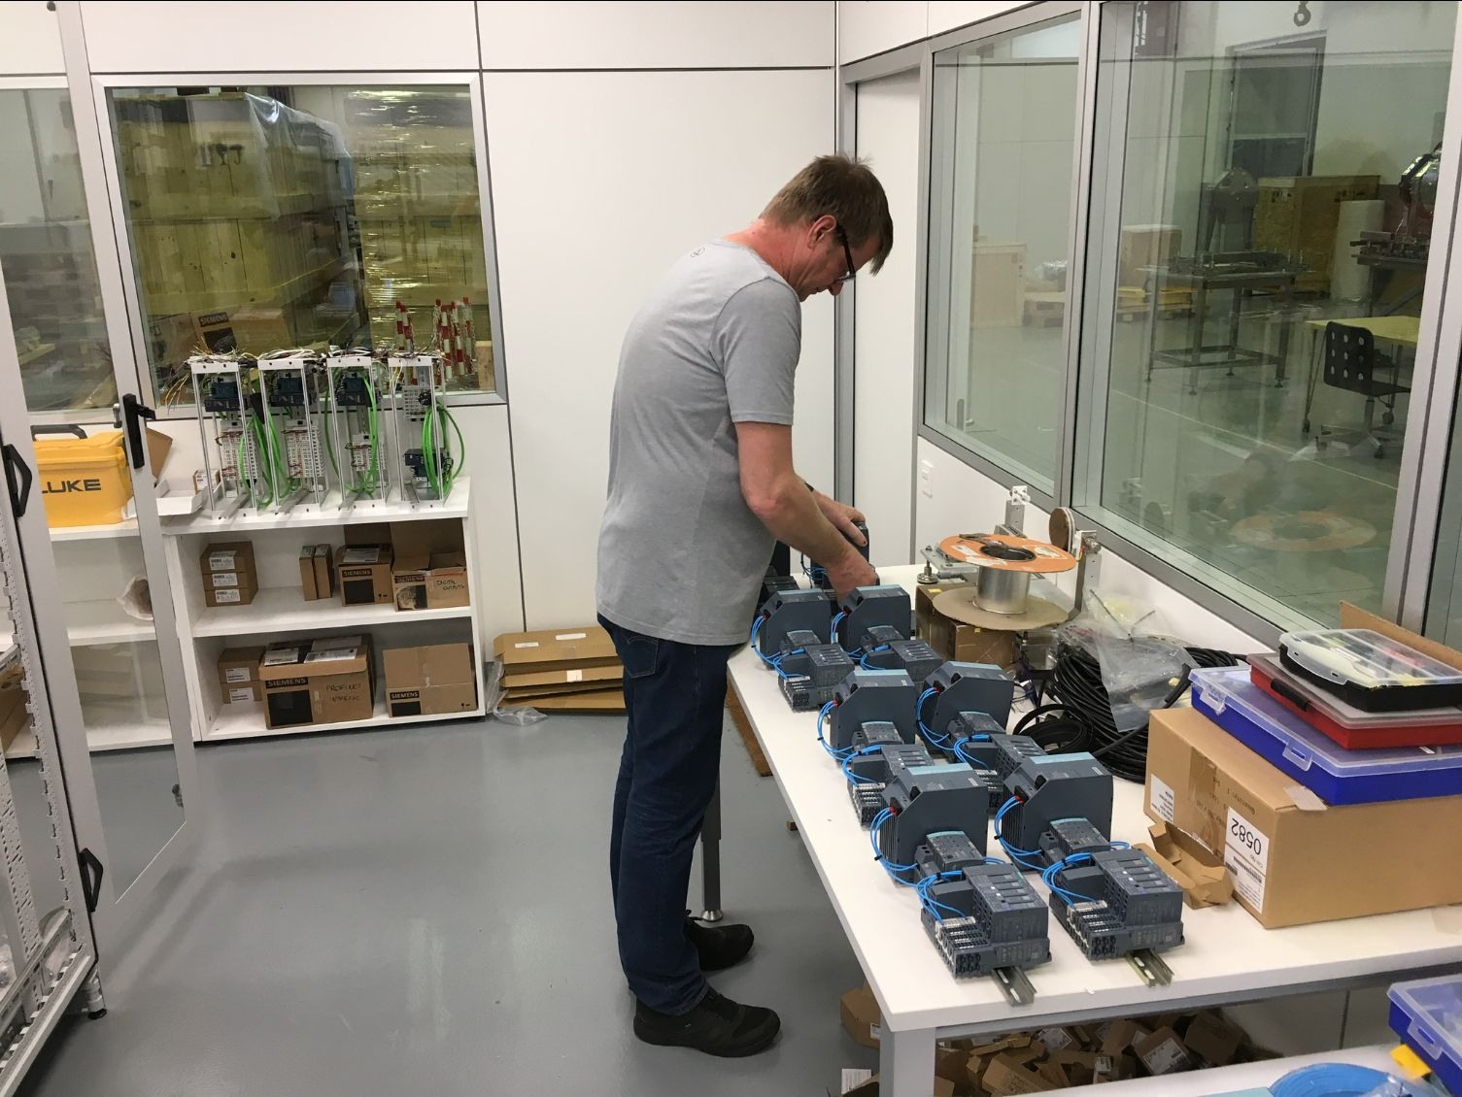
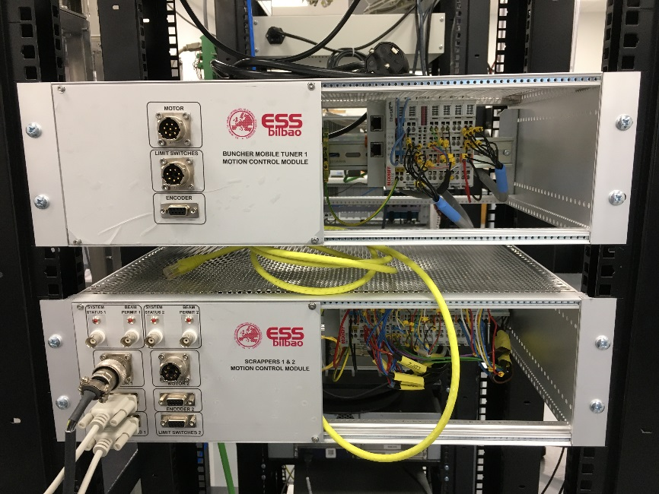
TAC 19 – Integration with in-Kind Partners
Hardware integration
The agreement sometimes is not clear about the scope of work on each side;
ESS Bilbao had to put extra effort to prepare the PLC and EtherCAT crates;
Lack of official standard for these kind of installations;
To mitigate this issue, ICS provided workforce in Bilbao;

Slide 13
TAC 19 – Integration with in-Kind Partners
Agenda
The MEBT Project
Hardware integration
Software integration
Support and collaboration
Lessons learned
Acknowledgements

Slide 14
TAC 19 – Integration with in-Kind Partners
Agenda
The MEBT Project
Hardware integration
Software integration
Support and collaboration
Lessons learned
Acknowledgements

Slide 15
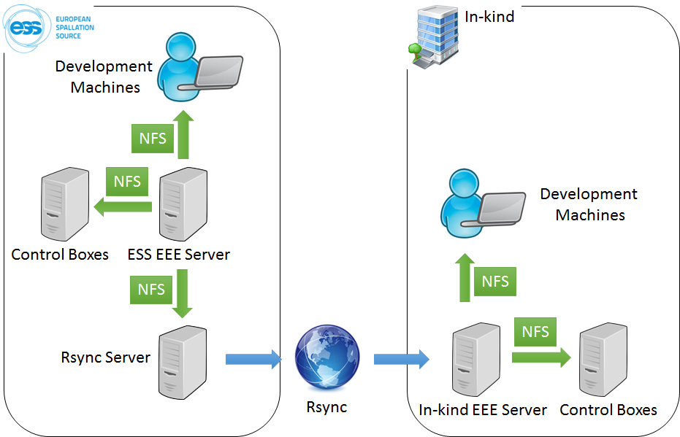
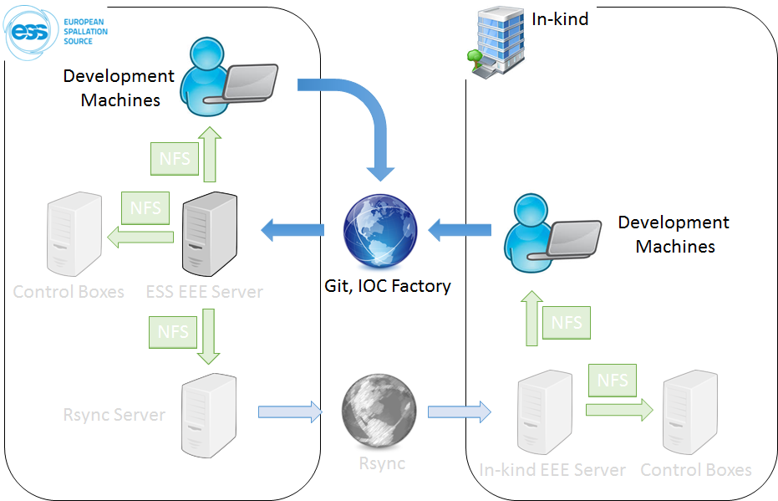
TAC 19 – Integration with in-Kind Partners
Software Integration
The main software component of ESS Control System: EPICS;
ESS EPICS Environment (EEE and now E3) was designed with the in-kind partners in mind:
  Small group of maintainers of the driver pool;
  Customized build system that offloads the complexity of the IOC structure;
  Big collection of EPICS modules and extensions already available;
  Those who are not familiar or keen on low-level development can concentrate on integration work;

Slide 16
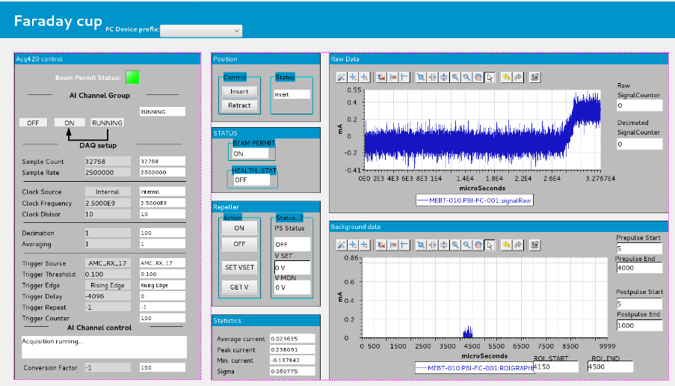
TAC 19 – Integration with in-Kind Partners
Software Integration
ESS Bilbao has an in-kind EEE server connected to our main server via Rsync;
This infrastructure allowed engineers with little or no previous experience with EPICS to rapid become part of the EPICS world;
ICS developed generic modules to help standardize some common applications:
  Generic Scanning Module;
  IFCDAQ – Generic Data Acquisition;
  mrfioc2 (*);

Slide 17
TAC 19 – Integration with in-Kind Partners
Agenda
The MEBT Project
Hardware integration
Software integration
Support and collaboration
Lessons learned
Acknowledgements

Slide 18
TAC 19 – Integration with in-Kind Partners
Agenda
The MEBT Project
Hardware integration
Software integration
Support and collaboration
Lessons learned
Acknowledgements

Slide 19
TAC 19 – Integration with in-Kind Partners
Support and collaboration
For most of the participants in this type of collaboration, an in-kind contribution is a new paradigm;
We learn together how to work together and how to overcome the problems and challenges;
A lot of communication is necessary, keeping track of discussions and actions that need to be taken is fundamental;
During the project execution phase, different stakeholders constantly request information and status updates, which adds an overhead to the in-kind partner. Having one contact person coordinating this flow of information is crucial for the progress of the project;

Slide 20
TAC 19 – Integration with in-Kind Partners
Support and collaboration
Although several issues can be solved regardless of the distance, visits to the partners plays a major role on the overall progress;
Over the course of two years, several trips to Bilbao were organized:
  2017-05: MEBT Control System CDR;
  2017-11: Installation of the first MicroTCA crate;
  2018-04: Project status and technical support;
  2018-06: Faraday Cup tests with ESS Bilbao injector;
  2018-10: Project status and technical support;
  2018-12: One week mission for technical support;
  2019-03: MEBT System Acceptance Review;
  2019-??

Slide 21
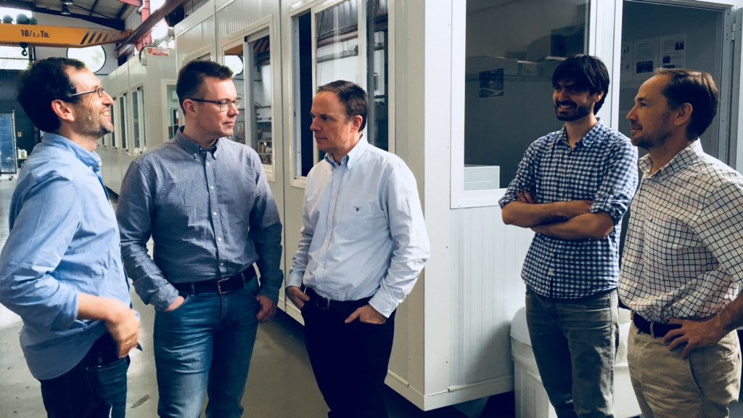
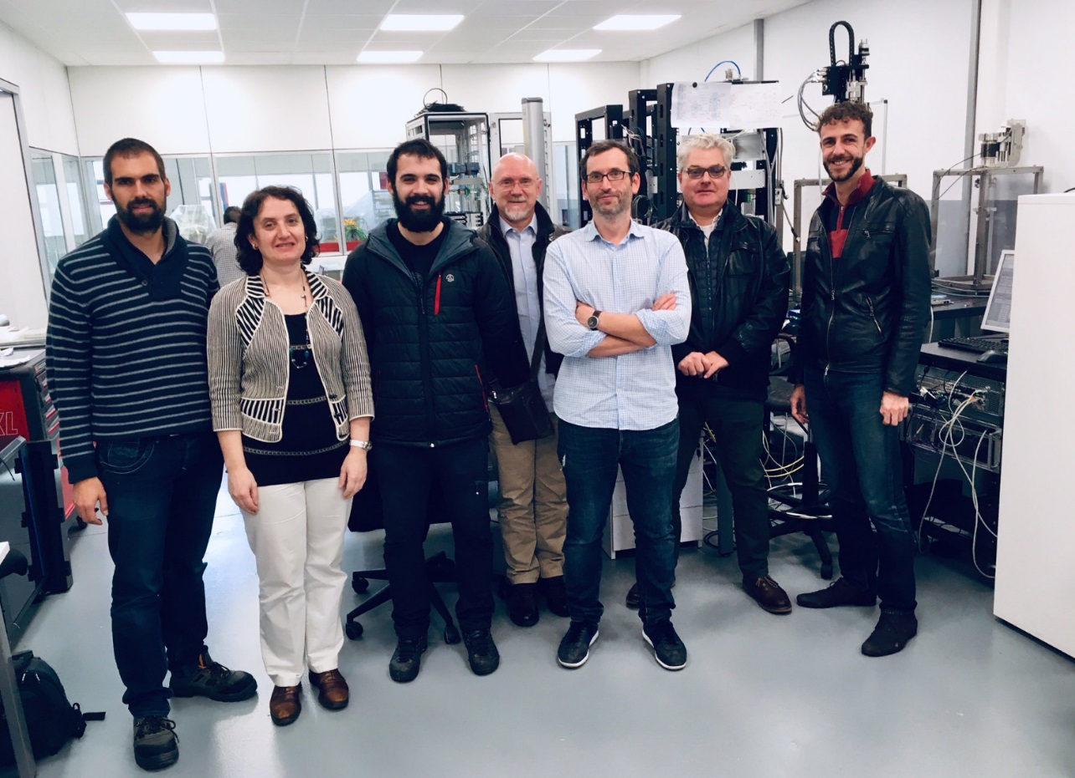
TAC 19 – Integration with in-Kind Partners
Support and collaboration

Slide 22
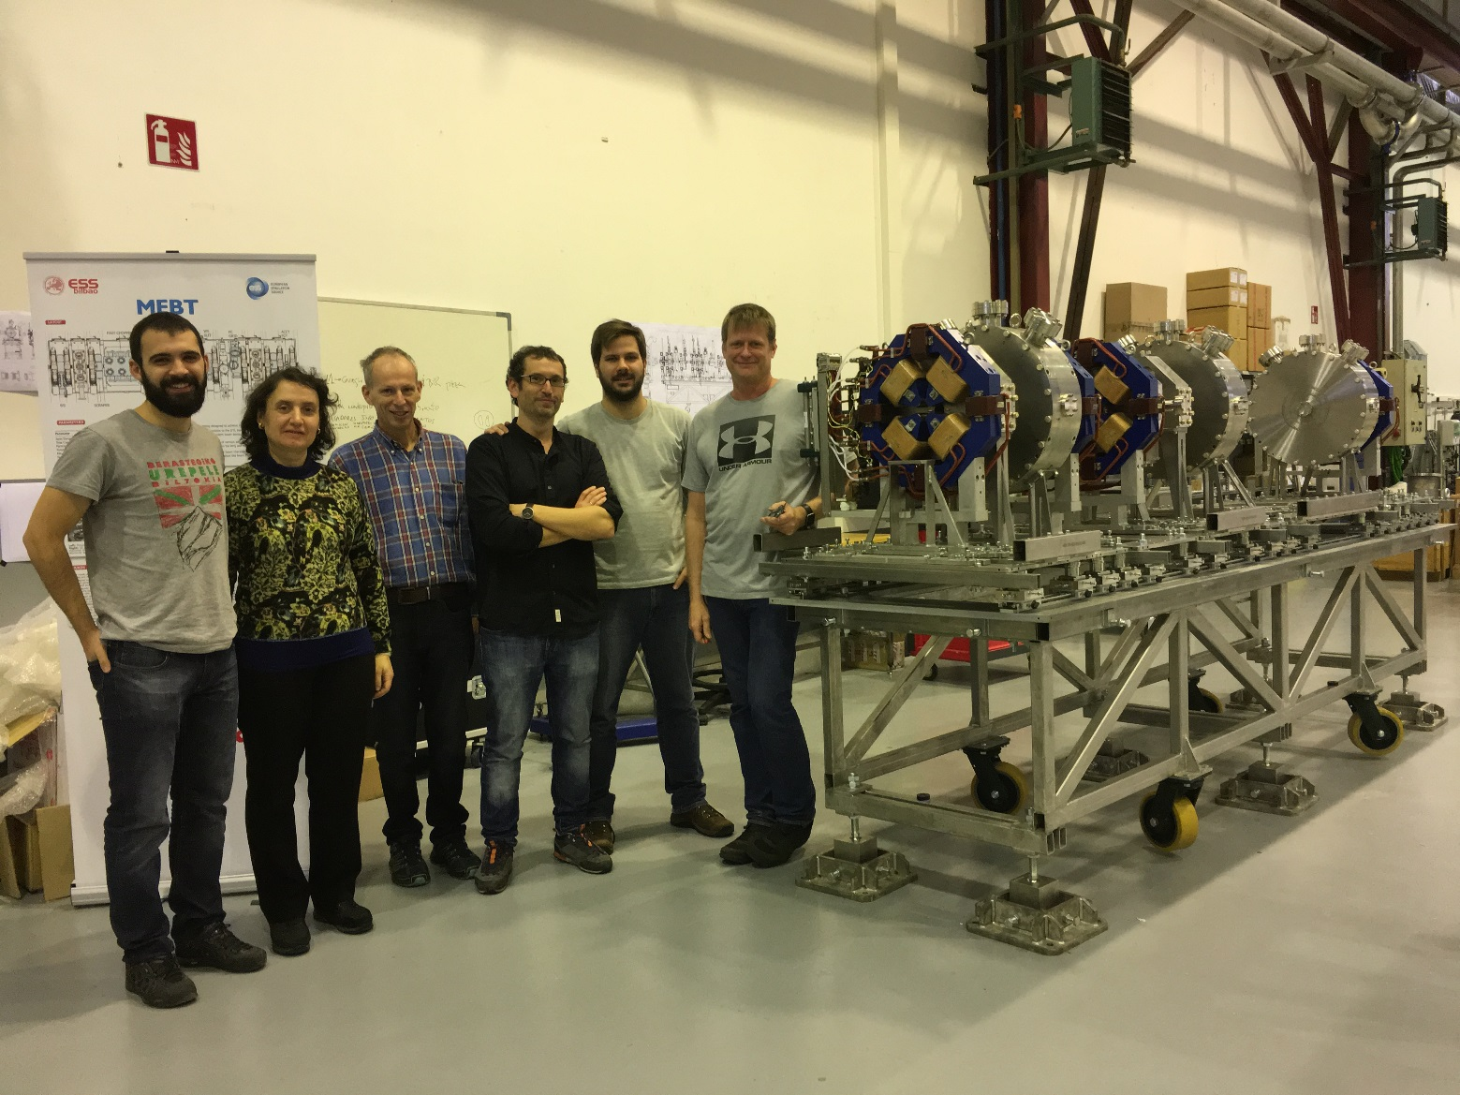
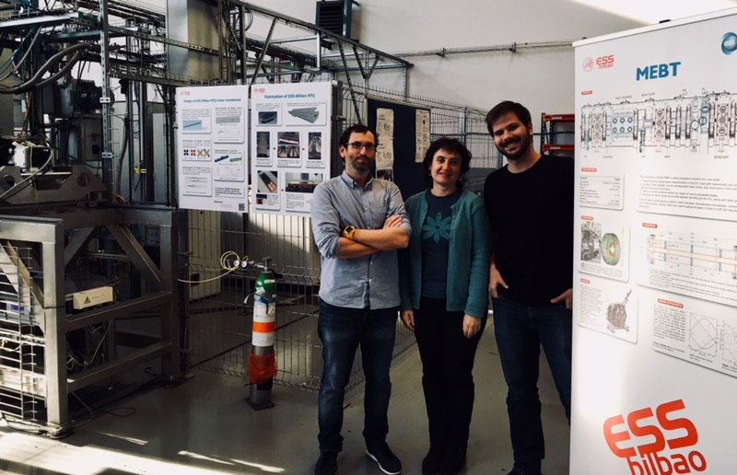
TAC 19 – Integration with in-Kind Partners
Support and collaboration

Slide 23
TAC 19 – Integration with in-Kind Partners
Agenda
The MEBT Project
Hardware integration
Software integration
Support and collaboration
Lessons learned
Acknowledgements

Slide 24
TAC 19 – Integration with in-Kind Partners
Agenda
The MEBT Project
Hardware integration
Software integration
Support and collaboration
Lessons learned
Acknowledgements

Slide 25
TAC 19 – Integration with in-Kind Partners
Lessons learned
When the scope of each part is not very detailed, patience, comprehension and, above all, collaboration spirit is necessary;
There is a hardware and software strategy from ICS to all in-kinds and stakeholders. Therefore, ESS should provide the fundamental building blocks that enables the partners focus on what is important: integration;
Issues and delays on ESS side directly affects the in-kind partners. To mitigate the effects, ESS should put extra effort on the technical support, sometimes even taking part in some tasks;
The more the interfaces and standards are defined, the better, always.

Slide 26
TAC 19 – Integration with in-Kind Partners
Lessons learned
The ecosystem provided by ICS constantly changed along the time:
  ESS EPICS Environment: EEE → E3;
  Motion Control hardware: Geobrick → Beckhoff EtherCAT;
  Motion Control Software: Ecat2 → ECMC;
  Digital platform: VME → MTCA;
  EPICS modules, FPGA firmwares, drivers …
This is the natural evolution of the project!
To mitigate the effects for the partner, each case should be analyzed:
  Sometimes the changes are minimal and we should encourage the update;
  In some cases, changes are dramatic: better to keep current status and update in house;

Slide 27
TAC 19 – Integration with in-Kind Partners
Agenda
The MEBT Project
Hardware integration
Software integration
Support and collaboration
Lessons learned
Acknowledgements

Slide 28
TAC 19 – Integration with in-Kind Partners
Agenda
The MEBT Project
Hardware integration
Software integration
Support and collaboration
Lessons learned
Acknowledgements

Slide 29
TAC 19 – Integration with in-Kind Partners
Acknowledgements
Working with ESS Bilbao team is a pleasure;
Special thanks to all internal ESS stakeholders involved: WP3, BI, RF;
Special thanks to Ibon, Idoia, Nagore, Giles, Angel and all ESS Bilbao team;
Questions?

