Slide 1
Neutron Beam Port Inserts and Optics, design and interface Target to NSS
Daniel Lyngh ¹, Alan Takibajev ¹ Naja dela Cour ¹, Lennart Åström ¹, Bengt Jönsson ¹, Bengt Andersson ¹, Kazim Raza Syed¹, Jarich Koning ¹, Luca Zanini ¹, Görel Hagermark¹, Iain Sutton¹, Hansdieter Schweiger ¹, Christopher Hall², Mario Koenen², Patrik Heldmann², Yannnick Beßler²
Position
¹ European Spallation Source ERIC, ² Forschungszentrum Jülich
2019-04-11

Slide 2
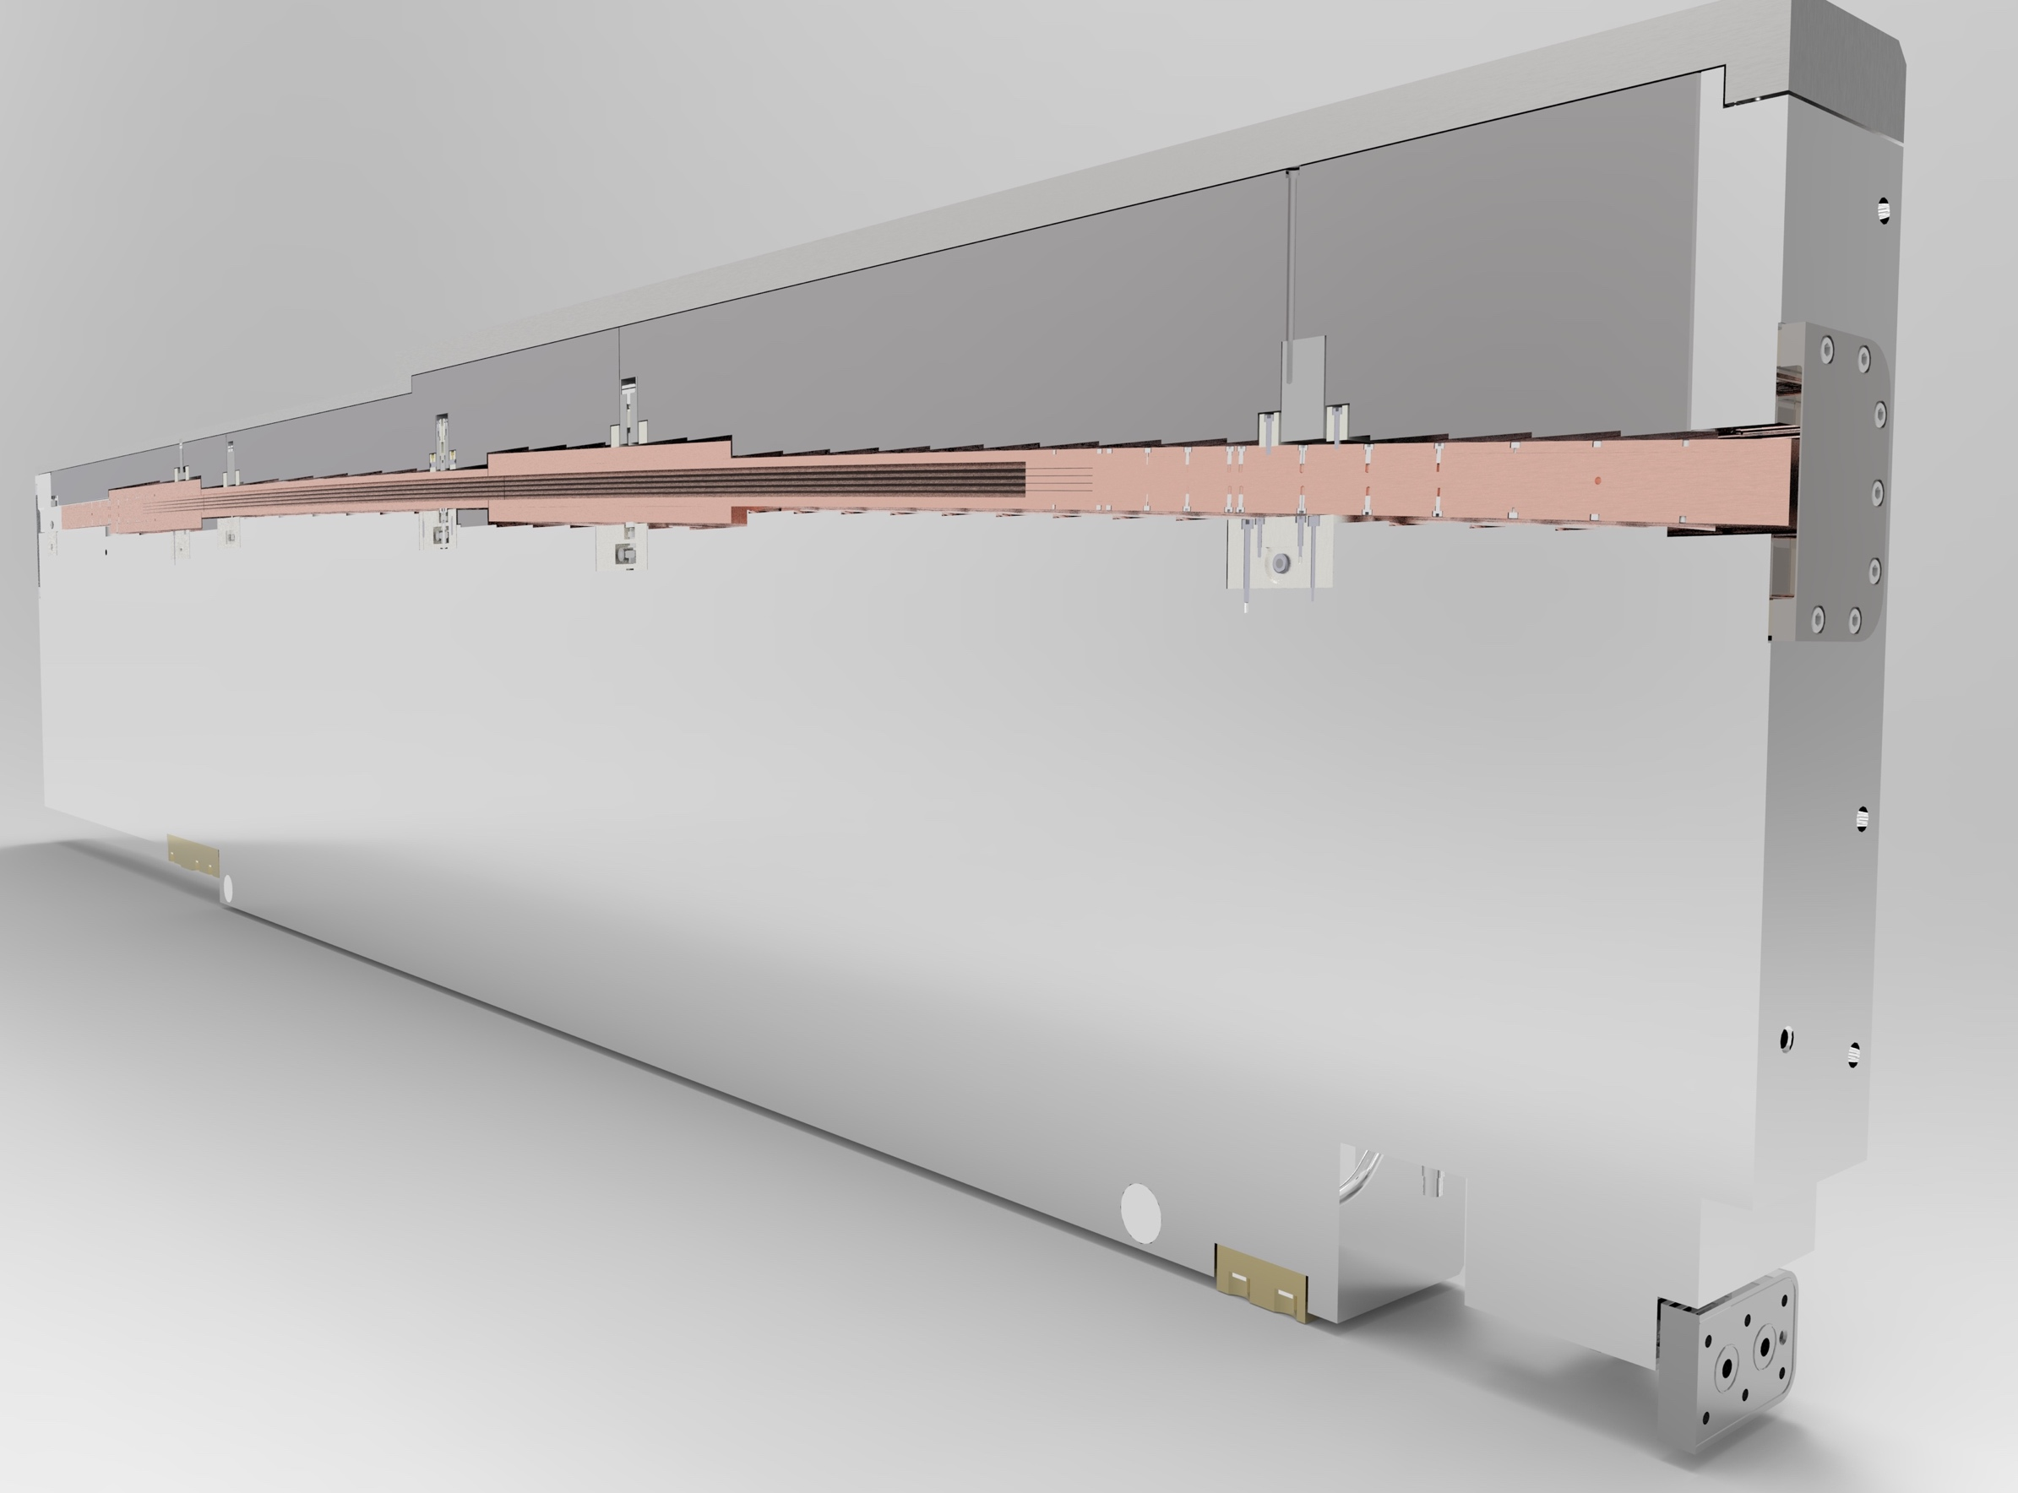
Talk Outline
Project Status
  Recent Accomplishments
  Schedule/plan
  NBOA design plan
Neutron Beam Port Insert Design Project
  Mechanical design Value Engineering
  Neutronic analysis
  NBOA integration & alignment features
  NBOA/NBPI cooling and helium atmosphere
Neutron Beam Port Plugs
Light Shutter System
  Mechanical design

Slide 3
Recent Accomplishments NBEX project
Engaged contracted, kicked-off collaboration with Forschungszentrum Jülich for:
  Test Stands for NBPI and Light Shutter System
  Neutron Beam Port Insert
  Light Shutter System
  Insert Installation Tool
In collaboration with FZJ implemented significant value engineering improvements for the NBPIs.
Agreed with NSS on handover method and schedule for delivery of Neutron Beam Optics Assemblies and corresponding standardized alignment features.
Contracted and initiated a study of motion control system for LSS and Beam Bridge Guide Optics alignment with a specialist company.
PDR approved for NBPI Cooling system H20 & He including released agreed interface with NSS.
Completion of neutronic analysis of NBPI/Port block gaps allows value engineering of design to be implemented.
Decided for removal of cooling system for Plugs (for ports not assigned to an instrument).
Ordered low cobalt SS raw material for NBPIs and NBPPs (~300Te@1.9M€) to secure schedule.

Slide 4
Schedule Overview
2019
Q1 Q2 Q3 Q4
2020
Q1 Q2 Q3 Q4
2021
Q1 Q2 Q3 Q4
Final Design
Make Phase
Installation Phase
Prototype & Test Stand
Neutron Beam Port Insert Prototype / Horizontal Test Stand
Light Shutter Prototype / Vertical Test Stand
Neutron Beam Ports
Inserts
Plugs
Light Shutter System
Tools
Neutron Beam Windows
Tools
Insert Extraction Tool (cask)
Delivery
To
Site
Start
of
Installation
System Test Complete
PDR
CDR
Last updated 2019-04-05

Slide 5
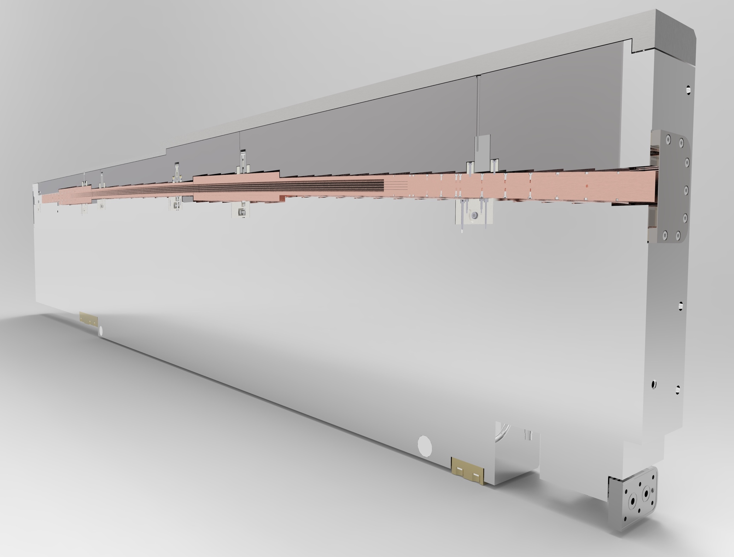
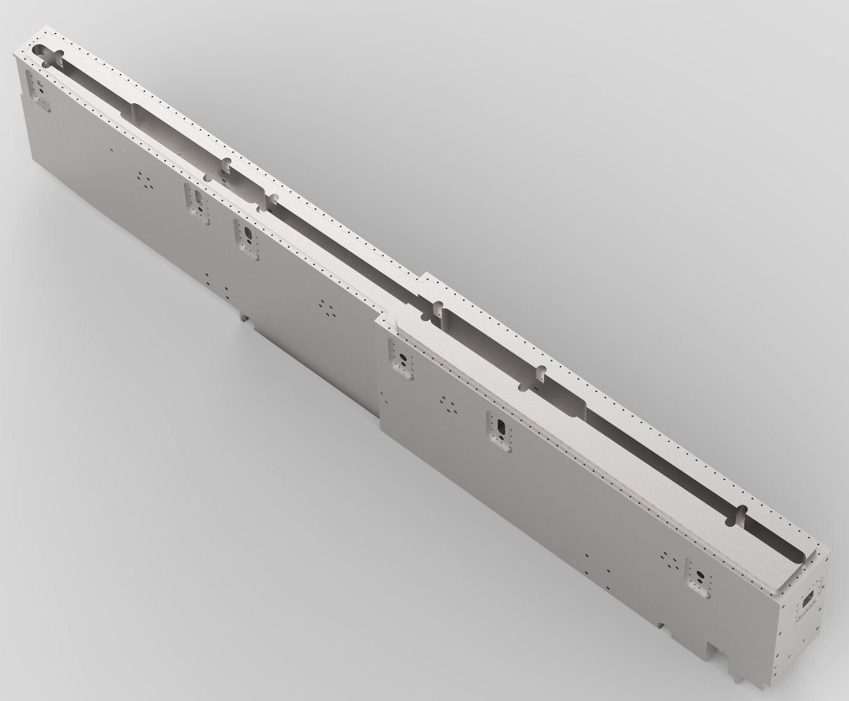
NBPI - NBOA Integration
NBOA compartment
NBPI body
Cavity for alignment features

Slide 6
NBOA-NBPI Integration review path
✗
✗
✗
NBOA Design from Guide vendor
NSS Check
NBEX Check
(geometrical interface)
FZJ Check
(NBOA geometry manufacturability)
CAD
ESS CAD
Released
TCS/BPCS
ESS CAD
Released
TCS/BPCS
✓
✓
Instrument Specific ICD-R sheet
(ESS-0238333)
✓
TG3
Instrument teams/Guide vendors
NSS
NBEX
FZJ (NBPI Design Owner)
CDR
Approved for NBOA manufacturing
Approved for NBPI manufacturing

Slide 7
NBOA NBPI Status
2019-04-09 (updated after distribution to TAC committee)
Milestones
TEST BEAM LINE
NBOA design del
NBOA appr. TD
NBPI CDR
FAT
Delivery to Site
NBOA integration
19-W8
19-W8
14/1-20
20-04-21 – 04-10-21
MAGIC
19-W9
19-W9
2/5
31/12-19
20-04-21 – 04-10-21
LOKI
(19-W9) W16
3/5
20-04-21 – 04-10-21
VESPA
(19-W14) W16
7/7-21
20-04-21 – 04-10-21
DREAM
(19-W14) W20
28/8
20-04-21 – 04-10-21
ESTIA
(19-W24) W23
ODIN
NBPI installation
20-04-21 – 04-10-21
25/9
20-04-21 – 04-10-21
BIFROST
(19-W24) W23
29/8
5/8-20
20-04-21 – 04-10-21
HEIMDAL
(19-W24) W23
31/3-21
20-04-21 – 04-10-21
FREIA
(19-W30) W30
30/1-20
20-04-21 – 04-10-21
NMX
(19-W30) W30
17/3-21
20-04-21 – 04-10-21
CSPEC
(19-W30) W33
19/8-20
SKADI
20-04-21 – 04-10-21
(19-W35) W35
21/11
20-04-21 – 04-10-21
T-REX
(19-W35) W35
16/9-20
20-04-21 – 04-10-21
MIRACLES
(19-W35) W40
19/12
6/1-21
20-04-21 – 04-10-21
BEER
(19-W35) 2020
20-04-21 – 04-10-21
(19-W24) W23
29/4-20
25/11-20
20/11
9/12-20
18/12
31/1-20
24/4-21
23/10
27/5-20
15/4-20
26/9
5/2-20
4/7
31/5
18/12
Notes:
Use week numbers
NBOA Design del = 3d model delivered to NBPI team as released chess file
NBOA Approval = ICD released for review TD+NSS
NBPI CDR = individual cdr of the NBPI performed by TD
FAT = Factory acceptance testing of the NBPI only (no NBOA)
Delivery to Site = Lund
NBOA Integration = tent integration
NBPI installation = installing NBPI in portblock in final position

Slide 8
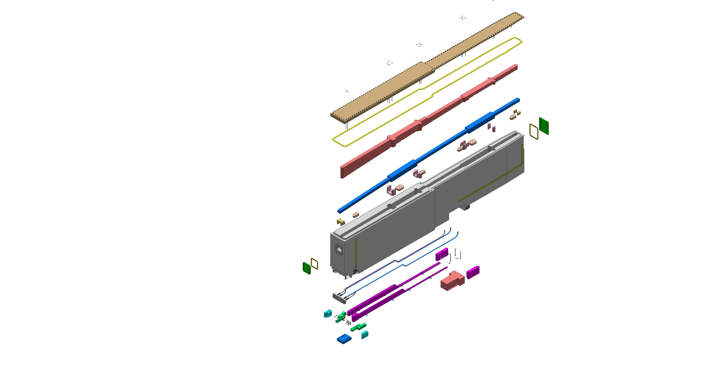
NBPI Prototype
Based on LOKI
Get to know the manufacturing limitations better:
  Verify achievable tolerances for machining of such a big piece
  Test cost effective and optimal seal solutions
  Deep channel machining limitations (vibrations in tools)
  Test manufacturer capability and quality
  Develop opportunities for value engineering
Simplifications/limitations of prototype:
  Normal cobalt level 316L
  No alignment features of NBOAs (however these can be added later)as they were note developed at the time

Slide 9
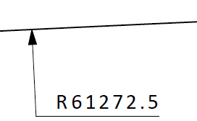
Value Engineering of NBPI
Based on LOKI - BEFORE
Identified challenges to address in the development work:
Many complex design elements and shapes
Water cooling in pipes and machined groves with welded lids, requiring a lot of backfilling to limit neutron streaming paths
Top sealing soft aluminium gasket placed between seal ridge on lid and body
Very complex contour for NBOA shapes
NBPI Lid
Al gasket
NBOA void
Backfilling
NBOA geometry
Backfilling
NBPI body
NBPI window
gasket
Machined grooves
with welded lids
NBPI window
Wheels
Cooling pipes
Media connector
Piping Backfilling

Slide 10
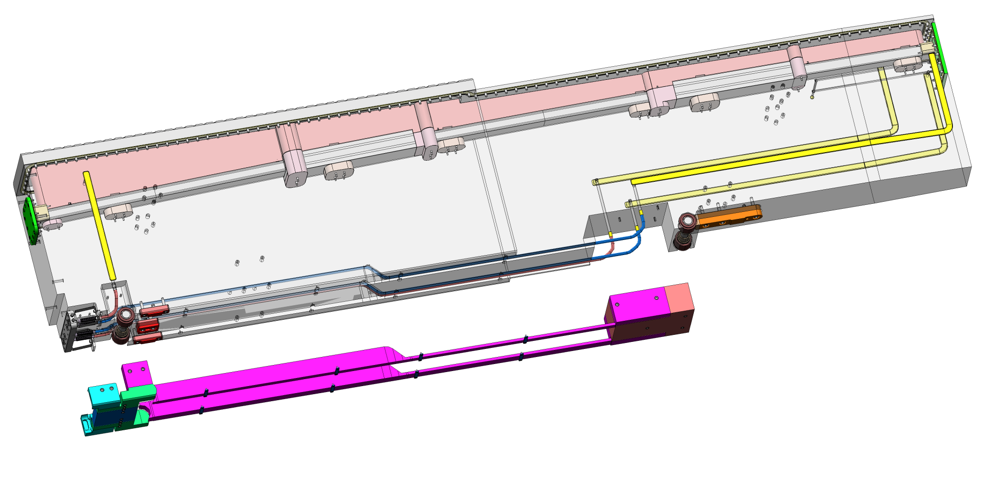
Value Engineering of NBPI
Simplifying cooling channels
Old solution consisted of pipes embedded into the NBPI body in combination with machined grooves with welded lids
Heat transfer, complex piping geometry and extensive need for backfilling was rationale for value engineering
Welded cooling channel lids
Piping Backfilling

Slide 11
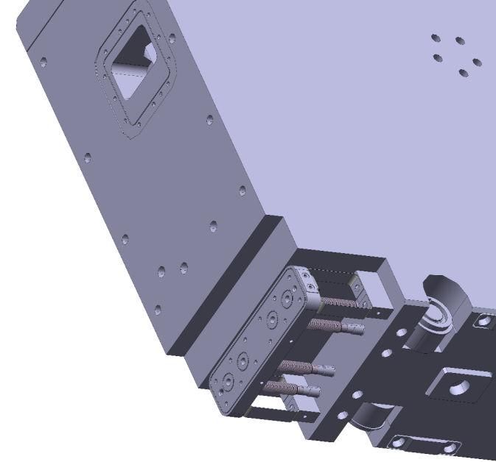
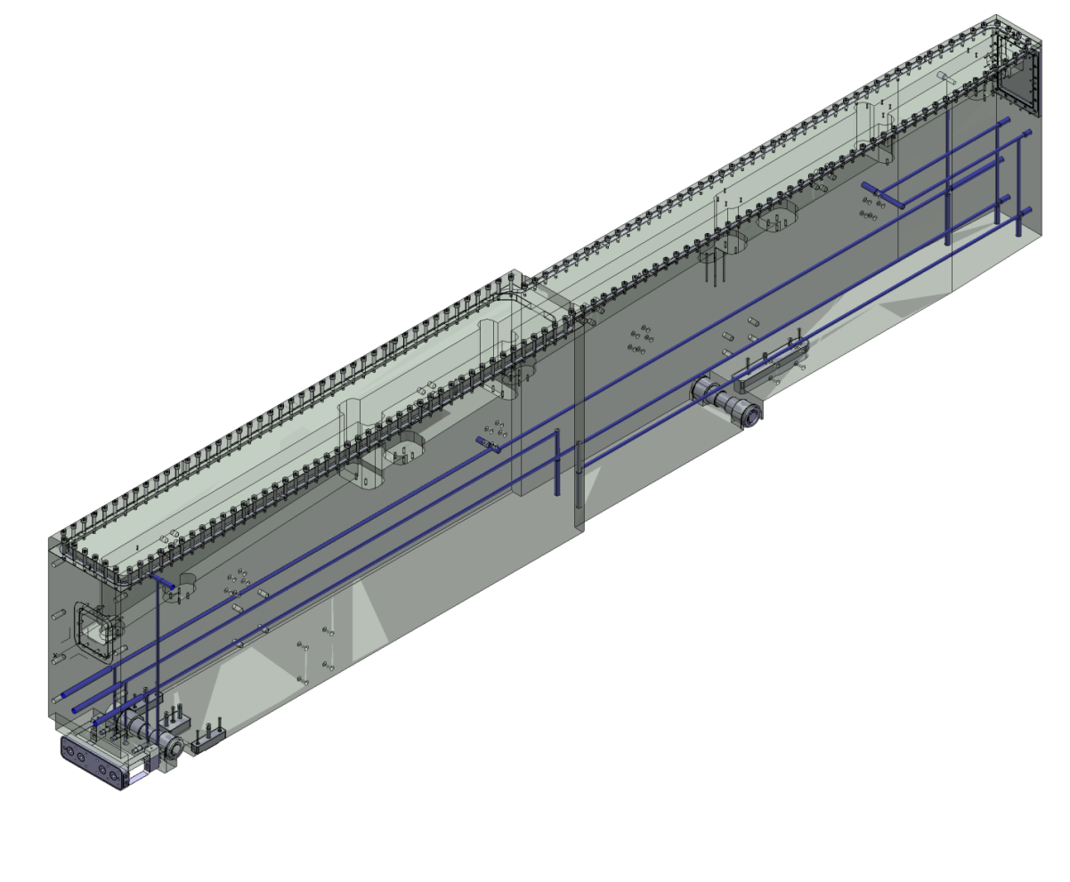
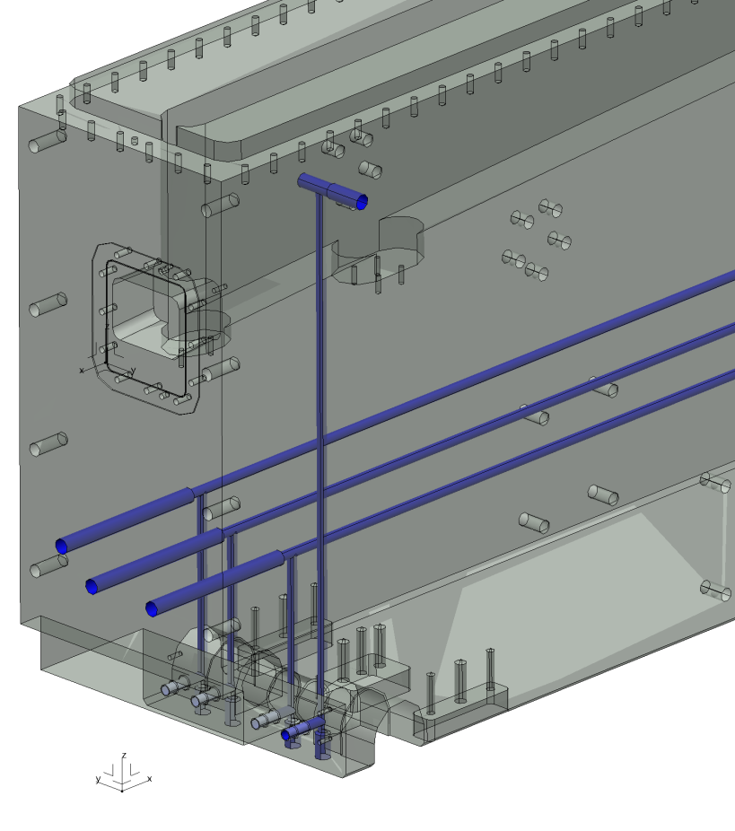
Value Engineering of NBPI
Embedded pipes replaced with gun drilling
Deep hole drilling was introduced and implemented with the support of FZJ.
Entry holes

Slide 12
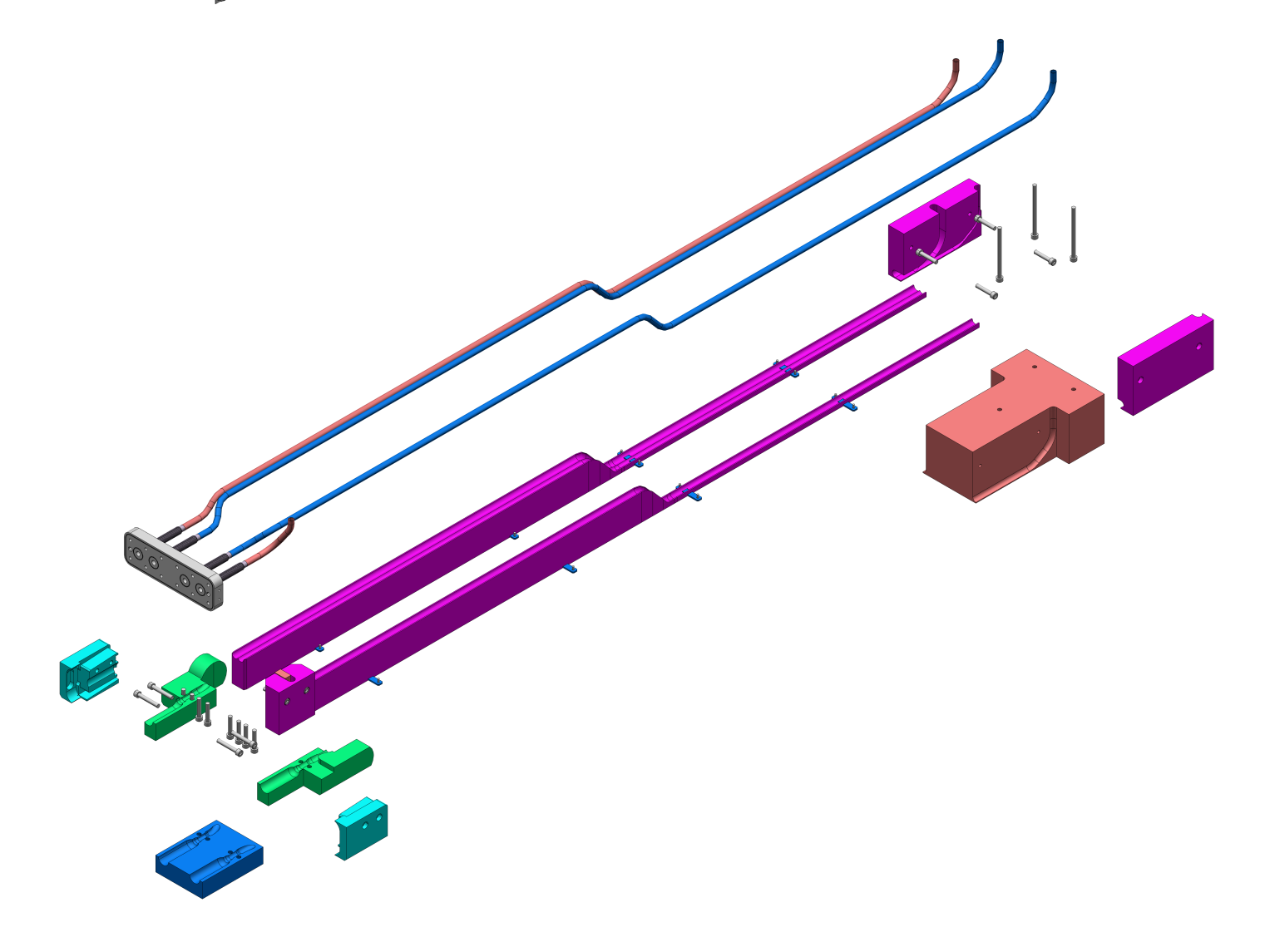
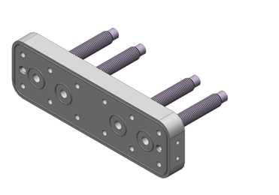
Value Engineering of NBPI
Removal of backfilling
As a result of change on cooling channel concept, backfilling of media channels can be removed completely
After:
Before:

Slide 13
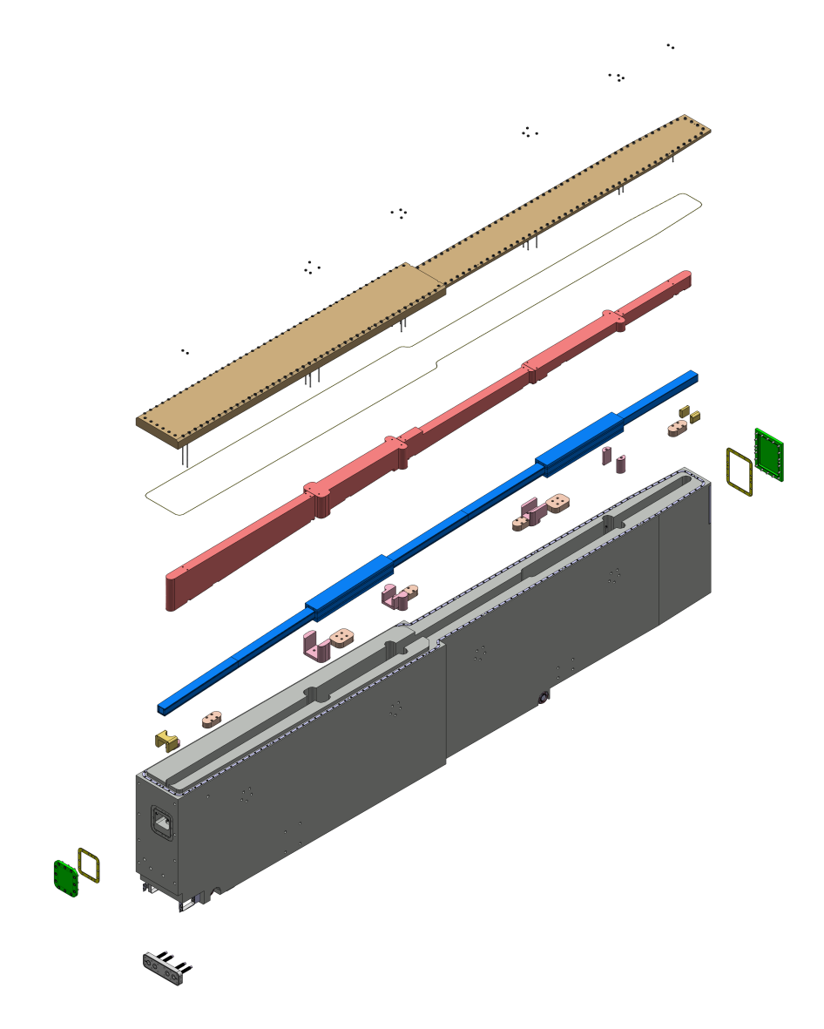
Value Engineering of NBPI
Based on LOKI - AFTER
NBPI Lid
Change of seal from soft aluminium gasket with to copper wire
Change of cooling to gun drilling
  Removal of machined grooves w. welded lids
  Removal of pipes
  Removal of media channel backfilling
Gasket changed
to Copper wire
NBOA void Backfilling
NBOA geometry
Backfilling
NBPI body
REMOVED: Machined grooves
with welded lids
NBPI window gasket
NBPI window
Wheels
REMOVED: Cooling pipes
Media connector
REMOVED: Piping Backfilling

Slide 14
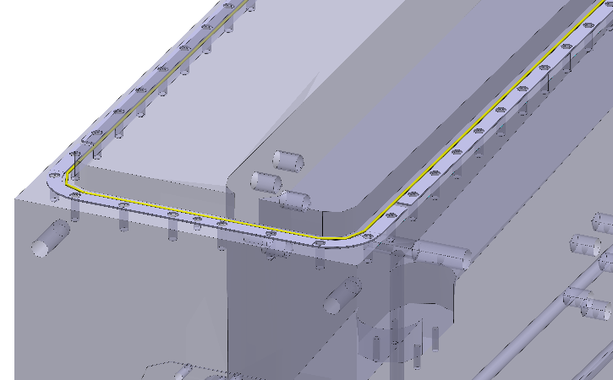
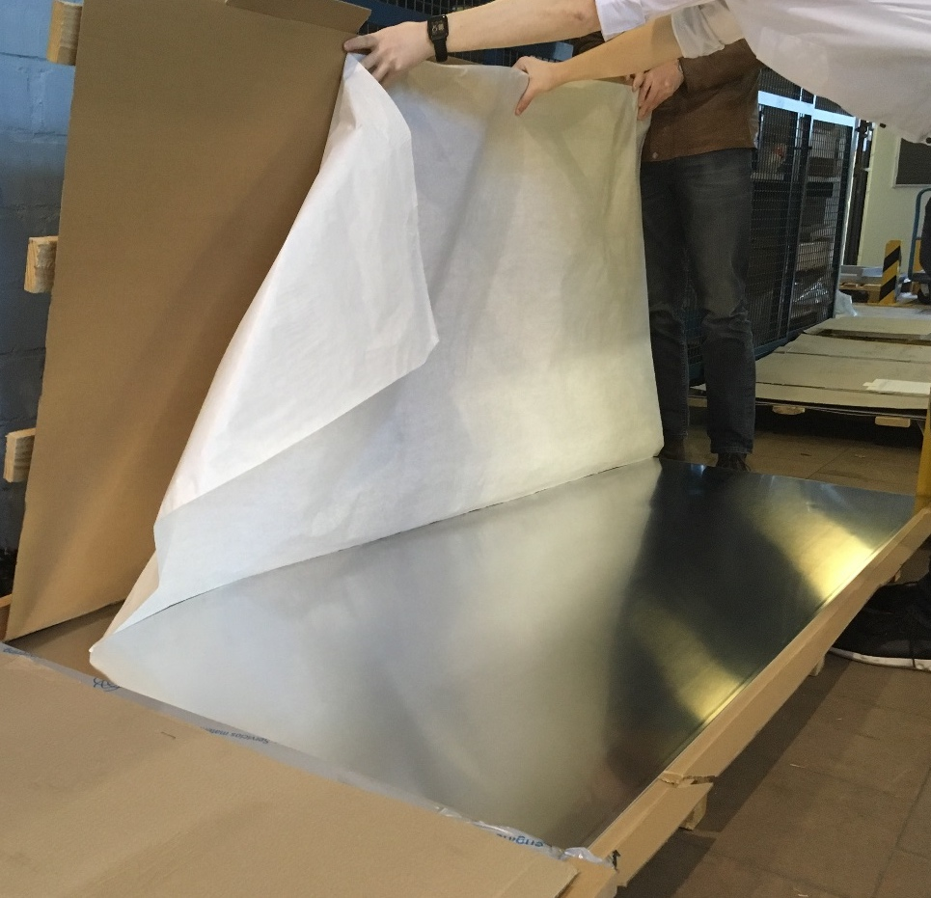
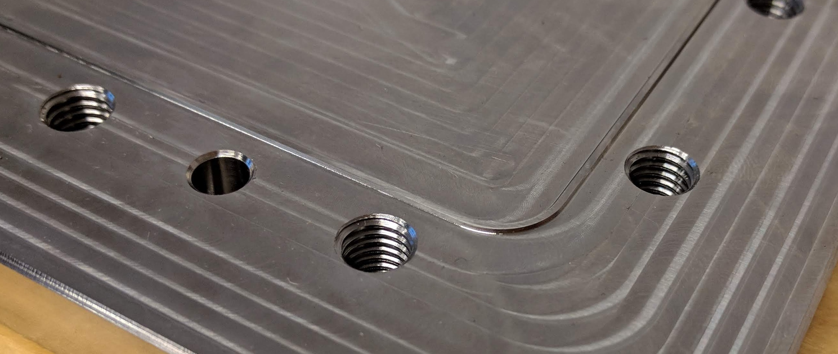
Value Engineering of NBPI
Change of seal - Old concept top lid
The chosen seal solution for the 3,5x0,3 m top lid vacuum seal soft aluminium gasket between milled ridges on body and lid was questioned.
Large sheets of soft aluminium is hard to practically handle
Easily scratches easily
Expensive to buy material and produce for such big sizes
FZJ proposed to instead use a copper wire for top lid which has been adopted. (while maintaining the possibility to modify the sealing surface if the test fails.)
Soft Al gasket material
Ridge concept

Slide 15
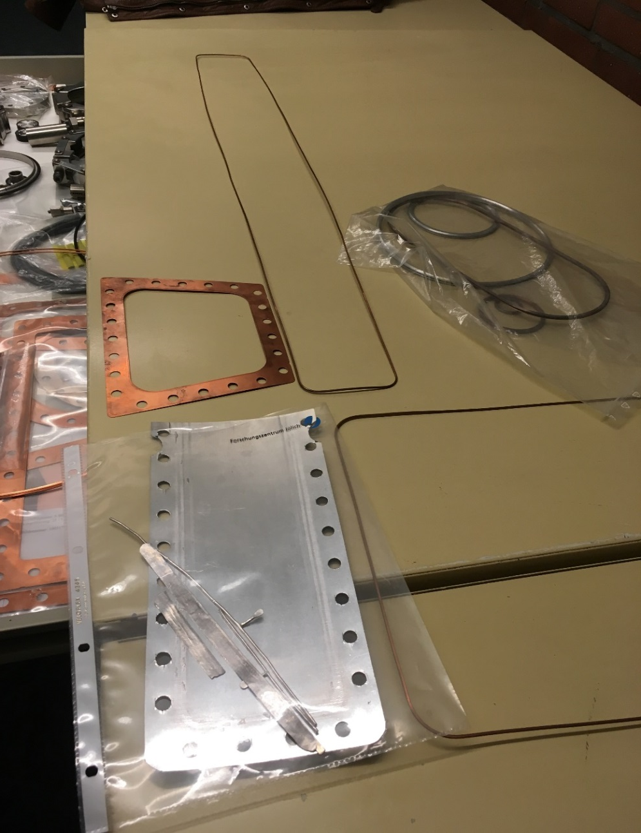
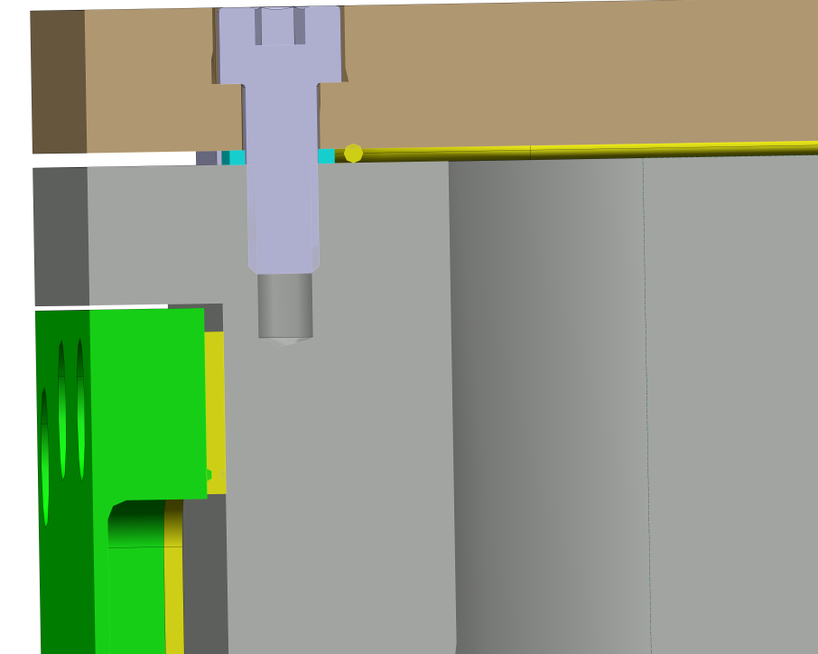
Value Engineering of NBPI
Change of sealing solution
Copper wire only used for horizontal surfaces. Soft Aluminium maintained for vertical.
Copper wire
Copper wire solution
Plate with ridge solution
Soft Al

Slide 16
NBPI / NBOA
NEUTRONIC ANALYSIS
Value Engineering Opportunities
The following slides are cut from Alan Takibayev’s presentation which has been attached to the indico page for reference.

Slide 17
Peak heat load is at the tip of NBPI in Port W-03
It does not mean that the strongest streaming is also there!

Slide 18
2D distribution in north-west sector
In order to quickly check relative streaming, NBPI were removed and the dose outside of the monolith (5.5-6.0 m distance) was calculated.
The strongest streaming was observed in Port W-02.
Note that Port W-02 contains a non-standard NBPI.
Note that streaming through Port W-03 is also among the strongest.
Therefore, selection of Port W-03 for further analysis seems justified.

Slide 19
Based on the results presented –
The following gap dimensions were adopted
NBOA-NBPI-Tube-NBPB gaps: 5 mm + 10 mm + 10 mm with grooves
NBOA-NBPI gaps refer to side, top, and bottom, while NBPI-Tube-NBPB gaps refer to side and top only
Bottom NBPI-Tube-NBPB gaps are kept the same (5 mm + 0 mm)

Slide 20
Streaming Update

Slide 21
Neutron Current vs NBOA Area
2+2X5 mm

Slide 22
Neutron Current vs NBOA Area
2+2X5 mm

Slide 23
System-Wide Streaming

Slide 24
Contribution of gaps to
total neutron current:
3.0%
Contribution of gaps to
neutron current above 100 MeV:
5.8%
[The same numbers with short (-70 cm) blind NBPI are 3.4% and 9.7% respectively]

Slide 25
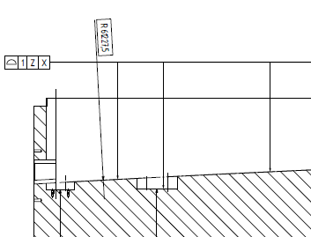
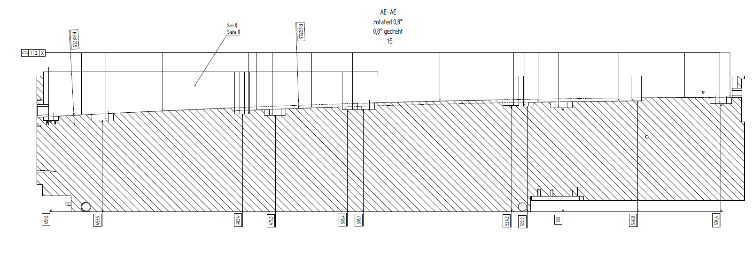
Value Engineering of NBPI
Change of gap based on neutronic calculations
Simplifying milling of the NBPI by use of steps or slope
Neuronic calculations showed that the gap between NBPI and NBOA can be 5 mm at maximum. Change allows us to introduce stepping of the insert instead of milling large radii
Requirement; gap less than 5mm and no less than 2mm.
R61227.5

Slide 26
Interface on sides during insertion
UP
Nominal 7 mm
Insert
Port tube
Manufacturing of insert ±0,5mm
Manufacturing of port tube ± 2mm
Gap 3,5 mm during insertion
Alignment ±1mm

Slide 27
Interface on sides during operation
UP
Nominal 7 mm
Insert
Port tube
Manufacturing of insert ±0,5mm
Manufacturing of port tube ± 2mm
Deflection of port tube 1,2 mm
Gap 2,3 mm during operation
Alignment ±1mm
Worst case 9.5 mm

Slide 28
Port block – NBPI gap during insertion
UP
Port tube
Manufacturing of port tube ± 1 mm
Nominal 3,5 mm
Gap 2 mm during insertion
Manufacturing of insert ±0,5 mm
Insert

Slide 29
Port Block – NBPI gap during Operation
UP
Port tube
Manufacturing of port tube ± 1 mm
Worst case 6.5 mm
Gap 2,5 mm during operation
Nominal 5 mm
Alignment ± 1 mm
Manufacturing of insert ±0,5 mm
Insert

Slide 30
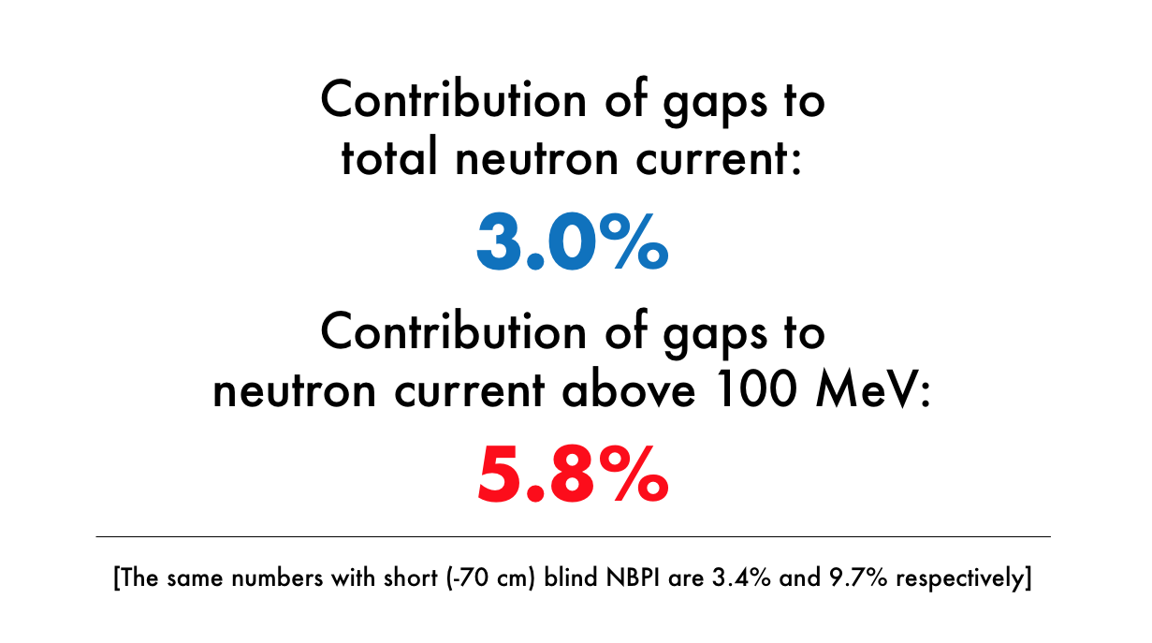
Gaps compared with Neutronic model
NBOA2NBPI 2<Gap<5mm, nominally 3,5mm
NBPI2PortBlock 3,5<Gap<9,5, nominally 7mm
PortBlock2Wedges 5<Gap<10 nominally 7,5*
Typically at approximately 70% of what was used in Alans analysis (5+10+10)
*not confirmed at the time of publishing presentation

Slide 31
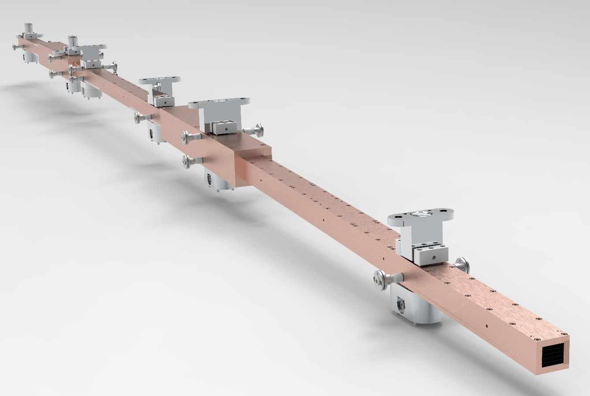
NBOA Alignment features

Slide 32
NBOA Integration
LOKI Prototype
NBOA compartment
NBPI body
Cavity for alignment features

Slide 33
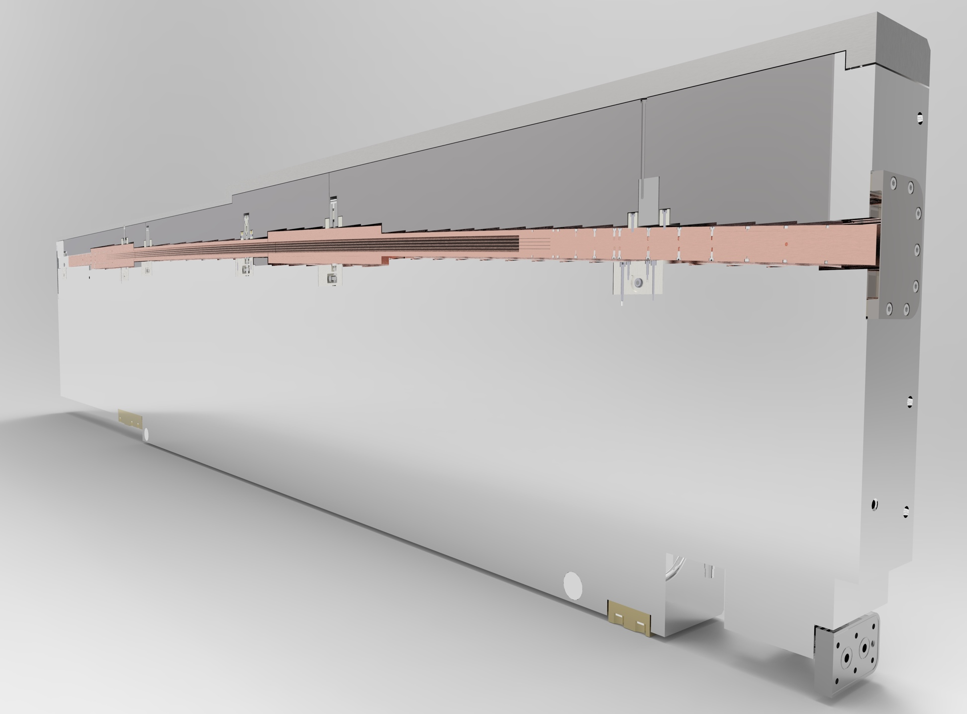
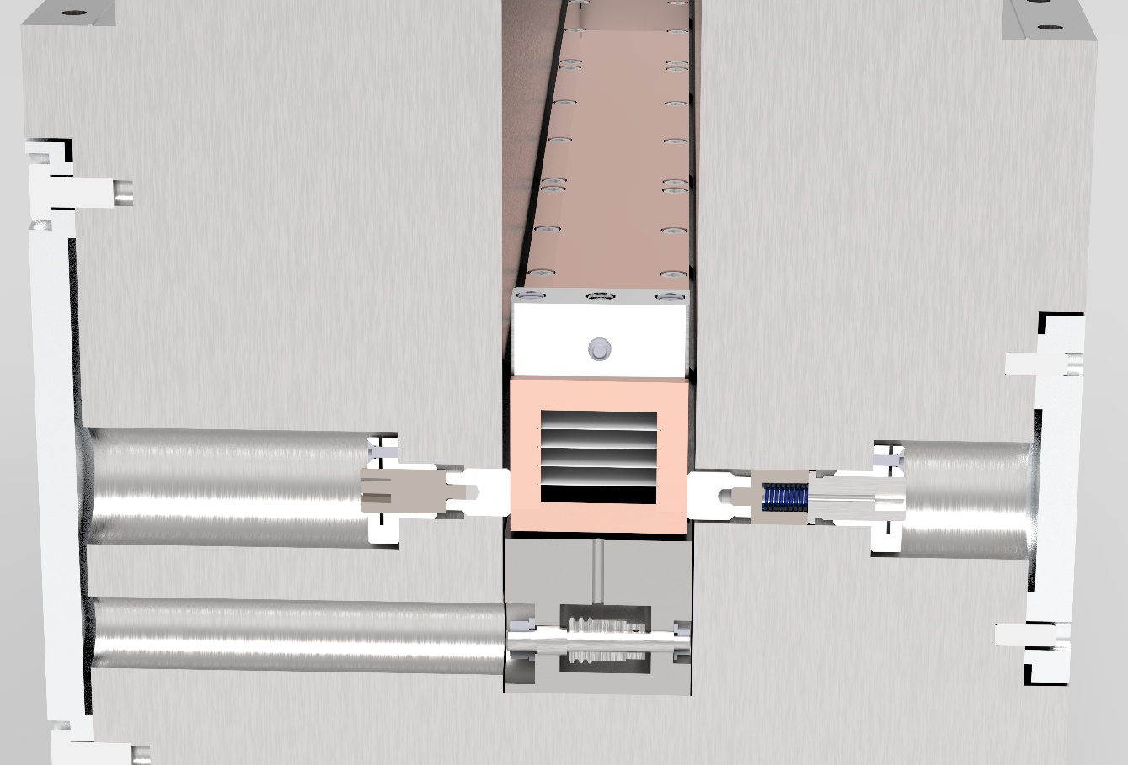
NBOA Integration
LOKI Prototype
Filler block
Lid
Alignment feature lid
NBPI body
NBOA Alignment feature
NBOA
NBPI window
Gasket
Adjustment / locking device
Cavity for horizontal alignment
Push rod
NBOA
Spring
NBPI window
NBPI Alignment feature
Spring retainer
Roller
Media connector
Threaded adjustment rod
NBPI body
Cavity for vertical alignment
Worm gear (vertical)
Roller
NBPI Alignment feature

Slide 34
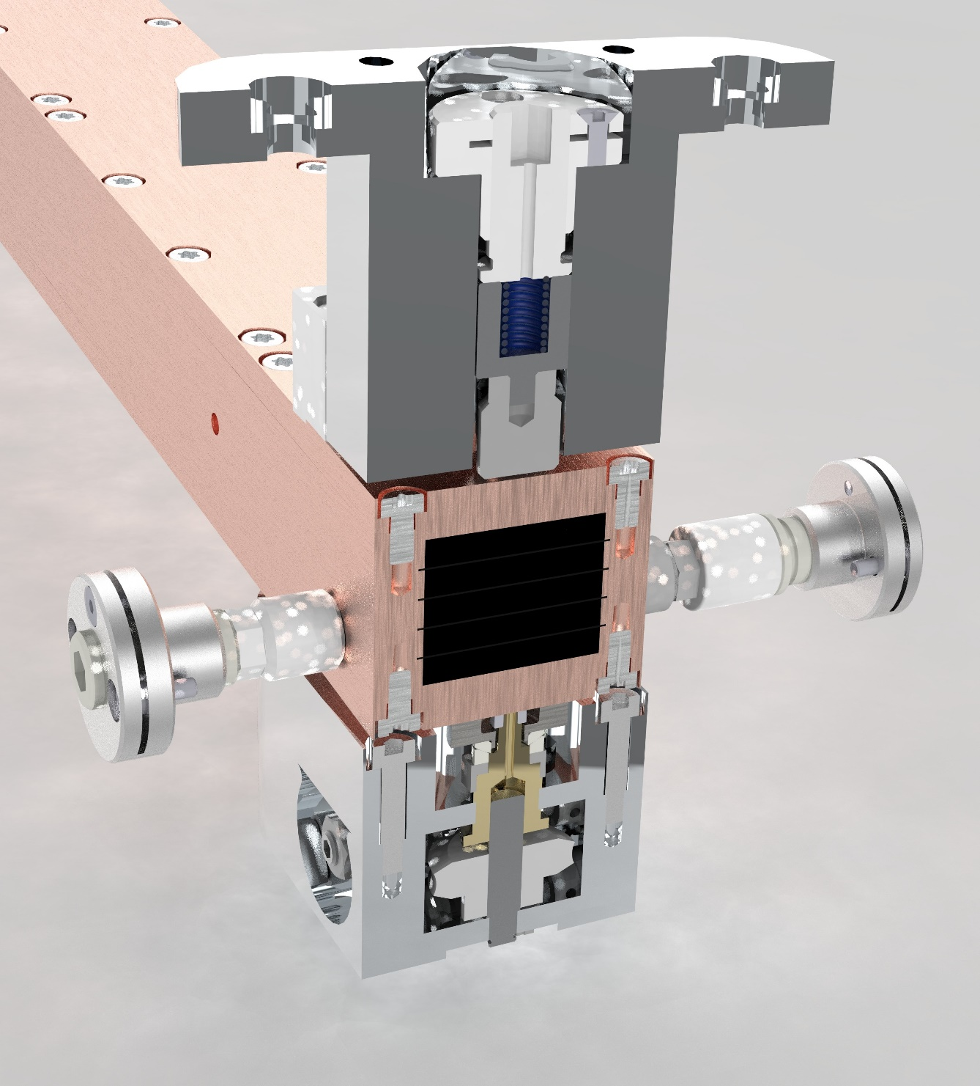
NBOA Design and alignment features
LOKI Prototype
6x Horizontal sideways adjustment
6x Vertical adjustment and fixation

Slide 35
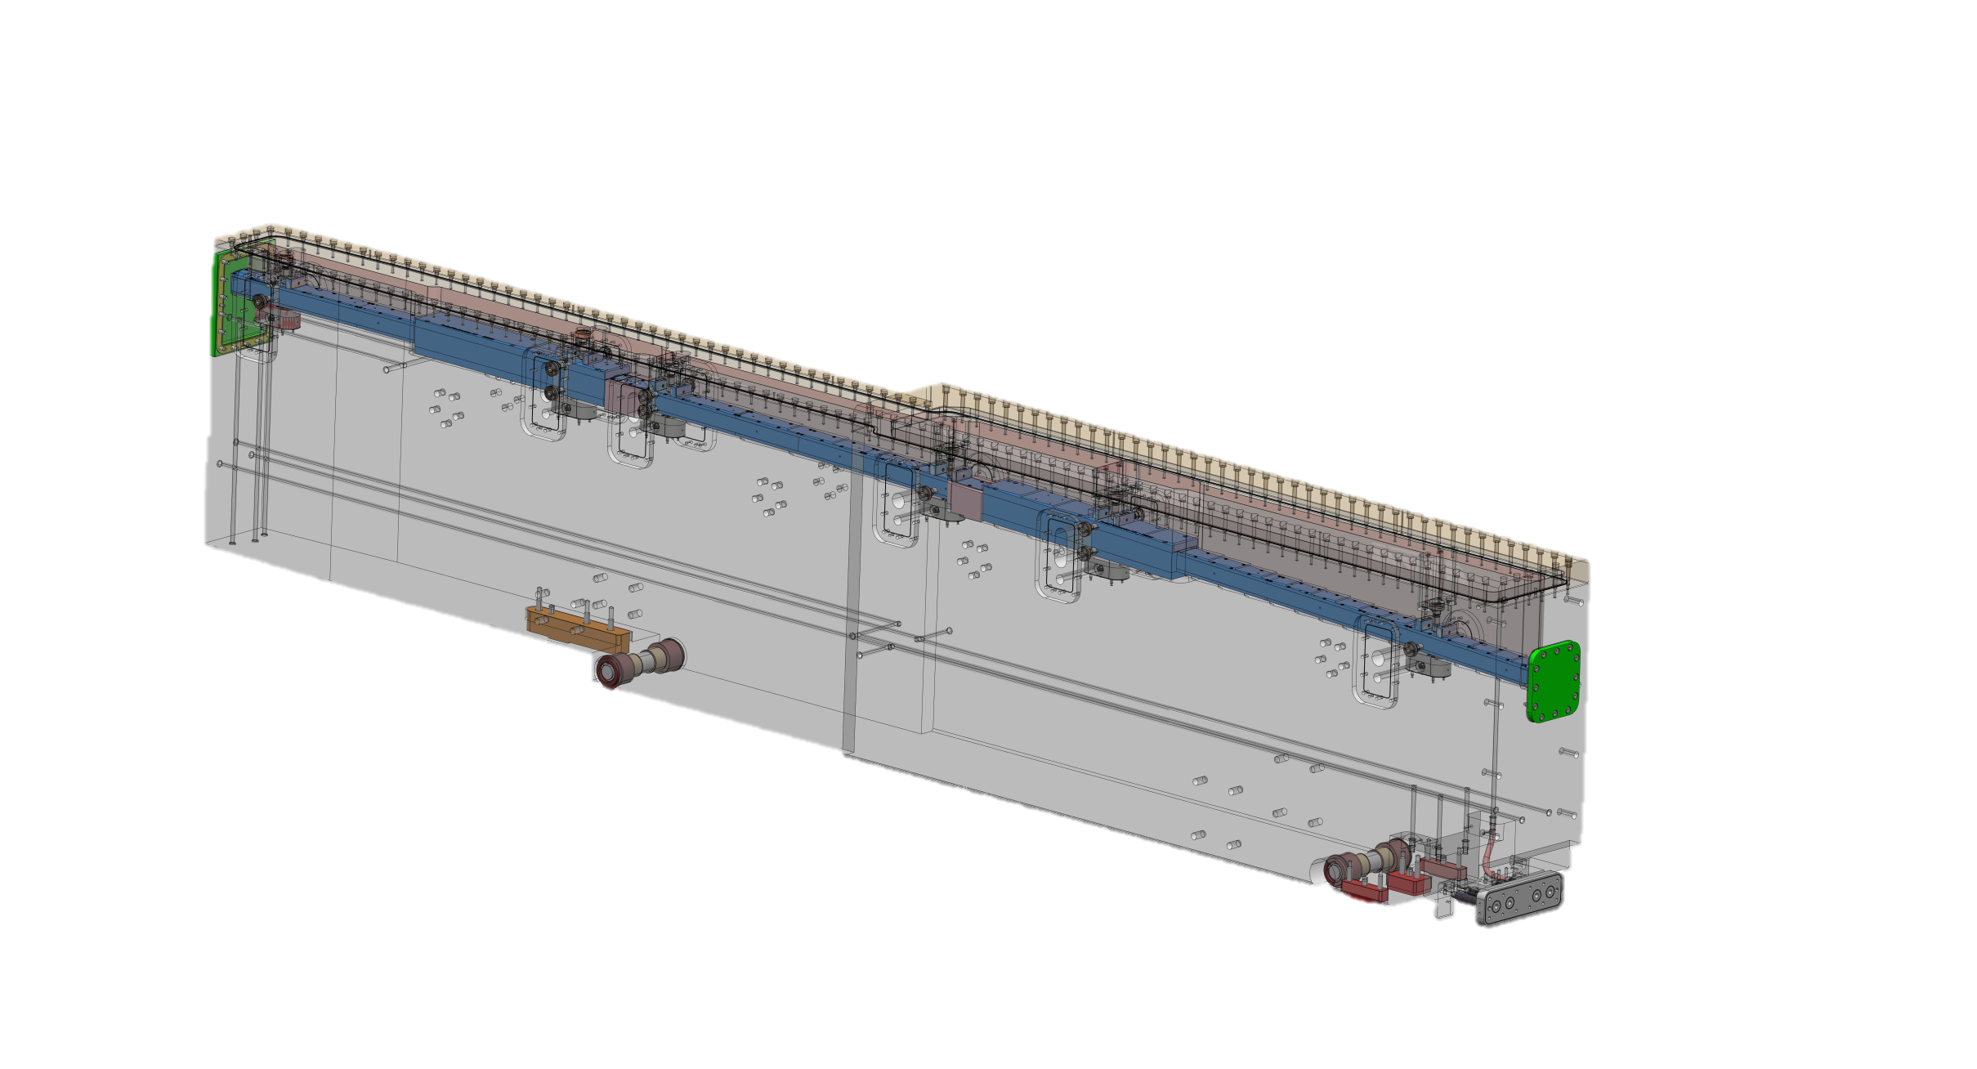
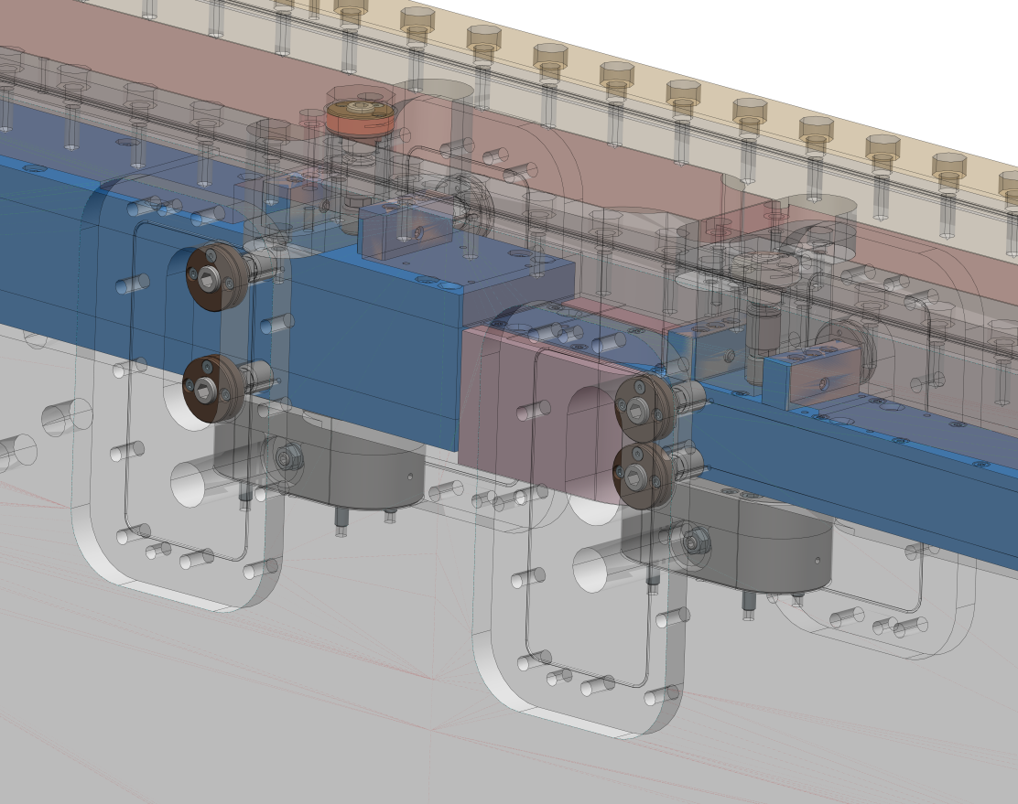
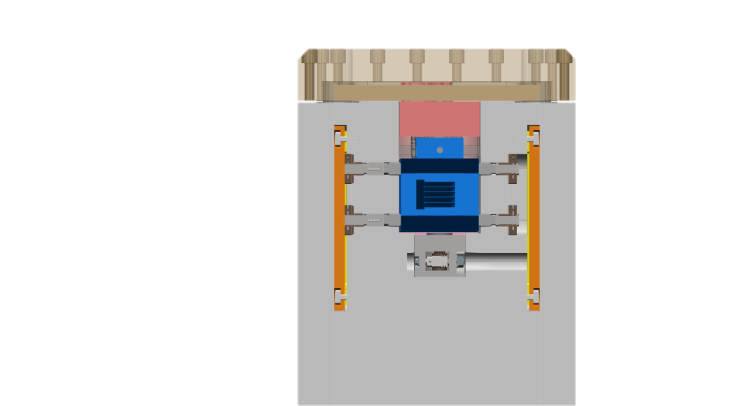
NBPI Alignment
NBOA alignment features
Alignment features provided by NSS for NBOA adjustment, six on each side of the NBPI

Slide 36
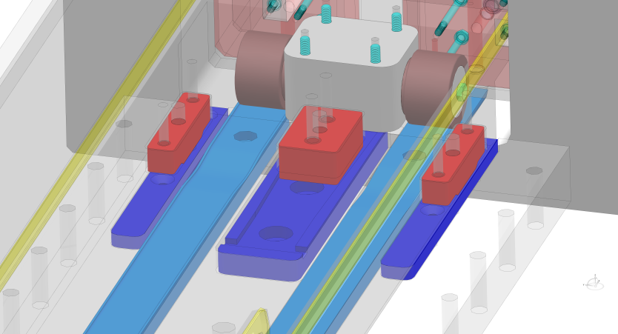
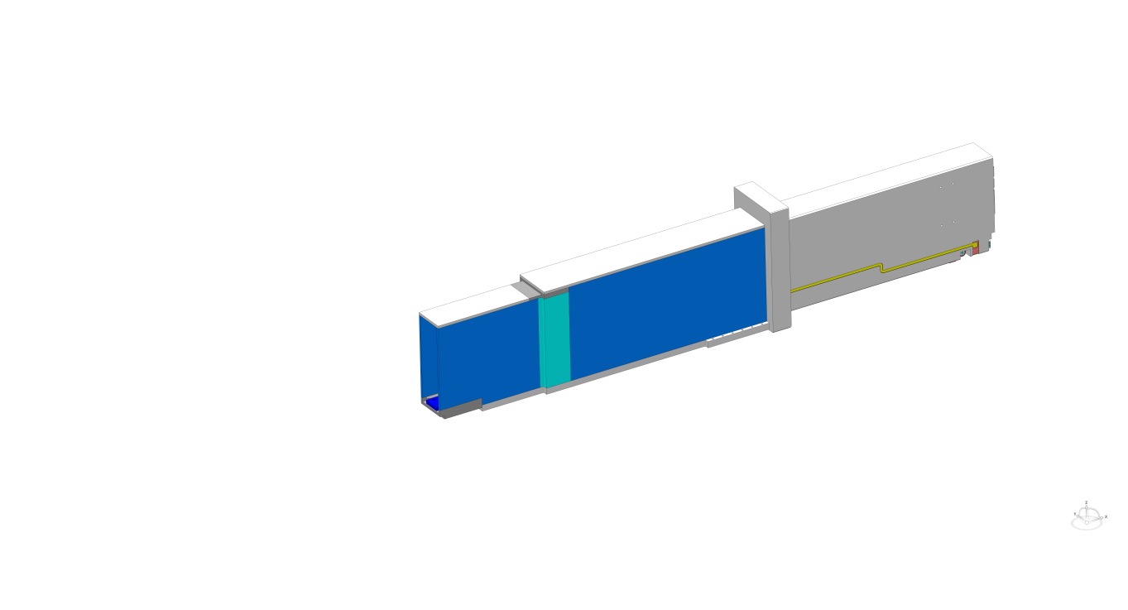
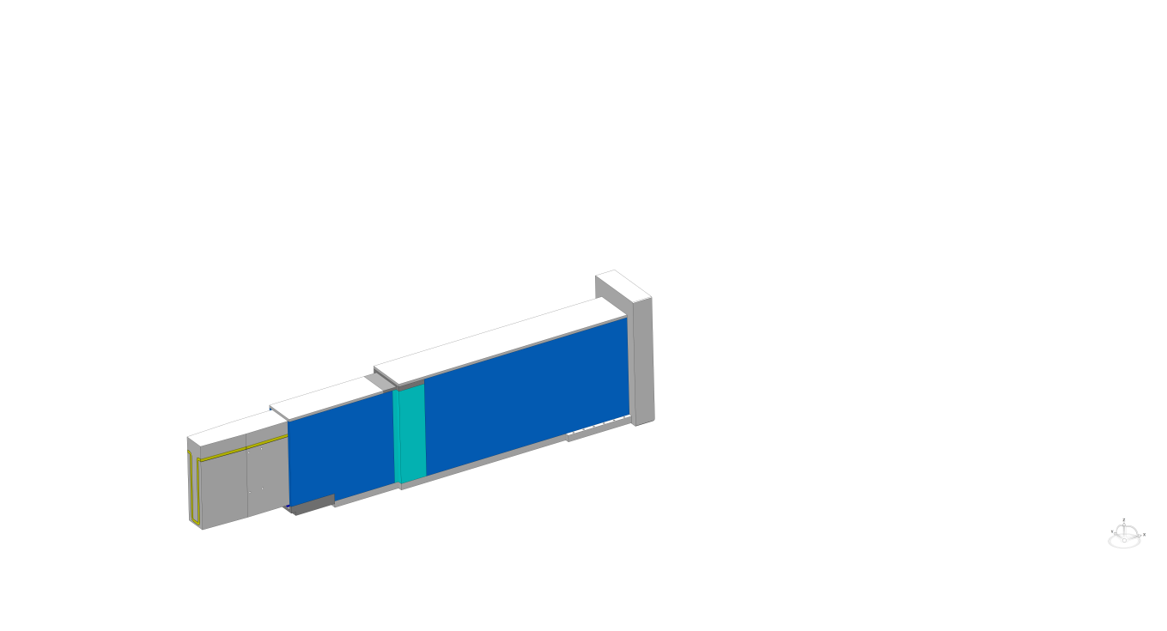
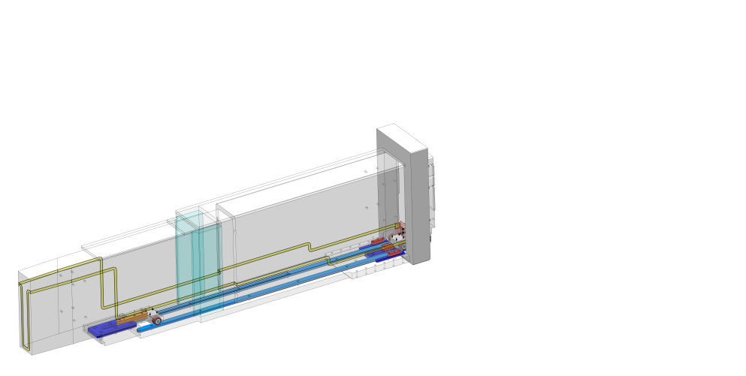
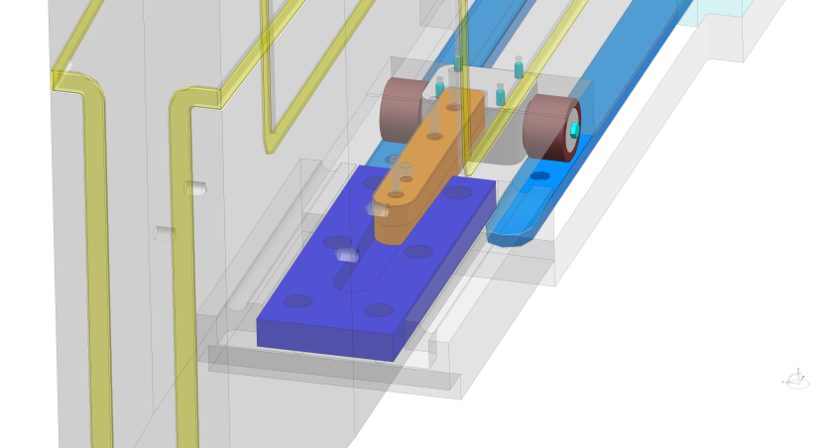
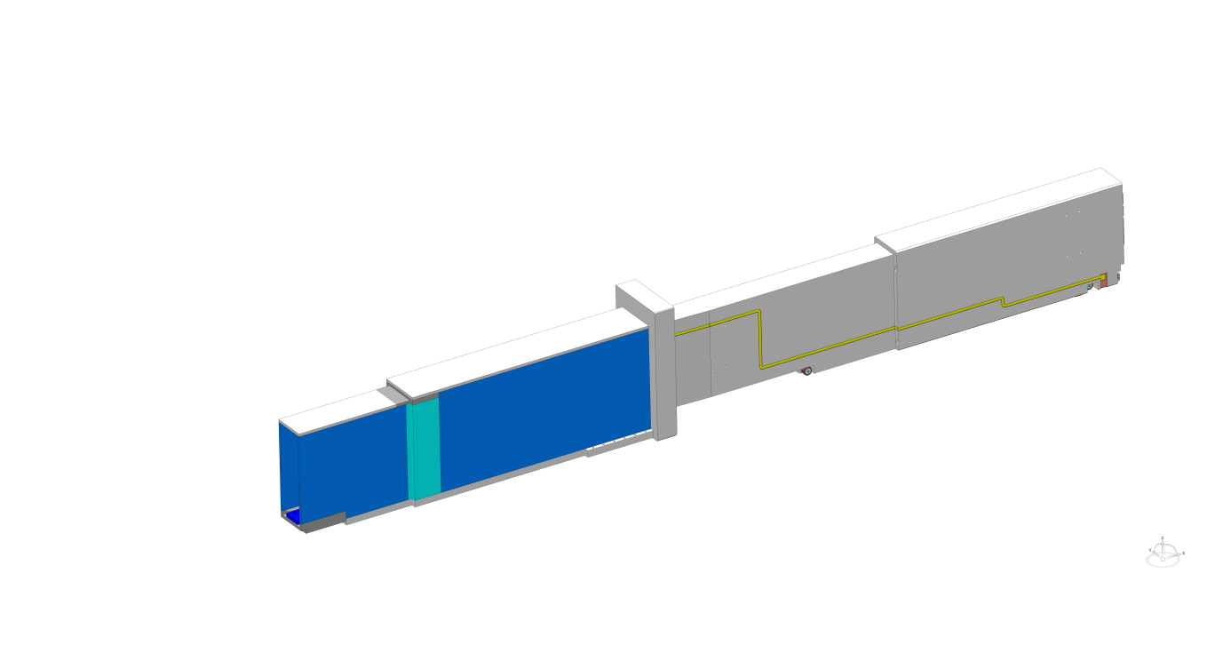
NBPI Alignment
Portblock position alignment
x-direction: along beamline
y-direction: horisontally normal to x-direction
z-direction: vertical
NBPI rolls into port block
  Port block guide rails light blue
NBPI alignment features interacts with port block alignment features
  NBPI: Rear red, front orange
  Port block: dark blue
Defines in z-direction
Defines in x- & y-direction
Defines in y- & z-direction
z-
y-
x-

Slide 37
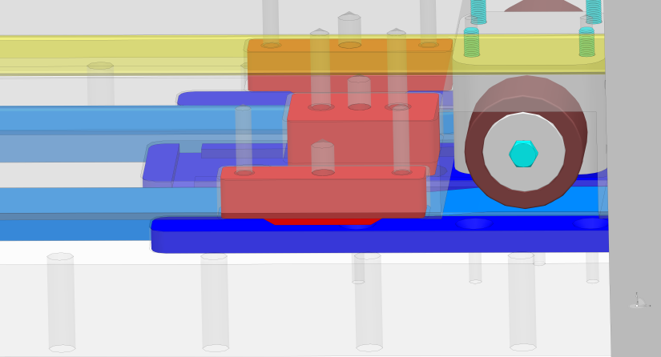
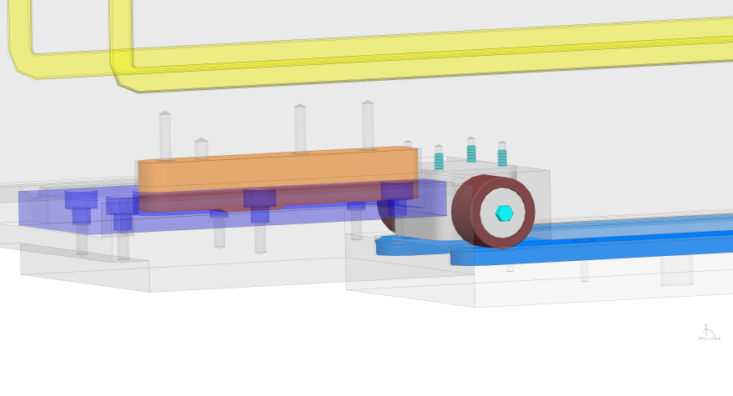
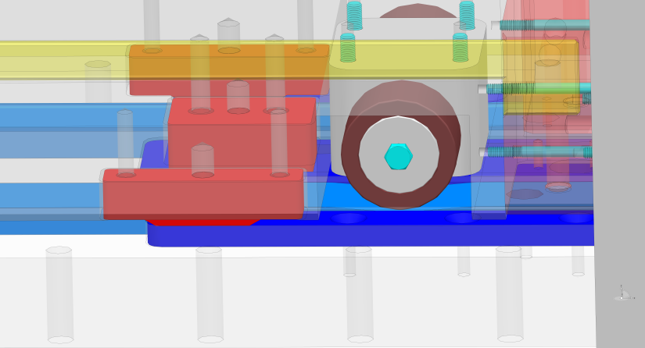
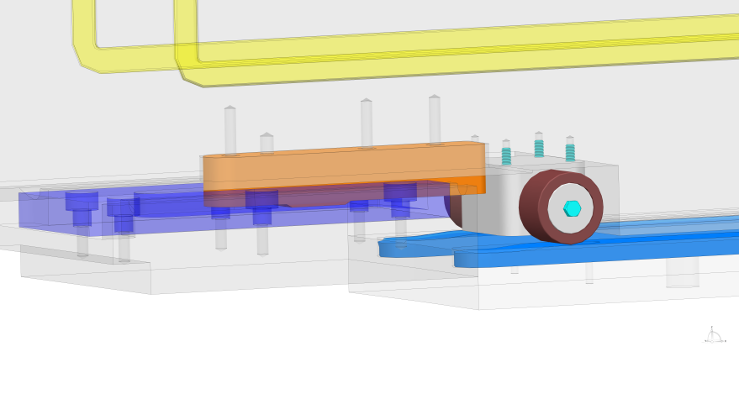
NBPI Alignment
Portblock position alignment
NBPI lands on alignment features
  Slope on guide rails
Slides the last mm’s into position guided by the port block alignment features
  Nominal sliding length 21.5mm
  Nominal vertical movement 1.5mm
Notes:
Nominal sliding length 21.5mm
Alignment features nominally 1.5mm vertical gap betwen NBPI and port block alignment features
After beam guide slope starts 43mm distance to stop (in beam direction). Total slope 3mm vertically (After 43mm)

Slide 38
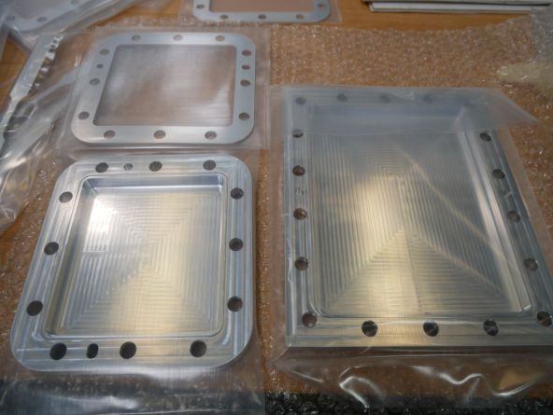
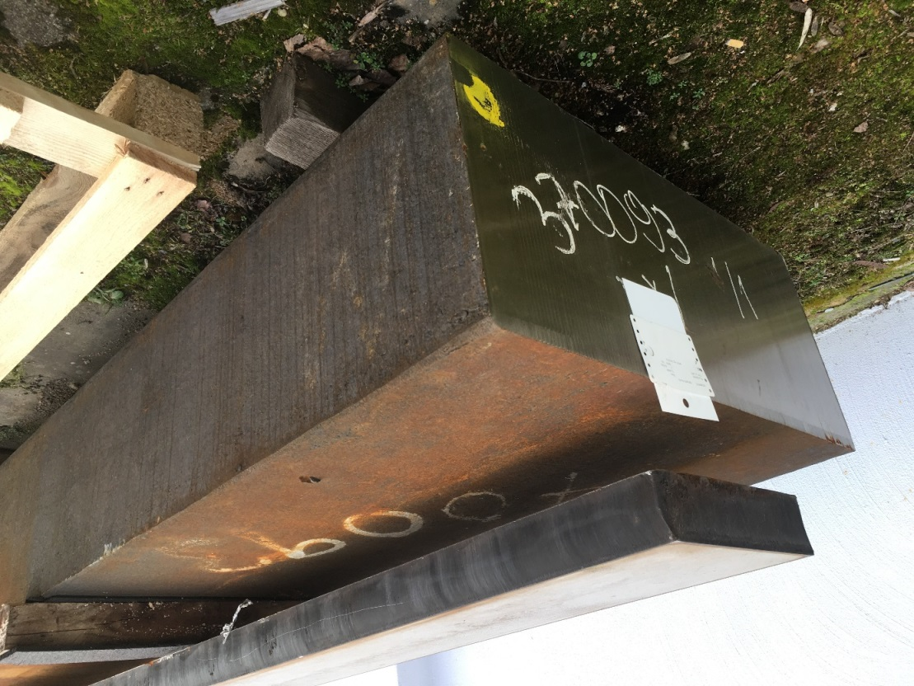
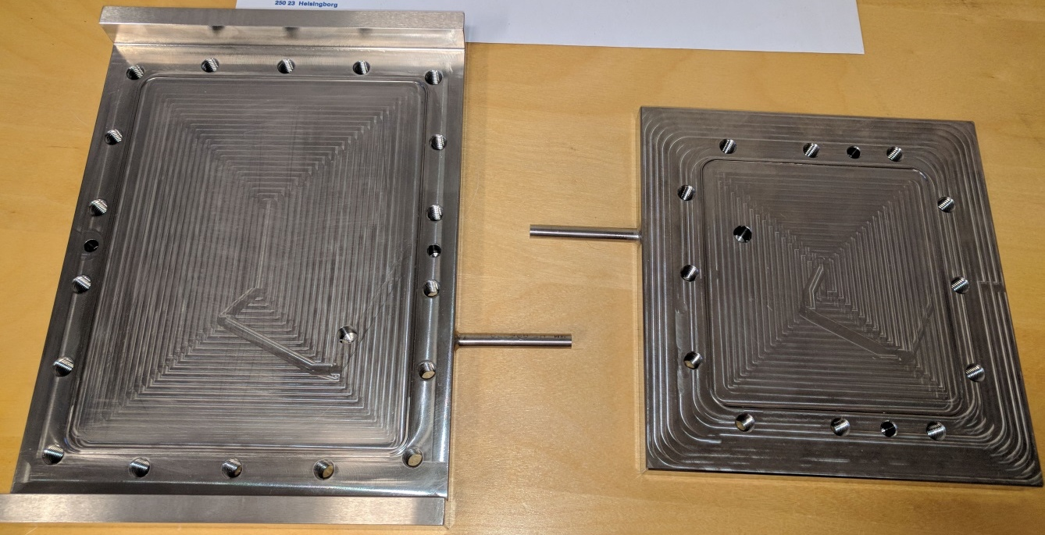
Manufacturing progress
NBPI windows and Gasket testing @ESS
Raw material for NBPI body and lid prototype delivered to FZJ ready for manufacturing
Test plate for NBPI windows

Slide 39
PDR of NBPI Cooling and NBOA atmosphere performed
System Interfaces and Design
Neutron Beam Port Inserts (NBPIs) 14 nos.
NBPI upstream
window
Monolith Port Tubes
NBPI downstream
window
NBOA
NBPI
NBW
NBOA atmosphere
Monolith Port Tubes
Water lines - System 1026
NBOA helium atmosphere
System1028
Weld connections to
NBW media flange

Slide 40
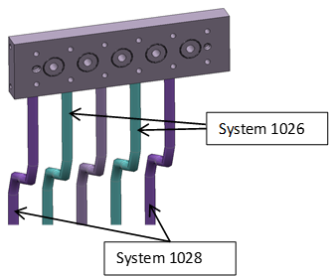
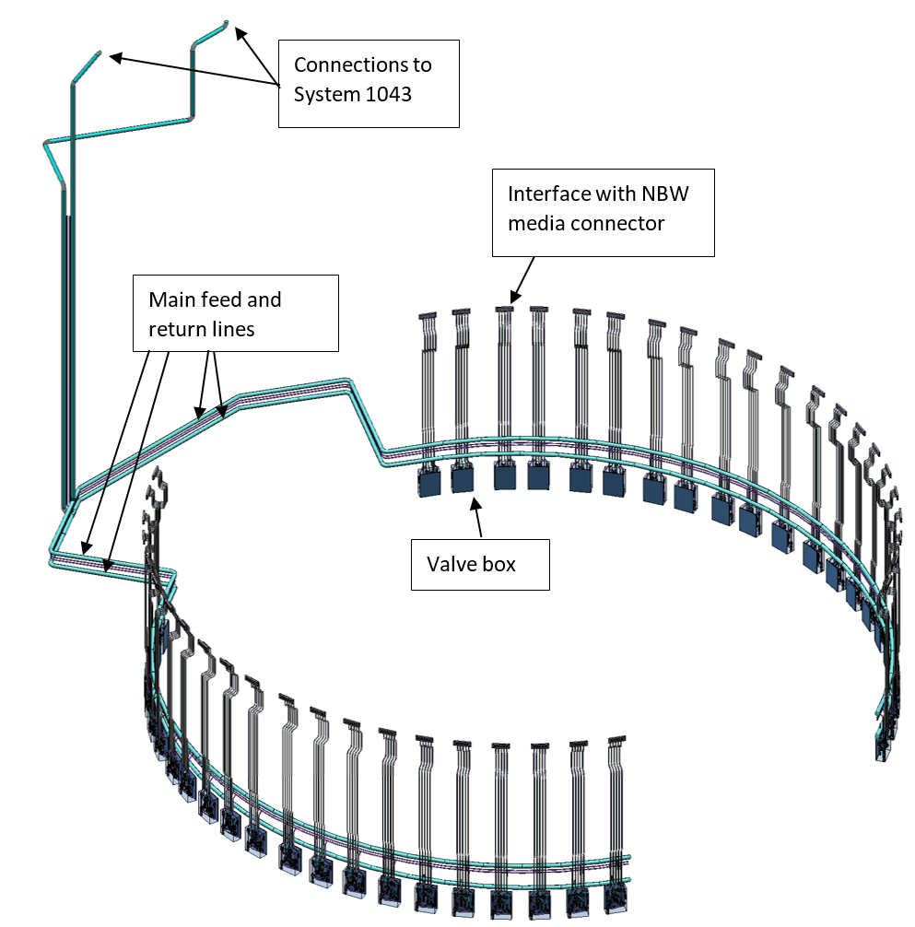
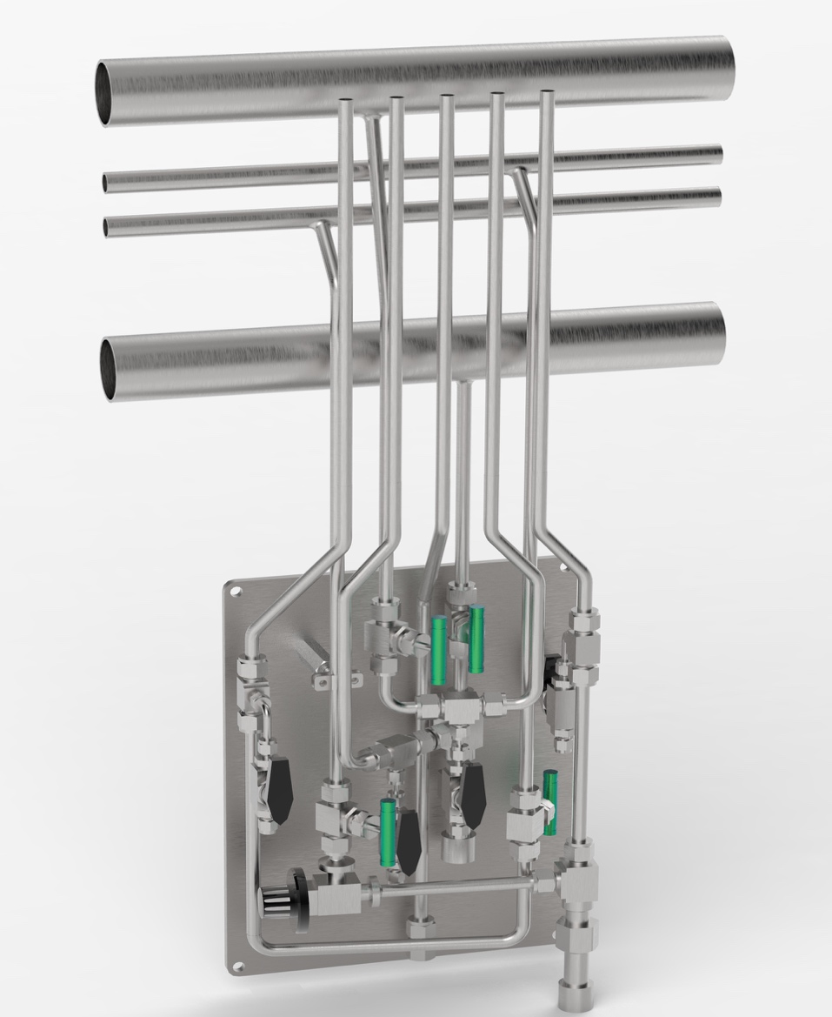
PDR of NBPI Cooling and NBOA atmosphere performed
Mechanical Piping Design
Shared circumferential routing around the monolith vessel
System isolation valves placed in D02.115.4003 and the filter placed in D02.091.4003
Welded connection with the NBW media flange, Headers to feedlines
Induction bended pipes.
Valves and instrumentation are placed within space constraint of 400x300x140. Manual reach from floor level.
Preferred material for piping is 1.4404 for improved corrosion resistance.
D02.115.4003
D02.103.4003
D02.091.4002
D02.091.4003
D02.091.4004
Notes:
Minimize penetration (full circle)
Isolation valves placed in D02.115.4003 In-build safety for isolating the system.
Filter change possible in D02.91.4003

Slide 41
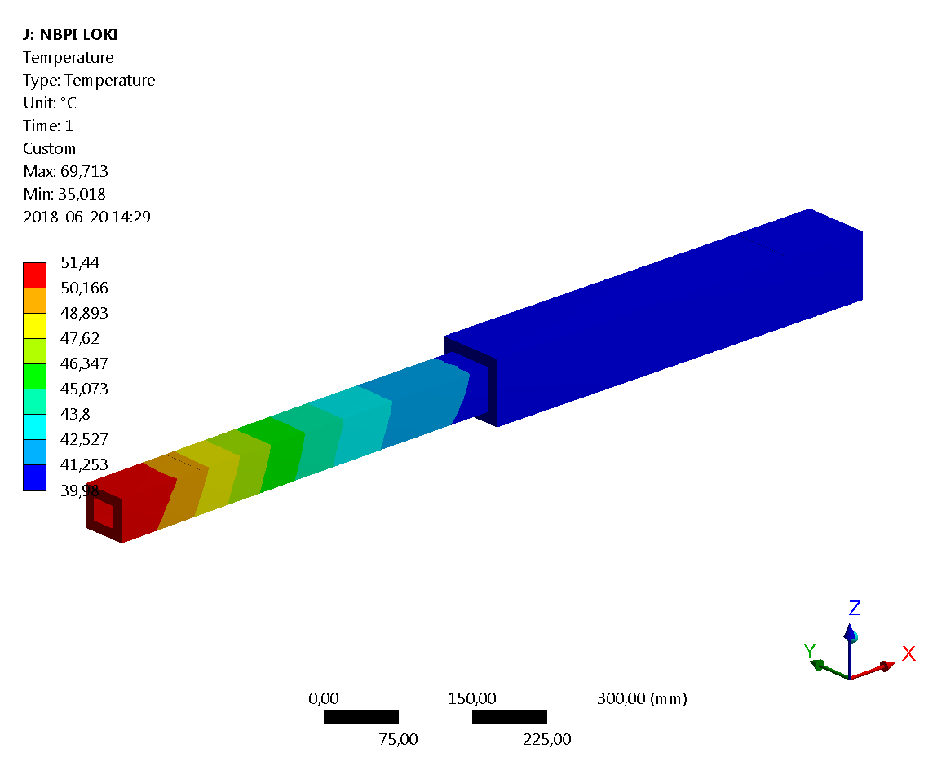
PDR of NBPI Cooling and NBOA atmosphere performed
Sweeping Helium or Stagnant
Leakage points in the NBPI-NBW path = 19
  As per ESS-0057844 Monolith Vacuum Handbook
  Continuous sweep flow rate = 3 mg/s
In-direct measurement of NBOA temperature possible in continuous sweep.
NBPI windows exposed to relatively constant pressure.
Disadvantages: Higher operating cost (6 days ~61 days for a 50L 200 bar cylinder)
2
3
 | High Vacuum | Rough Vacuum
Allowable leakage rate | >10⁻⁵ Pa.m³/s | >10⁻³ Pa.m³/s
Over-pressure loss time (0.2 bar) | ≈ 3 days | ≈ 43 mins
Compensation He feed-in rate | ≈ 0.0042 mg/s | ≈ 0.42 mg/s
NBOA atmosphere
1
NBPI
6x2=12
NBW
16,17
Water lines - System 1026
$$T_{in}=35°C$$
$$P_{in}=3.8 bar$$
18,19
$$T_{out}=37°C$$
$$P_{out}=3.2 bar$$
$$T_{in}^{He}=30°C$$
$P_{in}^{He}=$1.2 bar
$$T_{out}^{He}=45°C$$
$$P_{out}^{He}=1.11 bar$$
NBOA Helium Atmosphere
System 1028

Slide 42
NBPI design going forward
Perform Generic CDR preparing for individual mini CDRs
Learn from prototype manufacturing
Start detail design of real NBPIs
Contract 16NBPI’s design and manufacturing

Slide 43
Neutron Beam Port Plugs
Not prioritized recently
Value engineering opportunities have come up as part of NBPI development that has been caught and assessed to be implemented
Detail design will start after summer
Raw material already procured
Planned as open call for tender

Slide 44
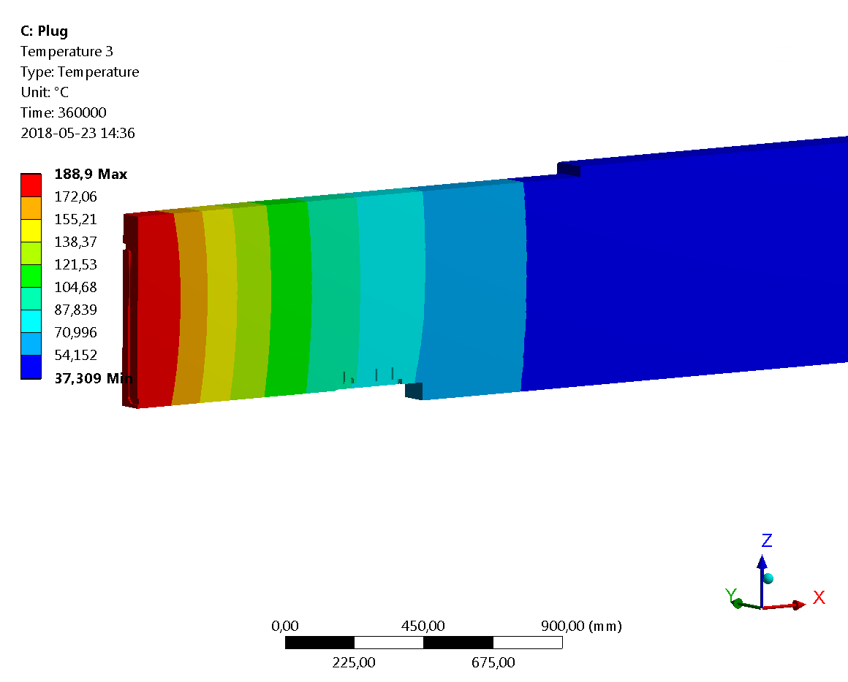
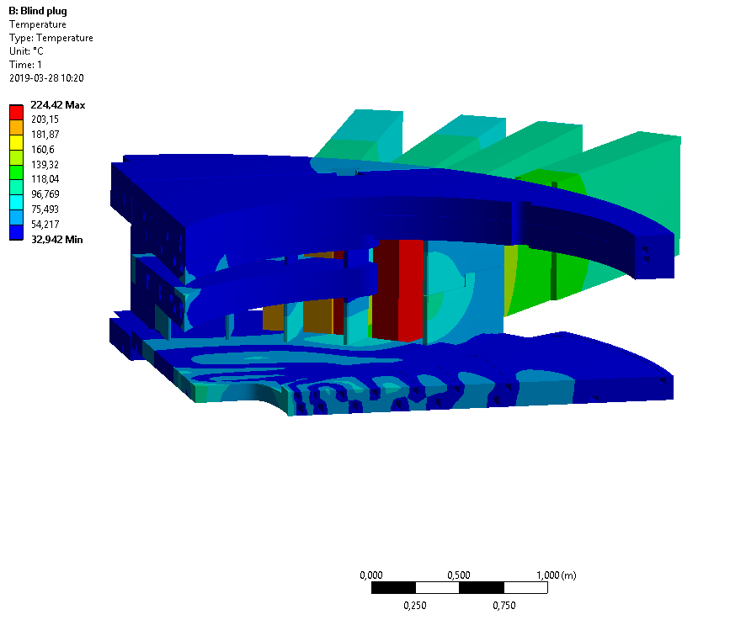
Port Plugs - Value Engineering
Could the cooling be removed entirely?
Consequence
Surface temperature of front of NBPP ∼220°C (surrounded only by NBPPs)
Gains
Valves and instrumentation can be removed from the cooling system of 26 NBPPs and potentially 2 NBPI (reduced by 2/3)
Deep hole drilling of cooling channels can be removed on 26 (28) NBPI/NBPPs, cutting both manufacturing and lead time
Media connector on NBPI/NBPP can be removed on 26 (28) instances
Handling of plug in Active Cell can be simplified. No need to drain and dry, cutting can be initiated, risk for leaks in the monolith is reduced

Slide 45
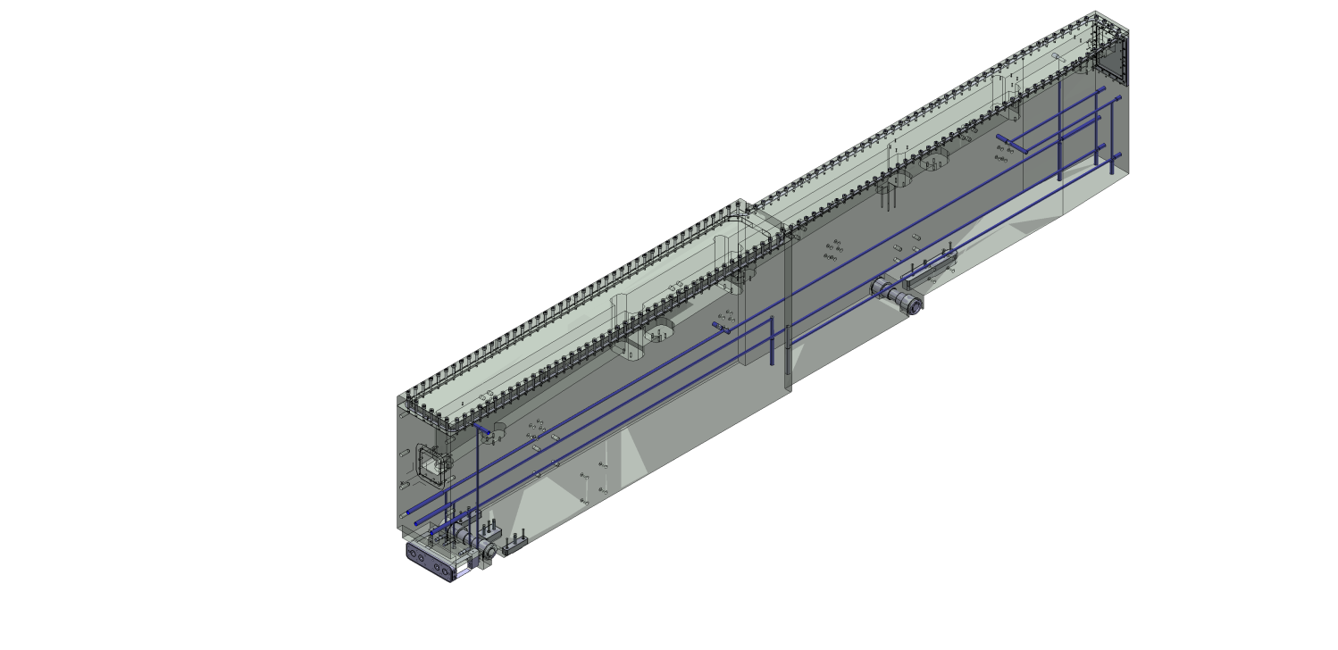
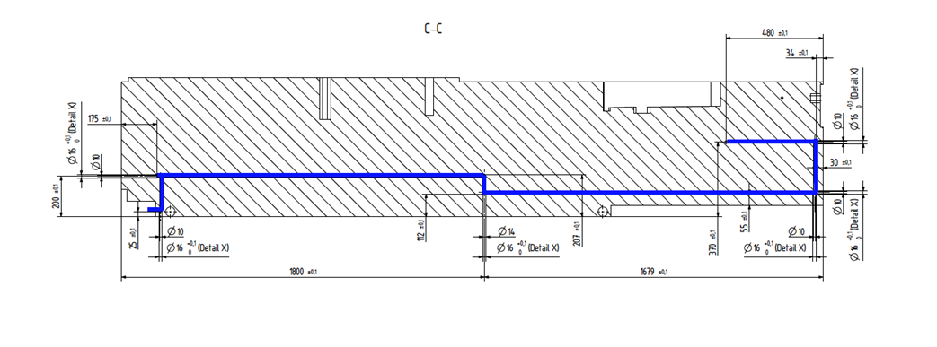
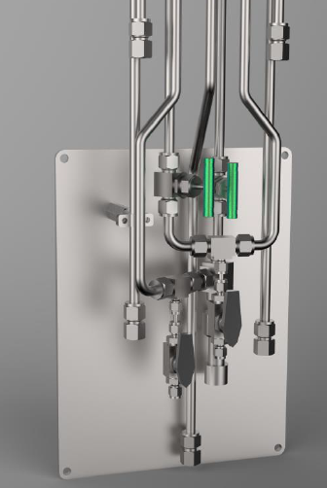
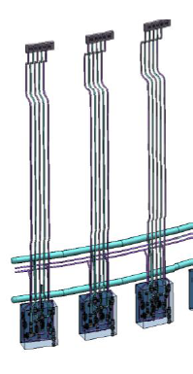

Value Engineering of Neutron Beam Port Plugs
Proposal to remove cooling
Potential to cut cost and manufacturing time if the cooling for the Neutron Beam Port Plugs is removed.
Suggest removal of cooling channels
The valve box for the NBPP is no longer needed
Piping would remain for future NBPI installations
The media connector of the NBPP would no longer be needed

Slide 46


Light Shutter System
LSS

Slide 47

Light Shutter System
Introduction
Functions:
Protect the bunker from radiation during shutdown by positioning the Gamma Beam Shutter (GBS) in front of the Port Block opening.
Highly accurate re-position of the Optical Assembly (BBGOA) accommodated in the Bridge Beam Guide (BBG) during start-up.
Facilitate the handling tools for the Neutron Beam Window via the LSS frame.
BBGOA
BBGOA

Slide 48

Light Shutter System
Introduction
GBS
Major components:
Gamma Beam Shutter (GBS)
Bridge Beam Guide (BBG)
Optics Assembly (BBGOA)
LSS Frame
Floor Filler Block (FFB)
Actuator
Switch Bar
BBGOA
BBG
LSS Frame
FFB
Actuator
Switch Bar

Slide 49
Light Shutter System
Introduction
BBGOA
Inside each BBG is an Optical Assembly (OA) operating as a part of the Neutron Beam Guide.
There are two principal different OA, fixed and switchable (2/3 positions).
This means that the LSS has to not only handling re-position but also the switching function, with high repeatable positioning accuracy.

Slide 50



Light Shutter System
Alignment
Aligning, the major challenge
Aligning in 5DoF (Z-led not constrained) will be done by constraining the BBG with 2 guiding rails combined with 1+2 roller cartridges.

Slide 51

Light Shutter System
Alignment
Aligning, the major challenge
For aligning in Z-led (vertical) we are pursuing two different approaches with the same set of LSS components:
During installation measuring, adjusting and setting a fix z-point on a switch bar with switches located below the concrete floor in a lower radiation zone with a switch rod sticking through connected to the BBG.
The accuracy will rely on repeatability combined with calibration.
During start up measuring the quality of the neutron beam with sensor located by the instrument in predefined set of positions and from the resulting curve position the BBG in the sweet spot.
The accuracy will relay on active measuring and resolution.
Connection point to BBG
Switch Rod
Actuator
Concrete floor
level
Switch Bar

Slide 52

Light Shutter System
Alignment
Repeatable vertical position of BBGOA:
Requested Alignment from NSS: 50microns
Suggested by TD: 500microns
Agreement with NSS that the instruments shall scan by use of moving the LSS to calibrate position of BBGOA.
Concept study with local automation company for improved understanding of alignment limitations ongoing.
Prototype of actuator and shutter system will enable better understanding and further detailing

Slide 53
Thank you!

