Slide 1
FREIA Laboratory Facility for Research Instrumentation and Accelerator Development
Status of the FREIA Test Stand
Roger Ruber for the FREIA Team
aTAC, ESS, 11 April 2019

Slide 2
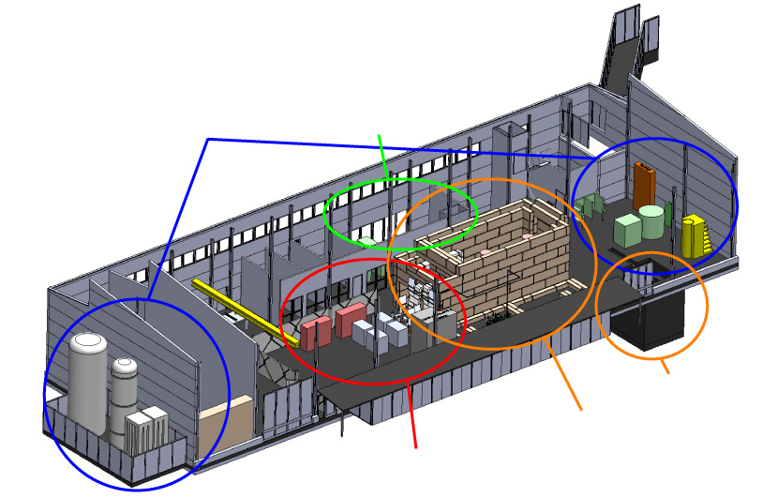
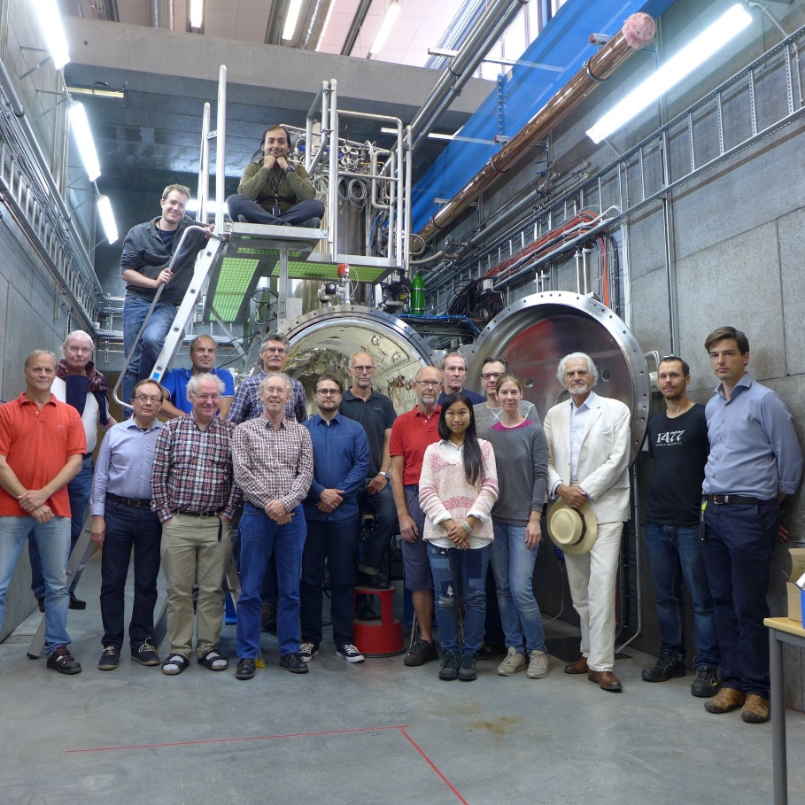
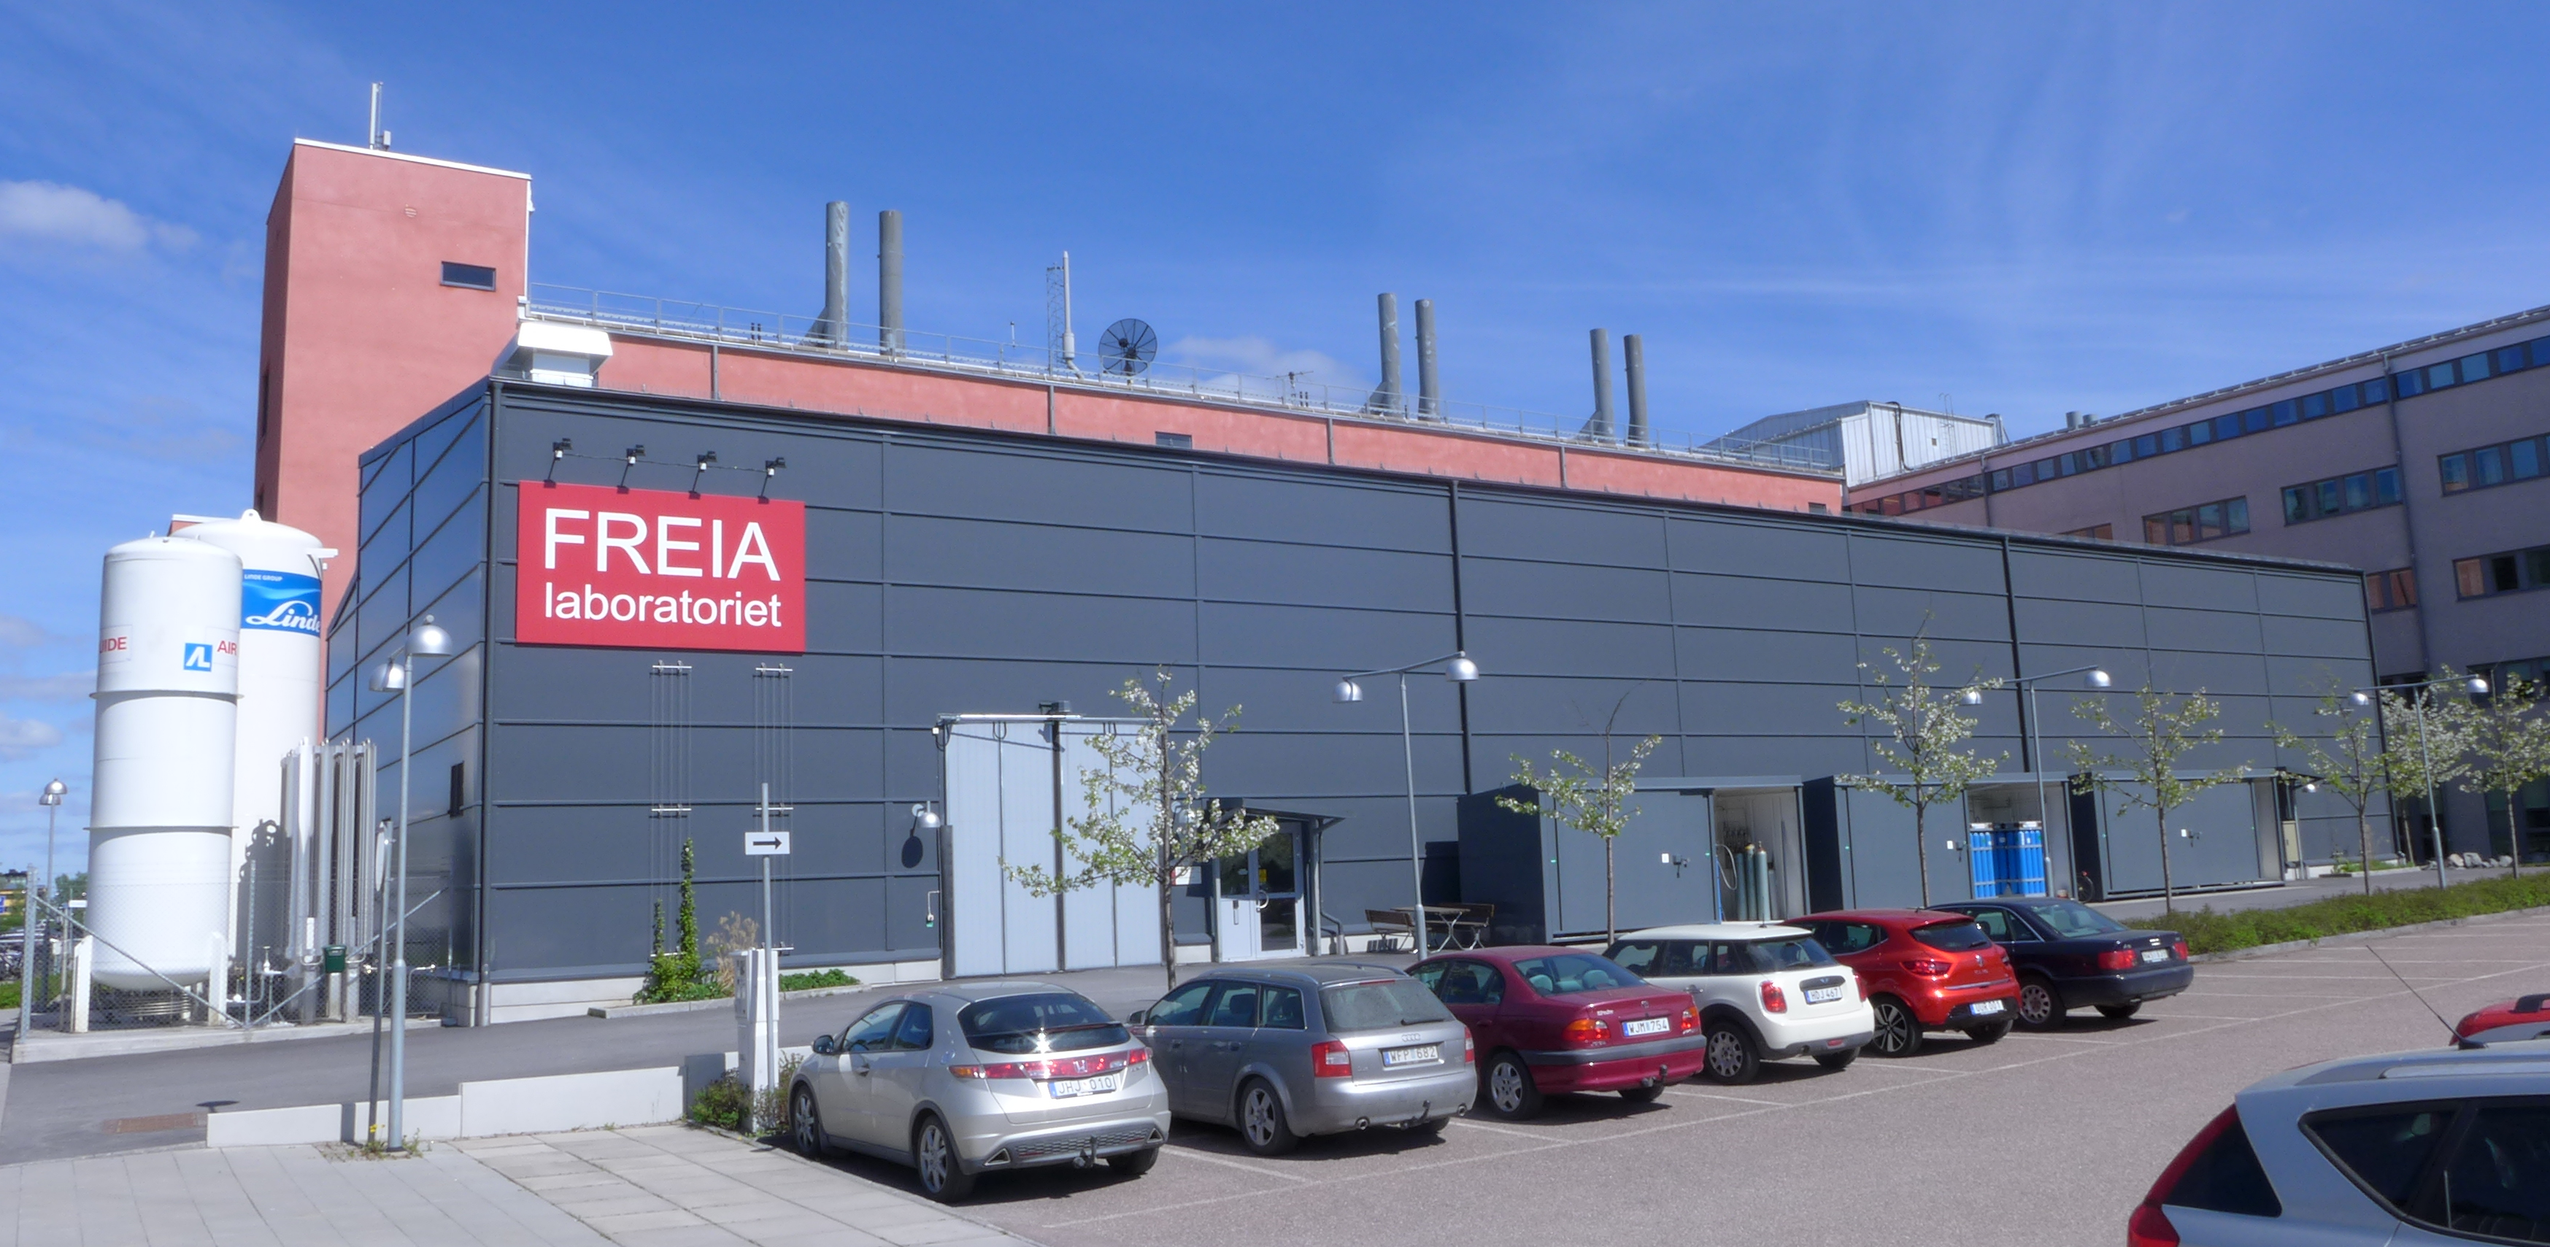
FREIA Laboratory
Facility for Research Instrumentation and Accelerator Development
Competent and motivated staff
collaboration of physics (IFA) and engineering (Teknikum).
State-of-the-art Equipment
cryogenics
- liquid helium
- liquid nitrogen
control room
- equipment controls
- data acquisition
vertical cryostat
3 bunkers
with test stands
horizontal cryostat
radio-frequency (RF) power sources

Slide 3
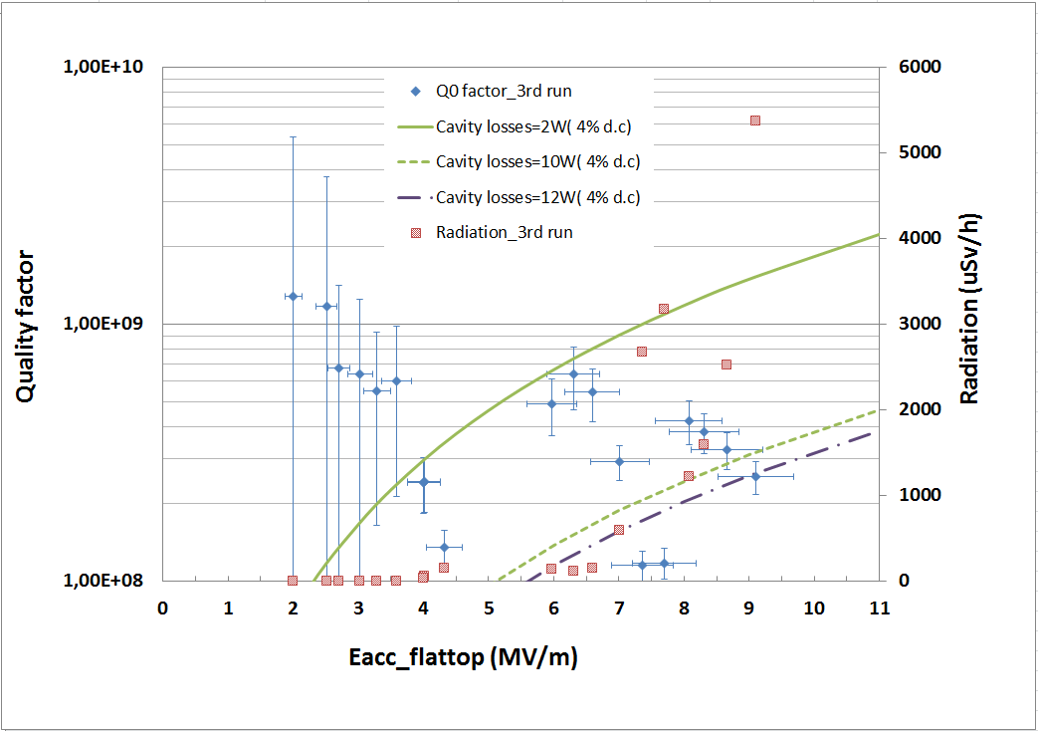
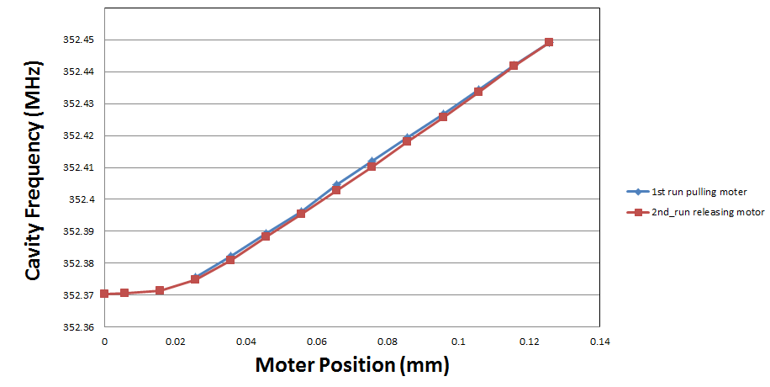
Double Spoke Cavity Package (2017)
Test from March – May 2017
Warm
RF conditioning with IPNO then FREIA system
about 30h; multipacting in 20-60 kW region
max 120 kW forward power (limit set by IPNO)
Cold
RF conditioning with FREIA system
about 30h; 3 major multipacting regions
RF testing
Q₀ = 2.6 x10⁸ at 9 MV/m (w/ heat load correction)
Lorenz force detuning ~400 Hz at 9 MV/m
cavity tuning sensitivity = 150 kHz/mm@2K
pressure sensitivity = +27.1 Hz/mbar
Final status/results
results presented at SLHiPP-7 (9 June 2017)
full report published: urn:nbn:se:uu:diva-335434

Slide 4
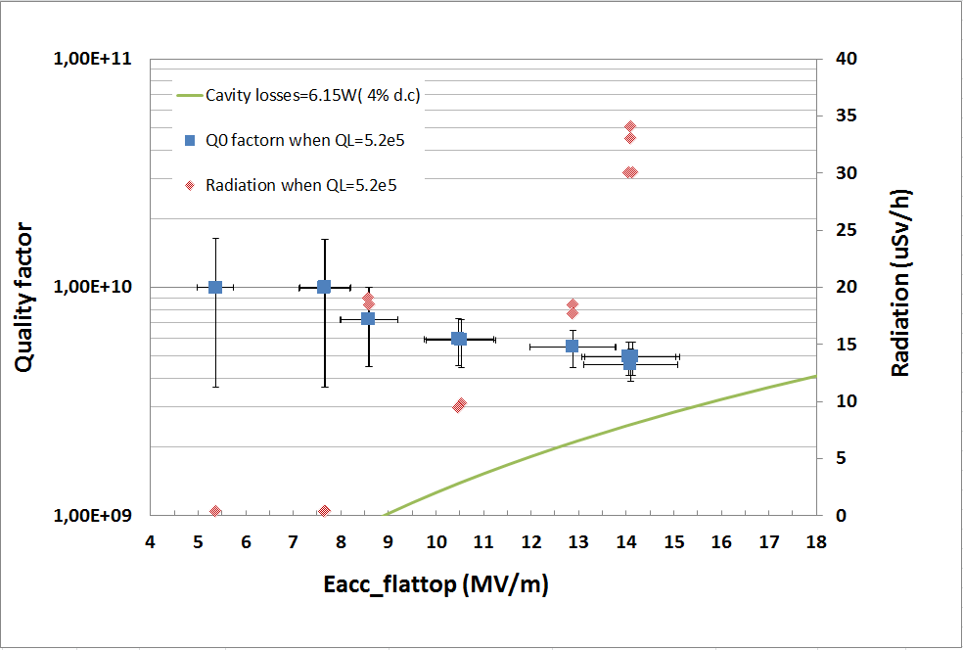
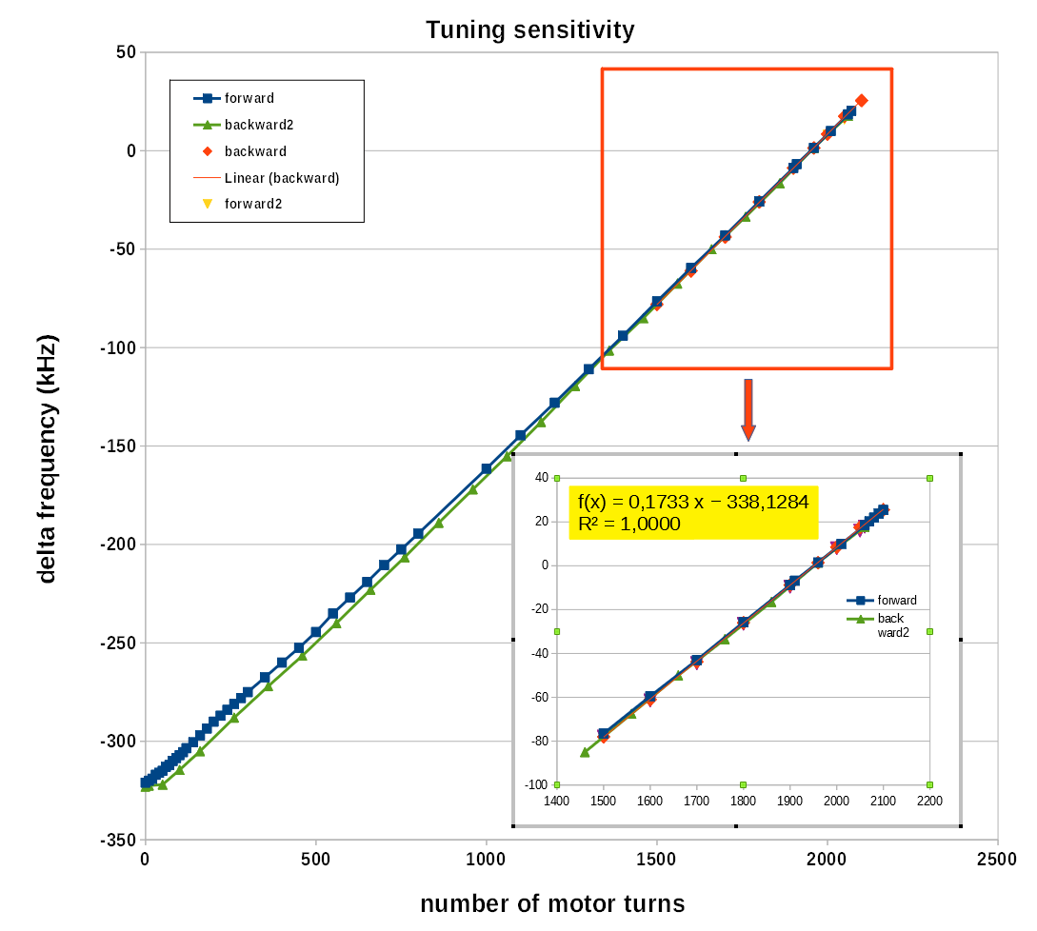
High-β Elliptical Cavity Package (2018)
1st run in June 2018
Warm-up and open to fix tuner problem
2nd run in August 2018
cooldown, then RF re-conditioning at cold
measurement
Q₀ preliminary result >10⁹
not much multipacting, cavity and coupler very quiet during last tests
Lorenz force detuning, cavity tuning sensitivity
lost some motor steps during 1st movement, others ok
test of new electronics for cold tuner system as being developed by our Polish colleagues
preliminary satisfied with the results
Final status/results
cavity back to CEA, modulator/klystron to ESS
results presented at SLHiPP-8 (12 June 2018)
full report published: urn:nbn:se:uu:diva-371627

Slide 5
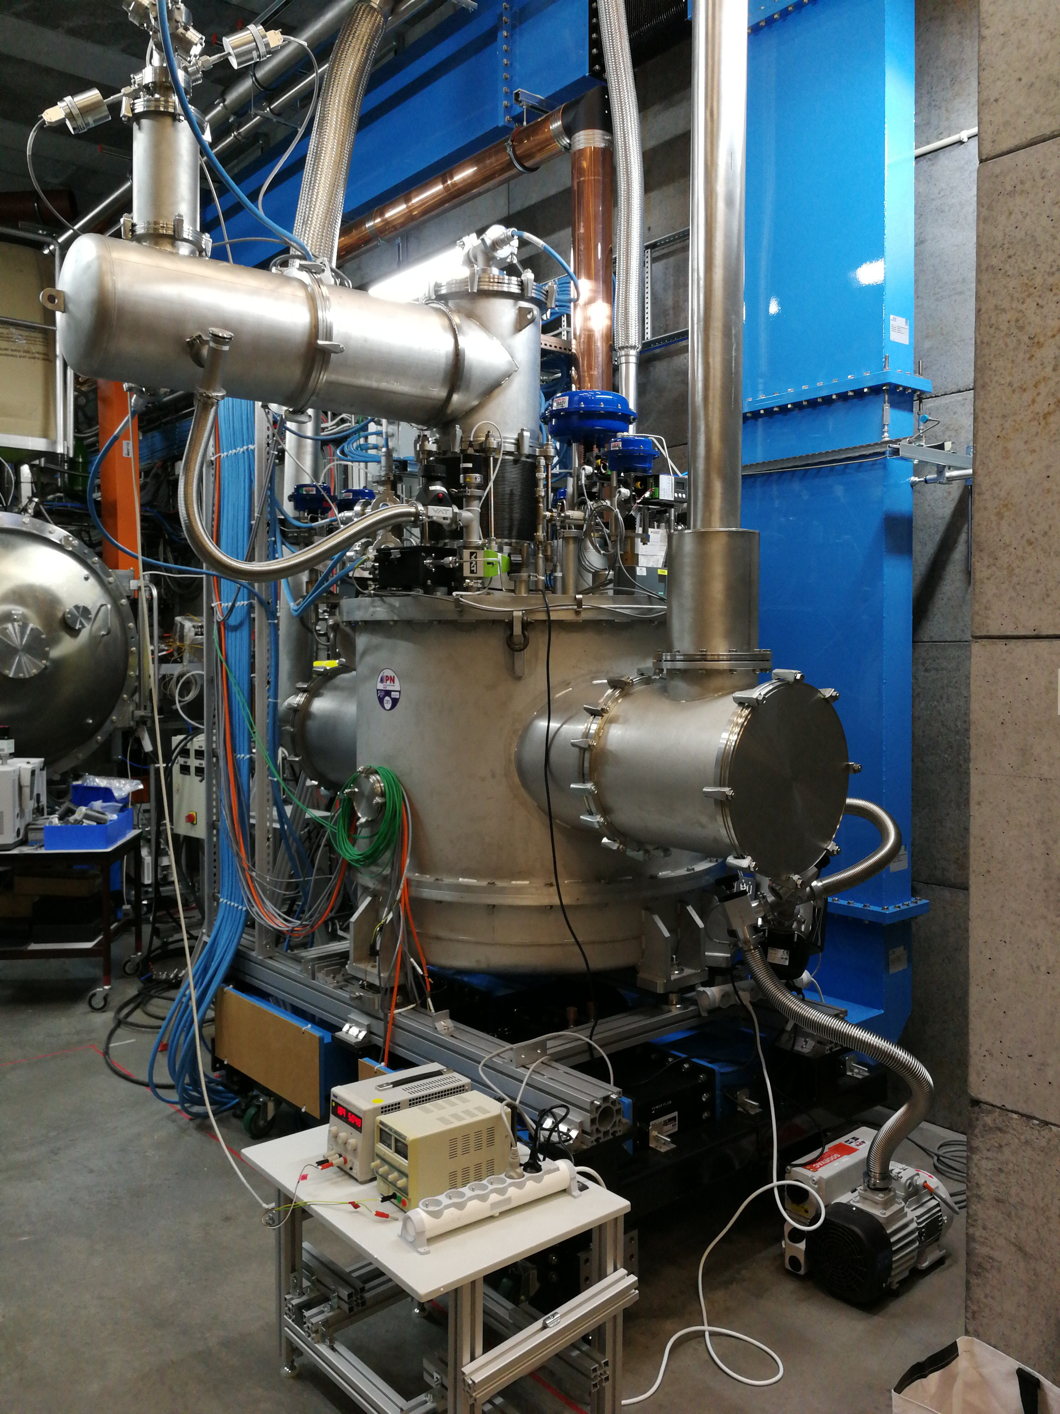
Spoke Valve Box Prototype (2019)
Cryo test run with simulator (Dec + Jan)
commissioning controls & functionality test
Thermo-acoustic oscillations
installed RLC-circuit to damp the oscillations (test with cryomodule cool down)

Slide 6
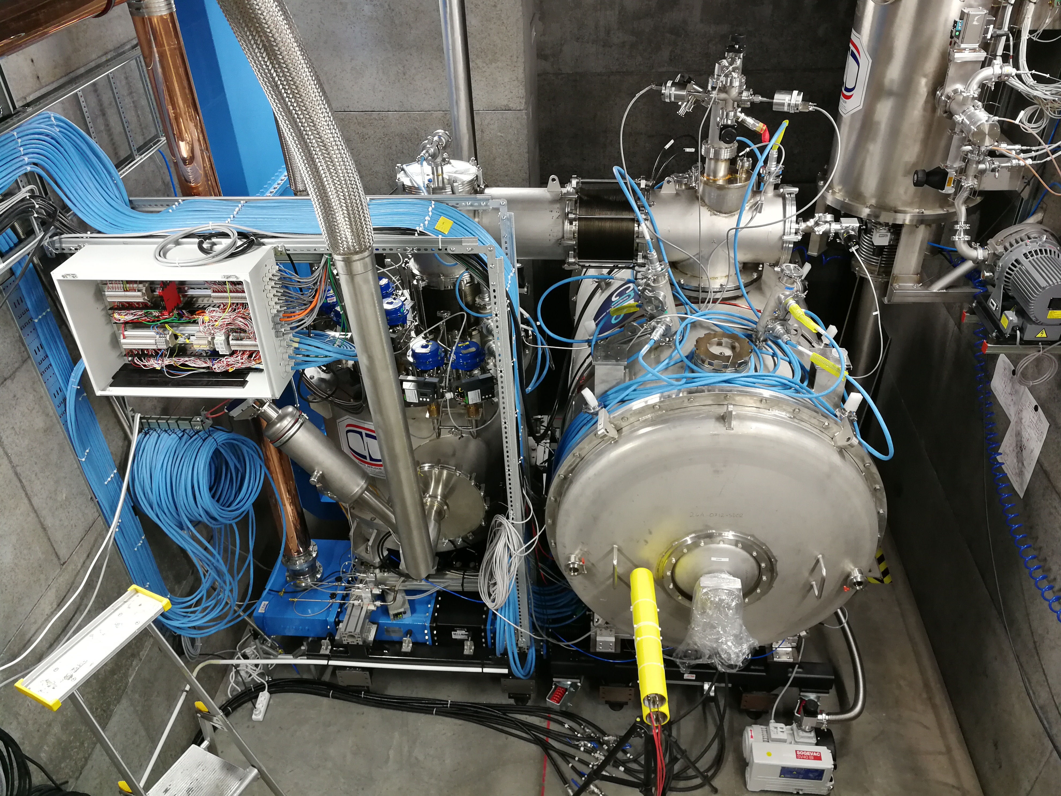
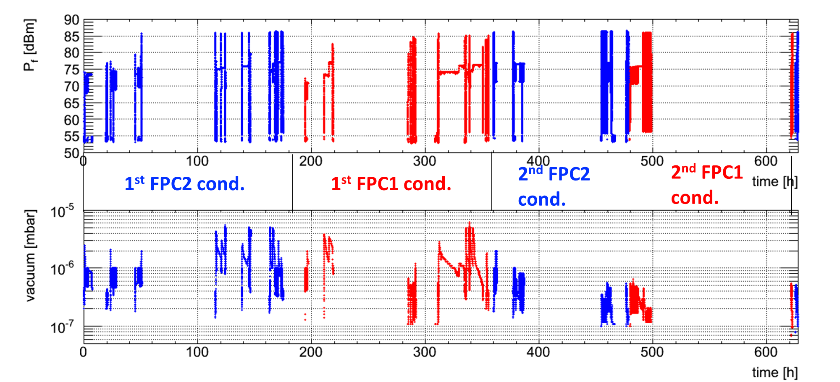
Spoke Cryomodule Prototype (2019)
Warm RF conditioning
~3 days/cavity
1st conditioning ~50 hours
2nd conditioning ~20 h (cross-contamination)
fully automatic system conditioning system
commissioned, now implemented to run 24h/day
MP bands were consistent with HNOSS test
strength depends on pulse length, 1st/2nd conditioning…
Cool Down
4h 15min to 4.5 K
2h 30 min for shield
Cold RF conditioning (4K)
no activity
~5h both couplers
next step RF test (2K) ...
cavity conditioning

Slide 7
Cryomodule Test Plan Draft
Warm Test | Cool Down | Cold Test | Warm-up
Central cavity frequency Q_{ext} | Frequency shift vs. temperature | Coupler cold conditioning | Frequency shift vs. temperature
 |  | Cavity conditioning
 |  | Central frequency Loaded Q and Q_{ext}
Coupler warm conditioning
 |  | Steady heat load
 |  | Q₀ Dynamic heat load Reach 12 MV/m Tuning range of the slow step tuner
 |  | Stabilization of the cavity field with LLRF using only RF compensation / with fast piezo
CRYO
VNA
SGD
signal
generator driven
SEL
Lund LLRF
NOTE: final optimized & minimized list under discussion (ESS/IPNO/UU)

Slide 8
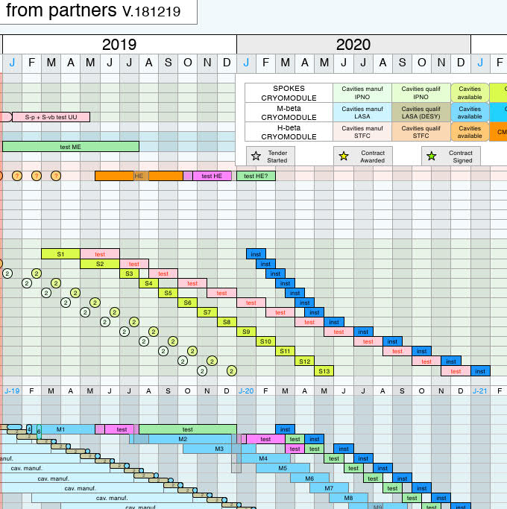
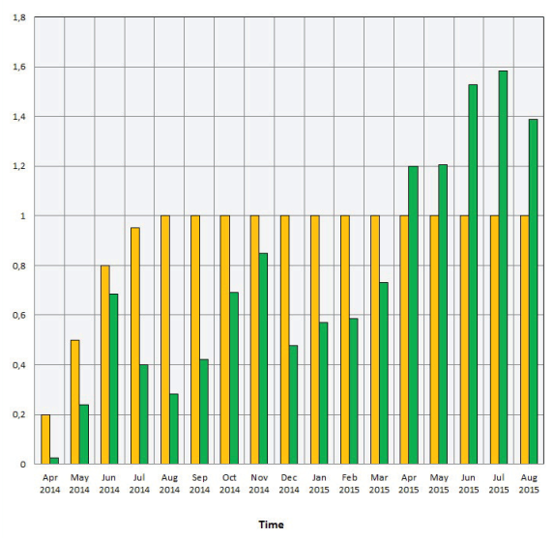
Series Spoke Cryomodule Testing (13x)
Acceptance testing of 13 cryomodules
best estimate: 6 weeks/module
ESS schedule:
4 to 6 weeks/module,
8 weeks for cryomodule S1,
driven by installation planning
DESY experience: 1 year to reach “full speed”
Present planning
first series cryomodule arrives in Summer (4 months delay compared to Dec.2018)
will “hit” installation schedule by S3 or S4 (transportation!)
ESS SRF schedule dated 2018-12-19
SRF2015 MOPB080
1 year
Yellow bars = planned
Green = real quantity

Slide 9
Cryomodule Test Schedule
 | time [days] | time [weeks] | in bunker [days]
Arrival, unpacking, initial inspection | 2.5
Installation, connection to valve box | 5.0 |  | 5.0
Warm test | 2.0 |  | 2.0
Cool down | 2.0 |  | 2.0
Cold test | 5.0 |  | 5.0
Warm-up* | 4.0 |  | 4.0
Disconnect, packing, shipment | 4.5 |  | 3.0
TOTAL | 25.0 | 5.0 | 21.0
Spare and wasted time, 20% (DESY statistics) | 5.0 |  | 4.2
GRAND TOTAL | 30.0 | 6.0 | 25.2
Time given in 8h work days, 1 shift/day. Not including weekend, holidays and vacation. *) Warm-up is shorter if during weekend
= ~5
weeks

Slide 10
Foreseen & Unforeseen Issues (1/2)
Operations take longer time than scheduled
RF conditioning scheduled for 2 days, present indication 3 days/cavity
investigating conditioning both couplers simultaneous, improving vacuum pumping
No time allotted for re-test or failure
also: no space at Uppsala to “store” extra cryomodules
Limited staff resources
No staff for 24h operation
SSM authorization does not allow un-attended operation if producing radiation
Not sufficient staff resources for high-peak workload
difficult to find replacement for high power RF & electronics engineer
several engineers working part-time (at/near retirement)
No time allotted for vacation
university "closure" 5 weeks during Summer, 2 weeks during Winter
also: multiple sick-leave will squeeze staff resources
Limited time contract (ESS agreement until Sept. 2020 w/ extension if delay)
employment rules require dismissal notification one (1) year in advance

Slide 11
Foreseen & Unforeseen Issues (2/2)
Test equipment failure
RF station failure
at present 1 of 2 stations operational
2 RF stations with 2 tetrodes each + 2 spares = 6 total; at present 3 tetrodes out-of-operation;
1 tetrode on order, delivery in September; 2 tetrodes back at Thales for investigation
LLRF/SEL/VNA failure
2 systems available for each (1 for each cavity)
Controls failure
1 system only, some spare parts available but not all
Infrastructure
electricity, primary cooling water, ventilation from Akademiska Hus
secondary cooling water, 2 circuits available
helium liquefier and recovery system
no spares, but maintenance contracts for compressors
vacuum
spares from other systems; 2 ESS pumping carts for beam vacuum

Slide 12
Summary
FREIA Cryomodule Test Stand up and running !
procedures developed and tested on HNOSS
procedure validation and optimization ongoing on prototype
strongly motivated & flexible personnel to make it work
support from ESS and IPNO when needed (RF/SRF/vacuum/...)
BUT:
tight in scheduled time & available resources

