Slide 1
The ESS integrated control system
Overview and status update
Henrik Carling
Head of integrated control systems, ESS
ESS/ICS
Date: 2019-04-10

Slide 2
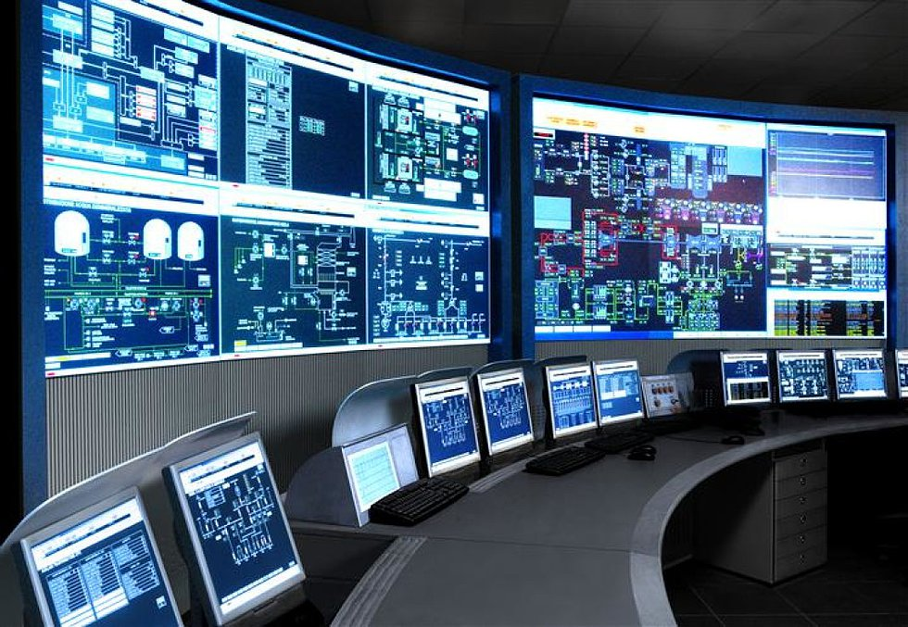
The ESS integrated control system
The ESS facility is a large and complex machine with very much and diverse equipment that needs to work in synchronization and with well-known configurations
The Integrated Control System Division (ICS division) is responsible for the control systems within the ESS facility including controls for
  Accelerator
  Target
  Neutron Scattering Systems
  Conventional Facilities
In addition, ICS will implement
  Machine Protection System
  Personnel Safety System
To build a distributed control
system of this size is a major
undertaking

Slide 3



ESS/ICS challenges
The ESS control system complexity is very high
  About 1 600 000 “process values”
  Ambitious approach to automation of control system configuration
Facility availability goals are very high
  ICS plays a key role for the availability of the facility - 95% availability
  High performance and availability requirements on equipment used
Some new approaches will be implemented at ESS/ICS
  Full scale deployment of EPICS 7
    ESS is committed to contributing to the EPICS community
  Full scale deployment of MicroTCA.4
    ESS is involved in a public procurement for innovation initiative
  Machine learning/Artificial intelligence assisted control system
    Project started to explore how machine learning technologies can be applied

Slide 4





ICS Project scope
Work package 01 Management and administration
Work package 03 Software core
Work package 04 Hardware core
Work package 05 Machine protection
Work package 06 Equipment
Work package 07 Control system infrastructure
Work package 08 Physics
Work package 09 Personnel safety systems
Work package 10 Integration - Accelerator
Work package 11 Integration - Target
Work package 12 Integration - Instruments
Work package 13 Integration - Conventional facilities
Work package 14 Test Stands
Work package 20 Installation
Software
Electronics
Infrastructure
Safety & protection

Slide 5
ICS Organization
2018-08
Henrik Carling
Division head
Wojtek Fabianowski in-kind manager
Thilo Friedrich
Systems engineer
Remy Mudingay
Controls infrastructure
Anna Gillberg
Team assistant
Annika Nordt
Protection systems
Karl Vestin
Hardware and integraion
Hector Novella
Deputy project manager
Susanne Regnell
Controls Software
Timo Korhonen
Chief engineer
Benjamin Bertrand
Software engineer
Alberto Toral
Technician
David Sanchez
Automation engineer
Angel Monera
FPGA Engineer
Benedetto Gallese
Integrator
Ben Folsom
PhD student
Banafsheh Hajinasab
Software engineer
Johan Christensson
Infrastructure technology engineer
Denis Paulic
DGL, PLC engineer
Enric Bargalló
Lead analyst engineer
Faye Chicken
Technician
François Bellorini
Integrator
Claudio Rosati
Software engineer
Dirk Nordt
Software engineer
Susann Skarin
Network administrator
Fernando Carrasco
Technician
Manuel Zaera-Sanz
Lead engineer slow interlocks
Javier Cerejo
PhD Student
Jeong Han Lee
Integrator
Emanuele Laface
Accelerator physicist
Georg Weiss
Software engineer
Stephane Armanet
System reliability engineer
Morteza Mansouri
Safety systems engineer
Mattias Eriksson
Technician
John Sparger
Integrator
Joao Martins
Integrator
Fredrik Söderberg
Software engineer
Jan-Åke Persson
Senior software engineer
Alessio Curri
System administrator
Stephane Gabourin
Lead engineer fast interlocks
Riccard Andersson
Technical coordinator
Peter van Velze
Technician
Julen Etxeberria
Junior controls engineer
Juan Esteban Müller
Software scientist
Karin Rathsman
Accelerator scientist
Anders Harrisson
Software configuration manager
Szandra Kövecses
Lead integrator
Stuart Birch
Senior engineer
Saeed Haghtalab
Integrator
Simone Farina
Embedded systems egineer
Ricardo Fernandes
Control system software architect
Lars Johansson
Software engineer
Fredrik Luthander
Software engineer
Yong Kian Sin
IEC61508 engineer
Viktor Fred
Lead engineer electrical installations
Thomas Fay
Integrator
Tomasz Brys
Integrator
Open position
Consultants
Samuel Crossland
PSS industrial automation
Paulina Skog
Technical coordinator
Philippe Rabis
Work package manager
Miklos Boros
Integrator
Mehdi Mohammednezhad
Integrator
Meike Rönn
Technical coordinator
Michael Beck
Work package manager
Oliver Talevski
Embedded engineer
Nour Akel
ICS Installation coordinator
Open positions (2)
Marino Vojneski
Integrator
Johannes Kazantzidis
Integrator
Krisztian Löki
Integrator
Position under consideration
Maria Romedahl
Technical coordinator
Nicklas Holmberg
Integrator
Open positions (3)
Employee
Consultant
ESS-0081625
Temporary employee
Consultant off-site

Slide 6
ICS Organization
2018-11
Joakim Söder
Electrical engineer
Henrik Carling
Division head
Wojtek Fabianowski in-kind manager
Thilo Friedrich
Systems engineer
Karin Rathsman
Accelerator scientist
Remy Mudingay
Controls infrastructure
Anna Gillberg
Team assistant
Annika Nordt
Protection systems
Karl Vestin
Hardware and integraion
Hector Novella
Deputy project manager
Susanne Regnell
Controls Software
Timo Korhonen
Chief engineer
Benjamin Bertrand
Software engineer
Alberto Toral
Technician
David Sanchez
Automation engineer
Angel Monera
FPGA Engineer
Benedetto Gallese
Integrator
Ben Folsom
PhD student
Banafsheh Hajinasab
Software engineer
Johan Christensson
Infrastructure technology engineer
Denis Paulic
DGL, PLC engineer
Enric Bargalló
Lead analyst engineer
Faye Chicken
Technician
Jeong Han Lee
Integrator
Claudio Rosati
Software engineer
Dirk Nordt
Software engineer
Stephane Armanet
System reliability engineer
Fernando Carrasco
Technician
Manuel Zaera-Sanz
Lead engineer slow interlocks
Javier Cerejo
PhD Student
Joao Martins
Integrator
Emanuele Laface
Accelerator physicist
Georg Weiss
Software engineer
Alessio Curri
System administrator
Morteza Mansouri
Safety systems engineer
Mattias Eriksson
Technician
John Sparger
Integrator
Julen Etxeberria
Junior controls engineer
Fredrik Söderberg
Software engineer
Jan-Åke Persson
Senior software engineer
Anders Harrisson
Software configuration manager
Stephane Gabourin
Lead engineer fast interlocks
Stuart Birch
Senior engineer
Peter van Velze
Technician
Simone Farina
Embedded systems egineer
Juan Esteban Müller
Software scientist
Lars Johansson
Software engineer
Fredrik Luthander
Software engineer
Szandra Kövecses
Lead integrator
Viktor Fred
Lead engineer electrical installations
Saeed Haghtalab
Integrator
Tomasz Brys
Integrator
Ricardo Fernandes
Control system software architect
Open position
Yong Kian Sin
IEC61508 engineer
Felipe Torres
Embedded systems engineer
Thomas Fay
Integrator
Mehdi Mohammednezhad
Embedded systems engineer
Open position
Consultants
Samuel Crossland
PSS industrial automation
Paulina Skog
Technical coordinator
Philippe Rabis
Work package manager
Miklos Boros
Integrator
Nour Akel
ICS Installation coordinator
Wayne Lewis
Integrator
Johannes Gustafsson
MPS automation engineer
Meike Rönn
Technical coordinator
Michael Beck
Work package manager
Oliver Talevski
Embedded engineer
Fabio dos Santos
Embedded systems engineer
Open position
Marino Vojneski
Integrator
Johannes Kazantzidis
Integrator
Consultants
Position under consideration
Maria Romedahl
Technical coordinator
Nicklas Holmberg
Integrator
Open position (2)
Employee
Consultant
ESS-0081625
Temporary employee
Consultant off-site

Slide 7
ICS Organization
2019-04
Henrik Carling
Division head
Joakim Söder
Electrical engineer
Thilo Friedrich
Systems engineer
Karin Rathsman
Accelerator scientist
Remy Mudingay
Controls infrastructure
Anna Gillberg
Team assistant
Annika Nordt
Protection systems
Karl Vestin
Hardware and integration
Hector Novella
Deputy project manager
Susanne Regnell
Controls Software
Timo Korhonen
Chief engineer
Benjamin Bertrand
Software engineer
Alberto Toral
PSS technician
David Sanchez
MPS engineer
Antoni Simelio
Integrator
Evan Foy
Integrator
Ben Folsom
PhD student
Banafsheh Hajinasab
Software engineer
Johan Christensson
Infrastructure technology engineer
Denis Paulic
DGL, PSS engineer
Enric Bargalló
MPS engineer
Angel Monera
FPGA Engineer
Jeong Han Lee
Integrator
Claudio Rosati
Software engineer
Dirk Nordt
Software engineer
Stephane Armanet
System reliability engineer
Fernando Carrasco
MPS technician
Manuel Zaera-Sanz
Senior engineer MPS
Faye Chicken
Technician
Joao Martins
Integrator
Emanuele Laface
Accelerator physicist
Georg Weiss
Software engineer
Alessio Curri
System administrator
Javier Cerejo
PhD Student
Martin Carroll
MPS engineer
Mattias Eriksson
PSS technician
Jerzy Jamroz
Integrator
Fredrik Söderberg
Software engineer
Jan-Åke Persson
Senior software engineer
Amir Forsat
Network reliability engineer
Anders Harrisson
Software configuration manager
Morteza Mansouri
PSS engineer
Stuart Birch
Senior engineer PSS
John Sparger
Integrator
Julen Etxeberria
Junior controls engineer
Juan Esteban Müller
Software scientist
Lars Johansson
Software engineer
Te-Hung Tsen
Junior devops engineer
Peter Holgersson
PSS senior technican
Viktor Fred
MPS engineer
Saeed Haghtalab
Integrator
Peter van Velze
Technician
Ricardo Fernandes
Control system software architect§
Consultants
Open position
Stephane Gabourin
MPS engineer
Tomasz Brys
Integrator
Thomas Fay
Integrator
Yong Kian Sin
Integrator
Open position (2)
Szandra Kövecses
MPS engineer
Attila Horvath
Integrator
Douglas Bezerra
Integrator
Mehdi Mohammednezhad
Embedded systems engineer
Samuel Crossland
PSS industrial automation
Paulina Skog
PSS documentation expert
Felipe Torres
Embedded systems engineer
Miklos Boros
Integrator
Ahmed Abujame
ICS Installation coordinator
Johannes Gustafsson
MPS engineer
Meike Rönn
PSS documentation expert
Philippe Rabis
Work package manager
Oliver Talevski
Embedded engineer
Fabio dos Santos
Embedded systems engineer
Marino Vojneski
Integrator
Michael Beck
Work package manager
Johannes Kazantzidis
Integrator
Consultants
Position under consideration
Employee
Consultant
Maria Romedahl
Technical coordinator
Nicklas Holmberg
Integrator
Open position
ESS-0081625
Temporary employee
Consultant off-site

Slide 8
Organizational development
ICS is lagging behind slightly in staffing according to plan
The loss of 5 employees through attrition at the end of 2018 has taken some time to recover but we are now on our way to follow the staffing plan again
ESS management has been supportive for the replacement recruitments
It is difficult (as always) to find some of the the more specialized competences needed for ICS, in particular EPICS Embedded systems, and MicroTCA competence
The ICS staffing plan during construction and early operations has been reviewed and benchmarked and optimized on several occasions since 2015. It is based on a “linear” planning for the constriuction phase
Gap increased due to attrition

Slide 9
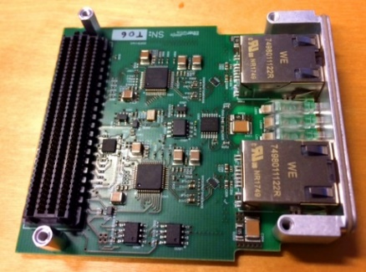
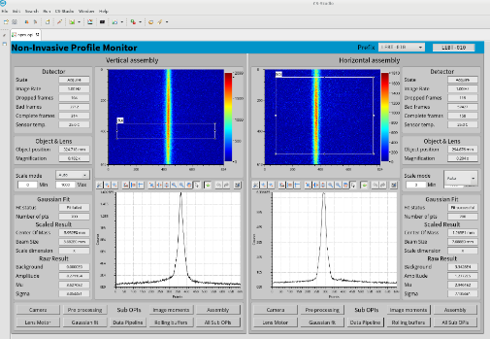
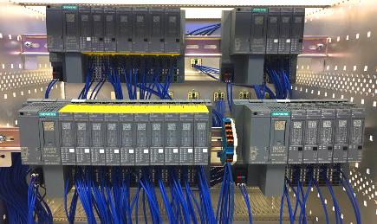
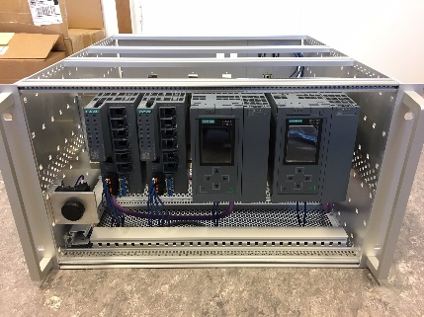
Progress since TAC 18 (1/2)
Project
  Progress on licensing project deliverables - delivery of documentation towards the next major application submission to SSM on time
  Critical design review of systems related to the ESS active cell facility delivered by Remote applications for challenging environments
  Successful integration of control system subsystems; timing system, E3 and EPICS 7 at the V20 test beam line at Helmholtz Zentrum Berlin
  Preliminary design review for the target station Helium cooling system successfully passed. One step forward for documentation alignment
  Handover of Oxygen deficiency hazard (ODH) system was made to the accelerator operations teams
  ICS risk register updated and available on the ESS intranet. It now contains 13 high severity risks, 13 medium severity risks and 7 low severity risks
  Implementation of controls for the accelerator cryod systems, project started with procurement for outsourcing of some of the activities
  Preliminary design review successfully completed for the personnel safety system implementation for accelerator test stand 2
  Revision of the ICS handbook kicked-off. The ICS handbook is a technical reference for stakeholders and partners working with ICS technology
Organization/in-kind
  Re-consideration a proposal from ESS in-kind partner Forschungszentrum Jülich, going from in-kind to commercial model
  Planned extension of in-kind contract with ZHAW in Winterthur, Switzerland cancelled and replaced with commercial framework agreement
  Good progress on many other in-kind projects. Some issues found recently, replacement of in-kind manager has been difficult
  Good progress on ongoing recruitments to replace staff that left ESS/ICS in 2018 - four out of five positions filled, one ongoing
  Planning for the ESS central networking team ongoing, scope is “All ESS networks at all sites”

Slide 10
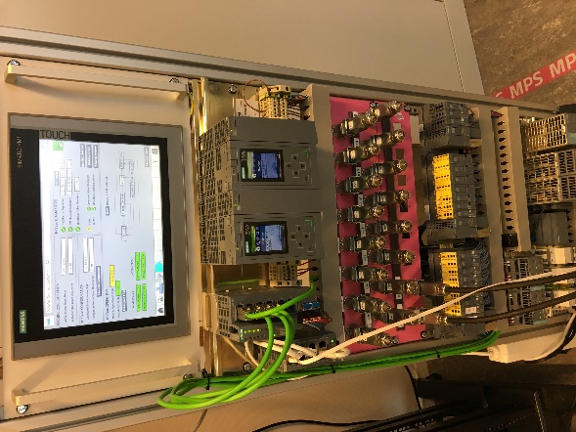
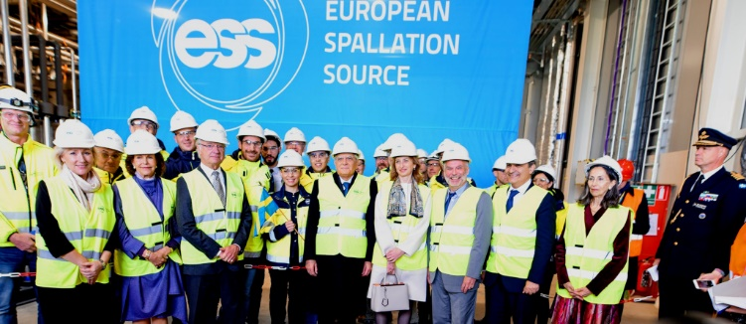
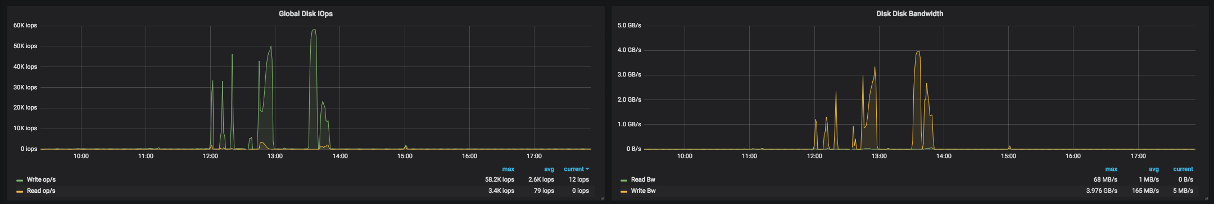
Progress since TAC 18 (2/2)
Technical
  Completed reconfiguration of the ion source EPICS channel access network for compliance with ESS technical network
  Operational limits and alarms for the ion source and low energy beam transport section have been defined and applied
  Overall good progress on commissioning of ion source and low energy beam transport section during the last quarter
  Successful tests of the ICS standard MicroTCA platform IFC1410 in real environment for neutron beam loss monitors
  All servers previously hosted at the Medicon village office complex have been moved to ESS -> increased reliability
  EPICS channel finder has been deployed to the production environment on the technical network, ready for population
  Network/system vulnerability management strategy defined, network intrusion detection/prevention system deployed
  Progress on documentation for the ESS EPICS Environment (e3). Self-training material also availabe
  Decision made on ESS logbook to be based on Infor EAM Light Logbook (developed by CERN as an open source extension)
  Integration of machine protection system with beam current monitors working at high speed and long cable lengths
  Progress on integration and interfaces for the ESS save/restore application with the new CSS Phoebus framework
  Progress on the ESS calibration service software product. Architectural design established and prototype developed
Installation
  Installation of new data centre racks with integrated cooling has started in the communication room in building G02
  WLAN access point installations for klystron gallery building and all network installations for cryogenic systems completed
  Good progress on the development of deployment and installation strategies for the ESS central timing system
  Early access has been granted to the server hall and in the central utility building and a formal inspection was carried out on 2019-01-29
  Installations of optical fiber for the radiation environment monitoring system have started. Cable routing for the technical network is underway
  Preparations for installation of the ESS central server room in Building H01 are progressing.
  Installation readiness review and installation binder documents created and negotiating/scoping to reduce the cost ongoing
  Early access to the ESS server hall in the central utility building granted. Status of the facilities documented and images available .

Slide 11
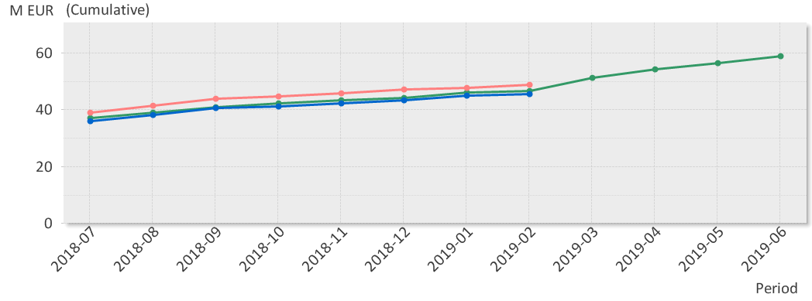
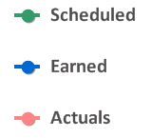
EV Graph
(* No InKind included)
Current Status
Cumulative schedule variance for ICS is within established variance reporting thresholds
Cumulative cost variance
  Work package 14.10 (accelerator integration) -1.2 M€: re-baselined plan not fully implemented yet - recoverable
  Work package 14.06 (equipment) -0.6 M€: historical cash expense to salvage in-kind project - not recoverable
  Work package 14.04 (controls hardware) -0.6 M€: planning artefact, but cost overshoot - work ongoing to recover

Slide 12
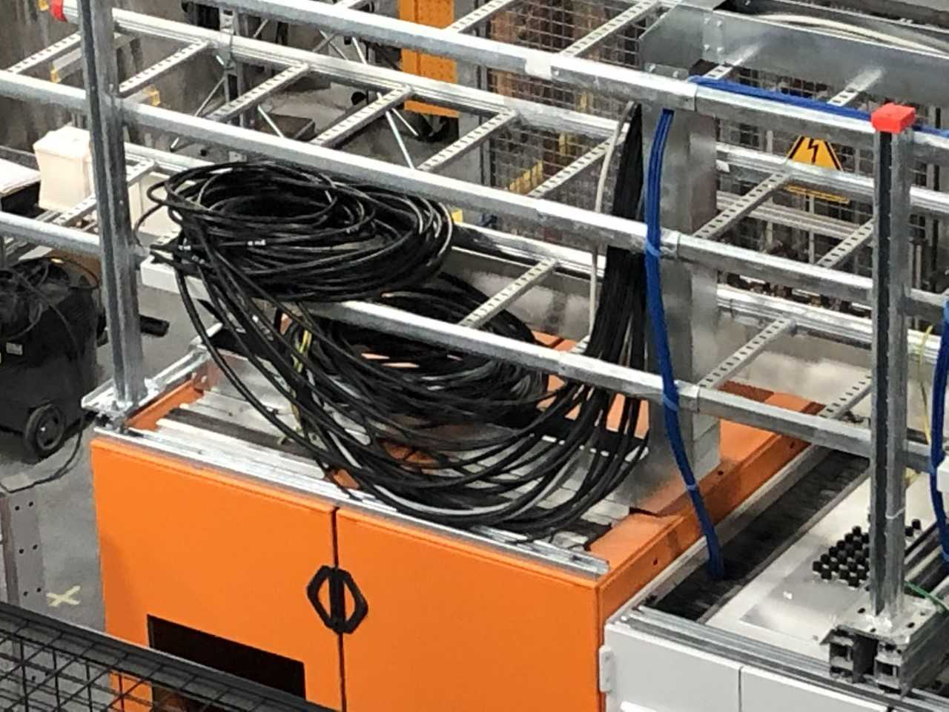
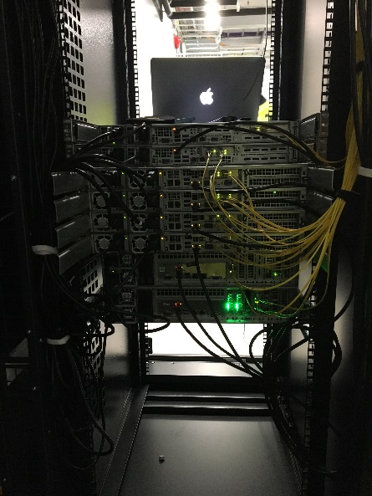
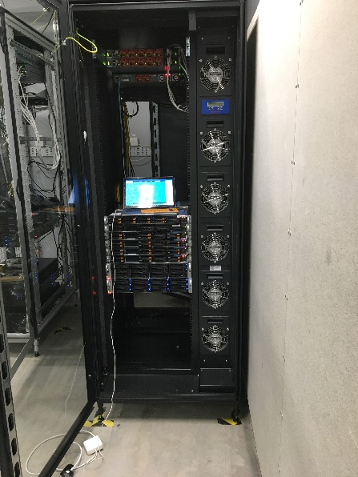
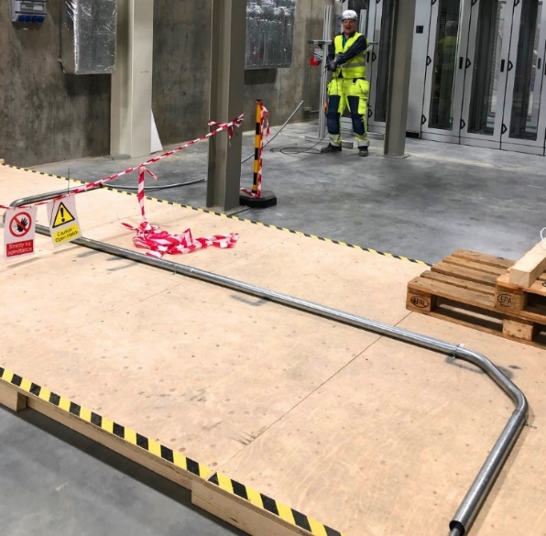
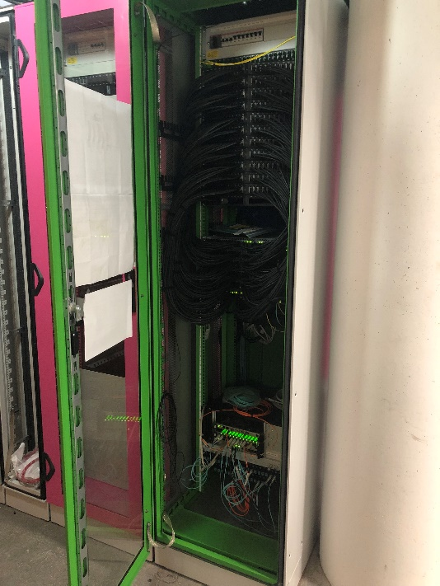
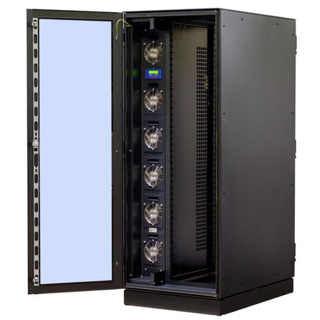
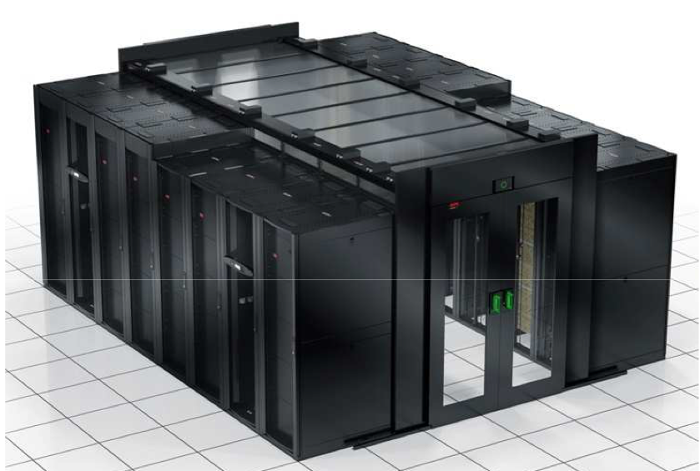
Installation
Installation and deployment of control system infrastructure is progressing according to plan
Technical network and timing system infrastructure is being installed
Further networking scope will likely be added to ICS’ scope

Slide 13
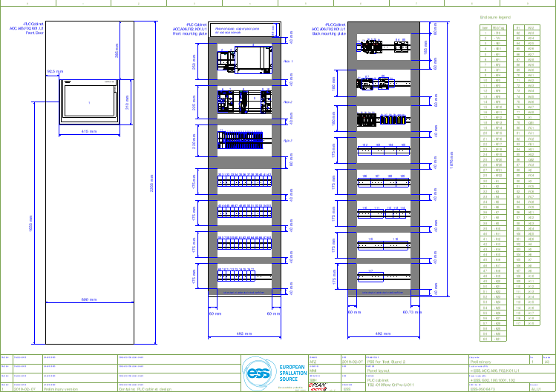
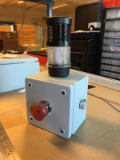
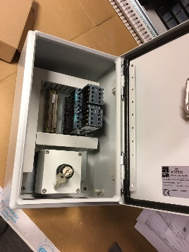

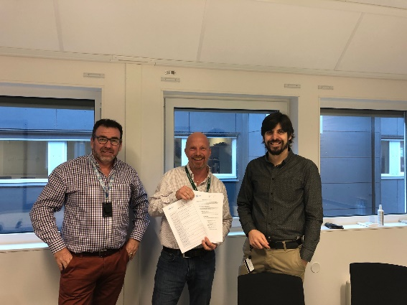
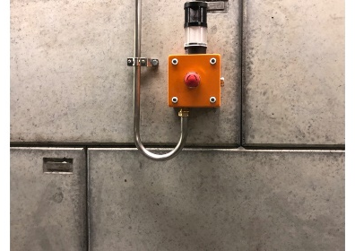
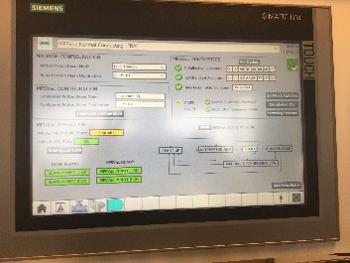
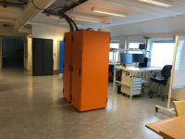
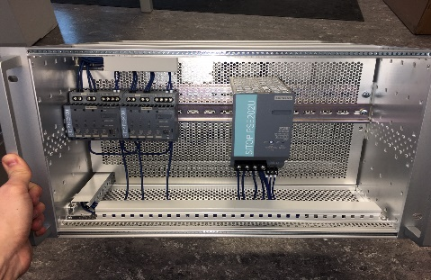
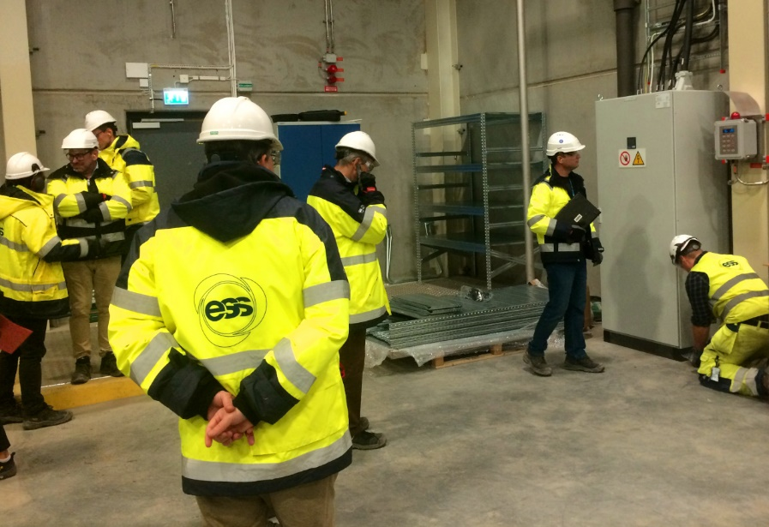
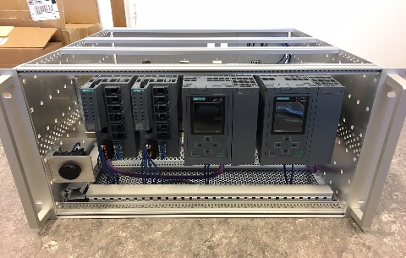
Installation and deliveries
The ICS protection system group has made good progress since TAC 18
The first implementation of the Oxygen deficiency hazard detection system was handed over in 2019-12

Slide 14
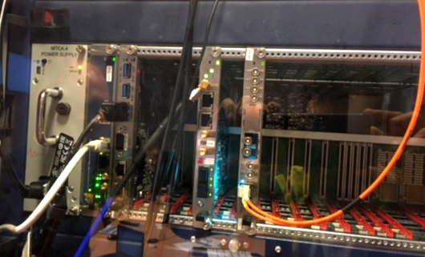
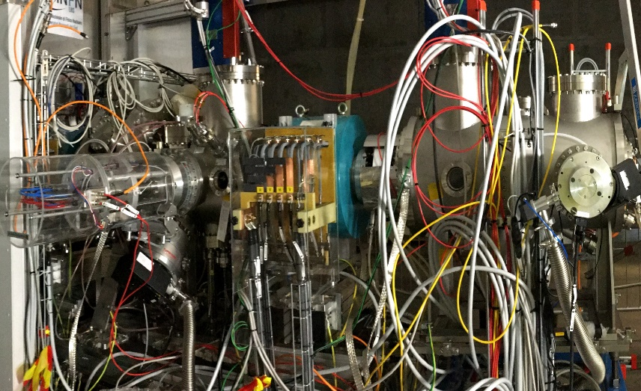

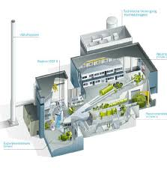
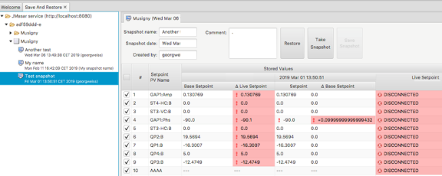
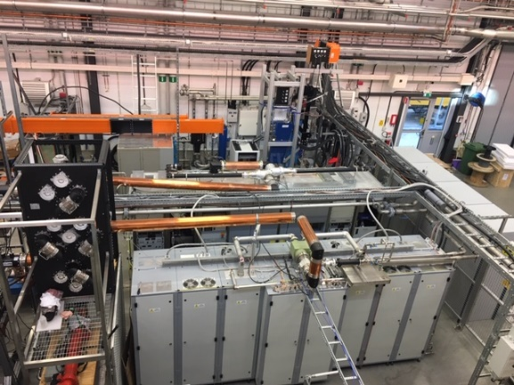
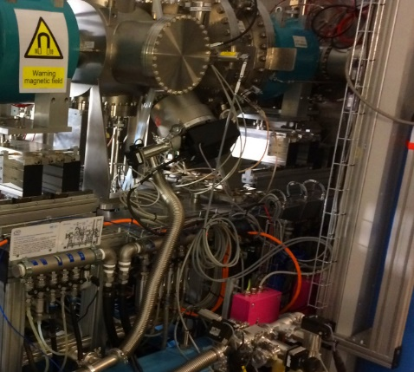
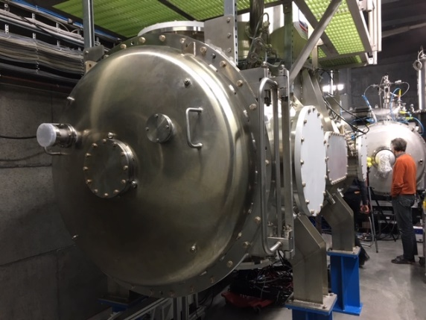
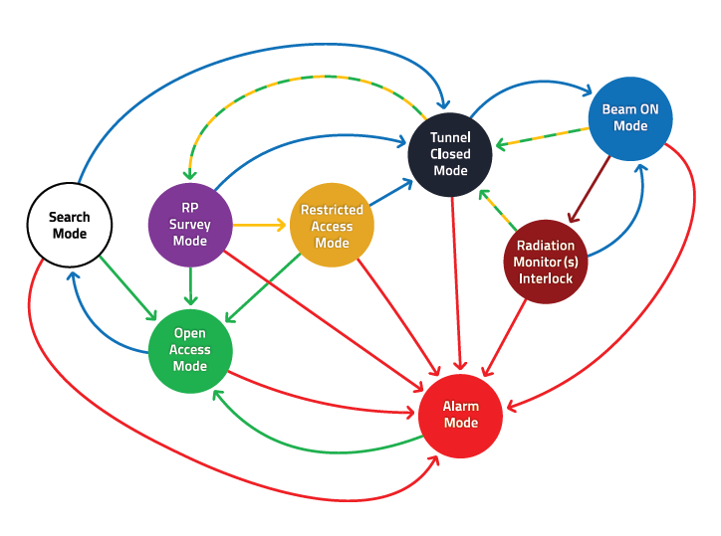
Test and commissioning activities
By contributing to the test and commissioning activities for the ion source and LEBT a new team-dynamic has been created
Tests of control system technologies for instruments at the V20 test beamline at Helmholtz Zentrum Berlin has successfully demonstrated the viability of the technology stack

Slide 15
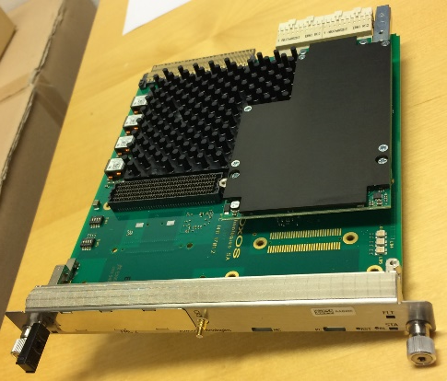
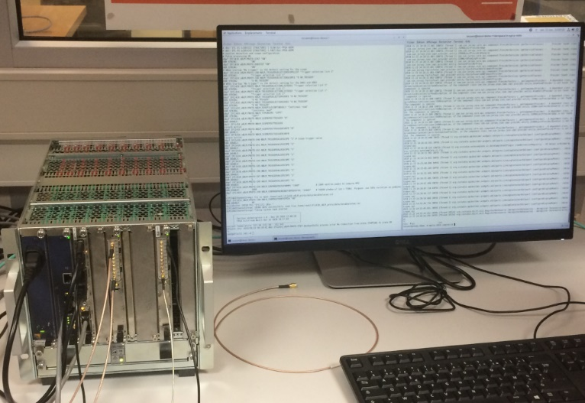
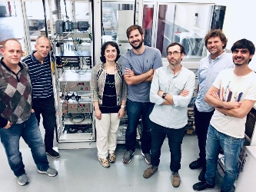
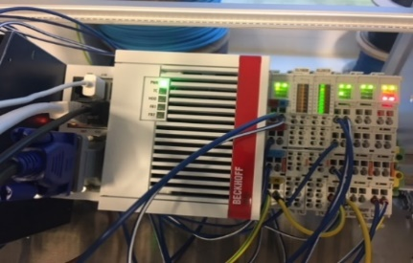
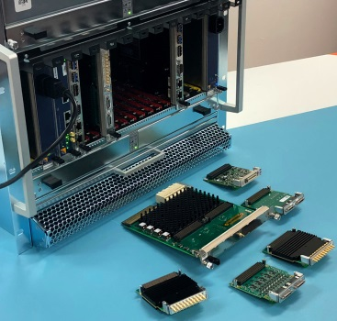
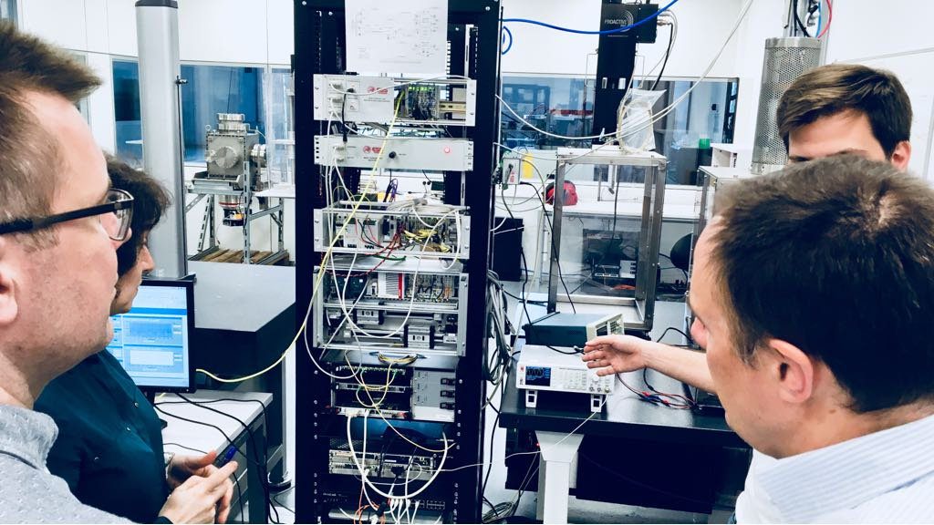
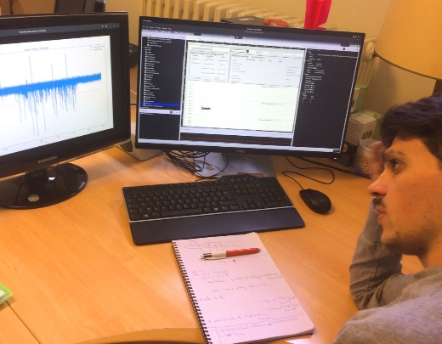
In-kind and in-house technology progress
Good progress on hardware technology development and integration
Meanwhile, work is continuing with maintaining and developing the ICS and EPICS software solutions

Slide 16











ICS in-kind status
  PSI: Most hardware deliveries done - Integration work started
  TUT: Ethercat FMC: Hardware deliveries made; FPGA-IOC: ongoing
  CEA: Good progress on RFQ controls integration
  ESS Bilbao: Progress on integration of control systems of the MEBT - SAR passed
  ZHAW: On track - good progress
  INFN Legnaro: Good progress of DTL controls integration
  IFE: Control room phase 3 to be re-negotiatated
  STFC: Project almost completed - ”hibernating”
  Łódź: Work ongoing on all three work units - mainly on nBLM

Slide 17

ICS In-kind partners
Agreement signed
Agreement waiting for signature
Collaboration/other agreement

Slide 18


In-Kind development (and not)
  Previously planned extensions with in-kind partner ZHAW, Switzerland, re-planned as commercial collaboration
  Previously planned in-kind contract with FZ Jülich, Germany, re-planned as commercial collaboration
  Delays have started to show up in some projects - in many cases this is an effect or the lack of an in-kind manager, even though project hand-overs have been made

Slide 19
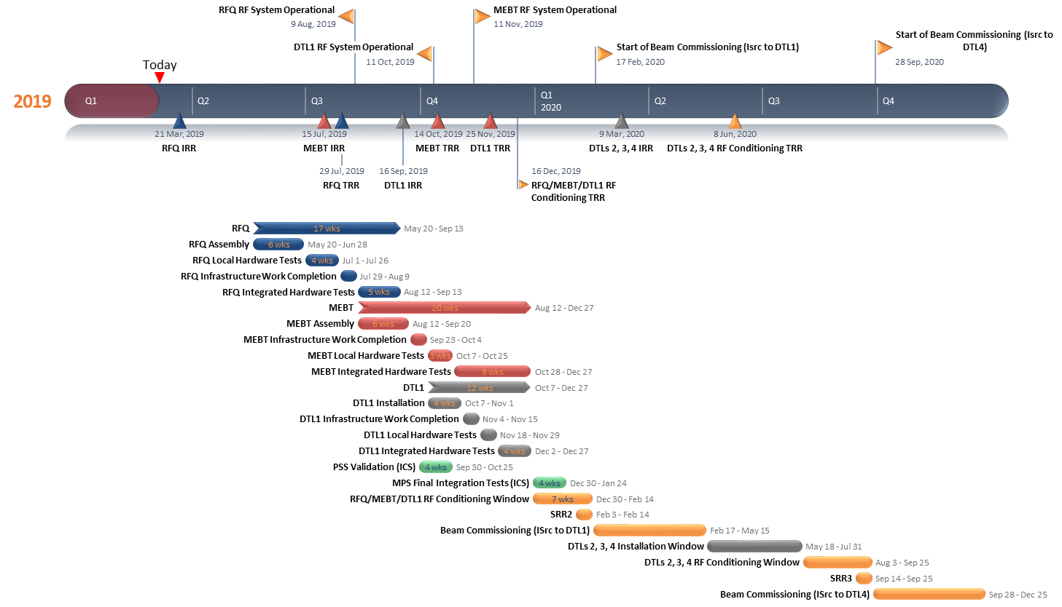
Next steps 2019
ICS is preparing for a very intense period of accelerator system integration with the expected deliveries of the normal conducting linac components MEBT, RFQ and DTL
Installation and commissioning of MPS and PSS functionality will also be high-intensity activities
Meanwhile work progresses with target system integration and work on instrument integration
Workload/resource balance will be challenging during the year and we expect to procure expert services to help offload staff

Slide 20
2019 MAJOR ACTIVITIES
Supporting and working with Accelerator
  Personnel safety and machine protection systems for accelerator commissioning
  RF systems for normal conducting linac
  Delivery and installation, commissioning of MEBT, RFQ and
  Cryogenic distribution systems controls
  Beam instrumentation systems
Supporting and working with Target, NSS and CF
  Continue working with process control systems and overall target systems
  Continue working with technology development for instruments while supporting integration efforts
ICS internal
  Rollout of central timing system
  Control system infrastructure - expanding to network services
  Continue adapting and enhancing controls configuration management software
  Continue adapting and enhancing software infrastructure (EPICS, CSS, Alarm, Logbook …)

Slide 21
Planned procurements 2Q - 3Q 2019
  Listed are the “major” procurements planned for the coming 6 months
  Red arrows indicate procurements where we see a larger number of suppliers participating
  The ICS procurement plan has been significantly refined during 2018
  In total ~30 major procurements are planned until 2022 with a total value of 10.8 M€
Notes:
ICS: priority is ODH and CUB

Slide 22
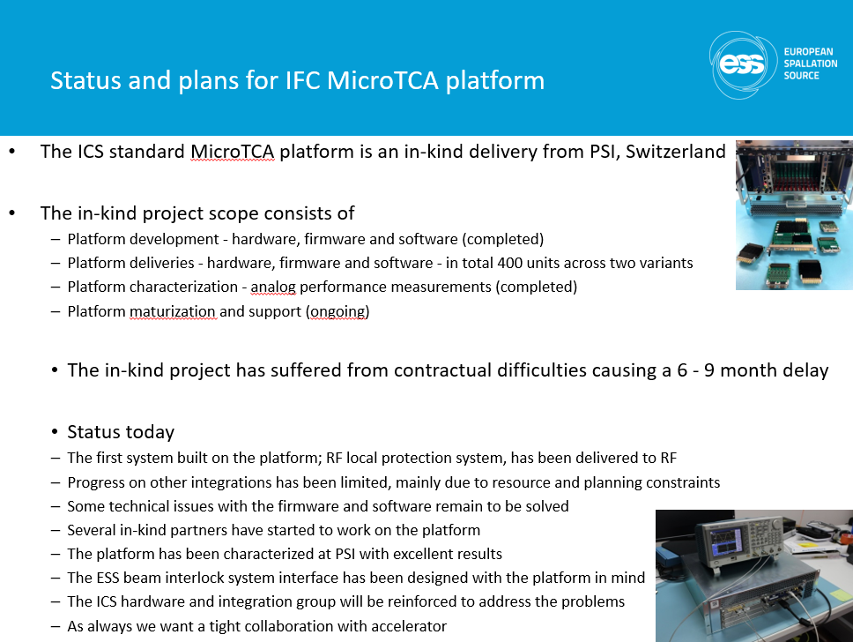
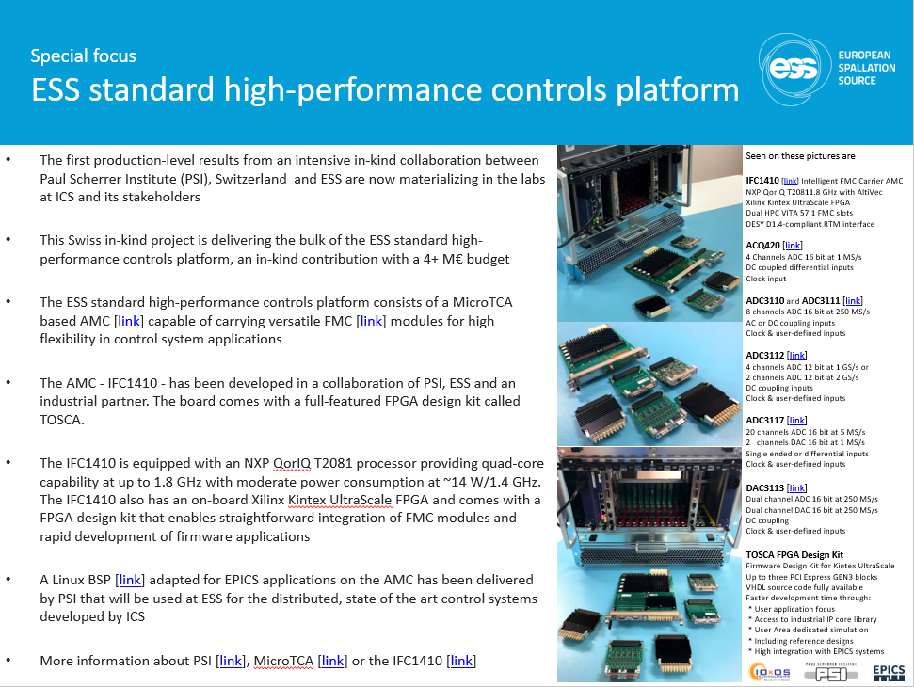
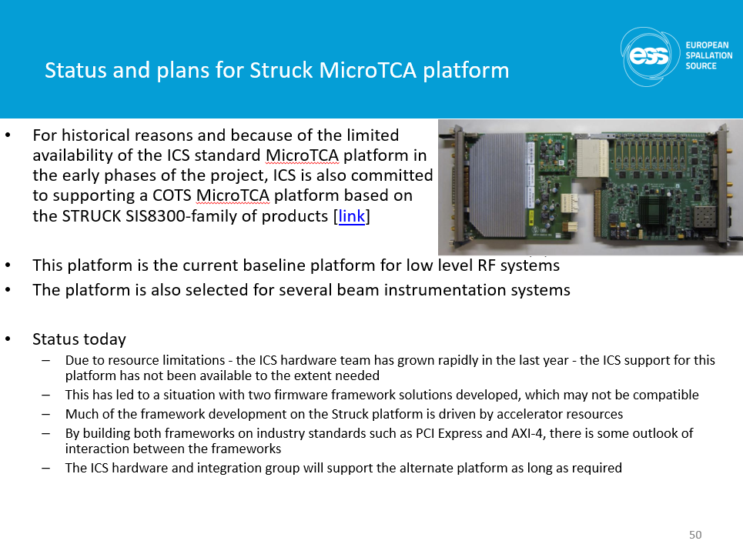
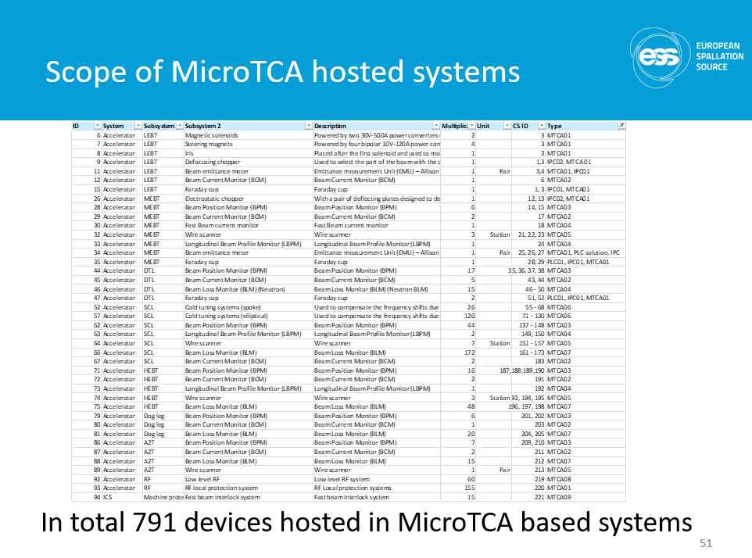
ESS driving technology - MicroTCA
ESS is investing significantly in MicroTCA technology
ESS will be around for many years to come
MicroTCA is a hardware platform generating a lot of interest

Slide 23
ESS driving technology - EPICS 7
Experimental Physics and Industrial Control System
EPICS is a set of software tools and applications which provide a software infrastructure for use in building distributed control systems to operate devices such as Particle Accelerators, Large Experiments and major Telescopes.
Such distributed control systems typically comprise tens or hundreds of
computers, networked together to allow communication between them and
to provide control and feedback of the various parts of the device from a central
control room
Flexible and scalable
EPICS is used at many science facilities around the world . Typically, there are hundreds of dedicated computers that directly or indirectly control almost every aspect of the machine operation, while workstations and servers in the control room provide higher level control and operator interfaces to the systems, and perform data logging, archiving and analysis
EPICS development
EPICS is developed through a collaborative open-source process where anyone is free to contribute to the EPICS family of software. The development roadmap is defined by the EPICS council which consists of major contributors to the EPICS community

Slide 24

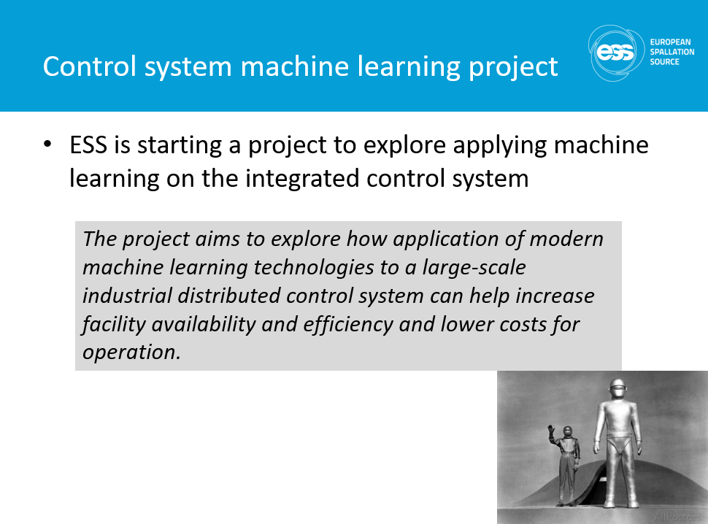
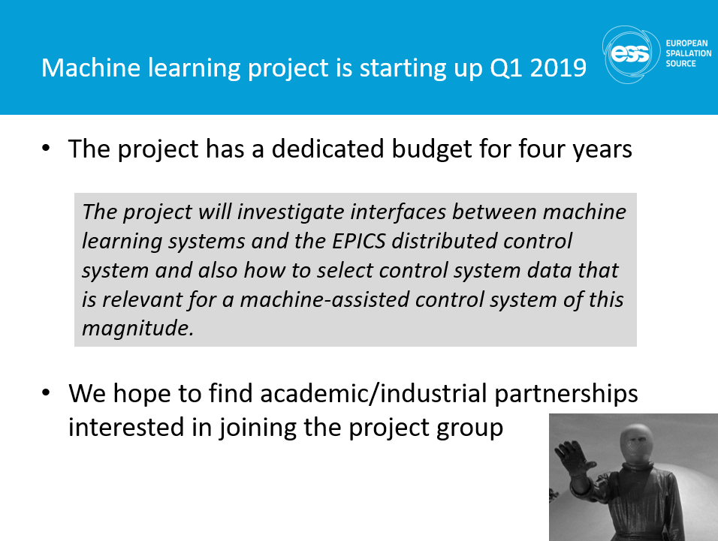
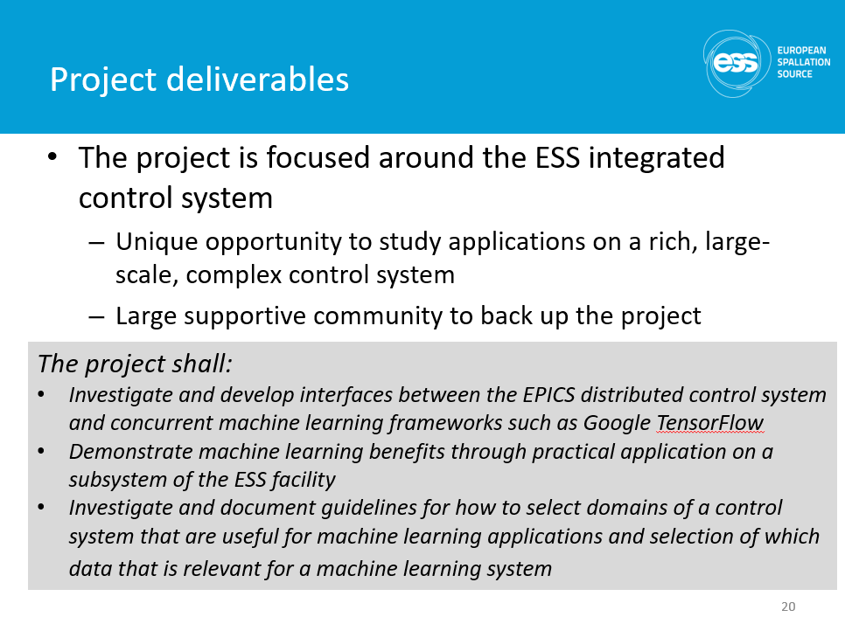
ESS driving technology - Machine learning
A project is ongoing to explore if modern AI/Machine learning technologies can be used to augment the ESS control system
  Decrease commissioning time and effort
  Increased facility availability (95% goal)
  Increased efficiency of operation
  Improved human/machine interaction
  Lowered operational and maintenance costs

Slide 25

Control system overview
ICS overview document available [link]
ICS weekly reports (130+ recipients)

Slide 26
Recommendations from TAC 18
ICS Management should give greater emphasis on the coordination with stakeholders beyond the accelerator to target and Neutron Scattering System (NSS). The role of an embedded ICS person in these Divisions could help improve understanding and trust
  The interaction with stakeholders beyond accelerator is currently managed by work package managers that are dedicated to supporting the stakeholder (NSS and target). The current set-up makes the work package managers "embedded" into the stakeholder to the extent needed for the situation and it provides the advantage of internal coordination in ICS.
  Also, external initiatives, such as the beamline controls group for NSS/ICS interaction, further clarifies the interface and roles between ICS and stakeholders.
The ESS TSS is a critical system for the facility. Given its importance, a dedicated review of the TSS with experts who have built and operated such systems would seem appropriate
  Target division is responsible for the target safety system - a series of critical design reviews have been arranged by the target division.
  The target safety system design, starting in 2013, passed the Preliminary Design Review (PDR) in 2016-02, with a review committee that included two external subject matter experts, one on safety system design and implementation and the other on facility radiation safety and analysis.
  Currently, the target safety system is undergoing a critical design review process, divided in three parts.
  The review committee has both members internal to the ESS organisation and several from other existing and similar facilities.
  The first part took place 2018-12-10, the second part in conjunction with TAC 19 (including a cTAC member) on 2019-04-08 - 2019-04-09, and the third part is scheduled in 2019-05
  Also, there will be an independent review of the TSS design, performed by a Swedish subject matter expert company, Safetech Engineering. This external review will also be finalised during 2019-05
Ensure each staff member and partner understands the intermediate activities needed to meet milestone and their role in the overall project success
  Since TAC 18, ICS has put increased focus on refining the project plan and work with the control system integration process.
  This development has resulted in a significant improvement in the documented ICS integration processes (as will be elaborated during TAC 19), which has or will help stakeholders and internal ICS staff better understand the flow of activities and intermediate steps needed to meet milestones.
  The integrated project plan has also been refined with various degrees of success - mainly depending on the clarity of plans from the stakeholders. Some work packages remain a worry.

Slide 27
Recommendations from TAC 18
ICS should maintain sufficient stock of standard PLC, EtherCat and MTCA components above and beyond what is scheduled such that they are available to issue to their customers when they need them. Even when not expected
  From experience, we have started being more proactive when it comes to standard hardware equipment.
  For MicroTCA infrastructure components (Crates, Power supplies, MCH:s) we have a level of stock that will be sufficient to cover "spontaneous needs" as well as the foreseen needs for installation.
  For MicroTCA specific equipment (processing boards, timing system components and CPU:s) we also have a sufficient stock to cover all spontaneous and installation needs.
  We are working on improve the availability of standard FMC modules - these often have long lead times and tend to be problematic if a sudden need arises.
  For PLC equipment we do not keep a stock but we have a well worked-in routine within our framework agreement with our standard PLC supplier that has a short turnaround time from request to supply (< 1 week)
  For EtherCAT equipment we also have a good relationship with the supplier and we are working on creating a framework to ensure continuous, short lead time supply.
  ICS is procuring in batches to get a price advantage, in the cases when framework agreements are not yet available
  Storage of these spares is done in our own lab-storage area, without incurring any logistics extra-cost
Bring more focus to the near term integration of the MPS with the linac. Less immediate emphasis on the reliability studies. Management should provide a compromise on the overly demanding documentation requirements
  The presentation during the last TAC indeed focussed on reliability analyses for the FBIS. However this does not mean that near term integration of machine protection systems are not being focussed on as well.In total 4 machine protection systems are needed for the nc linac:
    MPS-Vac (for vacuum)
    MPS-ID (for insertable devices, like wire scanners, Faraday Cups, etc)
    MPS-Mag (for quadrupole magnets)
    FBIS (to allow beam only when all relevant systems are ready and to stop beam upon detecting an issue, like beam losses)
  The following prototypes are ready and heavily tested in the different labs at ESS and ZHAW: MPS-ID, MPS-Vac, MPS-Mag, FBIS.
  The interface FBIS-BCMs-Timing System has been tested. Currently there is a lot of work done on removing the dependencies of BCM measurement from/to timing system, as this is an issue for protection.
  FBIS HW commissioning for the NCL is described here: ESS-0880176
  Interfaces FBIS-Ion Source have been tested on Ion Source, LEBT test stand
  Interfaces LEBT chopper-FBIS cannot yet be tested since LEBT chopper is not ready, but these tests are planned together with the operations team
  Detailed installation, testing and verification plan for all MP systems for NC linac are coordinated together with accelerator teams and integrated into AD plans and the plan can be found here: https://jira.esss.lu.se/plugins/servlet/softwareplant-bigpicture/gantt
  Electrical drawings for NCL MPS can be found here: ESS-0308178
  Installation of MPS will start on 2019-04-01.
  FAT, SAT, SIT and FIT templates and plans and protocols will be presented during TAC19.
  Conclusion: presentation during previous TAC was biased and requested integration and testing details will be presented in the upcoming TAC (April)

Slide 28
ICS vision and mission statements
ICS vision statement
ESS operated efficiently, reliably and safely, with a control system that everyone loves
ICS mission
The ICS division shall provide and maintain world-class and cost-efficient control, protection and safety systems and services for the ESS facility.
The division shall develop competence and innovative solutions that can be shared in the community through open processes

