Slide 1
TAC #19 - Plenary Session: “EIS”
Central Engineering service functions provided by
Engineering & Integration Support Div.
Magnus Täcklind
Acting HoD Engineering & Integration Support Div.
European Spallation Source ERIC
2019-04-10

Slide 2
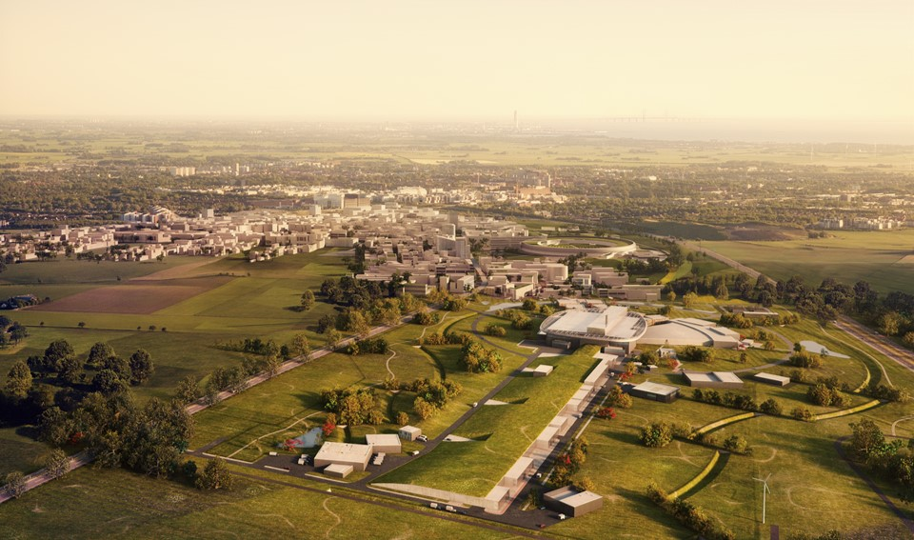
Content
Organization
Roles, Functions, Responsibilities
Focus TIM and TCM
Status, progress and challenges
Advice on strategy and approach

Slide 3
TAC#19 Technical Advisory Committee - Charge
Charge - key questions to review panel - from EIS:
Is the proposed approach for interacting with the in-kind partners going to lead to delivered documentation of the proper quality and usability?
Additional suggestions are welcome.

Slide 4
What services does EIS provide? High level
Services of technical nature - Engineering, hands-on work (technicians etc.) and engineering software, two business models:
  Full responsibility for scope e.g. Survey & Alignment
  Resourcing only/mainly, e.g. Design & Engineering
ESS Handbook for Engineering Management, including design rules, support for engineering software and structure for facility documentation.
Successively being developed and implemented as support to projects
EIS prefer agreed services across the whole ESS organization.
Support and perform engineering activities throughout ESS and ensure design integration. Develop and maintain methodologies and processes - proposed to be implemented and applied via matrixed recourses and support to engineering projects and other activities

Slide 5
Functions in Engineering & Integration Support Div.
Installation/Maintenance Support
  Rigging support
  Mechanical technicians
  Electrical technicians
  Operation and Maintenance of electrical infrastructure
  Operation and Maintenance cranes
  Engineering Management Support
  Systems Engineers
  Requirements + Configuration Management
  Technical Content Management
  Labeling
Machine Engineering Services
  Survey, Alignment & Metrology
  Mechanical Workshop
  Spatial Integration
Technical Information Management
  EAM - Enterprise Asset Management
  PLM - Project Lifecycle Management (CHESS)
  CAD software
  Engineering Support
Design & Engineering
  Technical Project/Design leaders
  CAD engineers
  Mechanical (incl. Mechanical lab)
  Electrical and I&C (incl. cable coordination)
  Plant/Process/Piping
  Analysis (Strength, fluids, etc)

Slide 6
Engineering & Integration Support organisational chart
Head of Division
Acting Magnus Täcklind
TIM Program Manager Ola Nanzell (C)
Technical Content Manager Joakim Meyer
Systems Engineer Eugene Tanke
Division Administrator Sofie Svärd
PLM & Process
Support Group
GL Henrik Lindblad
Machine Engineering Service Group
GL Fabien Rey
Installation Support and Technical Infrastructure Group
GL Kristofer Falkland
Design & Engineering
Group
GL Karen Jonsdottir (A)
Survey, Alignment & Metrology Section
SL Fabien Rey
Mechanical Engineering and Technology Section
SL Nick Gazis
Allocation resources to projects: (Approx.)
Target: 44
Accelerator: 43
Science / NSS: 11
ICS: 2
CF: 2
EIS Centrally: 22
Spatial Integration Section
SL Fabien Rey (A)
Electrical and I&C
SL Jonas Widing
  ESS Wide coordination:
  Technical Information Mgmt
  Spatial Integration
  ESS Standardization
  Cable coordination
  Technical Content Mgmt
Manufacturing Section
SL Benjamin Davidge
Plant and Process
SL Piero Valente
Analysis
Karen Jonsdottir (A)
Emil Lundh

Slide 7
Different approach for different functions and services
Responsibilities and scope well defined
Scope pending due to customer needs,
also on decision for centralization
Machine Engineering Services
  Survey & Alignment
  Metrology lab.
  Mechanical Workshop
  Spatial Integration
Technical Information Management
  EAM
  PLM/CHESS
  CAD software
  Engineering Support
Design & Engineering
  Generic Mechanical Engineers + Mechanical lab.
  Generic Electrical Engineers
  Generic Plant & Process engineers
  Discipline CAD engineers (Mech, El, Plant, Piping)
  Analysis (Strength, fluids, heat, process simulation)
  Technical project- and design leaders
Installation & Maintenance Support (ISTI)
  Rigging
  Mechanical and Electrical technicians
  Techn. Infra. (El. power, cranes, cooling etc.)
Engineering Management Support
  Requirements + Configuration Management
  (systems engineers)
  Centralized Technical Content Management
Working matrixed. Focus resource loading.
Not always with aligned and implemented Ways of working.
Clear defined ownership of Ways of working.
Clear scope and planning of resources

Slide 8
What Technical Framework exists?
ESS Engineering methods and tools consists of :
ESS Handbook for Engineering Management, ESS-0092276
  The necessary tool to incorporate external and internal requirements into the design and construction of specific systems
Technical Information Management (TIM)
  ESS-wide engineering software and processes
Technical Content Management (TCM)
  Management of technical information and documentation
Organization
  Central coordination to ensure a consistent and efficient approach across the project
  Matrix of resources to the project organization

Slide 9

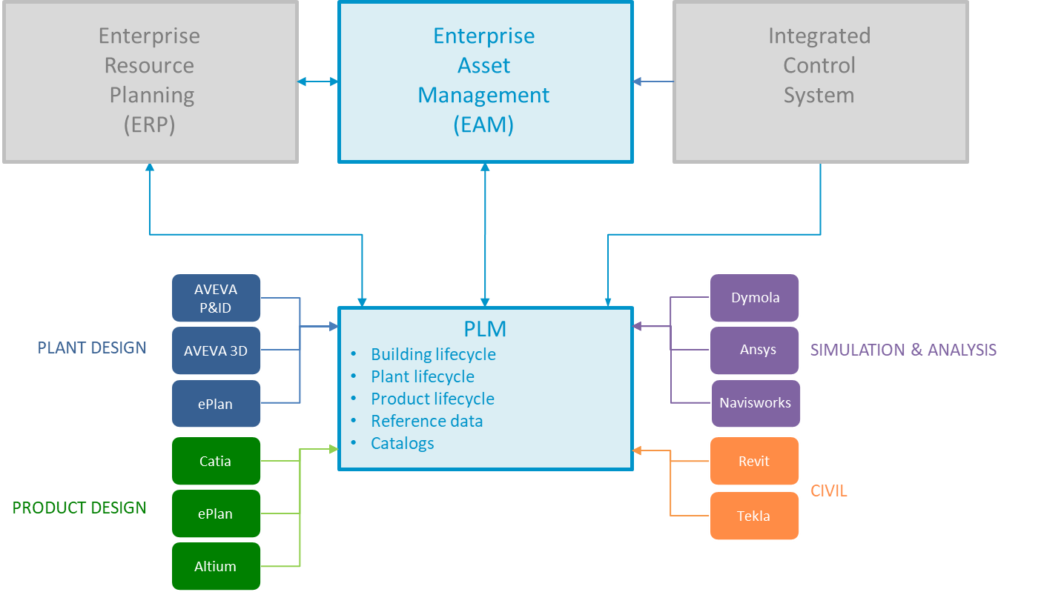

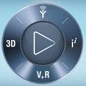
Technical Information Management (TIM)
TIM Manager ensures that ESS strategy is fulfilled. Addressing the needs of organizing, finding, tracking, sharing, monitoring and reusing technical project information and communications in a way that allows complete traceability of the whole ESS Project over its lifecycle.
The Technical Information Management System (TIMS) is based on EAM, PLM and design/support software and is ESS standard and official software
PLM & Process Support Group implement rules for CAD data exchange between ESS and IK/Contractors and provides training, support and back-office support of CAD data translation.

Slide 10
Level of integration for In-Kind partners –
ESS defines connection to the CHESS PLM database in three different categories:
Category 1:
For collaborators with the need to work concurrently with integration to the ESS design over a longer period of time. These will need to be connected to the CAD database or a replica database (multisite) to work directly connected, the same way as users at the ESS office in Lund.
Examples: Mechanical design @ ESS Bilbao , STFC , PSI and CEA
Category 2:
Used for collaborators/suppliers with design responsibilities of a more complex or longer term nature. A limited number of users at the IKC, are connected to the PLM database and responsible for updating the design information and design coordination.
Category 3:
For external collaborators that will only contribute with already designed items or items of simpler nature, where there is a limited amount of iterations to the design process. The data will be handled through a communications responsible at ESS (back office) who will manage design items and store them to the database, manage revisions and models integrity.

Slide 11
Technical Content Management (TCM)
Technical Content mgmt team is responsible for how we structure and manage of the facility documentation and provide support to projects to capture documentation, structure, upload and that it becomes baselined. TCM was established in 2016.
ESS
Machine Directorate
EIS Division
ES*
System Engineering*
Technical Content Management *
Supports the organisation, all projects and their partners, with:
  Managing documentation from partners
  Naming and tagging
  Labelling service
Support to In-Kinds and Partners
  Upload of documentation
  Help with systems, naming and tagging
  Trainings online or at our partners
  General guidance and support
A very small team having with a large impact:
  - Get documentation in the correct software, works fully integrated with project
  - Challenges: Enough mandate to coordinate how to structure documentation and get people to adopt the official software

Slide 12
Technical Content Management
In place:
  ESS Breakdown Structures
    Where ESS manages Facility documentation
  “Rules for Technical information”, ESS-0050017
  Generic Requirements for Marking and Labelling, ESS-0094091
  Generic Requirements for Naming and Tagging, ESS-0094090
  Generic Requirements for Documentation of Technical Systems, ESS-0094092

Slide 13
Technical Content Management
Example of support to In-Kind/Partners
  CEA
    Training at CEA
    Training through Link
    Support with printing labels
    Support with upload of documentation infor CHESS
  ESS Bilbao
    Support with upload of documentation to CHESS
  RACE
    Support with tagging and functional breakdown of system
  BrightNESS
    Training at ESS an through video link.
  INFN
    Support with upload of documentation
  GRE LTD
    Support with tagging and naming
  STFC
    Training at STFC

Slide 14
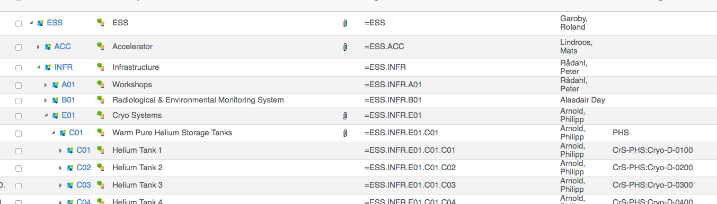
Basic requirements
  All technical information is consolidated in correct structure in CHESS (our EDMS software).
    In Facility and Location Breakdown Structure.
  Preferably design drawings and models are done in our standard tools (Catia V6, ePLAN and Aveva suite).
  Documentation from our partners shall clearly state the level of maturity (eg. for Manufacturing, As Built ...) and showing that the appropriate reviewers and approver have reviewed/approved its content.
  Documentation shall also be released in CHESS with the relevant reviewer and approver from ESS.

Slide 15
Interaction with In-Kind partners and contractors
Going Forward:
  During 2019/20 increase communication with and visits to our partners to make sure that ESS receives:
    CAD data information in ESS Standard tools
  Or at least receives information that is
    Searchable
    Linked
    Editable
    In a common and native file formats
This to ensure
  Data constancy
  Data quality
  Data maintainability

Slide 16
TAC#19 Technical Advisory Committee - Charge
Charge (key questions to review panel) from EIS:
Is the proposed approach for interacting with the in-kind partners going to lead to delivered documentation of the proper quality and usability?
A way to ensure satisfactory deliveries might be asking partners, systematically and with foresight, about format, content and structure of documentation to be submitted later on.
- Can this be a reasonable strategy and request to make?
Additional suggestions are welcome!
What experiences and advice can be shared via TAC?

Slide 17
Status, Progress…
Design packages and lead for parts of Infrastructure project
Resource loading for different projects and disciplines
E.g. 10 new electrical design engineers in 3 months have started (for Target and Acc. Infra project.)
Manufacturing - Establishment of Temporary Technical Center (Mech. workshop located on-site)
Machines installed. Several assignments delivered and new requests. As well now set to start welding!
The ESS Enterprise Asset Management (EAM) System is being deployed.
Providing the opportunity to track assets, maintenance, warehouse management, work orders and permits, non-conformities, logbook etc. Now start integration with business system ESSOn.
Virtual Reality system is operational
Helping subprojects diagnose and solve integration issues.
Team for rigging work established
Lifting/rigging equipment procured, handbook approved, team is involved in several projects and activities on site.
Lab for Mechanical testing, measurements and repairs established
The first assignments are on-going

Slide 18
… and Challenges
Number of requests for shorter assignments from matrixed competences are successively increasing.
Core team functions don’t mange and are not on top of planning.
Common understanding of model for efficient centralized and shared services
What functions and how to plan and assign tasks?
Take ownership for operation and maintenance of Technical Infrastructure projects
What functions/systems, timeline, strategy and plan for resources (what can be shared)?
Technical Information Management
Governance and prioritizing business needs for implementation and configuration of Engineering tools. Synergies and collaboration with IT.
Implementation of Enterprise Asset Management
Available and implemented when requested! Which functions and who should do what?
Facility documentation
How to take care of huge volumes, insufficient content or format?
Uniform ways of working for similar tasks
Assure consolidated solutions, regulative requirements, correct quality and availability for systems!

Slide 19
Areas where we seek advice on strategy and approach
Matrixed resources
- Common ways of working. – Efficient planning and usage
Engineering / Technicians service business model
- What services are “free” of charge vs. debited projects?
How to go from resourcing to deliverables?
- Today, focusing resourcing within e.g. design and installation support
Facility Documentation Management
- Small team with huge impact
Requirements, Configuration and Interface Management
- Today mainly de-centralised
In-Kind Partner / Contractor Deliverables
- Technical Annex / Contracts: Content and format

Slide 20
Back-up slides
Magnus Täcklind
Acting HoD Engineering & Integration Support Div.
European Spallation Source ERIC
2019-04-10

Slide 21
Functions in Engineering & Integration Support Div.
Design & Engineering: Central core team of personnel supporting ESS projects, with competences and resources within the technical areas of Mechanical-, Plant/Process-, Electrical and Instrument & Controls design, Analysis (Structural, fluids etc.) and Technical project-leaders. Responsibility for establishing and administrating governing and guiding documents, methods and templates, to assure the output of design and engineering is uniform.
Spatial Integration: Lead and coordinate the activities to ensure an effective and correct integration with baseline/configuration control. Ownership of ESS coordinate-systems and Master 3D model (EPL) with its related data and as-built models.
Survey, Alignment and Metrology: Coordination and support in all aspects of Survey, Alignment and Metrology activities.
Manufacturing: Responsible for Central Mechanical Workshop and framework agreement for related prefabrication/manufacturing services.
PLM & Process Support: Providing support on PLM & Design tools. Manage licenses and uphold and improve PLM and CAD tools quality and performance. Provide back-office support.
Installation Support: Coordinate the team of ESS-wide installation resources (personnel and equipment) and its related framework agreements, temporary services and needed routines and guidelines, e.g. rigging services and crane operations.
Technical Infrastructure systems: Accountability for e.g. electrical systems, in terms of operation, maintenance and safety.
Technical Content Management: Setting up and maintaining consolidated Functional and Location breakdown structures in PLM, as well the consolidation/transmittal of its data, facility documentation, including uniform principles for tagging, labelling and marking.
Systems Engineering: Supporting the creation and maintenance of Ways of working (as part of ESSMS) focusing Develop and Maintain facility and Manage configurations, as well support in e.g. requirements management and configuration/change control.
Enterprise Asset Management (EAM): Setting up and maintaining consolidated platform for EAM and provide service and support in different EAM functions.

Slide 22
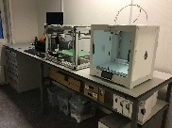
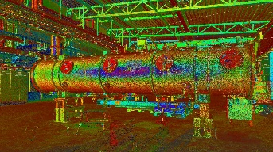
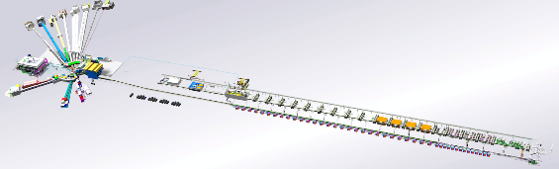
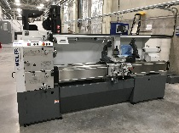
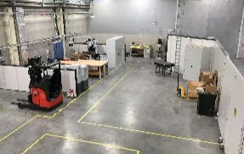
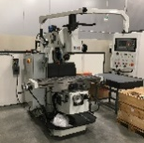
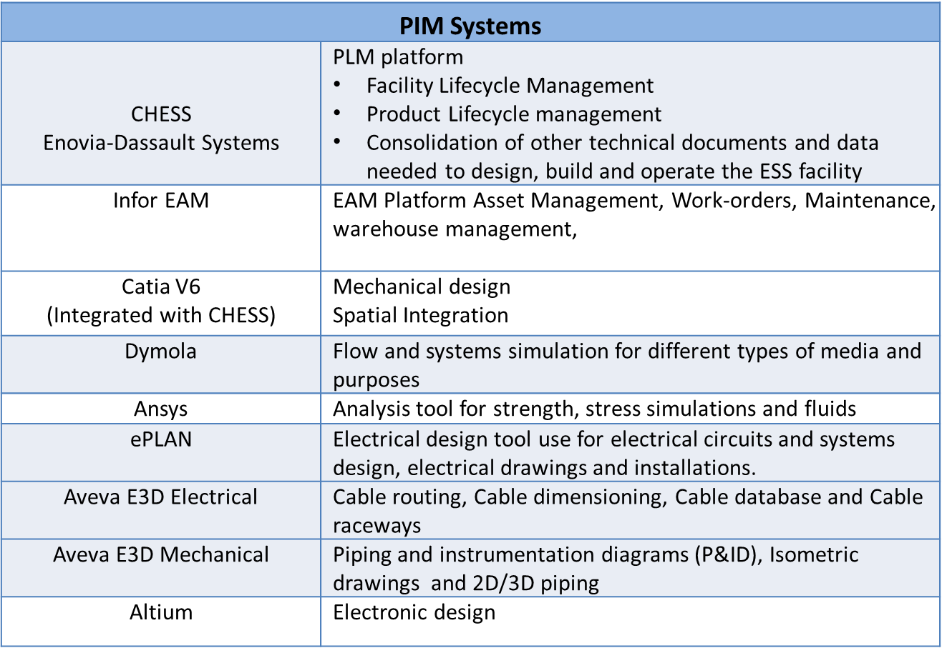
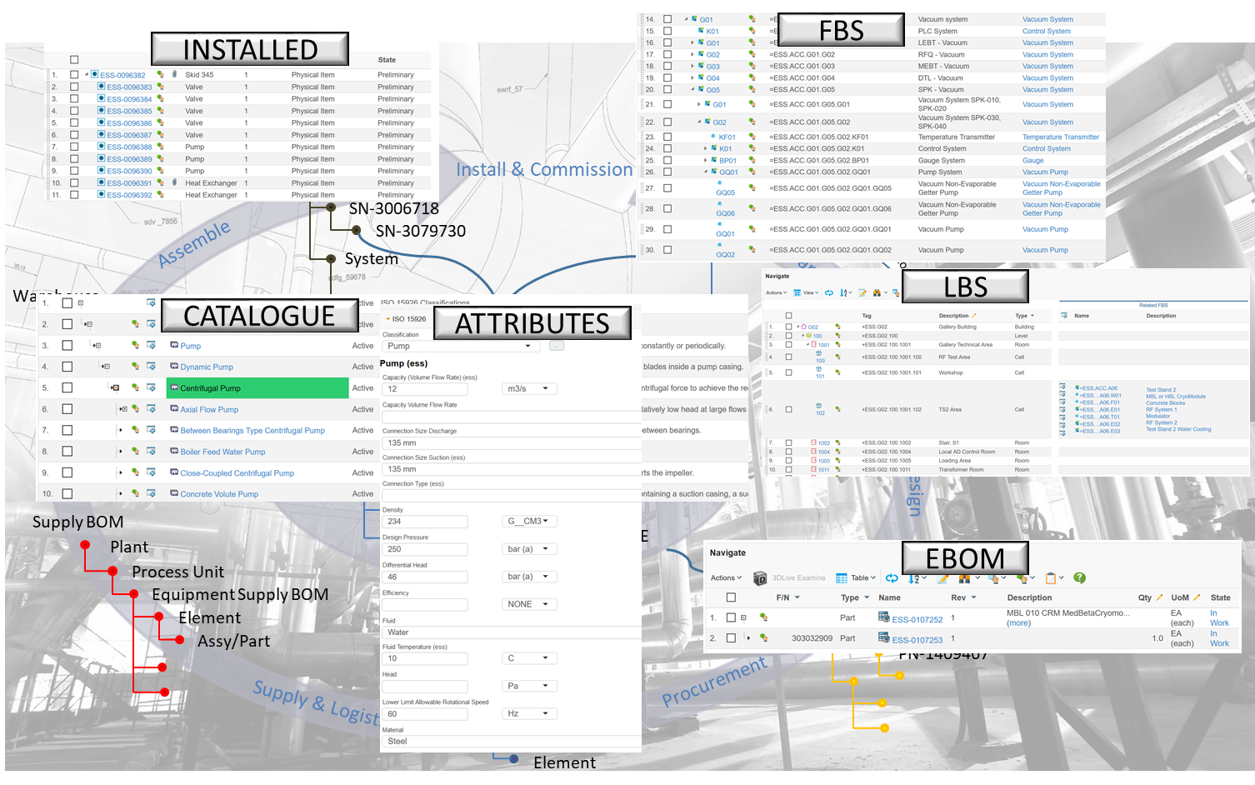
EIS services
Survey, Alignment and Metrology (SAM)
Spatial Integration (SI)
Workshop and manufacturing outsourcing (MAN)
Design & Engineering (D&E)
Activities
Survey
3D Laser Scanning
Alignment
Marking
Calibration
Fiducialization
Geometrical Control
As-built
Activities
Import/Translate Design data from CF, IK, contractors etc.
Manage ESS 3D Master model
Perform Quality/Clash/Collision Checks
Call for Integration meeting
Send/Communicate ESS Design Data
Drive release/LoM with each WP/WU
Virtual Reality
Activities
Operation of TTC workshop in G02
Time-critical modification and manufacturing
Basic fastener stock
3D printing in polymers
Coordinate outsourcing to vendors
Subject Matter advice
Activities
Resource management
Engineering Handbook, Design procedures, templates
Support projects with small tasks (1-3 hours)
Subject Matter advice and participation in reviews
Cable Coordination (central coordination)
FWA for Technical Consultant and Services
SSM permits support
Component Standardization.
Technical reference data
Mechanical
Electrical and I&C
Plant / Piping
CAD
Analysis
Cable coordination
Project mgmt
Technical Information Management (TIM)
Engineering Management Support
Installation Support and Technical Infrastructure (ISTI)
Additional
Activities
CHESS, EAM and CAD
Support and Training (Classroom/e-training)
Methods/Guidelines for how to use the software
FWA for PLM, CAD / PLM / EAM expertise
Licenses
Engineering Support (back office)
Technical Content Management
Activities
System Engineering
Requirement management
Configuration Management
Technical Content Management
Activities
Technical reference data
Coordinate ESS Facility Documentation
Document management service e.g sub-project work
in CHESS
Configuration Management service
Labeling service
Activities
Resource management
Installation coordinators
Rigging and crane operations
Mechanical and electrical technicians
FWA for mechanical and electrical installation
FWA for rigging
Subject Matter advice and participation in reviews
Applications, Training and Support in Software in 2019
900 CHESS users
80 Catia V6 users
250 EAM users (2019/2020)
16 E3D users (+ SWECO for infrastructure GO1/GO2)
25 ePlan (+SWECO for infrastructure GO1/GO2
5 Dymola
25 Ansys
Altium
Challenges
Lack of planning at ESS (What/How much/When)
Reactive way of working
Silo work restrain services (planning, deployment)
EIS is asked to participate in reviews but no budget
D&E and IS Service
Used as resources only
No consultant is ever sent back
No possibilities to use allocated resources for training and
cross-organizational reviews
Mechanical
Electrical
Rigging
Installation Coordination
Technical Infrastructure (Separate Breakout)
Operation and Maintenance
Technical Infrastructure

Slide 23
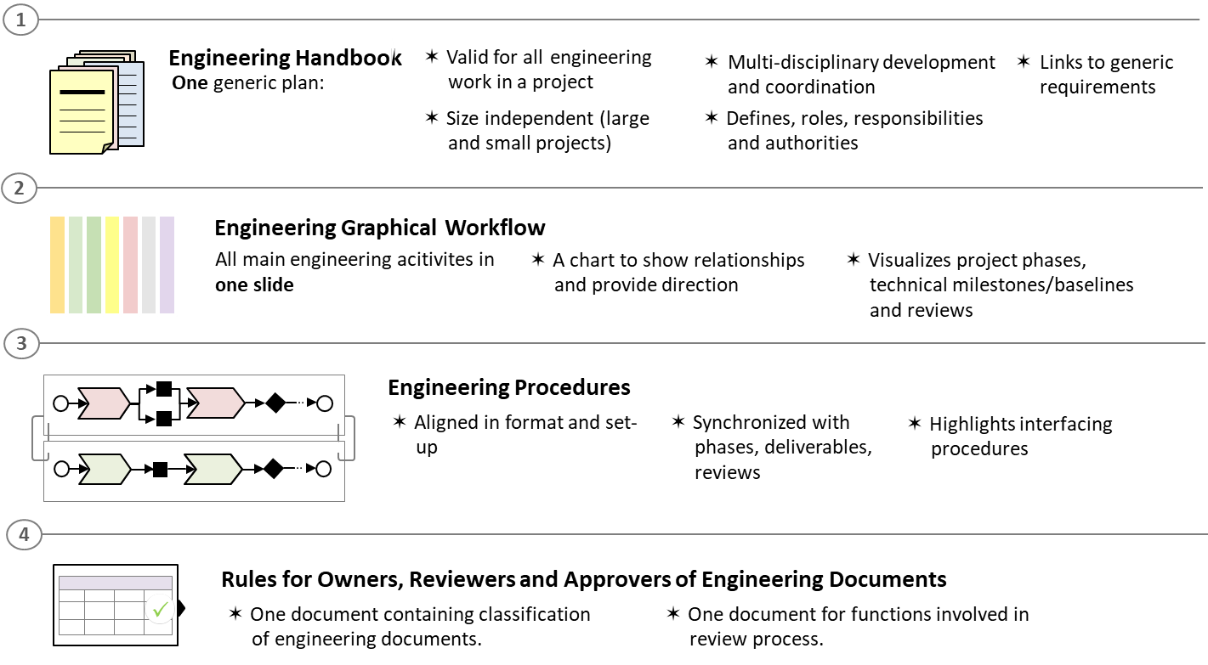
The Technical Framework strategies
ESS Engineering methods and tools are built on a common technical framework that focuses on standardized
  Procedures
  Components
  Documentation
  Engineering software
Central coordination of cross-cutting programs
Centrally matrixed resources

Slide 24
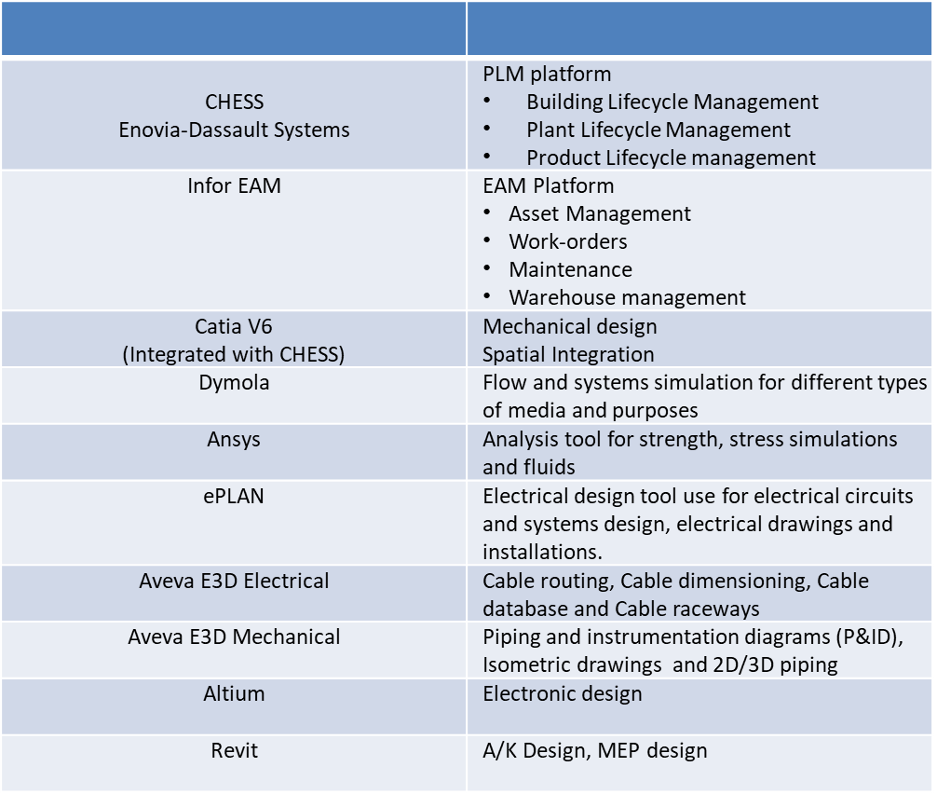
TIM Systems (TIMS)
Core tools
Design/Support tools

Slide 25
Technical Content Management
Goal:
  To make sure that sufficient information is gathered and structured for the operation, maintenance and redesign of the Facility. Which includes documents, models, drawings and other design and manufacturing information.
  To meet regulatory requirements.
  Make the information searchable from other systems at ESS e.g. EPICS and Asset Management through uniform naming and tagging.
Challenges:
  ESS is currently using a set of design tools (Catia V6, Eplan 2.8, Aveva Suite) to consolidate and manage the design information. In the future operation and maintenance of the facility we will need to update and redesign based on our partners deliveries meaning we must make sure that the partners delivers models and drawings that are linked and editable by the ESS Standard tools.

Slide 26
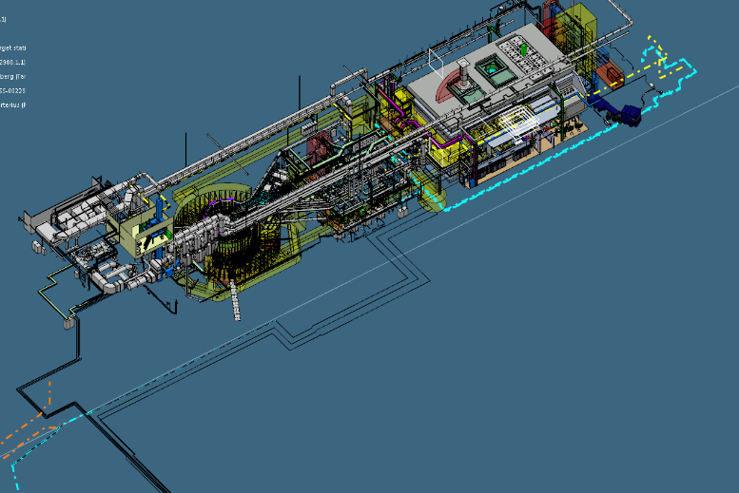
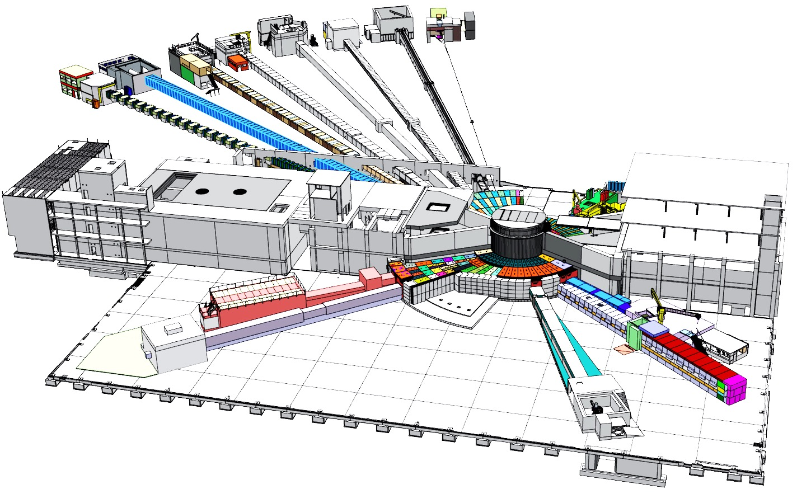
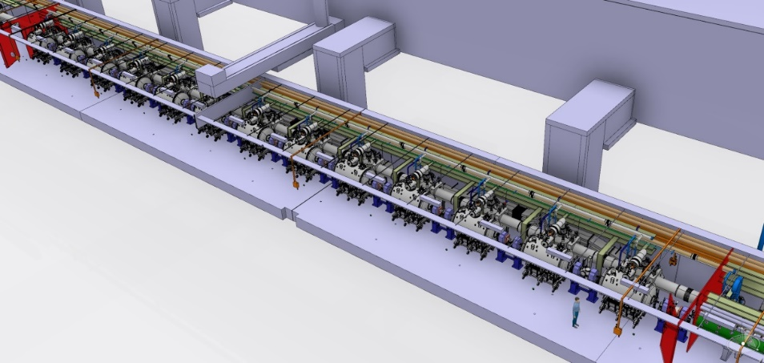
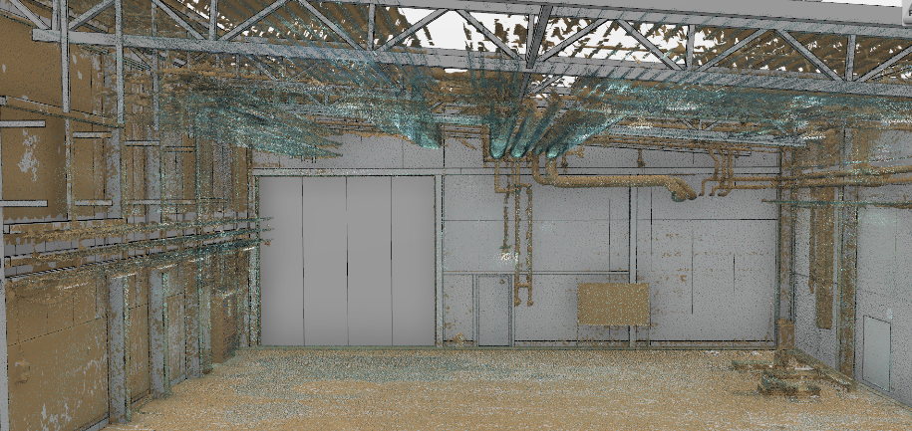
Spatial Integration -
Critical challenges around our 3D Data
Strategies: Configuration management of the space and volumes with central coordination
Techniques
One detailed 3D master model
One 3D light master model based and linked with the detailed master 3D model
Laser scanning
Virtual reality

Slide 27
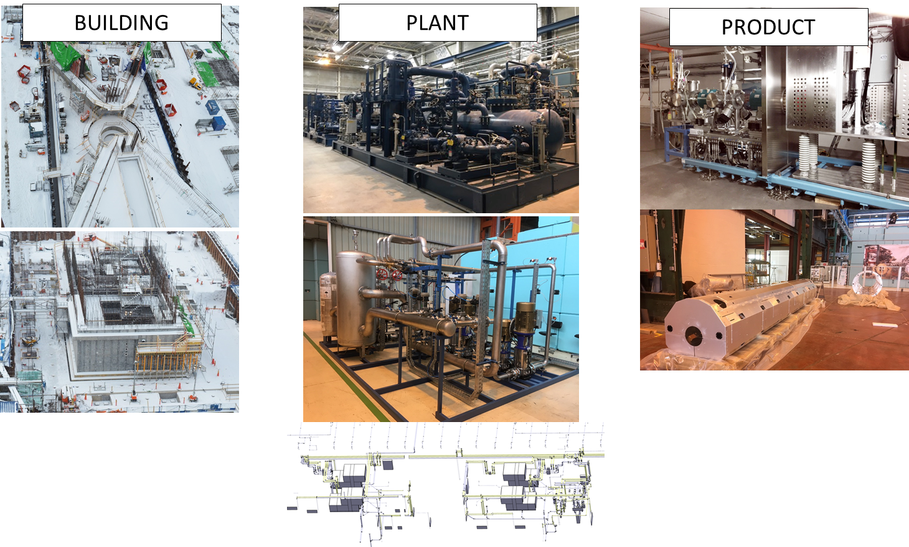
Different Aspects -
ESS Plant \ BIM \ Product Lifecycle Management
ESS bases the facility documentation/data and its lifecycle management in one PLM-platform for all disciplines and lifecycle aspects
Out of the box for Product Lifecycle Management
Customized for:
  Building Lifecycle Management
  Plant Lifecycle Management
Common reference data for all disciplines (ISO 15926-4)

Slide 28
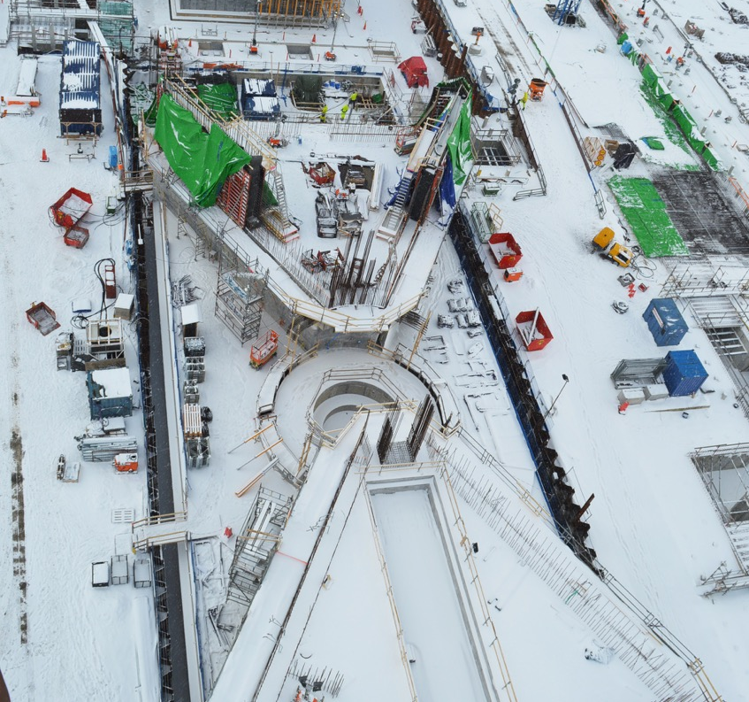
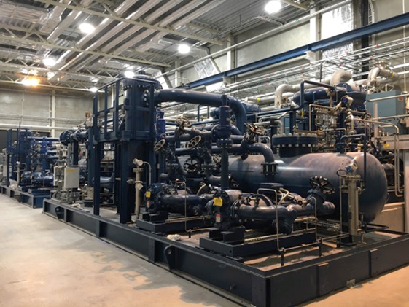
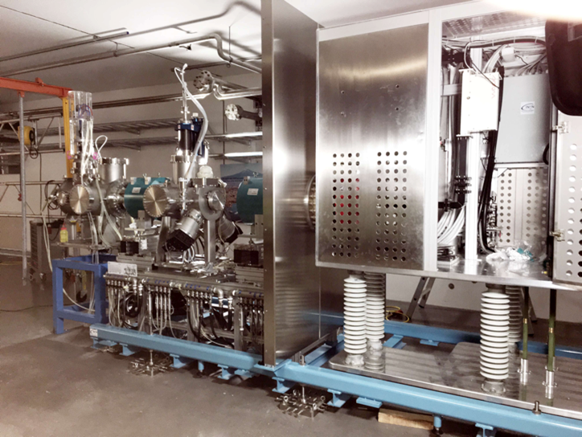
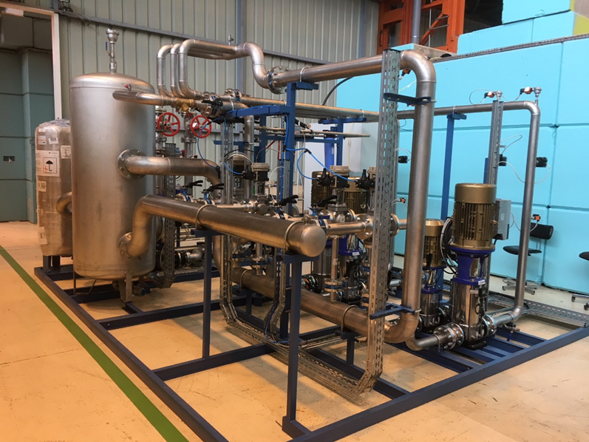
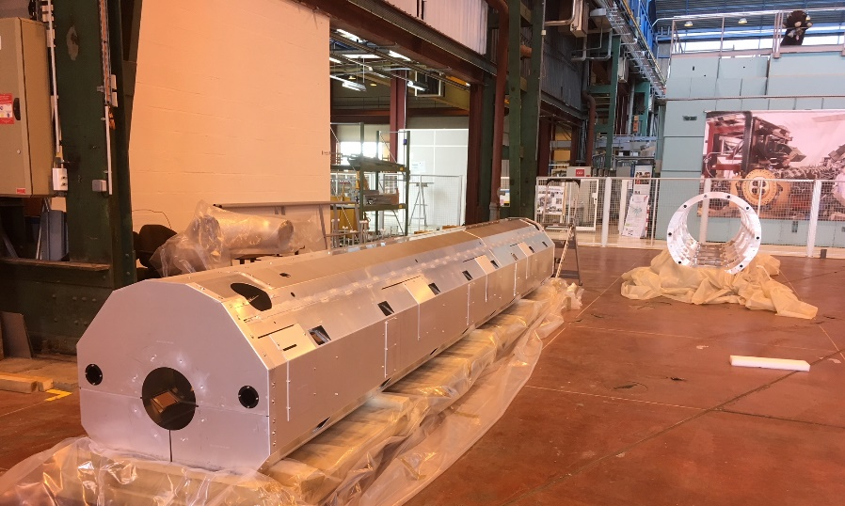
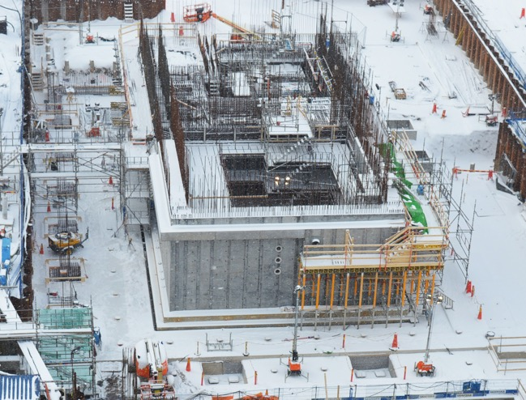
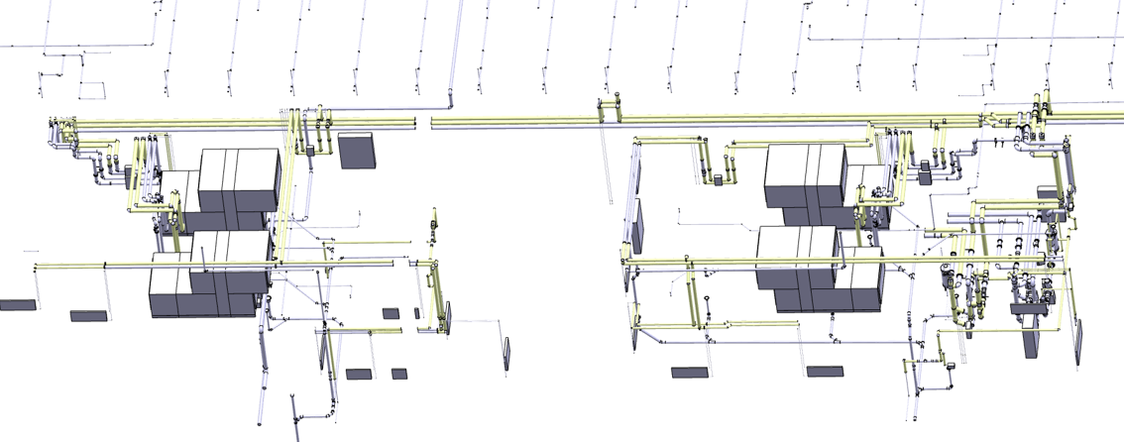
An integrated facility
BUILDING
PLANT
PRODUCT

Slide 29
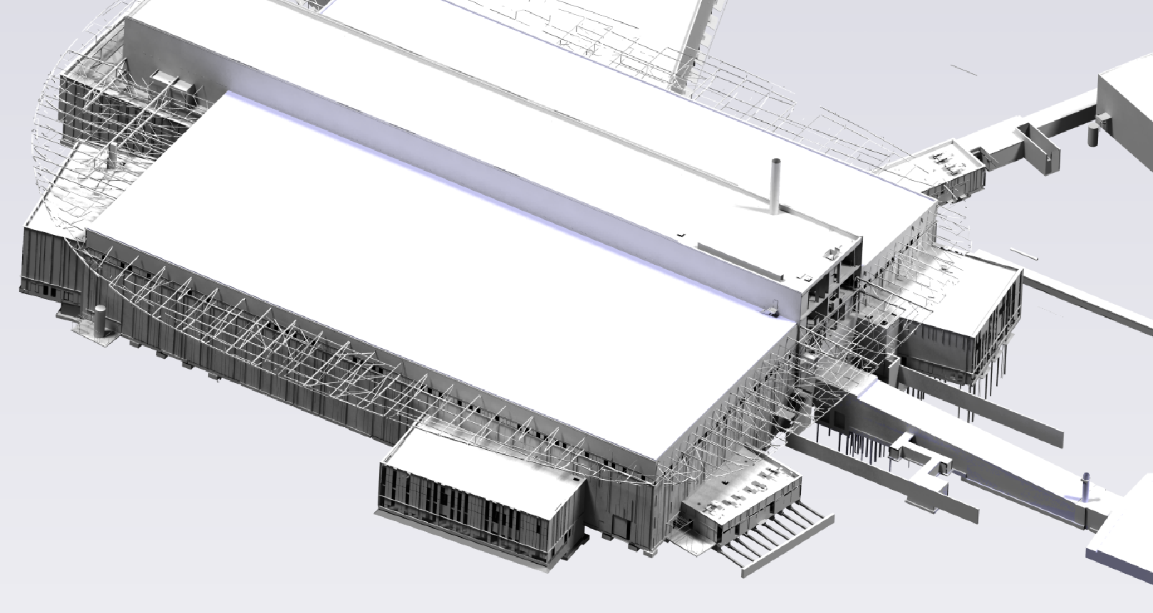
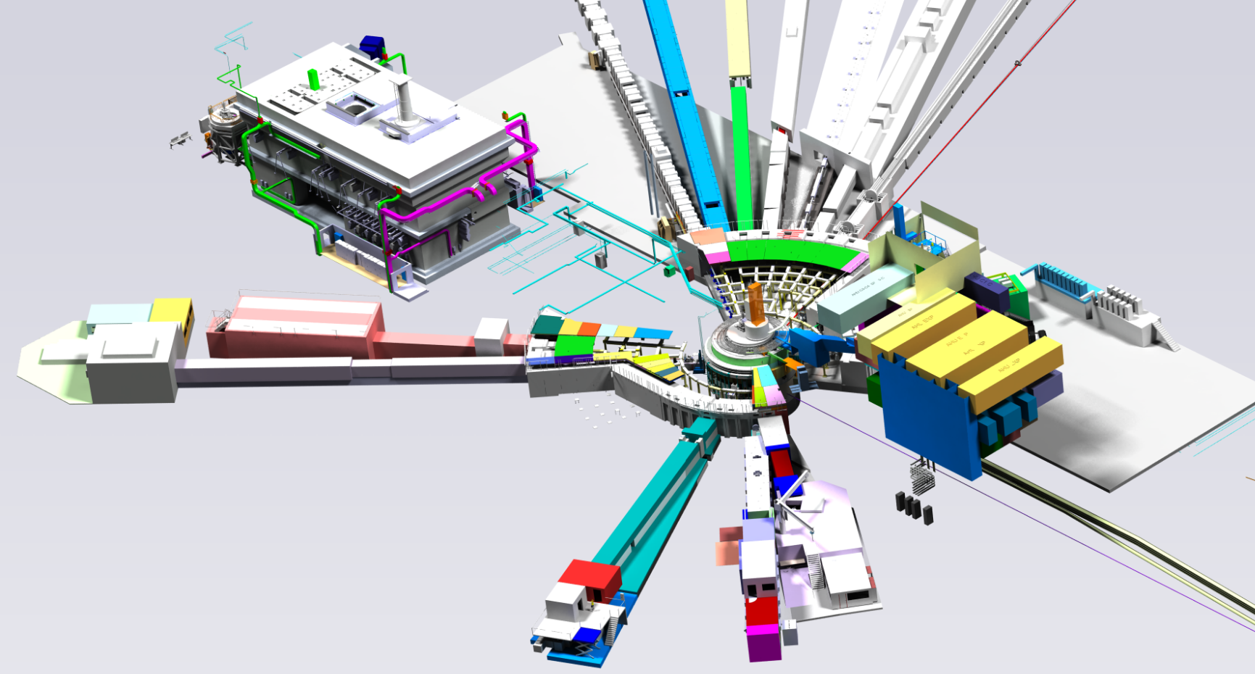
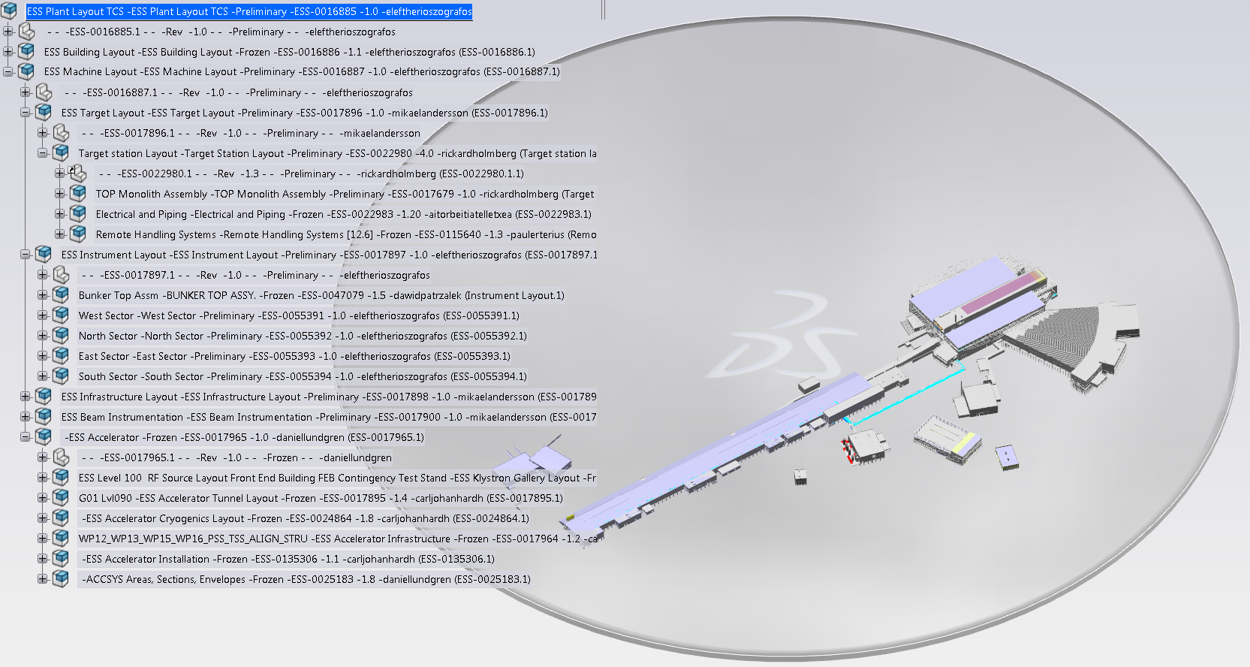
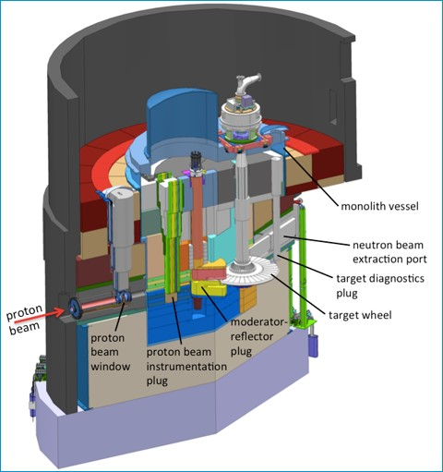
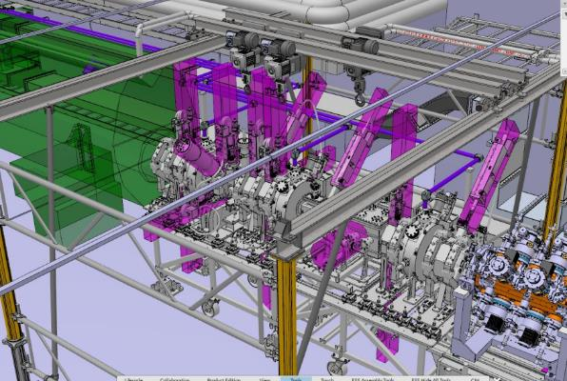
ESS Plant Layout – The link to ALL information
All information is connected and available through our master 3D model (EPL)
Buildings
Plant &
Machine

Slide 30

Lifecycle information management - ESS
Operate & Maintain
Physically Installed Structure
Functional Breakdown Structure - FBS
System
Install & Commission
=ESS
System
=ESS.ACC
SN-3006718
=ESS.ACC.E02
Assemble
SN-3079730
=ESS.ACC.E02.W02
System
=ESS.ACC.E02.W02.BF10
Warehouse
Location Structure
Plant design
+ESS
Element
Located In
+ESS.G02
Element
Catalog
Reference Data
+ESS.G02.090
Element
Physical Object
+ESS.G02.100
Process Instrument
Element
Oscilloscope
+ESS.G02.100.10001
Thermal Instrument
Product design
+ESS.G02.100.10001.102
Detecting Instrument
Supply BOM
Flow Meter
Plant
Engineering Bill Of Material
Process Unit
PN-1003367
Equipment Supply BOM
PN-1003467
Element
Sales BOM
PN-1203667
Assy/Part
PN-1409467
Element
Procurement
Supply & Logistics
Element
Element
Element

Slide 31
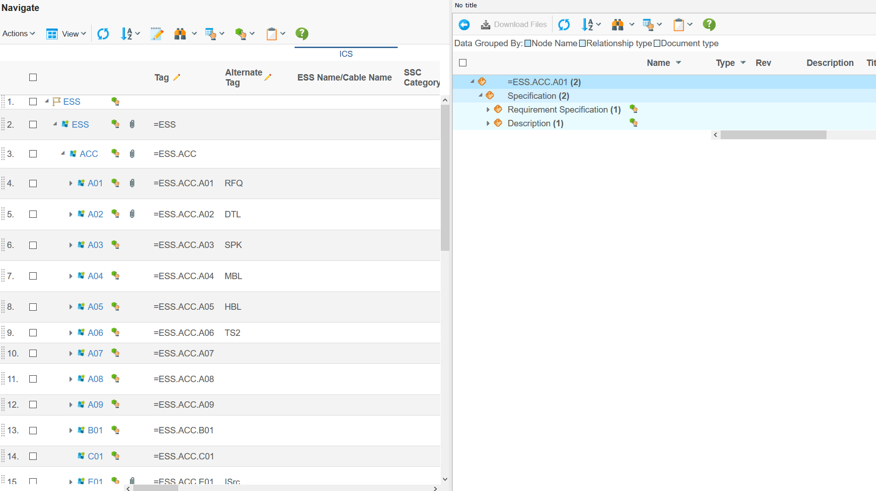
FBS-Facility Breakdown Structure - FBS
Example

Slide 32
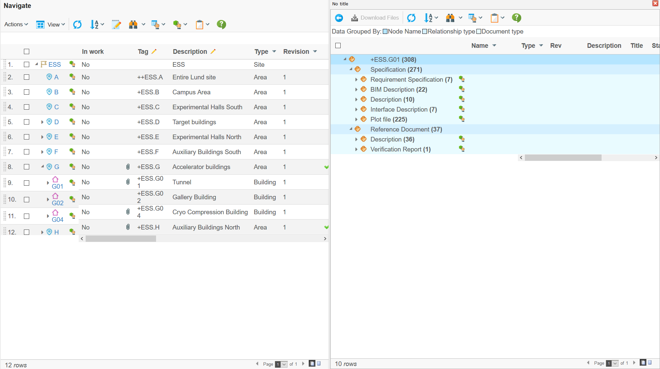
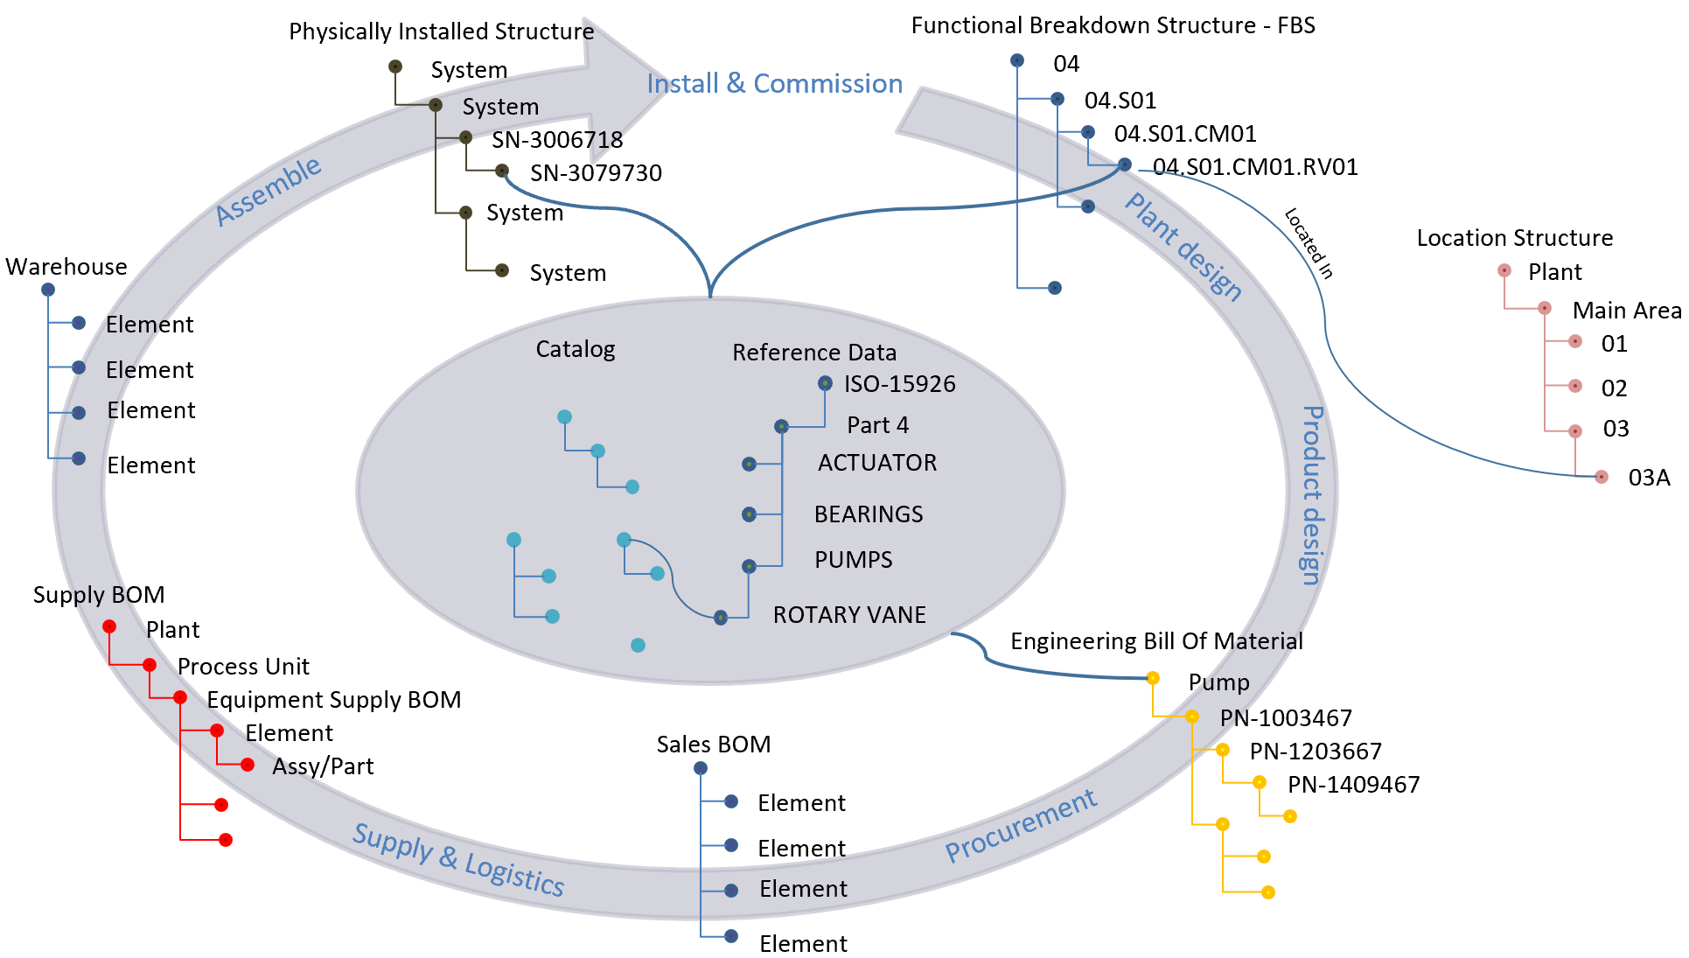
LBS-Location Breakdown structure
Example

Slide 33
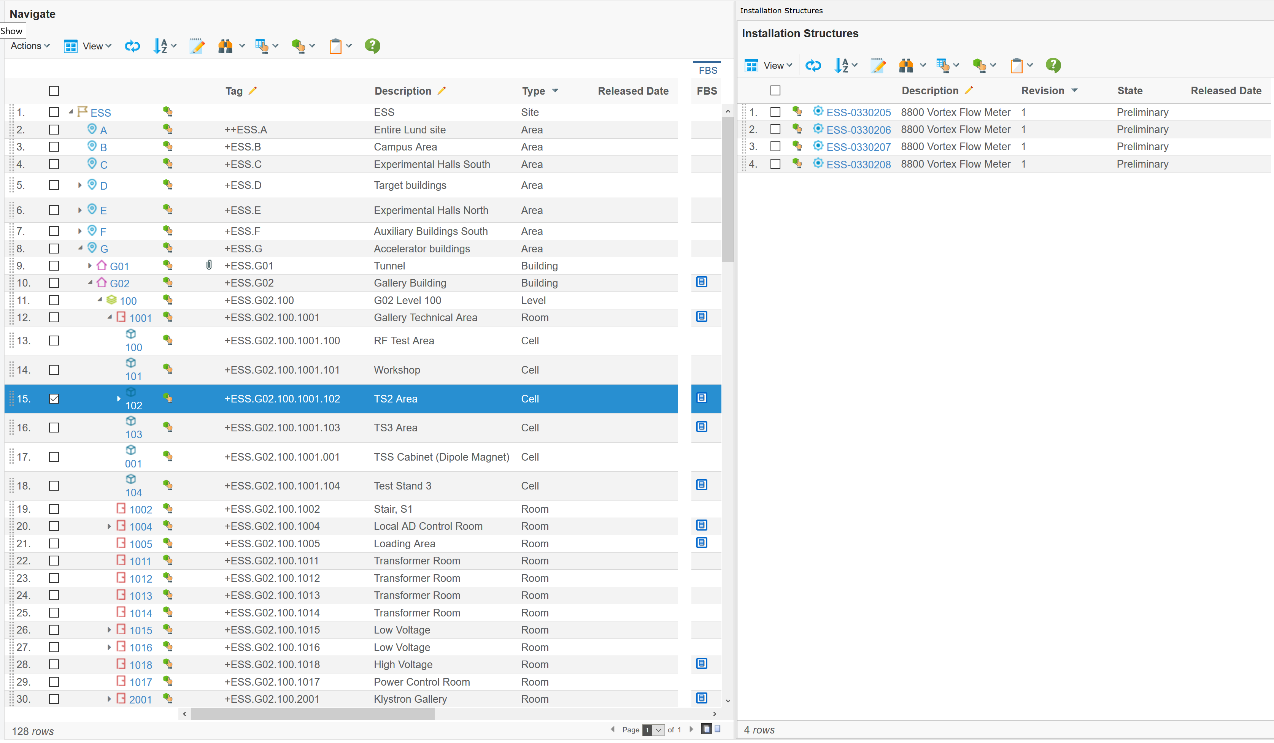
Installed Assets located in TS2 Area
Example

Slide 34
System Map
Enterprise
Resource
Planning
(ERP)
Enterprise
Asset
Management
(EAM)
Integrated
Control
System
AVEVA
P&ID
Dymola
PLM
Building lifecycle
Plant lifecycle
Product lifecycle
Reference data
Catalogs
PLANT DESIGN
AVEVA 3D
Ansys
SIMULATION & ANALYSIS
ePlan
Navisworks
Catia
Revit
PRODUCT DESIGN
ePlan
Tekla
CIVIL
Altium

