Slide 1
Introduction and Safety Plan
TS2 PSS Preliminary Design Review
Stuart Birch
ICS-Protection Systems Group- Senior Engineer Personnel Safety Systems
ESS/ICS/PS
2019-02-11

Slide 2
Welcome
Thank you everyone for attending today’s PDR for the TS2 PSS.
The PDR charge is ESS-0680092
The purpose of this PDR is to confirm that the initiating events, safety functions, requirements and interfaces are well understood, defined and documented; and that a preliminary design and concepts of operation sufficiently cover the high level system requirements.
This will enable the PSS team to complete the detailed design of the TS2 PSS ready for CDR and final installation.
The PDR also covers planning activities for the following processes:
Safety plan
Configuration management,
Software development,
Verification and validation.
These documents outline the planning strategy for personnel safety systems here at ESS and will ensure traceability throughout the process.
It is intended that these four documents will eventually be approved by the ESS “Safety Committee” will become standard global PSS documents.

Slide 3
Welcome
The charge questions are in a backup slides at the end of this presentation
The results of the review shall be summarized in a short report, outlining the answers to the above review questions and whether the review is considered passed, passed with action items, or failed.
The report may also provide findings, comments, and recommended actions.
Actions should be clearly categorized as one of the following:
Shall be addressed before PDR is considered closed
Shall be addressed prior to the CDR

Slide 4
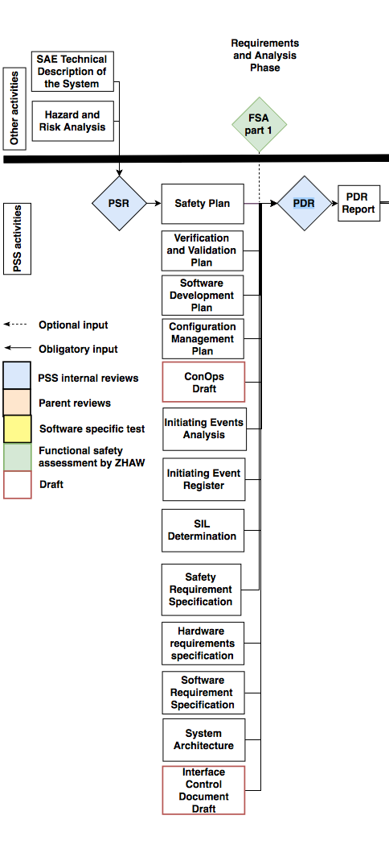
Contents
Safety Plan - ESS-0469185
Introduction to TS2 - ESS-0101133
TS2 hazard and risk assessment - ESS-0488867
TS2 PSS Pre-start Review - ESS-0505451
TS2 PSS Roadmap

Slide 5
Safety Plan
Safety Plan - ESS-0469185

Slide 6
Safety Plan – ESS-0469185
This safety plan defines the life-cycle activities for Personnel Safety Systems (PSS).
It establishes how the steps in the safety life-cycle are accomplished and ensures that the required activities during each life-cycle phase are adequately planned.
These activities range from:
Ensuring proper risk and hazard analysis,
Compliance with safety requirements,
Planning and execution of installation
commissioning to ensuring functional safety during operation.
This safety plan also defines the roles and responsibilities related to the life-cycle activities.
The development of a PSS follows IEC 61511

Slide 7
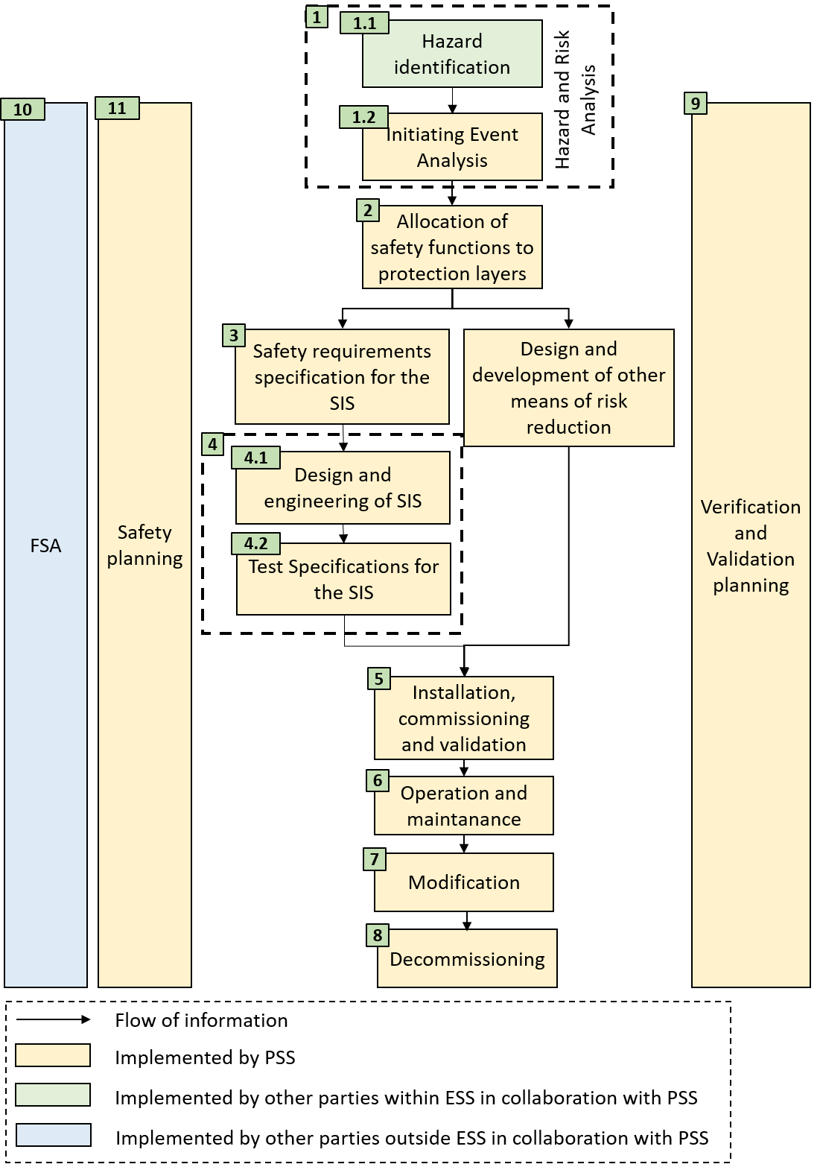
Safety Plan – ESS-0469185
Lifecycle phases
The plan describes each phase in the lifecycle
Each Phase has:
An overall objective
Inputs
Outputs
Acceptance requirements
Tools and methods
Responsibilities

Slide 8
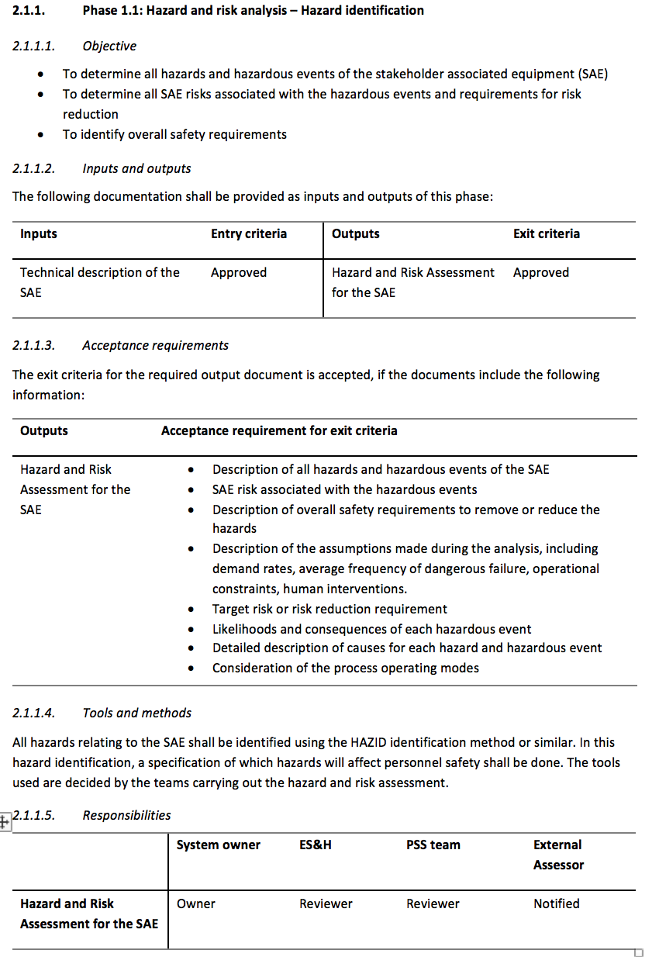
Safety Plan – ESS-0469185
Lifecycle phases

Slide 9
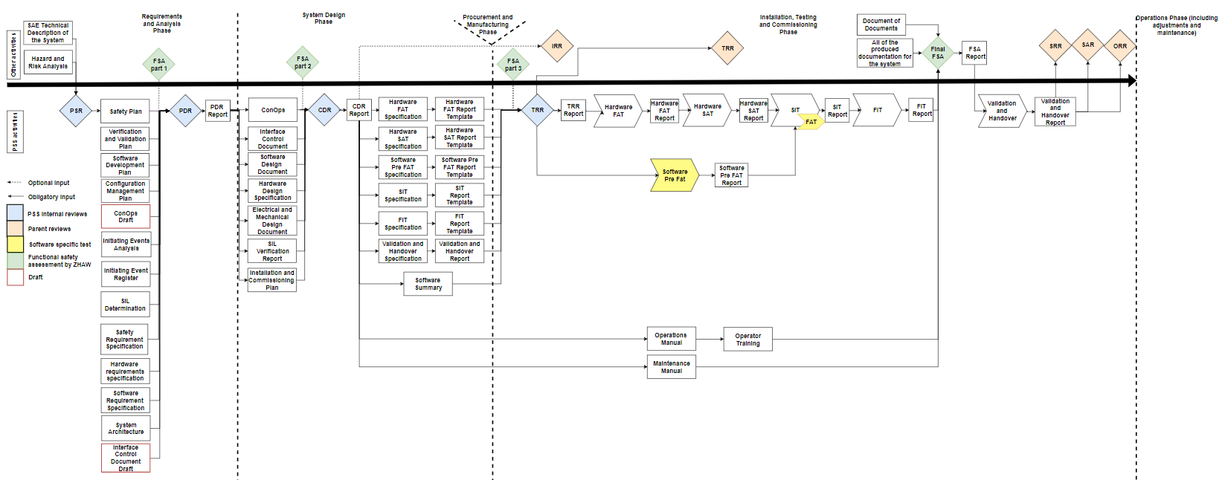
Safety Plan – ESS-0469185
Documents:
Part three details the minimum documentation required to deliver the PSS systems
The documents will be discussed in more detail in the V & V plan presentation

Slide 10
Safety Plan – ESS-0469185
Functional Safety Assessment
A FSA shall be performed to review the work carried out in the previous stage and the corresponding results at the following stages:
After safety life-cycle phase 3: Safety requirements specification
After safety life-cycle phase 4.1: Design and engineering
After safety life-cycle phase 5: Installation, commissioning and validation
In safety life-cycle phase 6: Operation and maintenance
In safety life-cycle phase 7: Modifications
At each of these stages, the external assessor shall review the documentation up to this point and evaluate the functional safety of the PSS under development.

Slide 11
Safety Plan – ESS-0469185
Appendices
Appendix A - Initiating Event Register:
The initiating event register summarizes all initiating events in relation to the hazards resulting from them and provides qualitative assessment of hazardous scenarios against a Conventional safety risk matrix. The appendix gives a step by step guide through this process.

Slide 12
Safety Plan – ESS-0469185
Appendix B – Safety Integrity Level SIL. determination and Verification
details the methodology used for determination and verification of SILs during the allocation of safety functions in the safety life-cycle.
General concepts of risk reduction
Safety Integrity Level SIL
Risk targets
Layer Of Protection Analysis LOPA
LOPA for low demand safety instrumented functions SIF’s
LOPA for High demand or continuous SIF’s
Independent protection layers
Hardware reliability
Probability of failure on demand
Failure rate
Mean down time
Voting configuration
Common Cause failure

Slide 13
Safety Plan – ESS-0469185
Appendix B (continued) –
Architectural Assessment Methodology
Hardware fault tolerance
Safe Failure Fraction SFF
Architectural constraints
Appendix C - Requirements formulation and naming :
Details the formulation and naming of the requirements developed in phase 3 of the lifecycle.
The requirements are to be formulated to be:
Unambiguous (Only one interpretation possible)
Traceable (Having a unique identifier)
Consistent (No conflict with other requirements)
Verifiable (It shall be possible to check whether the system meets the requirements)
Complete (No lack of relevant information)
The requirements are written statements using either “shall” “should”, where
“shall” is a mandatory statement and
“should” is an optional statement.

Slide 14
Contents
Introduction to TS2 - ESS-0101133

Slide 15
Introduction – TS2 – ESS-0101133
Test stand 2
Test and condition 30+ elliptical cryo-modules, both medium beta and high beta cavities before installation into the main accelerator.
The test stand will consist of the following:
Heavy concrete radiation protection bunker
Full cryogenic distribution system
RF system consisting of:
Modulator
2- Klystrons
LLRF system pi-controller
Circulator
Dummy loads
24 Racks controlling:
RF
Cryogenics
Vacuum
Cooling water
Timing system
Motion control

Slide 16
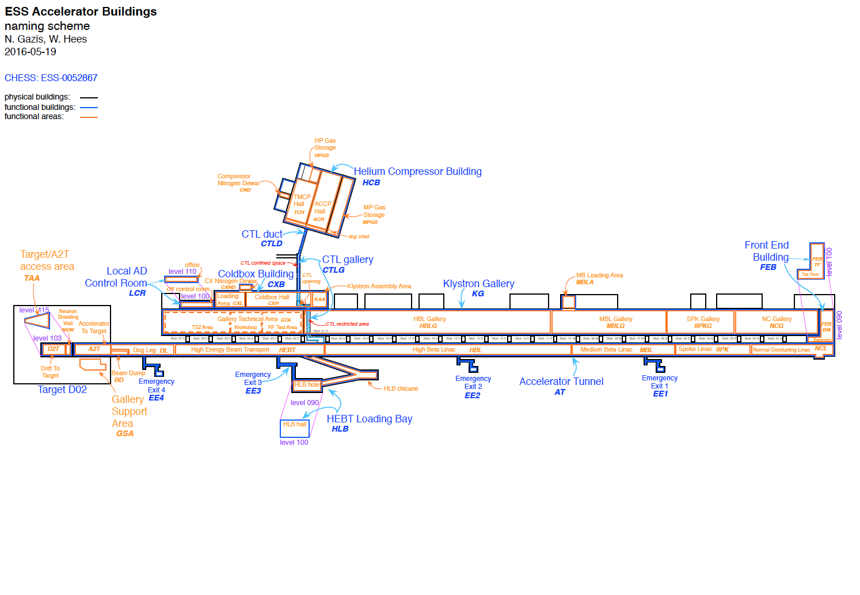
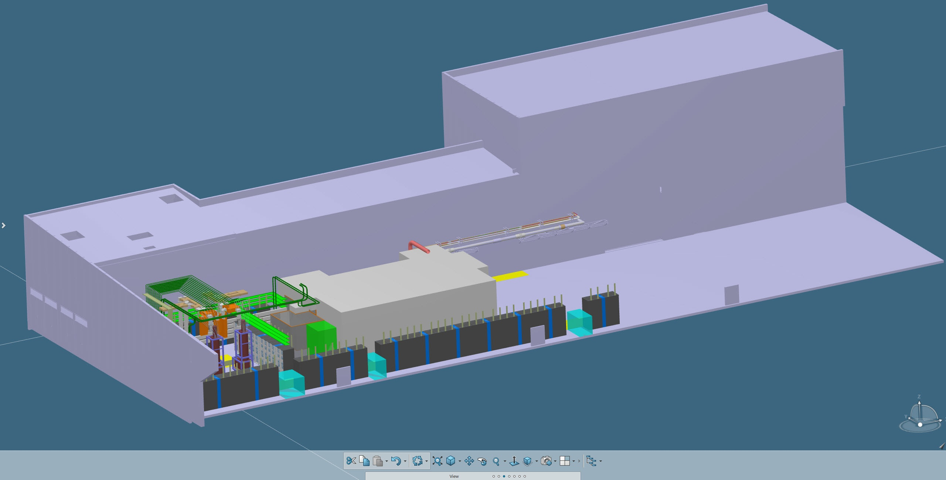
Introduction – TS2-ESS-0101133

Slide 17
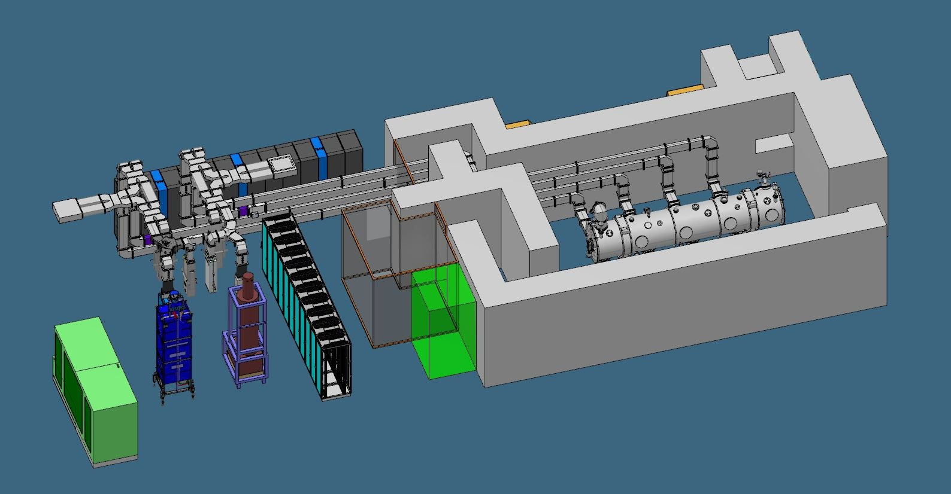
Introduction - TS2-0101133
TS2 Control racks
Removable Waveguides
Heavy Shield
Door
Cryo-Module
Modulator
Bunker Access
TS2 Bunker
Klystrons

Slide 18
Contents
TS2 hazard and risk assessment - ESS-0488867

Slide 19
Hazard and Risk Analysis – ESS-0488867
Two workshops were held with personnel from different groups representing the different systems involved. The system was divided into two nodes: equipment inside the bunker and equipment outside of the bunker.
Classification of risk.
Classification of risk for radiological hazards has been carried out in accordance with:
General Safety Objectives ESS-0000004
Charter for Radiation Safety Committee ESS-0440582
Classification of risk for non radiological hazards is carried out in accordance with:
Risk matrix for conventional safety ESS-0379511

Slide 20
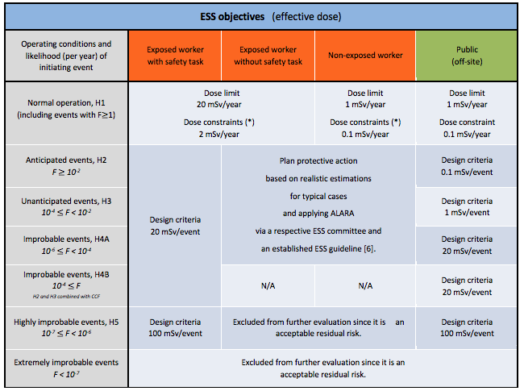
Radiation Safety Matrix
 | Acceptable range for exposure level (effective dose in mSv)
Event class Likelihood | Exposed workers without safety task | Non exposed workers (including public on site)
Anticipated events - H2 F $≥$ 10⁻² | order of magnitude for maximum value : 6 mSv for exposed workers Category B 20 mSv for exposed workers Category A | Order of magnitude for maximum value : 1 mSv for non-exposed workers
Unanticipated events - H3 10⁻⁴ $≤$ F < 10⁻²
Improbable events – H4A 10⁻⁶ $≤$ F < 10⁻⁴

Slide 21
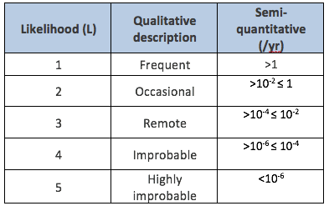
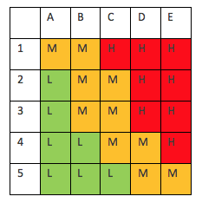
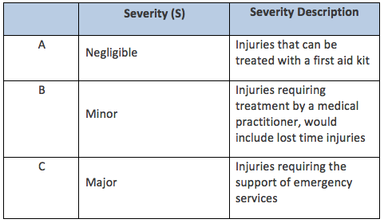
Conventional Safety Matrix
Likelihood
Severity

Slide 22
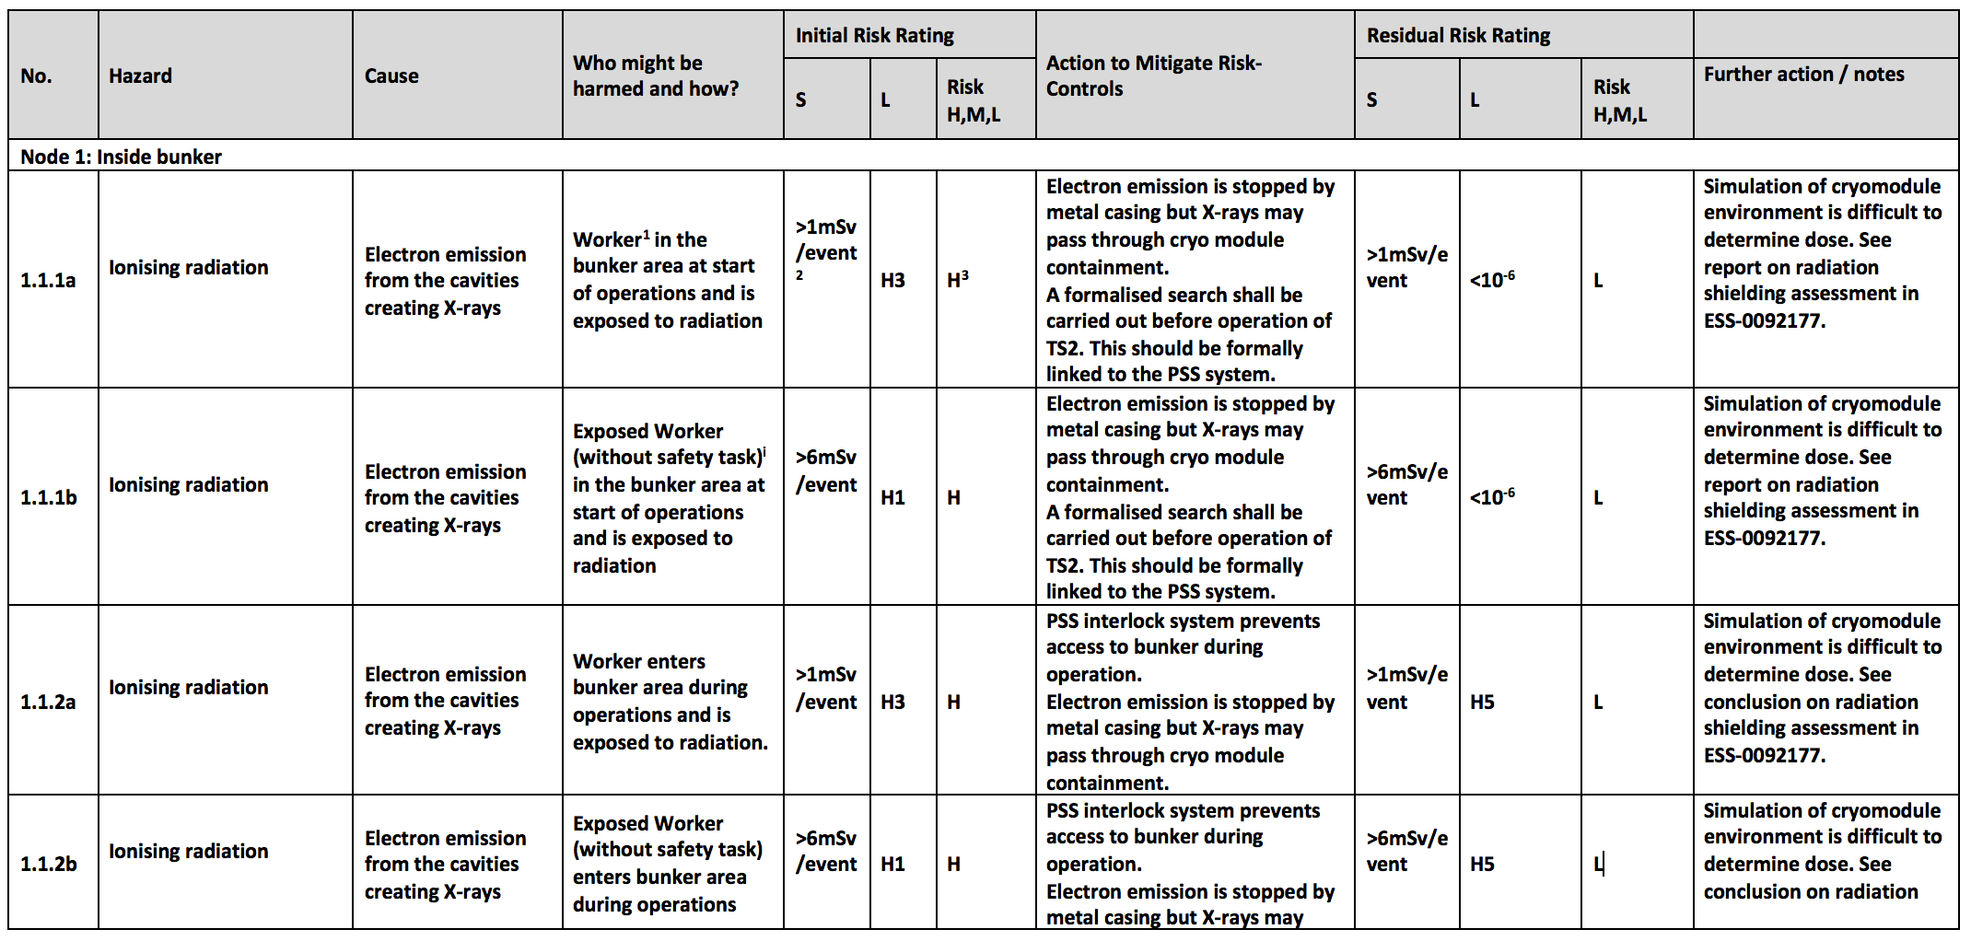
Hazard and Risk Analysis – ESS-0488867

Slide 23
Contents
TS2 PSS Pre-start Review - ESS-0505451

Slide 24
Pre-start Review – ESS-0505451
To discuss/review documents to be used as inputs to TS2 PSS analysis.
To ensure agreement on overall safety requirements (functions) for TS2 PSS.
To verify if all assumptions and technical details required to carry-out initiating events analysis for TS2 PSS are available and properly documented in higher level documents.
To agree on next steps and define actions required before starting with TS2 PSS analysis.
From the review a set of actions were agreed and all have been dealt with and agreed (see backup slide for list)

Slide 25
PSR – Assumptions – ESS -0508222
Assumptions
A set of operation assumptions have been developed to compliment the analysis the following assumptions have been agreed:
TS2 operation (cryomodule test) frequency
Daily operational hours
Klystron test frequency
Access
Human errors
For subsequent systems the PSS team will create a template for the system stakeholders to complete.

Slide 26
January TS2 PSS documents
Initiating events analysis
Initiating events register
Configuration management plan
SIL determination
Safety requirements specification
Hardware requirements specification
Software requirements specification
System architecture
Interface control document draft
1. ZHAW FSA Part 1
Documentation
11 days
2019-01-31
Installation
100%
3 days
3 days
5 days
5/19 - 5/23
5/24 - 5/28
5/29 - 6/2
10 days
2018
2019
65%
Week50
Week 6
Week 9
Week 10
Week 11
Week 14
Week 15
Week 16
Week 17
Week 18
0 days
5 days
5 days
0 days
6/3 - 6/4
6/5 - 6/9
6/10 - 6/16
6/17
11 days
15%
2018-12-06
2019-02-07
2019-03-07
2019-03-11
2019-04-01
2019-04-11
2019-04-16
2019-04-22
2019-04-30
5 days
4 days
2 days
TS2 PSR
TS2 PDR
TS2 CDR
TS2 FAT
TS2 SAT
TS2 SIT
TS2 FIT
TS2 PSS DEMO
TS2 SRR
6/18 - 6/23
6/24 - 6/29
6/30 - 7/3
4 days
2018-12-18
2019-03-01
2019-03-22
2019-04-22
1 day
1. ZHAW FSA Part 1
Documentation
2. ZHAW FSA Part 2
Documentation
3. ZHAW FSA part 3
Documentation
3. ZHAW FSA 4 Documentation
Pre-Christmas 2018 First TS2 PSS documents
SAE (Stakeholder Associated Equipment) technical description of TS2 systems
Global Hazard and risk assessment analysis for TS2
PSS Safety Plan
PSS Verification and validation plan
PSS Software development plan
Concept of operations for TS2PSS draft
Documents for TS2 CDR
Concept of operations
Interface control document
Software design document
Hardware design Specification
Electrical and mechanical design drawings
SIL verification report
Documents for TS2 TRR
Hardware FAT specification
Hardware FAT report template
Hardware SAT specification
Hardware SAT report template
Software Pre-FAT specification
Software Pre-FAT report template
SIT Specification
SIT report template
FIT specification
FIT report template
Validation and handover specification
Validation and handover report
Documents for TS2 SRR
TS2 FAT Report
TS2 SAT Report
TS2 SIT Report
TS2 FIT Report
Operations manual
Operator training
Maintenance manual
Procedures, Training documentation, presentations, etc.
2017
2017
Today

Slide 27
Questions?
Thank you for your attention!

Slide 28
Welcome
Have all action items from the Pre-Start Review been resolved properly to allow preparation of this PDR?
Are all or a sufficient coverage of requirements, safety objectives and specifications within the scope of this PDR documented and understood?
Is the safety plan for developing PSS systems such as TS2 PSS clear and properly documented?
Is the proposed implementation of the Oxygen Deficiency Hazard (ODH) detection system for TS2 acceptable?
Have all initiating events been identified and sufficiently evaluated in the initiating events analysis?
Have all safety requirements from the TS2 risk assessment been addressed in the TS2 PSS safety analysis and covered by the identified safety instrumented functions (SIF) and are they traceable through the process?
Is the validation and verification planning clear and appropriate for this stage of the project?
Have all operating procedures for TS2 PSS been addressed and are they properly documented?
Is the system architecture clear and mature enough for this stage of the project?

Slide 29
Welcome
Have all interfaces with other systems been identified and agreed with system stakeholders, and properly documented for this stage of the project?
Does the planning for software development meet the requirements within the scope of this PDR?
Is the configuration management plan appropriate for this stage of the project and is it clear how modifications will be traced?
Are there any outstanding agreements to be made or other actions necessary to allow the PSS team to transition to detailed hardware and software design?
The results of the review should be summarized in a short report, outlining the answers to the above review questions and whether the review is considered passed, passed with action items, or failed.
The report may also provide findings, comments, and recommended actions.
Actions should be clearly categorized as one of the following:
Shall be addressed before PDR is considered closed
Shall be addressed prior to the CDR

Slide 31
PSR - Actions
Who | Due Date | What
D. Paulic | 2018-12-09 | Send an example of AD requirements used for ODH detection system Phase 1 to John Weisend.
J. Weisend | 2019-01-31 | Write detailed requirements on the need of ODH monitors in TS2 area.
W. Hees | 2018-12-15 | Review Confluence pages where assumptions and technical details are documented (meeting notes from March 2018 [6] and Assumptions for TS2 [7]) and approve the contents via email.
D. Paulic | 2018-12-19 | Collect received emails on assumptions and communicated technical details and create a short CHESS document which will be used as a basis for TS2 PSS analysis. Put Wolfgang as an owner of this document.
S. Kozielski | 2019-01-24 | Provide a reference to PSS team for the report stating that there will be an RP survey in TS2 bunker area.
H. Boyer | 2018-12-31 | Check with M. Jensen and clarify what is the relation of ESS-0098998 to the TS2 risk assessment
S. Birch H. Boyer M. Mansouri | 2018-12-19 | Discuss the details of electrical hazards to be included in the TS2 risk assessment.
H. Boyer | 2018-12-14 | Add the need for PSS to interlock with the radiation monitors to the TS2 risk assessment
S. Kozielski | 2018-12-14 | Confirm we are considering "Exposed workers without safety task" in TS2 PSS analysis and what is documented for dose and risk target is correct.
H. Boyer | 2018-12-31 | Confirm with RP group and add risk target (>20mSv) and radiation safety risk matrix (or a reference to it) for analysing ionising radiation hazards to the TS2 risk assessment document.
W. Hees | 2019-01-10 | Provide references to documentation where emergency response procedures will be described.

