Slide 1
TS2 PSS Architecture, Concepts of Operations and Interfaces
TS2 PSS Preliminary Design Review
Morteza Mansouri
Lead Integrator Engineer for Safety Critical Systems
www.europeanspallationsource.se
19-02-11

Slide 2
Content
TS2 Layout
TS2 Personnel Safety System (PSS) Layout
TS2 PSS Architecture
TS2 PSS Interfaces
TS2 PSS Principles of Operation
TS2 PSS Modes of Operation
ODH Detection System for TS2
Summary

Slide 3
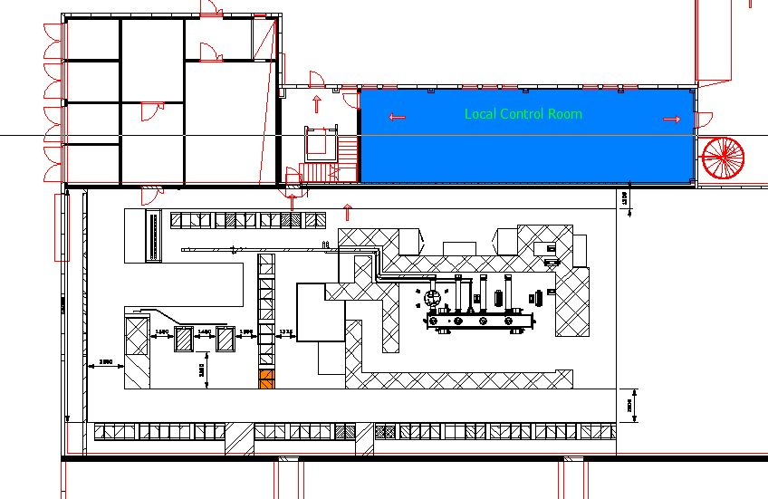
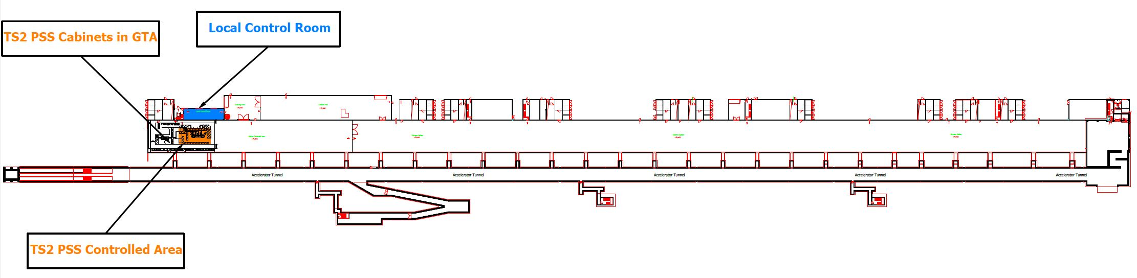
TS2 Layout

Slide 4
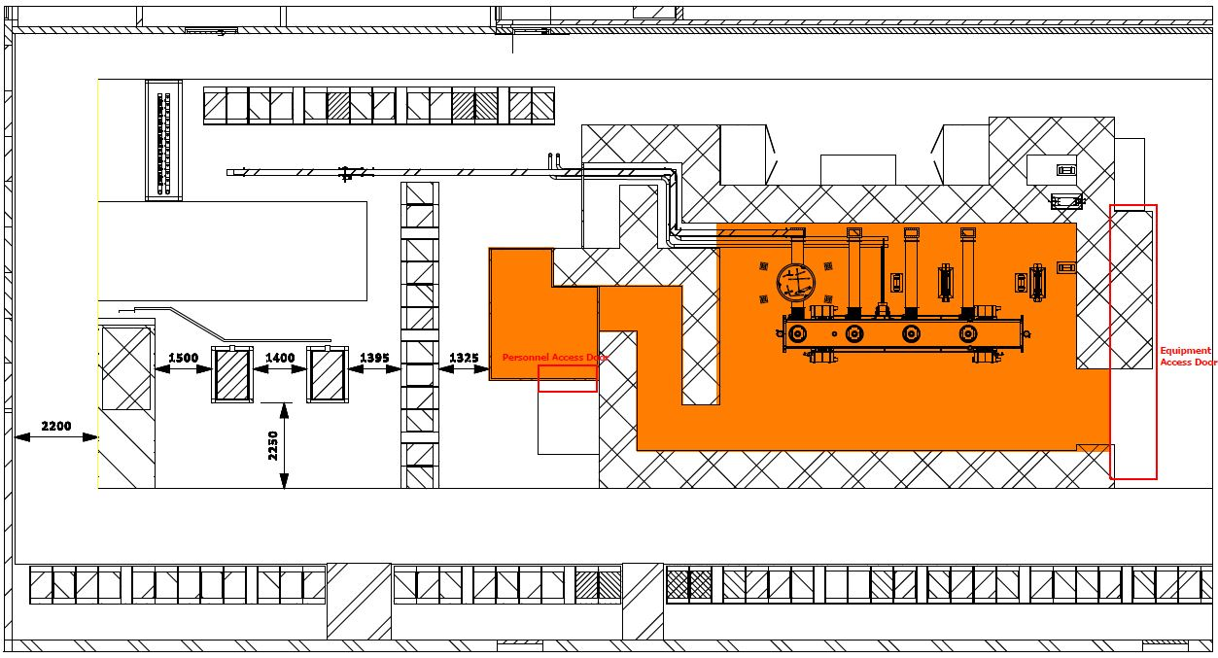
TS2 Personnel Safety System (PSS) Layout
The purpose of TS2 PSS is primarily to protect workers from being harmed by exposure to ionising radiation generated by the cavities receiving high-power Radio Frequency (RF) within TS2 bunker. This is achieved by providing access to TS2 bunker (hereafter referred to as “TS2 PSS controlled area”) only during safe state of the area.
Material Access Door (MAD)
Personnel Access Door (PAD)

Slide 5
Layer Architecture of TS2 Personnel Safety System
ESS Local Control Room
PSS Engineering Workstation
PSS Engineering WS
(TIA portal)
TS2 PSS
GUIs (CSS)
TS2 PSS
HMI (WinCC)
Machine for GUI (CSS)
and IOC Developing
High Performance
Data Network
EPICS
TS2 PSS
EPICS IOC
EPICS
Archiver
TS2 PSS
Gateway PLC
Personnel Safety Systems
TS2 PSS
PLC
TS2 RF LPS
PLC
Temporary
Remote
I/O
Remote
I/O
Remote
I/O
Remote
I/O
Remote
I/O
Remote
I/O
Remote
I/O
Remote
I/O
Fieldbus
Device signals
Search Buttons
Message Display & Annuciator Devices
Key exchange units
Radiation Monitors
E-Switch OFF Buttons
Door Switches
SAE Interface Relays & Contactors
Template: ESS-0505806

Slide 6
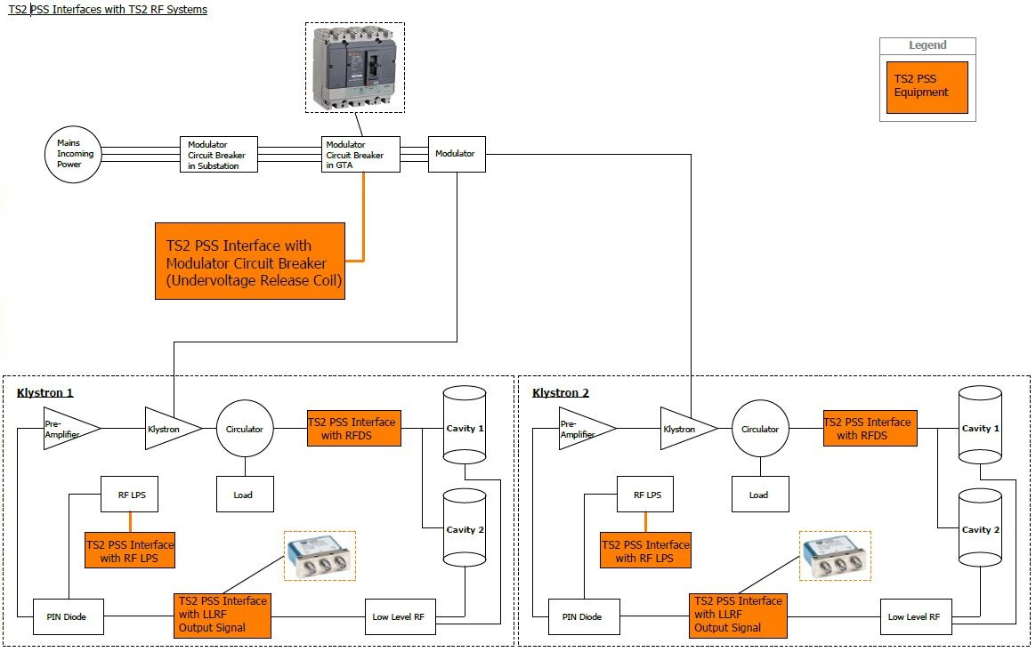
TS2 PSS Interfaces with TS2 RF Systems

Slide 7
TS2 PSS Interfaces with TS2 RFDS
Switch hood with male insert and contacts
Switch housing with female insert and contacts (Circuit A)
Cable to TS2 PSS
- Situation I (Waveguide in place)
- Circuit A (normal operation; RF to cavity when there is no access to TS2 bunker)
RF Waveguide
Removable Waveguide
RF Waveguide
Switch hood with male insert and contacts
Switch housing with female insert and contacts (Circuit B)
Cable to TS2 PSS
- Situation II (Waveguide removed
and short circuit plate in place)
- Circuit B (RF test in GTA during access to TS2 bunker)
RF Waveguide
RF Waveguide
Short circuit plate
Removable Waveguide

Slide 8
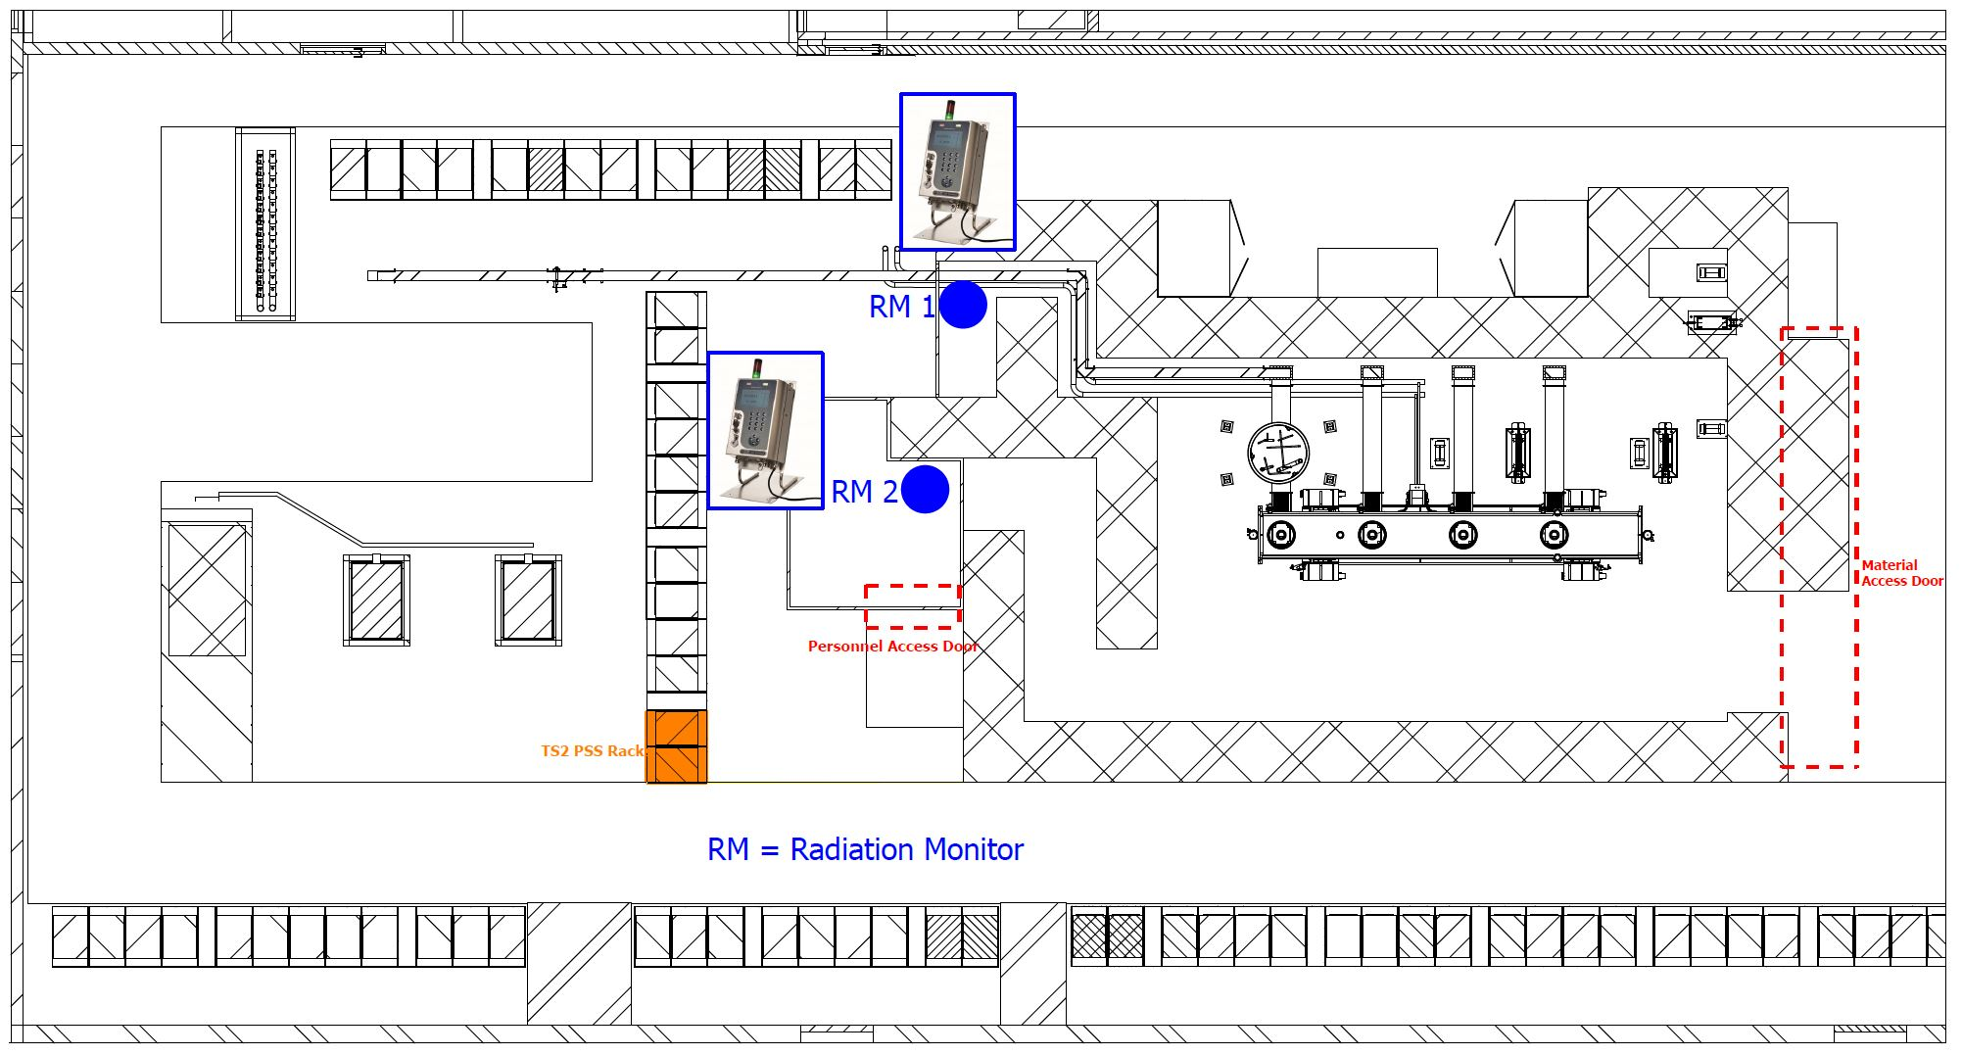
TS2 PSS Interfaces with Radiation Monitors

Slide 9
TS2 PSS Principles of Operation
Prior to energizing the RF system:
  Trained operator shall carry out a formalised search in the TS2 PSS controlled area.
  The access doors to the TS2 PSS controlled area shall be locked.
Prior to granting access to TS2 PSS controlled area:
  The SAE shall be turned off through the control system.
  The mains incoming power to the SAE shall be disconnected.
  The mains incoming power to the SAE shall be secured against re-connection.
  Stakeholder Associated Equipment (SAE) are the equipment in TS2 that TS2 PSS interlocks in order to mitigate risks associated with them. In case of TS2 PSS, TS2 RF systems are the SAE.

Slide 10
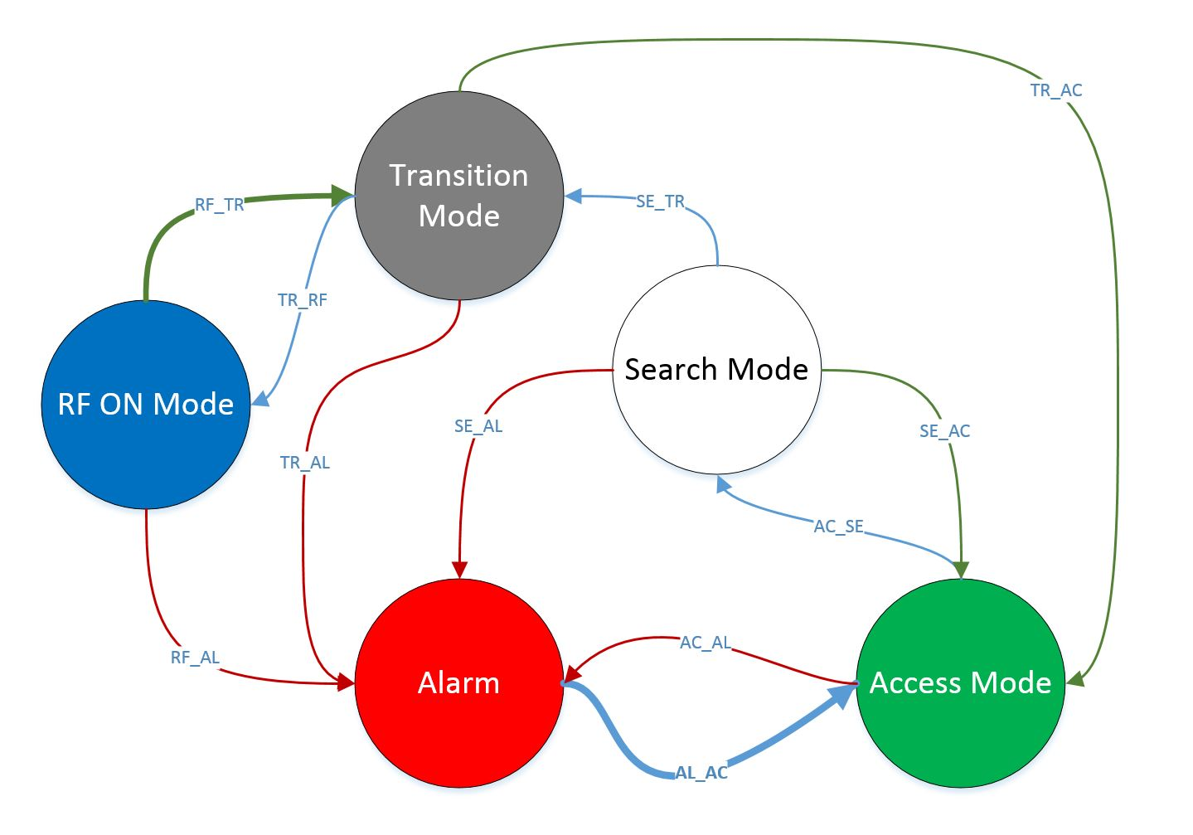
TS2 PSS Modes (preliminary design)
To ensure a safe transition between operation (no access permitted to TS2 PSS controlled area) and shutdown (access permitted to TS2 PSS controlled area) of the TS2, and a correct execution of procedures, the TS2 PSS operates in 5 modes.

Slide 11
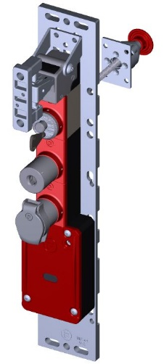

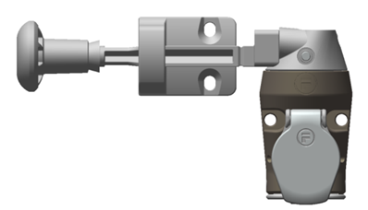
TS2 PSS Key Exchange Philosophy
TS2 PSS Key Exchange
Location: TS2 PSS Cabinet
Personnel Access Door (PAD)
Solenoid ON
Main Key
Slot 2
Slot 1
PAD Key locked
in Place
PAD Open
Slot 3
PAD Key
Slot 4
MAD Key
Material Access Door (MAD)
MAD Open
Slot 5
Spare Key
MAD Key Locked in Place

Slide 12
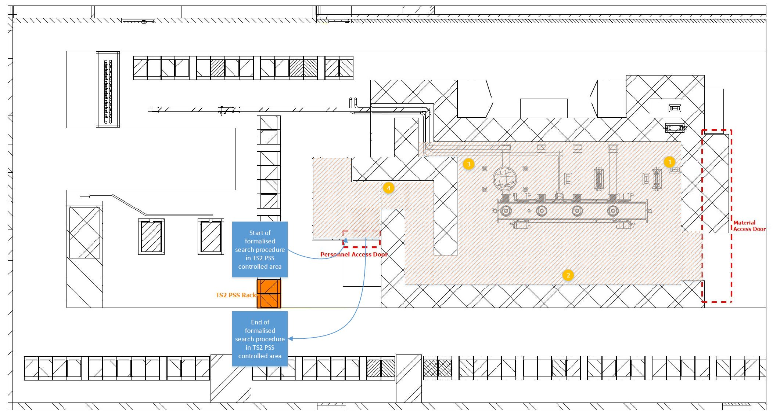
TS2 PSS Search

Slide 13
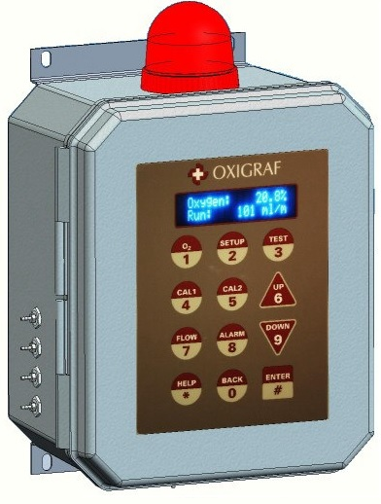
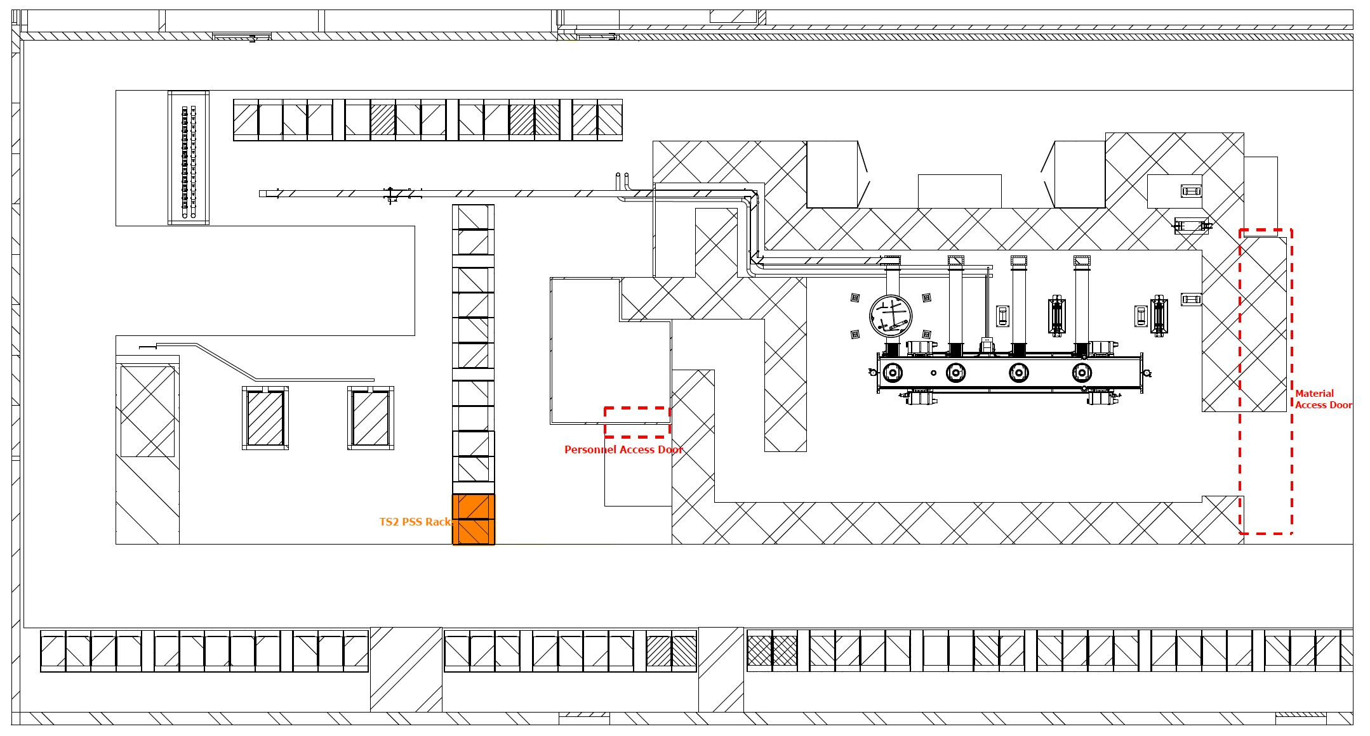
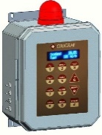

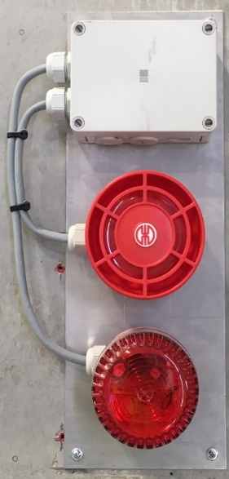
ODH Detection System for TS2
The ODH safety review of the accelerator buildings ESS-0068327

Slide 14
How to realize ODH Detection System for TS2?
Option 1:
  Solution 1: The Accelerator ODH Detection System is extended to include TS2.
    Advantages:
      This option is preferred if TS2 is a permanent installation.
    Disadvantages:
      The software of the current ODH Detection system needs modification. Hence the whole system shall be verified again and this is not feasible within the time frame expected to have TS2 PSS and ODH Detection system fully commissioned and validated.
  Solution 2: The TS2 ODH monitors work standalone and be integrated into Accelerator ODH Detection System later (during commissioning of ODH Detection system for accelerator tunnel end of 2019?).
    Advantages:
      In case TS2 is a permanent installation, this solution is the first step for realizing solution 1.
    Disadvantages:
      Only the local ODH lights and sounders of the monitors are functional.
      The TS2 ODH monitors do not communicate with LCR.
Option 2: TS2 PSS includes the ODH Detection system for TS2 as well.
    Advantages:
      This option is preferred if TS2 is a temporary installation.
    Disadvantages:
      TS2 PSS and ODH Detection system are not independent from each other. In case TS2 PSS is in maintenance, the ODH Detection system for TS2 is deactivated as well (ODH monitors can still work standalone).

Slide 15
Summary
See more details in Concepts of Operations for the Test Stand 2 Personnel Safety System (ESS-0304995)
Test Stand 2 Personnel Safety system Architecture (ESS-0513300)

Slide 16
Thank you!

Slide 17
TS2 PSS functionality
TS2 PSS ensures a safe access to TS2 PSS controlled area through a number of safety interlocks.
In case the TS2 PSS Main key in the key exchange system is removed, the RF system is switched off by removing the power to the TS2 modulator, and also by disabling the output signal of the Low Level RF (LLRF) of the TS2 RF system.
In case an intrusion into the TS2 PSS controlled area is detected by TS2 PSS, the RF system is switched off by TS2 PSS.
The TS2 PSS controlled area is equipped with a few emergency switch-off buttons. Pressing any of these buttons in the TS2 PSS controlled area immediately switches off the RF system.
In case a radiation level exceeding the pre-defined limit is detected by any of the radiation monitors outside the TS2 PSS controlled area, the RF system is switched off by TS2 PSS.
The RF systems might need to be tested in the GTA whilst the access to TS2 PSS controlled area is allowed. Only if a removable part of the RF distribution system is removed, the RF system is enabled by TS2 PSS. The TS2 PSS monitors the position of the removable part of the RF waveguide and ensures this part is removed prior to enabling power to the TS2 modulator and LLRF switch.

