Slide 1
Software Development Plan and Software Requirements
TS2 PSS Preliminary Design Review
Denis Paulic
ESS/ICS/PS
2019-02-11

Slide 2
Contents
Software Development Plan
Governance for PSS software
Software Requirements
Software Tools and Devices
Security measures
Open Questions

Slide 3
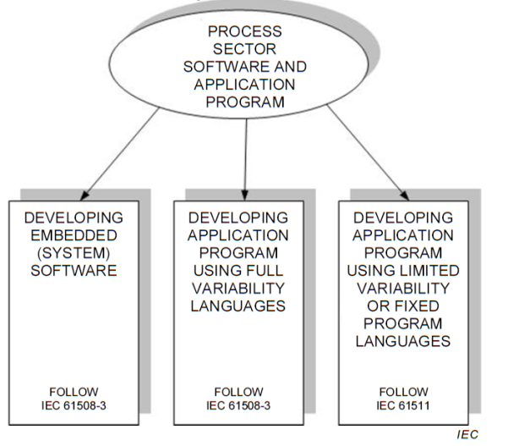
PSS Software Governance
Limited Variability Language (LVL)
Programming language for commercial and industrial PLCs.
Easily understood by process sector users.
Has the capability to combine predefined, application specific, library functions to implement the safety requirements.
For SIL 2 applications, a safety configured PLC may be used provided that all the following additional provisions are met (clause 11.5.5.5):
understanding of unsafe failure modes;
protection against unauthorized or unintended modifications.
Notes:
IEC61511
applies when application programs are developed for systems having limited variability language or when using fixed programming language devices, but does not apply to manufacturers, SIS designers, integrators and users that develop embedded software (system software) or use full variability languages
limited variability language LVL
programming language for commercial and industrial programmable electronic controllers with a range of capabilities limited to their application as defined by the associated safety manual. The notation of this language may be textual or graphical or have characteristics of both.

Slide 4
Software Planning Documentation
Software Development Plan
V&V Plan
SRS = Safety Requirements Specification
AP= Application Program
Notes:
Architecture Design description: Identify set of methods and techniques for developing the AP and justify use of them.
Development Support planning: Select a suitable list of tools; consider availability of support during the SIS lifetime; suitable set of procedures for tool usage; justify choice of programming language if needed.
Software Development: Ladder logic, Simulation and Integration test

Slide 5
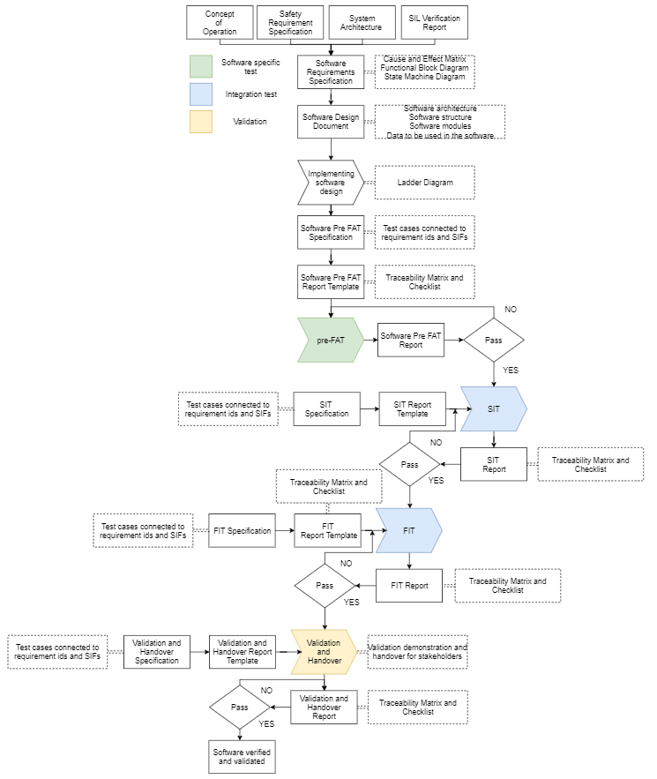
Software Development Flow
For each phase:
Purpose
Requirements
Inputs and entry criteria
Roles
Execution
Verification activities
Outputs and phase exit criteria
Link to SW development flow

Slide 6
TS2 PSS Software Documentation
ConOps
HWRS
SRS
ICDs
SWRS
Software Design Document
Software Summary
SRS = Safety Requirements Specification
AP= Application Program
Notes:
Architecture Design description: Identify set of methods and techniques for developing the AP and justify use of them.
Development Support planning: Select a suitable list of tools; consider availability of support during the SIS lifetime; suitable set of procedures for tool usage; justify choice of programming language if needed.
Software Development: Ladder logic, Simulation and Integration test

Slide 7
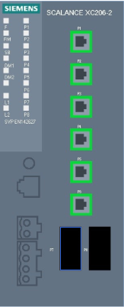
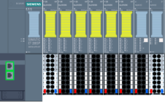
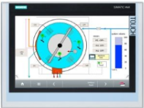
Network Architecture
PSS Engineering Workstation
Industrial Ethernet
1515F-2PN with CP1543-1
SCALANCE
XC206-2SFP
ET 200SP
HMI (PLC rack)
UPS 1600
PROFINET TCP/IP
1511-1PN with CM1542-1
PSS Supervision Station (LCR)
Technical Network
CP = Communication Processor
CM = Communication Module
HMI = Human Machine Interface
EPICS = Experimental Physics and Industrial Control System
LCR = Local Control Room

Slide 8
TS2 PSS Software Tools and Devices
Siemens SIMATIC STEP 7 TIA Portal V14 SP1;
Safety Advanced for developing safety software.
WinCC Comfort for HMI programming.
Siemens fail-safe PLC (1515F-2PN)
Allows processing of standard and safety programs on a single unit.
Communication processor (CP 1543-1)
Includes security features such as an SPI firewall, password requests and data encryption (i.e. FTPS).
Standard Siemens PLC (1511-1PN)
Used as a gateway to communicate with external systems (i.e. EPICS)
Communication module (CM1542-1)
Provides additional Ethernet connection.
PLC = Programmable Logic Controller
HMI = Human Machine Interface
SIL = Safety Integrity Level
SPI = Stateful Packet Inspection
FTPS = File Transfer Protocol Secure
Notes:
Siemens fail-safe CPUs allow the processing of standard and safety programs on a single CPU. This allows fail-safe data to be evaluated in the standard user program and thus, this integration provides the system advantages and the extensive functionality of SIMATIC also for fail-safe applications. Besides this, Siemens fail-safe CPUs (and SIMATIC Safety F-systems in general) are certified to satisfy the Safety Integrity Level SIL3 in accordance with IEC 61508:2010, which means it is suitable for the SIL required by each SIF it services in PSS accelerator system
Verification tests that the system was built right (according to the requirements). Validation checks that the right system was built (truly meets the needs and intent of the customer). V&V primarily involve testing of the software system, though it encompasses analyses, inspections, and reviews as well. The amount of testing can be tailored, with safety critical units and subsystems receiving the majority of the test effort. Traceability from the requirements, through design and coding, and into test is an important part of V&V.

Slide 9
Integrated Access Protection Mechanisms
S7-1500 controller with activated Protection level
The access to TS2 PSS safety software will be protected by two password prompts: one for the safety program and another for the safety CPU.
Checking the collective signature of the safety program (Checksum test):
In case of the software misuse, the system goes to safe state;
Checksum will change after any error-free safety software re-generation.
HMI panels in Secure mode
Automatically enabled in Siemens HMIs.
Managed network switches
Additionally have the ability to configure, manage, and monitor local network.
Help to monitor and decide who should have the access to local netrwork.

Slide 10
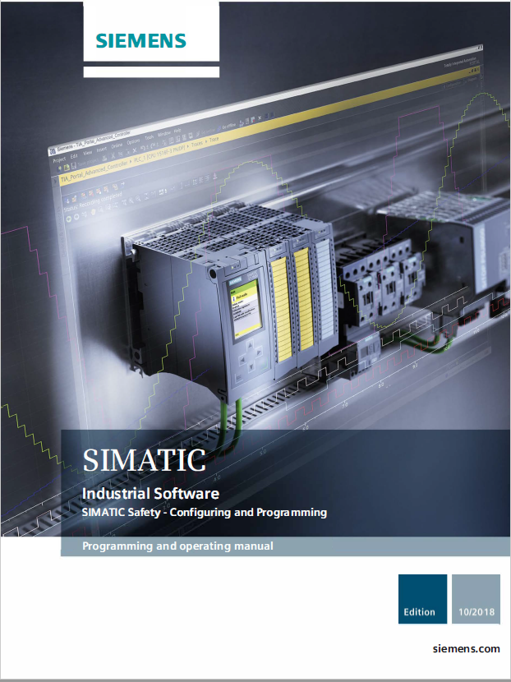
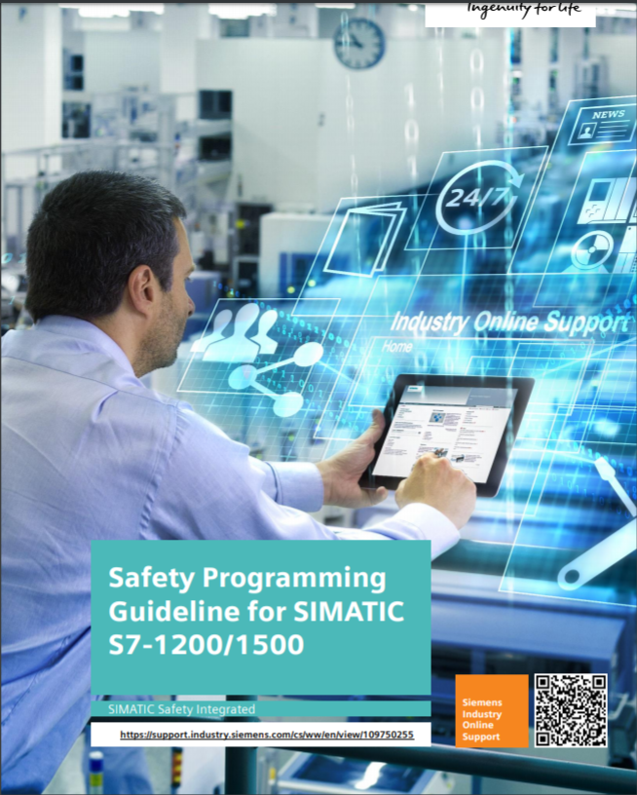
Siemens Guidelines

Slide 11
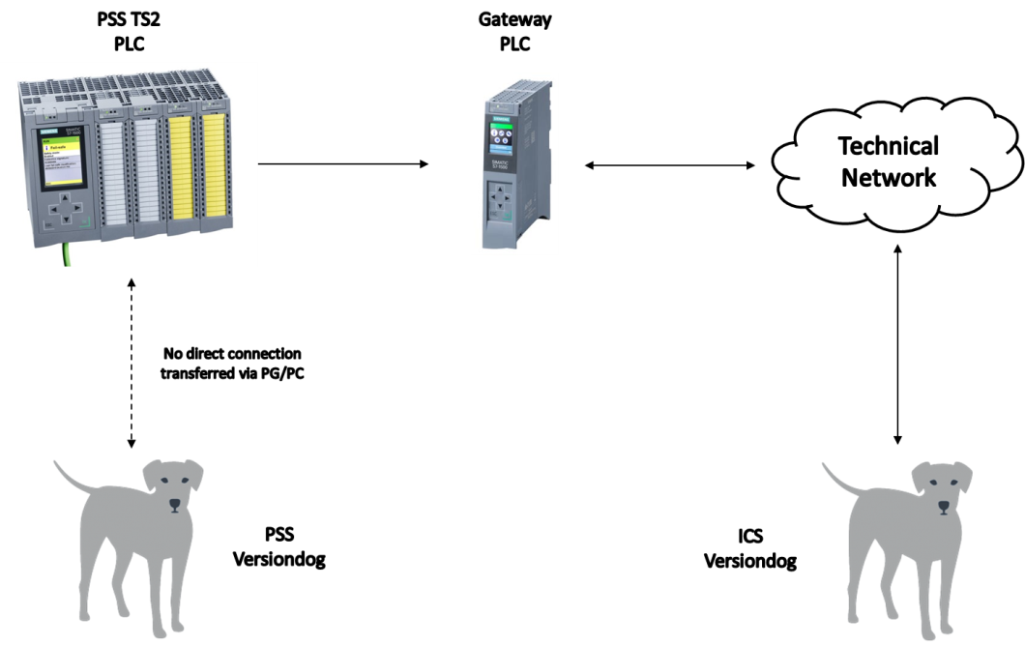
Versiondog
Tracks version, date, user and changes.
Stores all previous versions on server for comparison and download.
Automatically finds and lists code changes.
Compares local code to server code
TS2 PSS Setup

Slide 12
Example – TS2PSS_SIF01
Software requirements
From SRS
System shall be in a safe state upon power loss.
TS2 PSS shall be in Alarm Mode at SIS start-up / restart, until acknowledged from the HMI.
Process safety time and response time requirements.
The function shall be reset manually via the TS2 PSS HMI following a shutdown.
The HMI shall be password protected and can only be accessed by authorised TS2 operators and PSS team members.
Siemens proven-in-use devices and safety library shall be used.

Slide 13
Example – TS2PSS_SIF01
Software requirements
From SWRS
A discrepancy time to neglect comparing the switches from emergency switch-off button shall be shorter or equal to 50 ms.
The short circuit tests on sensor supplies shall be enabled in the failsafe digital input module channels the button is connected to. These tests shall be carried out in less than 5 ms.
E_SwitchOFF [1..4] | This variable indicates the status of the Emergency switch off button. E_SwitchOFF = TRUE → Emergency switch off button is not pressed | Contacts inside the Emergency switch off button
ModulatorUVR | This output energises the UVR coil of the modulator circuit breaker. ModulatorUVR = TRUE → The request to issue a permit to energise the modulator circuit breaker is active. | Modulator circuit breaker permit issued (UVR coil energised): TBD

Slide 14
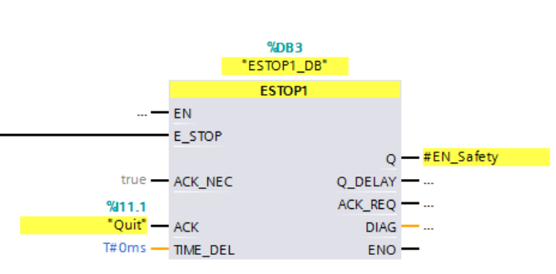
Example - Siemens Safety Library Function
ESTOP1:Emergency STOP up to stop category 1
Discrepancy monitoring of the two NC contacts (when two channels are involved) is performed with suitable configuration (type of sensor interconnection: 2-channel equivalent) directly through the F-I/O with inputs.
E_SwitchOFF
ModulatorUVR

Slide 15
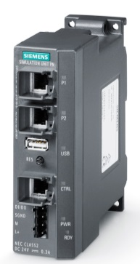
PSS Test Stand – TS2 PSS Software Virtual Commissioning
Software (system) development and testing
Preparing and testing the software updates before being downloaded to PLC
Facilitating preparation for operation, maintenance and periodical testing
As similar as possible to real system
Easier to detect software logic errors
Siemens Simulation Unit PN
Verification → Virtual Commissioning
Functionality and software verification tests:
PN = Profinet
Notes:
A Test Platform is necessary through the lifecycle of a safety system to:
develop the system and test it before production deployment
prepare upgrades
help during the operation & maintenance phase
The closer to production system the platform, the easier it is to detect all kind of errors, not only in the software logic.
In the LHC0 Test Platform, the introduction of SIMBA and SIMIT makes it possible to rapidly change the configuration of the test platform and to conduct the necessary tests or error reproduction on demand.

Slide 16
Open Questions
Procedures for software versioning
Versiondog – independent from the rest of ICS?
Configuration management
Change control – ensuring that a correct and approved software is running on the production PLC.
Security procedures for code development
Modern vs traditional approach.
Code development and code deployment
Hardened PSS engineering workstation
PSS laptop

Slide 17
Questions?
Thank you for your attention!

Slide 18
Network Architecture – Circuit Diagrams

Slide 19
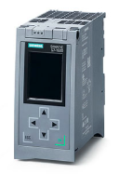
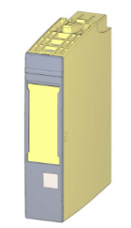
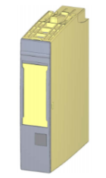
Devices for TS2 PSS Fail-safe Application
Fail-safe CPU (1515F-2 PN)
Network separation: Integrated PROFINET interface with 2 ports for line structure and 1 additional interface for Ethernet connection and basic PROFINET functionality;
Integrated system diagnostics;
Integrated security (copy, access and integrity protection).
Fail-safe digital input module (8x24VDC HF)
8 inputs (SIL3/Cat.4/PLe);
Diagnostics: short circuit, wire break → channel-specific;
load voltage missing → module-specific;
Fail-safe digital output module (4x24VDC/2A PM HF)
4 outputs, PM-switching (SIL3/Cat.4/PLe)
Diagnostics: short circuit, wire break, load voltage missing
Notes:
Functional safety is implemented principally through safety functions in the software. Safety functions are executed by the SIMATIC Safety system in order to bring the system to a safe state or maintain it in a safe state in case of a dangerous event. Safety functions are contained mainly in the following components: ● In the safety-related user program (safety program) in the F-CPU ● In the fail-safe inputs and outputs (F-I/O) The F-I/O ensure the safe processing of field information (sensors: e.g. emergency STOP pushbutton, light barriers; actuators, e.g. for motor control). They have all of the required hardware and software components for safe processing, in accordance with the required Safety Integrity Level. The user only has to program the user safety function. The safety function for the process can be provided through a user safety function or a fault reaction function. In the event of an error, if the F-system can no longer execute its actual user safety function, it executes the fault reaction function; for example, the associated outputs are shut down, and the F-CPU switches to STOP mode, if necessary.

Slide 20
Requirements For Operator Interface
System status information critical to maintaining the SIL shall be available as part of the operator interface:
where the process is in its sequence
indication that system’s protective action has occurred
indication that a protective function is bypassed
information about automatic actions from PSS system
status of sensors and final elements
the loss of energy where that energy loss impacts safety
the results of diagnostics
System operator interface shall prevent changes to SIS software.
Any writing from standard to safety part of the software shall be documented and tested to make sure it cannot lead the system to an unsafe state.
Notes:
It is essential to provide access protection in operation mode for the access to the safety part of the software. The access to PSS safety software shall be protected by two password prompts: one for the safety program and another for the safety CPU. To optimise the access protection, the passwords for safety CPU and safety program shall be different. More information about password protection of safety related software can be found in ESS-0058389.
Initially, no access protection is necessary for test purposes, commissioning, etc. That is, it is allowed to execute all offline and online actions without access protection, but the safety of the system shall be guaranteed through other organizational measures, for example, restricted access to certain areas.
To prevent the misuse, the system shall automatically check the collective signature of the safety program (Checksum test) and in case of the software misuse; the system shall go to Alarm mode and PSS system administrator must be informed immediately. Note that checksum will change after any error-free safety software re-generation.
In Siemens S7-1500 series, the F-runtime group information DB is used for that purpose, where data about F-signature of the safety program, safety program’s compilation date and F-runtime group collective signature can be found and used for checking. Note that these are standard program data and should not be part of the safety program.

Slide 21
Software Realisation Requirements
During realisation records shall be created, including:
decisions and their rationale;
problems and their solutions;
testing performed on each module.
Software manuals will be generated at a later stages of development process, and shall include:
drawings, diagrams, descriptions and explanations necessary for the use, maintenance and repair of the system and procedures for checking functionalities;
warnings concerning ways in which the system shall not be used;
instructions for the training of operators;
the description of the adjustment and maintenance operations (including preventive measures);
instructions for safe adjustment and maintenance actions;
the specifications of the spare parts and tools to be used and provided;
instructions for commissioning.
Documentation shall enable the Operator to create maintenance records.

Slide 22
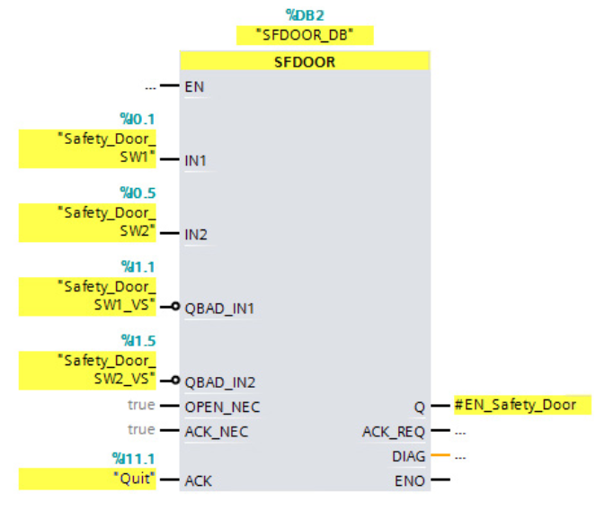
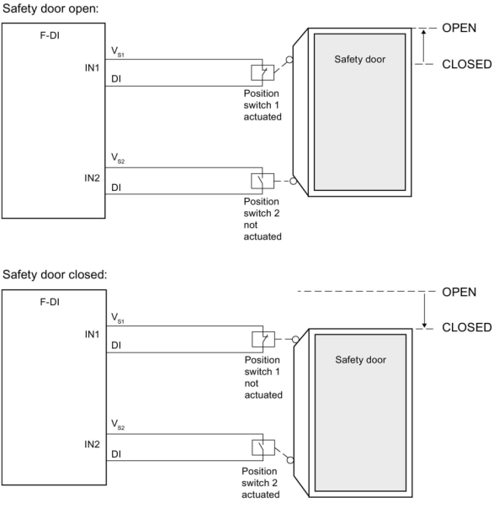
SIF02 – Siemens Safety Library Function
SFDOOR: Safety door monitoring
Enable signal Q is reset to 0 as soon as one of the inputs IN1 or IN2 take a signal state of 0 (safety door is opened). The enable signal can be reset to 1, only if:
Inputs IN1 and IN2 both take a signal state of 0 prior to opening the door (safety door has been completely opened)
Inputs IN1 and IN2 then both take a signal state of 1 (safety door is closed)
An acknowledgment occurs

