Slide 1
European Spallation Source
Ralf Trant
Associate Director
Environment, Safety, Health & Quality
European Spallation Source ERIC
ITSF 2019
May 14, 2019

Slide 2
The Big Picture
What is ESS all about?
Build and operate the world’s most powerful neutron source
enabling scientific breakthroughs
in research related to materials, energy, health and the environment,
addressing some of the most important societal challenges of our time.

Slide 3
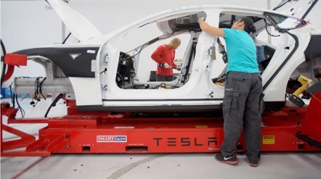
Big Science
Importance of Research Infrastructures
Scientific and technological innovation is essential to address
global challenges of energy, climate, environment, healthcare
economic and societal challenges of stalled productivity and long term wage stagnation

Slide 4
Basic Science
We, and everything around us, are made of atoms
Neutrons can tell us where these atoms are and what they do
ESS is a machine to generate beams of neutrons and use them to study everything from materials to molecules

Slide 5
HEALTH
With neutrons, we are able to study the building blocks of the human body by understanding how proteins, enzymes and other biological material work on the molecular and atomic level.
This includes research on DNA molecules and proteins that control aging and cancer, organs like muscles and teeth, and constructing better medical implants.

Slide 6
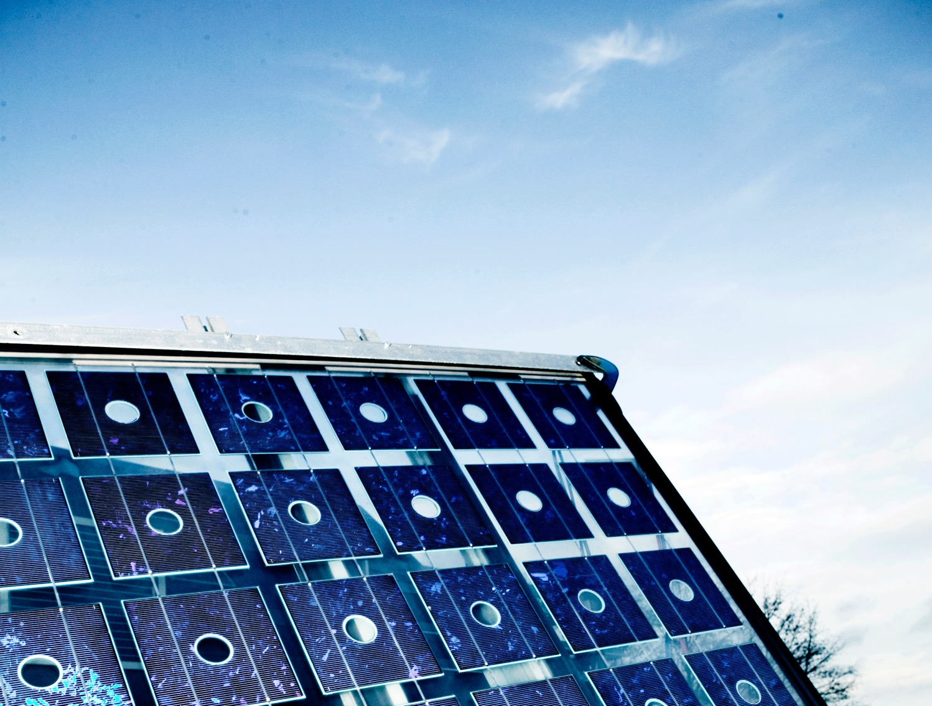
ENERGY
Neutrons enable the potential for developing more environmentally friendly products and processes.
Fuel cells driven by hydrogen, materials used for solar power, and telephone batteries are some of the areas that benefit from neutron technology.

Slide 7
FOOD
Consumers demand safe and healthy food, creating a need for companies to understand the complex structure of food and ingredients.
Neutrons are used to study enzyme structures and what happens during chemical processes. The non-destructive analysis techniques can reveal protein and emulsion structures and reduce energy consumption in food production.

Slide 8
NEW MATERIAL
Mobile phone and computer technology are developing fast while new technologies like LED lighting are emerging. New products full of advanced materials surround us in our everyday life.
Today's materials must be lighter, stronger, cheaper and sustainable. Neutrons help us not only understand the atomic structure of materials, but also their behavior.

Slide 9
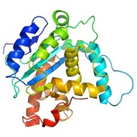
How a spallation source works
instrument
neutrons
moderator
sample
proton accelerator
target
“spallation” is the process that releases neutrons from the target nuclei

Slide 10
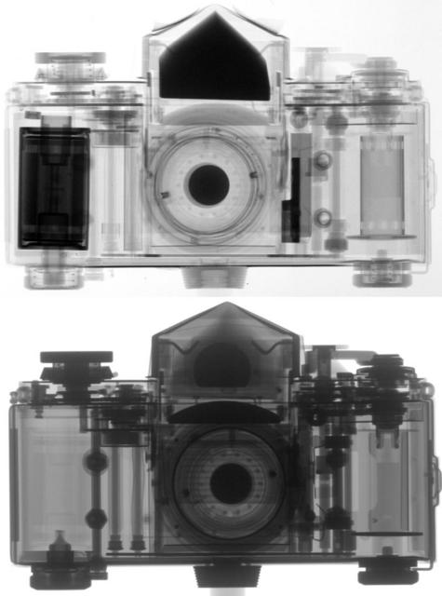
Neutrons
How do they work?
From PSI website
Neutrons
Neutrons can show details of plastic elements
X-Rays
Electromagnetic waves are stopped by metallic parts

Slide 11
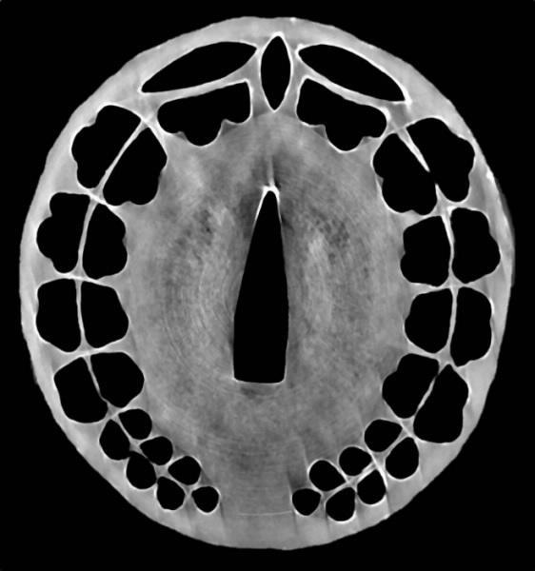
Neutrons
How do they work?
Non-destructive imaging
A tsuba (hand guard) from a samurai sword imaged using neutrons from OPAL
Credit: Floriana Salvemini, ANSTO

Slide 12
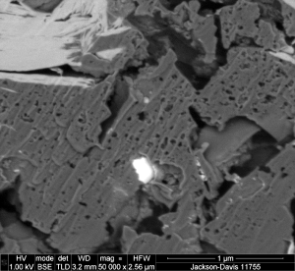
Neutrons
How do they work?
Ability to view complex materials on a molecular level
An image of the sponge-like pores in a shale sample
Credit: Neutronsource.org

Slide 13
ESS Vision: Build and operate the world’s most powerful neutron source
Reactor sources
Accelerator-driven sources
ESS
Effective thermal neutron flux 10¹⁵ n/cm²-s
J-PARC
NIST
ILL
LANSCE
ISIS
FRM-II
SNS
CSNS
Year

Slide 14
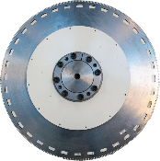
The facility – the Science
What is spallation?
Neutron Production Target
Experiments
Superconducting Proton Accelerator

Slide 15
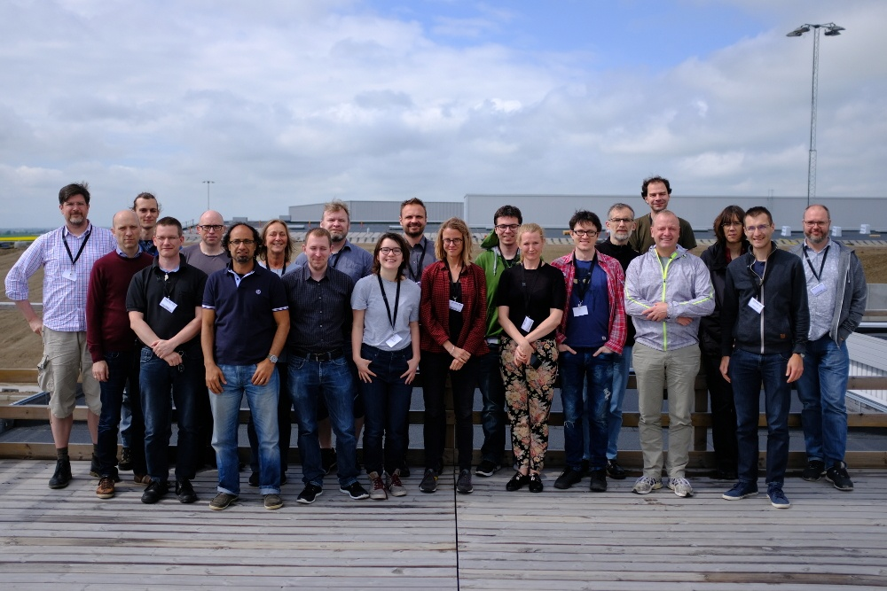
Data Management and Software Centre
Where does the data go?
Provide world leading scientific software and scientific computing support for neutron scattering at ESS
Scientific Software
ESS experiment control system, Data acquisition, Data correction software, visualisation, and software to model and analyse experimental data sets.
Data centre operations
Store and catalogue ESS datasets, provide ESS users remote access to their data, computing for live data correction, and analysis software during and after experiments.
User support
Support ESS users with data treatment and analysis.

Slide 16
Financing and In-kind
The European Spallation Source ERIC established in 2015
Host Countries Sweden and Denmark
Construction 47.5% Cash Investment ~ 97%
Operations 15%
Non Host Member Countries
Construction 52.5% In-kind Deliverables ~ 70%
Operations 85%
13 European Member Countries
16

Slide 17
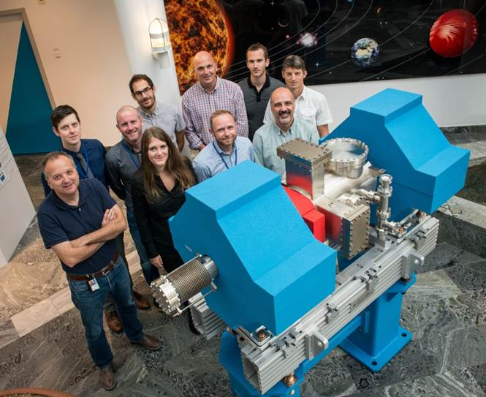
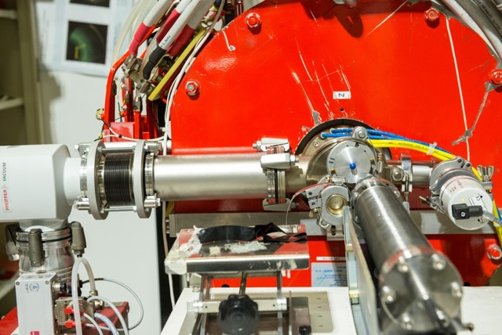
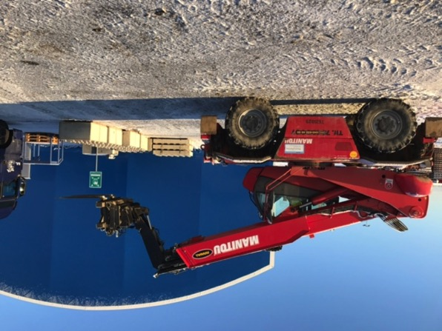
ESS In-kind Partners
Aarhus University
Atomki - Institute for Nuclear Research
Bergen University
CEA Saclay, Paris
Centre for Energy Research, Budapest
Centre for Nuclear Research, Poland, (NCBJ)
CNR, Rome
CNRS Orsay, Paris
Cockcroft Institute, Daresbury
Elettra – Sincrotrone Trieste
ESS Bilbao
Forschungszentrum Jülich
Helmholtz-Zentrum Geesthacht
Huddersfield University
IFJ PAN, Krakow
INFN, Catania
INFN, Legnaro
INFN, Milan
Institute for Energy Research (IFE)
ISIS - Rutherford-Appleton Laboratory, Oxford
Laboratoire Léon Brilouin (LLB)
Lund University
Nuclear Physics Institute of the ASCR
Oslo University
Paul Scherrer Institute (PSI)
Polish Electronic Group (PEG)
Roskilde University
Tallinn Technical University
Technical University of Denmark (DTU)
Technical University Munich (TUM)
Science and Technology Facilities Council
University of Copenhagen (KU)
University of Tartu
Uppsala University
Wigner Research Centre for Physics
Wroclaw University of Technology
Warsaw University of Technology
Zurich University of Applied Sciences (ZHAW)
17

Slide 18
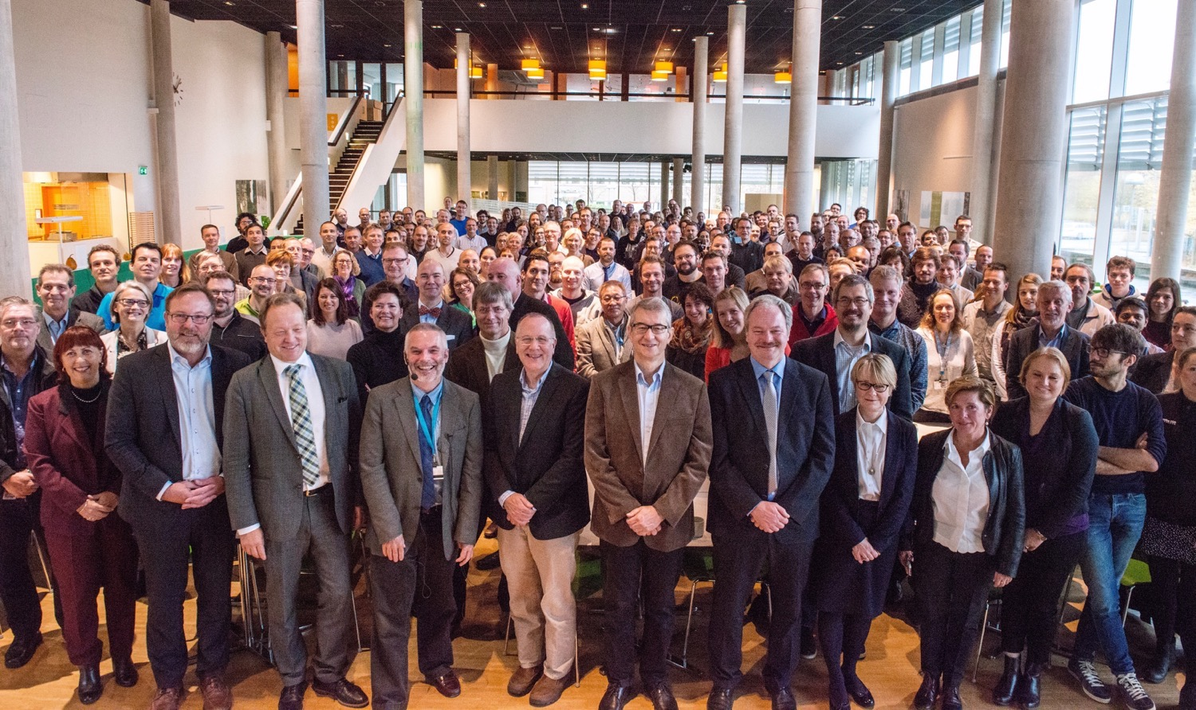
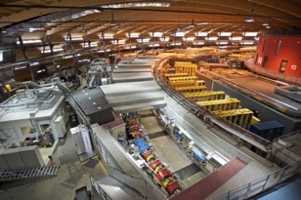
Organisation and People
Who is at the heart of ESS?
481
Employees
53
Nationalities
~ 100
Collaborating Institutions

Slide 19
Vision, Mission and Values
What is ESS at its core?
ESS Vision
Our vision is to build and operate the world’s most powerful neutron source, enabling scientific breakthroughs in research related to materials, energy, health and the environment, and addressing some of the most important societal challenges of our time.
Mission
To do this, we commit to deliver ESS as a facility that:
Is built safely, on time and on budget
Produces research outputs that are best-in-class both in terms of scientific quality and in terms of socioeconomic impact
Supports and develops its user community, fosters a scientific culture of excellence and acts as an international scientific hub
Operates safely, efficiently and economically, and responds to the needs of its stakeholders, its host states and member states
Develops innovative ways of working, new technologies, and upgrades to capabilities needed to remain at the cutting edge
Core Values
Excellence • Collaboration • Openness • Sustainability

Slide 20
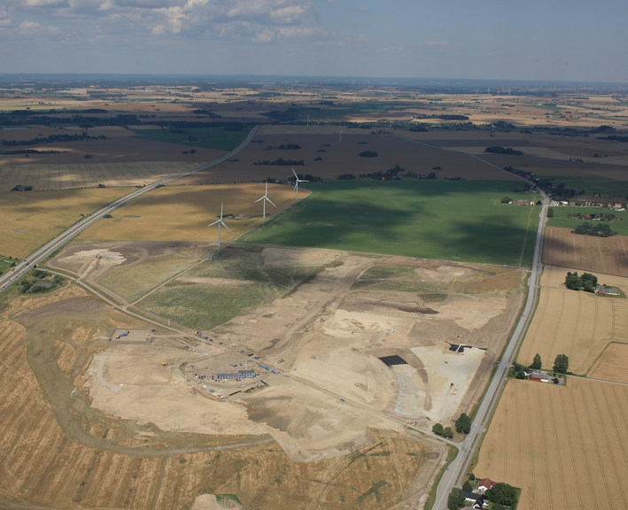
Civil Construction Groundbreaking
Groundbreaking
September 2014

Slide 21
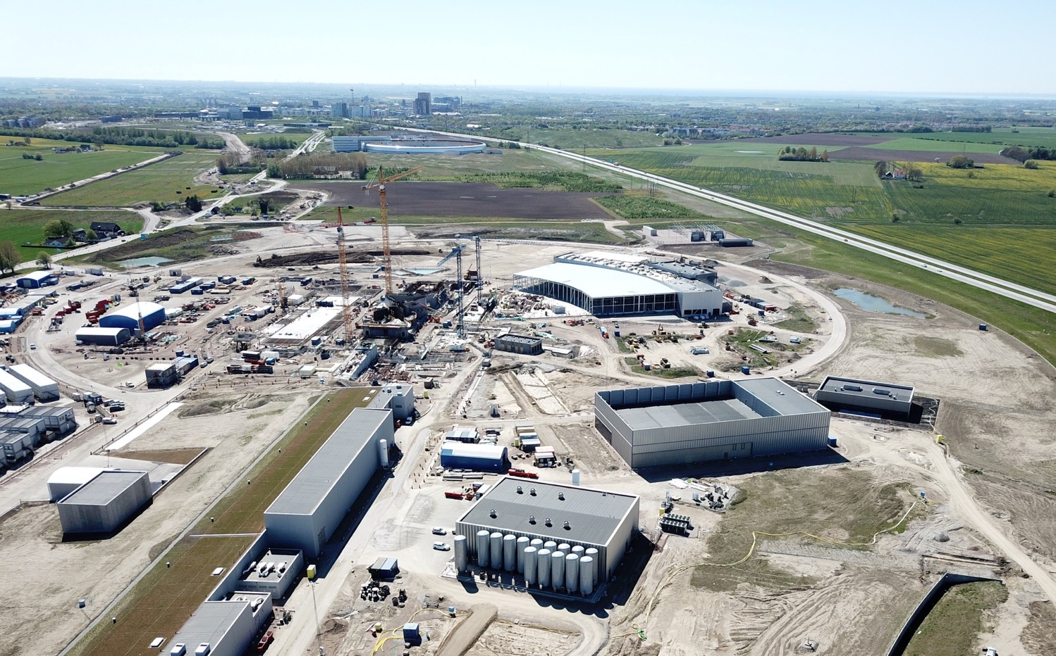
2019
2019
Construction
Installation
Commissioning

Slide 22
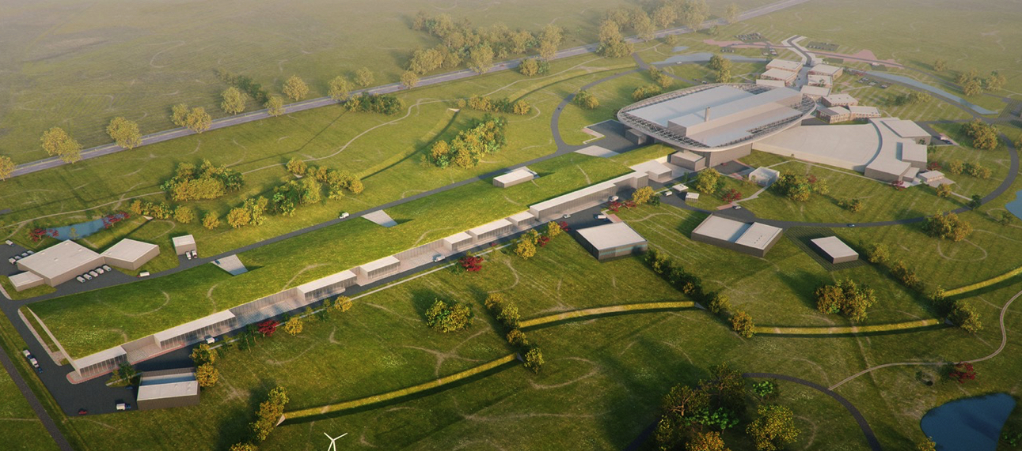
The ESS journey
Delivering the world’s leading facility for research using neutrons
2025
Construction phase complete
58%
2014
Construction starts on green field site
2009
Decision to site ESS in Lund
2023
Start user program
2019
Start of initial operations phase
2012
ESS design update phase complete
2003
European design of ESS completed

Slide 23
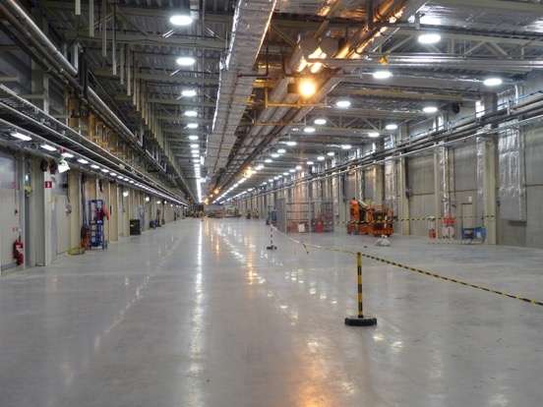
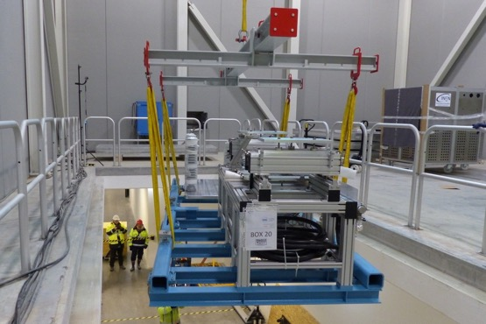
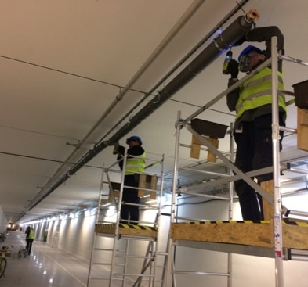
ESS is 58% complete
Peak of construction activity
First buildings have been handed over
In-kind deliveries of high tech equipment arriving and being installed
First commissioning activities on-going
All our staff moved out to site in June 2018

Slide 24
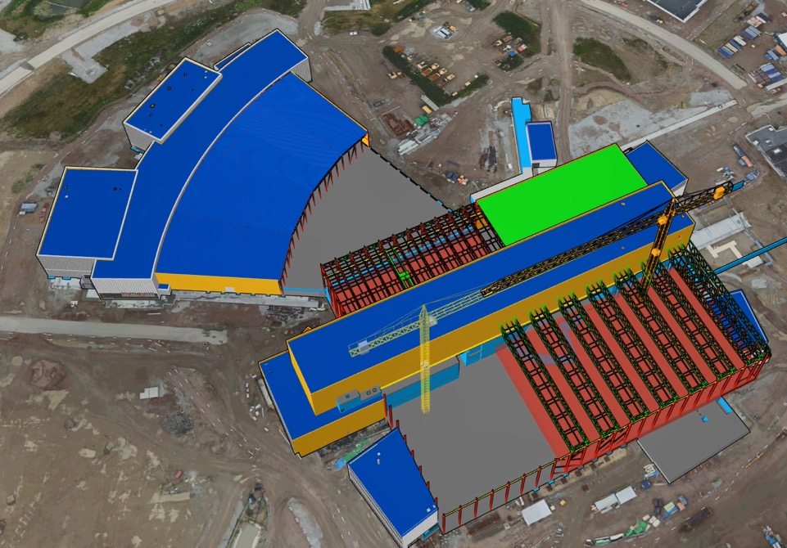
D-Buildings
D05
D04
E-Buildings
D03
D02
D06
D01
D07
D08
24

Slide 25
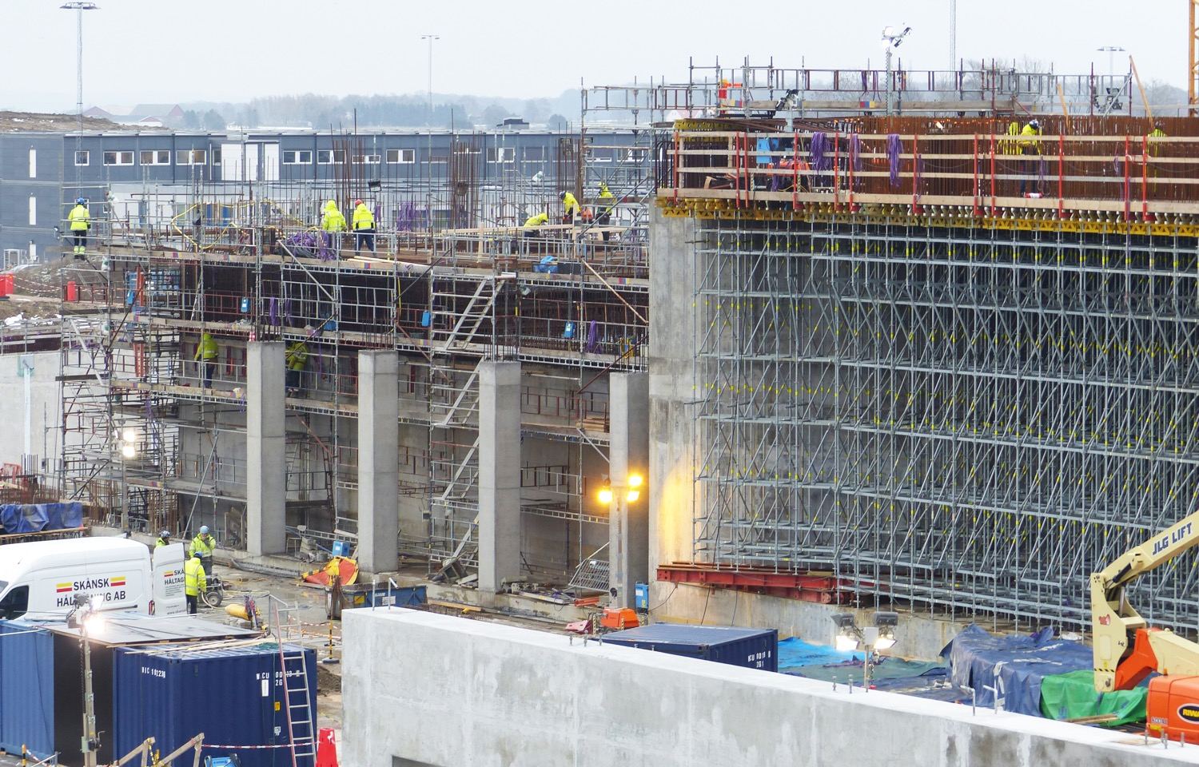
A2T

Slide 26
Target
Monolith - Highbay vault

Slide 27
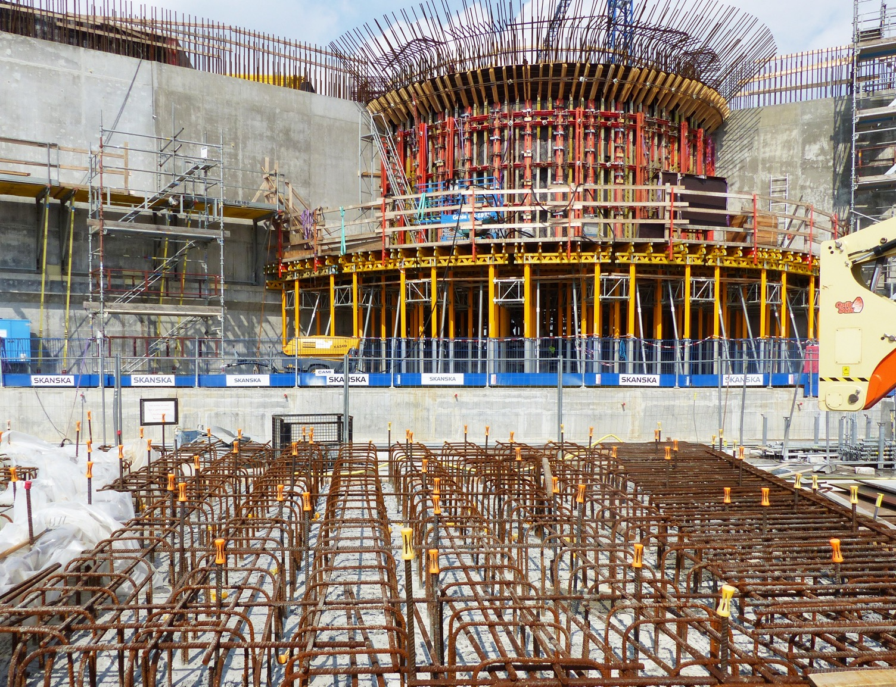
D01 view towards Monolith

Slide 28
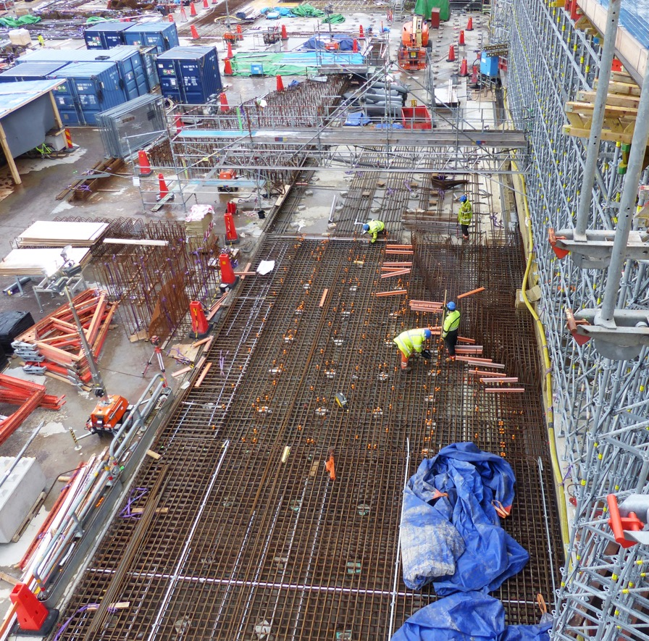
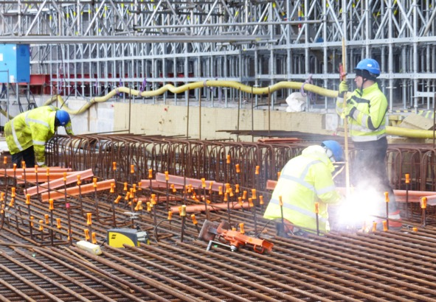
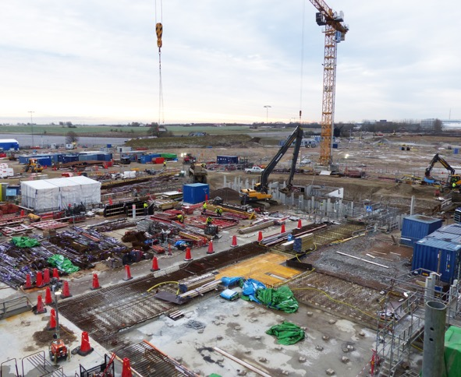
D01 Base slab
28

Slide 29
Active Cell

Slide 30
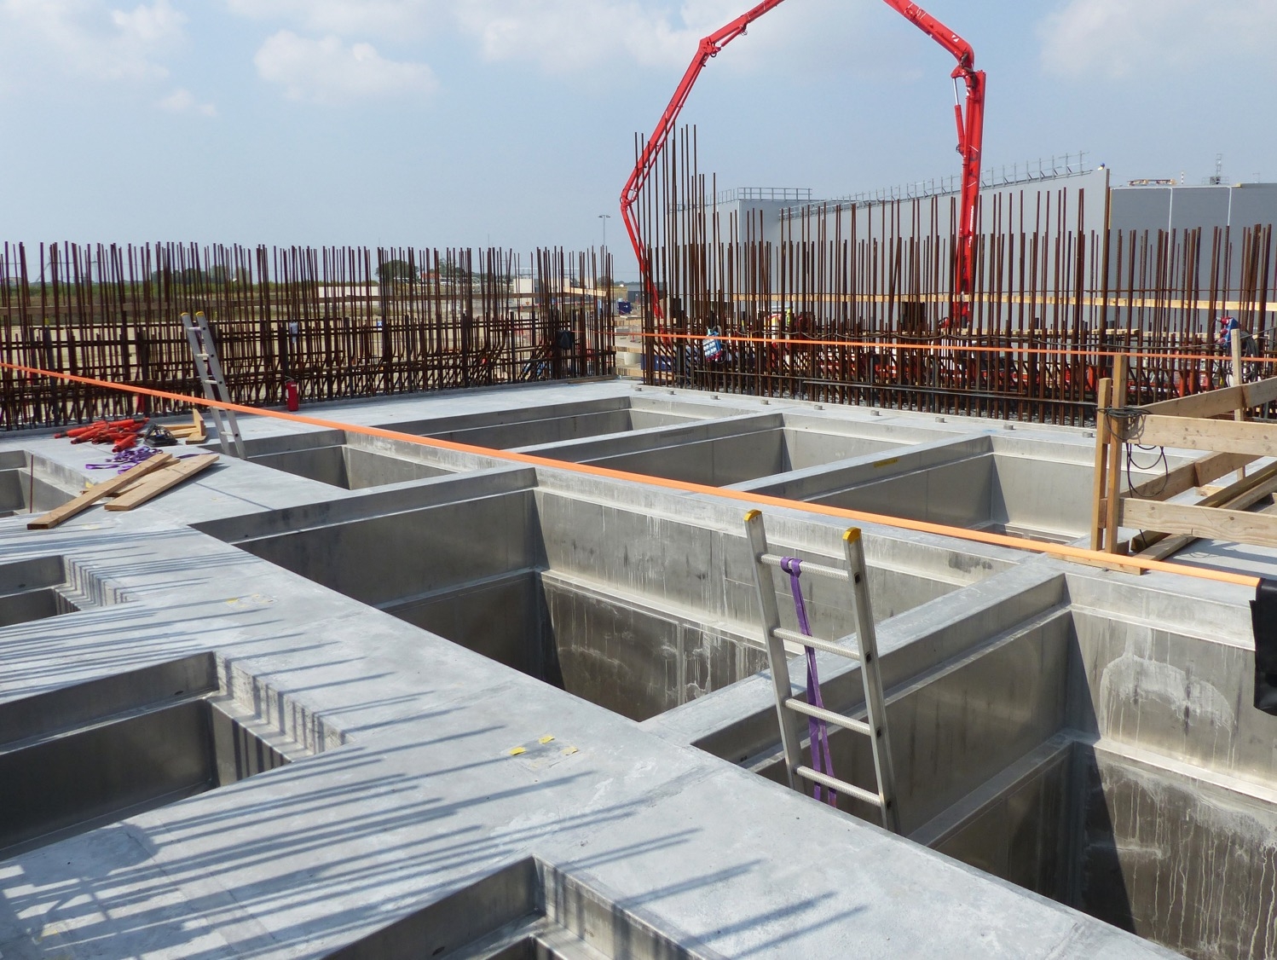
Active Cell – waste pits

Slide 31
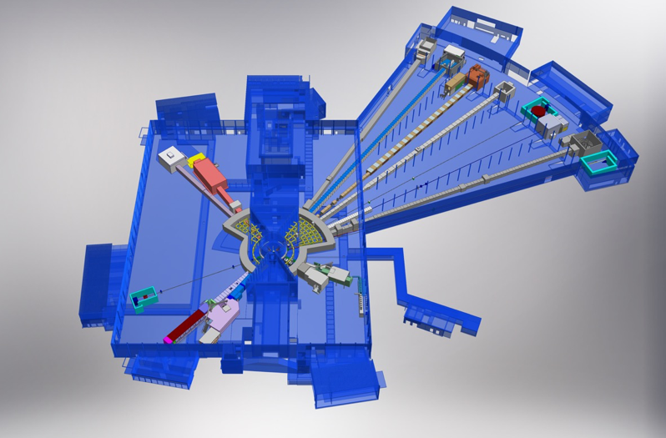
15 experimental stations (“instruments”)
ESS Lead Partners for instrument construction
+
Nuclear Physics Institute
NMX
BEER
+
C-SPEC
BIFROST
MIRACLES
MAGIC
ODIN
T-REX
DREAM
HEIMDAL
LoKI
VESPA
FREIA
SKADI
ESTIA
+
ESS In-Kind Partners also collaborate on sample environment, data management systems etc.
ESS Instrument Layout (December 2016)
31

Slide 32
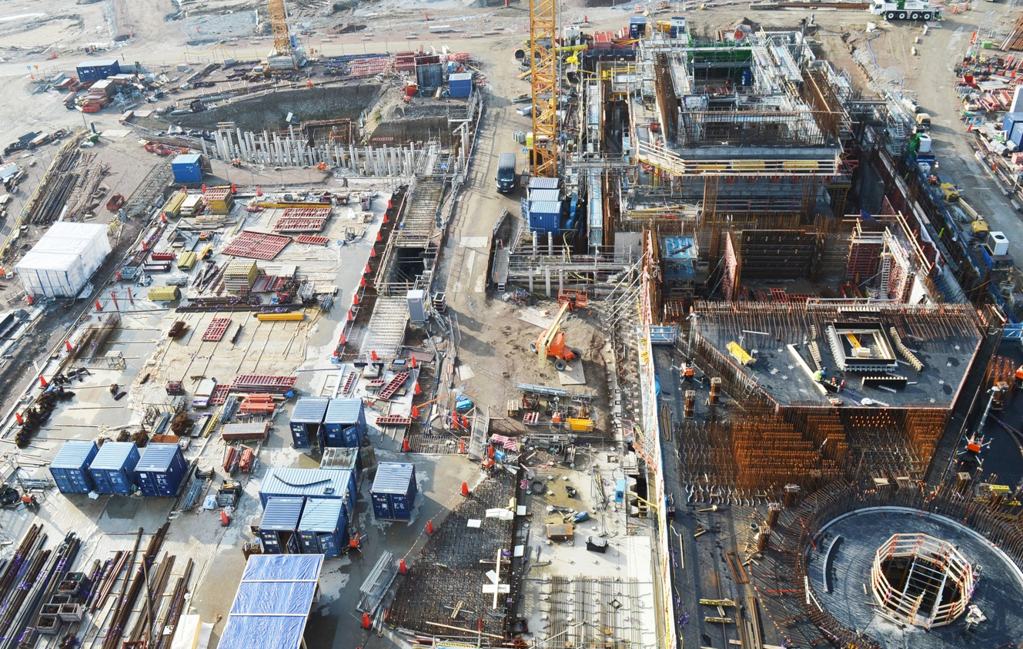
D01 & D02
Experimental Hall 1 + Target Building

Slide 33
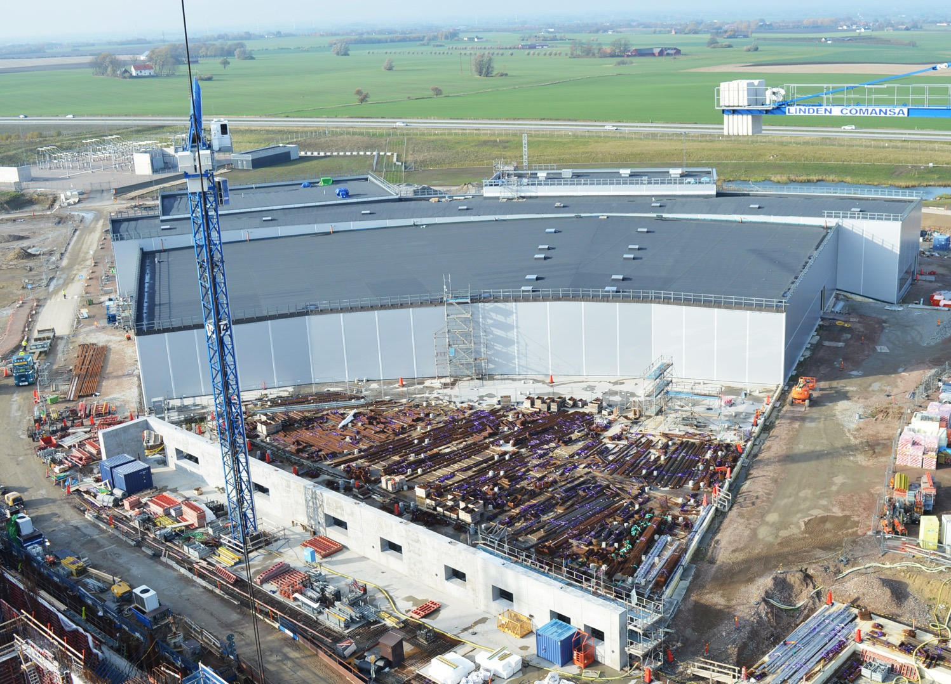
E-buildings

Slide 34
E-buildings
E02 Beamline NMX

Slide 35
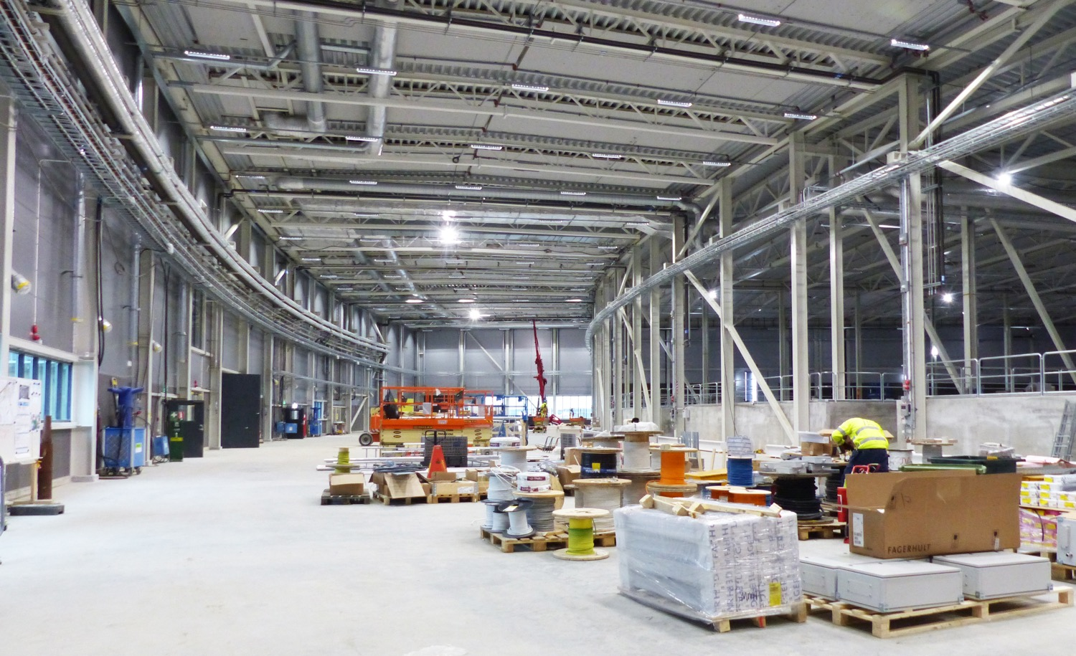
E-buildings
E01 MEP installation work

Slide 36
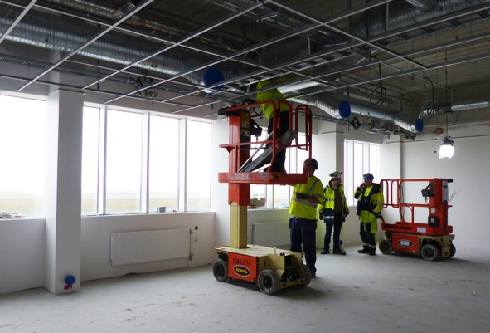
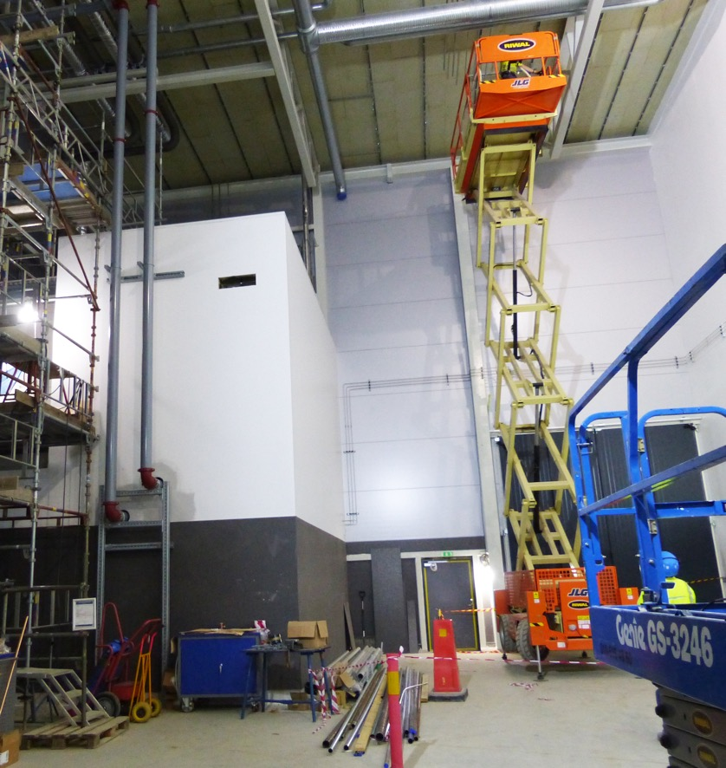
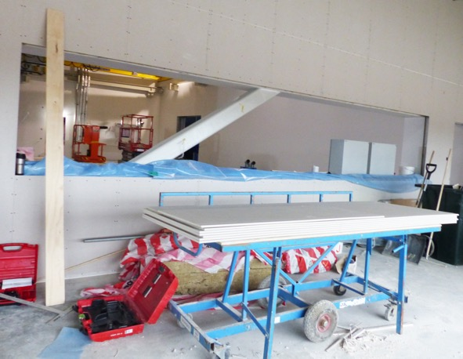
E03/E04 labs
Interior work
36

Slide 37
Accelerator & Klystron Gallery + F03

Slide 38
Accelerator
Proton beam tube

Slide 39
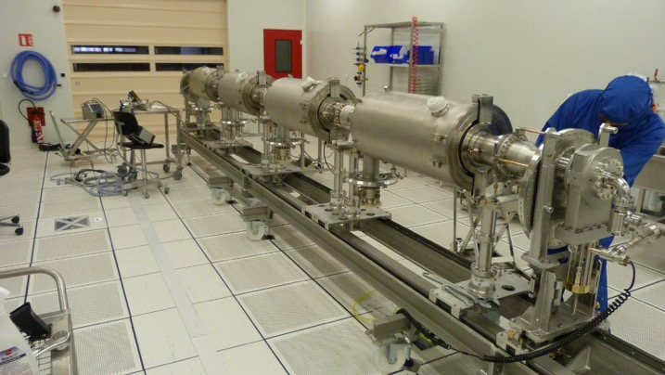
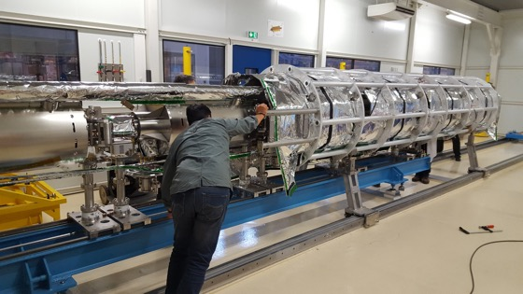
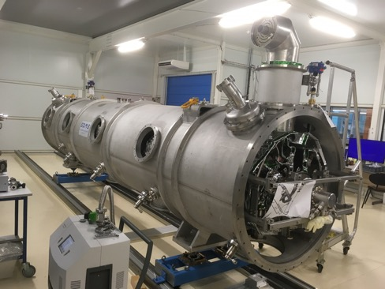
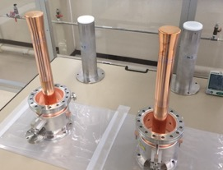
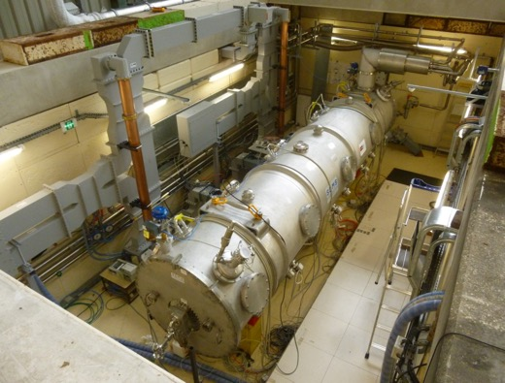
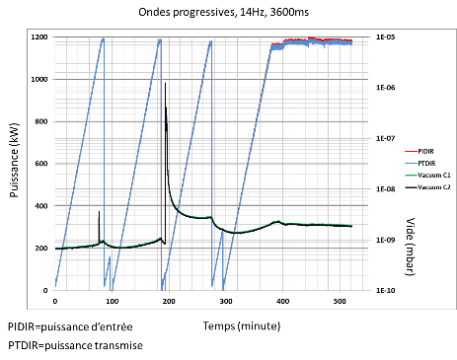
CEA – MB Prototype Cryomodule
March 2017
May 2017
July 2017
Assembly in ISO4 CEA CR
4 medium β 6 cell elliptical SRF cavities (1 LASA/3 CEA)
Cooldown at CEA test stand in Sept 2017
No RF operation due to accidental rupture of coupler ceramic
10 couplers at nominal specs
39

Slide 40
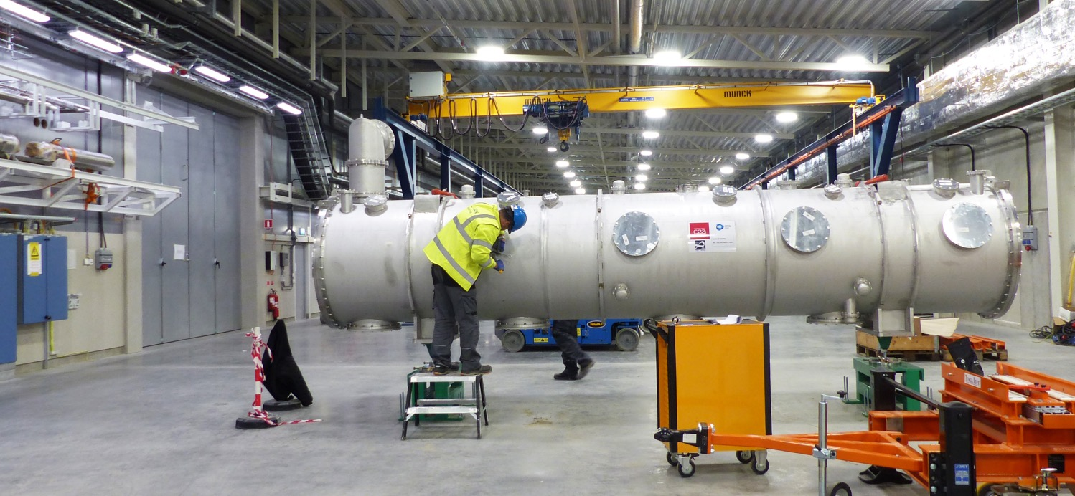
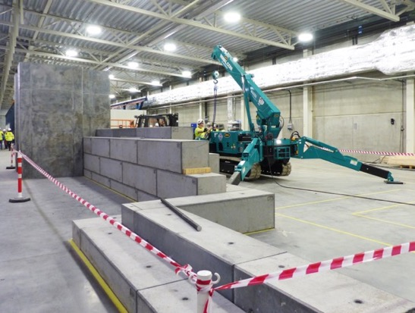
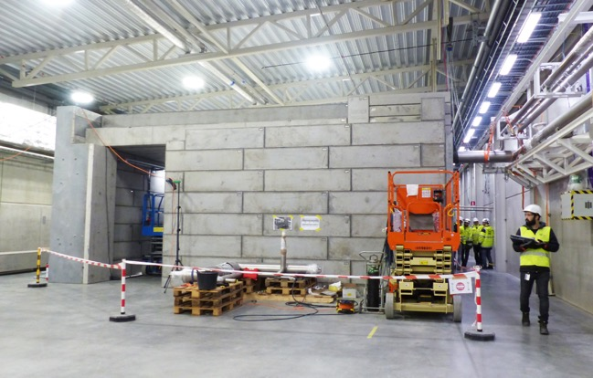
Cryomodule Test Stand - Klystron Gallery
Bunker

Slide 41
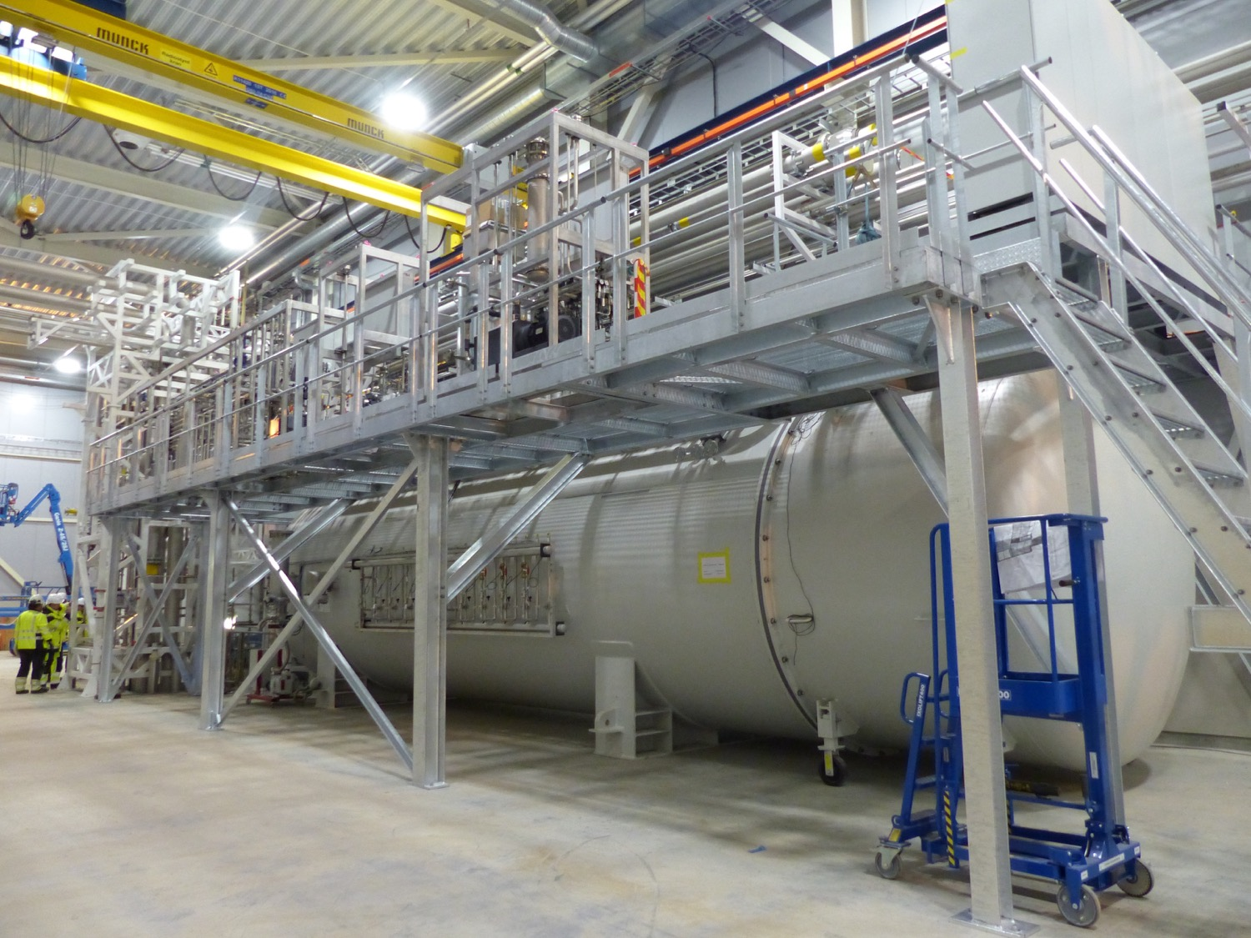
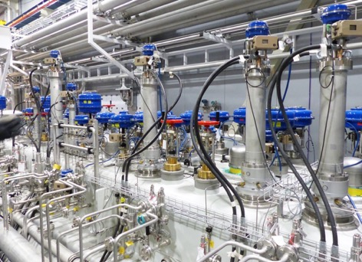
Coldbox – annex KlystronGallery
ESS is now producing liquid helium
41

Slide 42
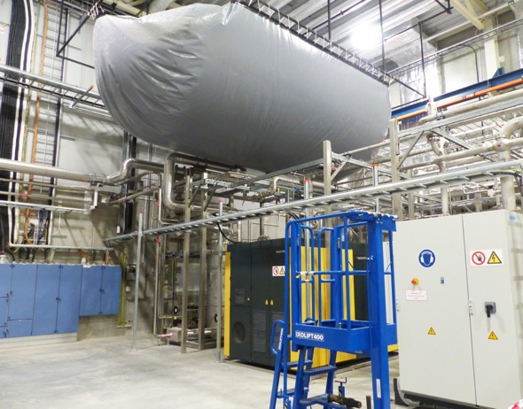
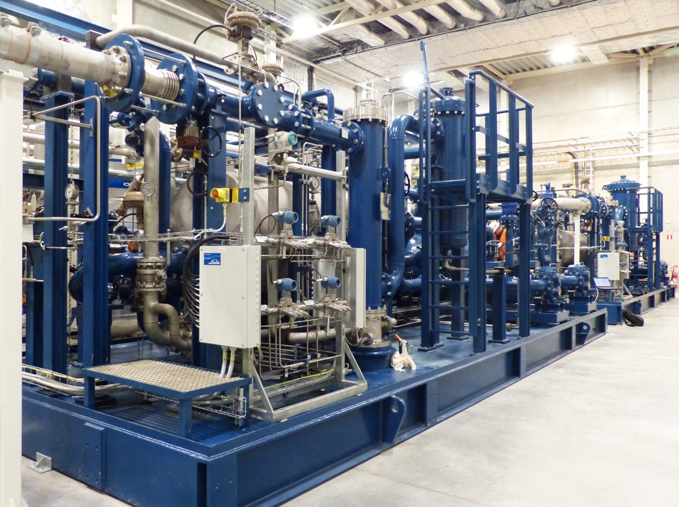
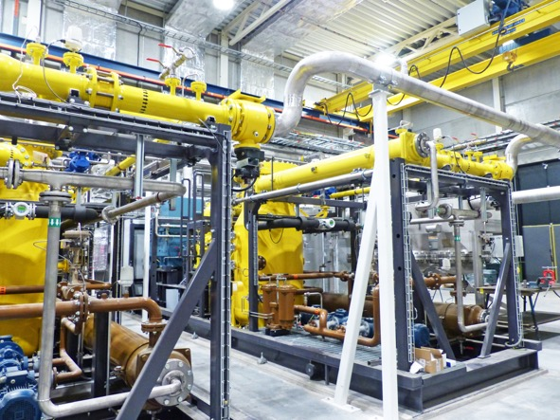
Helium Compressor Building - G04

Slide 43
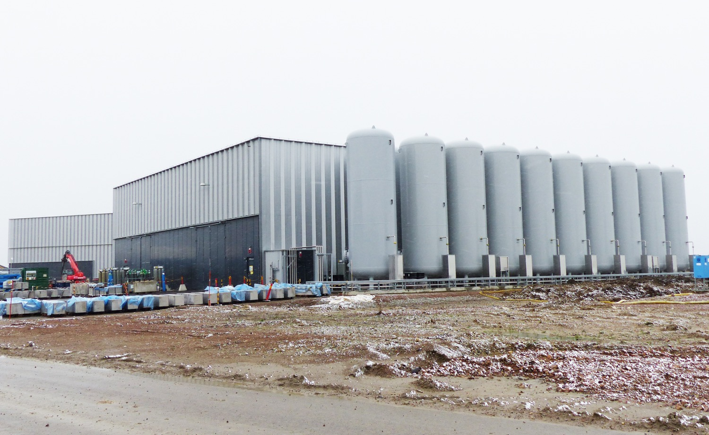
G04, Helium tanks (19)

Slide 44
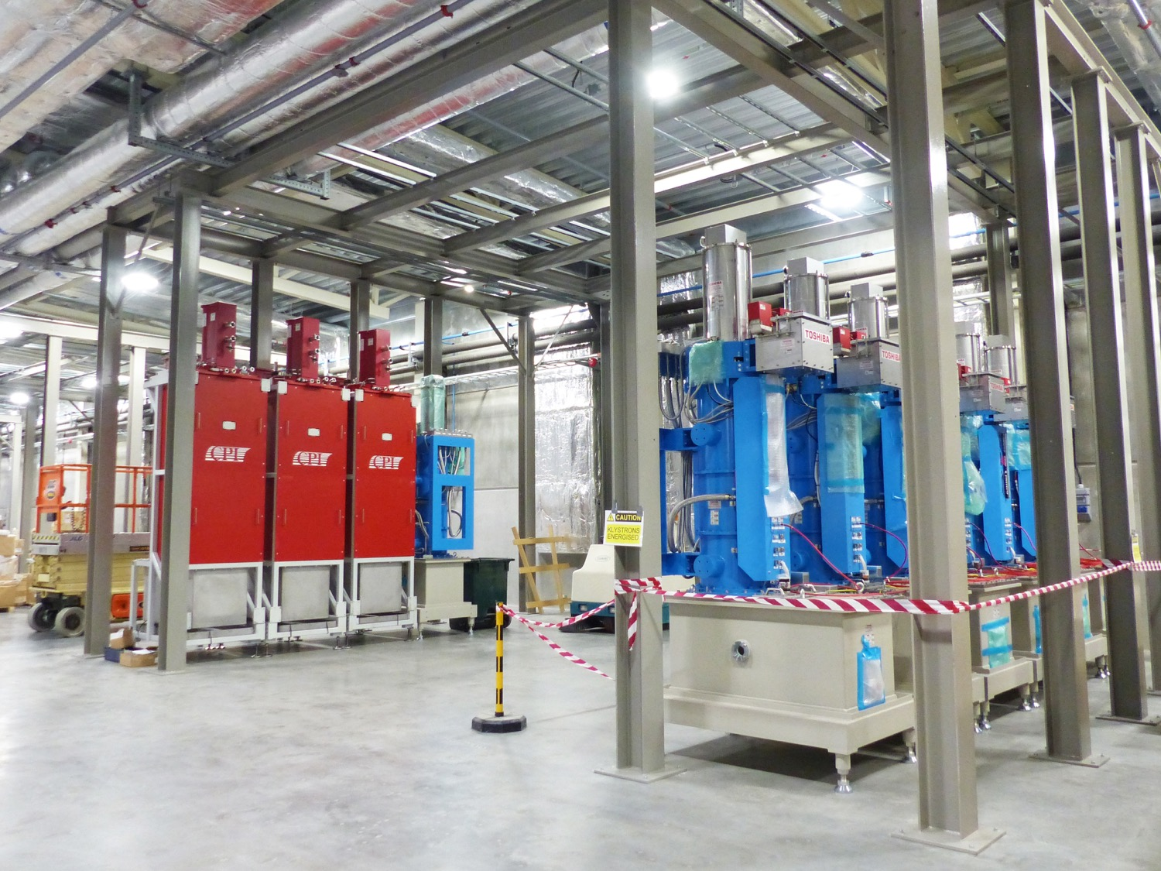
Klystron Gallery
Racks, waveguide support systems, klystrons

Slide 45
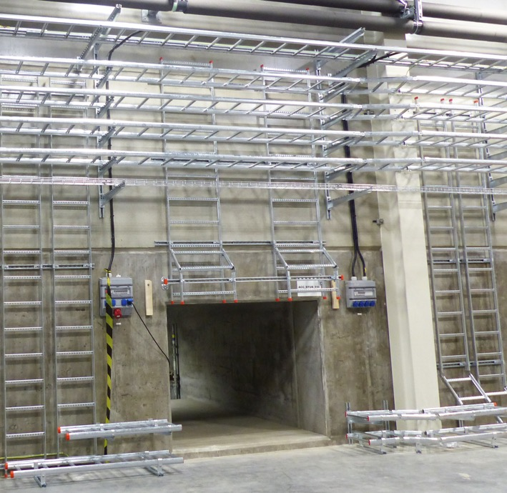
Stub installation

Slide 46
Ion Source & LEBT
- Commissioning activities on-going

Slide 47
Ion source & LEBT installation

Slide 48
F03 Logisitcs Centre

Slide 49
Office

Slide 50
ESS office Campus
Preparatory civil works
Foundation works start January 2019
Superstructure erection start in May
Moving in Spring 2021

Slide 51
ESS wishes you a great ITSF 2019 meeting

