Slide 1
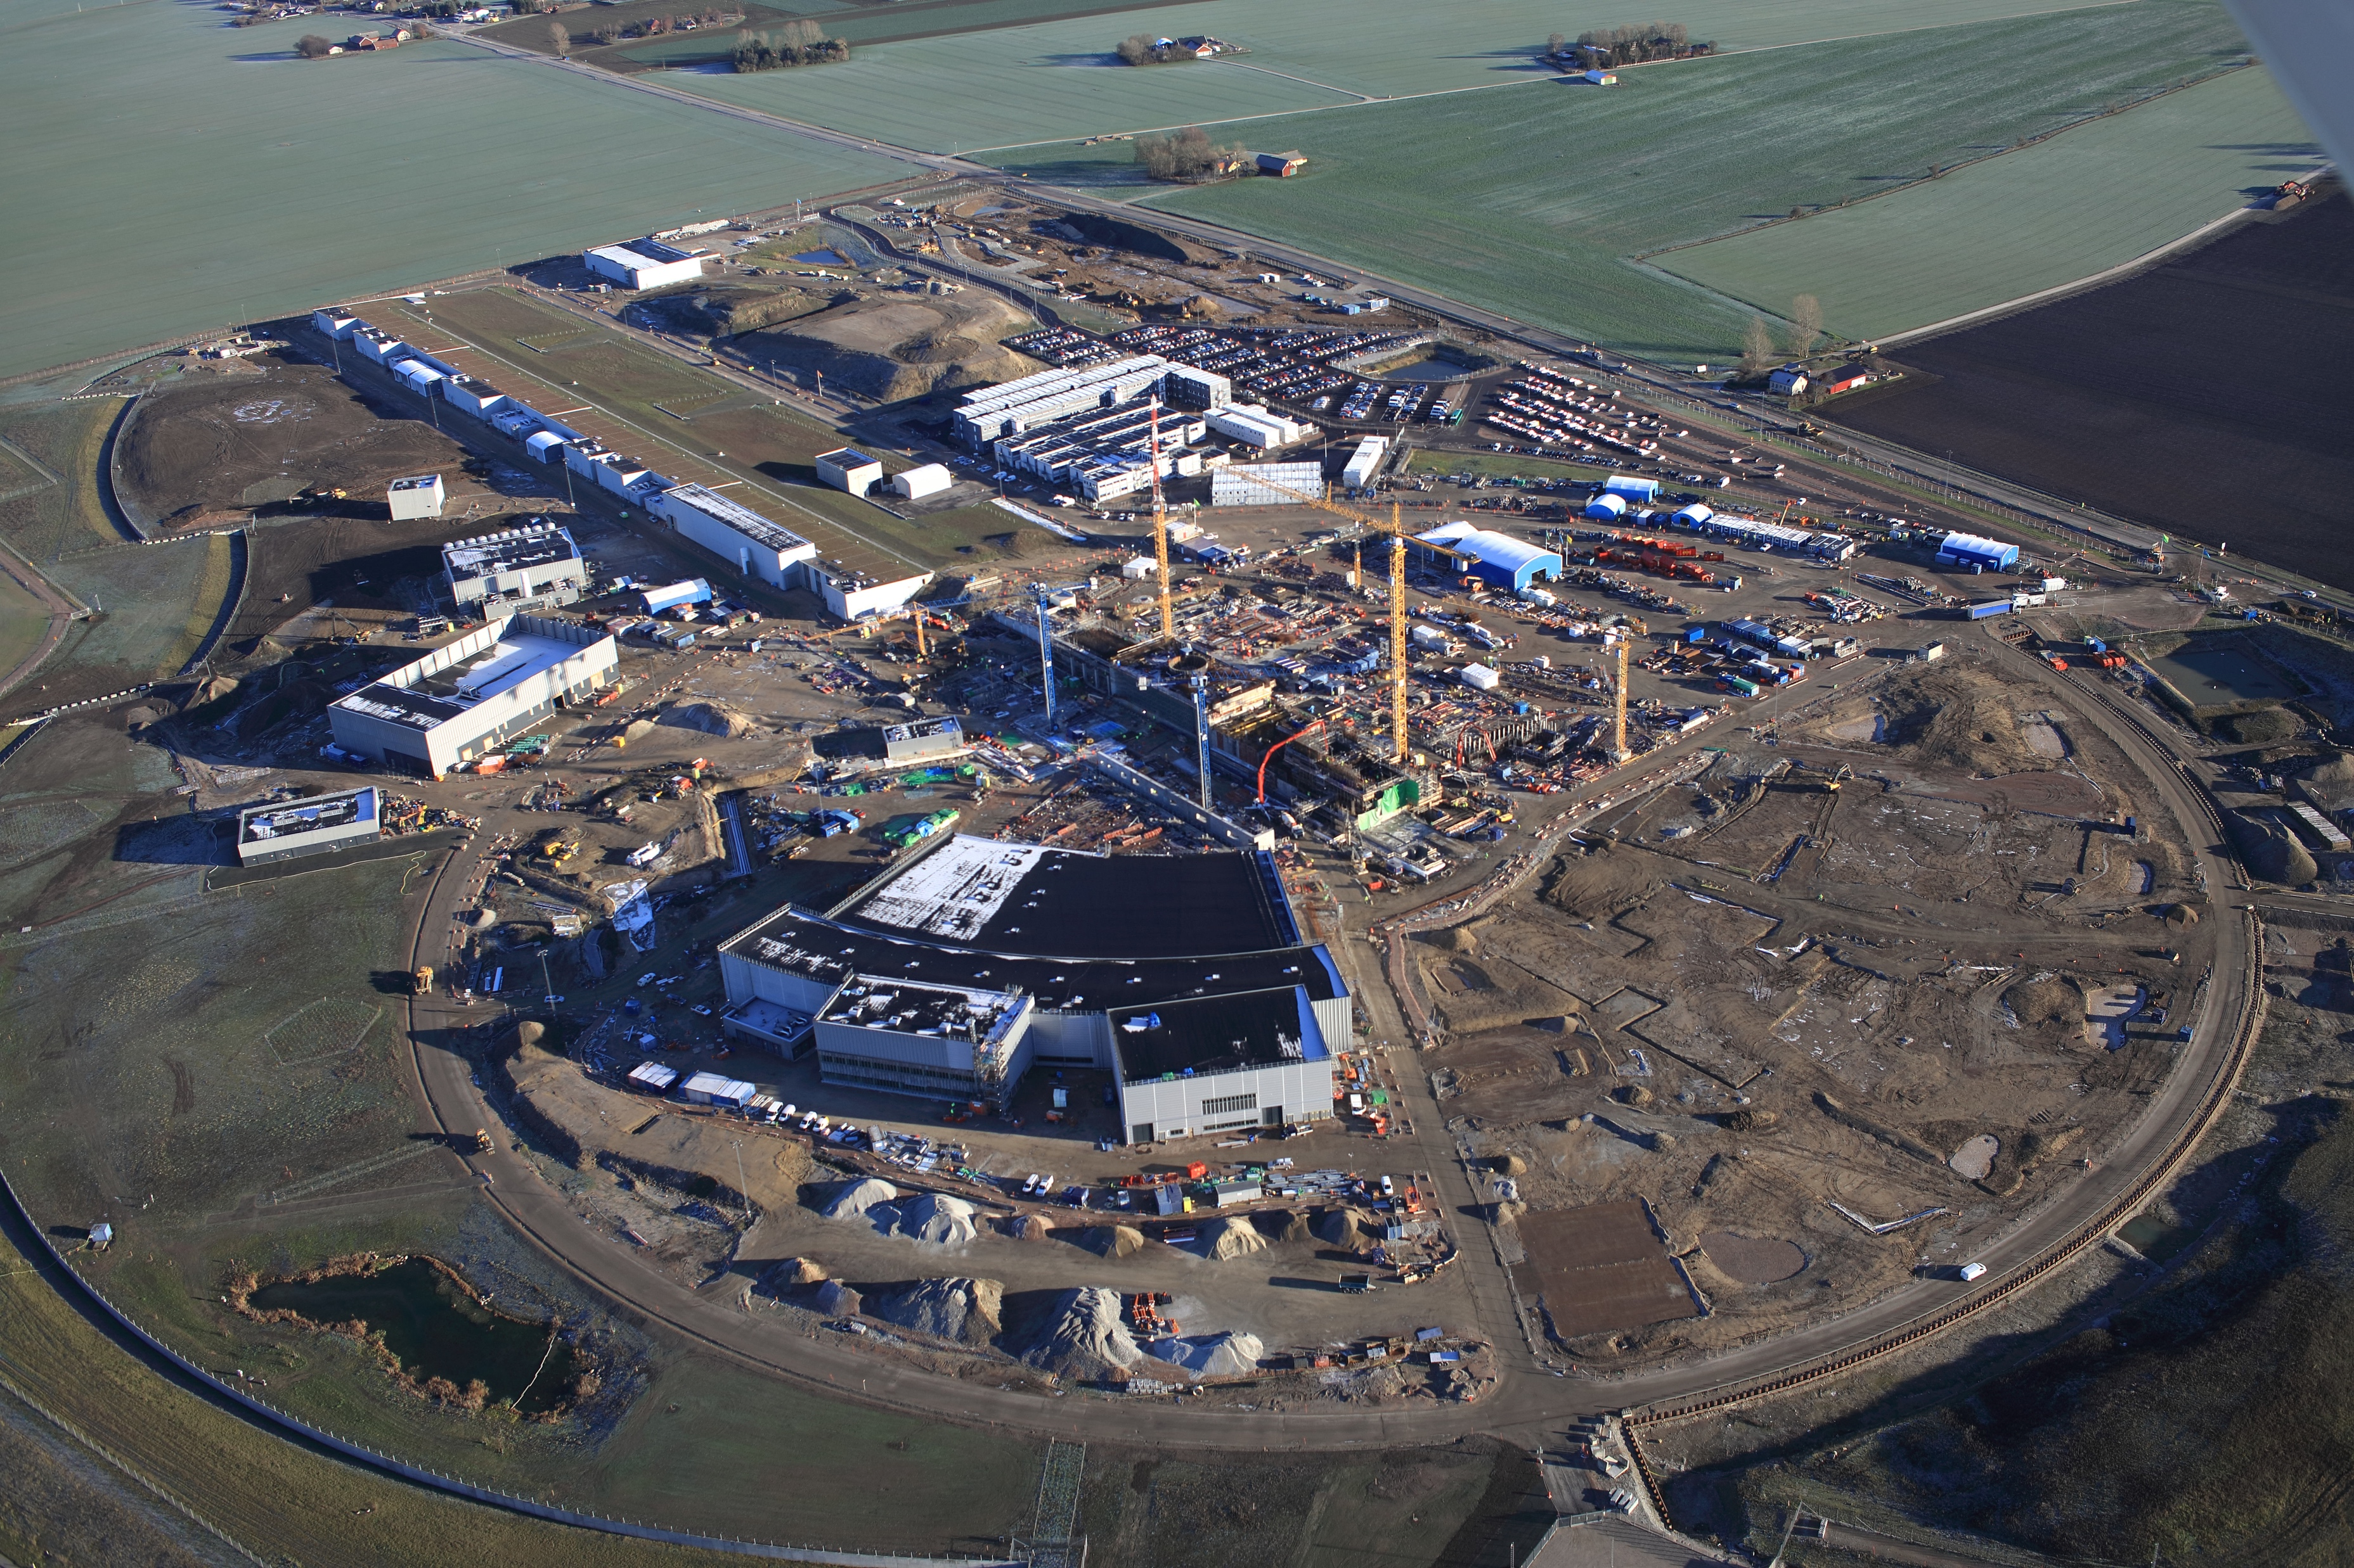

Bert Manzlac
Enrico Cennini
Andreas Hoppe
Peter Jacobsson
Nina Åsvatne
Fredrik Jörud
Helen Boyer
IT
SF
IT
SF
20
19
20
19

Slide 2
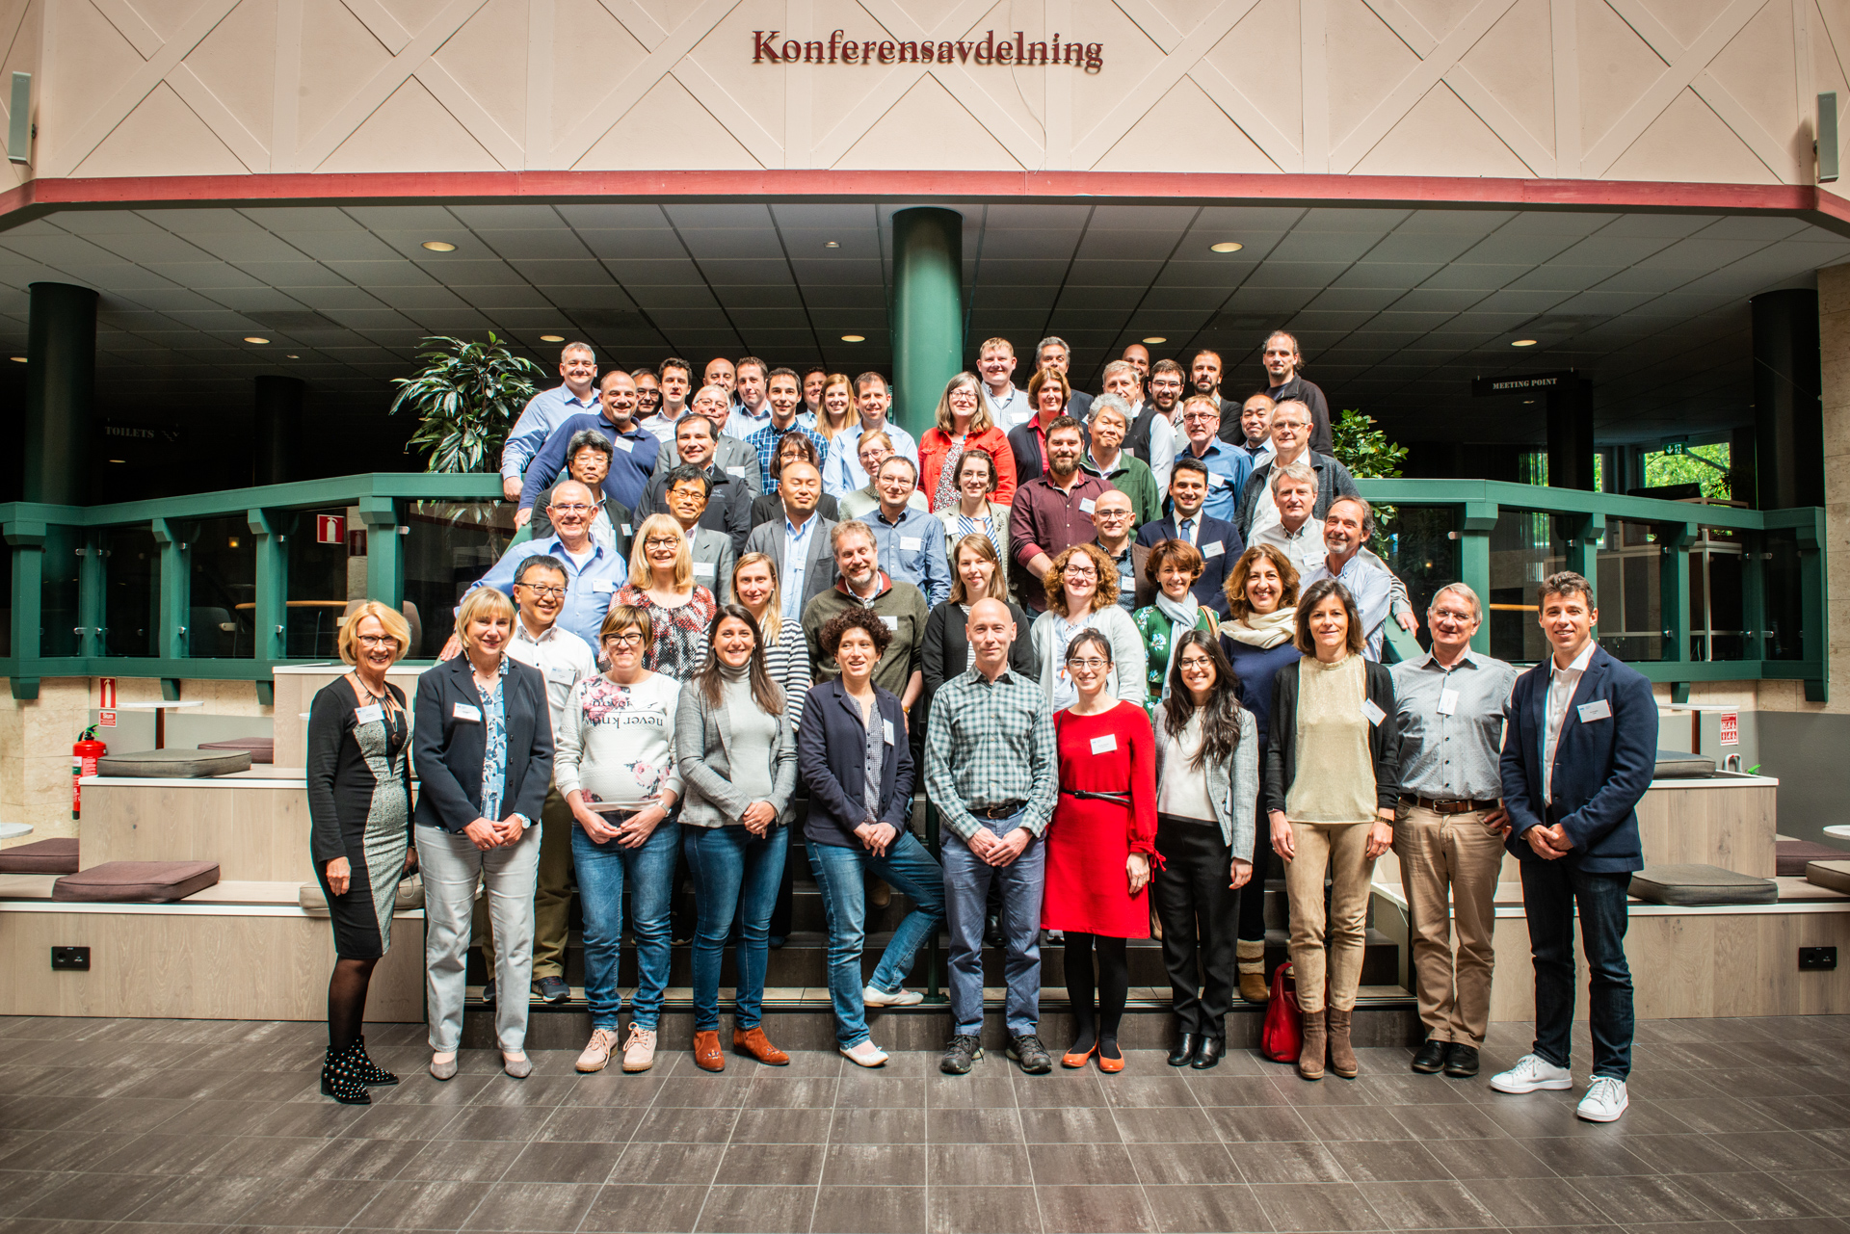

Slide 3
ITSF 2019 - Participants
ALBA
ALMA Observatory
Canadian Light Source
CERN
DESY
Diamond Light Source
ELI Beam Lines
ESRF
ESS
EURO Fusion
ESO
European XFEL
Fermi Lab
INFN
Jeffersson Lab
J-PARC
KEK
MAX IV
Max Planck Institute
RIKEN
SLAC
STFC

Slide 4
Our themes
New Projects & challenges (5)
Incidents and lessons learned (4)
Environmental Protection and sustainability (3)
Safety Training (2)
Equipment certification (2)
Risk Assessment (4)
Continuous improvement in HSE matters (5)
Communications (0)
Incident/Accident Management (2)
Technical Risks (6)
Safety Culture & Behavior (4)
Fire Safety (10)
Safety for complex shared research centers (0)

Slide 5
Retrospective Look
Fire Safety
  Specific Sessions on the ITSF 2013, 2016, 2019
Environment
  Specific topic at ITSF 2013
Safety Training
  Topic brought up on ITSF 2017 to be continued

Slide 6
What have we missed
Safety Training
  Topic brought up on ITSF 2017 to be continued
Handling of chemicals
Radiation Safety / Radiation Protection
Security/Cyber security

Slide 8
ITSF 2019 - Program
Monday
  Fire Safety
Tuesday
  Opening
  New projects
  Incidents & Lessons learned
Wednesday
  Invited speech
  Environment
  Safety Culture
  Safety Training
  Improvements in ESH
  Technical Risks
Thursday
  Tours (ESS & MAX IV)
  Risk Assessment
  Equipment & Certification
Friday
  Technical Risks
  Summary

