Slide 1
First Responder Partnership In Action
Long-term investment proves its value
Bill Rainey & Bert Manzlak CSP

Slide 2
The Central Helium Liquefier building (CHL) houses two separate large cryogenic plants. These two plants are responsible for cooling the superconducting radio frequency cryomodules in the tunnel that accelerate the electron beam.

Slide 3
12 October 2017 – Equipment Failure
Compressor motor control center starter – installed 1989

Slide 4
Event Timeline – 12 October, 2017
13:13 – worker activates alarm
13:17 – City of Newport News Fire Service at scene
13:27 – fire extinguished
19:00 – normal operations resume

Slide 5
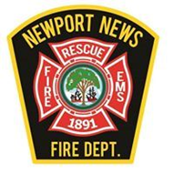
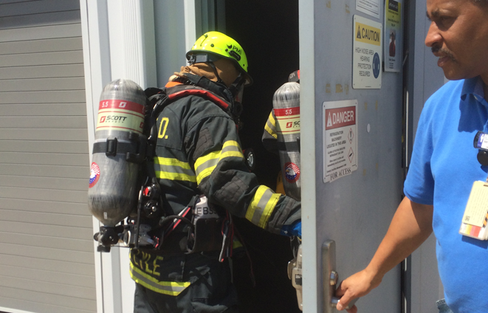
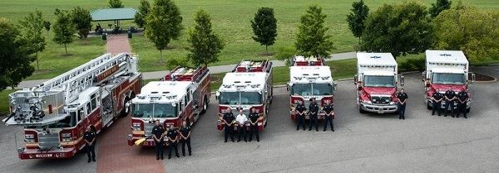
Response Success Factors
Logistics (4 minute response)
Fire house location
NNFD knows how to access site
Lab response system integration
Knowledge (no collateral damage)
NNFD understands our equipment and hazards
Lab understands NNFD capabilities
Practice

Slide 6
Jefferson Lab

Slide 7
Partnership History
Partnership begins with site construction (1987)
Visits to Lab early / often to understand facilities layout and equipment
Feedback included design & operational considerations
Joint development of Jlab-specific tools; 911 call center, floor plans
Lab engages City on location of new fire station

Slide 8
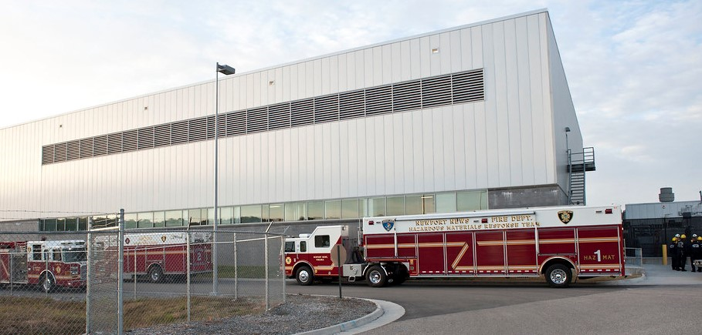
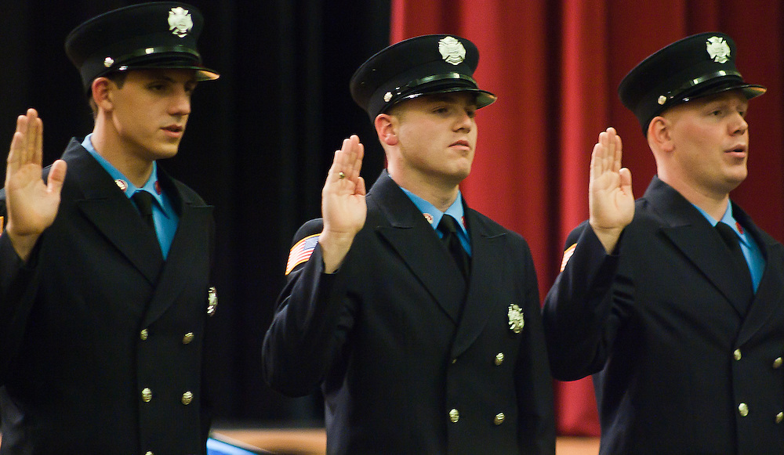
Practice & Relationship Building
Drills: Fire, HAZMAT, rescue, natural disaster (always with lessons learned)
Peer reviews including local fire fighters
Engagement through local, regional emergency response organizations
Lab provides NNFD with facilities for training, graduation
Critical hire from NNFD

Slide 9
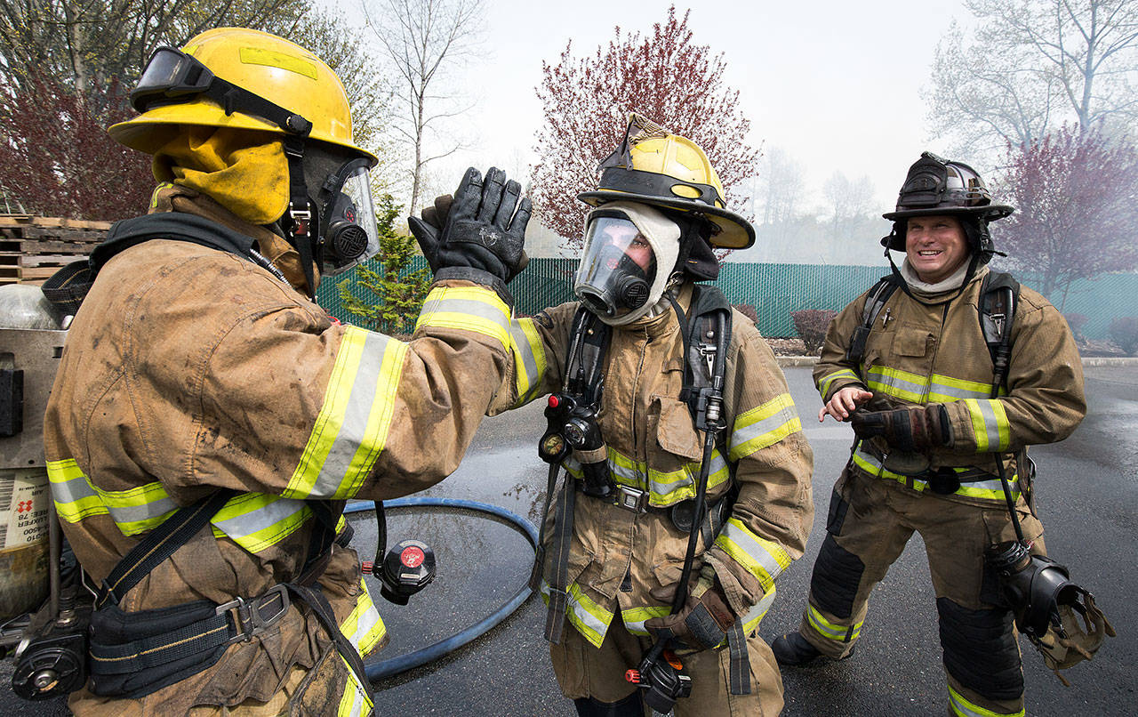
Mission Success
No injuries
No collateral damage
Resume mission same day
$

