Slide 1
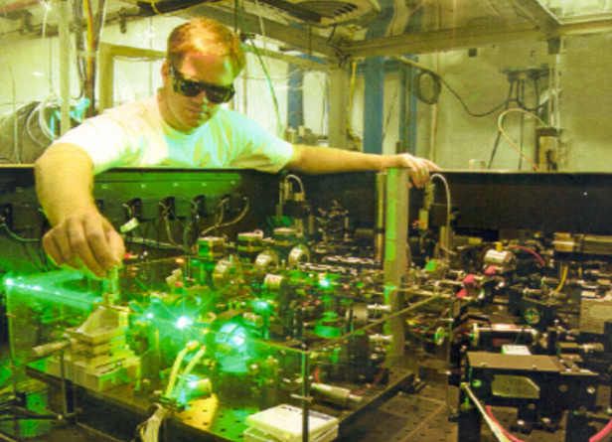
Fire Safety in Laser Labs at Jefferson Lab
International Technical Safety Forum
2019
European Spallation Source
Lund, Sweden
Bert Manzlak, CSP

Slide 2
U.S. National Laboratories

Slide 3
Thomas Jefferson National Accelerator Facility
Jefferson Lab Newport News, Virginia
Its primary mission is to enable basic research for building a comprehensive understanding of the atom’s nucleus
12 GeV Electron Beam Accelerator
~1,400 meters CEBAF Four Experimental Halls
~ 750 Staff
~ 1,500 Users (~ 200 daily)
~ 200 Students (~100 daily)
Class 4 or 3B Laser Labs - 18

Slide 4
Jefferson Lab

Slide 5
Government Requirement
Department of Energy
10 C.F.R. 851
Workers Safety and Health Plan
General requirements —
Contractors must provide a hazard free place of employment and ensure that all work performed is in compliance with the worker safety and health program.

Slide 6
Consensus Laser Standard & Fire Code
2016 Edition

Slide 7
ANSI Z136.1 - 2014 Safe Use of Lasers
Section 7.2.3 Fire Hazards
Class 4 laser beams represent a fire hazard.
Enclosure of Class 4 laser beam can result in potential fire hazards if enclosure materials are likely to be exposed to irradiances exceeding 10·W cm⁻² or beam powers exceeding 0.5 W.
Under some situations where flammable compounds or substances exist, it is possible that fires can be ignited by Class 3B lasers.
NOTE – The National Fire Protection Agency standard NFPA ® 115 states that for continuous wave (CW) lasers, 0.5 W·cm⁻² is a possible ignition hazard.

Slide 8
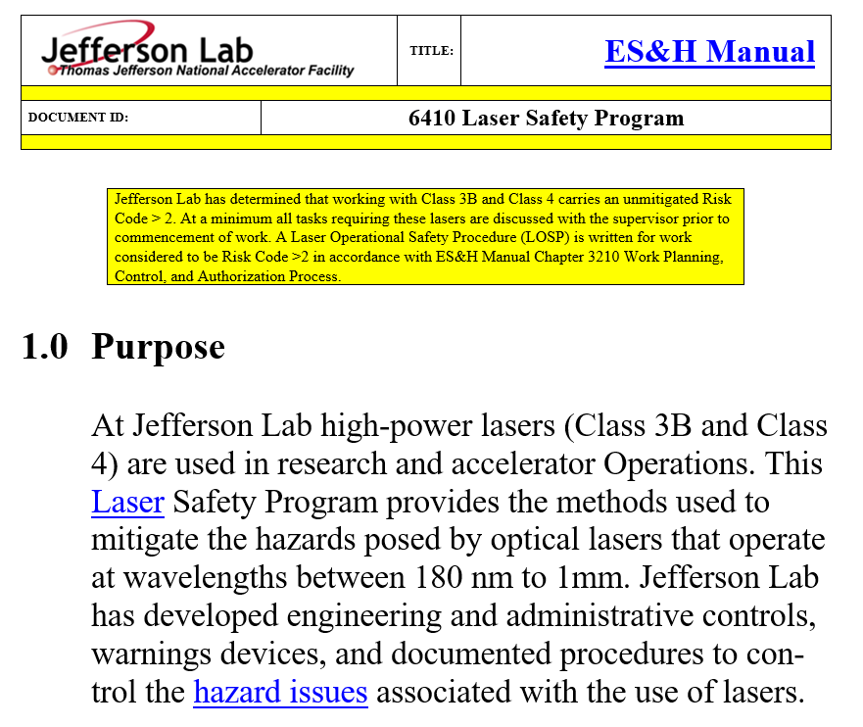
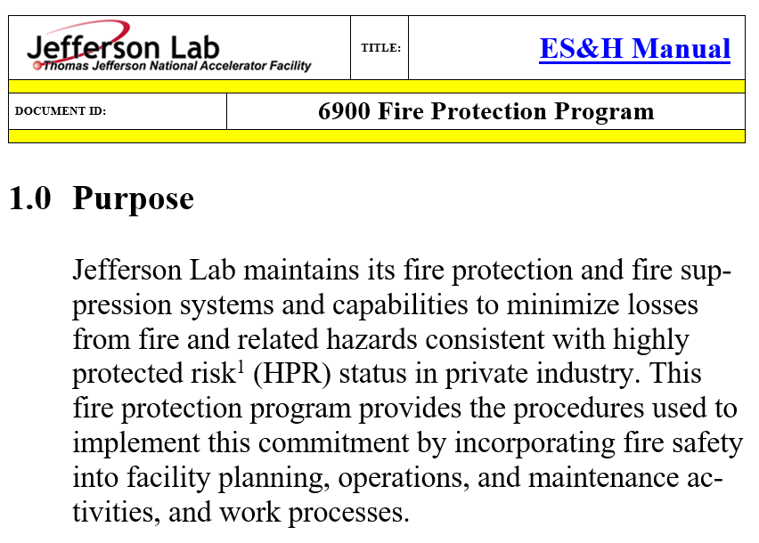
Jefferson Lab Policies
ES&H Manual Chapter 6410 Laser Safety Program
Mitigate hazards posed by lasers
ES&H Manual Chapter 6900 Fire Safety Program
Minimize losses from fire

Slide 9
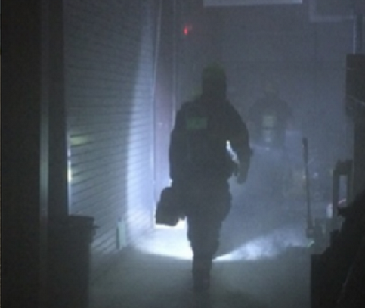
Fire Safety Objective
Life Safety
Access during an emergency
Medical
Fire
Other crisises
Egress from laser lab to exits
Primary & Secondary exits
Lab equipment / walkways
Laser barriers, curtains

Slide 10
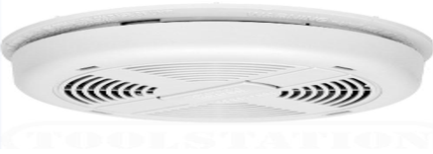
Fire Prevention Control Systems
Smoke Detection
Heat Detection
Alarms

Slide 11
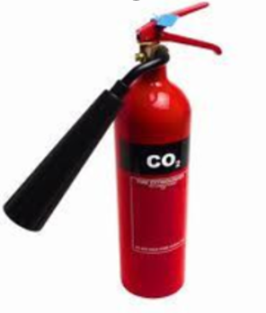
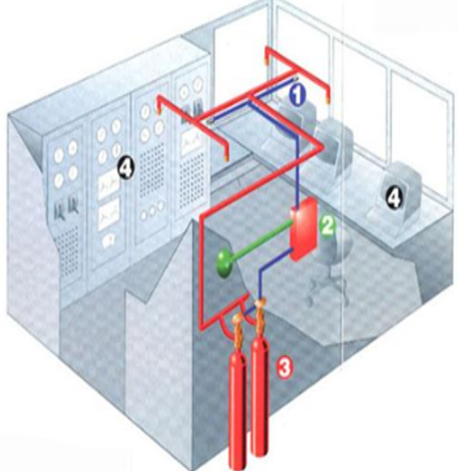
Fire Suppression Systems
Fire Suppression Equipment
Automated - General or Local
Manual

Slide 12
Laser Fire Safety Objective
Avoiding hazardous conditions from fire in:
Laser components, Optical paths, Target and Lab materials
Clothing of persons in or near laser laboratories
Building materials
Ignition of flammable chemicals and gases
Production of smoke, irritants or toxins

Slide 13
General Laser Fire Hazards
Class 4 lasers
Lab building materials
Combustible and flammable materials
Class 3B lasers under certain conditions

Slide 14
Laser Fire and Ignition Hazards
Combustible Material
Class 4 lasers
Typical office, lab, building materials
Flammable Material
Class 3B lasers
Create flammable atmosphere
Small ignition source needed

Slide 15
General Laser Fire Hazards
Combustible materials in labs
Room, building construction
Laser table, barriers, curtains
Ignition issues in labs
Flammable chemicals / material
Ignition sources

Slide 16
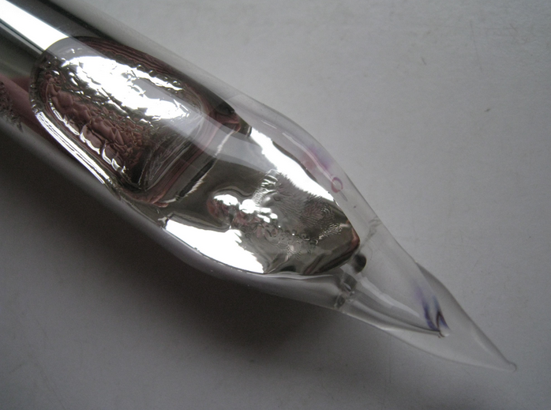
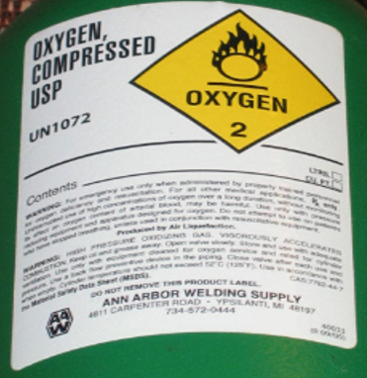
Specific Fire and Ignition Hazards
Ignitable chemicals
Flammable gases & vapors
Unusual targets

Slide 17
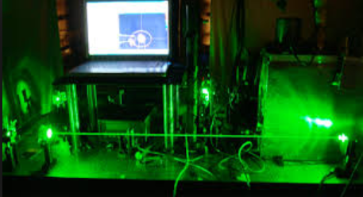
Laser Classifications of Concern
A Class 4 laser beam can cause materials to smolder or burn, especially at close range
Under some situations where flammable compounds or substances exist, it is possible that fires can be ignited by Class 3B lasers

Slide 18
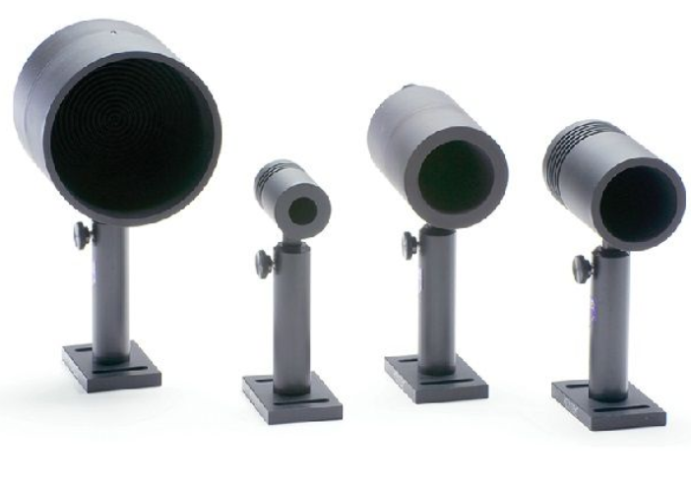
Standard Engineering Controls
Beam Stop or attenuation
Beam Shutters
Controlled Beam Path
Protective Housing

Slide 19
Jefferson Lab Administrative Control
Laser Operational Safety Procedure (LOSP) for all
Class 4 & Class 3B
lasers or laser systems

Slide 20
Laser Fire Safety - Key Personnel
Fire Marshal
Laser Safety Officer
Laser System Supervisor
Laser Operator
Area Safety Warden

Slide 21
Fire Marshal
Perform authority having jurisdiction (AHJ) authorities
Ensure the fire protection program is reviewed, assessed and implemented
Serve as Subject Matter Expert (SME) for the fire-protection systems

Slide 22
Laser Safety Officer
Perform laser equipment / area hazard evaluations
Approve LOSPs
Perform an ESH&Q Review on all lasers and equipment purchase requests
Approve acceptable procurement requests
Monitor and enforce hazard control requirements for laser systems

Slide 23
Laser System Supervisor
If supervising inexperienced workers, develop an equipment / area specific laser mentor program
Maintain a list of Qualified Laser Workers for specific equipment / areas
Perform Laser Safety Control Inspections (Bi-Annual Formal)

Slide 24
Laser System Supervisor

Slide 25
Laser Operator
Maintain current training (SAF 114O Laser Orientation), and specific training as determined by the Laser System Supervisor
Request an equipment / area hazard evaluation from the Laser Safety Officer if compliance with requirements is unclear

Slide 26
Safety Warden
Perform documented Safety Warden Inspections - Monthly
Inspect portable fire extinguishers
Inspect means of egress
Inspect area housekeeping
Inspect flammable storage

Slide 27
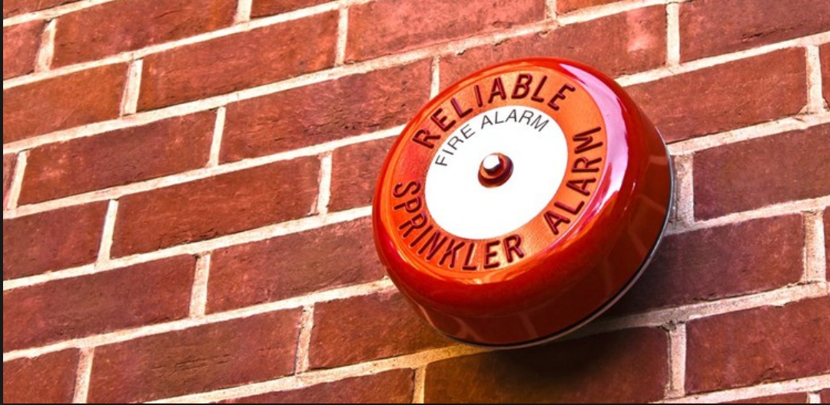
What More
Annual Building Fire Exercise
Test Alarms
Evacuation
Muster Points (designated area for accountability after evacuation)
Municipal Fire Department Information Exchange
Emergency Management Exercises
Building Hazard Highlight Discussions - Lasers

Slide 28
Bert Manzlak, CSP
manzlak@jlab.org
The Fire Safety Program in Laser Labs … Works!

Slide 29
Back-Up Slides

Slide 30
Jefferson Lab Street Hockey
Hall A

Slide 31
A Bit of Laser Classification Information
Class 3B
Lasers in this class may cause damage if the beam enters the eye directly. This generally applies to lasers powered from 5–500 mW.
Lasers at the high power end of this class may also present a fire hazard and can lightly burn skin.
Class 4
By definition, a Class 4 laser can burn the skin, or cause devastating and permanent eye damage as a result of direct, diffuse or indirect beam viewing.
These lasers may ignite combustible materials, and thus may represent a fire risk.

Slide 32
ANSI Z136.1 – 2014 “Safe Use of Lasers”
Section 7.2.3 Fire Hazards
Class 4 laser beams represent a fire hazard.
Enclosure of Class 4 laser beam can result in potential fire hazards if enclosure materials are likely to be exposed to irradiances exceeding 10 W cm2 or beam powers exceeding 0.5 W.
Under some situations where flammable compounds or substances exist, it is possible that fires can be ignited by Class 3B lasers.
NOTE – The National Fire Protection Agency standard NFPA ® 115 states that for continuous wave (CW) lasers, 0.5 W cm-2 is a possible ignition hazard.

Slide 33
A bit more about Class 3B lasers
Class 3B
A Class 3B laser is hazardous if the eye is exposed directly, but diffuse reflections such as those from paper or other matte surfaces are not harmful.
The AEL for continuous lasers in the wavelength range from 315 nm to far infrared is 0.5 W.
For pulsed lasers between 400 and 700 nm, the limit is 30 mJ.
Other limits apply to other wavelengths and to ultra-shot pulsed lasers.
Protective eyewear is typically required where direct viewing of a class 3B laser beam may occur.
Class-3B lasers must be equipped with a key switch and a safety interlock.
Class 3B lasers are used inside CD and DVD writers, although the writer unit itself is class 1 because the laser light cannot leave the unit.
Class 3B visible-beam lasers are medium powered, from 5 to 499 milliwatts.
A Class 3B laser can cause eye injury. The more powerful the laser, the greater the chance of injury.

Slide 34
A bit more about Class 4 lasers
Class 4
Class 4 is the highest and most dangerous class of laser, including all lasers that exceed the Class 3B Allowable Exposure Limit (AEL).
These lasers may ignite combustible materials, and thus may represent a fire risk.
These hazards may also apply to indirect or non-specular reflections of the beam, even from apparently matte surfaces – meaning that great care must be taken to control the beam path.
Class 4 lasers must be equipped with a key switch and a safety interlock.

