Slide 1
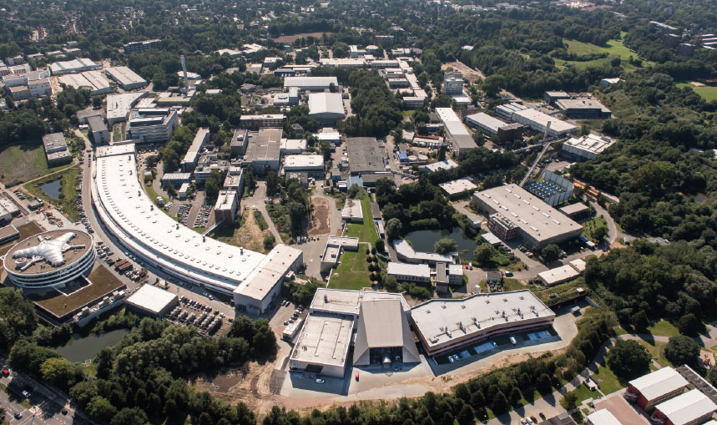
Chemistry User Community at the DESY PHOTON SCIENCE Division Additional Facilities and new Challenges
Anca Simona Ciobanu
Lund, 13-17 May 2019

Slide 2
Overview
User Facilities at DESY PHOTON SCIENCE
Chemistry Laboratories
Future Plans for the PETRA IV

Slide 3
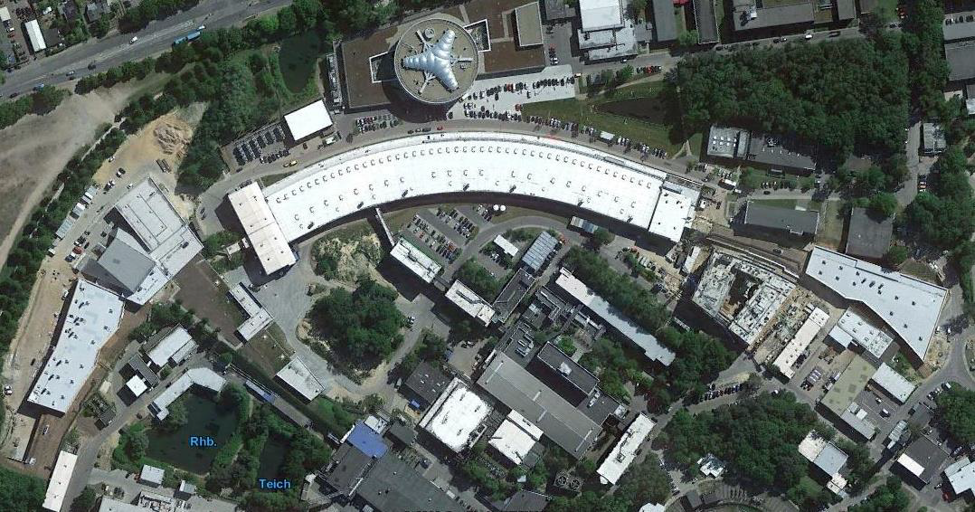
User Facilities at PHOTON SCIENCE
FLASH2
PETRA III
FLASH1
PETRA III Extension
East Hall
PETRA III Extension
North Hall
Building 25b

Slide 4
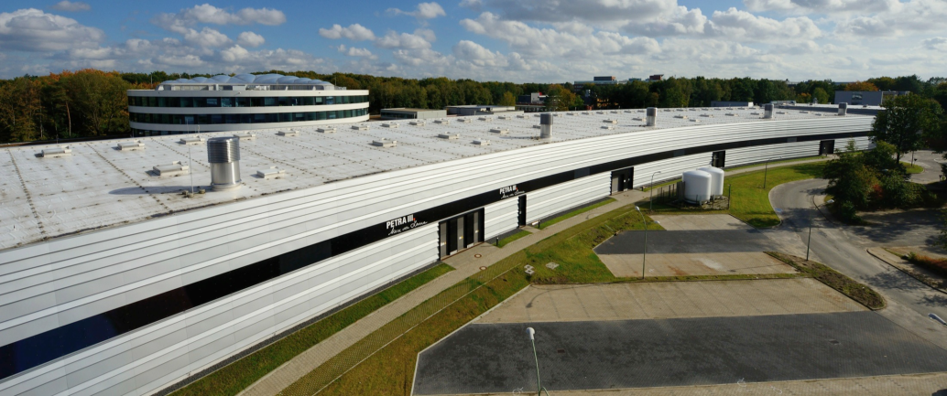
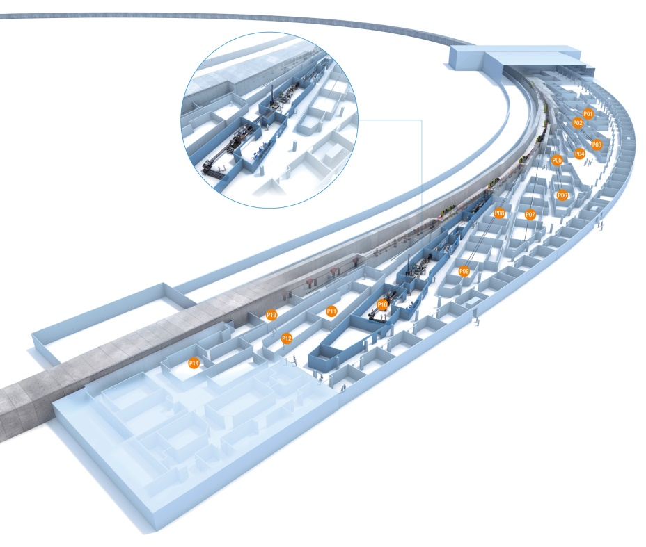
PETRA III experimental hall 'Max von Laue'
P01 High Resolution Dynamics
P02.1 Powder Diffraction and Total Scattering
P02.2 Extreme Conditions Beamline
P03 Micro- and Nanofocus X-ray Scattering
P04 Variable Polarization XUV Beamline
P05 Imaging Beamline(HZG)
P06 Hard X-ray Micro/ Nano Probe
P07 High Energy Materials Science (HZG)
P08 High Resolution Diffraction
P09 Resonant Scattering & Diffraction
P10 Coherence Applications Beamline
P11 Bio-Imaging & Diffraction

Slide 5
PETRA Extension
P61 High-energy Wiggler beamline (fall 2019)
P62 Small angle X-ray scattering (spring 2020)
P64 Advanced X-ray absorption spectroscopy
P65 Applied X-ray absorption spectroscopy
P66 Superlumi (time-resolved VUV luminesc.) (sommer 2020)
P21.1&2 Swedish Materials Science beamline
P22 Hard X-ray Photoelectron Spectroscopy
P23 In-situ and nanodiffraction beamline
P24 Chemical Crystallography

Slide 6
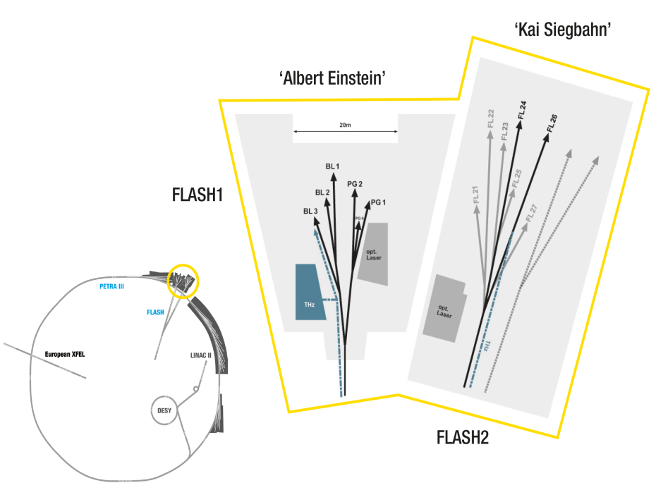
FLASH1 and FLASH2
FLASH1 5 beamlines: BL1, BL2, BL3, PG1 and PG2
FLASH2 2 beamlines: FL24 und FL26

Slide 7
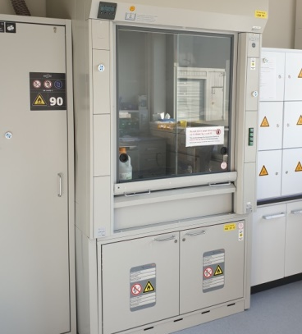
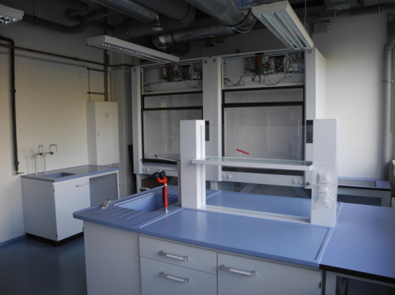
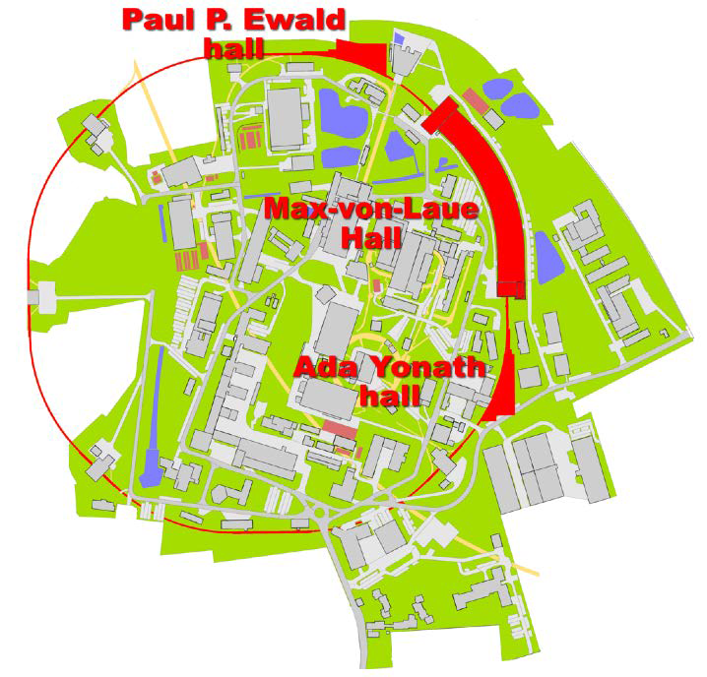
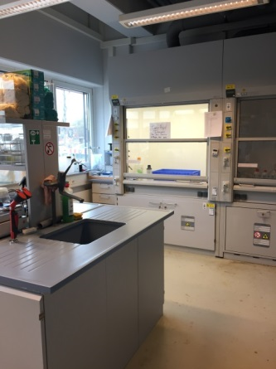
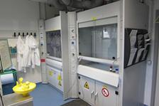
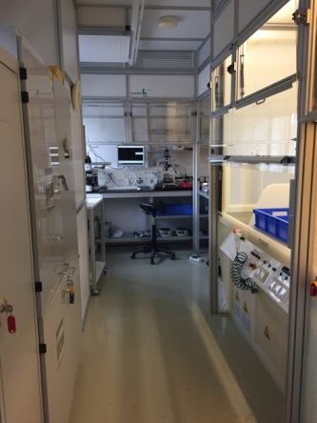
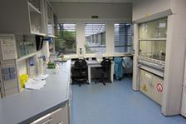
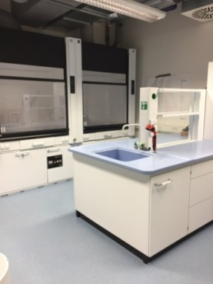
User chemistry laboratories

Slide 8
User chemistry laboratories at PHOTON SCIENCE
PETRA III Extension North Hall
FLASH1 and FLASH2
PETRA III
PETRA III Extension East Hall
Building 25b
User Chemistry Lab
User Chemistry Lab
User Chemistry Lab
User Chemistry Lab
Chemistry Lab
Clean room
Preparatory Laboratory
User chemistry labs
for general use
Chemistry
Laboratory for P64/P65 users
Chemistry
Laboratory for P02.1 users
Sample preparation laboratory P24
Sample preparation lab P10
Cooperation labs
for beamline users

Slide 9
Construction, Operation, Maintenance and Logistics
Construction
Order
Maintenance
Chemistry Group @Technical Infrastructure
Safety approval
Stock management& Disposal
Risk assess-ments
User support &
Logistics
On-site Safety
Instruc-tions

Slide 10
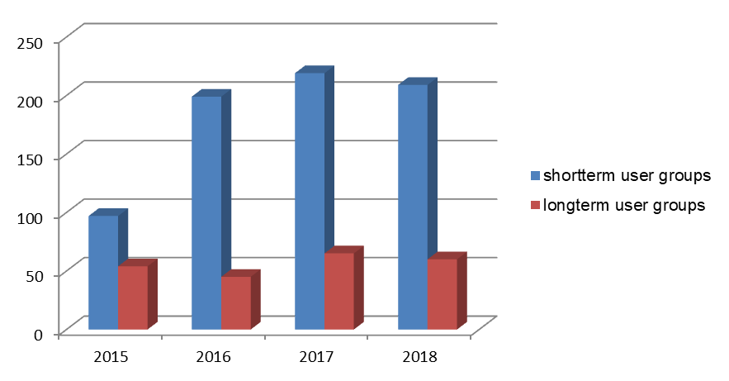
User community for chemistry laboratories
Shortterm users (users with a scheduled beamtime)
average duration of beamtime - 4 or 5 days
average size of working group - 4 people
priority access to the lab
Longterm users (users without a scheduled beamtime)
duration of registration – one year
scientists from other instituts
in-house research projects

Slide 11
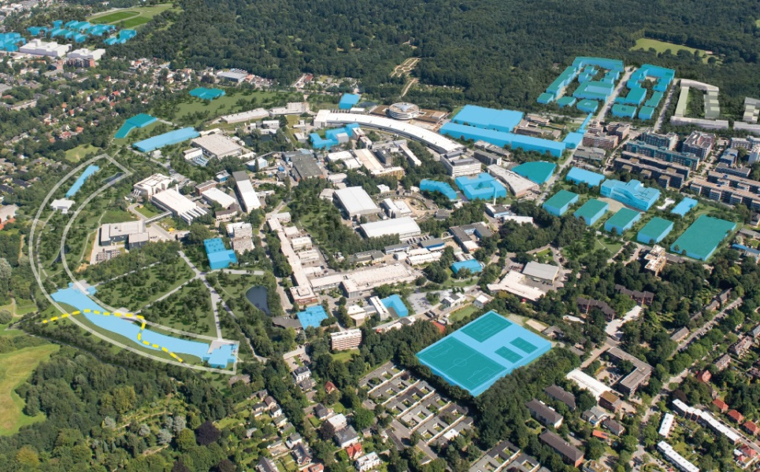
Future plans for the PETRA IV
12.2020:TDR
01.2021:Start
preproduction
07.2024:Start
construction
work
CDR
07.2026: PETRA IV
2019 2020 2021 2022 2023 2024 2025 2026 2027 2028 2029
PETRA IV

Slide 12
Future plans for the PETRA IV
A central chemistry facility providing technical and scientific support for all the
PHOTON SCIENCE Division users with other satellite chemistry laboratories in each
experimental hall
Increase the available equipment (furnace, microscope, mass spectrometer, UV-VIS
spectrophotometer, glovebox)
More technical staff

Slide 13
Thank you for your attention!

Slide 14
Anca Simona Ciobanu
FS-TI Technical Infrastructure
anca.ciobanu@desy.de
+49-40-8998-4683

