Slide 1
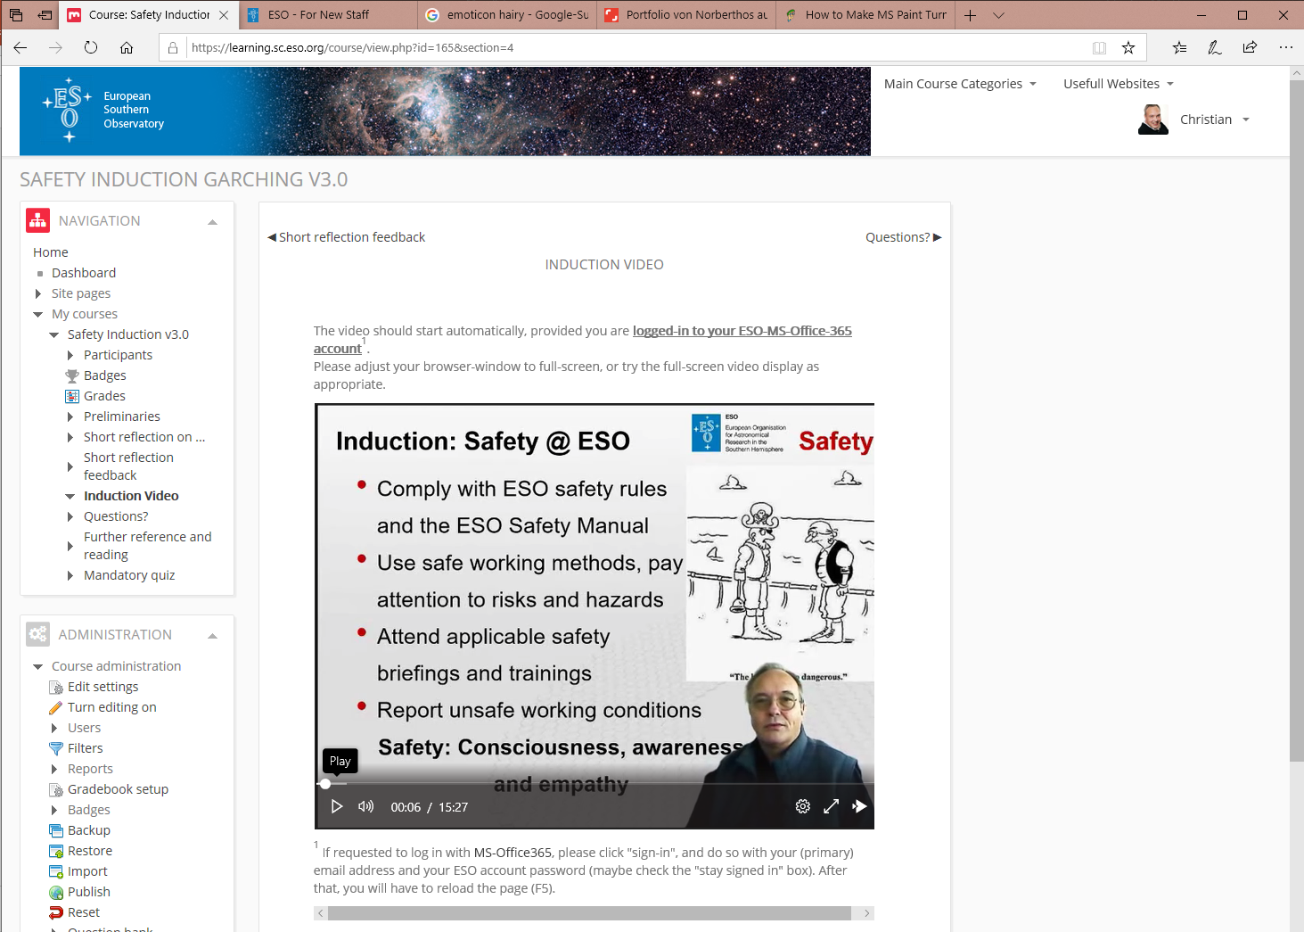
E-Learning Cookbook
Safety

Slide 2
E-Learning BUY or MAKE
Safety
If available languages match lingua franca If you run on national safety law If you have the funds available
consider buying
If any of the above doesn’t match
If you change / update / enhance frequently
consider producing your own
ESO: Own referentials ∩ Host State language ≠ English (LF) ⇒ We give it a try ...

Slide 3
E-Learning Cookbook
Safety
Take…
a learning management system (LMS)
your usual PowerPoint training presentation
a PC with a webcam and the permission to install a few no- or low-cost software accessories
a comb you’ll be filmed
all your creativity and courage

Slide 4
The LMS
Safety
Take… …Moodle if at all you can
It provides the full course and grades (!) mgmt.
It’s open source, and comes at 0,- license cost
It’s very common, and most probably already available at your institute/university
It runs on any Linux server, from RasPi onward
It is rather easy for “teachers” to set-up courses
Easy to use for “students”, provided “teachers” won’t complicate it artificially

Slide 5
E-Learning Course Concept
Safety
Mine? → Create as a teacher 1 course with 7 “topics” with a “label” (formatted text or media) in each & a quiz
Preliminaries → Objectives and pre-knowledge
Short reflection on ... → Take a coffee and think of…
Short reflection feedback → Rembered/thought of …?
Course video → The main message delivery
Questions? → How to reach me and/or Colleagues
Further reference and reading → Intranet, prof.orgs.
(Mandatory) Quiz → Check it was done/understood

Slide 6
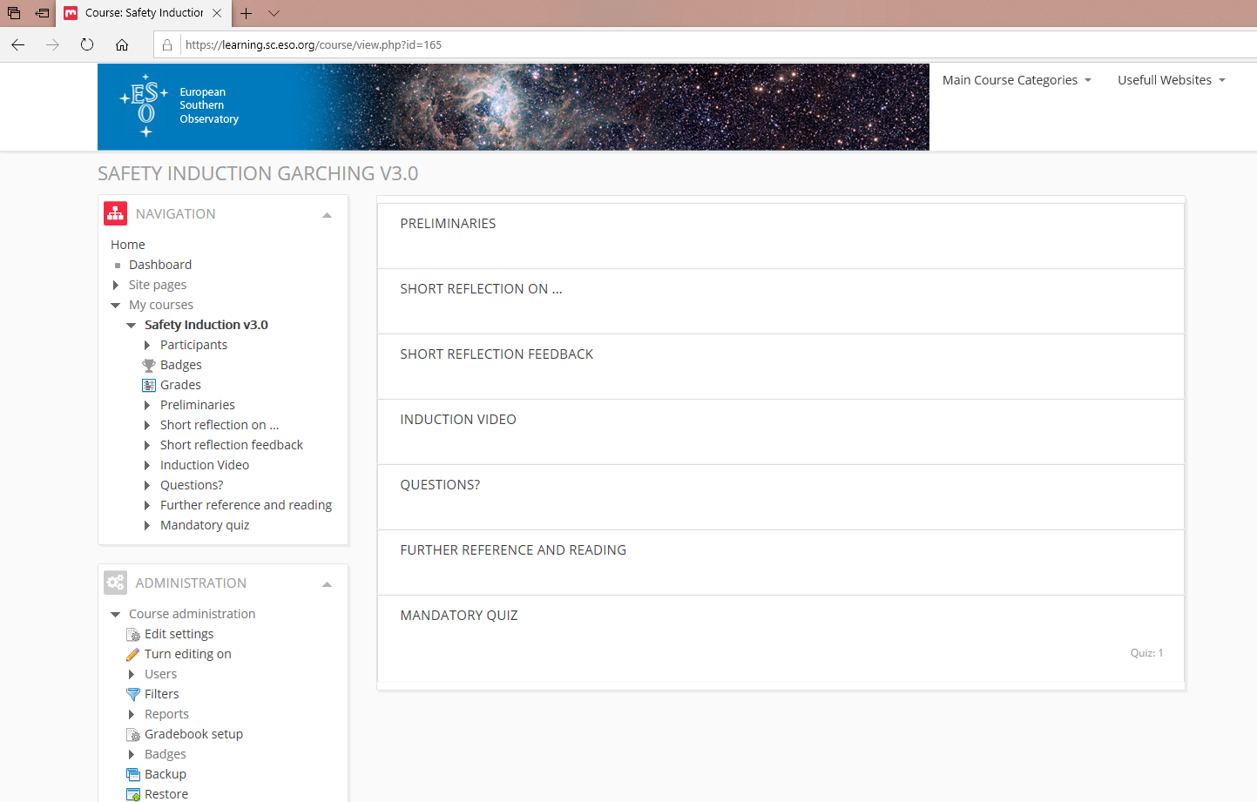
Topics
Safety

Slide 7
...with a label
Safety

Slide 8
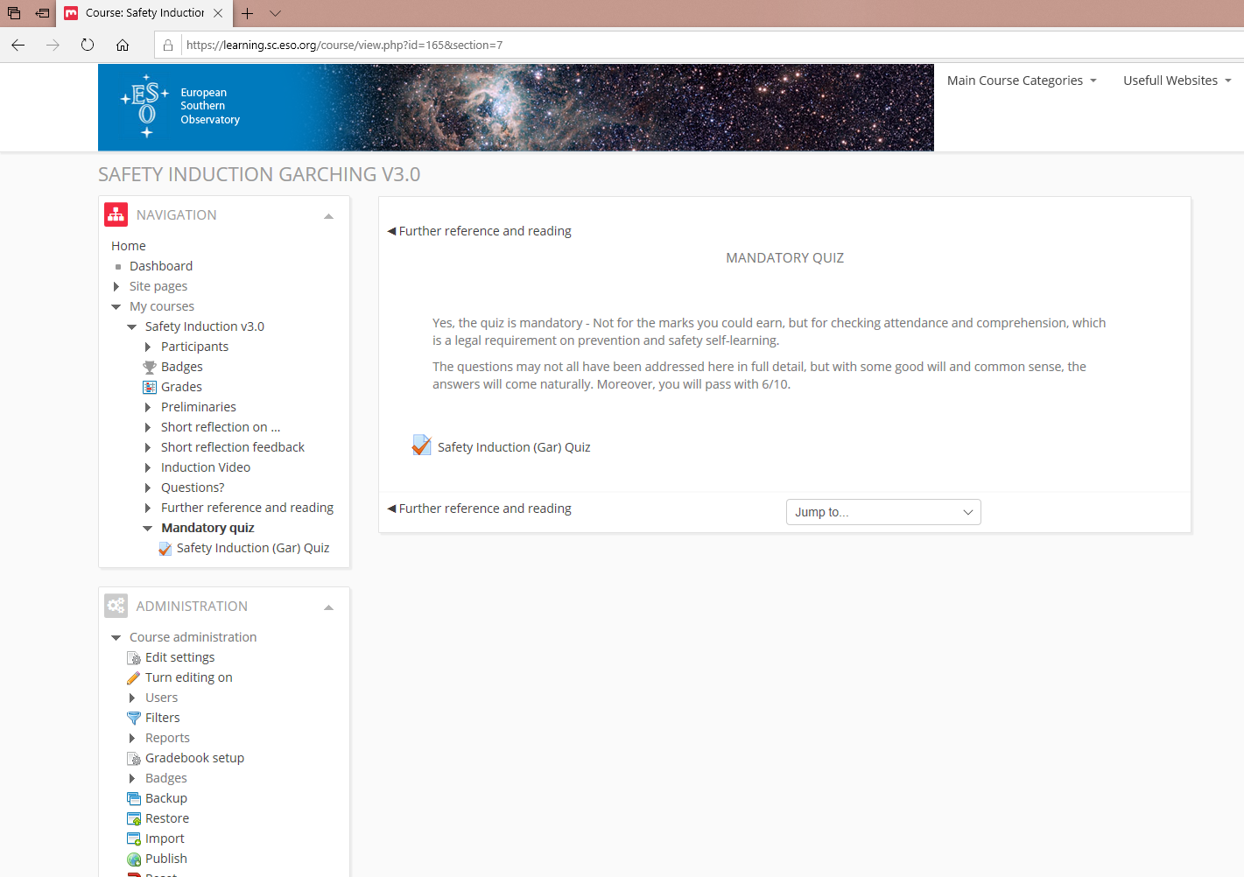
… and a quiz
Safety

Slide 9
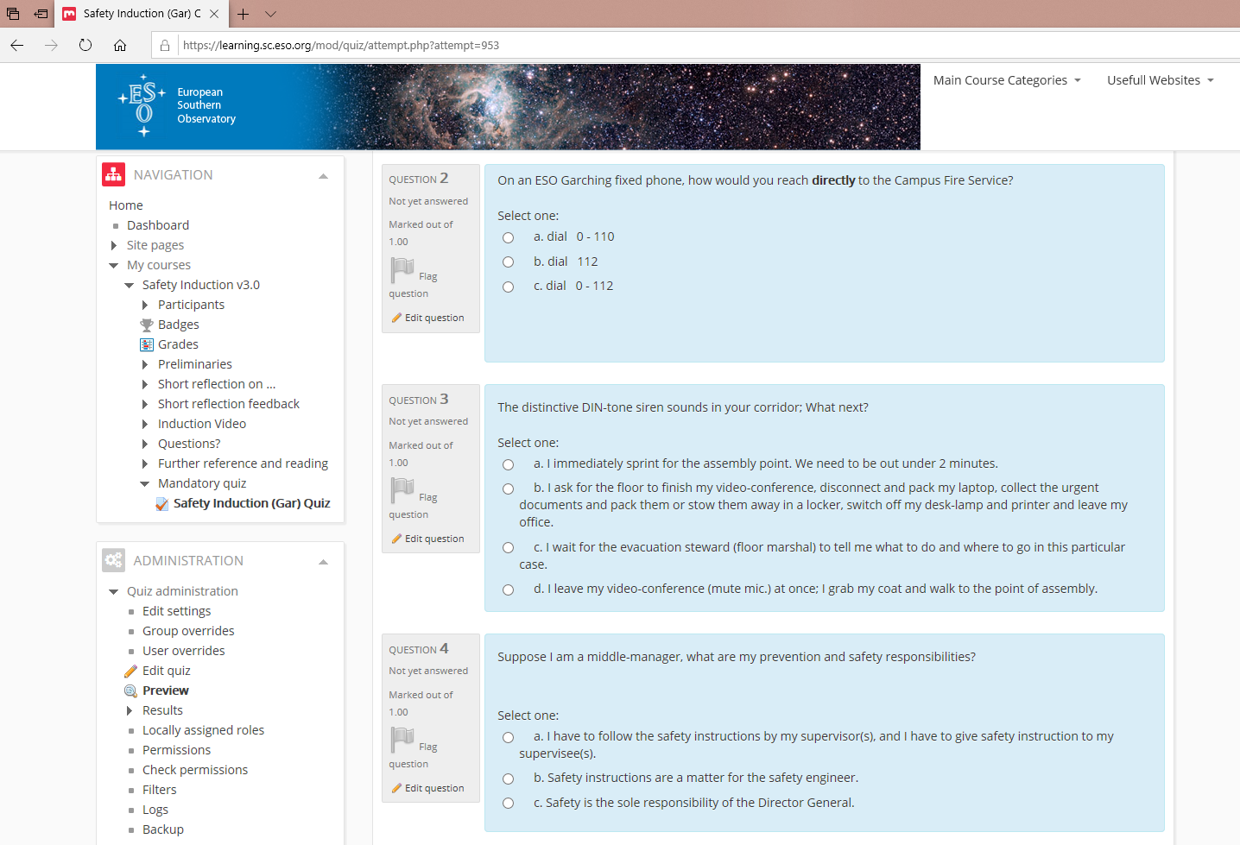
…started by a mouse-click.
Safety

Slide 10
Video-capture: XSplit VCam
Safety
as opposed to the “chroma key” process

Slide 11
Video assembly: OBS Studio
Safety

Slide 12
Tips and tricks (1/2)
Safety
Store video on a performant server outside Moodle (e.g. Office-365 ”Stream”)
Consider recording slide-by-slide with sufficient blanks (2-3 sec.)
This eases cutting / updating
For intensive cutting consider the VSDC Editor
A good webcam and a performant PC will spare you frustration
Don’t aim at rivalling with a news-channel!

Slide 13
Tips and tricks (2/2)
Safety
What you say on film is as if you had written it
Try a sympathetic smile, and avoid the “ehm”
Check for ambiguities / unclear messages
Moderate humor only; No “safety-fail” sequences
Use gender-neutral language
Share among colleagues, get feedback and eventually compliments
… and comb before you film …

Slide 14
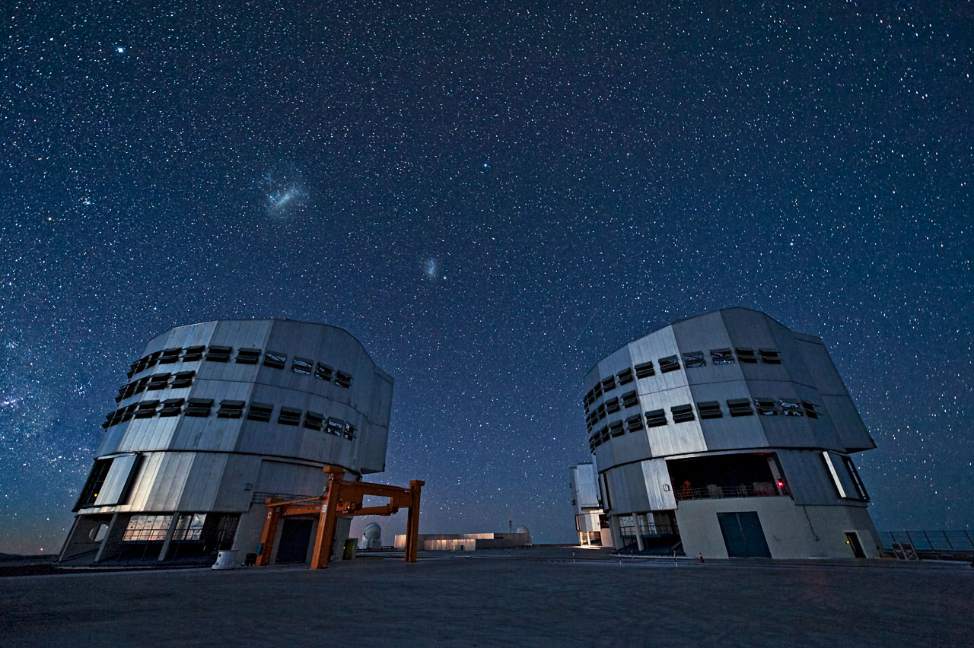
Questions?
Safety

