Slide 1
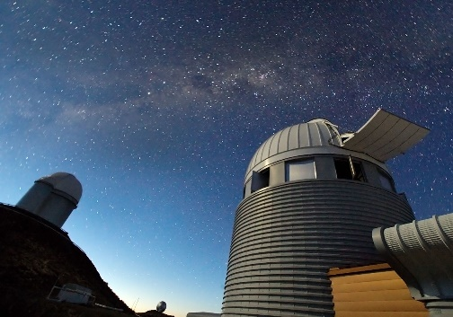
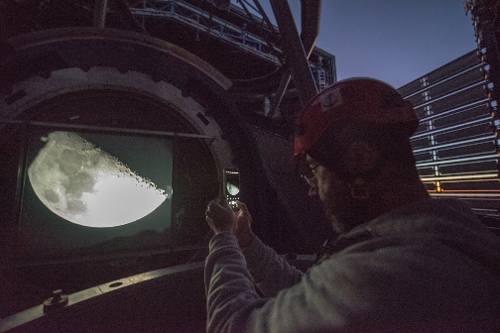
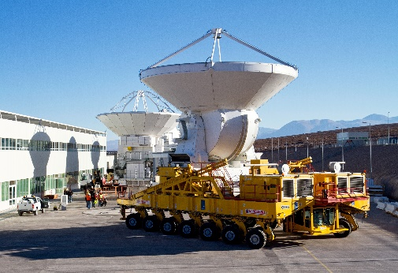
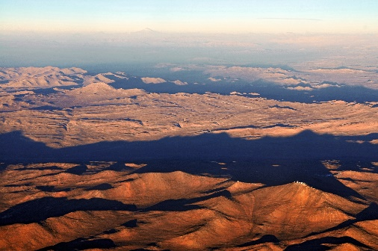
European
Southern
Observatory
www.eso.org
General information ESO, the European Southern Observatory, is the foremost intergovernmental astronomy organisation in Europe and the world's most productive astronomical observatory. It is supported by 16 member countries. ESO carries out an ambitious programme focused on the design, construction and operation of powerful ground-based observing facilities enabling astronomers to make ground-breaking scientific discoveries. ESO also plays a leading role in promoting and organising cooperation in astronomical research. ESO operates three unique world-class observing sites in Chile: La Silla, Paranal and ALMA. ESO is currently building the 38-metre-class Extremely Large Telescope.
History, Facts & figures,
1962 — Founding Members sign the ESO Convention, following the 1954 declaration
1963 — Chile is chosen as the site for the ESO observatory (first light 1966)
1976 — First light for the ESO 3.6-metre telescope in La Silla (CERN co-operation)
1998 — First light for the VLT’s first Unit Telescope (of four) in Paranal
2009 — First light for the first ALMA (EU/JP/US) antenna at 5000m-high Chajnantor
2012 — ELT programme approved
2014 — ELT construction started
2018 — CTA (South) hosting agreement
ESO counts about 750 international staff, over 1/3 in Chile; Budget 200 M€ (both figures from 2014)
Safety
ESO is an intergovernmental research organisation, incorporated under an international convention. It had therefore to develop its own legal framework for prevention and safety, and its specific process for conformity assessment of scientific equipment and infrastructure.
Safety (HSSE), therefore, plays a threefold role in the organisation: It keeps the a.m. referentials up-to-date, ensures the safety/OHS advisory function, and advises on compliance and conformity assessment of equipment designed and built by the organization. This is complemented by responsibilities relating to building safety during construction, and security during operation.
There are, ALMA included, about 10 FTE allocated to this work package. Due to the 365/24/7 operation of observatories the vast majority in Chile.
ESO currently chairs the AHG “Safety Officers” with the EIROforum co-operation of European Intergovernmental Research Organisations, and the ALMA Safety Advisory Group.
Projects
ELT, the Extremely Large Telescope (Cerro Armazones): Currently under construction.
CTA, the Cherenkov Telescope Array: Currently approaching construction.

