Slide 1
The IR Camera system in operation
First experiences
Fabian Saretzki
ITSF 2019, Lund, May 2019

Slide 2
Agenda
What’s this talk about?
01 IR camera system
Components
Layout
Parameters
Software
02 Commissioning
Test procedure
Videos
Surprise!
03 Operation
Alarm procedure
Additional benefits
04 Experiences
Issues
Reasons
(possible) Solutions
06 Conclusion

Slide 3
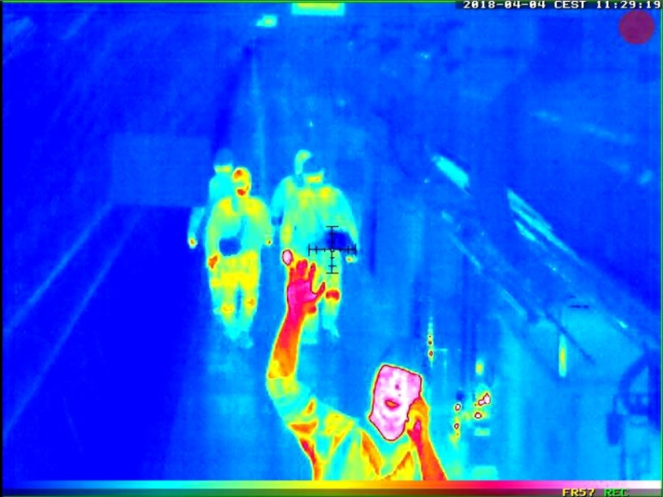
IR camera system

Slide 4
IR camera system
Components
M16 Thermal camera
16 devices
Thermal sensor (NETD 50 mK)
Resolution: 336x252
Regulated by ITAR
ExtIO
3 devices
Connects IP camera interface with fire alarm system
Provides potential-free contact
Each alarm needs an ExtIO
Notes:
NETD 50mK – detects temperature differences of 0,05 °C in the range within -40 to +550 °C
ITAR = International Traffic in Arms Regulation – forbidden to export to countries which are covered by embargos by the USA and ITAR – potential military use
Bilder: F.Saretzki

Slide 5
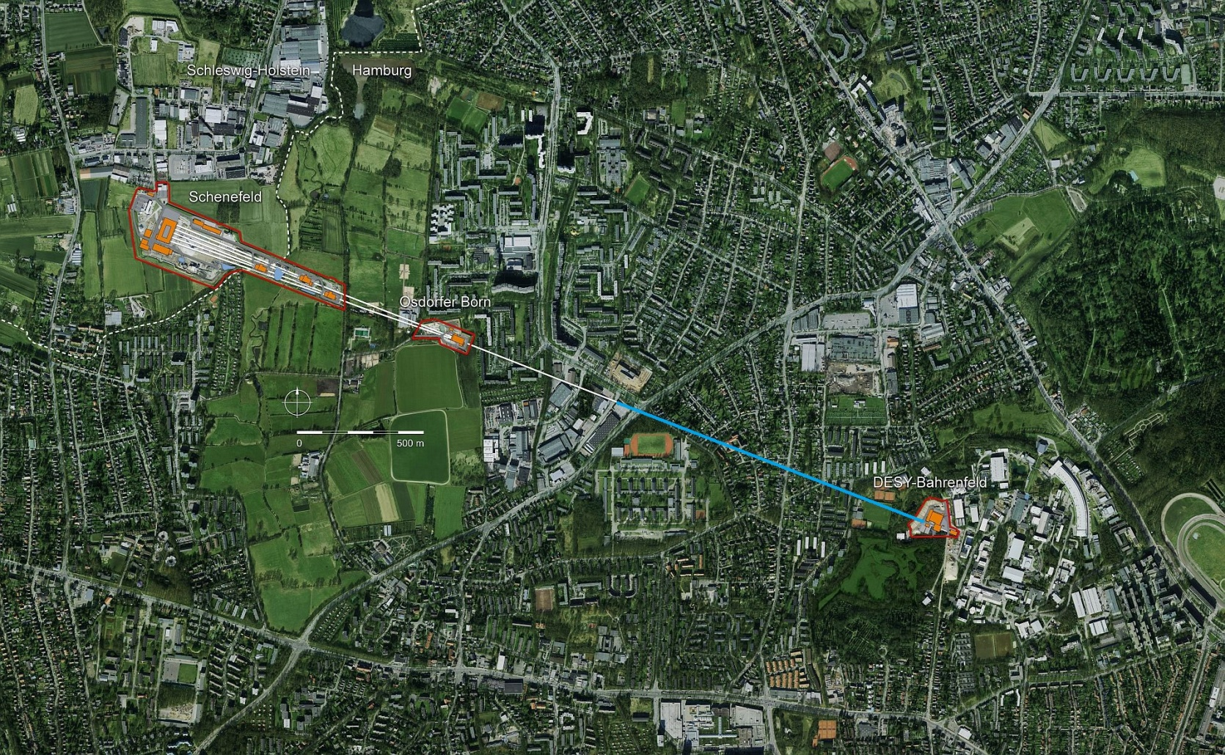
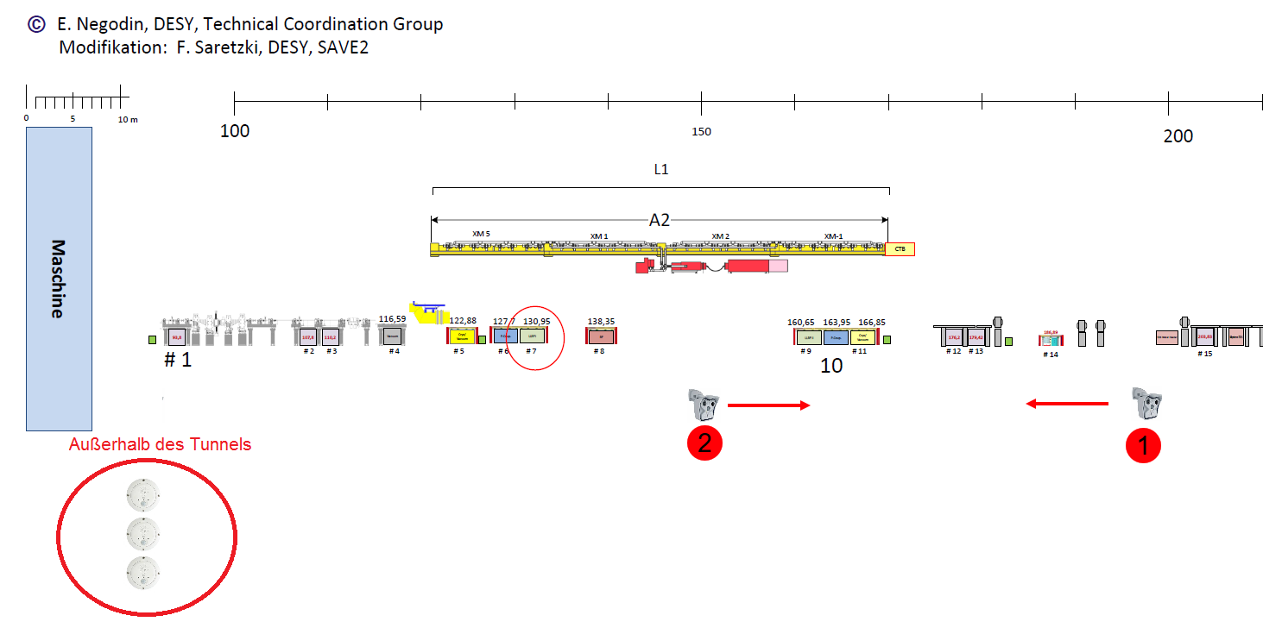
IR camera system
Layout
XTL
Cold linac = 1450 m
Max. 140 m of covered tunnel length per camera (avg. 100 m)

Slide 6
IR camera system
Parameters
Alarm
9 fps = reacts within approx. 100 ms
Malfunction = Safe mode = Alarm
Opens
Records 15 s video
Thresholds
Cold (He): < 1°C
Warm: > 65 °C

Slide 7
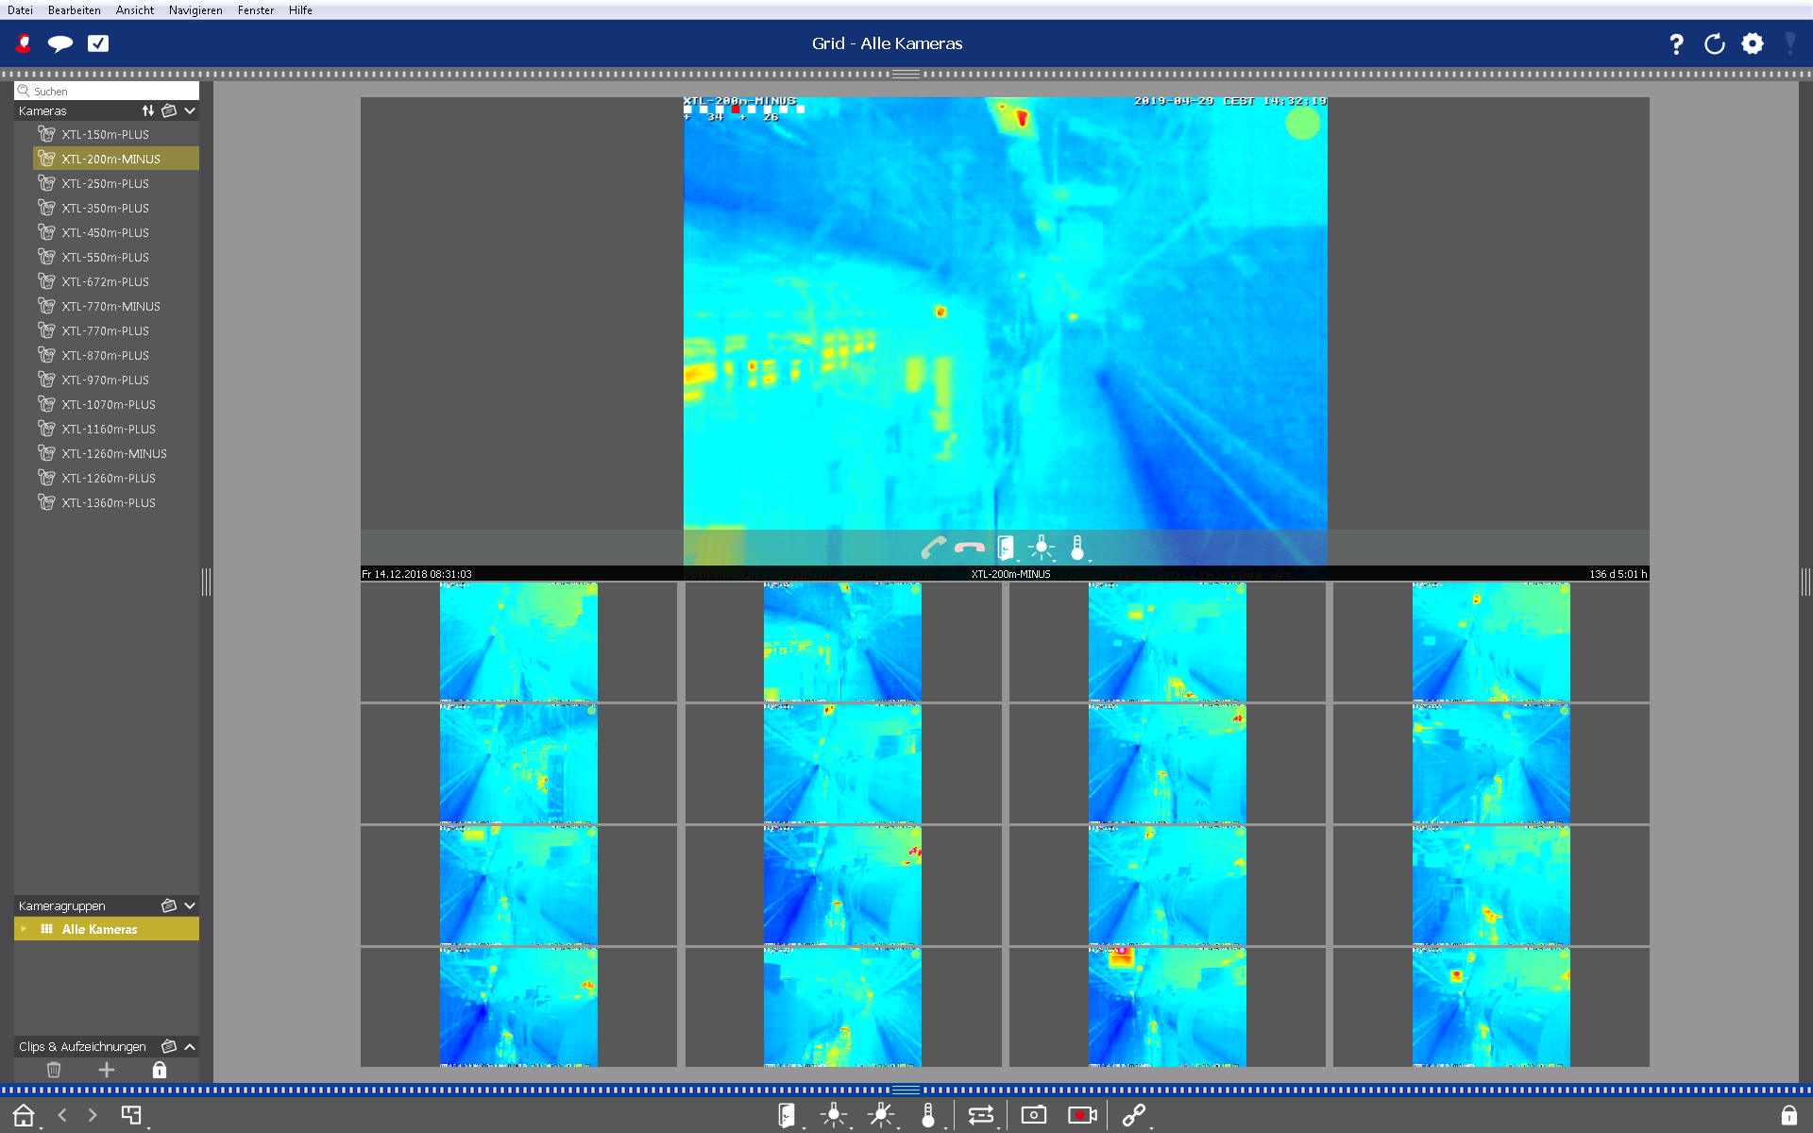
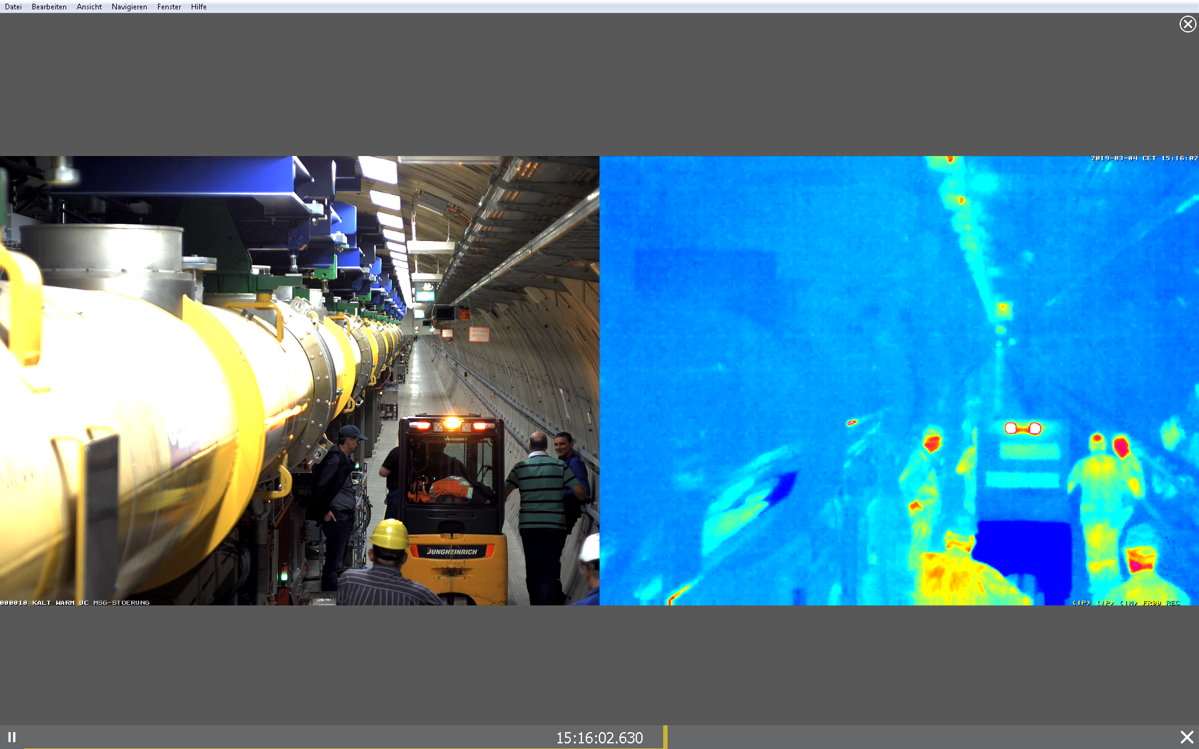
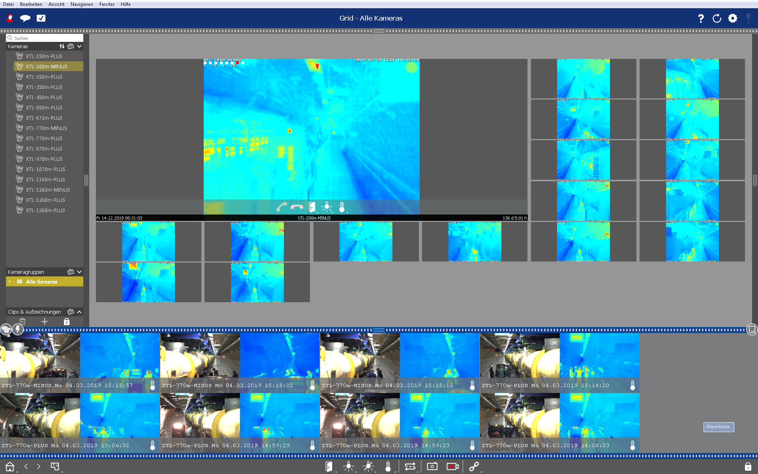
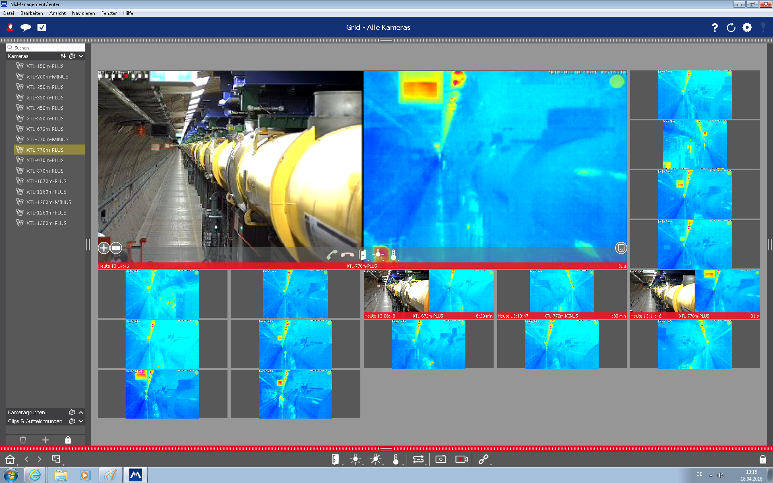
IR camera system
Software

Slide 8
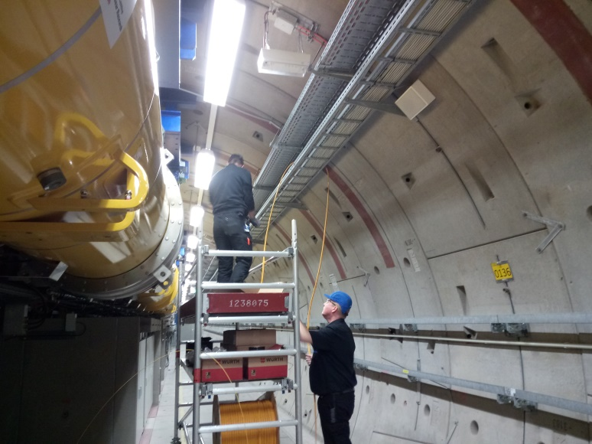
Commissioning

Slide 9
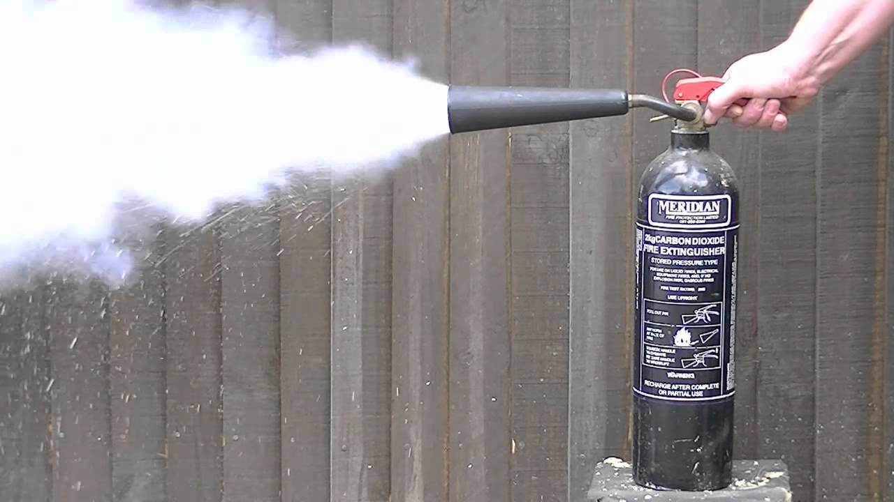
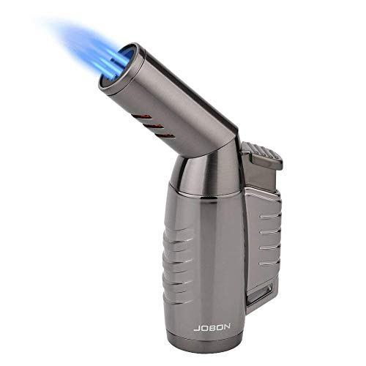
Commissioning
Test procedure
Cold alarm
Carbon dioxide extinguisher
Approx. 5 m and 100 m distance
Hot alarm
Lighter
Only low distance tested
Notes:
Bild1: https://www.google.com/url?sa=i&rct=j&q=&esrc=s&source=imgres&cd=&cad=rja&uact=8&ved=2ahUKEwiVzbKSrPXhAhXQIlAKHWutBuwQjRx6BAgBEAU&url=https%3A%2F%2Fwww.youtube.com%2Fwatch%3Fv%3DuV1j4xFvAoQ&psig=AOvVaw1daQf291U79g6yMBPcRtCi&ust=1556628756922336
Bild2: https://www.google.com/url?sa=i&rct=j&q=&esrc=s&source=images&cd=&cad=rja&uact=8&ved=2ahUKEwir0PqJsPXhAhUFY1AKHb9hBc8QjRx6BAgBEAU&url=https%3A%2F%2Fwww.produktefinder.com%2Ffreizeit%2Fsturmfeuerzeug-test%2F&psig=AOvVaw0UccZ0f1HWNqMgATUSVj0D&ust=1556629448561519

Slide 10
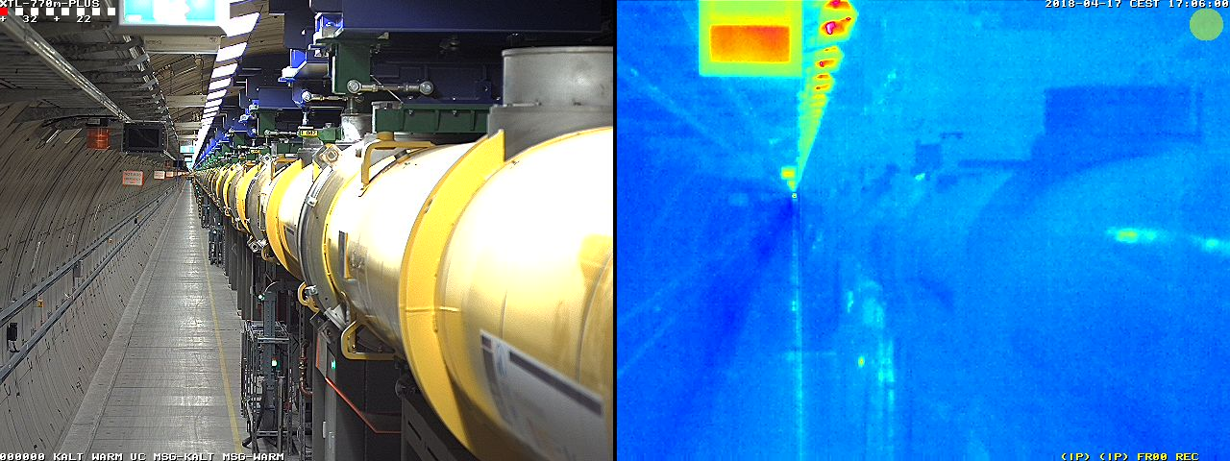
Commissioning
Videos

Slide 11
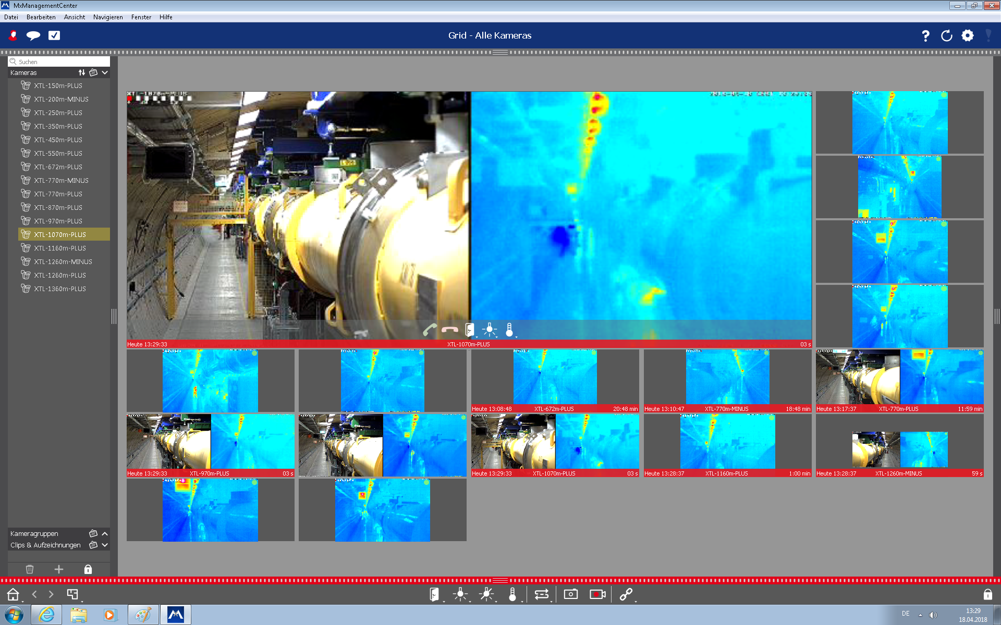
Commissioning
Surprise
Notes:
Ca. 320 m

Slide 12
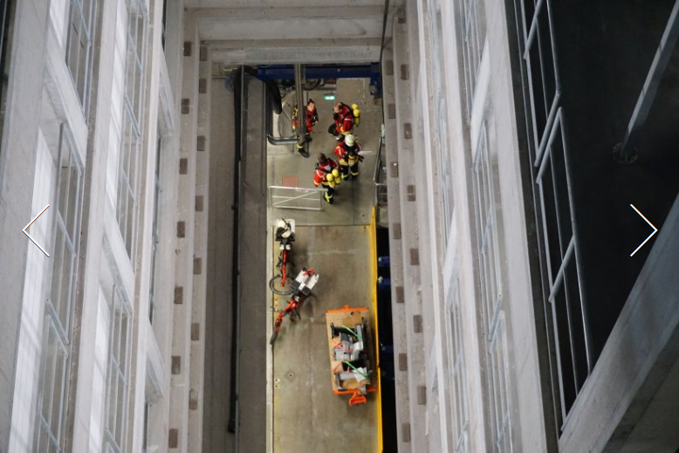
Operation

Slide 13
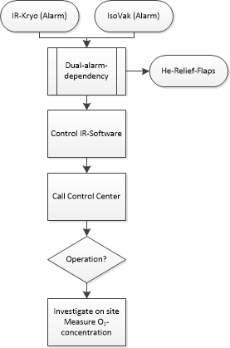
Operation
Alarm procedure
Notes:
Bilder: F. Saretzki

Slide 14
Operation
Benefits
Synergy effects
Records the event
Provides live view of site
Gives operator ability to supervise crew on site
Notes:
Bilder: F. Saretzki

Slide 15
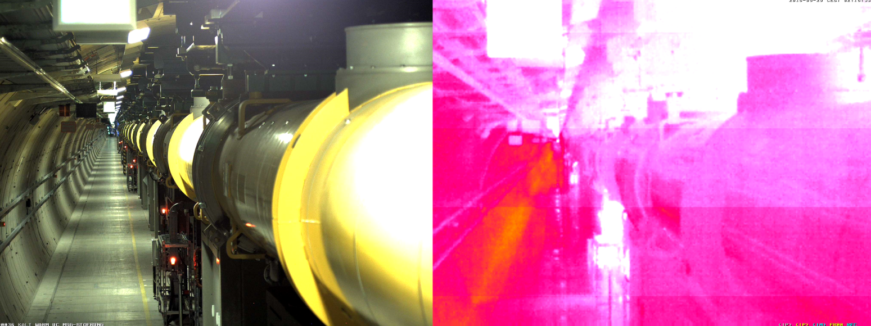
Experiences

Slide 16
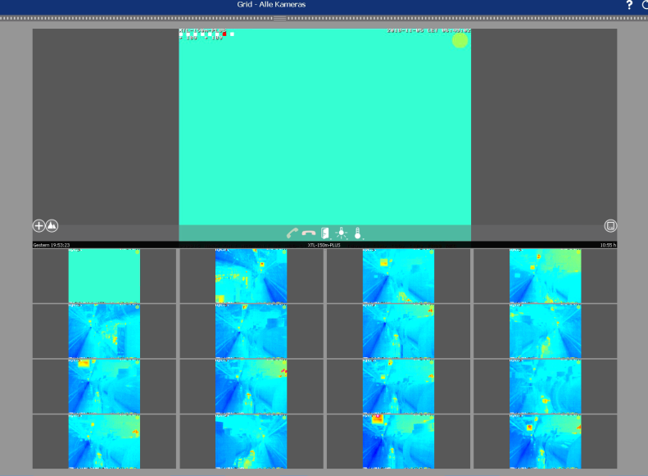
Experiences
Issues
Controllability by operators
Range of alerting threshold
IR sensor malfunction
Repeating false alarms
Sudden reboots

Slide 17
Experiences
Reasons
Controllability by operators
Restrictions to protect the system from operating errors
Range of alerting threshold
Hot devices trigger fire alarm
Winter: Cold objects trigger He alarm
IR Sensor malfunction
Unknown. Probable failure in the sensor electronics caused by special environment.

Slide 18
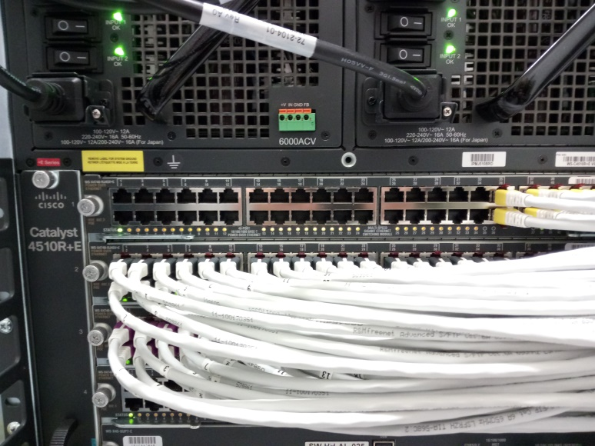
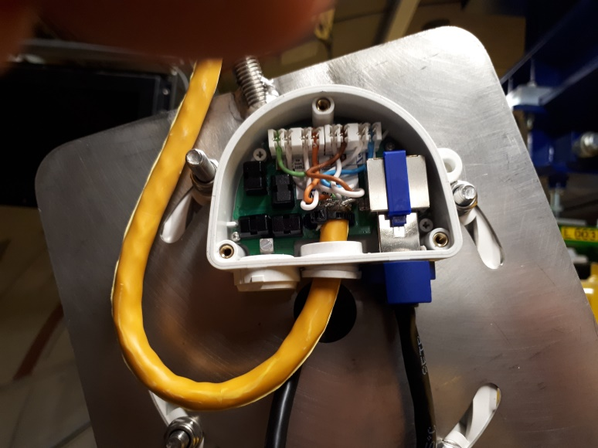
Experiences
Reasons
Repeating false alarms & sudden reboots
(Network errors)
Bad cable connection to device
Notes:
Bild1: https://www.google.com/url?sa=i&rct=j&q=&esrc=s&source=images&cd=&cad=rja&uact=8&ved=2ahUKEwiCnM_fzvzhAhXF66QKHQjXBu8QjRx6BAgBEAU&url=http%3A%2F%2Fcommpath.com%2Fdata-networking-equipment%2Fnetwork-switch-ethernet-art-getty%2F&psig=AOvVaw233o6gGIzxCcXby_NPc_zq&ust=1556878559912496
Bild2: IT-TK – R. Brandt/W. Schramm

Slide 19
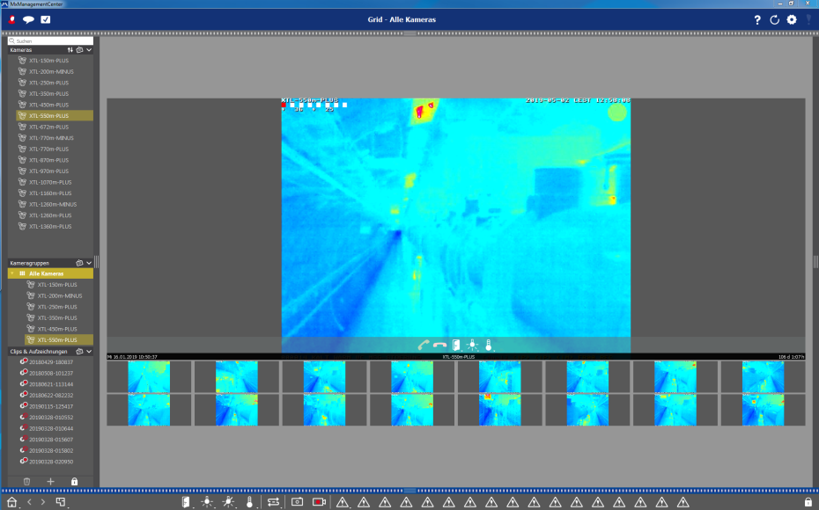
Experiences
Solutions
Controllability by operators
Added buttons for operators
Range of alerting threshold
Adjusted alerting range
IR Sensor malfunction
No solution yet
Repeating false alarms & sudden reboots
Revision of the cabling
Possibly: swap to own network

Slide 20
Conclusion

Slide 21
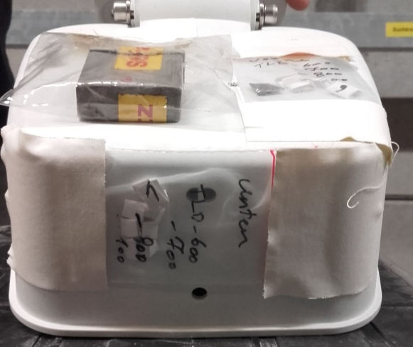
Conclusion
Old problem – new technology
Generally very good solution to detect He-leaks
First known application
Implementation in special environment
Teething troubles
Cabling issues are soon to be solved
IR sensors under surveillance

Slide 22
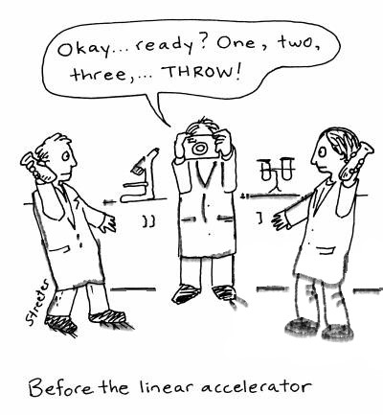
Thank you

Slide 23
Fabian Saretzki
SAVE
fabian.saretzki@desy.de
+49 40 8998 (9) 4763

