Slide 1


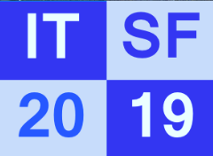
CE Certificiation at the ESRF
Paul Berkvens
ITSF 2019
13-17 May 2019
Scandic Star Hotel

Slide 2
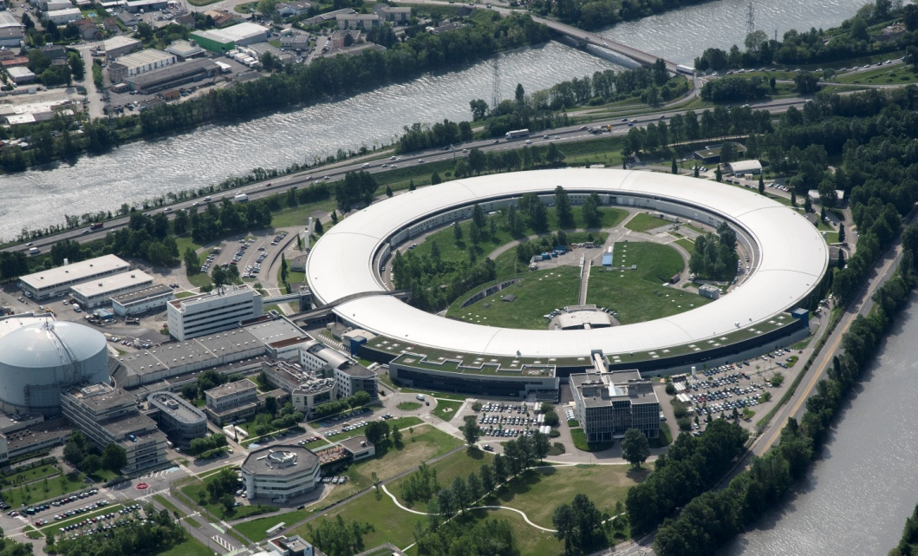
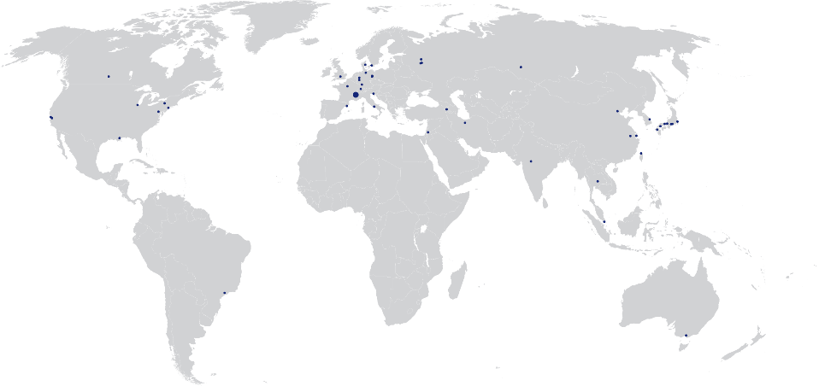
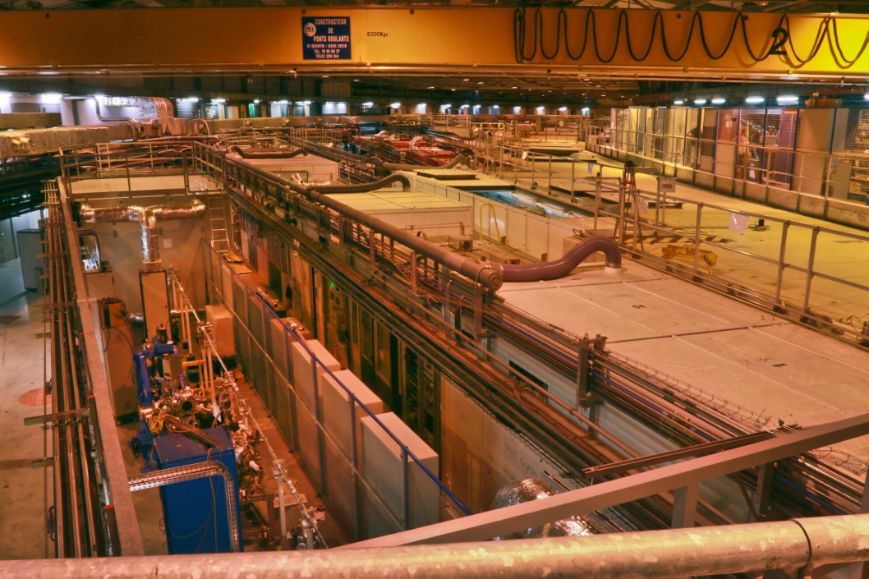
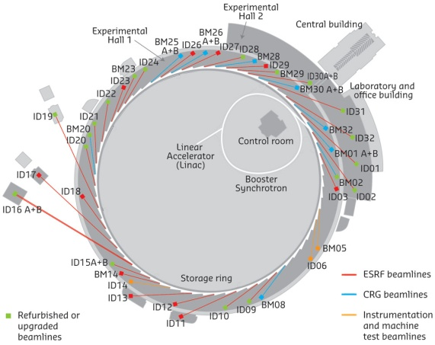
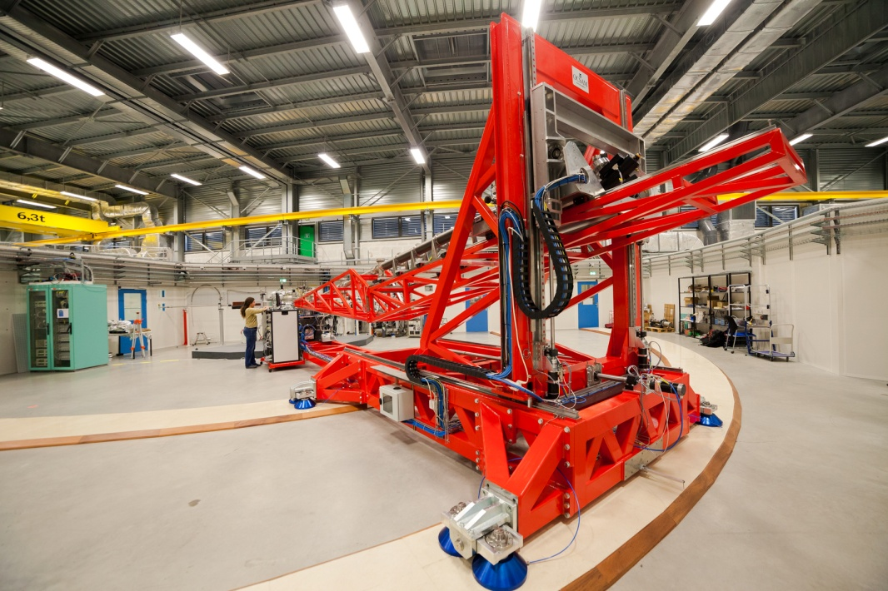

European Synchrotron Radiation Facility
3rd generation high energy synchrotron radiation facility
A research facility unique worldwide
6,500 scientific visitors every year including 4,000 users
2,000 proposals per year: 900 accepted,
1,550 experimental sessions
30% of the research involves industrial developments
6 GeV storage ring
31 public beamlines
12 CRG beamlines
Scientific excellence recognised worldwide
N ◦ 1 in scientific output
N ◦ 2 in number of users
N ◦ 1 in reliability & quality
4 Nobel prize-winners among the ESRF users
25,166 reference articles during the period 1994-2014
̴ 30 articles in Nature and Science per year
Nearly 2,000 publications per year: ̴ 5 every day

Slide 3






















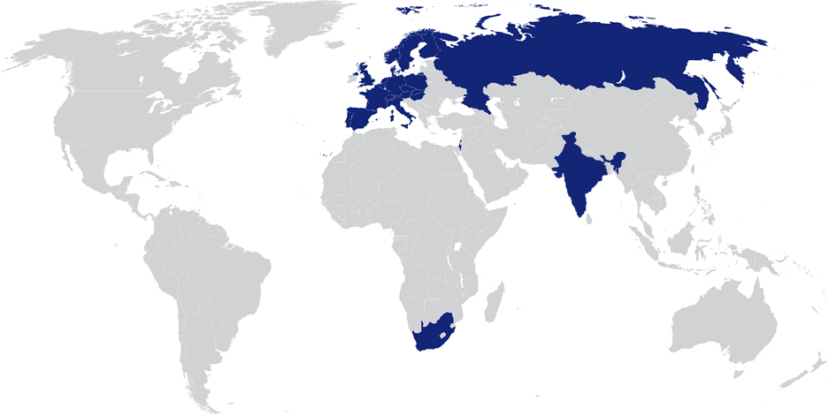
A model of international cooperation: 22 Partner nations
22 PARTNER COUNTRIES
13 Member states:
France 27.5 %
Germany 24.0 %
Italy 13.2 %
United Kingdom 10.5 %
Russia 6.0 %
Benesync 5.8 %
(Belgium, The Netherlands)
Nordsync 5.0 %
(Denmark, Finland, Norway, Sweden)
Spain 4.0 %
Switzerland 4.0 %
9 Scientific Associate countries:
Israel 1.5 %
Austria 1.3 %
Centralsync 1.05%
(Czech Republic, Hungary, Slovakia)
Poland 1.0 %
Portugal 1.0 %
India 0.66 %
South Africa 0.3 %
22 partner nations
Legal status: Private civil company subject to French law
Annual budget: 100 million euros
Staff: 630 of 40 different nationalities

Slide 4
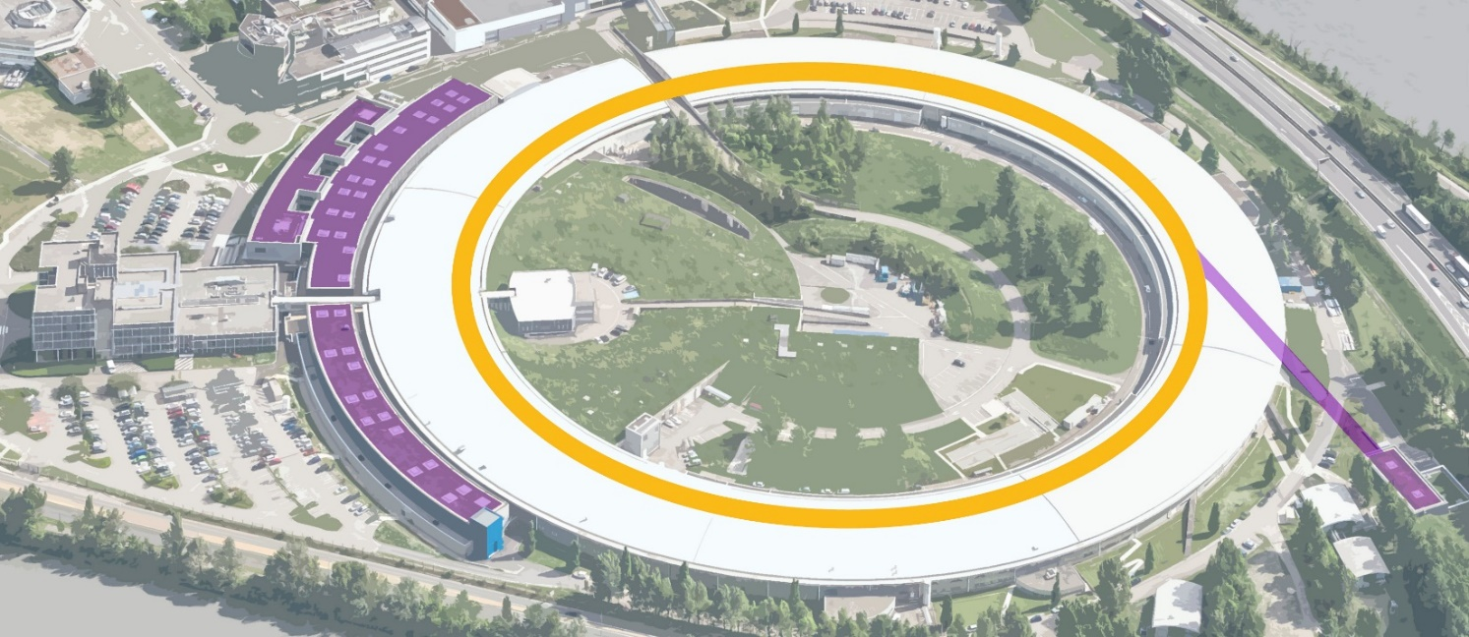
An ambitious and innovative project: The Upgrade Programme
2009
2015
Upgrade PHASE I – 180 M€
In time and within budget
2015
2022
ESRF-EBS – 150 M€
Launched in June 2015
- Construction of 19 new-generation experimental stations to explore the nanoworld
- Creation of a new ultra-stable experimental hall
- Improvement and refurbishment of most of the cutting-edge scientific equipment and accelerator infrastructure
- Construction of a new storage ring, inside the existing structure, with performance increased by a factor of 100
- Construction of new state-of-the-art beamlines
- Ambitious instrumentation programme (optics, high-performance detectors)
- Intensified big data strategy
Accelerator – 100M€
Beamlines – 20M€
Instrumentation and IT – 20M€
Personnel – 10M€

Slide 5
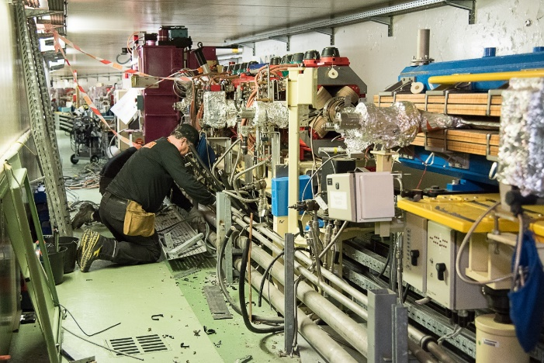
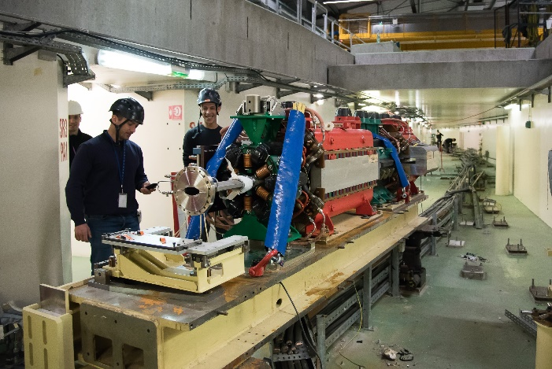
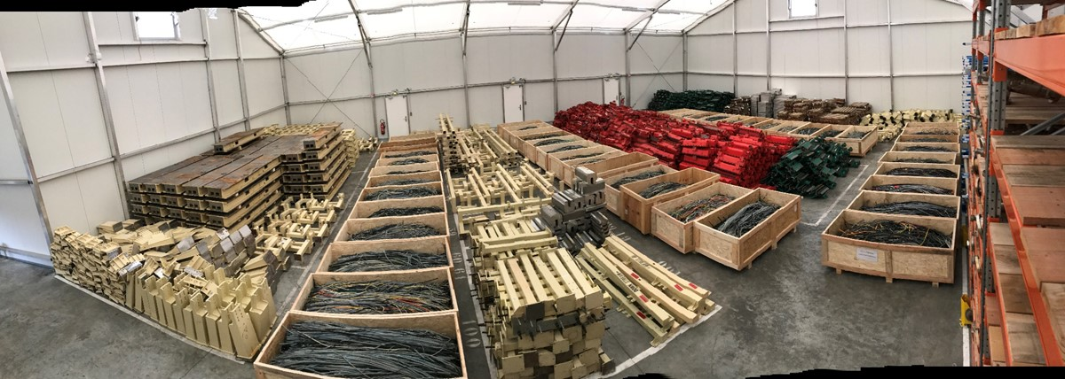
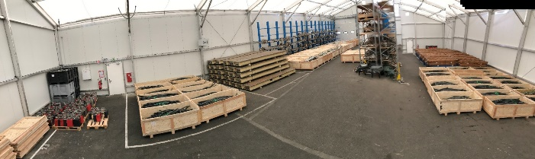
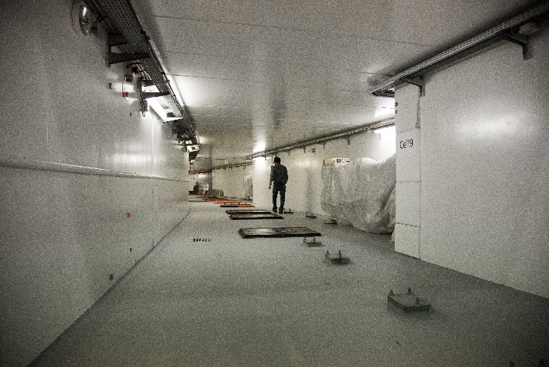
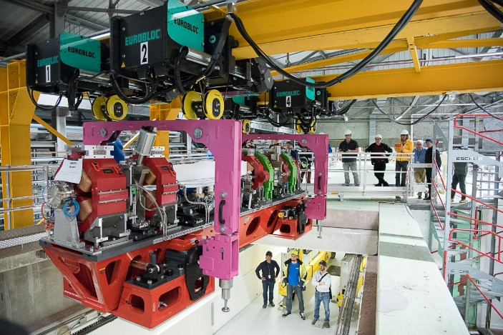
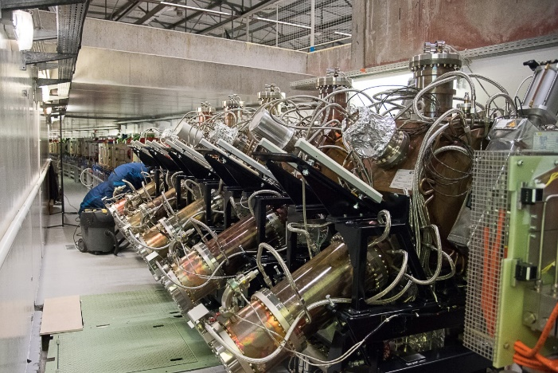
ESRF – EBS project
4 Jan 2019: start of dismantling
28 Feb 2019: removal of last girder
1 Mar 2019: ESRF11 and ESRF13
1 Mar 2019: tunnel ready for installation
6 Mar 2019: installation of 1st girder
9 Apr 2019: installation of 1st cavities
9 May 2019: installation of last girder

Slide 6
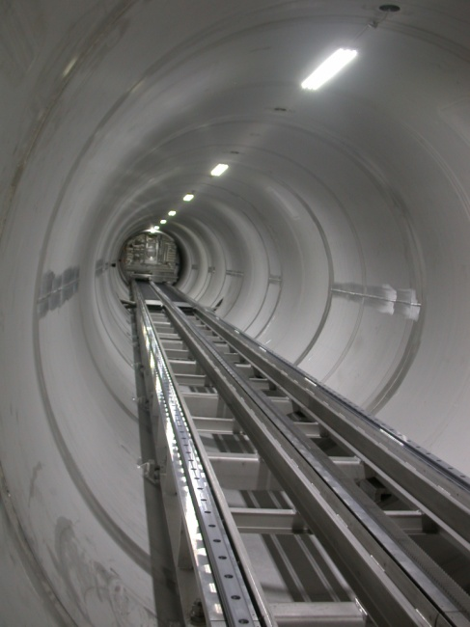
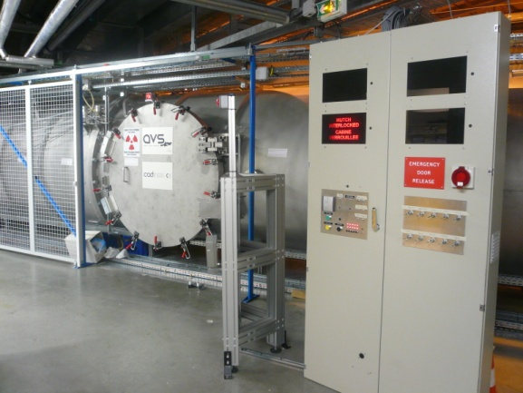
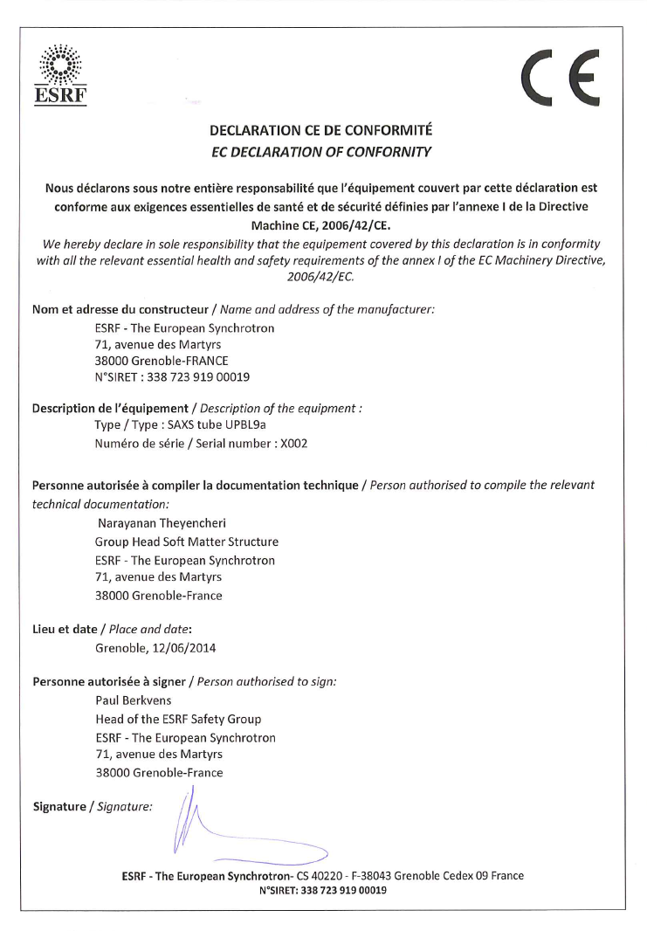

CE Certification at the ESRF
The CE certification has been formalised at the ESRF since 2014 and has been presented at previous ITSF conferences.
We give a short recall of the process and an update of the present situation.

Slide 7
CE Certification at the ESRF
Following rather poor experience with CE certification using external bodies, ESRF has decided to manage the CE self certification in an independent manner inhouse.
2014: CE certification process formalised.
New projects: CE certification taken into account from design phase (TDR).
Creation of a CE certification expert panel.
Present members of the panel:
  Trevor Mairs , Mechanical Engineering Unit
  Joachim Leonardon, Vacuum Group
  Jean Marc Gay, Electrical Engineering Unit
  Ricardo Hino, Electronics Unit
  Nicolas Janvier, Electronics Unit
  Eric Dettona, CRG Office
  Stéphanie Ricot, Safety Group
  Paul Berkvens, Safety Group

Slide 8
CE Certification at the ESRF
1. Identify the applicable Directive(s).
2. Identify the applicable requirements of the Directive(s).
3. Identify an appropriate route to conformity.
  Self certification or need for notified body…
4. Assessment of the equipment's conformity.
  Risk assessment
  ISO 14121-1 & 2 + ISO 12100: Risk Assessment – Principles & Practical guidance and examples of methods.
5. Compile the technical documentation.
  Technical description, drawings, circuit diagrams and photos, test reports and/or assessments, user instructions…
6. Make a Declaration of conformity and affix the CE marking.

Slide 9
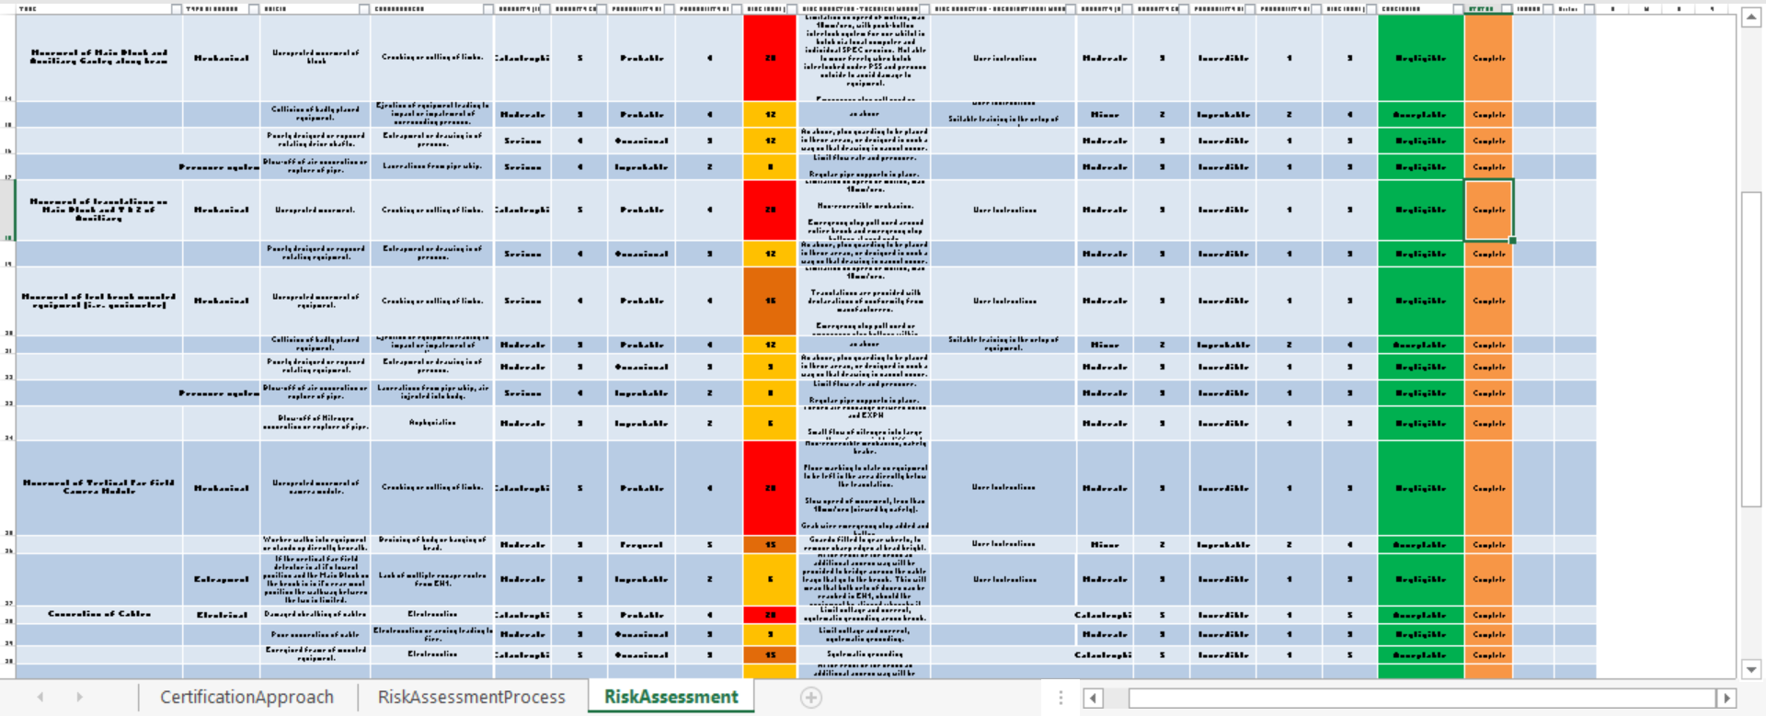
CE Certification at the ESRF
4. Assessment of the equipment's conformity.
  Risk assessment
  ISO 14121-1 & 2 + ISO 12100: Risk Assessment – Principles & Practical guidance and examples of methods.
5. Compile the technical documentation.
  Technical description, drawings, circuit diagrams and photos, test reports and/or assessments, user instructions…
6. Make a Declaration of conformity and affix the CE marking.

Slide 10
CE Certification at the ESRF
Weekly meetings, during which one or two projects are reviewed
Process:
  TDR → Identify equipment requiring CE certification.
  Invite instrument owner to meeting for presentation of project.
  Appoint member of panel to follow up project.
  Risk assessment.
  Review 1st draft risk assessment during one of the weekly meetings.
  Update risk assessment.
  Review revised risk assessment + 1st draft user instructions.
  Final meeting → certification.
  Risk assessment template (excel file).
  Template for Users Instructions.
  Formal milestones in project planning.

Slide 11
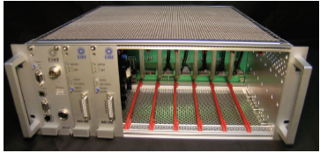
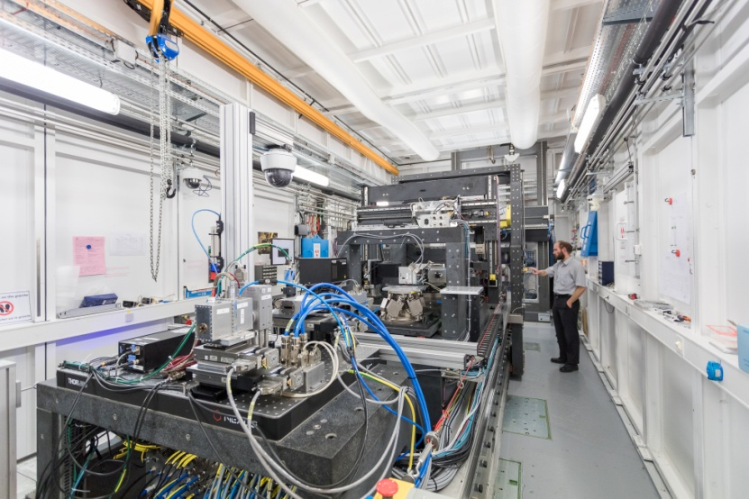
CE Certification at the ESRF
Equipment already certified (1/2)
ID02 SAXS tube
ID06 HRXM
ID31 CARNAC detector
ID32 RIXS spectrometer
BM32 ISN2 diffractometer
IcePAP control system
BM05 Diffractometer and STAUBLI robot
Polishing Machine
Pinch off tools
ID15-EH2 End station
ID23-2 Nano end station
ID30B Robotic sample changer (STAUBLI robot)
BM16 14 crystal spectrometer
ID15-EH3 End station
ID23-1 + 2, ID29 & ID30A-3 Robotic sample changer
BM16/BM30B 5 crystal spectrometer
ID21 Refurbishment OH1 Mirror M0
X-ray Reflectometer (Optics group)
Simplified anodic bonding machine (Optics group)

Slide 12
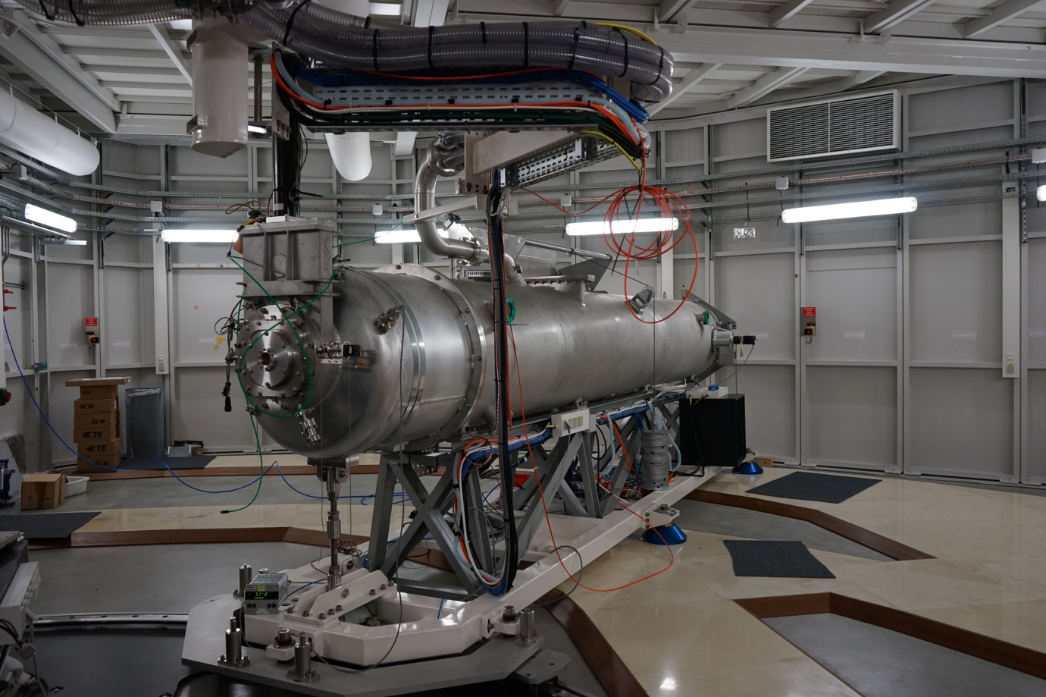
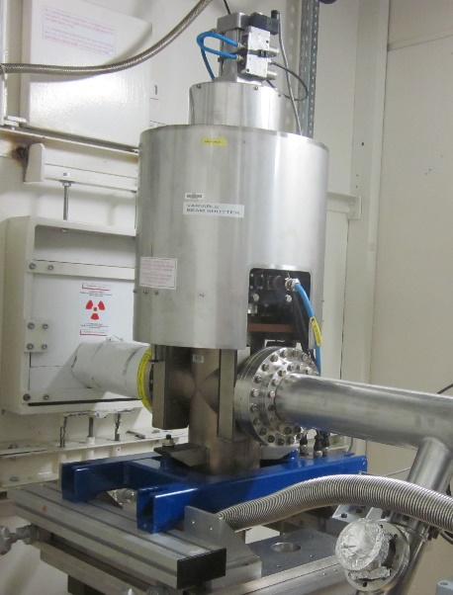
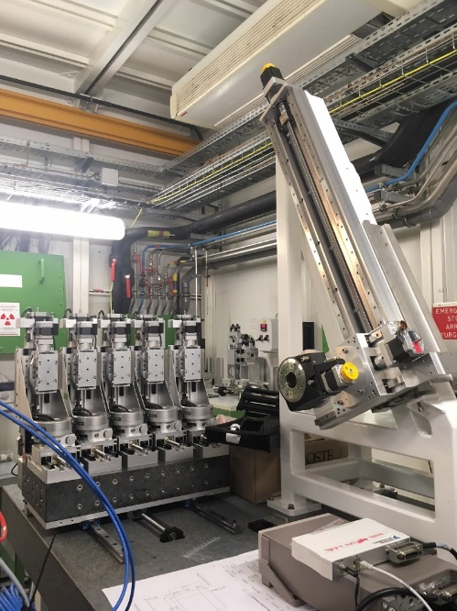
CE Certification at the ESRF
Equipment already certified (2/2)
ID20, ID26 Phase Plates
ID26 TEXS spectrometer
ID01 SAXS tube
BM20 Spectrometer
ID31 Microstation
EBS Scrapers: Horizontal
BM20 Glovebox
Beam viewers
White Beam Shutter
WHIST
Monochromatic beam shutter & Variable beam shutter

Slide 13
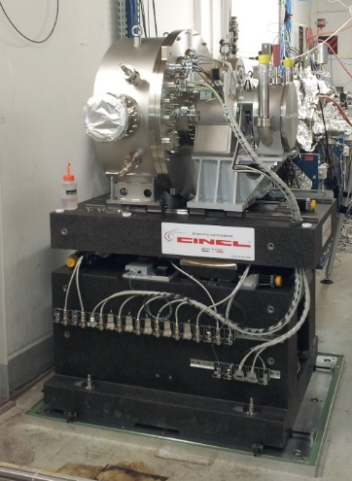
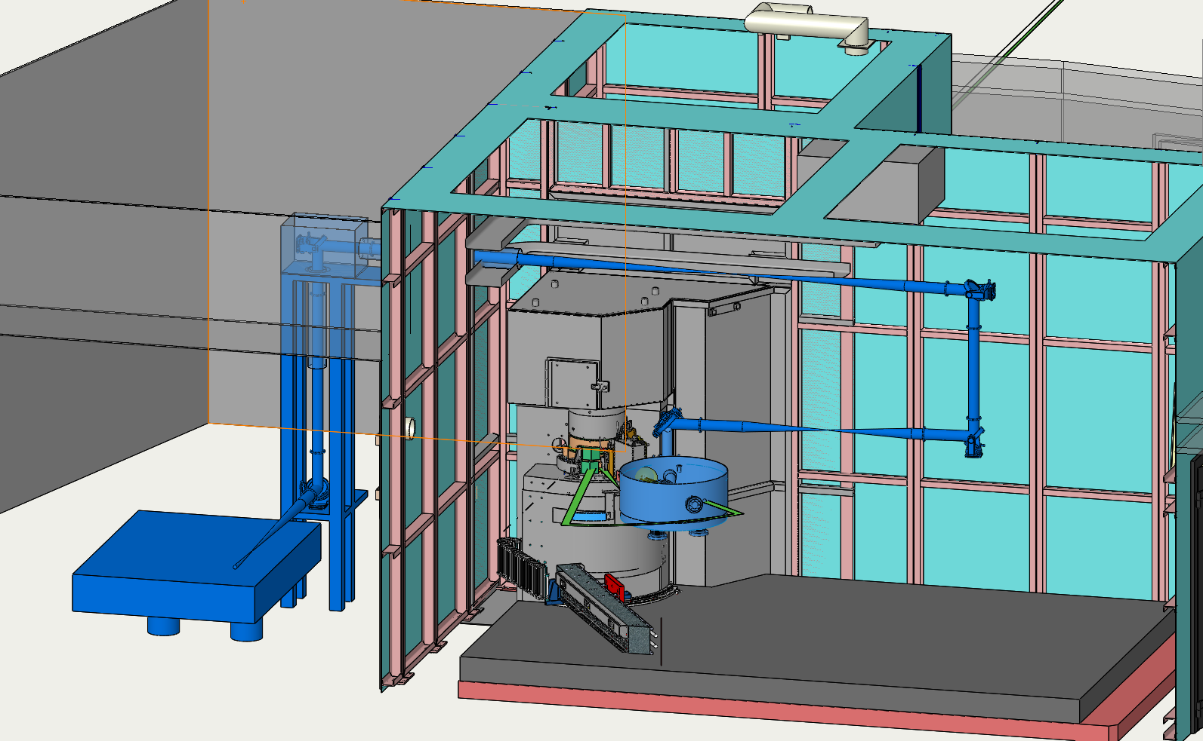
CE Certification at the ESRF
Certification in progress (1/2)
Double crystal monochromator
ID09 Chopper (new and old)
Girders
BM08 Monochromator
BM28 SAXS/WAXS measurements instrument
Epitaxy Furnace
ID24 High power laser facility
ID24 Experimental Hutch
ID21 Refurbishment CC4 & CC5
Semi-automatic anodic bonding machine (Optics group)
EBS Scrapers: Vertical, & Injection & EBS Beamkillers
BM28 Diffractometer
BM08 Experimental table: idem monochromator
BM18 New beamline
HP primary slits & Standard HP attenuators
HP attenuators with axis as beam viewer
Photon absorbers
Microjacks

Slide 14
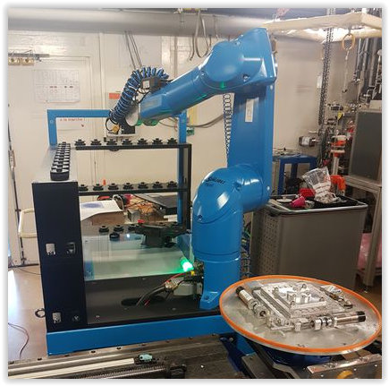
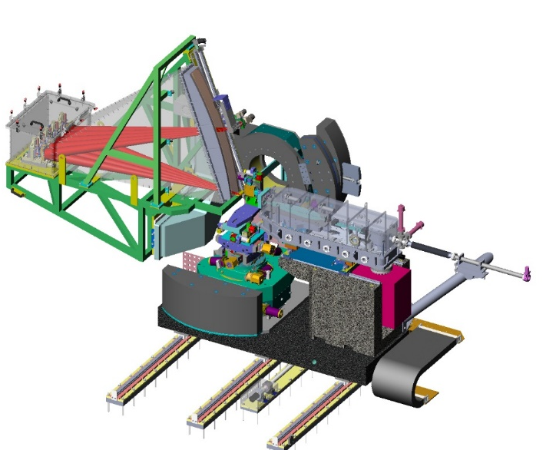
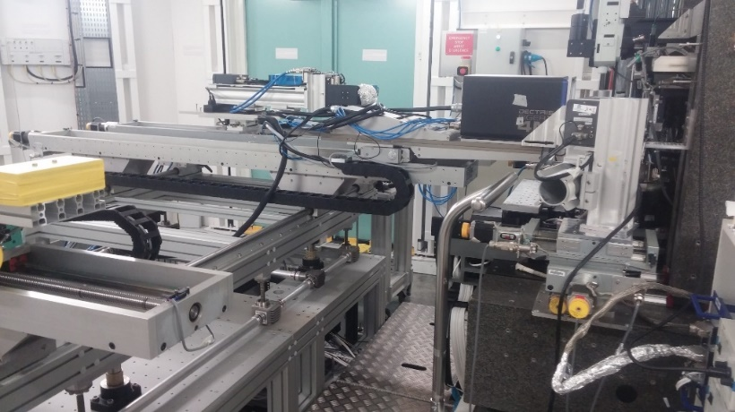
CE Certification at the ESRF
Certification in progress (2/2)
ID20 Spectrometer EH2 & EH3
Pulsed power supplies
BM07 Experimental Hutch
ID01 Hydraulic wafer press
ID22 High Energy Lab
ID19 Zoom optics
ID13 Motorised detector stage
ID20 R2D motorised phase analyser
ID21 In vacuum Cryo SXM
ID21 In vacuum XAS
ID21 In air SXM
ID19 Robotic sample changer
ID16A HPZ rotation stage
ID26 DCM
ID24 EDXAS Detector
ID29 Beamline Upgrade
ID27 Femto Drill

Slide 15
CE Certification at the ESRF
Overall positive experience.
Still on a learning curve.
Difficulties to finalise certification for a given equipment.
Risk of partial machinery: declaration of incorporation:
  Beware of “don’t put your head in the plastic bag” syndrome.
  Certification should clearly state that the equipment is not to be used by the “grand public”, but should be used by technically competent people.
Using the present long shutdown to catch up with existing equipment.

Slide 16


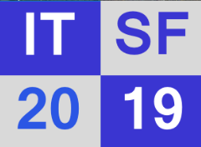
CE Certification at the ESRF

