Slide 2
Integration of Safety thru an extended project lifecycle: example of the CERN LHC Injectors Upgrade (LIU) project
A. Funken
LIU Project Safety Officer
CERN Beams Department, Safety Office

Slide 3
Outline
Introduction to the LIU project
Safety objectives
Safety organization
Safety milestones
Safety documentation
Safety compliance of the equipment
Outlook on possible improvements and summary

Slide 4
Introduction to the LIU project
Aim:
  The LHC Injectors Upgrade (LIU) project aims at making the injectors chain of the LHC, for both protons and ions, capable of supplying the high intensity and high brightness beams requested by the High-Luminosity LHC (HL-LHC) project
Overall scope:
  A new linear accelerator (Linac4)
  Five existing accelerators
  Related surface buildings

Slide 5
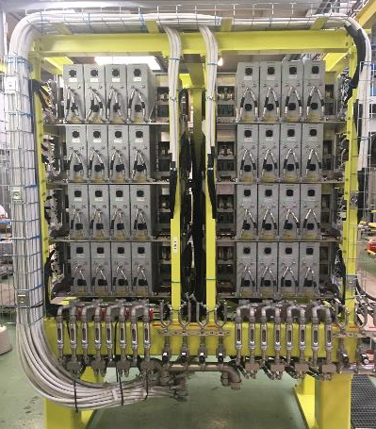
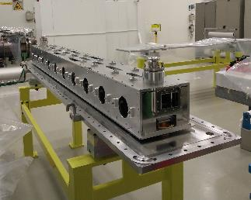
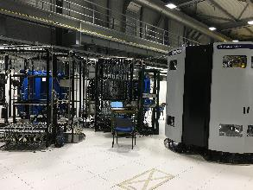
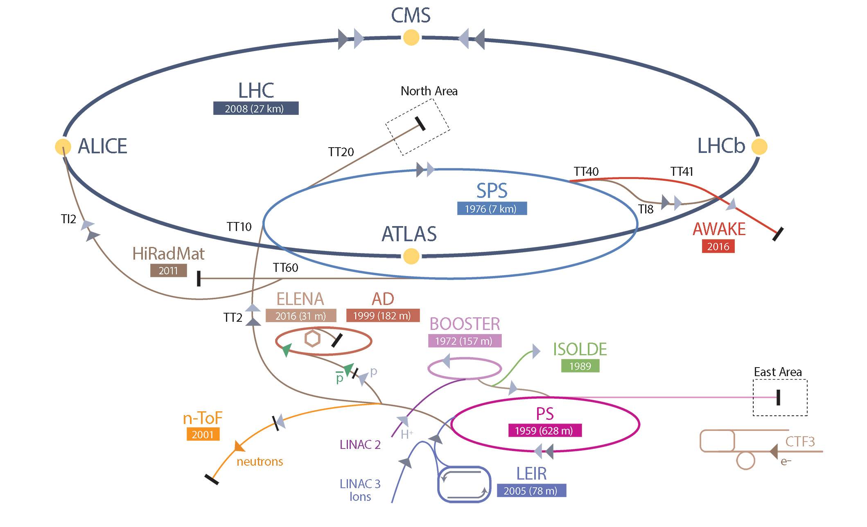
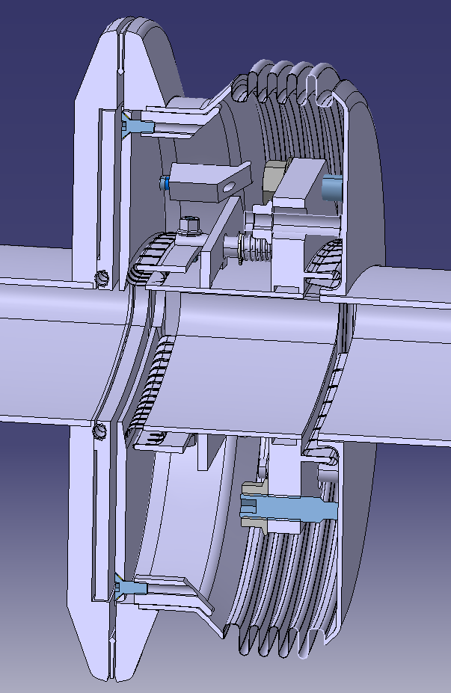
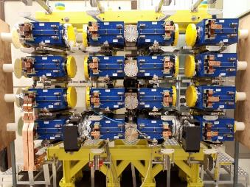
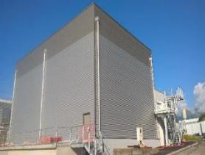
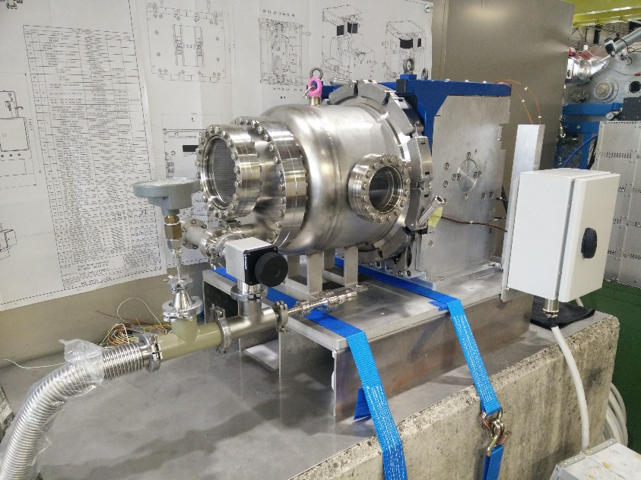
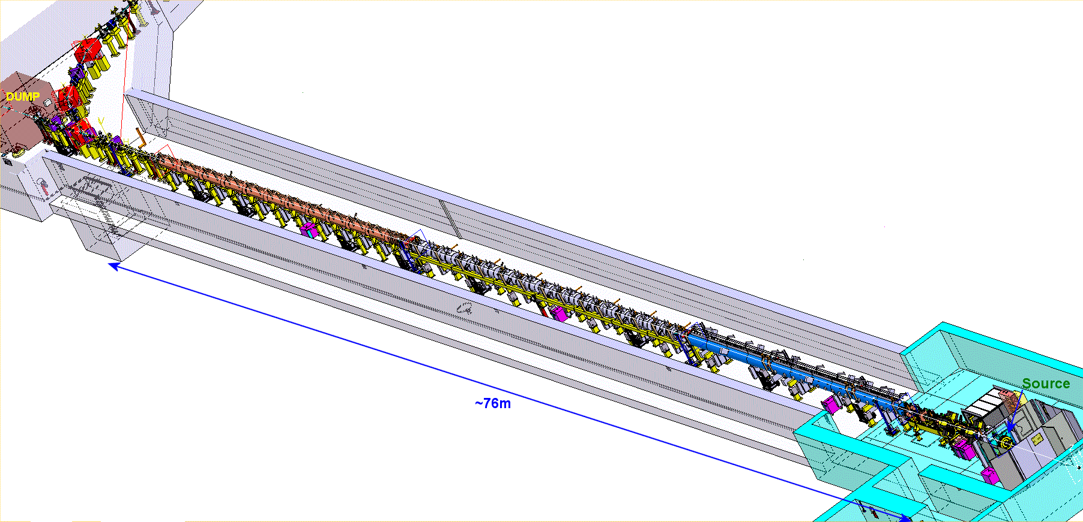
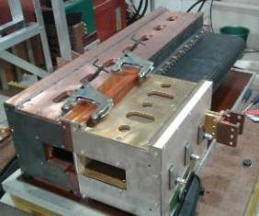
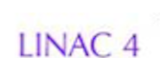
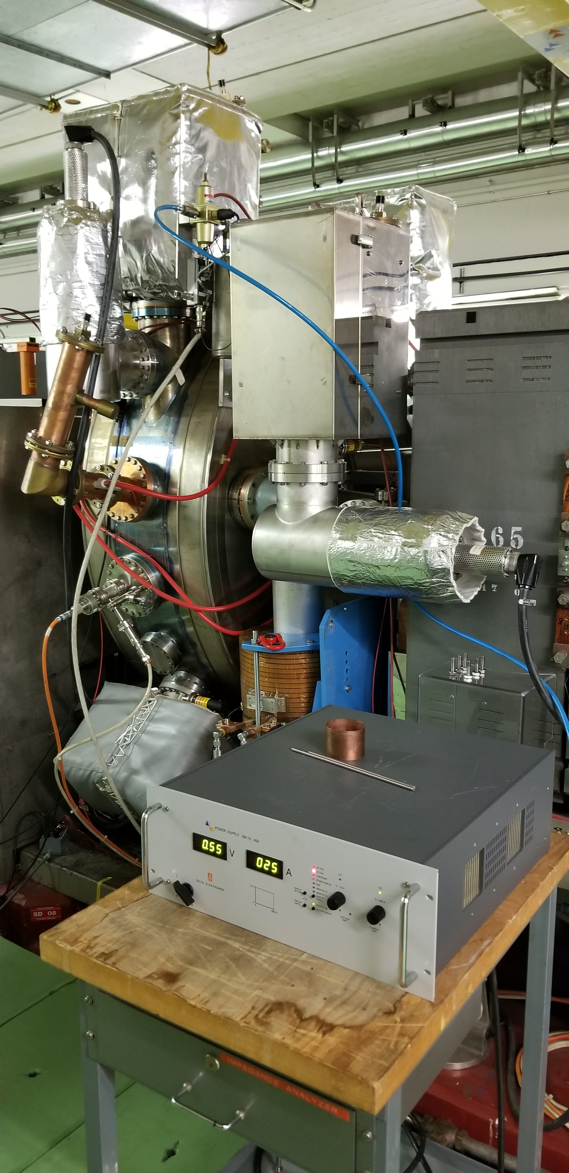
Overview on LIU
Main RF system (200 MHz) upgrade
Longitudinal impedance reduction & anti-ecloud coating
New beam dump and protection devices
160 MeV H⁻ charge exchange injection
Acceleration to 2 GeV with new main power supply and new RF systems
2 GeV injection
New RF equipment including broad-band feedback
Linac4
Acceleration of H⁻ to 160 MeV
Nominal 40 mA within 0.4 μm
Courtesy: G. Rumolo (CERN)

Slide 6
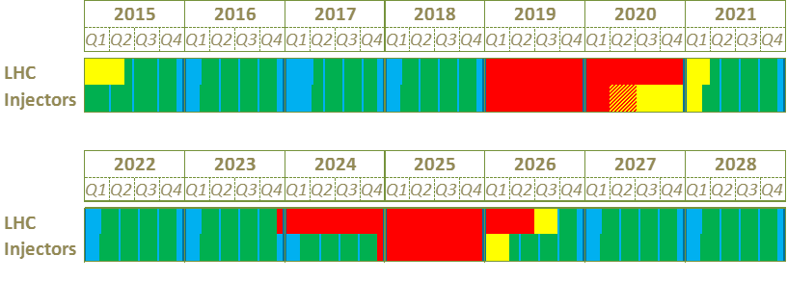
General timeline
Up to now:
  Equipment design, prototyping, procurement, advanced installation and testing;
  Cabling and decabling;
  Beam studies;
  Surface work (CE, racks);
  Linac4 commissioning
LS2: Mostly LIU installation work
Run 3: LIU beam commissioning through the injectors chain
We are here
LS2
Run 2
Mainly LIU work
LS3
Run 3
Proton Runs Technical Stops
Long Shutdowns Beam Commissioning

Slide 7
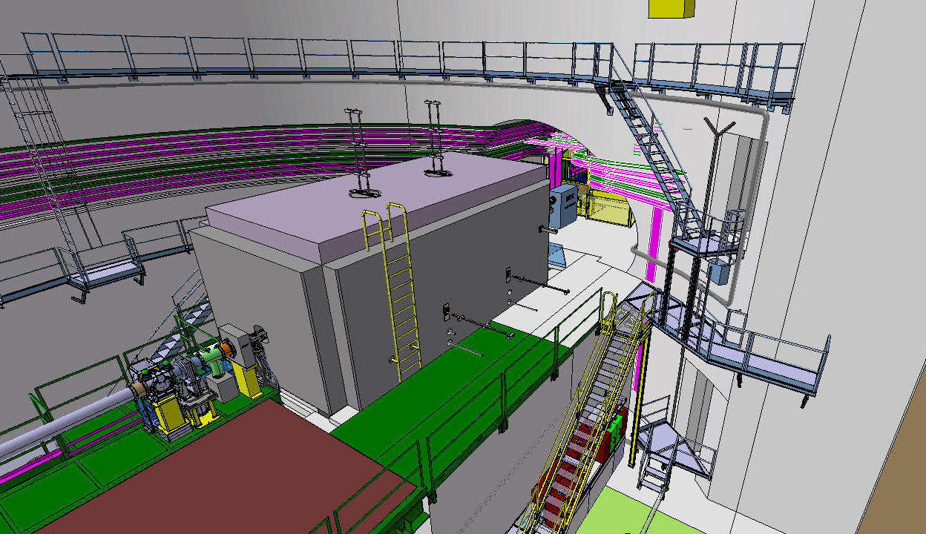
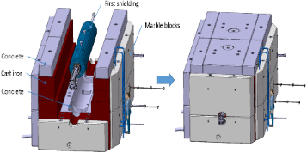
LIU Safety objectives
  Ensure the present level of Safety for the people and the environment during all project phases: design, prototyping, installation, commissioning, operation and dismantling
  Improve the level of Safety whenever possible or required
New SPS internal beam dump with the external shielding

Slide 8
LIU Safety organization
  Main actors
Project Leader (PL)
CERN HSE
Departments
HSE Correspondents
General safety
Radiation protection
Departmental Safety Officers (DSO)
Project Safety Officer (PSO)
Provide the safety rules
and requirements
(= Launch Safety Agreement)
Specialized Safety Officers (SSO)
Support the Department Head in matters of Safety
HSE experts (e.g. fire, gas, electricity)
Work package Holders
Provide expertise

Slide 9
LIU Safety organization
  Main actors
Project Leader (PL)
CERN HSE
Departments
HSE Correspondents
General safety
Radiation protection
Departmental Safety Officers (DSO)
Project Safety Officer (PSO)
Provide the safety rules
and requirements
(= Launch Safety Agreements)
Specialized Safety Officers (SSO)
LIU Safety Package Coordinators (SPC)
Support the Department Head in matters of Safety
HSE experts (e.g. fire, gas, electricity)
Work package Holders
Provide expertise

Slide 10
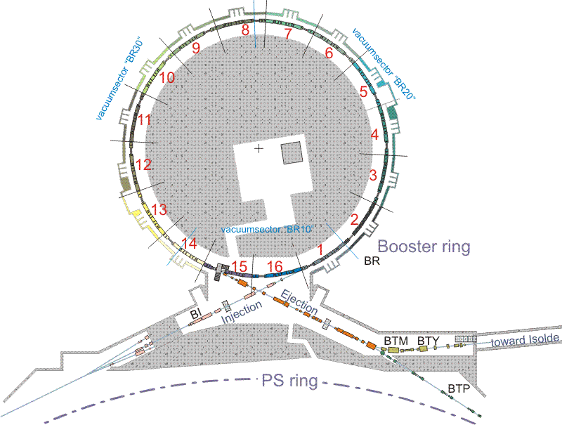
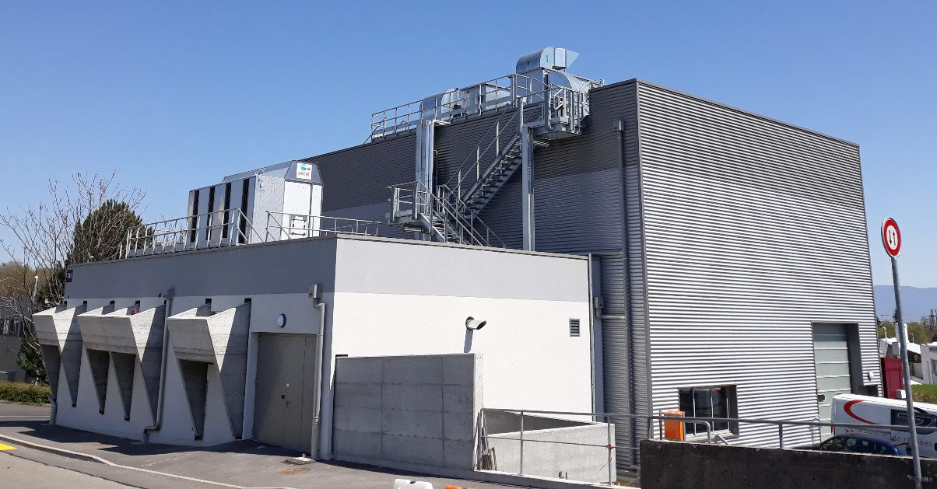
Example: safety packages of the LIU-PSB
PS Booster Rings
Injection
Extraction
Building 245 (POPS-B)
s
New power supply for the main dipole and quadrupole magnets of the PSB rings, called POPS-B
A HSE Launch Safety Agreement (LSA) is produced at the level of each LIU safety package (SP)

Slide 11
LIU Safety organization
LIU Project Team meetings (weekly)
Chair: LIU Project Leader
Members: LIU machine activity leaders, planning & installation coordinator, PSO
Reporting on the progress of the LIU safety documentation and on safety issues
LIU-machine coordination meetings (every 2 weeks)
Chair: machine activity coordinator
Members: WP holders, machine facility coordinator, SPC, PSO
HSE LSAs
Status of the safety documentation and further needs from the WP holders
Dedicated ad-hoc safety meetings
Members: machine activity leader, SPC, PSO, concerned WP holders, HSE experts, DSO/SSO
Analysis and solving of specific safety issues

Slide 12
LIU Safety milestones
Prerequisite to the beam authorization:
Completion of the safety documentation
Compliance of the equipment with the CERN rules and regulation
HSE safety clearance
All control measures implemented and functional

Slide 13
LIU Safety documentation
Safety files produced at the level of each LIU safety package (SP)
Structure and contents of the safety file of a SP:
Part 1 Descriptive
Goal, motivation, brief description of the systems/facility focusing on the safety aspects
Part 2 Demonstrative
List of hazards, risks assessment, mitigation measures for equipment/systems
Part 3 Operational
List of procedures required to operate and maintain the systems/facility safely, to dismantle it and dispose of its components safely
Part 4 Records, Experience, Monitoring (REM)
Inspection reports, safety reports, non-conformities, near-misses, incidents/accidents, experience gained
  For safety relevant equipment:
  New/modified equipment induce new hazards in the concerned area or,
  In case of same hazards, additional measures are required to ensure Safety

Slide 14
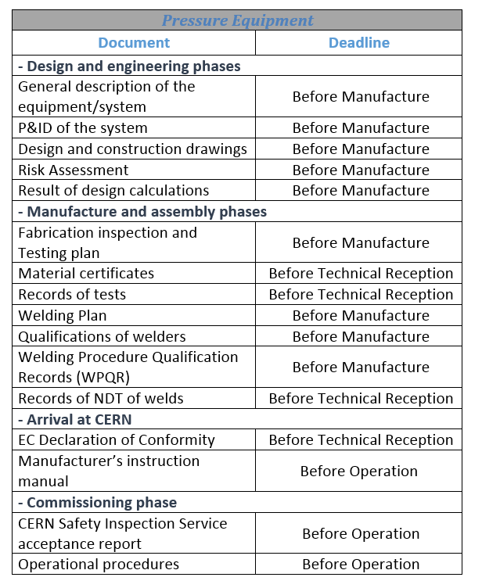
Safety compliance of LIU equipment
  Safety compliance demonstrated based on the applicable safety requirements (HSE LSAs)
  List of documents made available to CERN HSE during the project life-cycle (referenced in the LIU safety files)
  E.g.: for pressure equipment

Slide 15
Safety compliance of LIU equipment
Equipment owner
CERN HSE
Non conformities to solve
Safety validations on site
E.g. metallic structures
Regulatory controls (inspections)
E.g. electrical equipment
New or modified
LIU equipment
Autorization to be used
Request
Inventory done per accelerator
Activities integrated in the individual machine planning
Follow up at the LIU machine coordination meetings
Process of HSE electrical pre-visits in place
Verification of the risk of direct contact before installation in the accelerator
Inventory done per accelerator
Follow up done with the equipment groups

Slide 16
Outlook on possible improvements
CERN HSE
Equipment owner
Project
LSA for main projects :
List the documents required per safety domain, at each project phase (e.g. pressure)
Equipment with different safety hazards
Safety to be demonstrated beyond the project phase
Safety file of a new facility to be produced: 4 main parts (descriptive, demonstrative, operational, records & monitoring)
CERN Safety rules:
List the documents required for a type of equipment during the whole lifecycle (e.g. GSI-M-2 for standard pressure equipment)
Operation
Safety file to be regularly reviewed (once a year) and updated upon needs

Slide 17
Outlook on possible improvements
  Produce equipment safety files for standard equipment at CERN :
    Could be used for the safety file of different projects
    Ensure standardization of the contents for each project safety file
    Ownership: equipment group
    Demonstration of the conformity beyond the project phase
  Produce a safety file for a new facility focusing on:
    Collection of equipment safety files for standard equipment
    Identification of hazards and risks induced due to new equipment or processes
    Multi-risks assessments (e.g fire risk assesment)

Slide 18
Summary
  Safety fully integrated in the LIU project thanks to the efficient project organization
  New strategy for the management of the safety documentation introduced and deployed in order to meet the specificities and extend of the project (concept of LIU safety packages)
  Electrical pre-visits process in place to ensure safety compliance of equipment within the project deadline
  Equipment safety files for existing CERN-standard equipment would improve the process further, both for the projects and for the equipment life-cycle as safety has to be demonstrated beyond the project phase

Slide 19
Thank you for your attention !

Slide 20
LIU Safety packages
(*)
(*) New correspondents appointed per accelerator for LS2 : O. Williams (PSB, Linac3, LEIR), M. Andreini (PS) and A. Arnalich (SPS)

Slide 21
LIU Safety documentation
As for all projects, a safety documentation (Safety File) is required to demonstrate that the new systems or facilities:
  Are being designed respecting safety principles and
  Can be constructed, commissioned, operated and dismantled safely
It covers occupational health and safety, the protection of the environment and the safe operation of CERN’s installations
It provides relevant stakeholders with a framework to access all documentation relevant to Safety

Slide 22
Safety during worksite (Long Shutdown 2)
Engineering Change Requests (ECRs) and Work Package Analysis (WPs) prepared by equipment groups include the hazards and the related control measures
Documents to be provided by the equipment groups according to the HSE Launch Safety Agreements (LSAs): design compliance, conformity of equipment, procedures (part of the Safety Files of the Safety Packages)
Standard CERN-wide procedures applicable (Intervention Management Planning & Activity Coordination Tool, Joint Inspection Visits, Traceability of Radioactive Equipment at CERN, principle of As Low As Reasonably Achievable)
Facility coordination meetings at machine level ensure the management of the planning and the coactivity
Safety Support Officer LS2 appointed for the injectors

