Slide 1
Reuse of older facilities
Challenges in fire safety
Fabian Saretzki
ITSF 2019, Lund, May 2019

Slide 2
Agenda
What you’re going to hear.
01 The situation
Missing papers
Who cares?
Reuse
Two examples
02 SINBAD in DORIS
Sinbad
Fire safety concept
Necessary changes
03 ALPS in HERA
HERA
ALPS
Way to the safety concept
Safety concept

Slide 3
The situation

Slide 4
The situation
Missing papers
Building permission
On which basis has the facility been build?
Which regulations were used?
Special regulations?
Changes and compensations?
Drawings?
Standards change
Availability of old standards/regulations
History of changes

Slide 5
The situation
Who cares?
Specifically safety systems in abandon facilities
Voluntarily built to meet own standards?
Mandatory to operate the building?
Maintained?
Still operable?
Even existing?

Slide 6
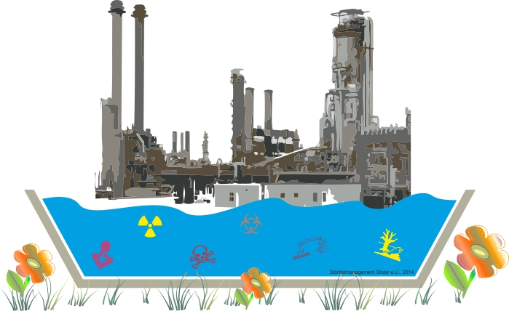
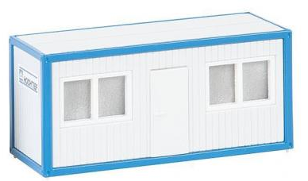
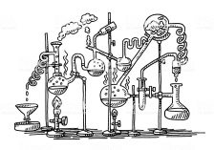
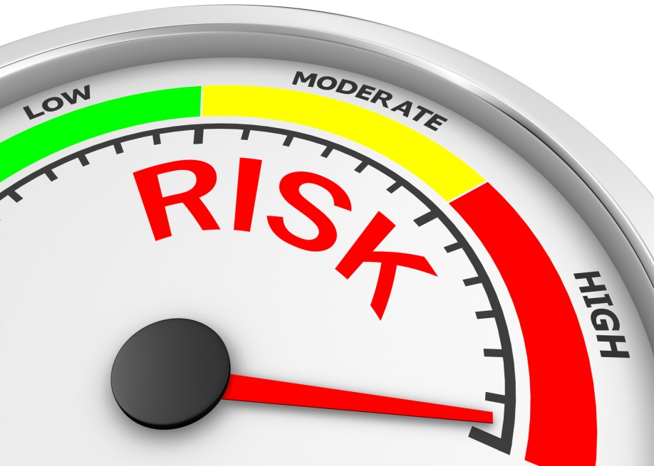
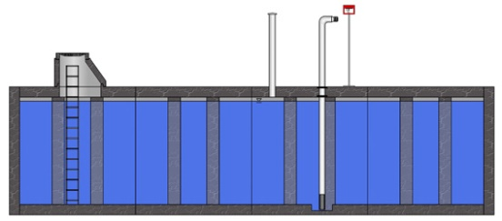
The situation
Reuse
What will change?
Is the building still used for the same purpose?
Are there major changes in the usage?
Number of users increase?
Risk of fire stays the same?
Experiments with hazardous substances?

Slide 7
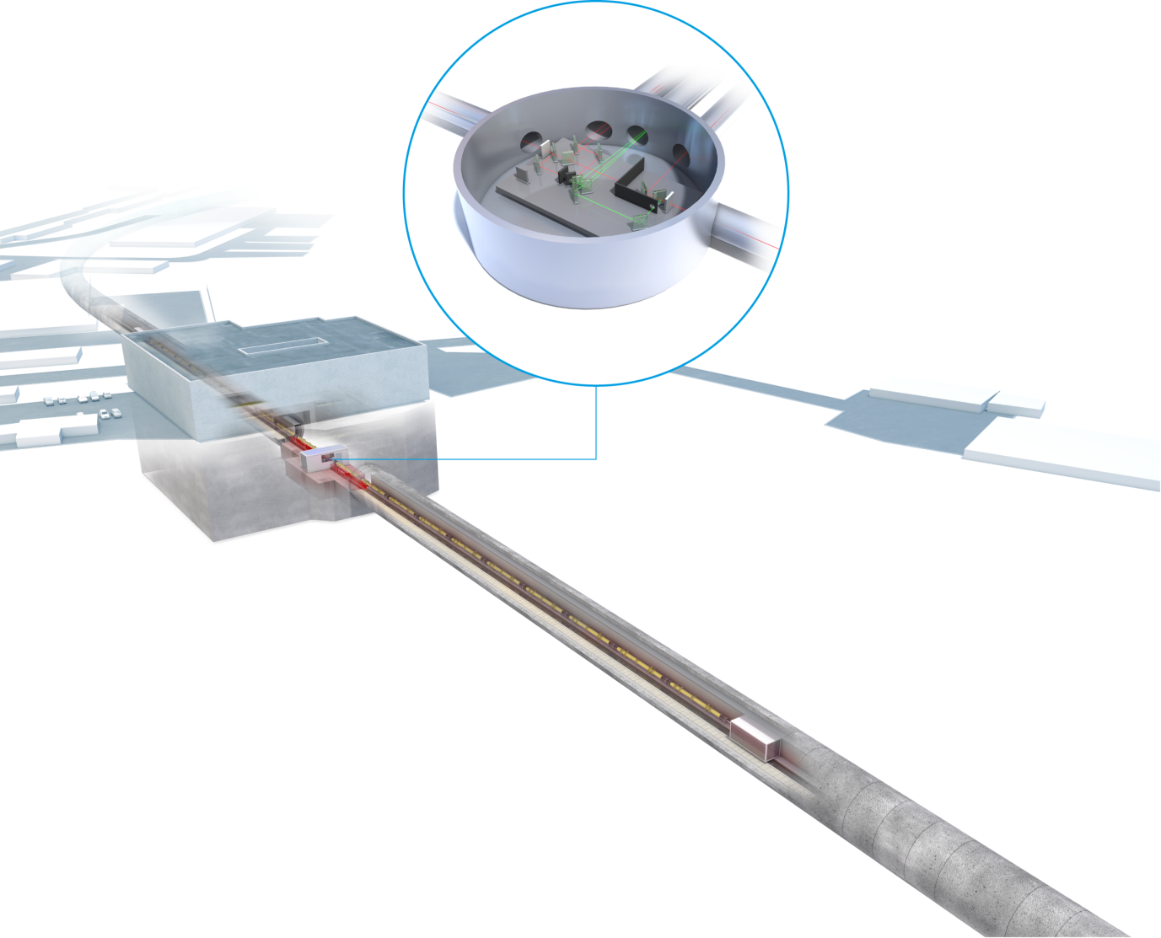
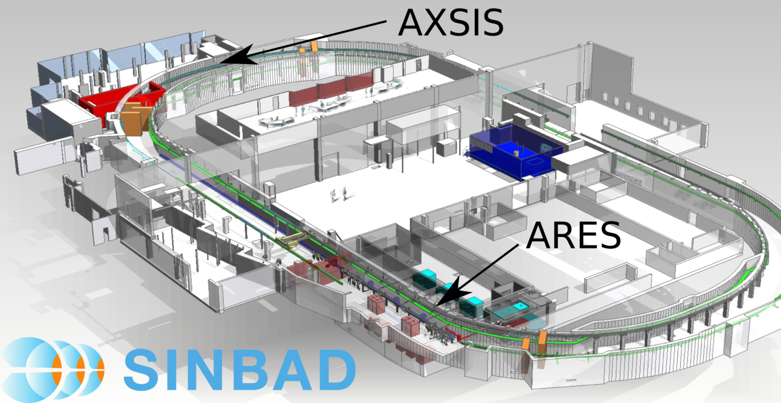
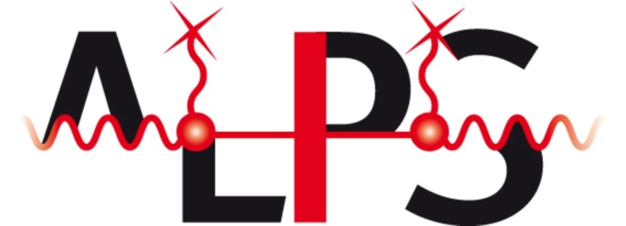
The situation
Two examples
Notes:
No need to have new safety concepts
Voluntarily to meet own safety standards and make the workplace of the staff as safe as possible

Slide 8
SINBAD in DORIS

Slide 9
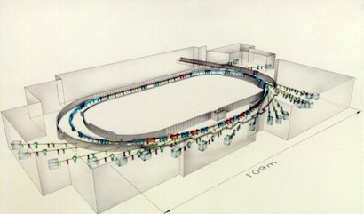
SINBAD in DORIS
Short Innovative Bunches and Accelerators at DESY
Former DORIS storage ring
Built in 1974
Source for synchrotron radiation
Switched off 2013
Shrink the accelerator
Part of the Accelerator Research & Development programme (ARD)
Multiple independent experiments
First experiments ARES and AXSIS

Slide 10
SINBAD in DORIS
Fire safety concept
Fire safety concept
From 2018
Fire compartments
Smoke compartments
Evacuation alert
Smoke extraction
…

Slide 11
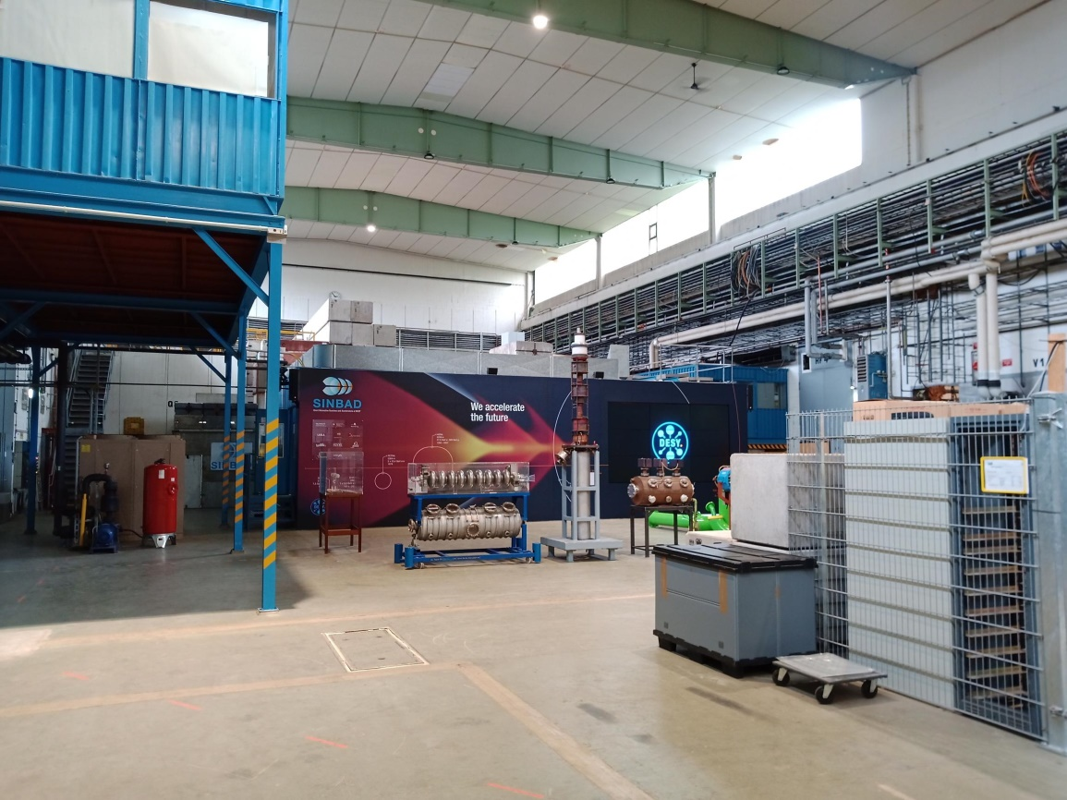
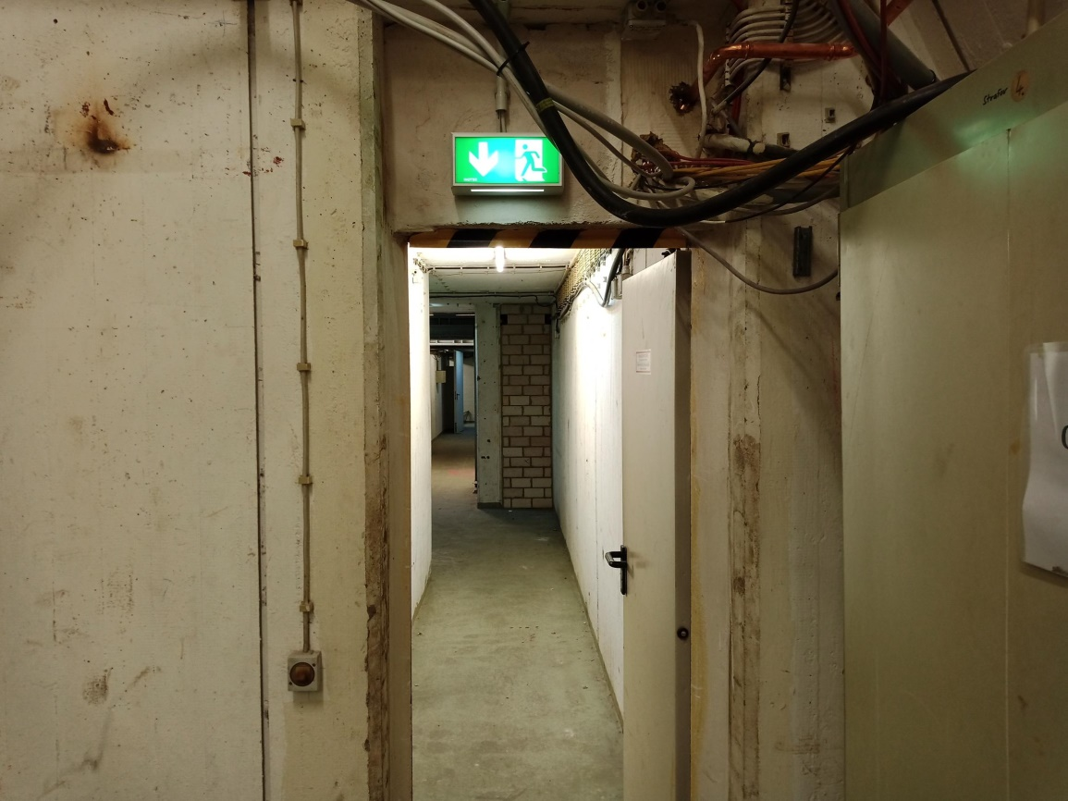
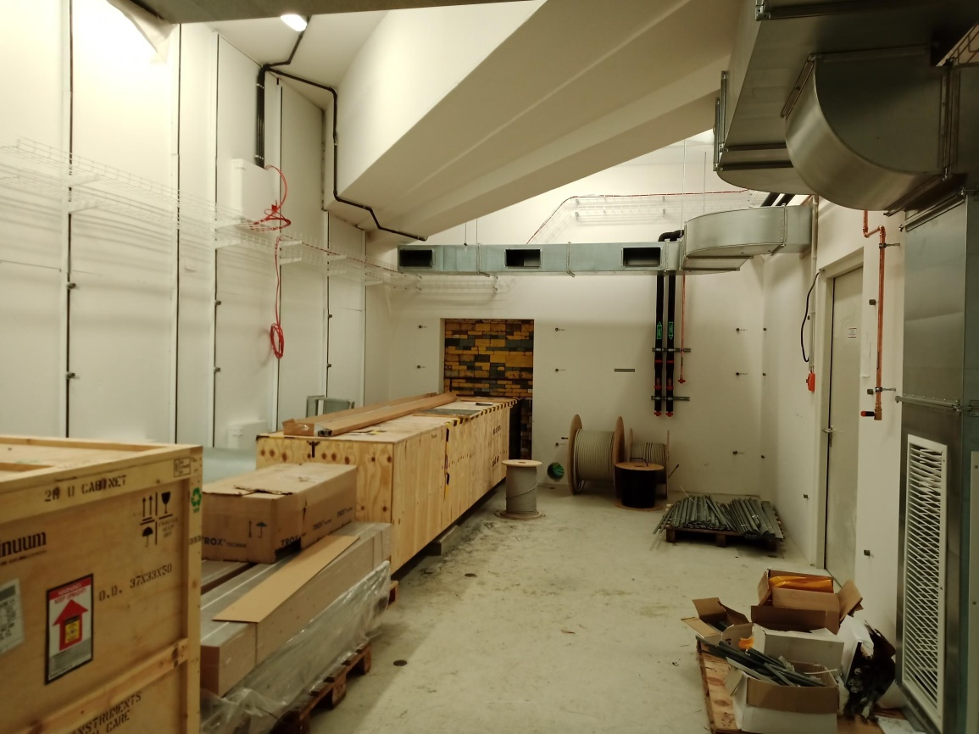
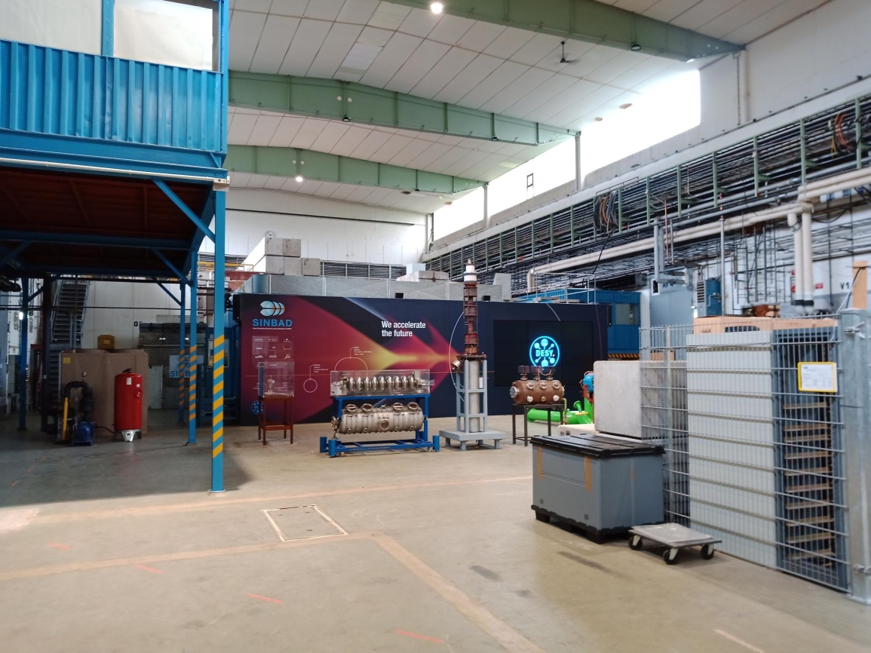
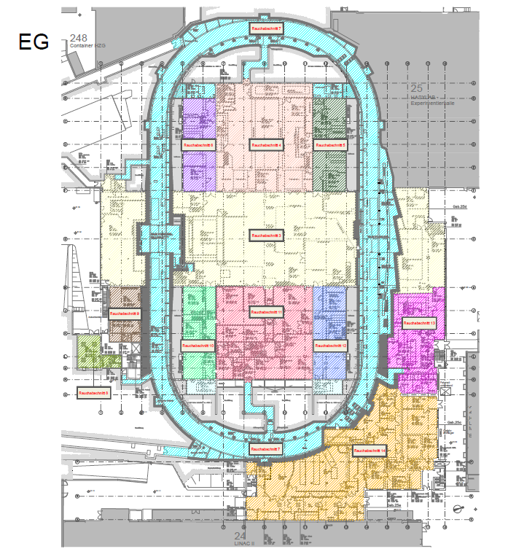
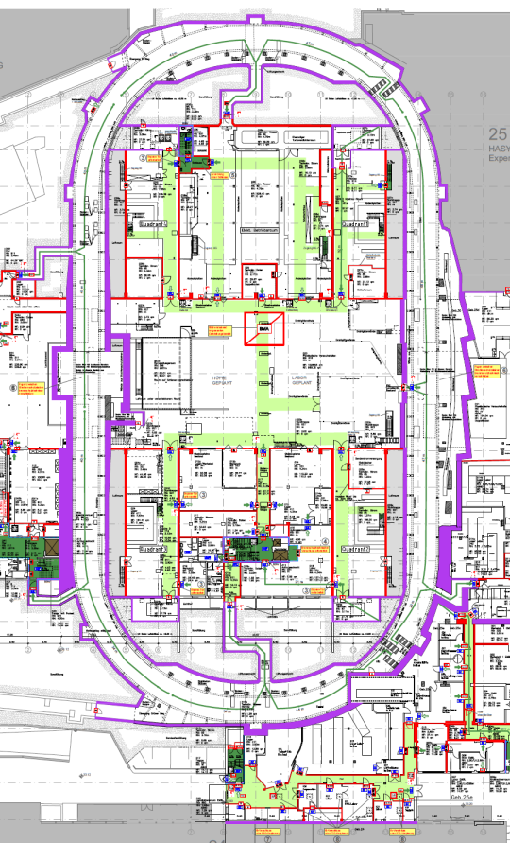
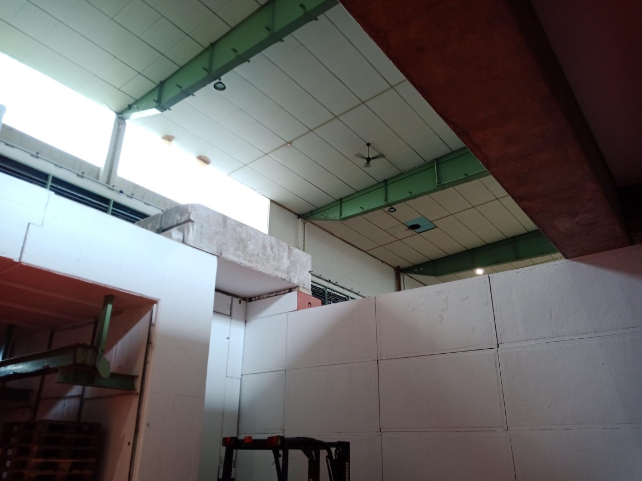
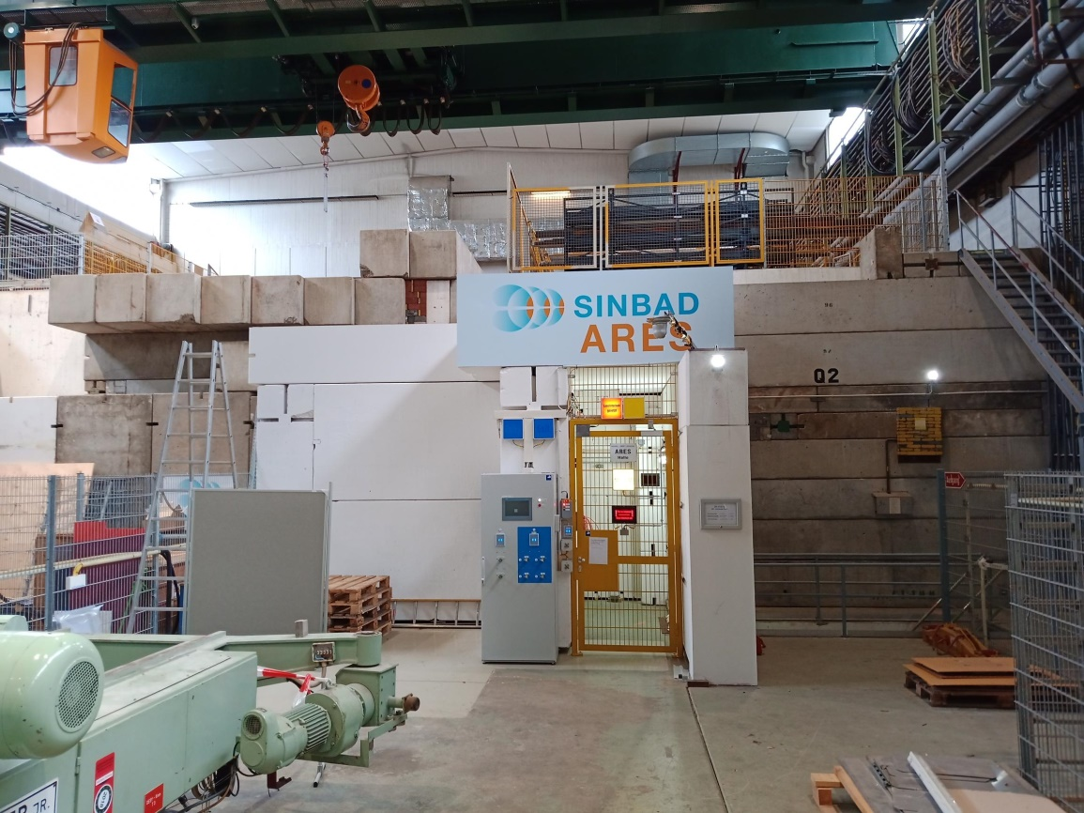
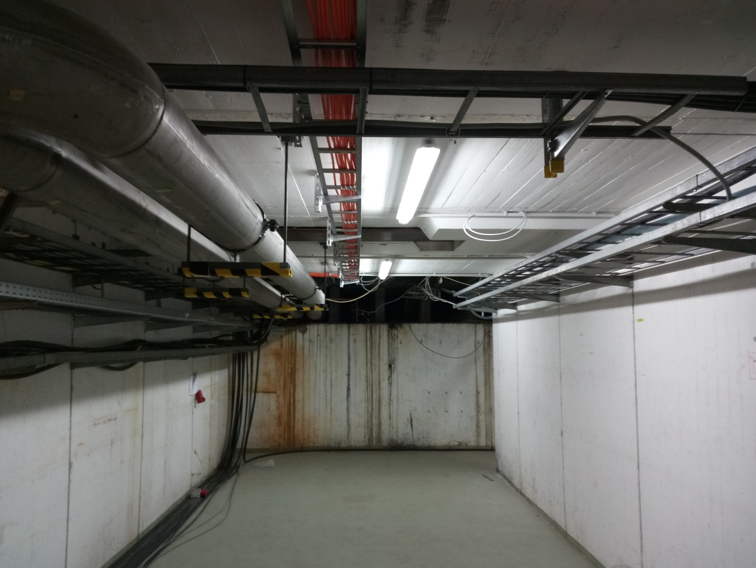
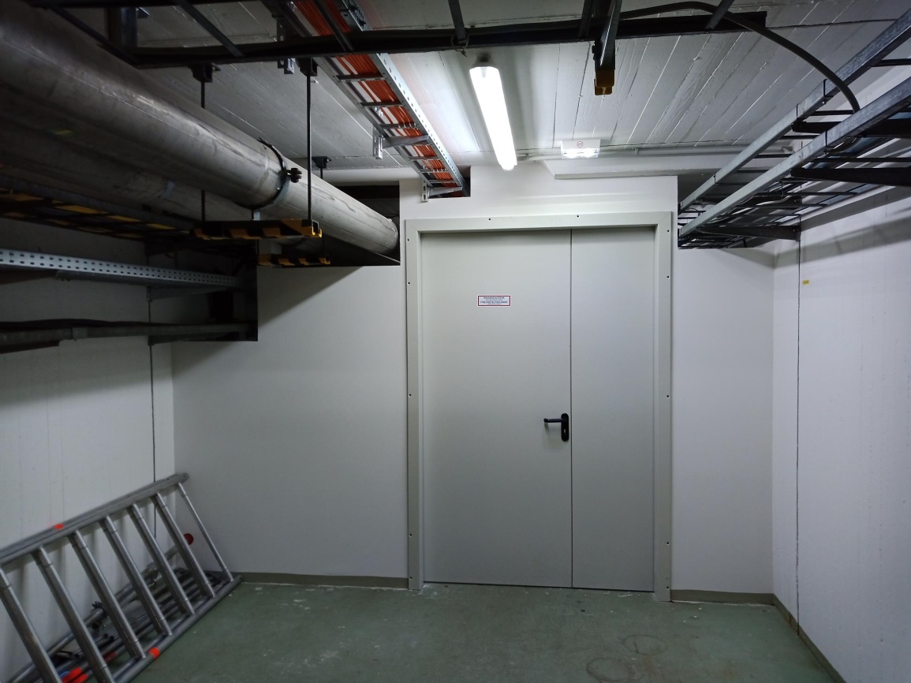
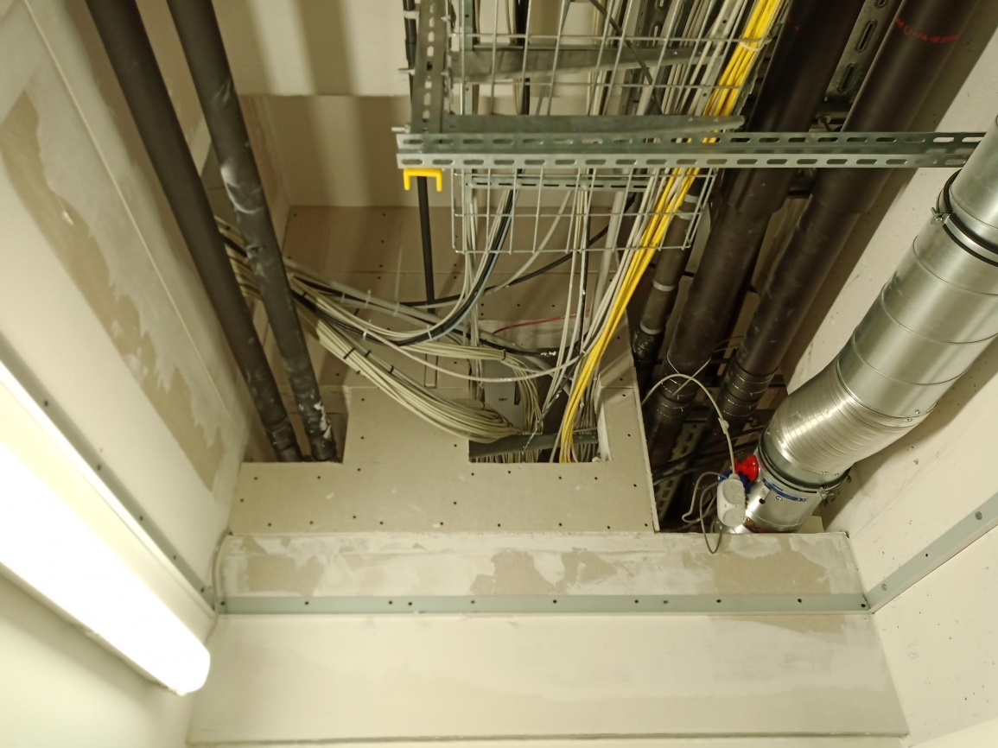
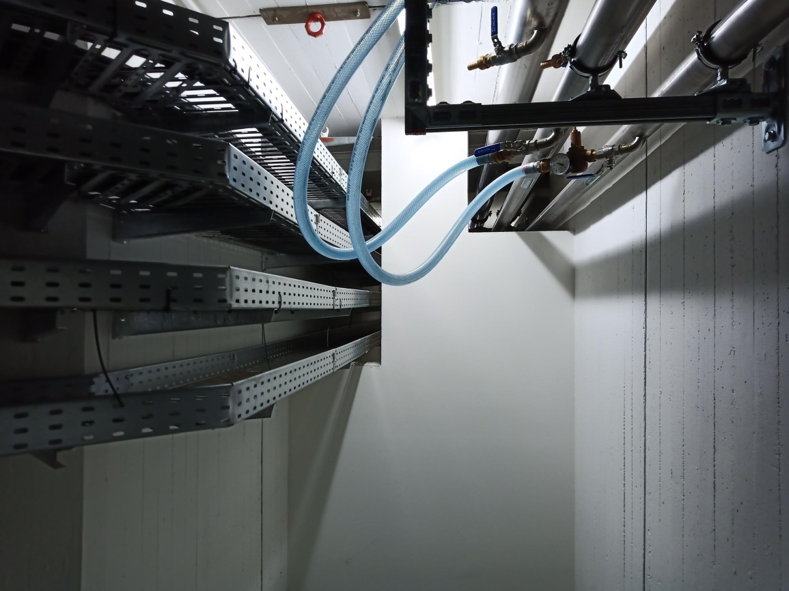
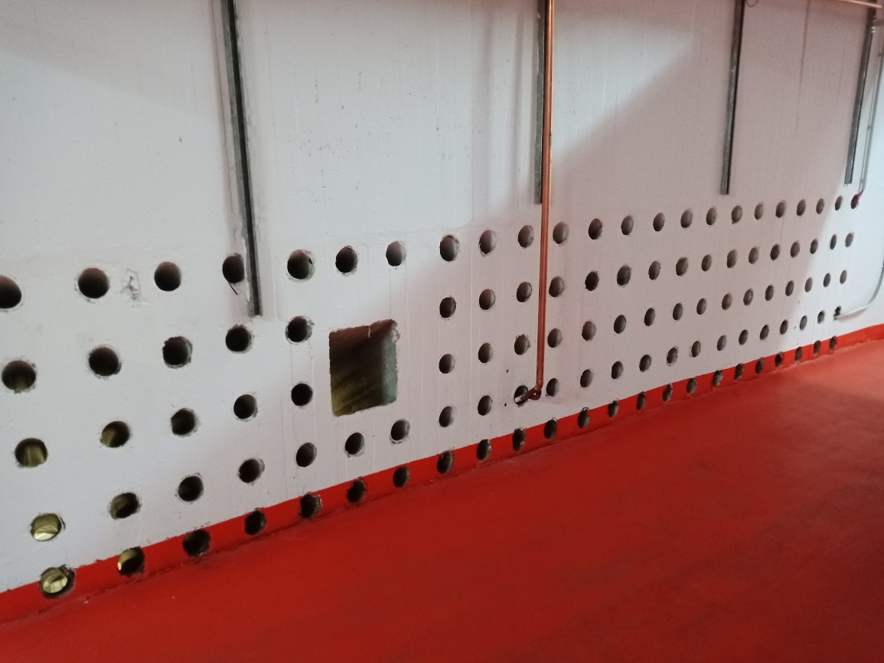
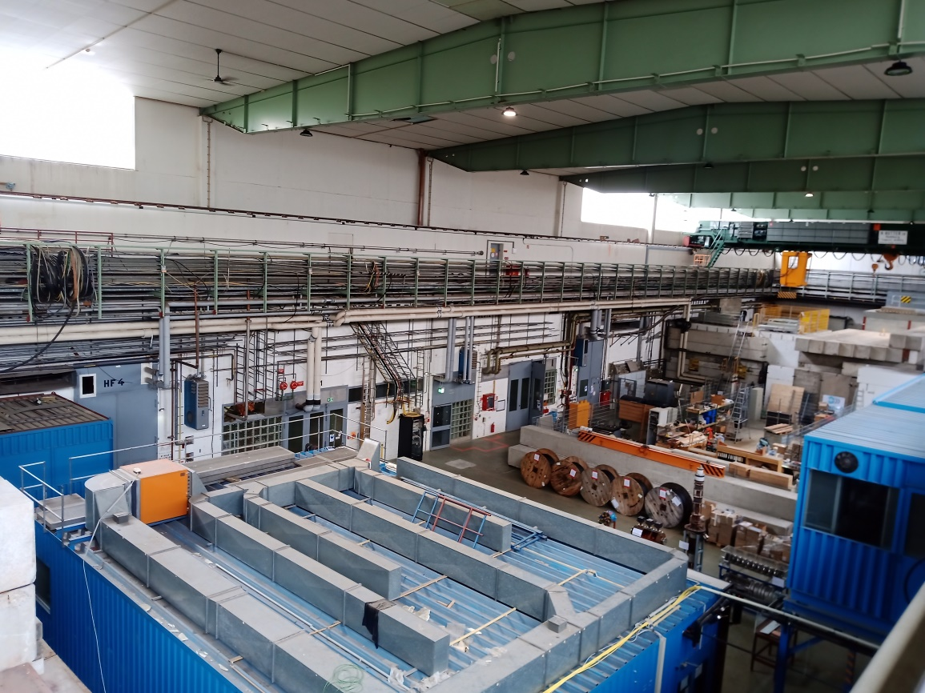
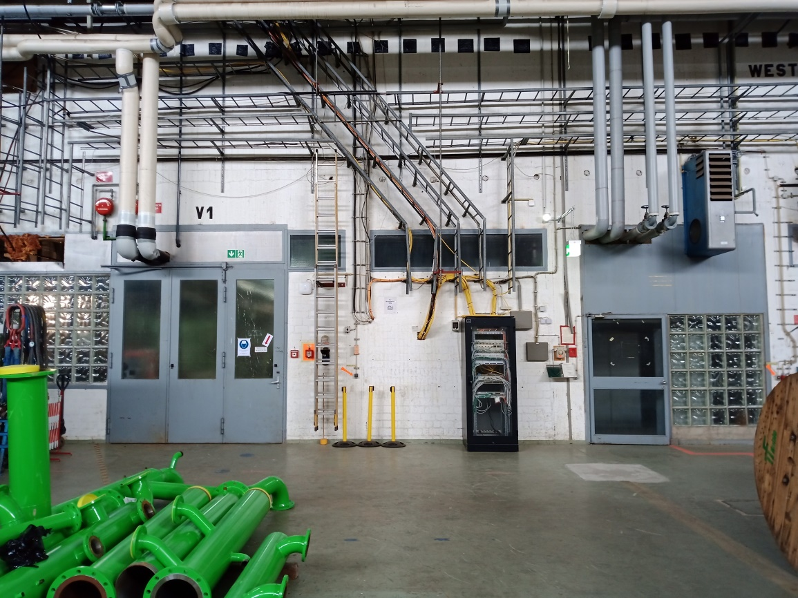
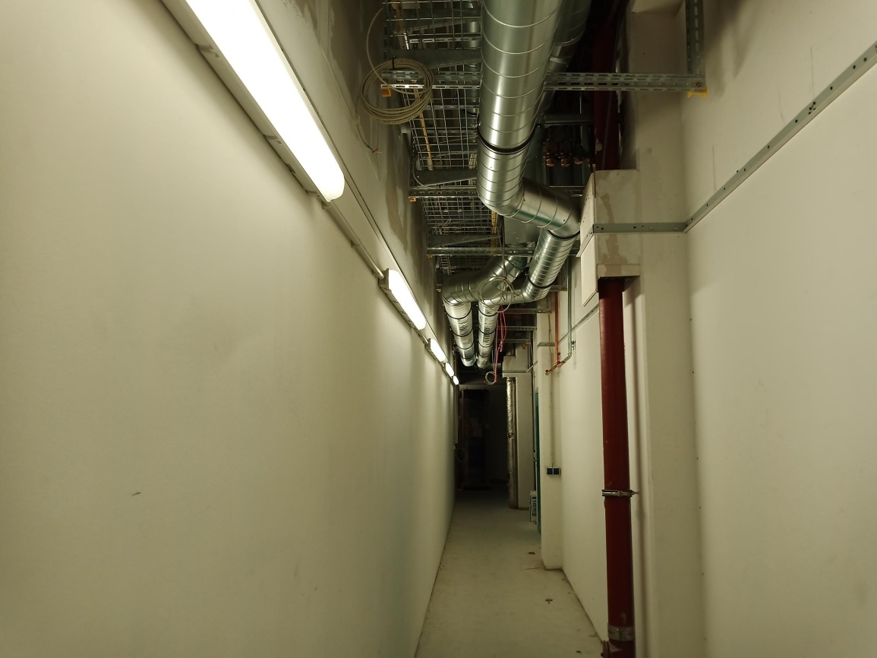
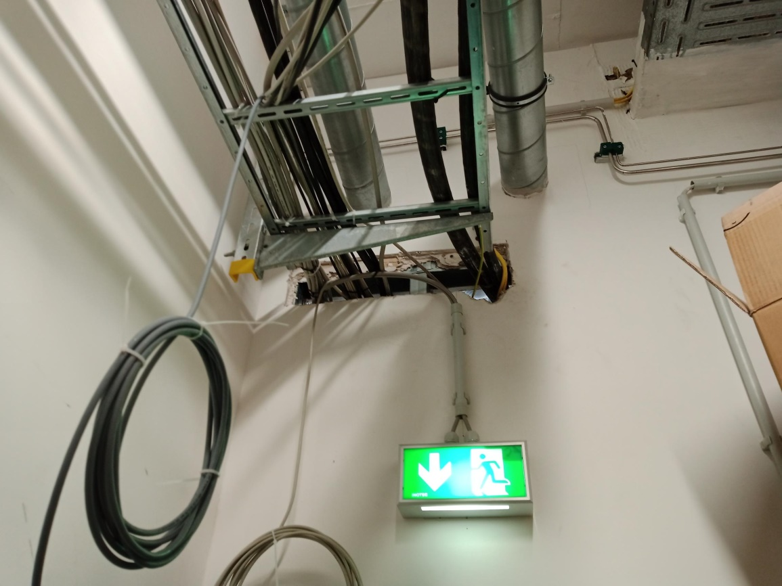
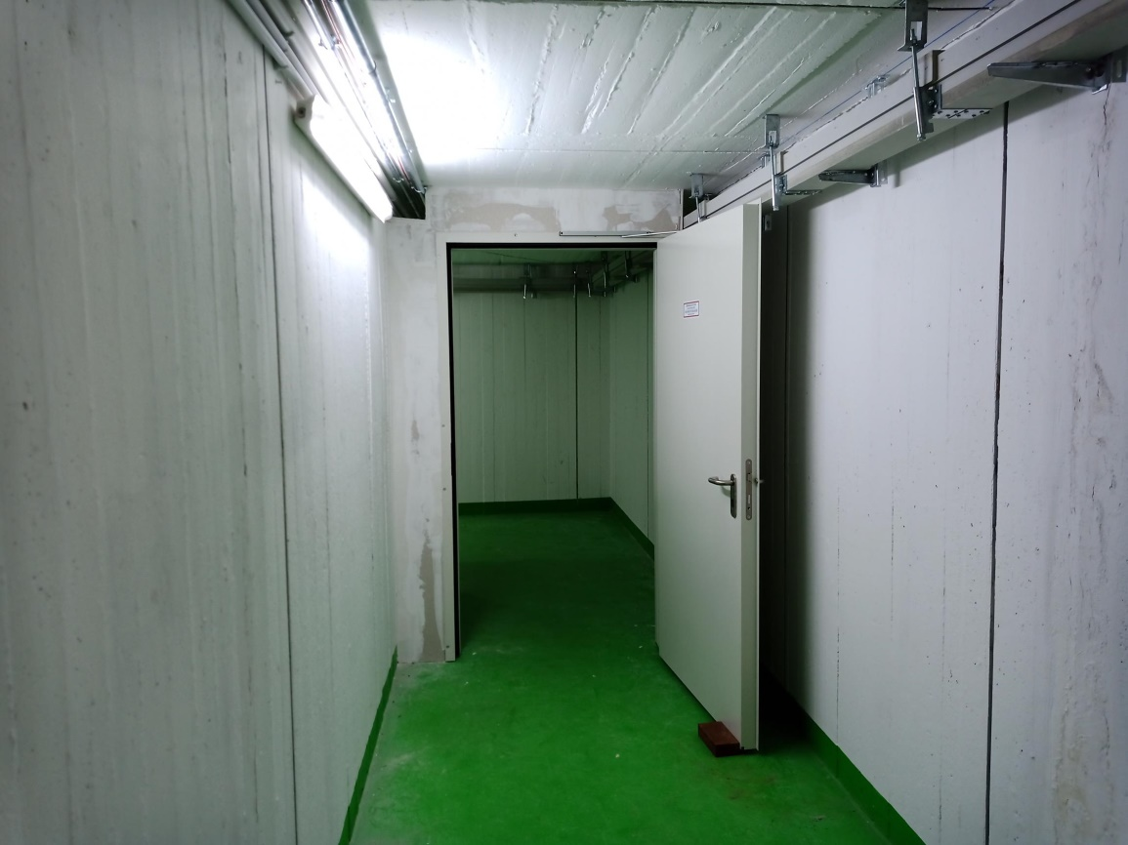
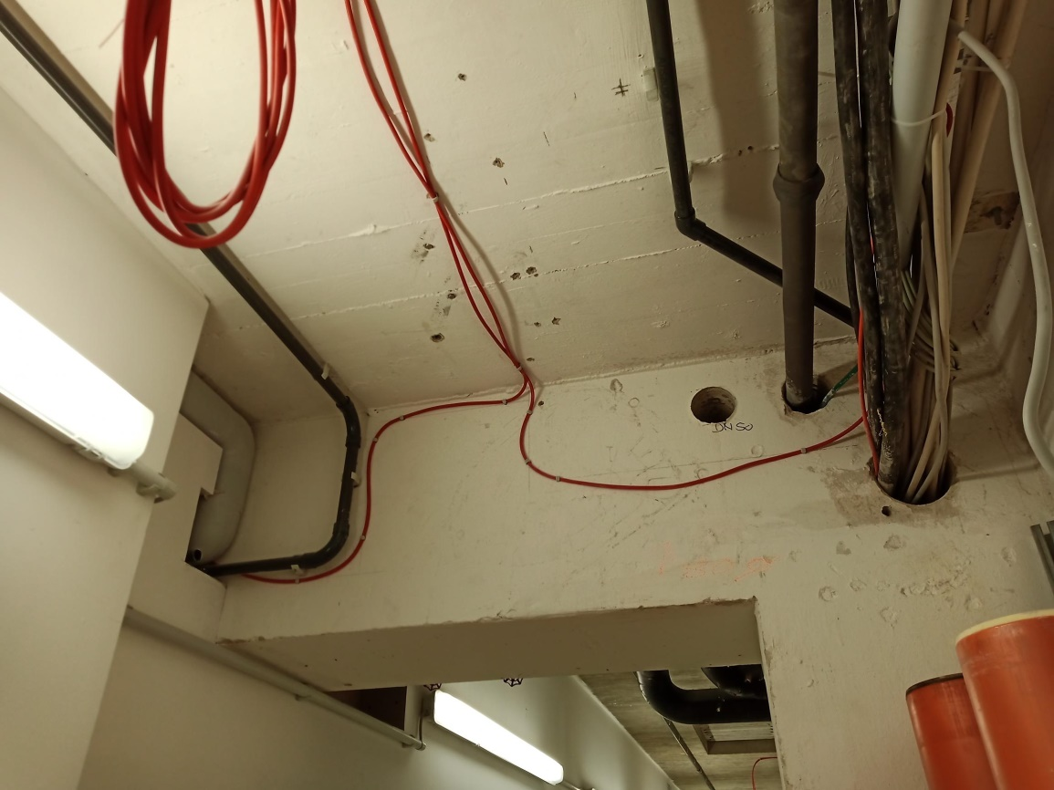
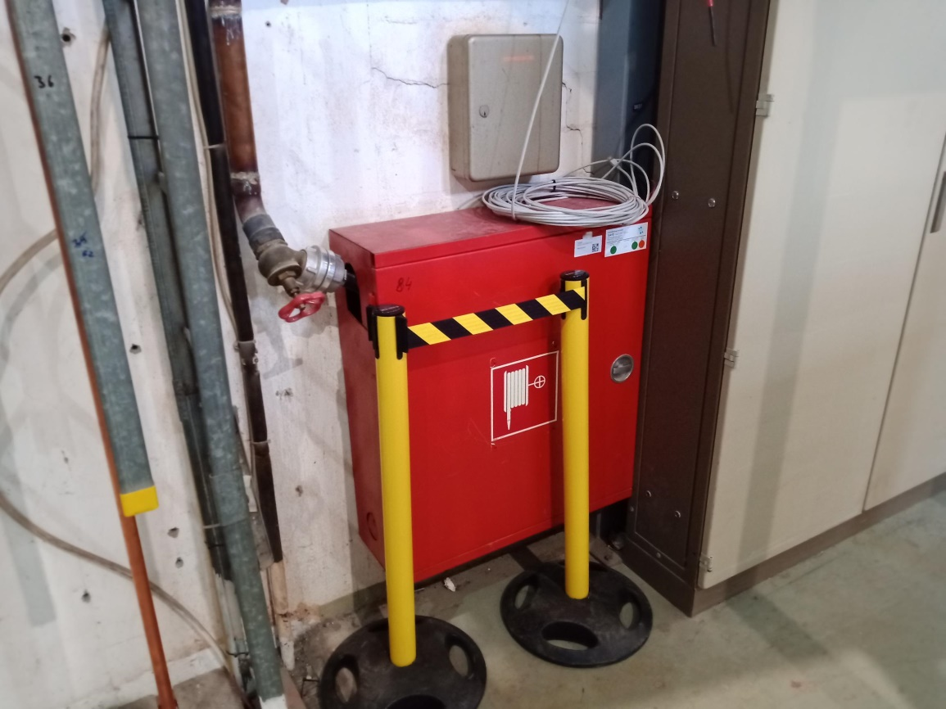
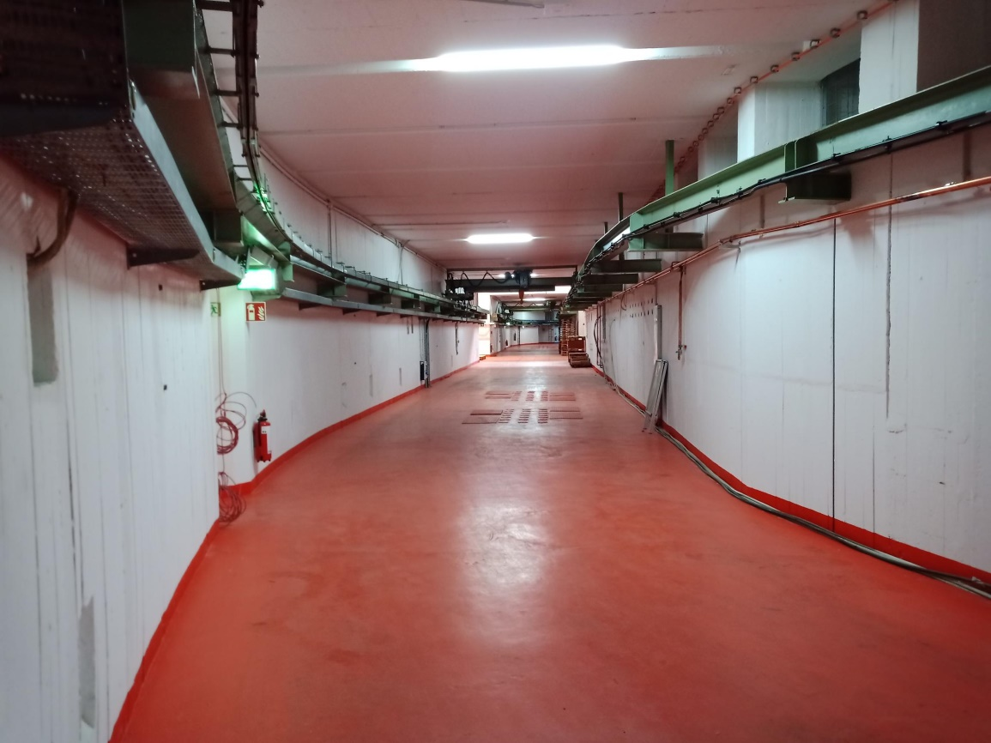
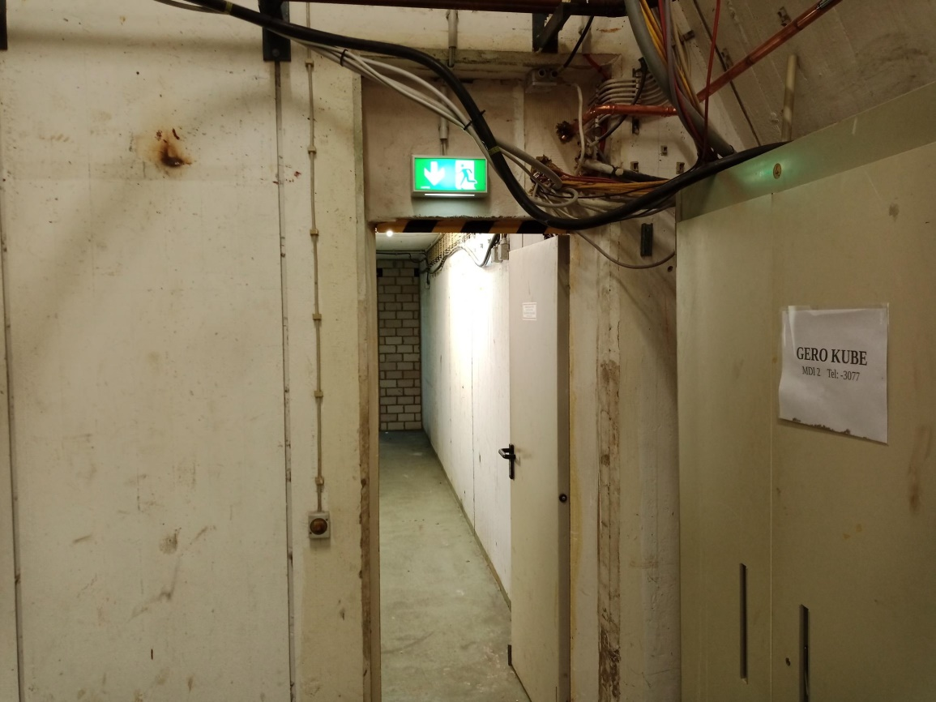
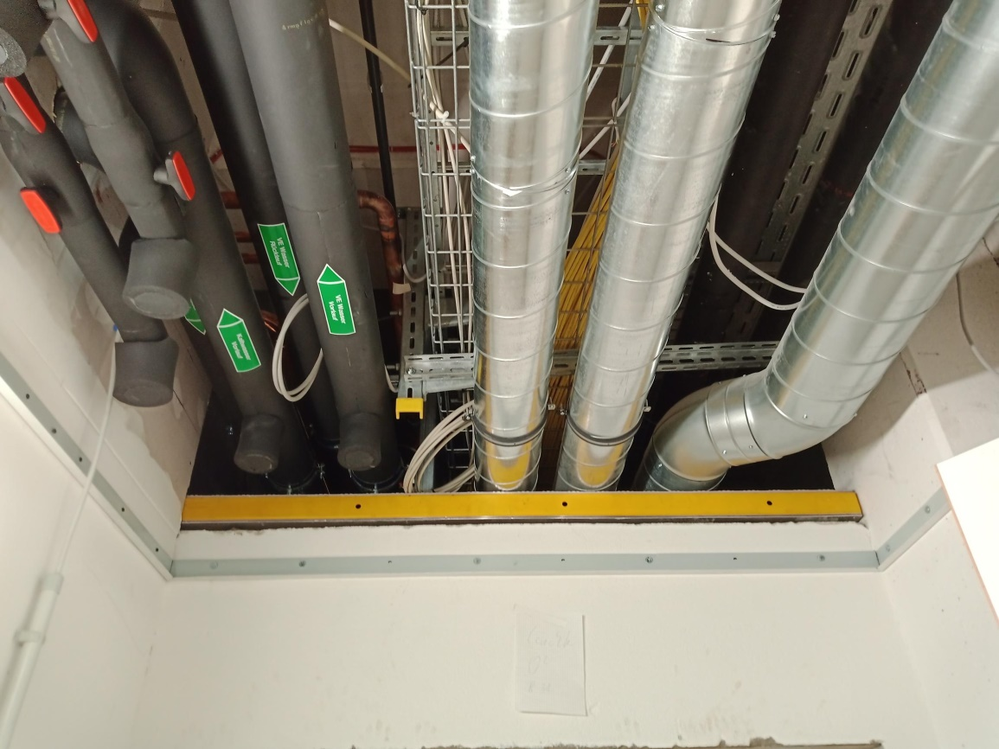
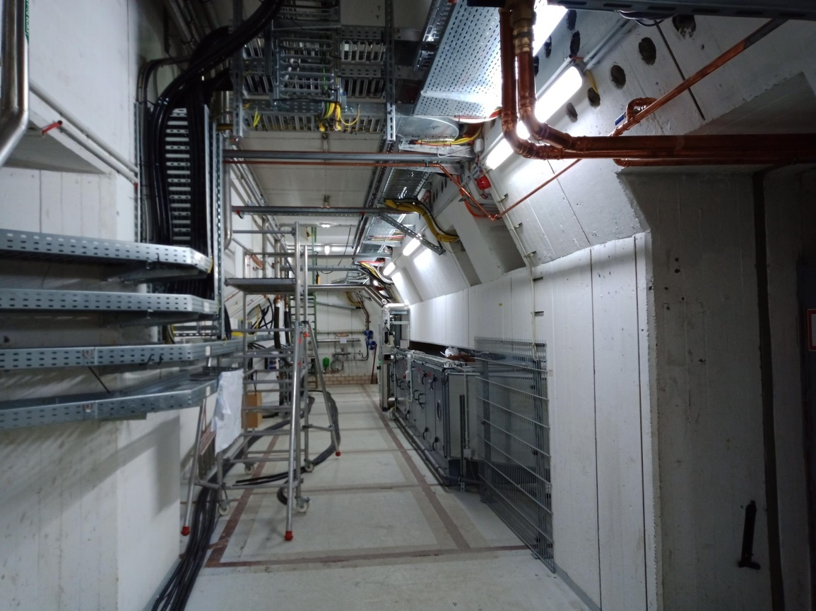
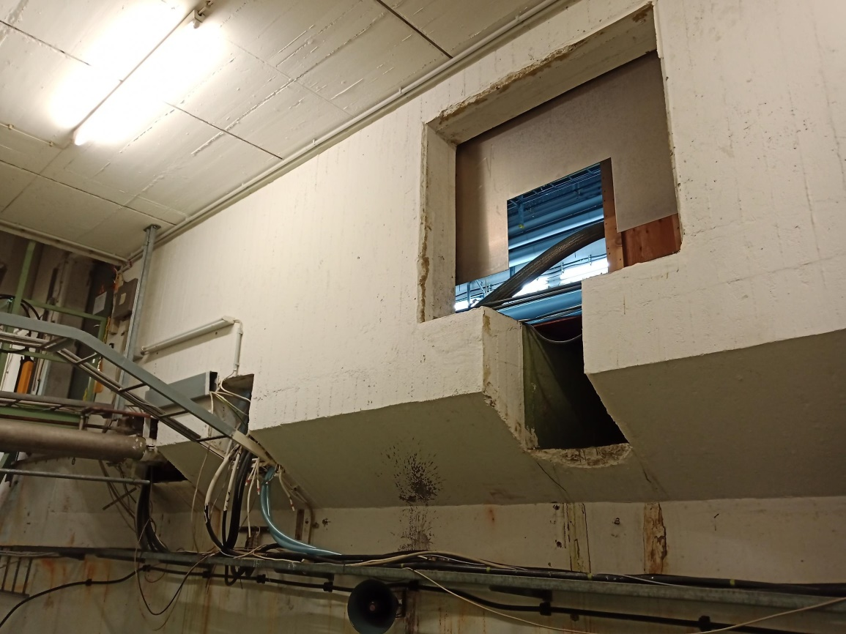
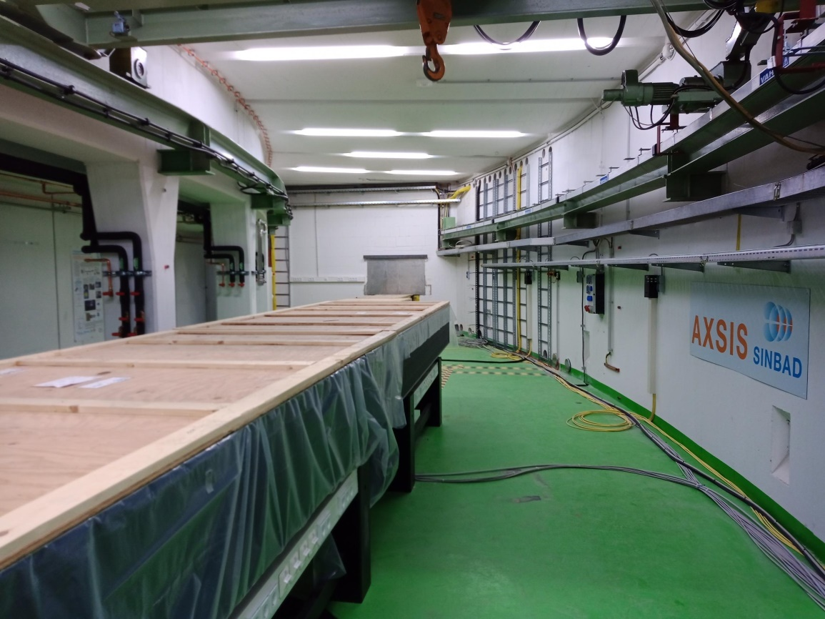
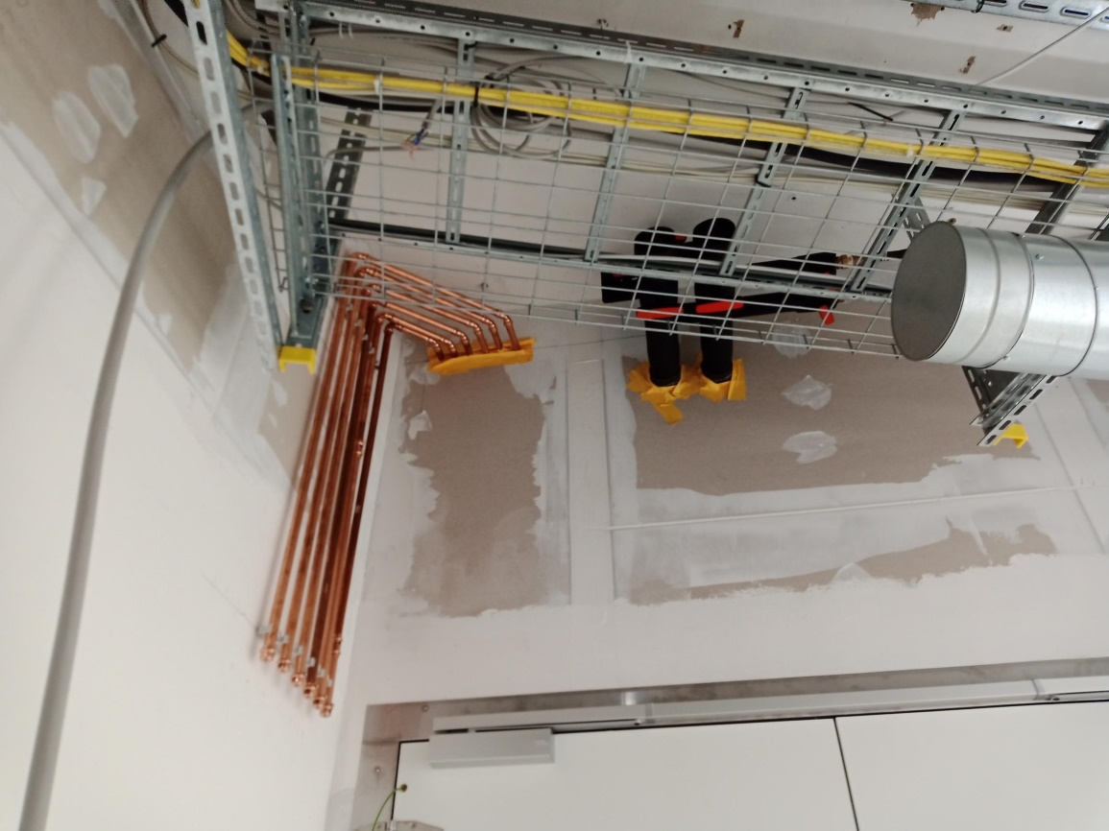
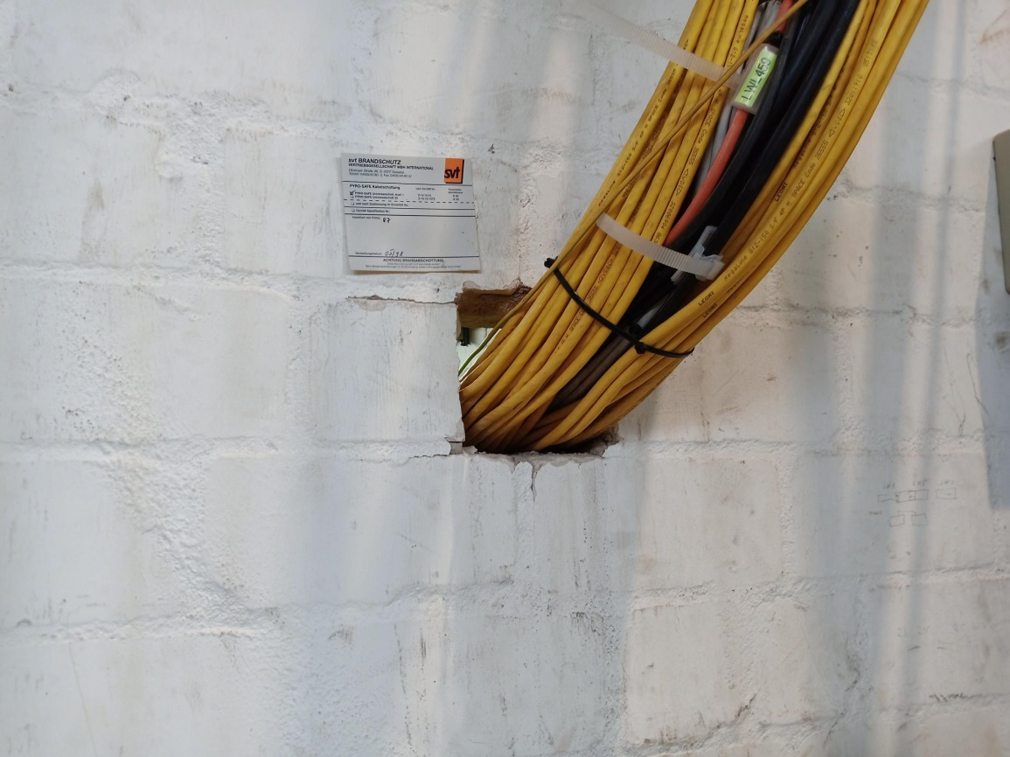
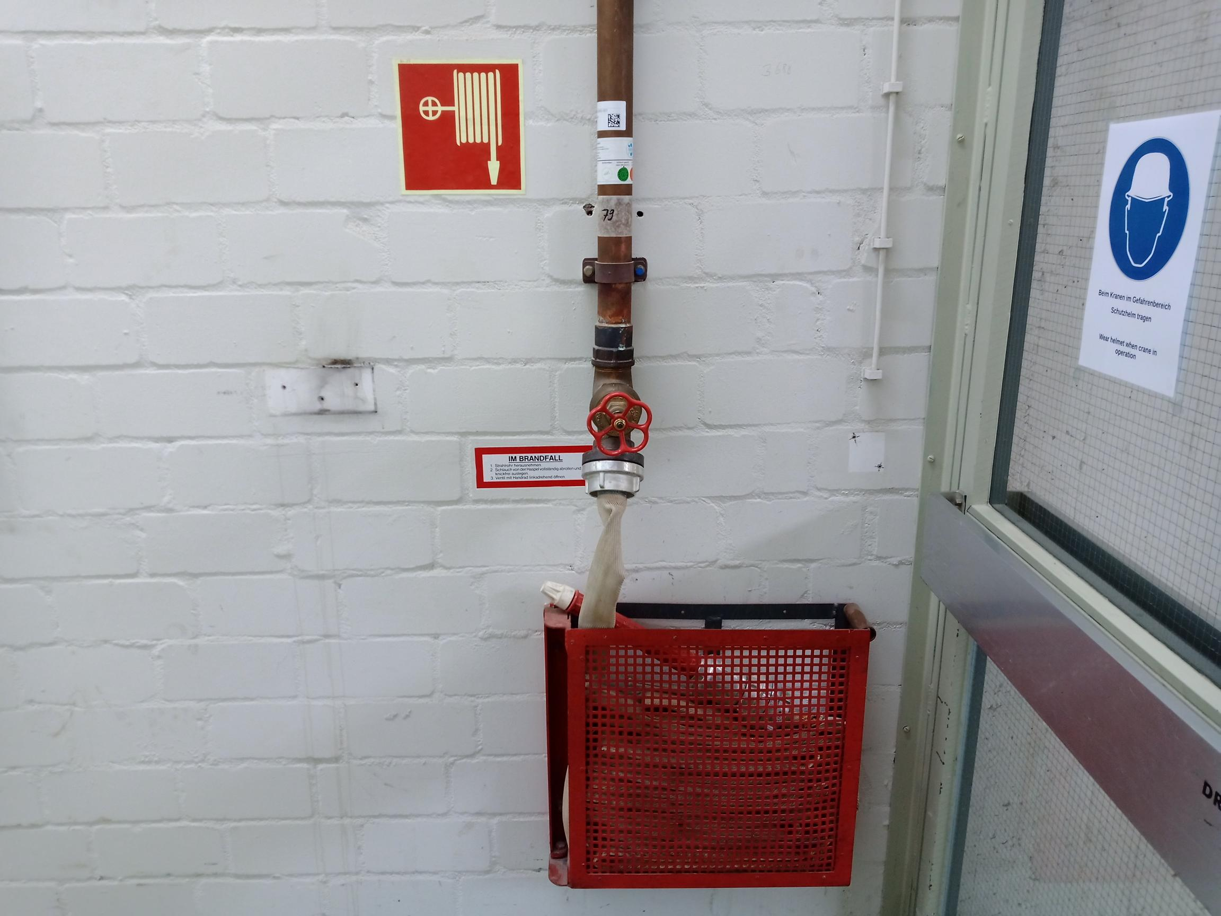
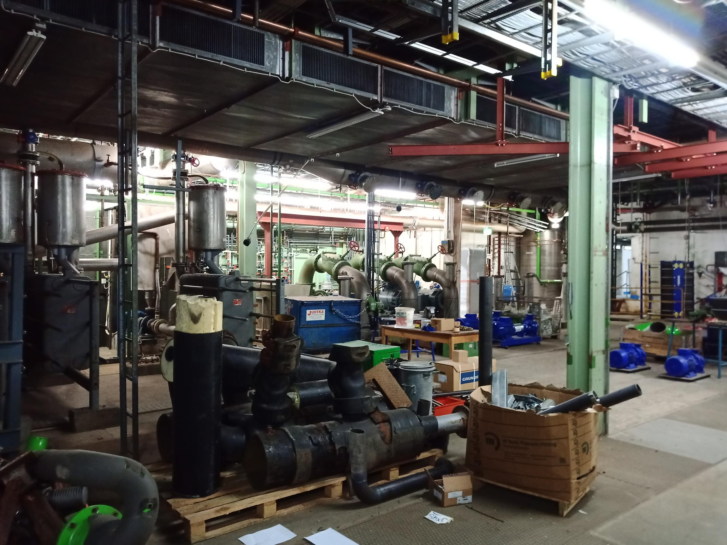
SINBAD in DORIS
Necessary changes
Outlook für Android herunterladen

Slide 12
ALPS in HERA

Slide 13
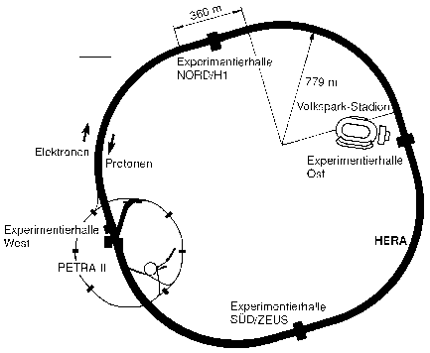
ALPS in HERA
Hadron-Elektron-Ring-Anlage
Former world-class experiment
Built in the 1980s
Commissioned in 1992
Biggest accelerator in Germany
6336 m circumference
Most precise electron microscope for 15 years
Switched off 2007
Today used as an attraction
Notes:
10.000 visitors per year

Slide 14
ALPS in HERA
Any Light Particle Search
ALPS IIc
Searching for lightweight particles
Axion
Light shining-through a wall
Convert photons to axion-like particles by using magnetic fields
Reconvert them behind a wall

Slide 15
ALPS in HERA
Way to the safety concept
Find documents
Find out how systems work
Find out if they still work
Find responsibles
Constructionphase
Safety system | Availability | Comment
Fire detection system | unrestricted | Old technology, not area covering
Evacuation alarm | No automatic activation | Activation via push button alarm
Wall mounted hoses | 150 m³ | Old technology, not reliable
Extinguishing water (tunnel) | 150 m³ | Old technology, not reliable
Fire extinguishers | State of the art
Smoke extraction | Cold smoke extraction
Intercom | unrestricted
Emergency telephone | Every 100 m | Some devices broken
Mobile communication | unrestricted
Radio communication | unrestricted
Safety lighting | unrestricted | Semiannual tested
Self-rescue devices (Oxy3000) | 20 Stk. available | New
Evacuation list | Registration on entry | No separation, no real tracking
Personal tracking | Not functional

Slide 16
ALPS in HERA
Safety concept (DRAFT)
Fire walls between tunnels and hall
Clean rooms
Breakthrough insulation
Safety systems
Organizational fire prevention
Rescue path concept
PPE
Visitors in HERA West!

Slide 17
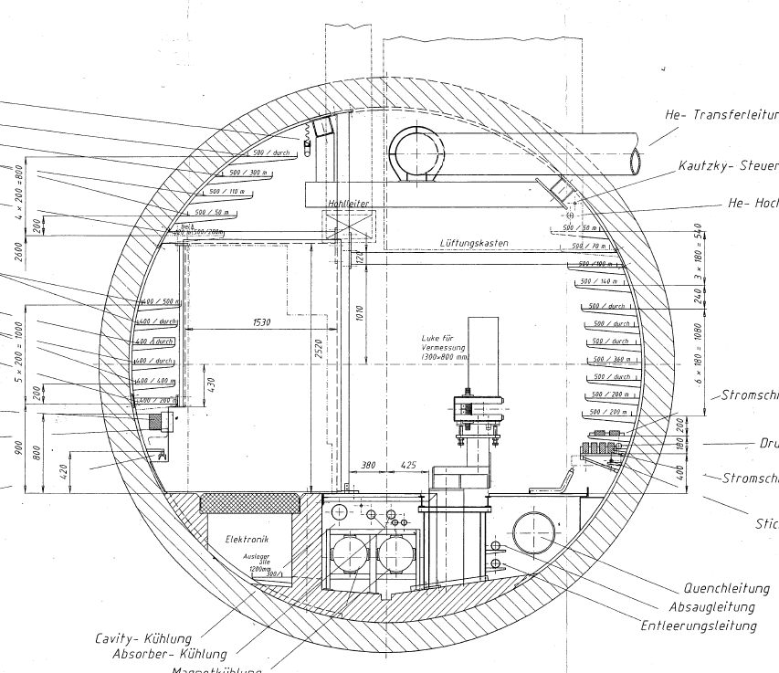
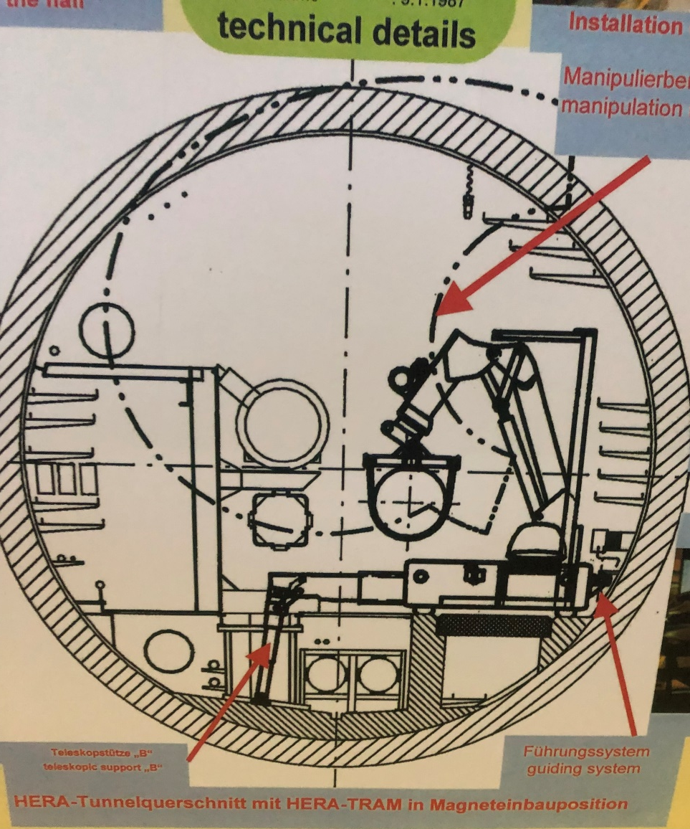
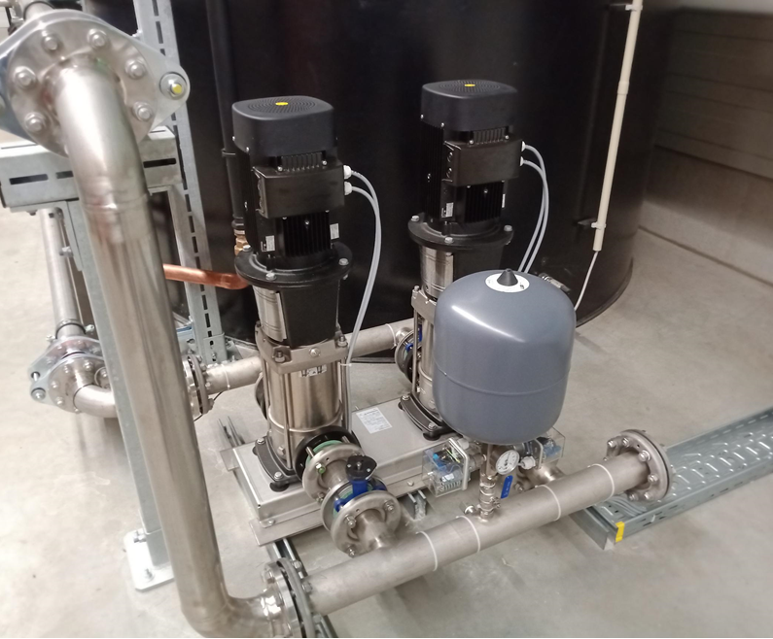
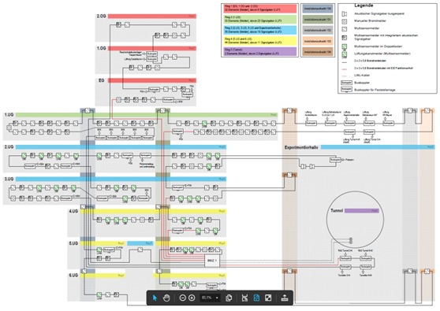
ALPS in HERA
Necessary changes
New fire walls between tunnels and hall
Special solution needed
New fire detection system
Incl. components for fire brigade
New extinguishing water pump plant
Possibly
Personal tracking system
Oxygen deficiency sensors
New smoke extraction
New escape route marking relevant to the position of the event

Slide 18
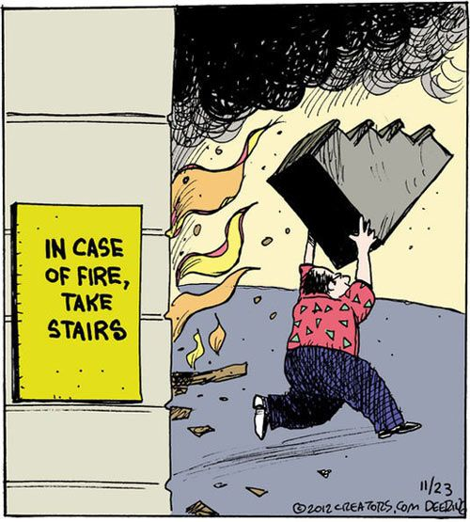
Thank you

Slide 19
Fabian Saretzki
SAVE
fabian.saretzki@desy.de
+49 40 8998 (9) 4763

