Slide 1
PIP-II Safety by Design Implementation
John Anderson Jr.
International Technical Safety Forum
13-17 May 2019

Slide 2
Outline
Fermilab Overview
  Accelerator Complex
Overview of the Safety by Design (SbD) Concept
Examples of hazards SbD can eliminate
Actions we’ve implemented
  What we are doing
  How we are doing it
SbD effectiveness assessment
Summary
Questions
Contact Information

Slide 3
Fermilab Overview
Fermi National Accelerator Laboratory (Fermilab)
  America’s premier laboratory for particle physics and accelerator research
  Fermilab employs ~2,000 staff members from around the world
    Collaborate with over 4000 researchers in over 50 countries
  Fermilab operates on a 6,800-acre or 28 km² campus located in Batavia, Illinois
  Managed by the Fermi Research Alliance LLC
    FRA is a partnership of the University of Chicago and Universities Research Association Inc., a consortium of 89 research universities
  Funded by the US Department of Energy Office of Science
  Major projects being undertaken include PIP-II and LBNF/DUNE
    Both constitute significant upgrades to the facility and experimental program
    Both have significant in-kind contributions from national and international partners
    When complete, the accelerator complex will deliver a proton beam power exceeding 1 MW at an energy of 120 GeV to the LBNF and DUNE detector

Slide 4
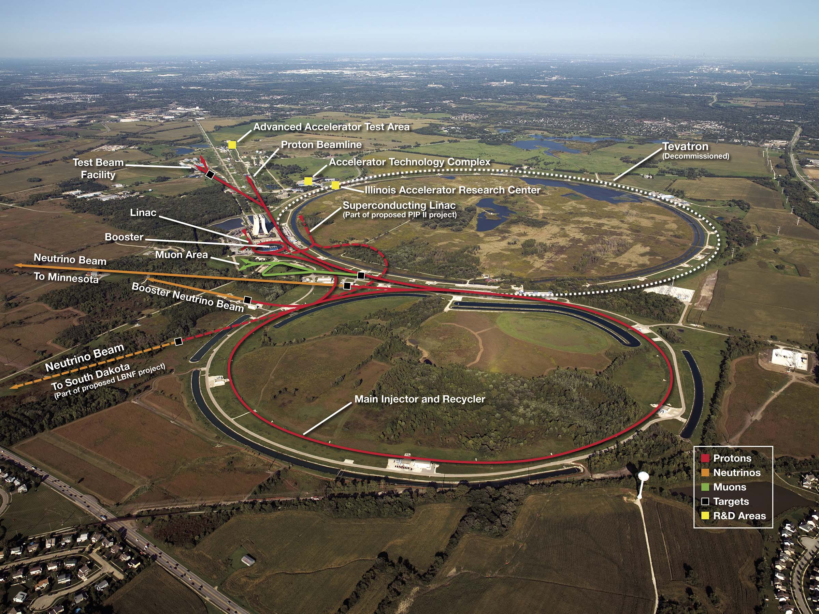
Accelerator Complex

Slide 5
Safety by Design Overview
Safety by Design (SbD), also called Prevention through Design (PtD), is the concept of applying methods to minimize occupational hazards early in the design process
This concept emphasizes eliminating hazards and controlling risks to workers “at the source” or as early as possible in the life cycle of equipment, products, or workplaces

Slide 6
Safety by Design Overview
The concept supports the view that along with quality, program and cost; safety is determined during the design stage
  “Safety” encompasses environment, safety and health aspects
Safety by Design is a shift in approach for on-the-job safety
  It involves evaluating potential risks associated with processes, equipment and structures
  It takes into consideration the product life cycle phases from design through disposal
  It increases the cost-effectiveness of enhancements to occupational safety and health

Slide 7
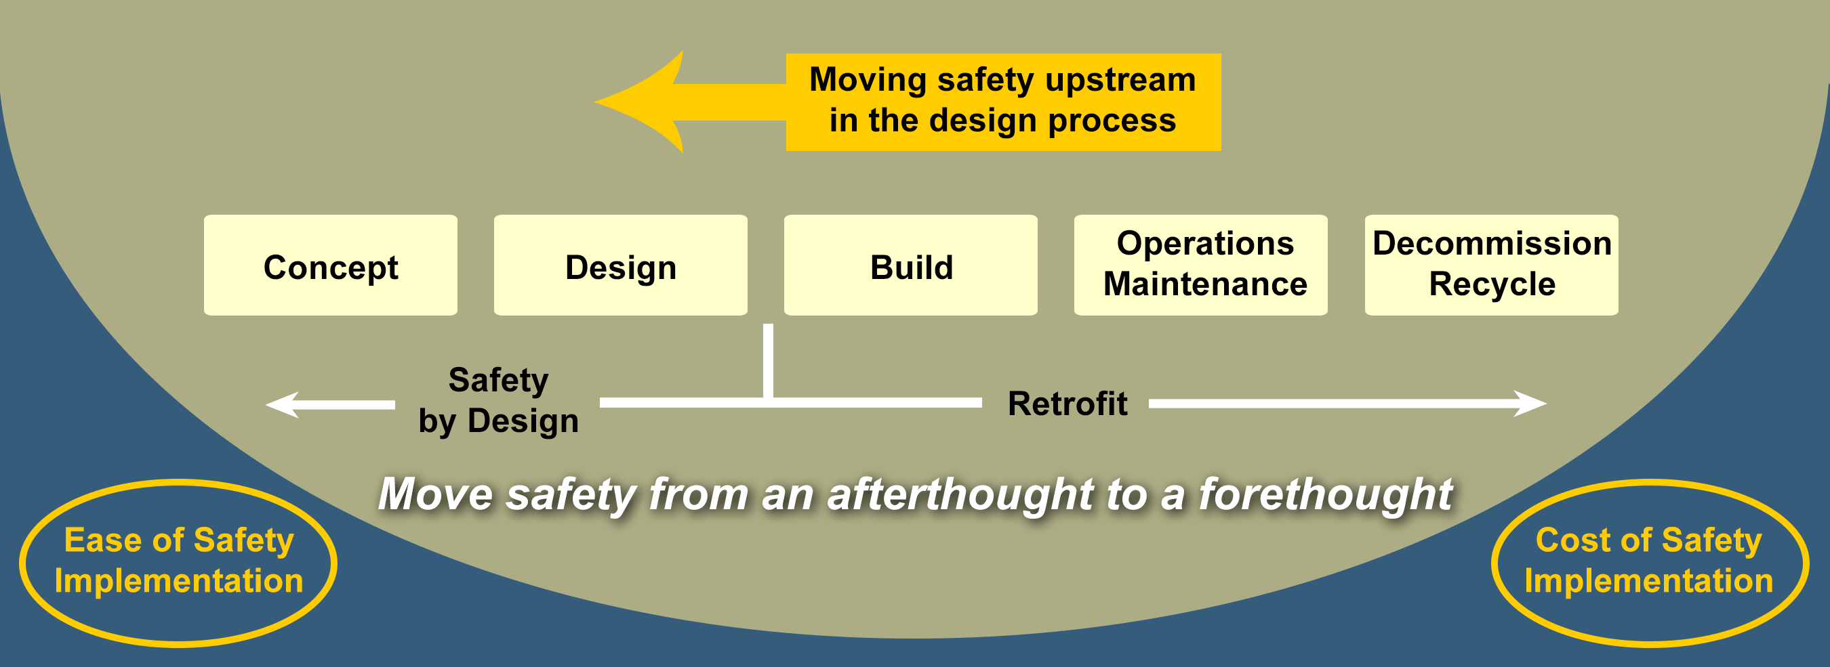
Safety by Design Model
Safety by Design Model adapted from “Safety Through Design”, Wayne Christensen, NSC Press, 1999.

Slide 8
Benefits of Safety by Design
→
Reduced hazards fewer injuries or incidents
Increased productivity
Fewer delays due to accidents or unwanted outcomes
Improved communications between engineers with interfaces to other systems
  Lifecycle hazards between systems
Improved specifications and interface documents
One of the design deliverables presented at each design review phase

Slide 9
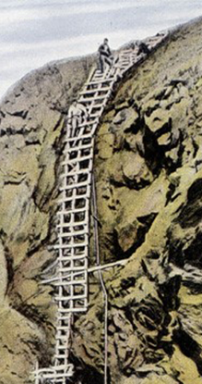
Concept Examples
Central Helium Liquefier (CHL)
  Employees needed to climb a ladder every shift to read a gauge
  After doing so for years …
    worker misstepped and fell off ladder
    resulted in a sprained ankle
  Moving the gauge or providing a remote readout at eye level in the design process would have removed the fall hazard

Slide 10
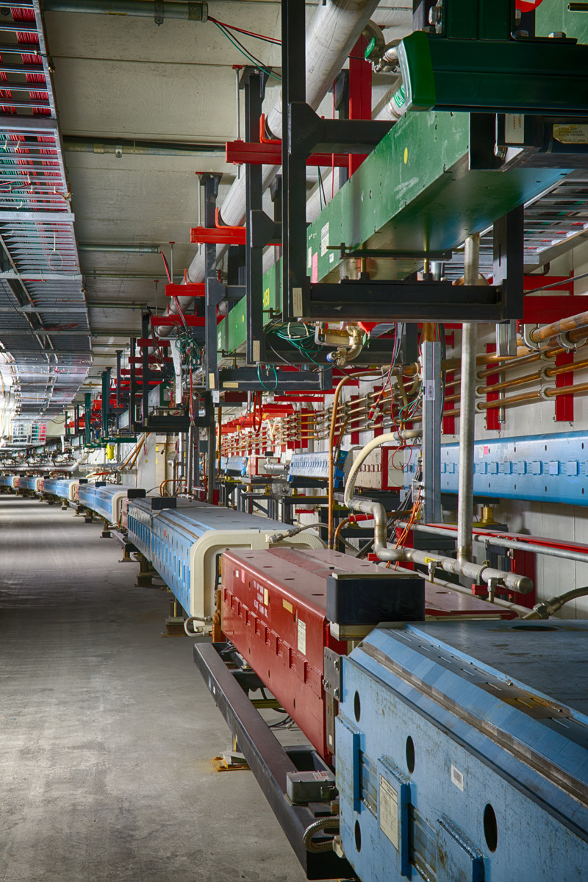
Concept Examples
Main Injector Accelerator
  Over time, magnets fail
  Two separate injuries replacing quad magnets (37,500 lbs., 17,000 kG)
    Both required surgery
  Cause
    Lack of magnet replacement equipment
  Considering maintenance and repairs in the design process may have prevented the injuries

Slide 11
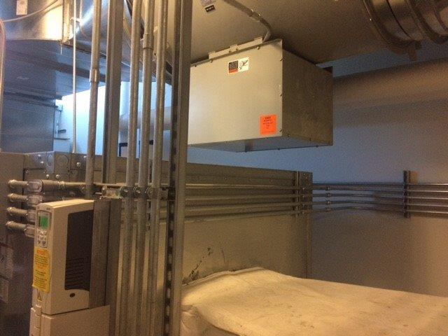
Concept Examples
MC-1 Experimental Hall
Recognize this picture?
Temperature control in the experimental hall is critical to the experiment’s operation
If this hadn’t been recognized and addressed before the start of operations,
a fan malfunction would have caused a delay in their experimental program
Main building HVAC fans
Air ducts routed directly underneath

Slide 12

What are we doing and how are we doing it?

Slide 13
Hazard Risk Assessment Process

Slide 14
Hazard Risk Assessment
Documents the system’s hazards at each life cycle stage
  Look to identify how systems can evolve to an undesirable state and who or what is at risk
  Life cycle stages (Think cradle to grave)
    Fabrication
    Installation
    Commissioning
    Operations
    Equipment Shutdown (Lock Out / Tag Out)
    Maintenance
    Trouble-shooting
    Repairs/Replacement
    Decommissioning
    Disposal or Recycling

Slide 15
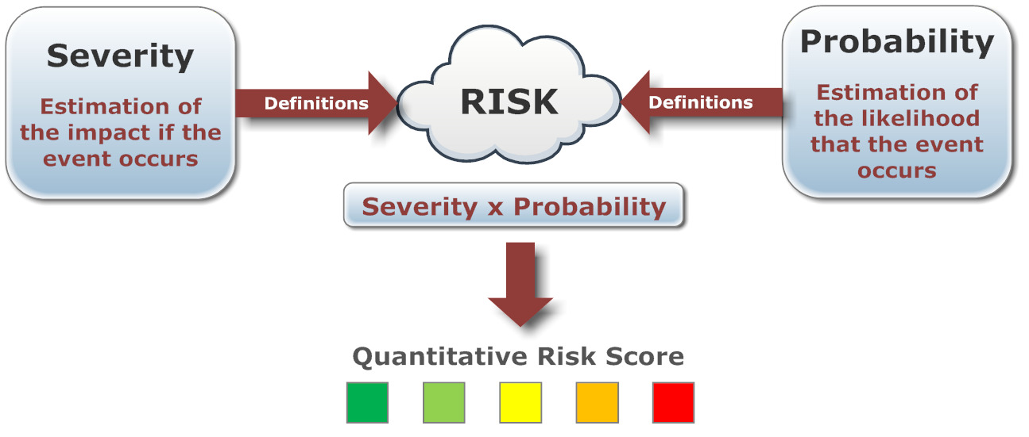
Quantify Risks
Risk is typically Measured As Severity times Probability
QAM 12030 Technical Appendix A has matrices to assist with identifying both severity and probability.
  Both are included in the backup slides

Slide 16
Risk Assessment Codes and Actions
Risk Code | Actions
1 - Very High | Unacceptable. Operation not permissible. Immediate action necessary.
2 - High | Remedial actions to be given a high priority.
3 - Moderate | Remedial actions to be taken at an appropriate time. - Can be considered an acceptable risk.
4 - Low | Remedial action discretionary. - Should try to design out.
5 - Negligible | No action necessary.
Actions are typically used for redesign efforts.
Safety by Design is intended to drive risks lower.

Slide 17
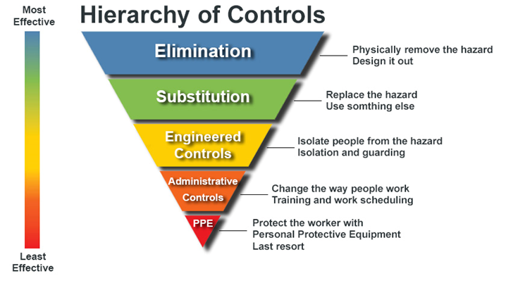
Identify Mitigations
What can be done to reduce the severity or likelihood?

Slide 18
Residual Risk
Assess the Residual Risk with planned mitigations
  If Unacceptable
    Identify additional mitigations
  If Acceptable
    Update project documentation to implement mitigations

Slide 19
Safety by Design Spreadsheet
Hazard Identification
Risk
Mitigations
Residual Risk
Status
Intended to be easy to use and fill out

Slide 20
Hazard Identification

Slide 21
Risk assessment and mitigations

Slide 22
Residual Risk Assessment and Status of Implementation

Slide 23
Early PIP-II SbD Effectiveness Assessment Results
Plan to rename program to Prevention through Design (PtD)
  Original program name chosen to resonate better with international partners
  PtD better aligns with the ANSI/ASSE Z590.3-2011(R2016) Prevention through Design Standard
  PtD better allows for incorporation of Project, Engineering and Quality Assurance risks in a single spreadsheet
Plan to expand spreadsheet to incorporate QA aspects
  i.e. Implementation Status – Incorporated into the QA Plan
Completed assessments not centrally located
  Issues finding completed assessment forms
  Need to tag assessments in our EDMS

Slide 24
Summary
Safety by Design Spreadsheet Implemented in PIP-II Project
  Assists with identifying hazards and mitigations to minimize occupational hazards early in the design process
  Documents the hazard assessment, risks and controls
  Tracks progress on implementation of mitigations
  Spreadsheet is intended to be a living document where hazards and mitigations can be added to or updated as necessary
  Effectiveness review is identifying areas where program improvements can be made

Slide 25

Thank you for your attention - Questions

Slide 26
Contact Information
John E. Anderson Jr.
Associate Head, Office of the Chief Safety Officer
PIP-II ESH Manager
Environment, Safety and Health Section
Fermi National Accelerator Laboratory
P.O. Box 500 MS 312
Batavia, IL 60510 USA
630 840 4973 office
www.fnal.gov
jea@fnal.gov

Slide 27
Fermilab QAM 12030 Hazard Severity Table

Slide 28
Hazard Severity
Estimate the Hazard Severity using the table
  Critical, High, Medium, Low, or Minimal
  Consider the worst potential consequence that is likely to occur without any mitigations
Individual judgment used when selecting severity

Slide 29
Fermilab QAM 12030 Mishap Probability Table
PROBABILITY | DESCRIPTION
A - Almost Certain | Could occur annually
B - Likely | Could occur once in two years
C - Possible | Occurring not more than once in ten years
D - Unlikely | Occurring not more than once in thirty years
E - Rare | Occurring not more than once in one hundred years.
Estimate the mishap probability
  Use individual judgement
Spreadsheet calculates Risk Score

Slide 30
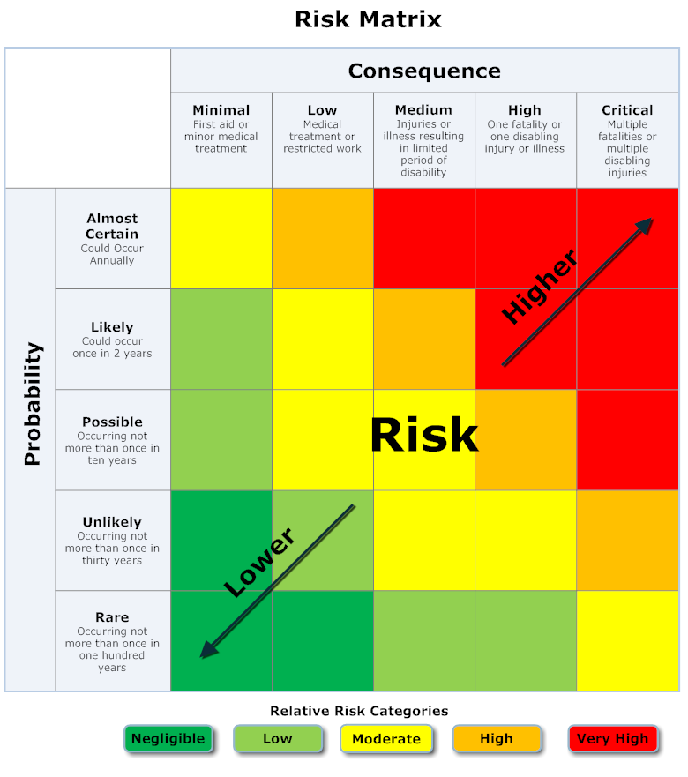
Risk Matrix
High and very high level risks may roll-up to
  Project Risk Register or
  Project Hazard Assessment Report

