Slide 1
Lessons Learned Working at Height at ALBA Synchrotron Facility
14/05/2019
José Aguilar
Carme Mármol

Slide 2
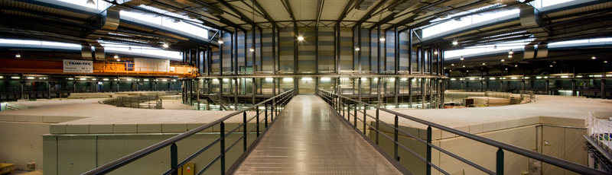
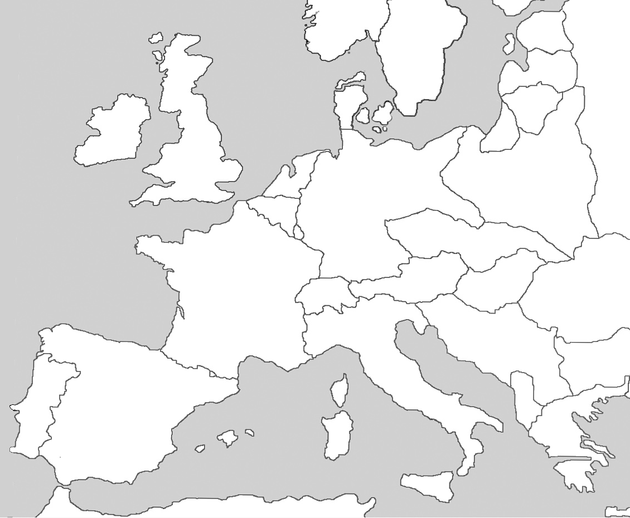
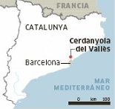
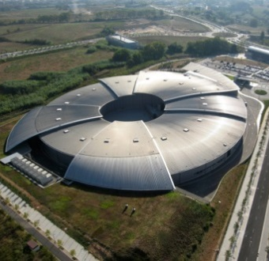
ALBA SYNCHROTRON LIGHT SOURCE
3 GeV electron synchrotron accelerator
8 Beamlines (+3 under construction, +1 in design stage)
Location: Cerdanyola del Vallès (Barcelona)
ALBA

Slide 3
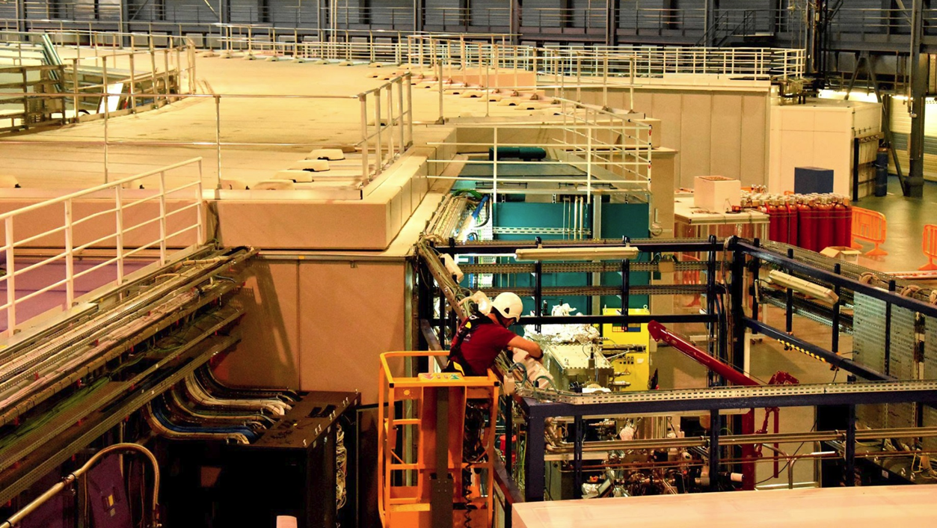
WORKS AT HEIGHT AT ALBA
1
Introduction
2
Accidents and Near Misses at ALBA
3
Lessons Learned
4
Aknowledgement
5
Conclusions

Slide 4
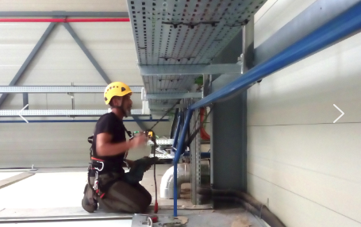
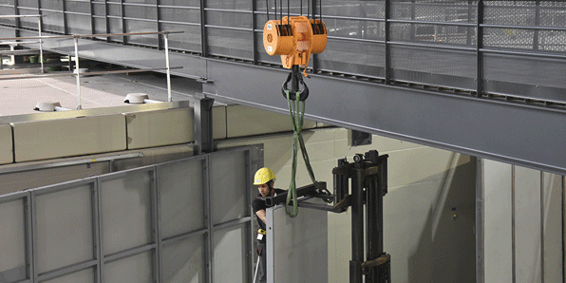
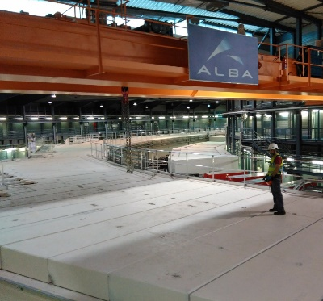
1. INTRODUCTION
Necessity of performing different kind of tasks:
Cable installation
Civil Works
Equipment Maintenances
Equipment installation inside tunnel or hutches
Cleaning
…

Slide 5
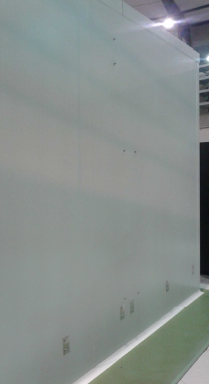
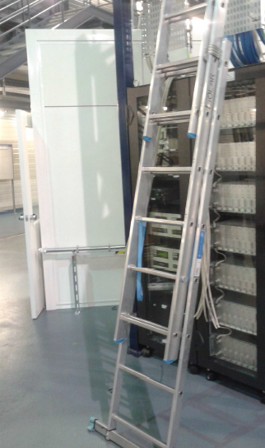
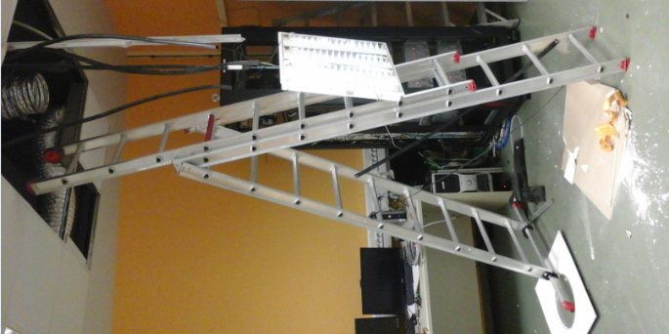
2. ACCIDENTS AND NEAR MISSES AT ALBA
03/04/14
Cleaning Service External Company
Accident > 3 day injury (~6 months)
30/04/15
Electronics tasks
Accident < 3 day injury
01/03/16
Electronics tasks
Near miss

Slide 6
2. ACCIDENTS AND NEAR MISSES AT ALBA
Accidents
What was going on?
Use of ladder (3 cases)
Lack of anchor points (3 cases)
Tasks inside false roof (2 cases)
Root Cause Accident Analysis
What could we do better?
New safety rules and working procedures
New equipment and infrastructures
New working methods
More trainings
Corrective Actions

Slide 7
3. LESSONS LEARNED
When you have to work at height:
Analyse the workplace in advance
Choose the most suitable equipment
Have good knowledge and experience
Never trust

Slide 8
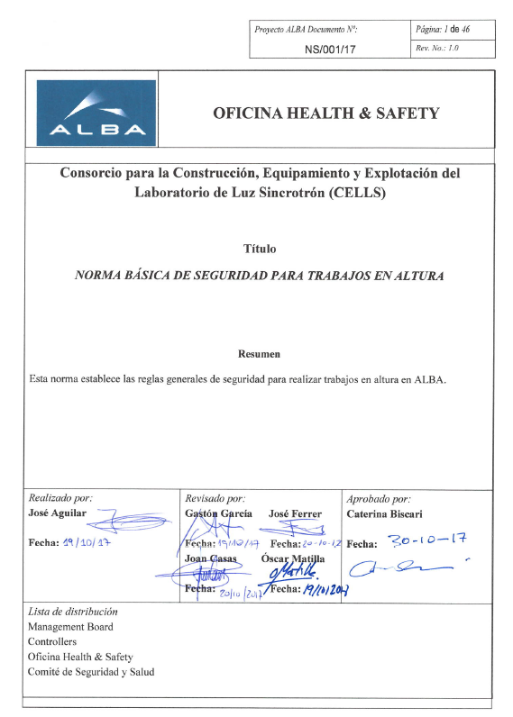
3. LESSONS LEARNED
New Safety Rule
To stablish:
Responsibilities (maintenance, purchasing, …)
Definitions (work at height, equipment, accessories, communication flowchart, …)
Requirements (trainings, authorizations, medical reviews and protective equipment)
What to do in case of a victim rescue

Slide 9
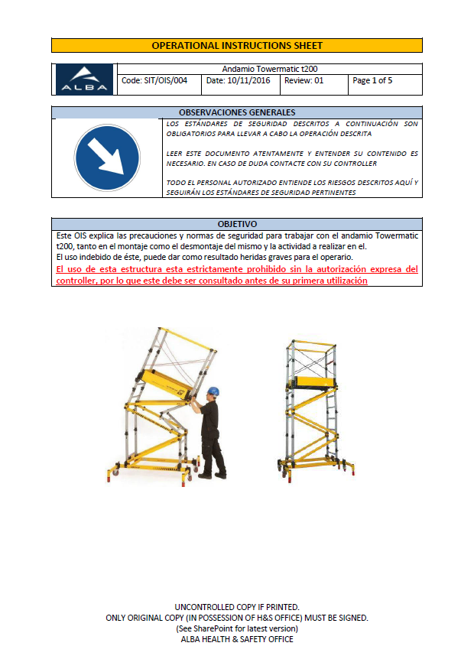
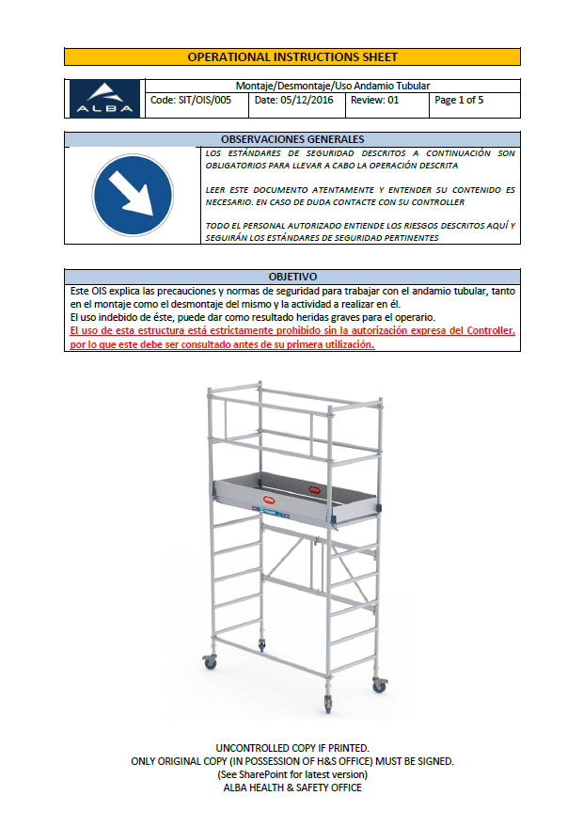
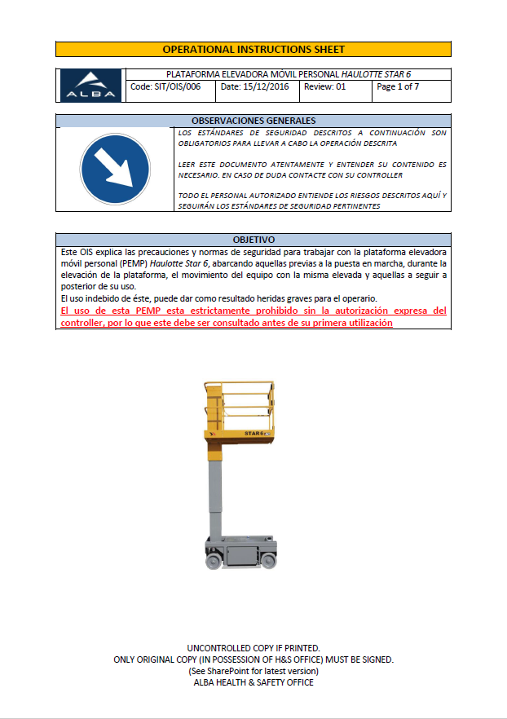
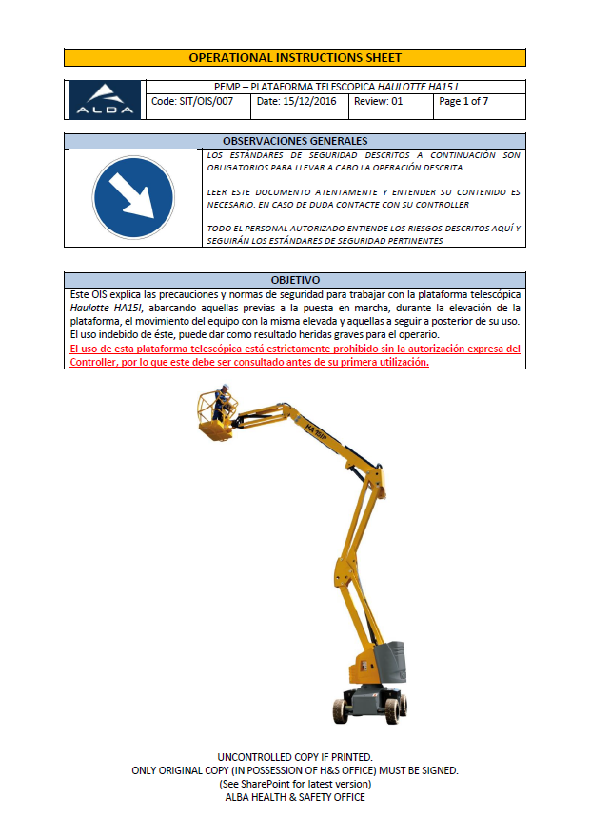
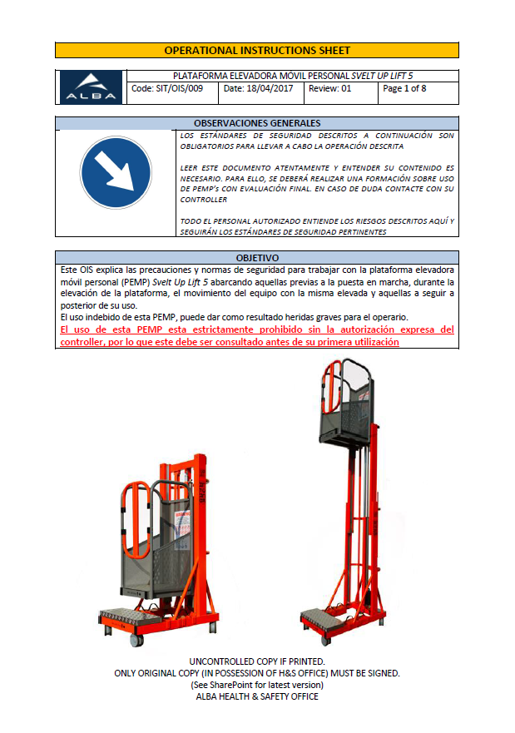
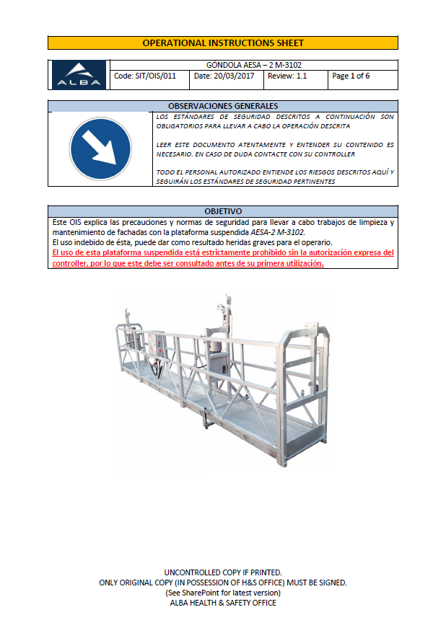
3. LESSONS LEARNED
New Safety Sheets for equipment usage:
Use of scaffold
Use of Mobile Elevating Work Platforms (MEWPs)
Use of Suspended Platform

Slide 10
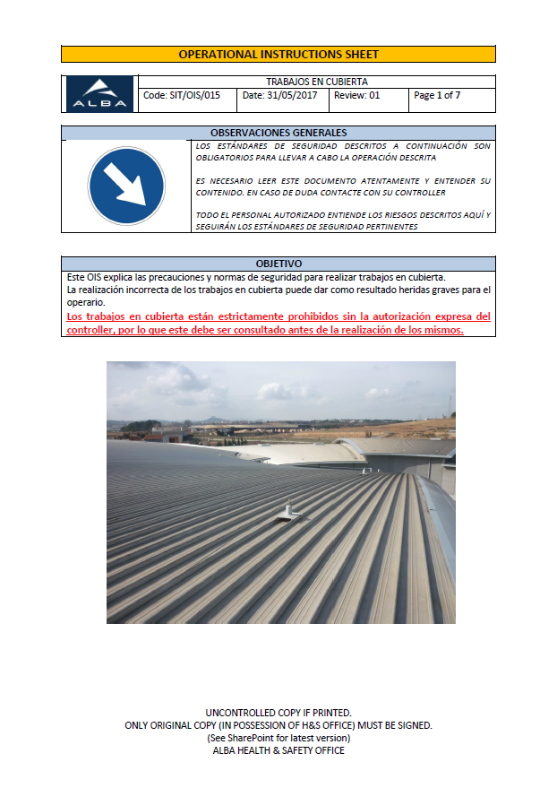
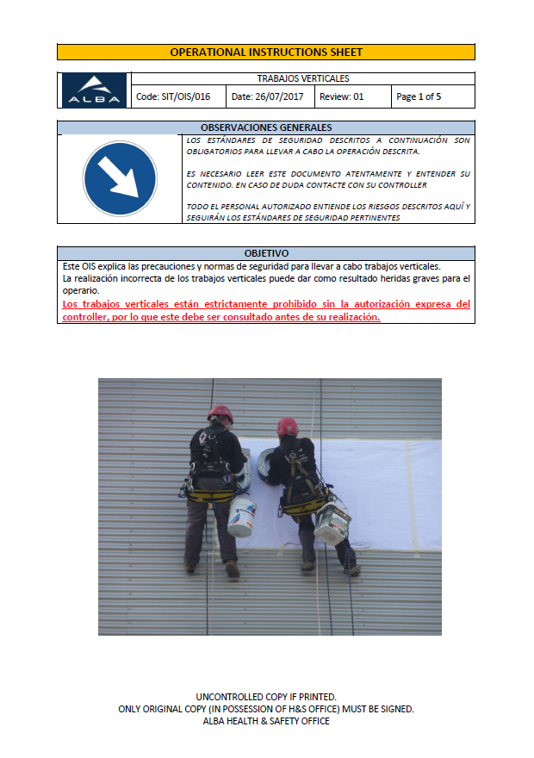
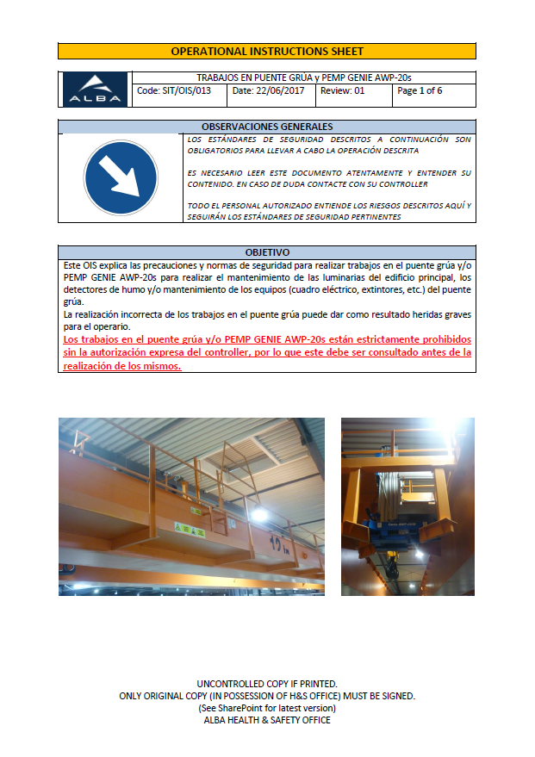
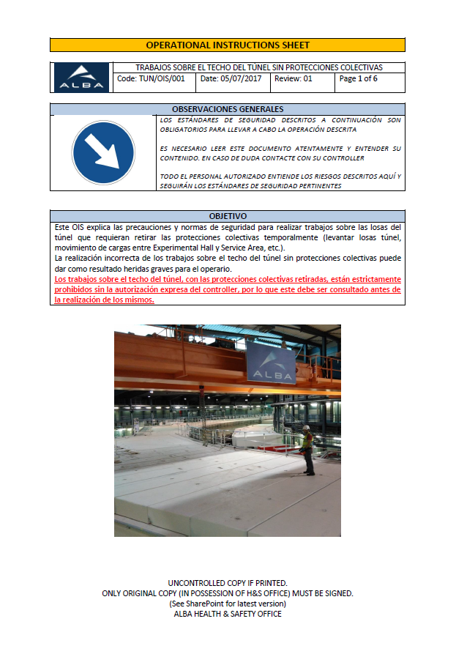
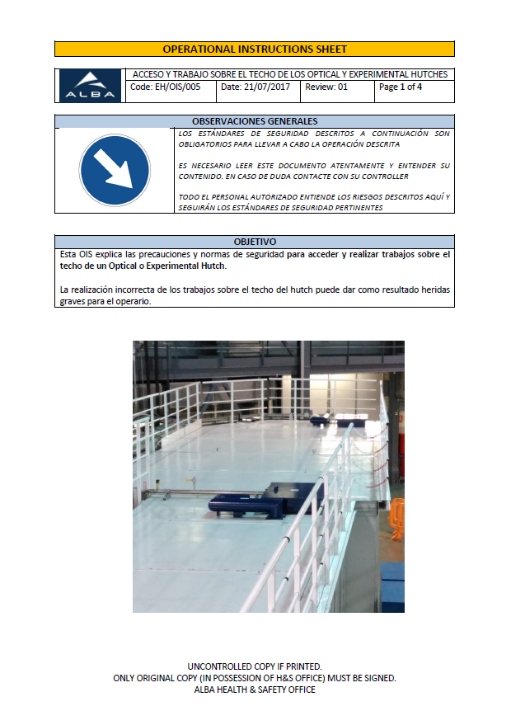
3. LESSONS LEARNED
New Safety Sheets for tasks:
Tasks on Roof Cover
Vertical Works in height
Tasks on orbital crane
Tasks on tunnel roof without railing
Tasks on hutches roof

Slide 11
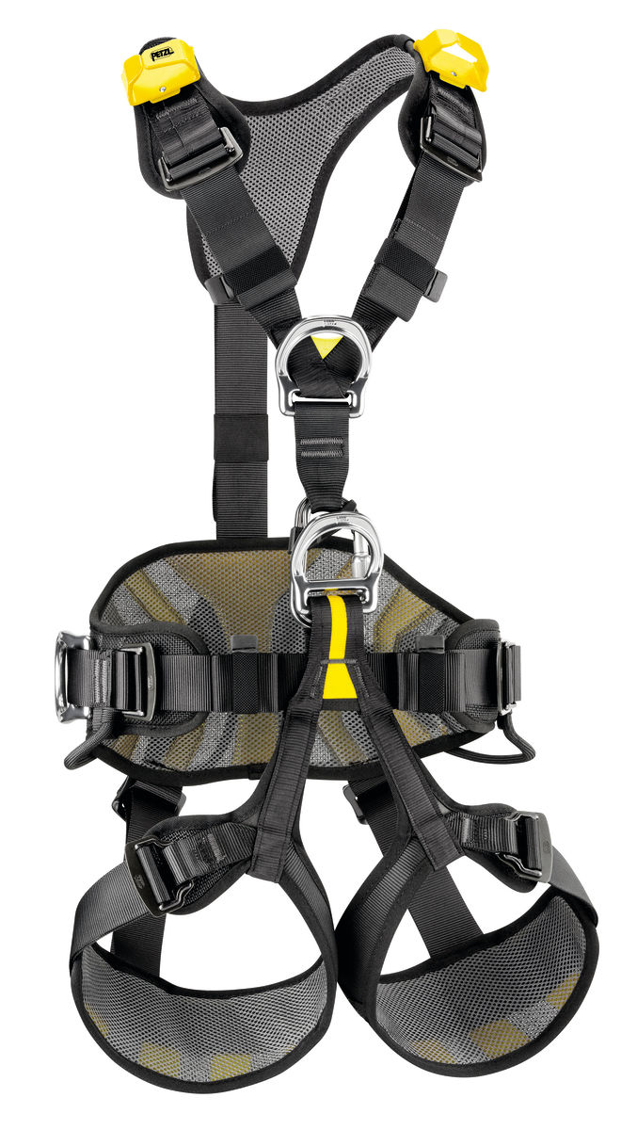
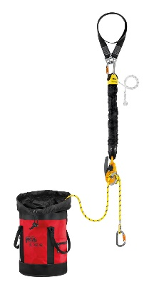
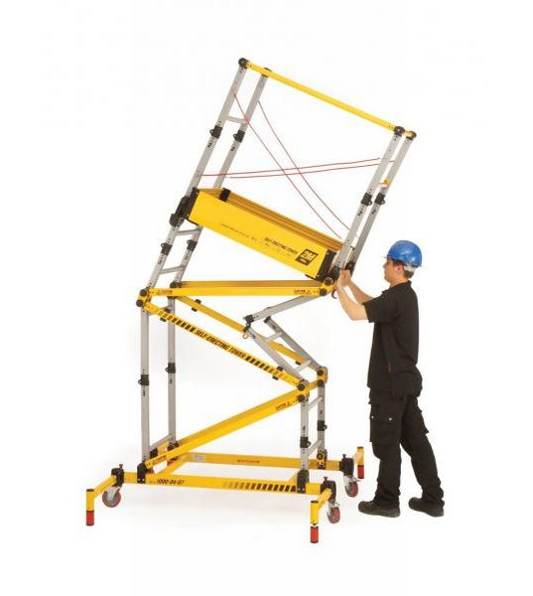
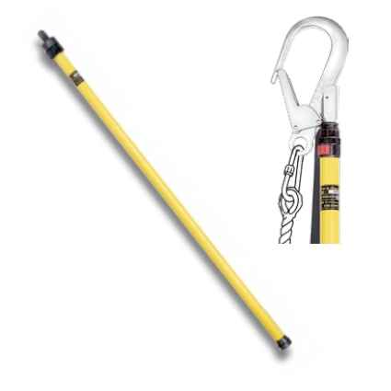
3. LESSONS LEARNED
New equipment at ALBA:
Harnesses renewed
2 x New Rescue Kit
2 x Towermatic T200 scaffold
2x Svelt Uplift 5 MEWP
1x Lifeline system in RF Lab
Insulating telescopic pole (pending)

Slide 12
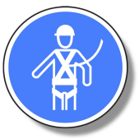
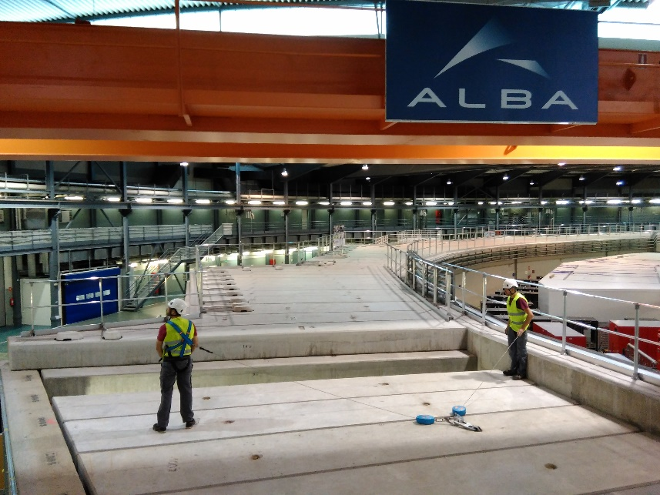
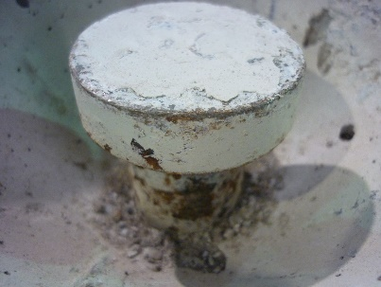
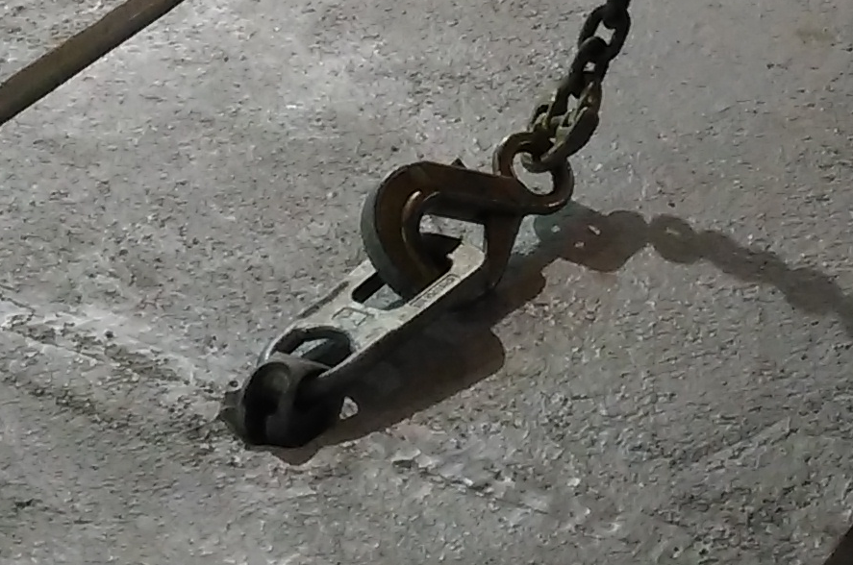
3. LESSONS LEARNED
New working methods:
Working on tunnel roof removing portable railing

Slide 13
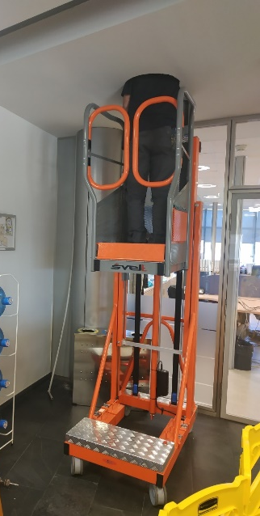
3. LESSONS LEARNED
New working methods:
Reducing ladder usage, principally to work in false roof
Advantages:
Great stability
Risk reduced
Very light
Weaknesses:
Access difficulties
Good maintenance

Slide 14
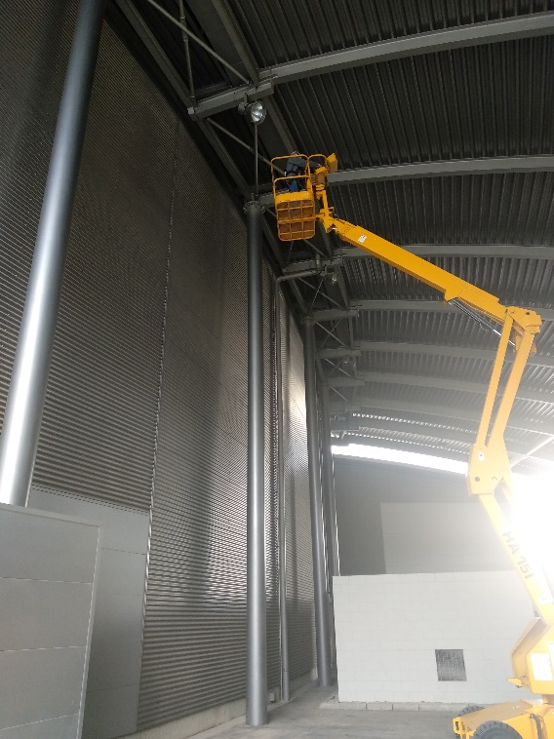
3. LESSONS LEARNED
More trainings have been scheduled:
MEWP usage

Slide 15
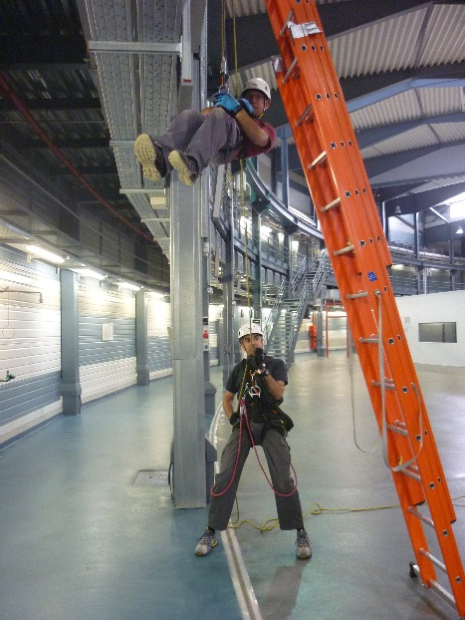
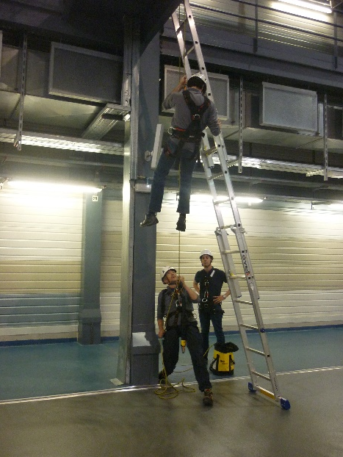
3. LESSONS LEARNED
More trainings have been scheduled:
Working at Height and Victim rescue with JAG Rescue Kit

Slide 16
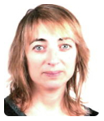
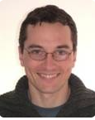
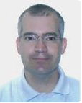
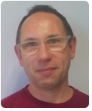
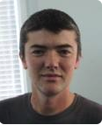
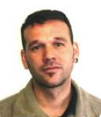
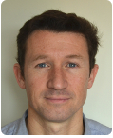
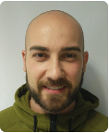
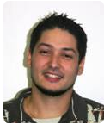
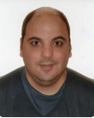
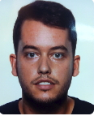
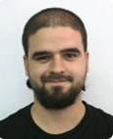
4. AKNOWLEDGEMENT
Infrastructures Section
Logistics Group
Lluïsa Fuentes
Ignasi Serra
Jordi Iglesias
Manel Portabella
Esteban Criado
José Ferrer
Óscar Borrego
Raúl Lorenzo
Electronics Section
Óscar Matilla
Alberto Ruz
Sergio Astorga
Xavi Fariña
Joan Pagès
Cristian Pérez
Bern Saló

Slide 17
5. CONCLUSIONS
No accidents involving works at height since 2016
Employees feel safer and more comfortable
External companies request our equipment

Slide 18
THANKS FOR YOUR ATTENTION
José Aguilar Occupational Health & Safety ALBA Synchrotron Light Source C/ de la Llum, 2 - 26 08290 Cerdanyola del Vallès (Barcelona) Tel.: +34 93 592 44 70 Fax.: +34 93 592 43 01 Mail: jaguilar@cells.es

