Slide 1
Safety coordination for external contractors at ALBA Synchrotron Facility
Carme Mármol
José Aguilar

Slide 2
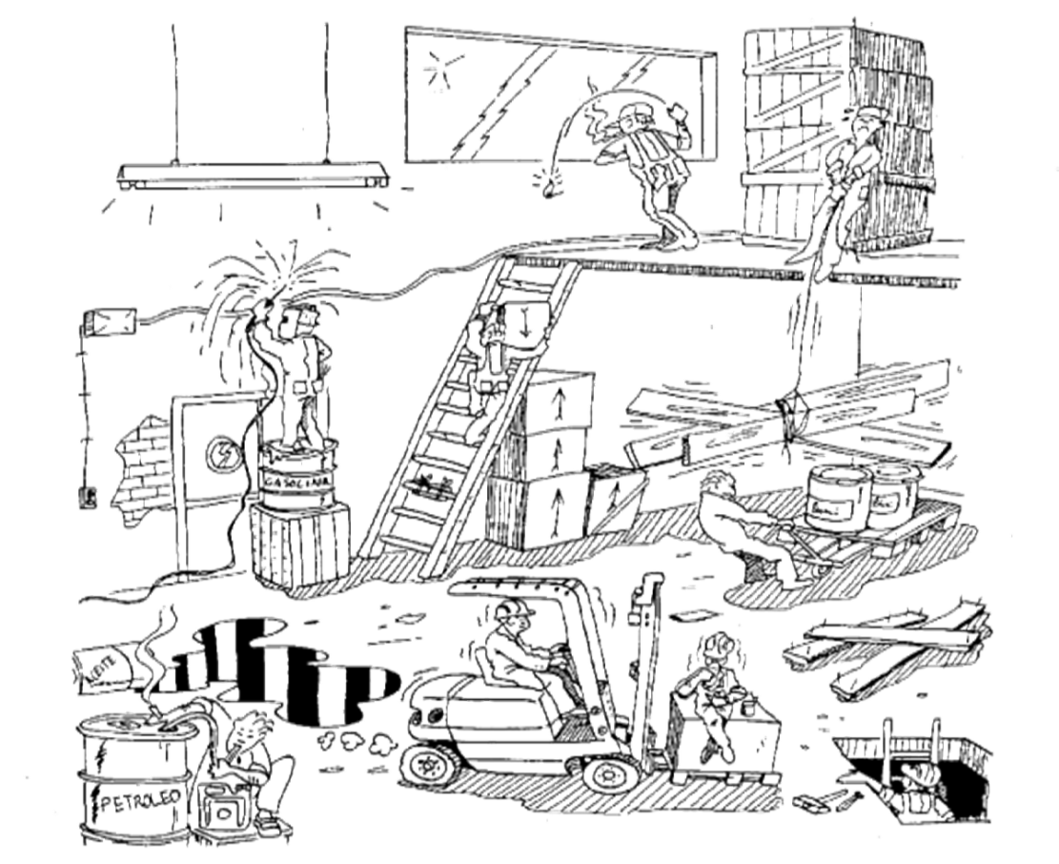
SAFETY COORDINATION FOR EXTERNAL CONTRACTORS
1
Why & When to coordinate?
2
Spanish regulation and its effects
3
How we face it at ALBA
4
Conclusions

Slide 3
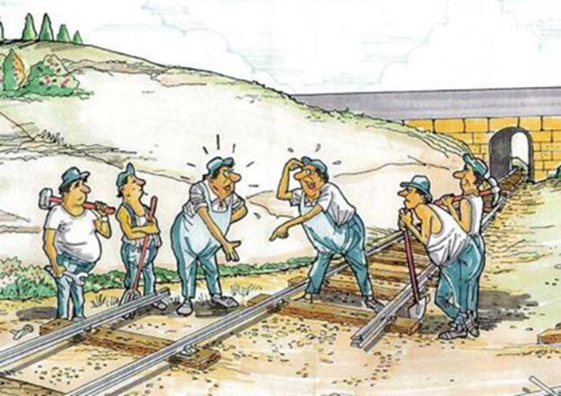
1. WHEN & WHY SAFETY COORDINATION?
When two or more companies meet in the same workplace, the occupational risks inherent to the activity of each one of them can be increased:
Due to lack of knowledge on the structural and intrinsic characteristics of an unknown site.
Due to the lack of knowledge of what other companies are doing, and consequently because of the lack of defense against the risks generated by others.
Due to the uncontrolled interaction of the different activities.

Slide 4
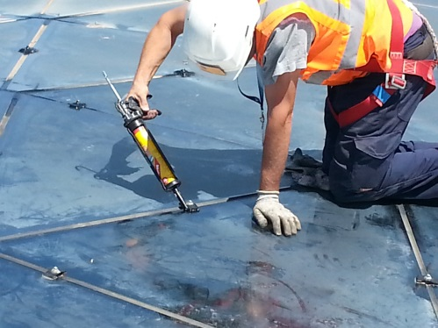
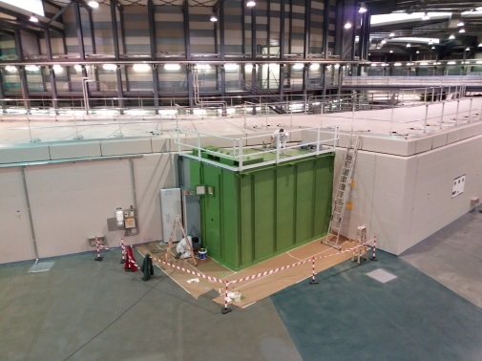
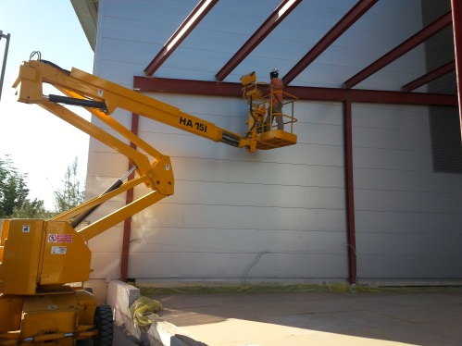
1. WHEN & WHY SAFETY COORDINATION?
Facility maintenance task
Conditioning a new BL hutch
He liquefaction plant

Slide 5
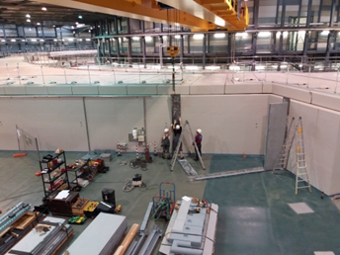
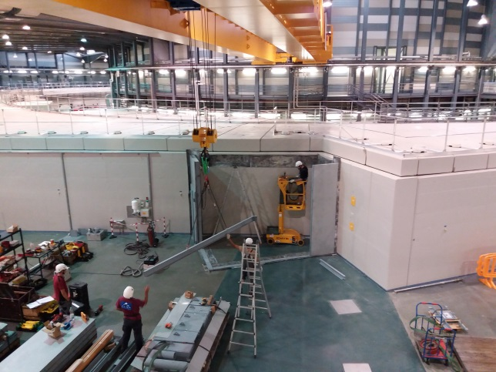
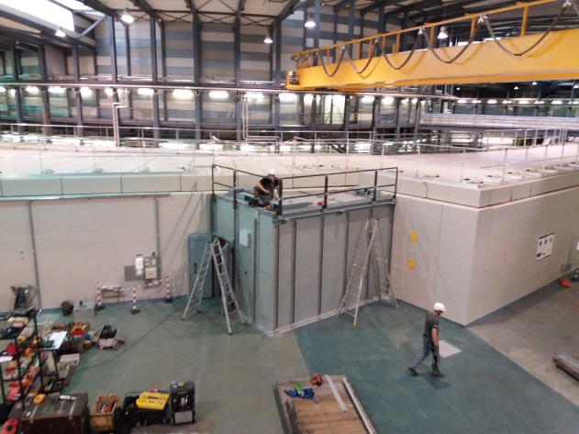
1. WHEN & WHY SAFETY COORDINATION?
New BL construction

Slide 6
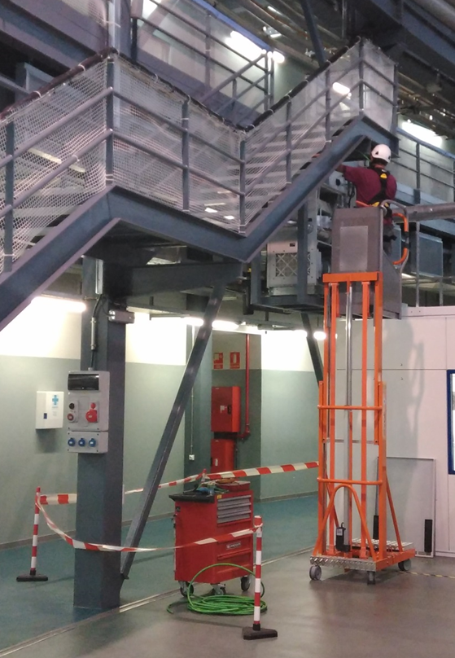
1. WHEN & WHY SAFETY COORDINATION?
Facility general maintenance tasks
equipment maintenance tasks

Slide 7
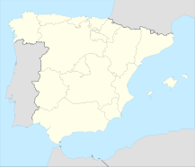
2. SPANISH REGULATION & ITS EFFECTS
Royal Decree 171/2004, of January 30, by which article 24 of Law 31/1995, of November 8, on Prevention of Occupational Risks, is developed in the area of coordination of business activities.
Directive 89/391 / EEC
art. 24 of the law of prevention of occupational risks
Royal Decree 1627/1997, of October 24, which establishes minimum safety and health provisions in construction works.

Slide 8
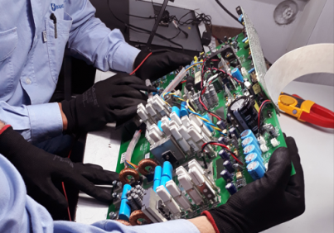
2. SPANISH REGULATION & ITS EFFECTS
Depends on the type of activities to be contracted… the role of the contractors play is : (lets say) active or soft
Are the activities contracted necessary for the normal operation of the Synchrotron?
If YES Contractor’s active profile role: Maintenance & Installation
If NO Contractor’s soft profile role: Services

Slide 9
2. SPANISH REGULATION & ITS EFFECTS
The MAIN difference between roles…
Service profile role: Inform external contractors about
risks
preventive actions
emergency procedures &
give instructions of safety work procedures
Maintenance & Installation profile role : the same plus….DUTY IN VIGILANDO which means
civil &criminal liability subsidiary of the legal non-compliance of our contractors in terms of Health and Safety and some & ALSO administrative aspects that have nothing to do with Health and Safety.

Slide 10
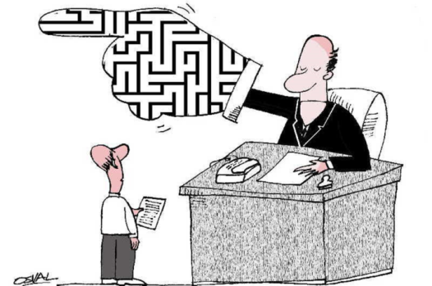
2. SPANISH REGULATION & ITS EFFECTS
Then…according to the jurisprudence.........
IN VIGLANO DUTY is done by asking to the subcontractors their safety documents.

Slide 11
3. HOW WE FACE IT AT ALBA
With balance (legal requirements vs effectiveness):
We focus in the working plan (specific risk assessment) & main important safety documents.
With tools:
Internal Procedure for Safety Coordination.
An internal communication tool: jira safety ticket system.
An external on line platform as document management tool
If special risk are detected :
In situ safety training.
Coordination meeting .
Visits &Inspections.

Slide 12
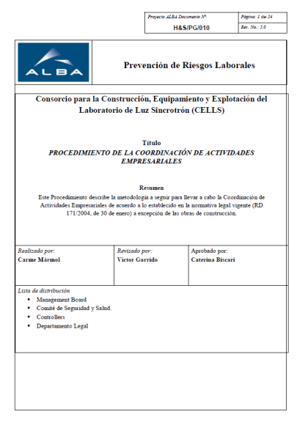
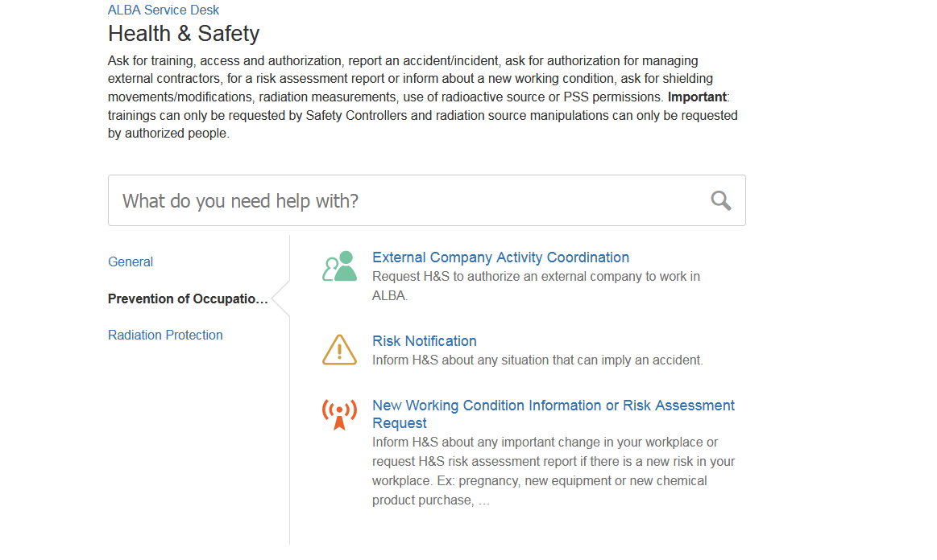
3. HOW WE FACE IT AT ALBA
The Tools:
Internal communication tool
Internal procedure

Slide 13
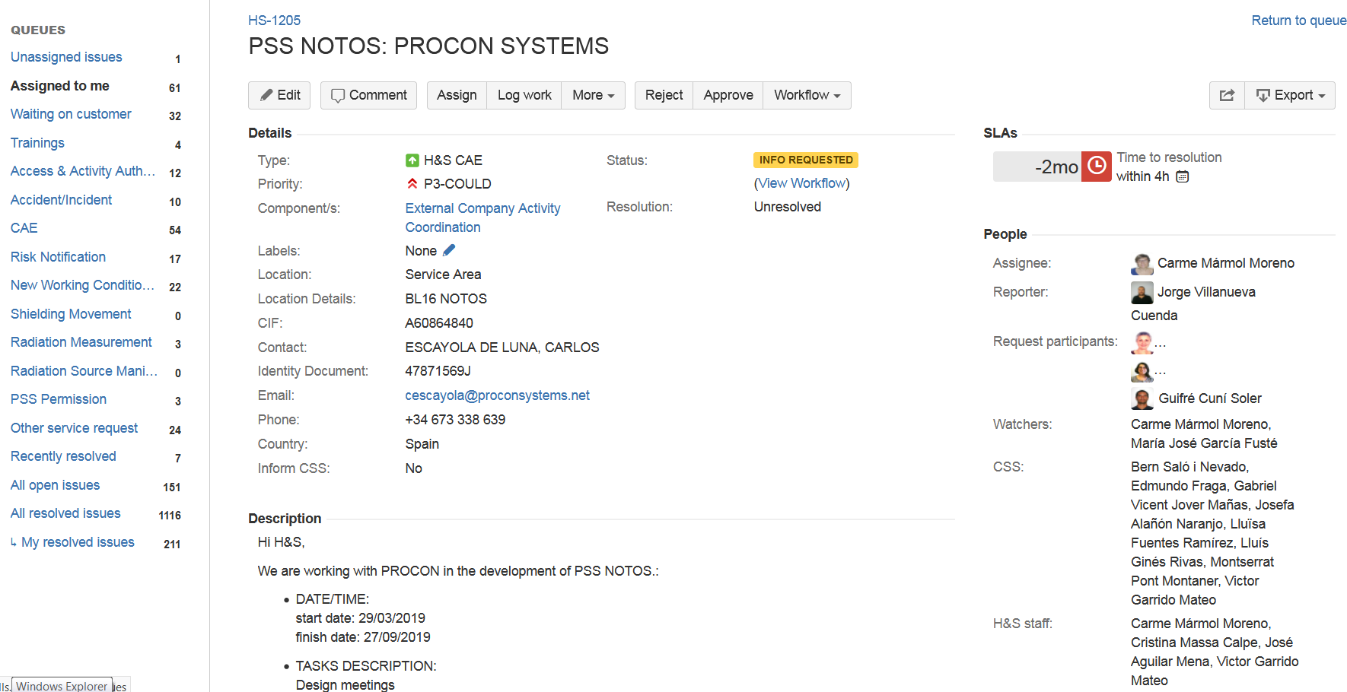
3. HOW WE FACE IT AT ALBA
Ask for the preliminary main information

Slide 14
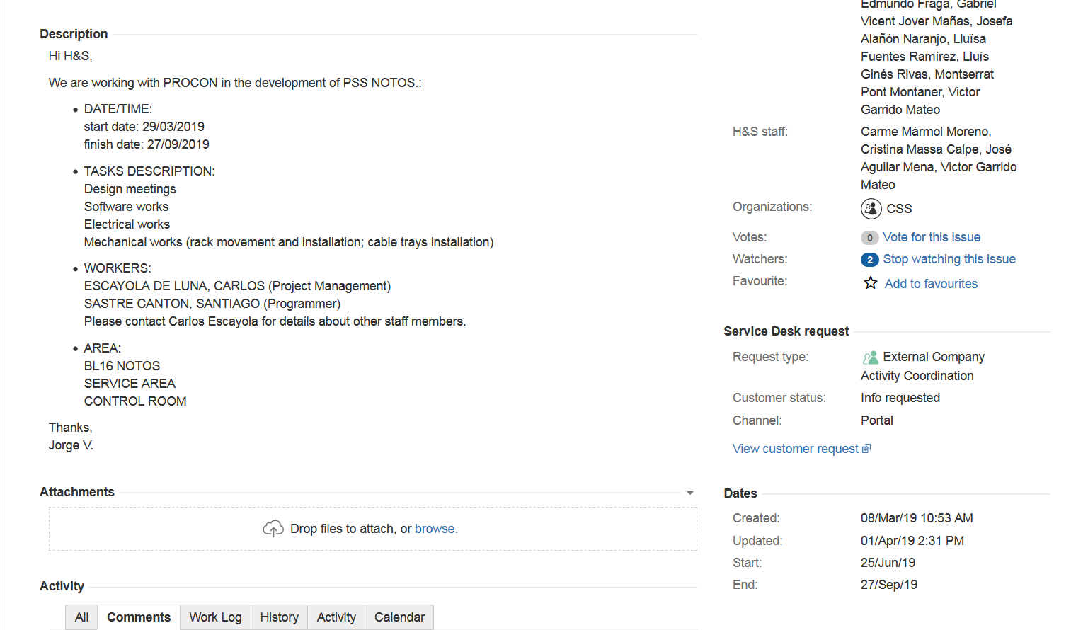
3. HOW WE FACE IT AT ALBA
Ask for the preliminary main information

Slide 15
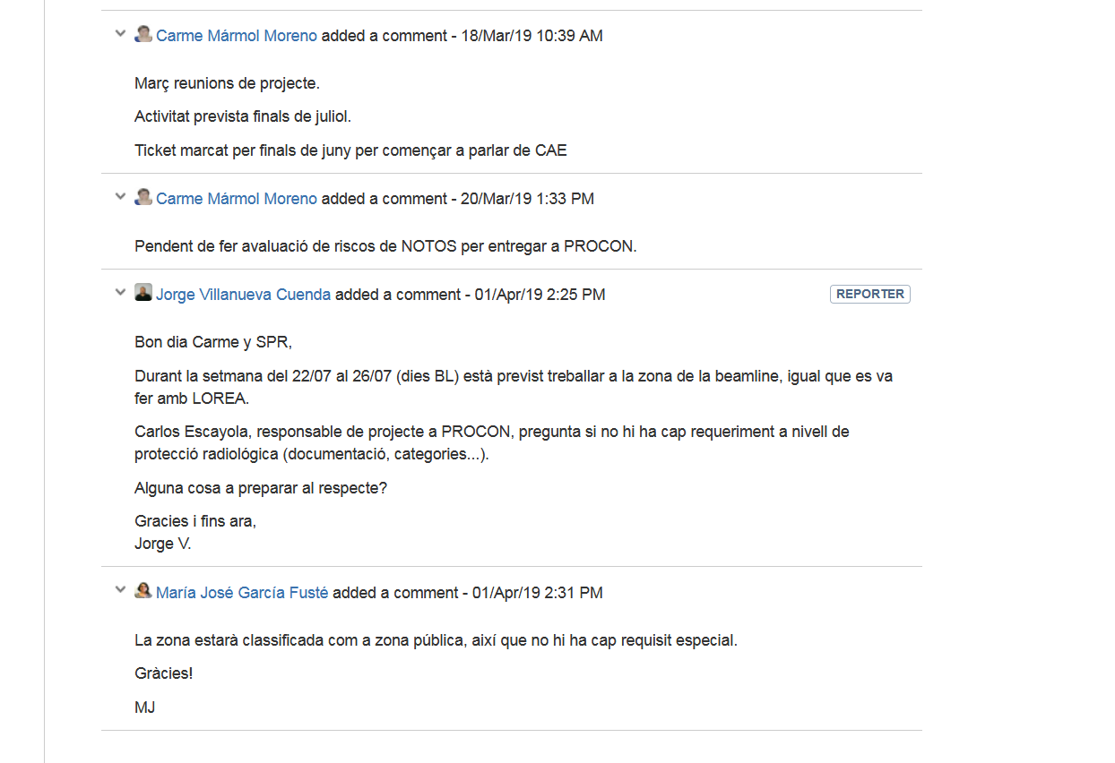
3. HOW WE FACE IT AT ALBA

Slide 16
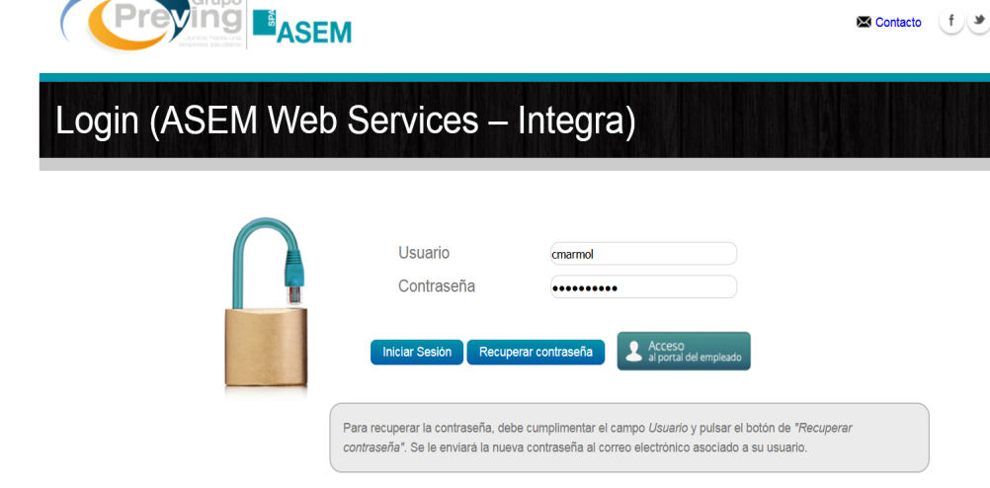
3. HOW WE FACE IT AT ALBA
Maintenance & Installation profile
Services profile
External online document repository
But the access management is done by ALBA ( platform is not linked with ALBA’s control access system).
Ask directly to the external contractors their safety documentation & validates it.
Working plan is assessed/validated by ALBA.

Slide 17
3. HOW WE FACE IT AT ALBA
Maintenance & Installation profile
Company’s documents
A document where the subcontractor confirm that he has received risk & emergency information from ALBA & he is in charge of distribute this information through his/her crew.
Risk assessment and planning of the preventive activity of the company.
Safety organization system certificate.
Safety on site responsible designation & he/she's training
Working Plan (specific risk assessment of the work to be performed). Own from ALBA.
Service profile
Company’s documents
A document where the subcontractor confirm that he has received risk & emergency information from ALBA & he is in charge of distribute this information through his/her crew.
Working Plan (specific risk assessment)

Slide 18
3. HOW WE FACE IT AT ALBA
Maintenance & Installation profile
Worker’s documents
Work Medical checking
Authorization of work to be done.
Certificate of delivery of individual protection equipment (EPIS).
Certificate of training in prevention of occupational risks
Specific training Certificates : Depending on the works :training such as training for work at height, confined spaces, electrical risk, forklifts, lifting platforms, electrical work, etc.
Certificate of delivery of workplace risk assessment information.
Service profile
Worker’s documents: No documents are requested

Slide 19
3. HOW WE FACE IT AT ALBA
Maintenance & Installation: Company screen
Soft called: Services

Slide 20
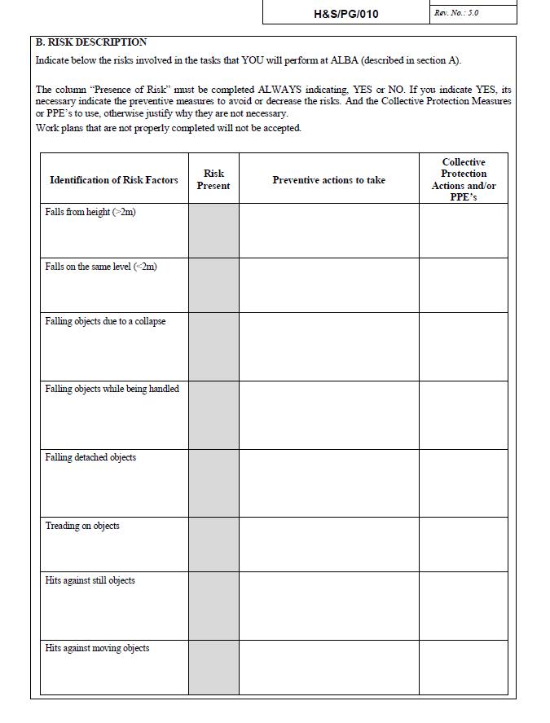
3. HOW WE FACE IT AT ALBA
Working Plan

Slide 21
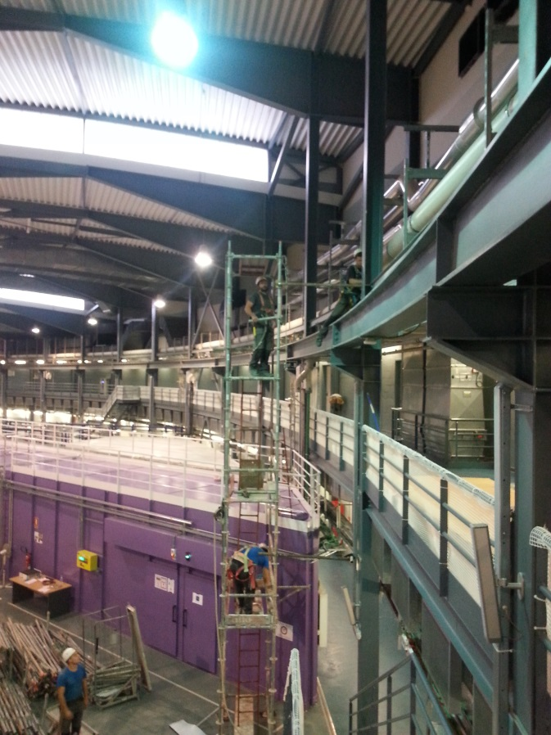
3. HOW WE FACE IT AT ALBA
In 2018…
We manage 210 contractors in our facility, in some cases with chain of subcontracting.
25% of them come 2-3 times for different activities
90% of the from Maintenance & installation profile .
A total of 8000 documents were reviewed .

Slide 22
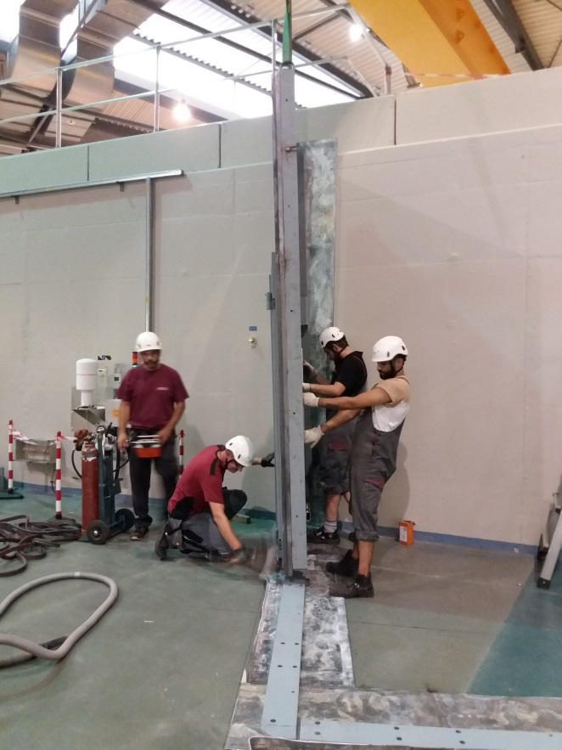
4. CONCLUSIONS
According to our experience…
The most essential document is the working plan. Is just where we detect (deficient risk assessment & lack of information).
ALBA’s staff responsible of the works contracted should be more implied than now (knowledge of works and site).
Focusing on the actions that really can avoid accidents/incidents and get evidence & tracking of these actions.
Monitoring that subcontractors complies with H & S regulations in fact should be an Administration role .

Slide 23
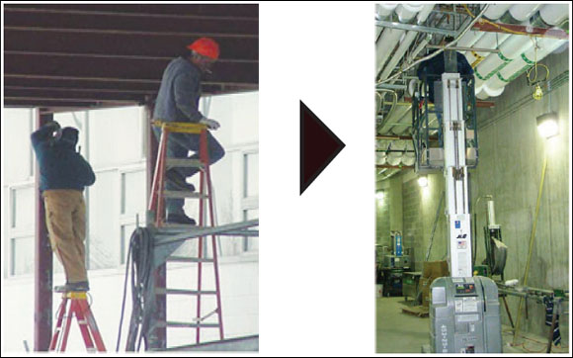
4. CONCLUSIONS
Summarizing Safety coordination helps to:
Identify and reverse risk situations.
Integrate safety in the organization.
Ensure contractors are informed and knows safety and emergency procedures.
Ensure that everyone knows how to perform their work safely.

Slide 24
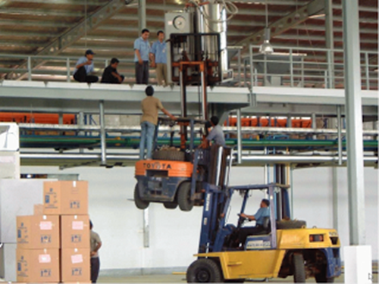
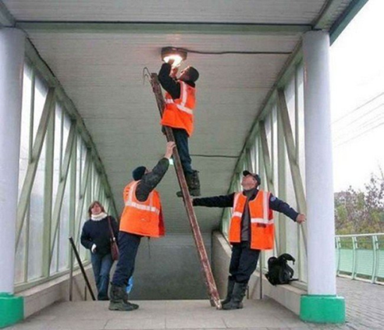
4. CONCLUSIONS
Not focus to much here …
Instead of do it here!!

Slide 25
THANKS FOR YOUR ATTENTION☺
Carme Marmol Occupational Health & Safety ALBA Synchrotron Light Source C/ de la Llum, 2 - 26 08290 Cerdanyola del Vallès (Barcelona) Tel.: +34 93 592 44 61 Fax.: +34 93 592 43 01 Mail: cmarmol@cells.es

