Slide 1
Safe operation of the Wendelstein 7-X fusion experiment
Sven Degenkolbe, Jörg Schacht, Reinhard Vilbrandt, Axel Winter, H.‑S. Bosch, Dirk Naujoks, Detlef Wieseler and the W7-X Team
14.05.2019
1

Slide 2
Outline
Introduction of Wendelstein 7-X
Goals
Major elements
Timeline
Main components and sources of hazards
Heating systems
Superconducting coil system
Gas system
High voltage
Structure of the control system
Conclusion
14.05.2019
1

Slide 3
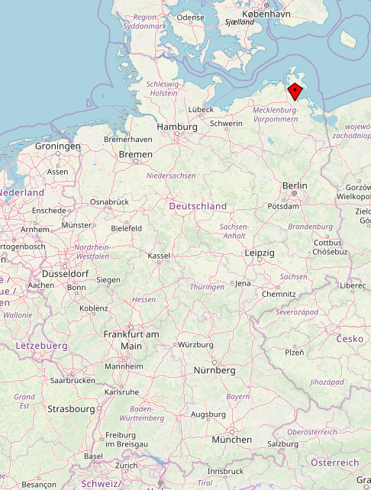
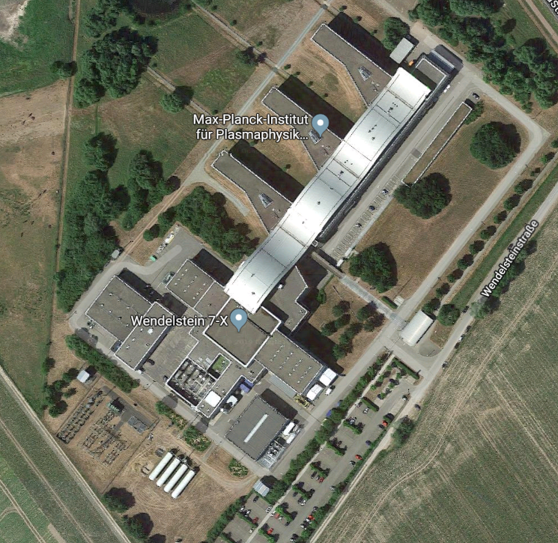
About Wendelstein 7-X
Max Planck Institute for Plasma Physics
Branch Greifswald → Wendelstein 7-X (Stellarator)
Max Planck Institute for Plasma Physics
Branch Garching → ASDEX Upgrade (Tokamak)
Data: Openstreetmap
14.05.2019
1

Slide 4
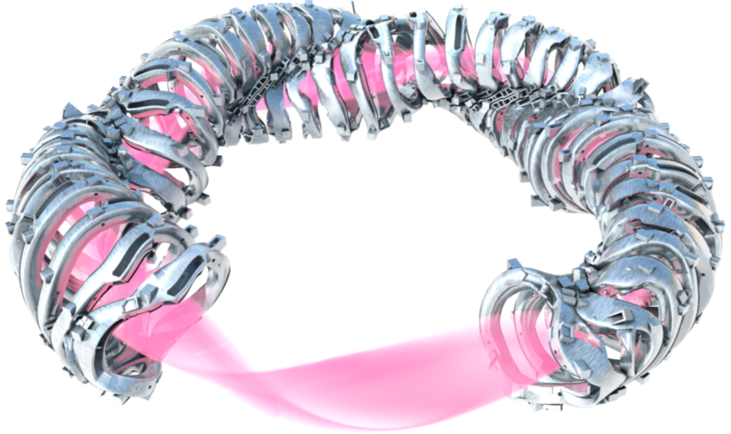
About Wendelstein 7-X
Wendelstein 7-X is the world largest fusion device of the stellarator type.
Goals:
Prove the suitability of this type of magnetic confinement for a power plant
Plasma discharges up to 30 minutes
14.05.2019
1

Slide 5
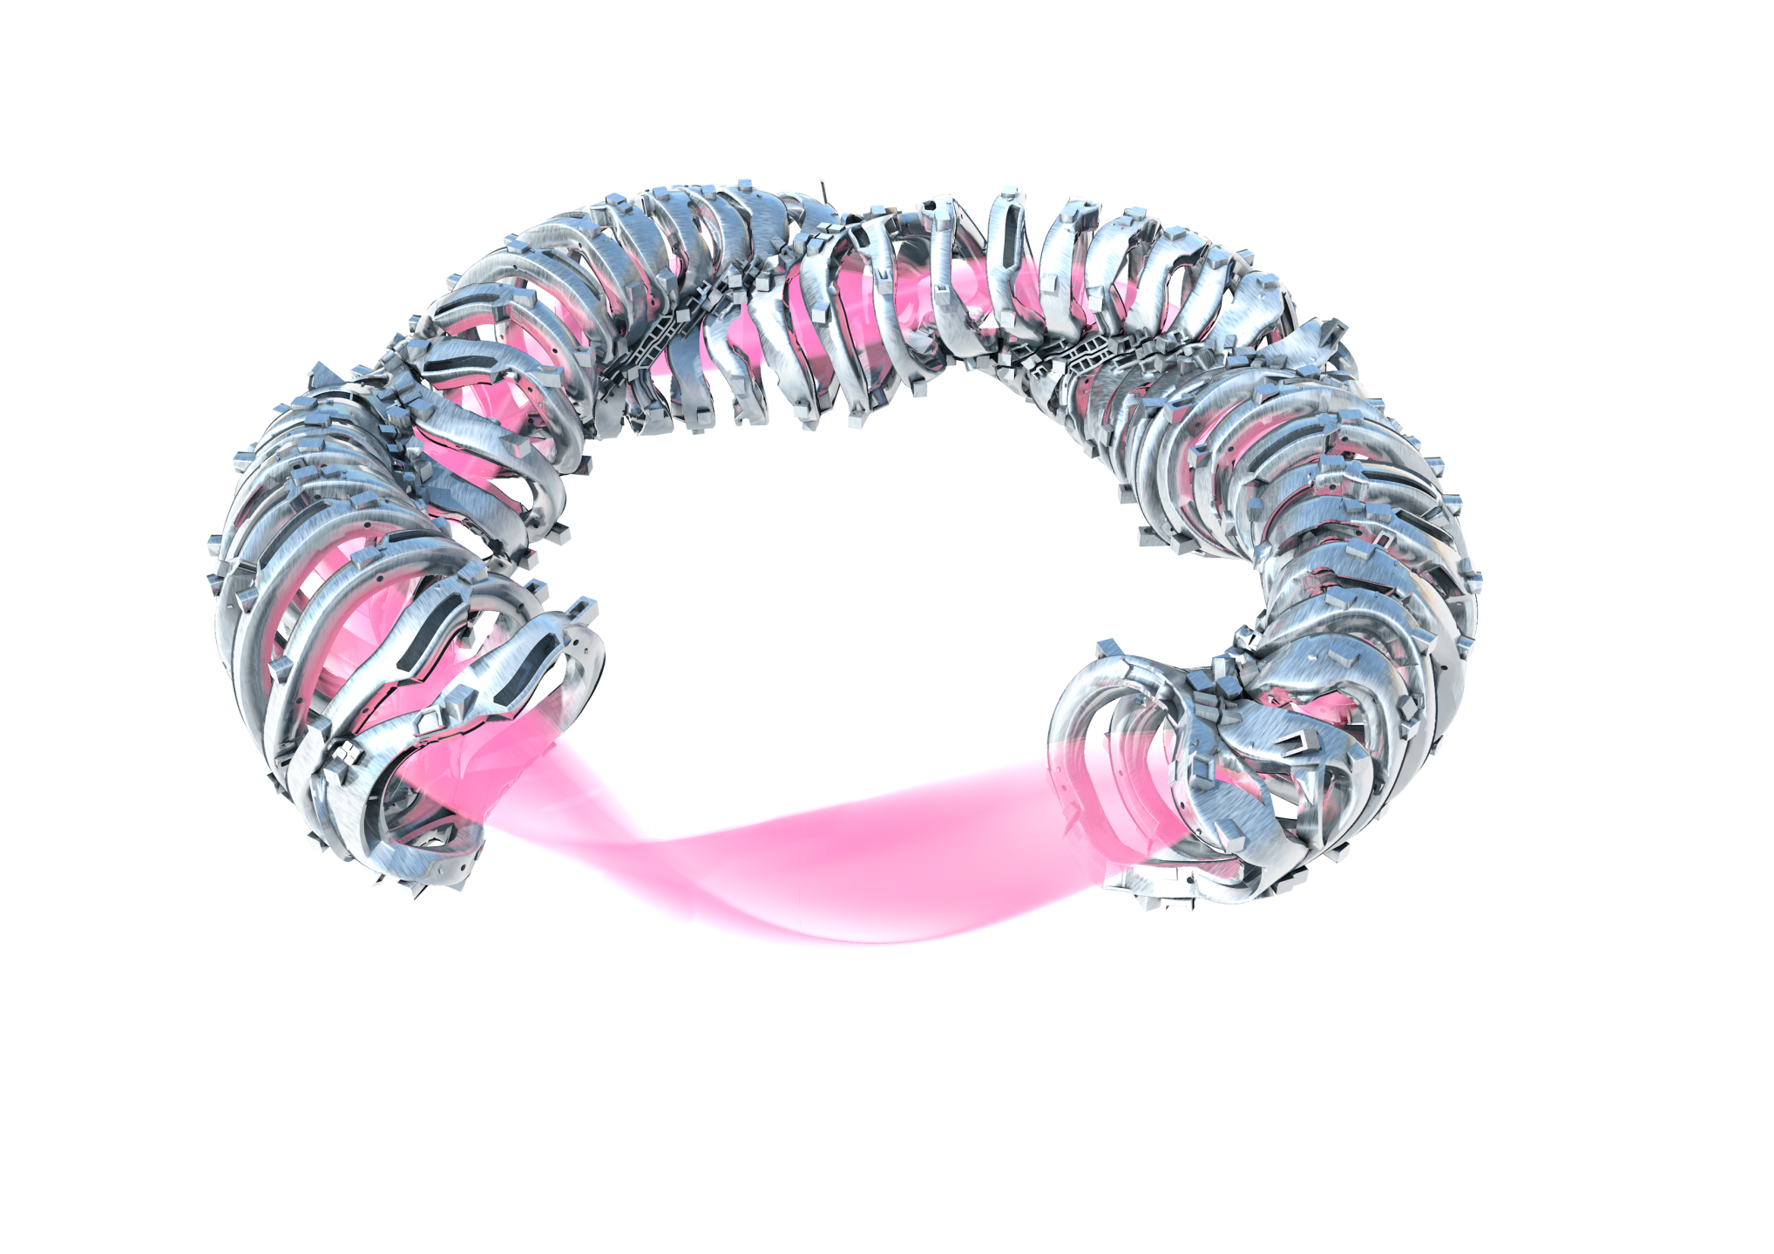
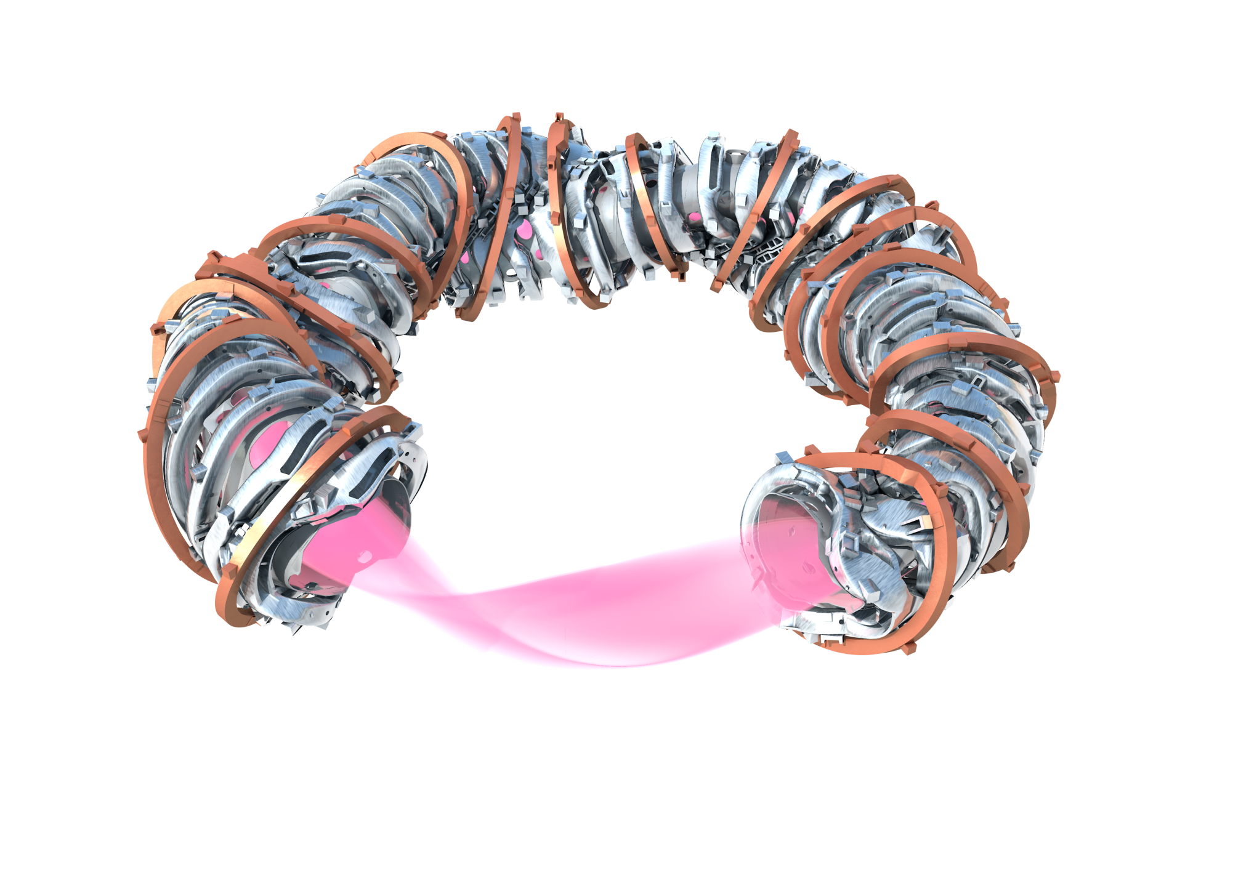
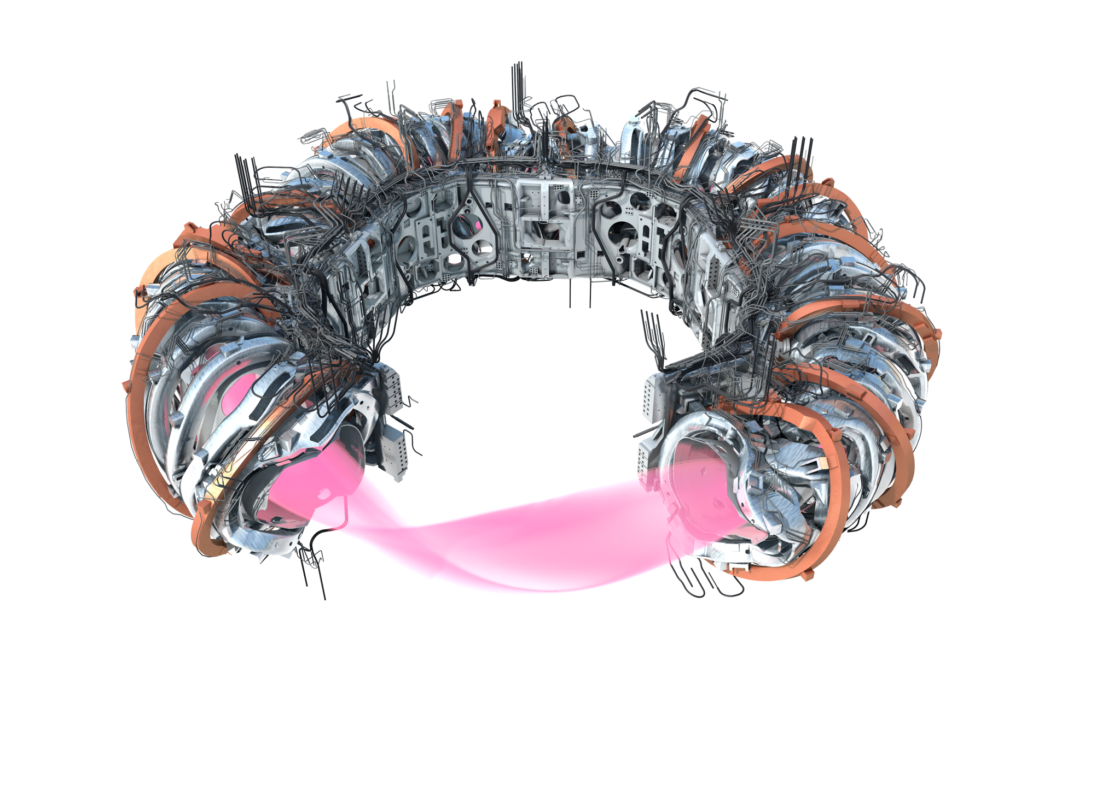
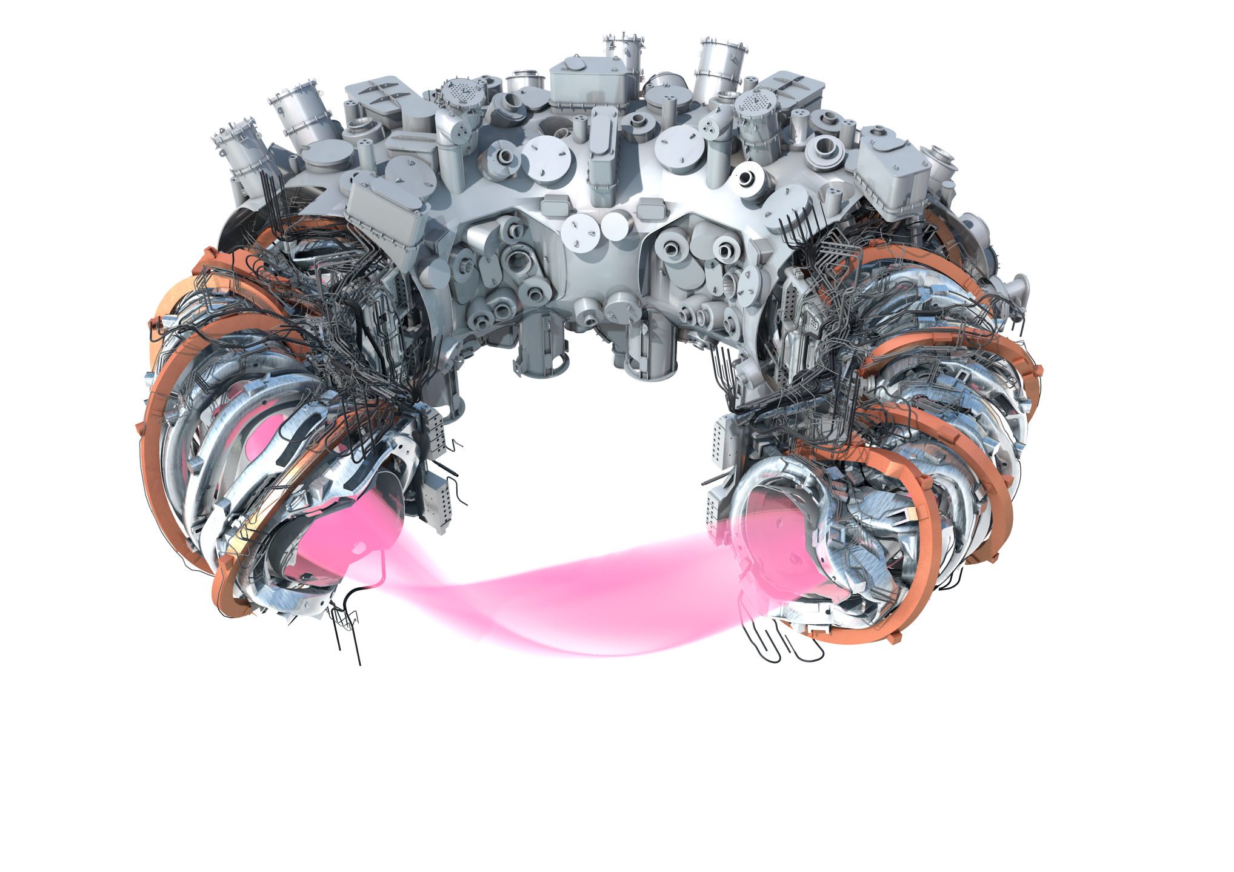
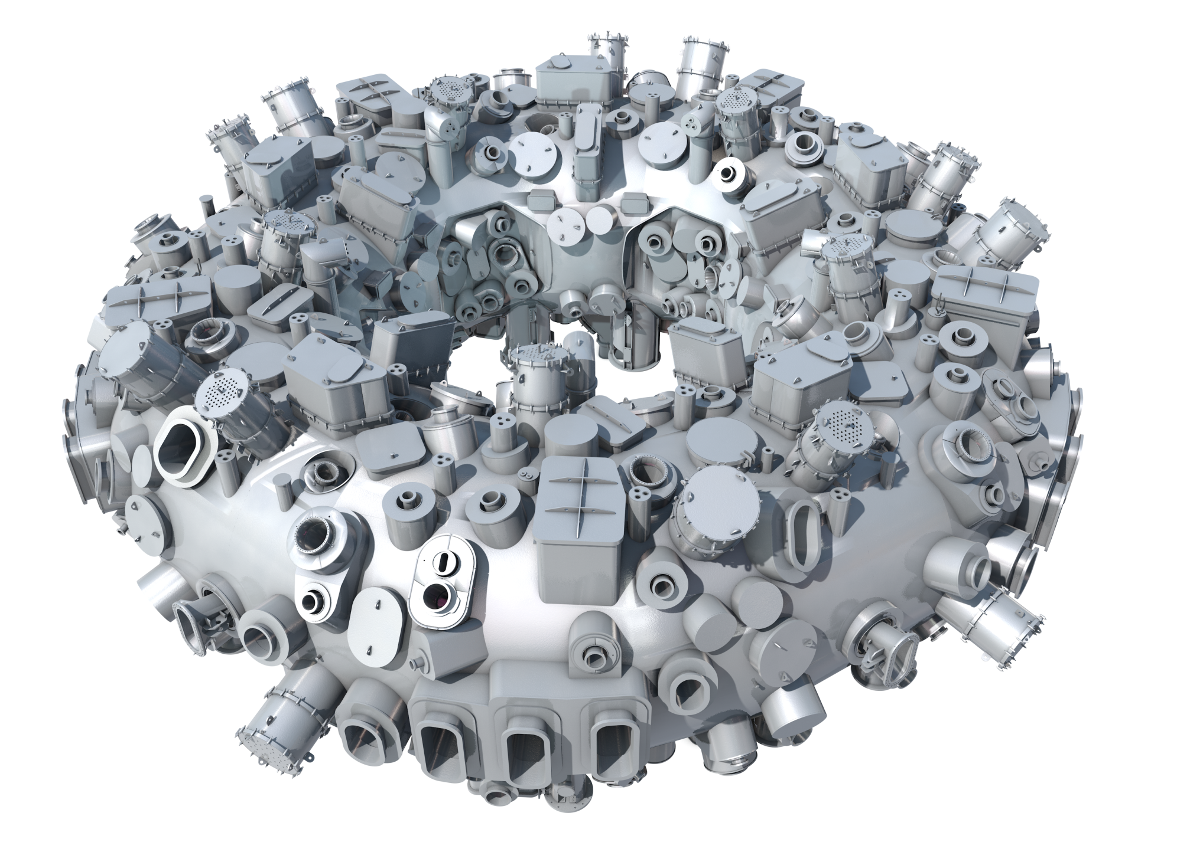
Major elements and parameters of Wendelstein 7-X
plasma vessel 80 m³
265 m² in-vessel components
plasma 30 m³
50 non-planar NbTi coils 5 types DC <18 kA
20 planar NbTi coils 2 types DC <16 kA
4.5 m machine height 16 m machine diameter 735 t device mass 435 t cold mass 3.4 K
2.5 – 3 T magnetic induction on axis
Central support ring
Helium piping
cryostat vessel 420 m³ thermal insulation
14.05.2019
1

Slide 6
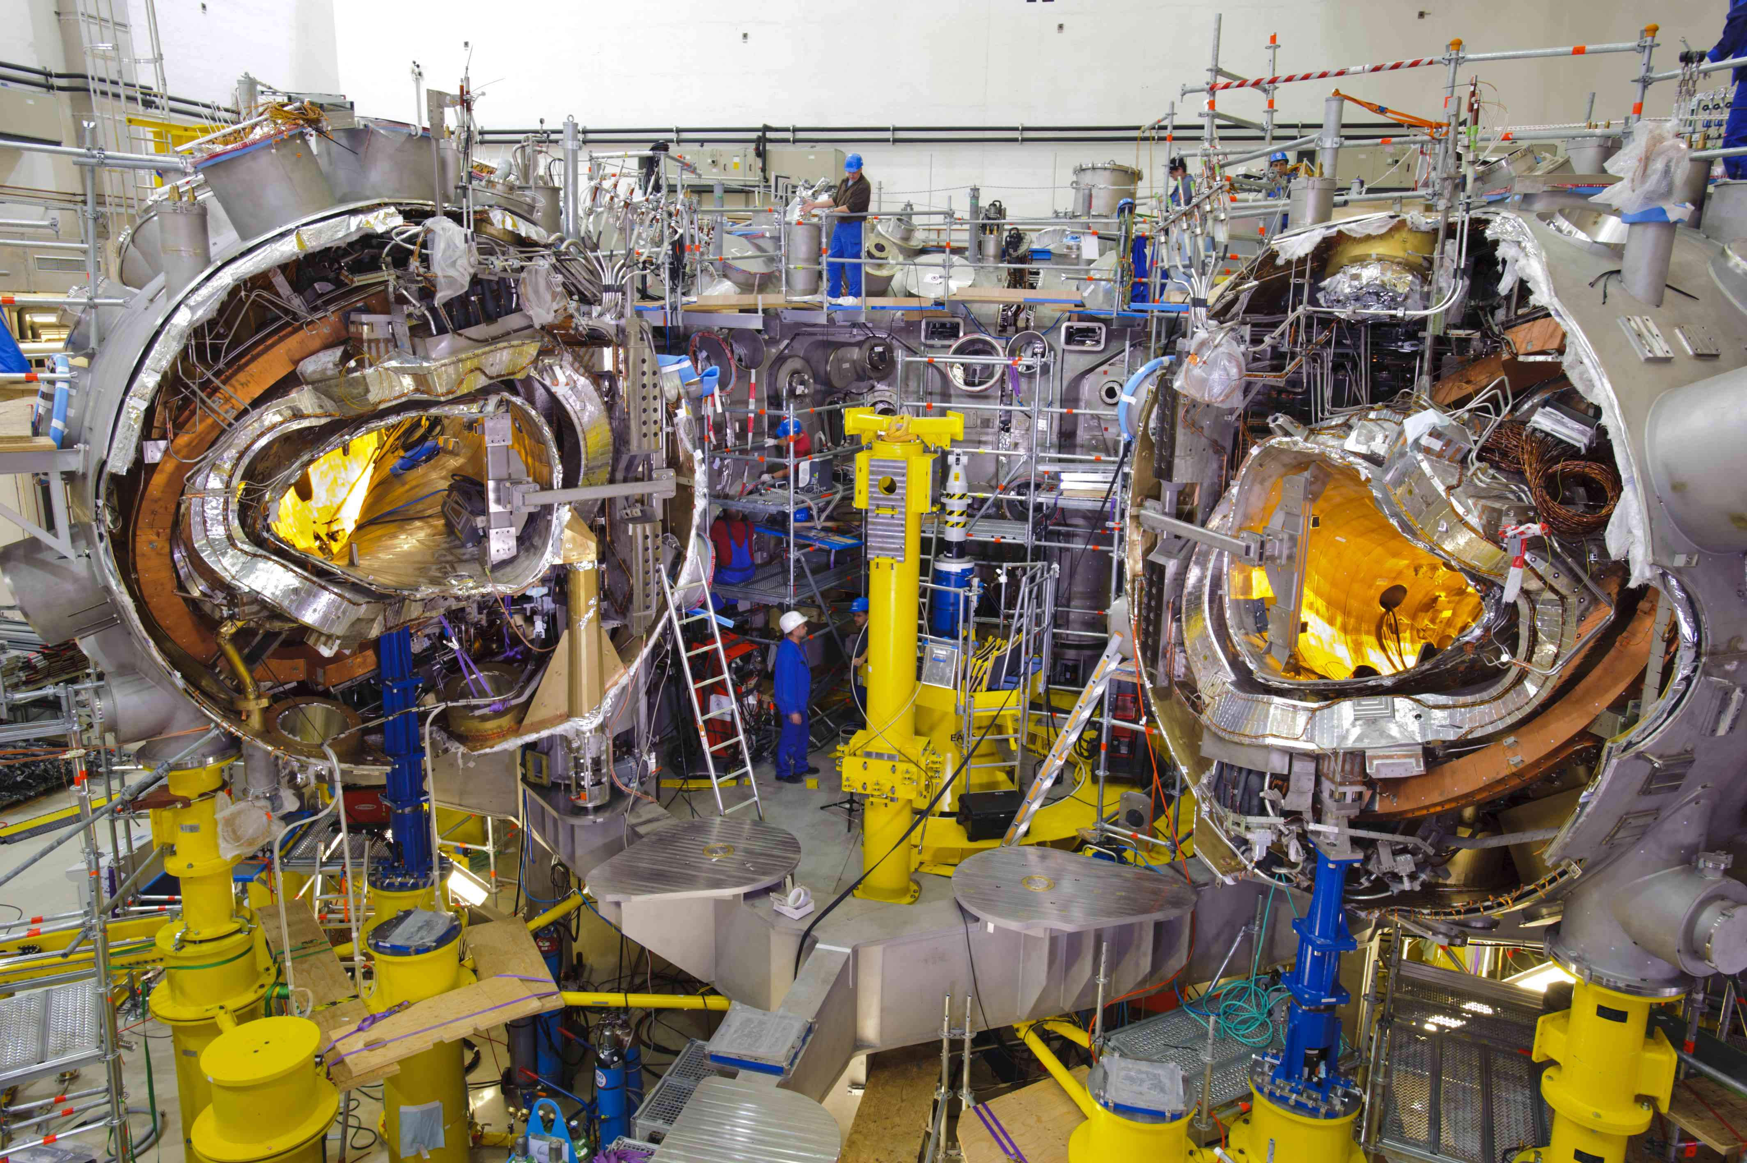
Construction of W7-X, 4/5 modules in the final position
non-planar SC coils
plasma vessel
SC bus bar He piping
central support ring
thermal insulation
outer
vessel
maschine
base
planar SC coils
14.05.2019
1

Slide 7
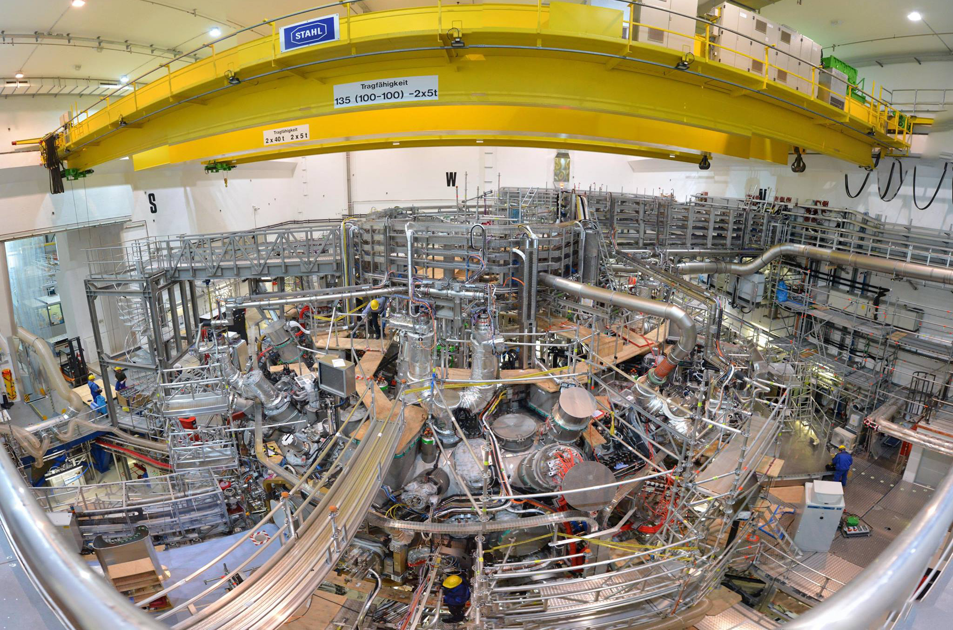
View of the Wendelstein 7-X 2017
14.05.2019
1

Slide 8
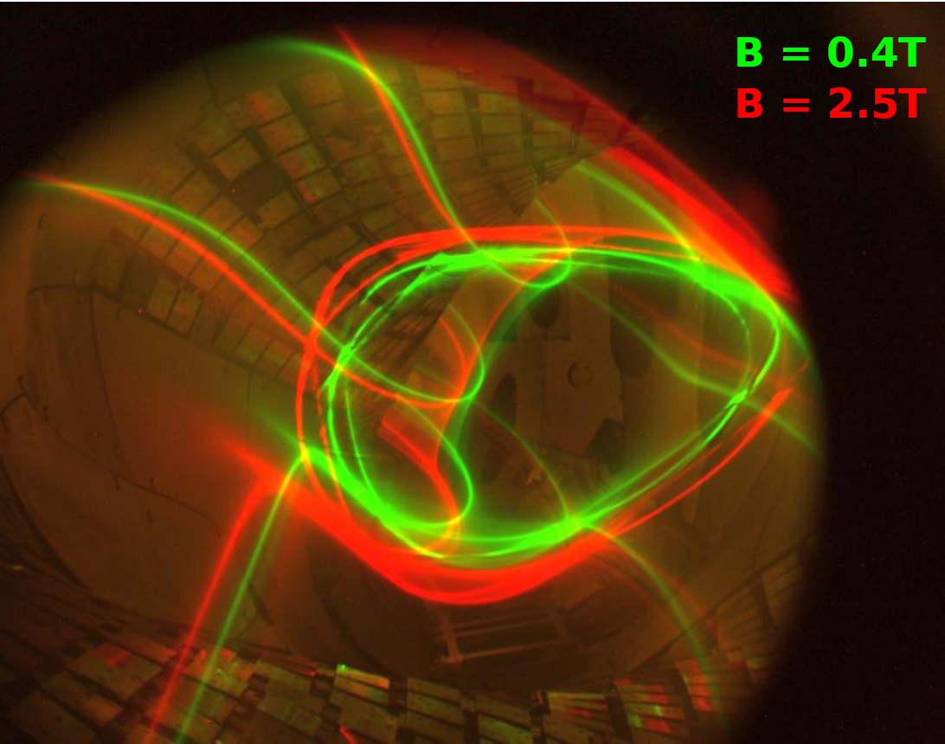
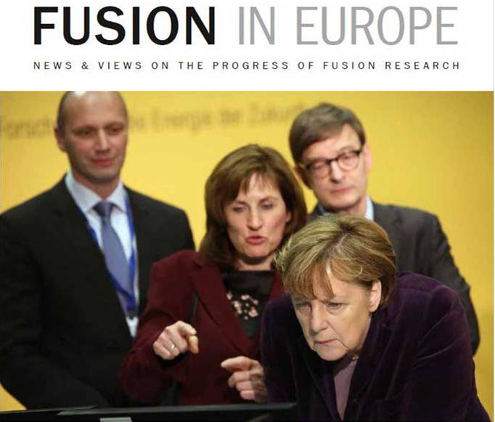
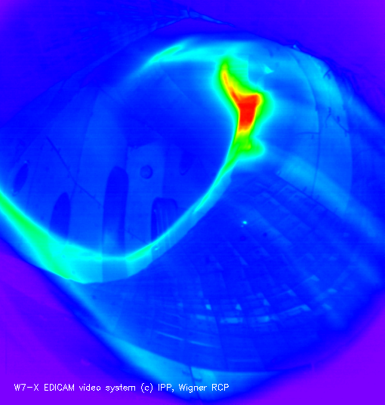
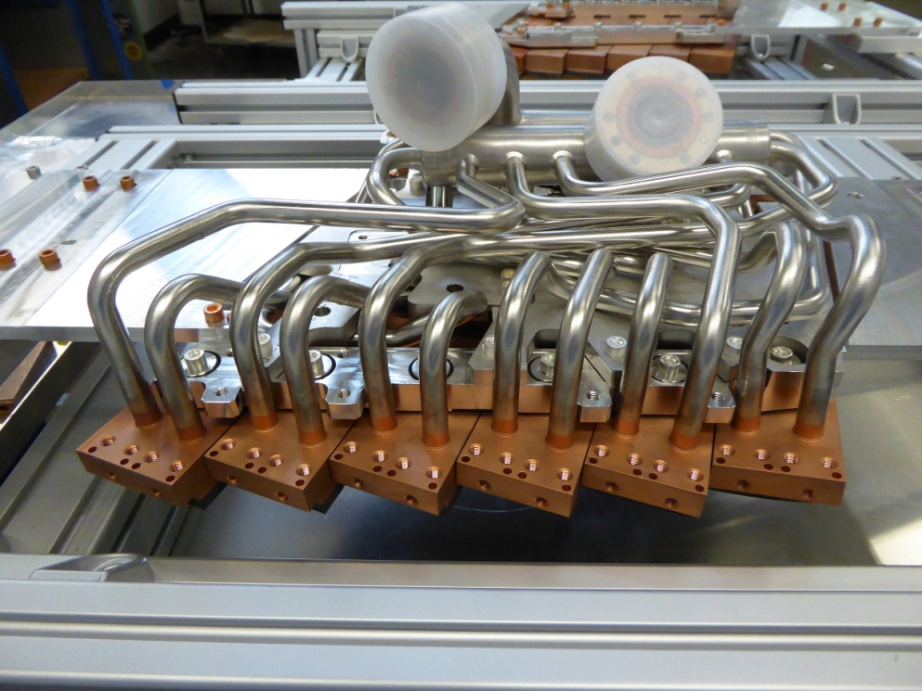
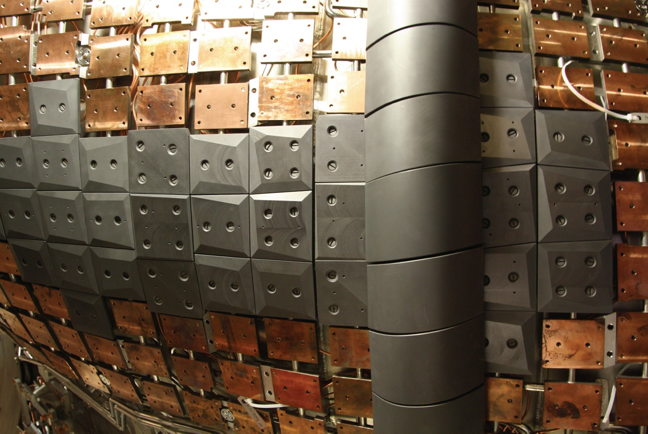
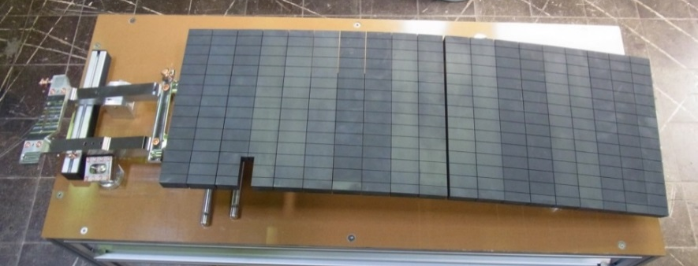
Timeline of the project Wendelstein 7-X
pump-down
cool down
magnet ramp-up
flux surfaces
1st plasmas 5 limiters E_{h}≤4 MJ
T_{p}∼1s
inertial cooling 10 divertors E_{h}≤200 MJ
T_{p}∼10-100 s
water cooling 10 HHF divertors E_{h}≤18000 MJ
T_{p}∼100-1800s
10 years assembly
18 months assembly
30 months assembly
2004-2014
2014
2015
2016
2017-2018
2019-2021
2022 …
14.05.2019
1

Slide 9
Main systems
General Supplies
W7-X central device
gas supply
cooling water
cryo supply
vacuum supply
power supply of magnet systems
plasma heating
diagnostics
monitoring and control
infrastructure (buildings,
general supply)
General Power Supplies
Liquid He & Liquid N2
Gases
Technical Services
Ventilation & Air Conditioning
General Control: Signals, CDC & CSS
General Water Supply
Fire Protection System
Access System
Compressed Air
W7-X
Vacuum System
Neutral gas
density
Power Supply
Magnet System
Cryo Supply
LHe, LN2
Current
W7-X
Torus
Plasma Heating Systems
PS Heating Systems
Gases
Energy
Signals
Monitoring & Control:
Sensors & Diagnostics
Gas Introduction System
Water
Water Cooling System
Coding Location:
Torus Hall Ground floor and Level -1
Torus Hall Level -2
Periphery
14.05.2019
1

Slide 10
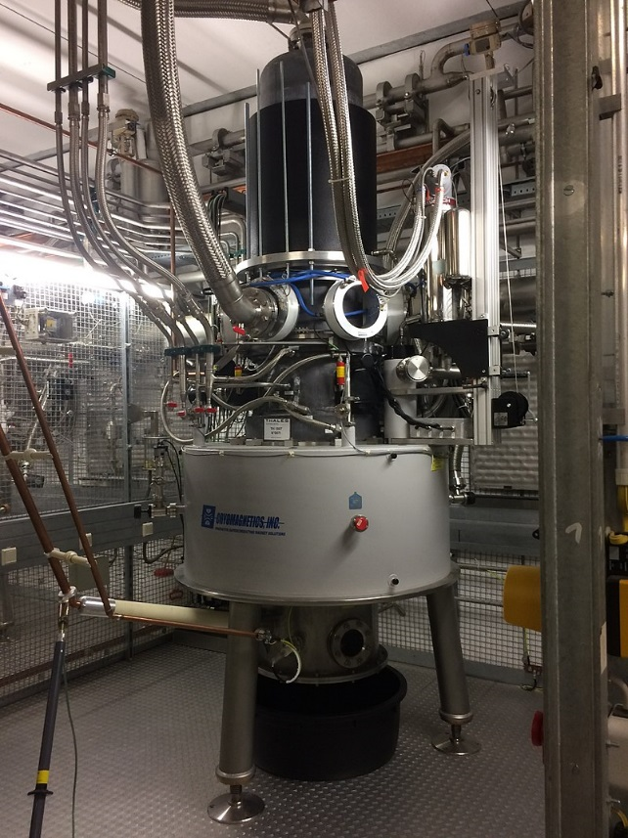
Heating Systems
Electron cyclotron resonance heating (ECRH)
max 1 MW at 140 GHz; 10 Gyrotrons
Neutral beam injection (NBI)
Hydrogen 1.65 MW per source; Deuterium 2.5 MW per source
4 sources
Ion cyclotron resonance heating (ICRH)
2 MW at 30 – 115 MHz, 2 generators
→ non absorbed power inside the plasma vessel will damage components
Gyrotron 140 GHz, 1 MW
14.05.2019
1

Slide 11
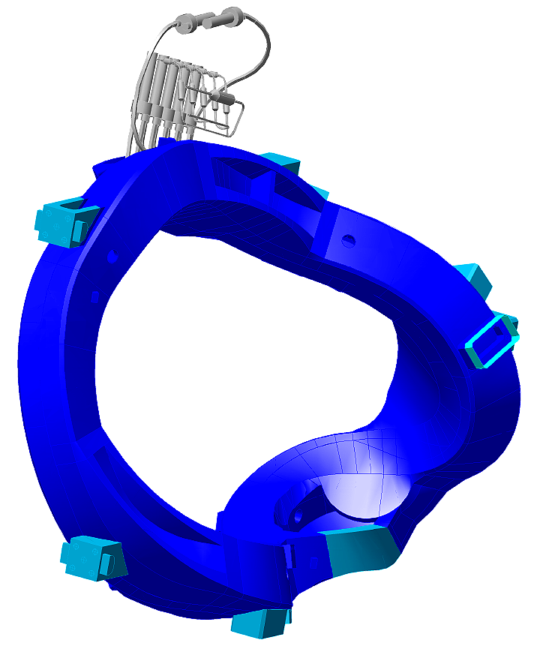
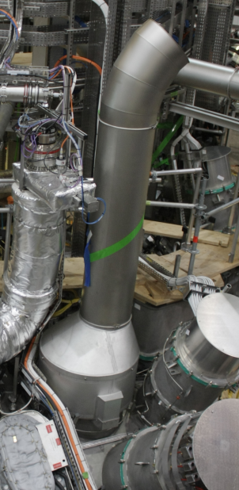
Superconducting coil system
50 non-planar coils 5 types; DC < 18 kA
20 planar coils 2 types; DC < 16 kA
2.5 – 3 T magnetic induction on axis
Mechanical forces on the structure up to 3.6 MN
Quench: coils loose superconductivity
→ Quench detection system
Cooled with helium at 3.4 – 4.5 K
→ Pressure relief system
Non-planar coil
Part of the pressure
relief system
14.05.2019
1

Slide 12
Gas system
Use of hydrogen, deuterium for plasma experiments
Use of hydrogen, diborane for conditioning (glow discharge cleaning, boronization)
→ Gas detection system
14.05.2019
1

Slide 13
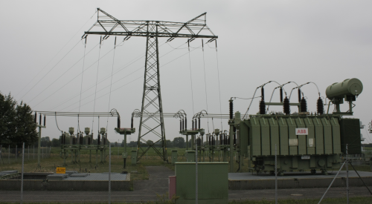
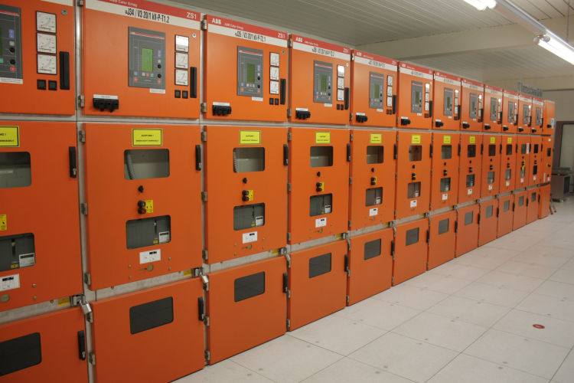
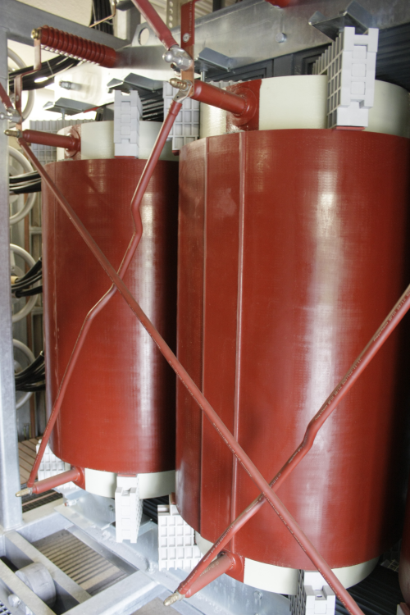
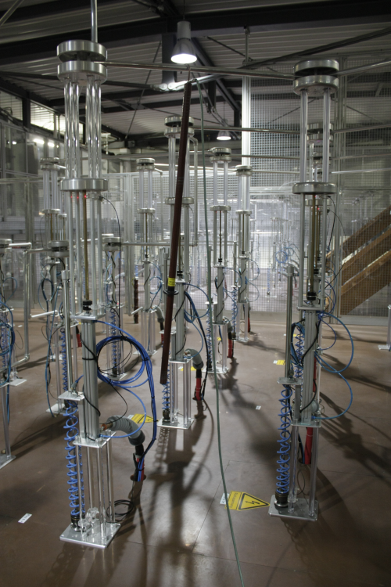
High voltage
110 kV feed-in and 20 kV feed-in
transformed to different voltage levels
For heating systems:
multi purpose high voltage supply DC:
ECRH 60 kV 50 A
NBI 65 kV 95 A
ICRH 30 kV 160 A
14.05.2019
1

Slide 14
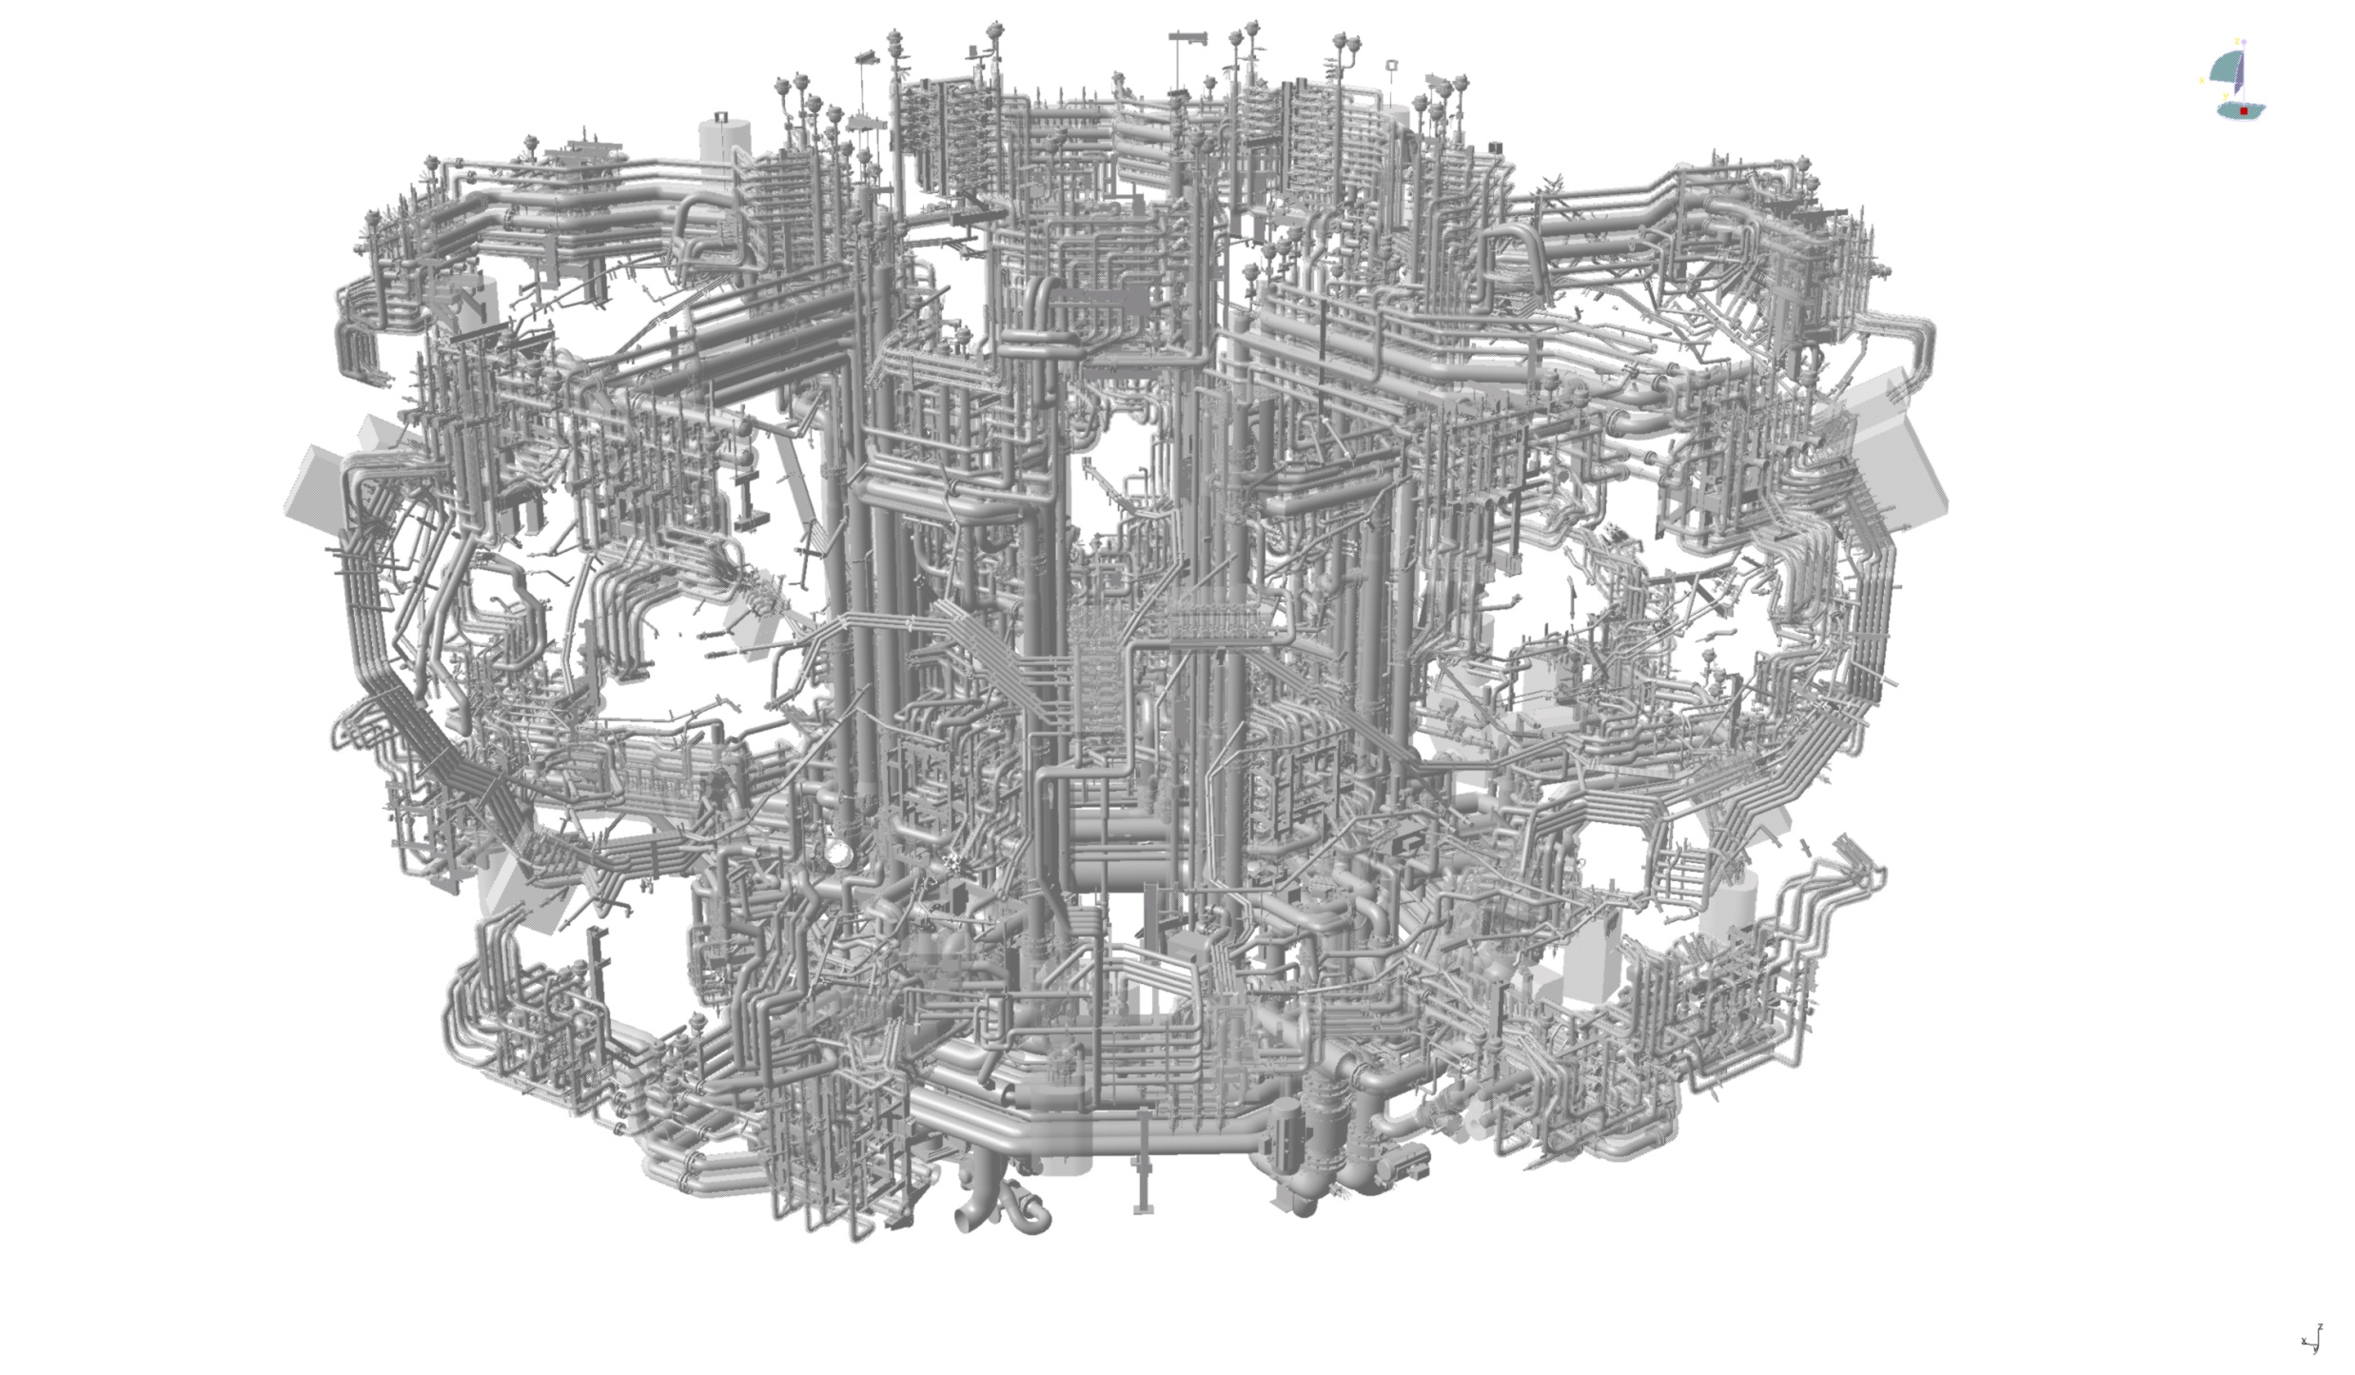
Water cooling circuits
At experiments: Cooling water with 28 °C
At baking: water at 150 °C p > 10 bar
14.05.2019
1

Slide 15
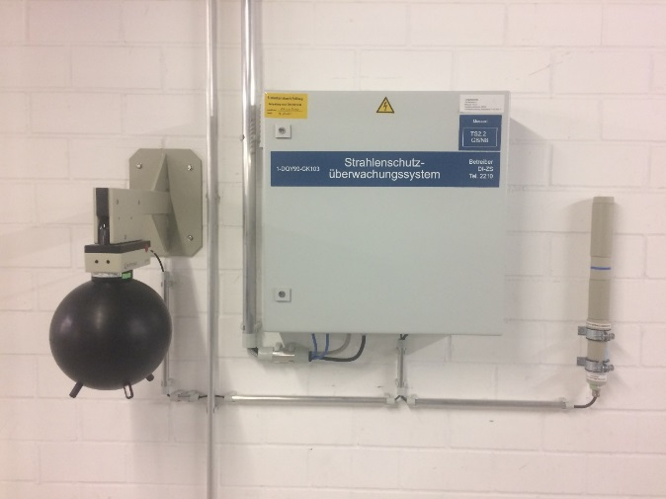
Different kinds of radiation
Radiation produced by the heating systems (microwave, radio waves)
Lasers: 4 Systems with class 4 lasers
Radiation produced by the plasma → x-rays, ultra violet
During deuterium operation fast neutrons will be produced
Special requirements from the authority
Radiation monitoring system
Radiation protection area with special access
Currently no deuterium operation
14.05.2019
1

Slide 16
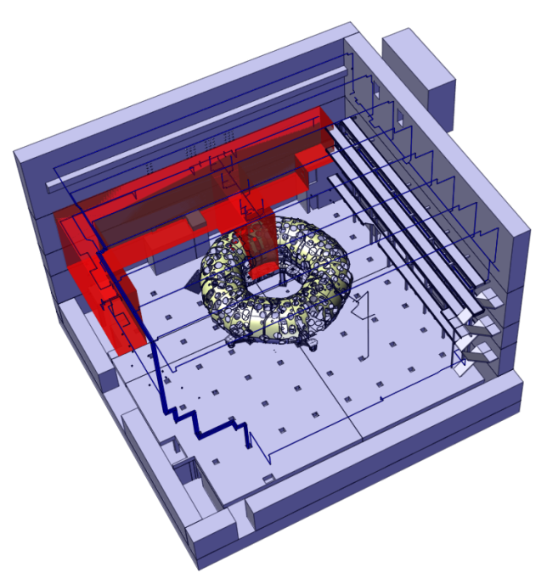
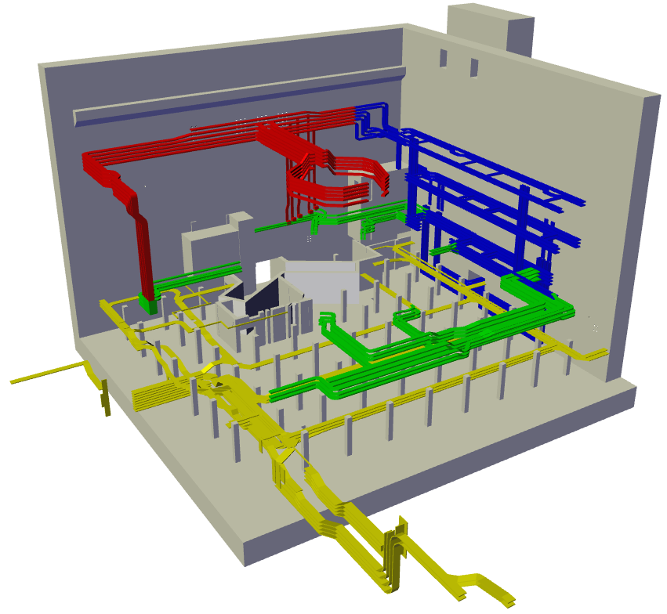
High-pressure water mist extinguishing system
Example of one extinguishing area control cabinets
Thermal differential and thermal maximum detectors of all main cable shafts
14.05.2019
1

Slide 17
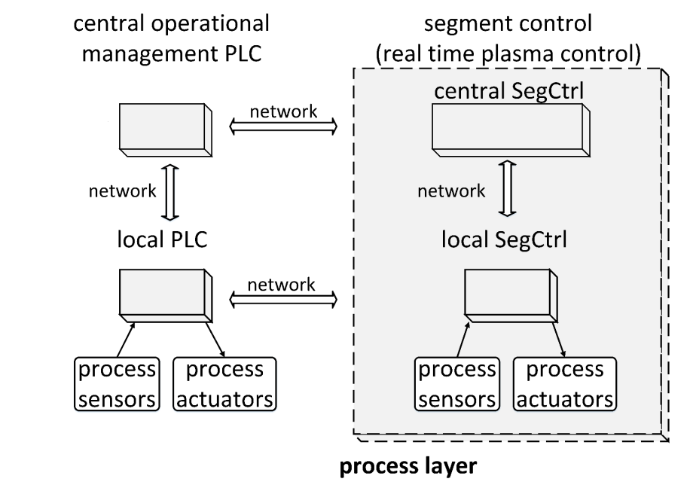
Process control system
W7-X control system with hierarchical structure
Segment control (real time) plasma discharges
Programmable logic controller
Central operational management
→ Process supervision functions
14.05.2019
1

Slide 18
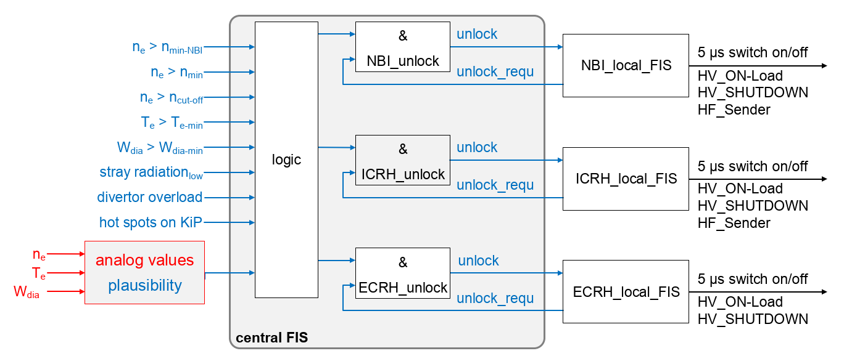
Fast interlock system
Plasma density, electron temperature, stray radiation, diamagnetic energy, temperatures of components are used to interlock the heating systems
14.05.2019
1

Slide 19
Central safety control system (cSS)
central safety instrumented functions
central
control
local
control
local
control
K3
K1
UK1
UK3
UK1
UK3
local
control
UK2
UK2
K2
UK1
local safety instrumented functions
UK3
UK2
safety signals
cSS
Operation permits
component xy:
safety interface
safe state signals
W7-X emergency stop
safe state signals
14.05.2019
1

Slide 20
Organisational measures (examples)
Safety analysis at the start of the design process of each component is mandatory
Functional Safety Management System established following the IEC 61511
Procedures before operation:
Before plasma operation systems are checked
Prior to plasma operation check for persons inside the radiation protection area
During plasma operation no access to the radiation protection area
→ monitored by the cSS, if door is opened → operation permits revoked
14.05.2019
<number>

Slide 21
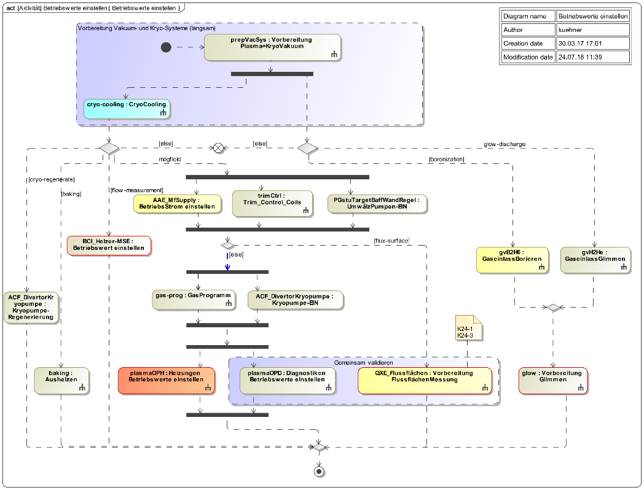
Conclusion
Different kinds of dangers have to be considered at different operations modes
→ System model will be developed
Requirements Engineering
The use of safety standards from industry is necessary
14.05.2019
<number>

