Slide 2
Environmental concerns from design to operation of a new electrical substation
ITSF 2019 - Lund
Presented by S. Schadegg - CERN

Slide 3
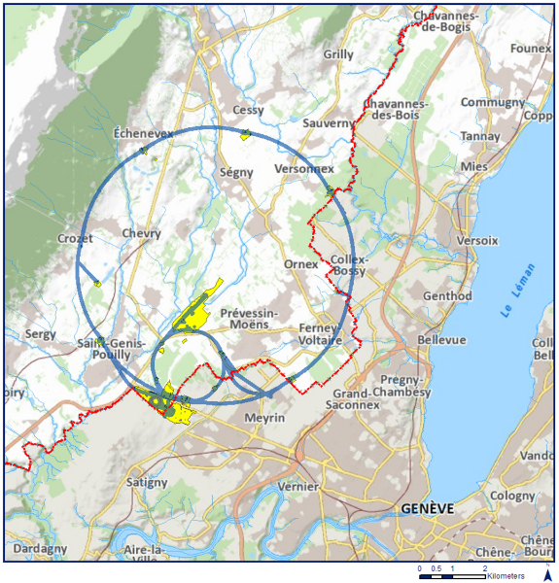
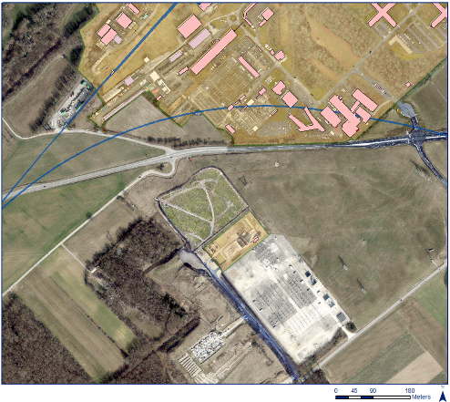
The new substation
LHC
Existing substation
New substation
SPS

Slide 4
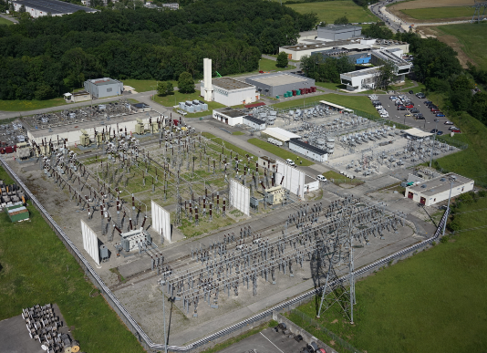
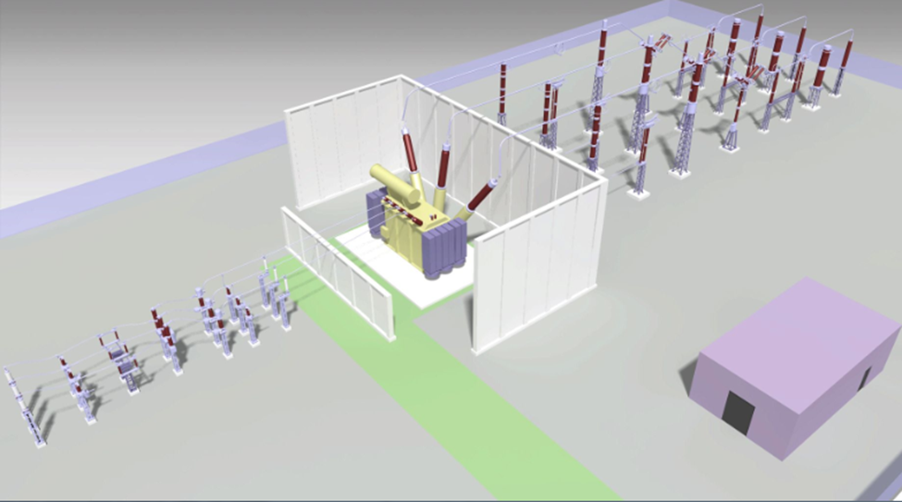
The new substation
Existing CERN substation
New CERN substation
220 MVA Transformer
66 kV starting point
400 kV Entry point
The operating building

Slide 5
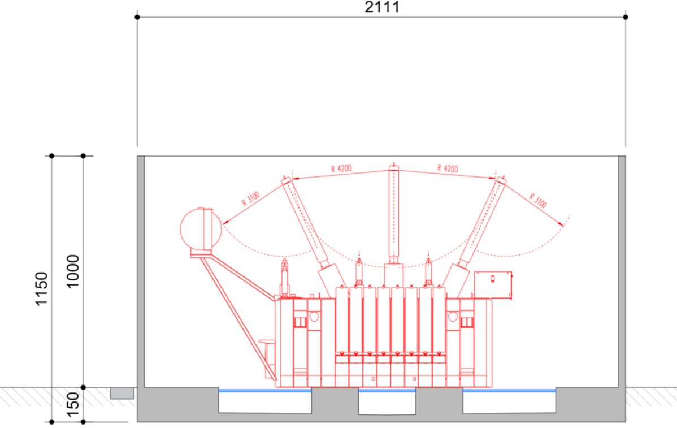
The new substation
The transformer characteristics:
220 MVA
224 tons
10*4*16 meters
82’000 liters of oil

Slide 6
Environmental aspect of a substation
Noise
Electrical & Magnetic Fields
Water resources (qualitative & quantitative)
Design

Slide 7
Environmental aspect of a substation
Noise
Electrical & Magnetic Fields
Water resources (qualitative & quantitative)
Design

Slide 8
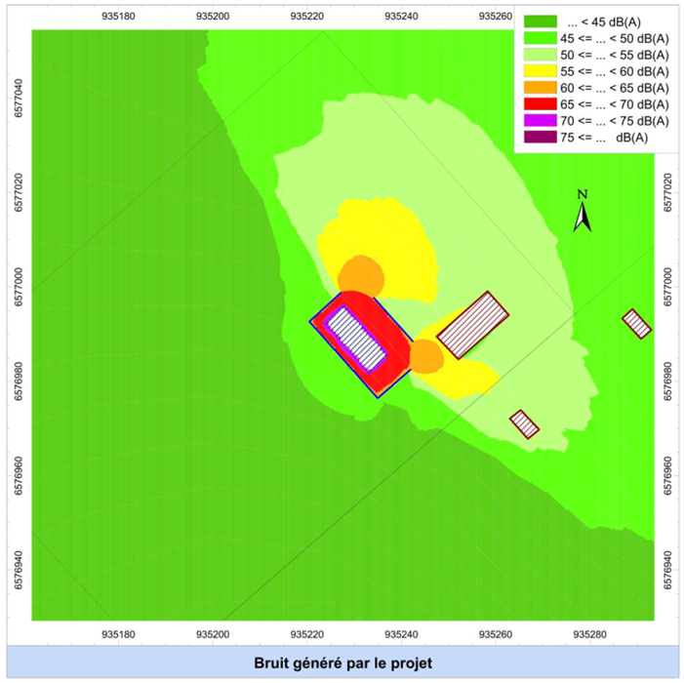
Environmental aspect of a substation
Design
Code de la Santé Publique R.1334-30:
Daytime (7 a.m. to 10 p.m) : emergence limits 5 dB (A)
Night time (10 p.m. to 7 a.m.) : emergence limits 3 dB (A)
Noise
Electrical & Magnetic Fields
Water resources (qualitative & quantitative)
Noise Level of the transformer (including fans) : 88 dB (A)
4 walls arround the transformer
→ < 1dB (A) of the noise emergence

Slide 9
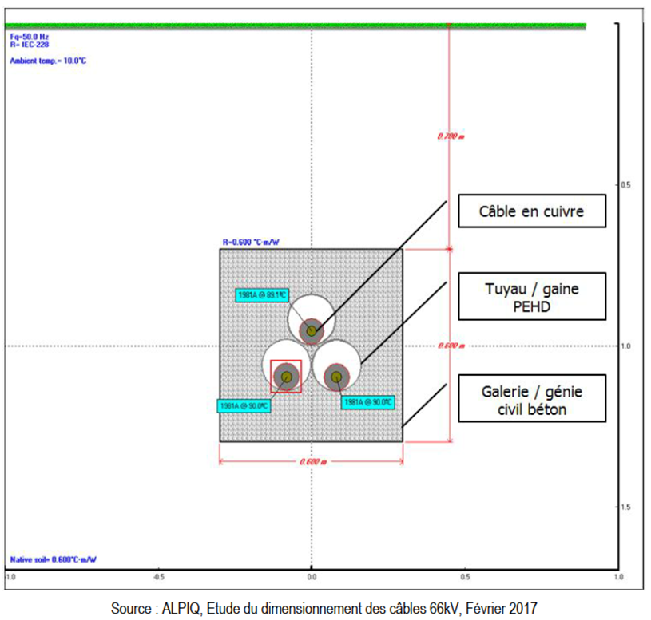
Environmental aspect of a substation
Design
Noise
Electrical & Magnetic Fields
Water resources (qualitative & quantitative)
No emission of Electrical fields (underground power lines)
Negligible Magnetic fields (19 µT, 1m above the soil)

Slide 10
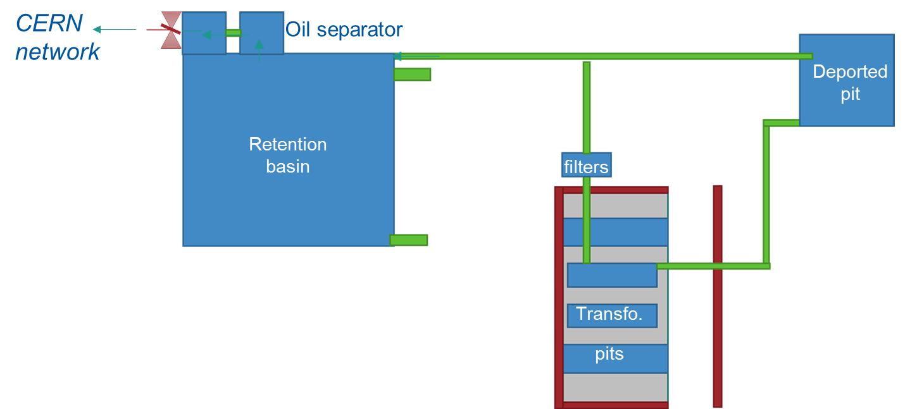
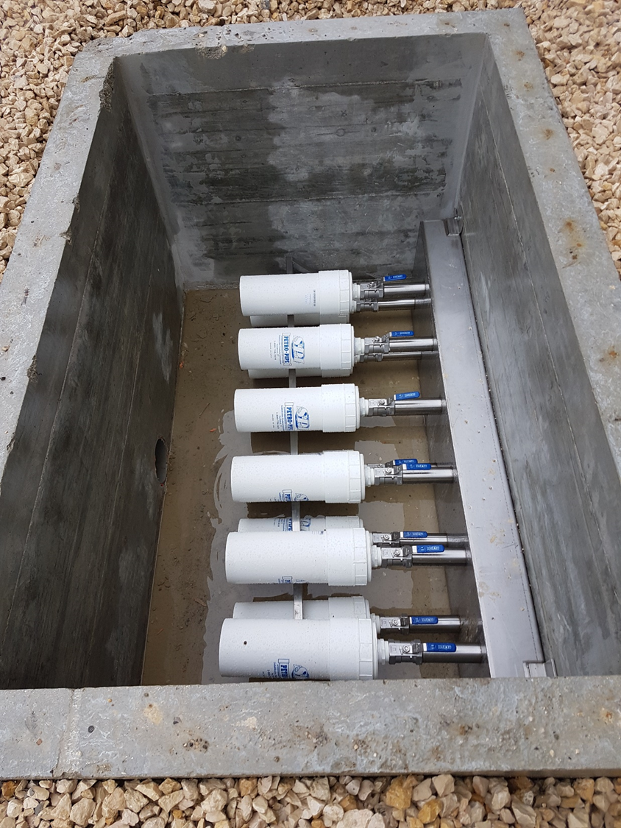
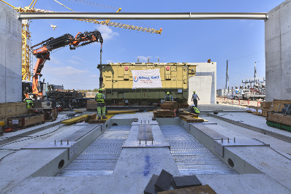
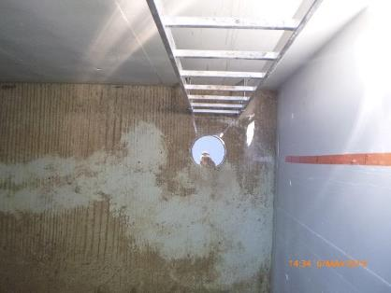
Environmental aspect of a substation
Design
Noise
Electrical & Magnetic Fields
Water resources (qualitative & quantitative)
(HC detector)
Hydraulic study:
49 m³ retention + <10 l/s flow release

Slide 11
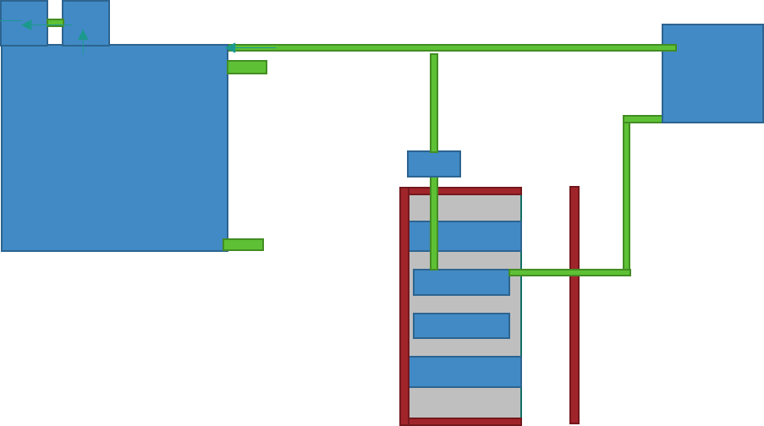
Environmental aspect of a substation
Design
CERN network
Oil separator
Deported pit
Retention basin
filters
Transfo.
Scenario 1: Normal running
pits

Slide 12
Environmental aspect of a substation
Design
CERN network
Oil separator
80 m³
Deported pit
Retention basin
filters
50 m³
Transfo.
Scenario 2: leak of the 100% of the transformer oil
pits

Slide 13
Environmental aspect of a substation
Design
CERN network
Oil separator
80 m³
Deported pit
200 m³
Retention basin
filters
50 m³
Transfo.
Scenario 3: leak of the 100% of the transformer oil with a fire
82 m³ oil
120 m³ extinguishing water
49 m³ Rain water
pits
Notes:
80 m3 in addtion

Slide 14
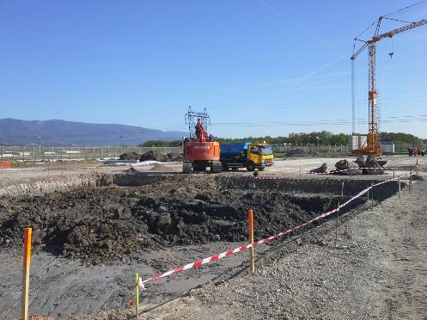
Environmental aspect of a substation
Worksite
Air
Waste management
Natural resources
Water resources (qualitative)
Soil protection
Other nuisances

Slide 15
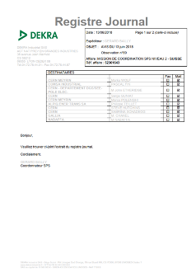
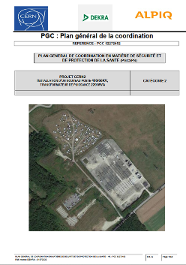
Environmental aspect of a substation
Worksite – on the paper
Air
Waste management
Natural resources
Water resources (qualitative)
Soil protection
Other nuisances

Slide 16
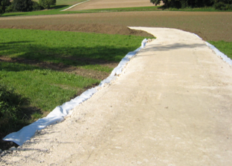
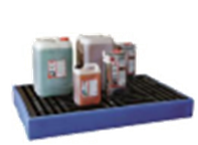
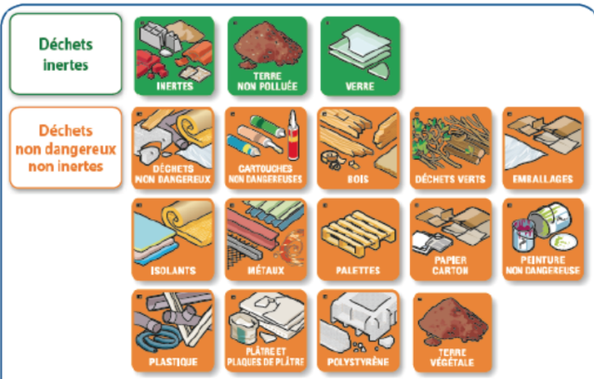
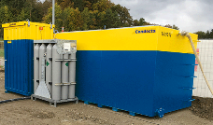
Environmental aspect of a substation
Worksite – on the paper
Air
Waste management
Natural resources
Water resources (qualitative)
Soil protection
Other nuisances

Slide 17
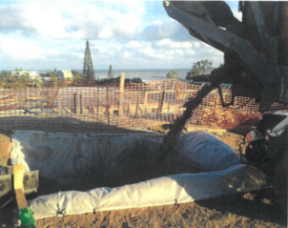
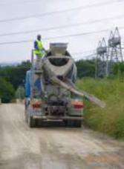
Environmental aspect of a substation
Worksite – on the field
Air
Waste management
Natural resources
Water resources (qualitative)
Soil protection
Other nuisances

Slide 18
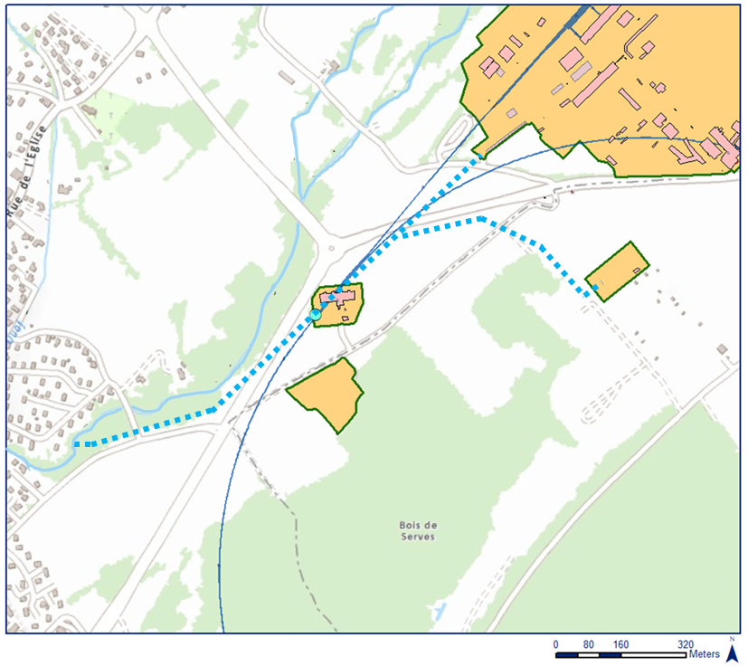
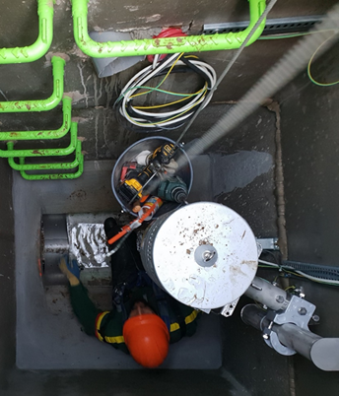
Environmental aspect of a substation
Worksite – on the field
Air
Waste management
Natural resources
Water resources (qualitative)
Soil protection
Other nuisances
CERN Water monitoring station

Slide 19
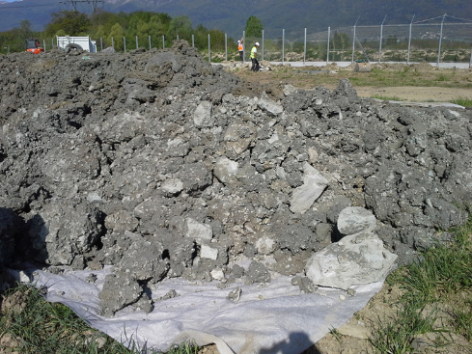
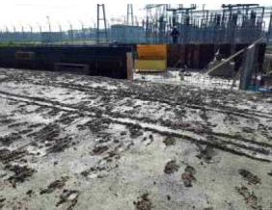
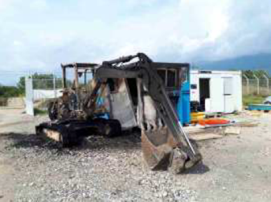
Environmental aspect of a substation
Worksite – on the field
Air
Waste management
Natural resources
Water resources (qualitative)
Soil protection
Other nuisances

Slide 20
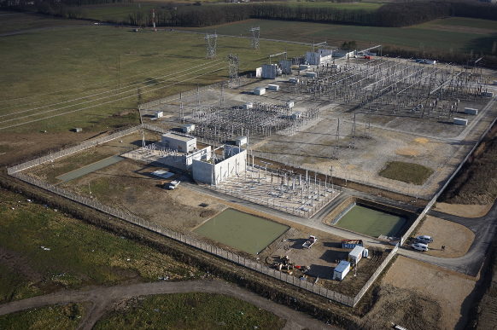
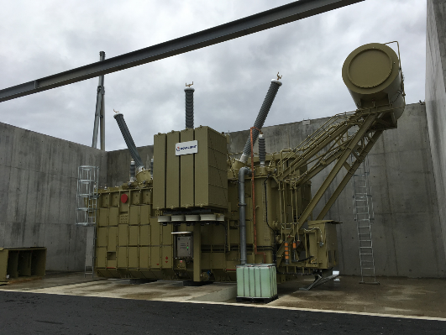
Summary

Slide 21
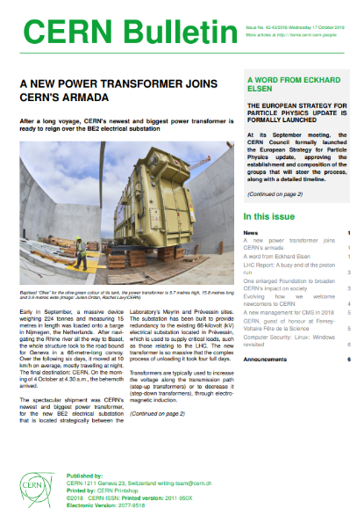
Conclusion (1/2)
“ Olive is designed to respect the strictest environmental standards, and its specially constructed noise-cancellation panels make it extremely quiet for a power transformer of its size. In addition, the new BE2 electrical substation contains an advanced oil-retention and ﬁre-suppression system to protect the environment in the unlikely event of a ﬁre or an oil leak.”

Slide 22
Conclusion (2/2)
Many challenges (land acquisition, no detailed technical prescriptions for the environmental protection, tricky cohabitation with Travellers,...) overcame by a good internal collaboration with the project team and the Safety specialists.
Accident scenarii shall be assess from the beginning to detail the requirements included in the Technical Specification.
→ Principles of the retention scenarii involving oil and fire extinguishing water will be applied to other similar projects

Slide 23
Thanks for your attention!
Sabrina Schadegg
Sabrina.Schadegg@cern.ch CERN HSE Unit
Environmental Engineer Tel +41 22 766 30 39 Port +41 75 411 70 33

