Slide 1
Emergency measures for earthquake and damage to facilities caused by earthquake in RIKEN
Tatsuyuki Aoshima
RIKEN Safety Division

Slide 2
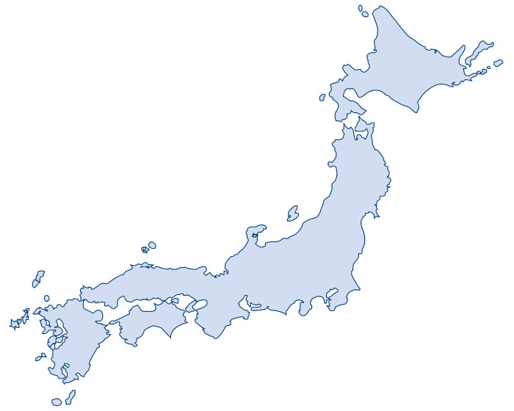
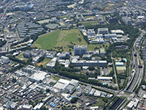
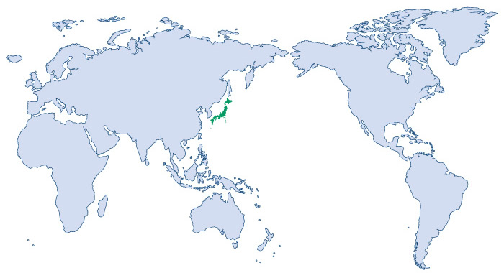
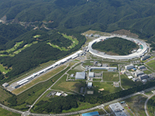
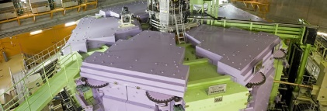
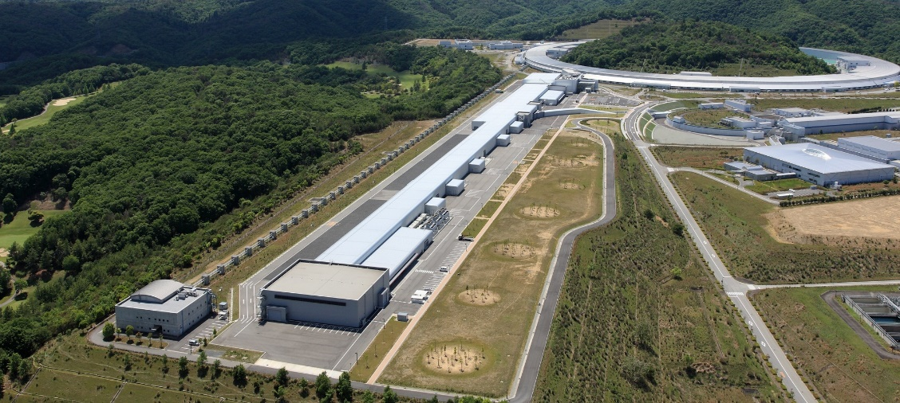
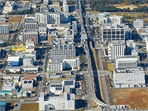
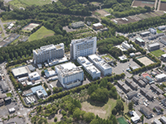
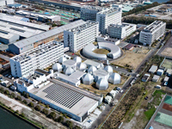
RIKEN Safety Division
Wako Campus, RIBF
Harima Campus, Spring 8
Superconducting Ring Cyclotron (SRC)
SACLA(XFEL)
Tsukuba Campus
Kobe Campus
Yokohama Campus
Notes:
RIKEN is Japan's largest comprehensive research institution in a diverse range of scientific disciplines.
RI beam Factory, Superconducting Ring Cyclotron (SRC) can deliver the world’s highest intensity beam.

Slide 3
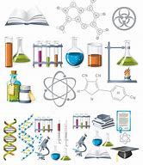
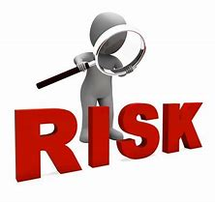
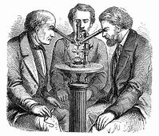
Main work of Safety Division
Establish of institutional regulation
Laboratory Inspection
Application procedure to government
Maintenance of facilities

Slide 4
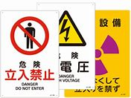
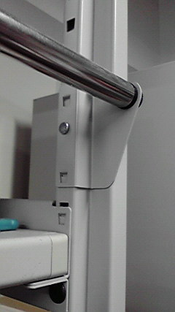
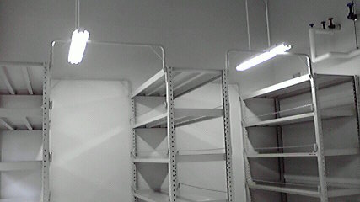
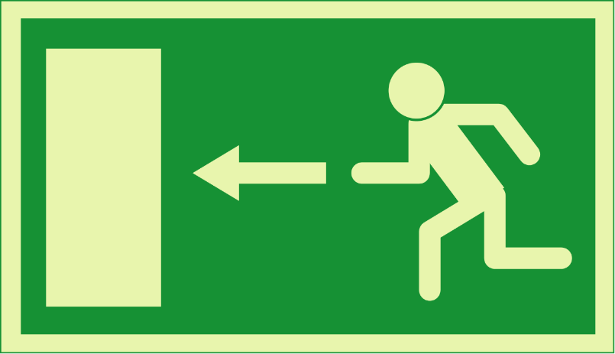
First mission of Safety Division
Secure the researcher’s safe
・Keeping laboratory safe (Chemicals, Animals, Waste, etc)
・Preparation to accident and disaster
・Establishment of emergency measures
Earthquake

Slide 5
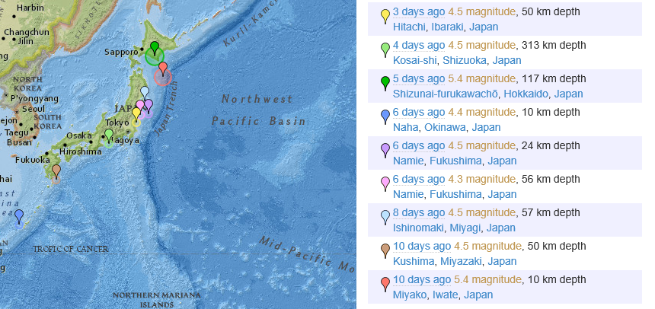
Earthquake in Japan
Recent earthquake occurred over magnitude 4 (April 22 to 28, 2019)
April 28, 2019 4.5 magnituide
50km depth, Hitachi, Ibaraki
April 27, 2019 4.5 magnituide
313km depth, Kosai-shi, Shizuoka
April 27, 2019 5.4 magnituide
117km depth, Shizunai-furukawacho, Hokkaido
April 26, 2019 4.4 magnituide
10km depth, Naha, Okinawa
April 26, 2019 4.5 magnituide
24km depth, Namie, Fukushima
April 26, 2019 4.3 magnituide
56km depth, Namie, Fukushima
April 24, 2019 4.5 magnituide
57km depth, Ishinomaki, MIyagi
April 22, 2019 4.5 magnituide
50km depth, Kushima. Miyazaki
April 22, 2019 5.4 magnituide
10km depth, Miyako, Iwate

Slide 6
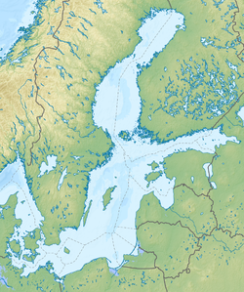
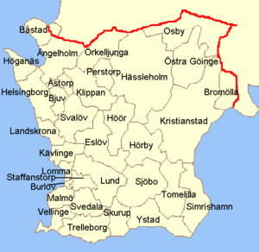
Earthquake in Skåne County
Only three small earthquakes detected between 1970 and 2008, and only 14 earthquakes since 1375.
On 16 December 2008, Skåne County earthquake occurred with a moment magnitude 4.2-4.3.
Notes:
The Skåne スコーネ region is known for extremely low seismic activity, with only three small earthquakes (each less than 2.8) detected between 1970 and 2008, and only 14 earthquakes since 1375.

Slide 7
Strength of earthquake
Magnitude
The Richter magnitude of an earthquake is determined from the logarithm of the amplitude of waves recorded by seismographs
epicenter
The intensity depend on earthquake depth, epicenter location, and more factors.
A difference in magnitude of 1.0 is equivalent to a factor of about 32 in the energy released; a difference in magnitude of 2.0 is equivalent to a factor of 1000 in the energy released.
Skåne County earthquake occurred with a moment magnitude 4.2-4.3 is equal to 15 tons of TNT, 63 x 10⁹ joule.
That is equal to North Korea Experiment of Hydrogen Bomb, 2006.

Slide 8
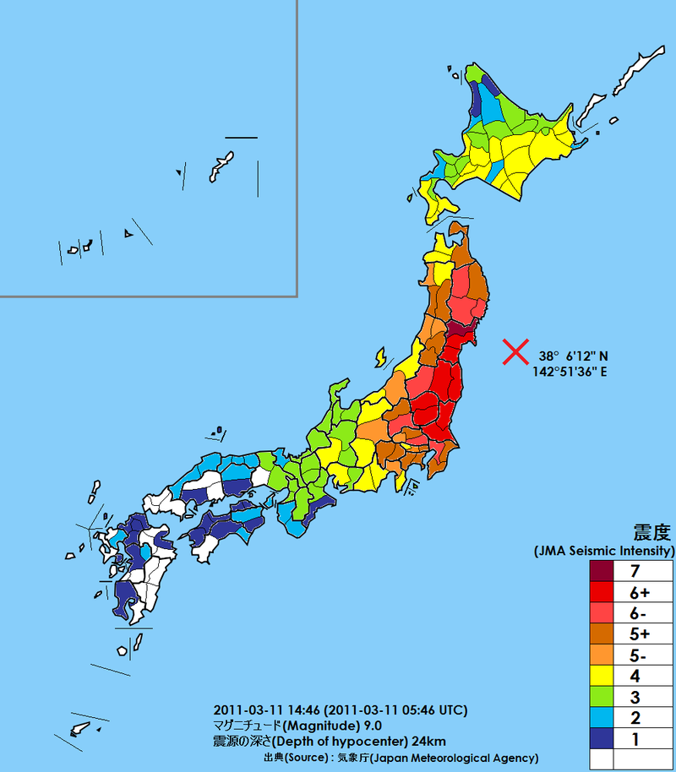
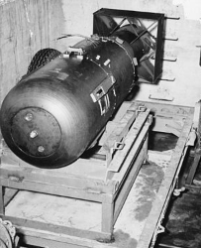
The Great East Japan Earthquake, 2011
Magnitude 9.0
Intensity was considered great in size. The earthquake released energy equivalent to almost 480 billion kilograms of explosives, about 200 thousand times the amount of energy that was released by the atomic bomb that destroyed the city of Hiroshima during World War II.
The intensity at Wako campus, RIBF was 5-.
About 450km from epicenter, depth 25km.
Intensity was considered moderate in size.

Slide 9
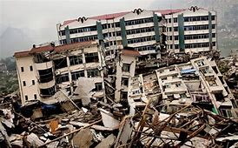
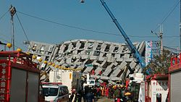
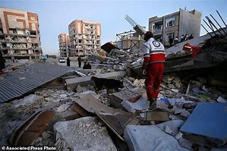
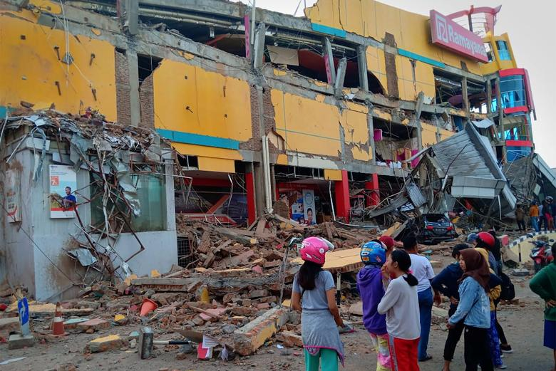
Collapsed building caused by major earthquake in Asia
2008 Sichuan earthquake
2016 Southern Taiwan earthquake
2017 Surigao earthquake
2018 Sulawesi earthquake
Notes:
Magnitude 5.8 to 6.5 which classified as moderate to strong in size.

Slide 10
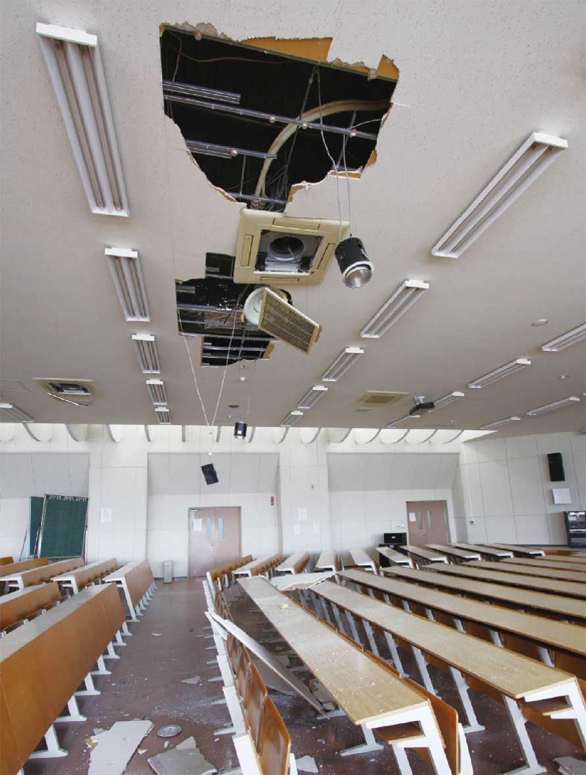
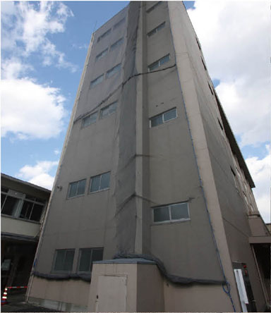
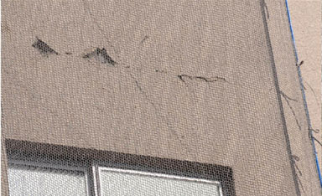
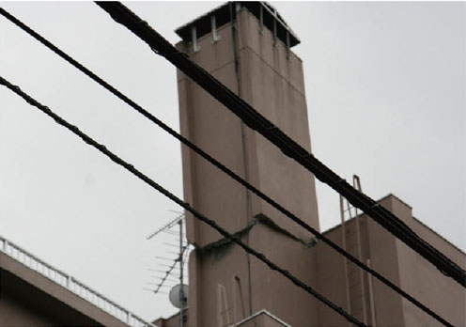
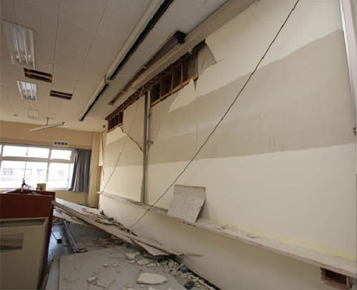
Damage caused by the Great East Japan Earthquake, 2011
The intensity at Sendai, Miyagi was 7.
About 90km from epicenter, depth 25km.
Pictures: Tohoku Gakuin University report
Notes:
the collapse of building is very small compare to the other countries because all the buildings constructed either seismic base isolation or earthquake proof method after 1981.

Slide 11
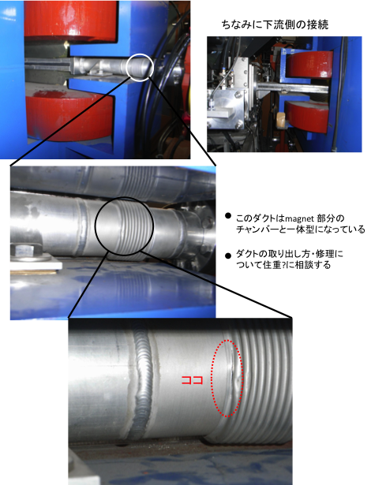
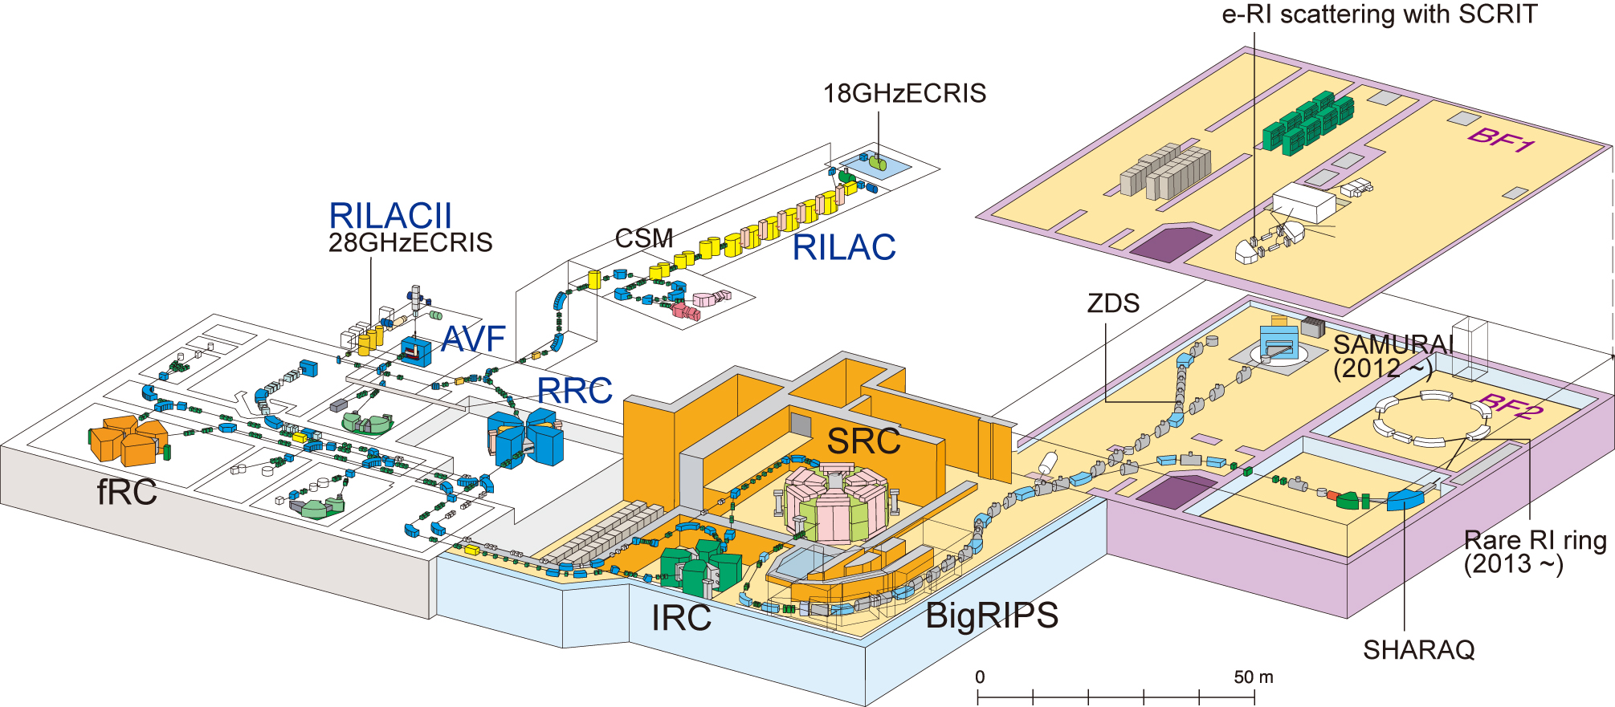
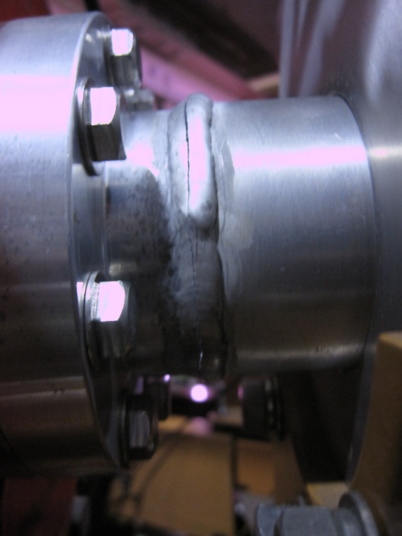
Damage to RIBF
Damage was only 2 cracks in the beam lines.

Slide 12
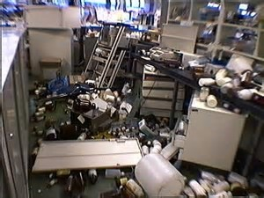
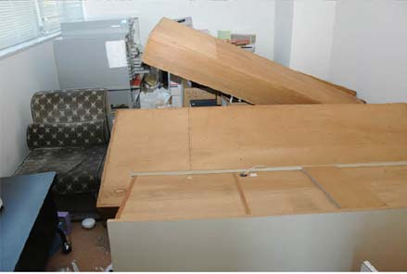
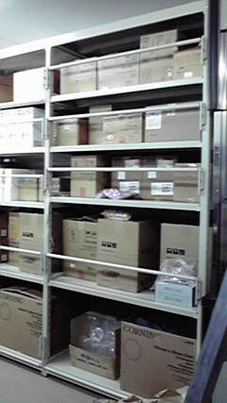
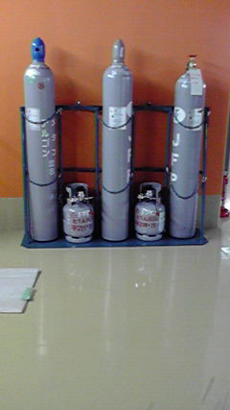
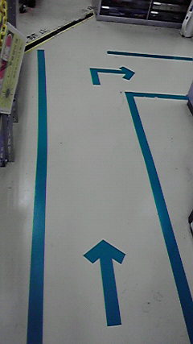
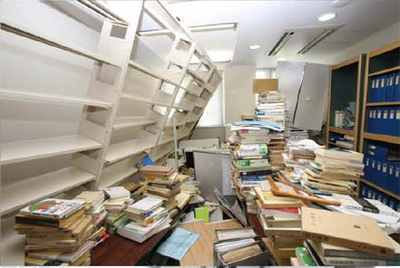
What we learned from past earthquake
Keeping laboratory safe to secure the escape route
Cylinder stand
Safety bar
Escape route

Slide 13
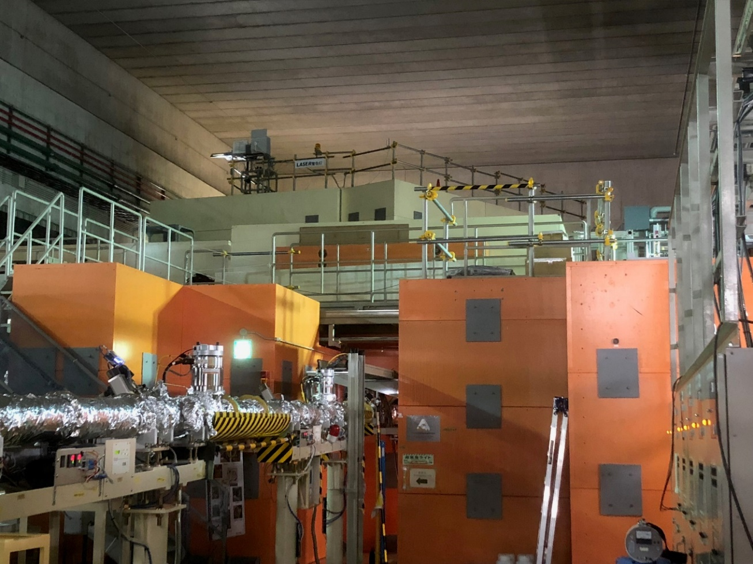
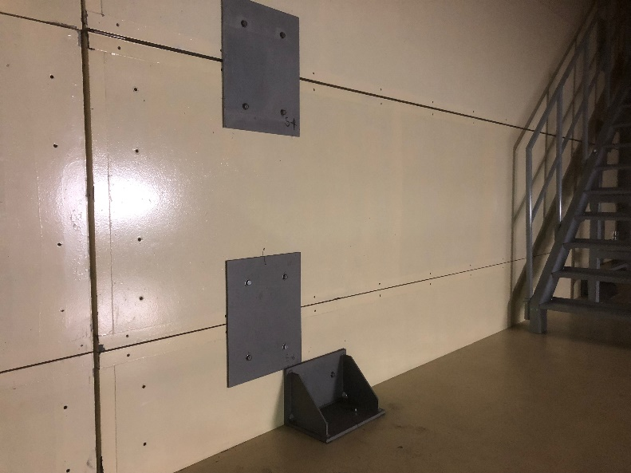
Preparation for earthquake in RIBF
Accelerator uses heavy shields
Steel plate of 8mm thickness
Weight of one block is
1m x 1.5m x 6m x 3.5t/m³=31.5 tons
7 kilotons of concrete shield are used for the target and beam dump

Slide 14
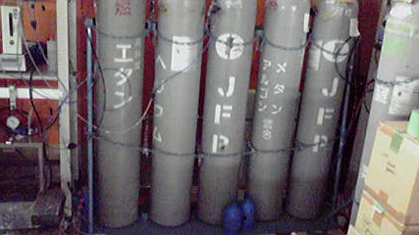
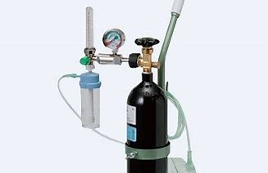
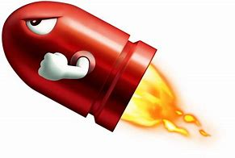
Preparation for earthquake in RIBF
Regulator is easy to break when it falls down
Gas cylinders are locked on the stand by chain or nylon sleeves
Gas cylinders become missile

Slide 15
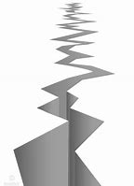
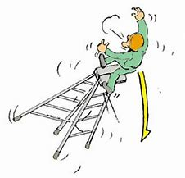
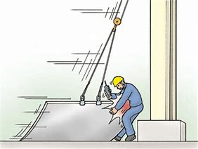
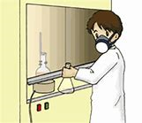
Emergency measures in RIKEN
First Proposal
Stop your work!
Step off from the ladder
Bring down the object from crane
Shut the bottle cap
Do not hold on the ladder
Ventilation might stop
Before you drop, it keep the damage at a minimum

Slide 16
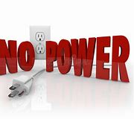
Emergency measures in RIKEN
Power supply might cut off
Turn off the equipment while emergency light is on. It will minimize the fire caused power return.
When the emergency light is out, it gets really dark.
Use flashlight or psyllium posted on the wall.

Slide 17
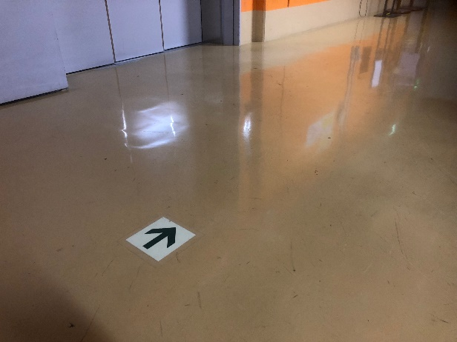
Emergency equipment
Luminescence tape
Luminescence tape lasts 15 minutes, helps you get out the facility.
Psyllium

Slide 18
Conclusion
Well preparation secure your escape route
Few steps to keep the damage at a minimum
Leads to public safe
Notes:
You do not panic and afford few steps to do.

Slide 19
Acknowledgement
Safety Management Group, RIBF
Dr. Kanenobu Tanaka
Dr. Yoshitomo Uwamino
Thanks to my colleague providing the pictures of the Great East Japan earthquake, 2011.
Tack så mycket!
Notes:
I would like to acknowledge

Slide 21
Seismic base isolation method
RIKEN K computer
Seismic structure and countermeasures against soil liquefaction, protect the main functions of the facility against earthquakes with an intensity of 6-plus on the Japanese scale of 0 -7.

