Slide 1

ITSF 2019 @ Lund
Injury during machining work
and preventive measures against
the recurrence of the accident
Kotaro BESSHO¹, Koji KIRIYAMA²,
Yoshihiro NAKANE¹, Yukihiro MIYAMOTO¹, Tetsuro ISHII¹,
J-PARC Center¹ / CROSS², Japan

Slide 2
Outline
Injury during machining work
Direct causes and problems leading to the incident
Root causes leading to inadequate actions
Preventive measures against the recurrence of
the accident (Various efforts for safety)

Slide 3
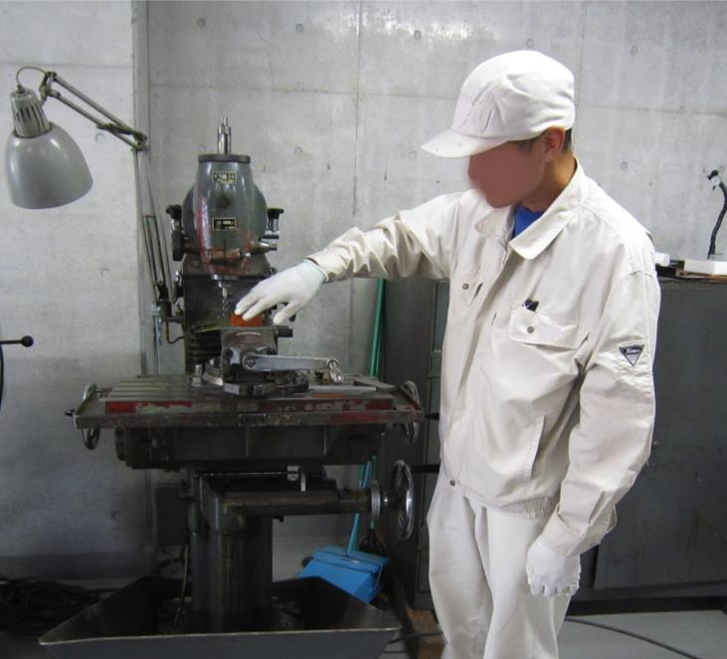
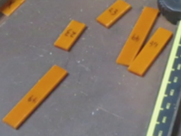
Injury during machining work using a milling machine
August 2018
Workshop area
Milling machine
worker-B
workers-C,D
(another work)
worker-A
(machining work,
injured)
Contractor worker’s team
Members: A, B, C, D
Leader : A
Worker’s location in occurrence of the injury
Manufactured parts
The accident occurred in manufacturing small parts for magnetic-field measurements using a milling machine.
Injured person : a contractor worker (leader of the team)

Slide 4
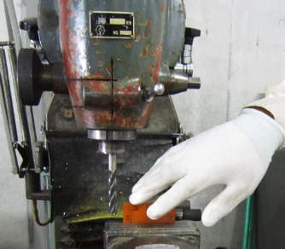
Injury during machining work using a milling machine
Machining work wearing gloves
(Prohibited)
The injured worker-A was brushing off the machining dust by hand with wearing gloves.
His middle finger of the right hand was caught in the rotating mill and got serious injury.

Slide 5
Direct causes and problems leading to the incident
The worker did not stop the rotation of the machine.
He tried to remove dust with hand, not using tools (brush, air..)
He engaged in the machining work putting on the gloves.
These procedures violate the regulations.
The company of the worker received a corrective instruction from the Labor Standard Inspection Office.
Team members could not caution the injured worker,
although they noticed he used a milling machine wearing gloves.
Root causes of the incident and the preventative measures
investigated by the working group
interview, inspection, analysis, discussion

Slide 6
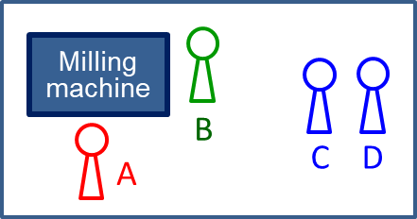
Important root causes leading to inadequate actions
1) Lack of concentration on the work
Insufficient Tool Box Meeting (TBM)
Unclear task for each worker
    The injured worker-A (leader) planned to let another worker-B to do the machining work. However in the TBM, the assignments of the tasks to each member was not enough confirmed.
    Just before starting the machining work, the worker-B hesitated to use the milling machine, thus the worker-A did the machining work by himself.
    The worker-A intended that he only attached an endmill (cutting tool) to the milling machine wearing gloves. Before starting the machining work, he forgot to take off the gloves.
    The team members (including A) could not stop their own works when their roles were changed.
Insufficient readiness before starting the work

Slide 7
Important root causes leading to inadequate actions
2) Insufficient skill for safety confirmation
2-1) Confirmation of wearing basic safety equipment
(not wearing gloves) was not developed into habit.
2-2) Other team members (B,C,D) could not caution the worker-A, although they noticed the worker-A kept wearing gloves during the machining work.
Insufficient recognition of danger
Other team members knew that wearing
gloves are prohibited.
However they could not imagine a
serious result caused by this violation.

Slide 8
Strengthening of safety measures after the accident
In the TBM, a work manager (J-PARC staff) must confirm
Tasks are clearly assigned to each worker.
The (supervisory) foreman does not engage in the high-risk works*.
*High-risk works : Mistakes in work procedures / operation lead to
serious incidents, such as occupational accidents,
fire, radiation exposure, radioactivity release, etc.
(examples of *high-risk works)
machining work, crane operation, electrical insulation works,
handling radioactivated materials
In these high-risk works, the work manager must have the worker concentrate his/her work.

Slide 9
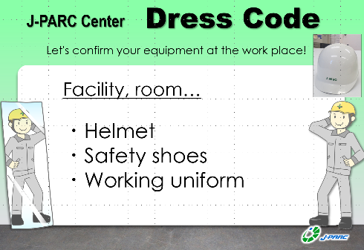
Strengthening of safety measures after the accident
2-1) Introducing the Dress Code and applying to all workplaces
- the rule for safety equipment defined at each workplace
Example

Slide 10
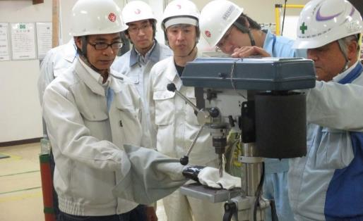
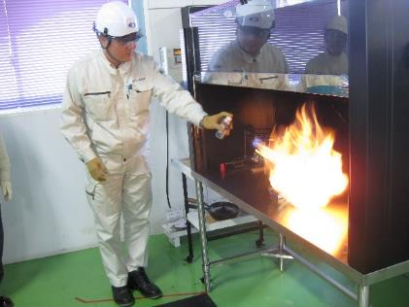
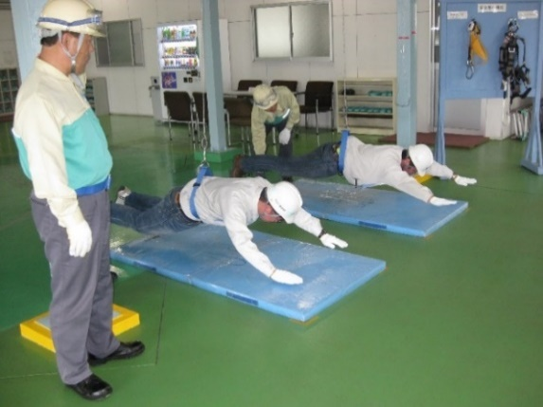
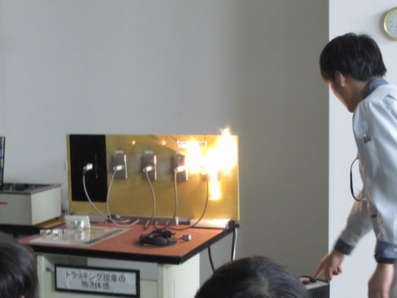
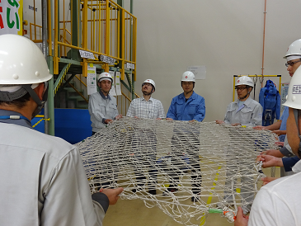
Strengthening of safety measures after the accident
2-2) Continuation and developments of
the hazard training based on experience
since FY2016
More than 70% of 400 J-PARC staffs already took this training.
J-PARC’s new rule : All work managers must take this training.
Caught in a rotating drill
Inflammable gas spray
Stepladder
Tracking phenomenon
Falling object
Safety belt

Slide 11
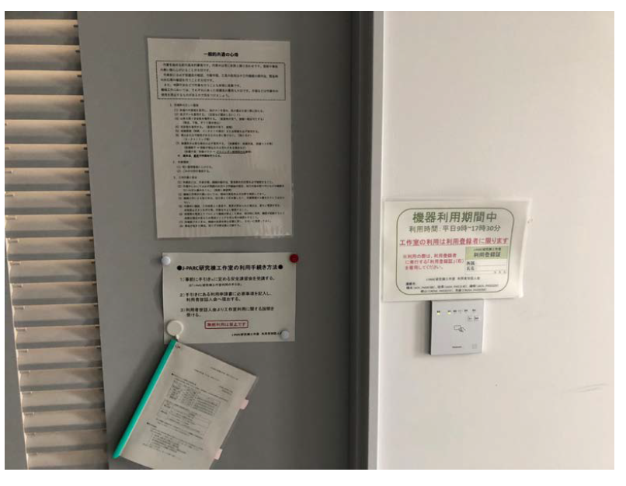
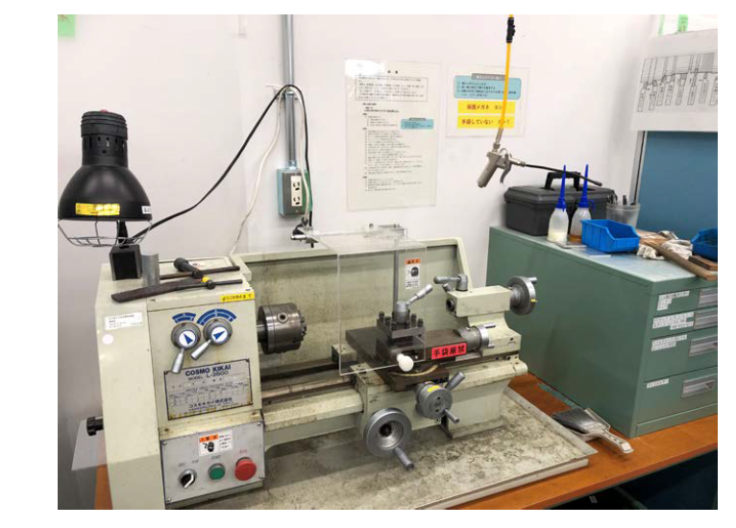
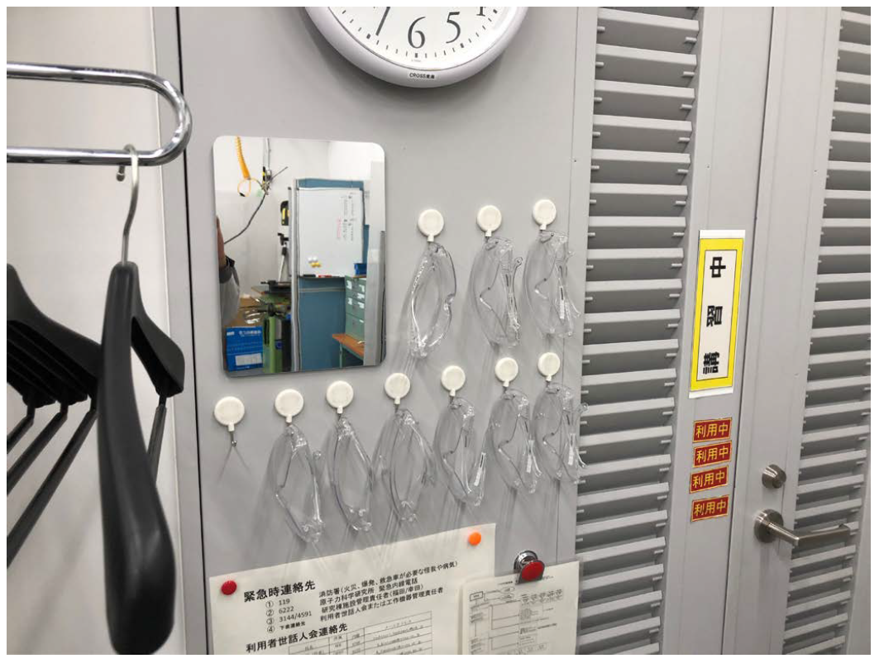
Improving safe working environments at workshops
Preparation of machines, places, equipment for safe works
Setting directions, manuals, checklists at workplaces
Confirming clothes, protectors for oneself and others
Good examples at a common use workshop
Directions for handling each machine tool
Mirror for checking safety equipment
Safety glasses on hand
Close wristband of the clothes.
Bind long hair. / Put on working cap.
Don’t use waste cloth for removing the machining dust (brush, air ..)
Directions for the workers on the entrance door of the room
Safety glasses OK!
No gloves OK!

Slide 12
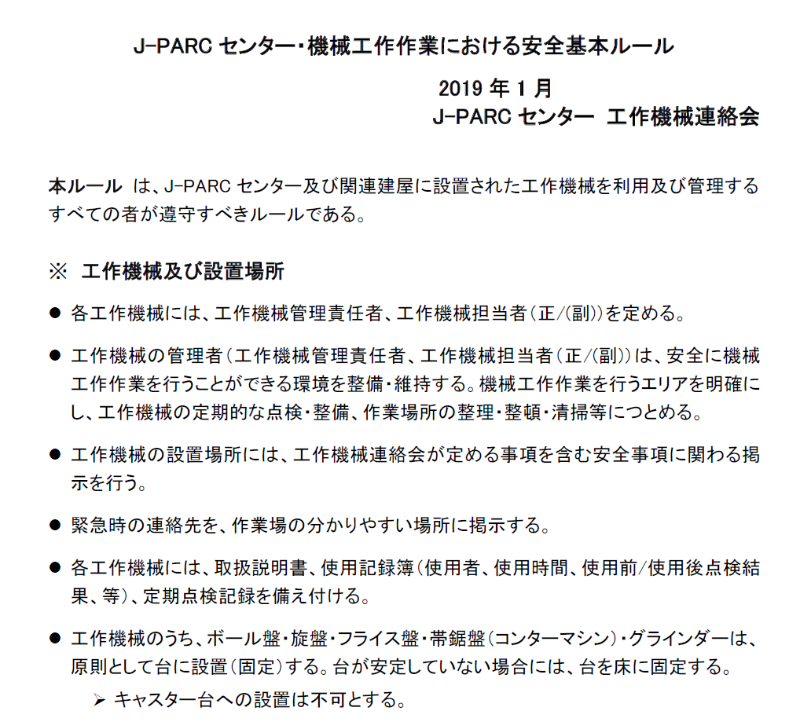
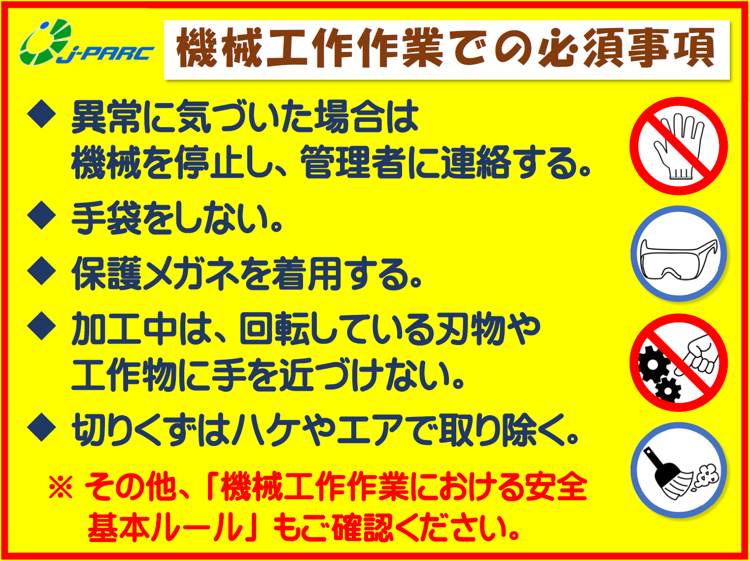
Setting expert group on machining work
Regulating matters required for safe works and guidelines
Preparing the rulebook for safety in machining work, which must be followed by all the J-PARC members.
Providing basic directions, manuals, checklists, and education materials for improving safety in machining works
Mutual inspection of workplaces and machines ;
Technical suggestions to the workplace managers
← Rulebook
for safety in
machining work
(6 pages)
→
Requirements
for safe works
(Poster)

Slide 13
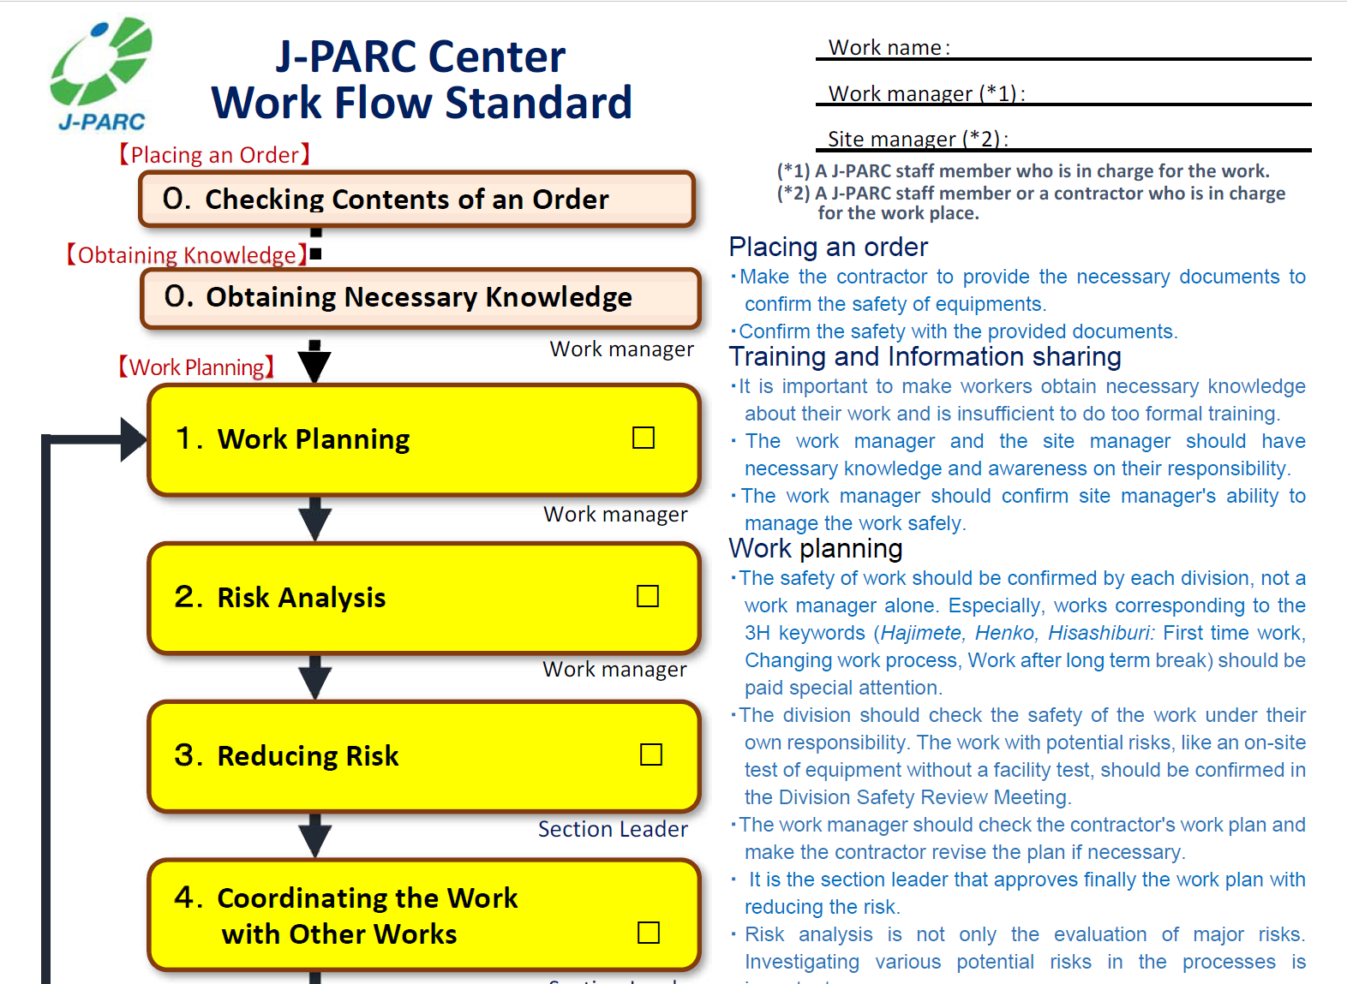
Other efforts for safety at J-PARC
since FY2015 (after the fire)

Slide 14
Other efforts for safety at J-PARC
In the 3H keywords situations,
Hajimete : First time
Henko : Changing
Hisashiburi : After a long interval
special attention must be payed.

Slide 15
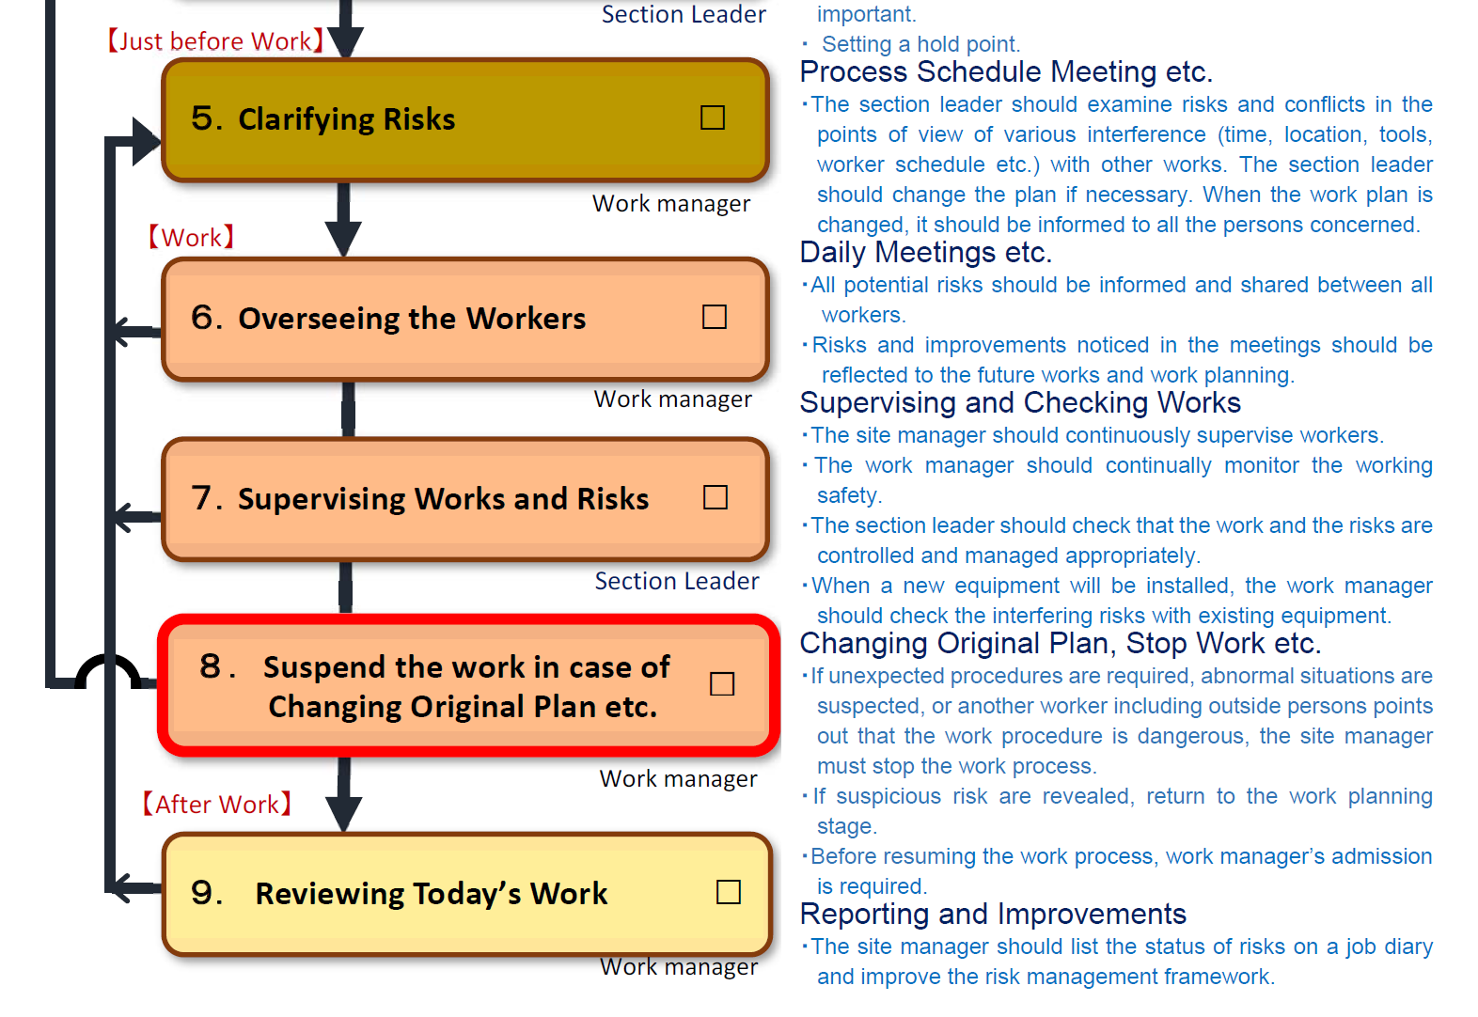
Other efforts for safety at J-PARC

Slide 16
Other efforts for safety at J-PARC
Unexpected procedures required
Abnormal situations suspected
Another worker points out that the process is dangerous
The site manager must stop the work process.

Slide 17
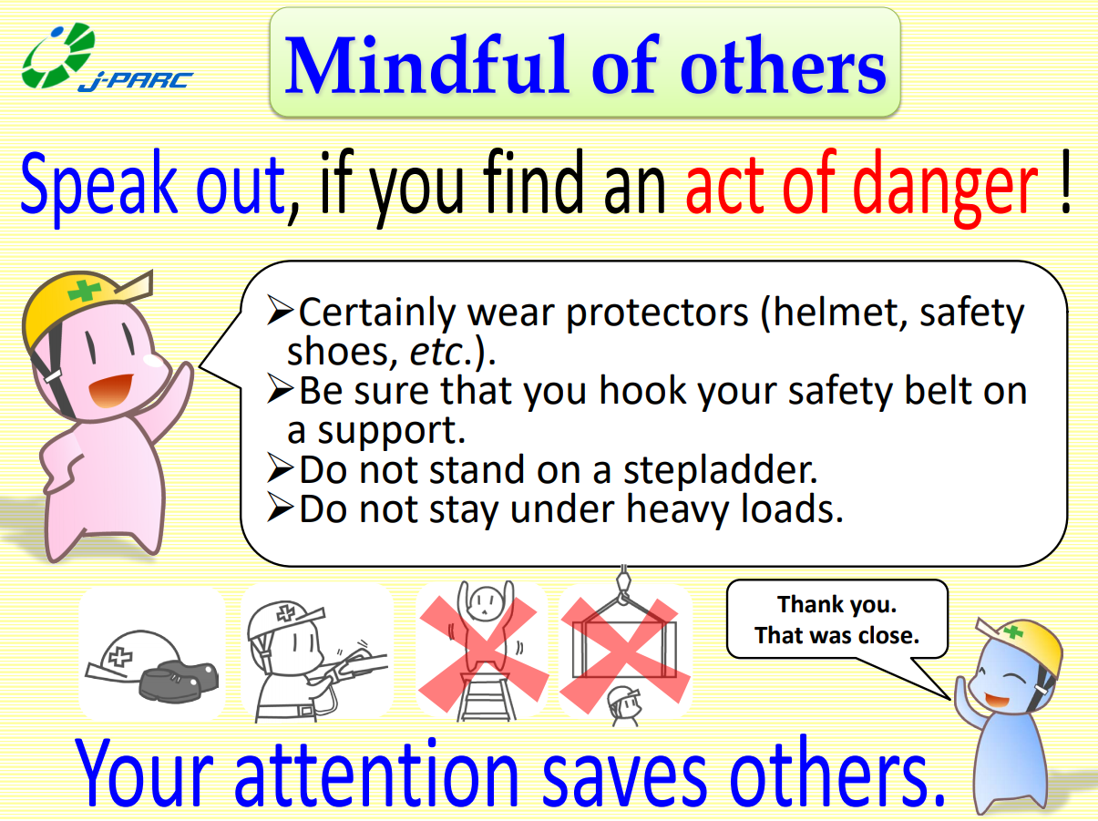
Other efforts for safety at J-PARC
“ Mindful of Others ” since FY2016

Slide 18
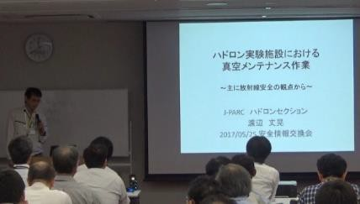
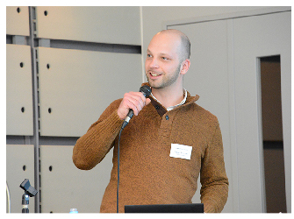
Other efforts for safety at J-PARC
Safety Information Exchange Meeting inside J-PARC since 2017
( held in the Safety-Day around 5.23 )
Award for good practices from the director Talk on safety works at a facility
Symposium on Safety in Accelerator Facilities since 2013
- to share information on safety issues between various institutions
- 100-150 participants from accelerator facilities, universities in Japan
(Topics) High-press. / Cryo. gas; Emergency response; Electrical safety;
Heavy load transportation; Fire safety, etc.
Invited speakers from the ITSF community introduced Japanese workers precious works!
Courtesy : R. Trant (CERN), Y. Loertscher (PSI),
C. Balle (CERN), A. Manzlak (J-Lab), F. Saretzki (DESY)

Slide 19
Summary
Strengthening of safety measures at J-PARC
Confirmation of assignments of the tasks for the workers
Application of the Dress Code at workplaces
Hazard training based on experience
Improving safe working environments
Expert group on machining work
( Preparing documents for safe machining works,
inspection of workplaces, technical suggestions)
Other efforts ( Work Flow Standard, Mindful of Others,
Sharing information )

