Slide 1
Lead – How to manage it safely?
CERN EP Department
L. Di Giulio, E. Dho

Slide 2
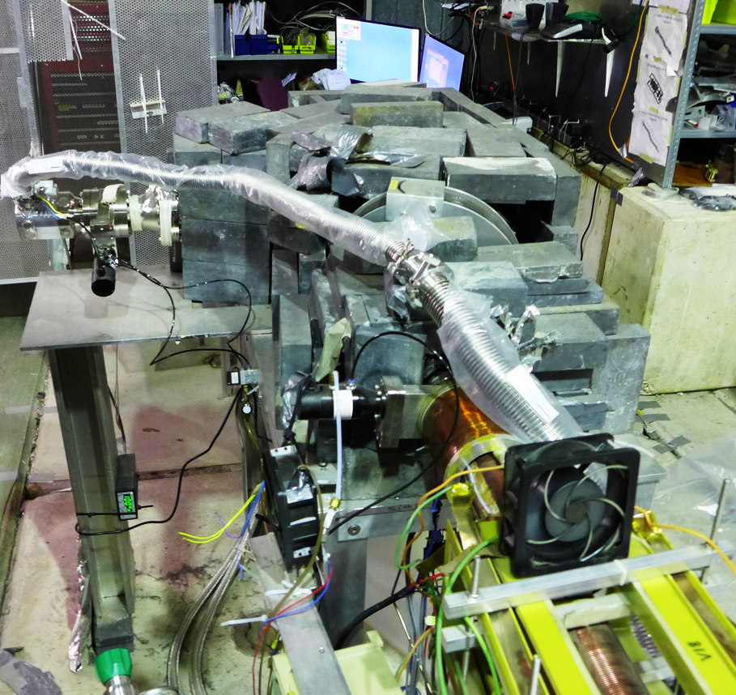
Lead usage at CERN
Allowed:
Shielding
Lead soldering
Forbidden:
Lead paint
Used as counterweight or similar
Notes:
Lead soldering is allowed at CERN under specific circumstances after risk assessment analysis.
Any activity involving intervention on painted surfaces (walls, wood, metal) requires an analysis

Slide 3
Hazards related to lead
Lead is classified as toxic to reproduction and to organs and harmful to aquatic life
Exposure can happen though inhalation (lead dust) or ingestion (lead powder/dust)
Symptoms are headaches, nausea or damage to kidney or brain, infertility, cancer
Notes:
“As you all know…”

Slide 4
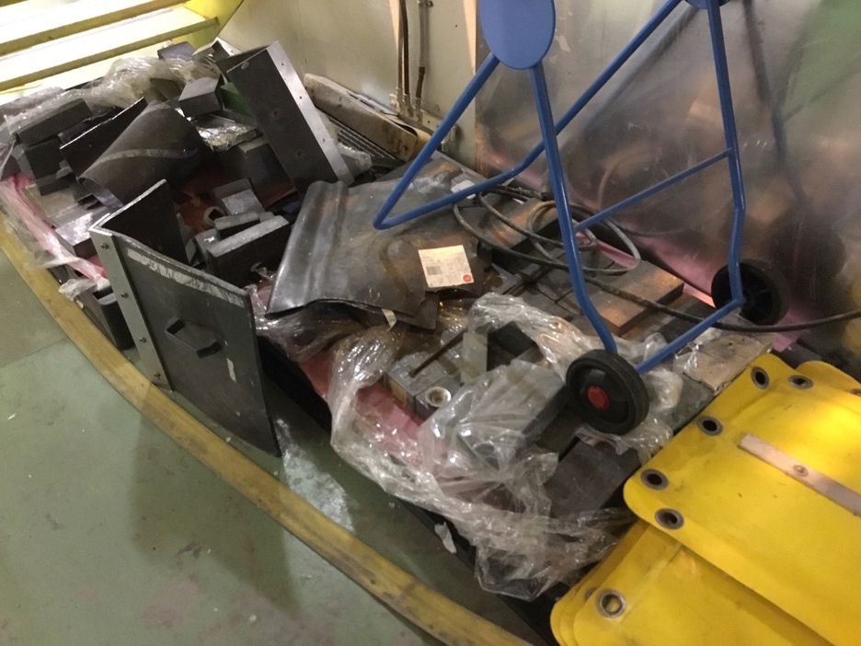
Issues faced
Not ideal situation:
High level of oxidation
Incorrect storing

Slide 5
Issues faced
Misuse
Poor traceability
Personnel not always conscious about:
basic CERN lead safety rules (HSE safety guideline on lead existing from 2011)
hazards and safety measures related to lead

Slide 6
First solutions
Latest attempt to intervene in 2016 (after previous actions in the years before) consisted in:
Increase awareness of users
Remove and store unused lead
Support for the experiments wanting to keep using lead
How?
Needed new/updated documentation and procedures!

Slide 7
HSE Guideline
HSE Safety Guideline – Safe handling and storage of lead at CERN
from 2011, latest version released in 2019
Health effects and potential exposure
Rules and safety measures for lead handling:
No pregnant woman, no <18
No eating, drinking, smoking and high standard hygiene
Training and PPE – mask (>1 h), gloves, safety shoes

Slide 8
HSE Guideline
Limits followed at CERN for lead:
Air exposure: | Surface contamination:
0.1 mg/m³ (average over 8 h/day) | 10 mg/m² (areas where lead is handled)
0.8 mg/m³ (over 15 min up to 4 times/day) | 1 mg/m² (areas lead free)
Swiss/France legal limits and quoted in HSE guideline | Values given by HSE guideline
Notes:
Milligram per cubic meter (mg/m3) is a unit of measurement for concentration. It is generally used in measurement of pollutants in the air. 1 milligram of gaseous pollutant per cubic meter of ambient air is expressed as 1 mg/m3.
The air exposure limit of 0.1 is given by INRS and SUVA (French and Swiss legal limits). The short term exposure limit of 0.8 is given only by SUVA.
The Chemical Agents Directive (Council Directive 98/24/EC of 7 April 1998) in Annex I gives an occupational exposure limit of 0.15 mg/m3 for 8 hours (less conservative than Suva) and also provides biological limit values and health surveillance measures in Annex II.
The lead surface contamination values are not in any France/Swiss legislation, but they are taken from BNL values (that were taken by Swiss IST). CERN values are less strict (more flexible) than BNL values, which are 2.7 and 0.43 mg/m2.

Slide 9
EP Procedure
EP Procedure – EP Department lead safety procedure for control, handling, transport and storage
from 2016, latest version released in 2018
Removal:
Residual activity measured by RP
Packed in plastic bags well sealed and secured on washable palette
Palette with barcode for tracking
Compliant storage:
Only conventional bricks
Far from workplaces
Ventilated and floor withstands the weight
Radioactive lead declared as radioactive waste!

Slide 10
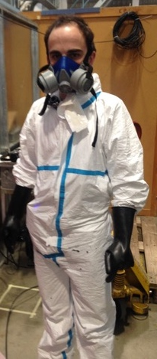
EP Painting Procedure
EP Painting Procedure – Lead bricks painting
from 2016, latest version released in 2018
Reference to HSE guideline and EP procedure
Requirements for location and type of paint
Safety procedure and PPE to be used
Procedure to use an EP paint spray booth
Reference for certain epoxy paints (best found so far)
Notes:
EP paint spray booth not ideal solution.

Slide 11
Application of the procedures
Since the past 2/3 years, EP started applying the guideline and procedures on different fronts:
Increase the awareness of users
Remove and store unused lead
Assess the areas where lead was used/stored

Slide 12
Increase awareness of users
Different meetings have been organised with:
TSOs (Territorial Safety Officer)
EXSOs (Experimental Safety Officer)
Workshop Supervisors
With their help, a list of areas containing/used to contain lead was created

Slide 13
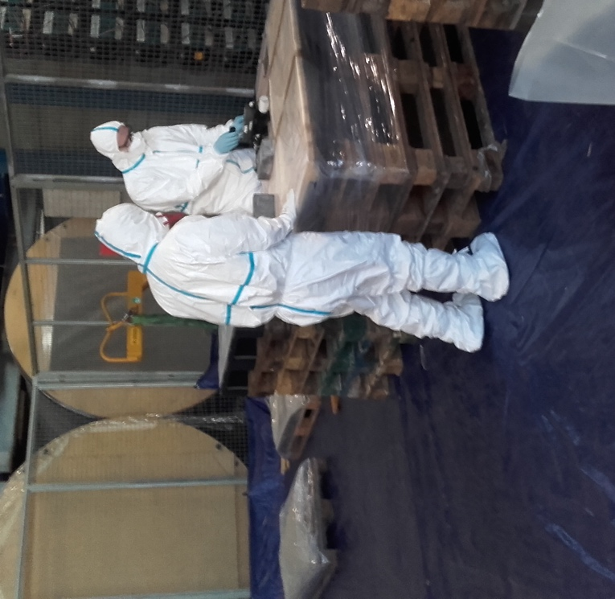
Remove and store unused lead
Found a compliant storage space
Organisational structure in place (who does what)
Starting the removal of all (discovered) unused lead from experimental areas, workshops and labs
Painting the removed lead
15 tons of lead removed (waste or storage) and 4 tons painted until now!

Slide 14
Assess areas with lead
Areas classification in ”lead free” or “lead present”
Sampling and analysis by accredited laboratory
Cleaning (if necessary) by chemical decontamination specialist
Area lead free:
Clean up affected areas by specialist
Check if contamination level is > 1 mg/m²
If yes
Organisational measures to avoid having lead back in the area
If no

Slide 15
Assess areas with lead
Area lead present:
Safety measures to be implemented:
Training on lead safety
Working procedures (avoid pollution and contamination)
Access control
Ventilation
PPE (mask if >1h, gloves, safety shoes, coverall)
Local lead storage and periodic cleaning
Clean up affected areas by specialist
Check if contamination level is > 10 mg/m²
If yes
Implementation of safety measures to handle lead
If no
Notes:
Declaration of professional risks (contact with lead): the medical service will decide whether or not to follow up.

Slide 16
Sampling and analysis
Sampling and analysis done by IST (Institut universitaire romand de Sante au Travail – Lausanne, CH)
Strategy:
Based on BNL (Brookhaven National Laboratory) method from 2017 ”Surface Wipe Sampling Procedure”
Rub a wet wipe following a specific pattern on a surface of known dimension
Concentration limits are the ones proposed by CERN
Report with conclusion issued for each area
Accredited Laboratory
Notes:
Under very specific conditions, CERN chemical laboratories have been allowed to take samples and do measurements. This was an exception done under certain circumstances (risk assessment – local that had never stored lead), and its application in the future is under discussion.

Slide 17
Sampling and cleaning so far
65 sampling points in workshops and labs
3 points > 10 mg/m²
28 points between 1 and 10 mg/m²
34 points < 1 mg/m²
Cleaning campaign by a firm specialised in chemical decontamination
Notes:
About 13 workshops/lab analysed – half of them to be cleaned. 3 labs already cleaned. It takes about 5 days to perform the cleaning.
Cleaning company is Alpha Bat:
It is compulsory to use respiratory mask for all personnel cleaning. Each person receives a mask FFP3 type and is trained to use it.
For the cleaning: vacuum cleaner with HEPA filter, wet wipes.
The waste material taken by the vacuum cleaner and the used wet wipes will be treated as chemical waste (labelled plastic bag).

Slide 18
Future developments
Discussion on going for a common CERN interdepartmental strategy for implementing guideline
Creation of a central lead storage space
More strict policy of lead usage traceability
Creation of a lead painting laboratory

Slide 19
Open discussion!
In other institutes:
What ‘limits’ are used?
How (and where) is stored the unused lead?
Are contamination measures done?
If yes, which contamination levels have been found?
Is lead painted somewhere on site?
If yes, using which paint and how it is organised?
Are dedicated lead workshops present?
Notes:
We would like to compare our methods with how the lead is treated in other institutes.

Slide 20
Thank you for your attention! Questions?

Slide 21
Backup Slides

Slide 22
Limits at BNL
Lead surface contamination:
26.9 µg/100 cm² (areas where lead is handled)
4.3 µg/100 cm² (areas lead free)
Notes:
It becomes 2.79 mg/m2 and 0.43 mg/m2.

Slide 23
Lead paint at CERN
Usage of lead paint at CERN is not allowed. This information is part of technical specifications for contractors
From Jan 2019, any activity involving intervention on painted surfaces (walls, wood, metal) requires an analysis
This statement will be part of the HSE guideline for lead safety

Slide 24
Lead paint at CERN
Specialised contractor is available at CERN to identify the presence of lead in painting (limit 0.2 mg/cm²)
In general, the following principles should be followed:
All interventions on painted surfaces should be limited
Non-destructive interventions are preferred
Methods of intervention that do not produce dust are preferred
In case lead is present, protective measures:
PPE (coverall, mask, gloves) and high standard hygiene
Suction equipment at source of dust
Waste in plastic bag well sealed
Protection of surrounding areas (confined working area)

Slide 25
Measuring lead in paint
Measuring instrument using x-ray fluorescence
CERN bought measuring instrument and is now training few members of the Staff

Slide 26
Lead paint – Further notes
Lead paint was widely used, because it dries quickly, gives colors and is anticorrosive
Legislations in Switzerland and France are the following:
Switzerland:
OTConst (Ordonnance fédérale) states that the responsible of the work should consider the dangerous pollutants (“lead” is no officially stated) caused by the activities
In 2013, Canton of Geneva states that all constructions built before 2006 should be analyzed in case of intervention on painted surfaces. If the analysis is not done, precautions must be taken as if lead is present. Limit value is 0.2 mg/cm².

Slide 27
Lead paint – Further notes
France:
Obligation to analyze lead quantity of painted surfaces only for inhabited houses built before 1949 (not applicable at CERN). Limit is 1 mg/cm².
In 2014, recommendation that any activity involving intervention on painted surfaces requires an analysis. No limits are stated.

