Slide 2
SPS FIRE Project
A major fire safety consolidation in an aging facility
ITSF 2019 (ESS)
Art Arnalich (CERN HSE-OHS-IB) on behalf of CERN Fire Safety Engineering Team
Contributions from Florence Pirotte (CERN BE)
Notes:
The SPS FIRE Project: a major fire safety consolidation in an aging facility to face future challenges. "
The Super Proton Synchrotron (SPS) is the second largest accelerator at CERN, a 450 GeV proton and heavy ion machine serving the North Area experimental area and playing a key role as an injector for the LHC (Large Hadron Collider). Commissioned in 1976, the SPS featured a fire safety concept dating from the 70’s, that remained unchanged until today and for which CERN management launched a fire safety consolidation study in 2015.
This presentation explores the findings of the consolidation study, the challenges of a fire safety consolidation project of a 40-year-old research machine and some of the lessons learned by CERN Fire Safety Engineering Team.
From a very early stage, the fire risk assessment carried out during the study phase, revealed a number of shortcomings in life safety objectives: occupant protection and firefighter safety did not comply with current standards and best practices. In addition, low levels of property protection showed not only potential damage beyond the SPS into upstream machines like the PS (Proton Synchrotron) but also a risk to the continuity of operations of machines and experimental areas located downstream the SPS.
In the absence of applicable or fit-for-purpose fire safety codes for large underground research facilities, technical solutions went through a Performance-Based Design exercise benchmarking potential trial designs with the existing situation. As in any retrofit project, operational and maintenance constraints factored heavily in the adopted solution which outstands as best effort from all stakeholders to reach a balanced result between operations, fire safety and budget.
A final word focuses on the lessons learned by CERN Fire Safety Engineering Team in this 11 million € fire safety project which stands as the largest and most ambitious fire safety initiative carried out at CERN.

Slide 3
The SPS FIRE Project
Jan
2015
Aug
2020
Scope
Need
SPS FIRE Study
SPS FIRE Project
Operation
Solution
Procurement
Implementation
Sept 2016
Dec 2018

Slide 4
Scope
CERN Super Proton Synchrotron
second largest CERN machine
450GeV, protons / ions
7km, 60m deep, 4.5m diameter
commissioned 1976
1970 fire safety standards

Slide 5
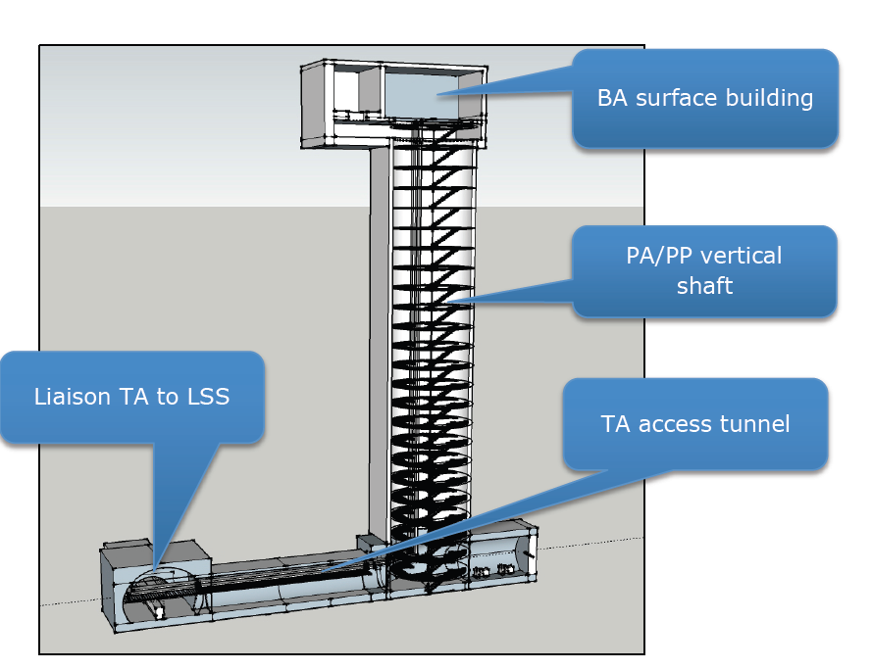
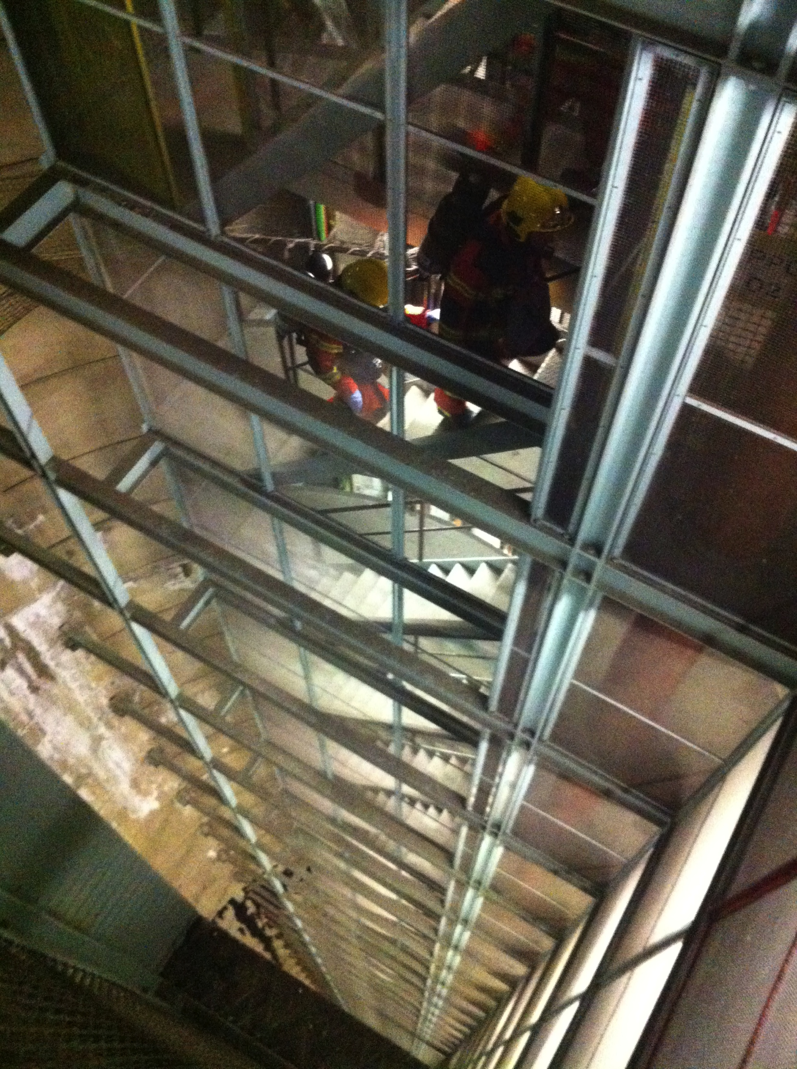
Scope
CERN Super Proton Synchrotron

Slide 6
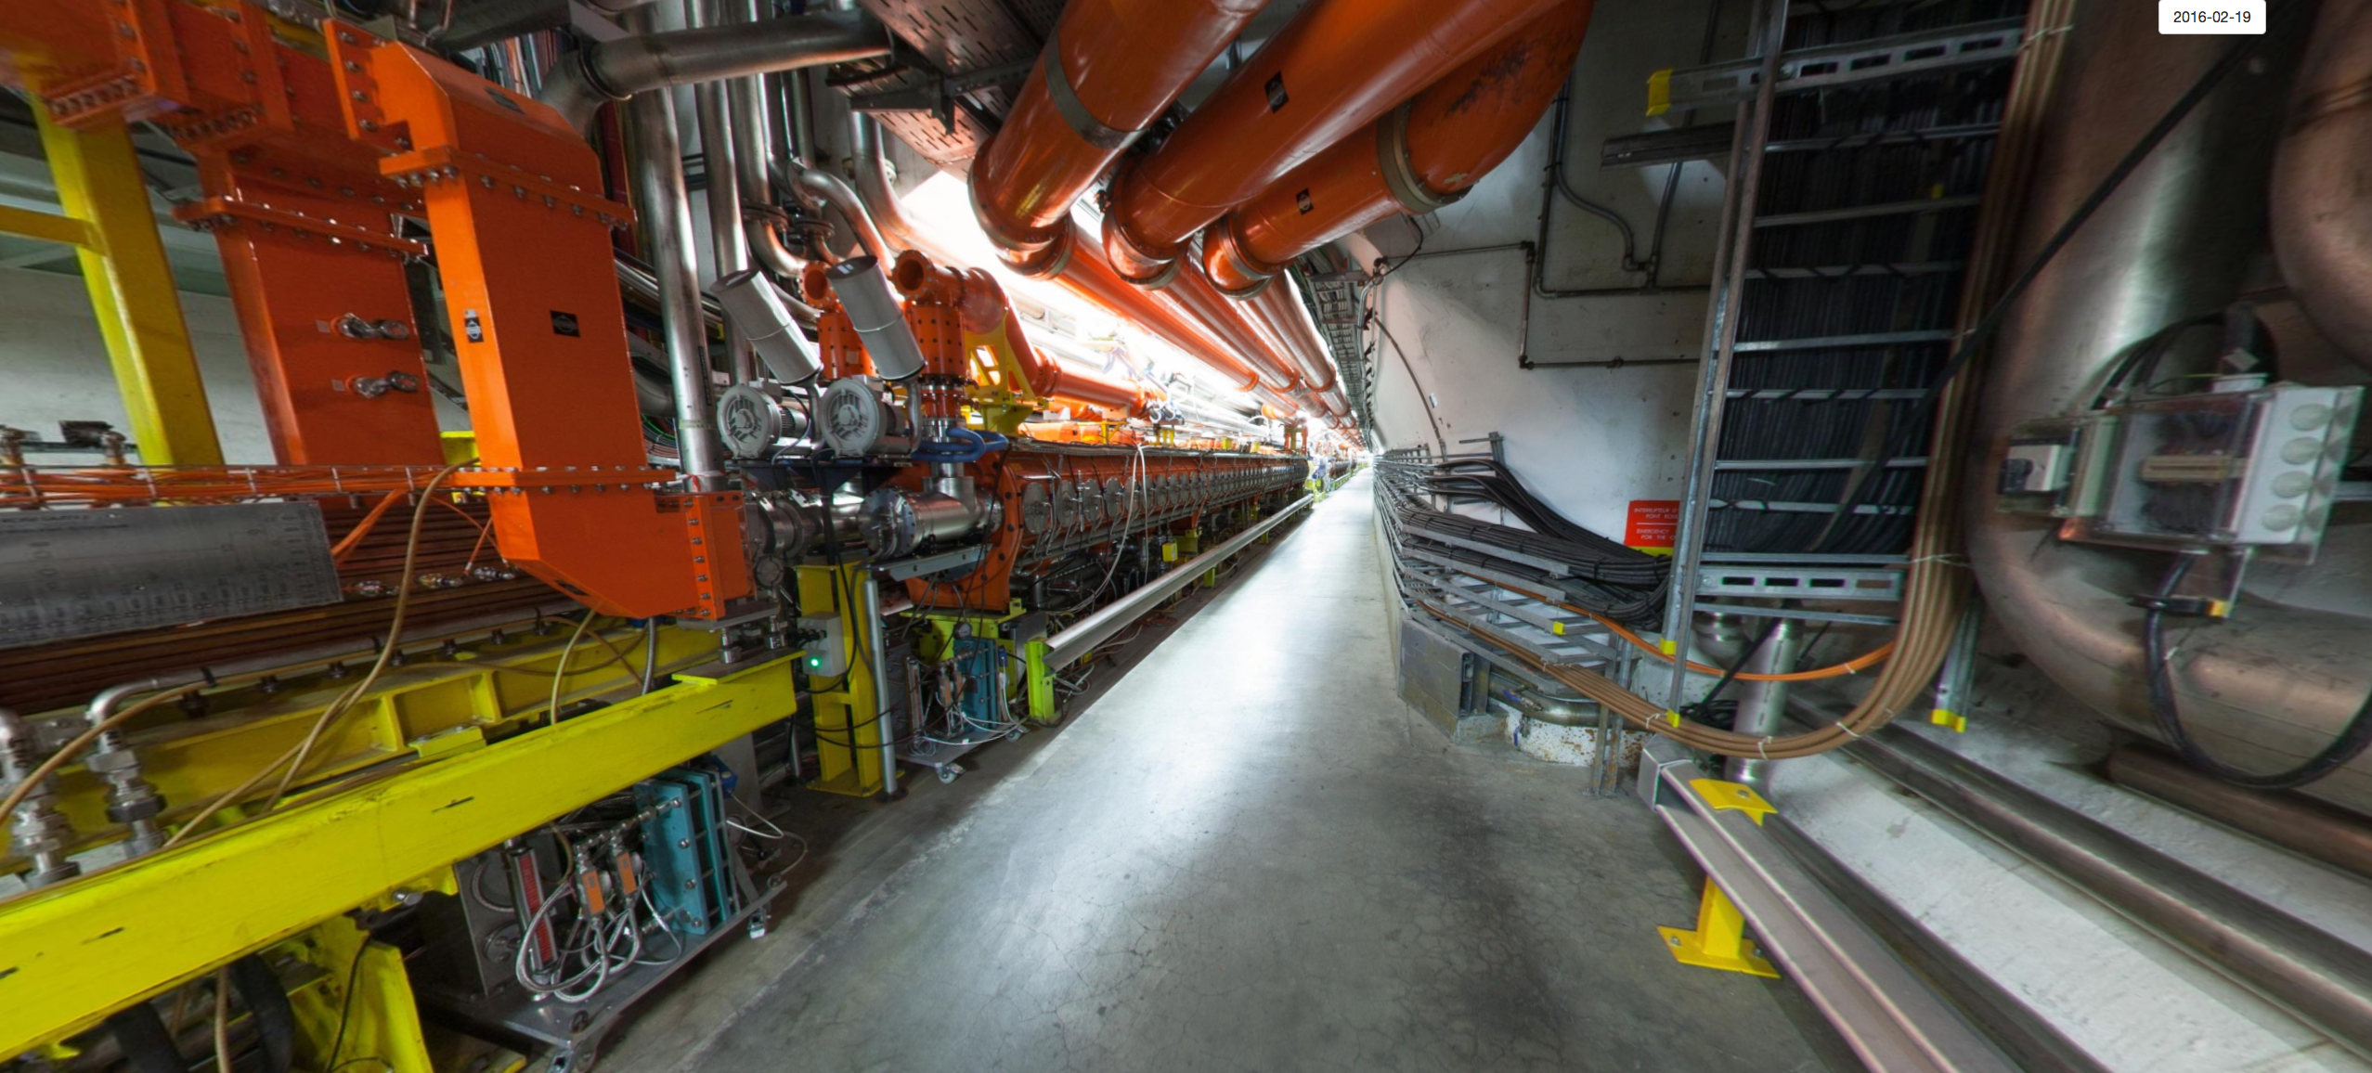
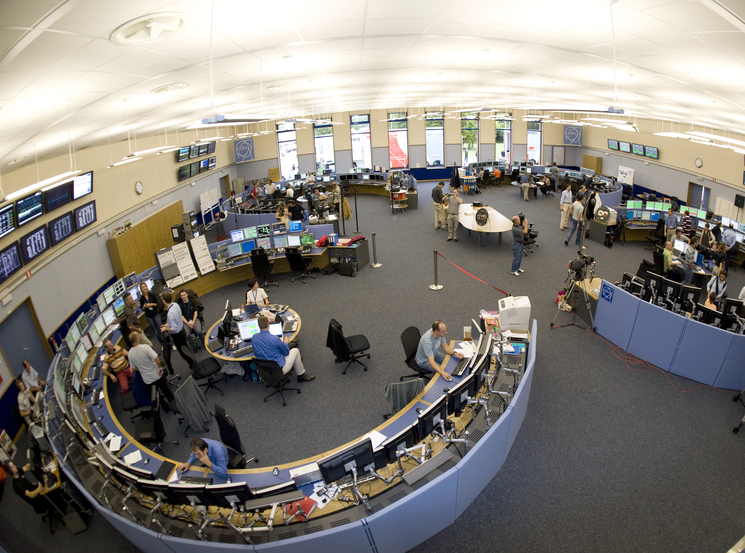
1976
2016

Slide 7
early days
2014

Slide 8
Fire Safety Concept evolution
SPS example
Need
SPS FIRE Project
~13MCHF
SPS risk level
acceptable risk level (*)
1976
2016
(*) acceptable risk levels evolve with risk acceptance by society, state of technology, incident experience, resilience expectations, evolution of costs of discontinuity of operations among other factors.

Slide 9
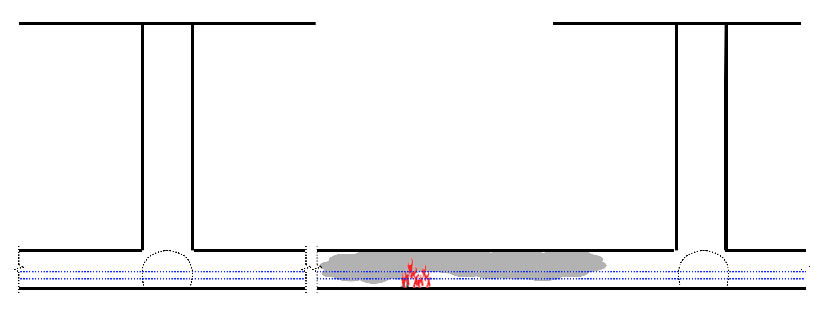
Current SPS layout
Need
1.1 km

Slide 10
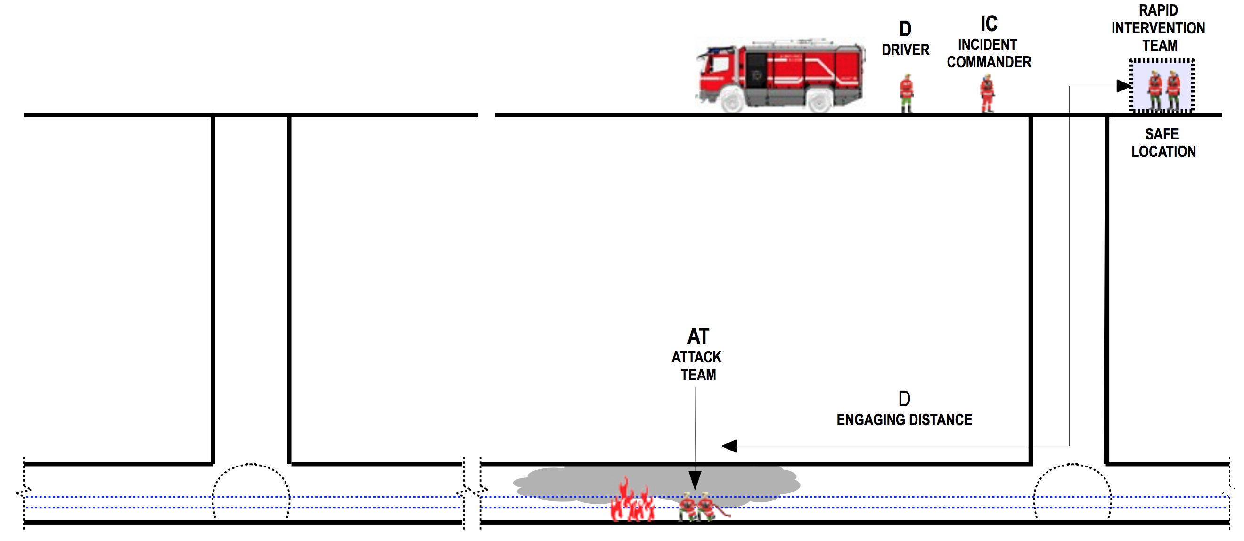
Need
Current SPS layout
1.1 km

Slide 11
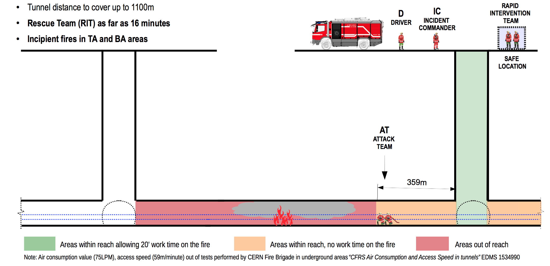
Accessible areas for firefighting
Current situation
Need

Slide 12
Study phase
SPS FIRE Study
Need
Jan 15 SPS Fire Safety Study is launched
triggered by a need of the fire service (HSE-FB)
endorsed/supported by facility risk owner (EN DSO)
led by facility operators (BE-OP)
multiple participants: radio protection, fire expertise,
emergency preparedness, environment, transport,
implementation actors, service providers….

Slide 13
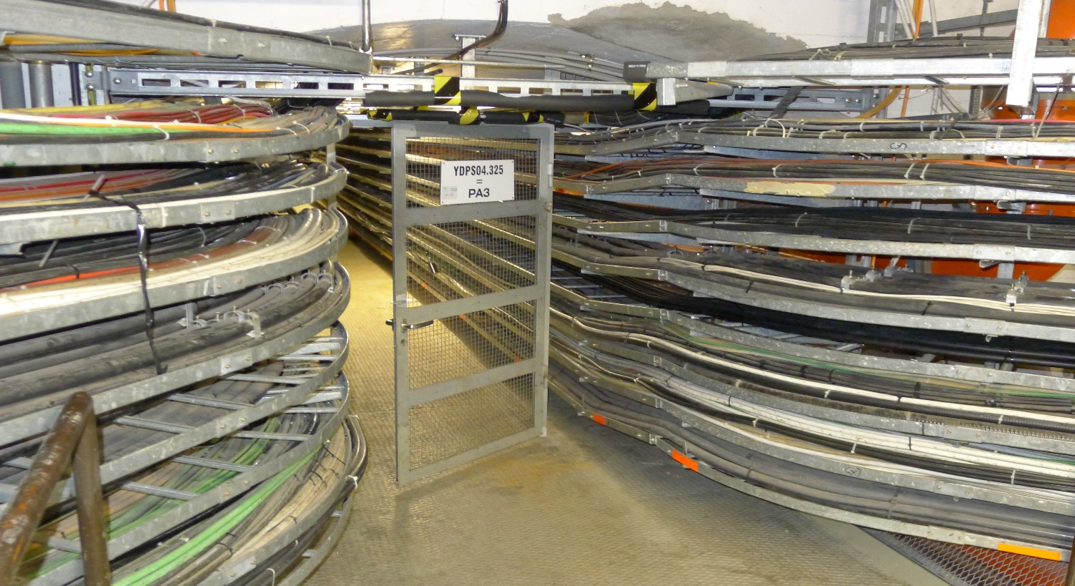
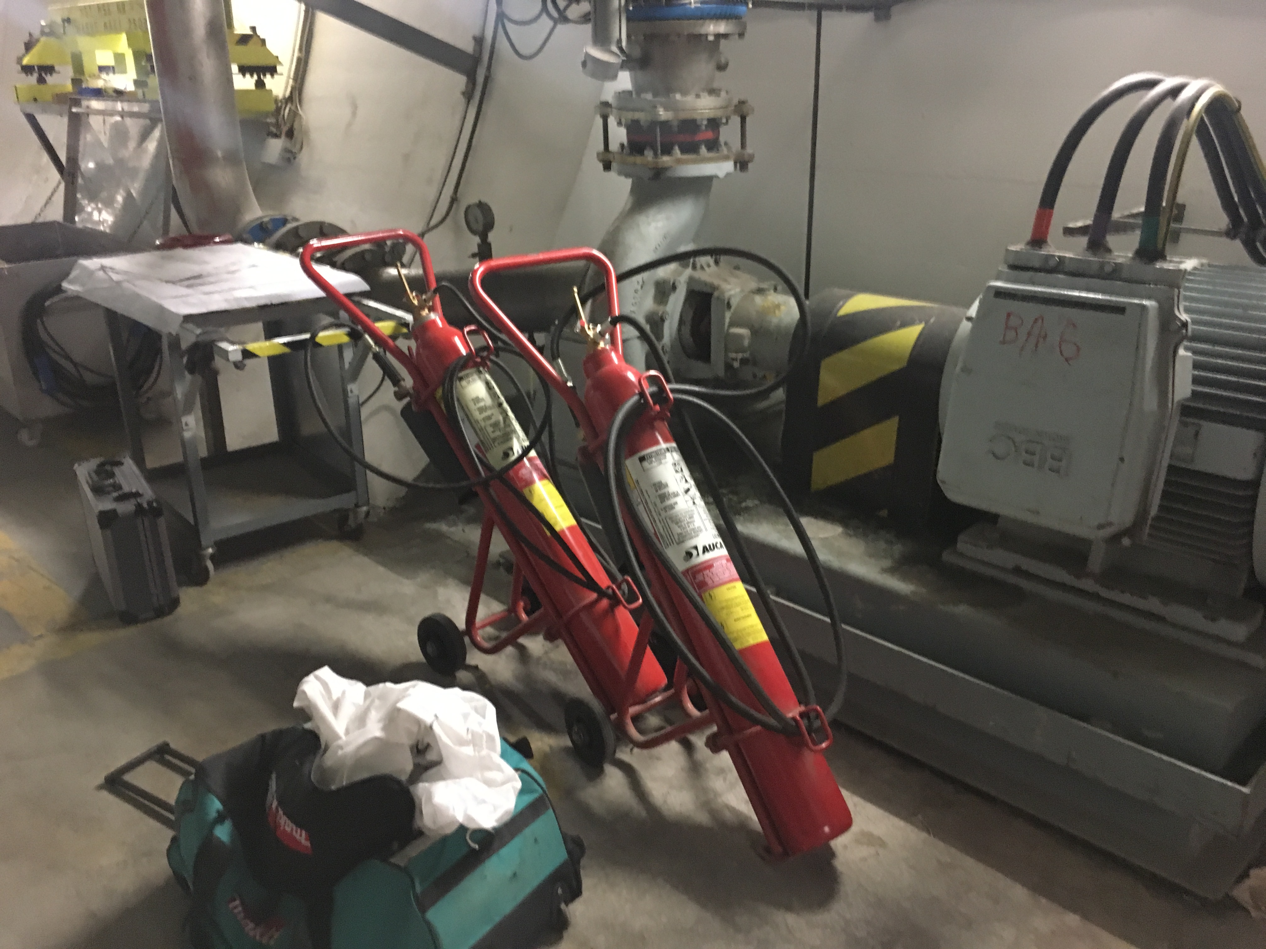
Fuel load, extinguishing means
SPS FIRE Study

Slide 14
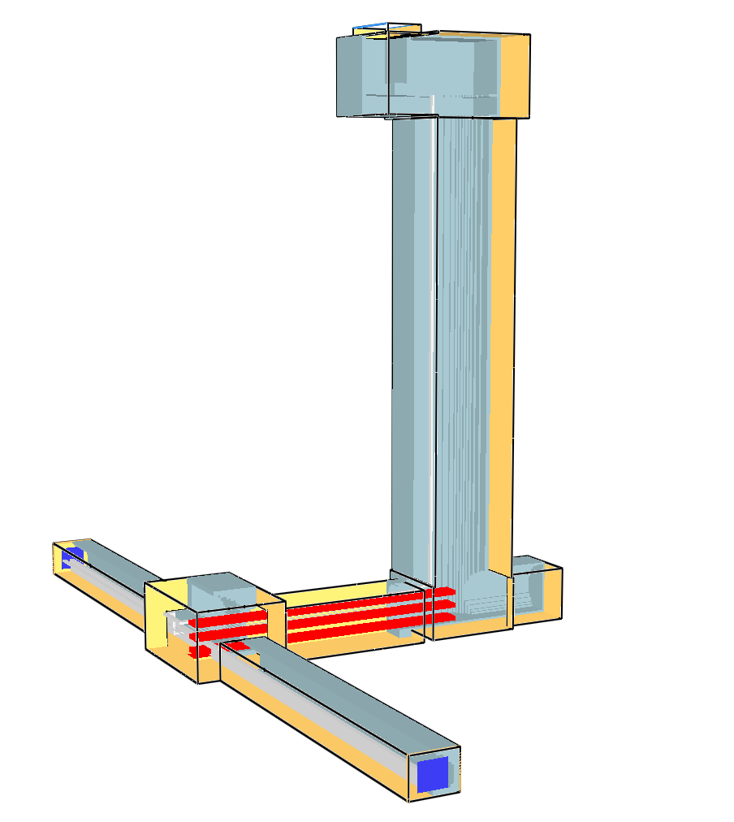
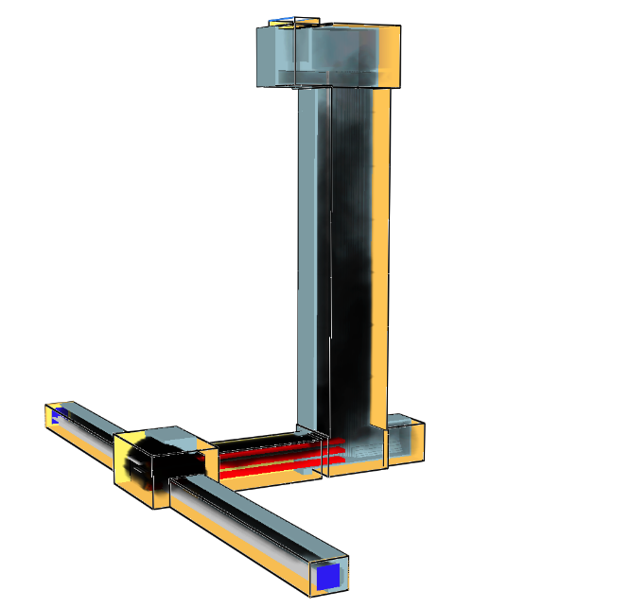
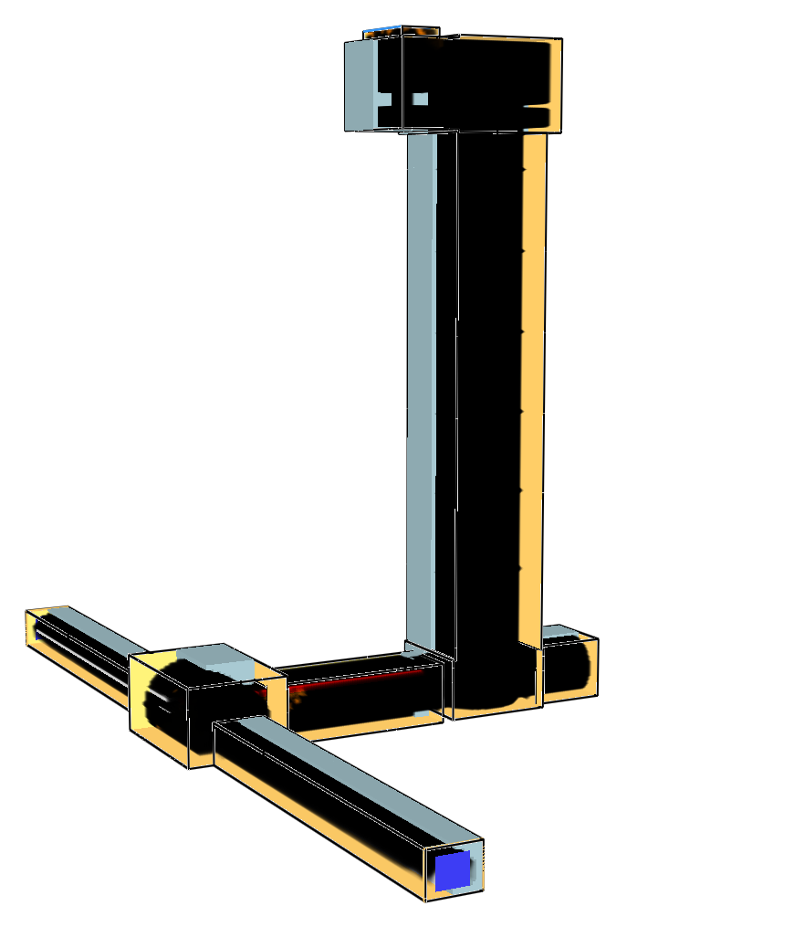
SPS FIRE Study
Evacuation conditions
t=0min
t=7min
t=30min

Slide 15
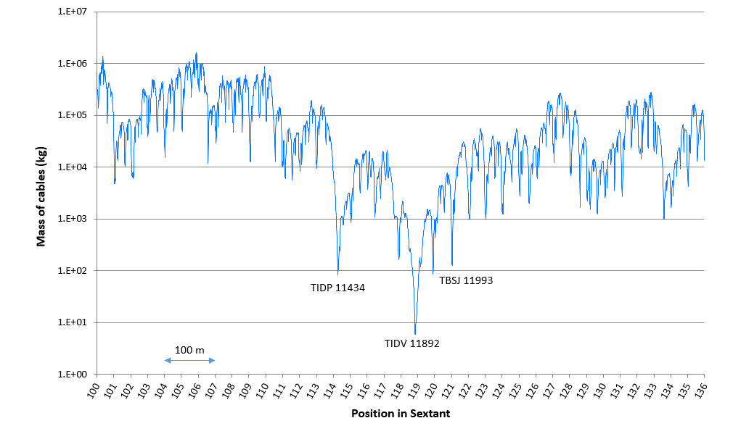
SPS FIRE Study
Uncontrolled radioactive release
Fuel load burnt resulting in a dose in members of the public above 0.3 mSv
100 kg

Slide 16
SPS FIRE Study
Findings
  Evacuation conditions to be improved
  Firefighter safety to be improved
  Search and rescue operations likely to fail
  Limited control of activated smoke
  Large property damage is plausible
  Critical impact in continuity of operations

Slide 17
SPS FIRE Study
SPS FIRE Project
13.1 MCHF
Clear mandate to solve findings of SPS Study
Time framing for LS2

Slide 18
SPS FIRE Project strategy
SPS FIRE Project
Compartmentalization by means of fire doors
Fire suppression system (sprinkler) in high fuel load areas
Integrated safety control system for fire detection, alarm, evacuation, ventilation control and fire door control
Fire attack means to ensure firefighter safety and intervention: dry riser and firefighting tractors/trolleys
Notes:
to protect evacuation routes
to supress fire early by sprinkler activation
to allow firefighter deployment for search&rescue and fire attack
to isolate SPS from other facilities
to protect/isolate high activation areas

Slide 19

SPS FIRE Project strategy
SPS FIRE Project
The proposed solution is a balance between fire safety, infrastructure and operation in a retrofit scenario.
All fire safety elements are foreseen as complementary systems.
Partial or stand-alone implementations involve degraded fire protection scenarios.
Notes:
to protect evacuation routes
to supress fire early by sprinkler activation
to allow firefighter deployment for search&rescue and fire attack
to isolate SPS from other facilities
to protect/isolate high activation areas

Slide 20
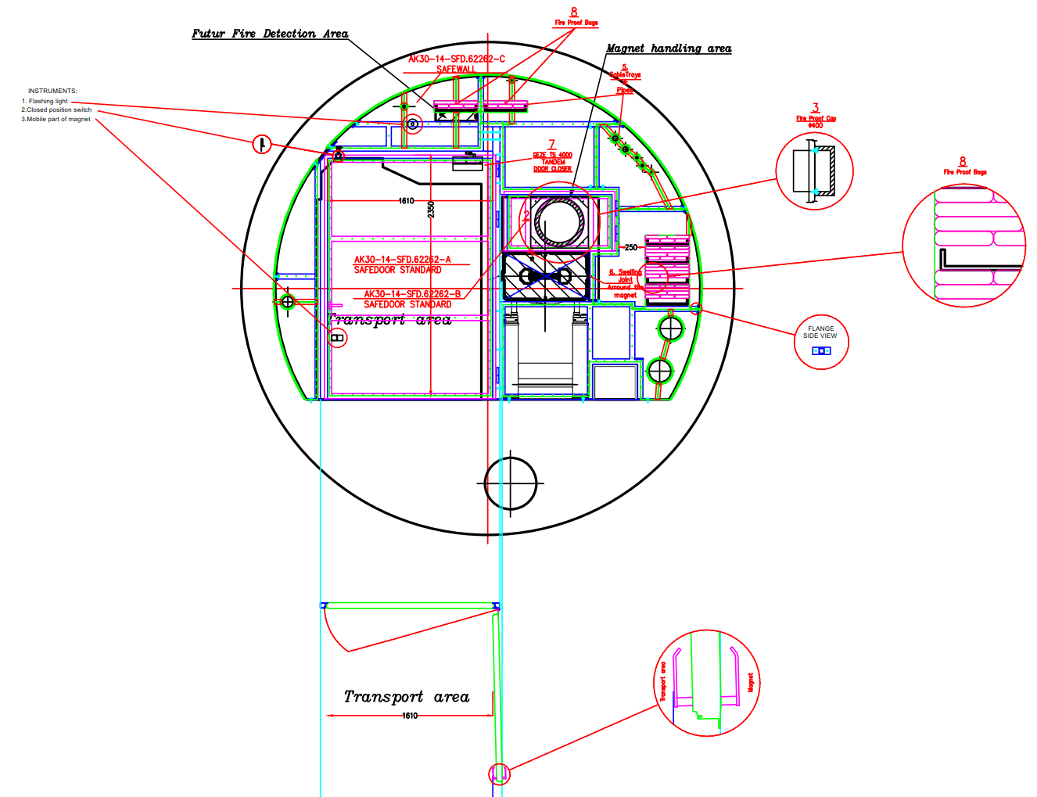
Compartmentalization
SPS FIRE Project
52 fire doors in different priority levels (colors)

Slide 21
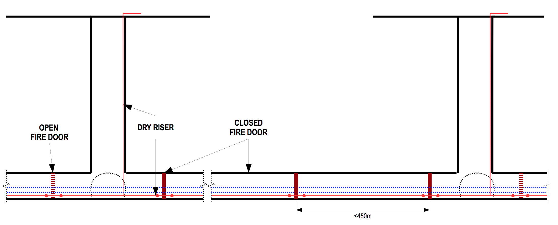
Compartmentalization
SPS FIRE Project

Slide 22
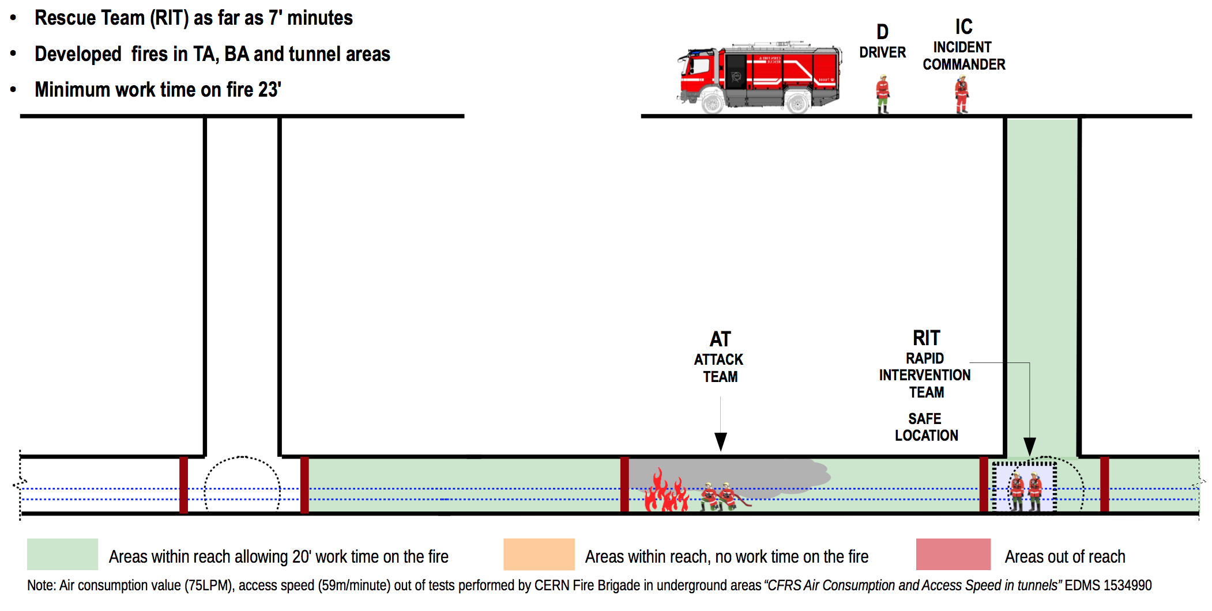
Accessible areas for firefighting
SPS FIRE Project

Slide 23
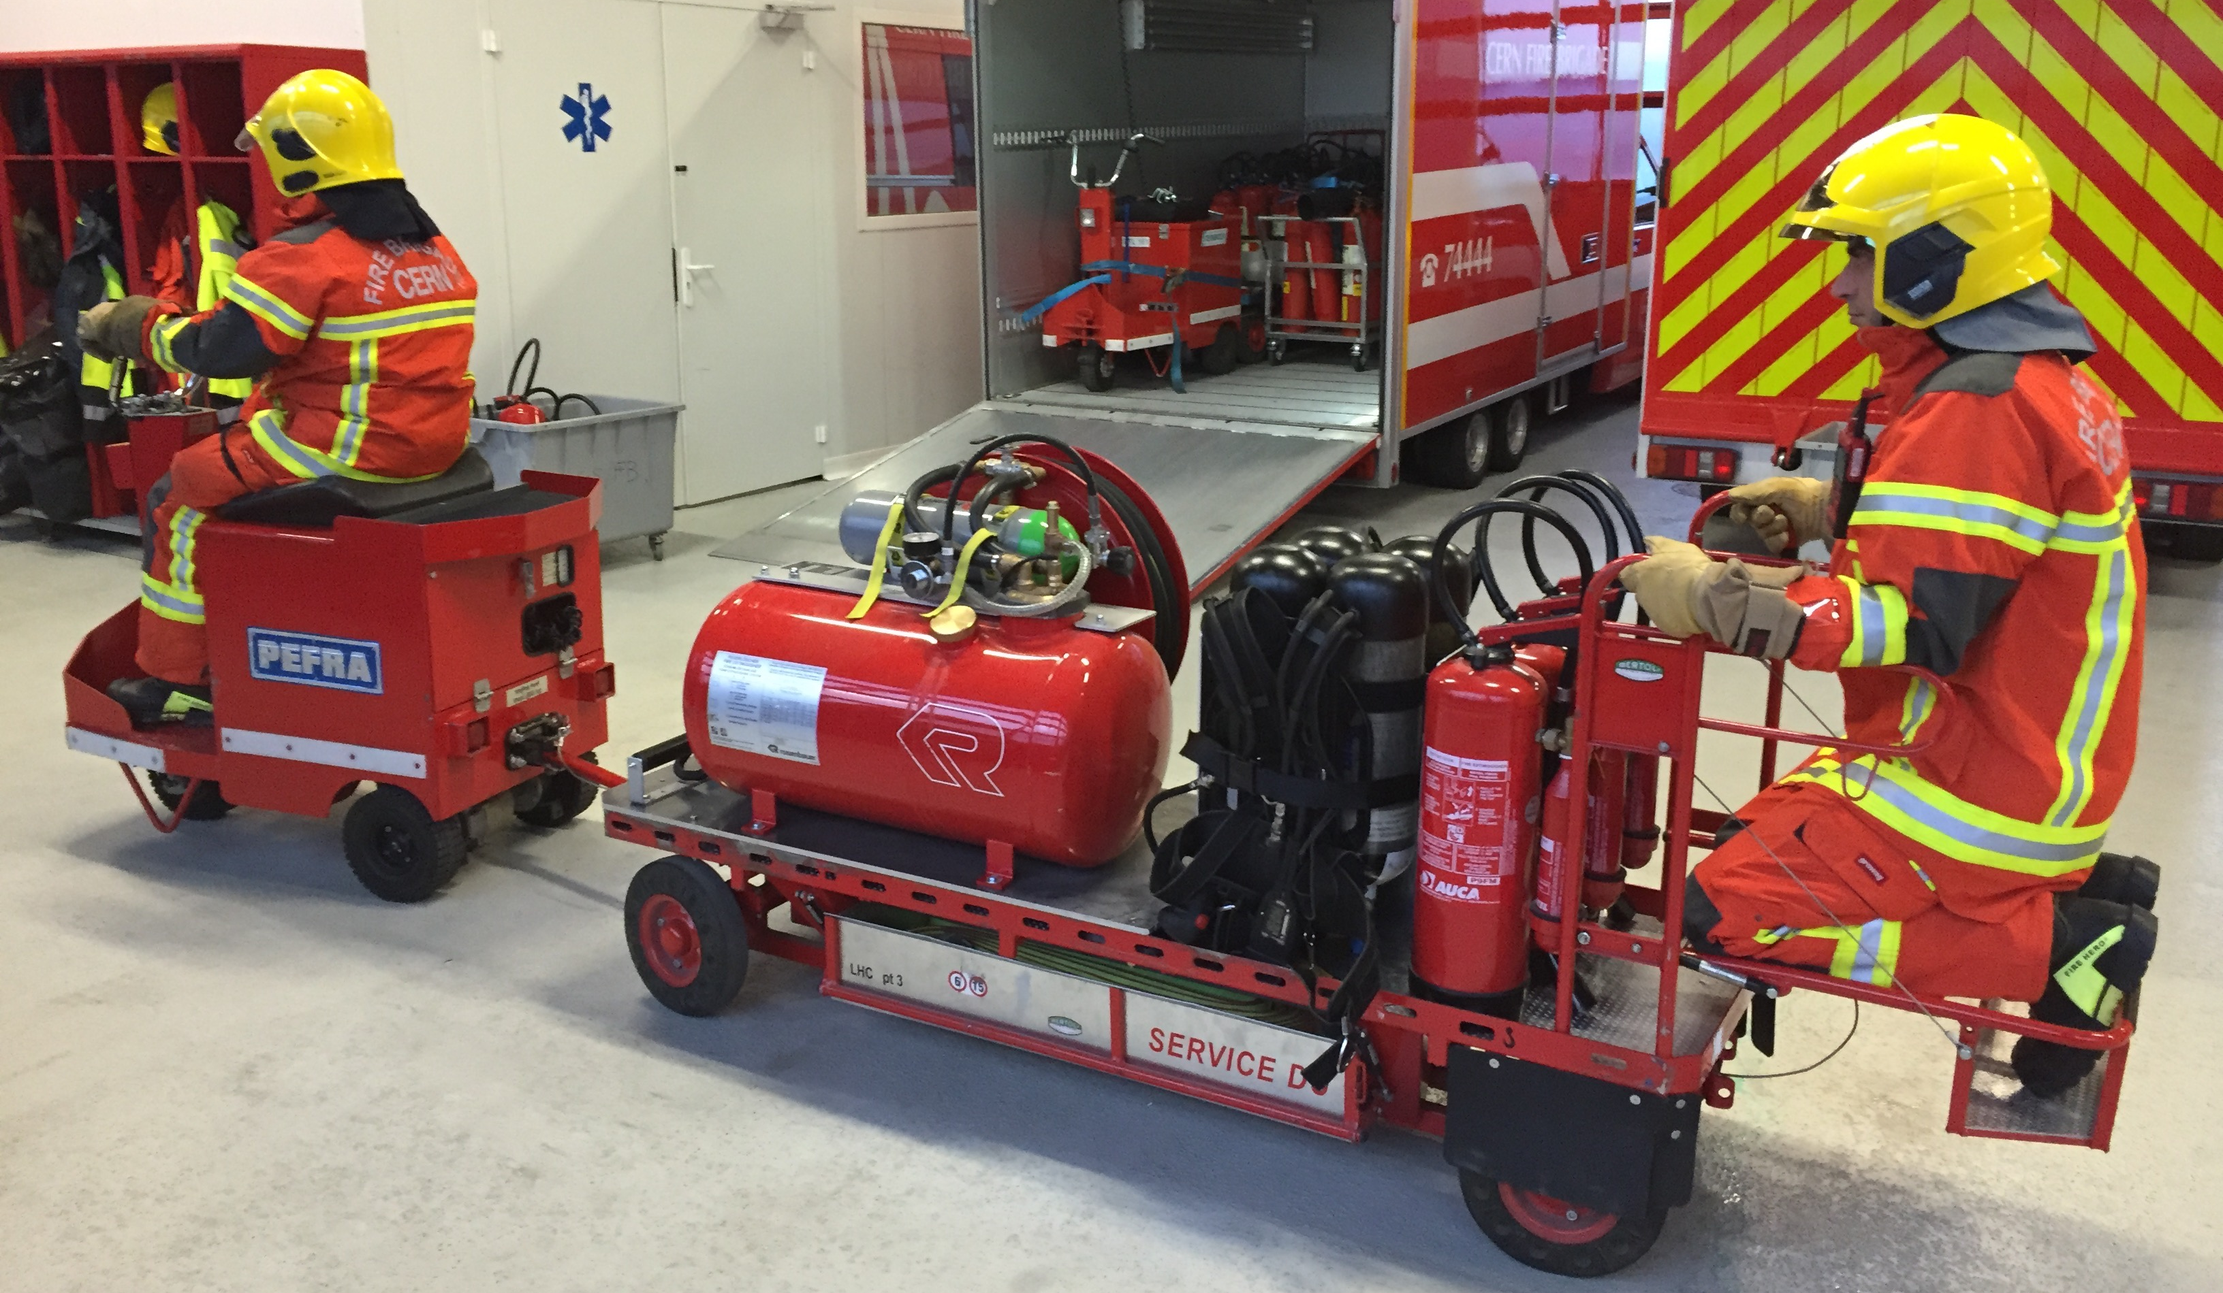
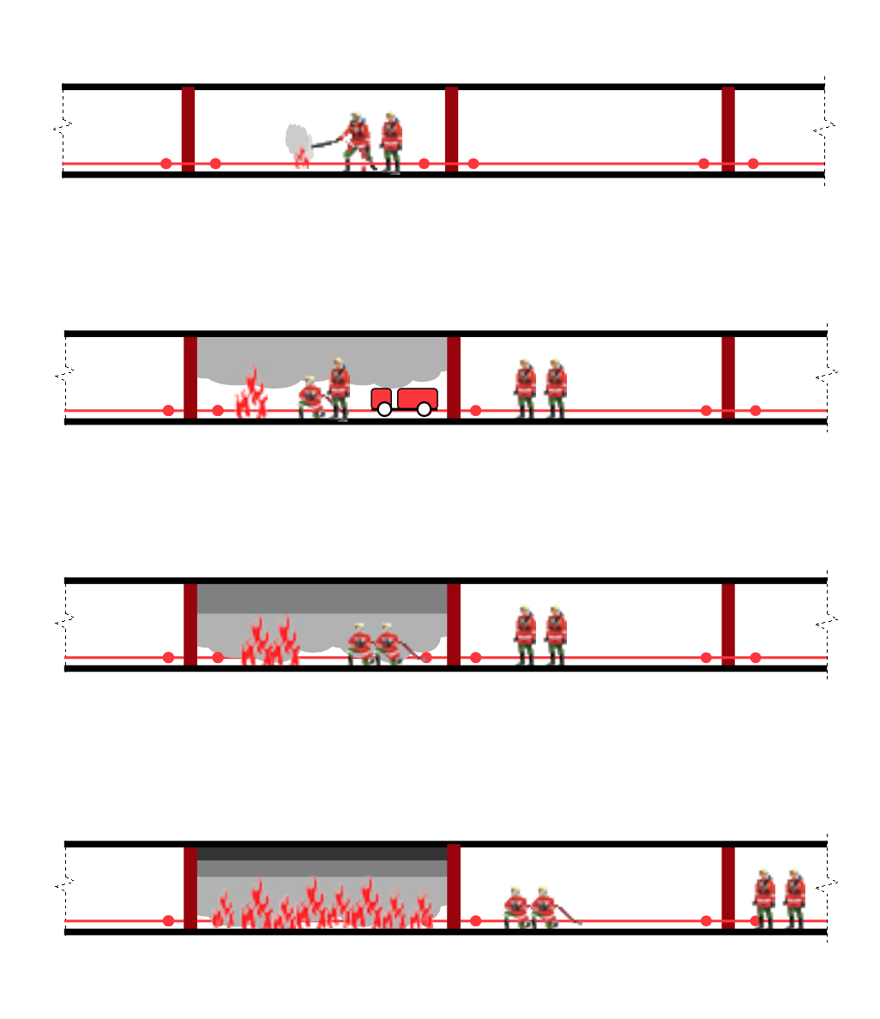
Firefighting means in every shaft
SPS FIRE Project

Slide 24
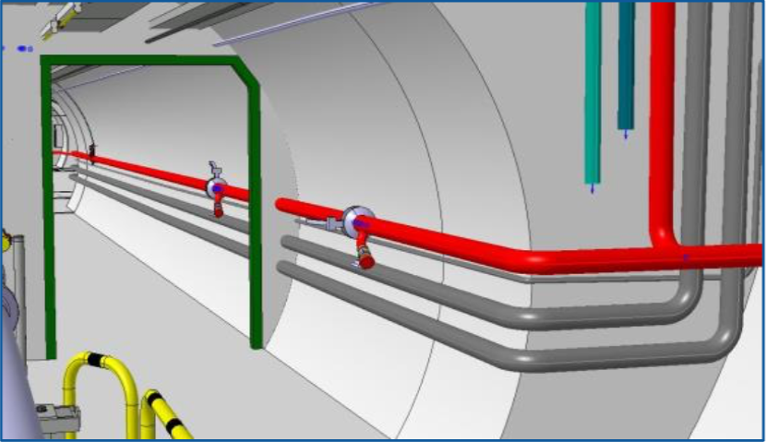
Dry riser for firefighter intervention
SPS FIRE Project
Dry riser covers entire facility
Dry by default, only filled with water in case of intervention

Slide 25
Dry riser for firefighter intervention
SPS FIRE Project

Slide 26
Fire detection and safety actions
SPS FIRE Project
Air aspiration smoke detection covers entire facility
6 safety zones covering the entire facility for evacuation and compartmentalization

Slide 27
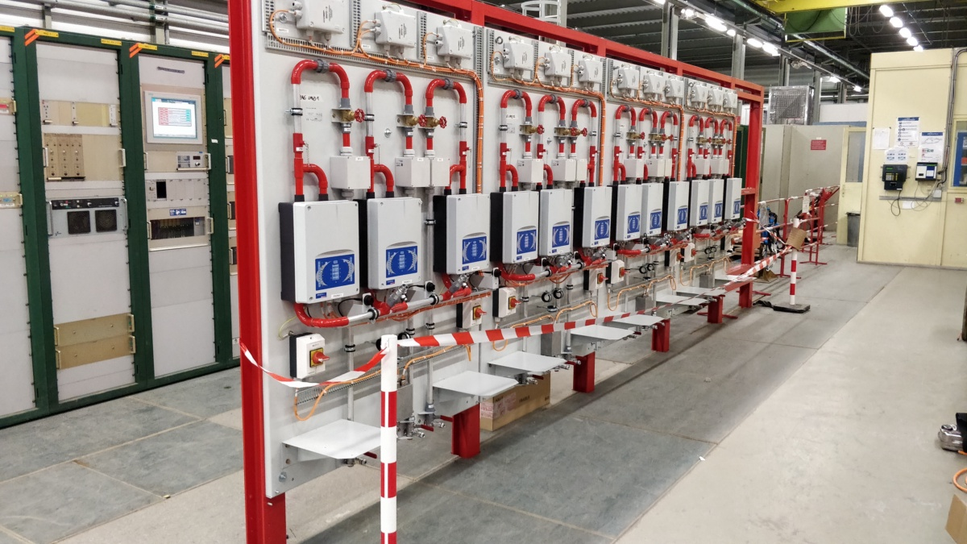
Fire detection and safety actions
SPS FIRE Project

Slide 28
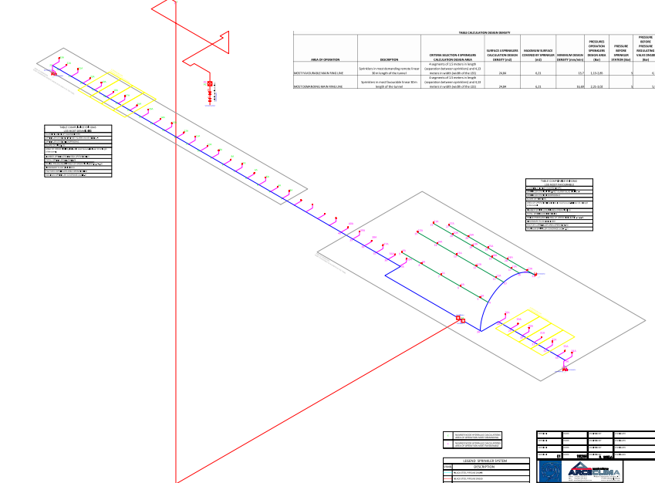
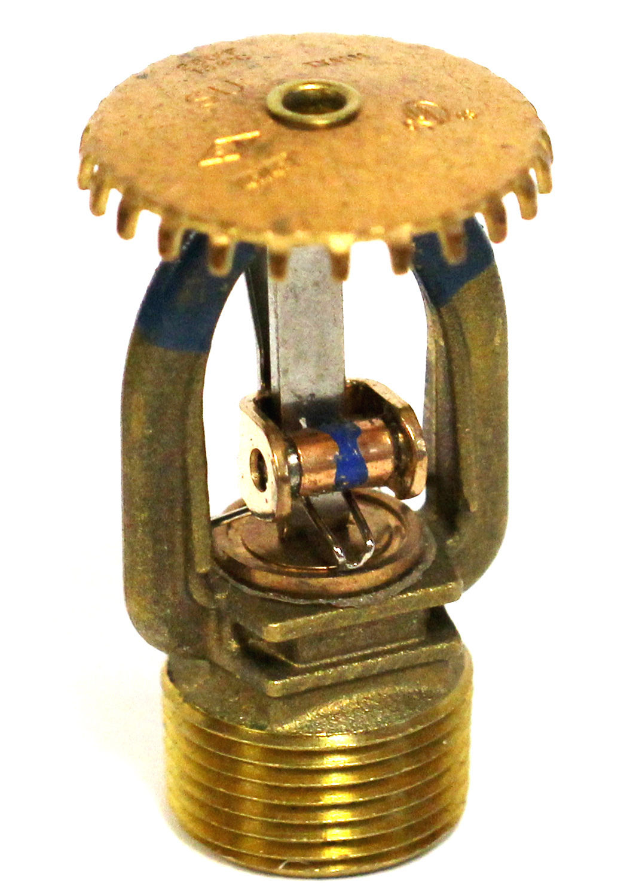
Sprinkler system
SPS FIRE Project
Covers shafts, TAs and LSSs

Slide 29
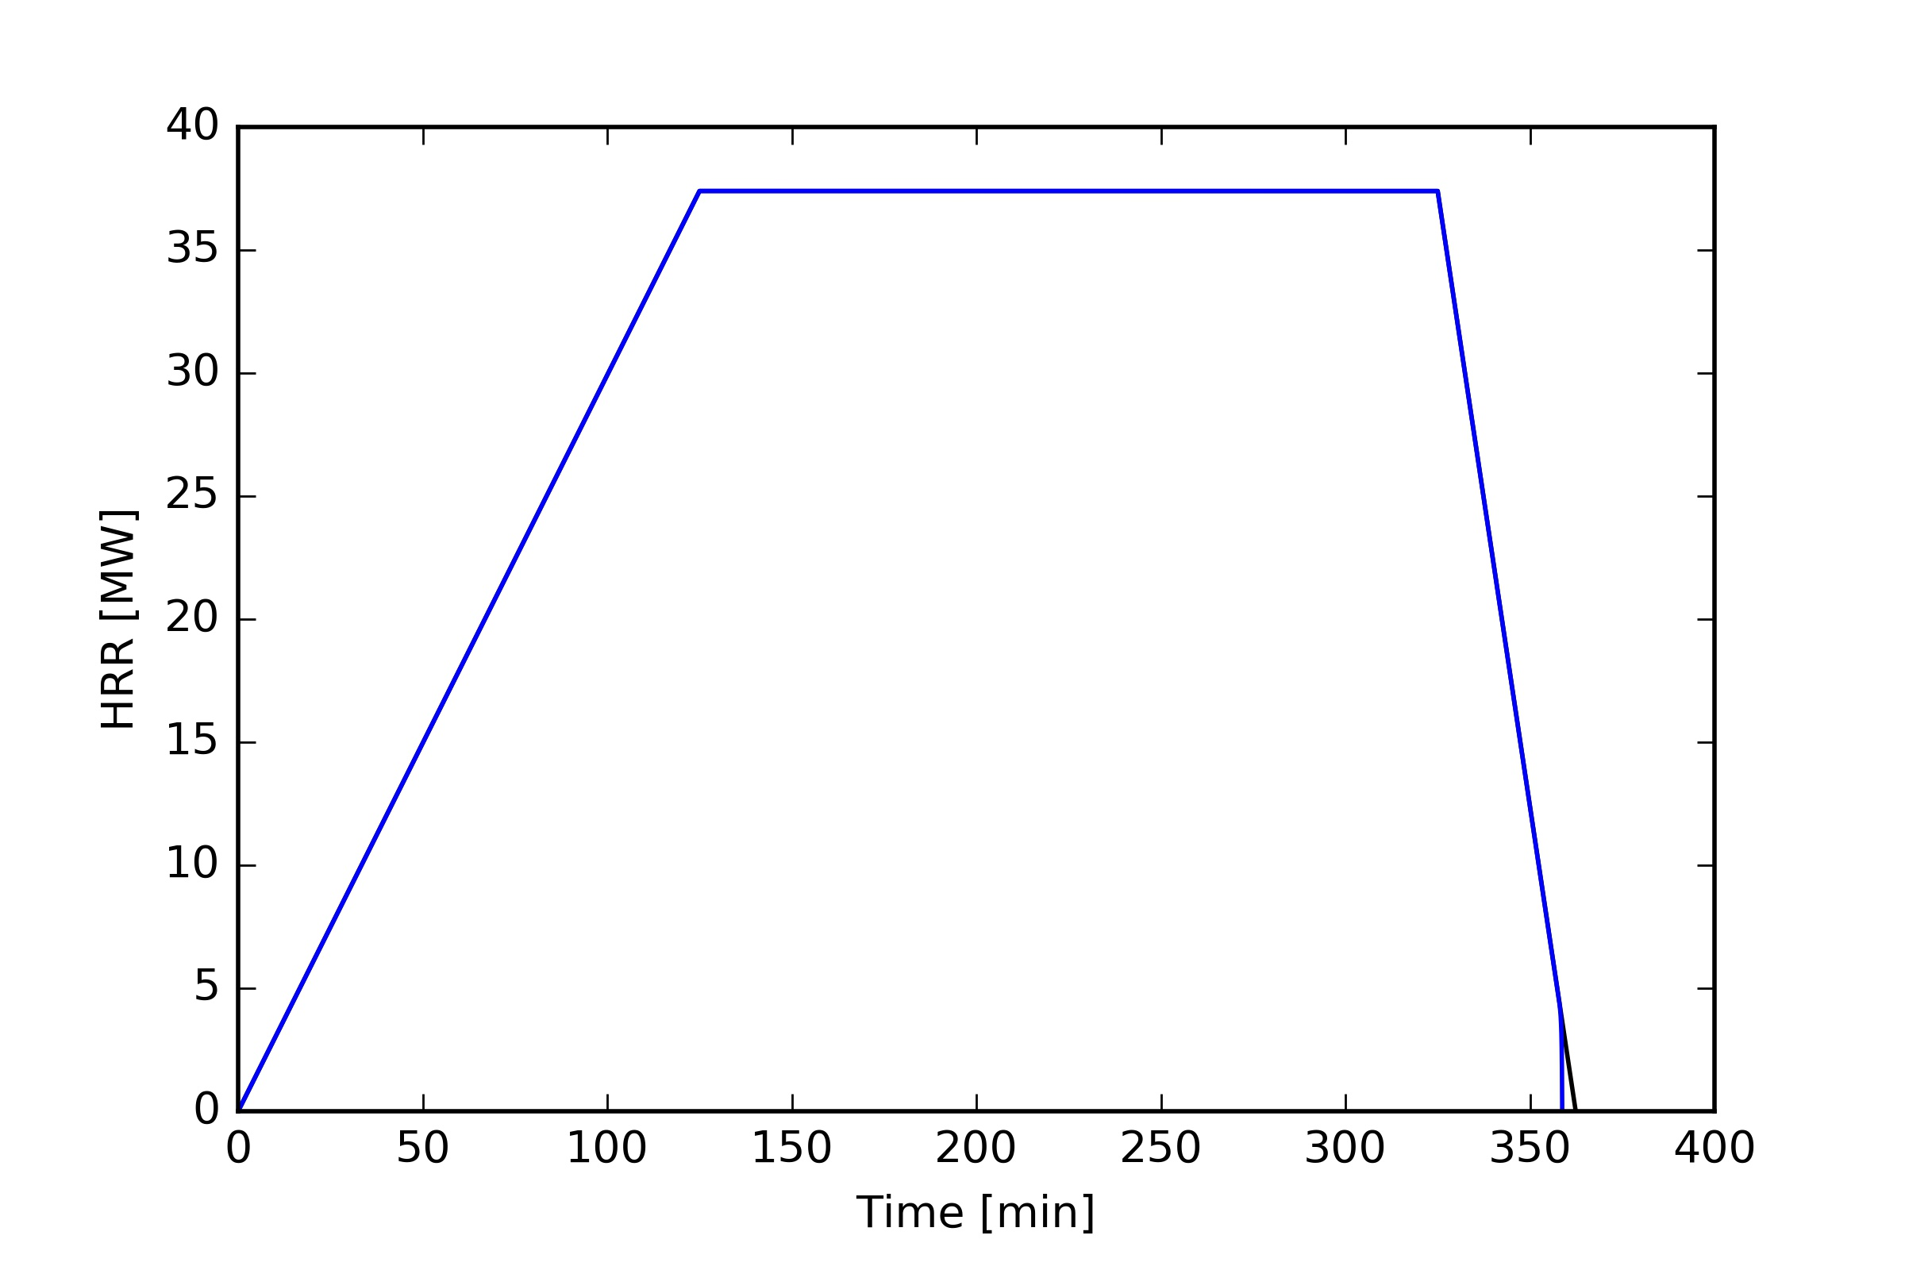
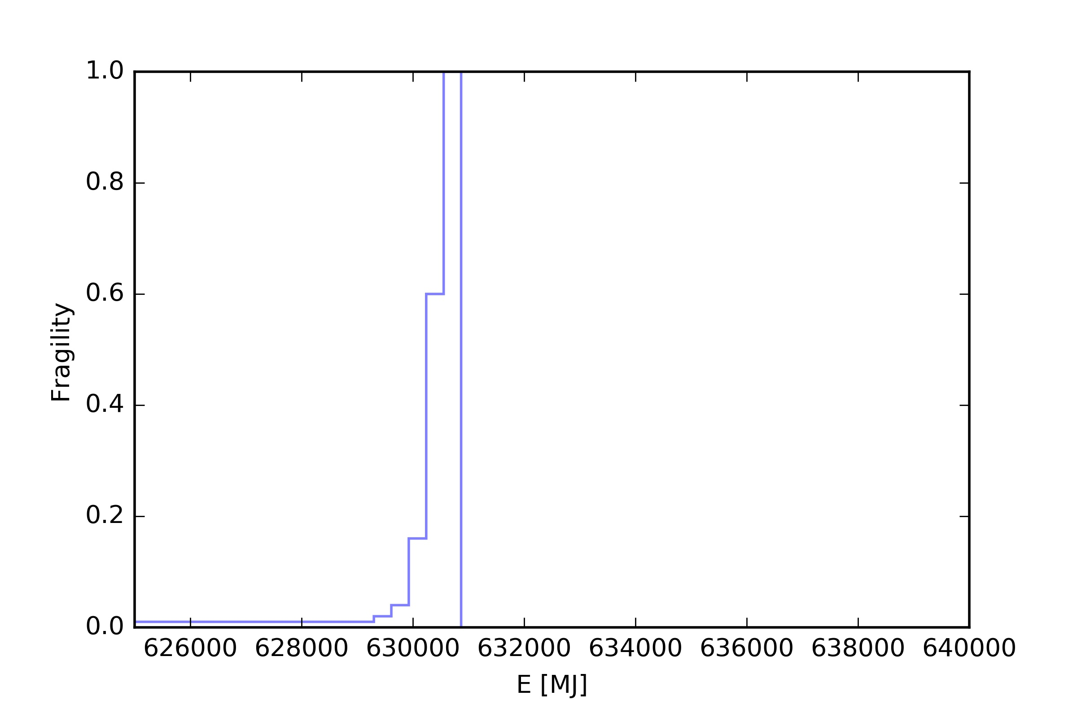
SPS FIRE Project
TA/LSS with/without sprinkler
Without sprinklers
0.9
~20000kg plastic burnt
E=630GJ, Hc=30MJ/kg, probability 90%
630GJ

Slide 30
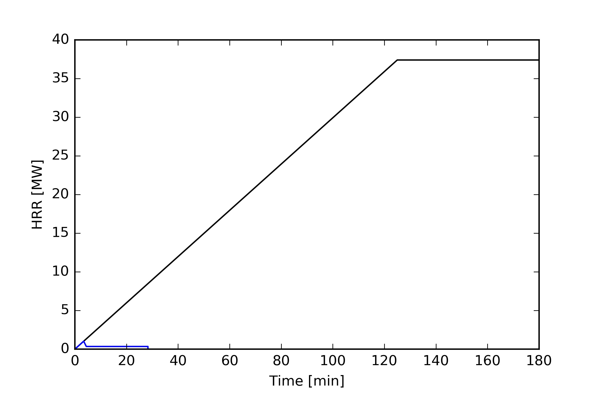
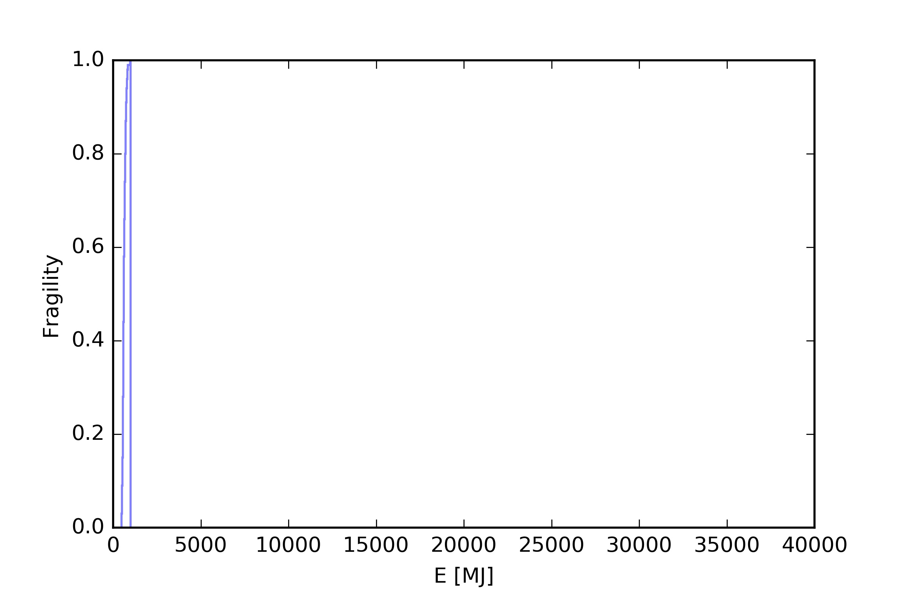
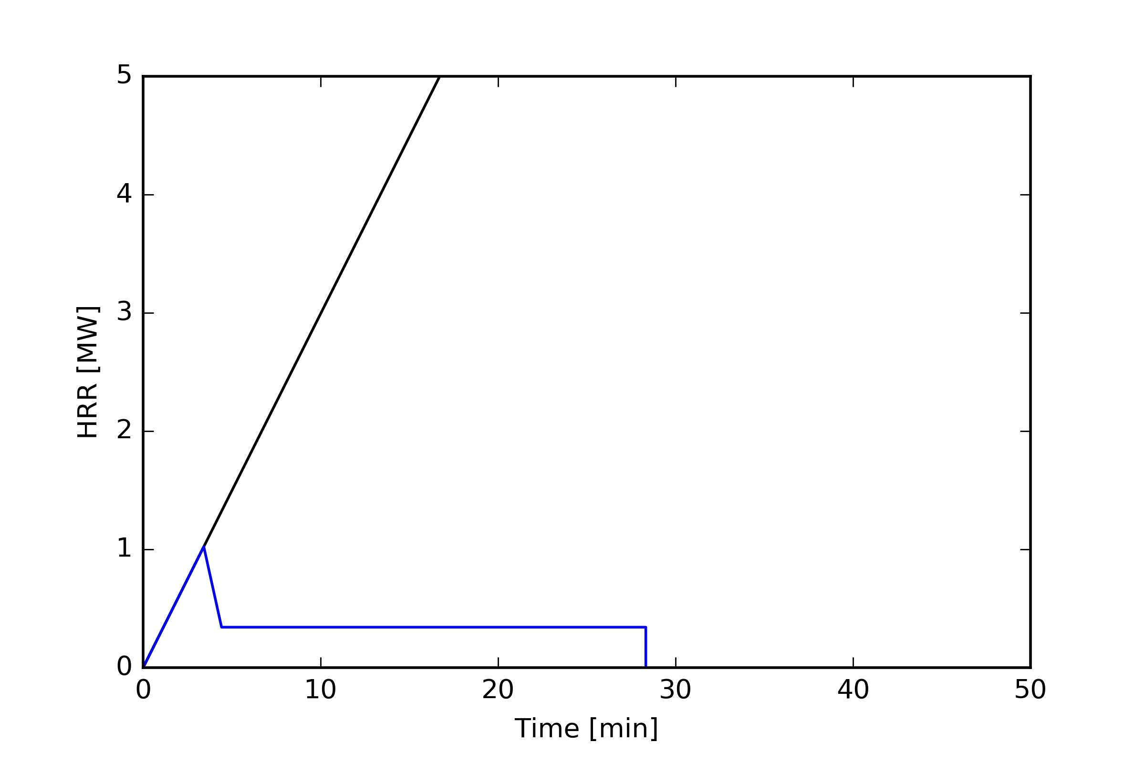
SPS FIRE Project
TA/LSS with/without sprinkler
Without sprinklers
0.9
~20000kg plastic burnt
E=630GJ, Hc=30MJ/kg, probability 90%
630GJ
With sprinklers
0.9
~35kg plastic burnt
E=1GJ, Hc=30MJ/kg, probability 90%
1GJ

Slide 31
SPS FIRE Project
Sprinkler system

Slide 32
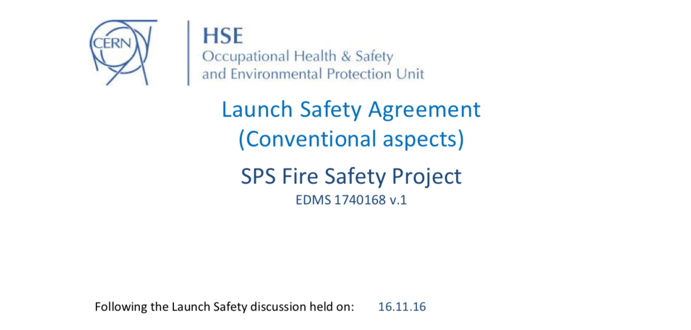
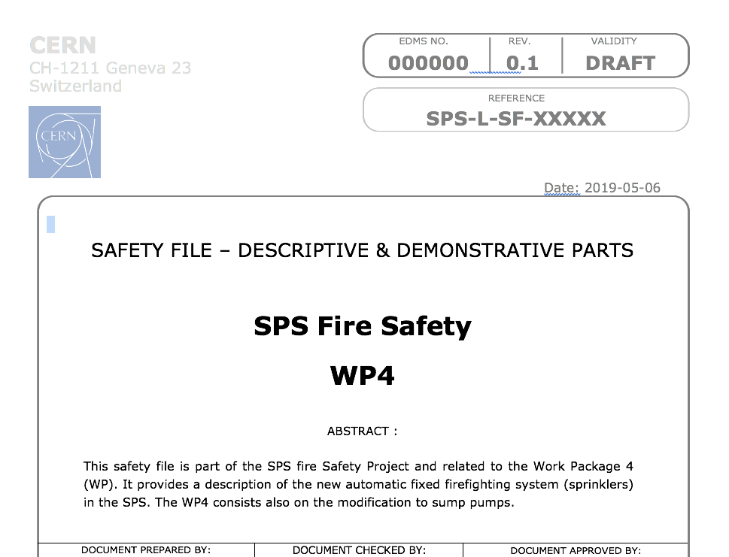
Documentation organization
(F. Pirotte BE)
The Launch Safety Agreement (LSA) covering the conventional safety aspects for all WPs.
One Safety File for each WP (4) with :
  the descriptive part (= purpose and motivation, location, safety system, life cycle of the project)
  the demonstrative part (= risk assessment and mitigation measures)
  the operational and REM (=REX) parts: after commissioning, when system in operation -> Safety procedures to operate, mand Safety related records: reports, lessons learned, changes, non- conformity, maintain, dismantle, dispose (incident/accident reports)
Prevention Plan for the installation phase: document defining all the measures for the prevention of risks.

Slide 33
Conclusions
Largest and most ambitious fire safety consolidation carried out at CERN.
Full endorsement and support of CERN management.
Considerable effort from SPS-FIRE to adapt to constraints to be obtained after full implementation.
HSE support during design and works remains essential.

Slide 34
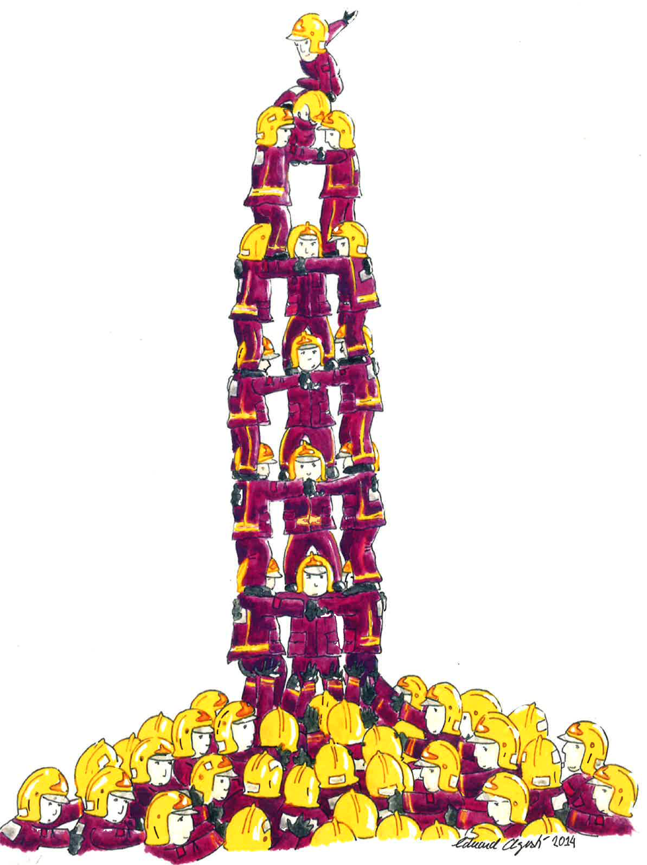
Thanks for your attention!
Success in fire safety
is driven by team work and excellence
in fire education, fire research, fire prevention, fire protection,
fire codes, fire safety engineering, firefighter training, ... and fire operations.

