Slide 2
International Technical Safety Forum ITSF 2019 13th May 2019, European Spallation Source The FIRIA project: an integrated approach to address fire and fire-induced radiological release risks at CERN Giordana Gai, HSE-OHS-IB FSE team on behalf of the FIRIA team
Giordana Gai
EDMS 2149906 v.1

Slide 3
International Technical Safety Forum 2019, Session “Fire Safety” The FIRIA project: an integrated approach to address fire and fire-induced radiological release risks at CERN
Outline
Introduction
Project organization
First FIRIA pilot case
Conclusions
Giordana Gai
EDMS 2149906 v.1

Slide 4
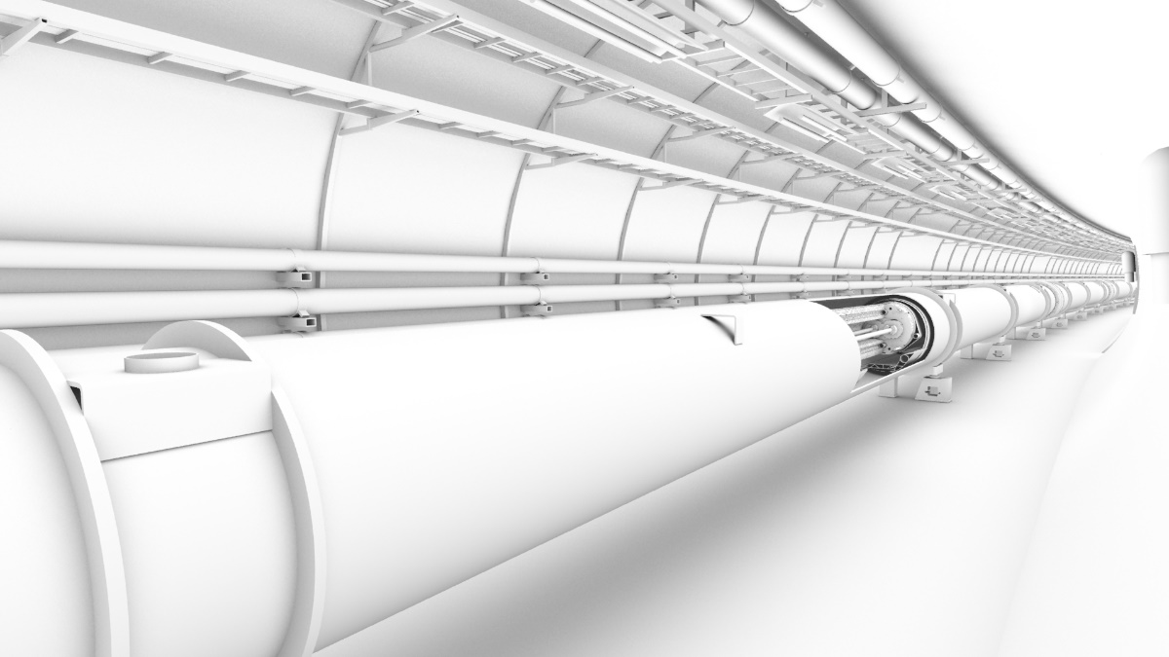
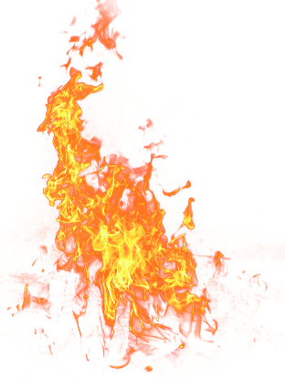
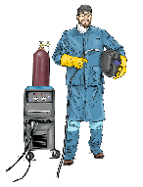
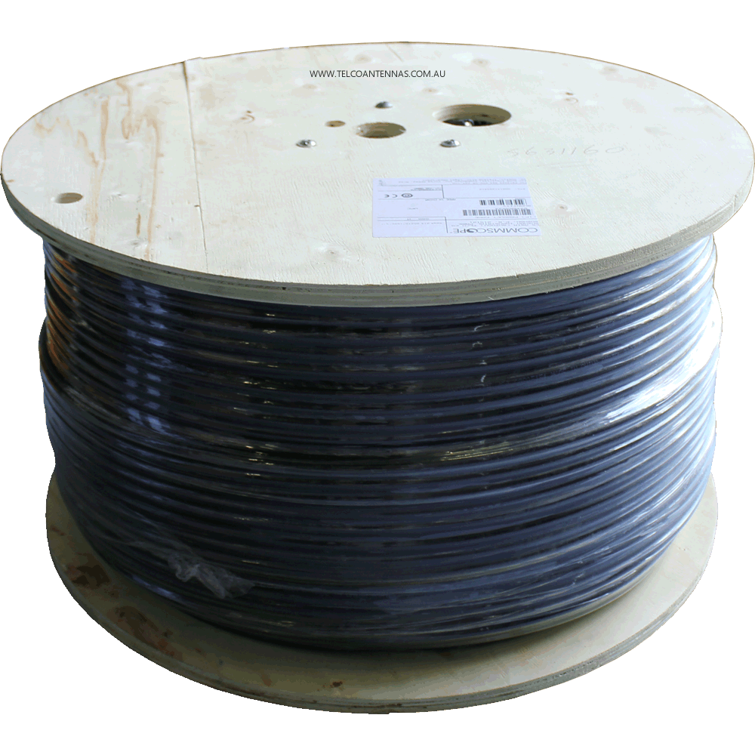
International Technical Safety Forum 2019, Session “Fire Safety” The FIRIA project: an integrated approach to address fire and fire-induced radiological release risks at CERN
Fire Risk Assessment
Exercise to assess the safety outcome in case of fire of a facility with a given fire protection concept.
Life
occupants
victims
first responders
Environment
Property
Continuity of operation
Art Arnalich
Giordana Gai
EDMS 2149906 v.1

Slide 5
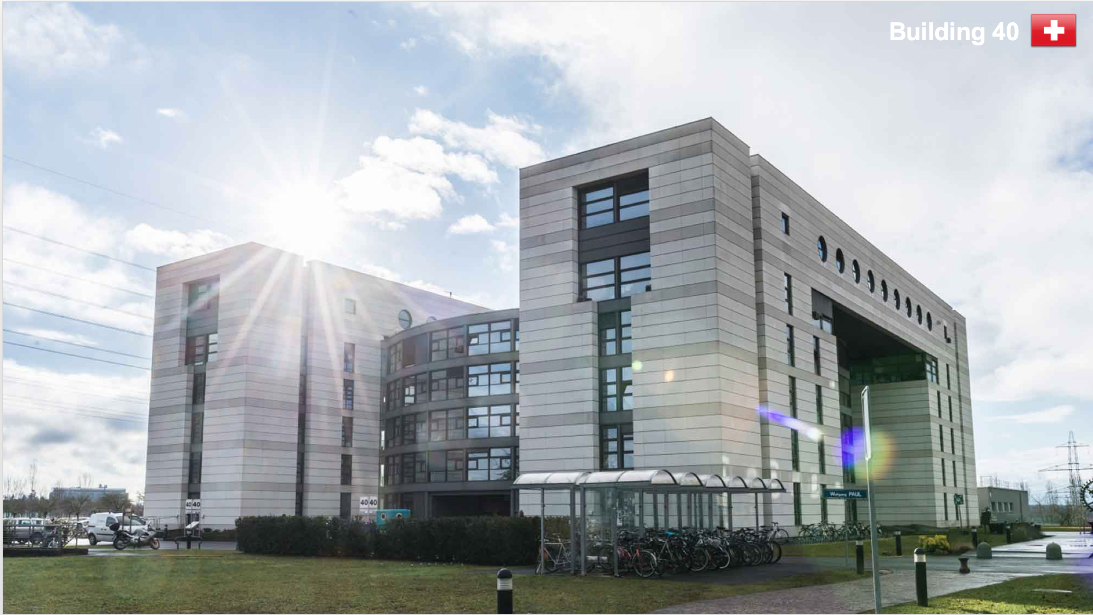
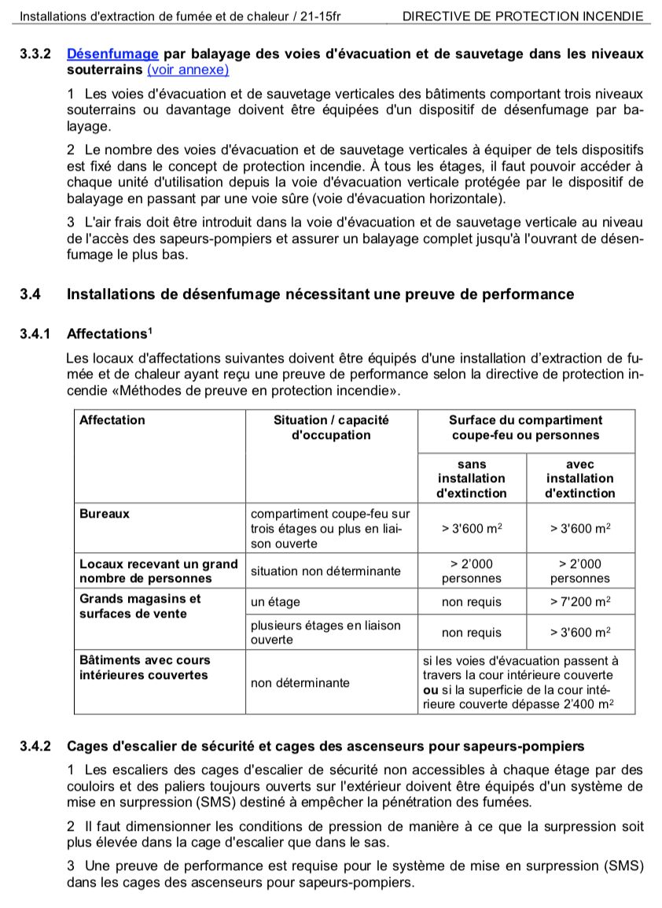
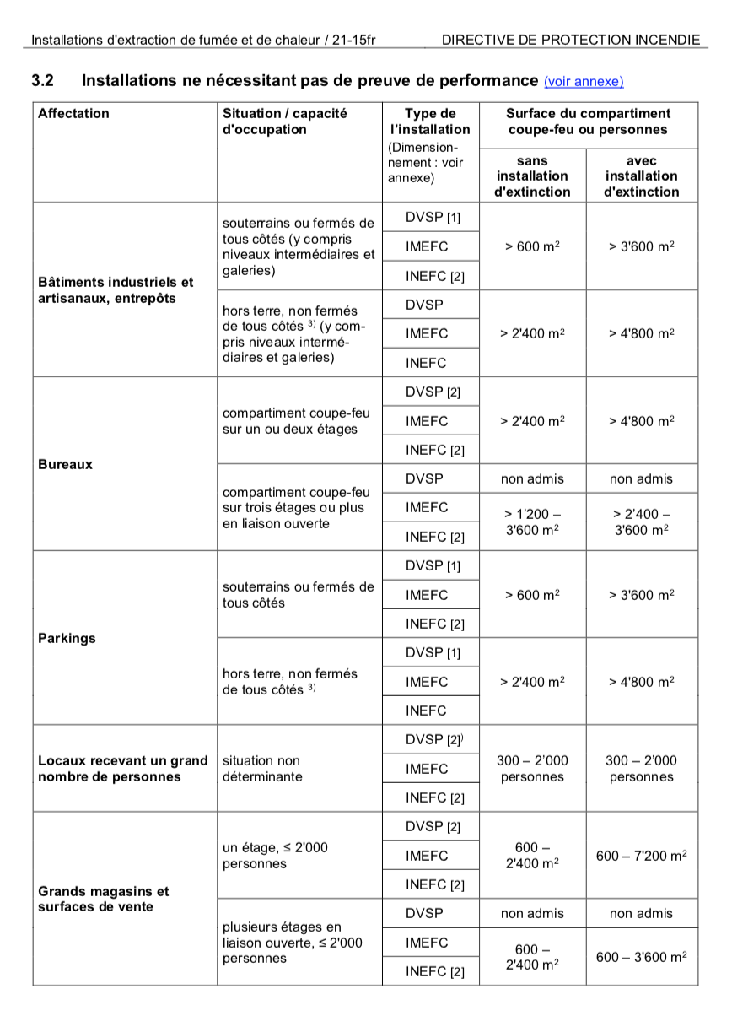
International Technical Safety Forum 2019, Session “Fire Safety” The FIRIA project: an integrated approach to address fire and fire-induced radiological release risks at CERN
Multiple methodology choice:
Code compliance
Prescriptive
Art Arnalich
Giordana Gai
EDMS 2149906 v.1

Slide 6
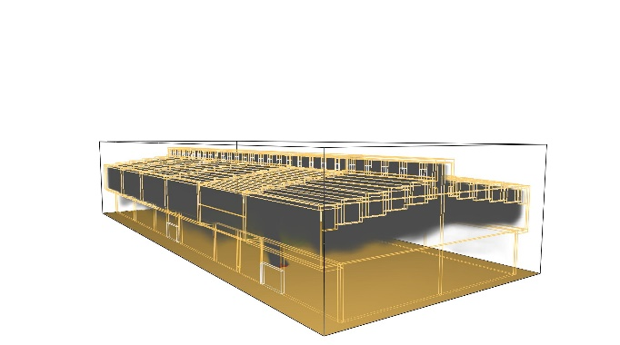
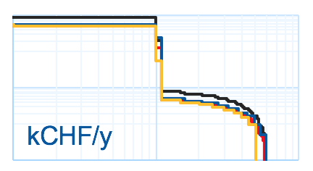
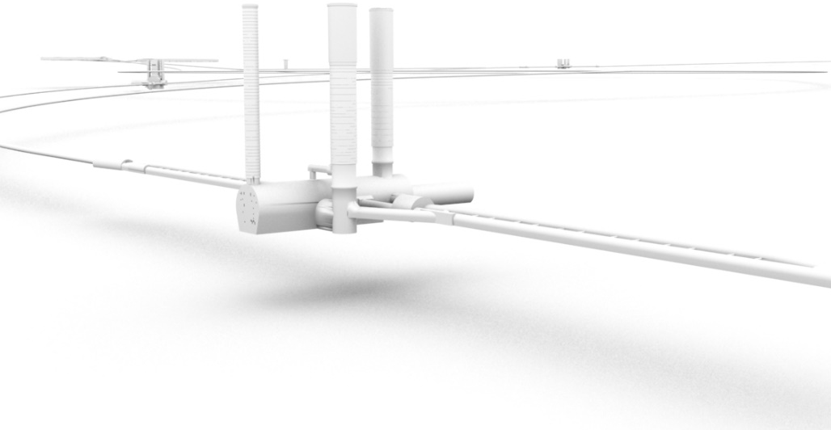
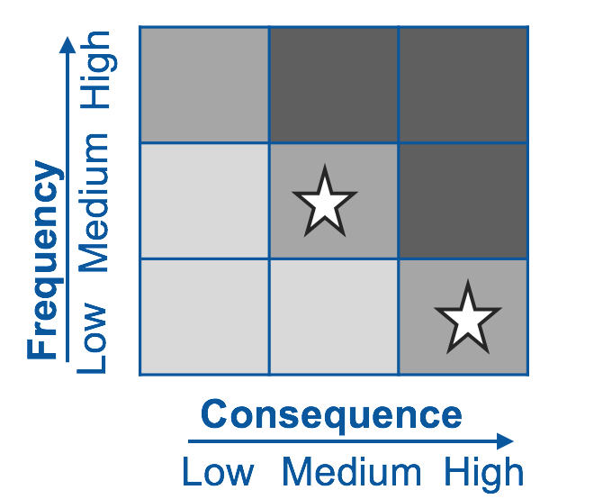
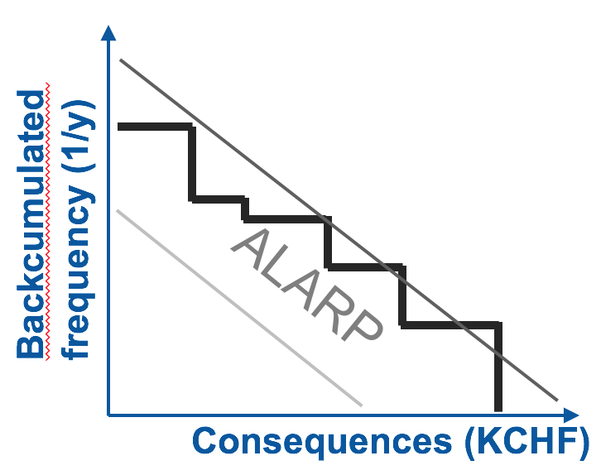
International Technical Safety Forum 2019, Session “Fire Safety” The FIRIA project: an integrated approach to address fire and fire-induced radiological release risks at CERN
Multiple methodology choice:
Risk based
LHCb
Qualitative
Quantitative
Art Arnalich
Giordana Gai
EDMS 2149906 v.1

Slide 7
International Technical Safety Forum 2019, Session “Fire Safety” The FIRIA project: an integrated approach to address fire and fire-induced radiological release risks at CERN
Current limitations
Radiological risk induced by a fire event not encompassed or overestimated
(100% transport assumption)
Fire Service
Public
Environment
?
?
?
Art Arnalich
Giordana Gai
EDMS 2149906 v.1

Slide 8
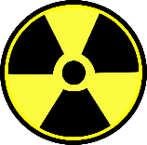
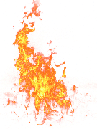
Art Arnalich
Giordana Gai
EDMS 2149906 v.1

Slide 9
?
?
?
Art Arnalich
Giordana Gai
EDMS 2149906 v.1

Slide 10
International Technical Safety Forum 2019, Session “Fire Safety” The FIRIA project: an integrated approach to address fire and fire-induced radiological release risks at CERN
Current limitations
Radiological risk induced by a fire event not encompassed or overestimated
(100% transport assumption)
In addition:
Using a probabilistic approach (risk methodology) instead of a scenario analysis
Including cost benefit analysis in the procedure of risk assessment e.g. when proposing mitigation measures
Giordana Gai
EDMS 2149906 v.1

Slide 11
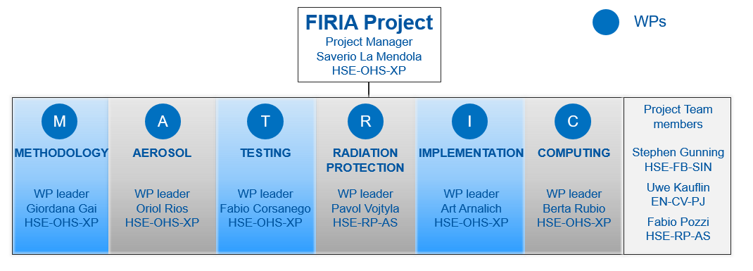
International Technical Safety Forum 2019, Session “Fire Safety” The FIRIA project: an integrated approach to address fire and fire-induced radiological release risks at CERN
Timeline
Jan 2018 → Jun 2021
HSE-OHS-IB
HSE-OHS-IB
HSE-OHS-IB
HSE-OHS-IB
HSE-RP-AS
HSE-OHS-IB
HSE-OHS-IB
10 team members
Cross CERN HSE sinergies (OHS, RP, FB)
Collaboration with CERN CFD team and IT colleagues
Giordana Gai
EDMS 2149906 v.1

Slide 12
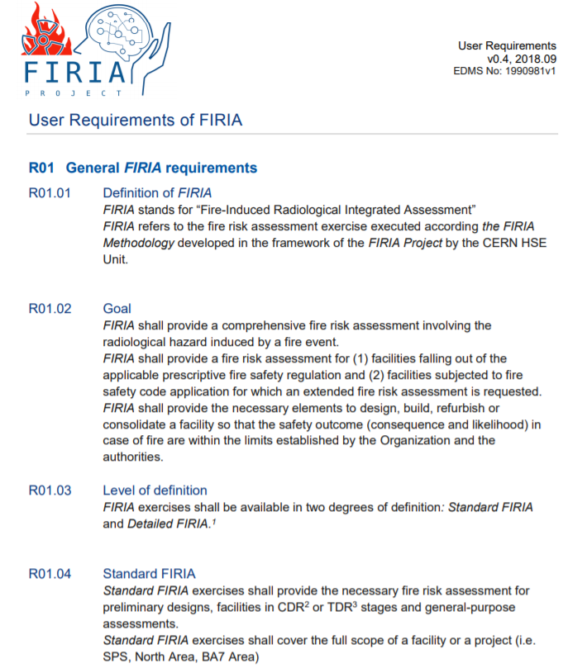
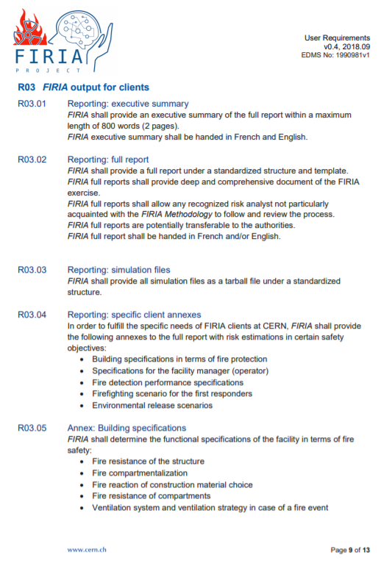
International Technical Safety Forum 2019, Session “Fire Safety” The FIRIA project: an integrated approach to address fire and fire-induced radiological release risks at CERN
WP-I Implementation and Communication
Art Arnalich
Exhange with safety actors and stakeholders at CERN
Feedback was collected and taken into account for the definition of the Users Requirements
List of pilot cases has been proposed and accepted by the project board
Giordana Gai
EDMS 2149906 v.1

Slide 13
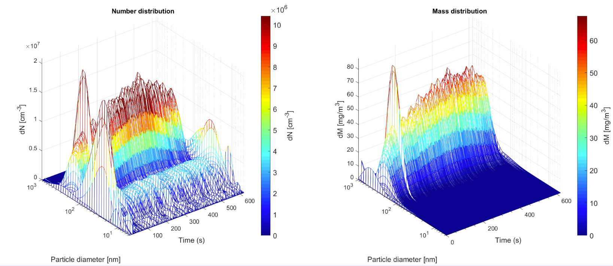
International Technical Safety Forum 2019, Session “Fire Safety” The FIRIA project: an integrated approach to address fire and fire-induced radiological release risks at CERN
WP-A Aerosol
Oriol Rios
WP-T Testing
Fabio Corsanego
A number of combustible items were tested at the Fire and Aerosol laboratories of Lund University
More appropriate design fires (HRR, soot yield)
Number and mass distribution of the soot
Aerosol deposition modelling in FDS (NIST & Jensen Hughes)
Giordana Gai
EDMS 2149906 v.1

Slide 14
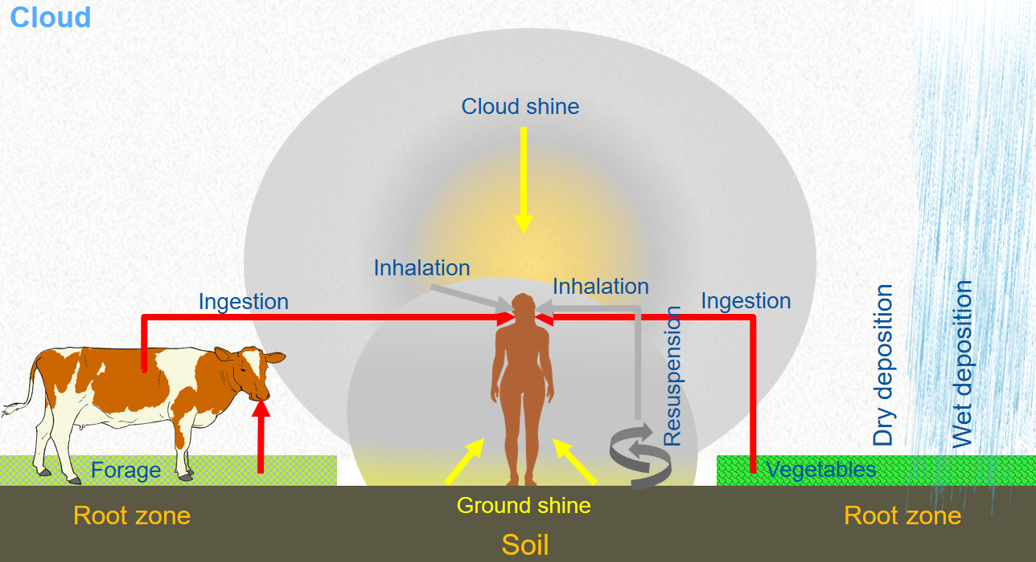
International Technical Safety Forum 2019, Session “Fire Safety” The FIRIA project: an integrated approach to address fire and fire-induced radiological release risks at CERN
Three main activities:
Activity level inside the facility (FLUKA calculations)
Outdoor dispersion and deposition modelling
Dose calculation to the public and environmental assessment
WP-R Radiation Protection
Pavol Vojtyla
Sameh Melhelm
Uwe Kauflin
Fabio Pozzi
Giordana Gai
EDMS 2149906 v.1

Slide 15
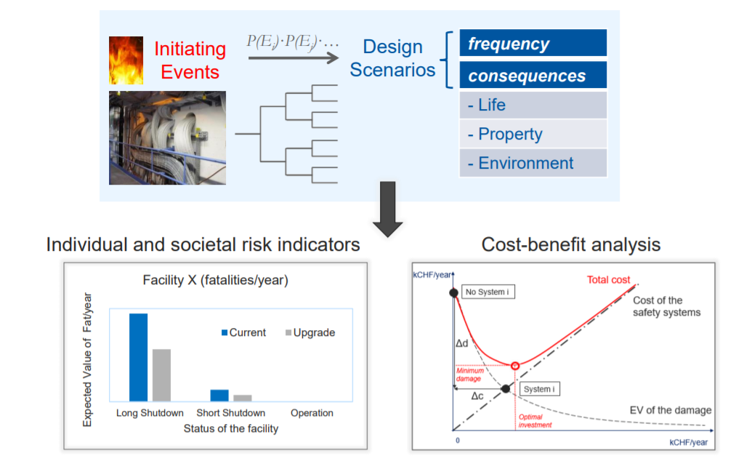
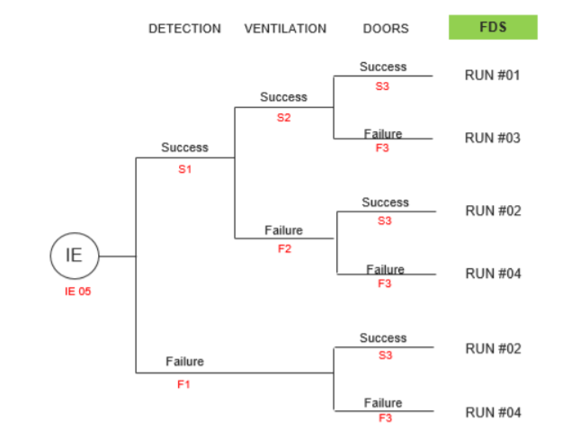
International Technical Safety Forum 2019, Session “Fire Safety” The FIRIA project: an integrated approach to address fire and fire-induced radiological release risks at CERN
WP-M Methodology
Giordana Gai
Development of a probabilistic framework of risk assessment wrt life safety, property protection and enviroment
Frequency analysis
Consequence analysis
Cost benefit analysis
Supervision of
H. Frantzich and E. Ronchi
Giordana Gai
EDMS 2149906 v.1

Slide 16
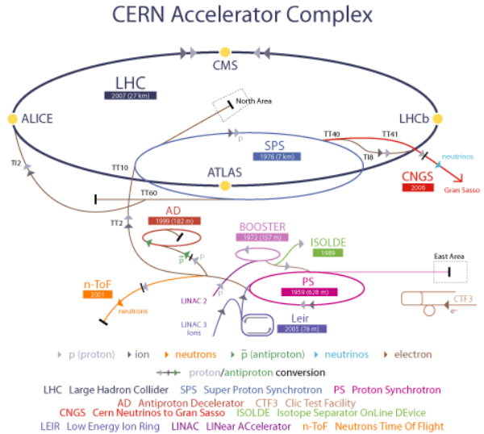
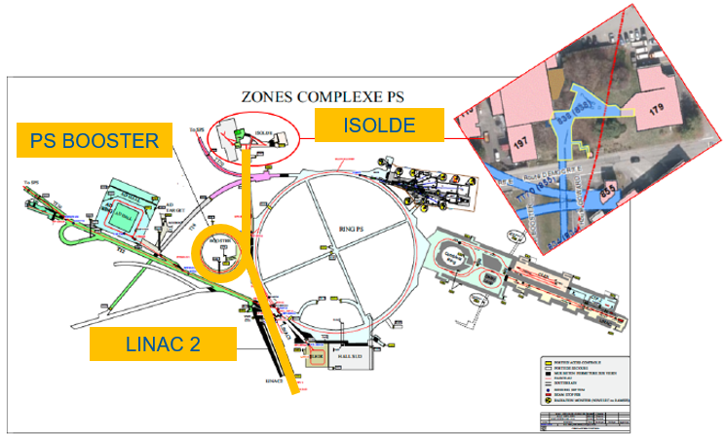
International Technical Safety Forum 2019, Session “Fire Safety” The FIRIA project: an integrated approach to address fire and fire-induced radiological release risks at CERN
ISOLDE: Isotope Separator On Line DEtector
Ongoing analysis of the first FIRIA pilot case
Giordana Gai
EDMS 2149906 v.1

Slide 17
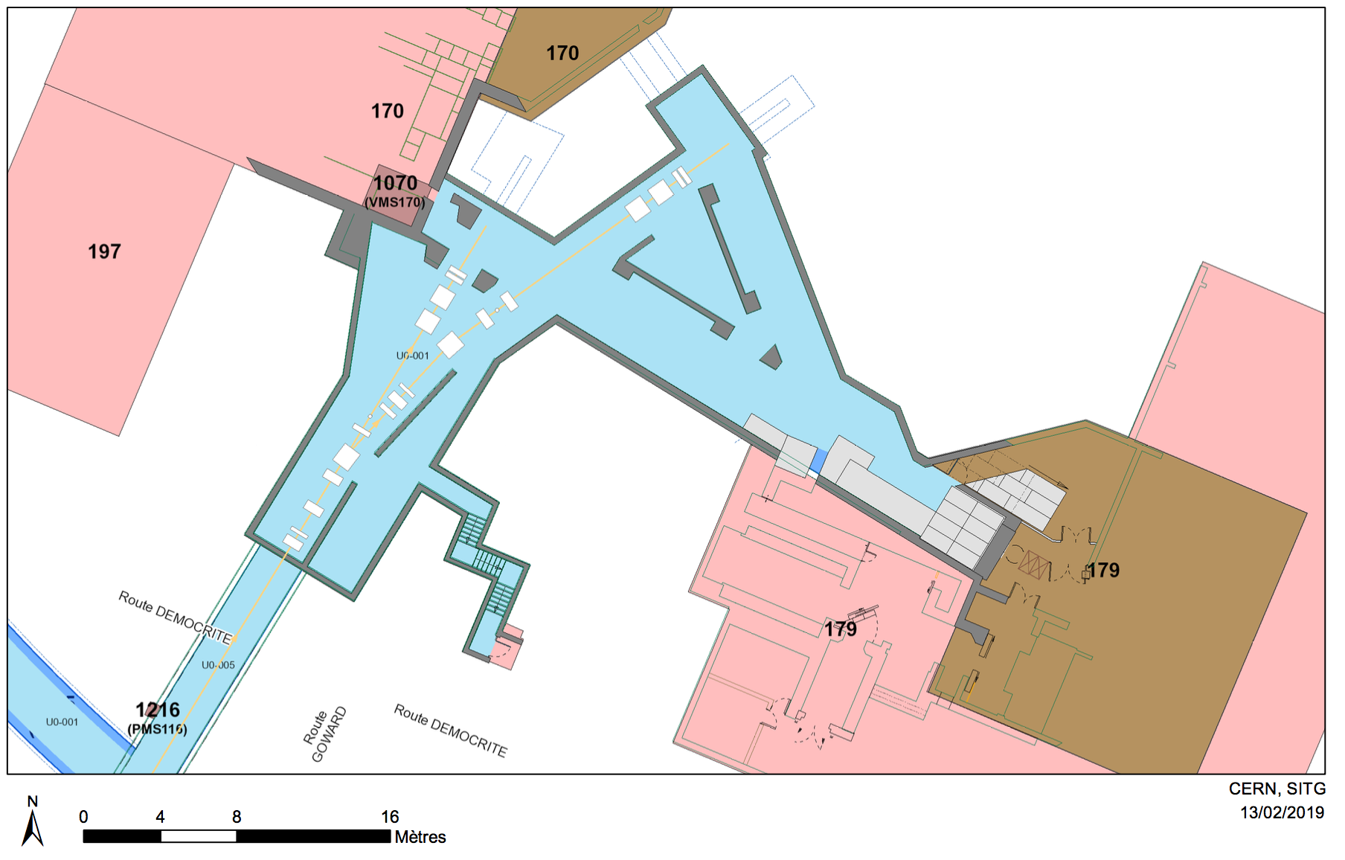
International Technical Safety Forum 2019, Session “Fire Safety” The FIRIA project: an integrated approach to address fire and fire-induced radiological release risks at CERN
ISOLDE: Isotope Separator On Line DEtector
ISOLDE
target area
838
355m²
1065m³
BTY line
834
40m
Giordana Gai
EDMS 2149906 v.1

Slide 18
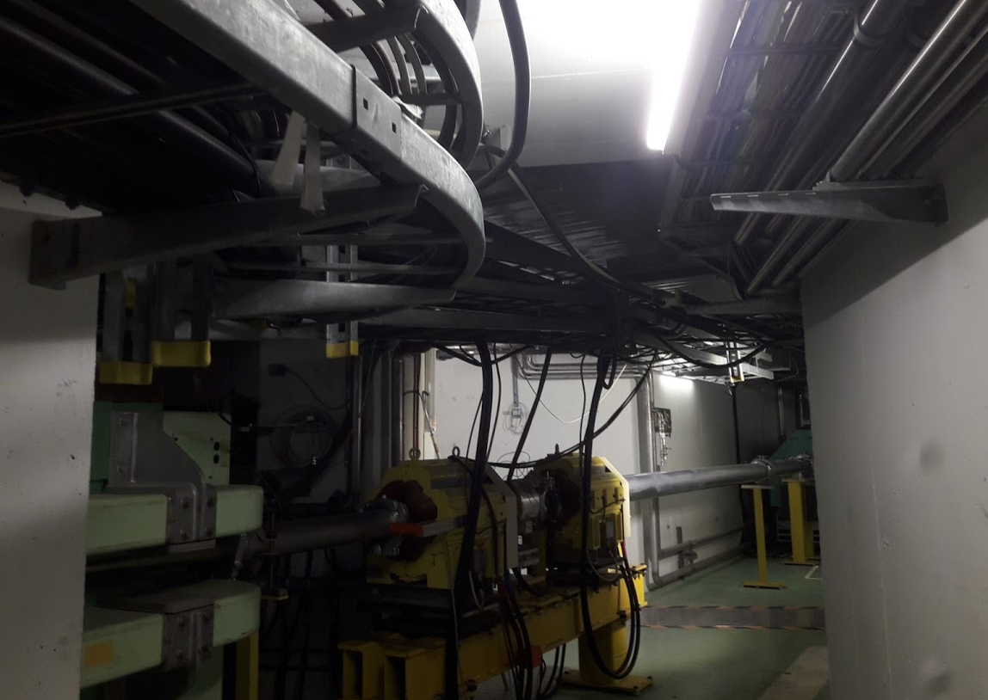
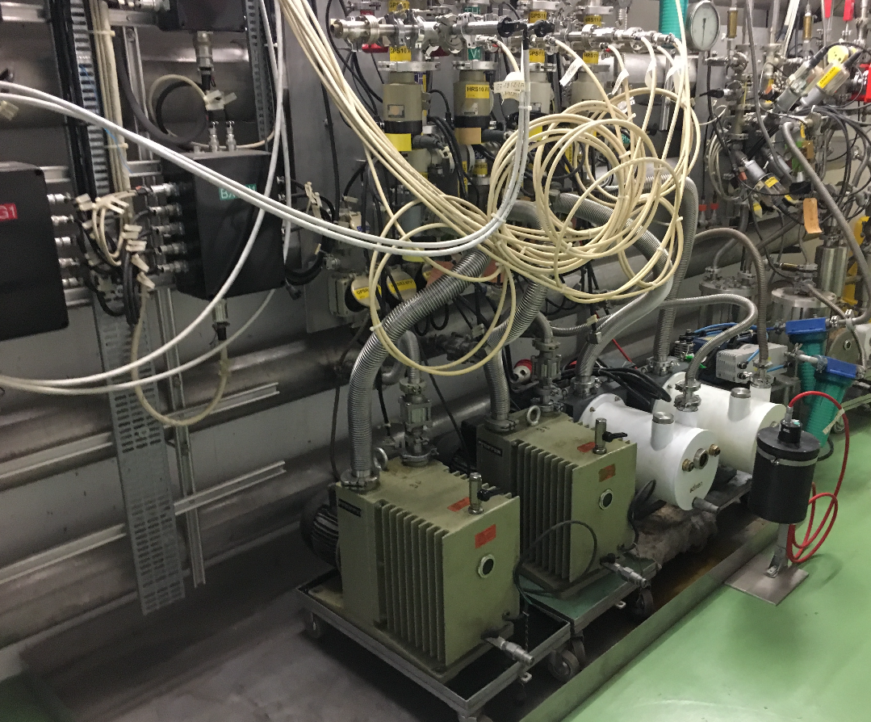
International Technical Safety Forum 2019, Session “Fire Safety” The FIRIA project: an integrated approach to address fire and fire-induced radiological release risks at CERN
Hazard identification
Beamline (magnets, cable trays)
Vacuum pump
Giordana Gai
EDMS 2149906 v.1

Slide 19
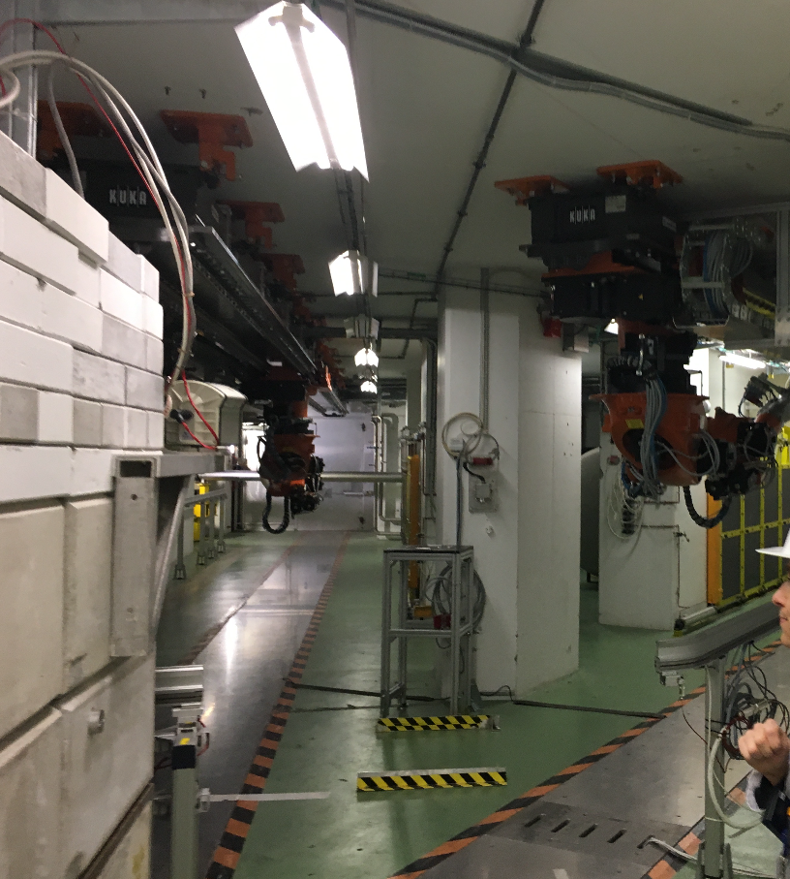
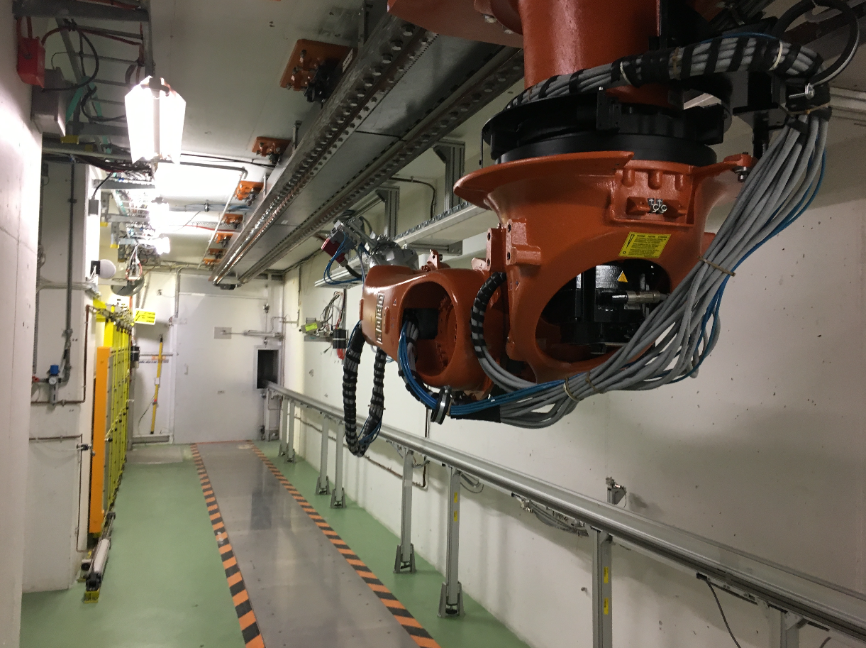
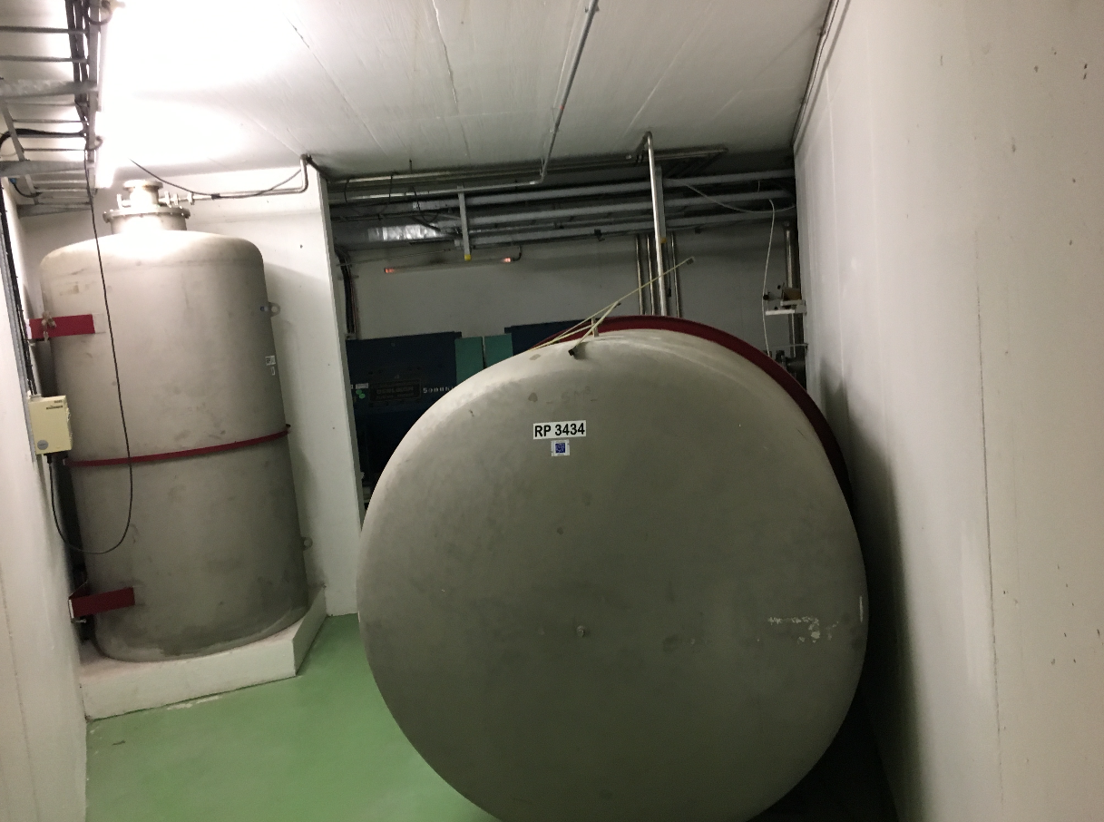
International Technical Safety Forum 2019, Session “Fire Safety” The FIRIA project: an integrated approach to address fire and fire-induced radiological release risks at CERN
Hazard identification
Target storage
Two robots
Tanks
Tanks
Giordana Gai
EDMS 2149906 v.1

Slide 20
International Technical Safety Forum 2019, Session “Fire Safety” The FIRIA project: an integrated approach to address fire and fire-induced radiological release risks at CERN
Selection of representative design fire scenarios
Three main scenarios have been identified and will be analysed under different conditions i.e. considering the failure on demand of fire safety systems
Total: 12 runs of FDS
Oil + cable tray fire
Cable tray fire
Robot fire
Giordana Gai
EDMS 2149906 v.1

Slide 21
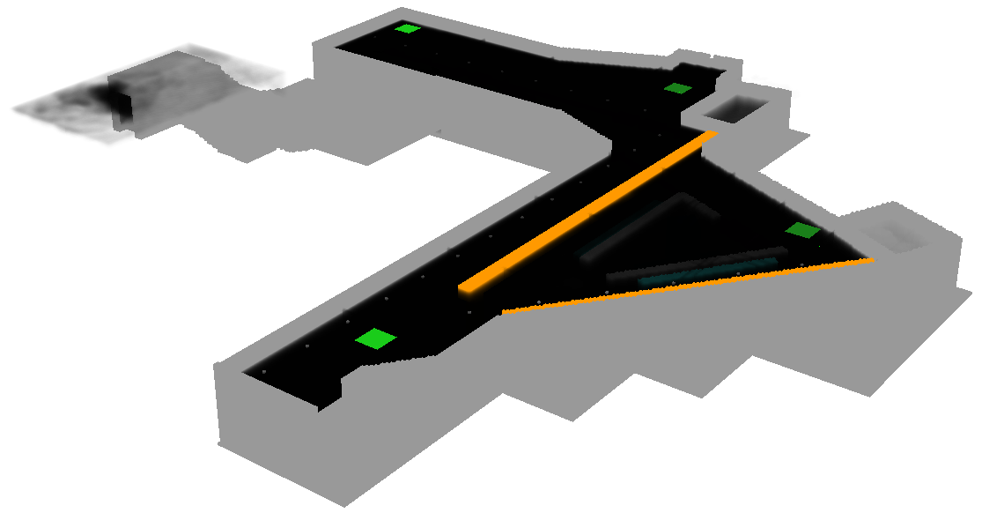
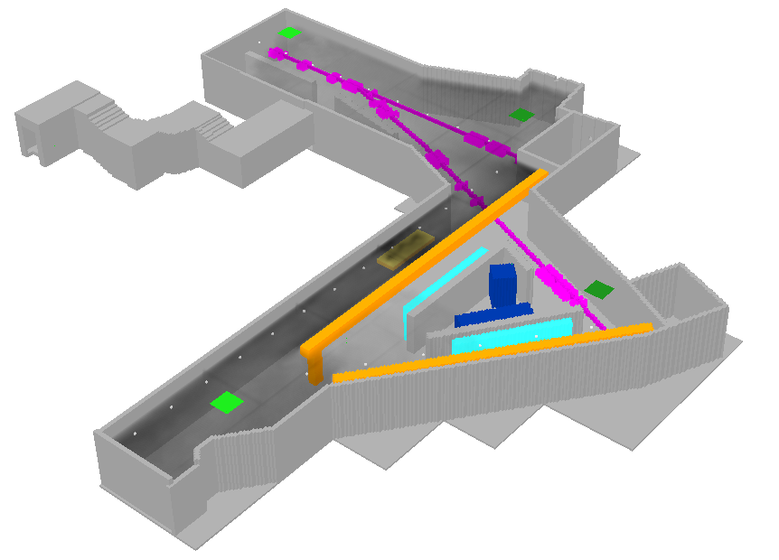
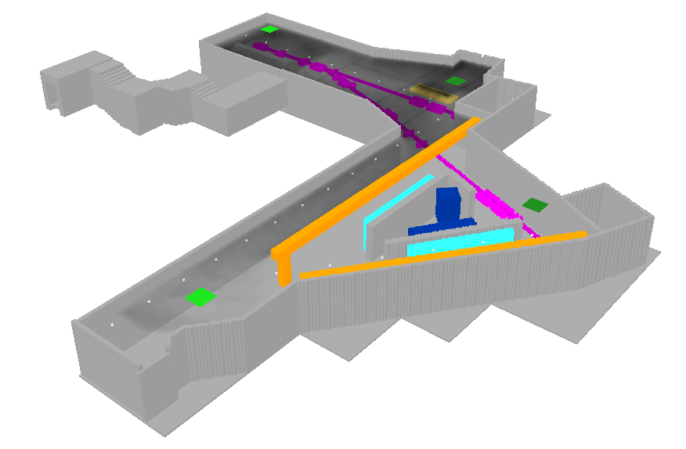
International Technical Safety Forum 2019, Session “Fire Safety” The FIRIA project: an integrated approach to address fire and fire-induced radiological release risks at CERN
Oil + cable tray fire (run 03)
Screenshot at t = 4 min
Smoke propagation in the facility under failure of the closing device of the doors
Cable tray fire (run 07)
Robot fire (run 11)
Giordana Gai
EDMS 2149906 v.1

Slide 22
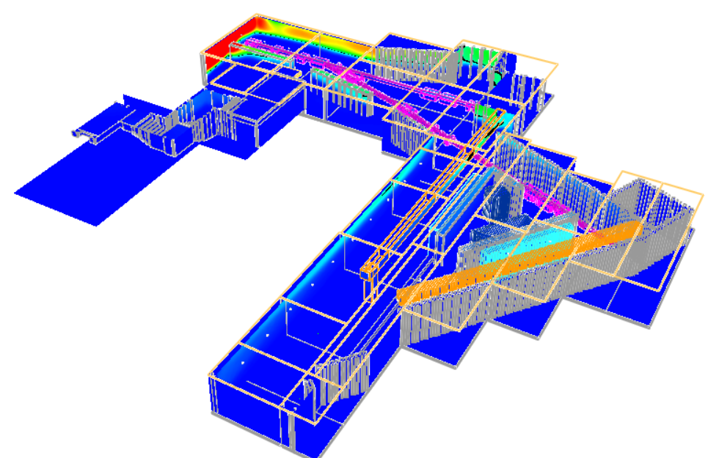
International Technical Safety Forum 2019, Session “Fire Safety” The FIRIA project: an integrated approach to address fire and fire-induced radiological release risks at CERN
Indoor modelling
Life safety of occupants
Property protection
Fire Brigade intervention
Screenshot at t = 4 min
Soot deposition in the facility under failure of the closing device of the doors
Giordana Gai
EDMS 2149906 v.1

Slide 23
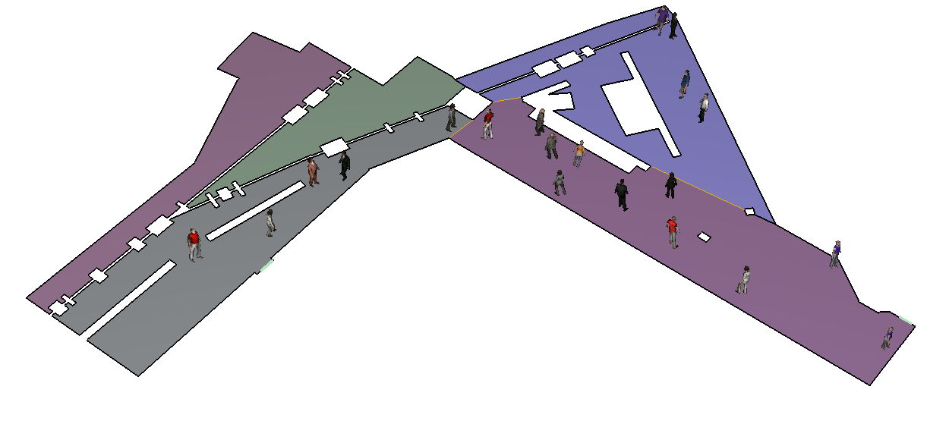
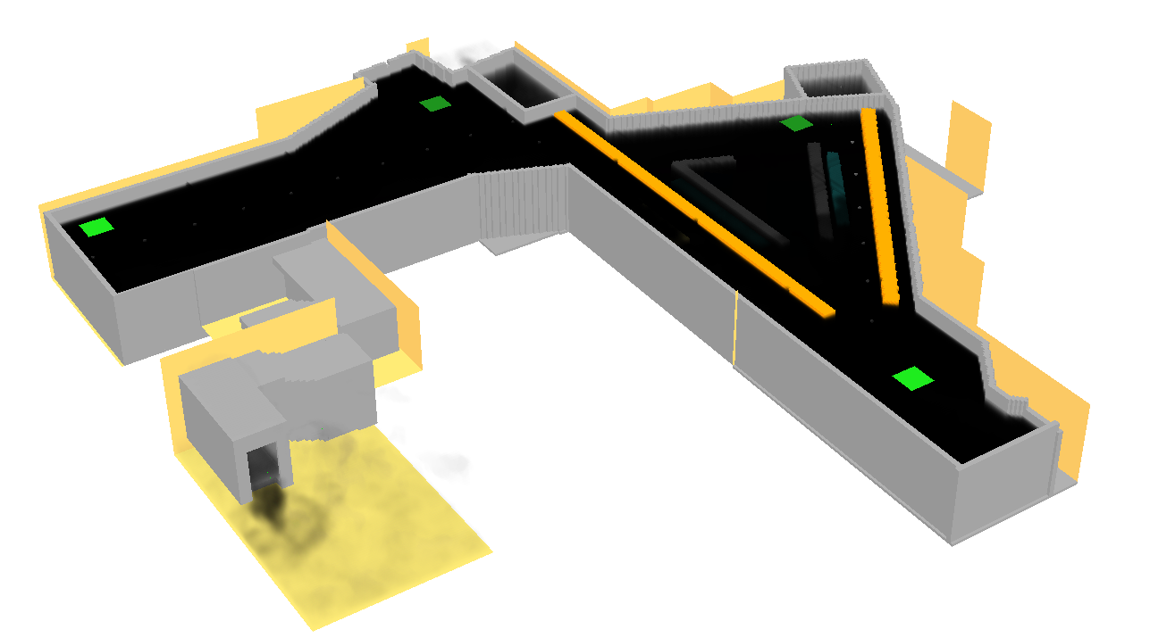
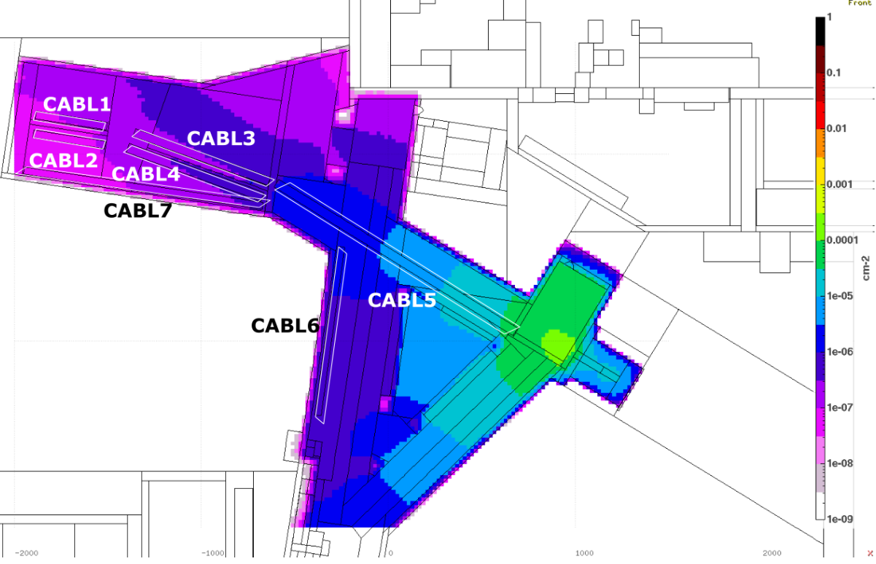
International Technical Safety Forum 2019, Session “Fire Safety” The FIRIA project: an integrated approach to address fire and fire-induced radiological release risks at CERN
Indoor modelling
Life safety of occupants
Property protection
Fire Brigade intervention
Smoke release to the environment
(less than the initial assumption of 100 % transport!)
Giordana Gai
EDMS 2149906 v.1

Slide 24
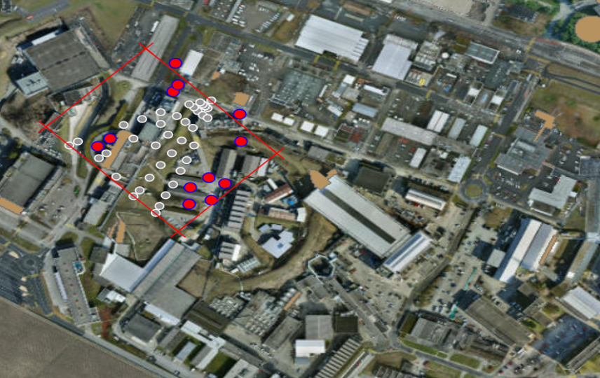
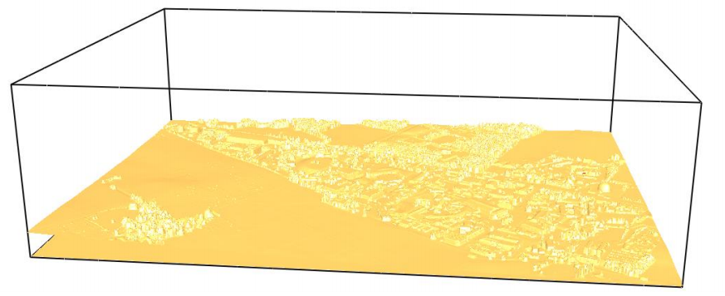
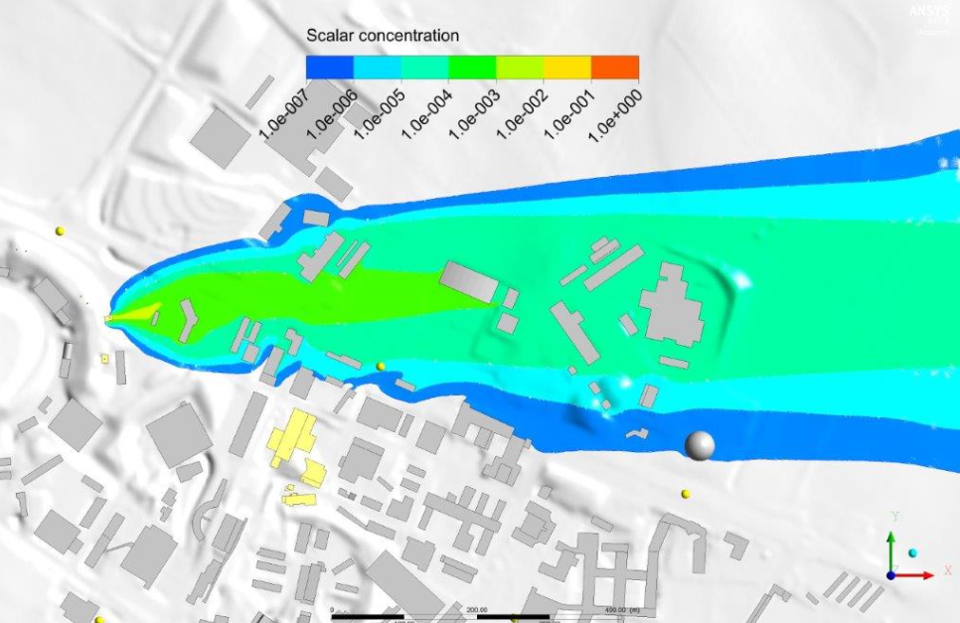
International Technical Safety Forum 2019, Session “Fire Safety” The FIRIA project: an integrated approach to address fire and fire-induced radiological release risks at CERN
Outdoor modelling
Environmental dispersion
Dose calculation
Giordana Gai
EDMS 2149906 v.1

Slide 25
Conclusions
International Technical Safety Forum 2019, Session “Fire Safety” The FIRIA project: an integrated approach to address fire and fire-induced radiological release risks at CERN
A number of international collaborations have been set up:
FCC fire safety study collaboration → FIRIA collaboration
Lund University
Methodology development
Testing campaign of combustible items
Italian Fire Services
Meyrin geometrical model in FDS
NIST
New features implemented in FDS driven by FIRIA needs
Investing in an experimental campaign to further validate the deposition model
Giordana Gai
EDMS 2149906 v.1

Slide 26
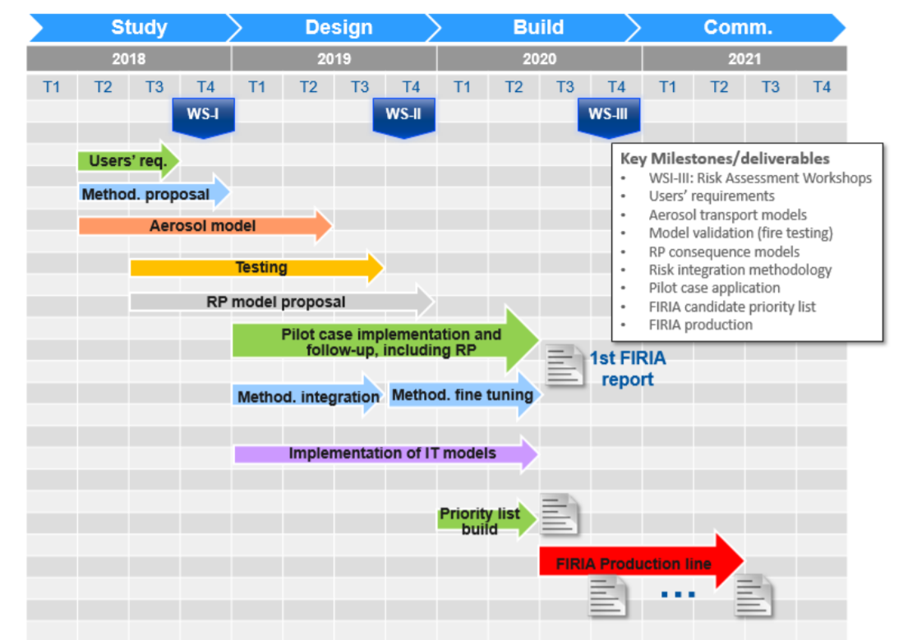
International Technical Safety Forum 2019, Session “Fire Safety” The FIRIA project: an integrated approach to address fire and fire-induced radiological release risks at CERN
Conclusions
Jul 2019: assessment of the ISOLDE target area (pilot case 1) will be presented to the project board
Dec 2019: assessment of pilot cases 2 and 3
----- LESSON LEARNT -----
Jun 2020: Refinement of the methodology based on CERN needs
From Jun 2020 on: FIRIA Production line is established
Giordana Gai
EDMS 2149906 v.1

