Slide 2
Conformity Approach for Pressure Equipment for the High Luminosity LHC Project - an update
Simon Marsh, Carlos Arregui, Owain Williams
CERN (HSE-OHS-PE)

Slide 3
CERN Mechanical Safety Rules
In accordance with its intergovernmental status, CERN establishes and updates Safety Rules to implement its Safety Policy
In the June 2015 refresh of the CERN mechanical safety rules, General Safety Instructions GSI-M-2 Standard Pressure Equipment and GSI-M-4 Cryogenic Equipment came into force, together with a number of associated Specific Safety Instructions
Available on the CERN Safety Rules website: www.cern.ch/safety-rules

Slide 4
CERN Mechanical Safety Rules
Defines the minimum safety requirements related to the life cycle of pressure equipment
  Cradle to grave approach for pressure equipment integrity management
Valid for all new equipment and equipment brought onto the CERN site from elsewhere
Defines and requires an equipment “Safety File”
Aligned, as far as possible, to existing standards

Slide 5
CERN Mechanical Safety Rules
Design, manufacture and procurement
  Primarily based on European Directives for pressure equipment and transportable pressure equipment
  Use of harmonised European standards
    Use of other technical standards is subject to approval by HSE Unit
  CE marking
  Declaration of conformity
  Factory acceptance tests, where applicable
  Instruction manual

Slide 6
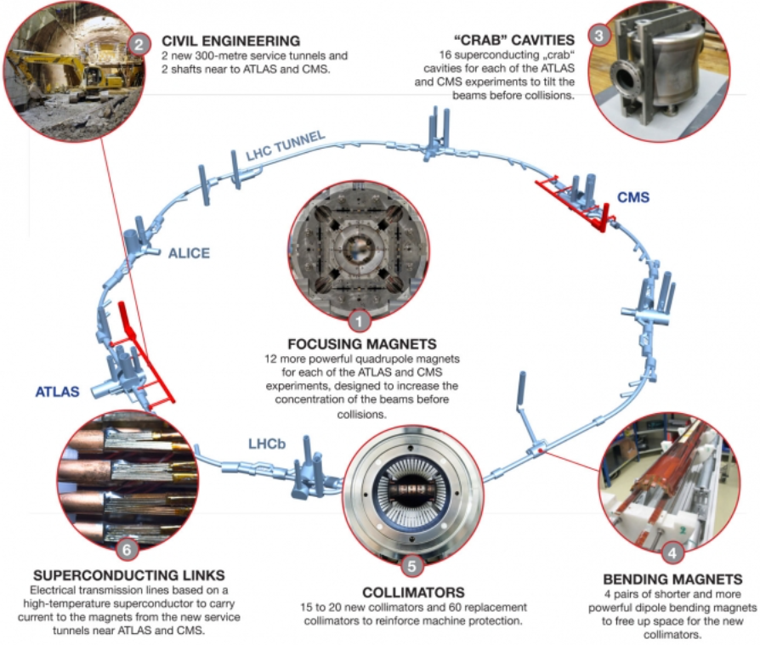
From LHC to HL-LHC

Slide 7
Safety assessments for HL-LHC equipment
There will be a presentation on this later on this week

Slide 8
Application of CERN Mechanical Safety Rules – High Luminosity LHC Project
Baseline approach for pressure equipment
  Design, manufacturing and testing as per EN harmonised standards
  Compliance with Pressure Equipment Directive (PED) 2014/68/EU
  CE marking

Slide 9
Application of CERN Mechanical Safety Rules – High Luminosity LHC Project
Exceptions to the baseline approach:
  Equipment that does not readily fit into the context of European harmonised standards (e.g. due to equipment type, materials, area of application, etc.)
  Only allowed at the discretion of the HSE Unit, preceded by a formal documented request by the Project
  Foreseen by the rules – automatically defines equipment as liable to have ‘major Safety implications’
  mSi equipment requires Safety clearance from the HSE Unit
  HSE Unit defines the Safety requirements that need to be met for the Safety clearance
  HSE Unit performs the conformity assessment, for all equipment categories

Slide 10
Conformity assessment by HSE
Requirements for HSE Safety clearance:
  Full compliance with the applicable Essential Safety Requirements (ESRs) in the PED
  Use of harmonised European standards wherever applicable (presumption of conformity) for design, manufacturing and testing, e.g.
    EN 13445 – Unfired pressure vessels;
    EN 13458 – Cryogenic vessels – static vacuum-insulated vessels;
    EN 10028 – Flat products made of steels for pressure purposes;
    …
  Other (inter)national standards may be used provided compliance with the ESRs is fully demonstrated
  Eventual non-compliances to be assessed individually. The Project shall propose compensatory measures to ensure a commensurate level of Safety
  Assessment of conformity to the ESRs is carried out by the HSE Unit acting as an ‘independent’ party

Slide 11
Conformity assessment by HSE
Provided Safety requirements are met and Safety clearance is achieved, CE marking is not compulsory as per the Safety Rules
HSE acts as de facto Notified body for equipment falling under a PED Category that would have normally required Notified body involvement
  Involvement of external Notified body therefore is not required
Safety accessories (e.g. relief valves, rupture discs) have to be, however, fully compliant with the Pressure Equipment Directive and harmonised standards

Slide 12
Conformity assessment by HSE
After significant discussion on the approach between safety and quality actors, a direct pursuit of the specific conformity assessment modules (as per the PED) was not deemed fully fit-for-purpose for the equipment types, quantities involved and contracting strategies
Instead, a listing of all the expected documents, verifications, validations, and physical tests to be witnessed has recently been developed showing the ‘who does what’ and against which standard(s) those items are evaluated against
  This appears to provide more clarity and transparency on the expectations of all parties

Slide 13
Conformity assessment by HSE
Design assurance
  HSE Unit will validate the design of the pressure equipment prior to the commencement of fabrication
  Manufacturer must produce technical documentation as to enable an assessment of the conformity of the equipment with the ESRs
Fabrication assurance
  HSE Unit and Project to agree on the Inspection and Test Plan, including Safety-relevant Hold Points
  Manufacturer to provide quality records for the manufacturing part of the QA system, such as inspection reports and test data, qualifications of personnel concerned, etc.
  Documentation to ensure full traceability of components and processes
  Witnessing of key steps, especially for ‘first-of-a-kind’ activities
  Final (re-)testing at CERN of some equipment, prior to installation in the LHC tunnel

