Slide 2
An overview of CERN HSE in-house developed software tools for Safety
Gustavo Segura
on behalf of the HSE-CEN-CO team

Slide 3
An overview of CERN HSE in-house developed software tools for Safety
HSE-CEN-CO Team
Databases and Web applications for HSE
SAILOR – Safety Inspections tool(s)
TSA - Tendering Support
RAISIN – Radiation Risk Areas Inventory
CERES – Chemical safety register
Personal Dosimetry
Supervision, Control and Data Acquisition systems
REMUS – Radiation an Environment Monitoring Unified Supervision
Future developments

Slide 4
HSE-CEN-CO Team
HSE-CEN-CO, HSE Computing Support
We are responsible for the development and support of a wide set of software tools for safety management at CERN
Two domains of expertise:
Databases and Web-applications supporting the HSE Unit activities
SCADA - Supervision, Control and Data Acquisition systems for Radiation Protection and Environment Protection
The 1st question: Commercial software or in-house development ?

Slide 5
SAILOR – Safety Inspections

Slide 6
SAILOR – Safety Inspections
Plan
Inspect
Write report and Notify
Resolution
Reporting & Analysis
SAILOR is a Safety Inspections Management System, i.e. a software where
Safety Inspectors register safety and environment issues - (what, where, urgency, responsibility, etc.)
Designated resolvers are requested to take Action in order to control /reduce/ suppress the risks record their progress.
Safety Managers (i.e.: HSE, Safety Officers, Department Leaders, Group Leaders, etc.) can follow-up the resolution of the issues.
General inspections – (2582 “buildings”) | Sep - 2014
Lifting equipment - (4947 pieces of equip) | Oct - 2018
Electrical installations | future project
Pressure equipment | …
Machine tools | …
General Inspections – until May 2019
Inspections | 2.840
Actions | 19.650
Lifting Inspections – until May 2019
Inspections | 1841
Actions | 358

Slide 7
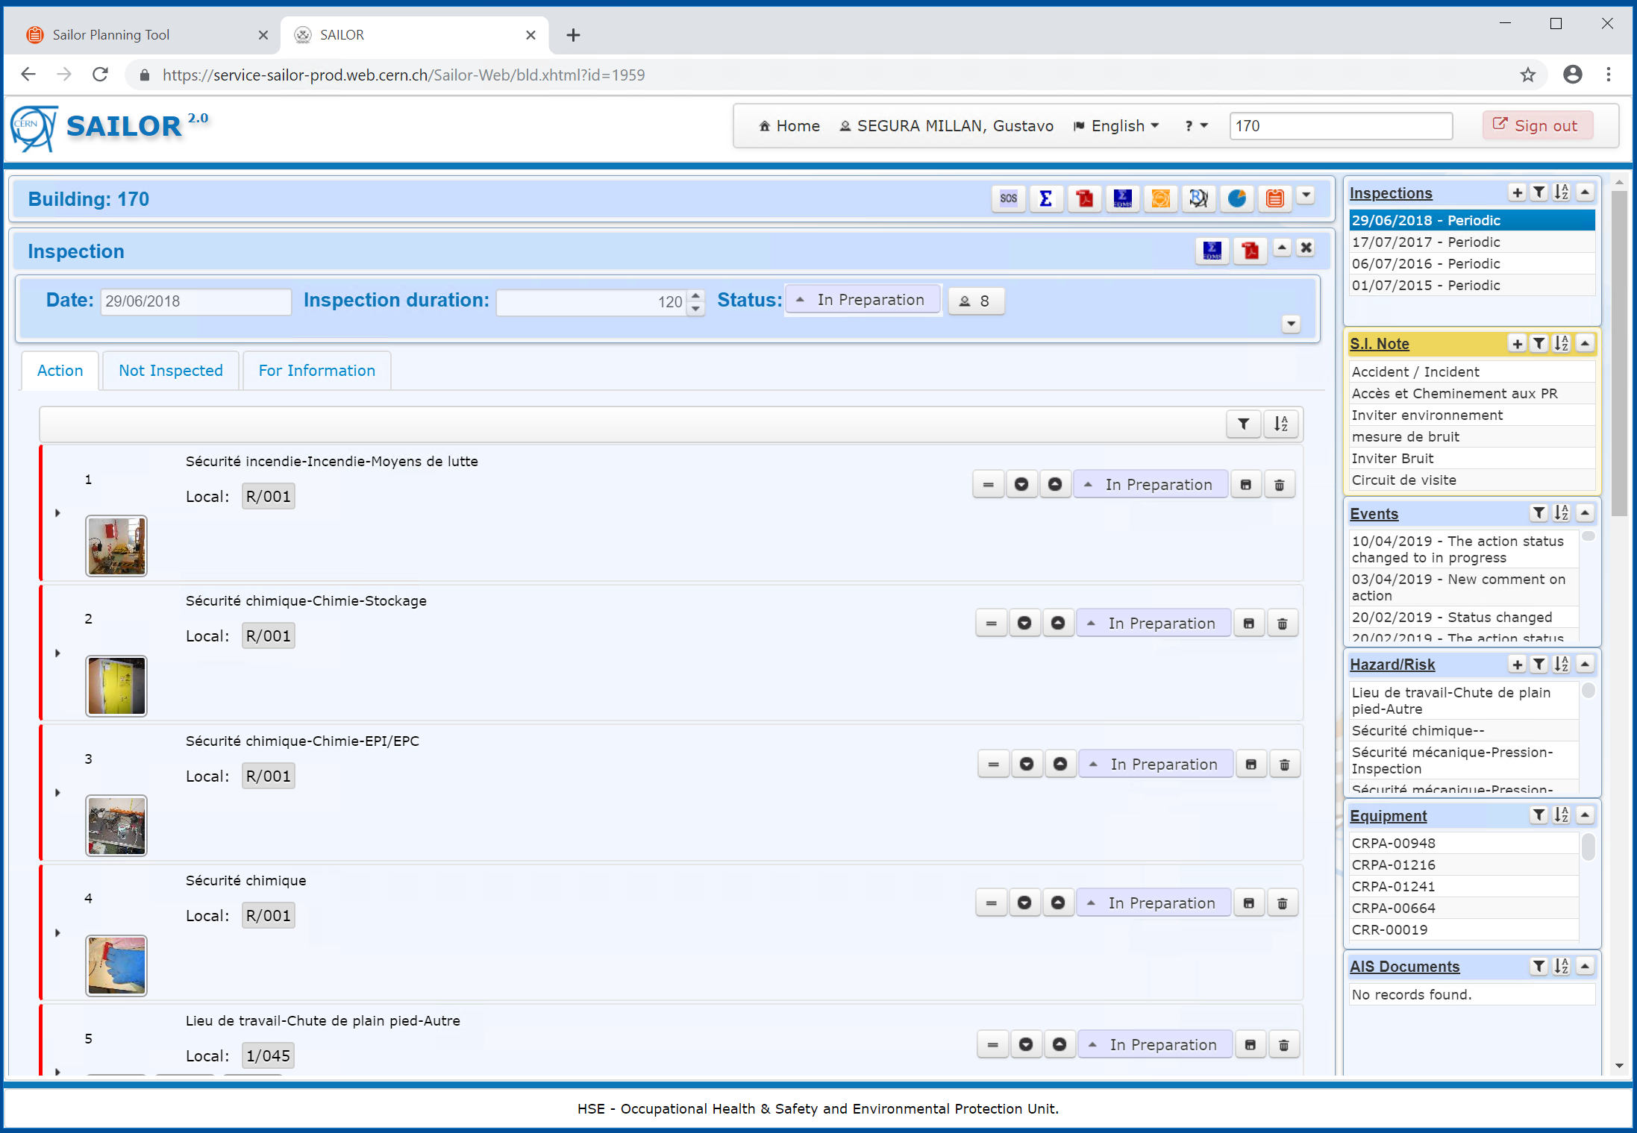
SAILOR – GENERAL Safety Inspections – Writing and Notif. phase
GENERAL
Inspections
Plan
Inspect
Write report and Notify
Resolution
Reporting & Analysis

Slide 8
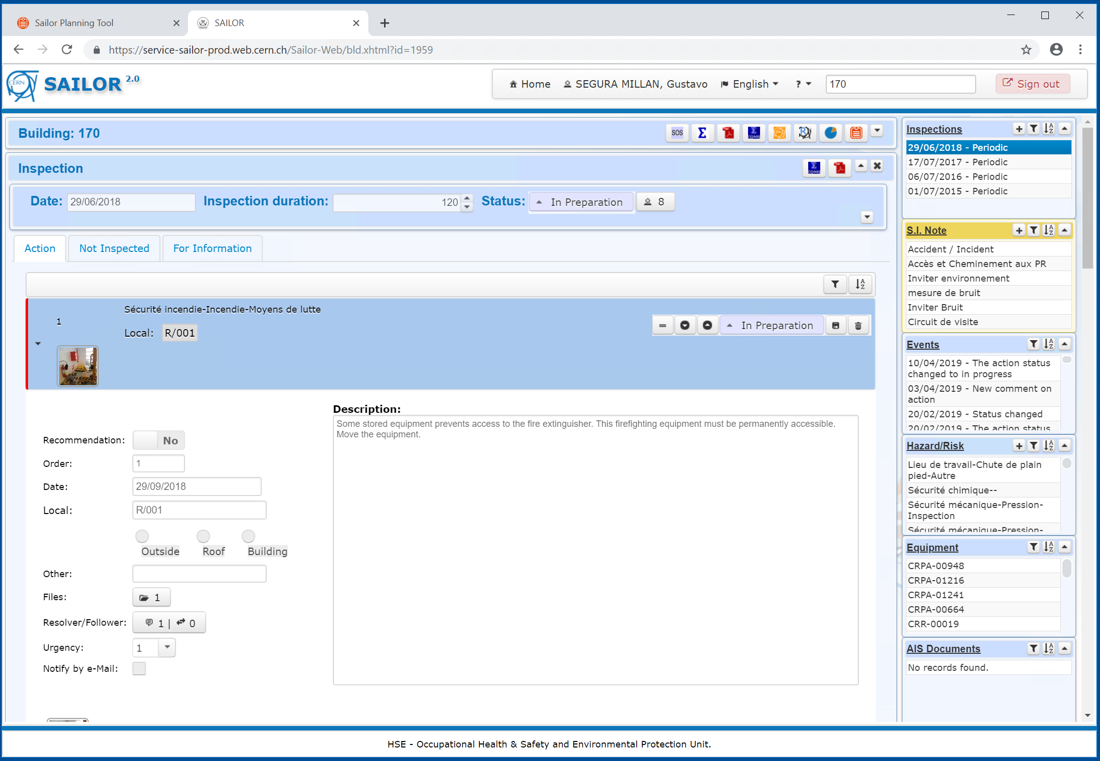
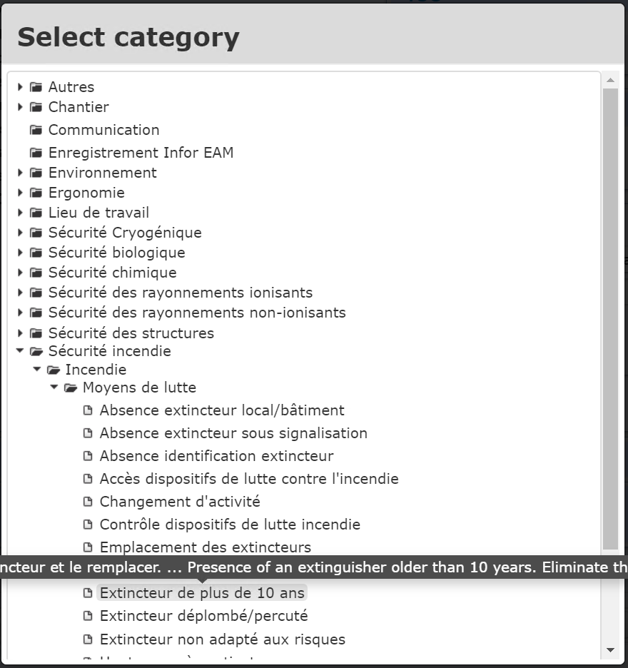
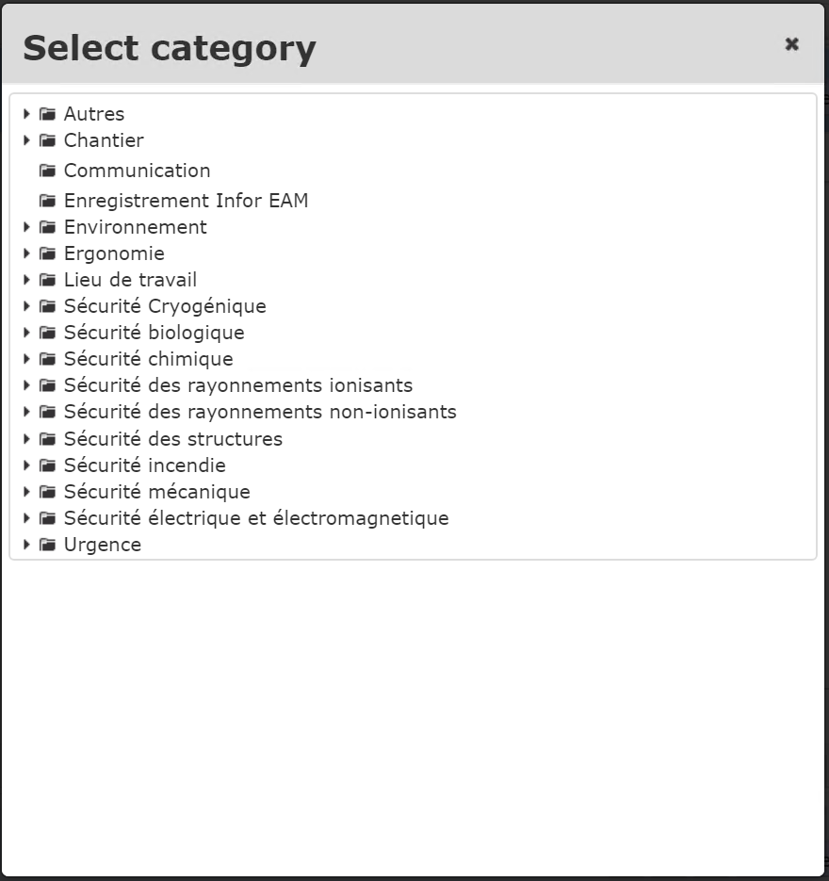
SAILOR – GENERAL Safety Inspections – Writing and Notif. phase
GENERAL
Inspections
Plan
Inspect
Write report and Notify
Resolution
Reporting & Analysis

Slide 9
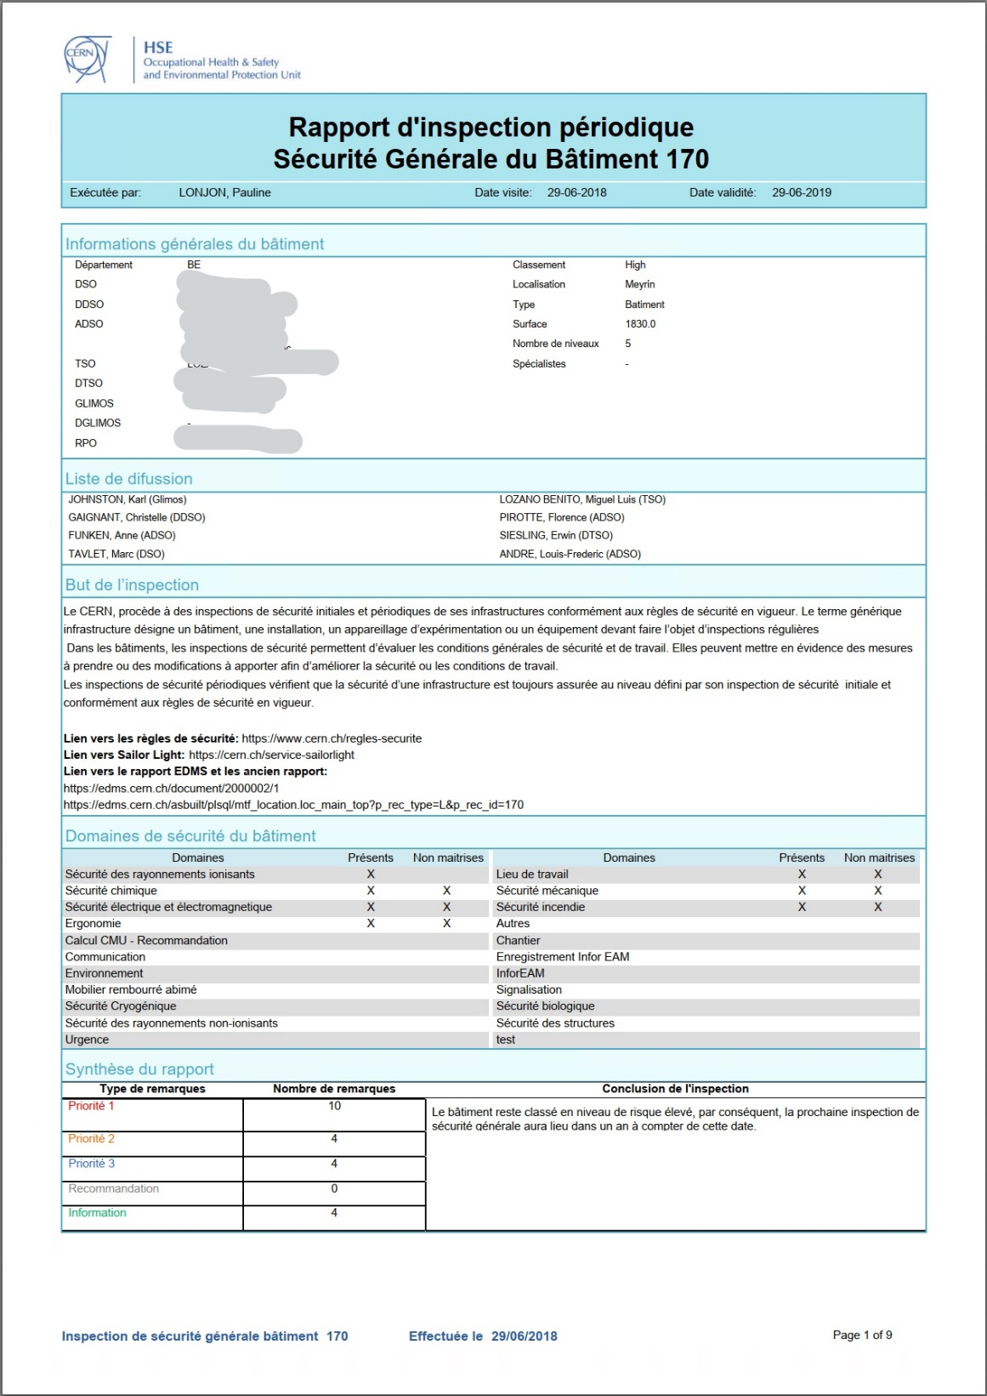
SAILOR – GENERAL Safety Inspections – Writing and Notif. phase
GENERAL
Inspections
Plan
Inspect
Write report and Notify
Resolution
Reporting & Analysis
https://sailor...

Slide 10
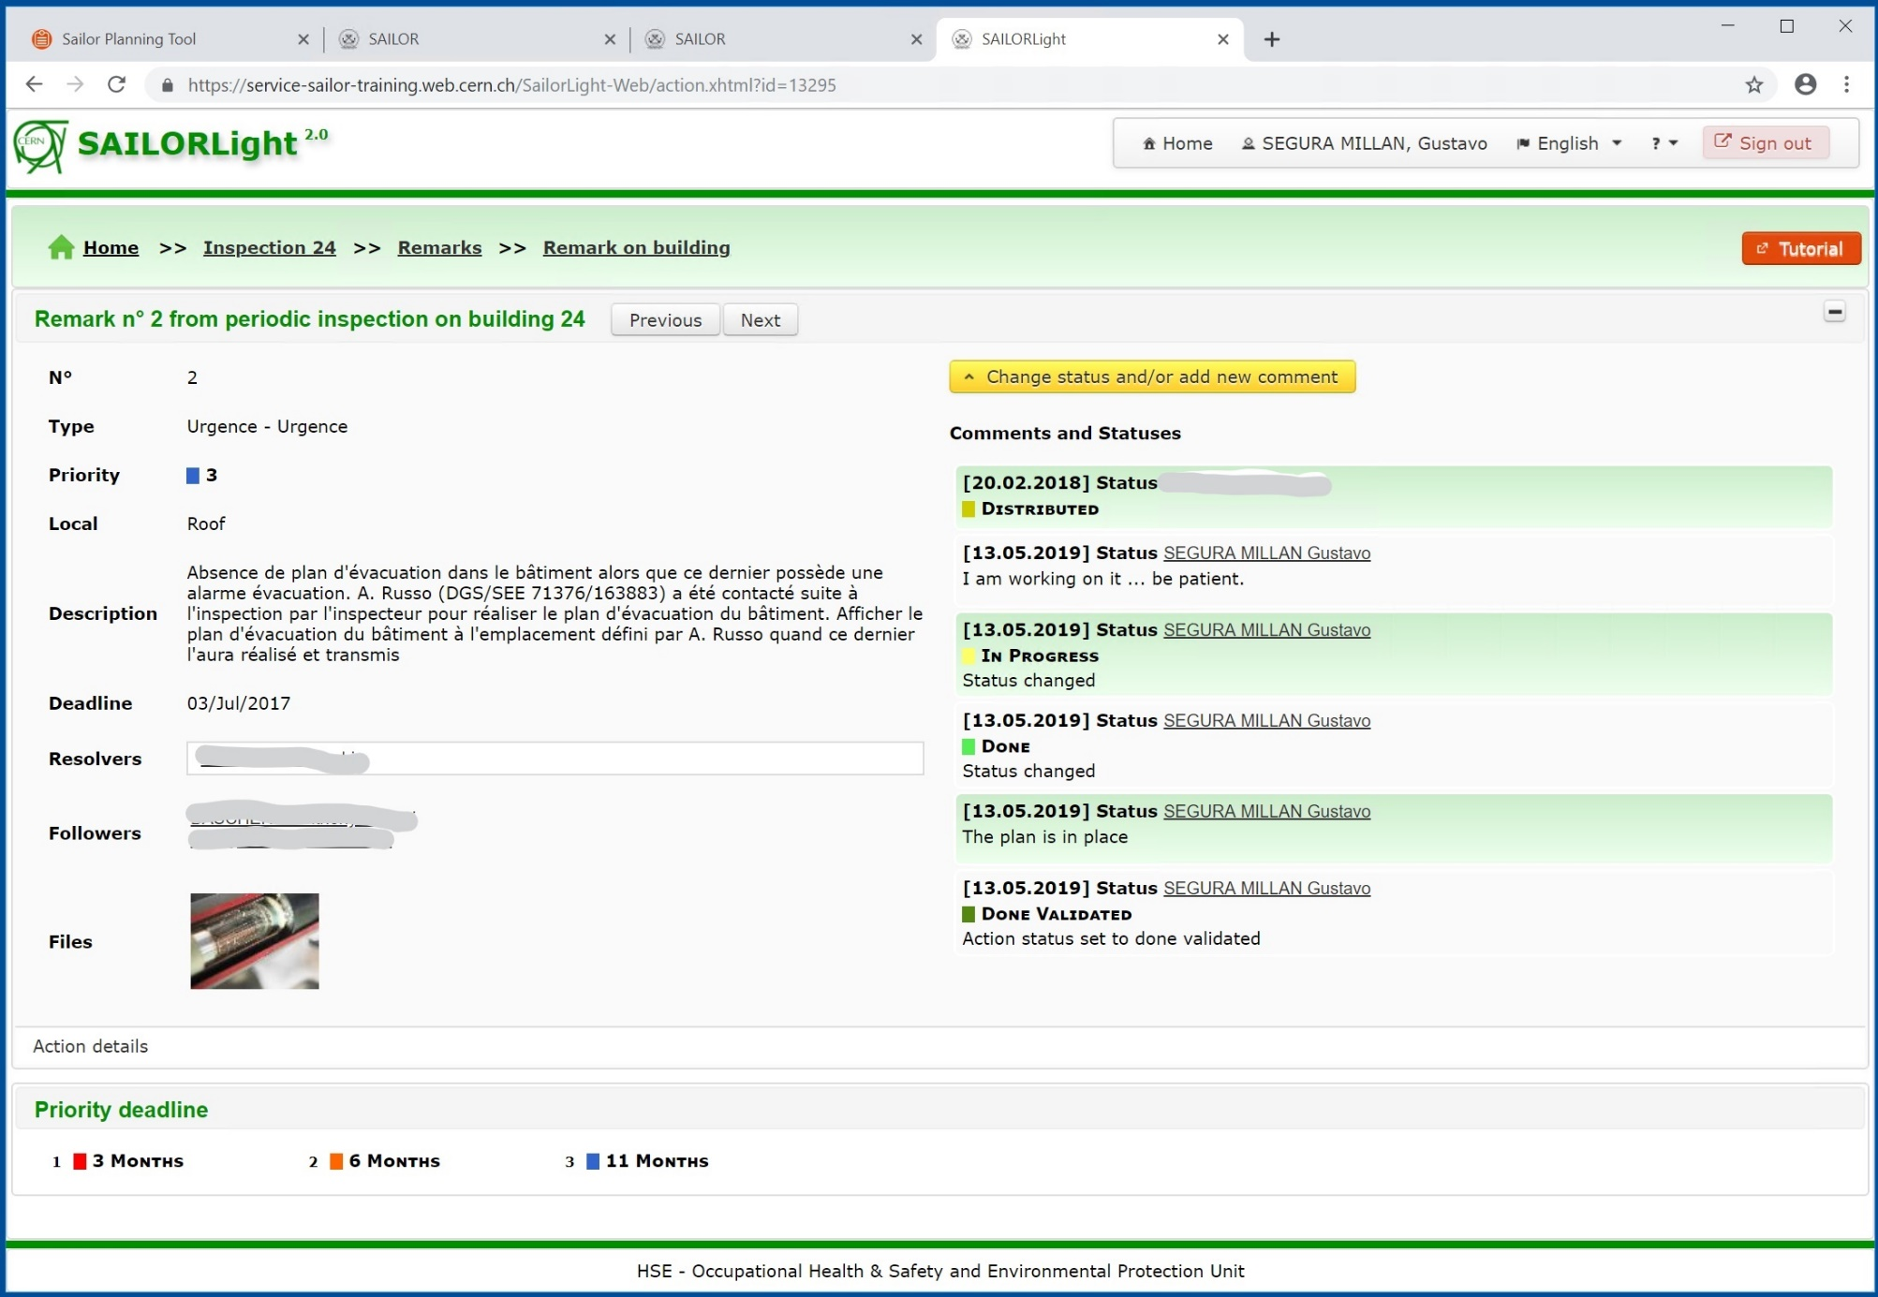
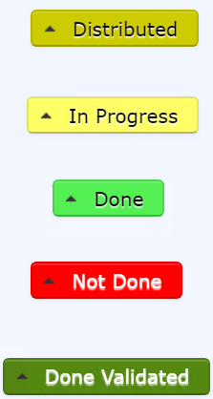
SAILOR – GENERAL Safety Inspections – Writing and Notif. phase
GENERAL
Inspections
Plan
Inspect
Write report and Notify
Resolution
Reporting & Analysis
https://sailor...
…

Slide 11
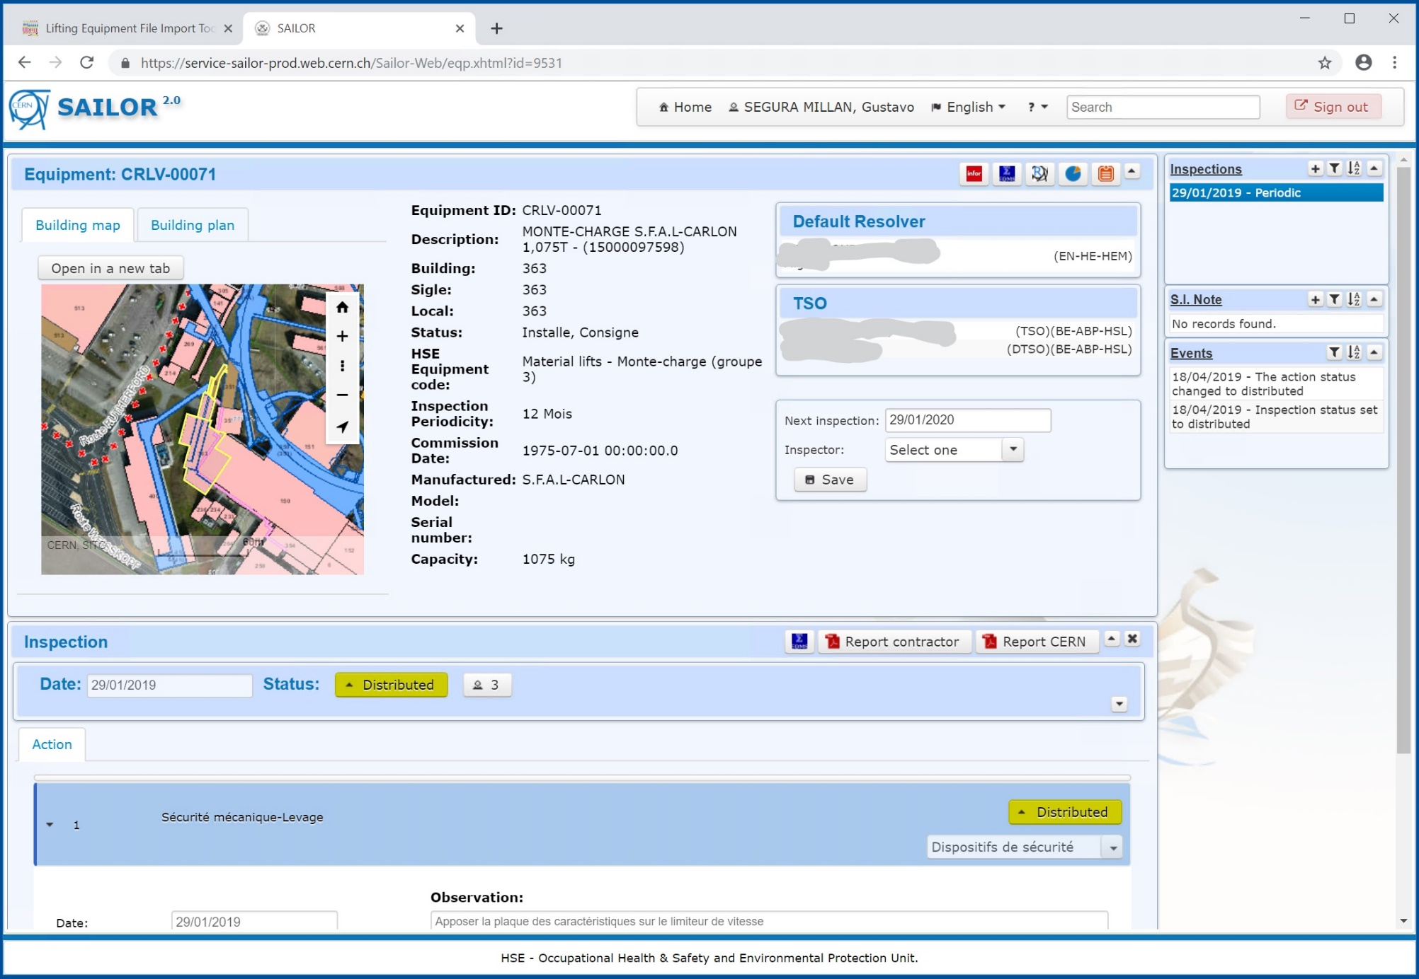
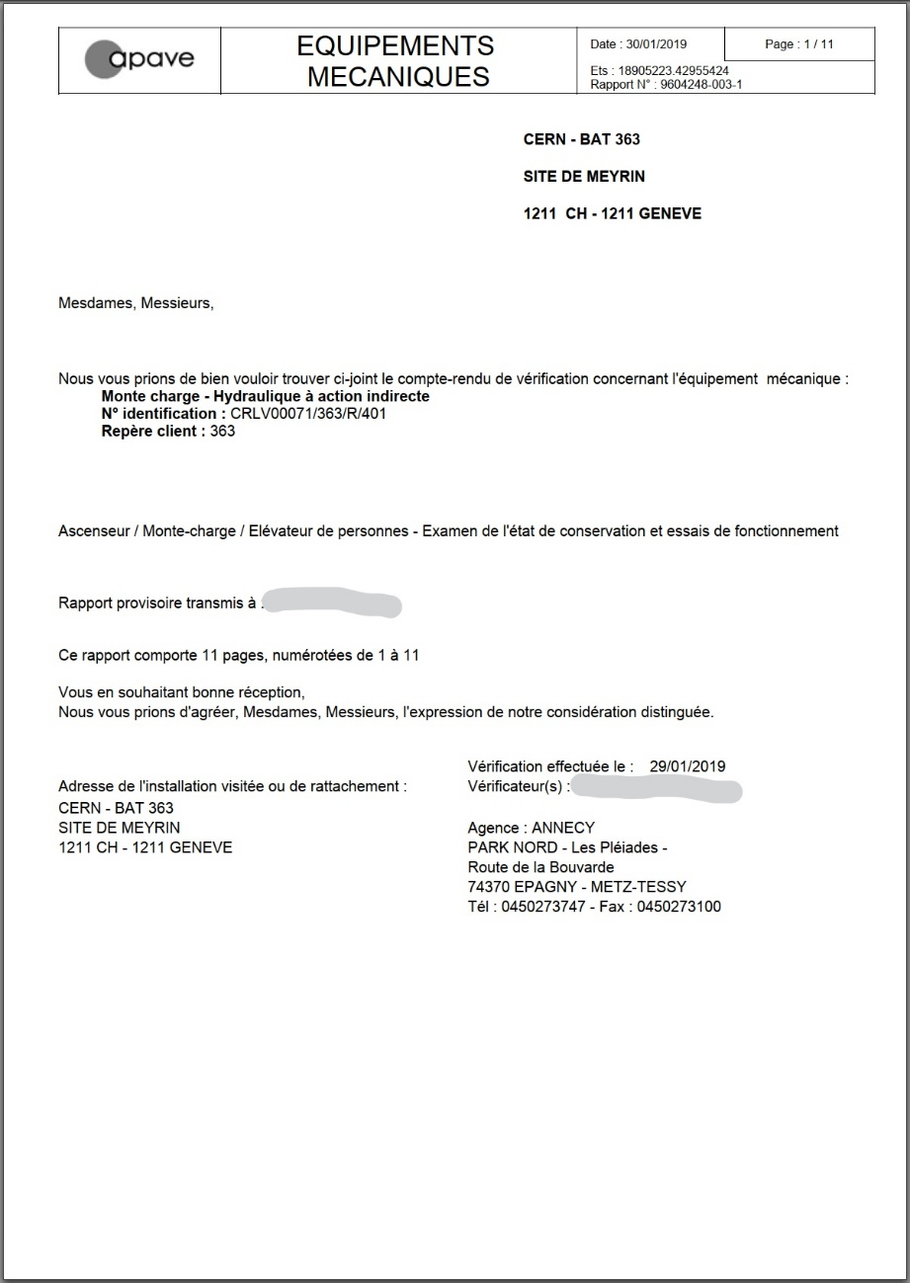
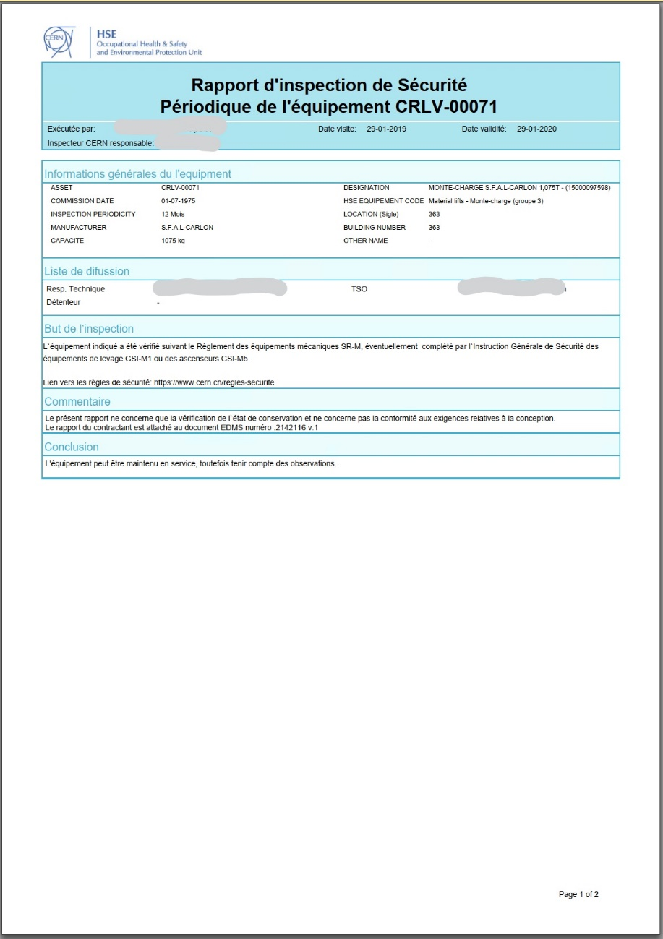
SAILOR – TECHNICAL Safety Inspections – Lifting equipment
By CERN
contractor
By CERN
Inspector
Plan
Inspect
Write report and Notify
Resolution / EAM WorkOrders
Reporting & Analysis
CERN validation
Plan
Inspect
Write report and Notify
Resolution / EAM WorkOrders
Reporting & Analysis
SAILOR creates corrective maintenance work-orders in InforEAM

Slide 12
TSA – Tendering Support

Slide 13
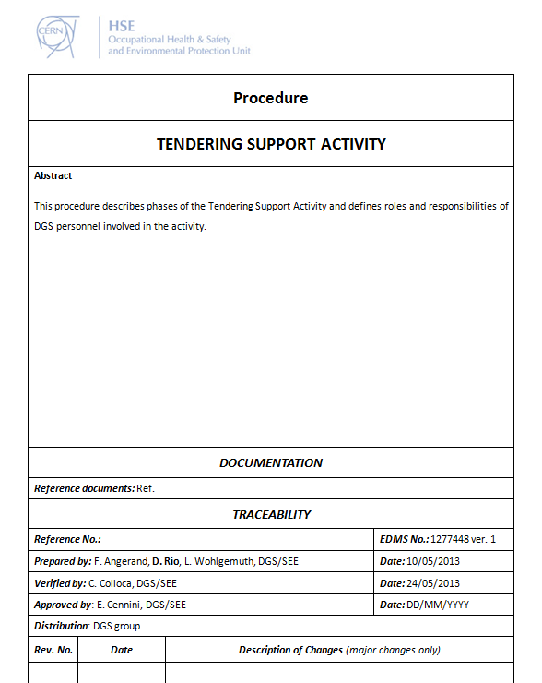
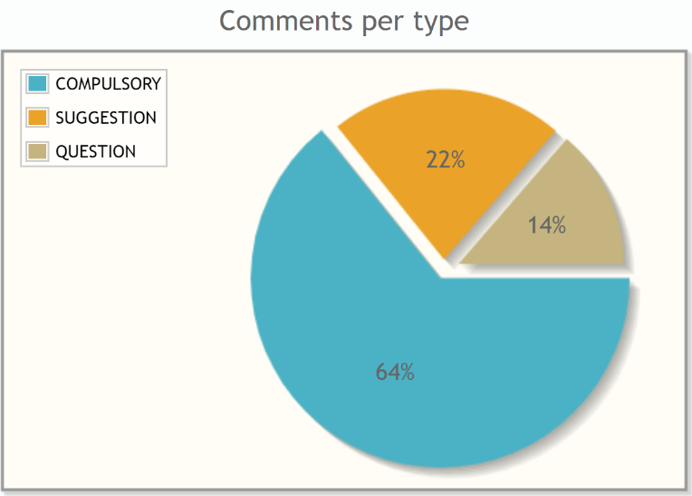
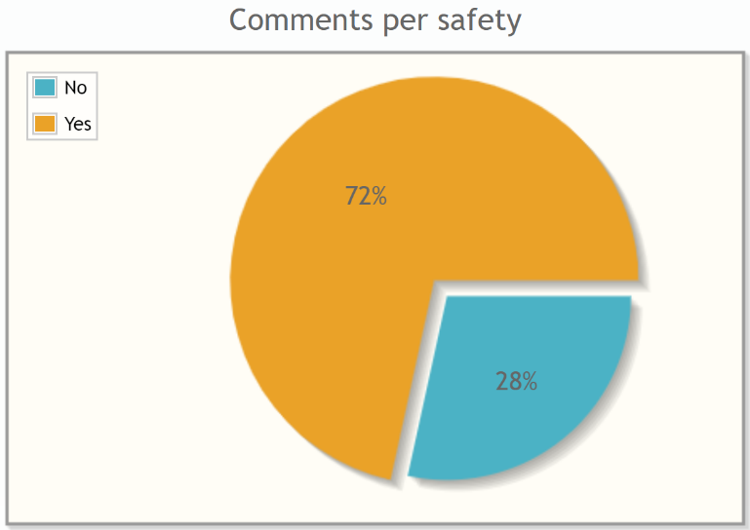
TSA – Tendering Support
HSE Objective: “Verify the compliance of the Tendering documents with the CERN Safety regulatory framework.”
TSA Software System
Implements the tendering support procedure
For each review – i.e. call for tender, contract
Registers tender documents to review
Assigns roles (coordinator, expert, etc.)
Stores inputs from HSE (mandatory changes, suggestions, etc.)
Generates final reports for the requestor
New request for review
Assignment of roles
Consultation
Feedback to Writer
Request closed
Reporting
2084
1283
6736
6044
2675
Since 2014
910 Requests
9411 Comments

Slide 14
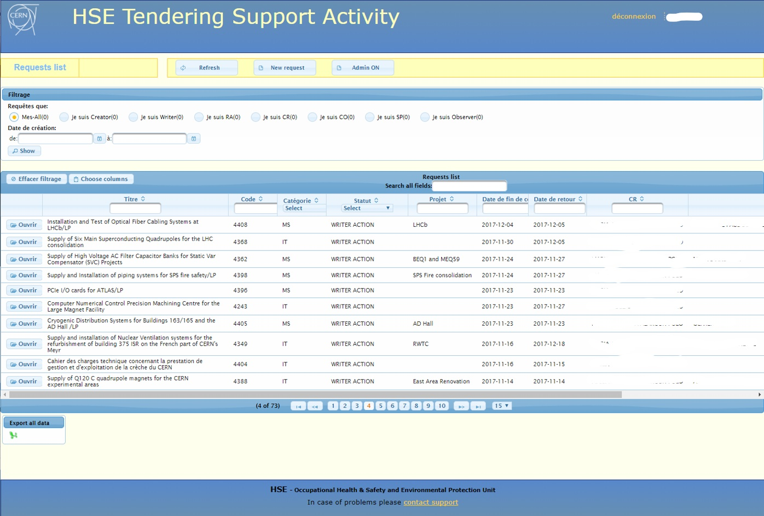
TSA – Tendering Support

Slide 15
RAISIN – Radiation Risk Areas Inventory

Slide 16
RAISIN – Radiation Risk Areas Inventory
RP Classification process
With the RAISIN System, RP Group :
Manages the inventory of CERNs radiation areas.
Identifies and documents the radiological risks classification.
Shares the classification with other systems (used for planning in a CERN-wide scope).
Install signs, check relevant parameters
Update classification database
Inform concerned people / systems
Determine classification
RAISIN
AIS
LOCATIONS
EDH
Transport
AOC
IMPACT
GIS
PORTAL
SAFETY
MANGERS
AIS
ROLES
RP CLASSIFICATION LEVELS
Non-designated
Supervised
Controlled – Simple
Controlled – Limited Stay
Controlled – High Radiation
Prohibited
RAISIN
 | Total | Classified
Number of constructions (“ouvrages”) | 2.582 | XXX
Number of locals (building/level/locals*) | 29.091 | XXXX

Slide 17
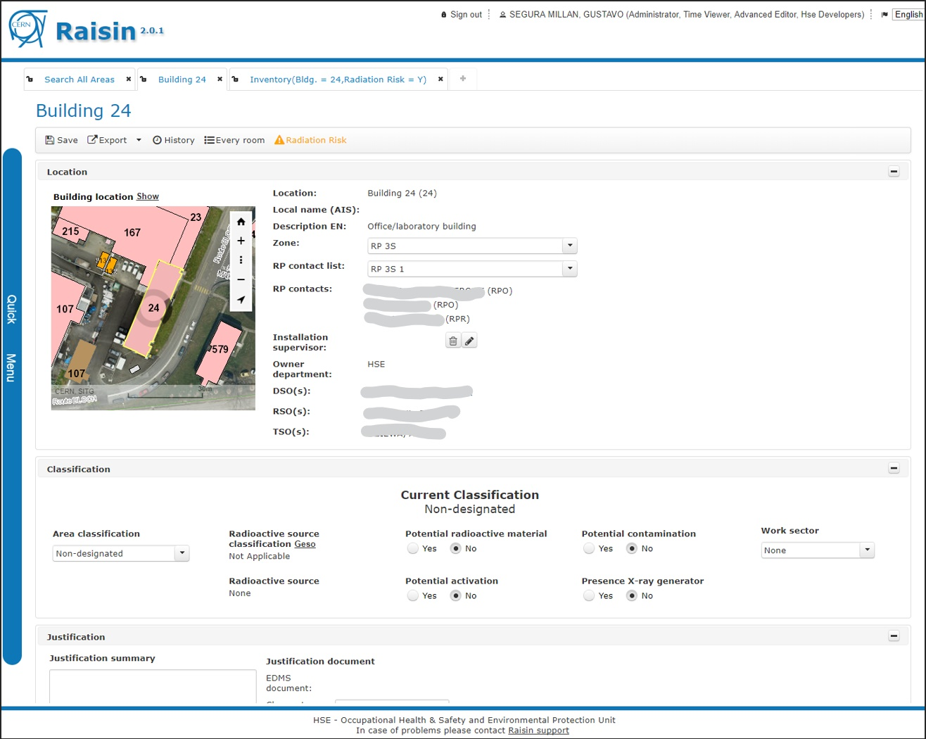
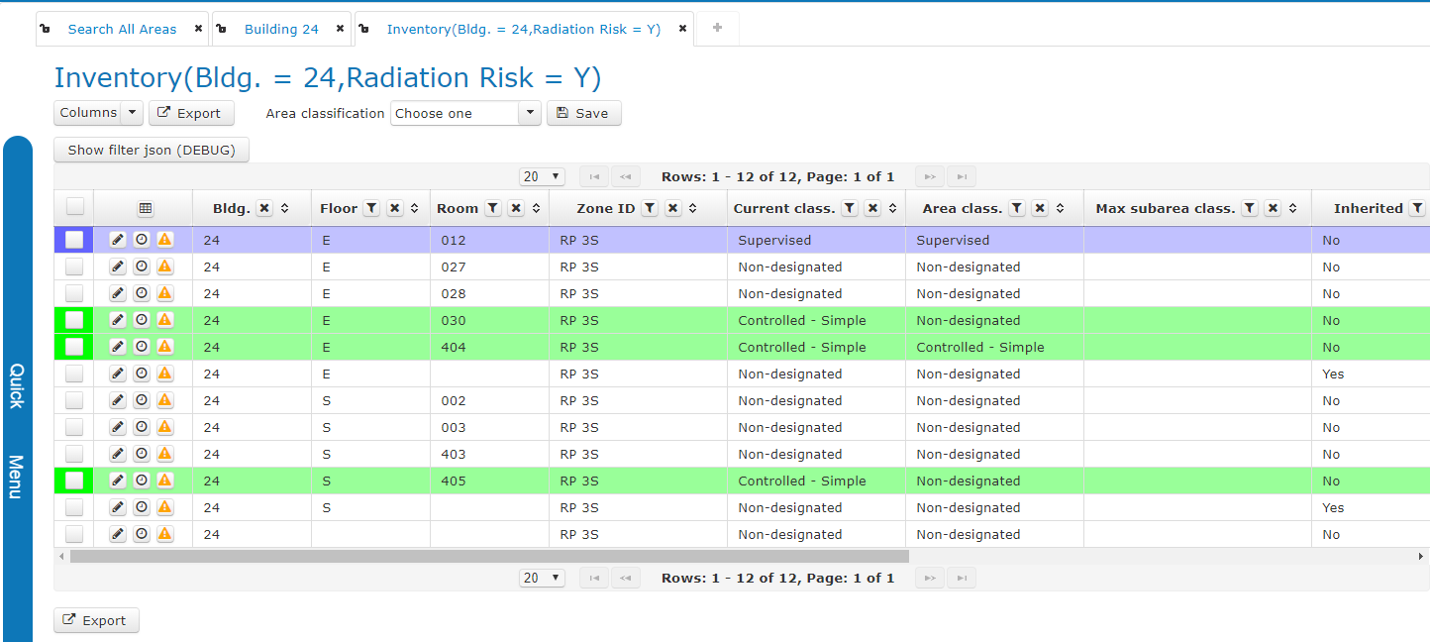
RAISIN – Radiation Risk Areas Inventory
https://raisin...

Slide 18
CERES – Chemical Risk inventory

Slide 19
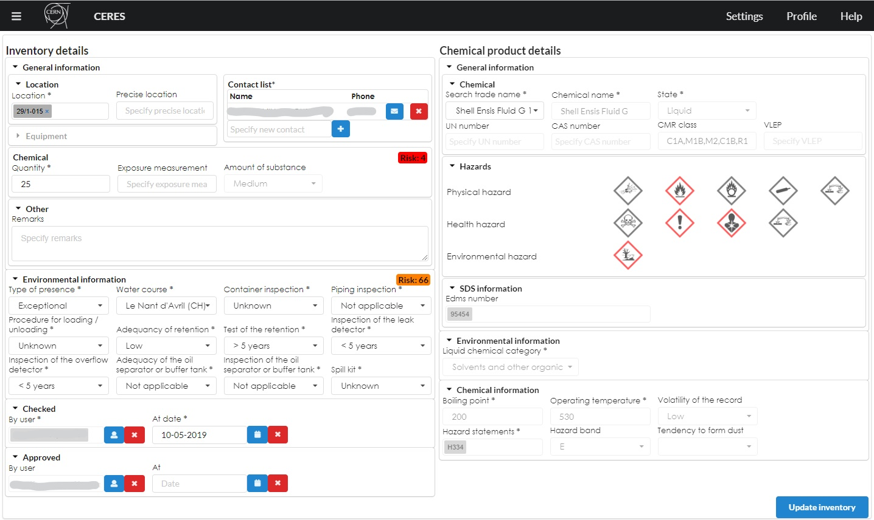
CERES – Chemical safety register
Please have a look to the presentation of CERES project this morning ….

Slide 20
Personal Dosimetry

Slide 21
Personal Dosimetry Systems
The Dosimetry System is the software system that we provide to RP Group allowing them to manage the legally required personal dosimetry monitoring of individuals occupationally exposed to ionising radiation at CERN.
Capabilities:
Distribution of dosimeters to requestors who fit the criteria: medical, contract, safety training
Recording personal doses in central database
Reports of personal doses
Send notifications: recall for reading dosimeters, renew contract, renew medical certificates, exchange dosimeters
Dosimetry
Medical Service
Access control
IMPACT
AIS
Contract
Safety Training
15-May-2019 cumulated
Dose records | 2.126.985
Users | 50.456
System breakdown → Forbidden access to accelerator and experimental facilities

Slide 22
REMUS – Radiation and Environment Monitoring Unified Supervision

Slide 23
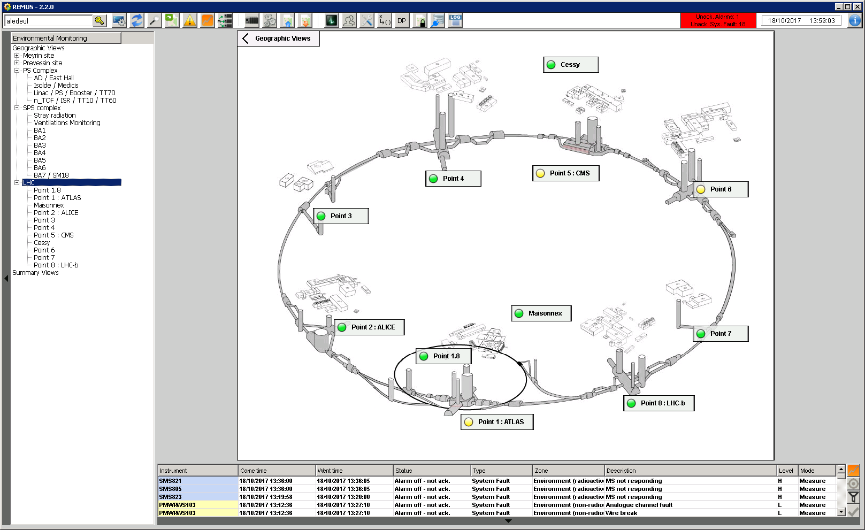
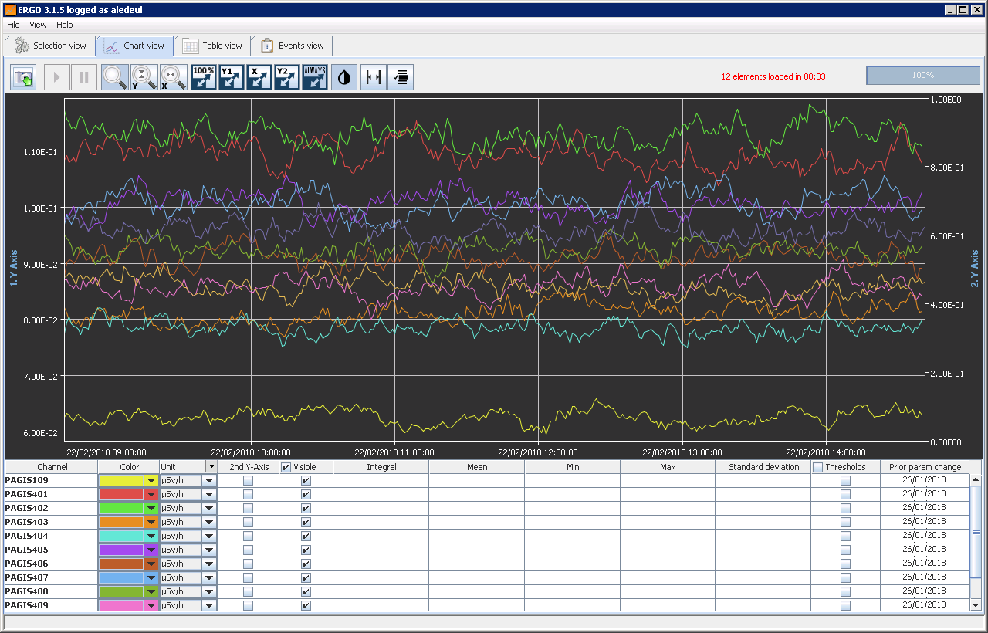
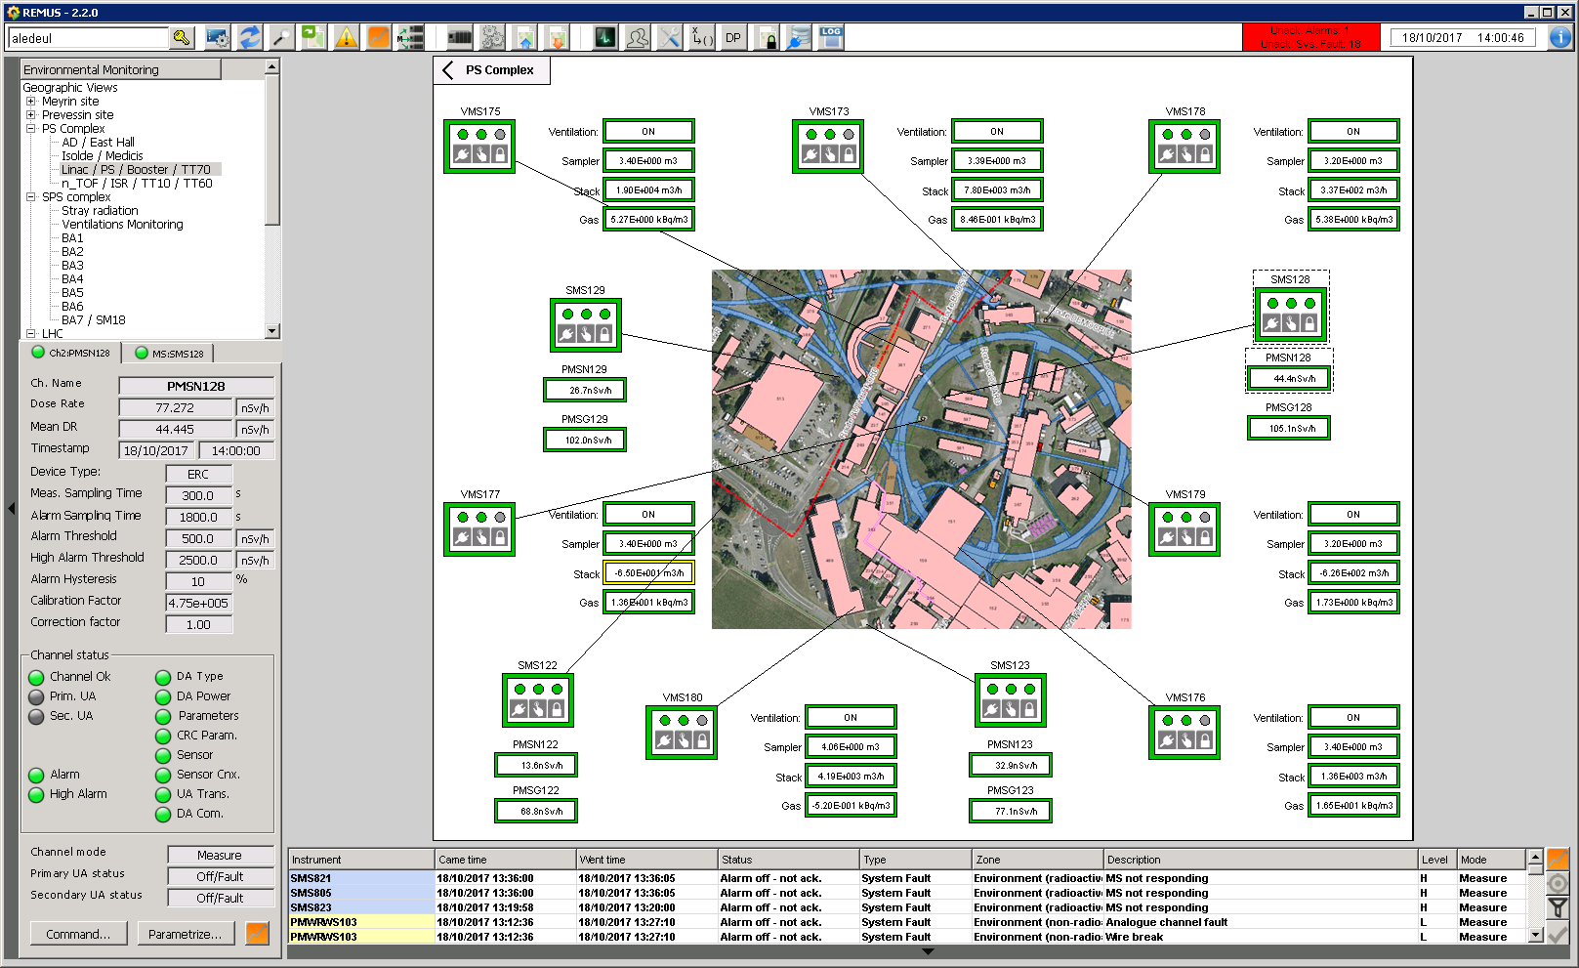
REMUS – Radiation and Environment real-time monitoring

Slide 24
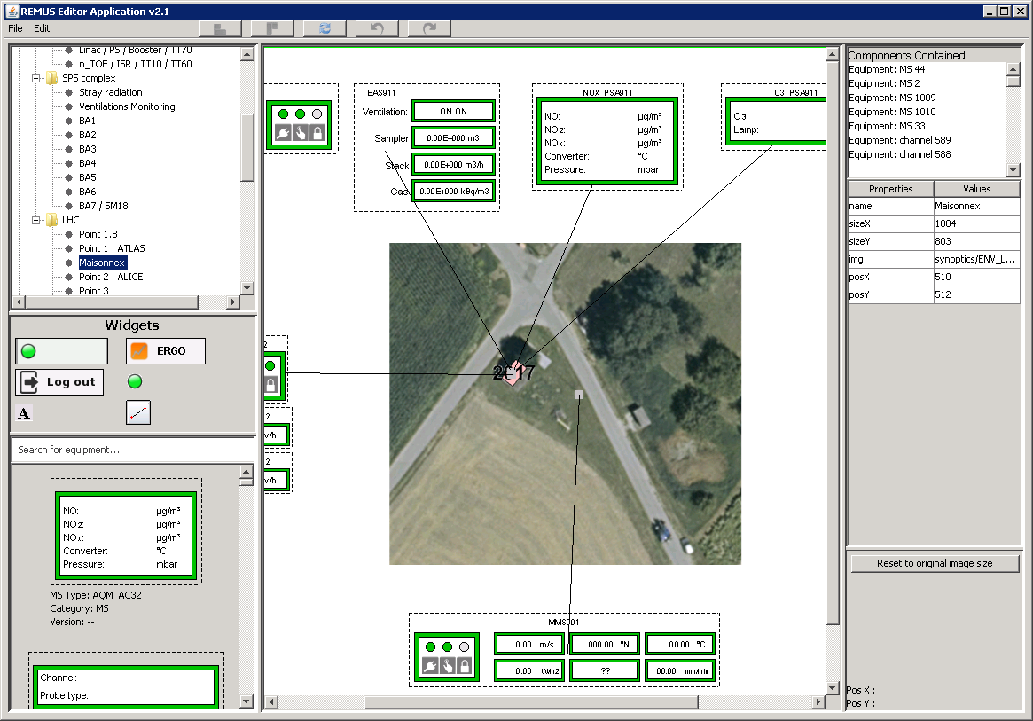
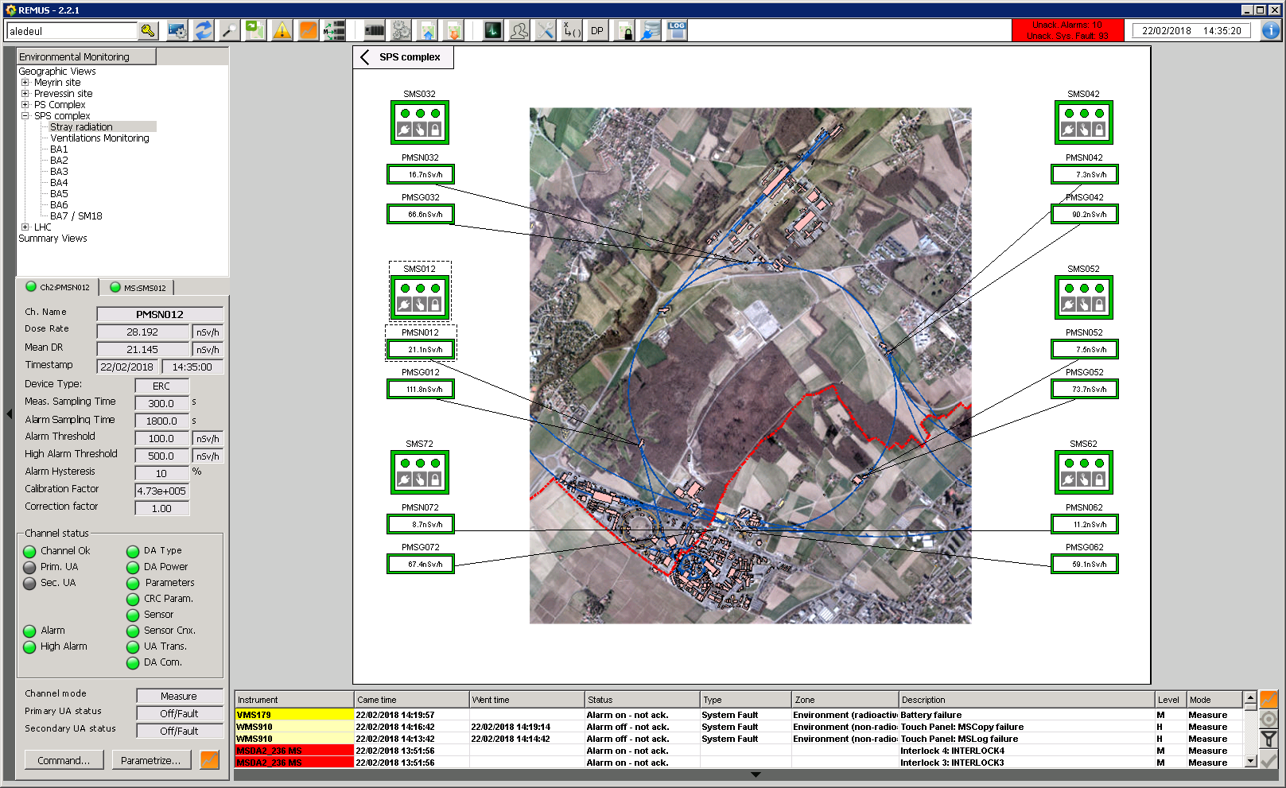
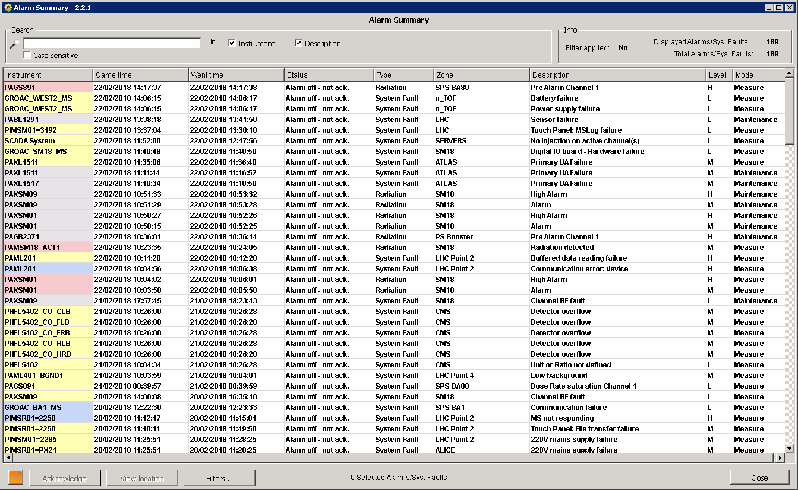
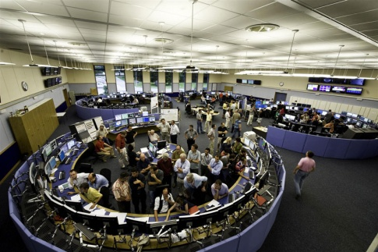
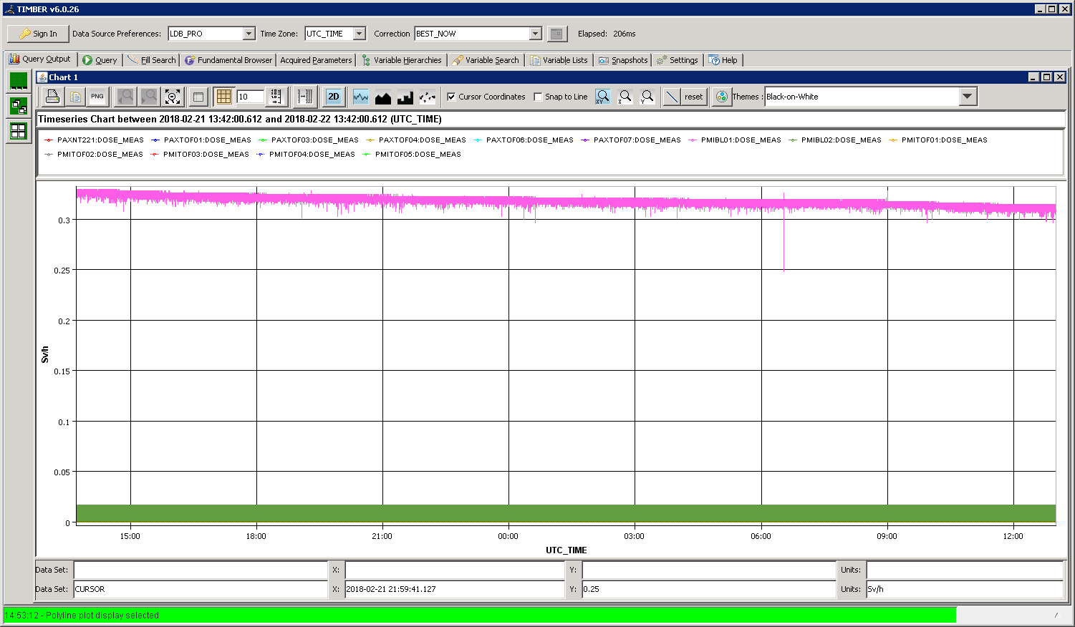
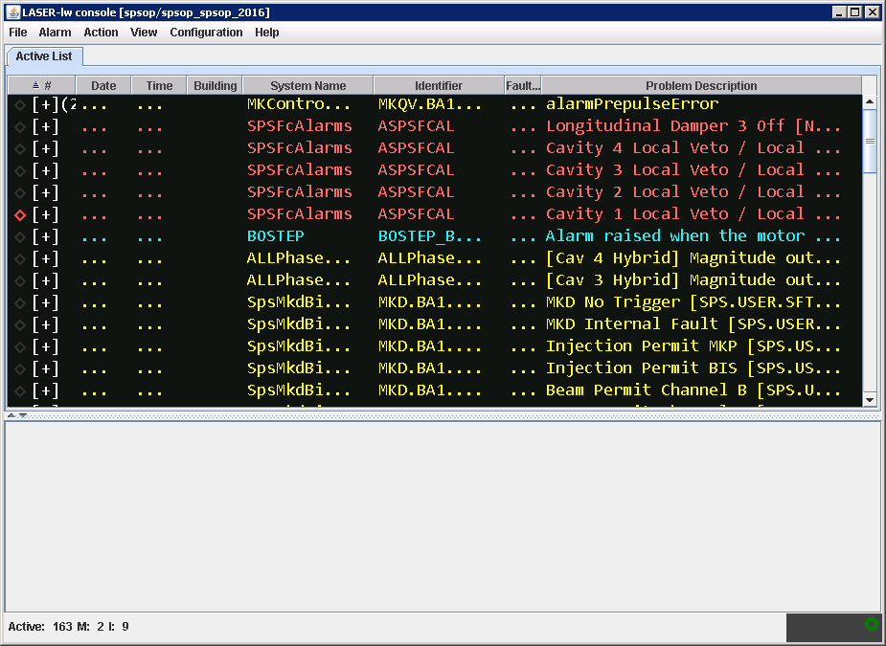
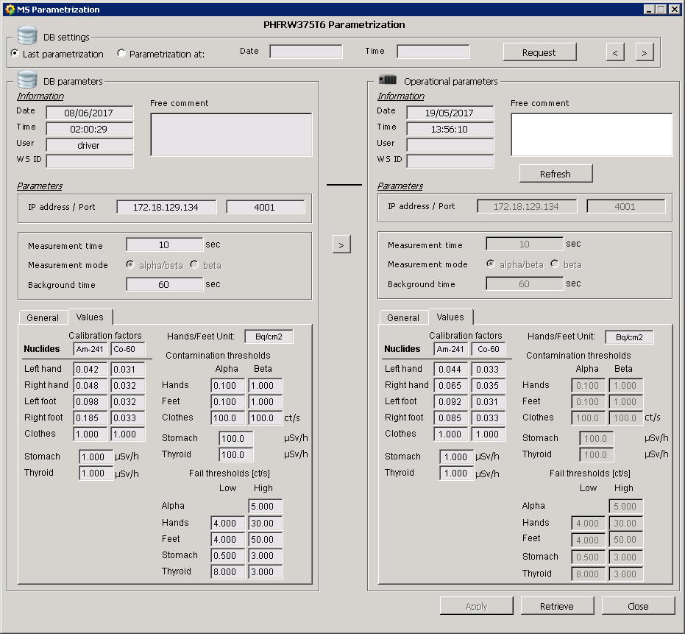
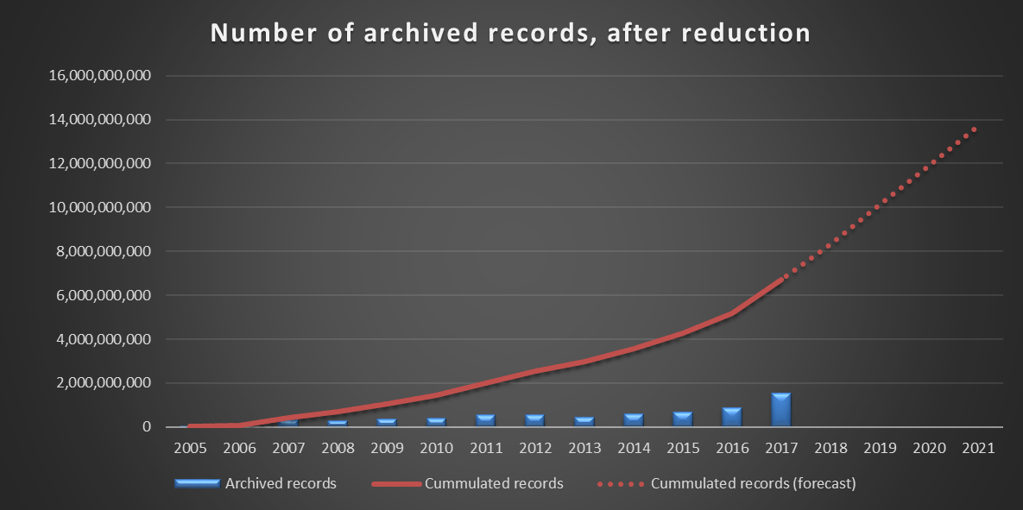
REMUS – Radiation and Environment real-time monitoring
GUI Editor
Data Visualization
Application Editor
Supervision
18 Applications
Control
Data Acquisition
Supervision
8Bn Meas.
Client
626 Synoptic
600K
Data Points
27
Station Types
Data Exchange
Alarm Screen
LASER DIP Meas. DB
3 200
Channels
500
Stations
Client
82K Alarms defined
Data Archiving
Online
Control/Command
38Bn Meas./year 2Bn after reduction
1 000
Meas./sec
Client
46k parameters
REMUS Functional Diagram

Slide 25
Future projects
Renewal of the Dosimetry System
CERES project to be completed in 2019 (on-going)
REMUS read-only mobile application (REMADS Project on-going)
REMUS data analytics (REMADS Project on-going)
SAILOR mobile application for Safety Inspectors
SAILOR technical inspections
… and may be … sharing and collaborating with you ?

Slide 26
Thank you for your attention

Slide 27
List of instrumentation supported by REMUS (1-14/27)
GROAC (CERN) General Purpose (counting cards)
MSDA (CERN+) Radioactivity
MMS (CERN+) Meteorological Station
VMS (CERN+) Ventilation Station
RWM (Bertin) Radioactive Water Monitor
HFM (Britec) Hand Foot Contamination Monitor
SGM (Bertin) Site Gate Monitors for Radioactivity
PCM (Bertin) Contamination
WMS (CERN+) Water Monitoring Station
AC32 (Environnement S.A.) NO, NOx,NO2 Monitoring
O342 (Environnement S.A.) O3 Monitoring
LB112 (Berthold) Gamma rays Monitoring
FHT1100 (Thermo) Contamination (mobile)
AD6 (Automess) Radioactivity (mobile)
COTS (Commercial Off-The-Shelf) instrumentation CERN developed instrumentation “CERN+”: CERN & COTS instrumentation

Slide 28
List of instrumentation supported by REMUS (15-27/27)
ICAM (Canberra) Air Alpha/Beta Monitor
SMART (CERN) General Purpose (PLC)
LB147 (Berthold) Hand Foot Contamination Monitor
iWMS (CERN+) Water Monitoring Station
RADHOME (Algade) Radon Monitoring
ABPM (Mirion) Alpha/Beta Particulate Monitor (mobile)
DTionix (Premium Analyze) Tritium Monitoring
MinAlarm (Thermo) Radioactivity
UNIDOS (PTW) Dosemeter
iAS (CERN+) Aerosol Sampler
Alarm Repeater (CERN) Alarm Signals
FHT1388 (Thermo) Truck Gate Monitor for Radioactivity
CROME (CERN) Radioactivity
COTS (Commercial Off-The-Shelf) instrumentation CERN developed instrumentation “CERN+”: CERN & COTS instrumentation

Slide 29
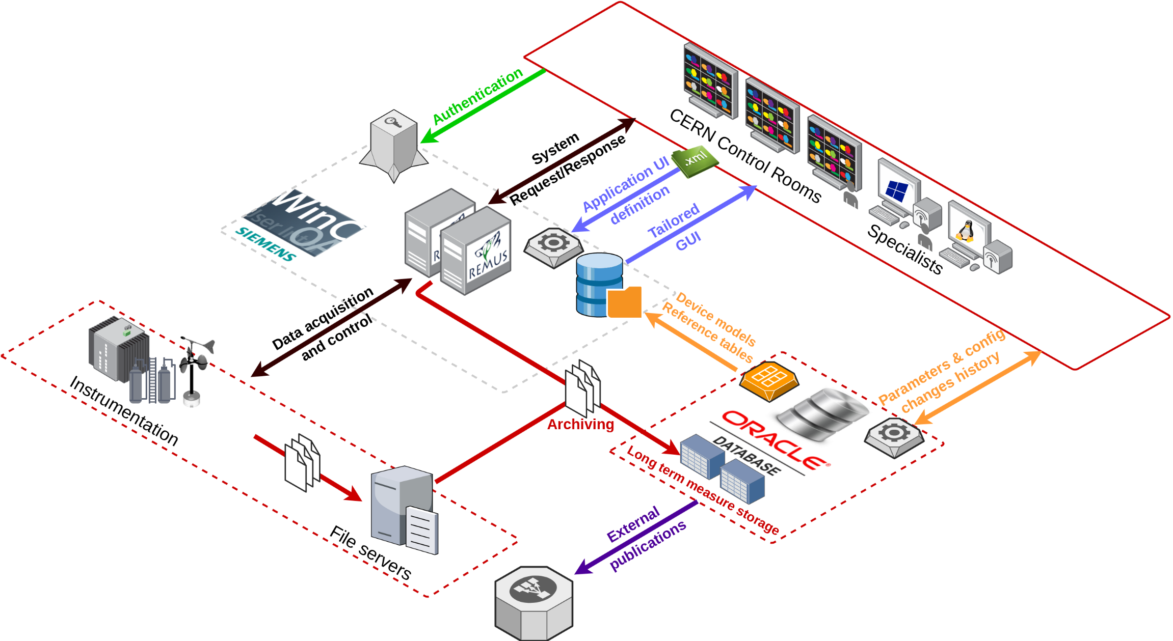
REMUS Architecture

