Slide 1
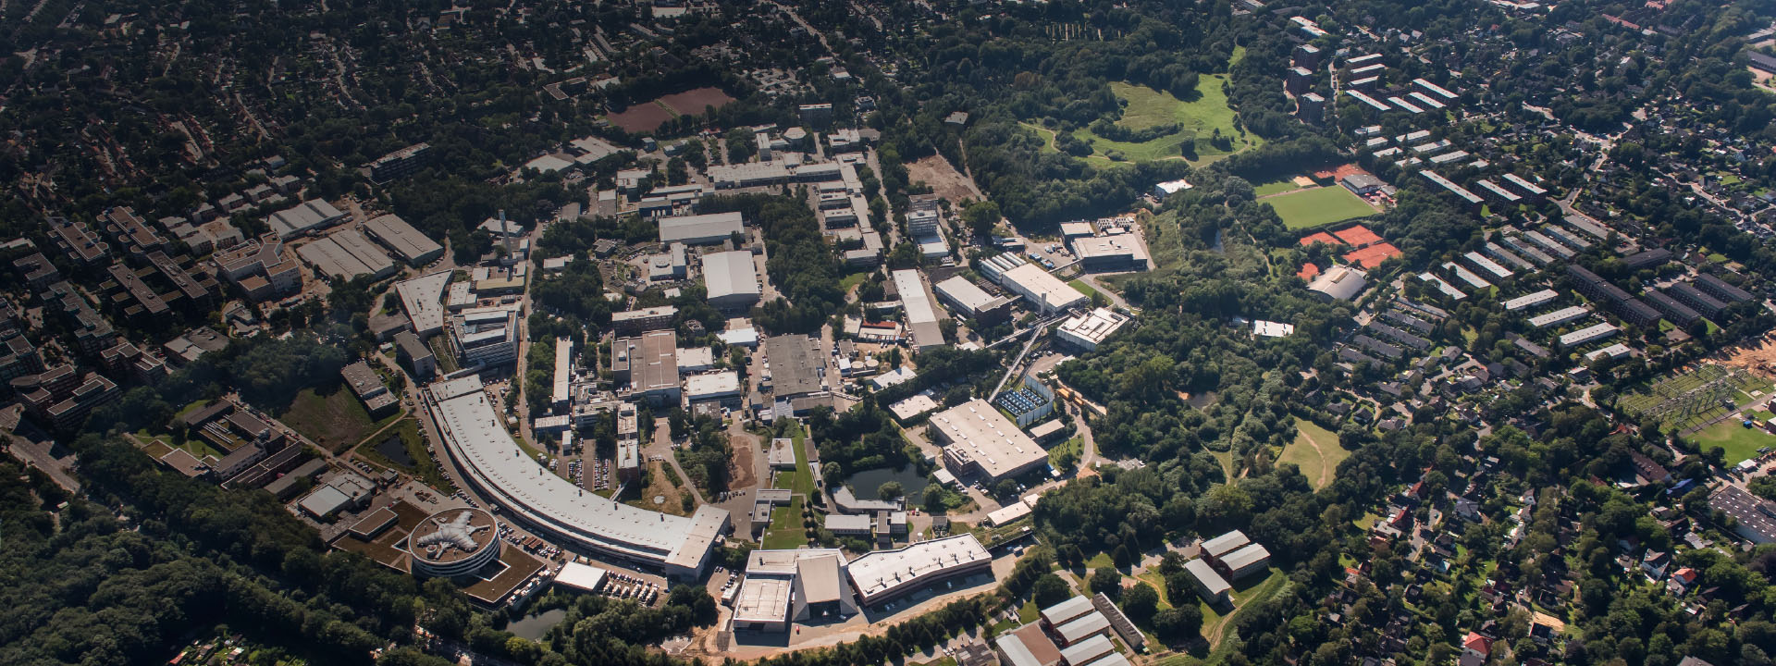
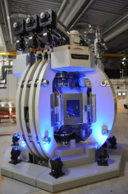
Large Volume Press P61B
Safety Aspects
Sabine Lessmann
ITSF Lund, May 2019

Slide 2
P61B Large Volume Press
P61 High-Energy Wiggler Beamline
1 Introduction
PETRA III Experimental Halls
Status of PETRA III Ext. Beamlines
2 P61B Beamline Layout
Technical Drawing, Parameter
3 From Delivery to Operation
Delivery on site
Some Parameters
First Standalone Experiments
More Construction Work
4 Technical Safety
Operating States Beam/without Beam
Safety Organization
P61B Safety Organization
6 Safety Documentation
P61B Safety Documentation
7 Summary
8 Outlook to Future DESY Campus

Slide 3
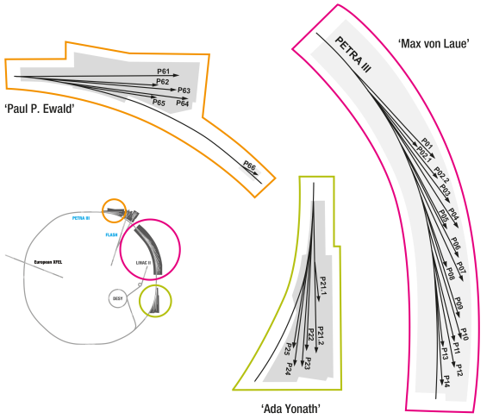
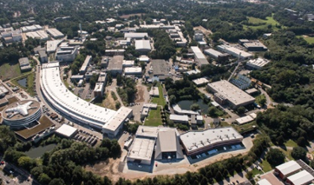
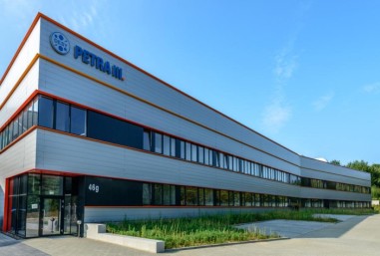

1. Introduction
PETRA III Experimental Halls
Beamlines Hall North, Status
P61A: High-energy wiggler beamline: Engineering Materials Science station, under construction
P61B: Large Volume Press - Extreme Conditions (LVP-EC) beamline under construction
  Simulation of the interior of planets, dynamic processes, synthesize new materials by compressing or controlled deforming of samples (typically 1mm³).
  Press of 4.5m height/ 50t could apply 500 tons on each of 3 axes
  LVP in operation 10/2015-12/2017, from 8/2018 on (construction work in between)
P62 Small Angle X-ray Scattering, under construction, start of operation spring 2020
P63 (open slot for an undulator beamline)
P64 / P65: Advanced / applied X-ray absorption spectroscopy, user operation since 2016
P66 Superlumi: Time-resolved luminescence spectroscopy experiments, under construction

Slide 4
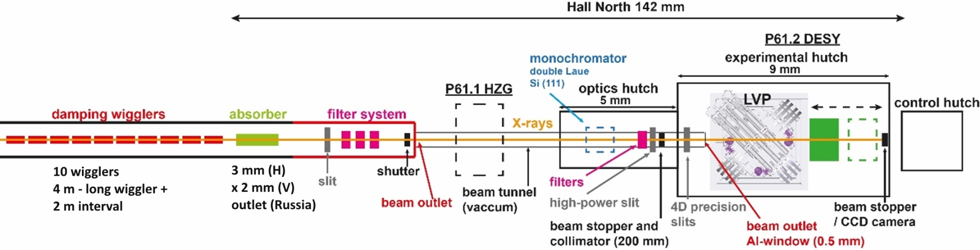
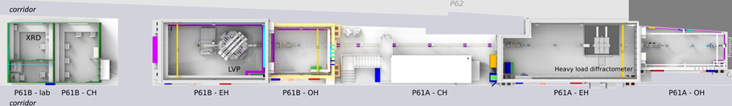
2. P61B- Large Volume Press
Beamline Layout
X-ray source: array of ten 4m long fixed-gap damping wigglers. The white beam will be filtered, >50% of the total emitted power will still be present in the high-energy spectrum (30-200keV). → RadSync 2019 talk about radiation protection issues by A.Wefer (DESY)
Large-volume press instrument (LVP) for in situ studies of materials under extreme conditions (high pressure up to 30GPa, typically 20GPa, up to 2000°C). The instrument can also be used off-line for materials synthesis. It is the world’s first 6 ram LVP to be operated at a synchrotron facility. Sample preparation and characterization lab is available for users.

Slide 5
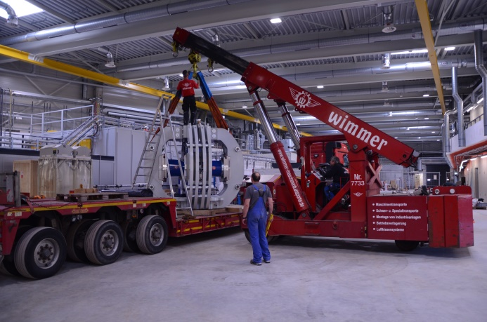
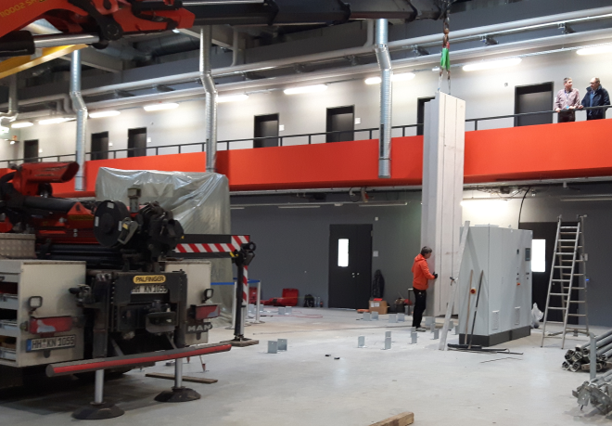
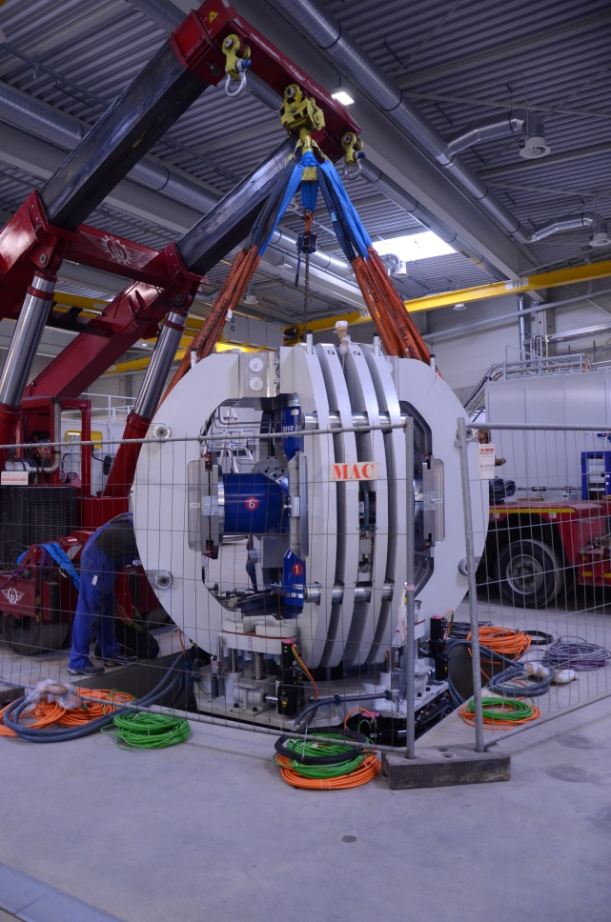
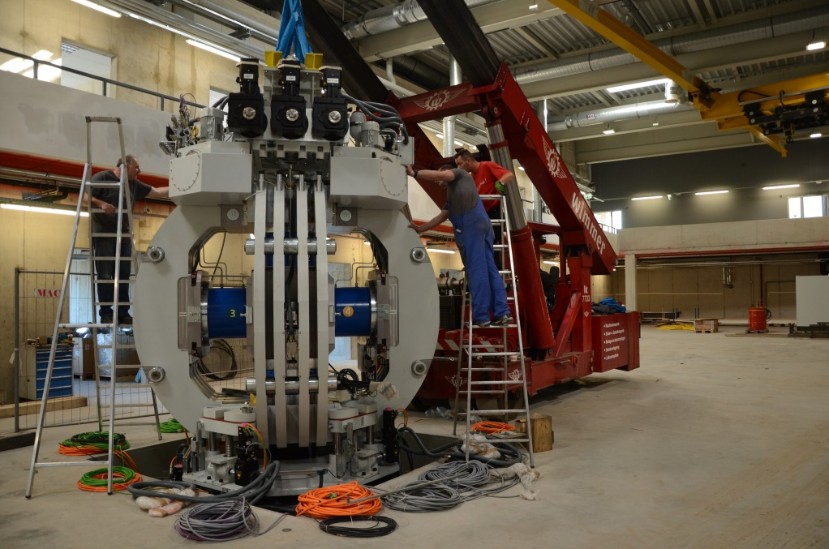
3. P61B LVP- From Delivery to Operation
Delivery of a 50t Press in 9/2015 in PETRA III Extension Hall North
Positioning system: 12 t
Press: 32 t
Hydraulic components 6 t
--------------------------------------
  50 t
CE certified
Foundation pit: 3m x 3m x 0,9m
Press: 3m x 3m x 4,5m

Slide 6

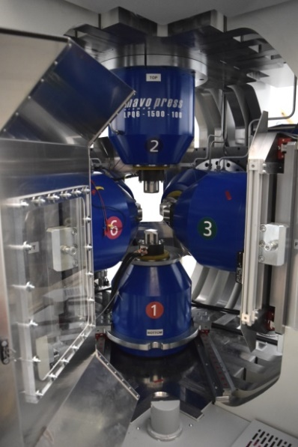
3. P61B LVP- From Delivery to Operation
Some Parameters
Voggenreiter Cubic Press, six independently hydraulically driven rams
Some technical data: Max.oil pressure: 630bar, Pressing force: 6x 5MN@610bar Ram stroke: 6x 100mm Ram velocity (rapid movement) < 30mm/min. Compression rate: 0-100 bar/min Decompression rate: 0-100 bar/min Positioning in low-pressure mode (50bar)
Safety Features by Manufacturer/DESY
Four interlocked, mechanically secured safety doors: splinter/blow out shield, against reaching in (designed and built in agreement with manufacturer by Stefan Sonntag, DESY).
In the event of a fault (emergency-off or power failure) the system pressure decreases very slowly over hours or days. Pressure relieve by a manual valve or via control unit. If operational again, the experiment may proceed at the actual pressure.
Press showcased during Night of Knowledge/
DESY Day in 11/2017
MavoPress LPQ6 - 1500 / 100

Slide 7

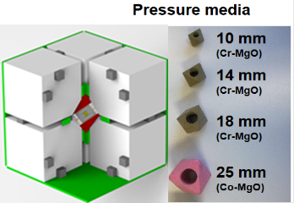
3. P61B LVP- From Delivery to Operation
First Standalone Experiments
10/2015-12/2017 LVP start of calibration and then operation as a stand-alone experiment
Disconnected during construction of concrete hutches around press
5/2018 (offline) operational again, now inside a heavy concrete hutch, but without beam
Application procedure for user operation is integrated into the user portal DOOR (DESY online Office for Research with Photons), similar to beamline application, choose LVP as a special instrument
Experienced users only (multi-anvil techniques)
Proposal
Declaration of substances
Online safety trainings (General Safety, PETRA III, + Chemistry Lab, Workshop if applicable), on-site briefing
Personal badge for authorized access (DACHS card)

Slide 8
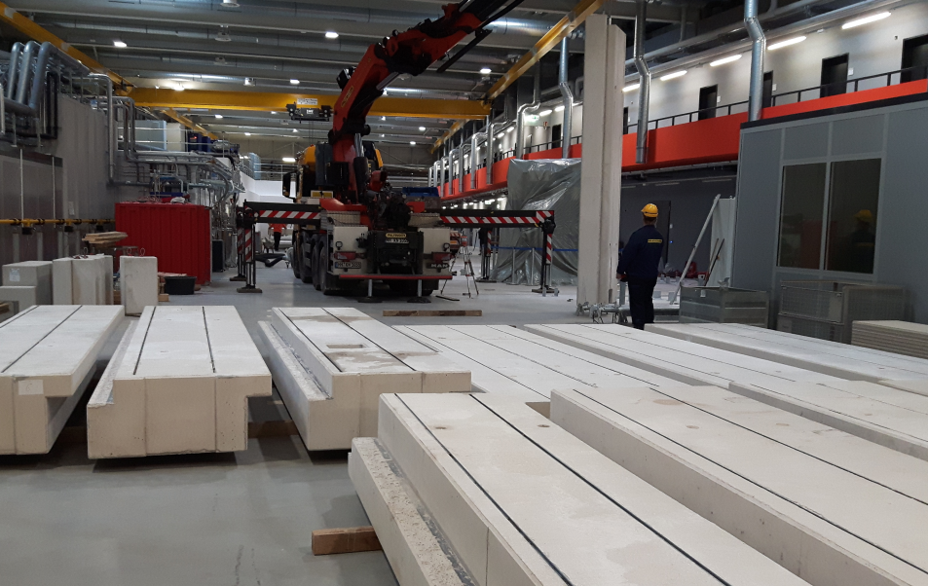
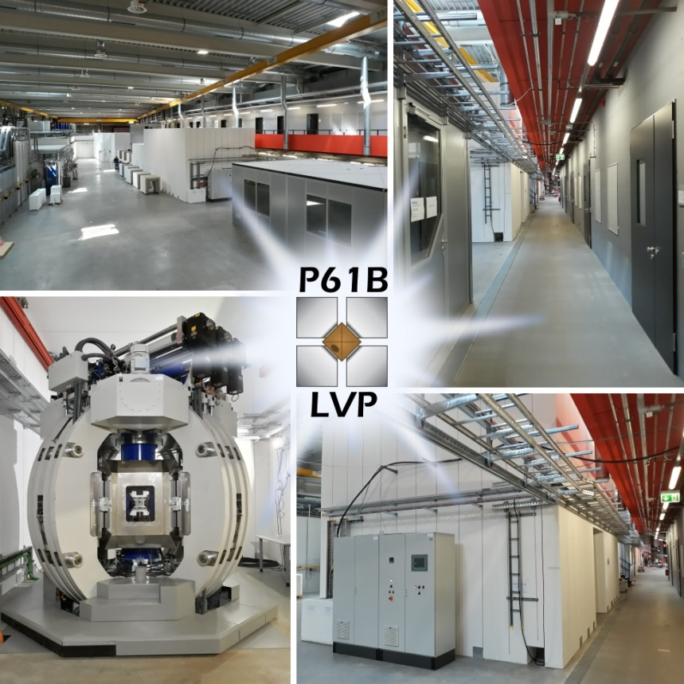
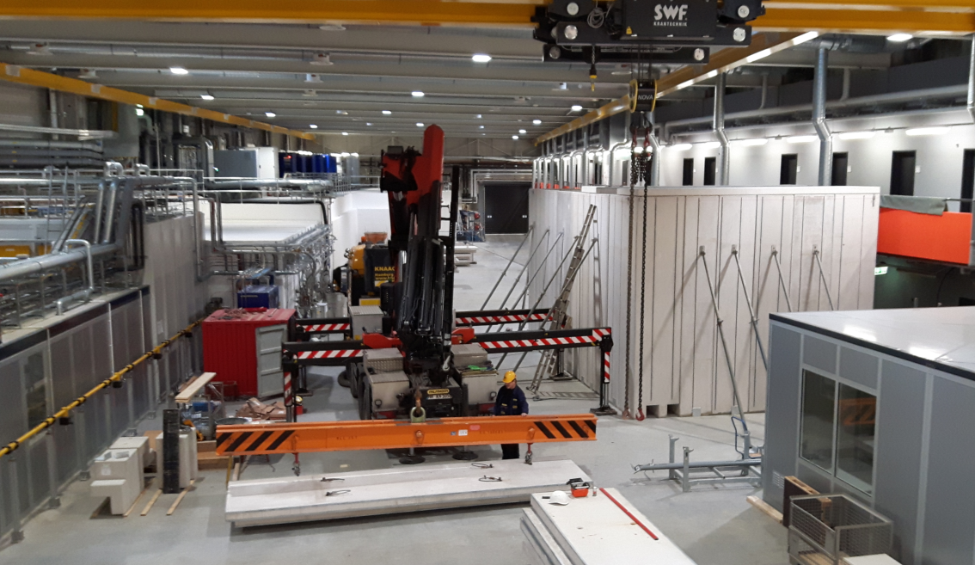
3. P61B LVP- From Delivery to Operation
More Construction Work, Hutch and Beamline
Concrete hutch built around wrapped press
5/2018 (offline) operational again, now inside a hutch

Slide 9
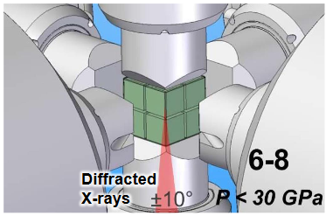
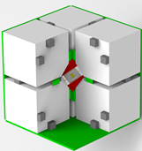
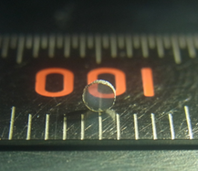
4. Technical Safety
From Standalone experiment to Special Beamline Instrument
Interlock system (by DESY interlock group MPS) specified for a safe operation of LVP in different states: with/ without beam/ during maintenance
Press procedure without beam:
  Sample positioning, start with open hutch door, but pressure is limited to max.50bar (door contact).
  Closed hutch door: pressing procedure will not proceed automatically, to be continued via software.
  Press > 50bar, door cannot be opened.
  Pressure release in case of a failure (power off). Now: release valve on top of press, but the hutch cannot be entered. Release via control unit from outside is ordered.
Sample characterization via XRD (x-ray powder diffraction), by using a benchtop diffractometer with strip detector for ex-situ studies
yellow spot: sample inside octaeder
Tungsten carbide
A sample of transparent polycrystalline cubic silicon nitride, synthesised at DESY. Credit: Norimasa Nishiyama, DESY/Tokyo Tech.
The super-hard window made of cubic silicon nitride can potentially be used under extreme conditions like in engines.
6 axes - 8 anvils sample assembly
epoxy insulation

Slide 10
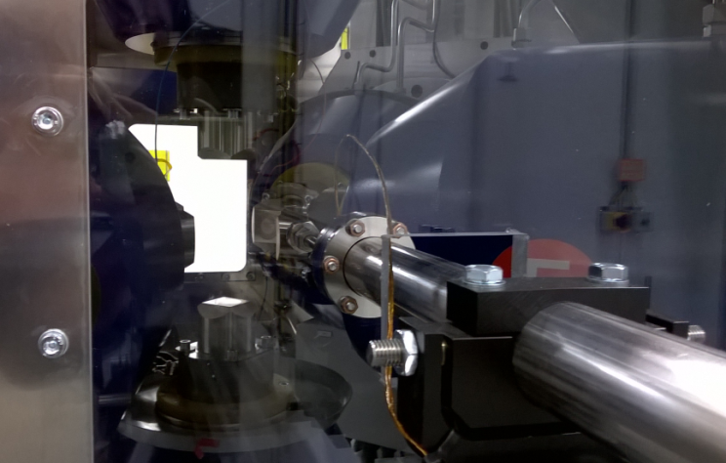
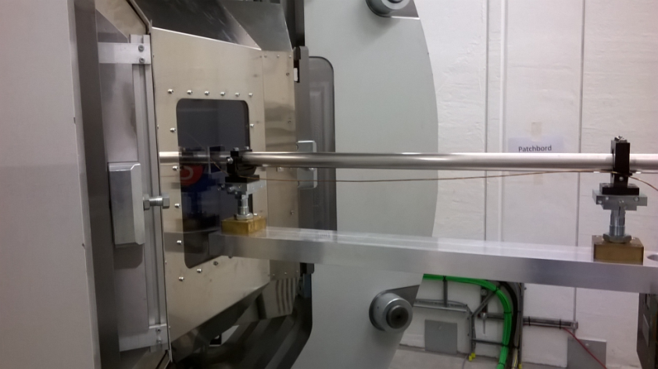
4. Technical Safety
From Standalone experiment to Special Beamline Instrument
Interlock system (by DESY interlock group MPS) specified for a safe operation of LVP in different states: with/ without beam/ during maintenance
  Press procedure with beam (prohibited area)
  Pressing procedure starts with an open hutch, pressure is limited to max.50bar (door contact).
  Interlock signals of LVP hutch must be present to open the beamshutter and continue press procedure: area search confirmed, emergency-stop, beam permission, door interlock, radiation monitors, chicane key, beamshutter key, vacuum interlock, doors locked + ozone sensor signal (white beam).
  Beamshutter open, press procedure to be continued > 50bar
  Ozone sensor signal in case of an alarm triggers beamshutter (close) and door (stays closed) until ozone level is below threshold (hutch ventilation).
  Press rotation limited to +/-10deg (temporary safety cover)

Slide 11
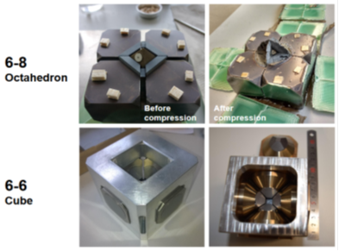
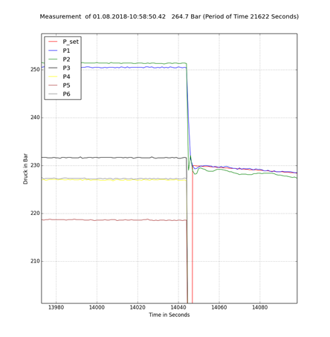
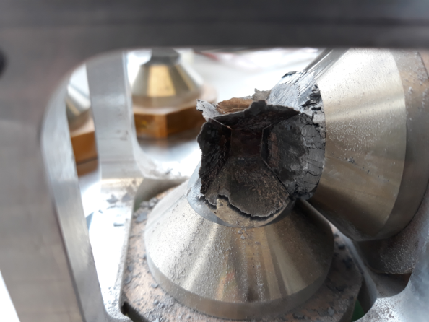
4. Technical Safety
From Standalone experiment to Special Beamline Instrument
Hazards during Sample Preparation, Positioning
  Danger of being crushed during assembly, alignment, sample positioning
    → Safety doors, interlock, operation with closed safety door.
  Danger of being hurt by blow out, splinter by disintegrated anvils
  → Precise preparation needed: Probe assembly parts have manufacturing tolerances in µ region, use flawless parts only.
  → Differently sized setups mean different pre-set parameter, like pre-charge pressure,
  → After a crash, rams positions to be recalibrated
  → Operation only by experienced and trained person
    → Maintenance only by beamline personnel (recovered anvils may break days after high pressure experiments > safety glasses)
  Machining, preparation lab (diamond saw, drilling, CNC, lathe, stereo-microscope, precision welder, furnaces, ..)
  → further restriction in use of machines needed, trained person only

Slide 12
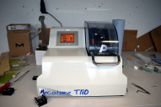
5. Safety Organization
P61B Safety Organization at PETRA III Exp. Hall North
Safety Personnel, active in hall north
Maintain safety communication!
Staff situation!
Technical Infrastructure
Position of main safety responsible for DESY Photon Science is about to be filled in → training
User Safety
PETRA III Ext. Hall North
D5 Safety
hall technician =
safety officer hall north
D3 Radiation protection
„voluntary“ hall safety officer
MPS interlock
Technical emergency service
local first aider
Beamline Manager: hutches +labs
Engineer
from project to new group structure: methods wise, beamlines in different halls, new group leader → communication !

Slide 13
6. Safety Documentation
P61B Safety Documentation
Documentation
CE certified press
User Portal: Procedures in DOOR, implemented
User: beamshutter permission training, press use
Manufacturer manual > beamline manual
..to be done
Risk assessment has to be updated due to hutch environment (prep lab), interlock,..
Add documentation about additional safety installations (additional pressure release control unit, safety doors, add. emergency-stop)
Technical safety installations (interlock, emergency-off, ozone,..), become part of regular tests
Operation instructions for prep lab, to be done

Slide 14
7. Summary
Safety issues Very Large Press
Beamlines Hall North
P61A: High-energy wiggler beamline: Engineering Materials Science station, under construction
P61B: Large Volume Press - Extreme Conditions (LVP-EC) beamline under construction, LVP in offline operation
P62 Small Angle X-ray Scattering, under construction
P63 (open slot)
P64 Advanced X-ray absorption spectroscopy, user operation since 2016
P65 Applied X-ray absorption spectroscopy, user operation since 2016
P66 Time-resolved luminescence spectroscopy experiments, under construction
Planned technical safety installations have to be set up and tested
Interlock
Ozone sensors
Access control
Emergency stop, emergency off
Preparation lab safety installation
Safety documentation has to be updated and continued
Risk analysis
Operation instructions
User procedures
Follow up of safety documentation
Organizational issues have to be solved to maintain communication
Position of a main safety responsible Photon Science
Transition from project status to new DESY group structure, group leaders in a new position have to be trained in terms of safety

Slide 15
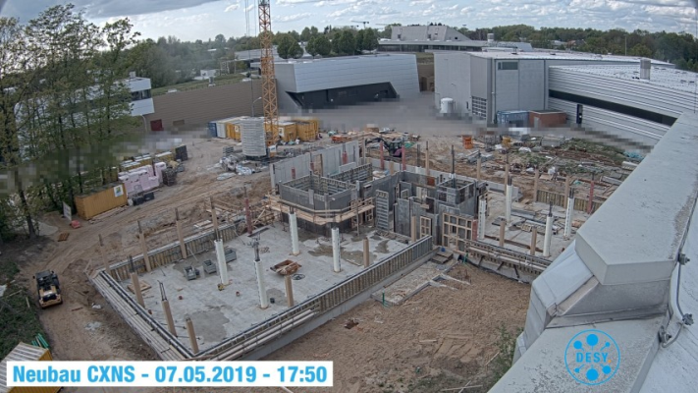
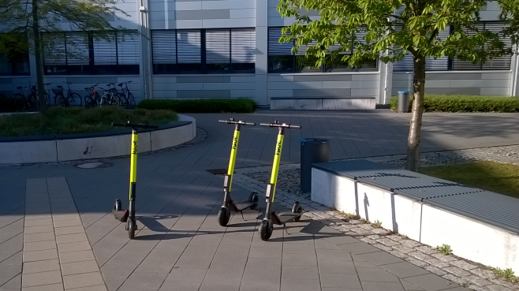
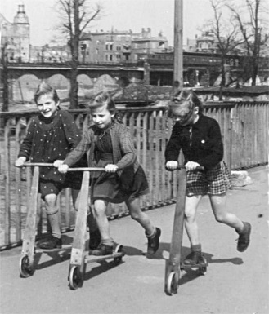
8. Outlook to Future DESY Campus
What`s next? Some Photon Science Construction Sites…
CXNS, Center for X-Ray and Nano Science
PETRA IV, future experimental hall in Lise Meitner park area
Electric scooter test ground
...and how to get from one place to another!

Slide 16

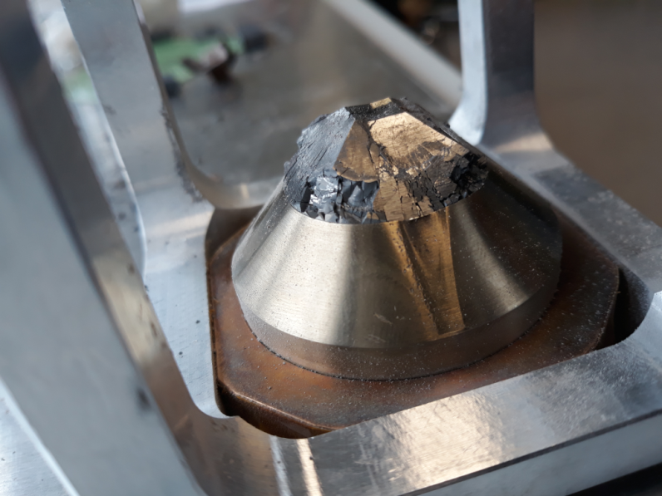

Thank you! for you attention and thanks to my DESY colleagues
Robert Farla, P61B beamline manager
Stefan Sonntag, P61B beamline engineer

Slide 17
Sabine Lessmann-Bassen
FS-TI Technical Infrastructure
sabine.lessmann-bassen@desy.de
+49 40 8998 3180

