Slide 1
Radiation protection at ELI Beamlines facility
Veronika Olsovcova
Marek Bizdra, Tomas Franek, David Horvath, Jaroslav Kaspar, Hana Manaskova, Stephan Maree, Petr Prochazka, Roman Trunecek, Andrea Tsinganis, Vojtech Stransky, Roberto Versaci

Slide 2
ELI pillars
Infrastructure
Infrastructure
Infrastructure
ELI
Nuclear Physics
New generation of secondary sources for interdisciplinary applications in physics, medicine, biology and material sciences
Physics of ultrashort attosecond pulses
Photonuclear physics, nuclear spectroscopy

Slide 3
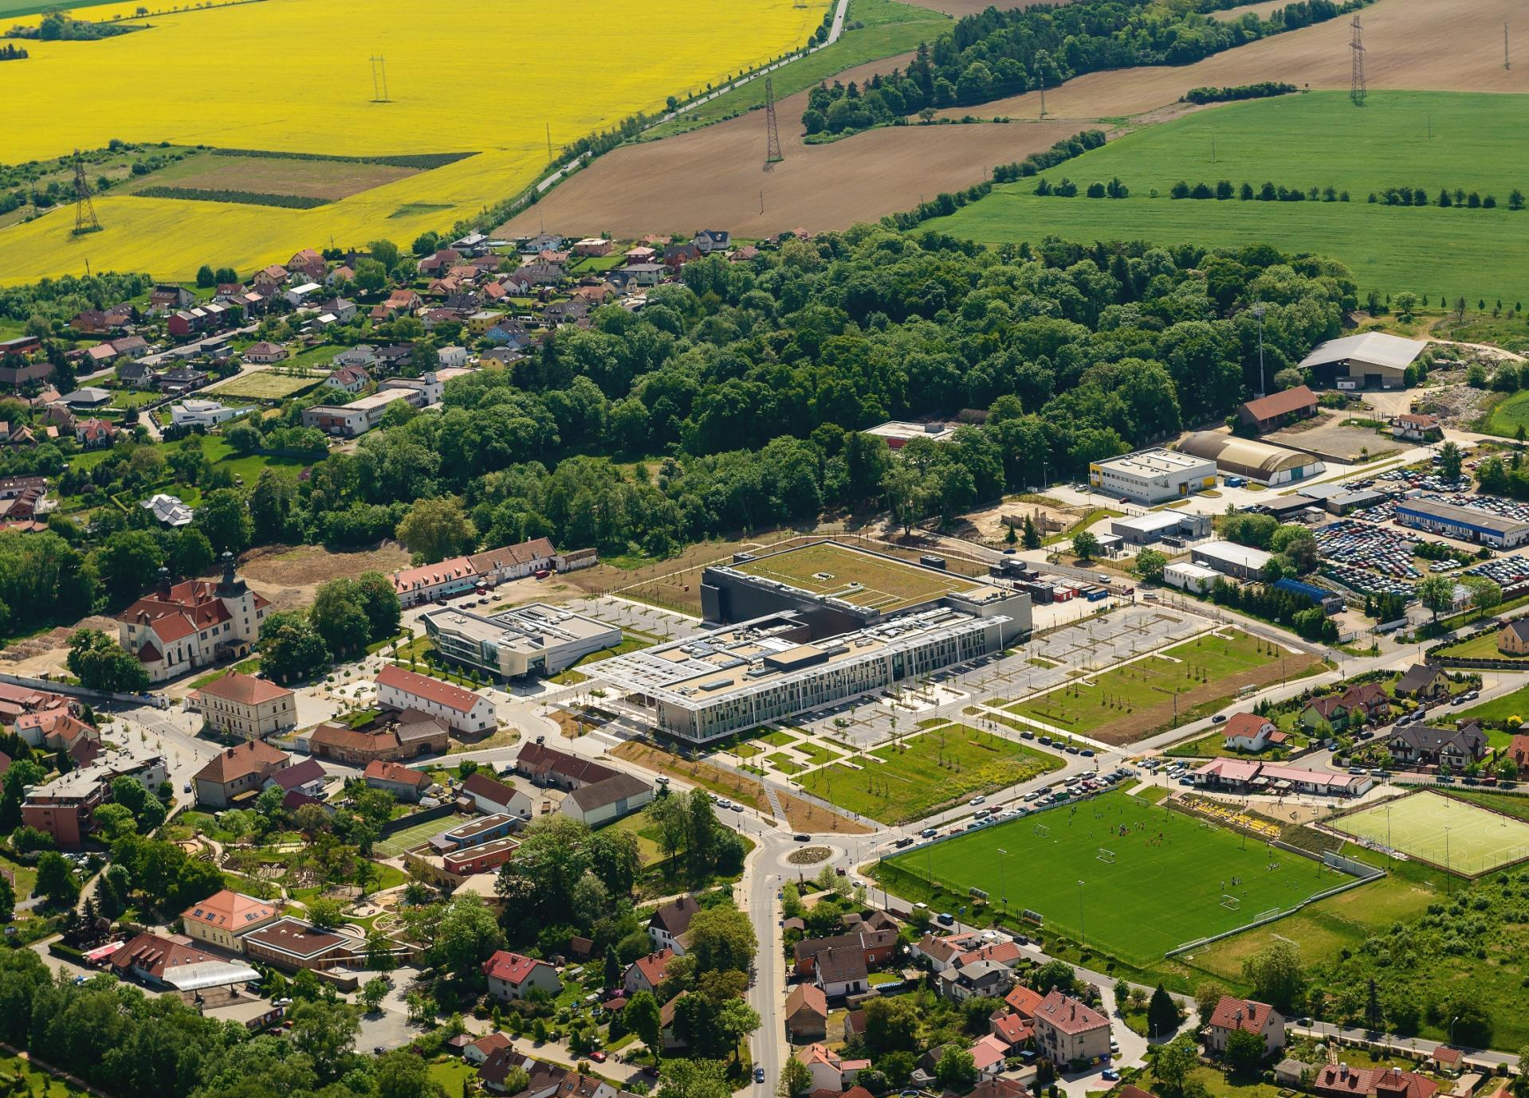
Supporting technology
Experimental building
Administrative building
Laboratory

Slide 4
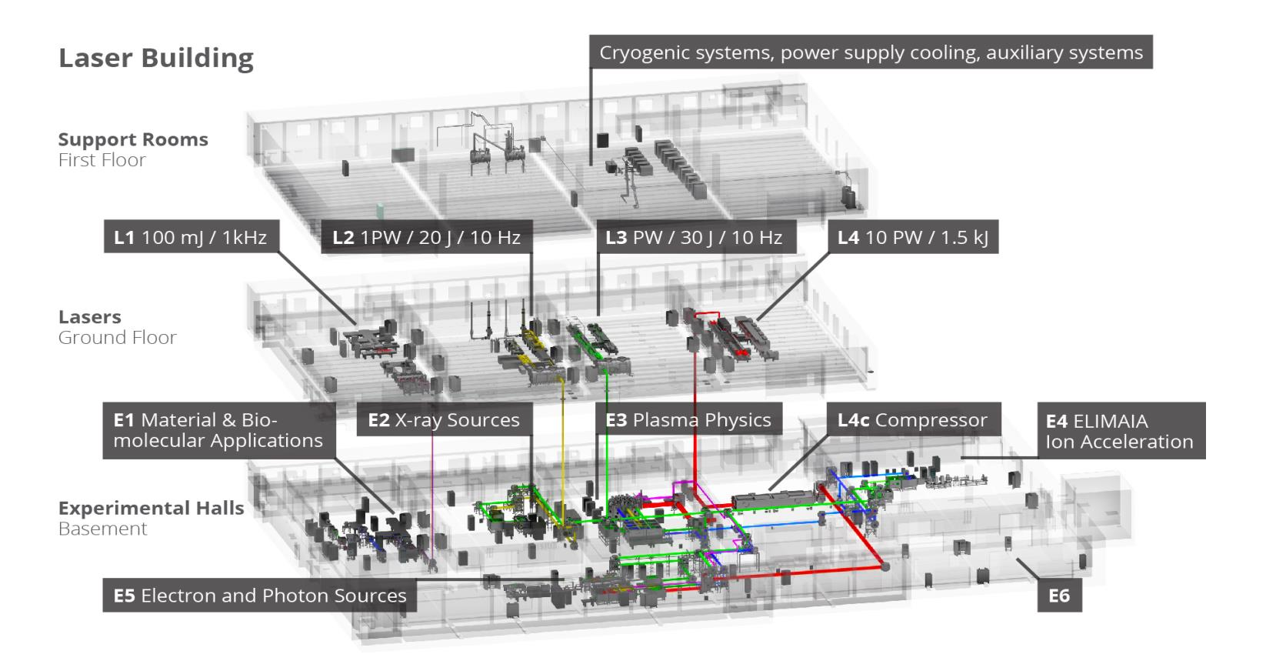
Experimental building scheme

Slide 5
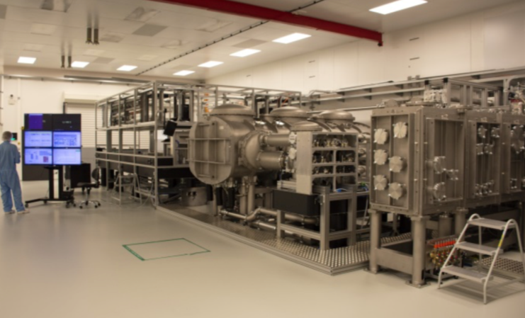
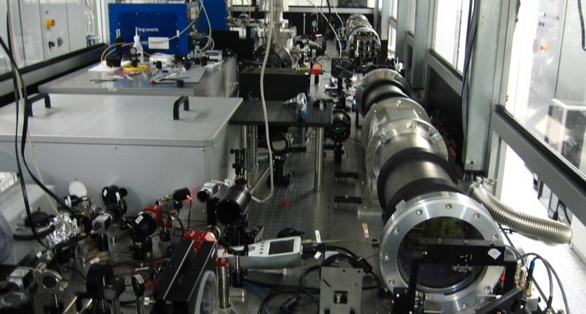
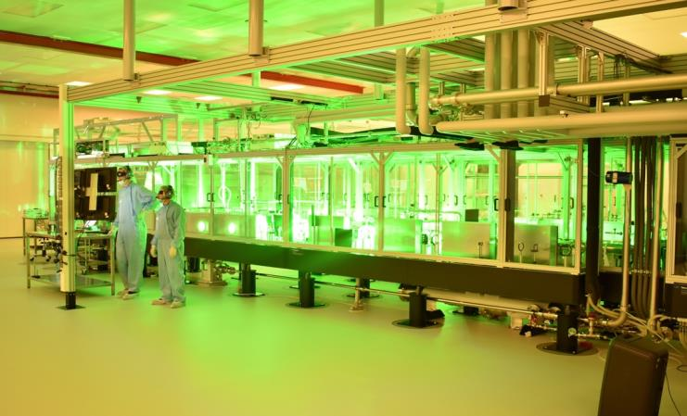
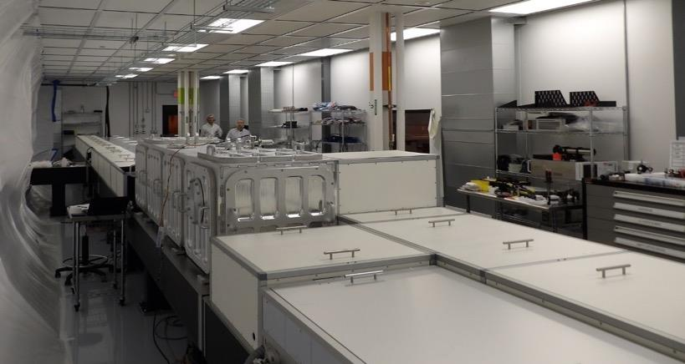
Main laser systems
L1 ALLEGRA
L2 AMOS
L3 HAPLS
L4 ATON

Slide 6
Operational laser systems
L1 ALLEGRA
Development: in house
Commissioning (10mJ, 1kHz) – since 07/2018
First experiment – 09/2018
Upgrade of parameters – 30mJ, 1kHz – 05/2019
First users – 06/2019
Target parameters: 100 mJ, 5TW, 1 kHz
L3 HAPLS
Developed together with LLNL, USA
Commissioning (16J, 3,3Hz) – since 07/2018
First experiment – 02/2019
Upgrade of parameters – 30J, 3,3 Hz – 07/2019
Target parameters: 30J, PW, 10 Hz

Slide 7
Work-in-progress laser systems
Development: together with STFC, UK
Instalation started - 01/2019
Target parameters: 20 J, PW, 10Hz
L2 AMOS
Development: NE, USA & Ekspla, Lithuania
Installation ongoing
Target parameters: 2 kJ, 10 PW, 0.1Hz
L4 ATON

Slide 8
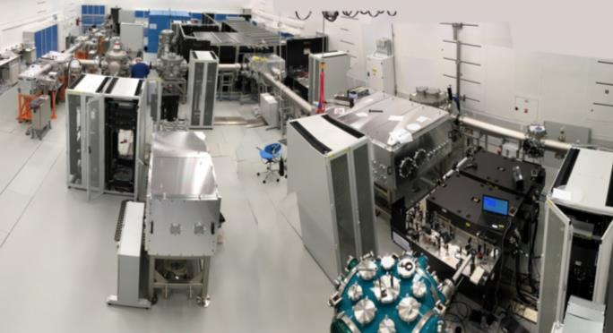
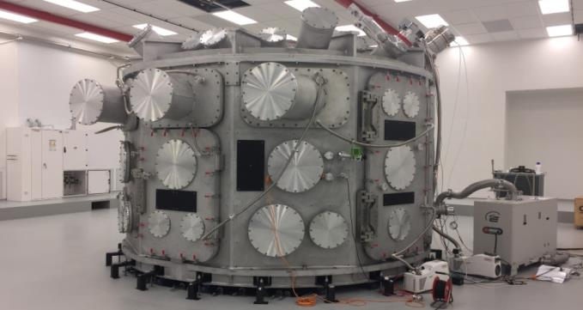
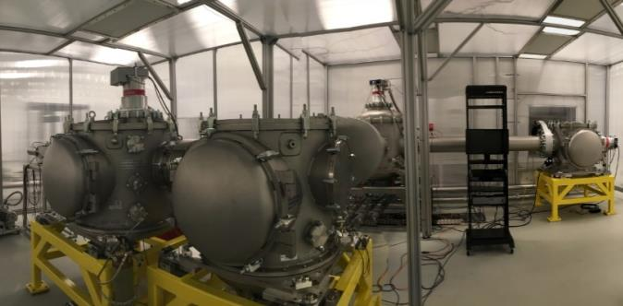
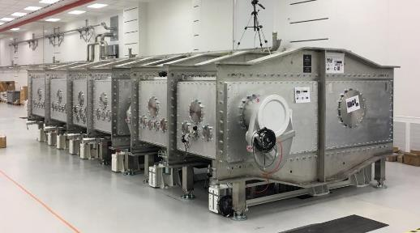
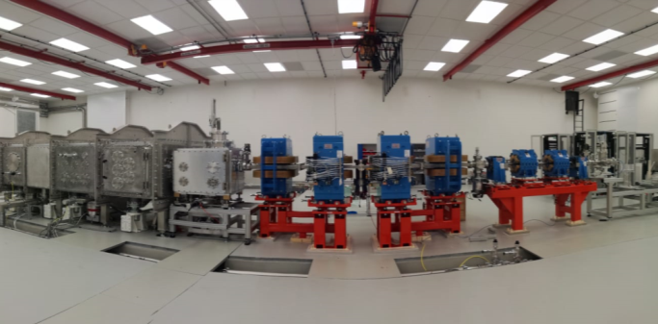
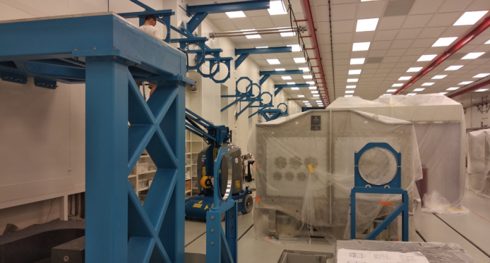
Experimental halls
E1
E3 – P3
TERESA
E5 - LUIS
E5 -HELL
E4 - ELIMAIA

Slide 9
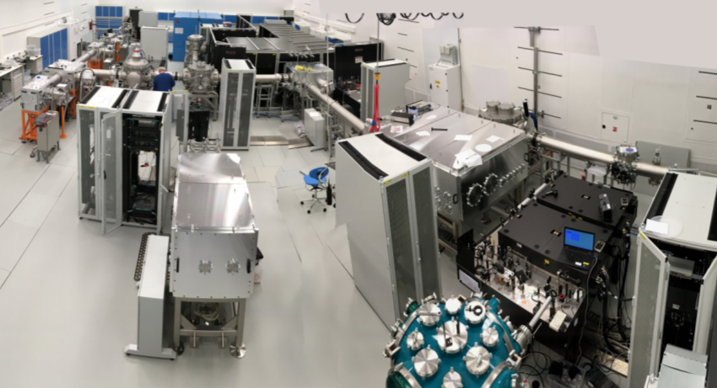
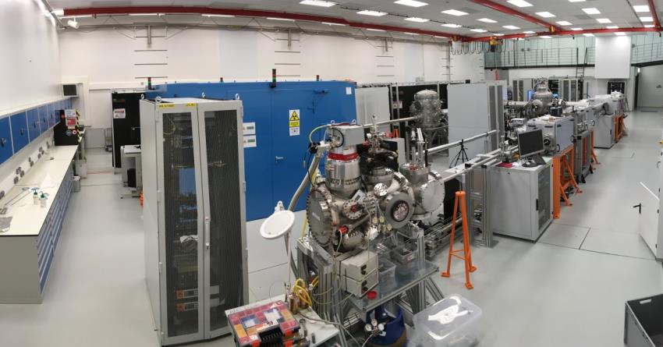
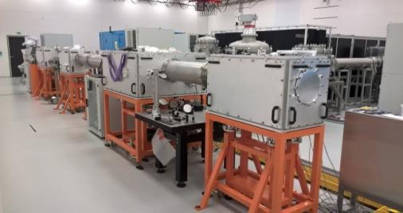
Experimental halls
E1
Operation
since 02/2018 with Astrella laser
since 09/2018 with L1 laser
  SRS – operation since 05/2018, ready for users
    MAC, ELIps – commissioning
HHG: X-ray <1 keV
Operation since 05/2018, ready for users
  PXS: X-rays < 30 keV, commissioning ongoing
PXS
HHG

Slide 10


Experimental halls
Plasma physics
Main chamber installed
(Ø 4.5 m, height 3.3 m,~ 14 t, volume~ 50 m³)
spring 2018
Mechanical tests
  Start of commissioning autumn 2019
  From spontaneous to coherent electron radiation
Development in cooperation with
University of Hamburg
First beam in Germany (400 MeV electrons,
5 Hz) 06/2016
  Installation of upgraded system at ELI
  First phase of commissioning 2020
E3 – P3
E5 - LUIS

Slide 11

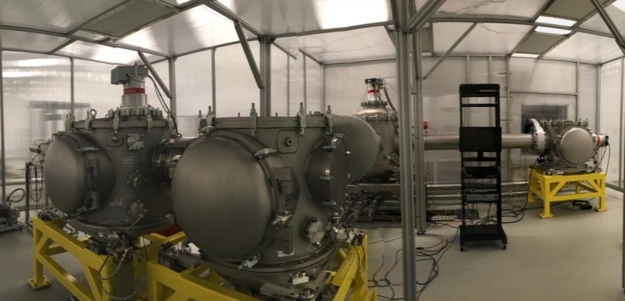
Experimental halls
E4 - ELIMAIA
Ion acceleration
Developed together with INFN, Italy
Installation 08/2018
  Commissioning - autumn 2019
Temporary testbed
- operated with L3
- goal: protons 10 MeV, electrons 150 MeV
Installation of technology and shielding
  Commissioning since 02/2019
TERESA

Slide 12
Safety at ELI Beamlines
High power ultrashort pulse lasers used for particle acceleration
Full independent operation of experimental halls, mostly external users
Multi hazard facility
Clean room areas (ISO 7 and ISO 8)
~330 employees
~30 countries from all over the world
~100 registered contractors
Safety team: 12 people, covering
  Security
  OHS
  Fire protection
  Environmental protection
  Risk assessment
  Ionizing radiation protection
  Monte Carlo simulations
  Laser safety
  Biosafety
  Chemical and gas safety
  …

Slide 13
Radiation protection at ELI Beamlines
Non ionizing radiation
      Electromagnetic pulse
          passive protection – Faraday cage
          systematic grounding, shielding
      Laser
Ionizing radiation

Slide 14
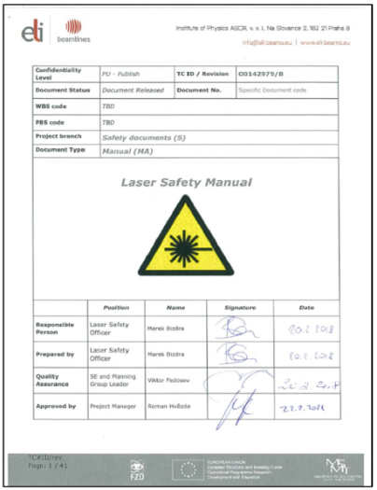
Laser safety
  Laser safety officer (member of Safety team)
  Laser safety supervisor (member of the operating team) – designated for each large laser system
Laser safety manual
        Main rules and responsibilities in laser safety
Laser safety committee
        Supervisory authority
        8 members (one external)
        Quarterly meetings or when needed

Slide 15
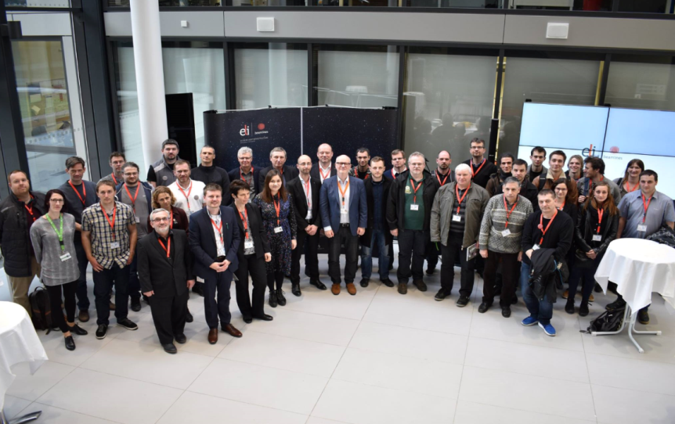
Laser safety - Training
Training provided at three levels
        A1 - Laser safety supervisor
        A2 - Laser or experimental scientist
        A3 - Support teams
        LSO – external training
Sharing knowledge
Laser safety workshop - March 2019
For universities and industry

Slide 16
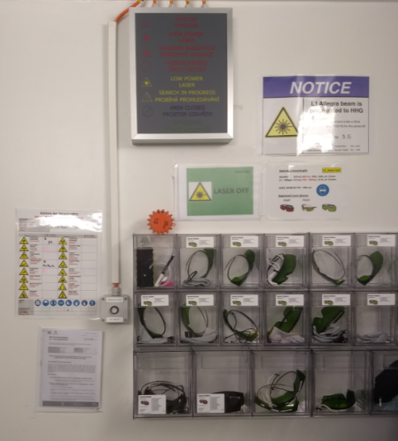
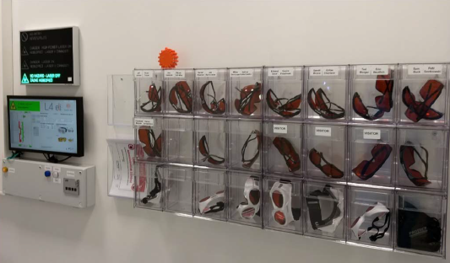
Laser safety - PPE
        - Many lasers with various parameters My kingdom for … the goggles!
        - The right goggles for
            Particular laser AND its current operating parameters (multipurpose goggles - too dark)
          The person (different face shapes)
        Several near misses
          smaller choice of goggles, signs, pictures, administrative procedures (incl. better planning)

Slide 17
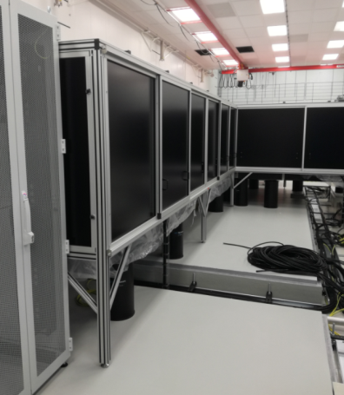
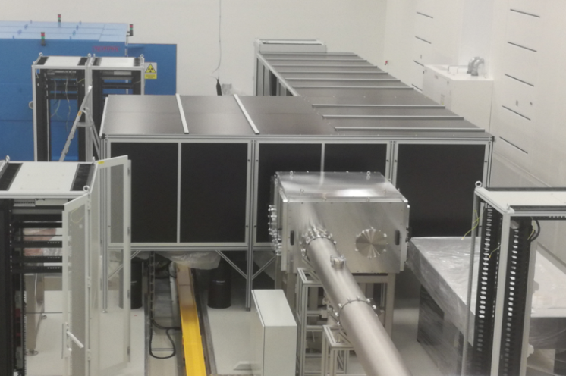
Laser safety – local enclosures
        Creating separate laser zones
        Laser curtains
        Metallic sheets
        Wall partitions

Slide 18
Ionizing radiation protection
  Radiation workplace category III
Radiation field
      Mixed: photons, e-, n, p+, ions, µ
      Pulsed: fs-ps
      Low repetition rate: 0.1 Hz – 1 kHz
      Wide energy range (keV -> GeV)
      Extremely high dose rate in a single pulse
Source term not well known
      Subject of research
      Strongly dependent on the experiment
  Reliable procedures do not exist
  Laser community not used to working with radiation

Slide 19
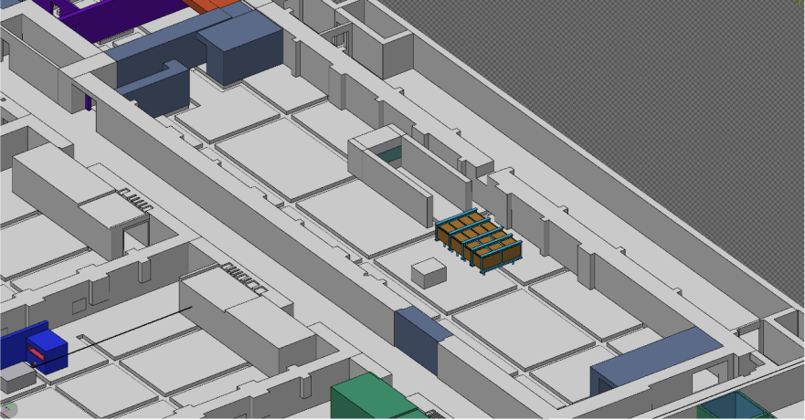
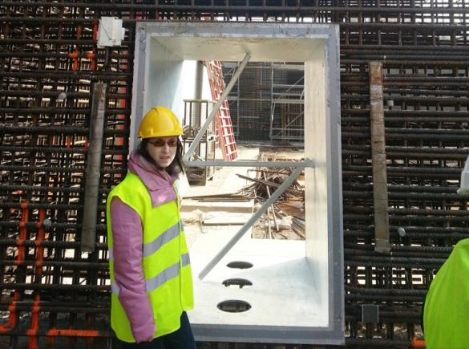
Ionizing radiation protection
Simulations
Monte Carlo method – code FLUKA
Members of FLUKA collaboration
Civil structure design
Target dose limit <1 mSv/y for employees
Cooperation with architects
First calculations by Nuclear Technologies
(2009-2013)
Worst case (max source term, open penetrations)
penetrations: shielded as much as feasible
Beam dumps and local shielding
For several configurations (minimal, typical, maximal)
Gradual refinement - going to more detail, more realistic description, influence of magnetic field

Slide 20
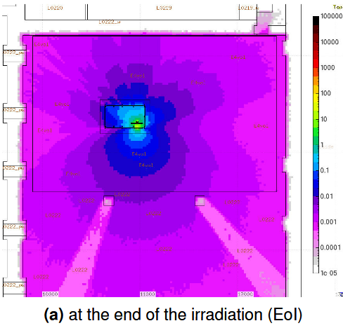
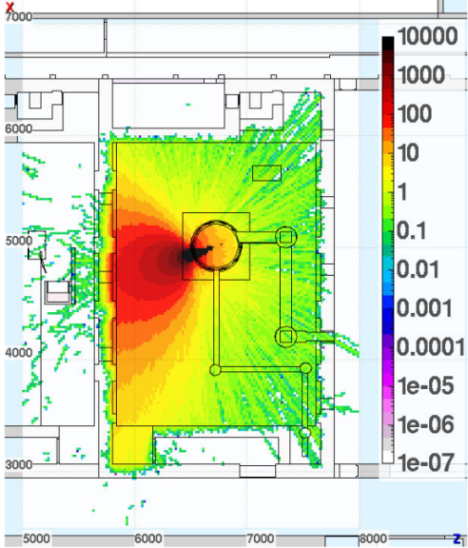
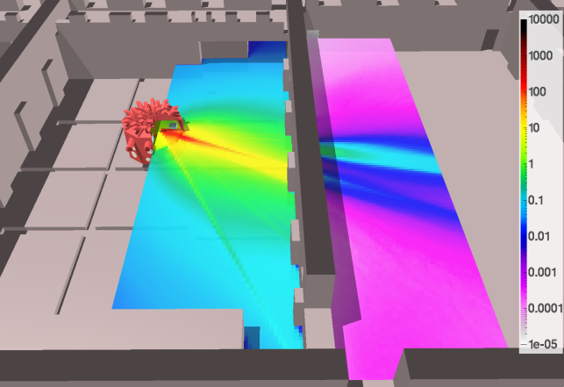
Ionizing radiation protection
Simulations
Material activation
Radiation damage
Ḣ*(10), µSv/h
Dose rate H*(10)
[#particles/cm²/shot]
H*(10) rate map [mSv/shot]
Notes:
Poškození jednou událostí
(Single event effect)
Fluence vysokoenergetických (>20 MeV) hadronů

Slide 21
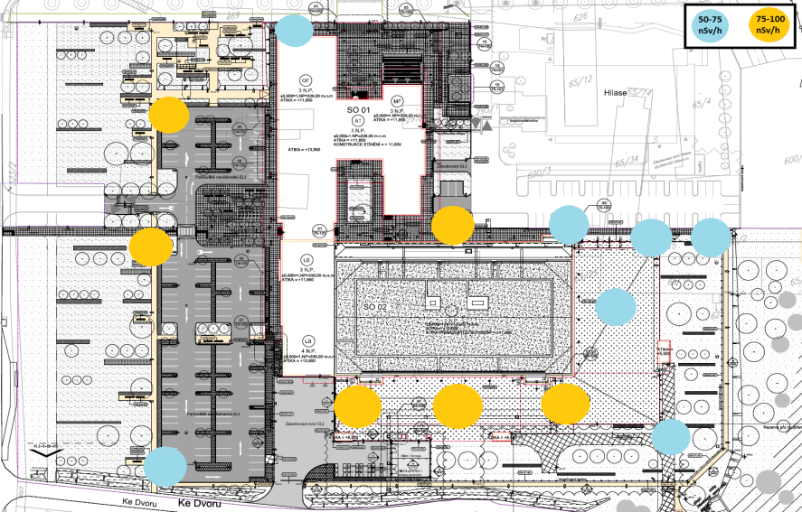
Ionizing radiation protection
Monitoring
Passive (OSL)
  Environment (since 01/18)
  Workplace
Active monitoring
  Several types of detectors
  Indicators
  Dose rate measurement
      Pulsed field (prompt)
      Continuous field (residual)
  Interfaced to Interlock system
Personal dosimetry
  Combination of passive and active

Slide 22
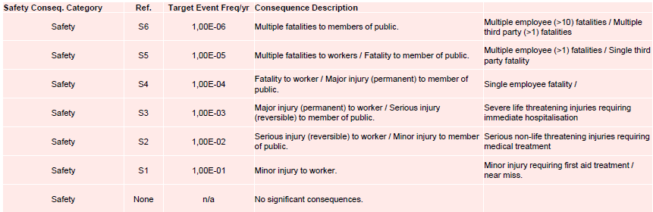
Personal safety interlock
    Covered hazards
      Laser
      Ionizing radiation
      EMP
      Technical gases
      Vacuum
Based on industrial safety standards (IEC 61508)
Method used: LOPA
Currently being implemented

Slide 23

Test-bed TERESA
TEst-bed for high-REpetition rate Source of Accelerated particles
New facility… and already significant changes of use
Small experimental arrangement in the hall where use of ionizing radiation was NEVER planned
      No passive shielding of the walls
      On ground level
      Ceiling not prepared for heavy loads (dump)
      Hall not prepared for simultaneous use of more teams
Notes:
TEst-bed for high-REpetition rate Source of Accelerated particles

Slide 24
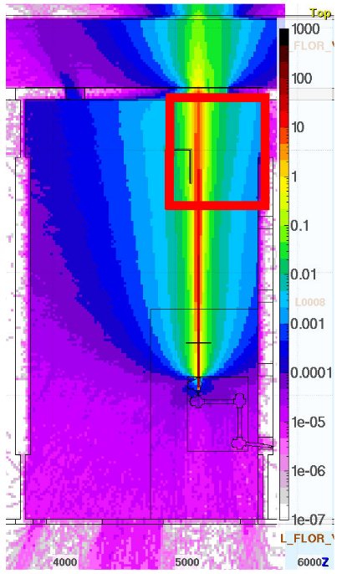

First results
Smoking area
Corridor
Control room
Simple and easy arithmetic (smoking area):
    ~0,1 microSv/shot, i.e.~3 microSv/s
    1 mSv (limit for members of public)
        within ~5 min of operation
    20 mSv (limit for radiation workers)
        within ~100 min of operation
Impossible we do immediately,
miracles take a bit longer…
µSv/shot

Slide 25
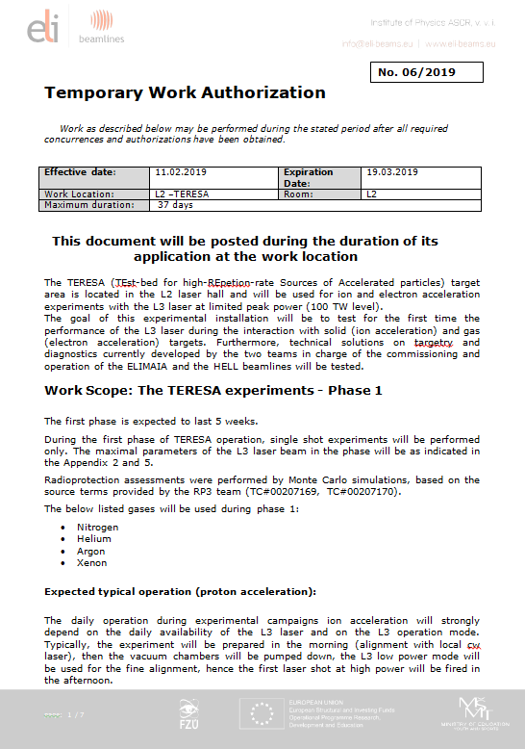
Test-bed TERESA
Risk assessment:
  Shielding
      Stopper of the ionizing beam
      Laser safety curtains
  Enclosure of the setup (clean room tent)
  PPE
  Monitoring
  Local Interlock
  TWA – temporary work authorization reflecting setps in each phase of operation

Slide 26
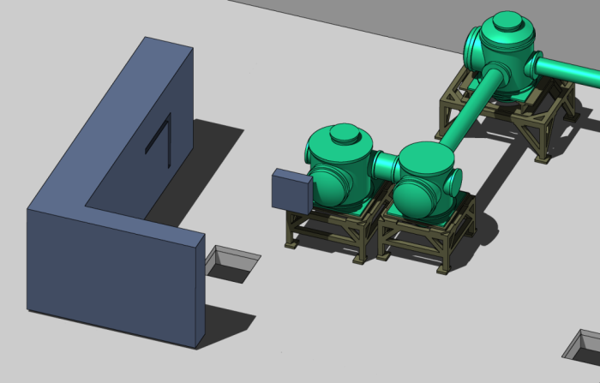
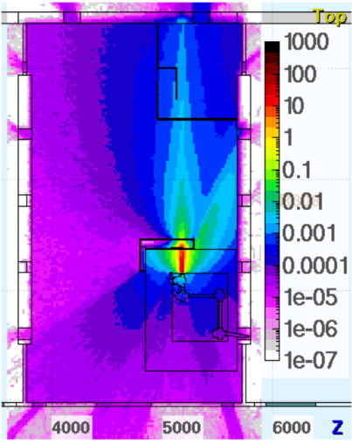
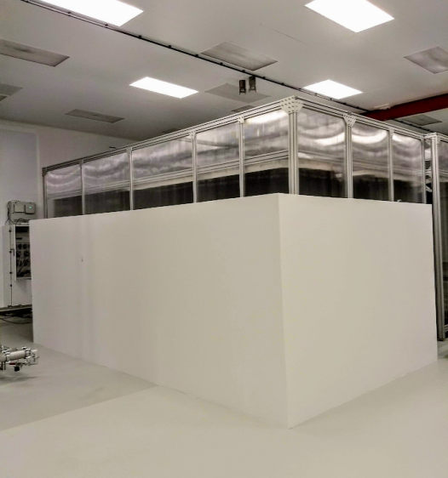
Test-bed TERESA: safety measures
Concrete beam dump
µSv/shot

Slide 27
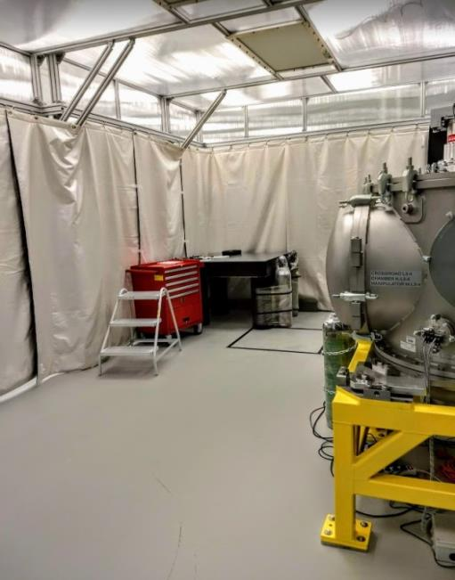
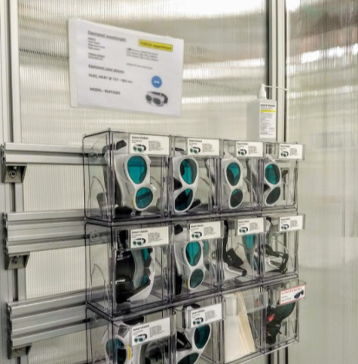
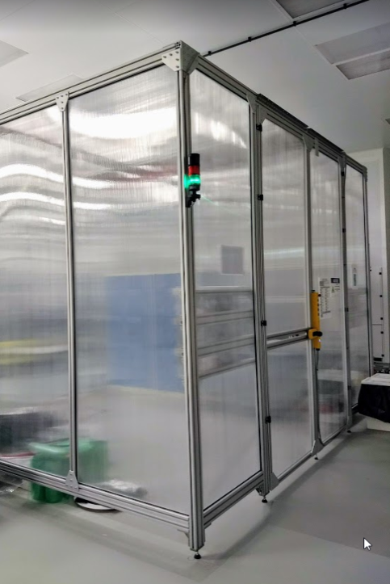
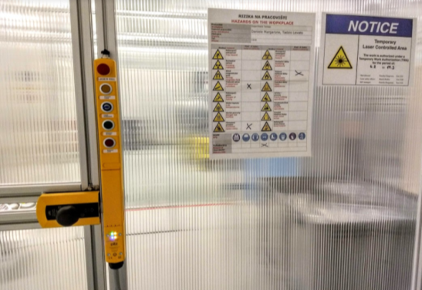
Test-bed TERESA: safety measures
PPE
Laser curtains
Interlock

Slide 28
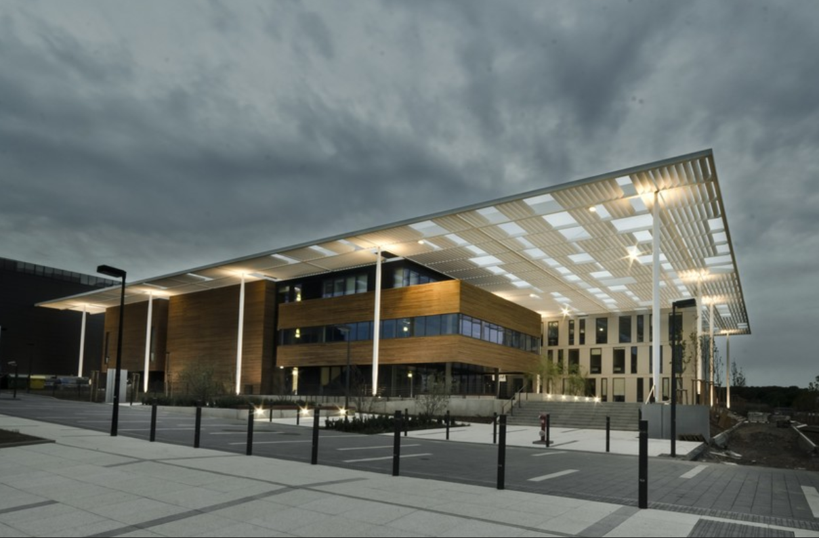
Thanks for your attention
veronika.olsovcova@eli-beams.eu
www.eli-beams.eu

