Slide 1
CERN Experiments Safety Validation and sign-off Process
An example .. The Neutrino Platform
NP04 Experiment

Slide 2
The Context
The validation of the physics Experiments at CERN is based on an historic close collaboration between the CERN HSE (environment, health and safety unit) and the EP Physics department.
3 years ago, we have decided to revise the procedure of validation to :
- strengthen the collaboration HSE unit / EP Safety Office
- optimise and clarify the role of each entity towards the Experiments
- develop the assistance of the EP Safety Office to the Experiments in order to guarantee their safety compliance and a safe operation.
In parallel, we have developed uniformed inter-departmental
sign-off process for safety permits (beam, cryogenics, lasers,..)
This revised process was fully implemented for the first time in EP on NP04 experiment
… from design to operation.

Slide 3
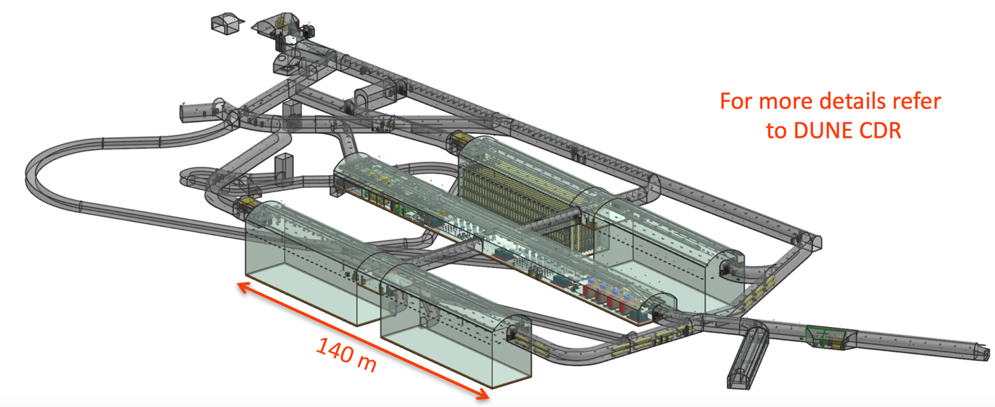
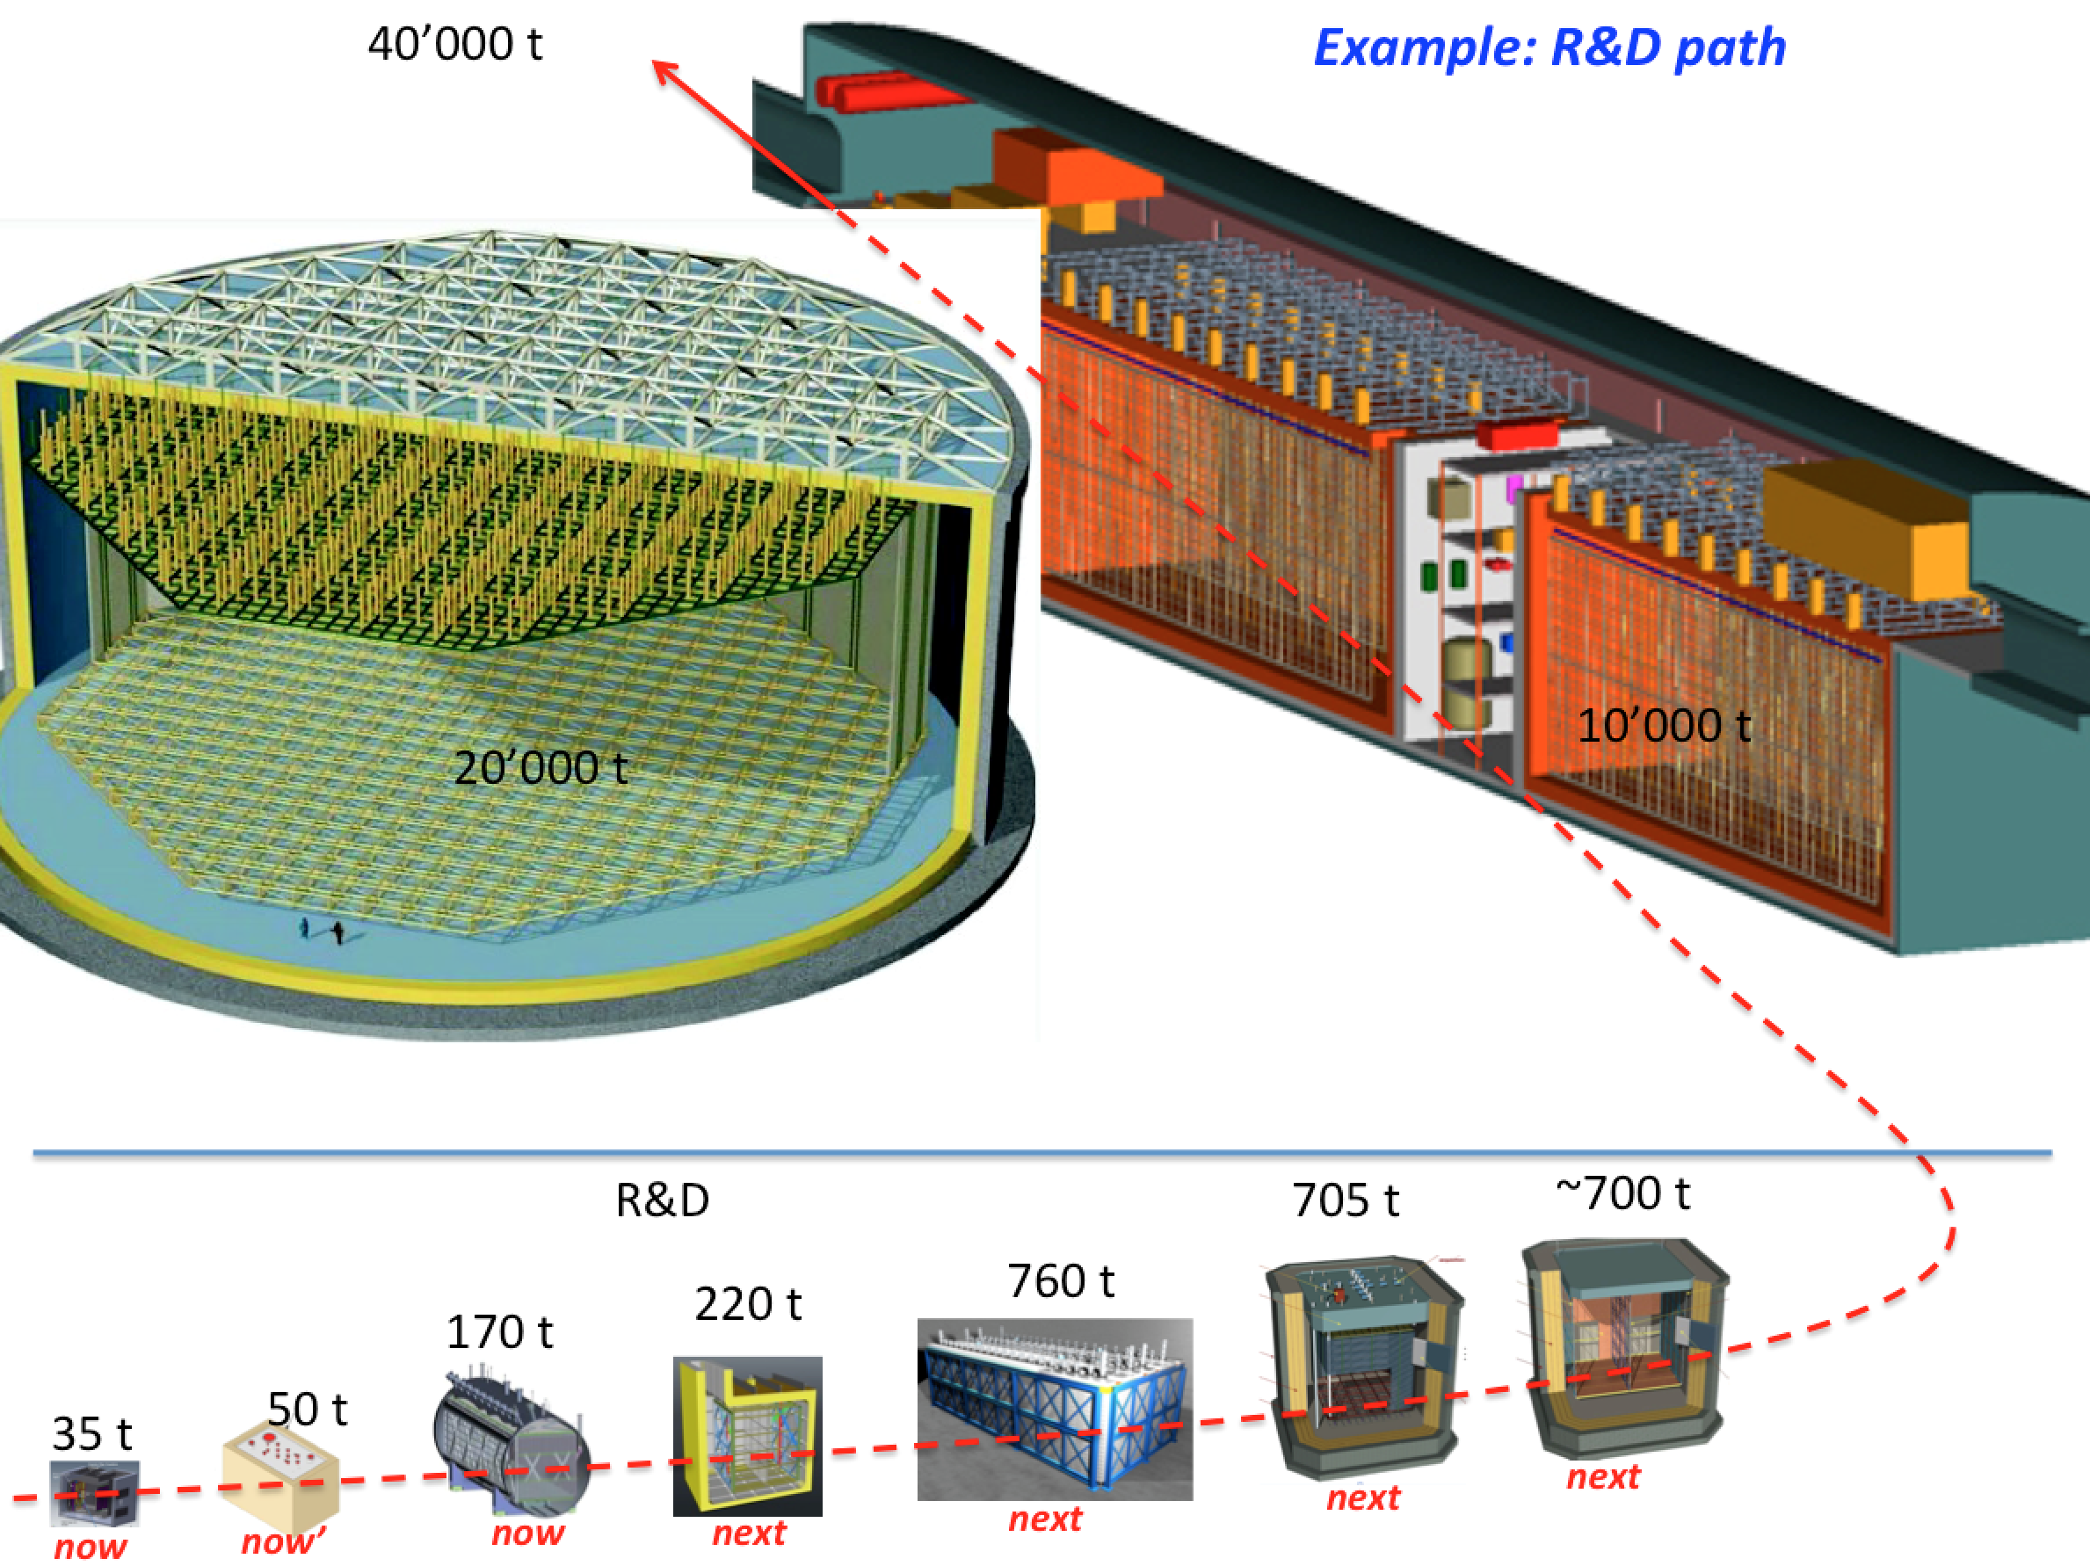
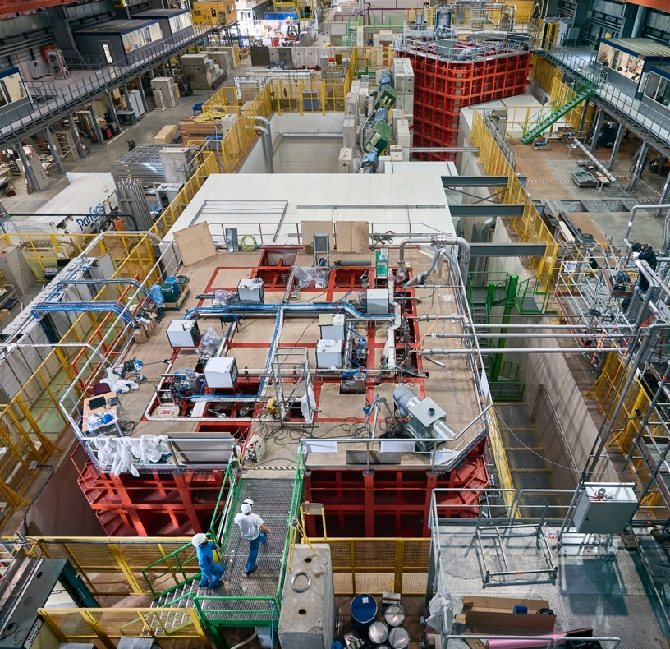
An example: the ProtoDUNE experiments at CERN - NP04 as part of the general Neutrino Platform step by step project
LBNF / DUNE
(South Dakota – US)
~ 750 t
~ 750 t
2 x 360 t
ProtoDUNE (CERN)

Slide 4
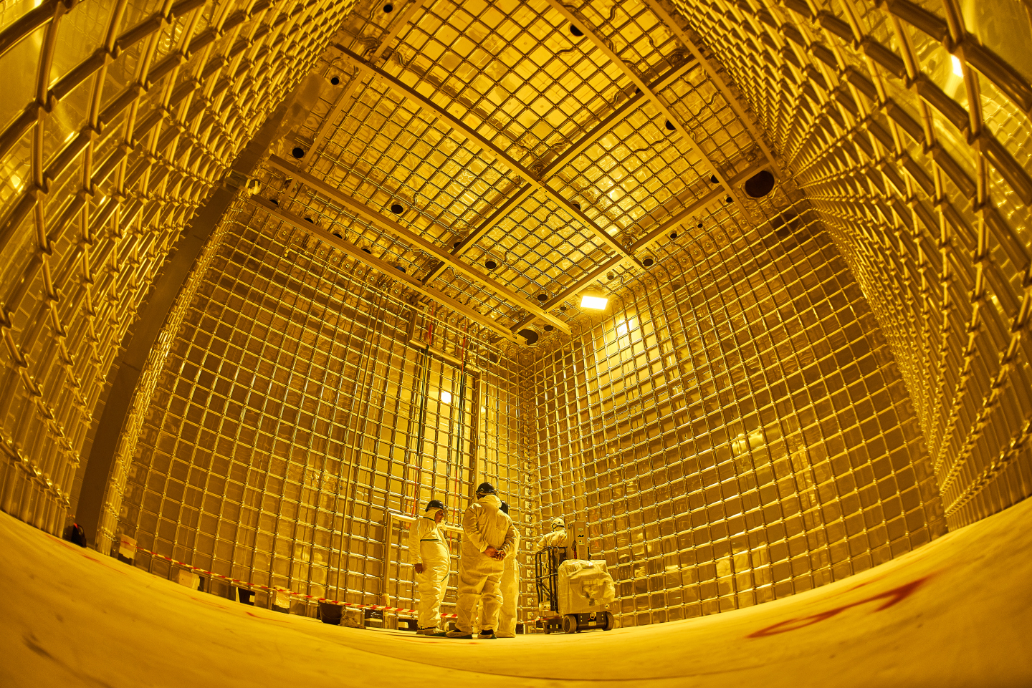
NP04 Experiment .. the risks and specificities
  NP04 is hosted in the North area extension at CERN.
  We had to face some “common” hazards like fire, flammable gases, radiations, confined space, working at height, HV, etc..
  Main specificities:
  A membrane tank cryostat of 11 m height filled at 96 % with
  550 m3 of Lar with a maximum gas overpressure 350 mbarg, with side penetration (Protego valve) for liquid recirculation
  A complex cryogenics commissioning process
  Main risks and safety challenges:
  A complex process of validation and sign-off due to the complexity of the experiment and of the nature of the EU/US nature project
  EU (NP04 prototype) → US (DUNE experiment)
    for example .. the validation of the cryostat structure is challenging in term of standards and regulation:
  it is effectively an atmospheric cryogenic storage tank with low pressure (not subjected to PED or ASME)
  Very large quantity of cryogenics : risk of ODH
  Large stored energy in the vessel during cryogenics commissioning phases : risk of blast

Slide 5
NP04 Cryogenics/Cryostat Commissioning Safety Validation Process
Initial safety declaration of equipment
Design and fabrication of sub systems
Installation
Cryogenics/Cryostat commissioning
validation and sign-off process
- Detailed description of the system
- Mechanical calculations
- Certificates
- Tests results
- Activity declaration
- Detailed installation info
- Write operational procedures
- Perform tests
Equipment responsible
- Cryogenics/Cryostat equipment and related safety systems installed, tested and validated as required
- Safety file validated
(inter-departmental)
Cryogenics/Cryostat commissioning authorised
- List of hazards (EP)
- Applicable rules and regulations (HSE)
- Required safety checks (HSE / EP)
- Formal authorisation
to start design (EP/ HSE)
- Equipment safety validation
by expert engineer
(mechanical, electrical, ..)
(HSE with the collaboration of EP specialised safety officers)
- Activity safety
analysis (EP)
- Validation of the activity (EP with the assistance of HSE)
- Supervision on site (EP)
- Safety inspections (HSE/EP)
- Required safety systems commissioned (EP with the assistance of EN/BE/TE dep.)
- Organisational Safety procedures validated (EP)
EP Safety
Office/HSE Unit
Safety Permit
signed off!
(inter-departmental)
SAFETY FILE EDITION
RISK ASSESSMENTS (ODH/Blast)

Slide 6
An example: Risk assessment of a possible mechanical rupture / blast effect during cryo. commissioning
Initial safety declaration of equipment
Design and fabrication of sub systems
Installation
Cryogenics/Cryostat commissioning
validation and sign-off process
- Detailed description of the system
- Mechanical calculations
- Certificates
- Tests results
- Activity declaration
- Detailed installation info
- Write operational procedures
- Perform tests
Equipment responsible
- Cryogenics/Cryostat equipment and related safety systems installed, tested and validated as required
- Safety file validated
(inter-departmental)
Cryogenics/Cryostat commissioning authorised
- List of hazards (EP)
- Applicable rules and regulations (HSE)
- Required safety checks (HSE / EP)
- Formal authorisation
to start design (EP/ HSE)
- Equipment safety validation
by expert engineer
(mechanical, electrical, ..)
(HSE with the assistance of EP specialised safety officers)
- Activity safety
analysis (EP)
- Validation of the activity (EP with the assistance of HSE)
- Supervision on site (EP)
- Safety inspections (HSE/EP)
- Required safety systems commissioned (EP with the assistance of EN/BE/TE dep.)
- Organisational Safety procedures validated (EP)
EP Safety
Office/HSE Unit
Safety Permit
signed off!
(inter-departmental)
SAFETY FILE EDITION
RISK ASSESSMENTS (ODH/Blast)

Slide 7
An example: risk assessment of the cryogenics /cryostat commissioning
  Cryogenics/cryostat commissioning phases:
  Purge, cool down and filling up to 96 % of the internal volume by LAr
Detailed risk assessment performed (EP/ HSE)
before starting the cryogenics commissioning phases
For risks of: ODH
Explosion – blast effect
Mechanical break of structural elements including welds and penetrations that could lead to a sudden depressurisation of the cryostat with potentially blast effects depending on the energy stored in the cryostat
Provided:
An exhaustive QC of the cryostat structure design, fabrication and installation and testing campaign
A cryogenics safety control system and:
- regulation vent valve at 200 mbarg
- safety valve opens at 350 mbarg.
We concluded:
The scenario of exceeding the 200 mbarg is considered very unlikely.
A sudden depressurization of the cryostat warm vessel and an ODH in the area is considered totally unlikely.
Nevertheless, we put in place compensatory safety measures for the risk of ODH and blast effect in case of sudden depressurization.

Slide 8
An example: risk assessment of the cryogenics /cryostat commissioning
Energy induced by a possible cryostat mechanical failure due to an internal overpressure of gas determined using the Baker isentropic method:
200 mbarg gas overpressure in 570 m3 volume
Equivalent to 1.75 Kg of TNT
Determination of personnel injuries: for eardrum and lung hemorrhage
Determination of structural damages
For a TNT mass of 1.75 Kg :
Safe distance for eardrum is 11 m
Safe distance for lung haemorrhage is 3.7 m
Safe distance for structural damages is 20 m
Safety measures:
Exclusion areas
Restricted access
Trained people
Cryogenics system under permanent control
Cryostat structure behaviour under surveillance

Slide 9
An example : Cryostat structure design and validation process
Initial safety declaration of equipment
Design and fabrication of sub systems
Installation
Cryogenics/Cryostat commissioning
validation and sign-off process
- Detailed description of the system
- Mechanical calculations
- Certificates
- Tests results
- Activity declaration
- Detailed installation info
- Write operational procedures
- Perform tests
Equipment responsible
- Cryogenics/Cryostat equipment and related safety systems installed, tested and validated as required
- Safety file validated
(inter-departmental)
Cryogenics/Cryostat commissioning authorised
- List of hazards (EP)
- Applicable rules and regulations (HSE)
- Required safety checks (HSE / EP)
- Formal authorisation
to start design (EP/ HSE)
- Equipment safety validation
by expert engineer
(mechanical, electrical, ..)
(HSE with the assistance of EP specialised safety officers)
- Activity safety
analysis (EP)
- Validation of the activity (EP with the assistance of HSE)
- Supervision on site (EP)
- Safety inspections (HSE/EP)
- Required safety systems commissioned (EP with the assistance of EN/BE/TE dep.)
- Organisational Safety procedures validated (EP)
EP Safety
Office/HSE Unit
Safety Permit
signed off!
(inter-departmental)
SAFETY FILE EDITION
RISK ASSESSMENTS (ODH/Blast)

Slide 10
An example: Cryostat structure design and validation
  Designed by EN1993, EN1990, EN1991, EN1997, EN1998
  Calculated using FEA global and detailed modeling
  Validated by HSE unit
Design
  Manufactured and assembled following EN1090-2
  (execution of steel structures)
  Followed a strict QA / inspection / testing plan as per EN1090 validated by HSE unit
  Extensively leak tested - primary and the secondary membrane including penetrations
Fabrication and installation
Commissioning
  Cryostat structures have been finally qualified in steps during the NP04 cryogenics commissioning phases

Slide 11
Cryostat structure qualification … in steps
4 main steps of structural qualification:
Pressure test at 200 mbarg (few hours)
Cooling and purging (few weeks)
Liquid argon filling of the cryostat (about a month)
Final pressure test when the cryostat is full (few hours)
Sizing load case of the cryostat structure : Cryostat full of LAr – 350 mbarg overpressure (safety relief valve opening)
  The cryostat structure is instrumented with strain gauges (60), displacement sensors and temperature sensors
We monitor structural behaviour of the cryostat during commissioning
at least twice a day or in real time :
check the maximum stresses and strains are not exceeded in the most loaded areas and the symmetrical behaviour
monitor the maximum deformations of the cryostat
validate the FEA models (global or sub models) that have been developed
as a safety indicator of an abnormal behaviour of the cryostat while commissioning

Slide 12
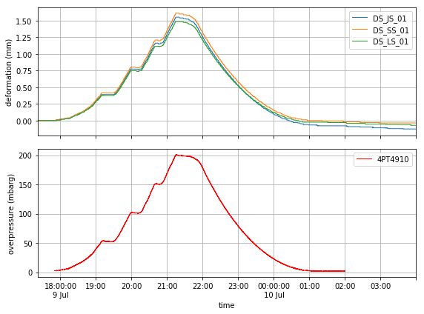
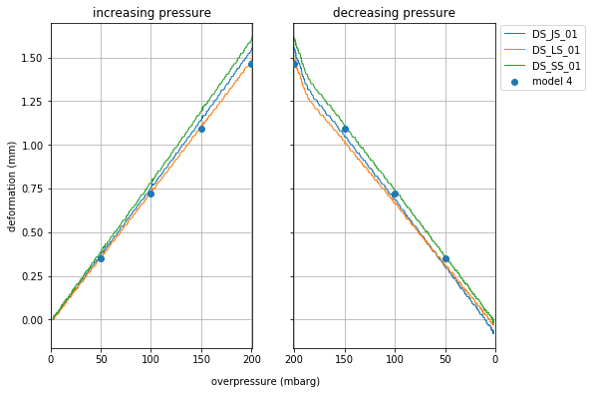
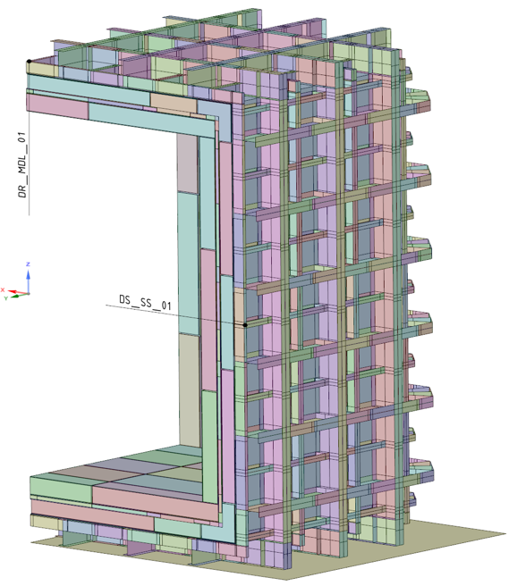
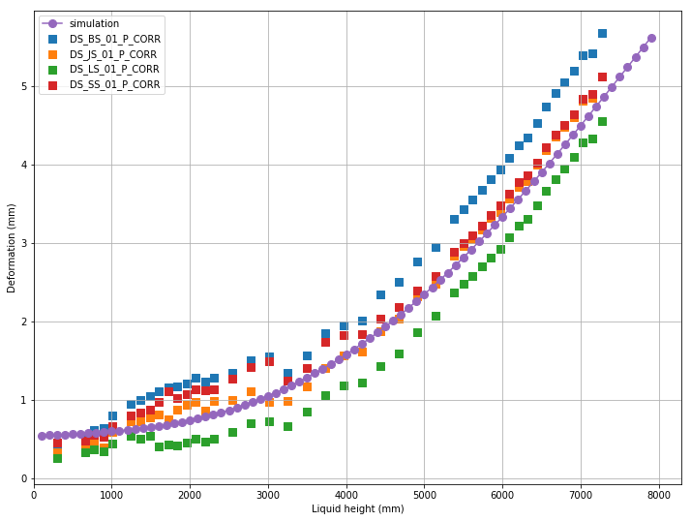
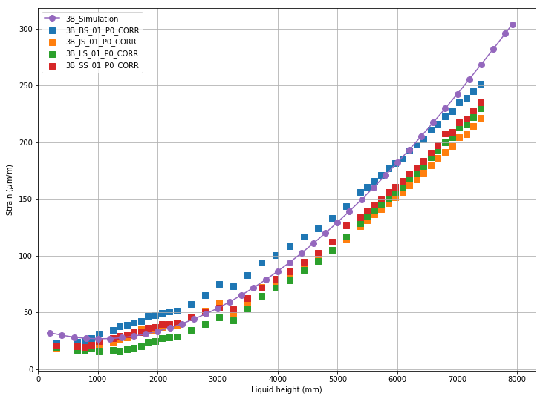
Cryostat structure testing campaign – some results
Initial pressure test@200 mbarg
linear behaviour of the strain gauges
symmetric behaviour of the cryostat
very good agreement between measurements and simulations (within 15 - 20 %)
rerun FEA for a final check of the EU regulation with updated FEA models
NP04 structure is qualified
3B
DS
DS
3B
LAr filling phase – august 2018

Slide 13
Safety files creation
Initial safety declaration of equipment
Design and fabrication of sub systems
Installation
Cryogenics/Cryostat commissioning
validation and sign-off process
- Detailed description of the system
- Mechanical calculations
- Certificates
- Tests results
- Activity declaration
- Detailed installation info
- Write operational procedures
- Perform tests
Equipment responsible
- Cryogenics/Cryostat equipment and related safety systems installed, tested and validated as required
- Safety file validated
(inter-departmental)
Cryogenics/Cryostat commissioning authorised
- List of hazards (EP)
- Applicable rules and regulations (HSE)
- Required safety checks (HSE / EP)
- Formal authorisation
to start design (EP/ HSE)
- Equipment safety validation
by expert engineer
(mechanical, electrical, ..)
(HSE with the assistance of EP specialised safety officers)
- Activity safety
analysis (EP)
- Validation of the activity (EP with the assistance of HSE)
- Supervision on site (EP)
- Safety inspections (HSE/EP)
- Required safety systems commissioned (EP with the assistance of EN/BE/TE dep.)
- Organisational Safety procedures validated (EP)
EP Safety
Office/HSE Unit
Safety Permit
signed off!
(inter-departmental)
SAFETY FILE EDITION
RISK ASSESSMENTS (ODH/Blast)

Slide 14
NP04 Safety Files
HSE Safety Clearance for NP04 released on 29/08/’18
More than 300 documents

Slide 15
NP04 Cryogenics/Cryostat signature of the cryo. Safety permit
Initial safety declaration of equipment
Design and fabrication of sub systems
Installation
Cryogenics/Cryostat commissioning
validation and sign-off process
- Detailed description of the system
- Mechanical calculations
- Certificates
- Tests results
- Activity declaration
- Detailed installation info
- Write operational procedures
- Perform tests
Equipment responsible
- Cryogenics/Cryostat equipment and related safety systems installed, tested and validated as required
- Safety file validated
(inter-departmental)
Cryogenics/Cryostat commissioning authorised
- List of hazards (EP)
- Applicable rules and regulations (HSE)
- Required safety checks (HSE / EP)
- Formal authorisation
to start design (EP/ HSE)
- Equipment safety validation
by expert engineer
(mechanical, electrical, ..)
(HSE with the assistance of EP specialised safety officers)
- Activity safety
analysis (EP)
- Validation of the activity (EP with the assistance of HSE)
- Supervision on site (EP)
- Safety inspections (HSE/EP)
- Required safety systems commissioned (EP with the assistance of EN/BE/TE dep.)
- Organisational Safety procedures validated (EP)
EP Safety
Office/HSE Unit
Safety Permit
signed off!
(inter-departmental)
SAFETY FILE EDITION
RISK ASSESSMENTS (ODH/Blast)

Slide 16
July 2018 … Signature of the Cryogenics Safety Permit for NP04
Complex and very formal process signed by:
NP04 Technical Coordinator
Equipment responsible
CERN section responsible involved
Summarises tests and inspections
Refers to safety file content and safety validations
Identifies usage restriction (if required)
Can be suspended by signatory person, if a safety condition is lost

Slide 17
In Conclusion
The CERN experiment safety validation is a complex process based on CERN inter-department experts’ controls and sign-off process.
This process has been recently successfully applied to the Neutrino Platform NP04 experiment (and to other experiments).
NP04 has the particularity to be a CERN experiment but also a prototype for the US future DUNE experiments.
We are currently in discussions with our US colleagues to discuss the standards equivalency and the possible adaptation of our method of validation to match the US uses and requirements.

