Slide 1


Joint Workplace Safety Committee as a Reflection of Safety Culture
Grant Cubbon
Canadian Light Source
HSE Manager
ITSF 2019 – Lund Sweden

Slide 2
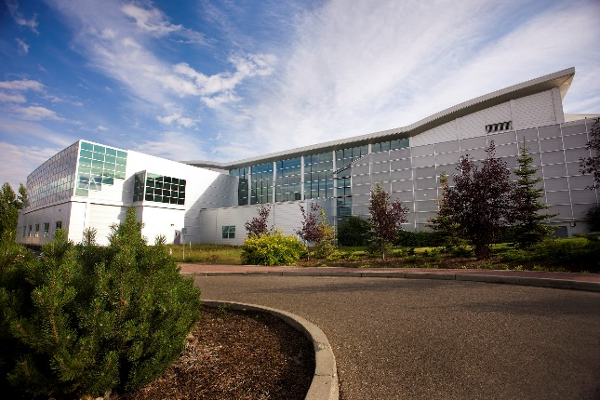
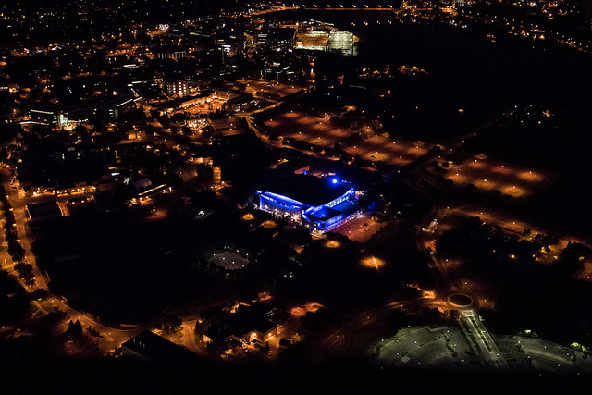
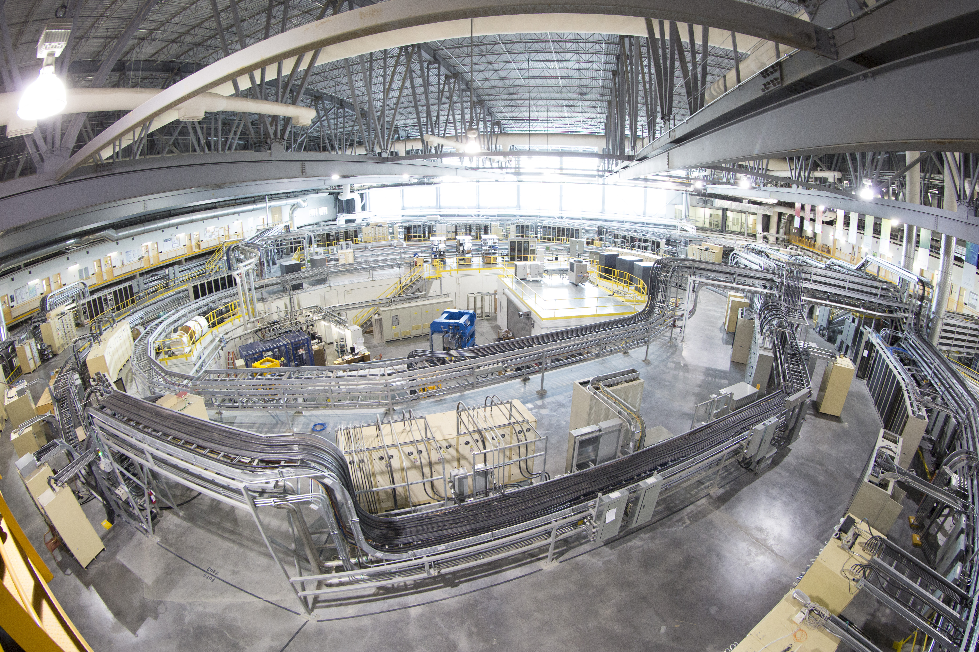
Outline
CLS Facility
Regulations
Joint Workplace Committee
Analysis

Slide 3

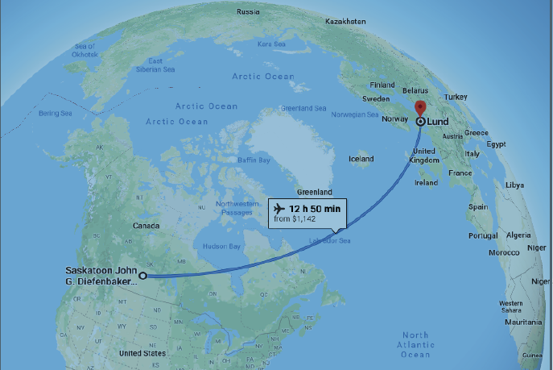
Canadian Light Source
National Synchrotron Facility
250 employees
1200 User visits annually
City of Saskatoon
  Pop 300,000
Province of Saskatchewan
  Pop 1.1 M
On U of S Campus
  20,000 students
Near city center, residential areas

Slide 4
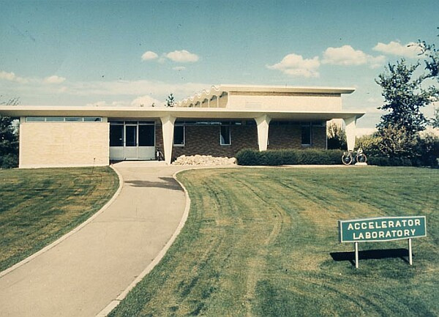
Facility Overview
Saskatchewan Accelerator Laboratory
  1964 -high energy physics research facility
  300 MeV e⁻ LINAC 2 stories underground
    Owned by University of Saskatchewan
    360 Hz
      CLS now 1 Hz

Slide 5
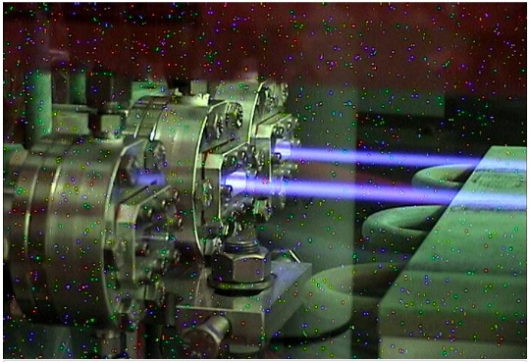
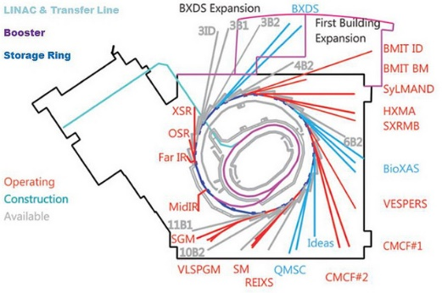
CLS Facility
Synchrotron Facility
  Construction start 1999
  Transfer lines to bring beam
  up two floors to Booster Ring
  Booster Ring ramps 250 MeV to 2.9 GeV
  2.9 GeV Synchrotron Storage Ring (178m)
  17 Beamlines in ‘new’ section of building
  3 hectare footprint
  1800 m² building

Slide 6
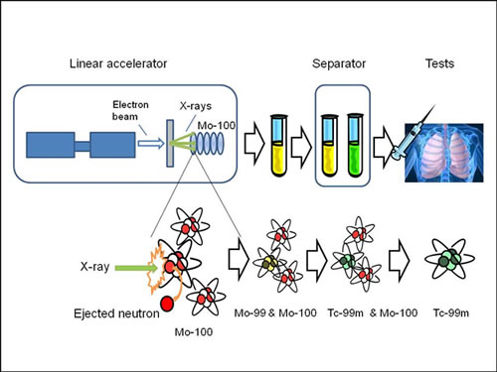
Medical Isotope LINAC
2012 addition
30 MeV, 40 kW e⁻ linac
E- beam hits tantalum target
  Bremsstrahlung strikes Mo-100
  Mo-100 produces Mo-99
Research Facility
  Small impact on overall operation
  Separate operating licence - budget

Slide 7
Regulatory Oversight
Canadian Nuclear Safety Commission (CNSC)
  Act and Regulations
  Licencing and oversight (inspections)
  Licencing requires CLS to follow other regulations and internal documentation also
Labour Canada
  Canada Labour Code

Slide 8
Safety Culture
CNSC Definition:
“the characteristics of the work environment such as the values, rules, and common understanding that influence workers perceptions and attitudes about the importance the organization places on safety”
REGDOC 2.1.2 ‘Safety Culture’

Slide 9
Canadian Labour Regulations
Canada Labour Code Part II -135 (1)
“Every employer shall … establish a workplace health and safety committee…”
  Why is the committee a legal requirement?
  What does the committee mean to the workers?
  Does the committee reflect safety culture?

Slide 10






Not Another Committee!!!
Who needs this committee?
I’m busy enough!
I work safely!
It’s the Law!
Canadian companies with more than 20 employees must have a workplace safety committee
Why do we need this??

Slide 11


Right To Participate
Workers Have Rights!
Right to Know
Right to Refuse
Right to Participate
Participation in the Committee is Defined!
Employer Co-Chair
Employee Co-Chair
Worker Members
Management Members
Rules Support Workers

Slide 12

Engagement
Interaction
Discussion
Dialogue
  With workers and management
A place to report issues not resolved with your supervisor
Empowerment
Foster Safety Culture!

Slide 13


Committee Activities
Inspections – Entire facility must be inspected annually
Meetings – Minimum 9 meetings per year
Raise Concerns – Safety concerns raised by committee and other workers discussed
Escalate concerns – concerns raised not addressed escalated to senior management
Foster Safety Culture – interaction, dialogue, engagement
Is it Effective????

Slide 14
Committee Inspections Findings
Observations:
I ~ C
Parabolic Curves
2005 exception
Apart from 2005, Identified ~ Completed for every year
Identified highest in 2005, drops, trends back up starting 2013
2005 – Start of Normal Operations after Commissioning Period
Very busy with transition to Operations
Push to get machine going, then push to get committee going
50% Identified in November led to high # Remaining

Slide 15
Committee Inspections Findings
Observations:
I = C
2005 exception
Parabolic Curves
R ~ trending down
‘flat spots’
As Remaining persisted ~ 60 (2006 – 2008), Identified reduced
  Commitment to correct issues lacking
As Remaining persisted ~ 40 (2008 – 2014), Identified rose then fell
  Commitment to correct issues lacking
As Remaining started to reduce from 2013 level, I + C Increase
  2015 saw large change

Slide 16
Committee Inspections 2013-2018
Identified have increased, but resolution has kept pace
Inspection item findings low risk
CLS Organizational changes led to
Improvements in accountabilities:
Reduced number of remaining inspection items
Higher completion rate
In 2018 completion times – 25% in < 3 days

Slide 17

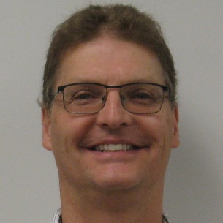
In Closing
Data shows
  correlation between Findings addressed and management commitment
  Organizational Structure played a role
  Committee is a reflection of safety culture
“… Performance in Conventional Health and Safety is Fully Satisfactory.”
(2017 CNSC Inspection Findings)
Employee Co-Chair
Patti Cason-Kent
Employer Co-Chair
Mark Silzer

Slide 18
Thank-you for Listening!
QUESTIONS???

