Slide 1
Hazardous substance management in dynamic scientific environments
Sven Mohr
Lund, May 15th 2019
International Technical Safety Forum

Slide 2
Content
01 Legal requirements
European/German law
Internal regulation
Obligations
02 Register of Hazardous Substances
Software solution
Challenges
03 Basis for discussion
04 Acknowledgements

Slide 3
Legal requirements
According to European/German law
Relevant laws
Chemicals Act
Definition of hazardous substances, classification, producer/importer/distributer
Ordinance on Hazardous Substances
Details on protective measures
Working Conditions Act
Risk assessments with regard to hazardous substances

Slide 4
Legal requirements
Internal regulation
Relevant documentation
DESY safety regulation #8: Handling of working substances
Includes chemical and biological agents
Process scheme
Orders / warehouse requisitions
Storage
Transport
Disposal

Slide 5
Legal requirements
Obligations
Register of Hazardous Substances
List of substances
Specific properties
Documentation
Reference to facility management system (location)
Interface to electronic data management system

Slide 6
Register of Hazardous Substances
Software solution
Database of approx. 960 substances
Name
GHS symbol
H & P statements
Location
Responsible person
Link to safety data sheet
CAS number
Minor updates in 2018 (e.g. additional statuses, producer URL)

Slide 7
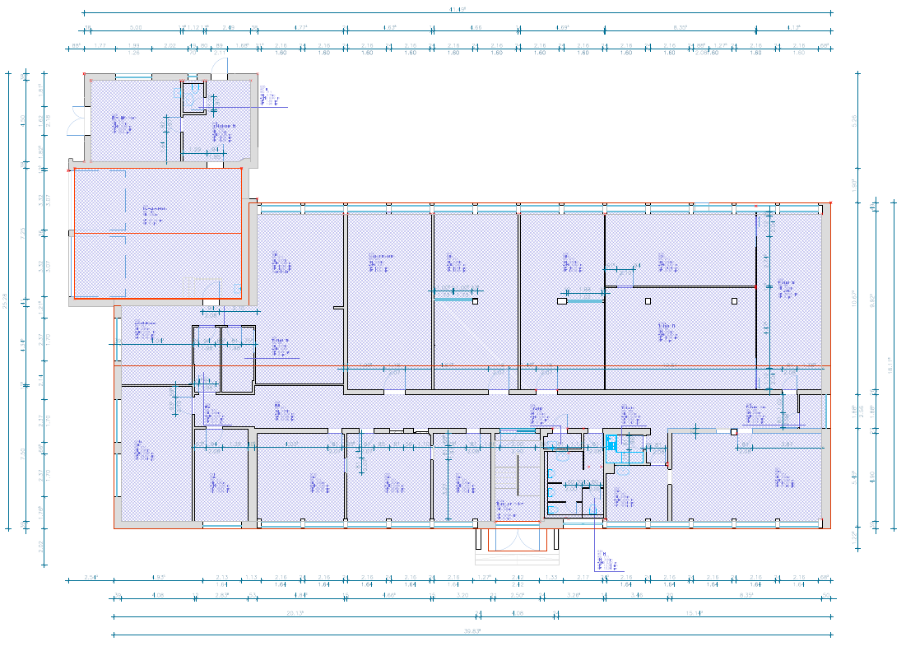
Register of Hazardous Substances
Challenges
New lab/workshop
Location
Clarify responsibility
Proper storage
Capacities
Number and type of chemical agents
Documents
→ Enormous amount of work to enter base data
?

Slide 8
Register of Hazardous Substances
Challenges
Register update
Update cycles
Contact / responsible person
File formats (!)
Dublicates
Consistent data
Quality control

Slide 9
Register of Hazardous Substances
Challenges
Content of database
Definition “Hazardous Substances”
Minimum quantity
Same substance, different producers
→ keep duplicates?
Actuality of linked documents

Slide 10
Register of Hazardous Substances
Challenges
Remainders of experiments
Low and/or minimum quantities
Sometimes very dangerous substances
Storage ↔ disposal
Documentation?
Responsibility
→ for further processes
→ for storage/disposal
→ registration
DESY Photon Science solution for user experiments via user portal (DOOR), risk assessment, verification of substances approval and documentation done via DOOR
But no transfer of data (of substances for short-term experiments) to official register

Slide 11
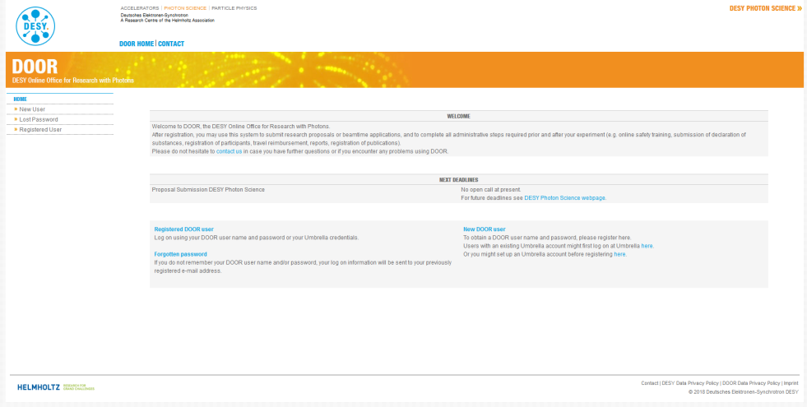
Register of Hazardous Substances
Solution via DOOR
Photon Science User Experiments
Substances declared via user portal (DOOR):
Large number of different substances and samples (hazard characteristics from harmless to toxic etc.)
Typically small quantities
Sometimes new compounds
Database of 12.000 substances/samples
Verification of substances, risk assessment, safety approval and documentation done via DOOR
Latest MSDS can be downloaded via link to different suppliers
But no transfer of data (of substances for short-term experiments) to official register.
Storage ↔ disposal: arranged in user chemistry labs - if not possible to be taken home by the user (due to flight etc.)
Responsibility:
Chemistry lab operation: DESY staff
User activities in chemistry lab: user group, project leader

Slide 12
Basis for discussion
Is it even possible to track all hazardous substances (in real-time)?
Is it worth the effort to transfer substances (from DOOR) into the institute´s register that are needed only for short-term experiments?
As long as we handle them professionally, do we really need to register all substances (immediately)?
Are there resulting safety issues when substances are not (temporarily) registered?

Slide 13
Acknowledgements
Anca Ciobanu
Photon Science – Technical Infrastructure
anca.ciobanu@desy.de
+0049 40 8998 4683
Sabine Lessmann-Bassen
Photon Science – Technical Infrastructure
sabine.lessmann-bassen@desy.de
+0049 40 8998 3180

Slide 14
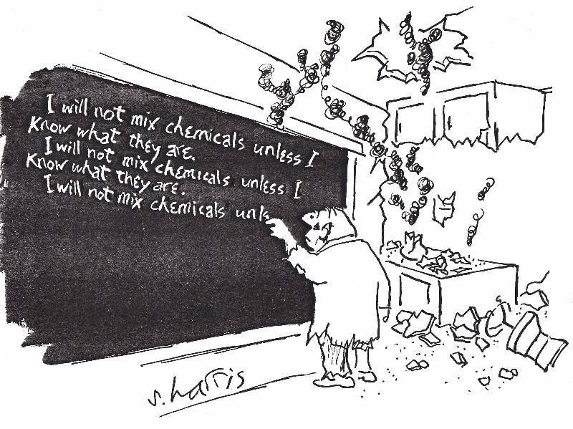
Thank you

Slide 15
Sven Mohr
Occupational Safety and Environmental Protection
sven.mohr@desy.de
+0049 40 8998 4831

