Slide 1
Safety at a shared construction site – ESS perspective
Åsa Alström Johannesson
Senior Occupational Health and Safety engineer
European Spallation Source ERIC
2019-05-14

Slide 2
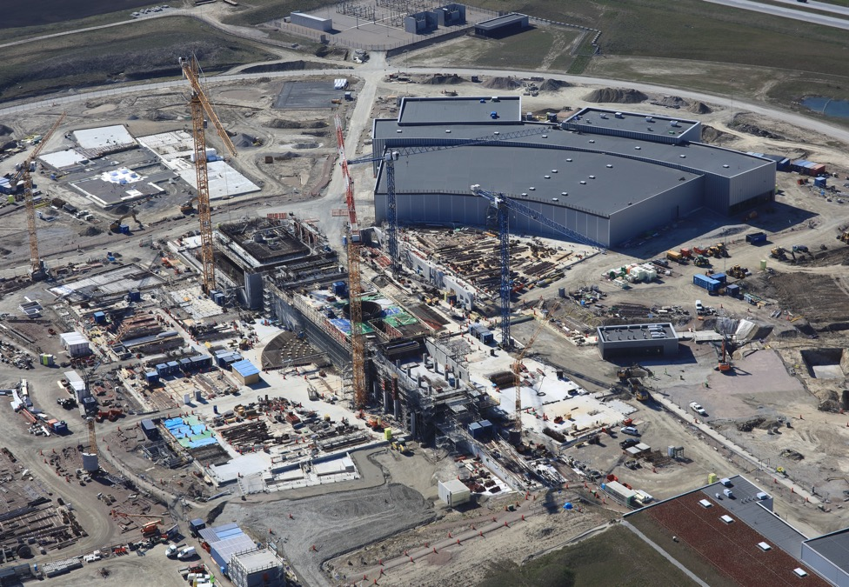
Safety at a shared construction site – ESS perspective
Background
ESS Site Safety coordination organisation
Challenges and Key Success factors

Slide 3
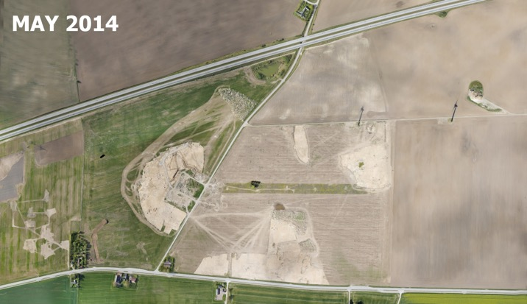
Background
2014 - Skanska Selected as Main construction contractor and formed Collaboration organisation Skanska ESS Construction Company (SEC) and construction work starts
2015 - Safety Coordination (BAS U) assigned to SEC for overall safety coordination at site
2017 - Installation work of ESS starts
2018 - Handover of buildings from SEC to ESS and Initial operations starts
New set up of Site Safety coordination
Installation
Installation
Construction

Slide 4
Continued Installation during ongoing Construction
Project Scope (22 buildings) – May 2019
Building handed over to ESS
H05 Primary Substation
E01 Experimental Hall 3
H06 Distribution Substation
H01 CUB Building
Under construction
E02 Beam Line Gallery
H09 Waste Treatment Facility
G02 Klystron Gallery
G04 Cryo Compressor Building
ESS Campus - Under construction
E05
E04 Lab
H10 Sprinkler Building
E03 Lab
D03 Exp. Hall 2
ESS Campus
D05
D04
D08
D06
G01 Linac Tunnel
F03 Logistic Centre
D02 Target Building
D07
F04 Guard House
D01 Experimental Hall

Slide 5
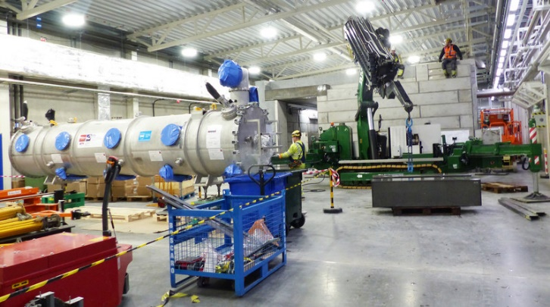
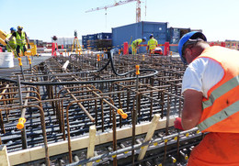
Site Safety Coordination set up
”Permanent work area”
ESS responsible for overall safety coordination within area
Area Coordinator appointed for Safety coordination of Building/area
SEC can remain safety coordinator for Construction works
”Construction work area”
Main Contractor (SEC) responsible for overall safety coordination within Construction area
SEC (BAS U) appointed as Safety coordinator for area

Slide 6
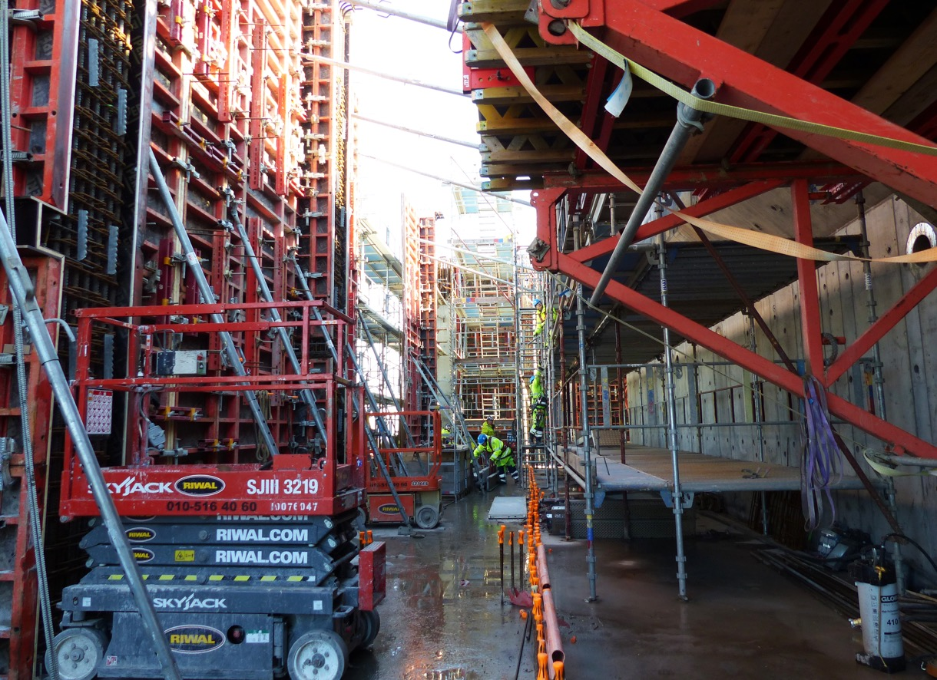
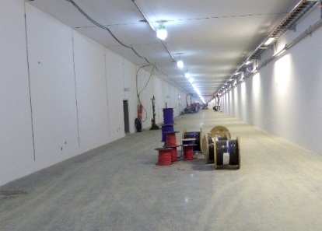
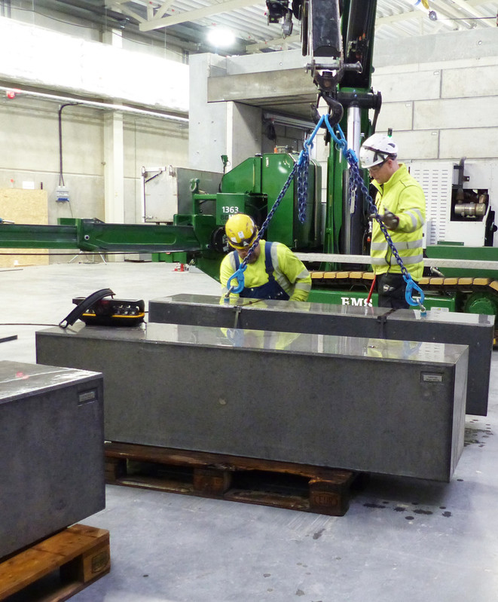
How does this it work in practise?

Slide 7
Organisation of Safety coordination at ESS Safety Coordination areas
Construction Work Gallery SEC Coordination area

Slide 8
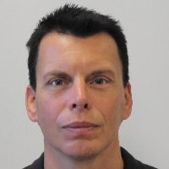
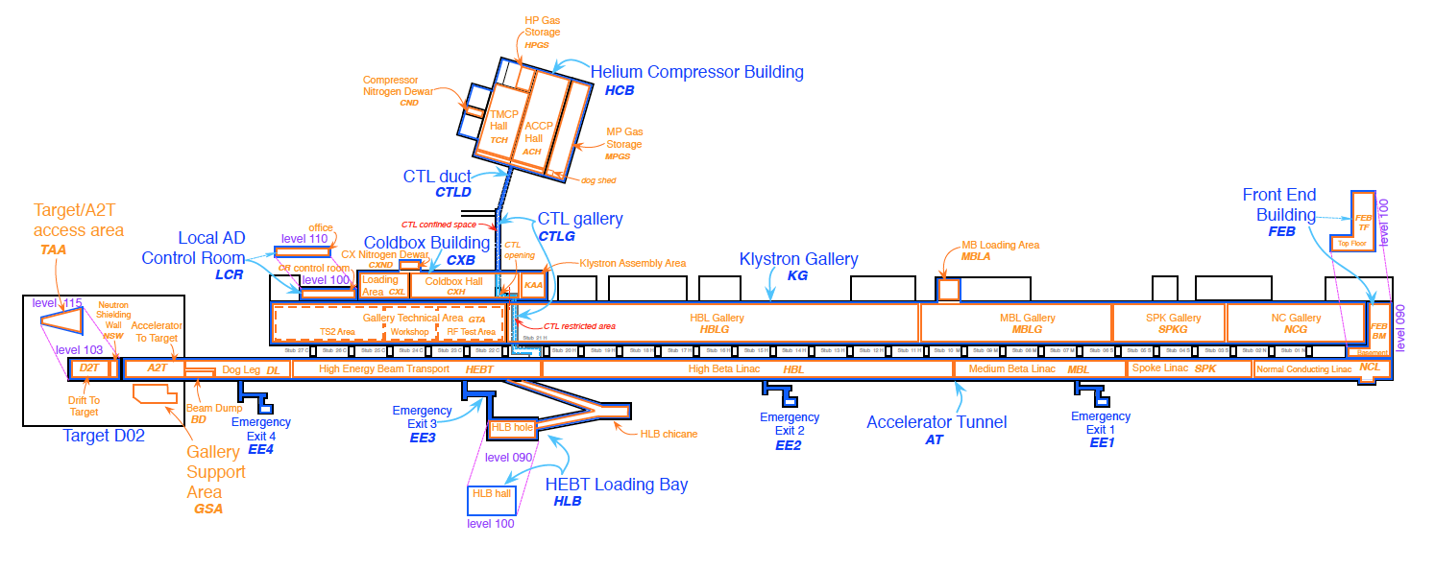
Restricted areas – Accelerator buildings – week 15
Christer Sjöblom
Ila Sjöholm
Nicolas Eke
Area Co-Ordinator for Cryogenic buildings- G04 & ColdBox
ESS-0104828 Cryogenic Building Risk Assessment
Area Co-Ordinator Accelerator Tunnel (G01/FEB100)
ESS-01512890 NCL Risk Assessment
ESS-0105616 G01 Risk Assessment
Area Co-Ordinator& OHS Engineer (G02)
ESS-0488867 TS2 Risk Assessment
ESS-0105581 Klystron Gallery Risk Assessment
ESS-0150035 G02 Control Room Risk Assessment
Restricted area
Authorized area
Restricted area, access card needed
Until further notice the TMCP Hall is classed a high noise environment due to compressor pumps continuously running and all personnel must wear ear protection at all times, this is a mandatory requirement.
There will be ongoing commissioning activities at the Ion Source(LINAC) for weeks 15, Ion Source(LINAC) & FEB areas it will remain a restricted area and is a NO thru passage, signs and rules apply. Please contact Ila Sjoholm or LCR for further information.
Waveguide Installation ongoing G01 sides currently STUB 150-160.
General Information
IFJ PAN Cell
Installing Hilti Hangers, testing Circulators, inst. of Conduits in STUB 210-300.
Assemblin conduit installation STUB 250.
TS2
TS3
TTC workshop
DTL workshop
T2
100m of G02 from FEB100 closed off. Andreas Lööw is the SEC BAS-U for this area. Please obey rerouted walkways if in place in the area. Please contact Nicolas Eke for further information for ongoing works.
Water pressure testing ongoing during wk15 in the DTL area, please obey signs and barriers.
Eslov & Assemblin will continue drilling STUB 110 to IRSC & reposition earthing busbars and G01 floor during week 15. Please be aware of silica dust & high noise in this area.
Comments: OBEY ALL SIGNS & BARRIERS (if unsure contact Area Co-Ordinator), G02,G04 & G01 FEB are restricted and are accessible by card readers only, please contact the Area Coordinators before accessing these areas. Please note that ALL site visits to G01 must enter thru the HEBT Loading Area and passage to the G01 thru that Emergency Exit ONLY, not HLB Chicane, plus all personnel must have G01 Training completed, check with G01 Area Co-Ordinator.

Slide 9
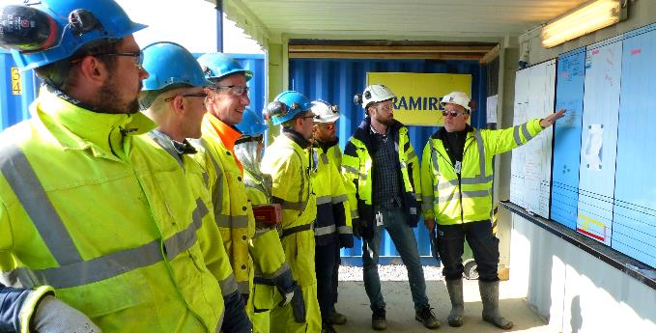
Safety Coordination activites and follow up on site
Daily briefings at site
Coordination meetings (daily and weekly)
Risk workshops
Jointly Safety inspections, fire inspections and electrical inspections
Lessons learned of Accidents, Near misses and risk observation on a daily basis (mail send-out)
Jointly performed rescue exercises
Other jointly performed Safety activities

Slide 10
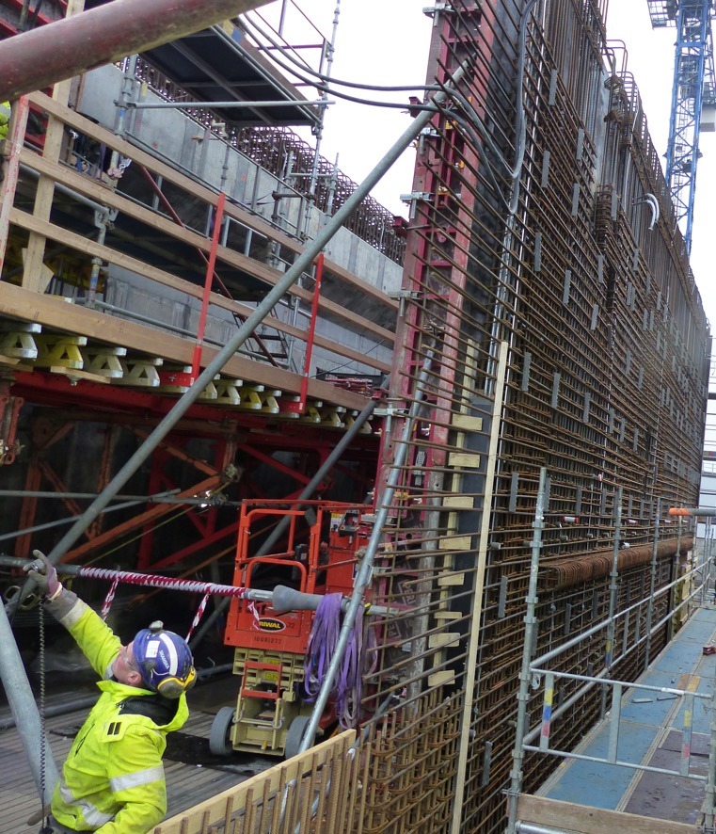
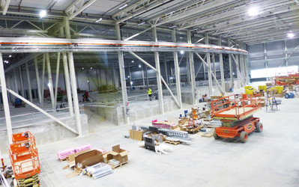
Challenges and Key Success factors for Safety performane at Shared Construction site in 2019-2020
Challenges:
Coordination of Parallell works in Permanent work areas (Clystron Gallery, Linac etc.)
Coordination of Parallell works in Target and Experimentals halls
Start of operation and maintenece work
Key Success Factors:
Common time schedule
Common planning and coordination meetings on all levels
Communication of risks
Robust structure for safety coordination set up of site
Strong Safety culture!

Slide 11
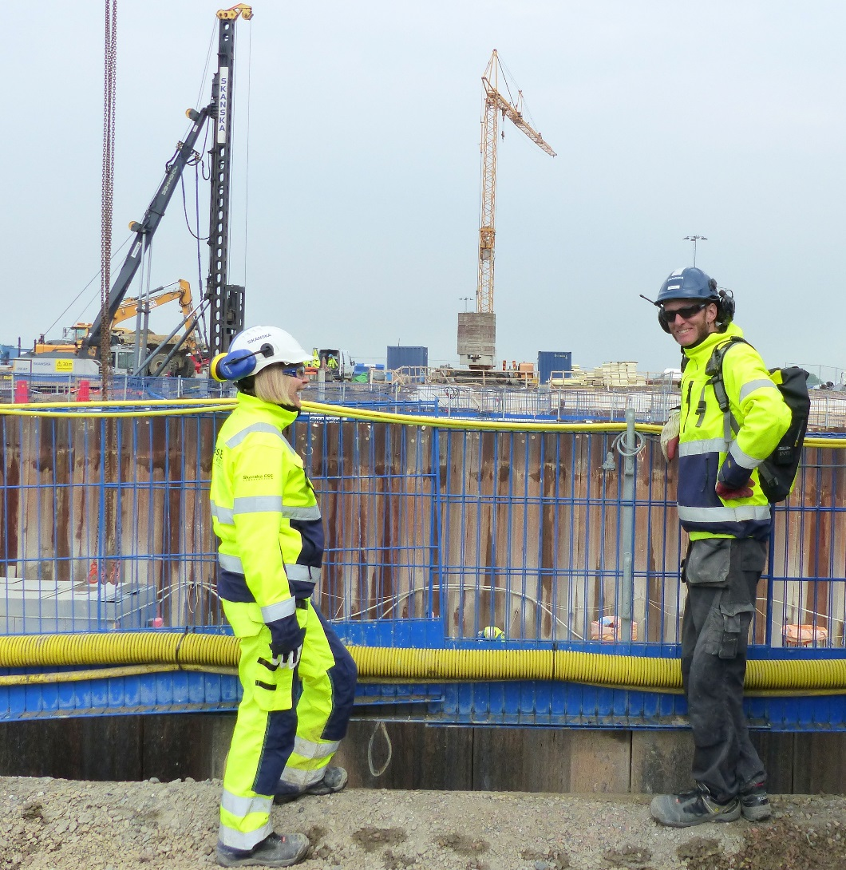
Thank you!

Slide 12
Questions?

