Slide 1
Incidents and Incident management @ ESS
Helen Boyer
OHS Group leader
European Spallation Source ERIC
Date

Slide 2
Overview
Health and Safety organisation at ESS
Development of an OHS handbook for ESS
Incident reporting
Examples of incidents and lessons learned
Communication
Risk assessment

Slide 3
ESH&Q Organization
ESH & Q
Security
CM & ER
Licensing
ESH Division
Training
Environment
Radiation Safety
Quality
Radiation Protection
Occupational Health & Safety
- 35 staff plus some consultancy
- Ramping up in line with project phases

Slide 4
ESH&Q Scope
4

Slide 5
Developing a management system - OHS
Incident management
Work permits
(eg Hot works)
First responders & Emergency organisation
Developing procedures, rules, guidance, communication & training
Risk Assessment
Chemical management
Electrical safety rules

Slide 6
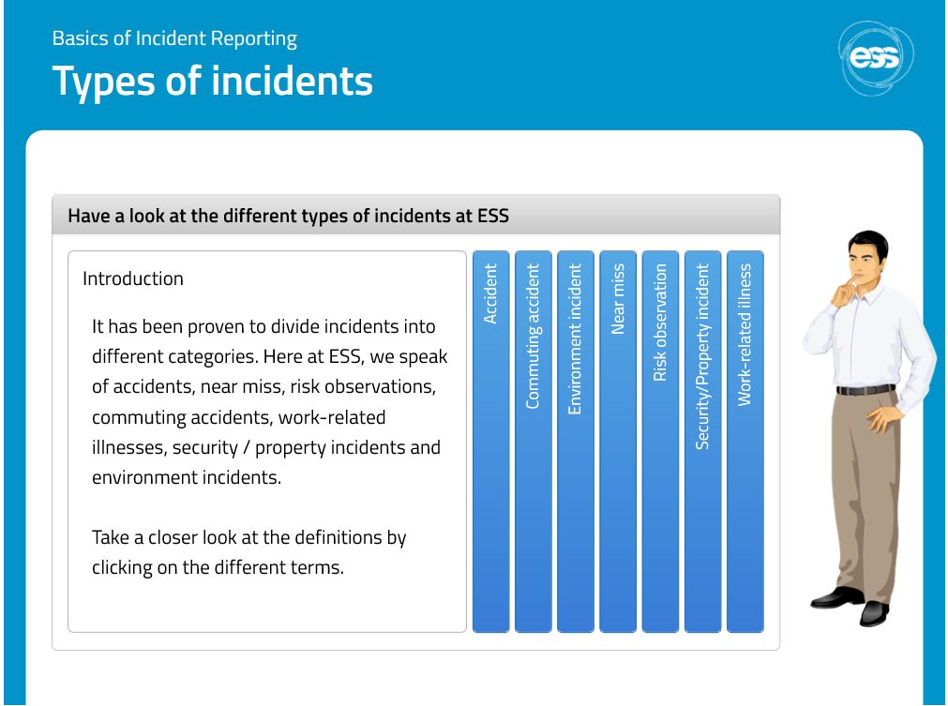
Incident Reporting
ESS use an information system (IA) made available by the Swedish insurance company AFA. TIA is derived from Swedish: ” Teknisk informationssystem om Arbetsmiljö”.
Everyone at ESS can report incidents using this tool.
An incident management database that also allows direct reporting of claims to the insurance company.
An e-learning training has been put in place to guide you on how to report an incident.

Slide 7
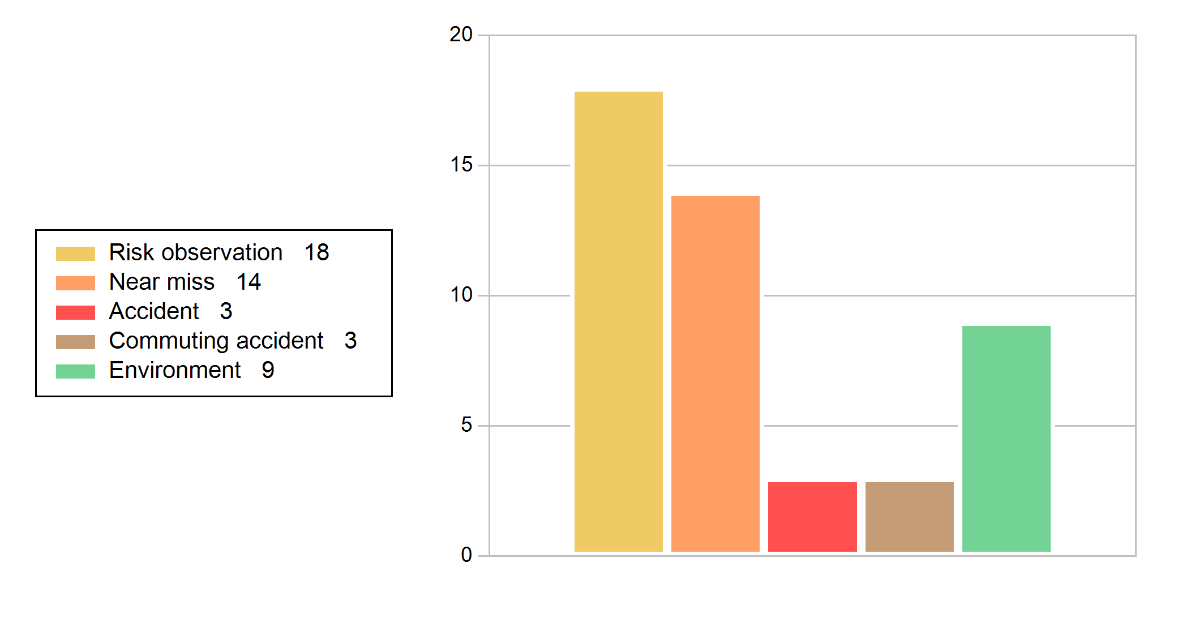
Incident Statistics: Jan to May 2019

Slide 8
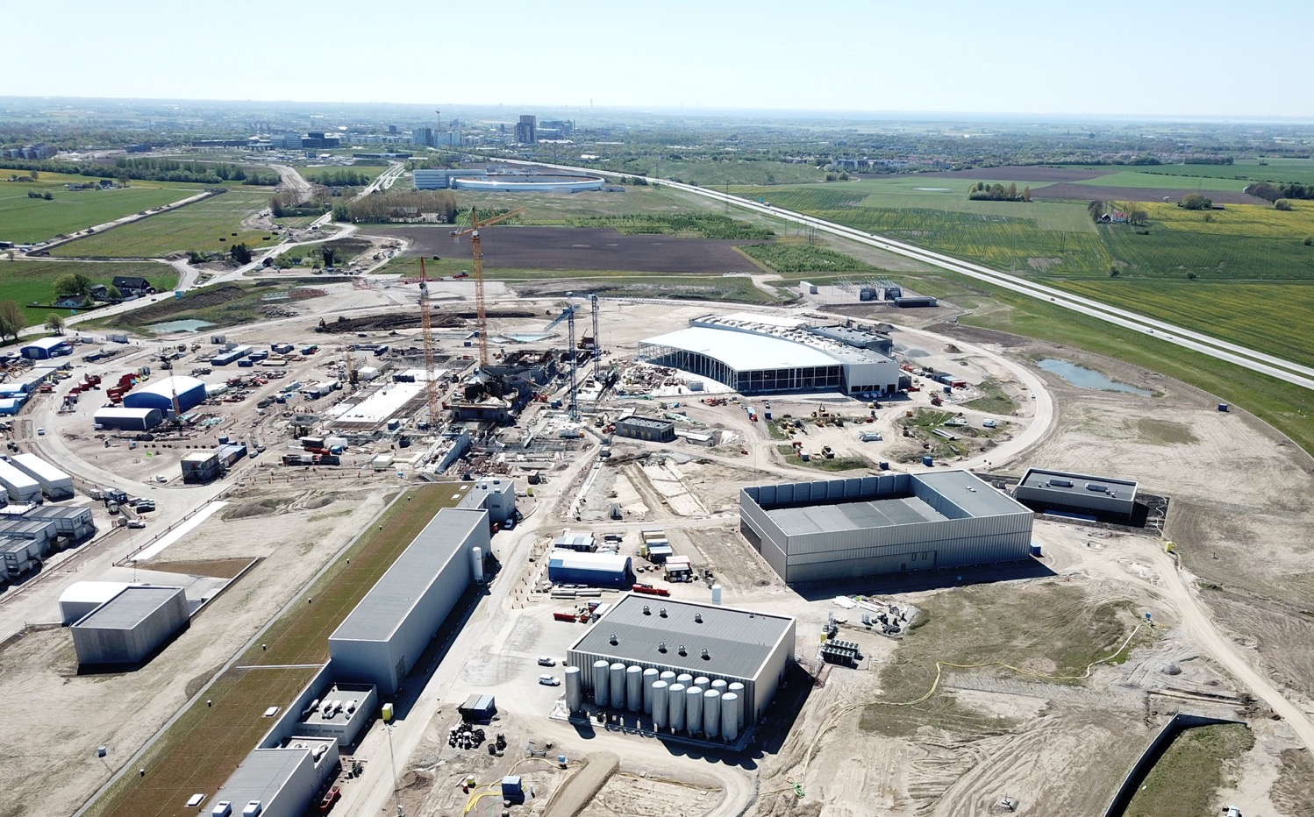
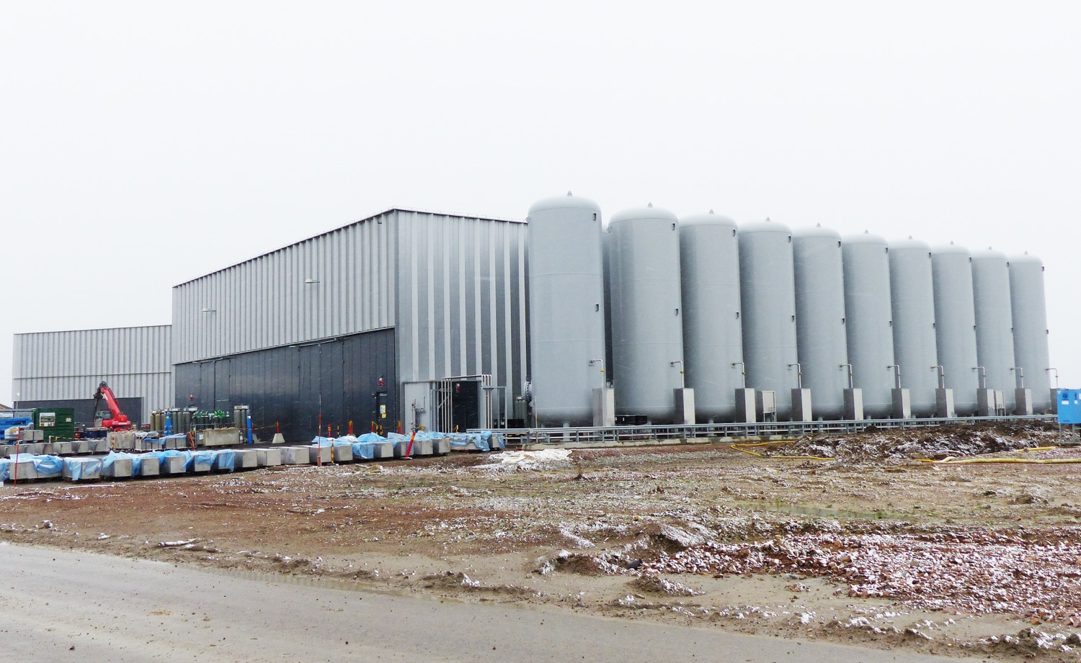
Incident location

Slide 9
Oxygen Deficiency Hazard (ODH) incidents - Nitrogen ingress into working area
The incident occurred at G04, in an area known as the dogshed. This area is where the regulators for the helium gas system are located.
Nitrogen was being exhausted outside building.
Poor sealing of pipework into the dogshed building then allowed the nitrogen that had built up in this ’box’ to enter the dogshed.
Person working in this are ODH alarm activated.

Slide 10
Oxygen Deficiency Hazard (ODH) incidents - Nitrogen ingress into working area
Recommendations from incident investigation included:
ODH alarm outside dogshed area
Repositioning of alarm detection
Redesign of exhaust pipework
Improved sealing of pipework
Ensure that modifications to design are considered by all parties

Slide 11
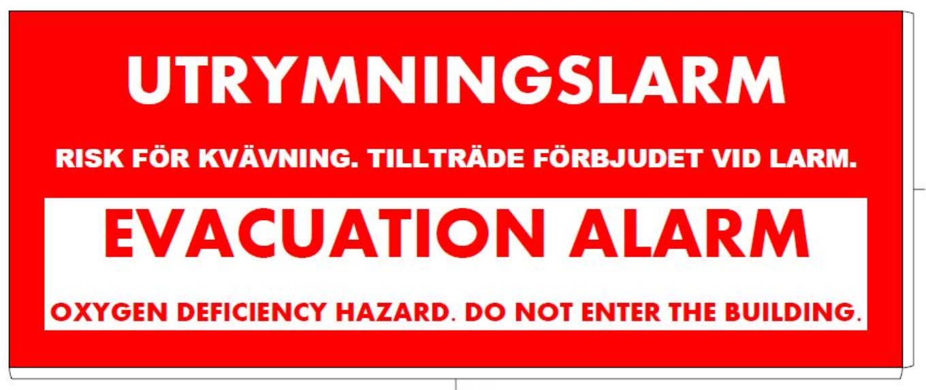
Oxygen Deficiency Hazard (ODH) incidents – Power failure
Alarm of an oxygen deficiency hazard (ODH) monitoring system due to loss of electrical power
Lessons learned:
  UPS power to be provided as soon as possible.
  Procedures needed to ensure an operator does not enter a building when the ODH monitors are not working following a power failure.
  ODH alarms to be sent to security company so the gate guard is aware if an alarm activates.

Slide 12
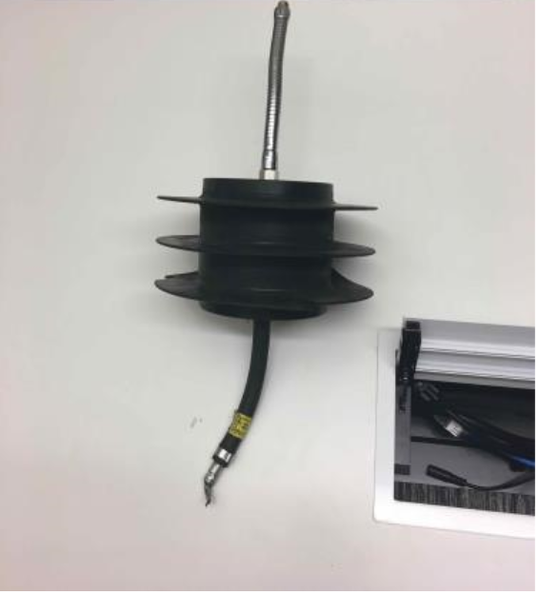
ODH incidents – welding plug
During the regeneration process of one of the dryers, nitrogen was released into the safety relief header. The discharge port at the outside building was discovered to be blocked by a welding plug, (which had been left behind by the piping manufacturer). A large amount of gaseous nitrogen blew off into the compressor hall. The ODH alarms were triggered, 17.6% recorded.
  Observations:
    When the ventilation system is on maximum, as required when there is a leak, the doors exiting the building are very difficult to open. Changes have been made to the positioning of the sensor to ensure doors can be easily opened
    Some technicians working in the area were not immediately aware of an alarm since the compressor is running at high noise levels - additional ODH lights installed
Meeting held to investigate incident with all parties involved

Slide 13
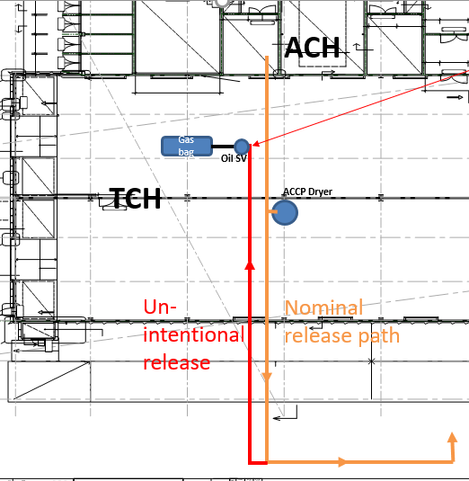
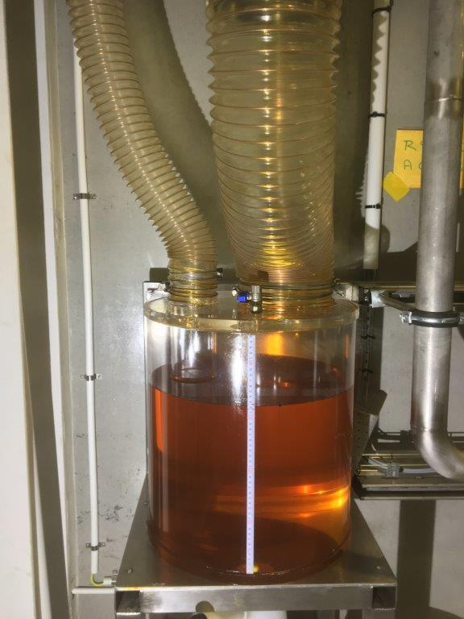
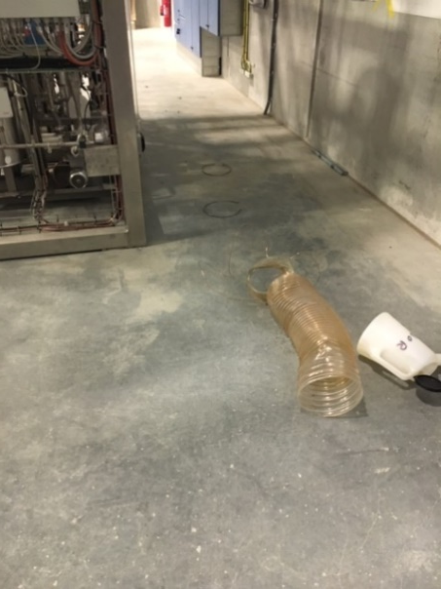
ODH Incidents – incorrrect dryer depressurisation
Incorrectly performed dryer depressurisation (in <1 second instead ~15 minutes) caused pipe disconnection,
serious pressure relief incident
ODH Warning (sensor position 6 < 19.5 % for ~40-50 seconds) and
Fire alarm (presumably caused by oil vapour cloud)

Slide 14
ODH Incidents – incorrrect dryer depressurisation, actions
Immediate stop of commissioning and machinery
Removing root cause by putting a blind flange on the safety relief header
Check for further flow restrictions
Design of a separate safety relief line only for the gas bag relief
HAZOP of dryer system (planned)

Slide 15

Communication of lessons learned
Local briefings
Management meetings
Work Environment Committee
Crisis Management team table top exercise

Slide 16
Risk assessment
Going forward trying to identify hazards before installation having a global risk assessment.
Used to identify safety requirements for the personal safety system
No. | Hazard | Cause | Who might be harmed and how | L | S | Risk | Risk mitigation | L | S | Risk
1.5.1 | ODH | Release of helium into bunker (250 L of He per cryo module) | Low oxygen levels in bunker causing ODH symptoms, possibly ultimately death, to personnel in the bunker | D | 3 | H | He to be routed outside bunker from relief valves. An ODH system and alarm to be installed inside the bunker | D | 4 | M
1.2.1 | Pressure | Release of 14 bar pressurised helium in cryomodules | Breach of cryomodule could lead to pressurised gas being released and injury to personnel in the bunker. | C | 4 | M | The cryomodules are inside the vacuum envelope. Safety Valves and rupture discs are installed on the cryomodule Rupture discs are routed inside G02 outside of the bunker. The safety relief valves go to a gas bag in the compressor hall. | C | 5 | L

Slide 17

Any questions

