Slide 1
The choice between single or multiple evacuation alarms in multi-hazard environments
13/05/2019 – International Technical Safety Forum ITSF 2019
Enrico Ronchi
Department of Fire Safety Engineering
Lund University, Sweden
Based on student thesis work by
Robin Magnusson and Claude Pagnon Eriksson
enrico.ronchi@brand.lth.se

Slide 2
Acknowledgements
Fredrik Jörud (this research is his idea ☺ ) and Marina Giampetro (ESS)
Stefan Wiklund (Max IV)
Valentin Algoet, Saverio La Mendola and Oriol Rios (CERN)
Interviewees and questionnaire responders

Slide 3
Outline
A single or multiple alarms?
Data collection
(online questionnaires and interviews)
Results
What did we learn?

Slide 4
A single or multiple alarms?
Facilities may have different hazards (e.g., fire, radiation, oxygen deficiency, explosions, etc.) triggering evacuation
Not clear if a single alarm or multiple alarms referring to each threat is the best solution

Slide 5
A single or multiple alarms?
Alarms are crucial to reduce pre-evacuation time (→ possibly decreasing hazard exposure and improving life safety)
Proulx and Laroche (2003): people may have trouble correctly identifying a fire alarm, even if they have heard it before
Pre-evacuation time
Movement time
We evaluated sound alarms (no voice messages in the study)

Slide 6
A single or multiple alarms?
Research questions
Is the urgency of an alarm interpreted differently by different people?
Do different people associate alarm signals to the same hazards, or do they interpret the alarms differently?
Is there a relationship between the perceived urgency of an alarm and the interpretation of that alarm?
What are the respective views of safety experts and other occupants of multi-hazard facilities on having multiple alarms?

Slide 7
Data collection
Online questionnaire
3 multi-hazard facilities: ESS, MAX IV and Kemicentrum (KC) at Lund University
54 respondents
Audio files of 8 alarms
Semi-structure interviews
5 safety experts at several multi-hazard facilities

Slide 8
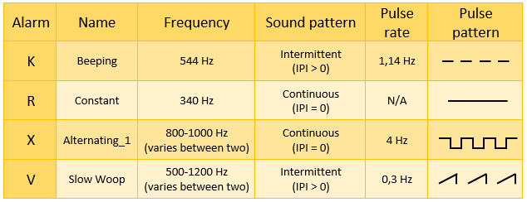
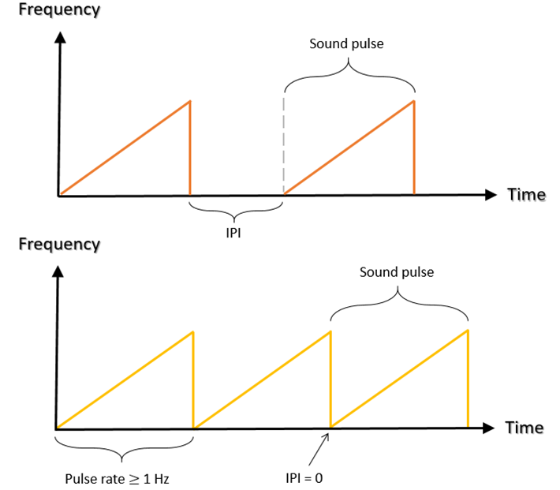
Data collection
First 4 alarms selected based on acoustic properties
More or less urgent based on a combination of properties
More urgent and attention-getting | Less urgent and attention-getting
Varies between 2 or more frequencies | Constant tone / single pitch
IPI = 0 s (continuous sound) | Long IPI
Pulse rate ≥ 1 Hz | Pulse rate ≤ 1 Hz
High pulse level (volume) | Low pulse level (volume)
High frequency | Low frequency

Slide 9
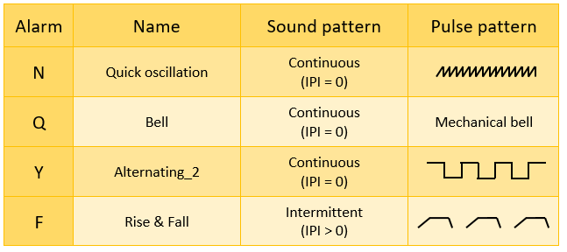
Data collection
Additional 4 evacuation alarms are actually used for different hazards
CERN: ODH alarm
Swedish fire alarm
ESS: ODH alarm
CERN: evacuation alarm

Slide 10
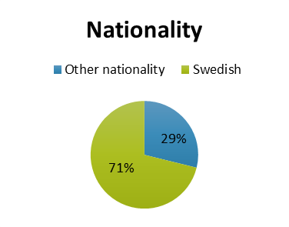
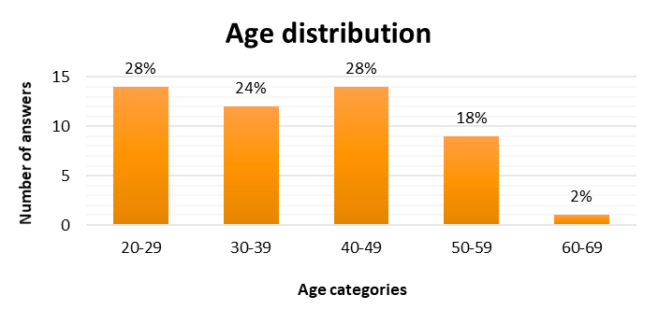
Results

Slide 11
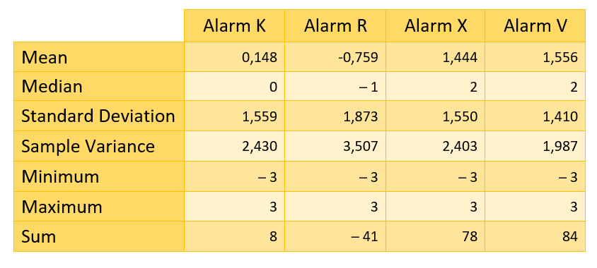
Results
Is the urgency of an alarm interpreted differently by different people?
Different interpretations of urgency
Observable trends

Slide 12
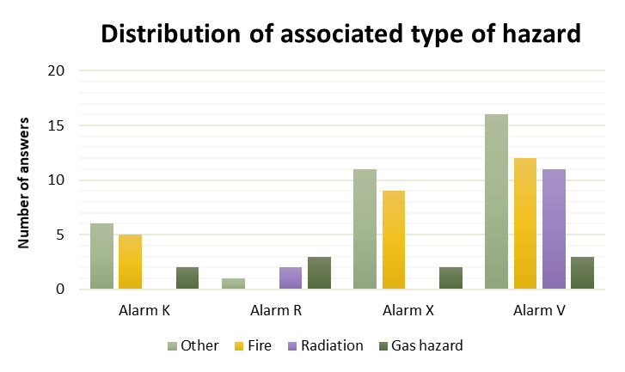
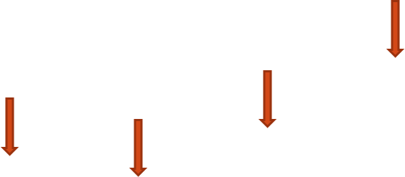
Results
Do different people associate alarm signals to the same hazards, or do they interpret the alarms differently?
Different interpretations of alarm meaning
Even within the ’hazard’ category meanings/interpretations were different

Slide 13
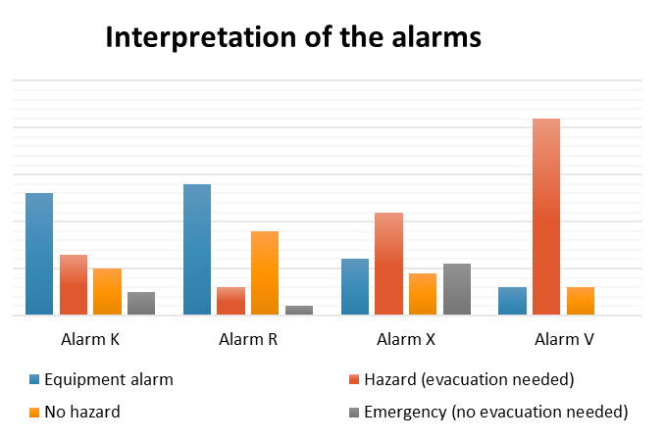
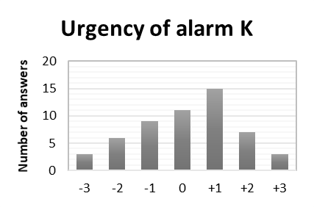
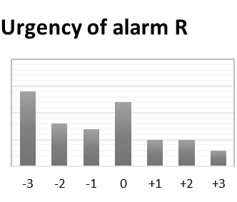
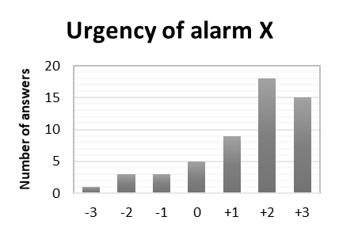
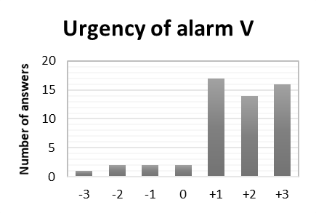
Results
Is there a relationship between the perceived urgency of an alarm and the interpretation of that alarm?
More urgent-sounding alarm → more often associated with hazard
Alarm V has the highest perceived urgency →
most associations with hazard

Slide 14
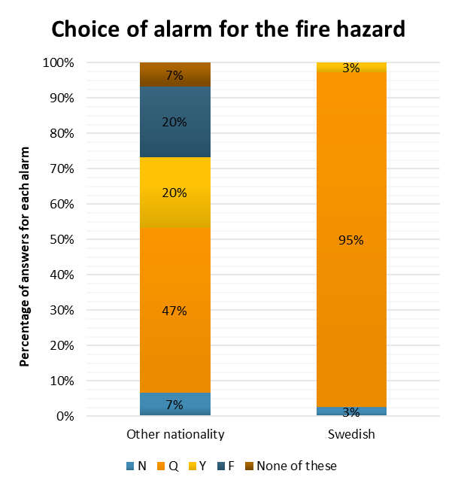
Results
Do people associate alarm signals to the same hazards, or do they interpret the alarms differently?
Different interpretations of alarm meaning →
Swedish fire alarm case
CERN: ODH alarm
Swedish fire alarm
ESS: ODH alarm
CERN: evacuation alarm

Slide 15
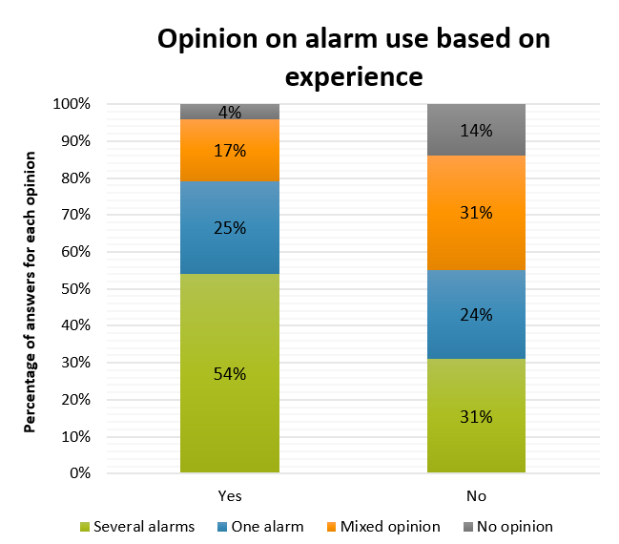
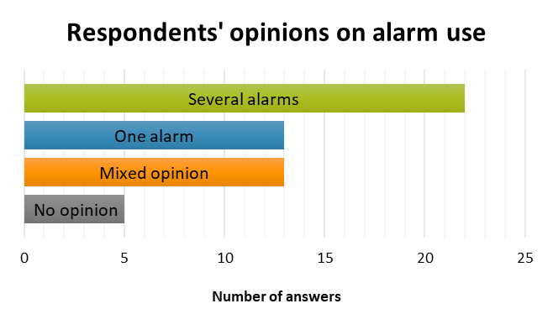
Results
What are the views of safety experts and other occupants of multi-hazard facilities on having multiple alarms?

Slide 16
What did we learn?
Key findings from interviews
Safety experts have different opinions
Multiple alarms can be difficult to learn
Training is necessary – not too frequent?
One alarm for all hazards may be subjected to individual assessment
Sound level (volume) important for perceived urgency
Different urgency levels of evacuation alarms seems illogical
Different alarms useful for different evacuation responses

Slide 17
What did we learn?
People seem to interpret urgency and meaning of alarms differently
Higher perceived urgency → more often associated with a hazard
People could identify purpose of alarms that they are widely known (Swedish fire alarm)
Mixed opinion on single and multiple alarms, but if multiple alarms are used → Ensure they are known → Training is necessary (some alarms may not be known)
Experienced a real emergency → majority prefer use of several alarms
Idea? Alarms can be based not only on the hazard that triggers them but on the required response

Slide 18
Information
Full report will soon be available open access online at the Division of Fire Safety Engineering at Lund University website: www.brand.lth.se

Slide 19
THANK YOU!
Email: enrico.ronchi@brand.lth.se
Department of Fire Safety Engineering: www.brand.lth.se

